Slide 1
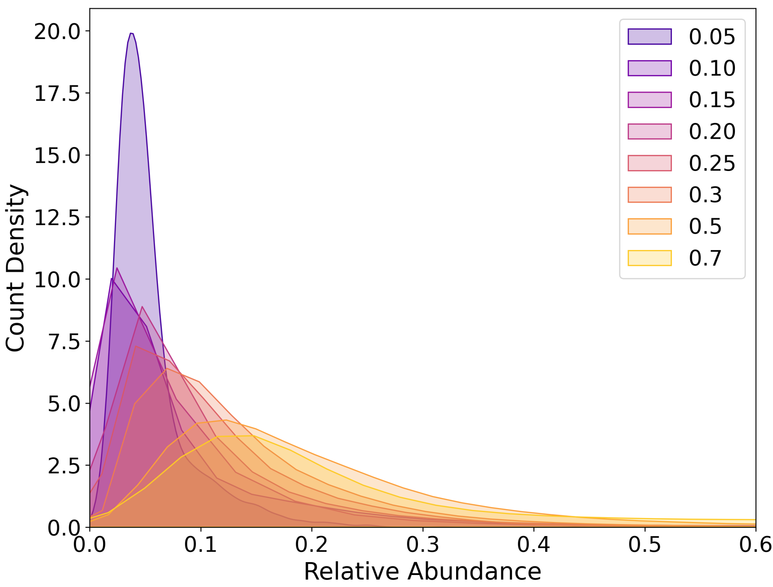
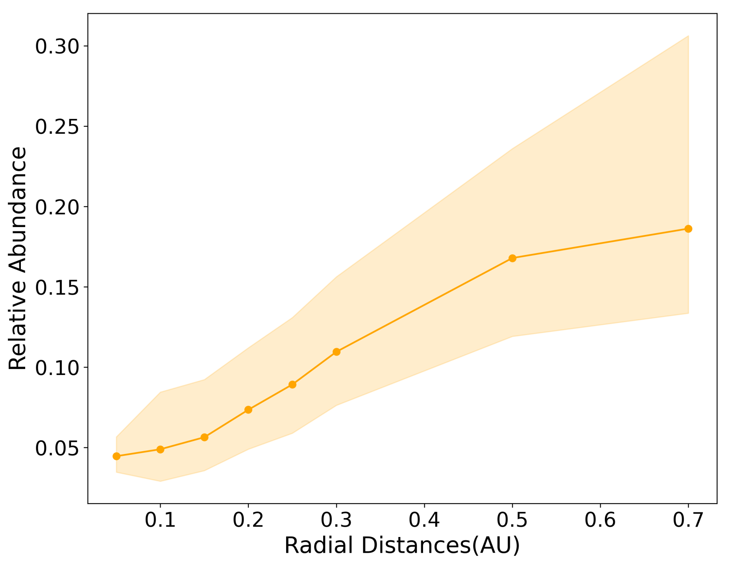
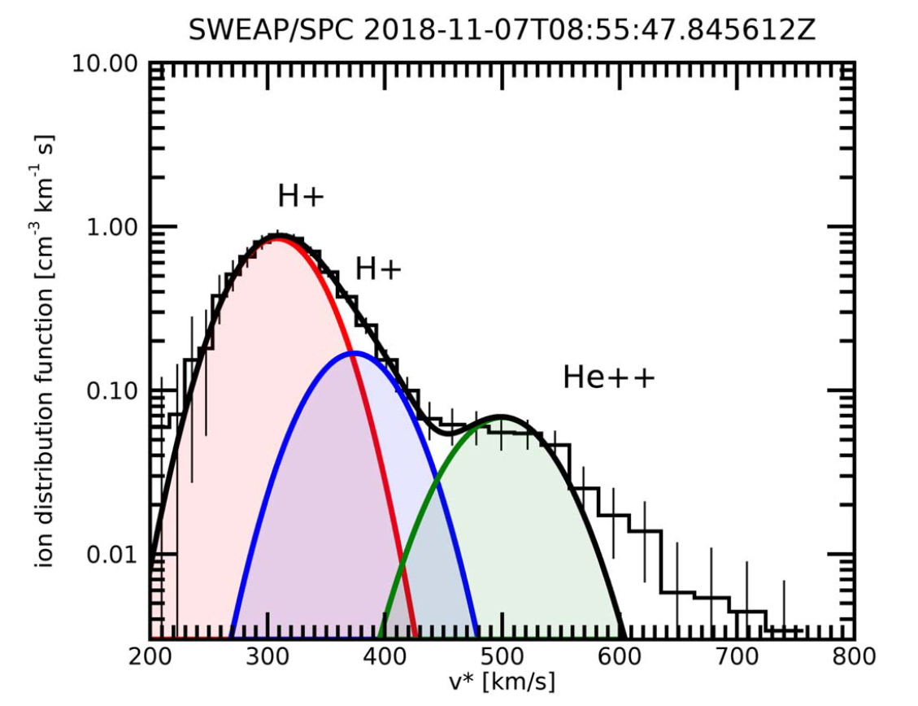
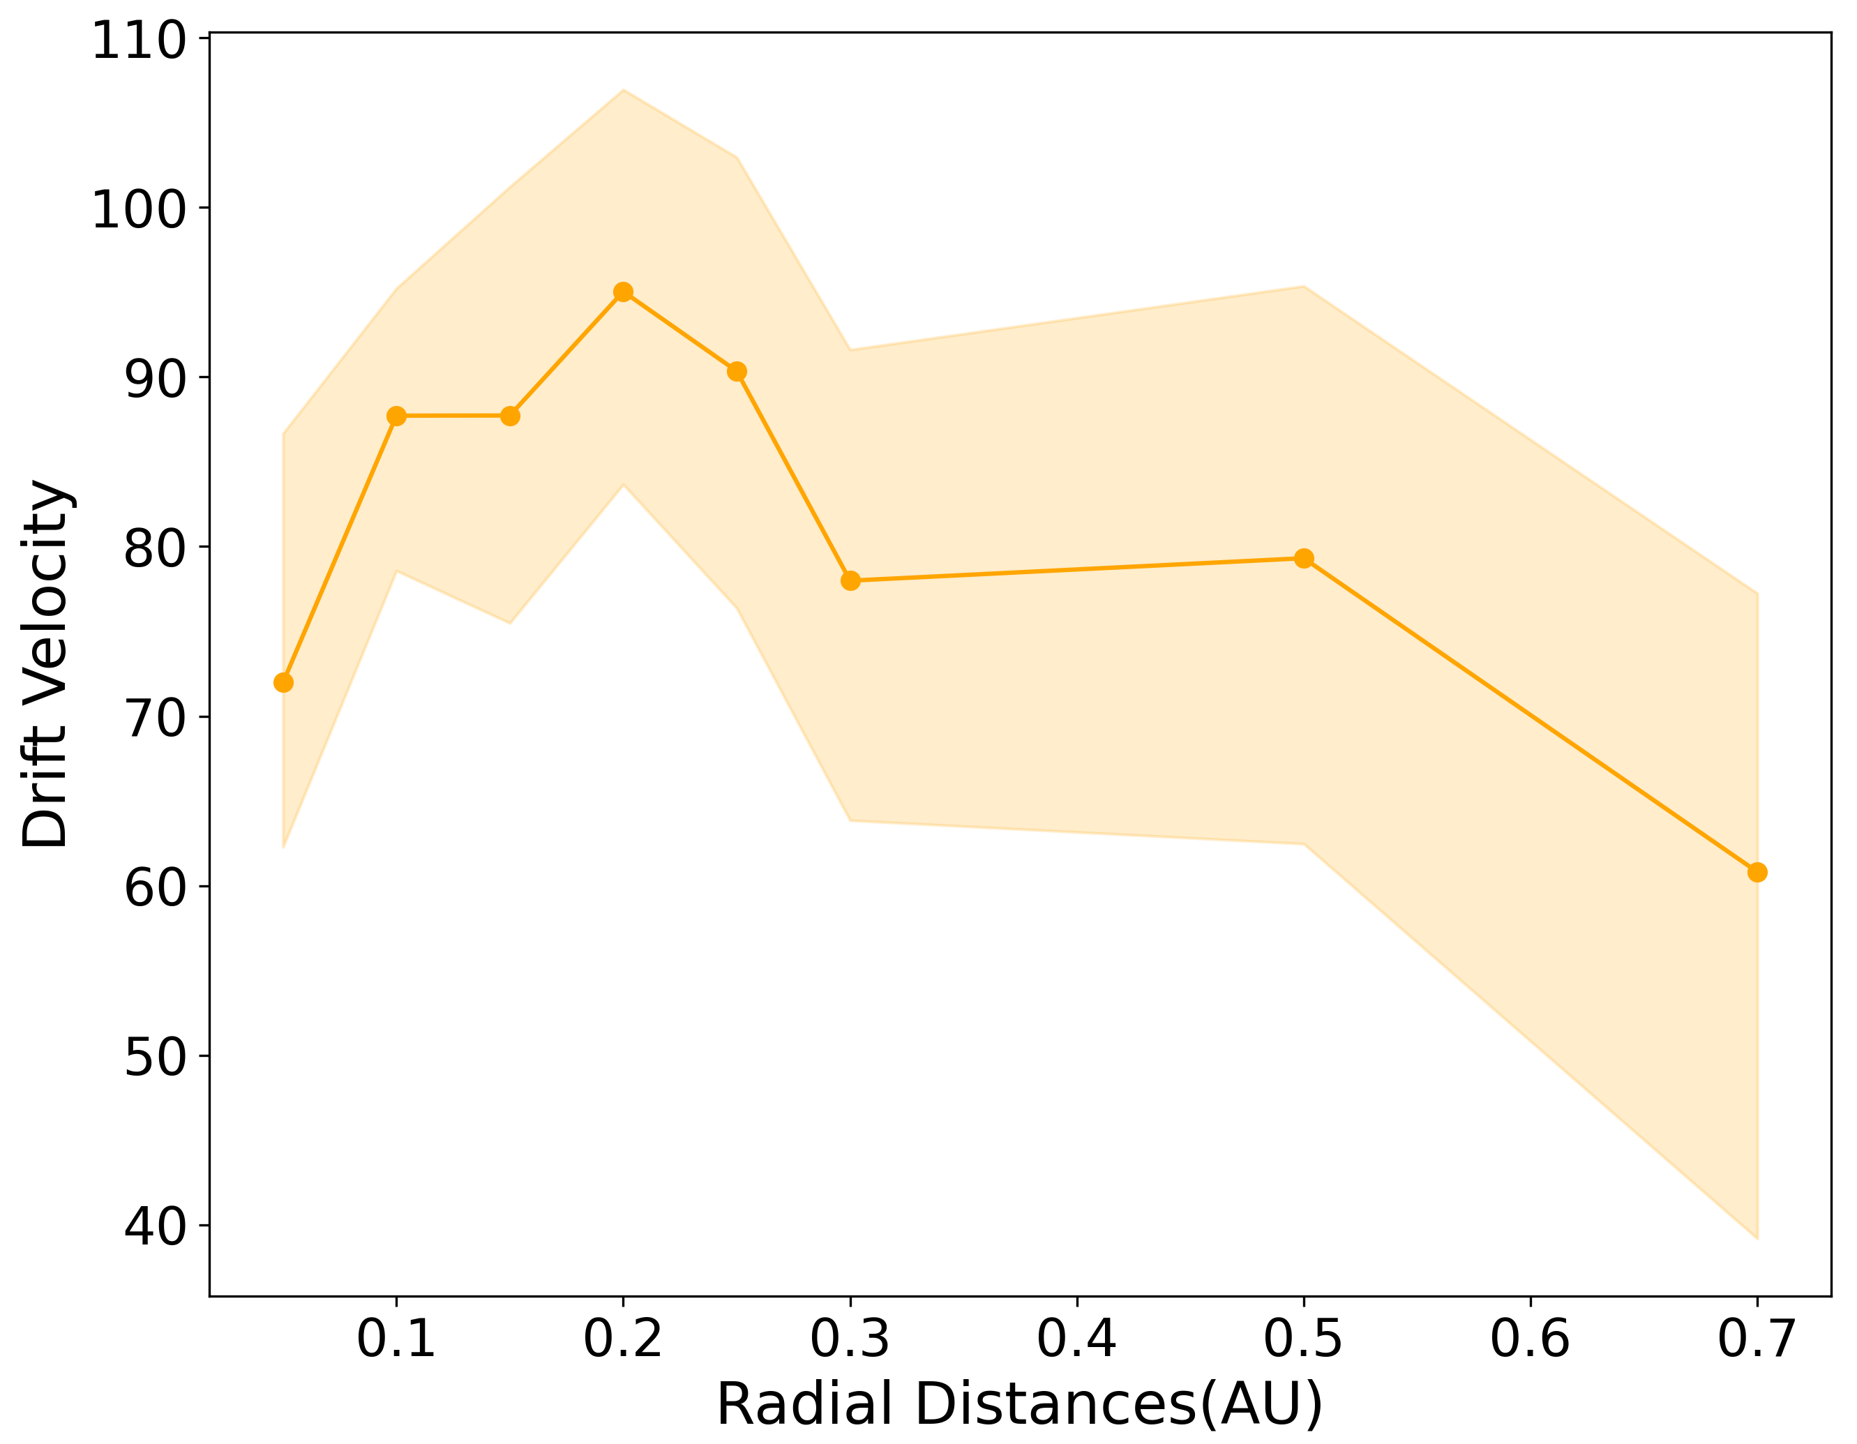
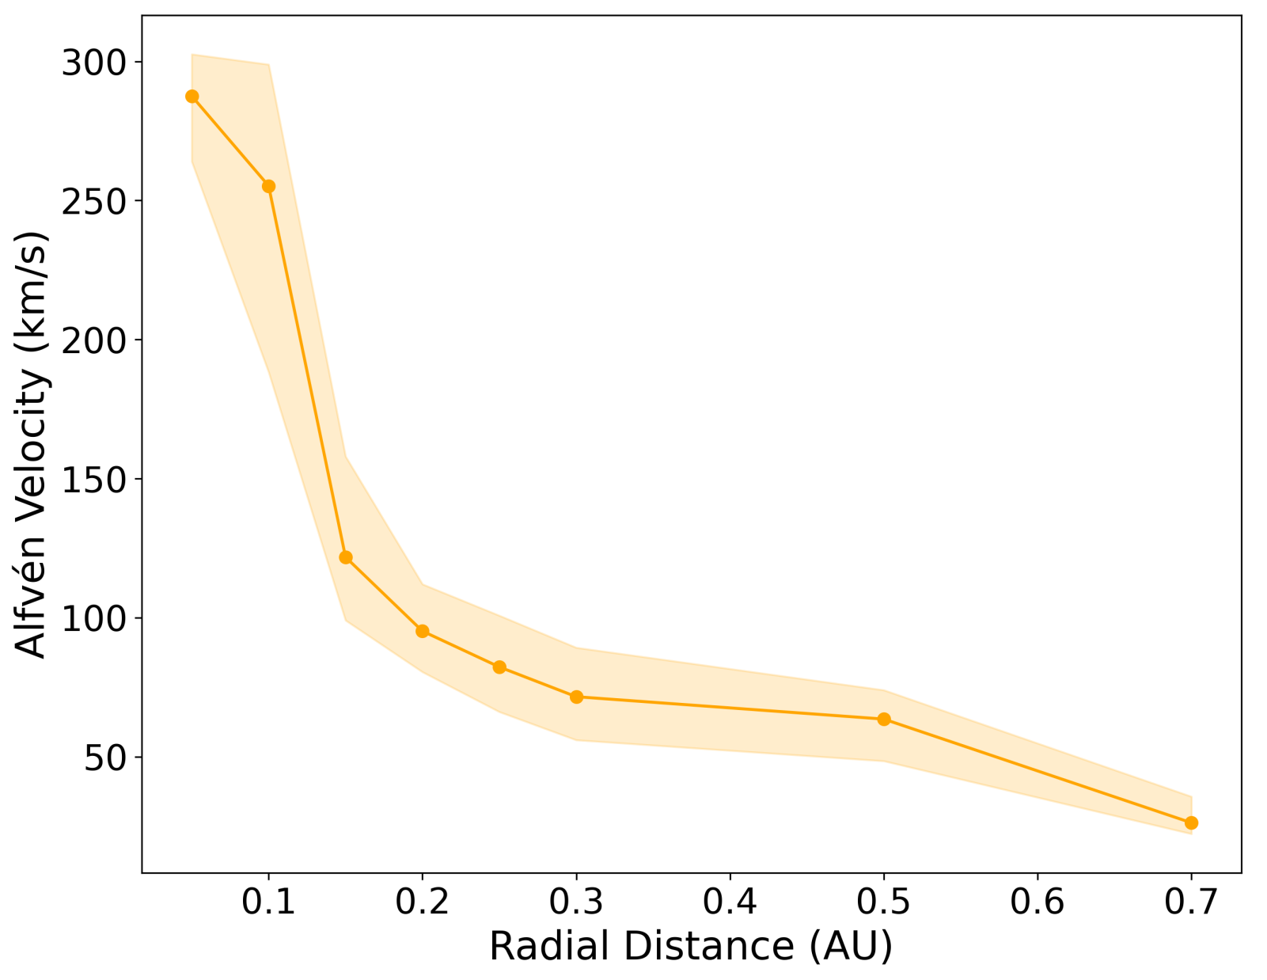
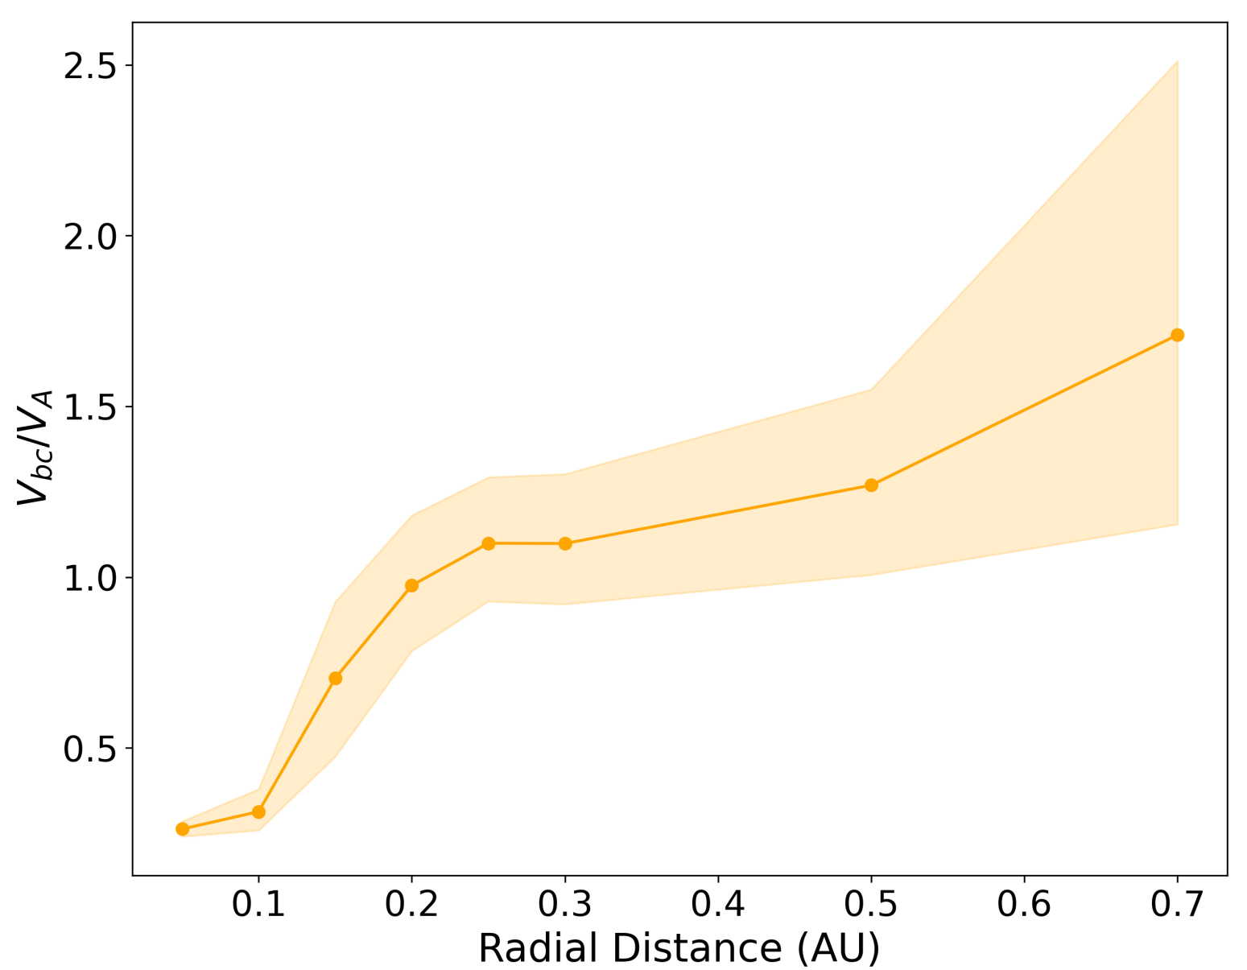
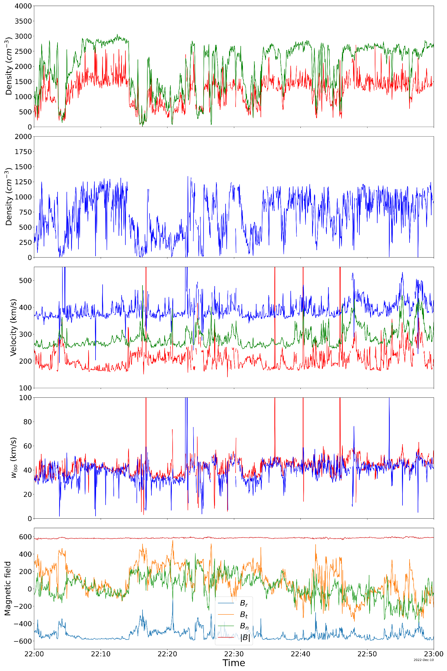
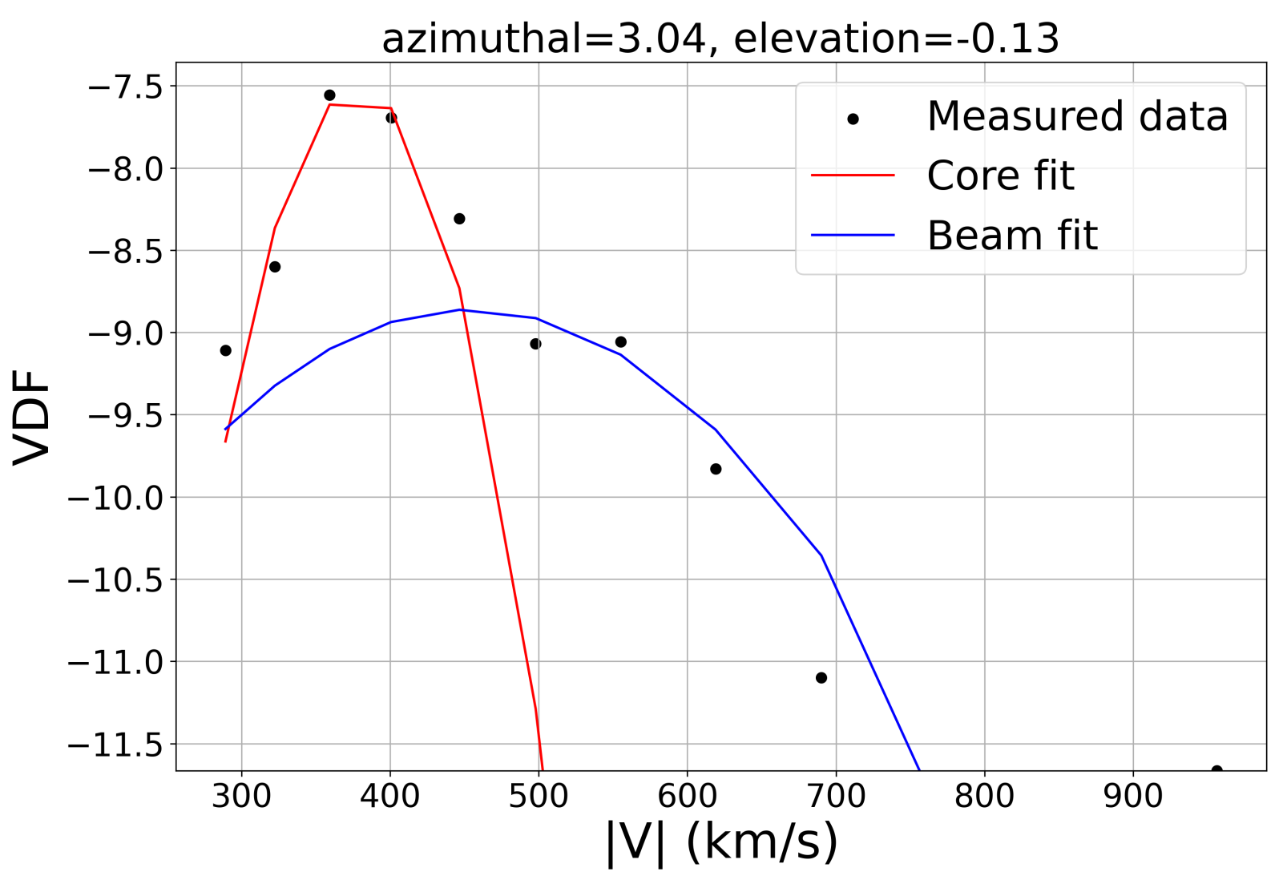
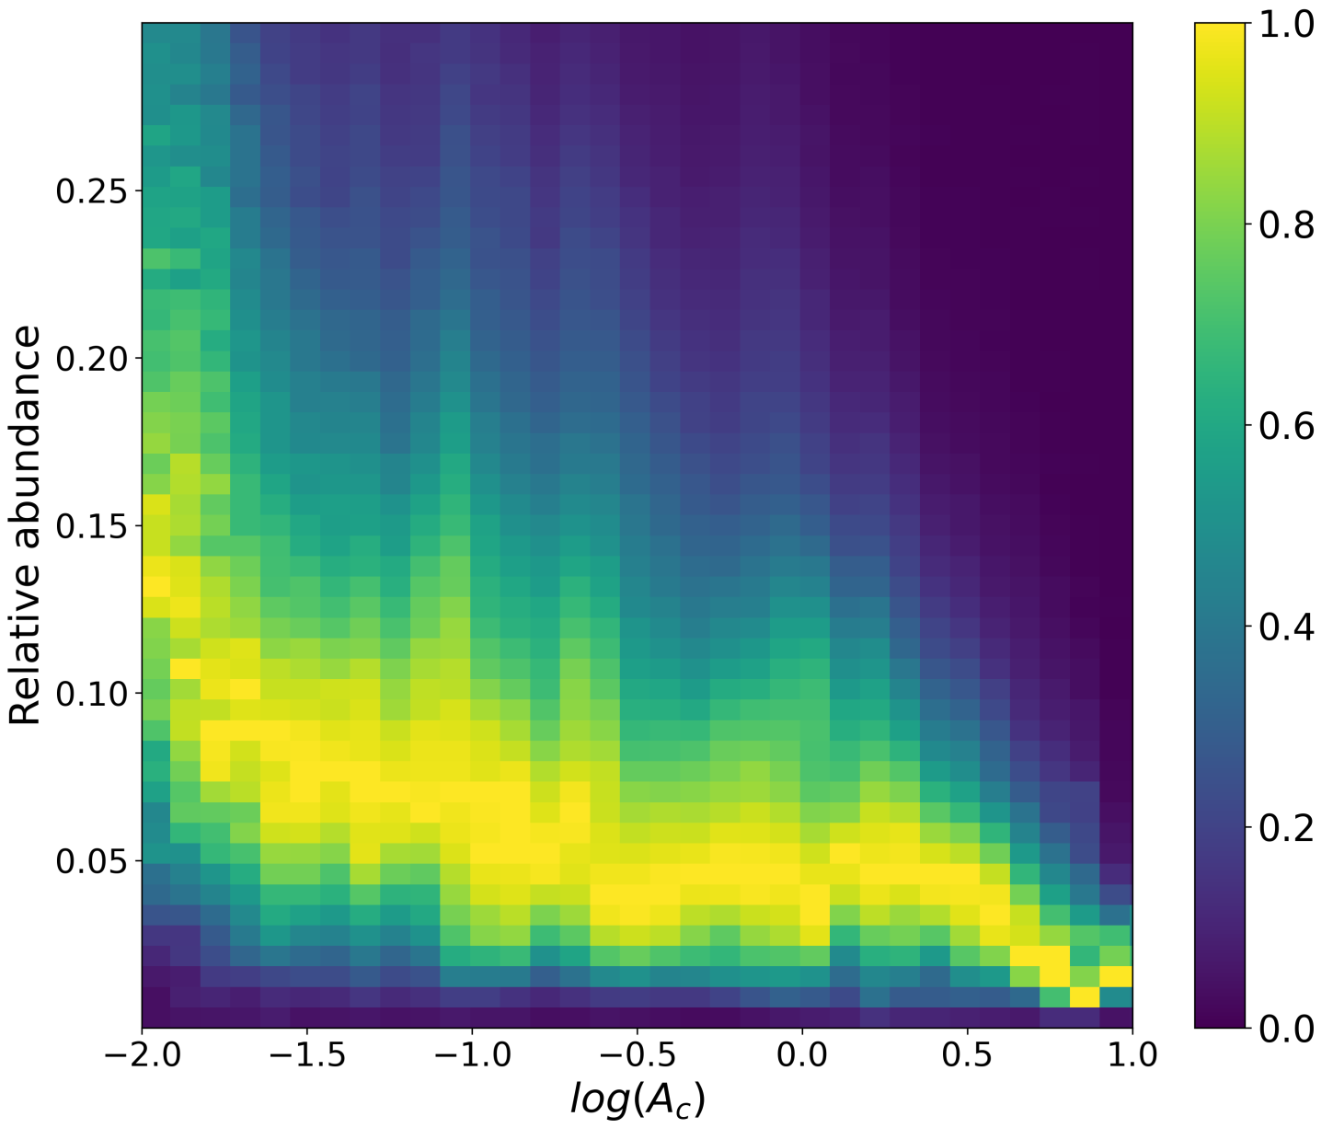
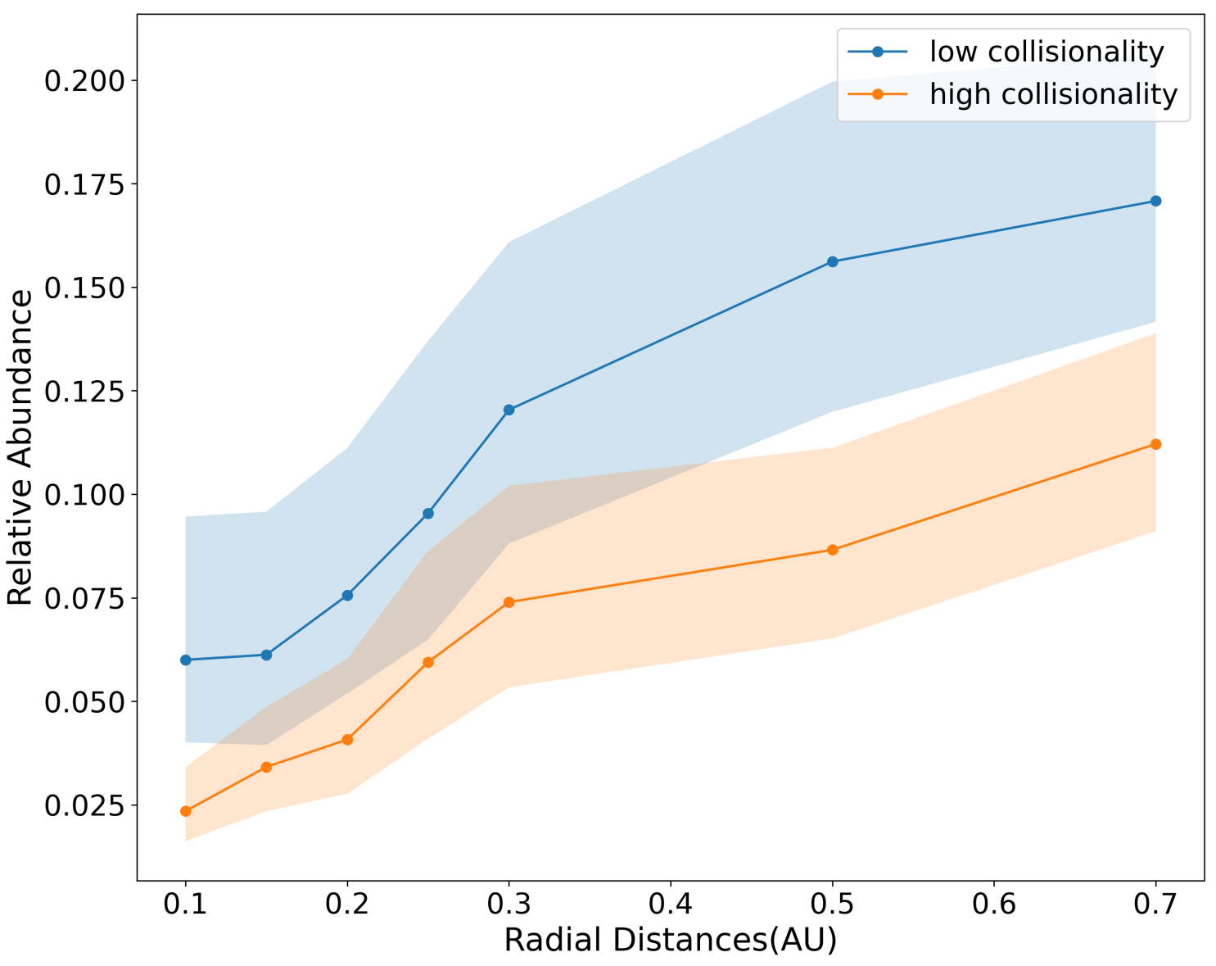
Study of the Proton Beam Parameters near the Sun
Sruti Satyasmita, Tereza Ďurovcová, Zdeněk Němeček, Jana Šafránková
Faculty of Mathematics and Physics , Charles University
X4.113
sruti.satyasmita@matfyz.cuni.cz
Abstract
Radial evolution of the proton beam (SPC data)
Proton beam near the Sun (SPAN data)
One of the commonly observed features of the solar wind is the simultaneous streaming of two different proton populations, one of which is the dominant denser core, and the other is the less dense and faster-propagating, minor population called the beam. The proton beam relative abundance is typically 10-20%, and the proton beam moves relative to the core along the interplanetary magnetic field at about 1.2 local Alfven speed. The origin and evolution of the proton beam is not yet fully understood. A previous study based on data from the Helios mission suggests that the seed of the proton beam forms close to the Sun. The Parker Solar Probe (PSP) mission gives us an opportunity to study the proton beam parameters near the solar wind source regions. We focus on the non-thermal features of the ion velocity distribution functions (VDFs) observed near the Sun by PSP. We investigate the changes of the proton beam parameters both in the initial phase of the solar wind expansion and on its way towards the Earth.
Using the SPC data, we study the radial evolution of the relative abundance of proton beam, the beam-core drift velocity and the evolution of proton beam in the solar wind streams with different collisional age. Our study covers radial distances of 0.05 – 0.7 AU from the Sun.
The relative abundance of proton beam
A gradual increase of the proton beam relative abundance is observed with increasing radial distance (Fig. 3). At about 0.3 AU, the radial profile of beam abundance changes its character (Fig. 4).
The change of beam abundance is greatest from 0.15 AU – 0.4 AU (Fig. 4).
The beam-core drift velocity
Near the Sun, the beam-core drift velocity is lower than the local Alfven speed (V_{A}) and increases with increasing radial distance (Fig. 5).
Between approximately 0.1 and 0.2 AU, V_{A} drops significantly (Fig. 6), therefore the drift velocity becomes slightly larger than V_{A}.
At larger radial distances, the drift velocity does not decrease as rapidly as V_{A}, and therefore the drift velocity increases slightly when showed in units of the local Alfven speed (Fig. 7).
Evolution of the proton beam with collisional age
The collisional age ($A_{c}$) is usually used to characterize the role of Coulomb relaxation in the thermalization of the solar wind. The proton beam relative abundance is lower for the collisionally old solar wind than for the collisionally young wind (Fig. 8). However, the SPC observations indicate that the beam abundance increases with radial distance independently of the collision age (Fig. 9).
The analysis shows the enhancement of the proton beam between the Sun and the Earth, with the increase of the beam abundance being highest at small radial distances.
To obtain the proton beam parameters during the PSP closest approaches to the Sun, we need to process the ion VDFs measured by SPAN.
Processing of the SPAN VDFs
We follow the schematic process below to fit the measured VDF at each timestep. The Levenberg-Marquardt method is used.
An example of the 2D cuts of the measured and fitted proton VDF is shown in Figure 10. The fitting result shows a good agreement with the measurement.
Resample the corresponding FIELDS data to SPAN measurement times and transform it to the SPAN instrument frame
Compute the phase space densities and velocity components in the SPAN instrument frame
Transform the VDF into the interplanetary magnetic field (IMF) aligned frame
Compute moments of the VDF
(Used as initial estimation for the fitting procedure)
Fit the VDF
(bi-Maxwellian functions are used)
Visualize the measured and fitted VDFs
Transform the computed bulk velocities into the RTN frame
Remove the suspicious fits
Data
To study the radial evolution of proton beam parameters, we use data measured by the Solar Probe Cup (SPC) onboard the PSP covering the radial distance range from 0.05 AU to 0.7 AU. We analyze the Level-3 data which were computed by fitting the spectra with the Maxwellian distributions for proton core, proton beam and alpha particles (Fig. 1). We only use data with a general flag equal to zero, which indicates reliable fits.
Due to large aberration, the SPC is unable to provide plasma measurements during the PSP closest approach to the Sun. We therefore use the VDFs observed by the Solar Probe ANalyzer (SPAN) instrument, which is also onboard the PSP, to calculate the plasma parameters at small radial distances from the Sun. We develop a fitting procedure to obtain the basic plasma parameters under the assumption that the core and beam VDFs can be approximated by bi-Maxwellian distributions (Fig. 2)
Figure 3: The relative abundance of proton beam for different ranges of radial distance from the Sun.
Figure 4: The median and 30th and 70th percentiles of the proton beam relative abundance w.r.t. to the radial distance from the Sun.
Figure 1: The measured energy spectrum was fitted with Maxwellian distributions for the core protons (red), proton beam (blue), and alpha-particle population (green). Adopted from Case et. al. (2020).
Figure 10: 2D cut of the measured (left) and fitted (right) proton VDF in the $V_{∥}−V_{⊥2}$ plane.
Figure 11 shows an example of the computed proton core and beam parameters during the perihelion #14 on December 10, 2022, from 22:00 to 23:00. VDF processing was performed for the full-resolution data. However, a number of abrupt spikes is present and it is probably related to the limited number of VDF points above the one-count level.
Conclusions
Figure 7: The drift velocity in units of the local Alfvén velocity ($V_{bc}$/ $V_{A}$) w.r.t radial distance.
Using the SPC L3 data, we found the following radial evolution of the proton beam parameters:
The proton beam relative abundance increases with radial distance from the Sun, undergoing a change in its character around 0.3 AU. Both high- and low-collisional winds show an increase of the proton beam relative abundance as the radial distance from the Sun increases.
Near the Sun, the beam-core drift velocity is much lower than the local Alfvén velocity. Around 0.15 AU the local Alfvén speed drops significantly. For larger radial distances, the beam-core drift velocity is about 1.2 times the local Alfvén velocity.
We develop the processing of proton VDFs measured by SPAN. When fitting the data with full time resolution, we found that there are many spikes in the computed beam and core parameters. To increase stability, we plan to modify the processing to be performed on the larger time windows that include more VDFs.
Figure 5: The drift velocity ($V_{bc}$) w.r.t radial distance.
Figure 6: The Alfvén velocity ($V_{A}$) w.r.t radial distance.
Figure 2: The measured data (black dots) was fitted with bi-Maxwellian distributions of the core protons (red), proton beam (blue).
Figure 8: The 2D histogram of the proton beam relative abundance as a function of the collisional age.
Figure 9: The median, 30th and 70th percentiles proton beam relative abundance w.r.t. radial distance, as per their collisional age.
References
Acknowledgements
Case, A. et. al., The Solar Probe Cup on the Parker Solar Probe, ApJS, 246, 43, 2020
Livi, R. et al., The Solar Probe ANalyzer—Ions on the Parker Solar Probe, ApJ, 938, 138, 2022
This research was supported by the Czech Science Foundation under the contract number 23-06401S and by the Ministry of Education, Youth and Sports under the contract number LUAUS25060.
Facilities: Parker Solar Probe (CDAWeb)
Figure 11: Example of one hour during the perihelion #14, core parameters in red and beam in blue. From top to bottom: core and beam density, bulk speed, thermal speed, and IMF components in the RTN frame and IMF magnitude.

