Slide 1
Comparative Analysis of ANN and SVM for Groundwater Potential Mapping in Karst Terrains of Southwestern Iran
Saeid Pourmorad¹, Mostafa Kabolizade², Rui Ferreira¹, Shahin Mohammadi², and Luca Antonio Dimuccio¹
¹University of Coimbra, Centre of Studies in Geography and Spatial Planning (CEGOT), Department of Geography and Tourism, Portugal
²Department of Remote Sensing and GIS, Faculty of Earth, Sciences, Shahid Chamran University of Ahvaz, Iran
1

Slide 2
Location
SVM
ANN
Hybrid
Conclusion

Slide 3
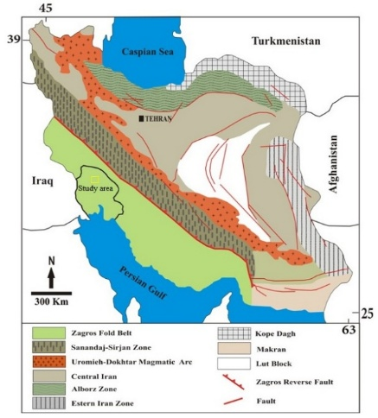
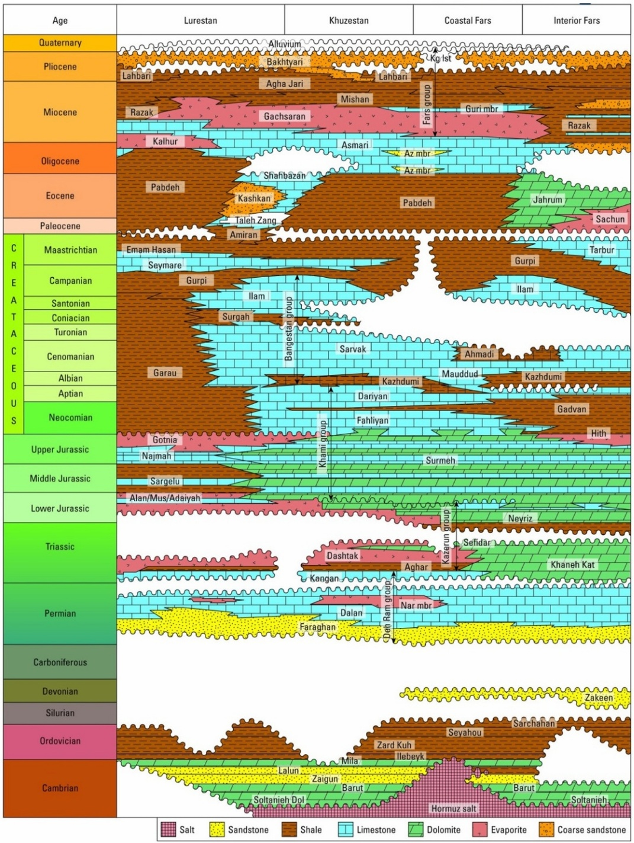
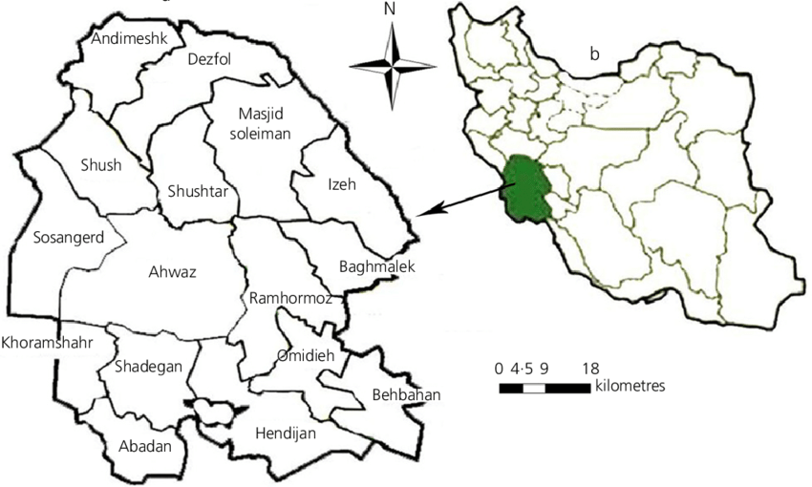
Geographical and geological location

Slide 4
Methodology

Slide 5
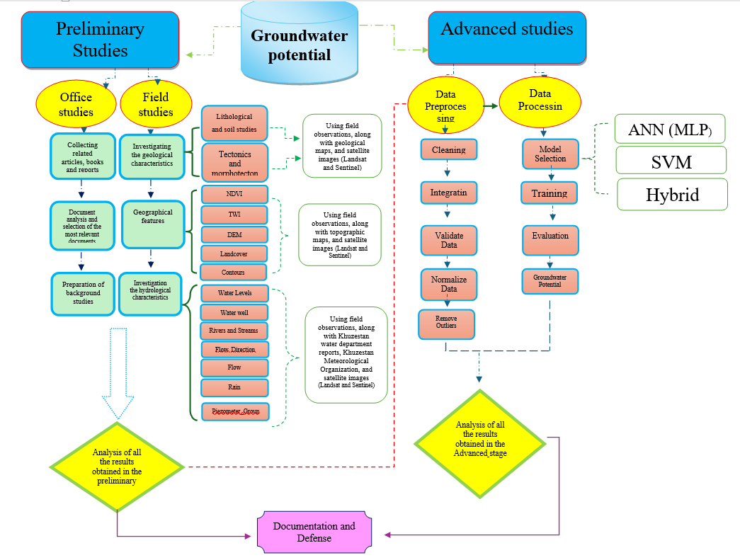

Slide 6
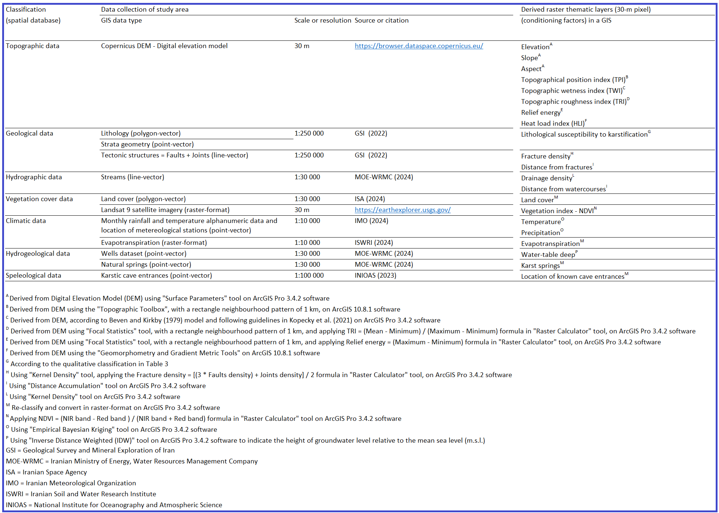
Spatial Database and Derived Thematic Layers Used (30m Resolution)

Slide 7
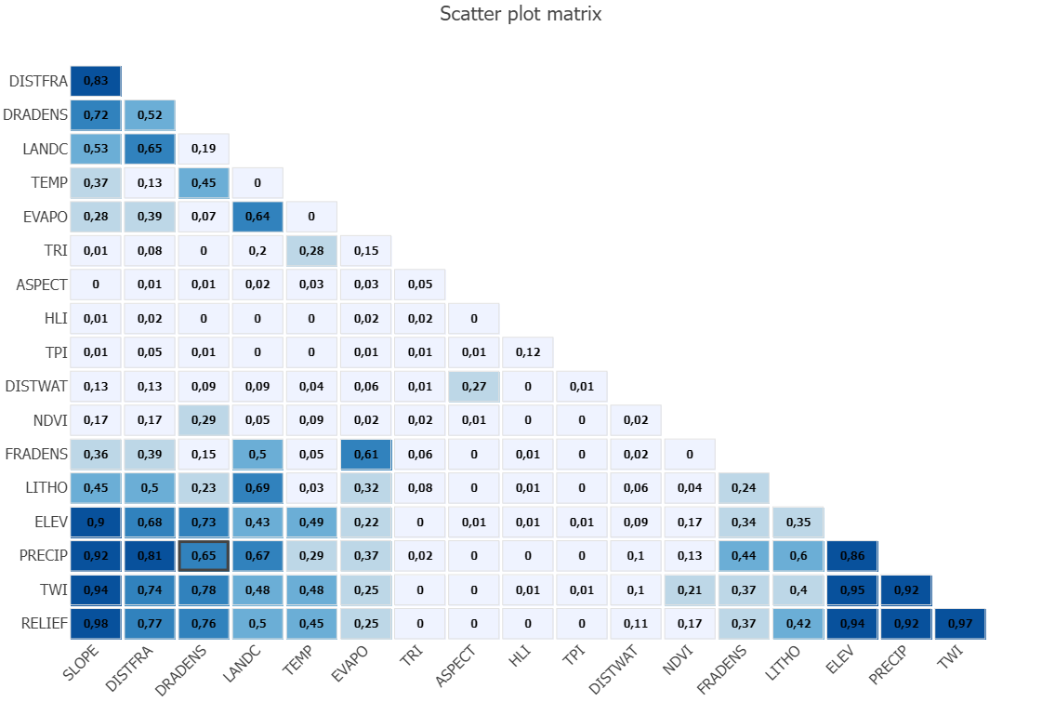
Correlation Matrix for Identifying Relevant Layers

Slide 8
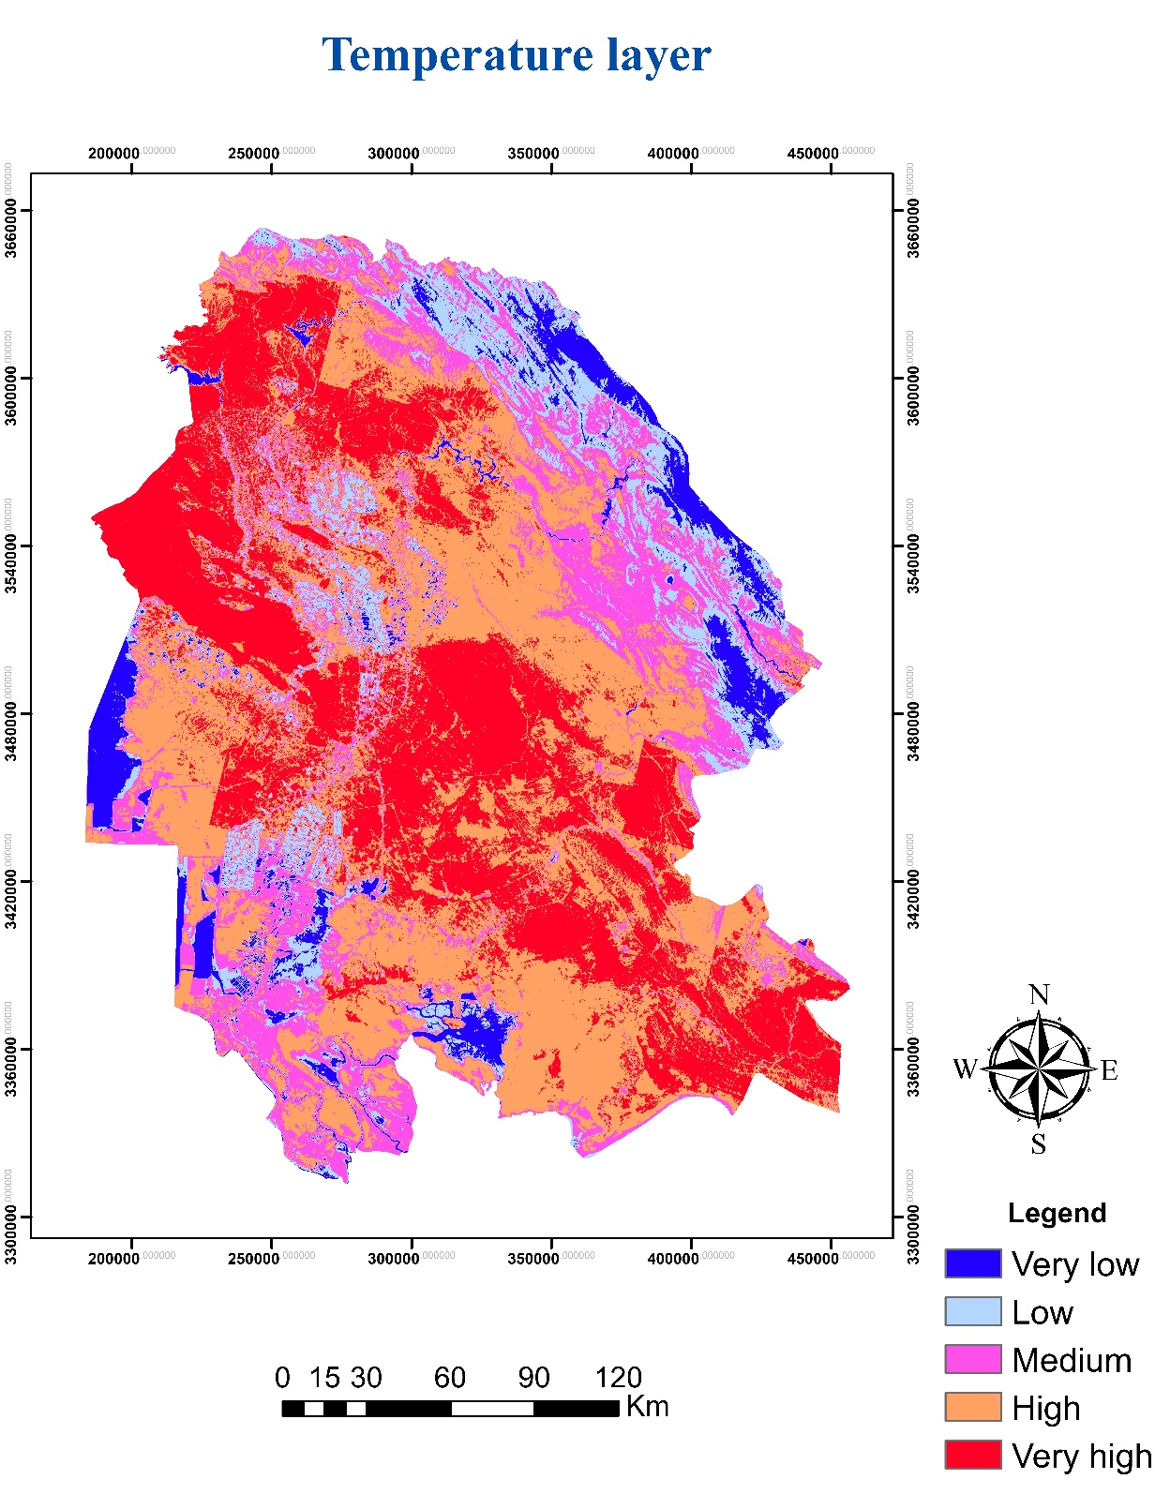
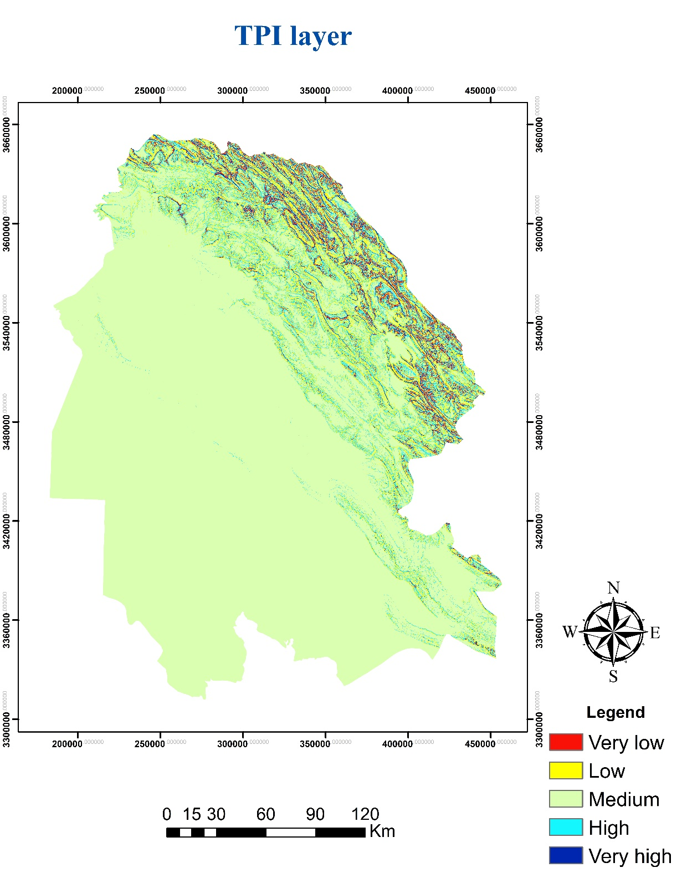
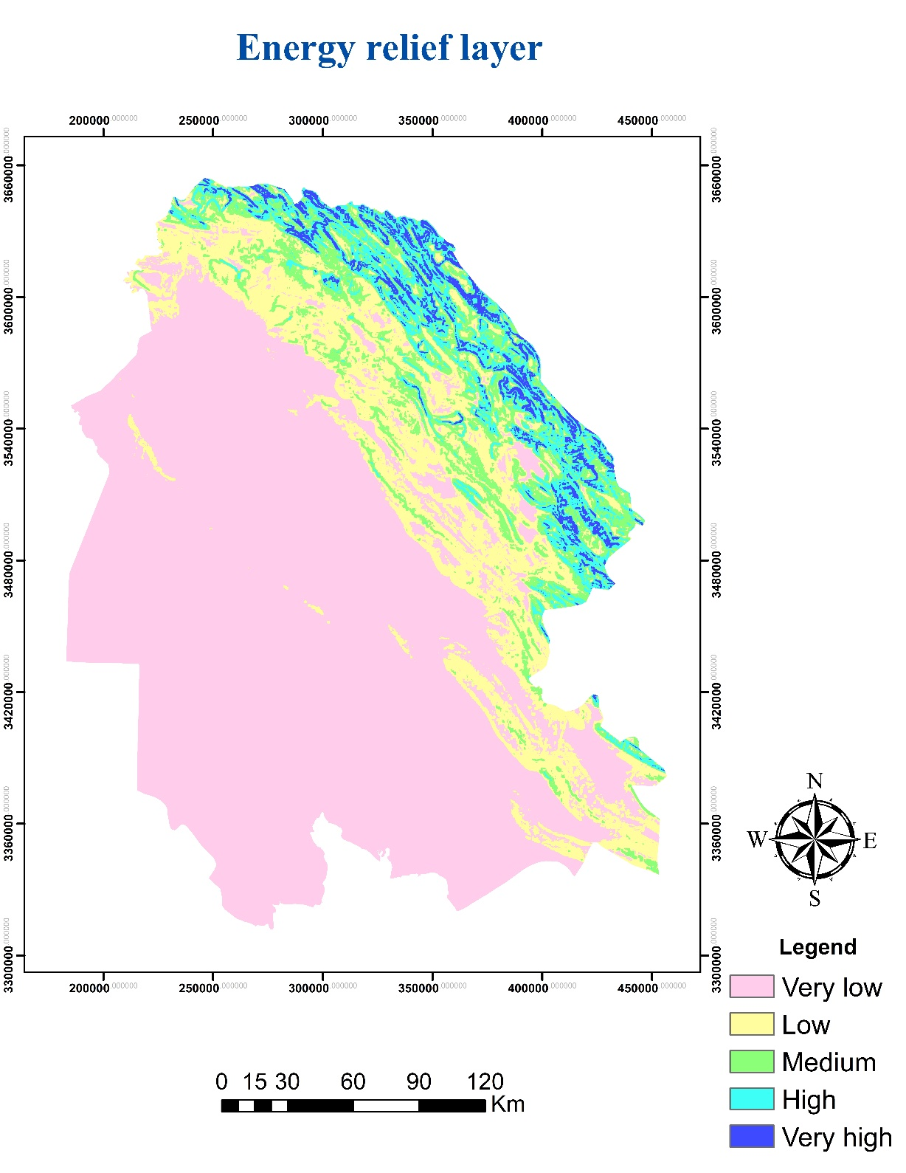
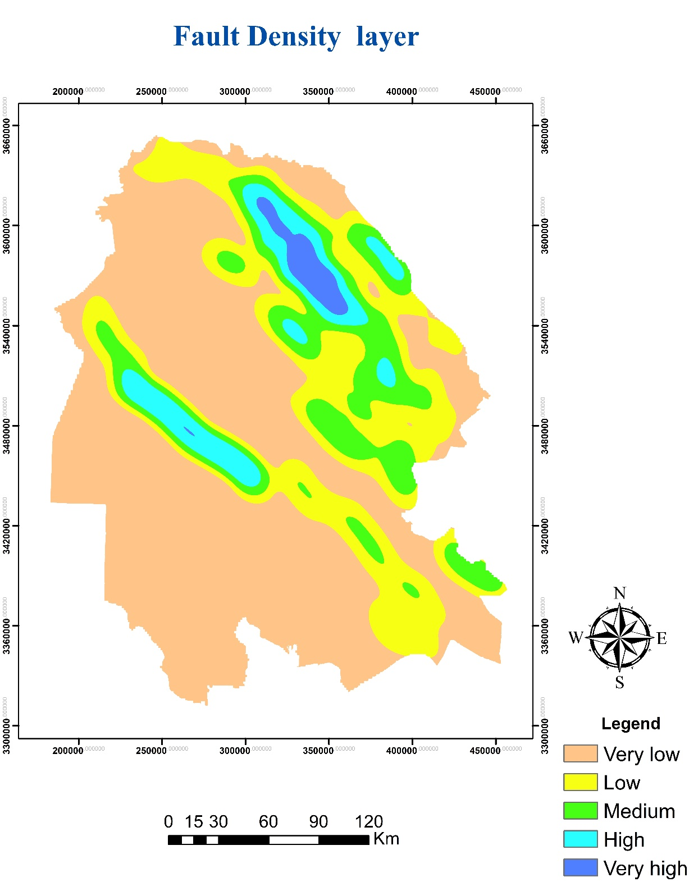
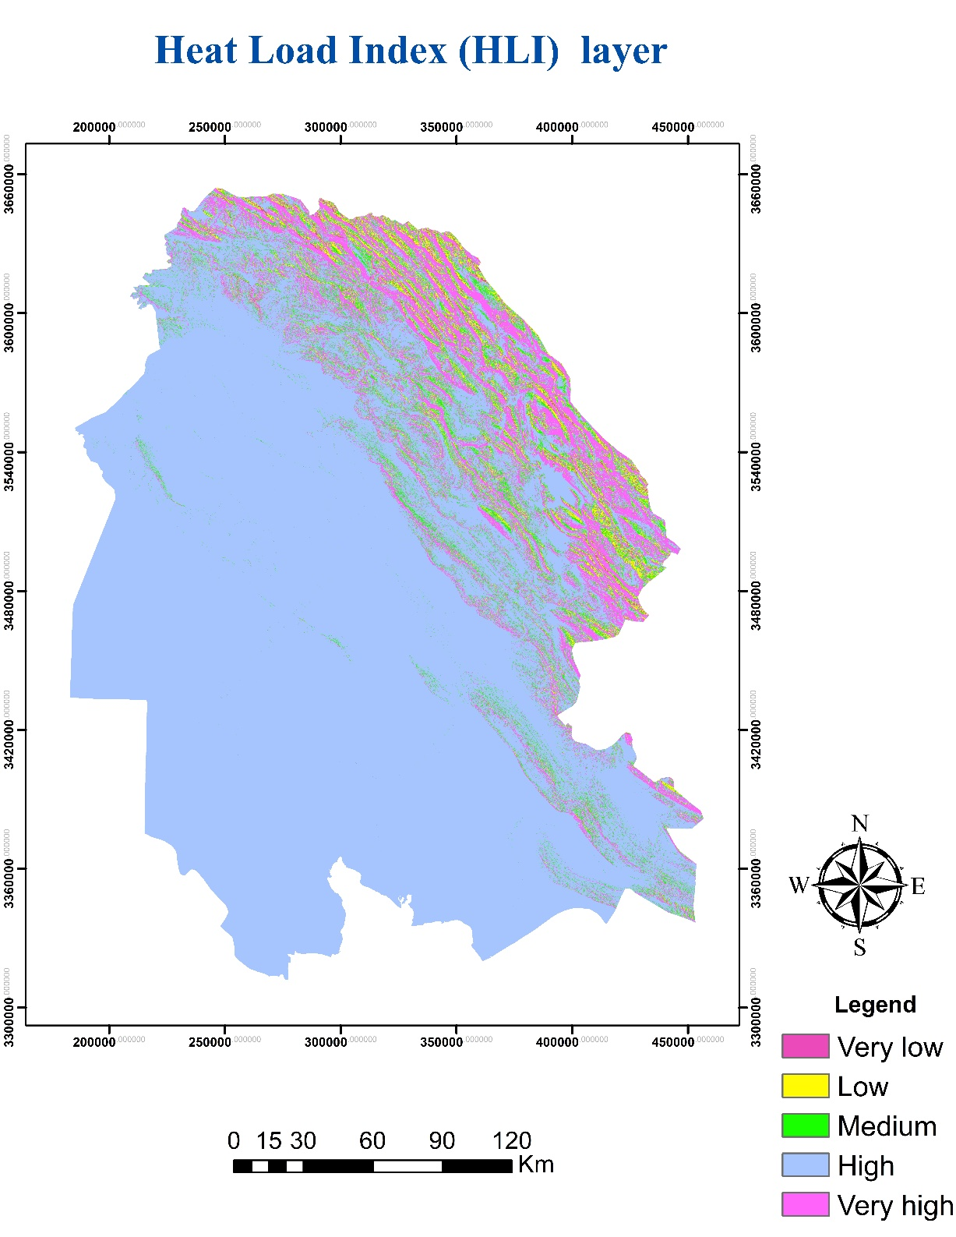
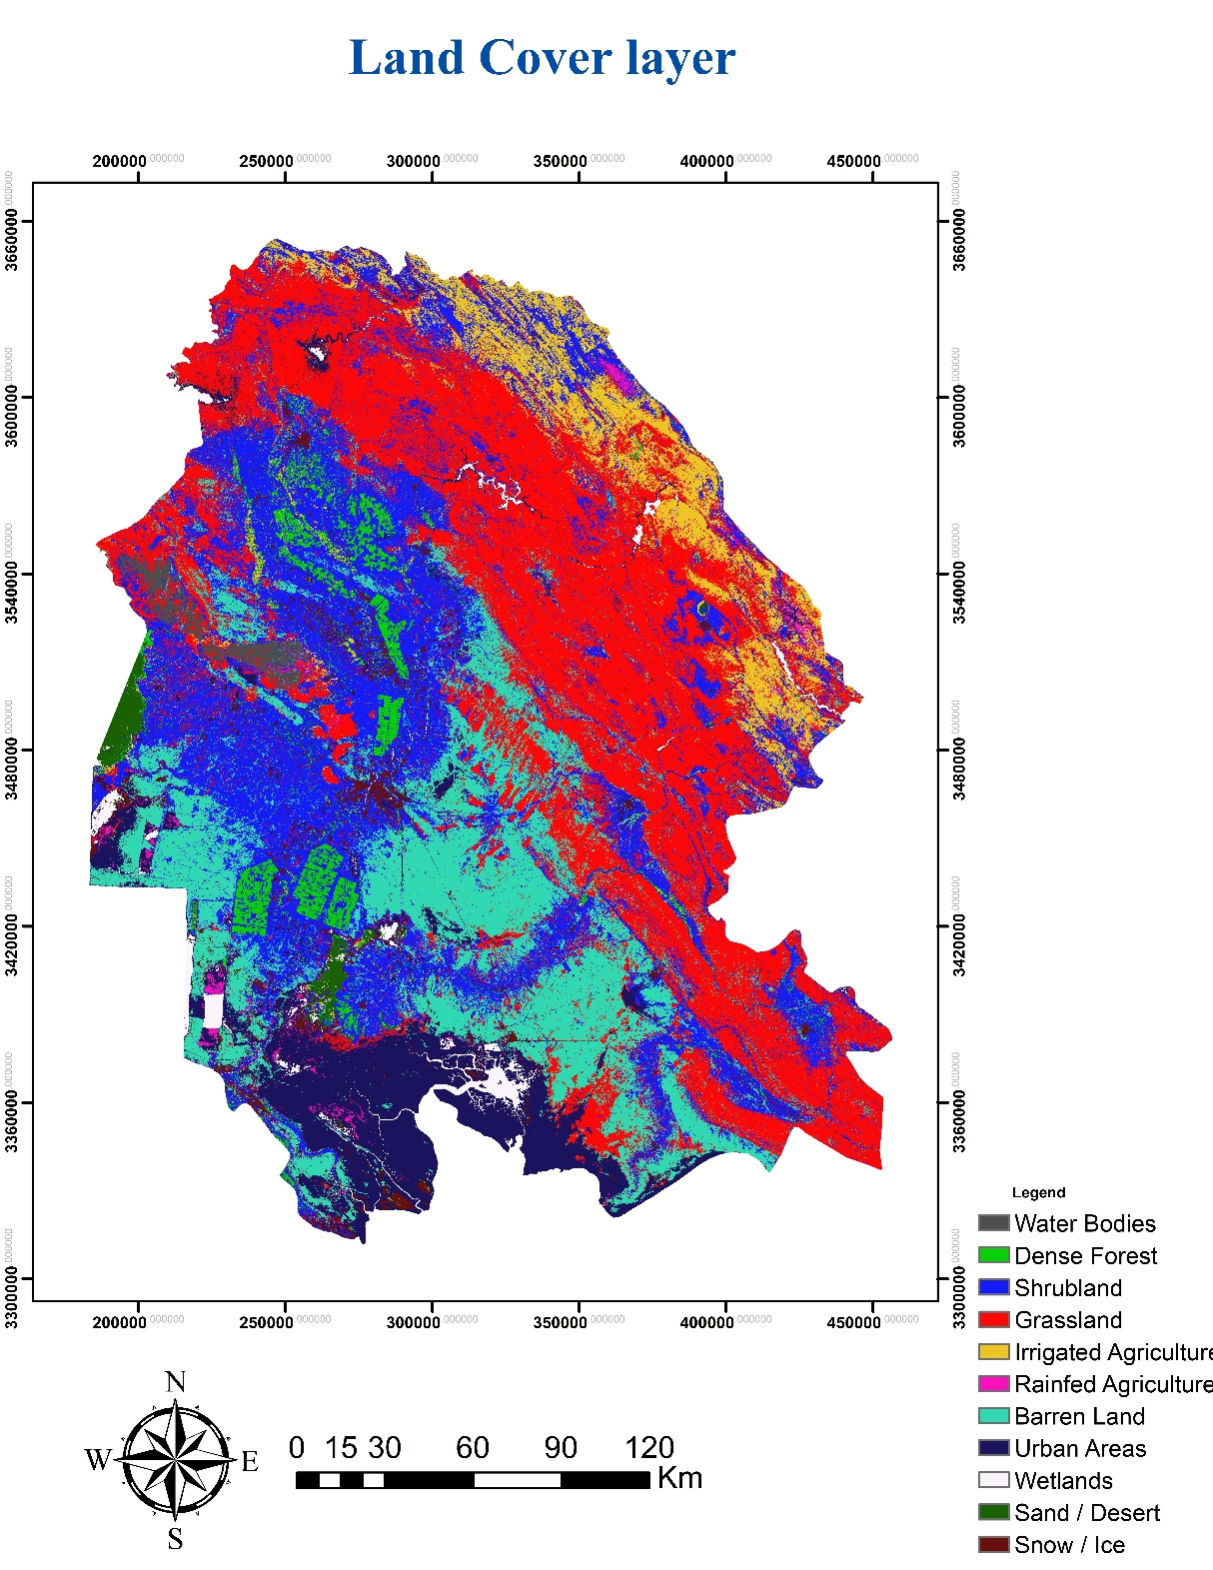
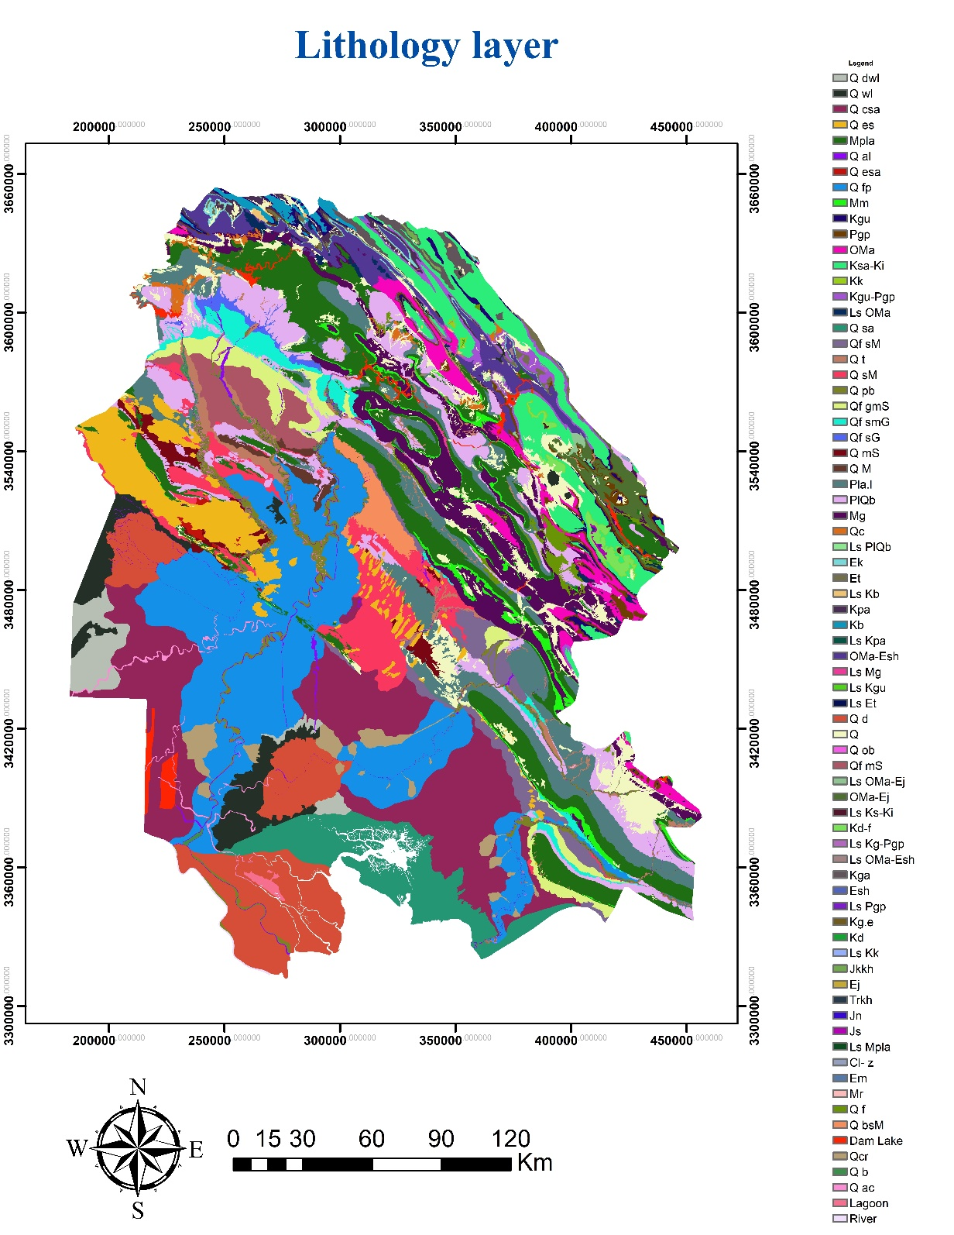
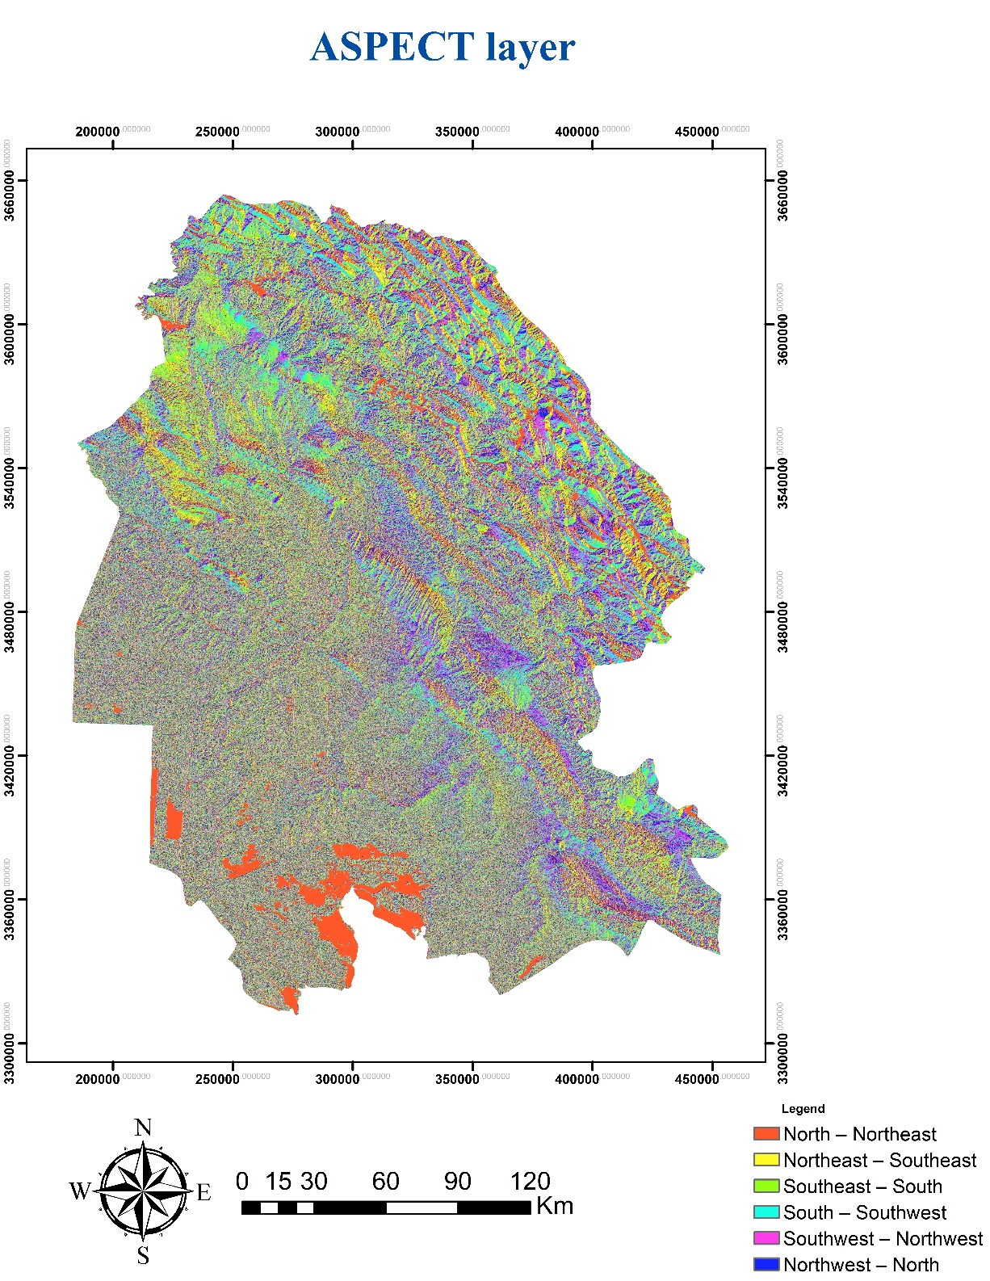
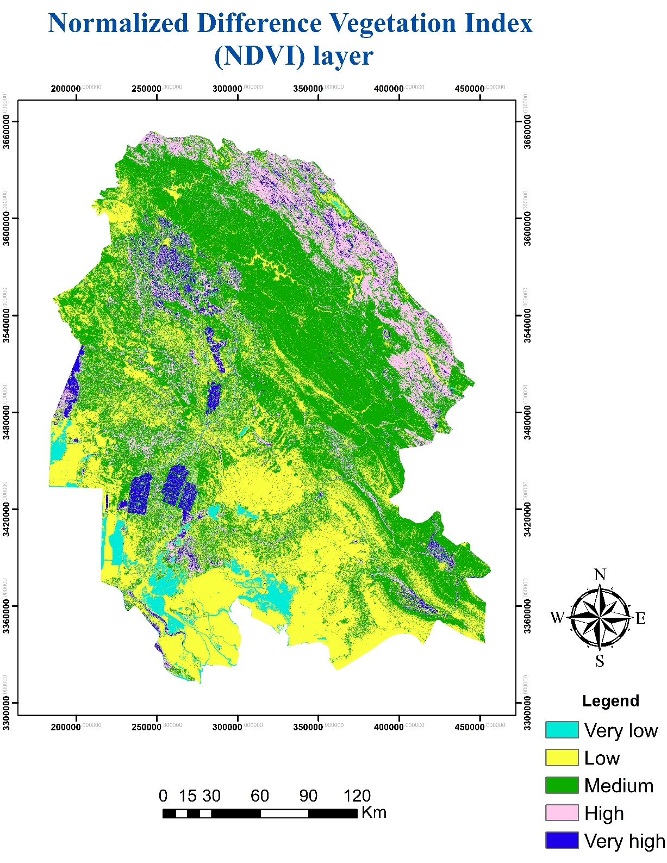
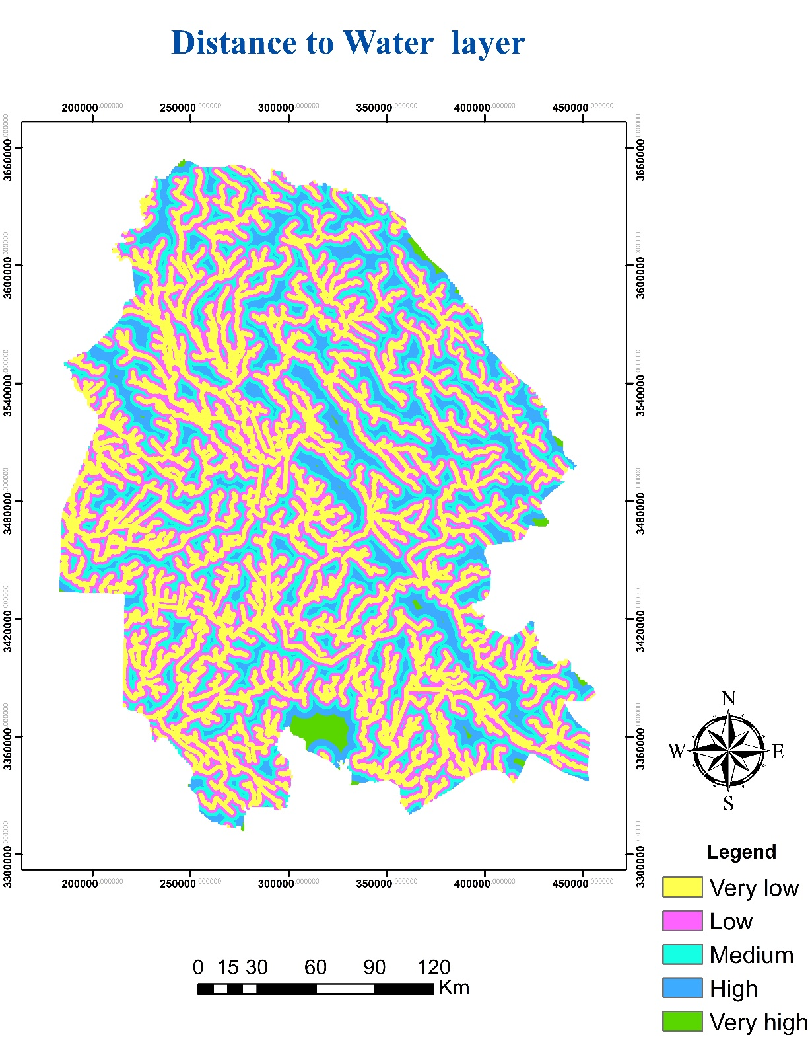
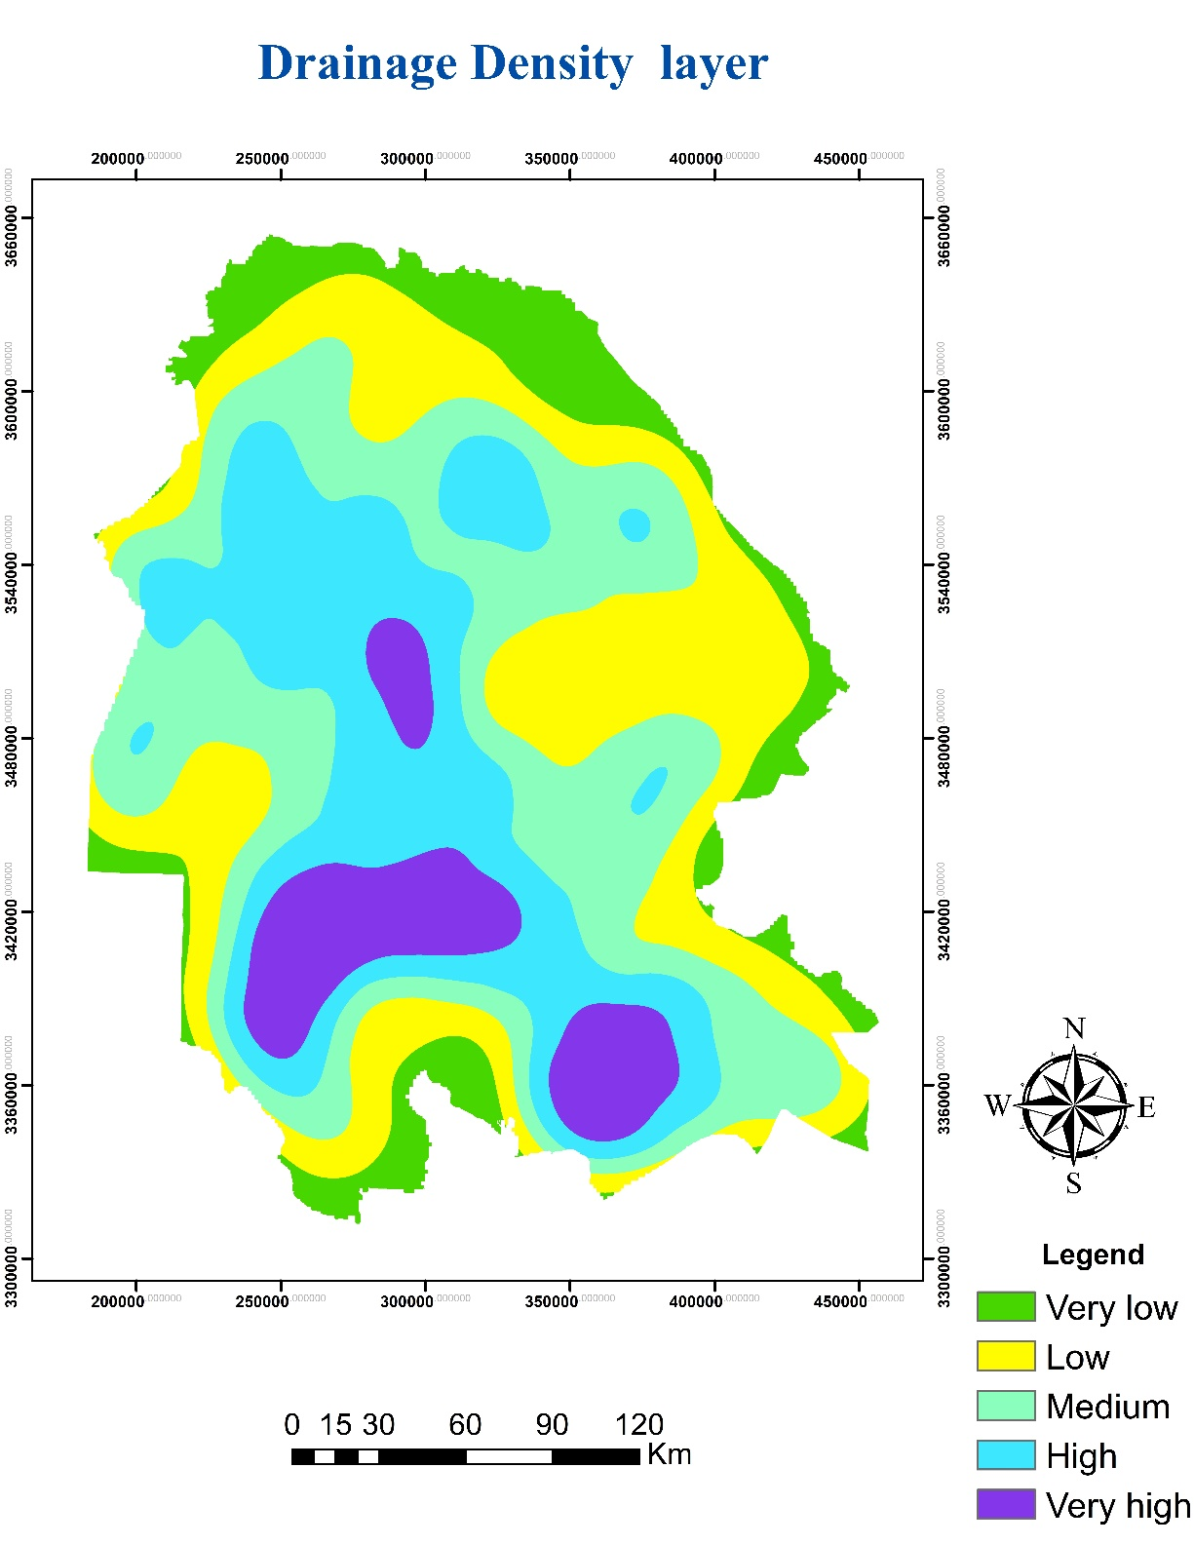
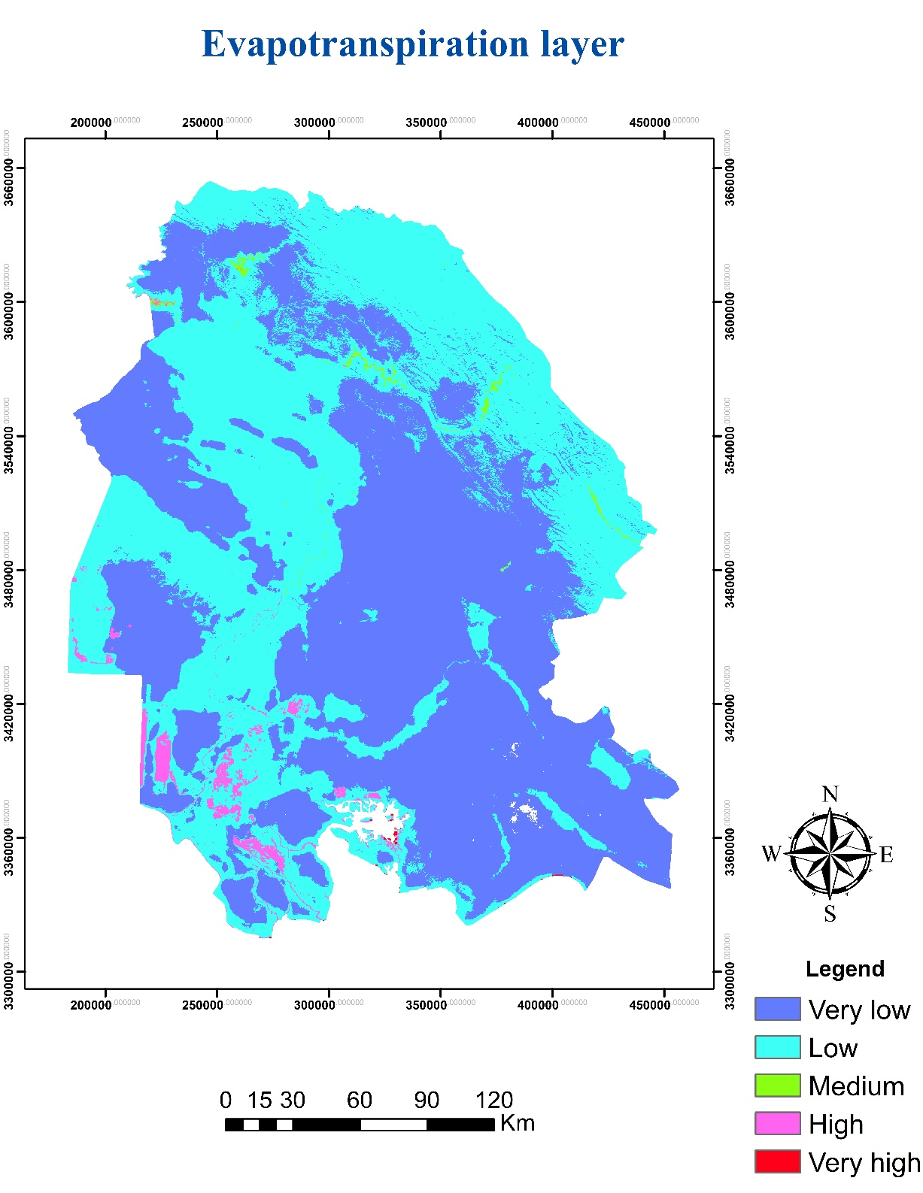

Slide 9
Results

Slide 10
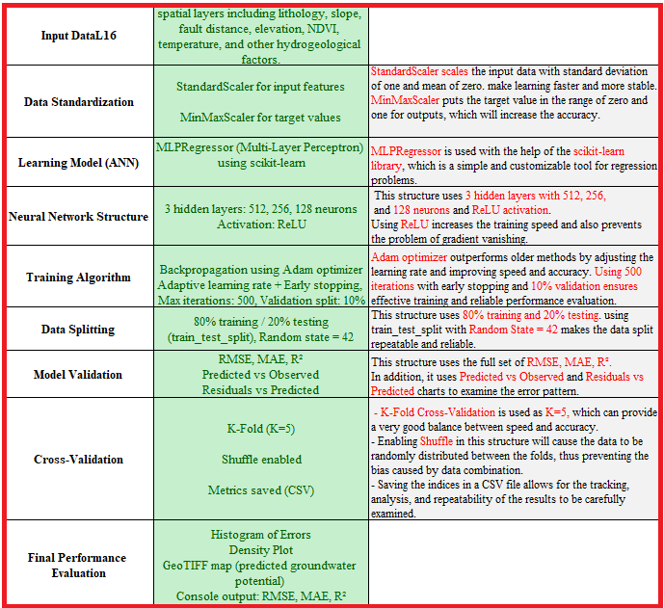
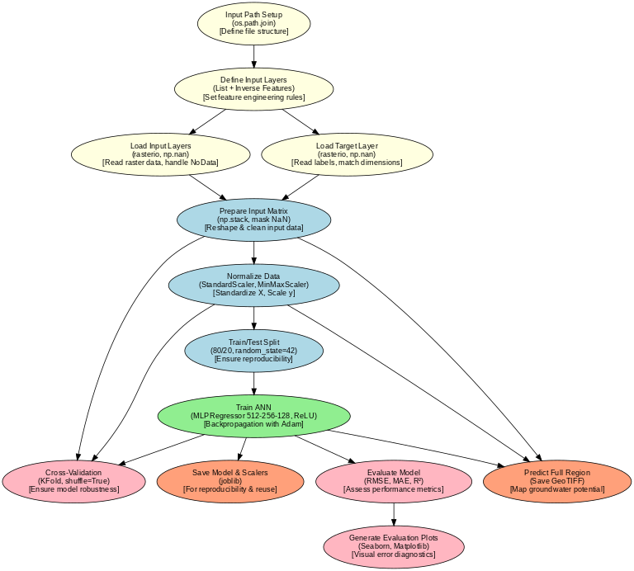
ANN model structure

Slide 11
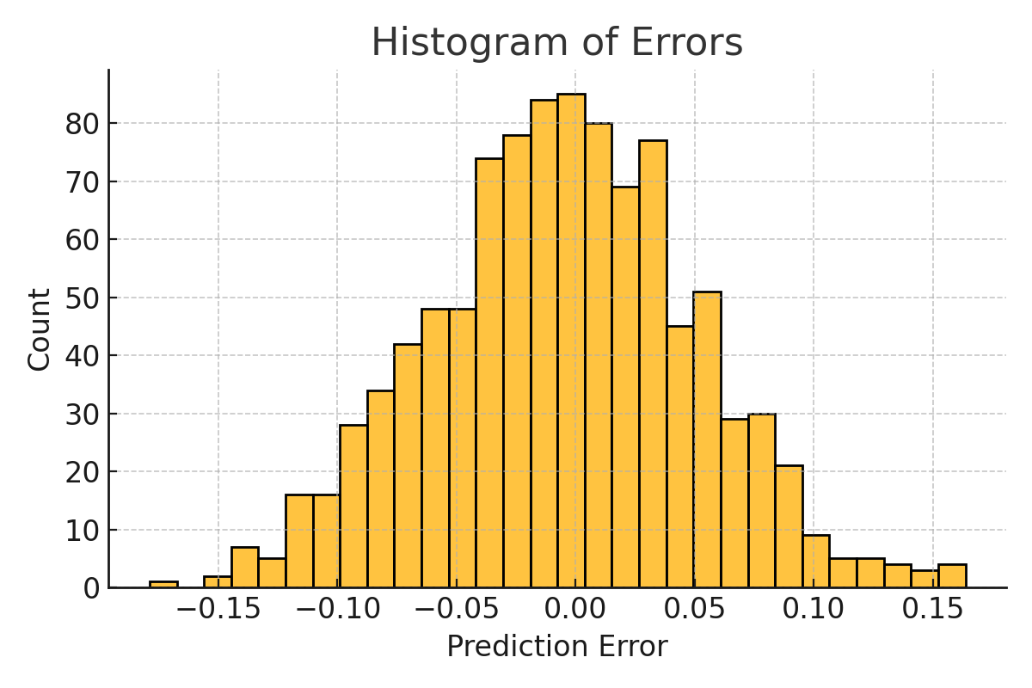
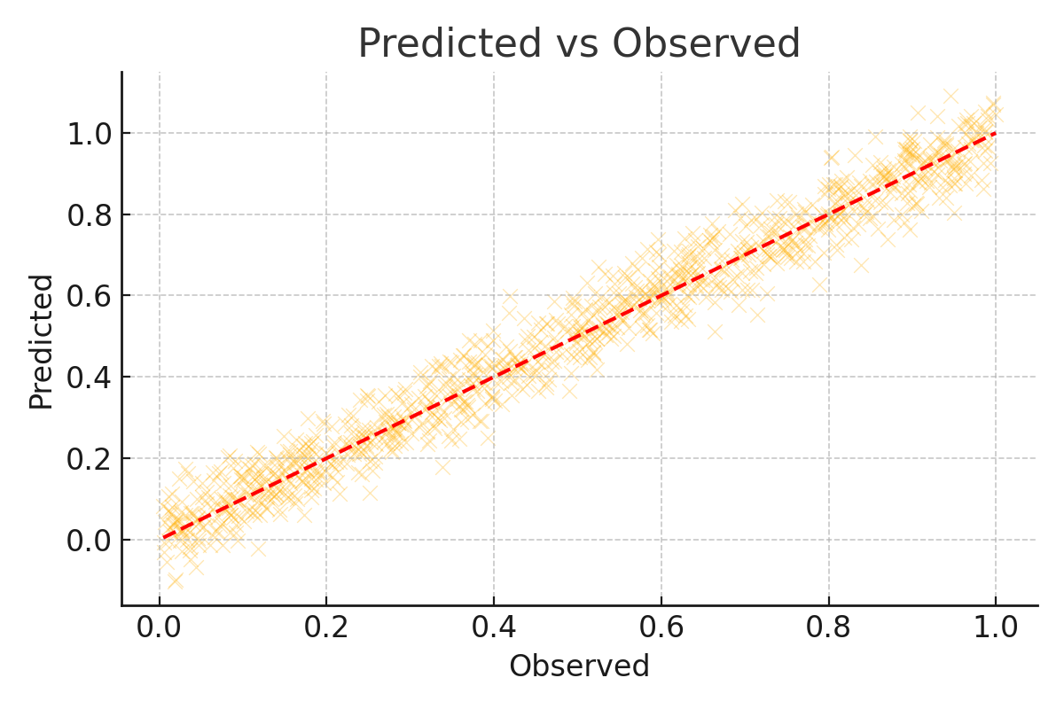
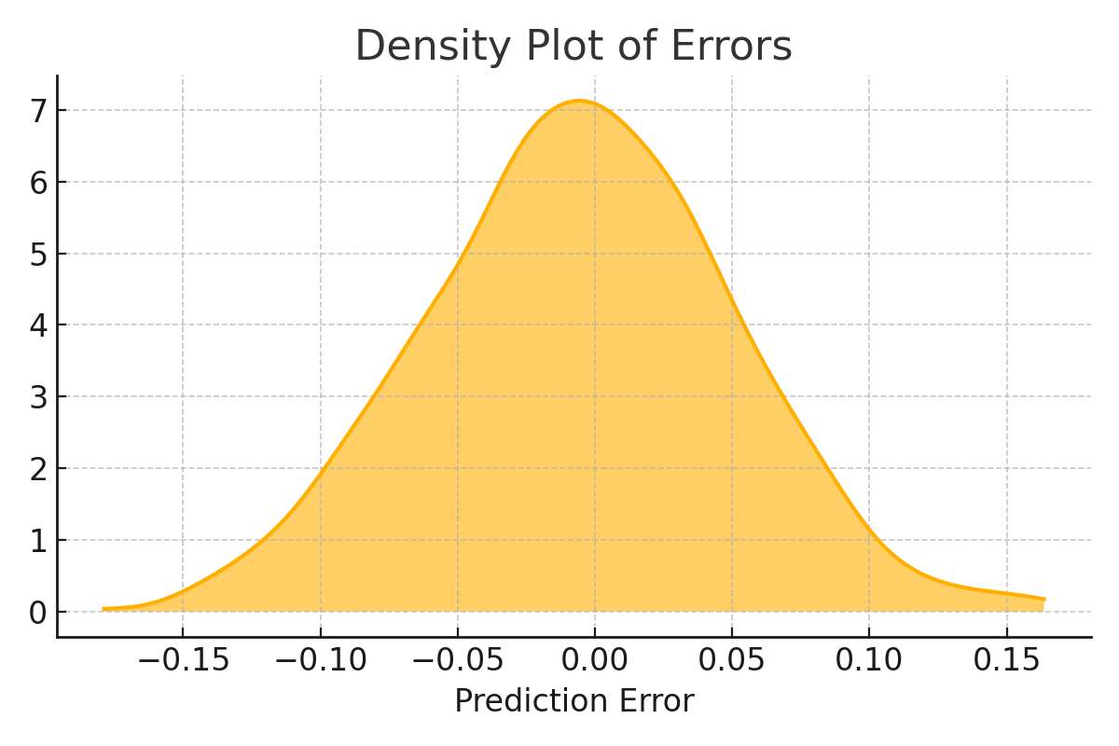
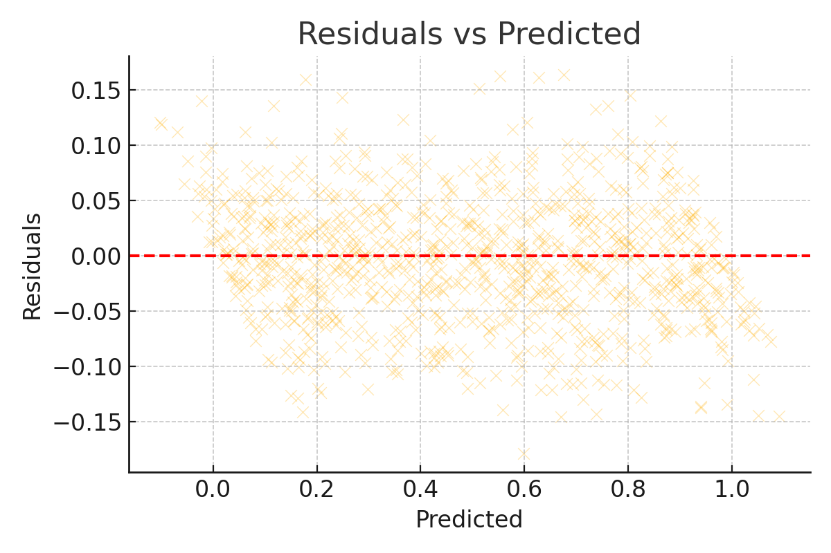
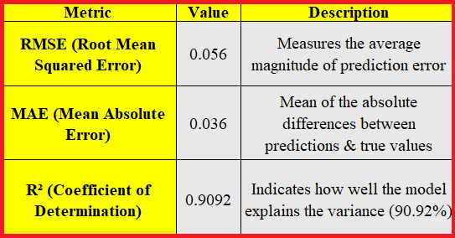
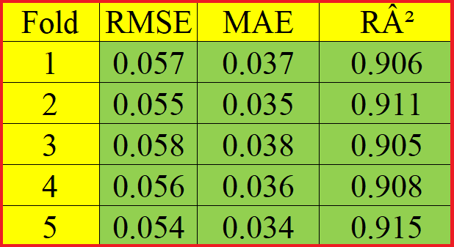
ANN model validation and evaluation results

Slide 12
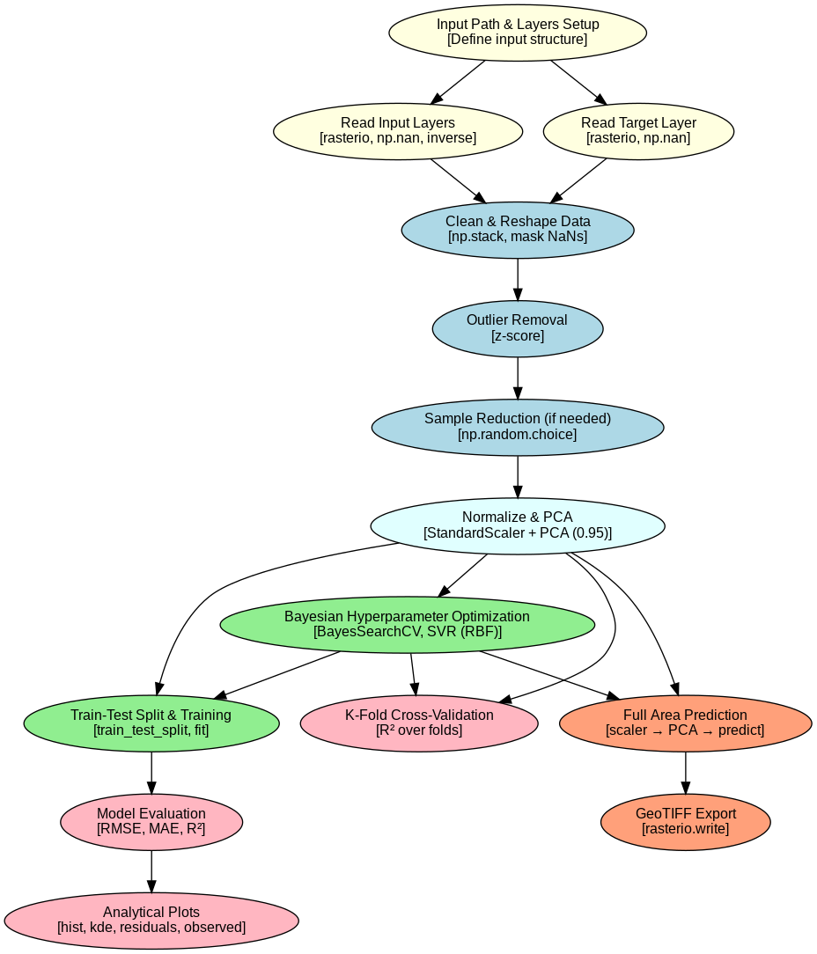
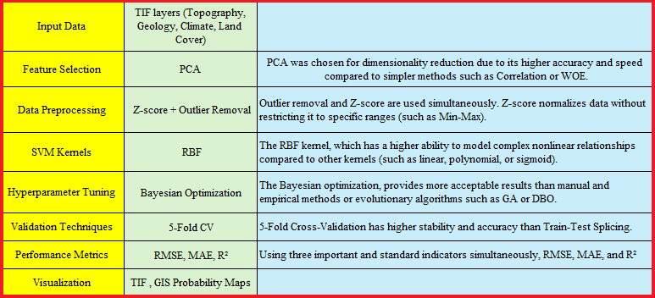
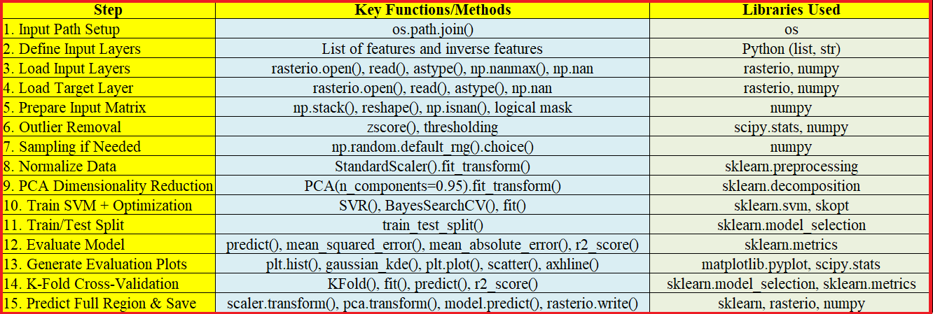
SVM model structure

Slide 13
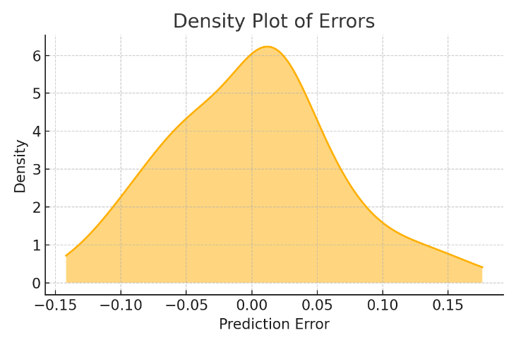
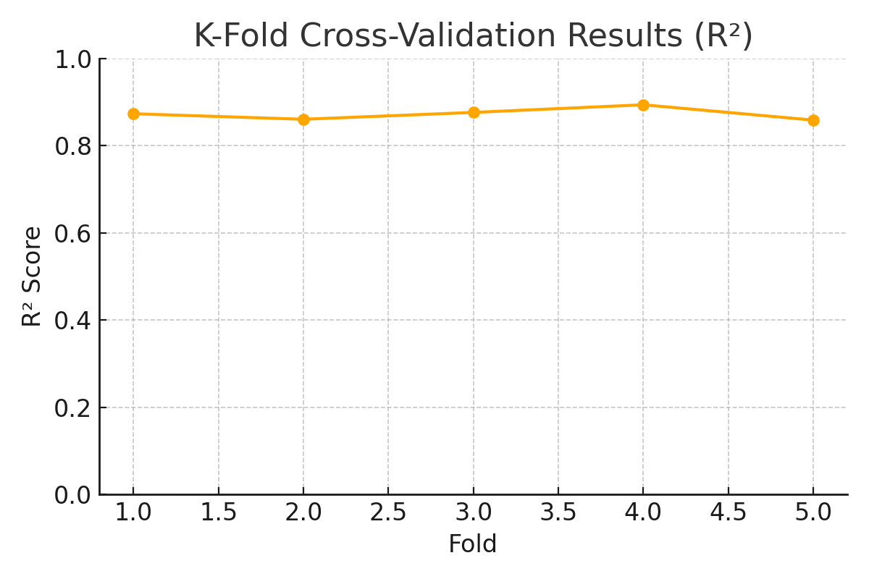
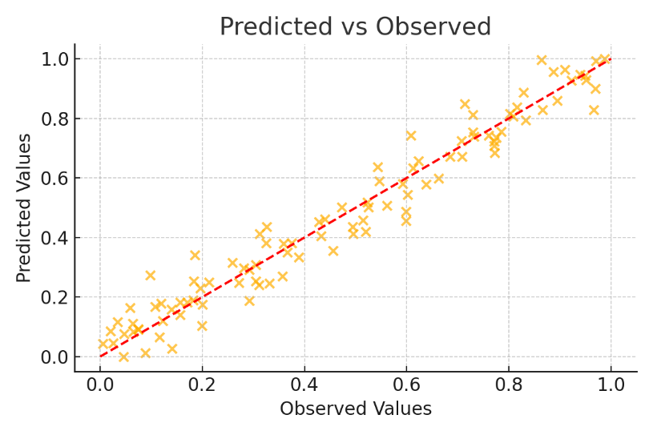
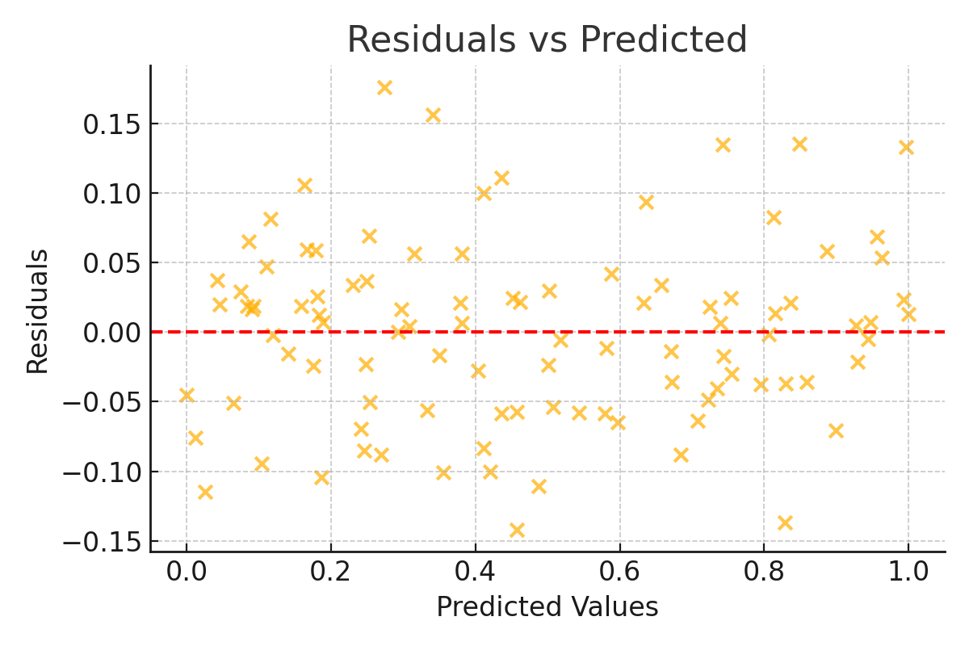
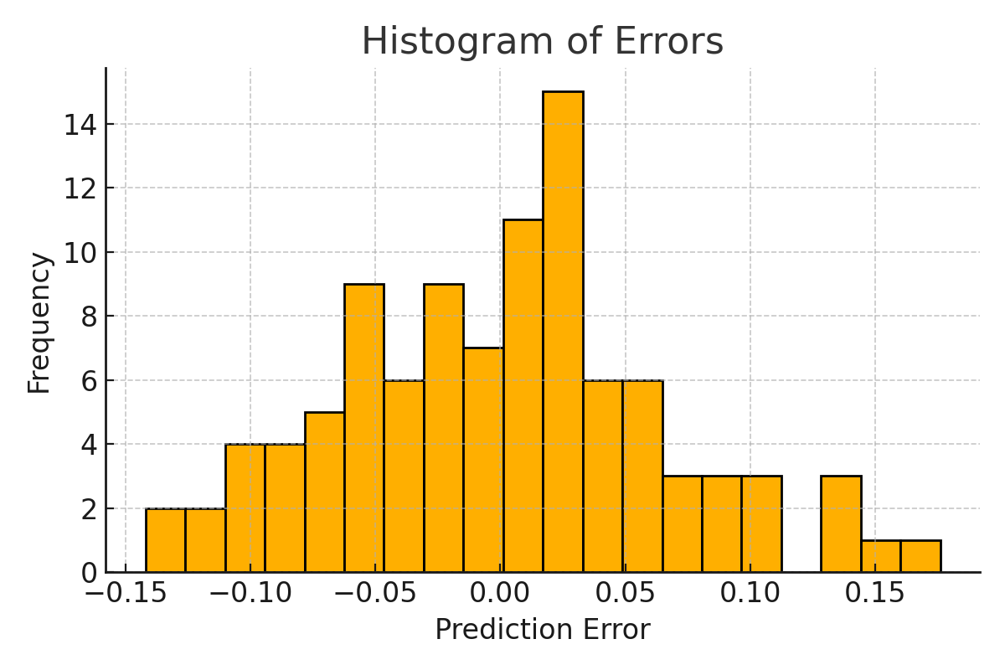
SVM model validation and evaluation results

Slide 14
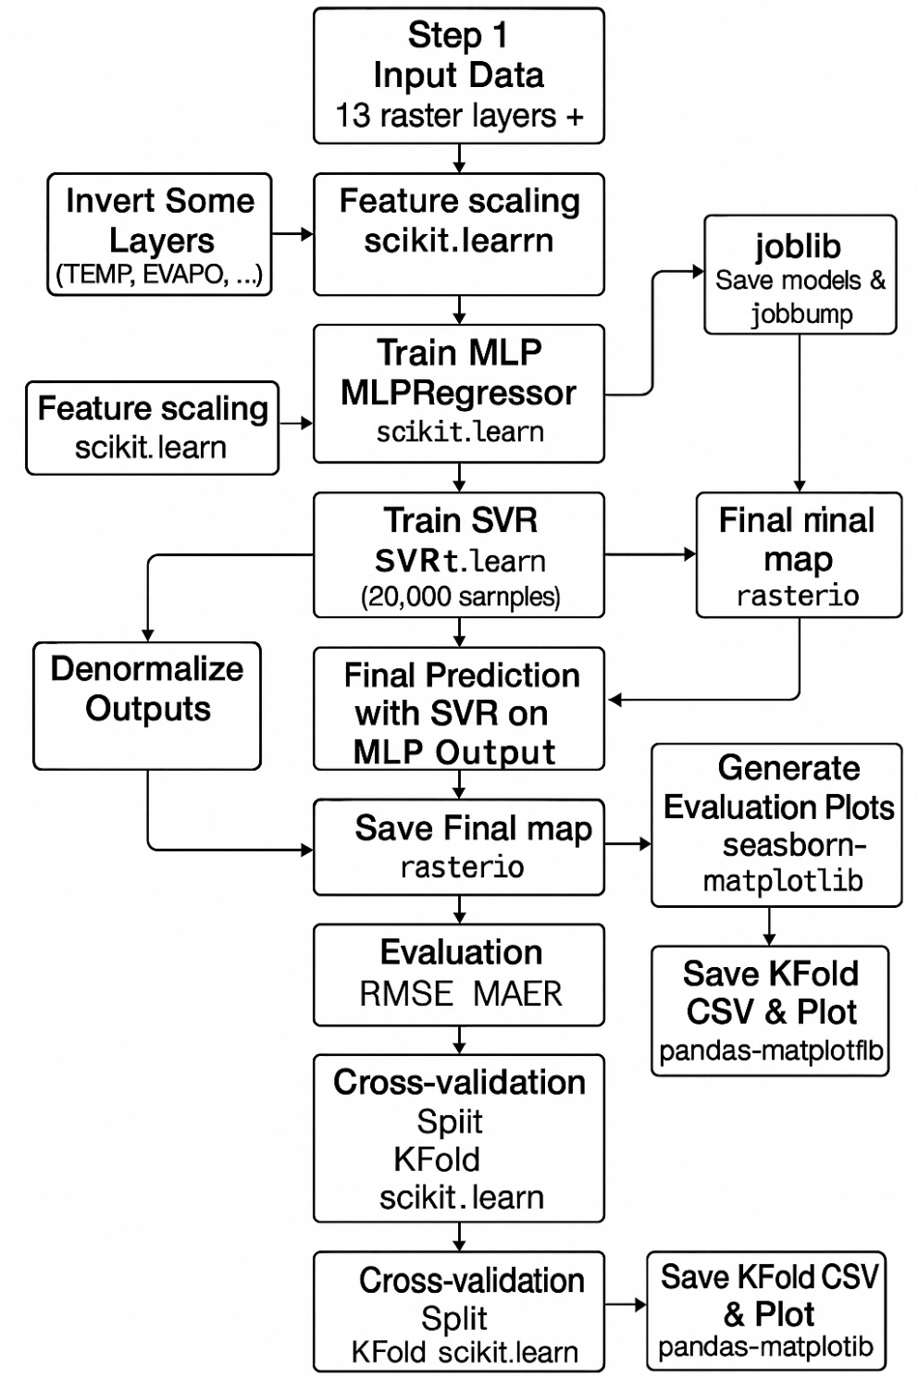
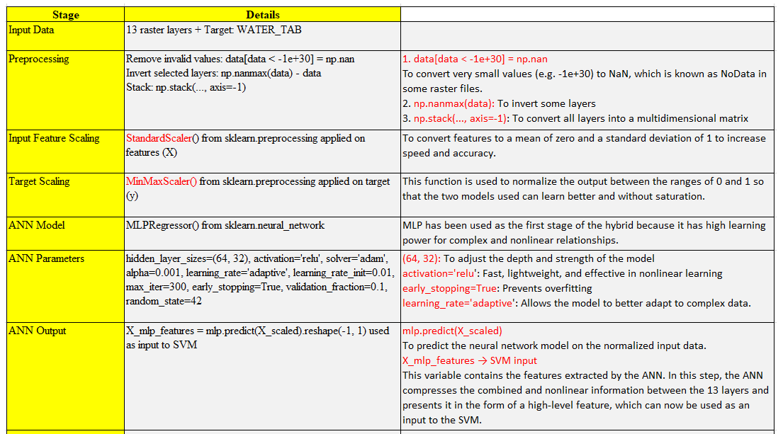
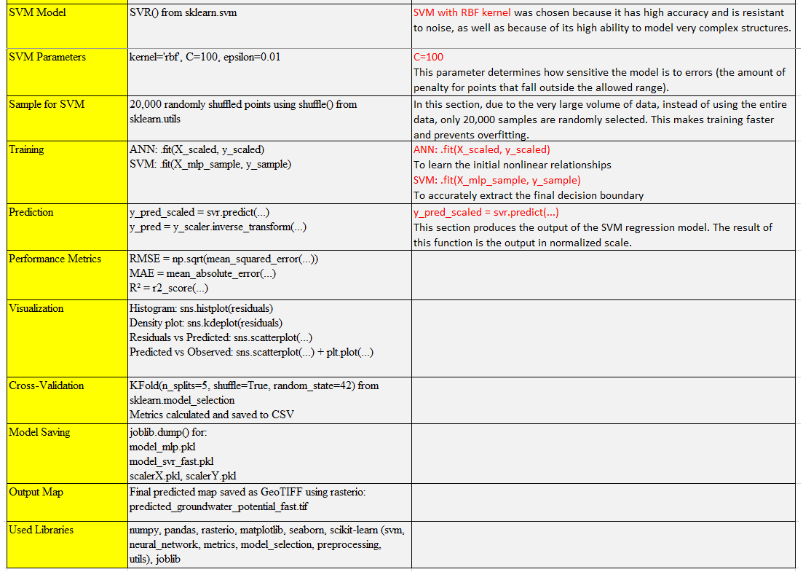
Hybrid model structure
Feature | Our Model | Other Studies
Hybrid Type | Sequential combination ANN to SVM | Using combination of outputs with simple methods (e.g., averaging).
Data Type | Raster data with 13 precise layers (slope, lithology, etc.) | Often, few study layers are used due to the use of complex algorithms, which can reduce the accuracy of the output.
Preprocessing | Adjusted layer directions and cleaned invalid data | Limited or no data correction
Model Training | Simple, controllable, and fast | Sometimes relies on complex optimization algorithms
Operational Output | GeoTIFF + model saving + visual plots | Often only numeric tables or closed-code results

Slide 15
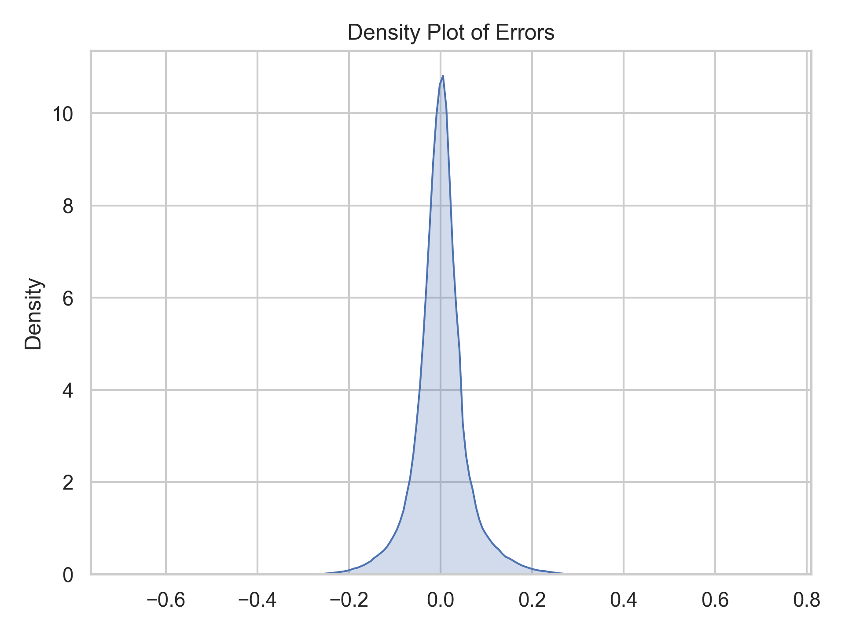
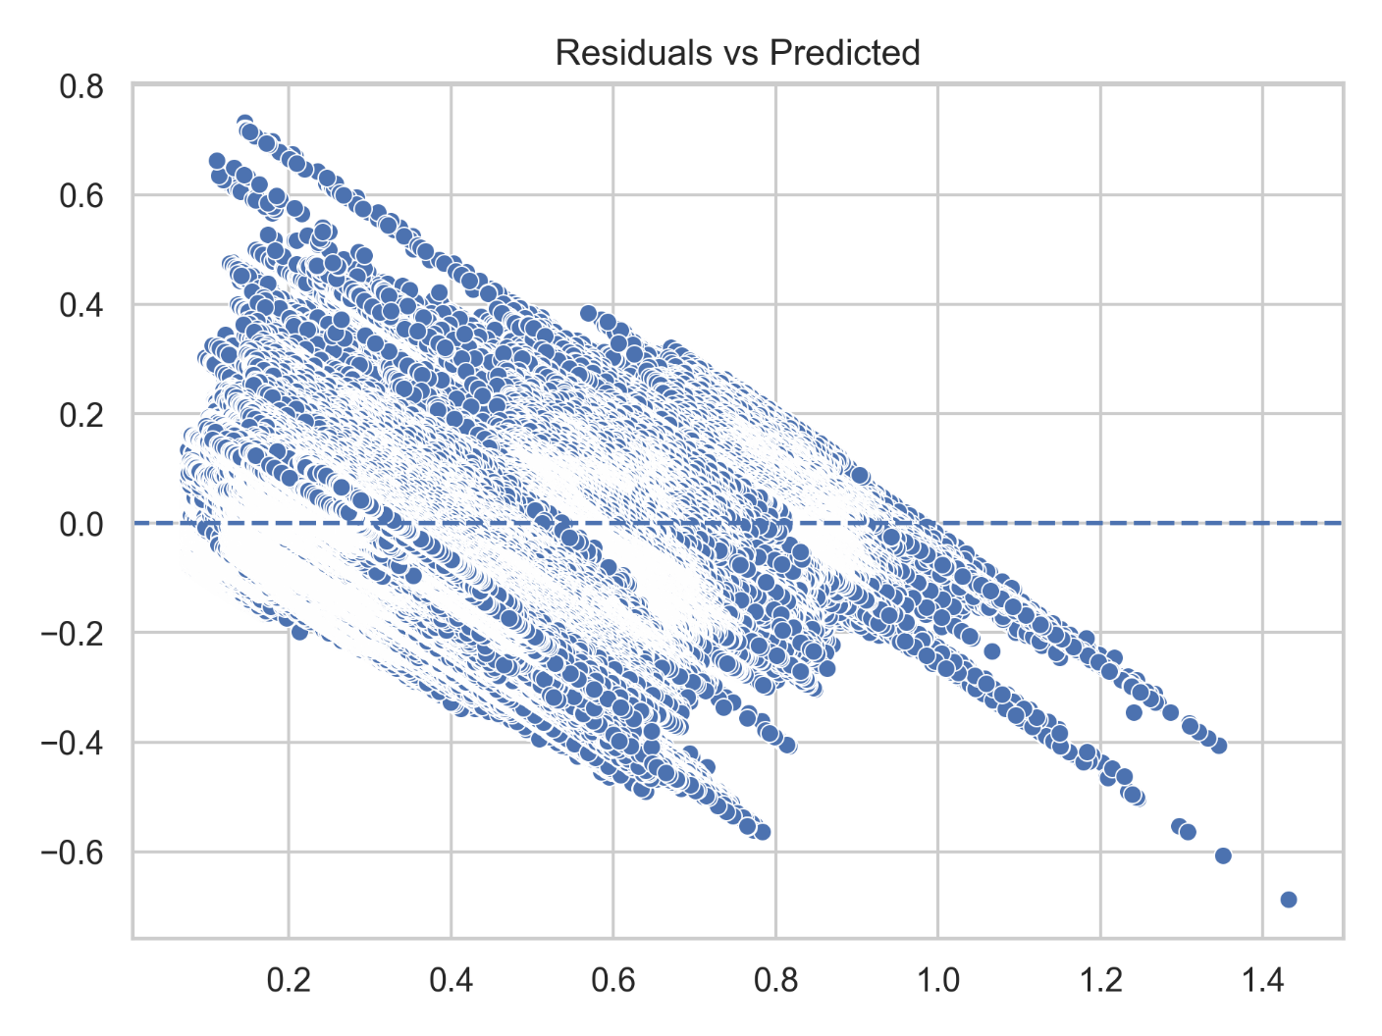
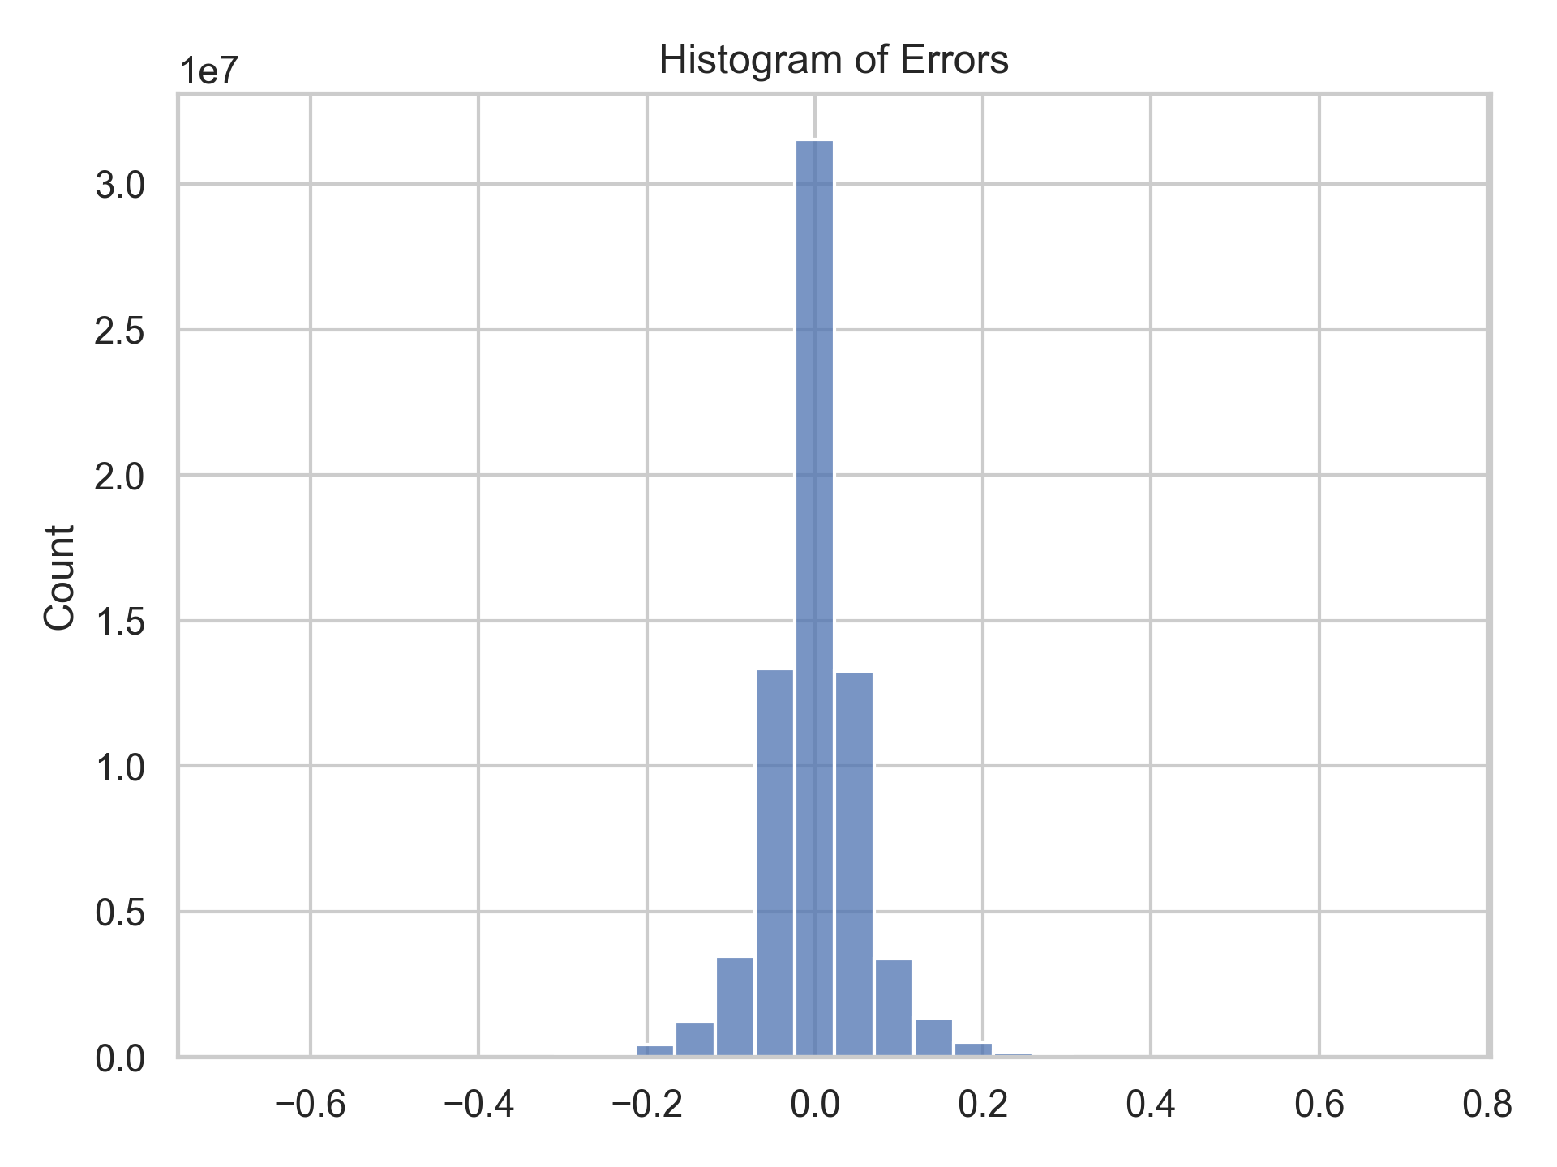
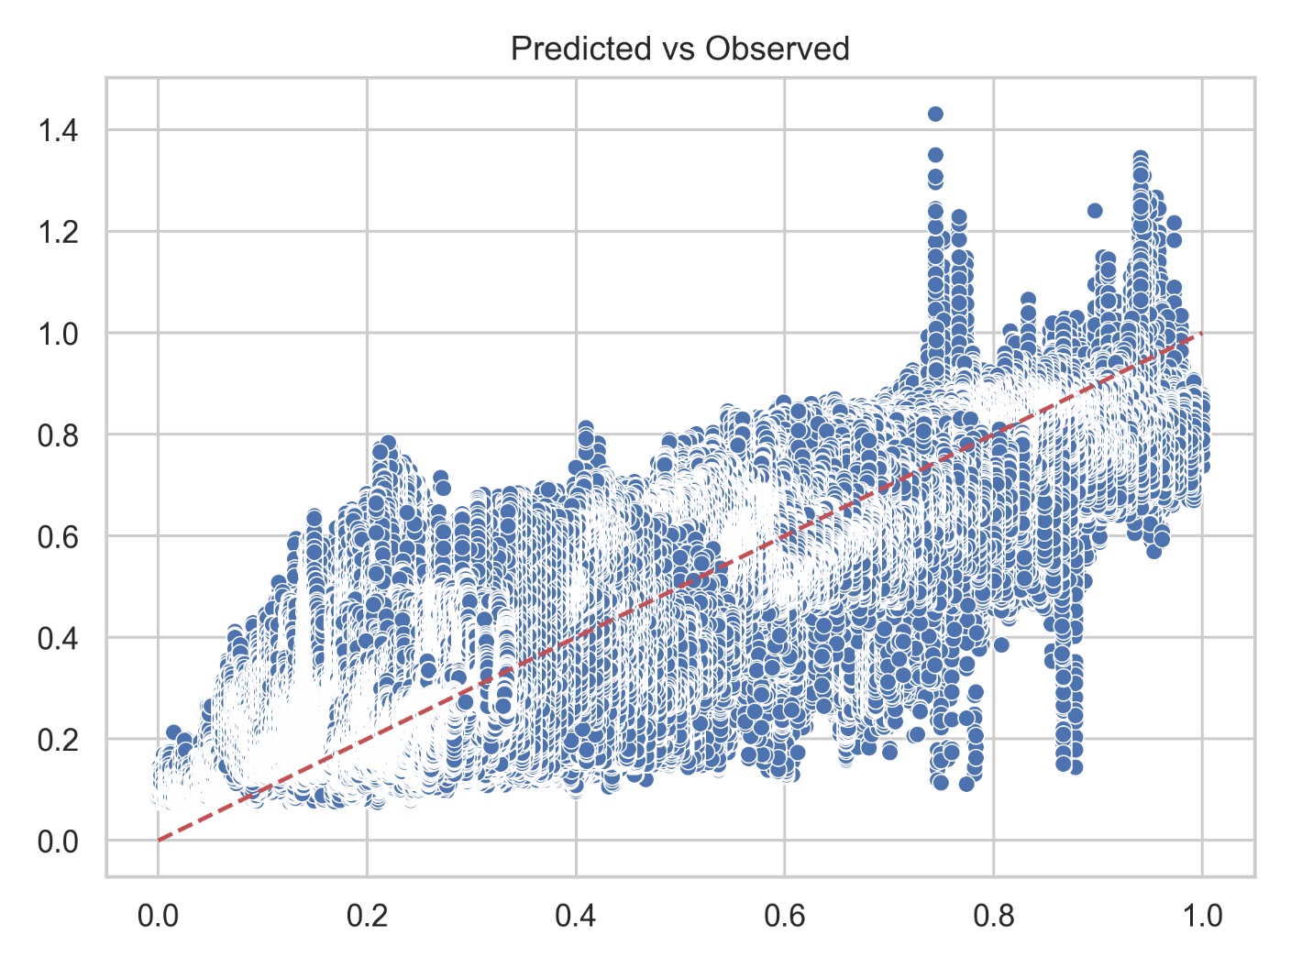
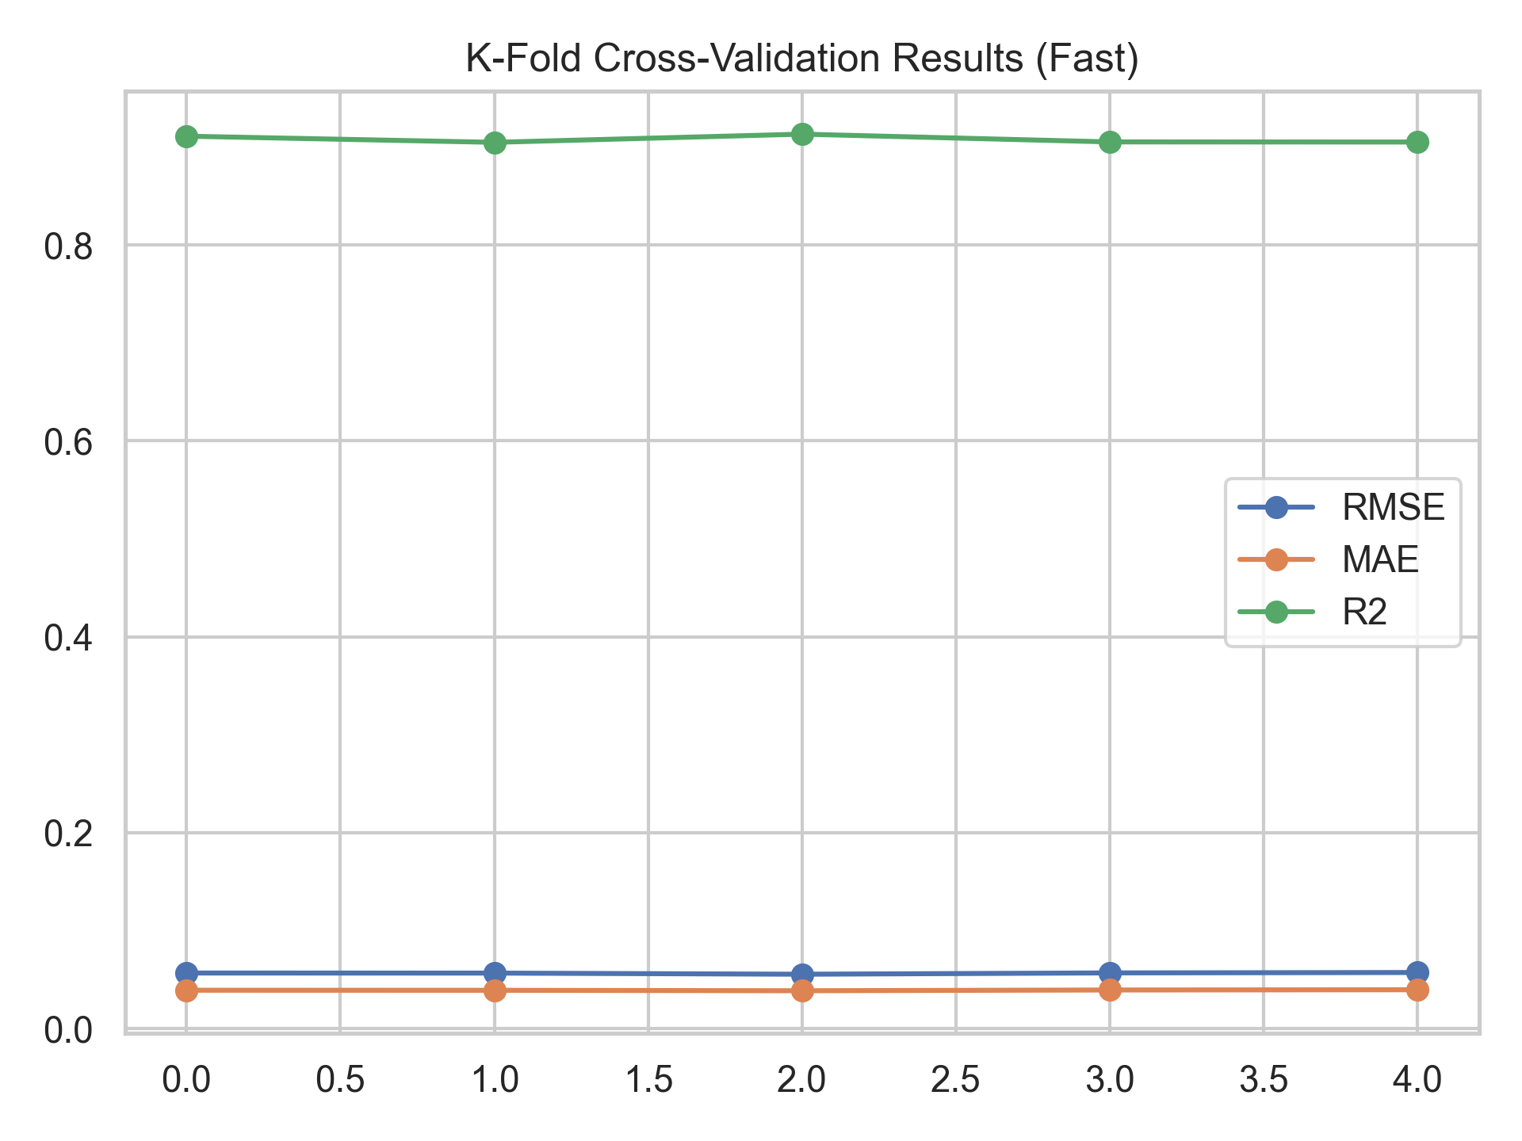
Hybrid model validation and evaluation results

Slide 16
Conclusions

Slide 17
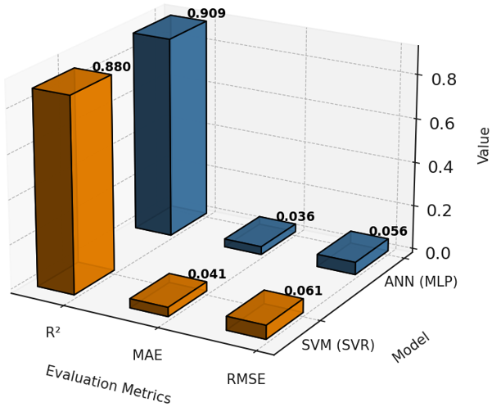
Comparison of Groundwater Potential Mapping Using SVM and ANN (MLP)

Slide 18
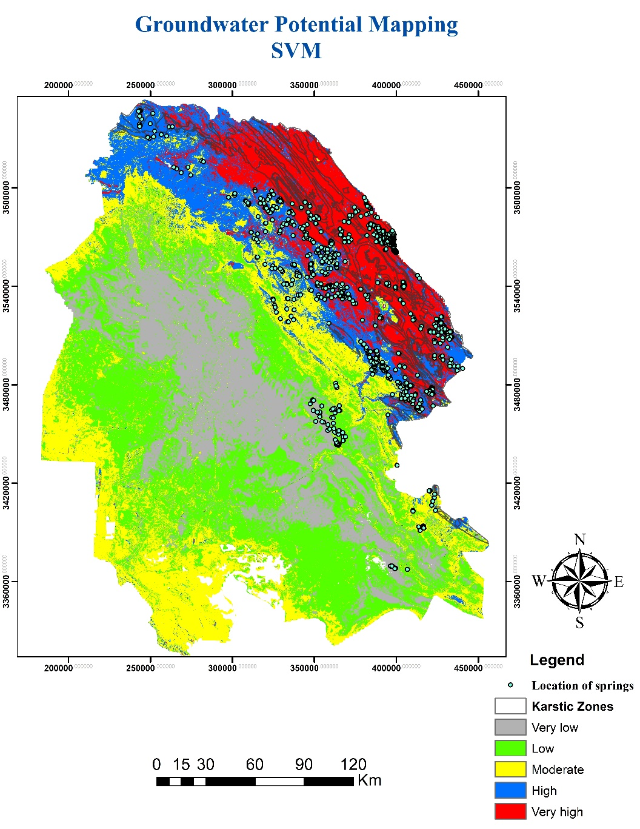
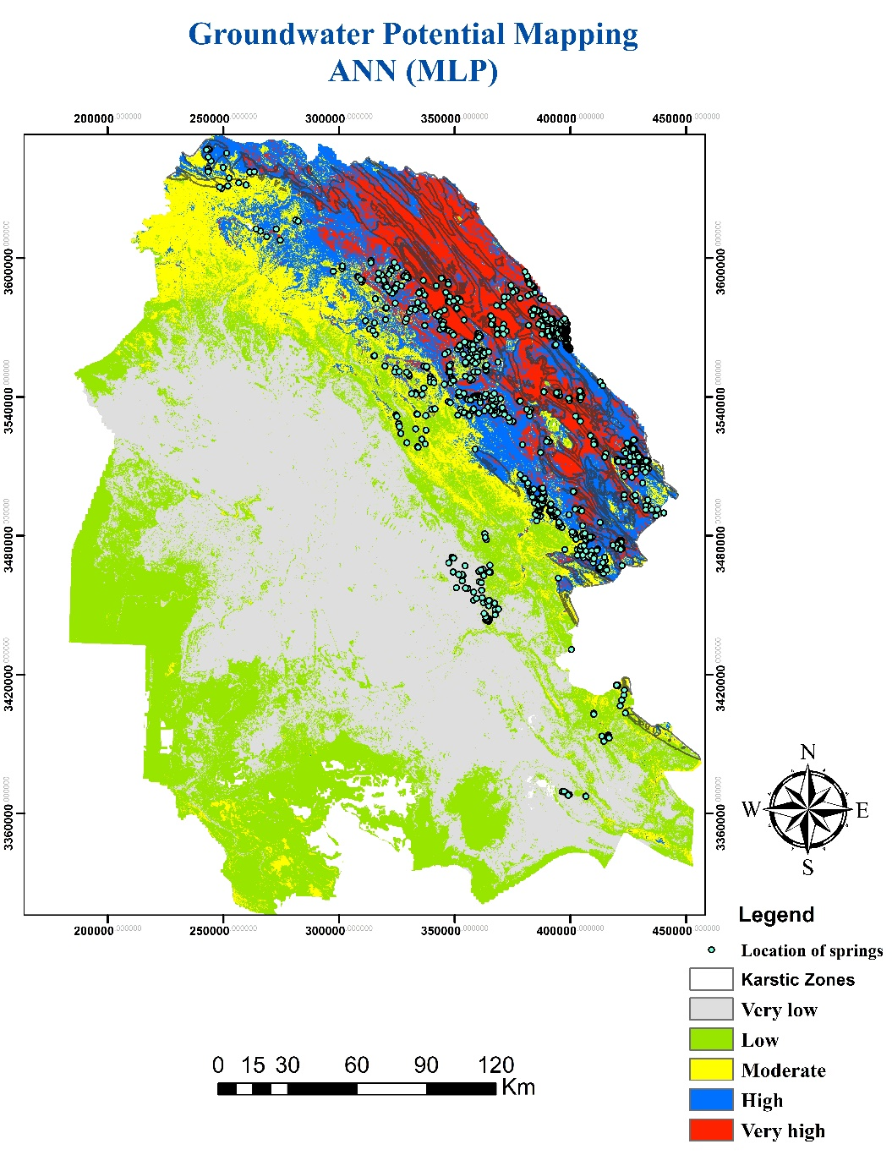
Final maps (ANN vs SVM)

Slide 19
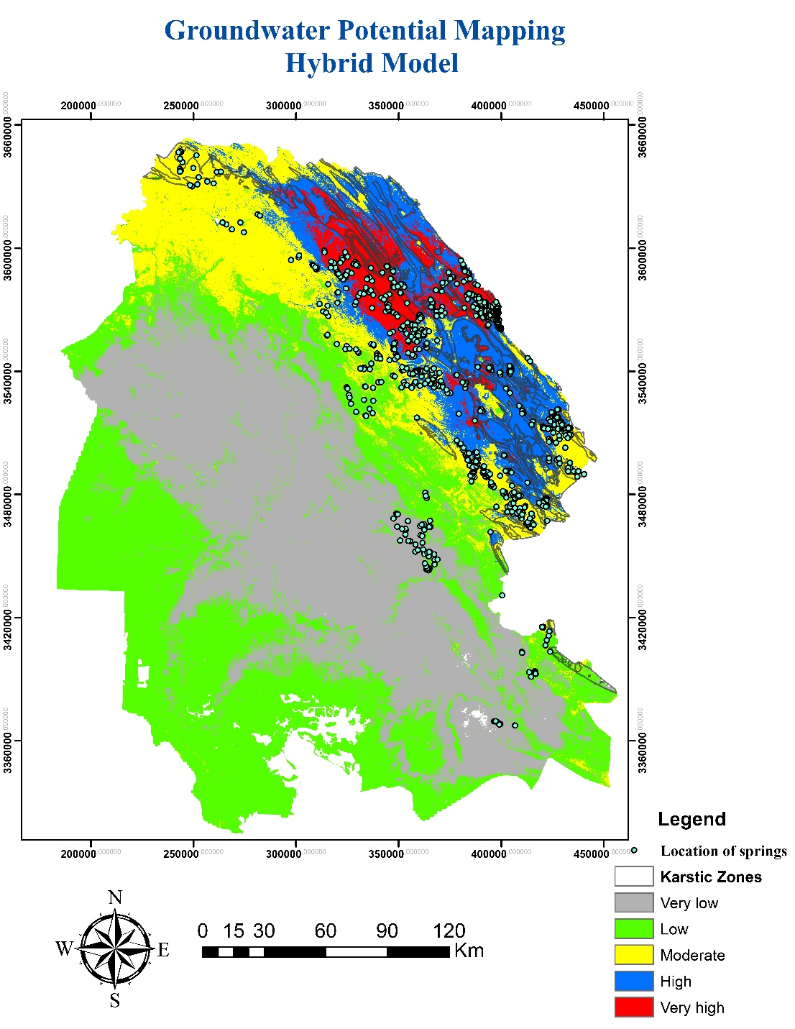
Metric | Value | Description
RMSE (Root Mean Squared Error) | 0.0569 | Measures the average magnitude of prediction error
MAE (Mean Absolute Error) | 0.0394 | Mean of the absolute differences between predictions & true values
R² (Coefficient of Determination) | 0.9219 | Indicates how well the model explains the variance (92.19%)

