Slide 1
Spatial variability and temporal changes in inter-catchment
groundwater flow across the contiguous United States
Chao Lei, Larisa Tarasova, Stefano Basso, Matthew J. Cohen, Andreas Musolff, Christian Schmidt
Speaker: Chao Lei (chao.lei@ufz.de)
Date: 28.04.2025

Slide 2
Water balance method for identifying gaining and losing catchments
P: Precipitation; AET: actual evapotranspiration; Q_{g}: Groundwater discharge
More losses
$$\text{(}\text{P}\text{ − }\text{AET}\text{) − }{\text{Q}}_{\text{g}} \text{− }\text{∆}\text{S}\text{ = }{\text{Q}}_{\text{out}}$$
Long-term averaged datasets
Cluster 2
Cluster 1
Gaining
$${\text{Q}}_{\text{g}} \text{= (}{\text{P}\text{ − }\text{AET}\text{) − }\text{Q}}_{\text{out}}$$
Losing
Cluster 3
Cluster 4
Moving window averaging
More
gains
Slope (Q_{g1}, Q_{g2}, …, Q_{g25})
1

Slide 3
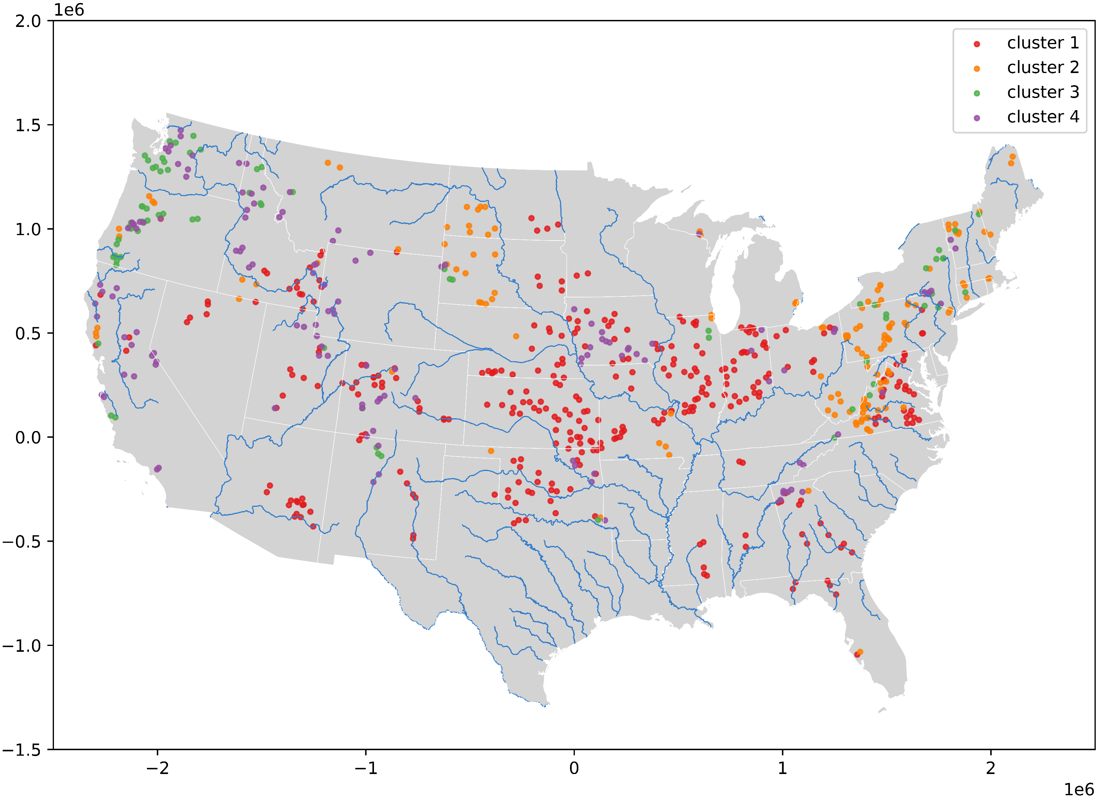
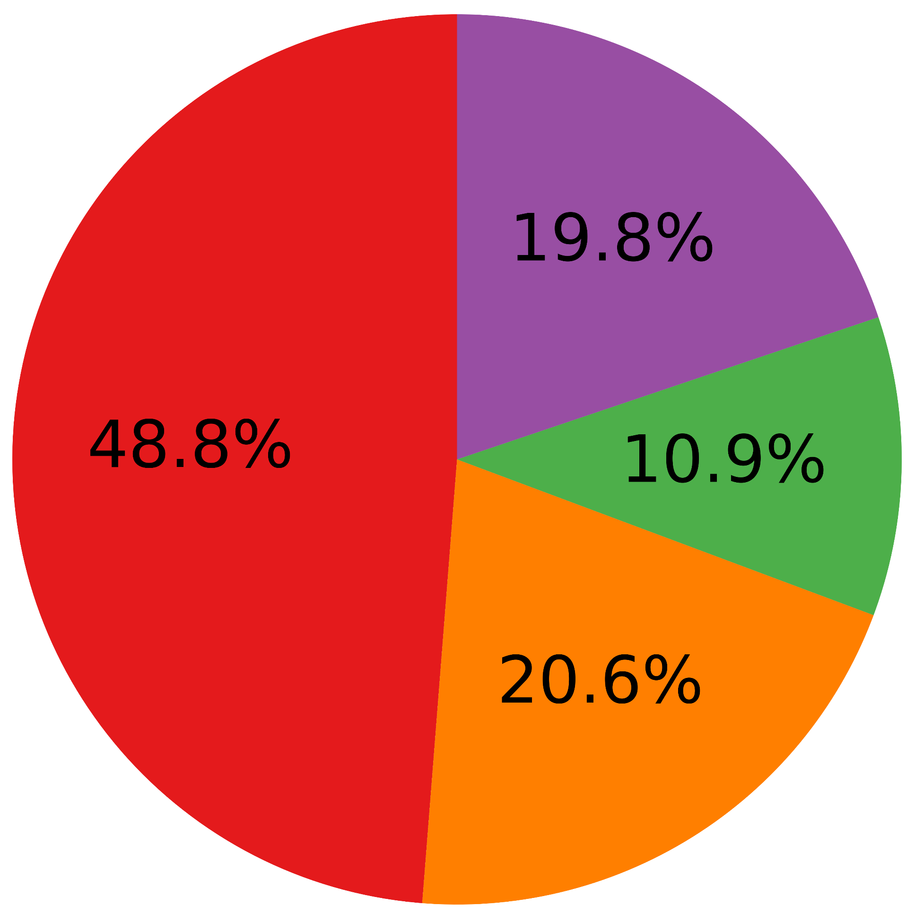
Classifications of 681 single catchments into 4 clusters
Around 50%: losing catchments
with more water losses
Gaining
Increasingly losing
Losing
Increasingly losing
Gaining
Increasingly gaining
Losing
Increasingly gaining
2

Slide 4
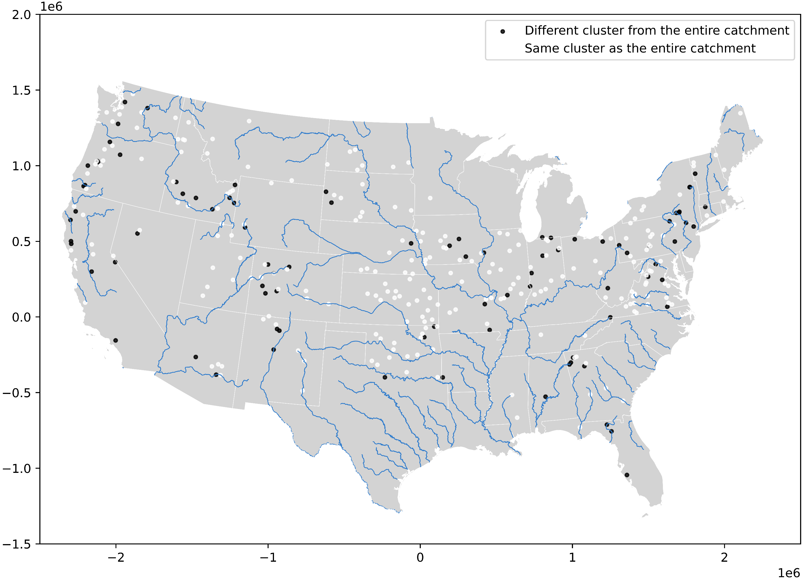
Overlooked subcatchments by the previous studies
$${\text{Q}}_{\text{g}} \text{= }{\text{P}\text{ − }\text{AET}\text{ − (}\text{Q}}_{\text{out}} \text{−} {\text{Q}}_{\text{in}})$$
2
1
3
26.5% of subcatchments
3

Slide 5
Thanks for your attention!
Spatial variability and temporal changes in inter-catchment
groundwater flow across the contiguous United States

Slide 6
Additional information about datasets and ongoing work
Study period: 1981.01.01-2020.12.31
P: PRISM_annual
AET: GLEAM_annual
Q: USGS
Fraction of croplands: NLCD, 1985-2020
Aridity index: Global-AI_PET_v3, 1970-2000
Ratios of lakes: HydroLAKES
One more attribute: Precipitation seasonality
Two more windows: 10-year and 20-year
Two more AET datasets
4

Slide 7
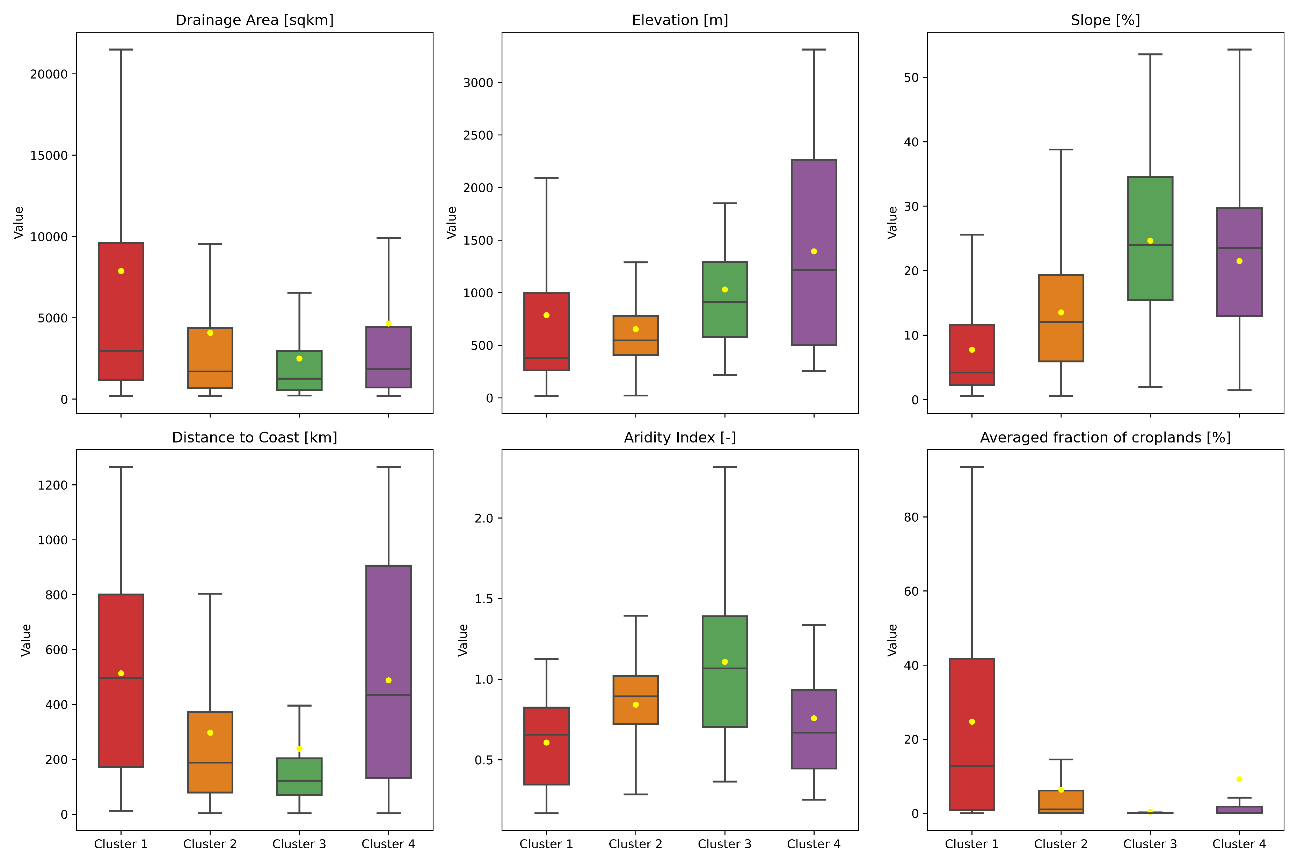
Attribute analysis for the clusters of single catchments
Gaining
Increasingly losing
Losing
Increasingly losing
Gaining
Increasingly gaining
Losing
Increasingly gaining
Losing catchments
Flatter slopes
More arid
Gaining catchments
Groundwater withdrawal
Lower fractions of croplands
5

Slide 8
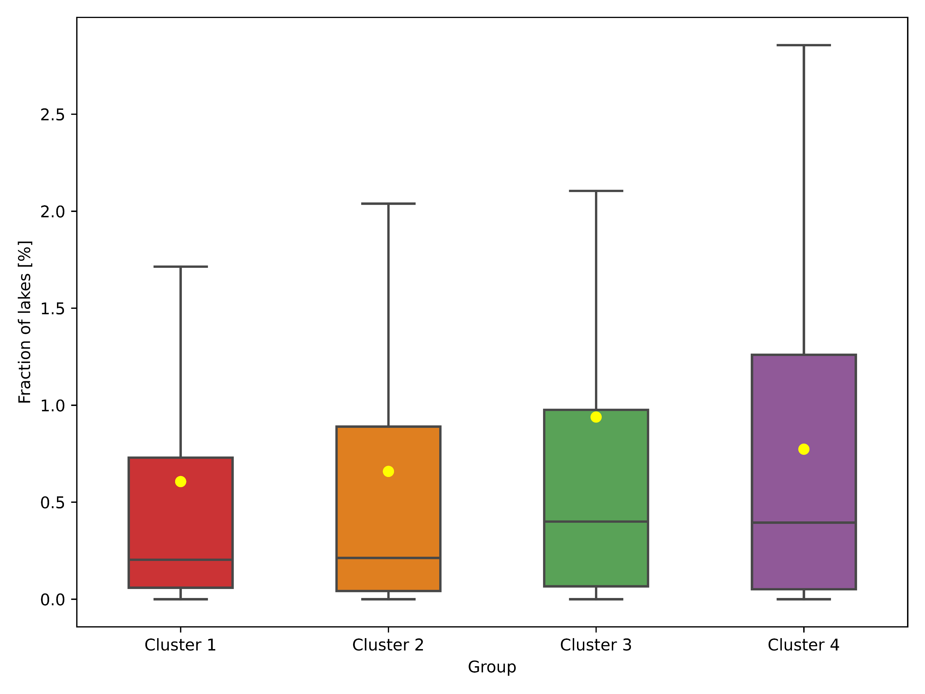
Attribute analysis for clustering single catchments: Fraction of lakes
Gaining
Increasingly losing
Losing
Increasingly losing
Gaining
Increasingly gaining
Losing
Increasingly gaining
Gaining catchments
Higher fraction of lakes
Data about volume of lakes
6

Slide 9
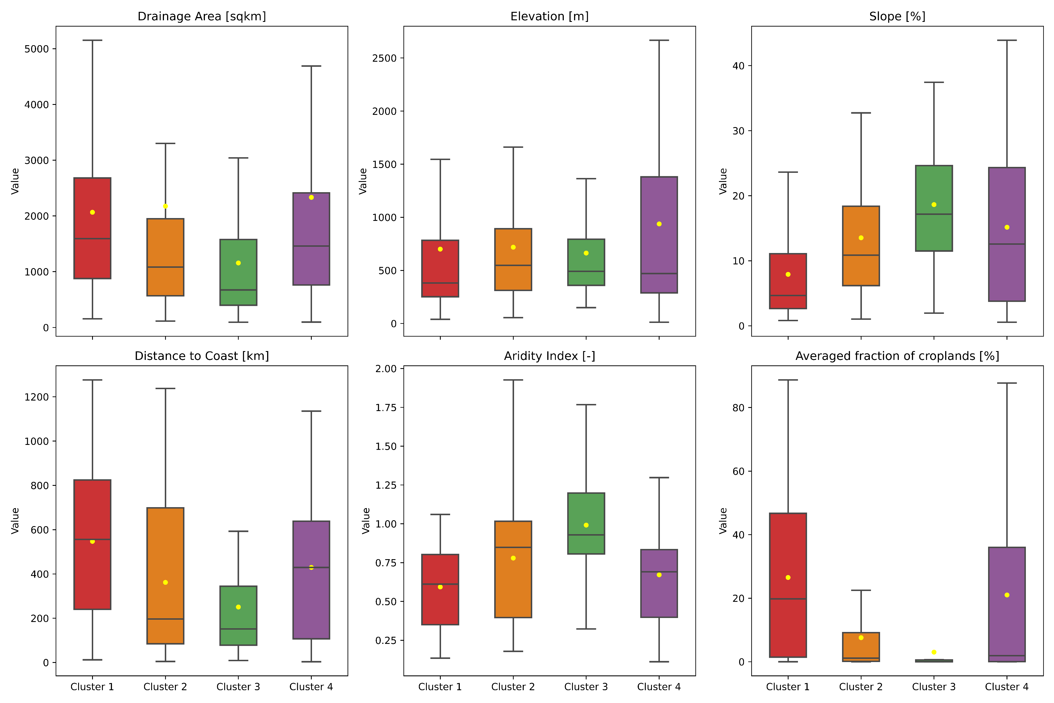
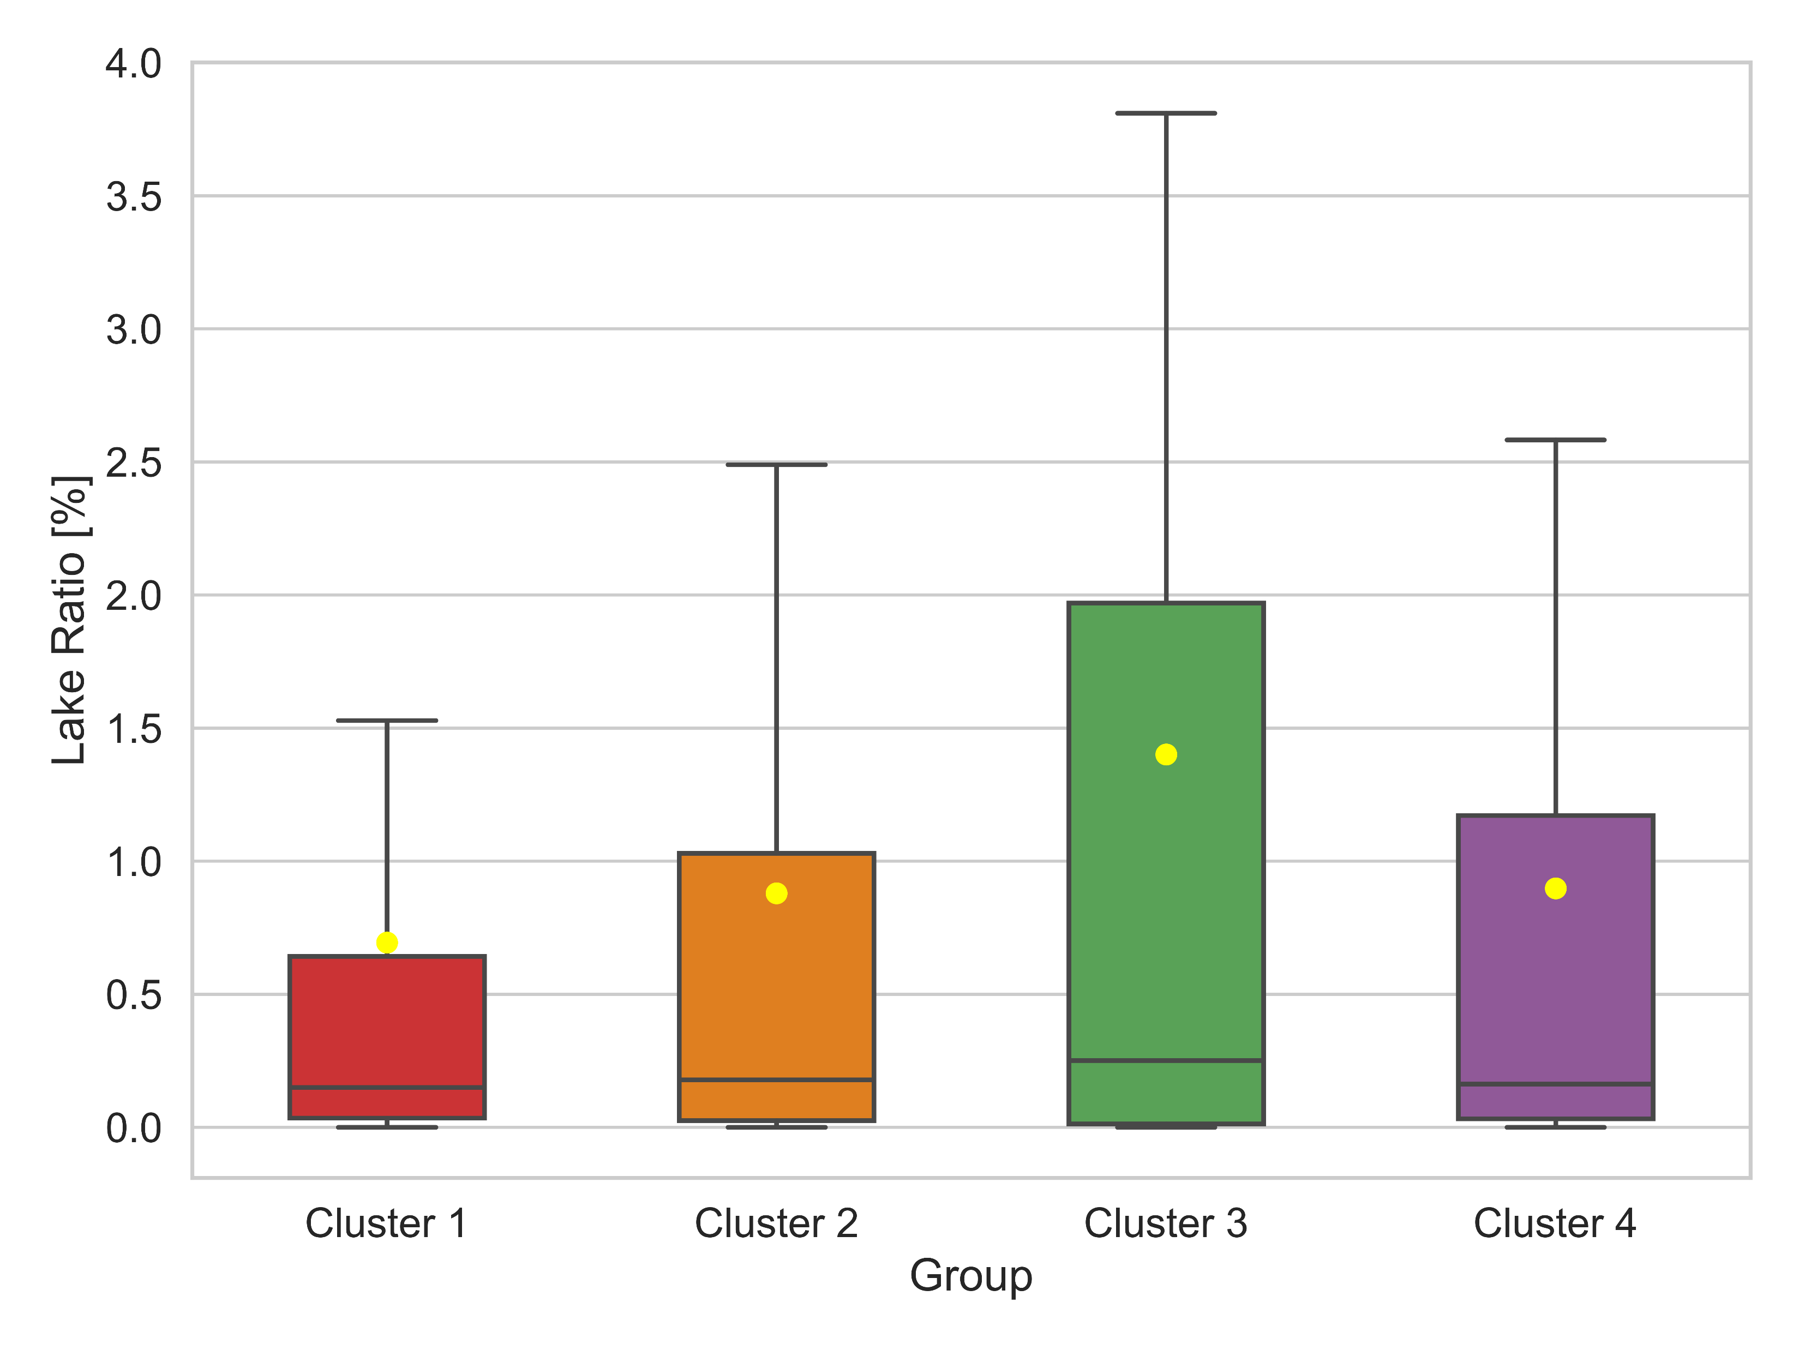
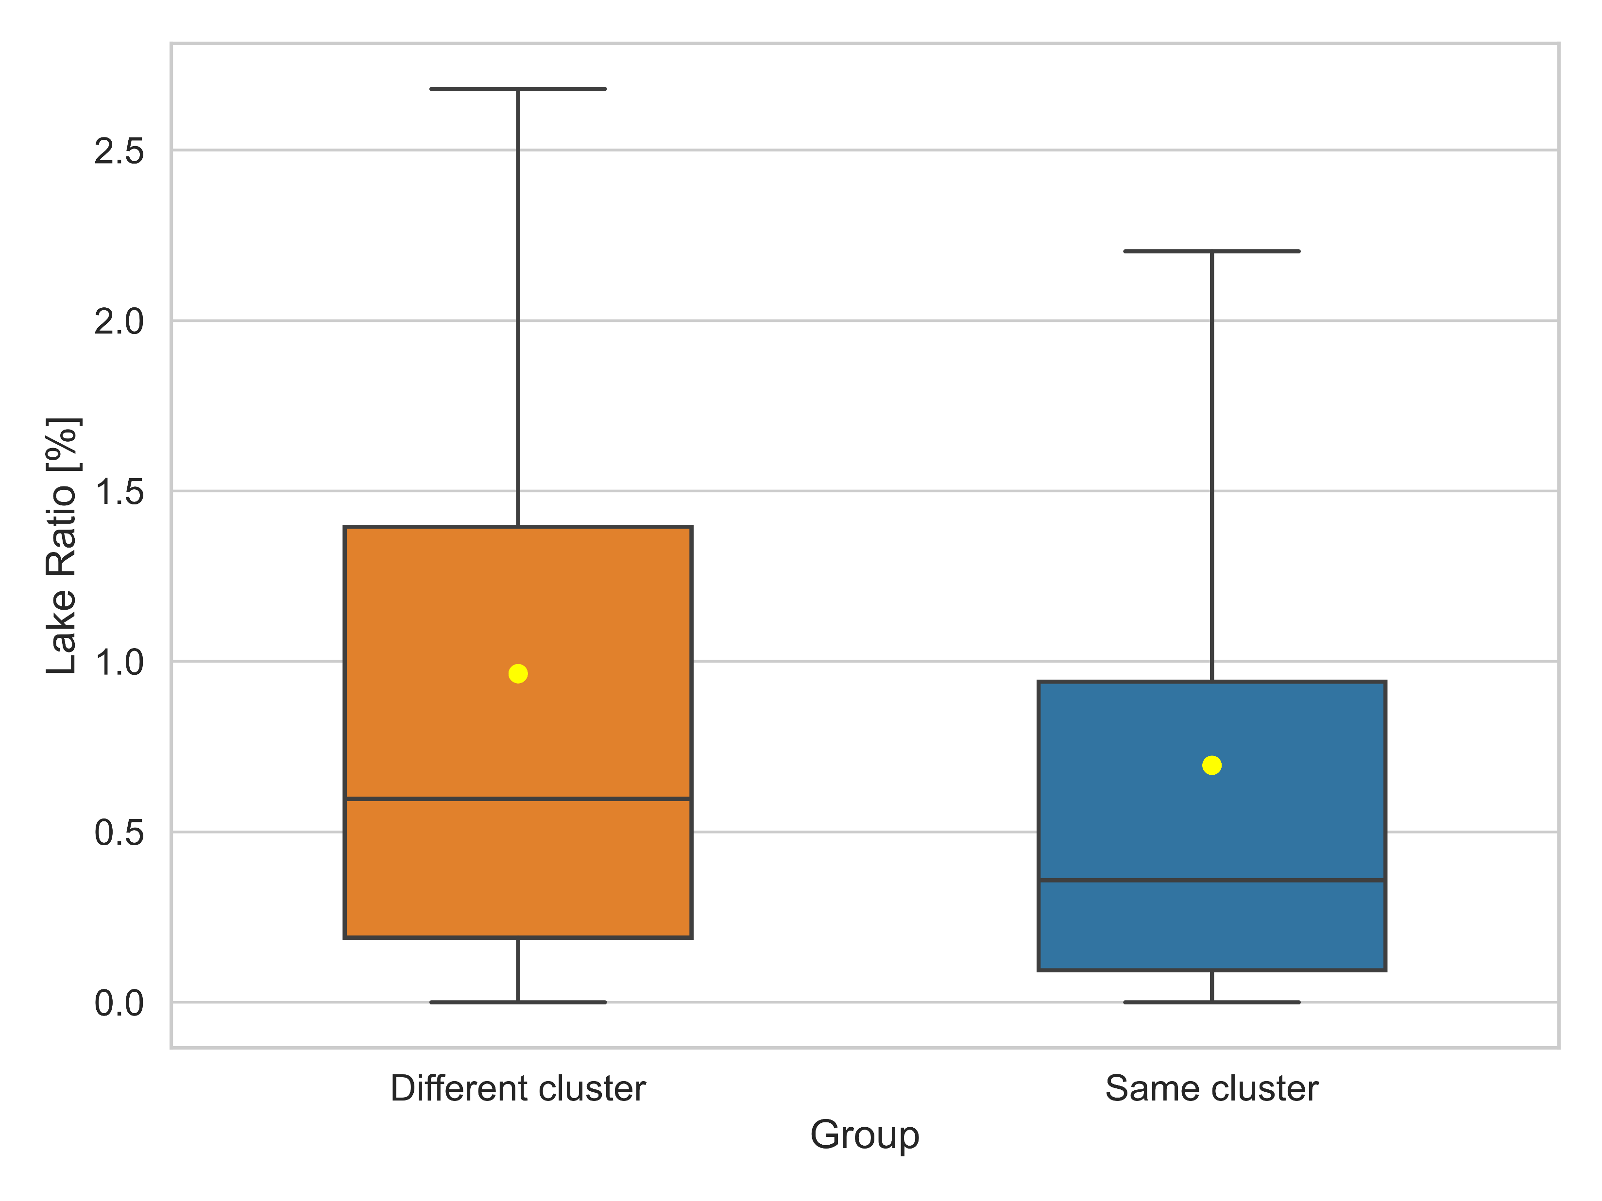
Attribute analysis for the clusters of subcatchments
7

