Slide 1
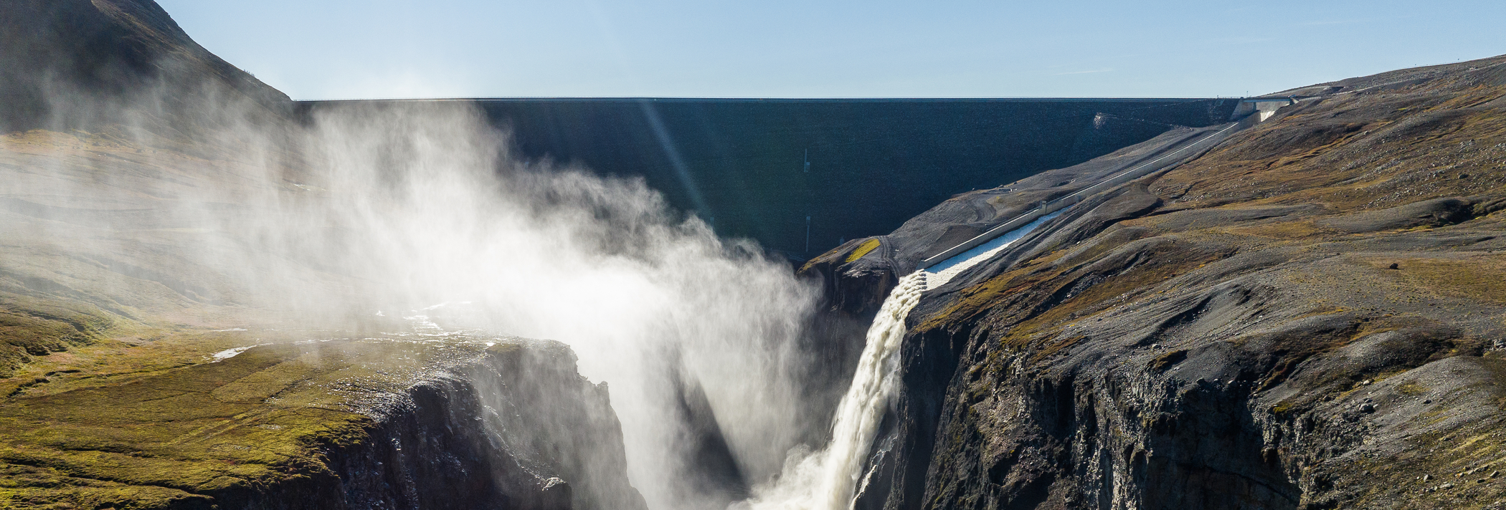

HS5.3.4 | EGU25-6596
Opportunities for Hydropower under Climate Change in Snow-ice Dominated Landscapes: Case of the Hálslón Catchment Kárahnjúkar Powerplant in Eastern Iceland
https://www.landsvirkjun.com/
Antonius Heger
Peter Molnar
David C. Finger
02.05.2025
EGU2025, Vienna
Notes:
https://www.landsvirkjun.com/

Slide 2
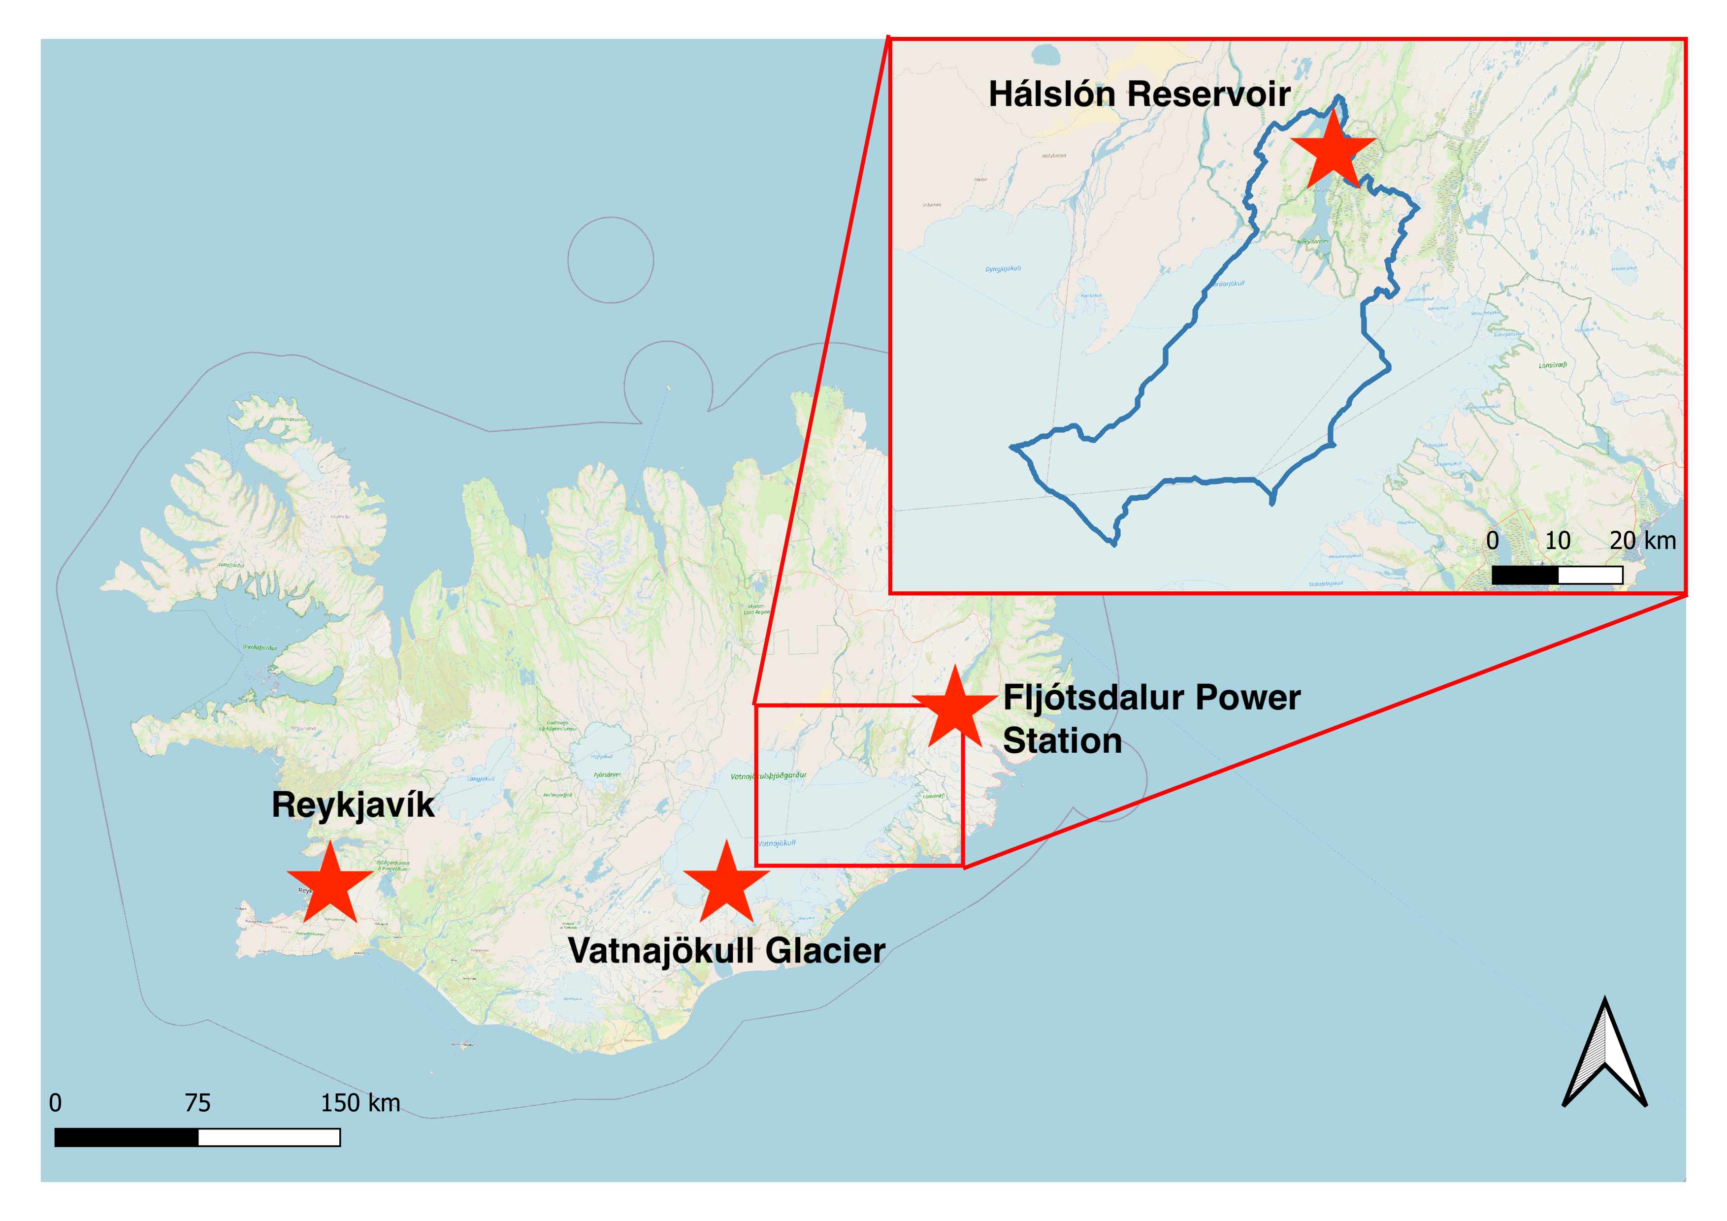
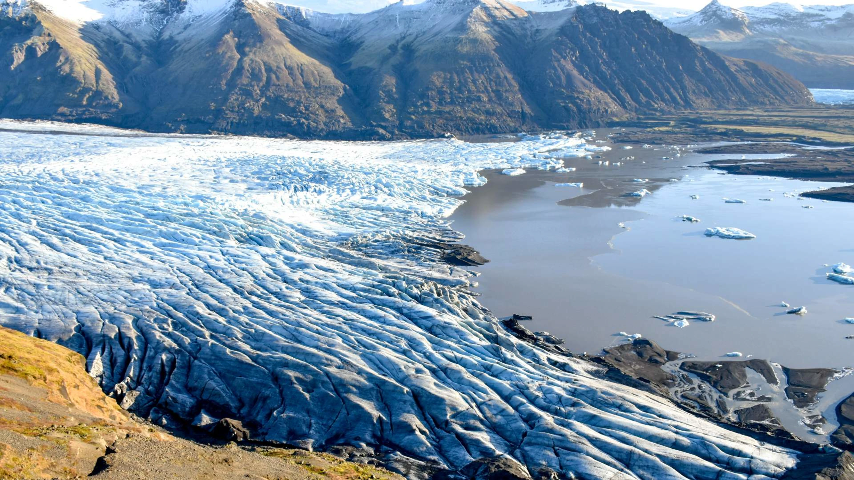
How will Climate Change influence Runoff?
2 Minute Madness
https://res.cloudinary.com/icelandtours/g_auto,f_auto,c_fill,w_3840,q_auto:best/vatnajokull_glacier_martin_robles_unsplash_c2f641f9d6.jpg
Notes:
Iceland‘s runoff dominated by glacier melt → 50% of total runoff
large HP potential across the country
Catchment contains largest reservoir
70% covered by Vatnajökull glacier

Slide 3
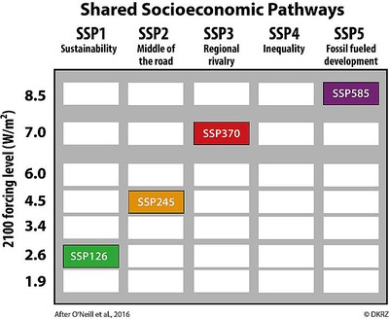
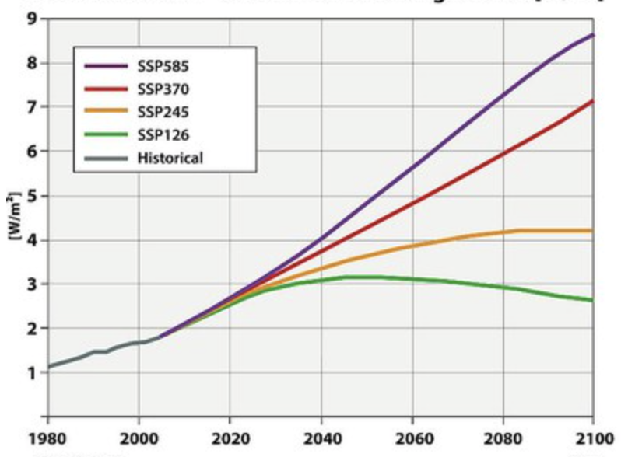

Run Climate Projections to Model Glacier Melt
2 Minute Madness
Combination of RCP and SSP
Radiative forcing development
Notes:
Emission scenarios from IPCC 6th assessment report
12 global climate models used, bias corrected with CARRA data by Vedurstofa

Slide 4
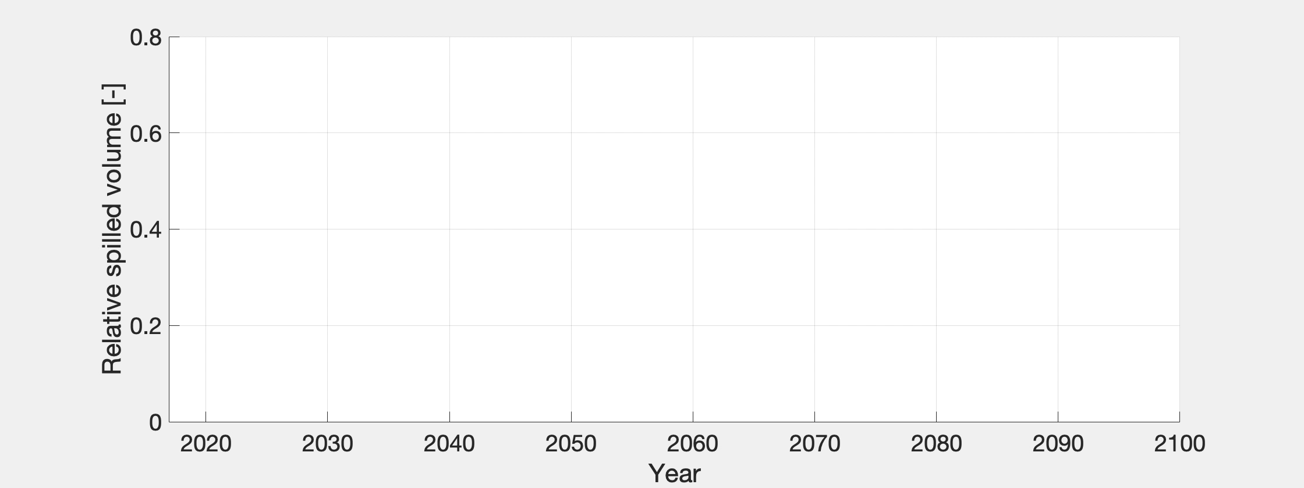
Excess discharge increases significantly
→ Largely increased hydropower potential!
2 Minute Madness

Slide 5
EGU25-6596: Opportunities for hydropower under climate change in snow-ice dominated landscapes
Antonius Heger^{1,2}
Peter Molnar¹
David C. Finger²
¹Eidgenössische Technische Hochschule Zürich
²Háskólinn í Reykjavík
Scope and Study area
Data, Model Overview
Methods
Results and Discussion
Conclusion
Click on the Contents on this slide to jump to sections
Click on the arrows to go to the next slide
Click on the icons in the orientation bar to jump to sections

Slide 6





Scope and Study Area
Scope and study area→ Data, model overview→ Methods→ Results & Discussion→ Conclusion
Catchment area: 1‘614 km²
550m to 1‘825m a.s.l.
70% covered by Vatnajökull glacier
Location of the catchment

Slide 7
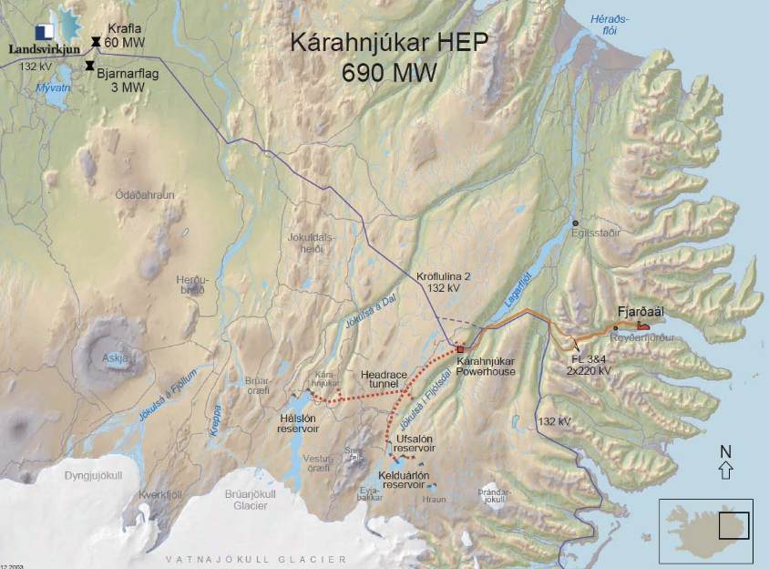
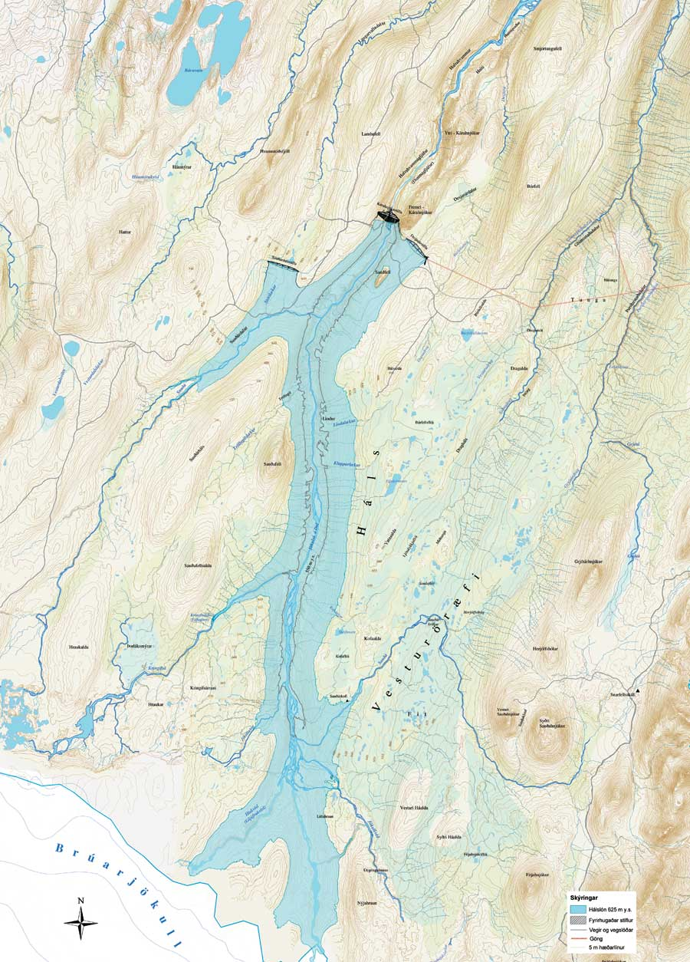
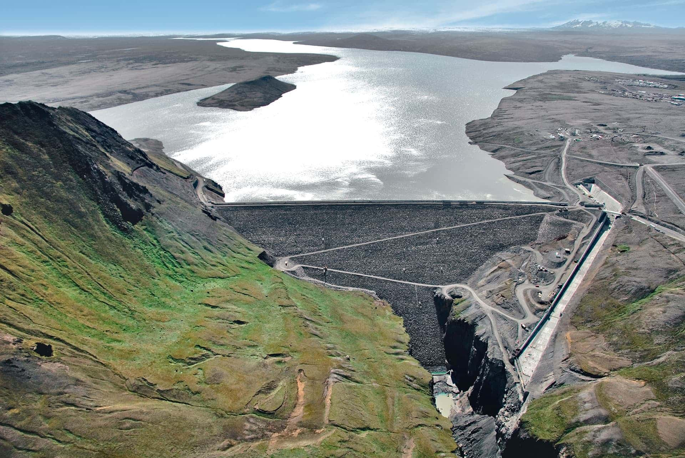
Kárahnjúkar Powerplant: 690 MW
Scope and study area→ Data, model overview→ Methods→ Results & Discussion→ Conclusion
Landsvirkjun, 2009
https://engineers-channel.blogspot.com/p/karahnjukar-dam.html
Notes:
Biggest power plant in Iceland
690 MW
20% of icelandic electricity

Slide 8
Input Data
Scope and study area→ Data, model overview→ Methods→ Results & Discussion→ Conclusion
Geodata, Landvover: 2016 DEM (Icelandic Land Survey)
Calculated inflow and withdrawal Hálslón reservoir (Landsvirkjun (National Power Company))
Climate Projections: Veðurstofa Islands (Icelandic Met Office)
Meteorological, Snow, Glacier: LamaH-ICE (Helgasson, Nijssen, 2023)
Notes:
LamaH-ICE = Large sample dataset for hydrology Iceland

Slide 9
Climate Projections
Scope and study area→ Data, model overview→ Methods→ Results & Discussion→ Conclusion
Combination of RCP and SSP
Radiative forcing development
Notes:
Emission scenarios from IPCC 6th assessment report
12 global climate models used, bias corrected with CARRA data by Vedurstofa

Slide 10
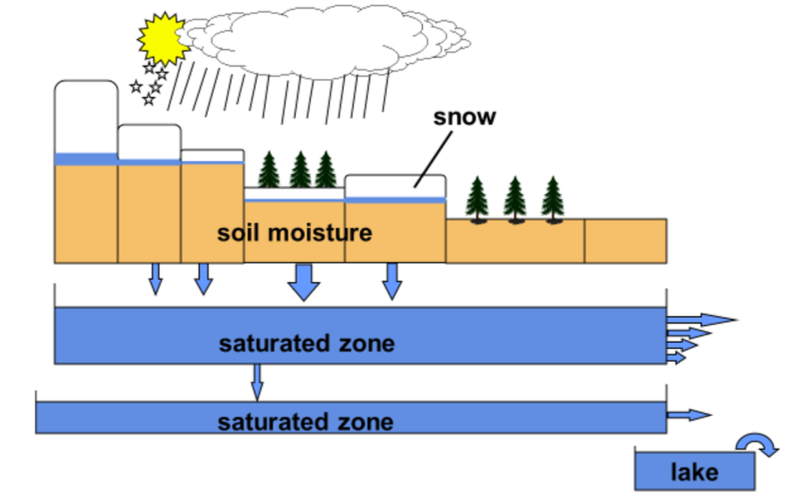
Model Overview: HBV-Light
Scope and study area→ Data, model overview→ Methods→ Results & Discussion→ Conclusion
HBV-light model structure (Seibert, Vis, 2012)
Notes:
based on HBV, developed by Jan Seibert, Marc Vis, UZH

Slide 11


Methods: Summary
Scope and study area→ Data, model overview→ Methods→ Results & Discussion→ Conclusion
Catchment definition
Calibration + Validation of the model
Future Projections
Uncertainty Analysis
Calculation of excess discharge

Slide 12
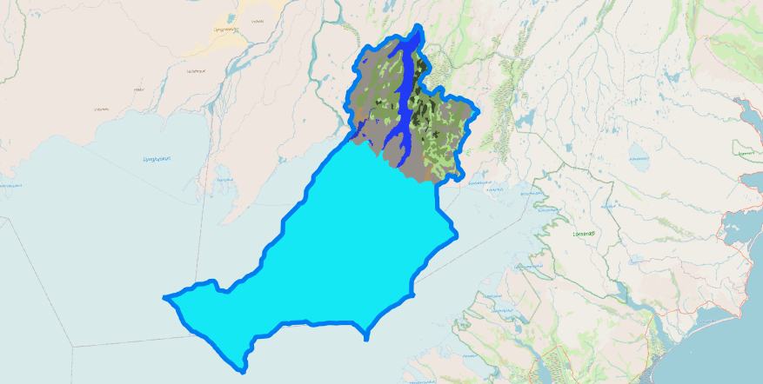
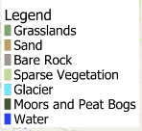
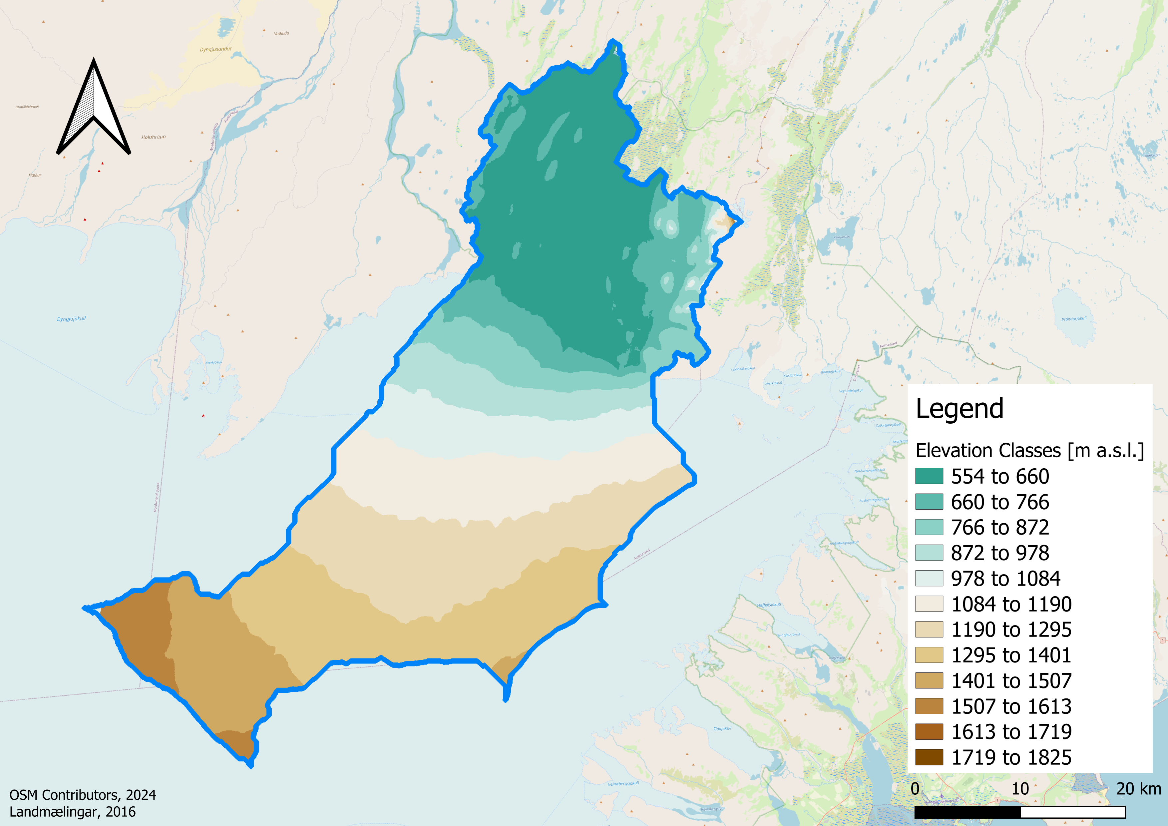
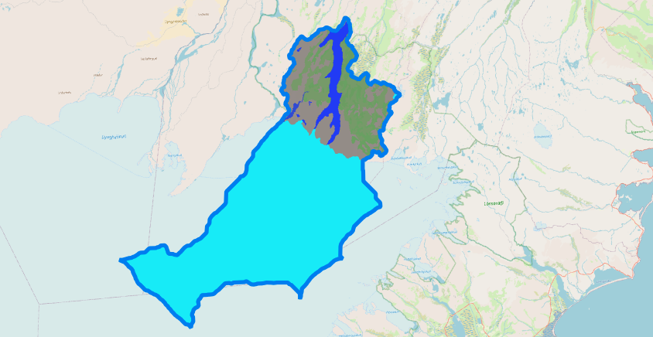
Catchment Definition
Scope and study area→ Data, model overview→ Methods→ Results & Discussion→ Conclusion
Elevation classes
Land cover
Notes:
DEM Classification: 12 elevation classes, 105 m each
Reduction of vegetation classes from 9 to 4 for HBV input

Slide 13

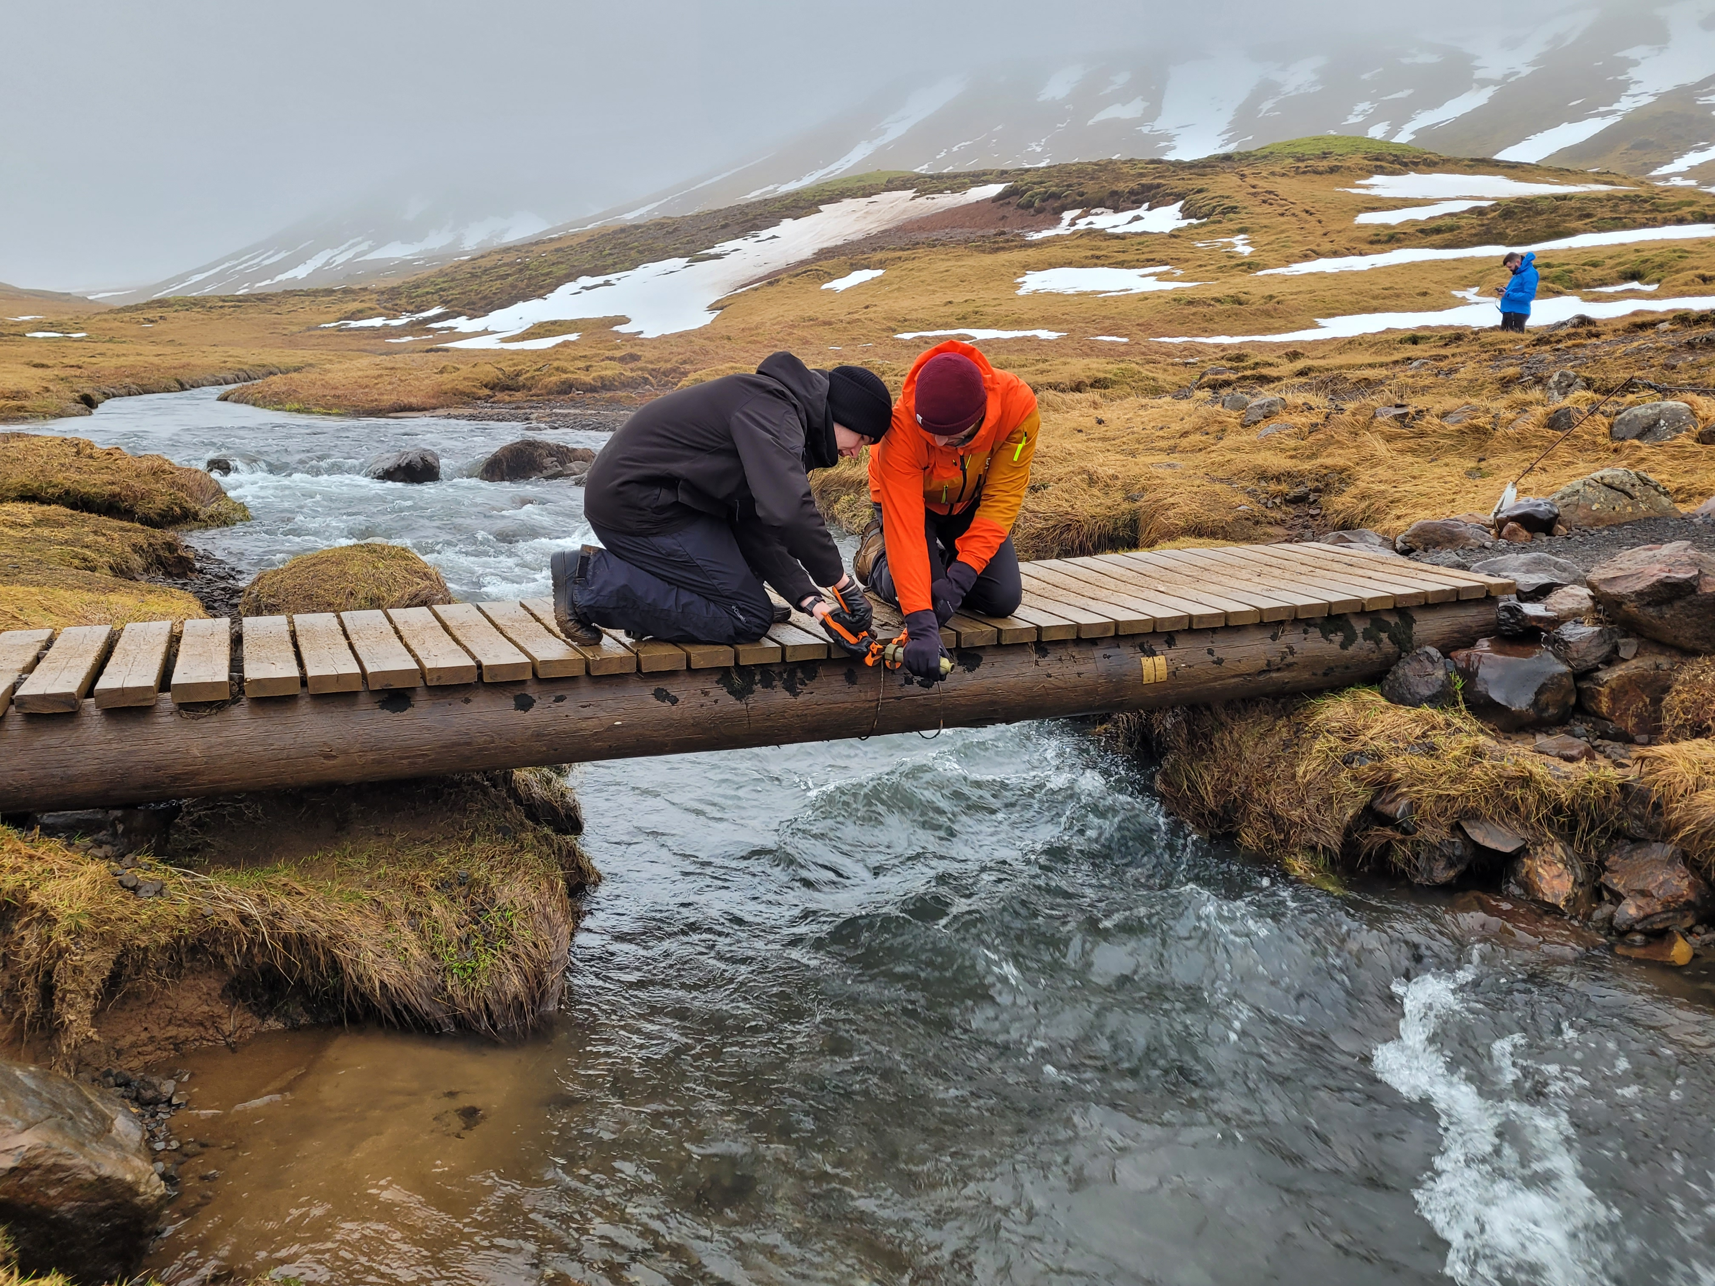
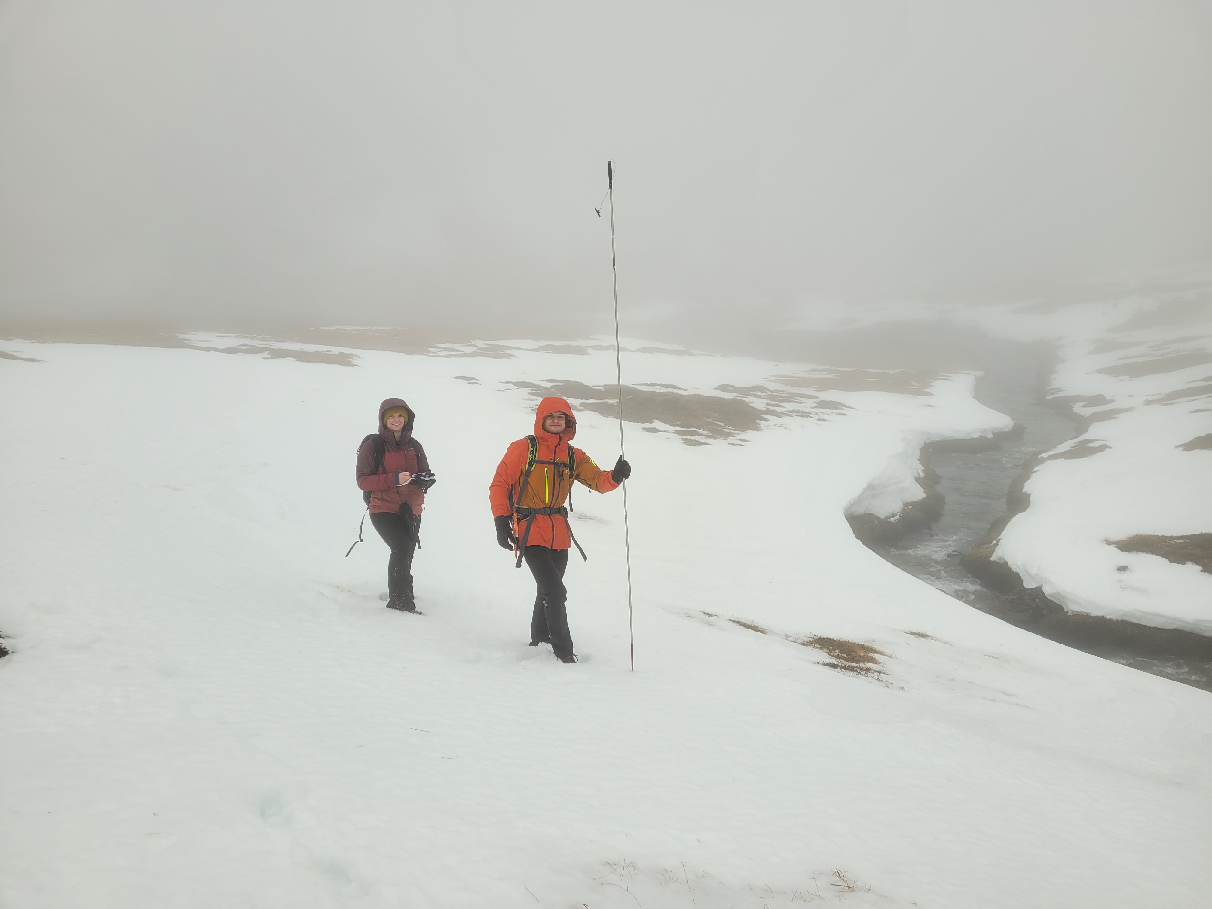
Calibration + Validation
Scope and study area→ Data, model overview→ Methods→ Results & Discussion→ Conclusion
Kling-Gupta Efficiency
Glacier Mean Absolute Error
Notes:
Calibrated for Flow and Glacier Mass balance
KGE: Better fit for peak flows than NSE

Slide 14
Calibration + Validation
Scope and study area→ Data, model overview→ Methods→ Results & Discussion→ Conclusion
10‘000 calibration runs with Monte Carlo
Validation: 01.01.2010 – 31.12.2015
Select 10, 100 best Parameter sets
Calibration: 01.01.2016 – 31.12.2021

Slide 15

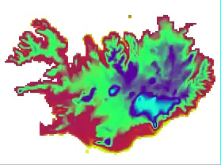
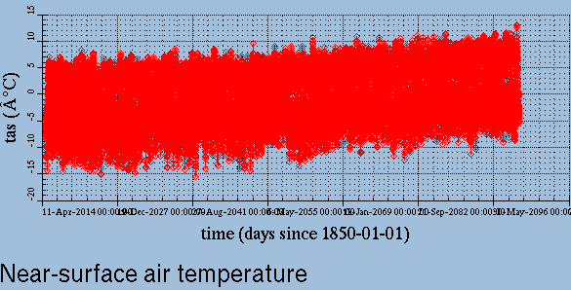
Climate Data Operators
Scope and study area→ Data, model overview→ Methods→ Results & Discussion→ Conclusion

Slide 16
Future Projections
Scope and study area→ Data, model overview→ Methods→ Results & Discussion→ Conclusion
3 Emission Scenarios
12 climate models
10 and 100 parameter sets
Notes:
3600 simulations run

Slide 17
Future Projections: Time Periods
Scope and study area→ Data, model overview→ Methods→ Results & Discussion→ Conclusion
Current: 2016 - 2035
Intermediate: 2051 - 2070
Long Term: 2081 - 2100
Notes:
20 years each period: Trend stronger than variability, less than 30 years ok

Slide 18

Future Projections
Scope and study area→ Data, model overview→ Methods→ Results & Discussion→ Conclusion
Change in monthly mean inflow
  $∆Qi,j,k=Qfuture,i,j,k − Qcurrent,i,j,k$
  Change in run off components (glacier melt, snow melt, rain)
Total yearly inflow
Notes:
i = scenario. j = model, k = parameter set

Slide 19
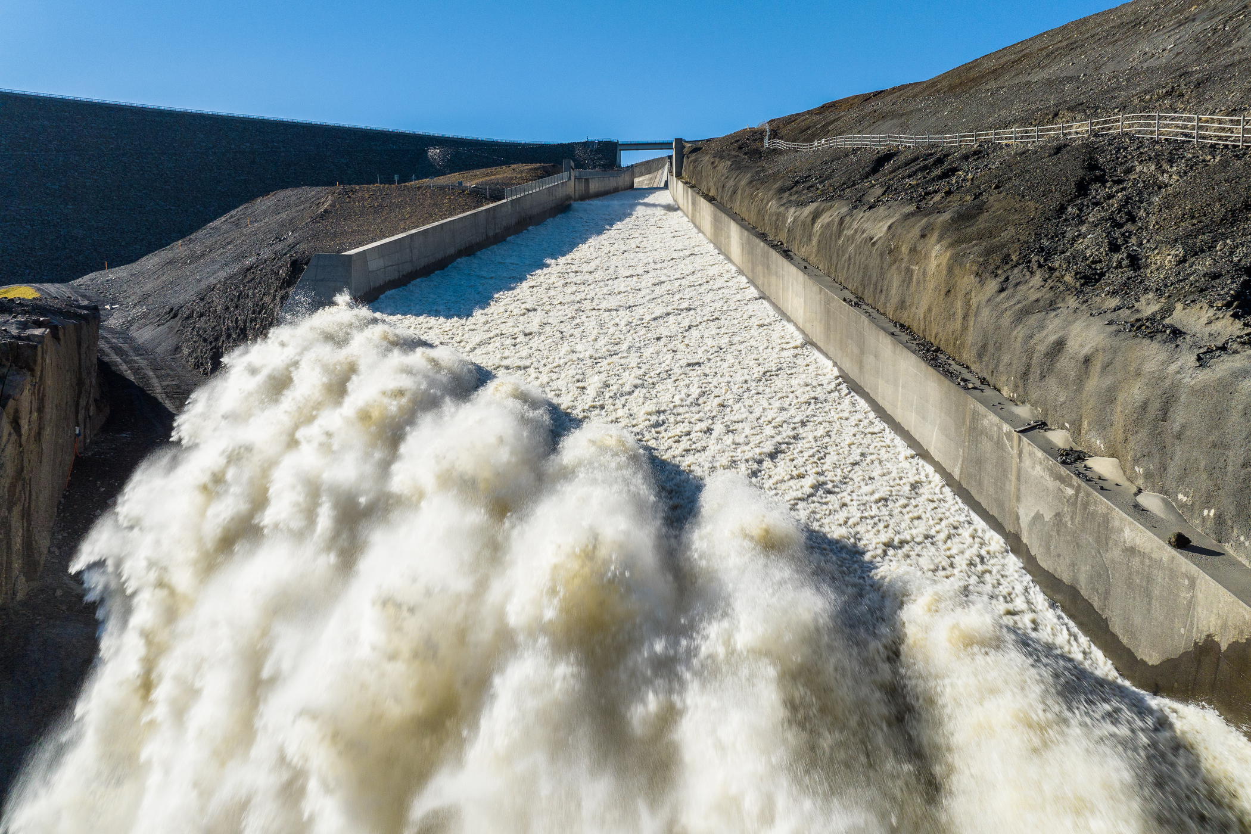
Calculation of Spillway Discharge
Scope and study area→ Data, model overview→ Methods→ Results & Discussion→ Conclusion
Assumption: Constant Withdrawal
No adaption, 94 m³/s
144 m³/s constantly
Linear increase to 144 m³/s
3 Scenarios:
Inflow – Withdawal = Δvolume
Level >= 625 m a.s.l.→ Inflow = Spill
https://www.landsvirkjun.com/
Notes:
Constant: no seasonality in withdrawal time series
Inflow – Outflow,
Volume-Level rating curve to calculate lake level.
Level >= 625 m: inflow = Spill

Slide 20
Uncertainty analysis
Scope and study area→ Data, model overview→ Methods→ Results & Discussion→ Conclusion
ANOVA:
  Analysis of Variance
  Contribution to uncertainty from
    Emission scenarios
    Climate models
    Parameter sets
Inter annual variability
  Significance of change
  Trend > variabilitty

Slide 21
Results: Summary
Scope and study area→ Data, model overview→ Methods→ Results & Discussion→ Conclusion
Calibration + Validation of the model
Future Projections
Uncertainty Analysis
Calculation of excess discharge

Slide 22
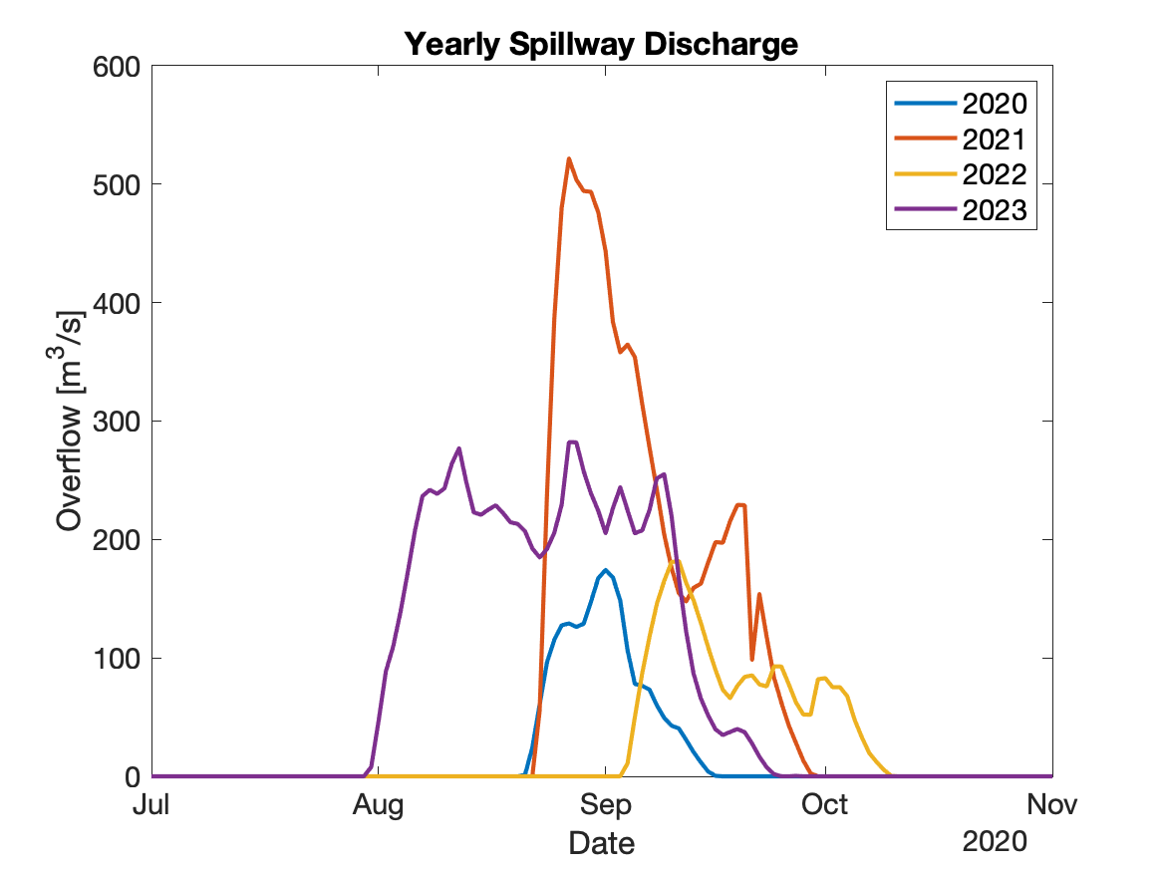
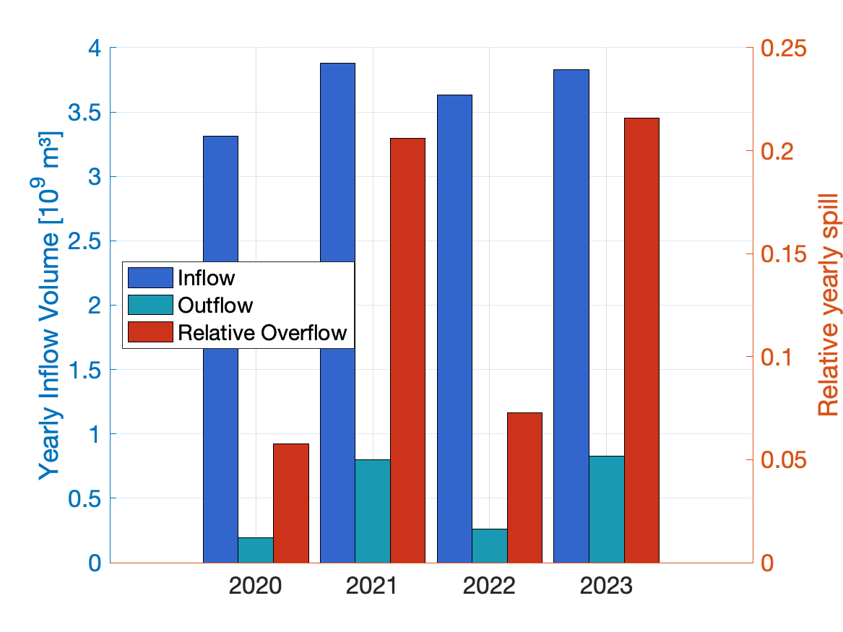
Results and Discussion
Scope and study area→ Data, model overview→ Methods→ Results & Discussion→ Conclusion
Currently, up to 20% of inflow bypass the turbines via the spillway
Expected increased inflow will increase the spill
Significant amount of potential energy stays unused
Notes:
First: Current situation. Between 5-20% Spilled each year

Slide 23
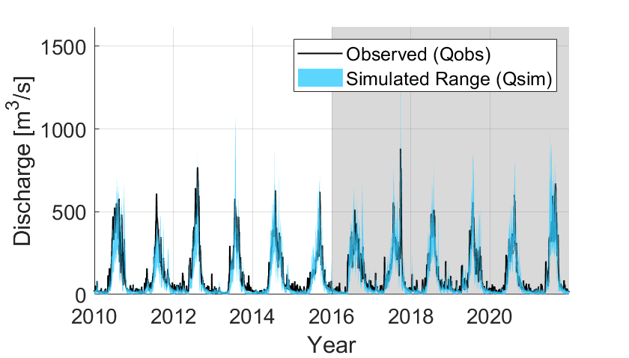
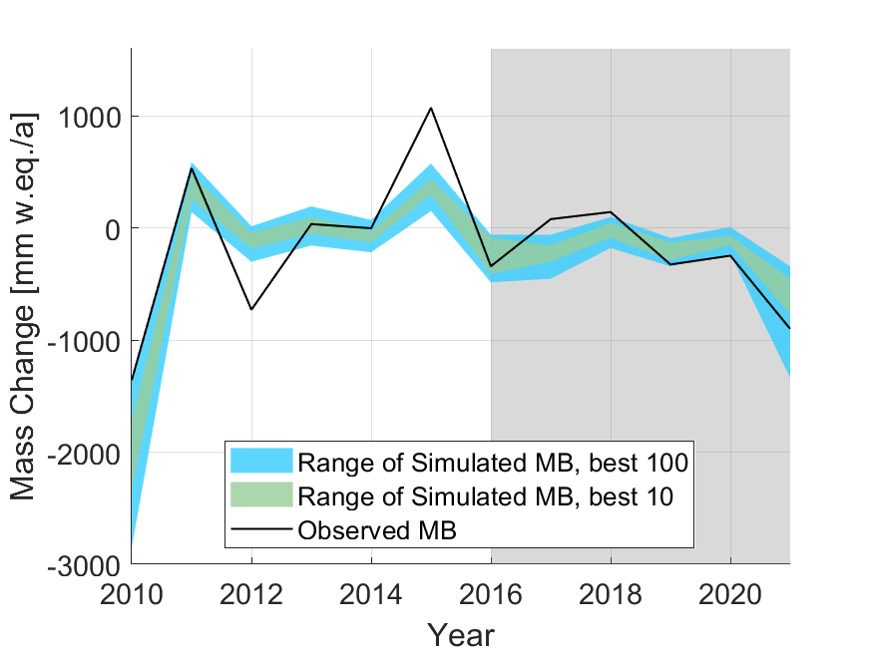
Calibration + Validation
Scope and study area→ Data, model overview→ Methods→ Results & Discussion→ Conclusion
Calibration | KGE mean | KGE max | KGE min | MAE mean | MAE max | MAE min
Best 10 | 0.83 | 0.86 | 0.80 | -250.5 | -133.0 | -429.7
Best 100 | 0.80 | 0.90 | 0.72 | -417 | -108.7 | -1389.8

Slide 24
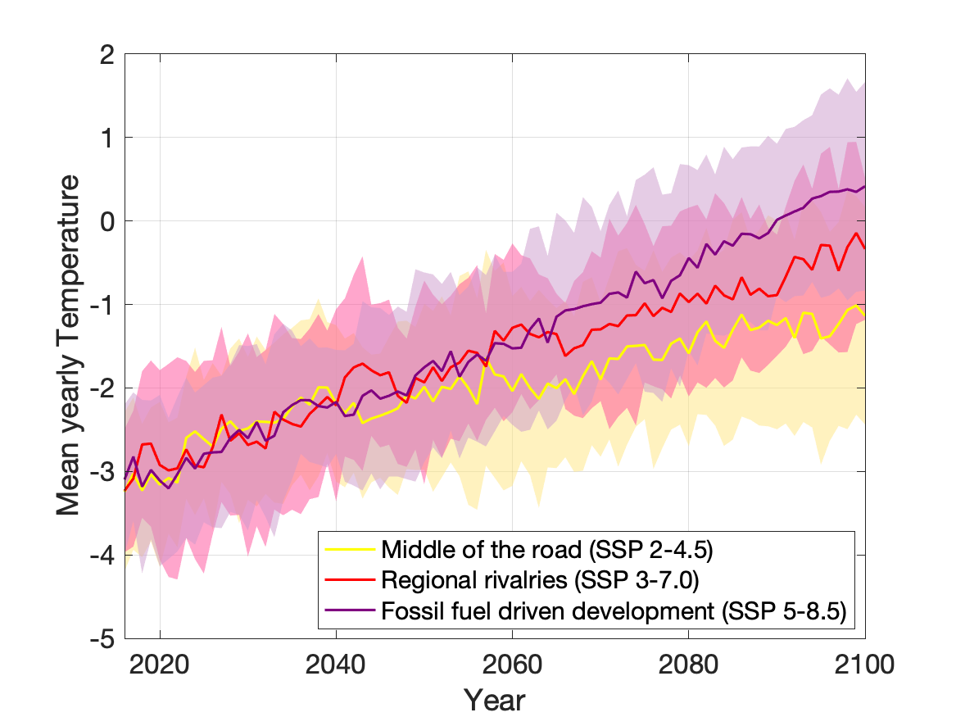
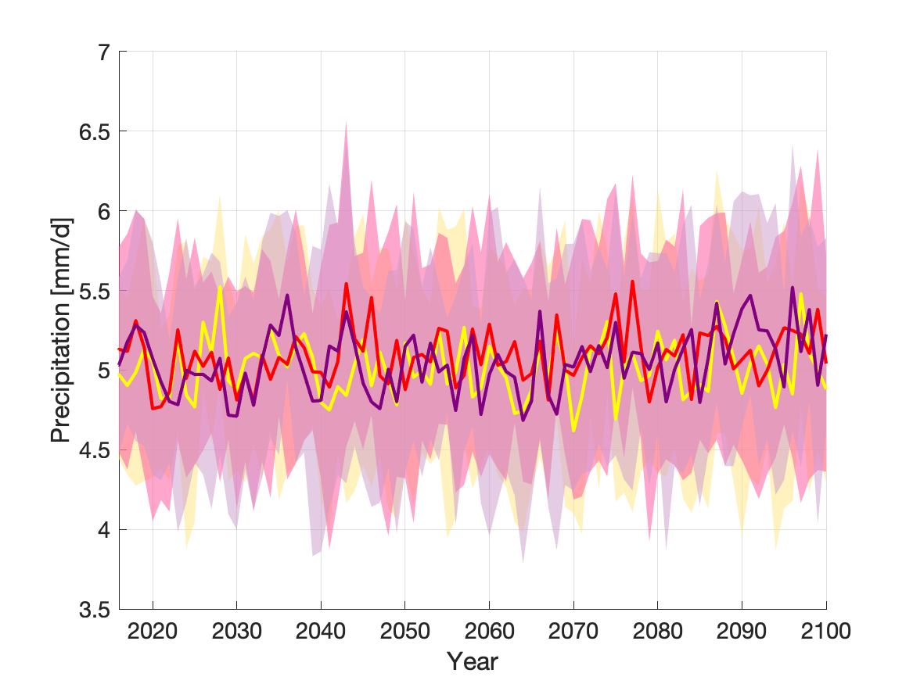
Future Projection Data
Scope and study area→ Data, model overview→ Methods→ Results & Discussion→ Conclusion
Temperature development in the catchment:
Temperature increases in all Scenarios
Similar development until mid century
Larger deviations after 2060
Average temperature stays below 0°, apart from SSP5-8.5
Precipitation development in the catchment:
No significant change of precipitation in any scenario

Slide 25
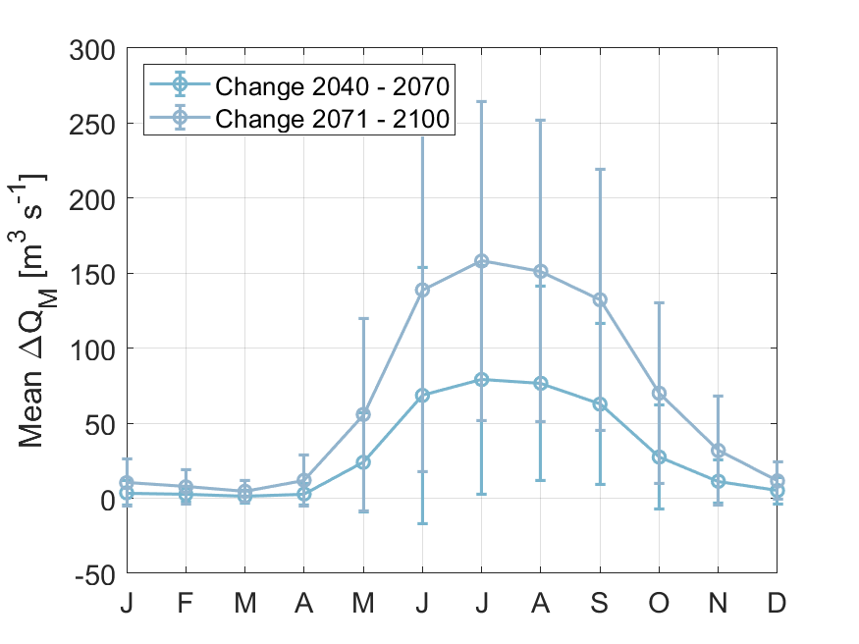
Inflow Change and Uncertainty
Scope and study area→ Data, model overview→ Methods→ Results & Discussion→ Conclusion
Notes:
Small compared to change → significant change caused by climate, not weather variability
Rel. variability lower in summer, decreases in future periods

Slide 26
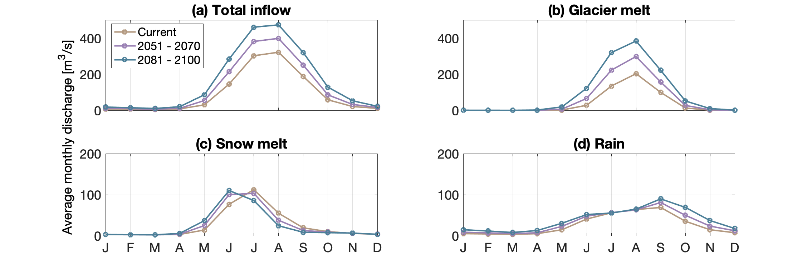
Inflow increases significantly
Scope and study area→ Data, model overview→ Methods→ Results & Discussion→ Conclusion
Inflow into Hálslón in current and future time periods, total and divided into run off components, glacier melt (b) dominates runoff
Notes:
Careful, axes upper and lower are not same

Slide 27
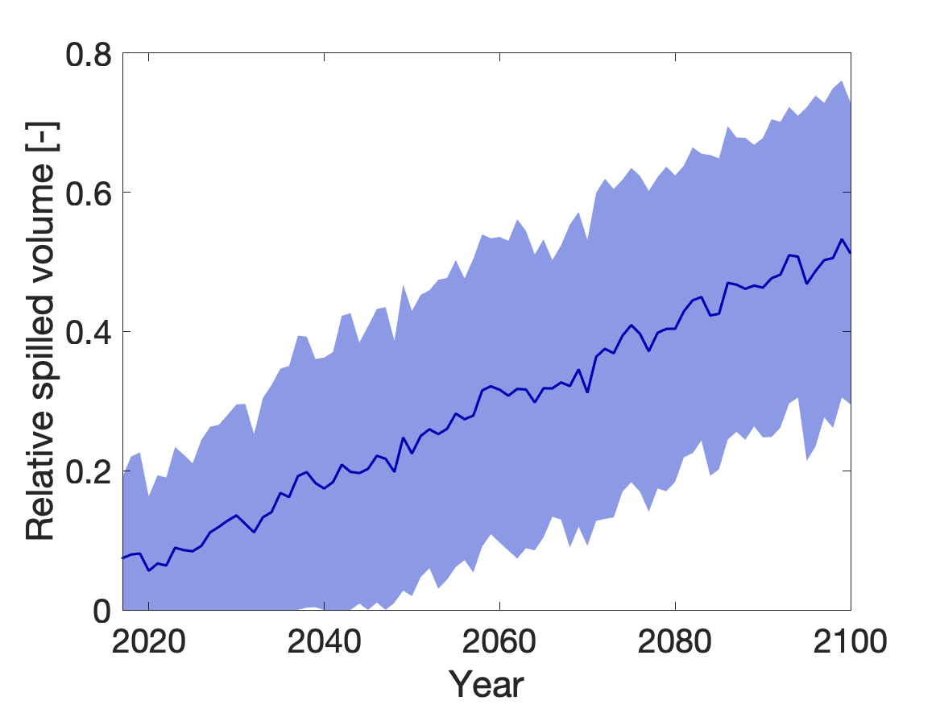
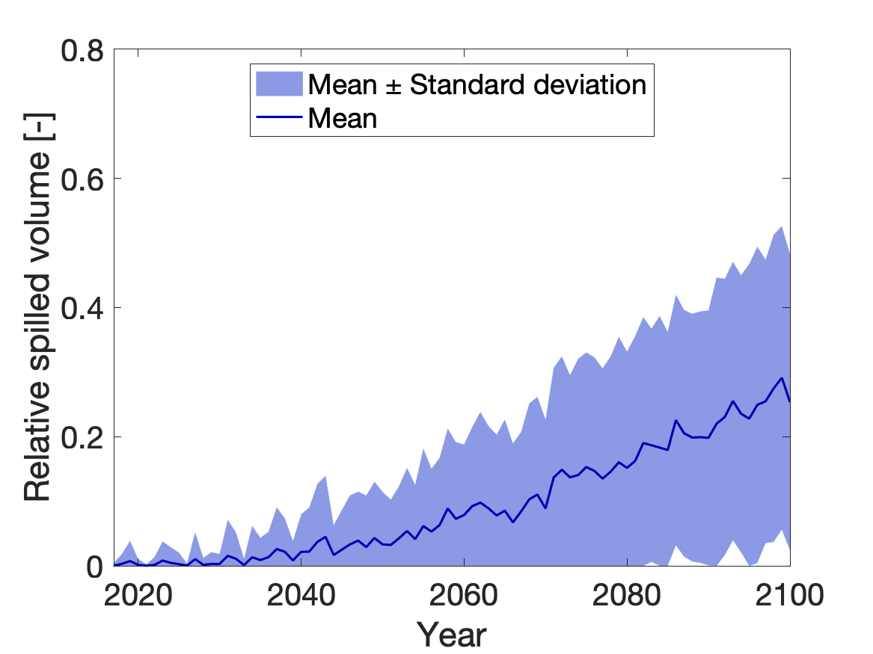
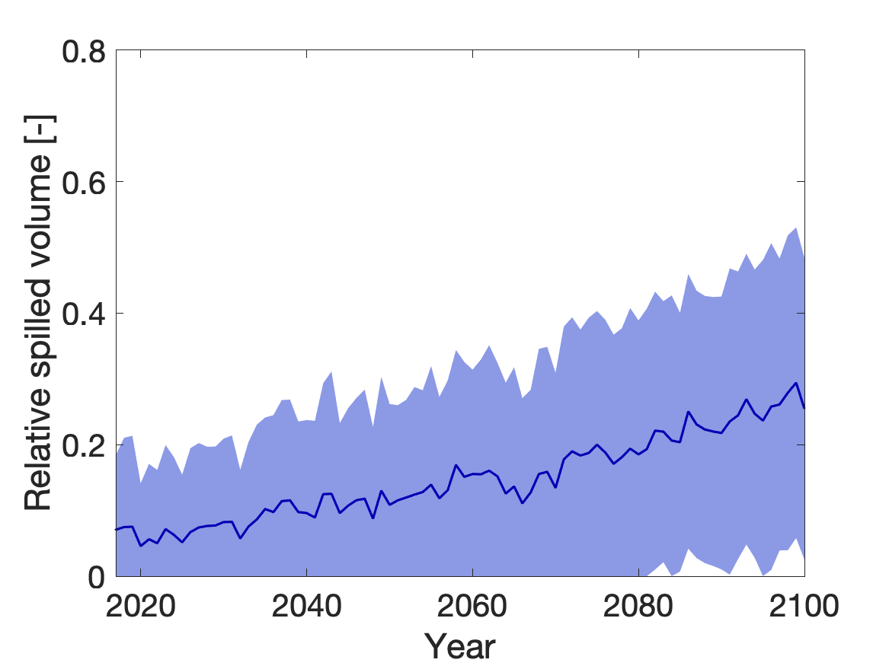
Spillway discharge increases
Scope and study area→ Data, model overview→ Methods→ Results & Discussion→ Conclusion
No Adaption of the system causes 50% of inflow to be wasted by the end of the century
Operational adaptions can mitigate this to a degree
In the long term, structural adaptions are necessary because the plant‘s current capacities are too low
No Adaption, constant withdrawal of 94 m³/s
Constant withdrawal of 144 m³/s
Linear increase to 144 m³/s
Notes:
Noo adaption: 50% wasted by end of century, 4 – 5 TWh / a
constant 144: Frequent drawdown of the reservoir, not. feasible
linear: Operational adaption until mid century, then capacities are exploited

Slide 28
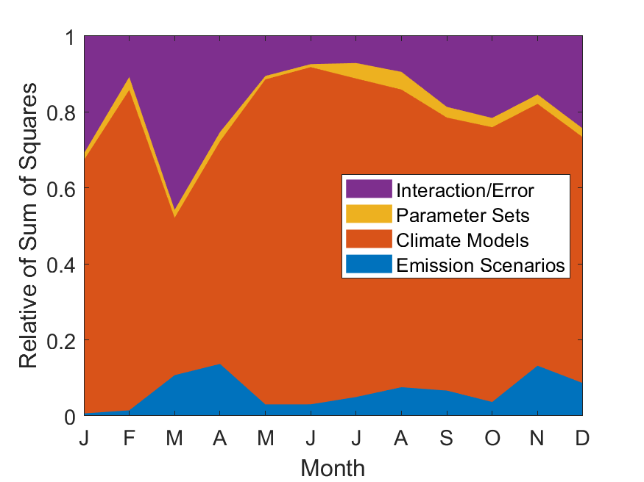
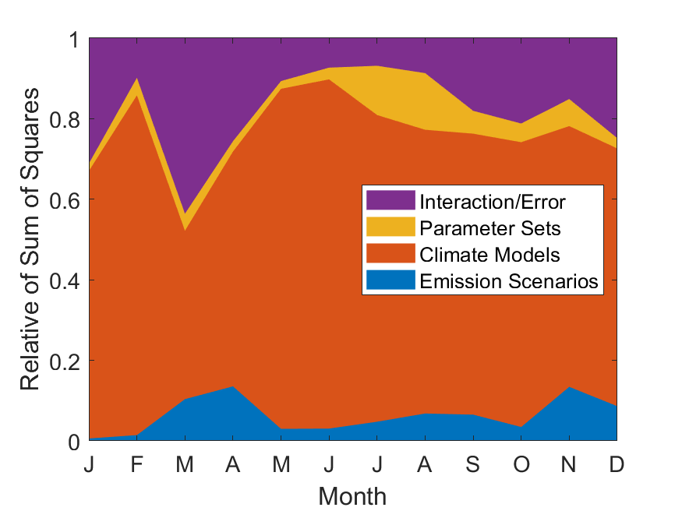
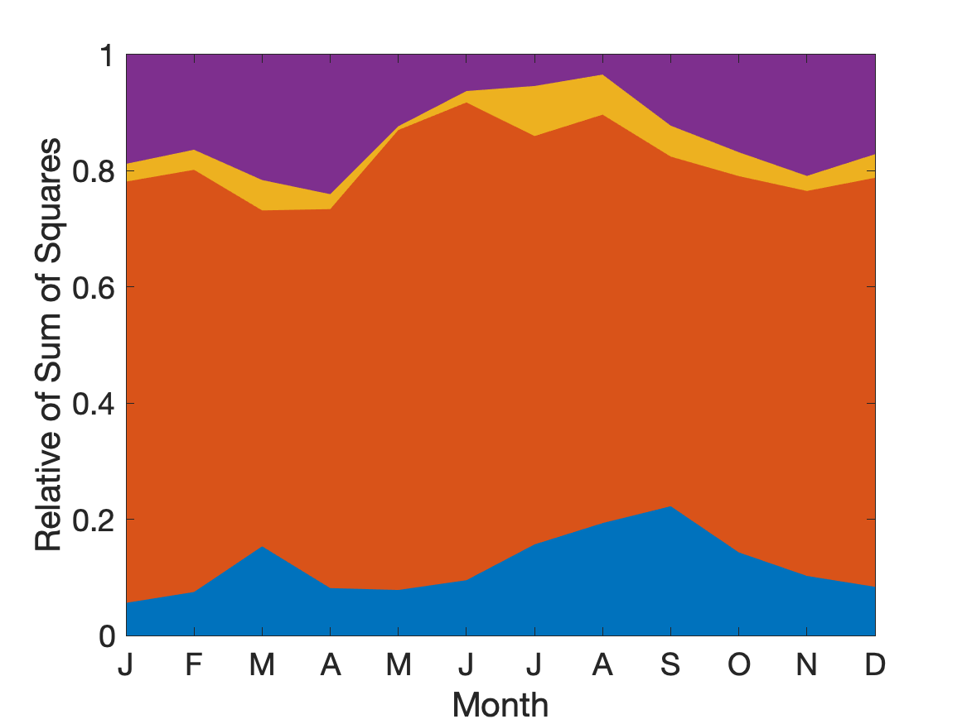
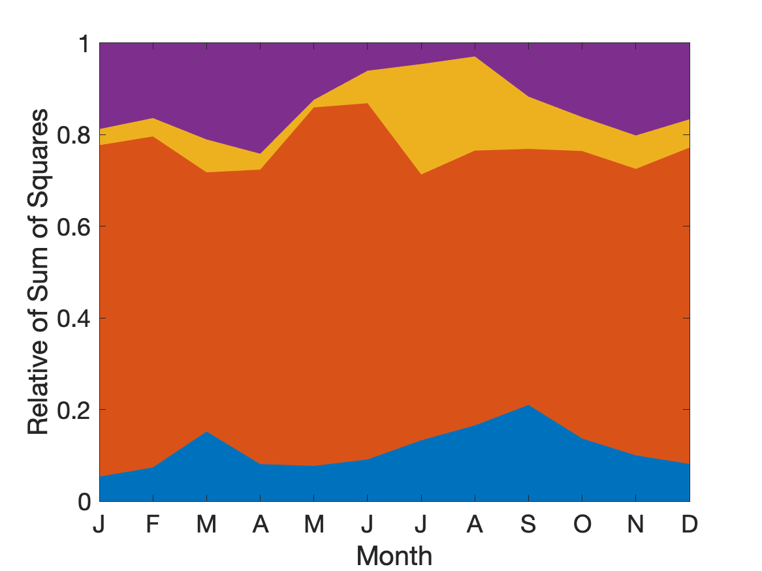
Uncertainty Contributions
Scope and study area→ Data, model overview→ Methods→ Results & Discussion→ Conclusion
Climate Models (CM) contribute the largest share of uncertainty
Emission scenarios increase contribution in long term, but are still significantly lower than CM
Parameter uncertainty increases over time but even with 100 parameter sets only adds small amount of uncertainty. Parameter uncertainty is highest in summer due to highly uncertain glacier calibration
10 Parameter sets
2051 - 2070
100 Parameter sets
10 Parameter sets
2081 - 2100
100 Parameter sets

Slide 29
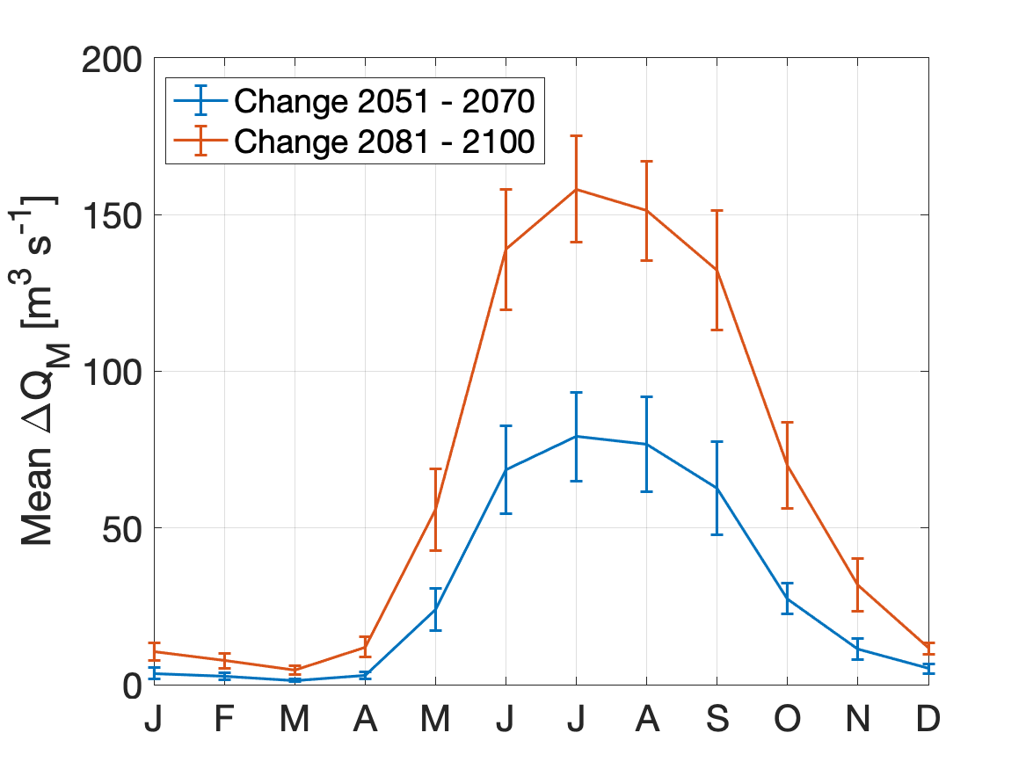
Interannual variability
Scope and study area→ Data, model overview→ Methods→ Results & Discussion→ Conclusion
Interannual variability is significantly lower than mean change signal
This shows significance of the change caused by climate trends, not random weather conditions
Mean change and variability
Notes:
Small compared to change → significant change caused by climate, not weather variability
Rel. variability lower in summer, decreases in future periods

Slide 30
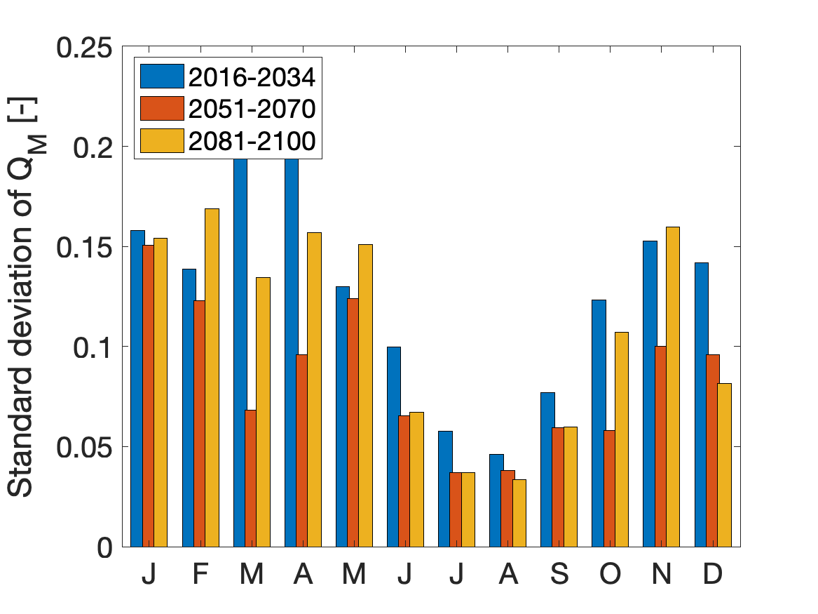
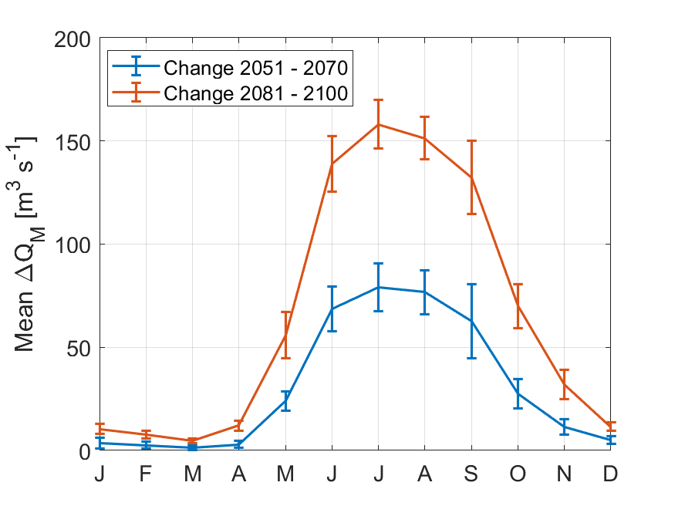
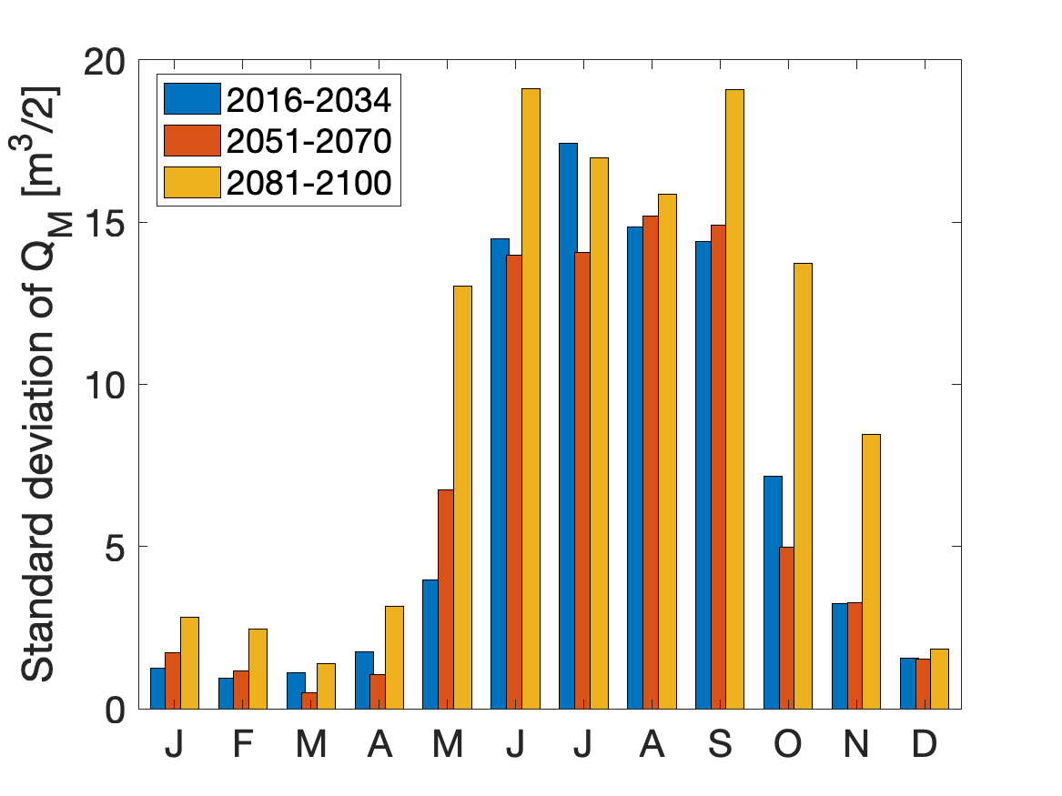
Interannual variability
Scope and study area→ Data, model overview→ Methods→ Results & Discussion→ Conclusion
Relative Variability
Absolute variability
Notes:
Small compared to change → significant change caused by climate, not weather variability
Rel. variability lower in summer, decreases in future periods

Slide 31
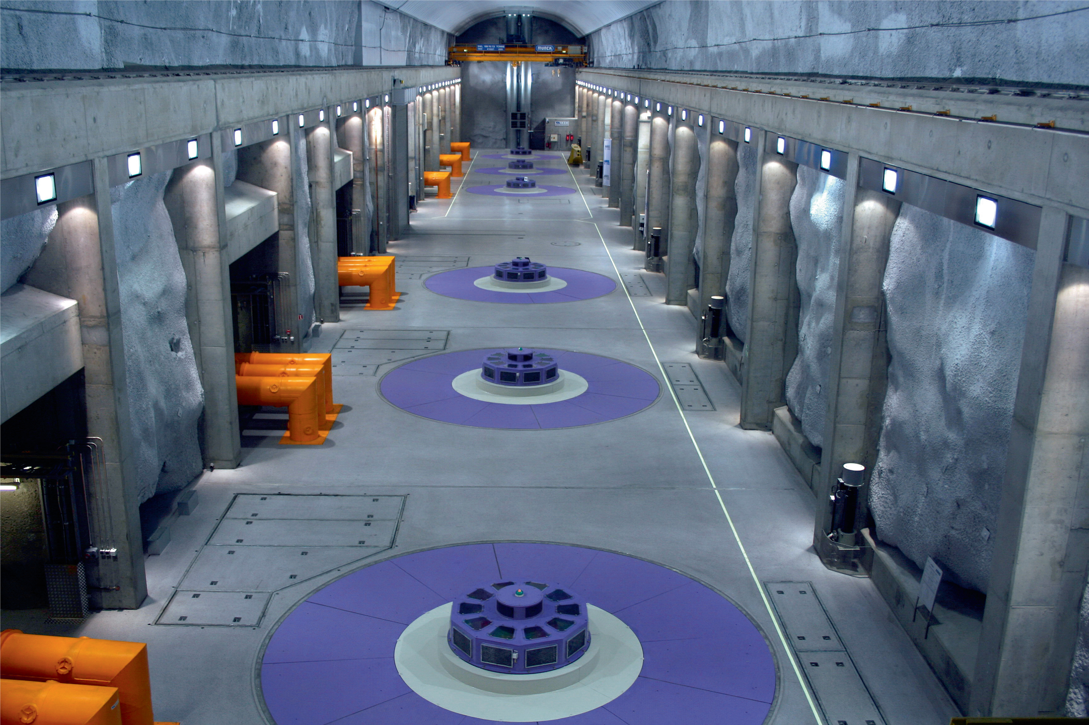
Adaptation of Kárahnjúkar possible?
Scope and study area→ Data, model overview→ Methods→ Results & Discussion→ Conclusion
Spillway discharge with gradual adaption
Turbine cavern of Kárahnjúkar (https://www.landsvirkjun.com/)
Notes:
Until mid century: Probably operational measures possible
after that: Strtuctural measures needed

Slide 32
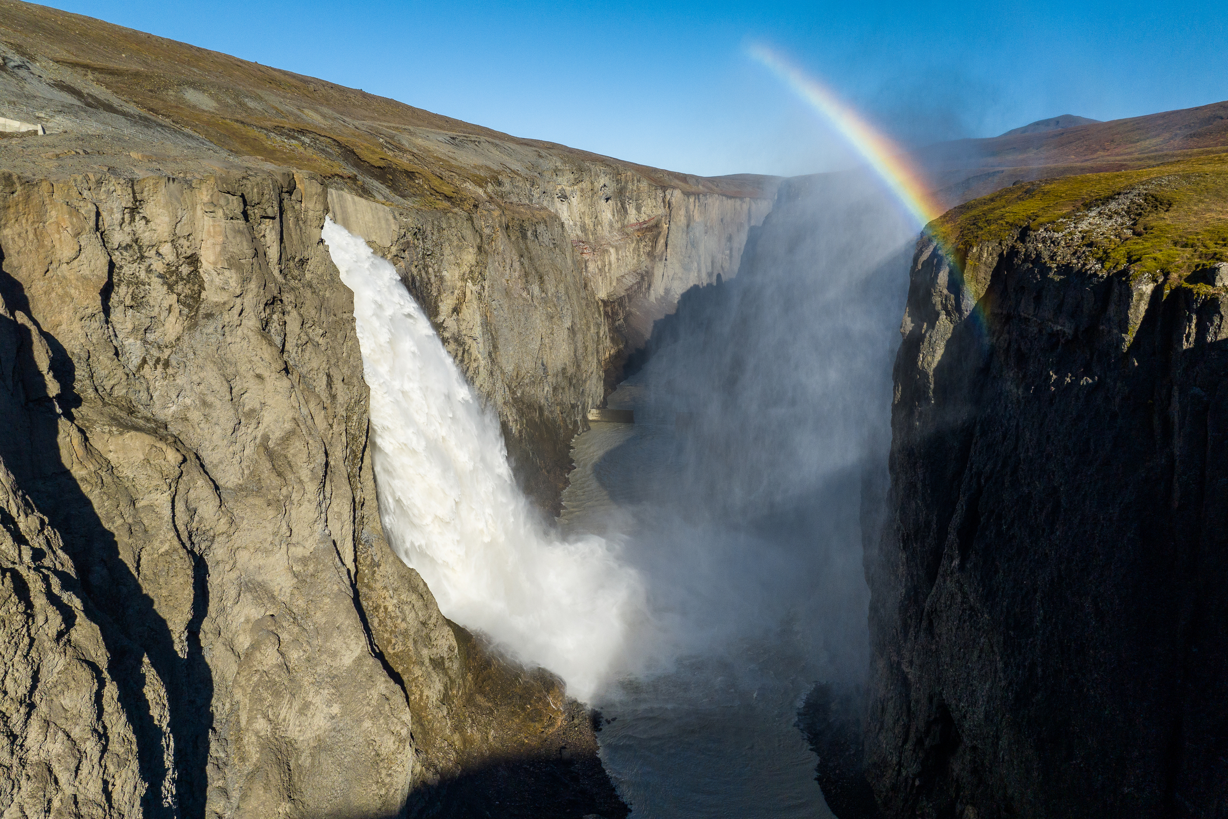
Conclusion
Scope and study area→ Data, model overview→ Methods→ Results & Discussion→ Conclusion
Significant increase in inflow until the end of the century
Large uncertainties, mainly due to climate models
Adaption of Kárahnjúkar system should be considered
Active Spillway of Kárahnjúkar (https://www.landsvirkjun.com/)

Slide 33

The End
Thank you!

