Slide 1

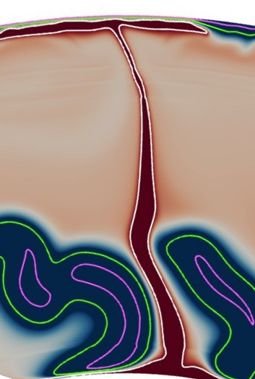
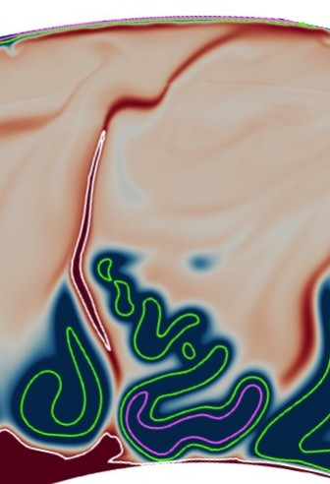

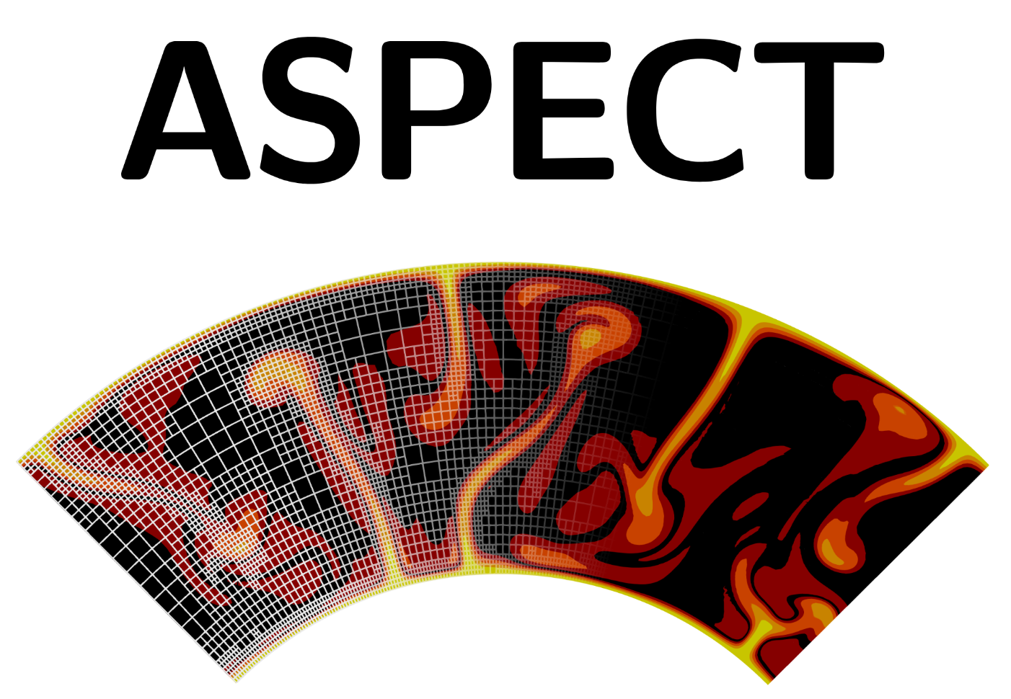

How Phase Transitions Impact Changes in Mantle Convection Style Throughout Earth’s History:
From Stalled Plumes to Surface Dynamics
Start Page
Entropy method
Abstract
#6598
Model Setup
Result
Snapshots
Ranpeng Li ^{a b}
Juliane Dannberg ^{a b}
Rene Gassmöller ^{a b}
Carolina Lithgow-Bertelloni ^{c} Lars Stixrude ^{c}
Robert Myhill ^{d}
Straight plume today
(mantle potential T = 1600 K)
Layered plume in the past
(mantle potential T = 1800 K)
Statistics
Regimes
3D models
Videos
Discussion
ͣ GEOMAR Helmholtz Centre Kiel
ᵇ University of Florida
ͨ University of California, Los Angeles
ͩ University of Bristol
Multi-component Averaging Method
Summary
Our Publications

Slide 2
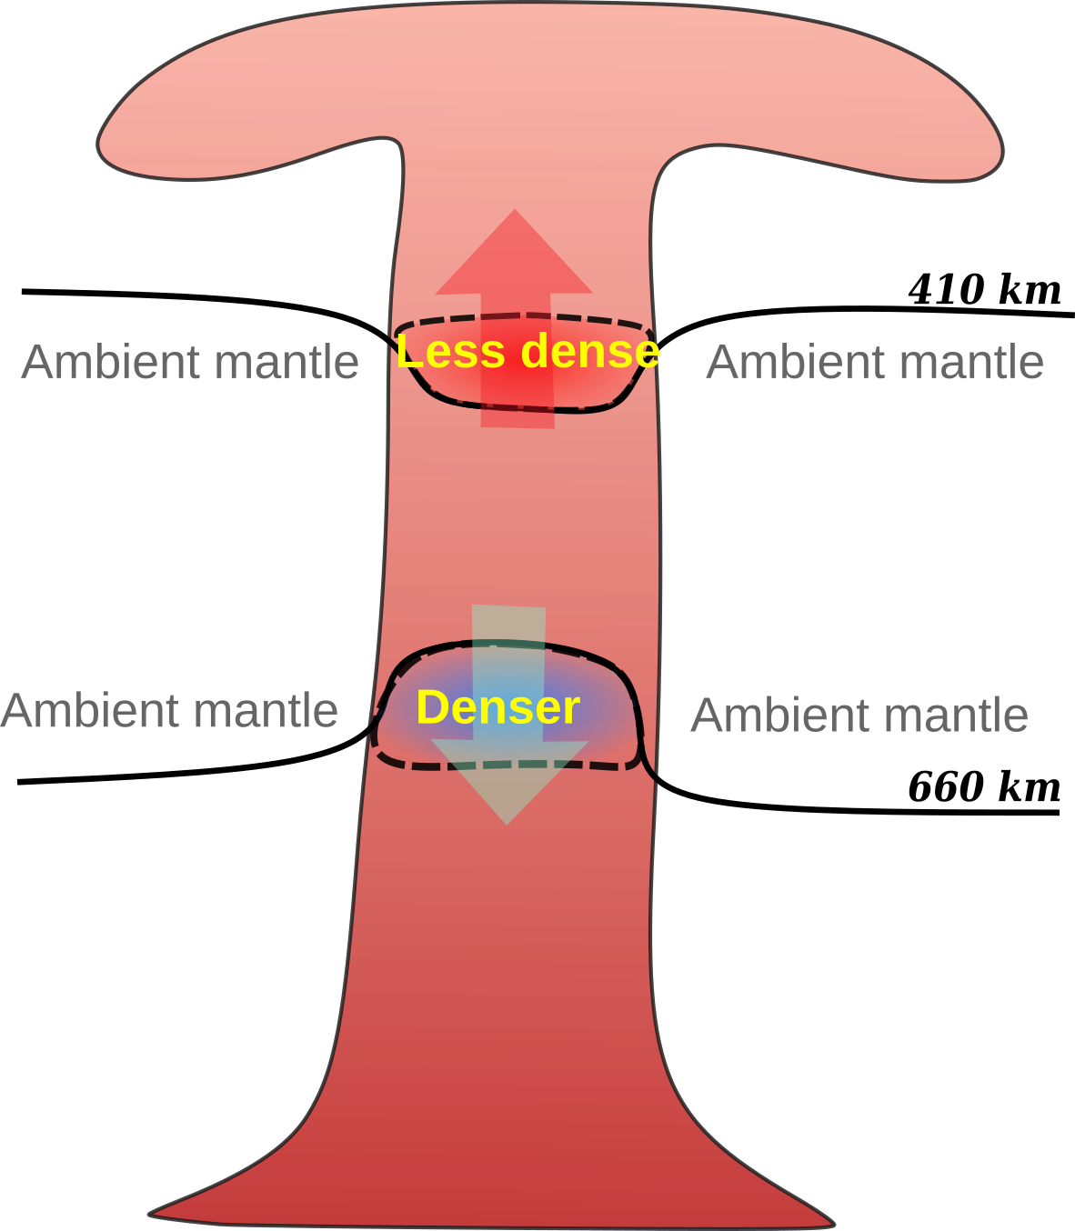
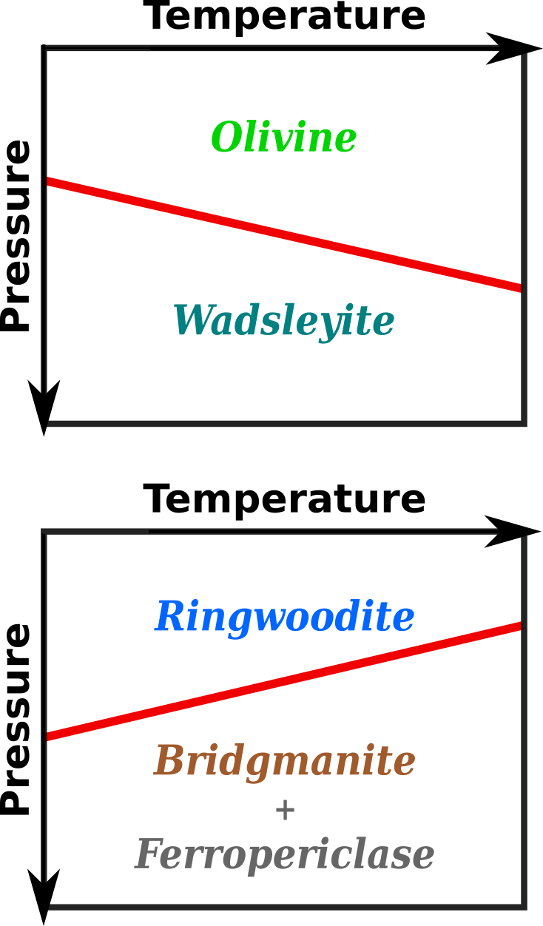
Phase Transitions Affect Convection Style
Start Page
Entropy method
Clapeyron Slope = dP/dT
Model Setup
Positive Clapeyron Slope (Exothermic)
→ When the temperature is higher, the transition occurs at higher pressure
→ Accelerates flow
Result
Snapshots
Statistics
Regimes
3D models
Videos
Discussion
Negative Clapeyron Slope (Endothermic)
→ When the temperature is higher, the transition occur at lower pressure
→Impedes flow
Multi-component Averaging Method
Summary
Our Publications

Slide 3
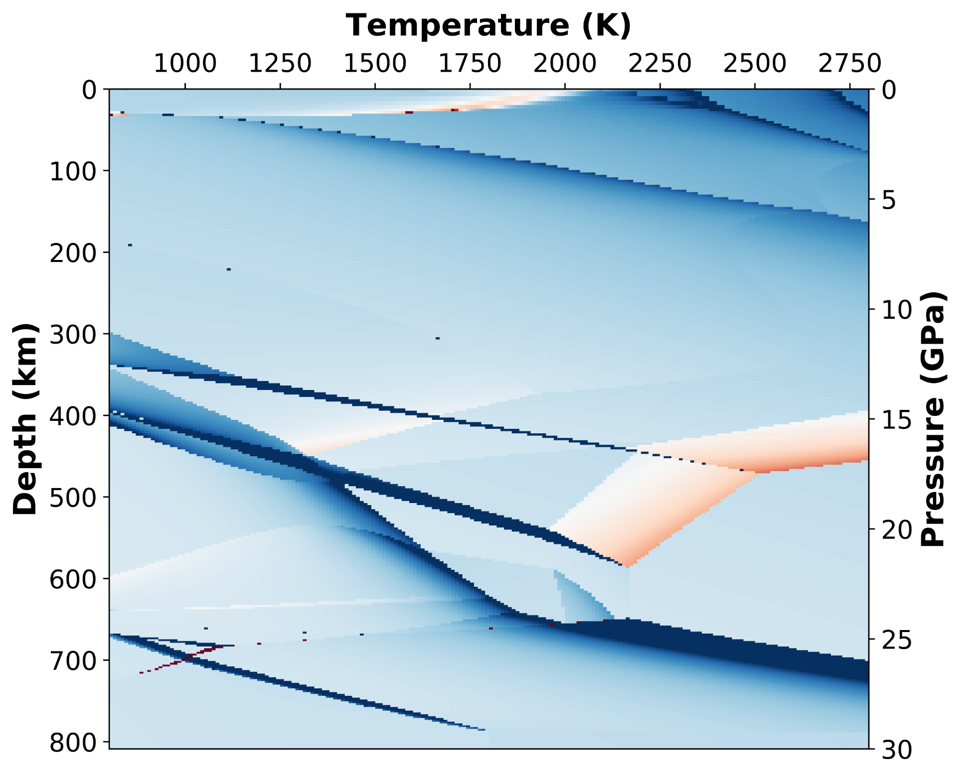
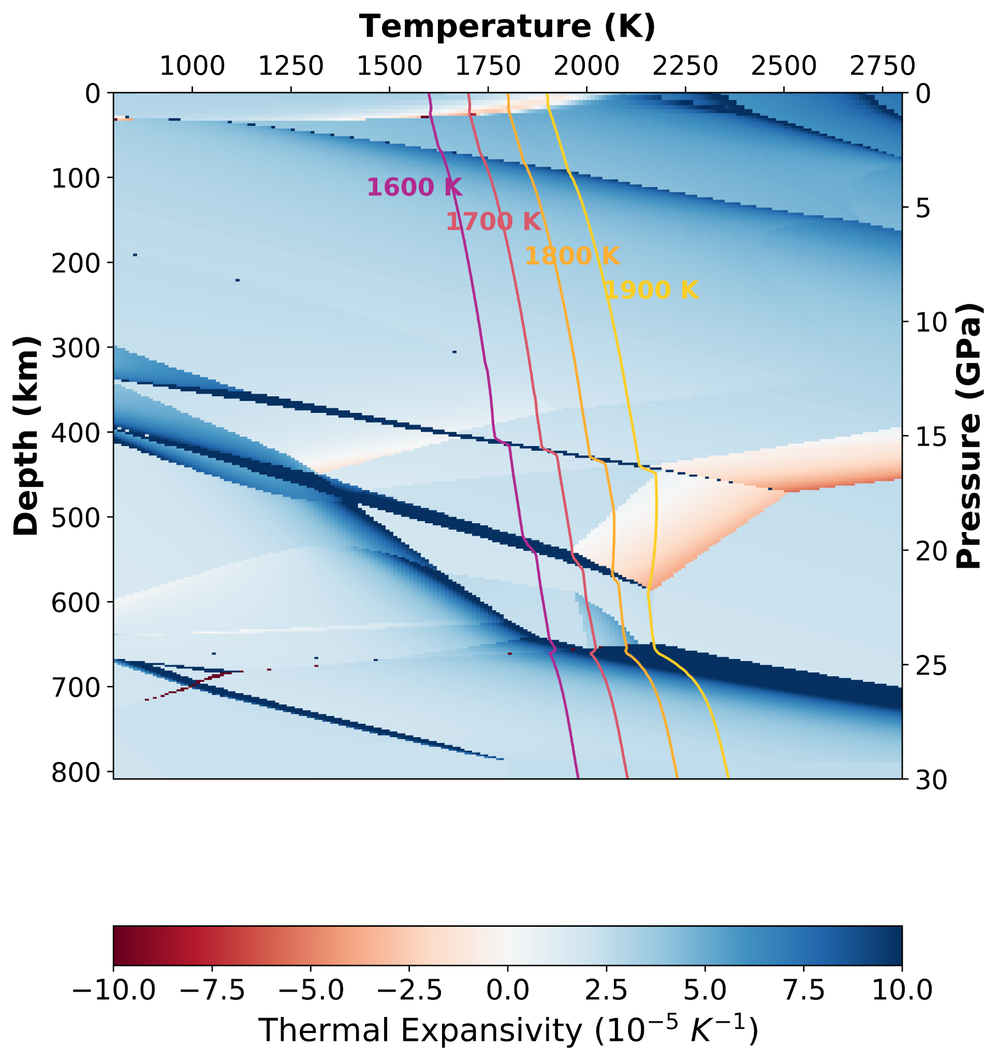
Phase Transitions in the Pyrolitic Mantle
Start Page
Entropy method
Model Setup
Pyrolite: model mantle composition. 18% basalt + 82% harzburgite
(Xu et al., 2008)
Thermal Expansivity: rate of volume change with temperature
-> red areas: density decrease when temperature increase – these phase transitions can impede flow
Result
Snapshots
Statistics
Regimes
Time Evolution
3D models
ol → wa
Videos
wa→gt+fp
Discussion
Multi-component Averaging Method
ri→bg+fp
wadsleyite -> garnet + ferropericlase may impede plume in a hotter mantle
Summary
Our Publications
Negative Clapeyron slope ||
Positive Clapeyron slope

Slide 4
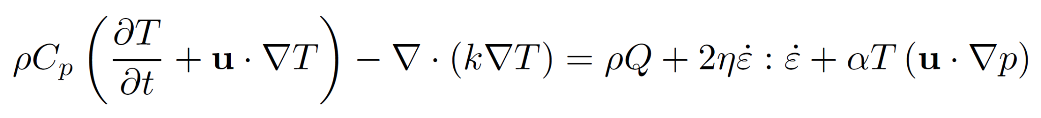
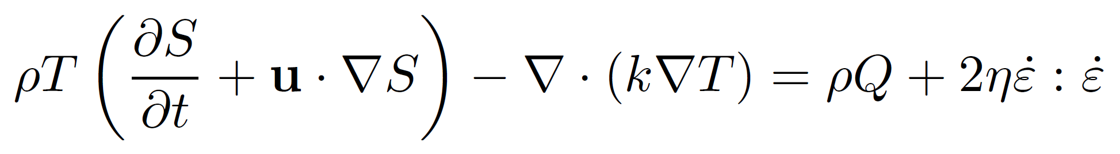

Our new method reformulates the energy equation in terms of entropy
Capture the full dynamic and latent heat effect of phase transitions
Use a material properties lookup table to solve the equations
All complex phase relations are included through the physical properties change
A New Entropy Method
Start Page
Entropy method
Model Setup
Result
Snapshots
Statistics
Energy conservation on pressure-temperature space:
ρCp (∂T/∂t + u · ∇T) − ∇ · (k∇T) = ρQ + 2ηέ : έ+ αT (u · ∇p)
Regimes
Change in thermal energy over time
Advection
Conduction
Internal heating
Frictional heating
Adiabatic compression
3D models
Videos
Discussion
Energy conservation on pressure-entropy space:
Multi-component Averaging Method
Summary
Our Publications
Method paper: Dannberg, J., Gassmöller, R., Li, R., Lithgow-Bertelloni, C., & Stixrude, L. (2022). An entropy method for geodynamic modelling of phase transitions: capturing sharp and broad transitions in a multiphase assemblage. Geophysical Journal International, 231(3), 1833-1849.

Slide 5
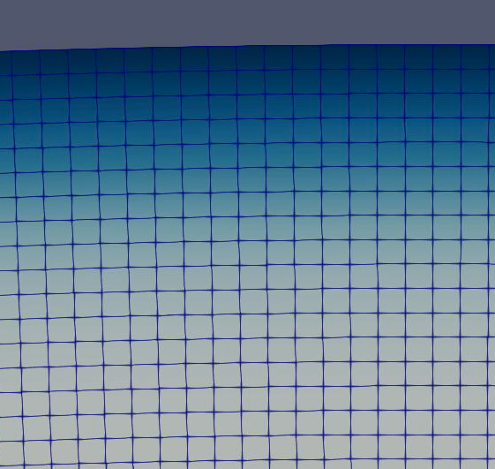
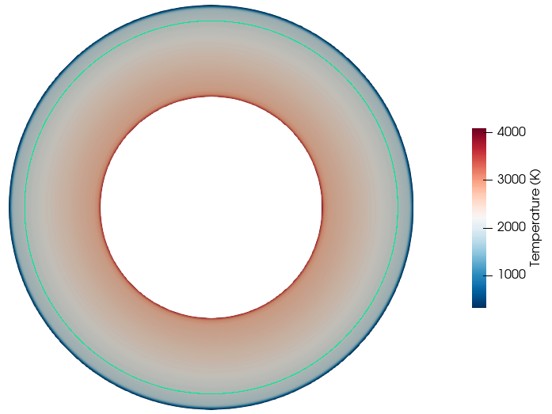
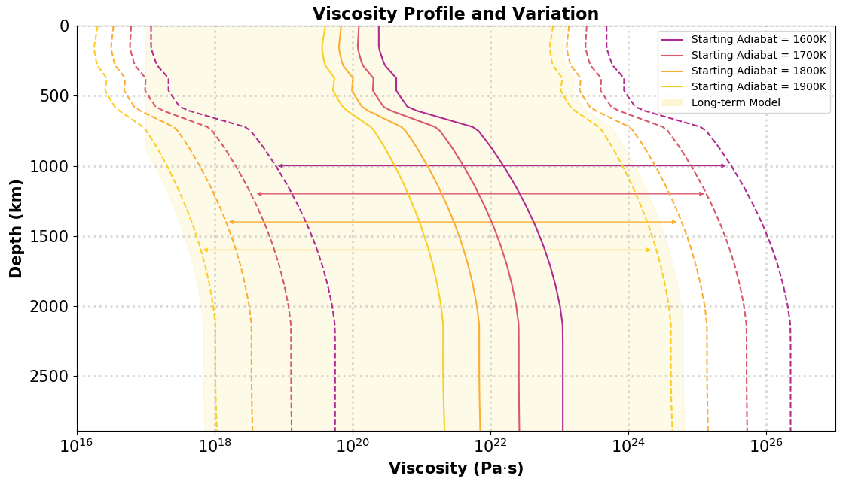
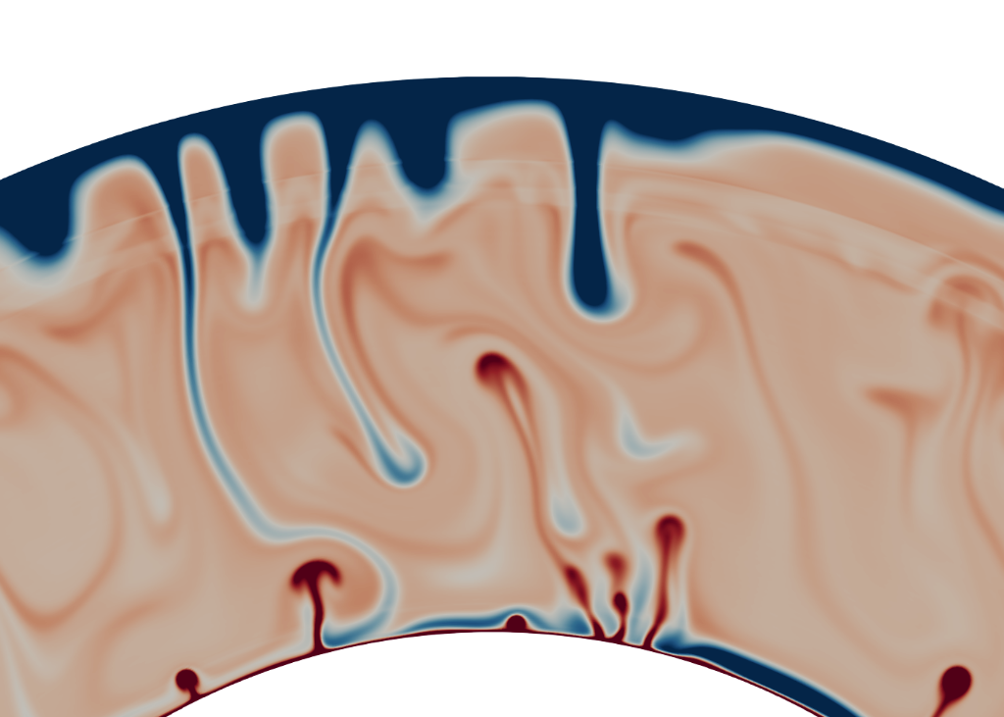
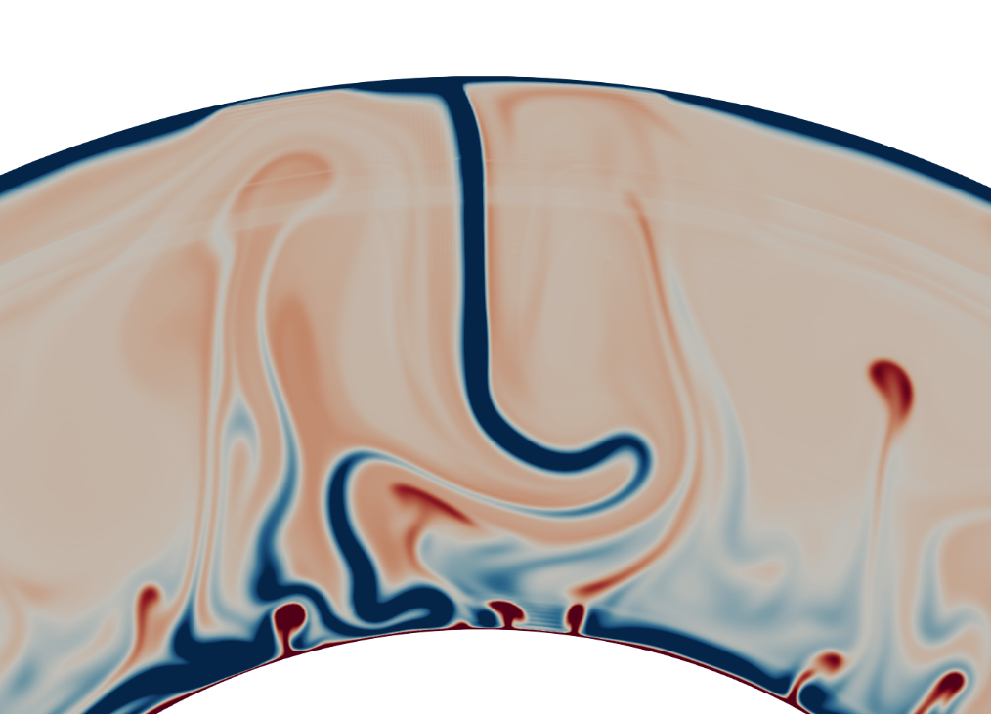
Model Setup – Geometry & Rheology
Start Page
Entropy method
2D cylindrical annulus with 128 cells in radial direction
Prescribed core-mantle boundary (CMB) and surface entropy
Include plasticity to form plate like behavior
Reference viscosity profile from Steinberger & Calderwood (2006). Profiles for the hotter models are less viscous.
Model Setup
Result
Snapshots
Statistics
Regimes
3D models
Videos
Discussion
Multi-component Averaging Method
Time Evolution
Pure viscous
With plasticity
Summary
Our Publications

Slide 6
Model Setup – Equation of States
Start Page
Entropy method
Model Setup
Result
Snapshots
Statistics
Regimes
Homogeneous pyrolitic composition generated by thermodynamics code HeFESTo
(Stixrude & Lithgow-Bertelloni 2005b, 2011)
3D models
ol → wa
Videos
wa→gt+fp
Discussion
ri→bg+fp
Multi-component Averaging Method
Summary
Our Publications

Slide 7
Model Setup – Two Series of Models
Start Page
Entropy method
Model Setup
10 Quasi-steady-state models
  Run for 500 Myr
  Various mantle potential temperatures (ranging from 1600 K - 1900 K)
  Prescribe constant CMB temperatures (ranging from 3800 K - 4300 K)
  Each represents a stage during Earth’s cooling
  A long term model
  Runs for 3 Gyr
  Starts from mantle potential temperature = 1900 K
  Prescribes CMB to cool for 500 K in 3 Gyr Shows a gradual change
Result
Snapshots
Statistics
Regimes
3D models
Videos
Discussion
Multi-component Averaging Method
Summary
Our Publications
Notes:
(Nakagawa et al., 2015)

Slide 8
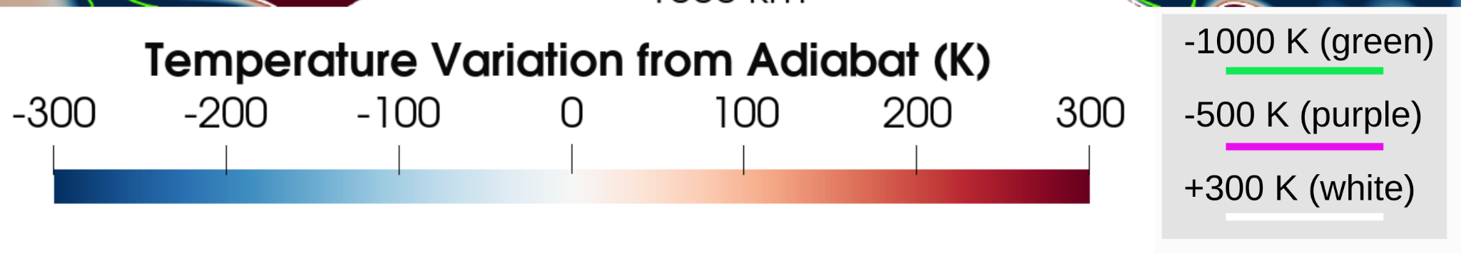
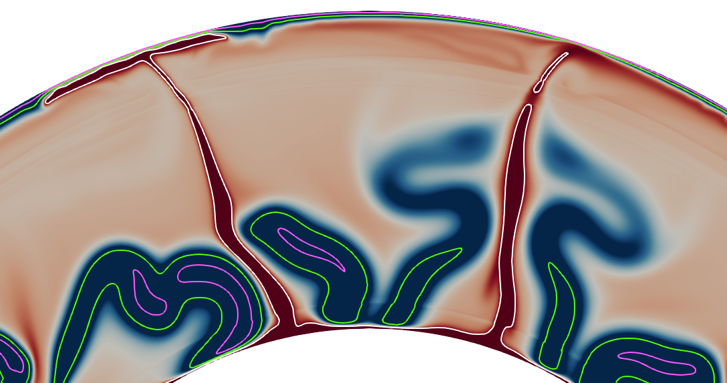
Results - Snapshots of the Quasi Steady State Models
Results – Snapshots of the Quasi Steady State Models
Start Page
Entropy method
Starting Adiabat = 1600 K (today’s temperature)
CMB Temperature = 4000 K
Snapshot at 400 Myr
Model Setup
Result
Snapshots
Statistics
Regimes
3D models
Videos
Discussion
Multi-component Averaging Method
Summary
Our Publications

Slide 9
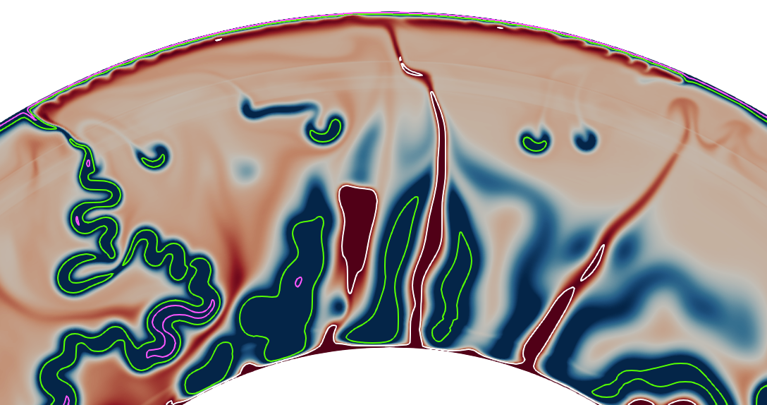
Results – Snapshots of the Quasi Steady State Models
Start Page
Entropy method
Starting Adiabat = 1700 K (Earth’s past)
CMB Temperature = 4100 K
Snapshot at 330 Myr
Model Setup
Result
Snapshots
Statistics
Regimes
3D models
Videos
Discussion
Multi-component Averaging Method
Summary
Our Publications

Slide 10
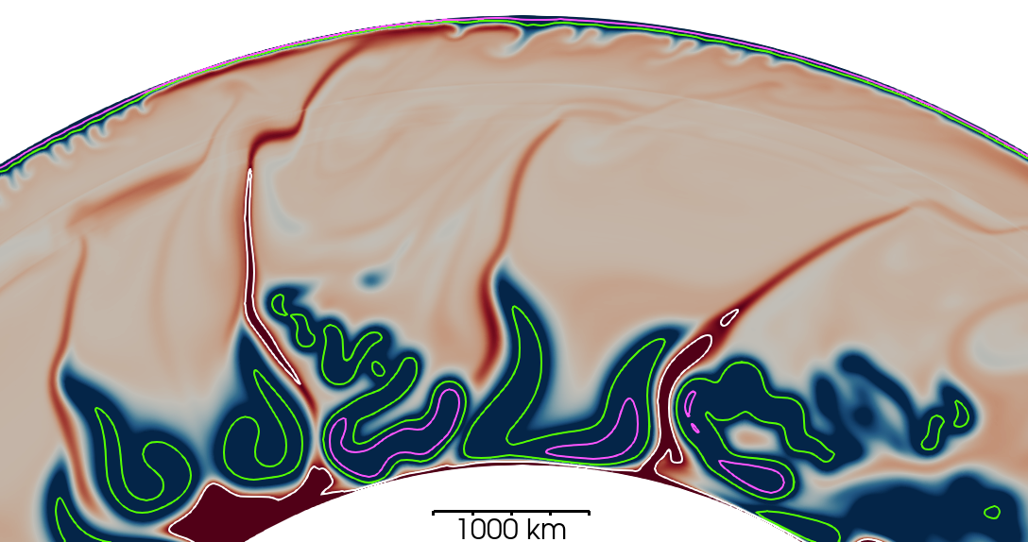
Results – Snapshots of the Quasi Steady State Models
Start Page
Entropy method
Starting Adiabat = 1800 K (Earth’s past)
CMB Temperature = 4200 K
Snapshot at 400 Myr
Model Setup
Result
Snapshots
Statistics
Regimes
3D models
Videos
Discussion
Multi-component Averaging Method
Summary
Our Publications

Slide 11
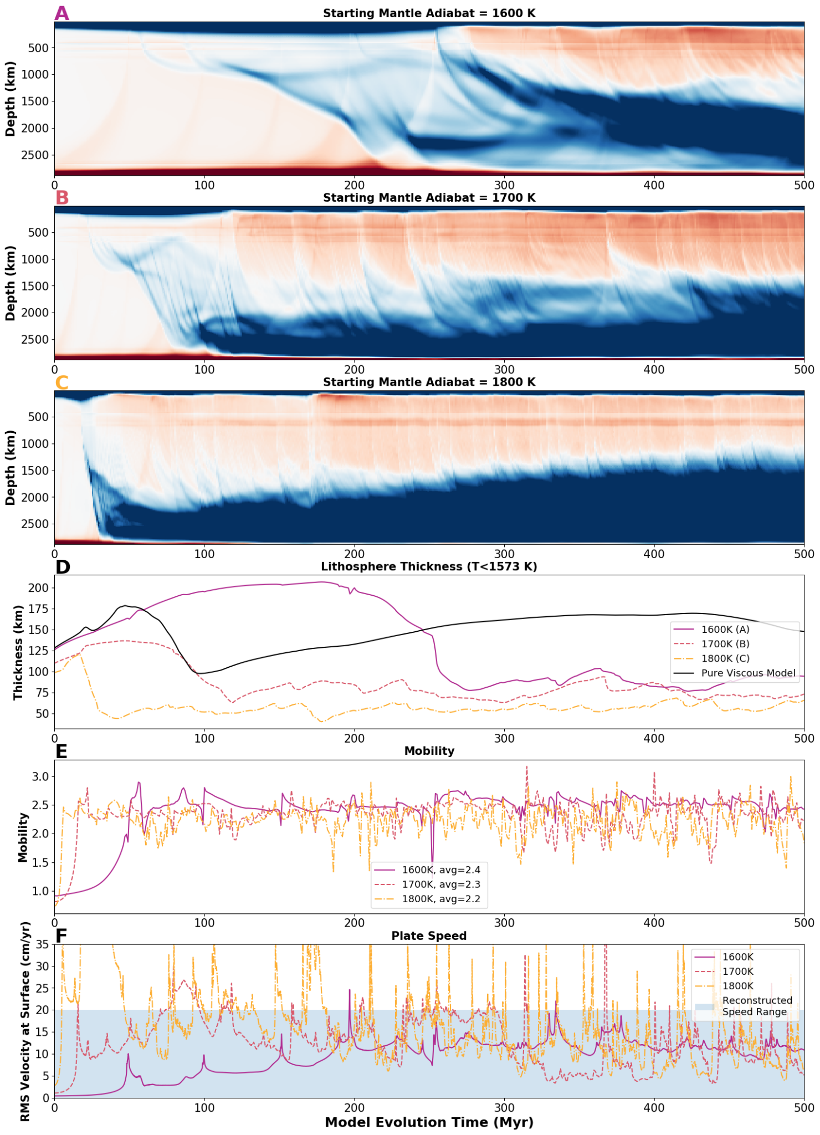
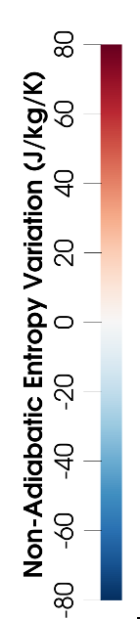
Results – Thermal Profile of Quasi Steady State Models
Start Page
Entropy method
This figure shows depth-averaged entropy plotted over the model evolution time
Model Setup
Result
Snapshots
slab
Statistics
plume
Regimes
3D models
Videos
Discussion
Multi-component Averaging Method
Summary
layered plumes
Our Publications
Time Evolution
Model Evolution Time (Myr)

Slide 12
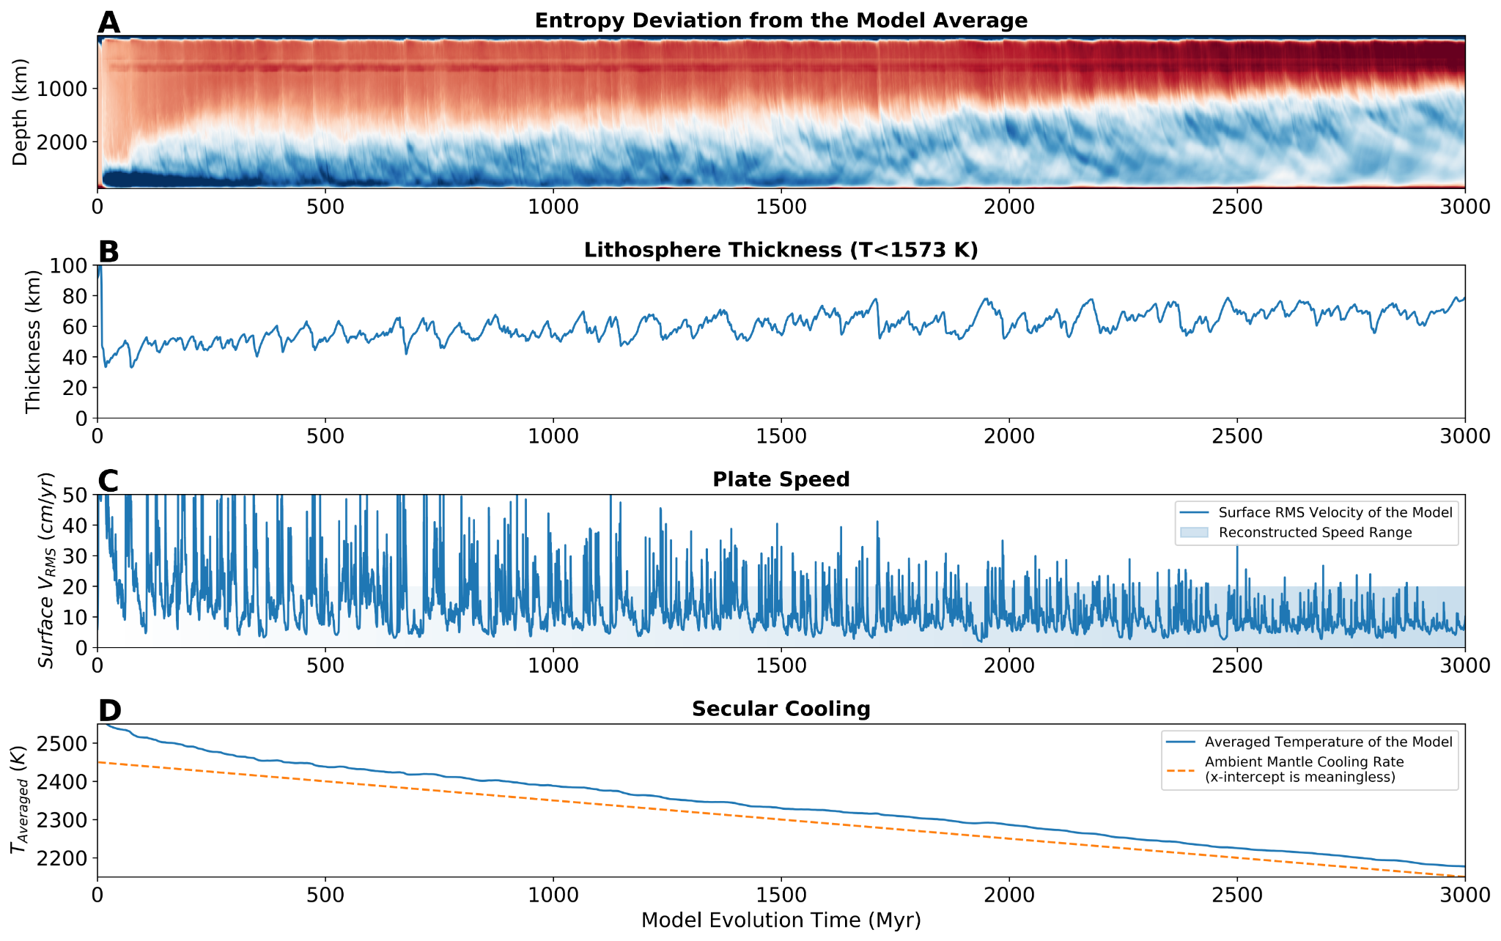
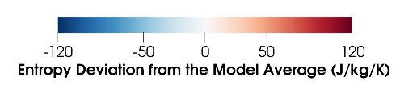
Results – The Long-term Model shows a Gradual Change
Start Page
Entropy method
Model Setup
Result
Snapshots
Statistics
Regimes
Cooling rate: 100 K/Gyr
(Herzberg et al., 2010)
3D models
Videos
Discussion
Multi-component Averaging Method
Summary
Time Evolution (Myr)
Our Publications

Slide 13
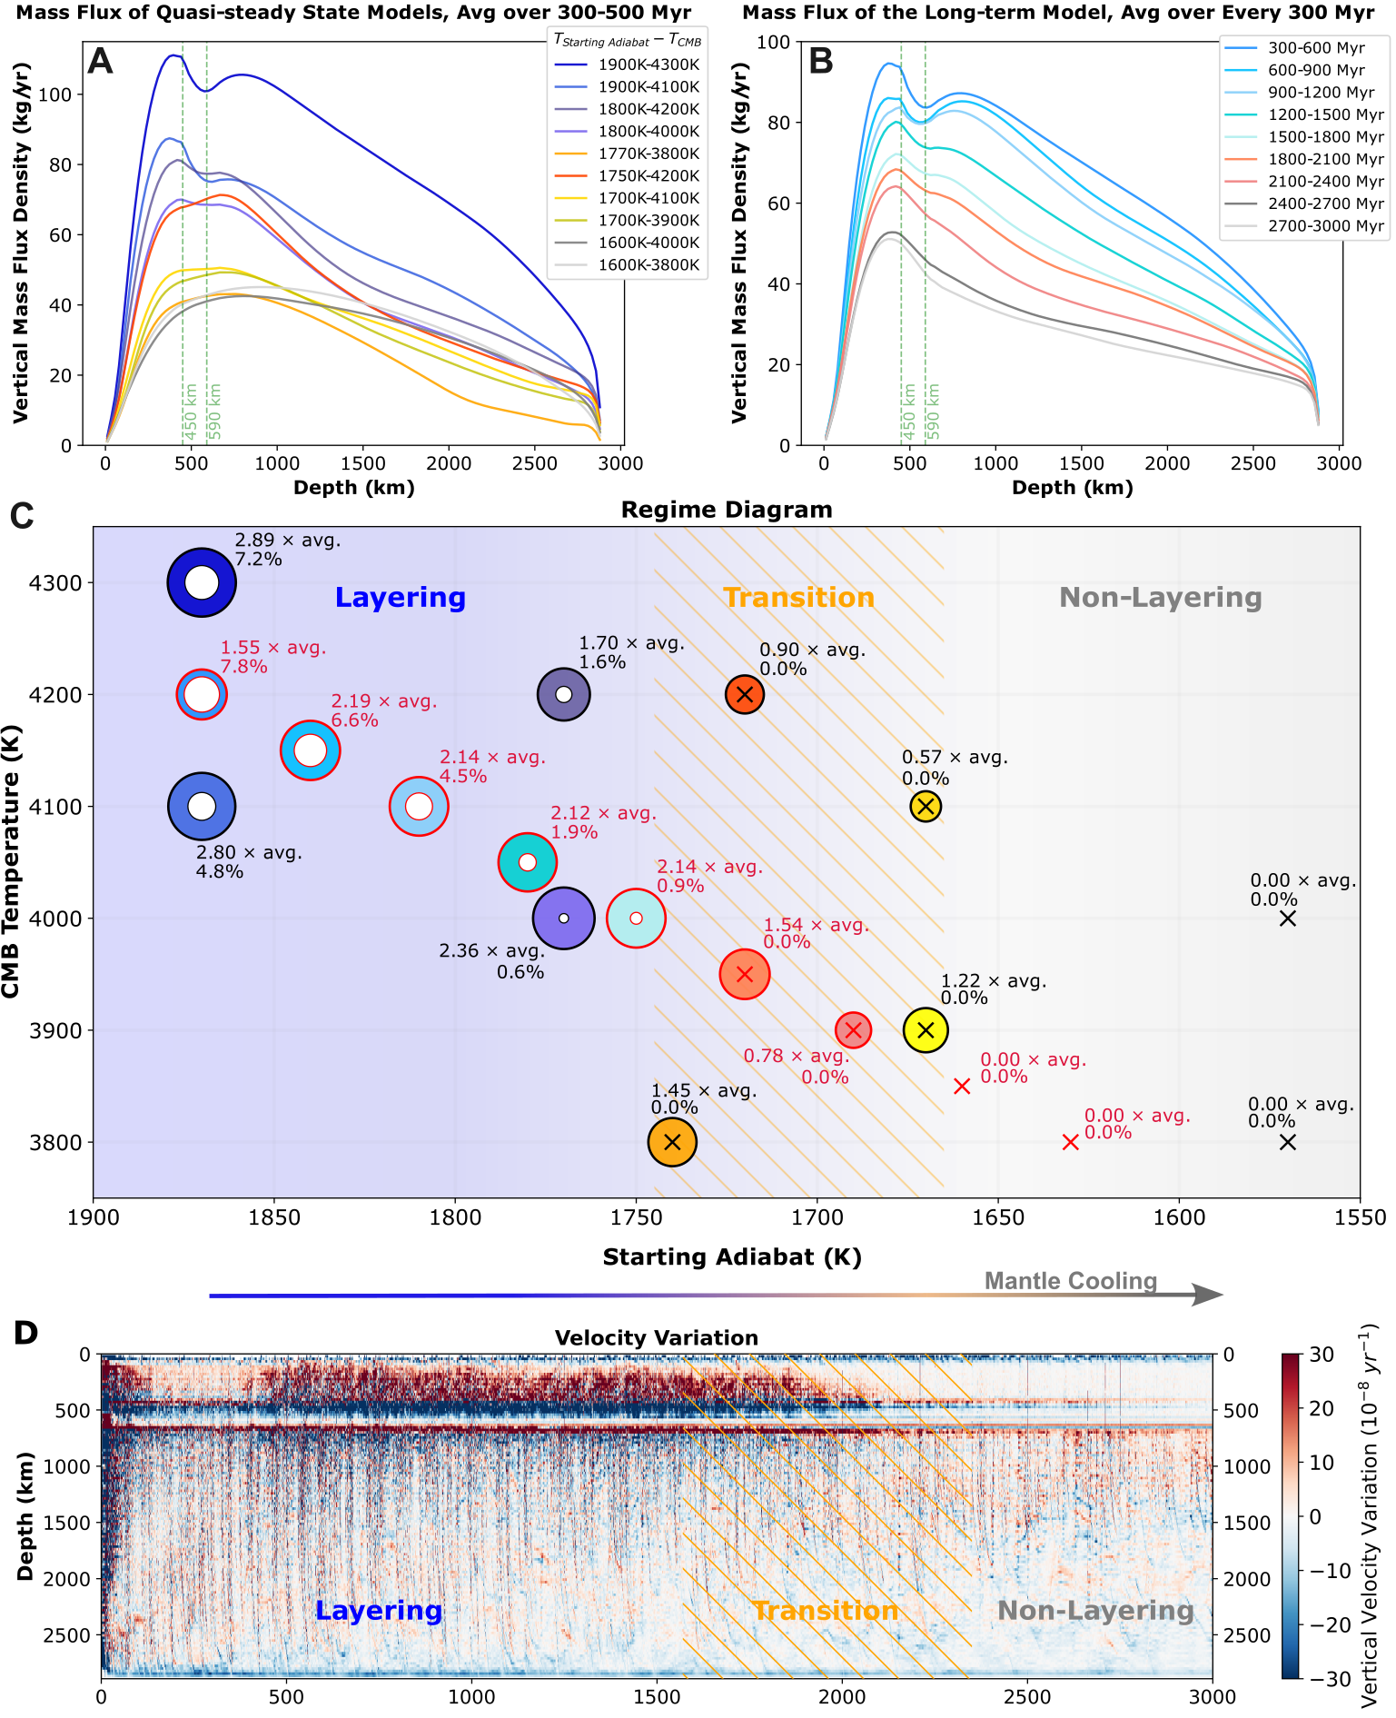
Results – Deceleration at Phase Transition
Start Page
Entropy method
Red Area: Averaged vertical velocity increases
Blue Area: Averaged vertical velocity decreases
Model Setup
Result
Snapshots
Statistics
Vertical Velocity Gradient
Regimes
3D models
Videos
Discussion
Multi-component Averaging Method
Summary
Time Evolution
Our Publications

Slide 14
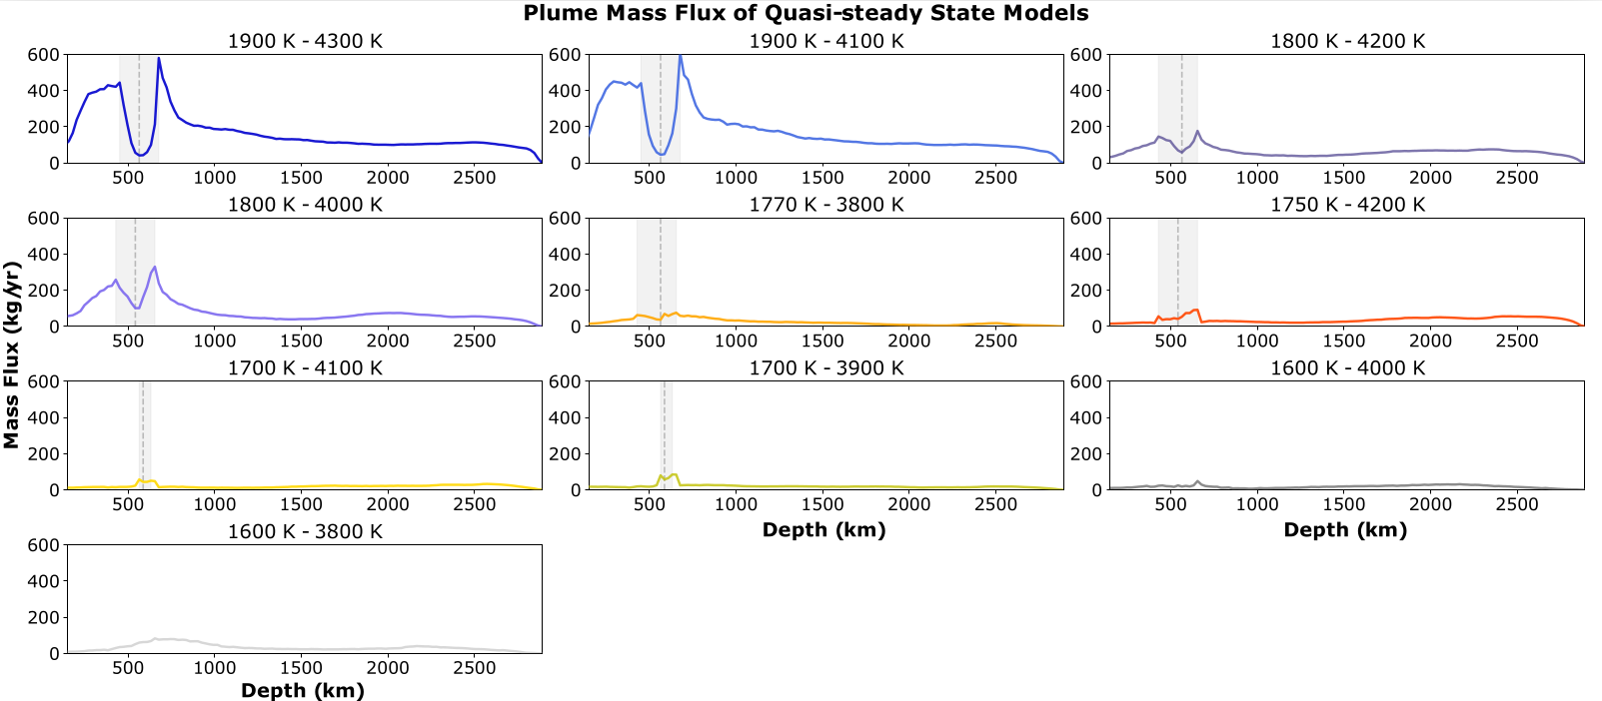
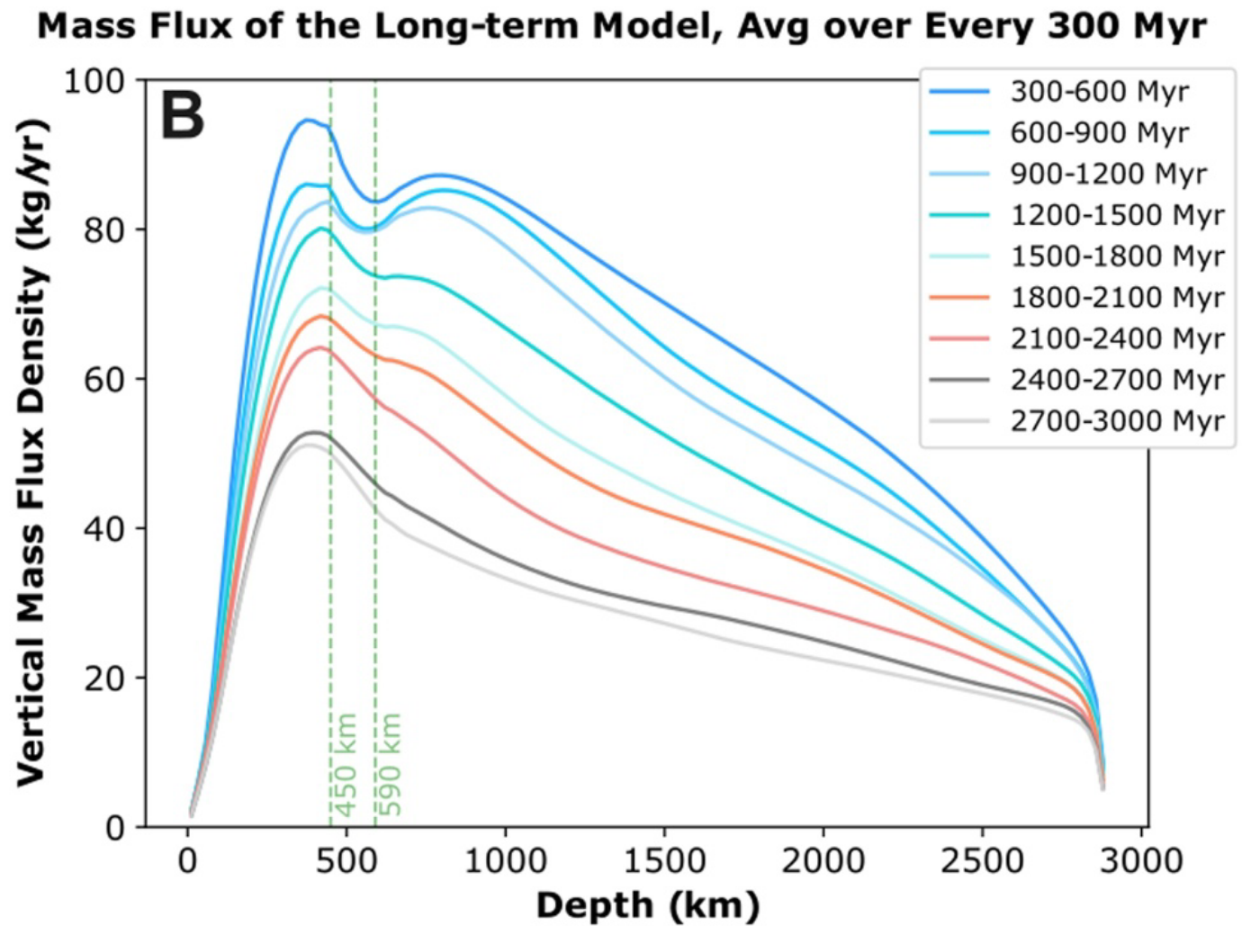
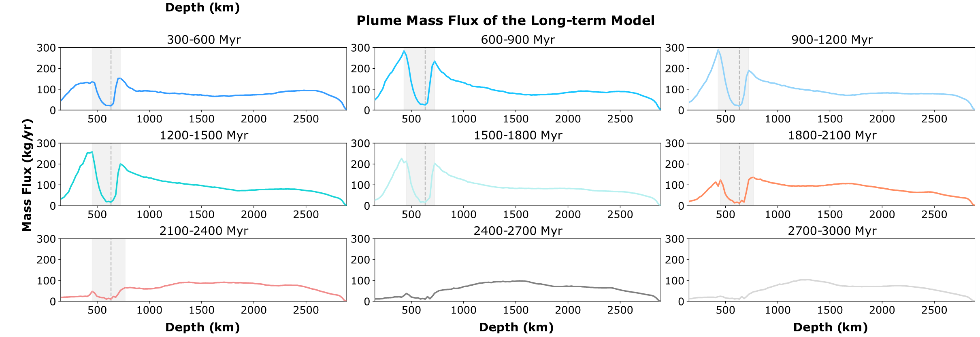
Results – Quantify the Layering
Start Page
Entropy method
Global Mass Flux Reduction
Mass Flux Reduction in Plumes
Model Setup
Result
Snapshots
Statistics
Regimes
3D models
Videos
Discussion
Multi-component Averaging Method
Summary
Our Publications

Slide 15
Results – From Layering to Non-layering Regime
Start Page
Entropy method
Black Outline: Quasi-steady state models
Red Outline: The long term model
Model Setup
Result
Snapshots
Statistics
Layer regime:
mantle potential temperature > 1750 K
Non-layer regime: mantle potential temperature < 1675 K
The layering are not strong enough to form fully layered convection
Regimes
3D models
Videos
Discussion
Multi-component Averaging Method
Summary
Our Publications
Time Evolution

Slide 16
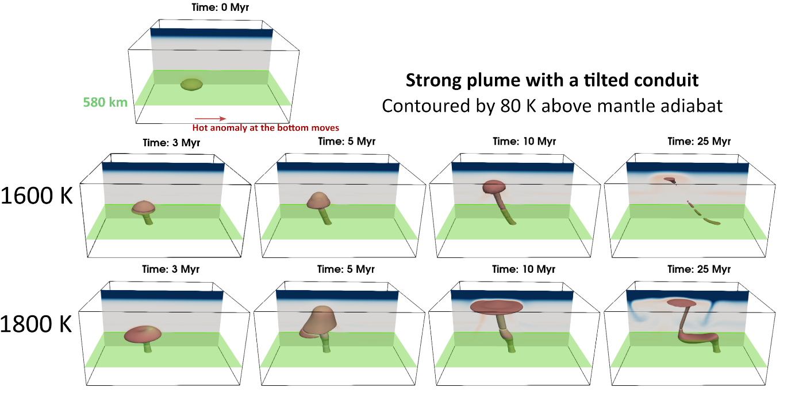
Results – Layering also observed in 3-D Models
Start Page
Entropy method
Model Setup
Result
Snapshots
Statistics
Regimes
3D models
Videos
Discussion
Multi-component Averaging Method
Summary
Our Publications

Slide 17

Results – Video of the Long-term Cooling Model
Start Page
Entropy method
Model Setup
Result
Snapshots
Statistics
The video file has been removed to reduce the size of this file.
Regimes
3D models
https://youtu.be/hZB_ZIl748U
Videos
Discussion
Multi-component Averaging Method
Summary
Our Publications

Slide 18


Results – Video of Two Quasi-Steady State Models
Start Page
Entropy method
Starting Adiabat = 1600 K
CMB Temperature = 4000 K
Starting Adiabat = 1800 K
CMB Temperature = 4200 K
Model Setup
Result
Snapshots
Statistics
Regimes
3D models
https://youtu.be/wD2iinksTj8
https://youtu.be/R7cNCqxnjCc
Videos
Discussion
The video files have been removed to reduce the size of this file.
Multi-component Averaging Method
Summary
Our Publications

Slide 19
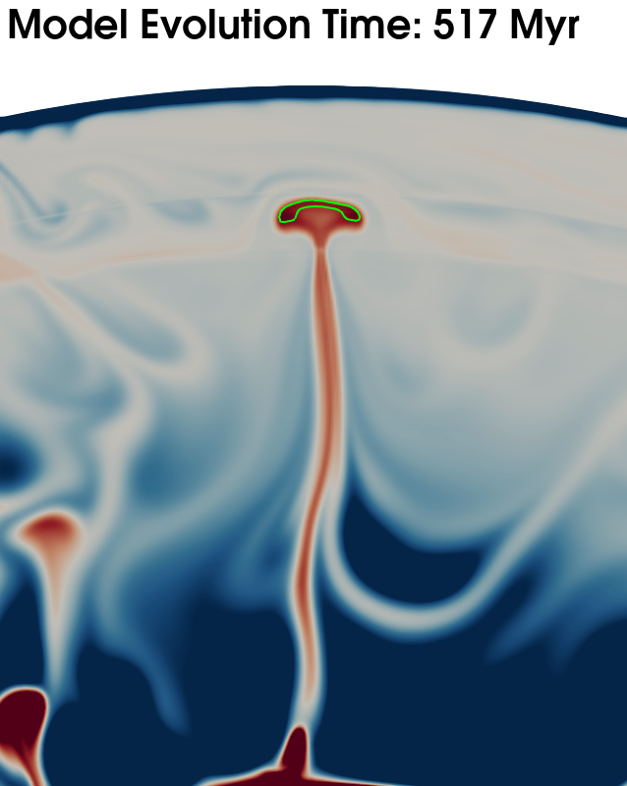
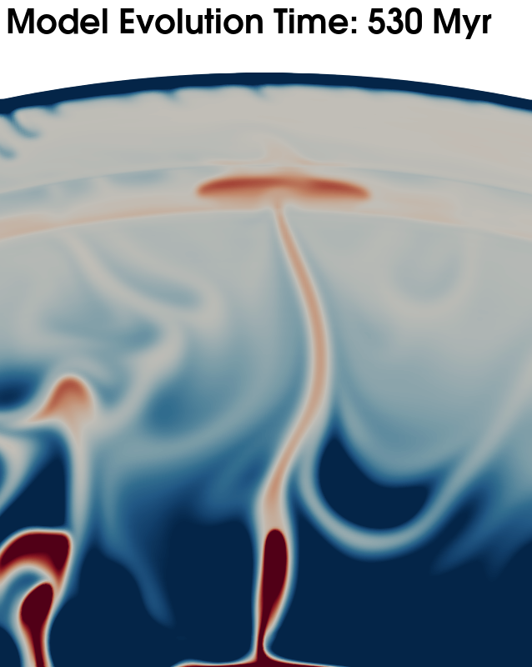
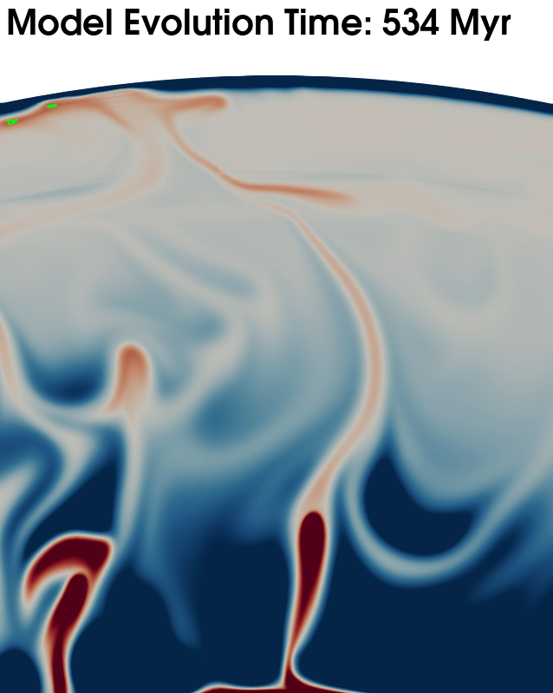
Discussion – Implication for Earth’s Evolution
Start Page
Entropy method
The layering of plumes may cause:
Warm transition zone in the past
Differentiated secondary plume
Model Setup
Result
Snapshots
Statistics
Regimes
Partial melt
3D models
Videos
Discussion
Multi-component Averaging Method
Summary
Our Publications

Slide 20
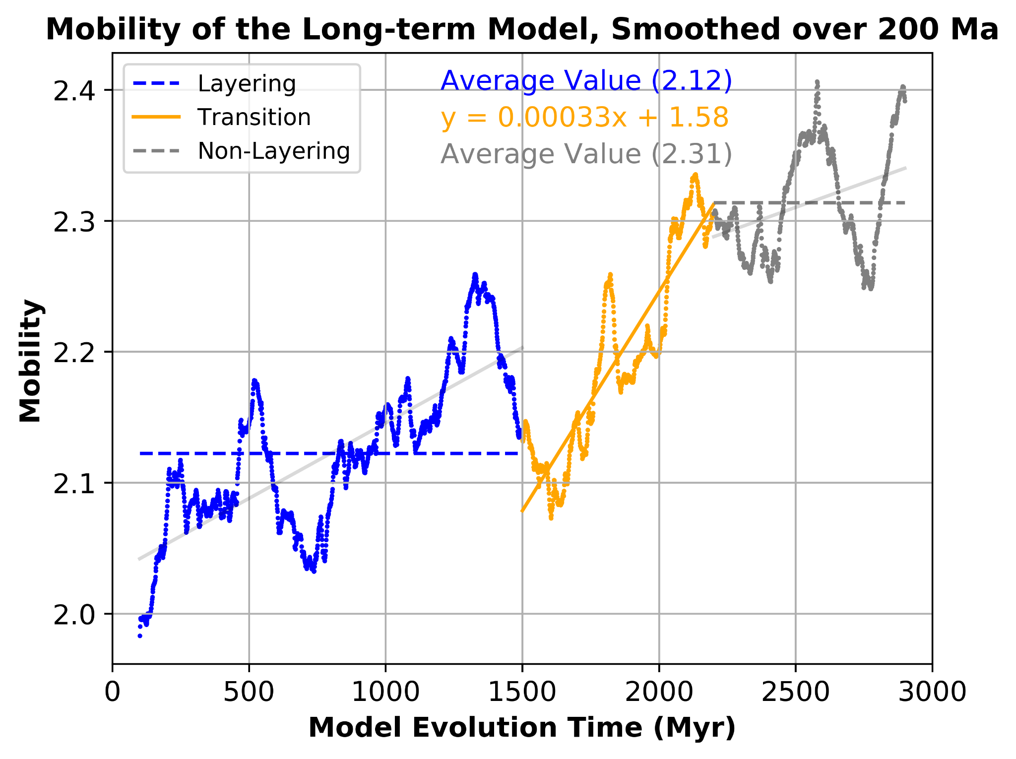
Discussion – Change in Surface Tectonics
Start Page
Entropy method
Model Setup
Result
Snapshots
Statistics
Surface mobility = V_{Surface RMS} / V_{mantle RMS.} It shows the vigor of plate tectonics
Surface mobility increases as Earth transitioning to a
non-layering regime
Regimes
3D models
Videos
Discussion
Multi-component Averaging Method
Time Evolution
Summary
Our Publications

Slide 21
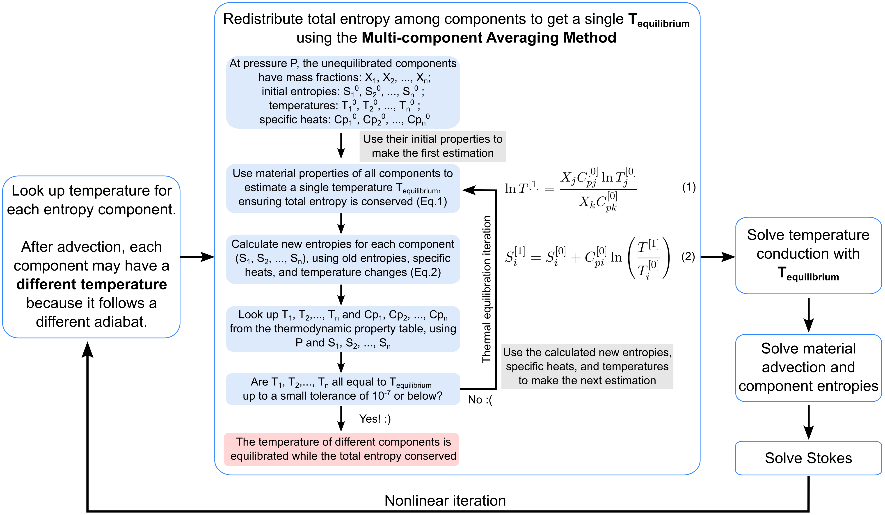
Multi-component Averaging Method
Start Page
Entropy method
An equilibration step is required for modeling multiple components with the entropy method
Model Setup
Result
Snapshots
Statistics
Regimes
3D models
Videos
Discussion
Multi-component Averaging Method
Summary
Our Publications

Slide 22

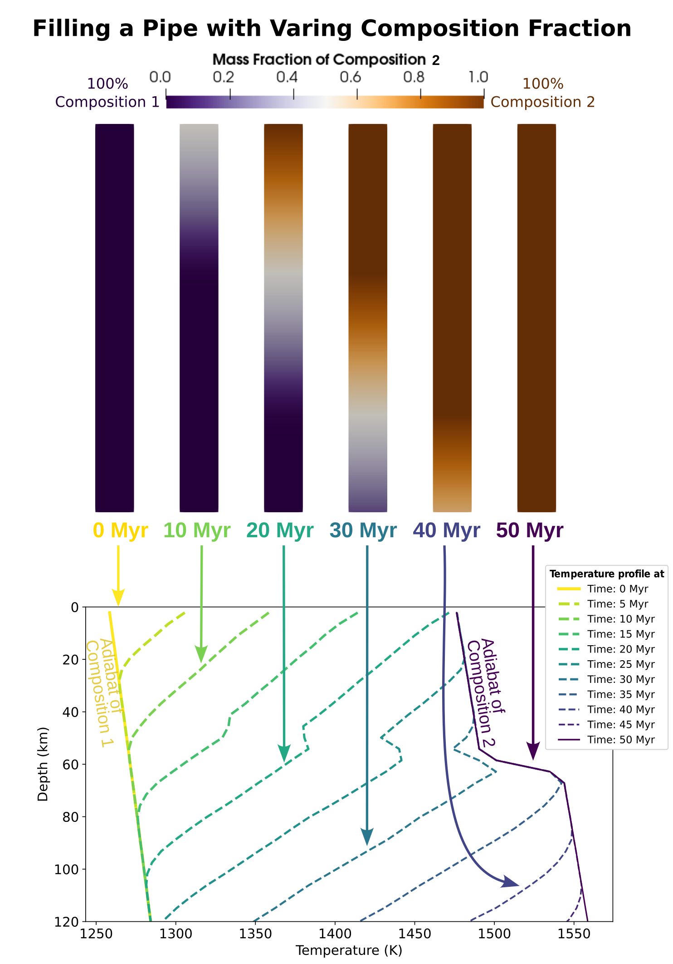
Multi-component Averaging Method - Showcase
Start Page
Entropy method
Model Setup
Result
Snapshots
Statistics
Composition 1: Olivine
Composition 2: Olivine and wadsleyite.
The phase transition is included.
Material properties calculated with BurnMan
(Myhill, R. et al., 2023)
Regimes
3D models
Videos
Discussion
Multi-component Averaging Method
Summary
Our Publications

Slide 23
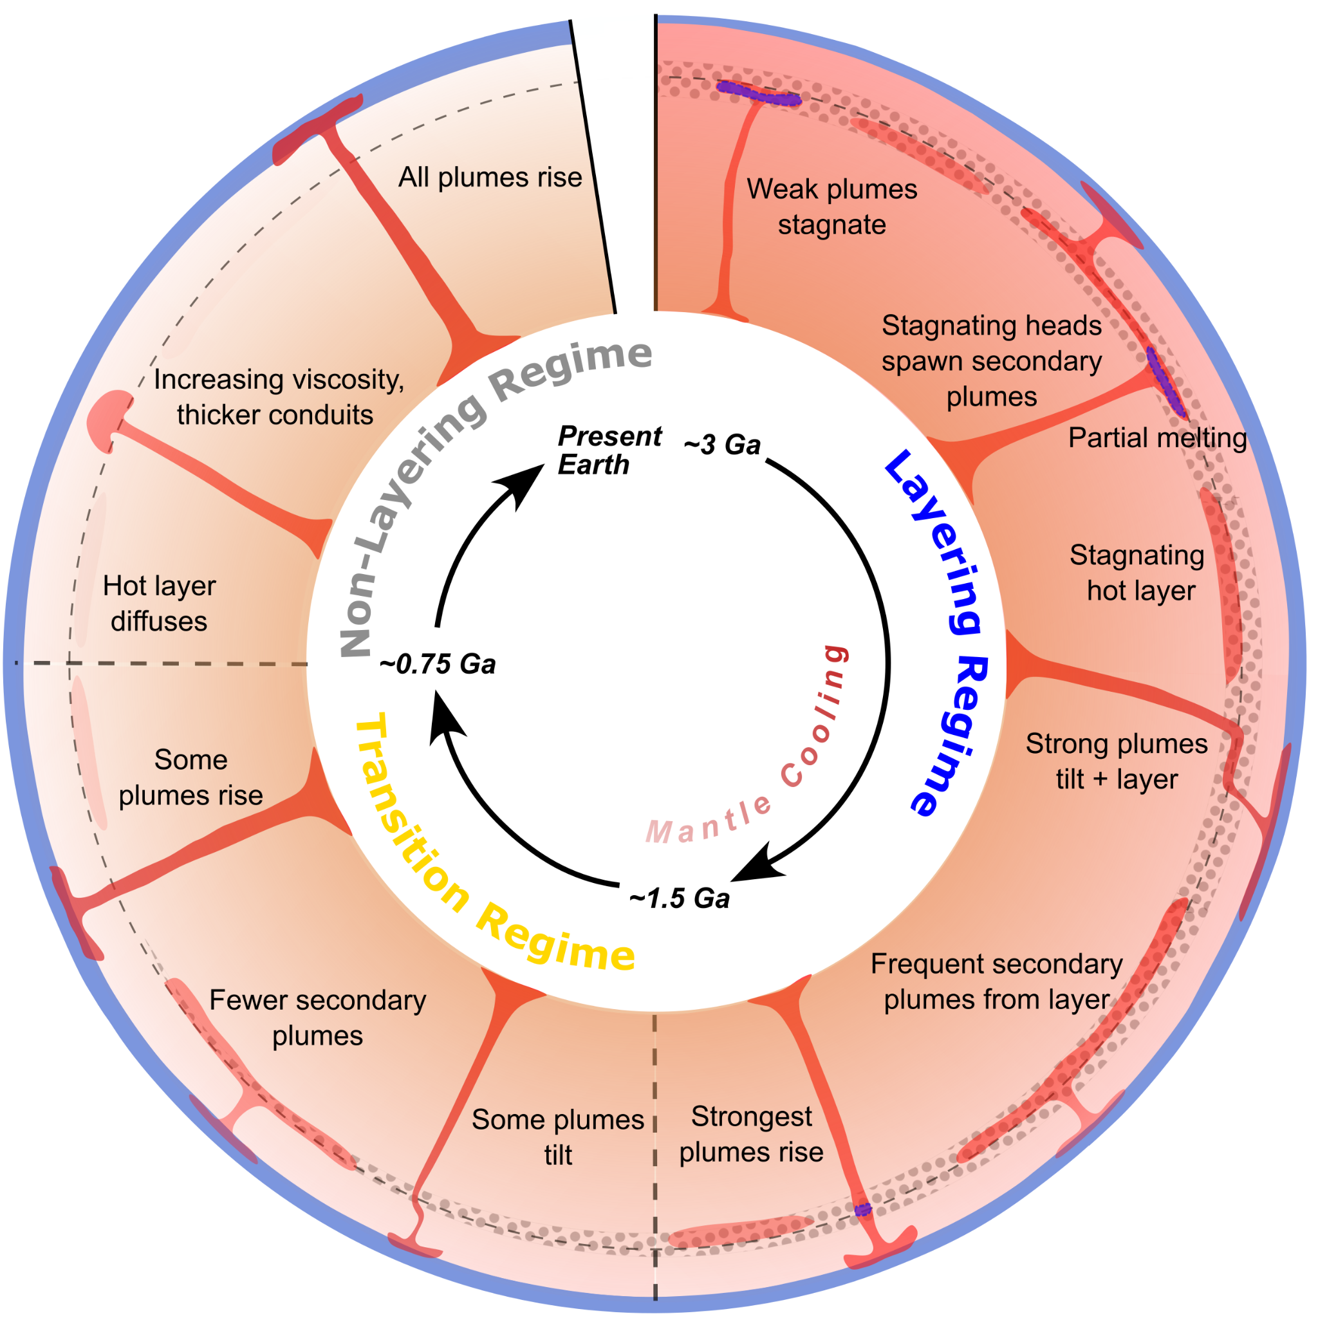
A Schematic Summary
Start Page
Entropy method
Main Takeaways:
The wadsleyite to garnet + ferropericlase transition can hinder plumes and induce layering when mantle potential temperature >1750 K.
The layering increases temperature in the transition zone and reduces mass flux exchange by <10%.
The layering could cause higher surface mobility & chemically differentiate the plume.
Model Setup
Result
Snapshots
Statistics
Regimes
3D models
Videos
Discussion
Multi-component Averaging Method
Summary
Our Publications

Slide 24

Our Recent Publication
Start Page
Entropy method
Model Setup
Result
Snapshots
Li, R., Dannberg, J., Gassmöller, R., Lithgow-Bertelloni, C., & Stixrude, L.
How Phase Transitions Impact Changes in Mantle Convection Style Throughout Earth's History: From Stalled Plumes to Surface Dynamics. Geochemistry, Geophysics, Geosystems,
26, e2024GC011600. https://doi.org/10.1029/2024GC011600
Statistics
Regimes
3D models
My email: rli@geomar.de
Videos
Discussion
Abstract
EGU25-6598
Multi-component Averaging Method
Paper
Summary
Our Publications

Slide 25
Start Page
Entropy method
Model Setup
Result
Snapshots
Statistics
Regimes
Click here to go to the Start Page
3D models
Videos
Discussion
Multi-component Averaging Method
Summary
Our Publications

Slide 26
Results - Models vs. Observations
Supplementary – Quasi Steady State Models vs. Observation
Start Page
Entropy method
Model Setup
Real Earth:
Oceanic lithosphere thickness < 120km
Mobility = surface RMS velocity / whole mantle RMS velocity, it is > 1 for models with plate tectonics
Plate speed < 20cm/yr
Result
Snapshots
Statistics
Regimes
3D models
Videos
Discussion
Multi-component Averaging Method
Summary
Our Publications
Time Evolution

Slide 27
Supplementary – The Long-term Model vs. Observation
Start Page
Entropy method
Model Setup
Result
Snapshots
Statistics
Regimes
3D models
Videos
Discussion
Multi-component Averaging Method
Summary
Time Evolution (Myr)
Our Publications

Slide 28
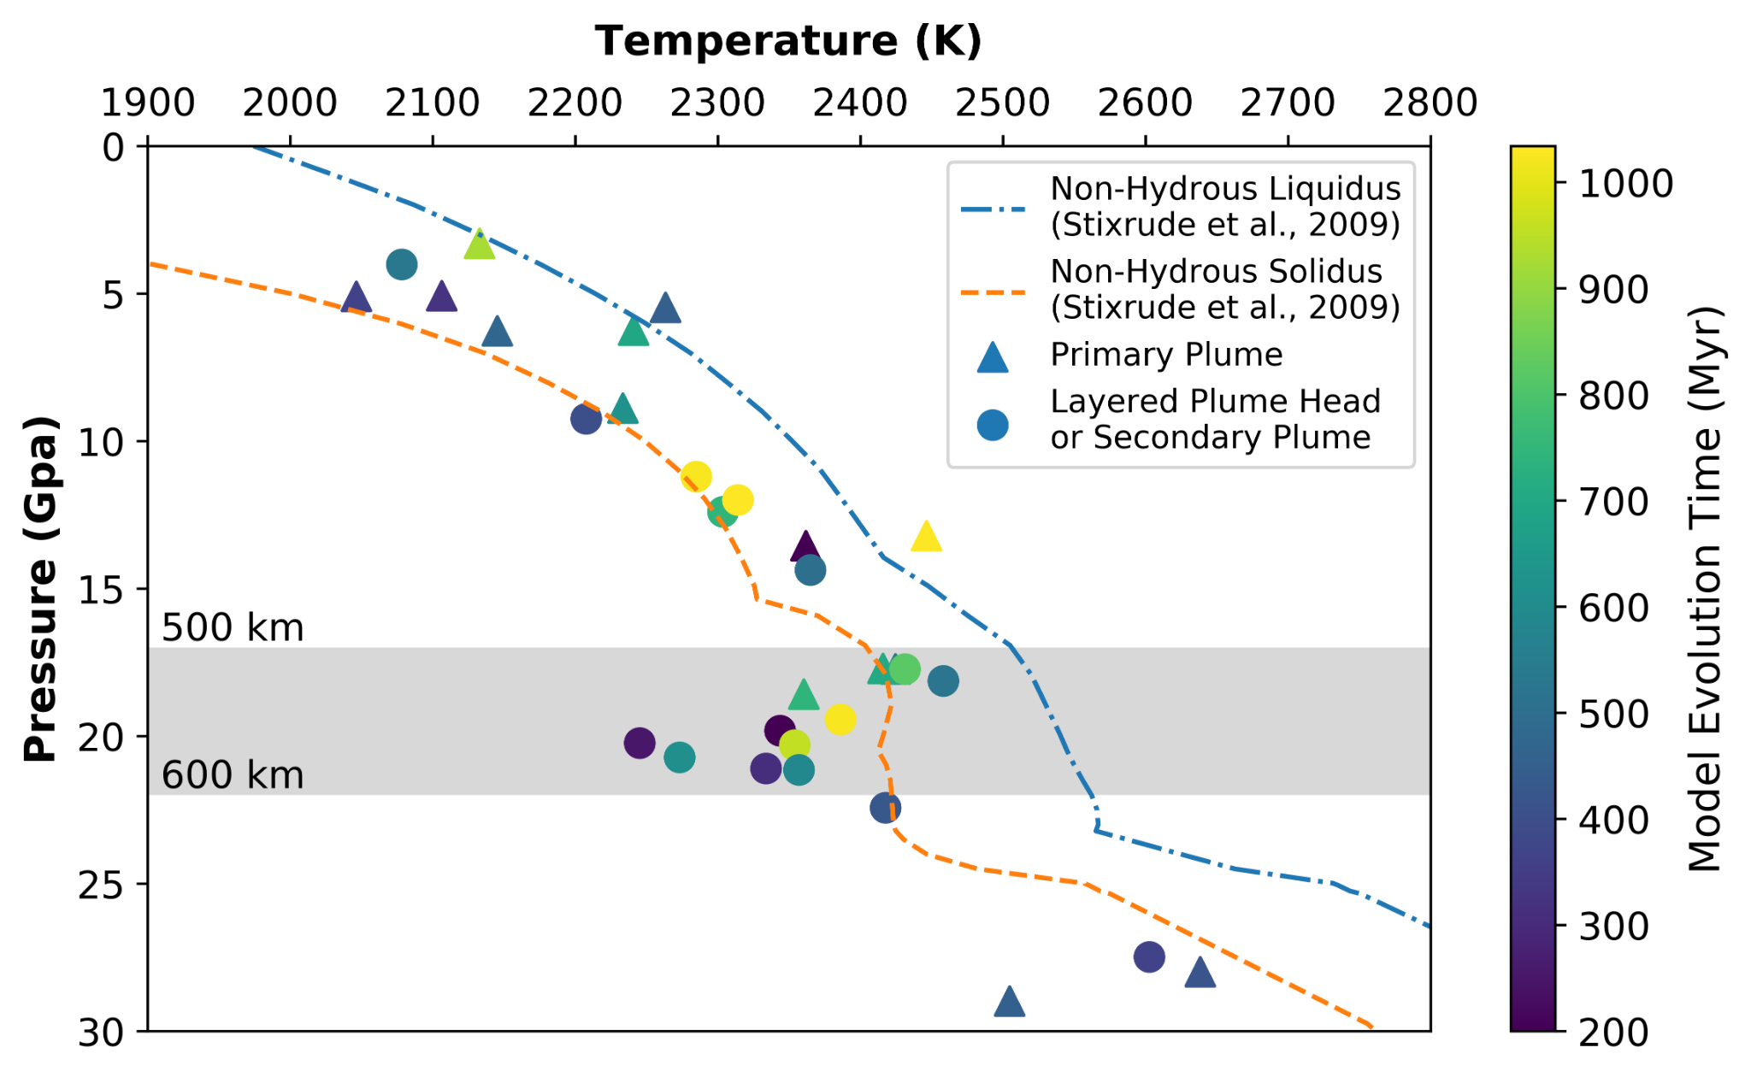
Supplementary – Tracking the Melting
Start Page
Entropy method
Model Setup
Result
Snapshots
Statistics
Regimes
3D models
Videos
Discussion
Multi-component Averaging Method
Summary
Our Publications

Slide 29
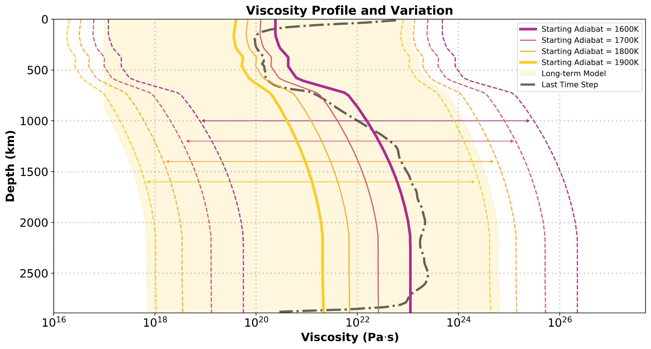
Supplementary – Viscosity Profile
Start Page
Entropy method
Model Setup
Result
Snapshots
Statistics
Regimes
3D models
Videos
Discussion
Multi-component Averaging Method
Summary
Our Publications

