Slide 1
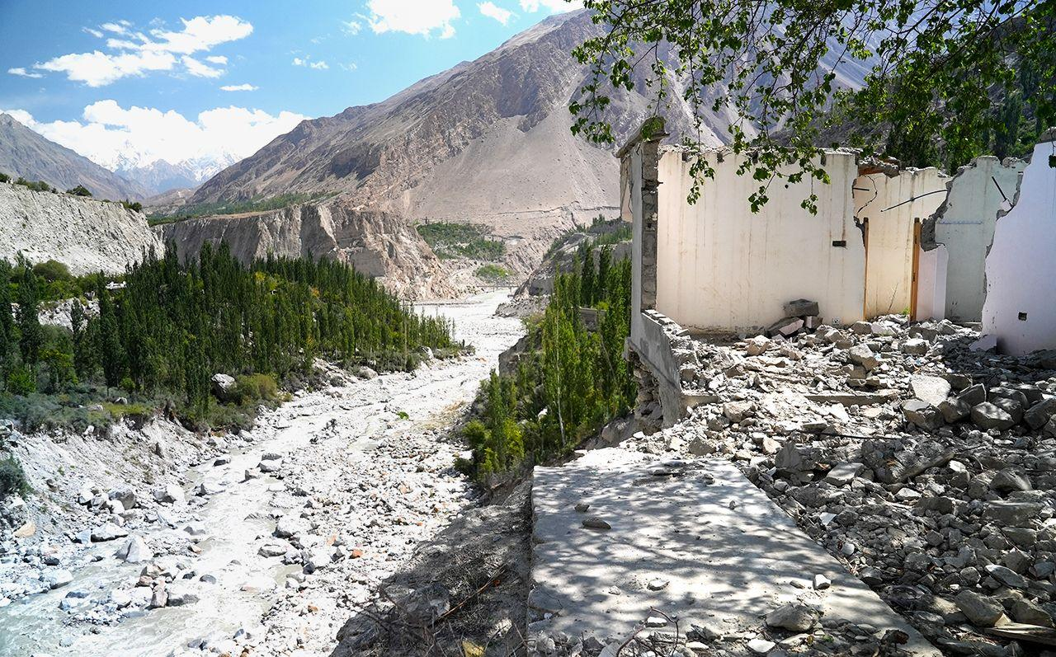
Improving Flood Resilience Planning and Decision-making in the Himalayas: A Collective Action Approach with System Dynamics Modeling
Sabuhi Essa
EGU25-6624, 29th April 2025
Cover Picture: BBC, 2024
Notes:
Hello, everyone. I'm Sabuhi Essa, a PhD student at the University of Cambridge. I am excited to share my research on enhancing flood resilience in the vulnerable Himalayan Mountain regions (also known as the Third Pole), where traditional engineering-focused resilience efforts are falling short.

Slide 2
Notes:
Evidence from around the world and current studies show that "Predict-and-control" and top-down approaches neglect the complex social, organisational, economic, and technical dimensions of flood resilience.

Slide 3
Notes:
These limitations are topped up with contextual challenges, which necessitate a shift towards a whole-of-systems approach for planning and decision-making.

Slide 4
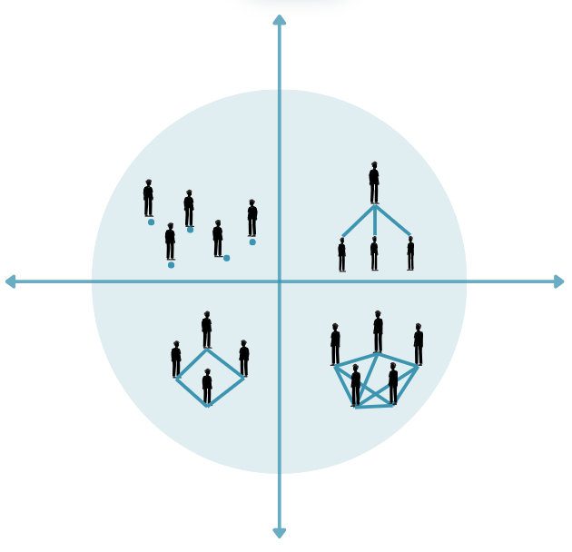
Integration of Grid-Group Theory, Participatory System Dynamics Modelling (PSDM) and Socio-ecological Resilience
Flood
Resilience
SOCIO-ECOLOGICAL RESILIENCE
System-based Collaborative planning approach for
Flood infrastructure resilience
Participatory/ Collaborative planning
GRID-GROUP THEORY
Theory of complexity
SYSTEM DYNAMICS
Participatory System Dynamics Modelling PSDM method for flood resilience planning and decision-making
University of Cambridge- Sabuhi Essa-se449@cam.ac.uk
EGU2025
Notes:
This research introduces a system-based collective action approach, integrating Grid-Group Theory and Participatory System Dynamics (PSD) with socio-ecological resilience. This also makes the three layers of the System Dynamics model.

Slide 5
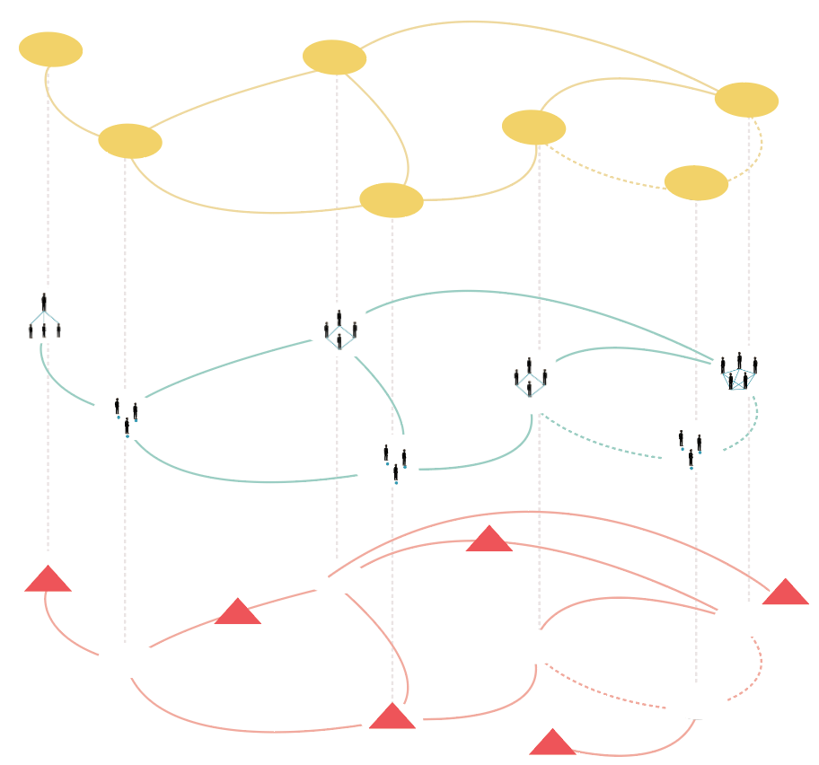
Situation
(Past)
2. Preparation
(Present)
3. Action
(Future)
PSDM
Elements
connections
Root causes
Cascading effects
Leverage
points
Grid-Group
Stakeholder
Values and interests
Outcomes
Stakeholder roles, capacities, level of interest
Flood resilience
Coping
Mechanisms &
Resilience
Interventions and
Resilience
Outcomes
analysis
University of Cambridge- Sabuhi Essa-se449@cam.ac.uk
EGU2025
Notes:
This makes the three layers of the System Dynamics model.

Slide 6
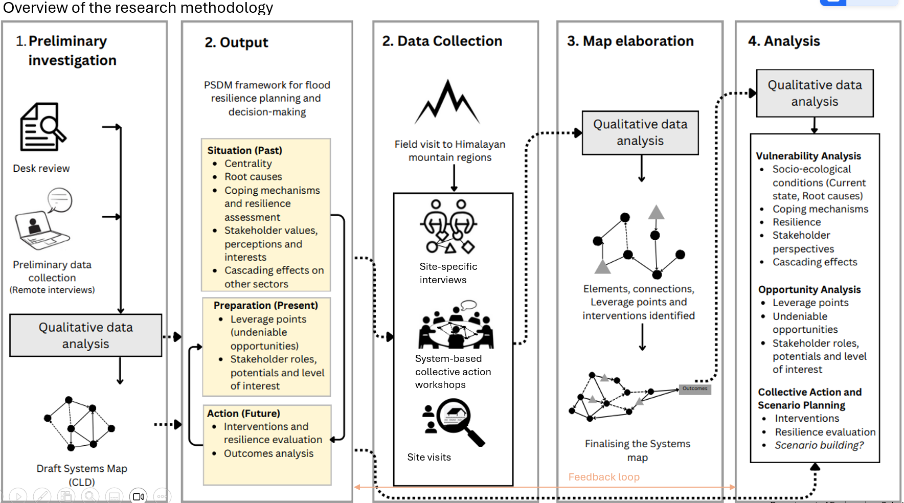
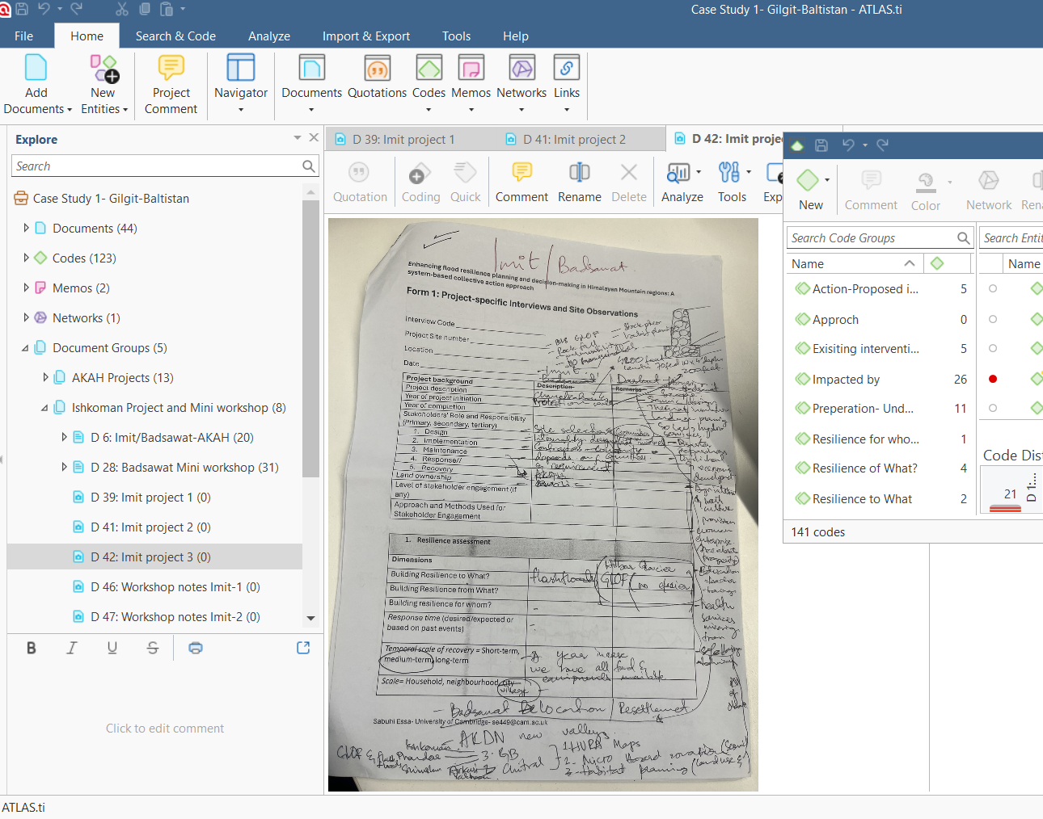
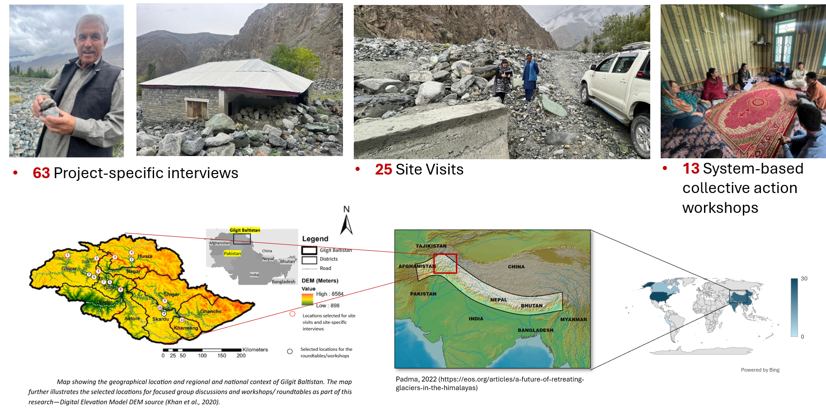
Methodology
University of Cambridge- Sabuhi Essa-se449@cam.ac.uk
EGU2025
Notes:
I applied this method in Gilgit-Baltistan, Pakistan, a region facing climate change impacts and underdevelopment. I conducted 13 participatory workshops, site observations, and interviews, developing system dynamics models with stakeholder input.

Slide 7
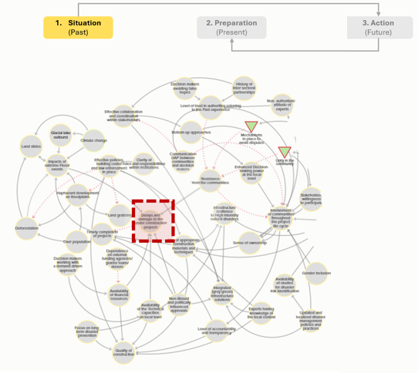
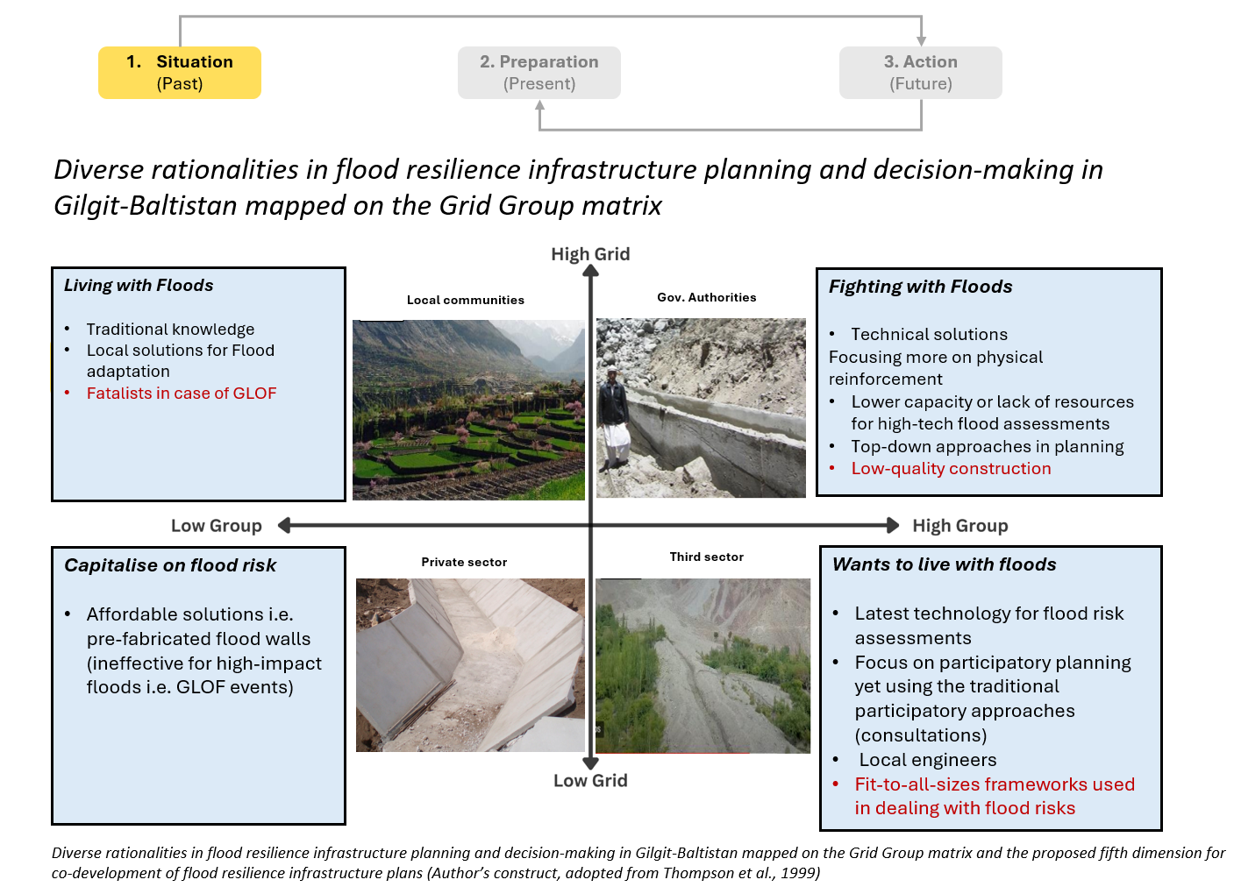
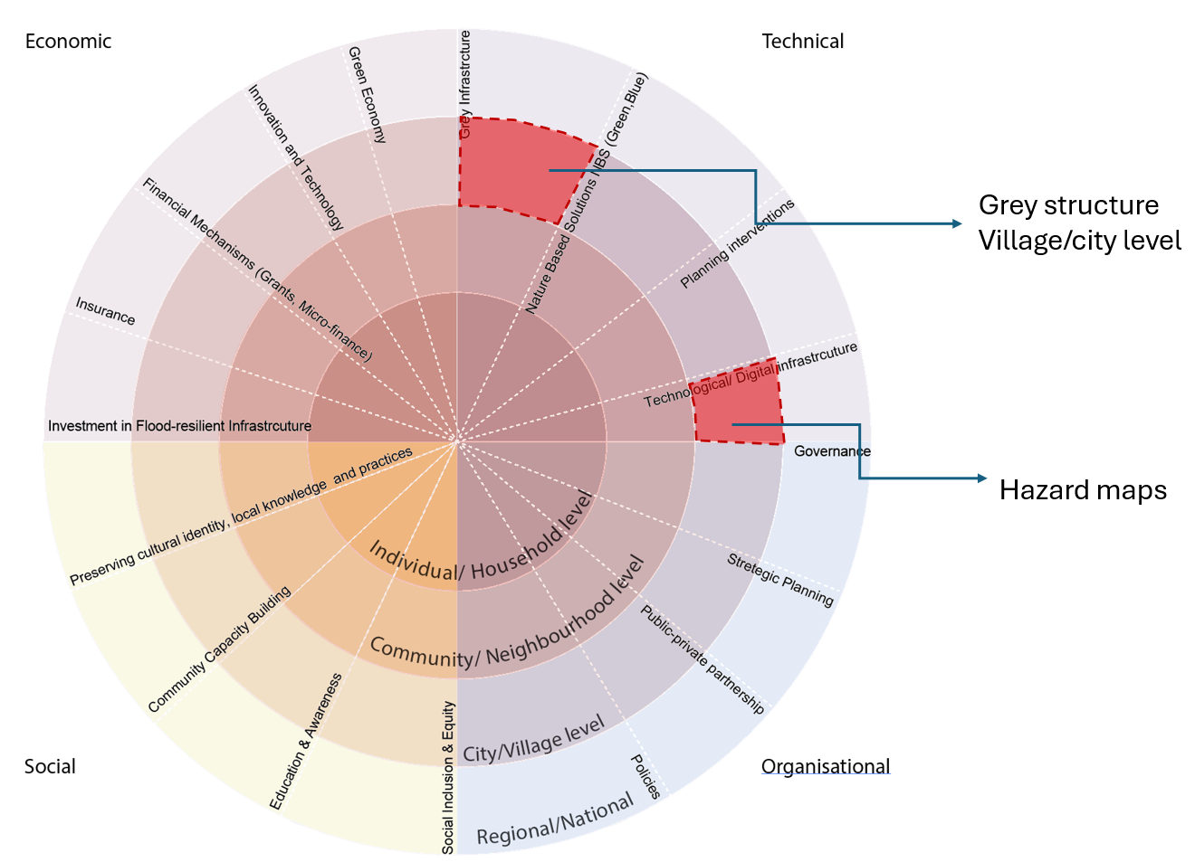
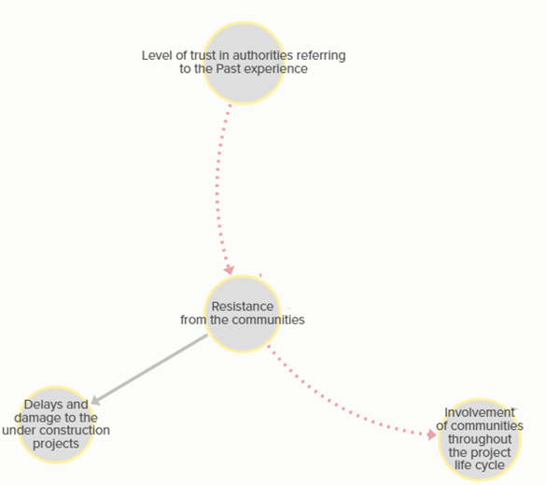
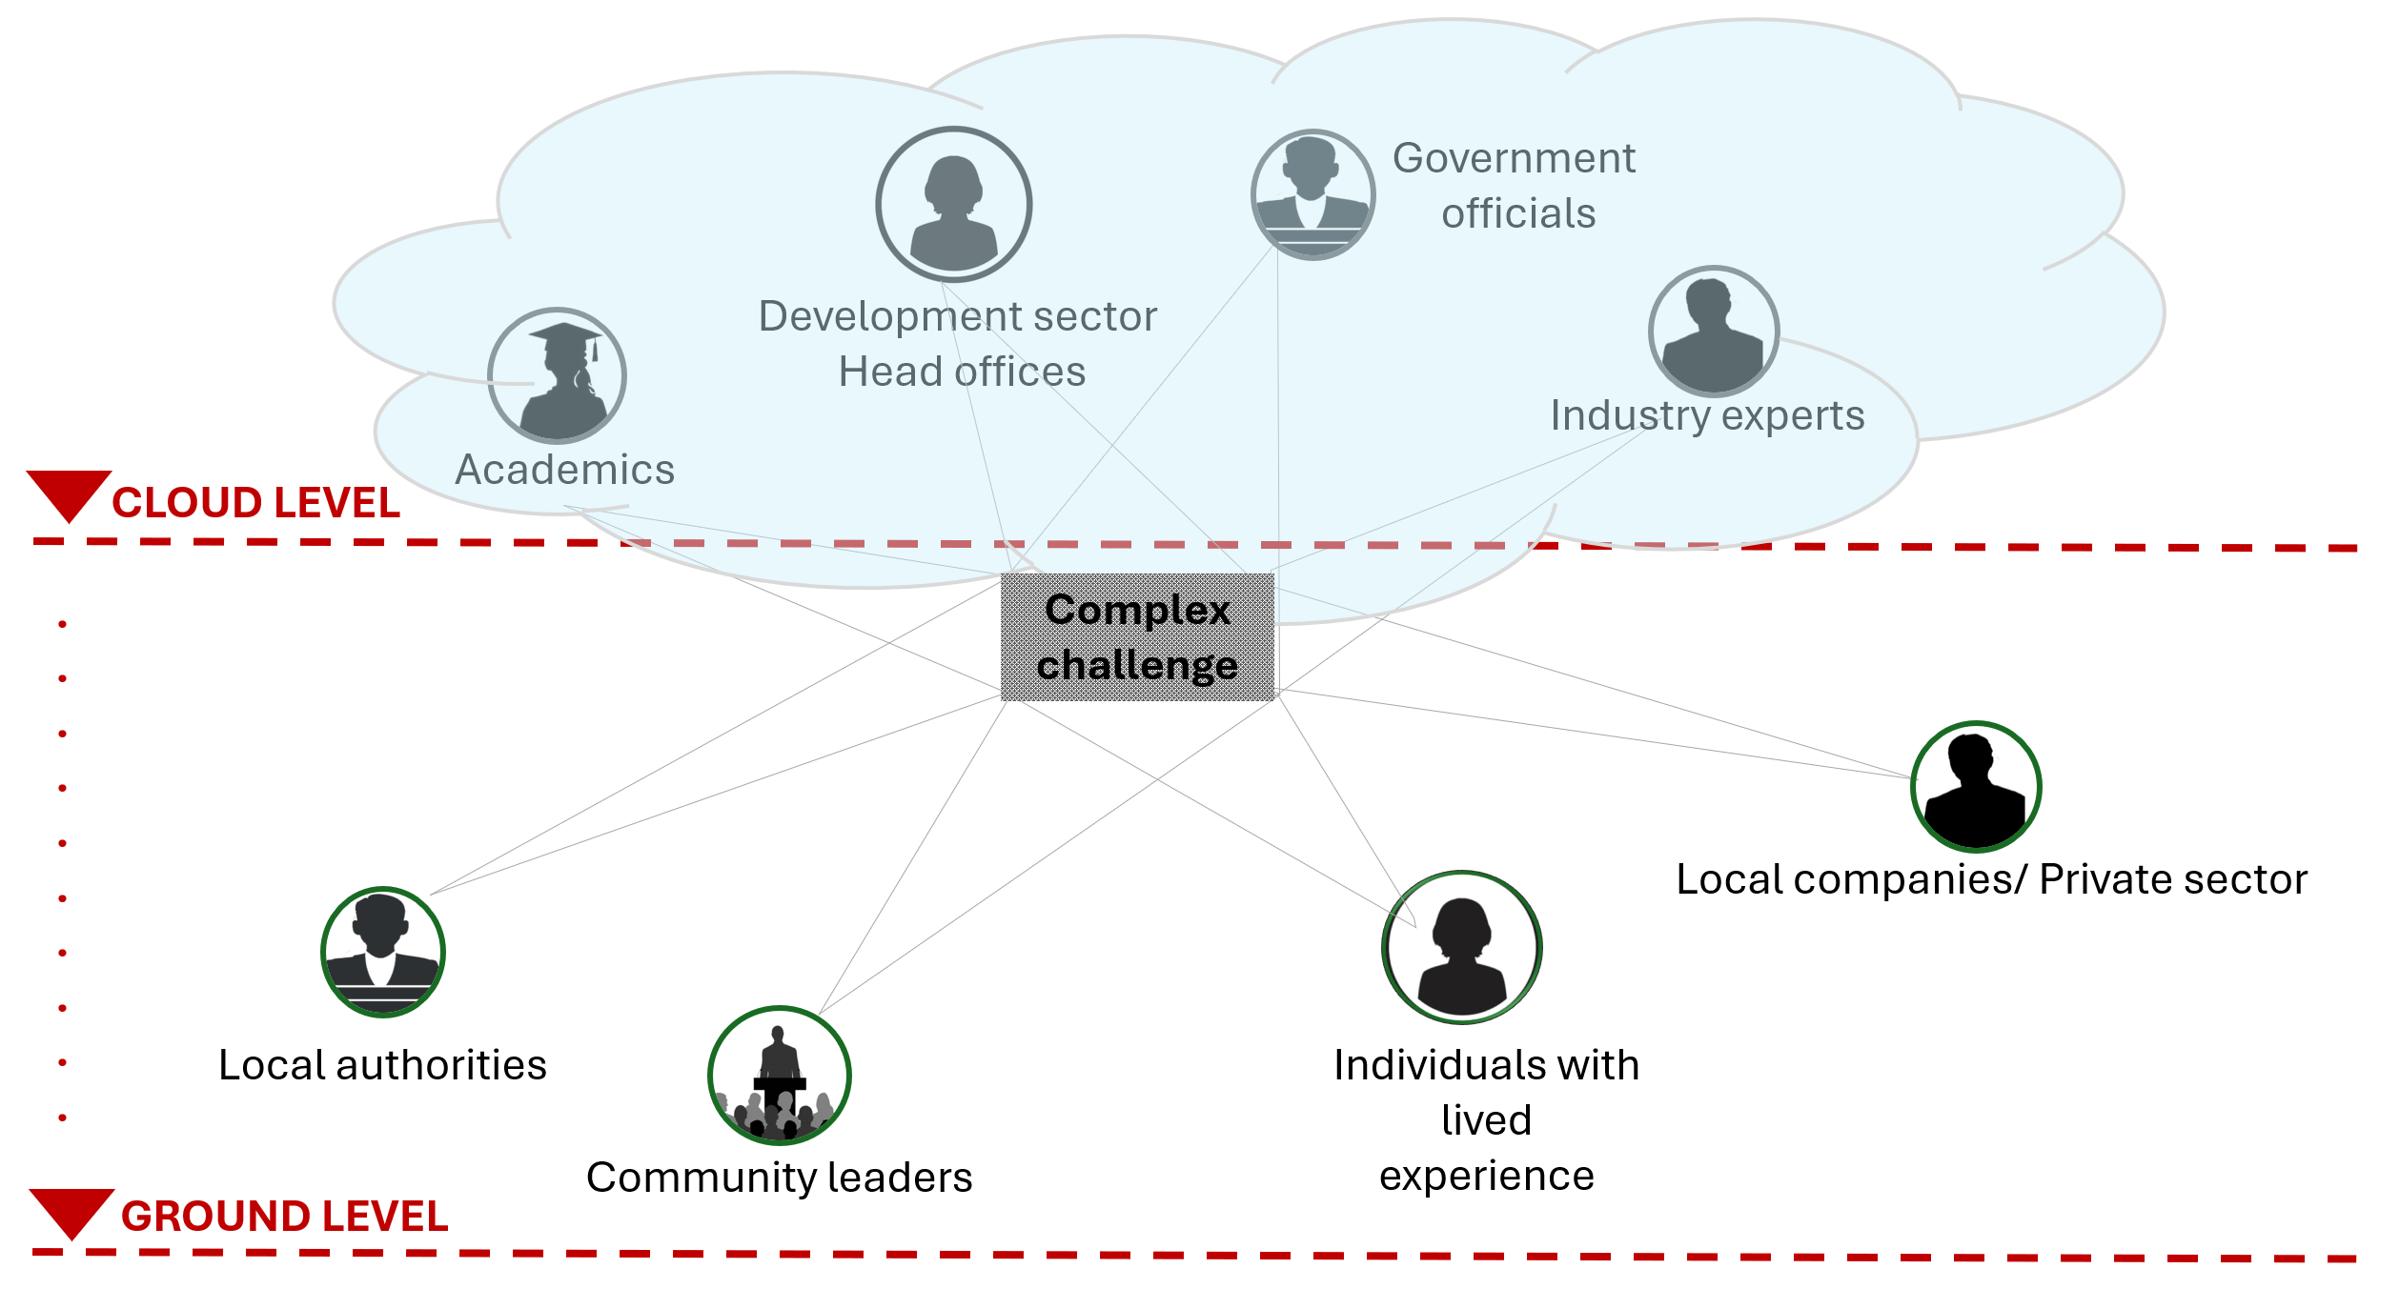
Example elements and connections: 20 out of 25 projects, community supervision increased the level of accountability, leading to timely completion and quality assurance
Illustration showing the divide between the CLOUD LEVEL and GROUND LEVEL stakeholders (Author’s construct)
88% of projects Focus on PREDICT (risk assessment) and CONTROL (physical reinforcements) (Author’s construct)
University of Cambridge- Sabuhi Essa-se449@cam.ac.uk
EGU2025
Notes:
Preliminary results show a dominant 83% focus on engineering resilience, with limited ecological and no socio-ecological considerations. the models also highlight critical interdependencies and leverage points for improved resilience.

Slide 8
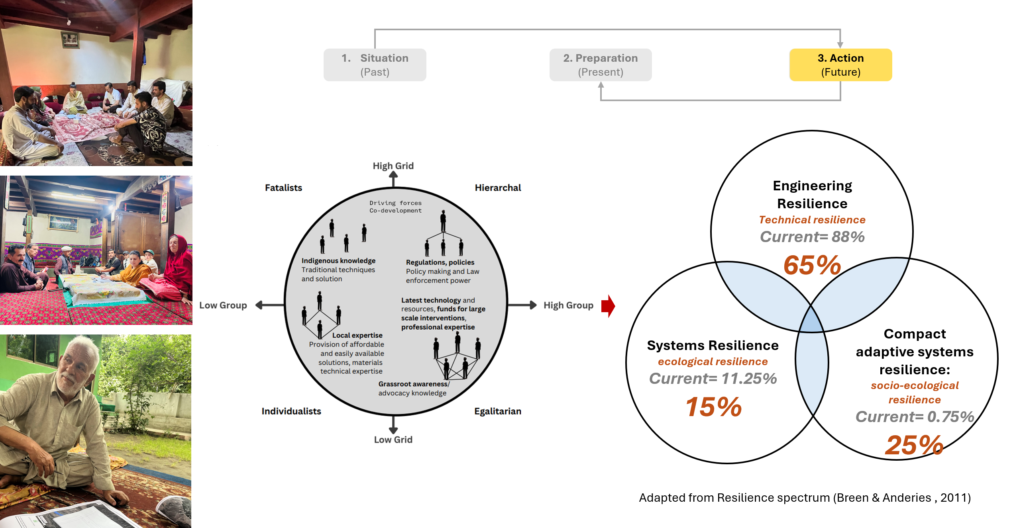
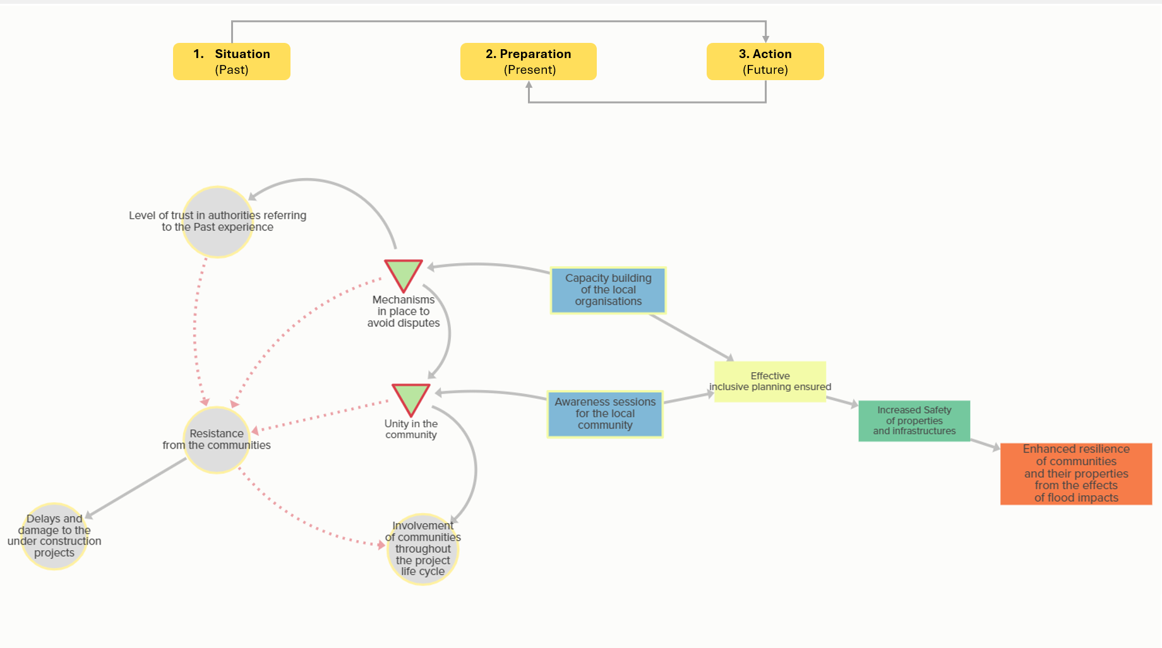
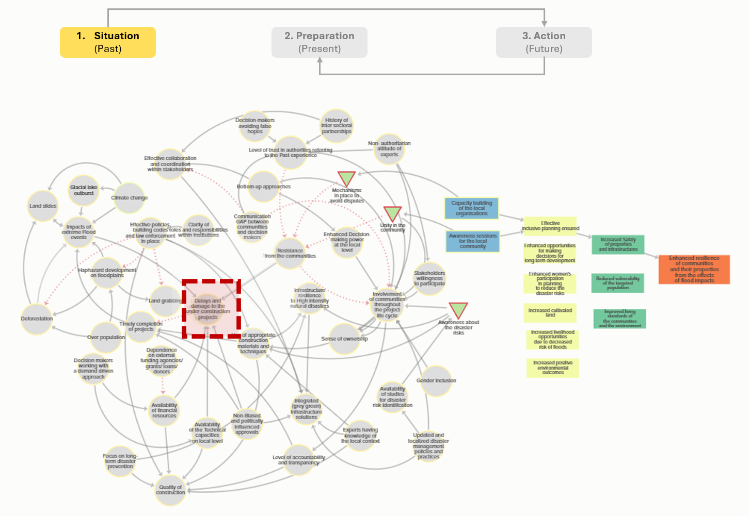
Preliminary Findings
Distribution of interventions on Resilience spectrum (Breen & Anderies , 2011) proposed in the Collective action workshops (Author’s construct)
Pathways and feedback loops within the System Dynamics map (Author’s construct)
- Improved evidence-based decision-making
- Empowers diverse stakeholders - Improved outcomes of flood resilience planning and decision-making - Long-Term Sustainability: Ownership, adaptation and long-term planning
University of Cambridge- Sabuhi Essa-se449@cam.ac.uk
EGU2025
Notes:
Interestingly, the interventions proposed within the system-based collective action workshops go beyond just engineering solutions, incorporating ecological and socio-ecological strategies. This shows how transformative this multidisciplinary method can be for improved evidence-based decision-making especially in high-risk underdeveloped regions such as Himalayan Mountains.

Slide 9
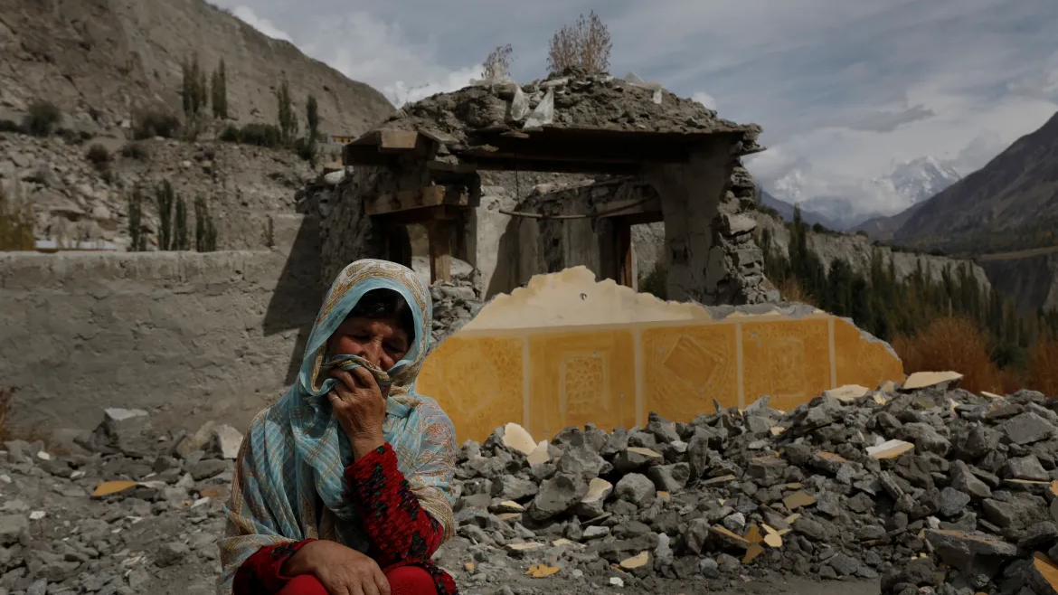
Questions and Feedback Welcome!
Sabuhi Essa
University of Cambridge
se449@cam.ac.uk
EGU2025
Notes:
If you are interested in this method and the findings, I am right there at the PICO spot! Thankyou!

Slide 10
PICO Slides continue…
University of Cambridge- Sabuhi Essa-se449@cam.ac.uk
EGU2025

Slide 11
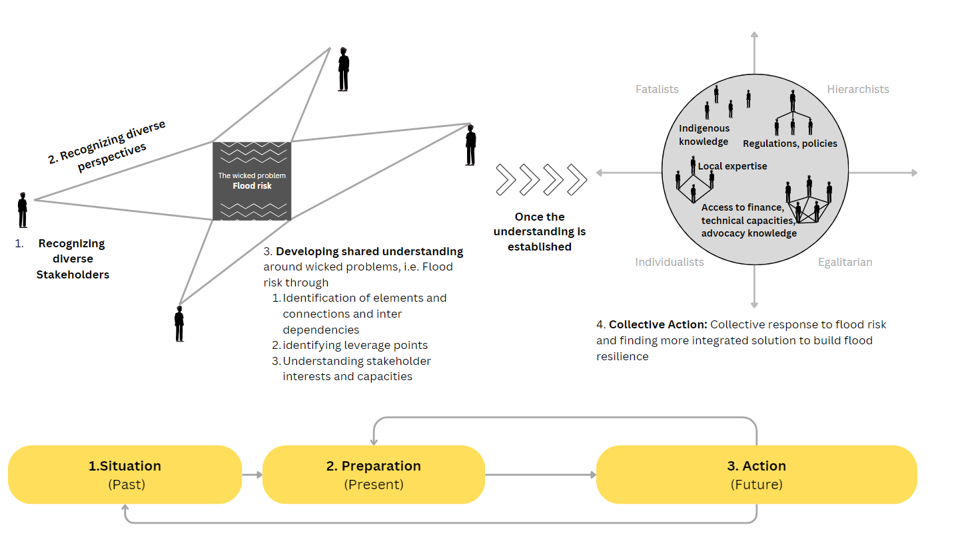
System-based collaborative action for flood resilience planning and decision-making
Participatory System Dynamics Modelling PSDM
The Cambridge Country Consultation (CCC)
University of Cambridge- Sabuhi Essa-se449@cam.ac.uk
EGU2025
Notes:
The Cambridge Country Consultation (CCC) method applies systems thinking with political economics theories to collect data directly from representatives of governments, citizens and multilateral agencies.
Iterative process

Slide 12
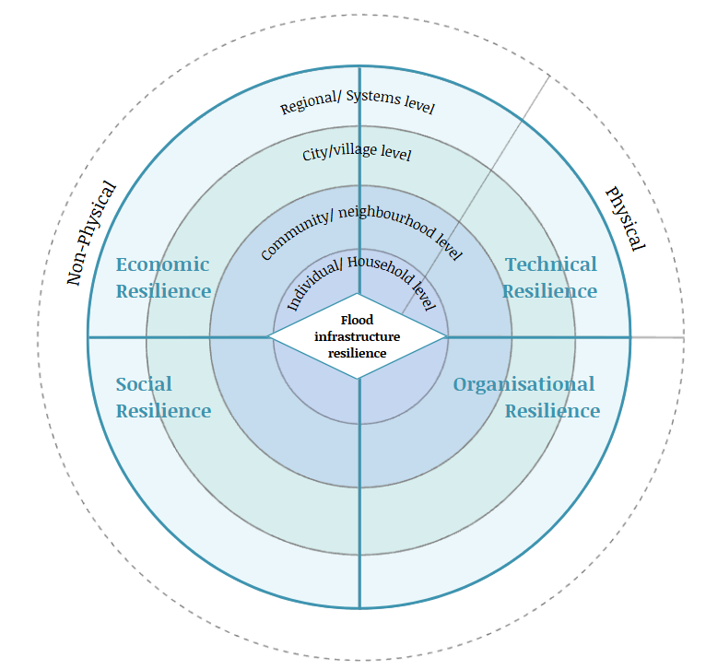
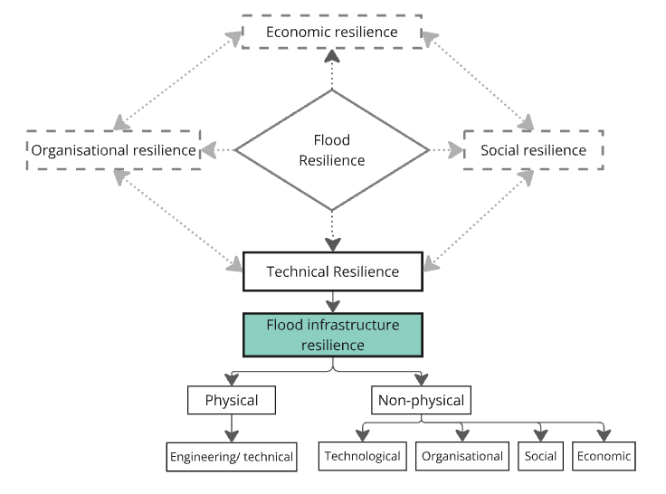
Multidimensionality of the Flood Resilience concept
(a)
(b)
Figure (a) Conceptual representation of the various dimensions of Flood infrastructure resilience and their interconnections.
Figure (b) Conceptual representation of the Physical and non-physical elements of flood infrastructure resilience across various levels and dimensions
University of Cambridge- Sabuhi Essa-se449@cam.ac.uk
EGU2025

Slide 13
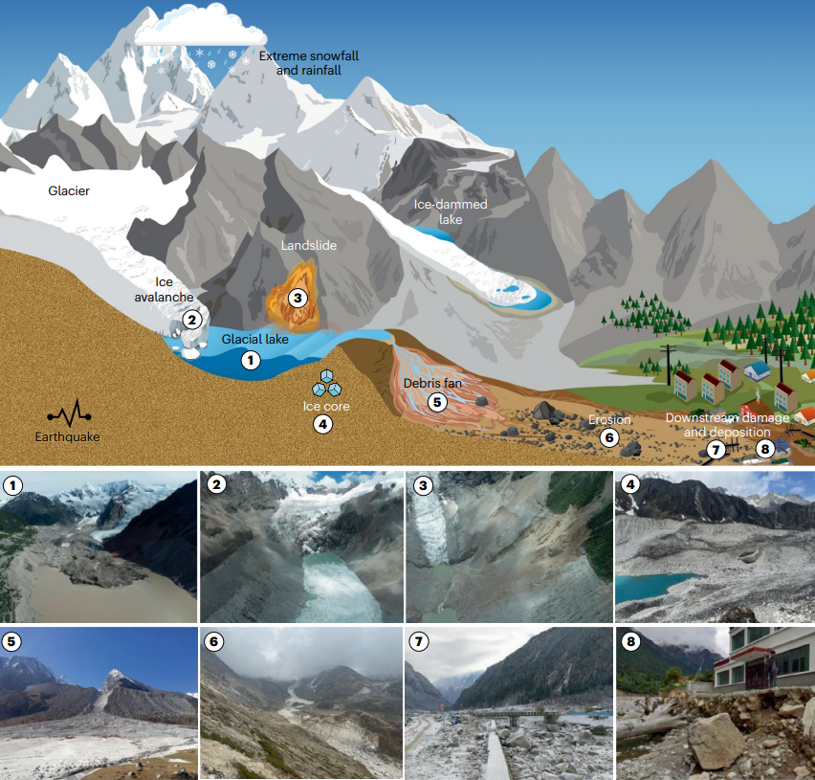
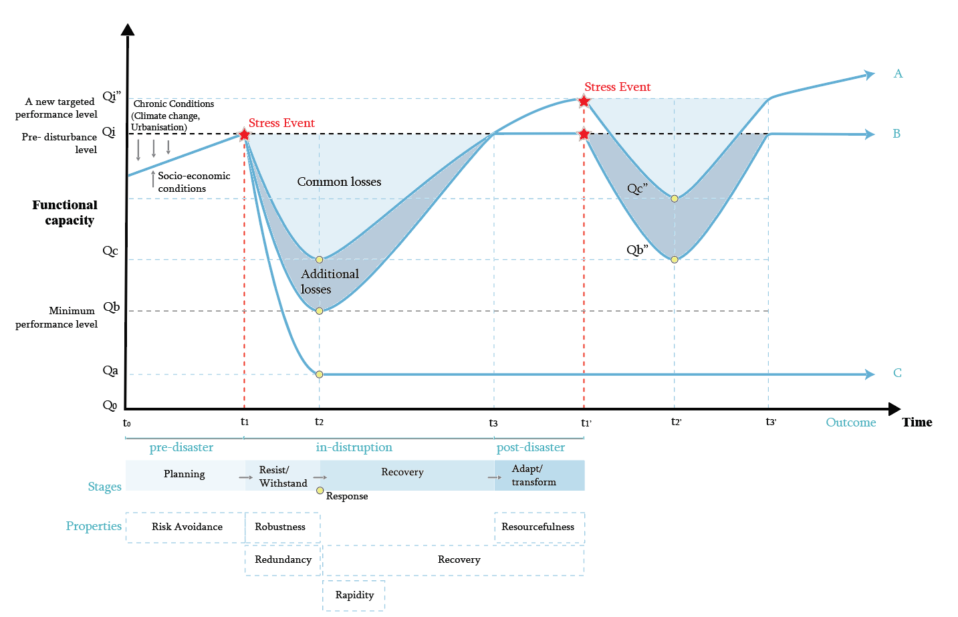
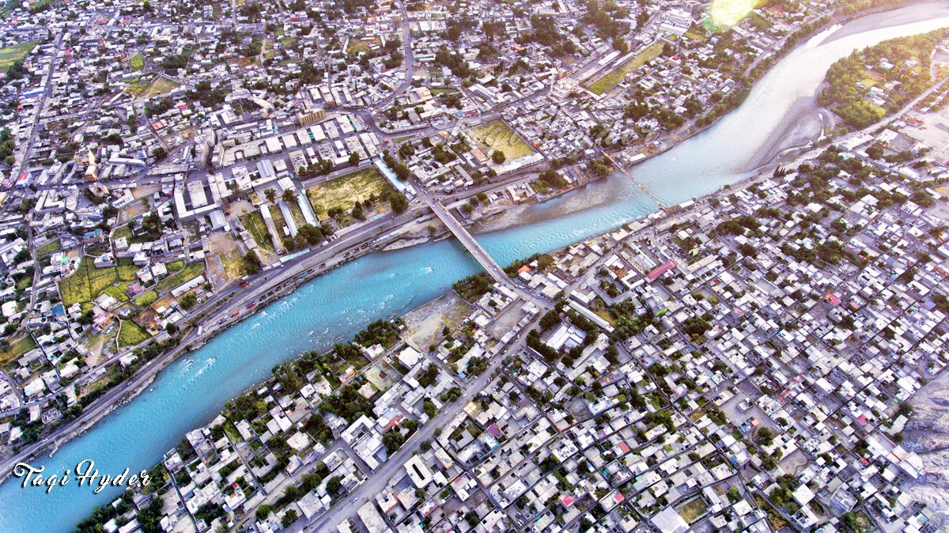
Direct
Residents/ Local communities
Landowners
Assets (Land, infrastructure, livestock)
Indirect
Local businesses (tourism)
Agriculture sector (livelihoods and food security)
Social infrastructure
Culture and identity
Health and wellbeing
Cities, towns, and Villages in the Himalayan Mountain regions with a focus on flood infrastructure system as part of a broader system…
Definition of Flood Resilience in this research:
A mechanism to understand how an infrastructure system withstands the impact of an extreme flood event outside its traditional design boundaries to recover its functionality and allow continuous transformation (McClymont et al., 2020; Disse et al., 2020).
Definition of Flood Resilience in this research:
A mechanism to understand how an infrastructure system withstands the impact of an extreme flood event outside its traditional design boundaries to recover its functionality and allow continuous transformation (McClymont et al., 2020; Disse et al., 2020).
Gilgit city, GilgitBaltistan GB, Pakistan Flooding in Shishkat village Hunza,
Source: Source:
Functional capacity over time taken to recover after an impact or acute disruption. The Lines A, B, C, and D represent various post-shock equilibrium states as outcomes (Adopted from Disse et al, 2020).
Household
Resilience of what?
(Keating et al., 2017)
Neighbourhood
Resilience to what?
City/town/village
Resilience for whom?
City/town/village as a system of systems
University of Cambridge- Sabuhi Essa-se449@cam.ac.uk
EGU2025
Types of floods in the Himalayan mountain regions (ICIMOD, 2021; Campagno et al., 2022)

Slide 14
Approaches in dealing with Floods
Studies focusing on flood protection
A focus on predict and control approach
Focus on resisting floods instead of building resilience and adaptability to floods
Hartmaan, 2012; 2016; Zevenbergen et al., 2020; Fleming, 2002; Tempels, 2016; Davis et al., 2021; Bi et al., 2023
Frameworks/ tools for Flood infrastructure resilience planning and decision-making
Flood resilience
Dominated by engineering and system resilience
Research focus on technical approaches such as risk assessments and provision of physical reinforcement
3% of studies define and access Compact adaptive system Resilience
Breen & Anderies, 2011; MacClaymont et al., 2019; Tempels, 2016; Zevenbergen, 2016 ; Keating et al., 2017
Socio-ecological resilience
Despite the emphasis lack of system-based participatory approaches for resilience building
Bond et al. 2015; Resilience Alliance, 2010; Walker et al., 2002; Hartman,2016; Stave,2010; Videira et al., 2017
System-based Participatory approaches in Building Resilience to flood risk
Limited studies presenting Participatory System dynamics modelling PSDM methods tailored to the flood resilience concept (CAS resilience)
Traditional models often overlook social dynamics and stakeholder perspectives.
A major dependence on simulations and quantitative data analysis for flood-related planning and decision-making
Stave, 2010; Pluchinotta et al., 2021; Pagano et al., 2019;Videira et al., 2017; Antunes et al, 2006; Hossain et al, 2020; Perrone et al, 2020
System-based frameworks for co-creation/ collaborative planning
Participatory System dynamics Modelling PSDM method for
Collective action planning in flood resilience
University of Cambridge- Sabuhi Essa-se449@cam.ac.uk
EGU2025
Department of Engineering- Sabuhi Essa-se449

Slide 15
Combines quantitative (data analysis and scenario building) & qualitative data (empirical data collected from the fieldwork) into Participatory System Dynamics Modelling (PSDM)
Overview of the research methodology
Site-specific interviews
System-based collective action workshops
Feedback loop
Site visits
Feedback loop
University of Cambridge- Sabuhi Essa-se449@cam.ac.uk
EGU2025
Department of Engineering- Sabuhi Essa-se449
Notes:
From top down ploting the classes of knowledge - Classes of drivers- knowledge graphs – graph theory to analyse network of objects- design structure matrix- DSM, Adjecent C metrix

Slide 16
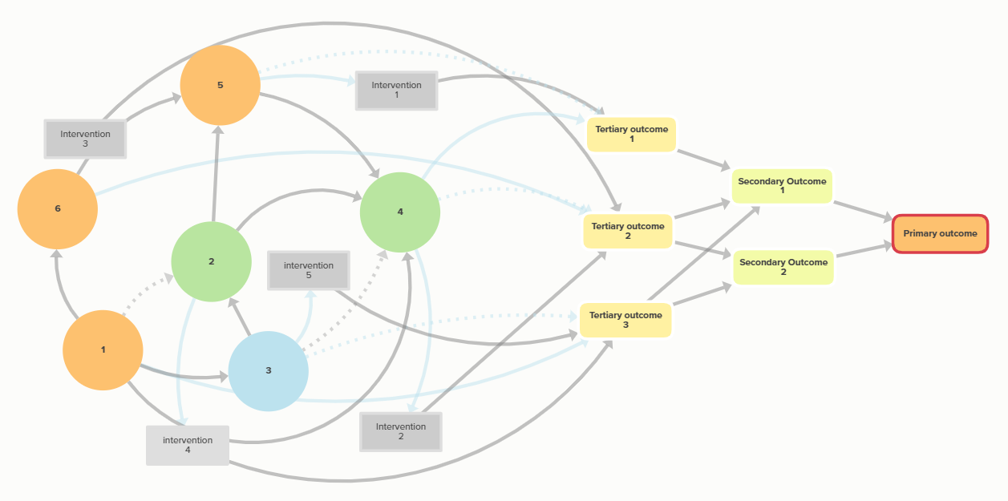
Steps in Systems Map elaboration
Step 1: Situation: Identification of elements and connections
Step 2: Preparation: Identifying the root causes and leverage points within the system
Step 3: Action: Identifying the outcomes and co-developing the interventions
University of Cambridge- Sabuhi Essa-se449@cam.ac.uk
EGU2025
Department of Engineering- Sabuhi Essa-se449
Notes:
Knowledge taxonomy, starts with why, what how, drivers, resources, knowledge – supply side= techno;logy, resources,

Slide 17
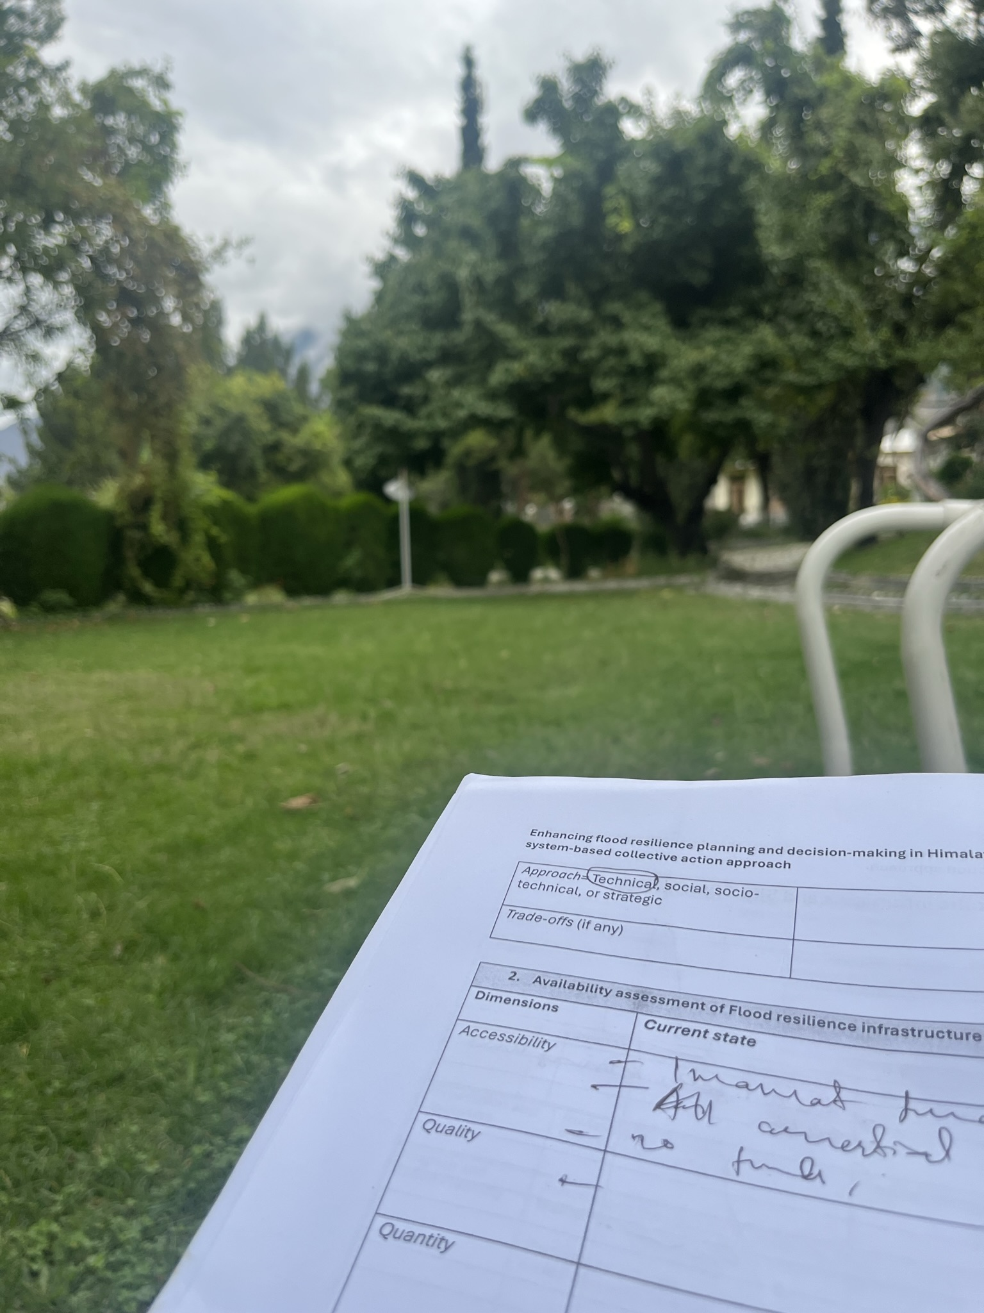
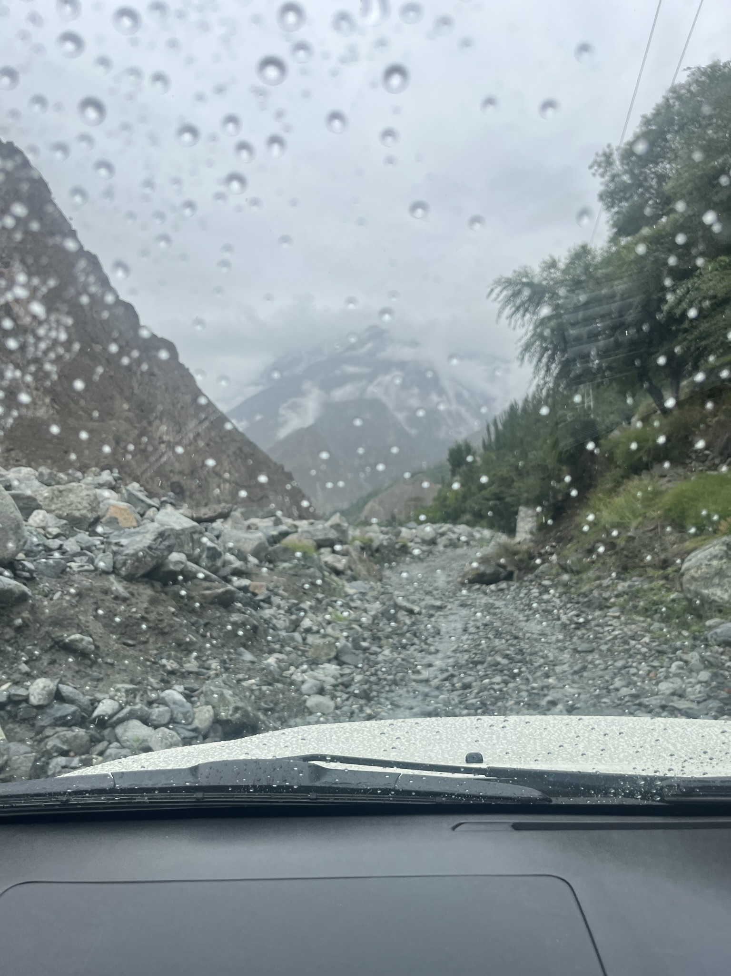
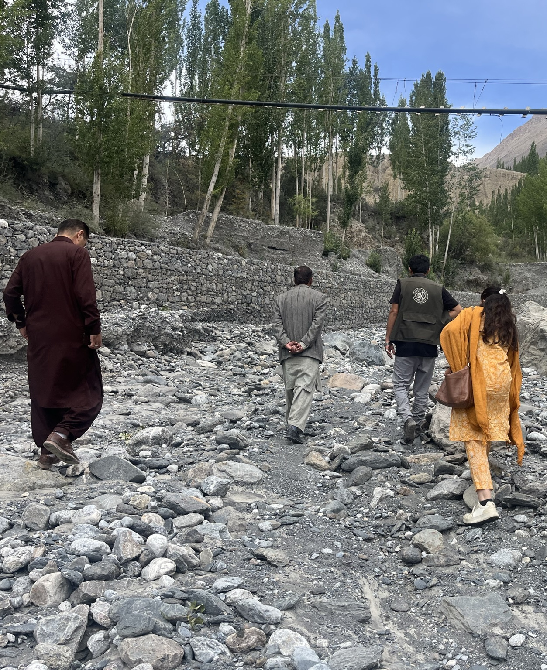
Limitations
Power and internet issues
Road blockages
Gender imbalance
Sectoral silos
University of Cambridge- Sabuhi Essa-se449@cam.ac.uk
EGU2025

Slide 18
Notes taking template for workshops and site visits
Hazard Assessment maps (Aga Khan development network and UNDP)
University of Cambridge- Sabuhi Essa-se449@cam.ac.uk
EGU2025

Slide 19
System-based frameworks for co-creation/ collaborative planning
System-based Participatory approaches in Building Resilience to flood risk
Research Limitations
No established flood infrastructure resilience planning and decision-making framework effectively integrates technical, social, and ecological dimensions of flood resilience (Compact adaptive system resilience).
Traditional models often overlook social dynamics and stakeholder perspectives.
PSDM methods often rely solely on quantitative data analysis and simulations to understand system behaviour.
PSDM modelling often ends with the evaluation of the current state of the system with limited studies proceeding to identify leverage points and interventions in the context of flood-related decision-making
Research Novelty
1. First application of system-based collective action framework using Participatory System Dynamics Modelling (PSDM) tailored for flood resilience planning and decision-making
2. Integrates Grid-Group Cultural Theory into Participatory System Dynamics Modelling (PSDM) to understand social factors influencing flood resilience.
3. Combines quantitative (data analysis) & qualitative data (empirical data collected from the fieldwork) into Participatory System Dynamics Modelling (PSDM)
4. Development of a novel system-based collective action framework for long-term flood resilience planning (Past, present, future).
Only 03% of studies focus on the Himalayan, Karakoram and Hindukush regions in the context of Flood resilience.
Lack of case studies using system-based collective action for planning & decision-making.
No focus on extreme events in high-risk regions (GLOFs)
5. First comprehensive, context-specific study to inform effective resilience planning and decision-making for extreme and uncertain events (i.e. Glacial lake outburst flooding GLOFs)
Participatory System Dynamic Modelling PSDM for flood resilience planning and decision-making
University of Cambridge- Sabuhi Essa-se449@cam.ac.uk
EGU2025
Department of Engineering- Sabuhi Essa-se449

Slide 20
Questions and Feedback Welcome!
Sabuhi Essa
University of Cambridge
se449@cam.ac.uk
EGU2025

