Slide 1
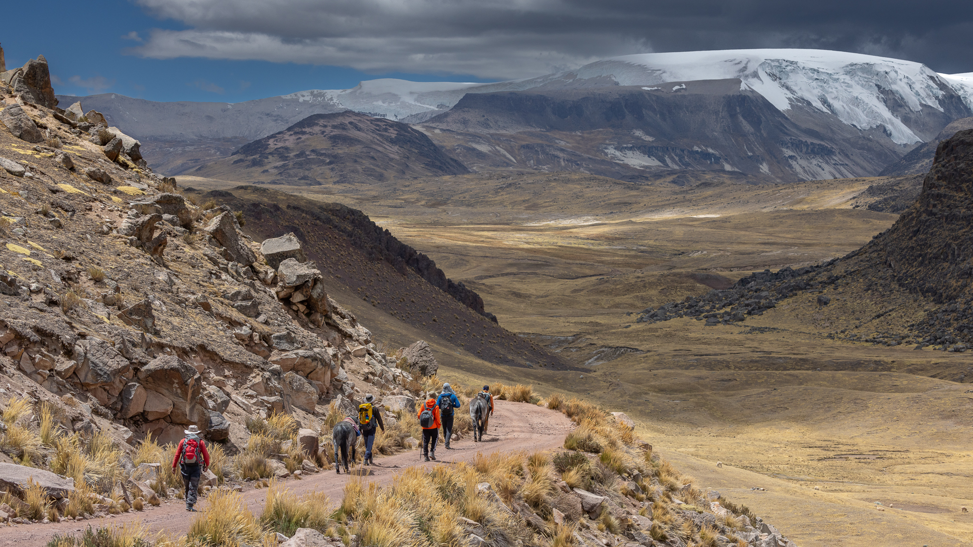
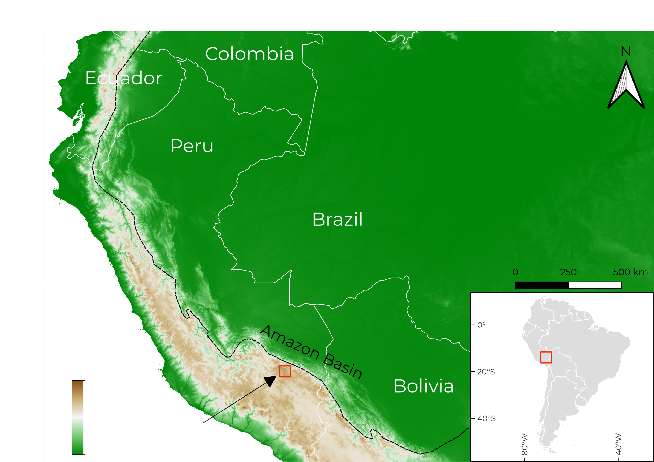
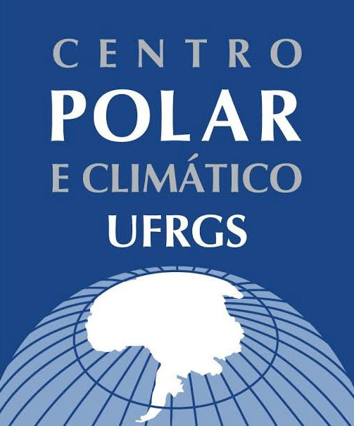
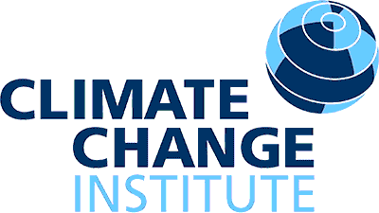
PROXIES OF AMAZON CLIMATE IN A PERUVIAN ICE CORE
THE QUELCCAYA ICE CAP
Ilha, JG., Portella, MBP, Barbaro, E., Simões, JC., Mayewski, P., Barbante, C.
Access my abstract here!
An ice cap only 70 km away from the border with the Amazon Basin
5674 meters above sea level
Almost 130 meters of ice core
Possibly 2000 years of record
Photo: Mariusz Potocki
Photo: Mariusz Potocki
João Gomes Ilha, PhD Candidate in Polar Sciences (joao.gomes.ilha@gmail.com)

Slide 2
PROXIES OF AMAZON CLIMATE IN A PERUVIAN ICE CORE
THE QUELCCAYA ICE CAP
Access my abstract here!
Ice core
From the top to the bottom we analyze:
Levoglucosan (biomass burning proxy)
Inorganic Ions (Na⁺, K⁺, Cl⁻, Mg²⁺, Ca²⁺, SO₄²⁻, …)
Organic Ions (Acetate, glycolate, C2:C7 diacids, …)
Using Liquid Chromatography coupled with Mass Spectrometry
What do we do with this ice core?
Photo: Mariusz Potocki
João Gomes Ilha, PhD Candidate in Polar Sciences (joao.gomes.ilha@gmail.com)

Slide 3
PROXIES OF AMAZON CLIMATE IN A PERUVIAN ICE CORE
THE QUELCCAYA ICE CAP
Access my abstract here!
If you are keen to discuss:
Proxies in ice cores
Tropical glaciers
Amazon climatology
Biomass burning
Then you should come talk to me in my PICO presentation
You can find me in the
PICO SPOT2.2
Thank you and see you soon!
PICO SPOT2.2
Photo: Mariusz Potocki
João Gomes Ilha, PhD Candidate in Polar Sciences (joao.gomes.ilha@gmail.com)

Slide 5
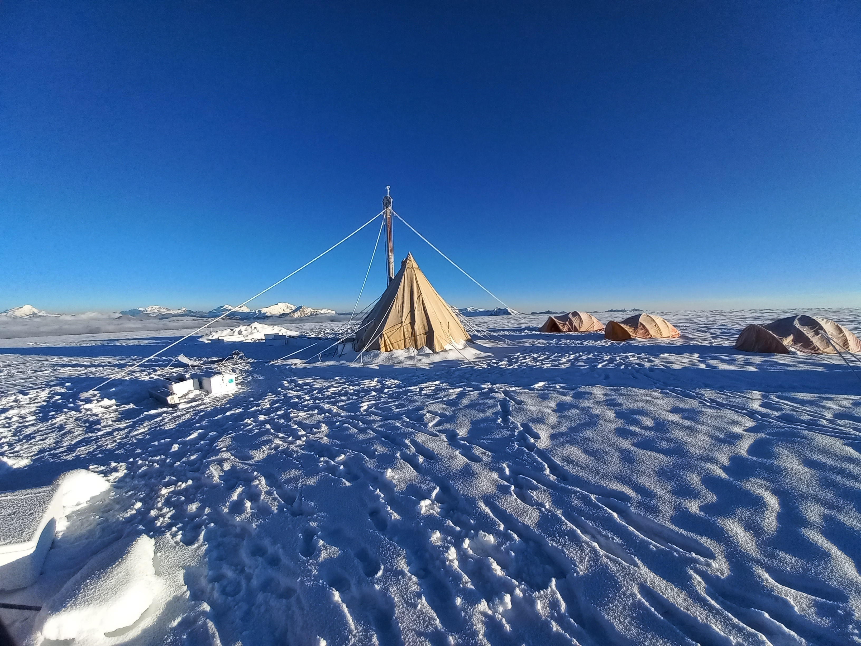
PROXIES OF AMAZON CLIMATE IN A PERUVIAN ICE CORE
THE QUELCCAYA ICE CAP
Ilha, JG., Portella, MBP, Barbaro, E., Simões, JC., Mayewski, P., Barbante, C.
START PRESENTATION
FOR THOSE SEEING THIS PRESENTATION AS MY SUPPLEMENTARY MATERIAL: PLEASE, INTERACT WITH THE PRESENTATION USING ONLY THE MOUSE AND NOT THE KEYBOARD ARROWS. THIS WAY YOU SIMULATE THE TOUCHSCREEN OF THE PICO SESSION KEEPING THE NAVIGATION SCHEME FUNCTIONAL.
Check out my abstract here!
Partner Institutions
Contact me!
Photo: João Ilha

Slide 7
PROXIES OF AMAZON CLIMATE IN A PERUVIAN ICE CORE
THE QUELCCAYA ICE CAP
Ilha, JG., Portella, MBP, Barbaro, E., Simões, JC., Mayewski, P., Barbante, C.
The Quelccaya Region
Ice coring, melting & subsampling
The Dating Problematics
Dating
INTRODUCTION
METHODOLOGIES
RESULTS & DISCUSSION
CONCLUSIONS
Why Ice Cores?
Levoglucosan
Levoglucosan
Proxies
Next Steps
Air mass circulation
Inorganic & Organic Ions
Inorganic & Organic Ions
Check out my abstract here!
Partner Institutions
Contact me!
Photo: João Ilha

Slide 9
PROXIES OF AMAZON CLIMATE IN A PERUVIAN ICE CORE
THE QUELCCAYA ICE CAP
Ilha, JG., Portella, MBP, Barbaro, E., Simões, JC., Mayewski, P., Barbante, C.
INTRODUCTION
METHODOLOGIES
RESULTS & DISCUSSION
CONCLUSIONS
The Quelccaya Region
Ice coring, melting & subsampling
The Dating Problematics
Dating
Why Ice Cores?
Levoglucosan
Levoglucosan
Proxies
Next Steps
Air mass circulation
Inorganic & Organic Ions
Inorganic & Organic Ions
Check out my abstract here!
Partner Institutions
Contact me!
Photo: João Ilha

Slide 11
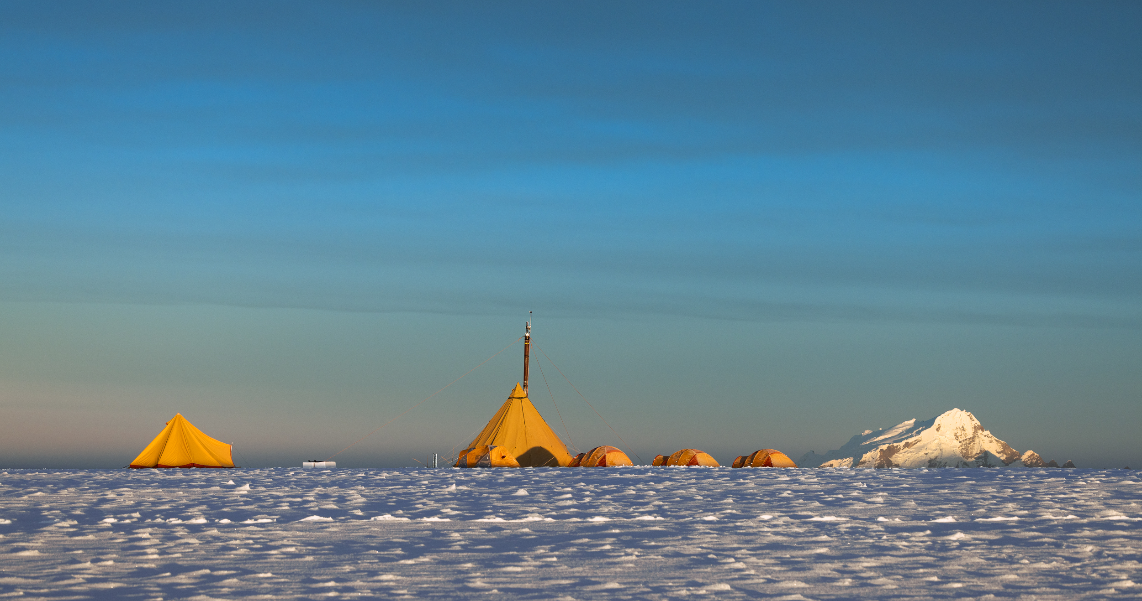
Photo: Mariusz Potocki
INTRODUCTION
INTRODUCTION

Slide 12
End Presentation
Photo: Mariusz Potocki
The Quelccaya Region
What is the Quelccaya?
What is the Quelccaya?
INTRODUCTION
INTRODUCTION
An ice cap (5764 masl) sat atop a volcanic plateau (approx. 5300 masl)
Ice caps are large, relatively flat, bodies of ice that feed multiple glaciers.
Two main domes:
North Dome
Summit Dome (drilled)
Contact me!
Check out my abstract here!

Slide 13
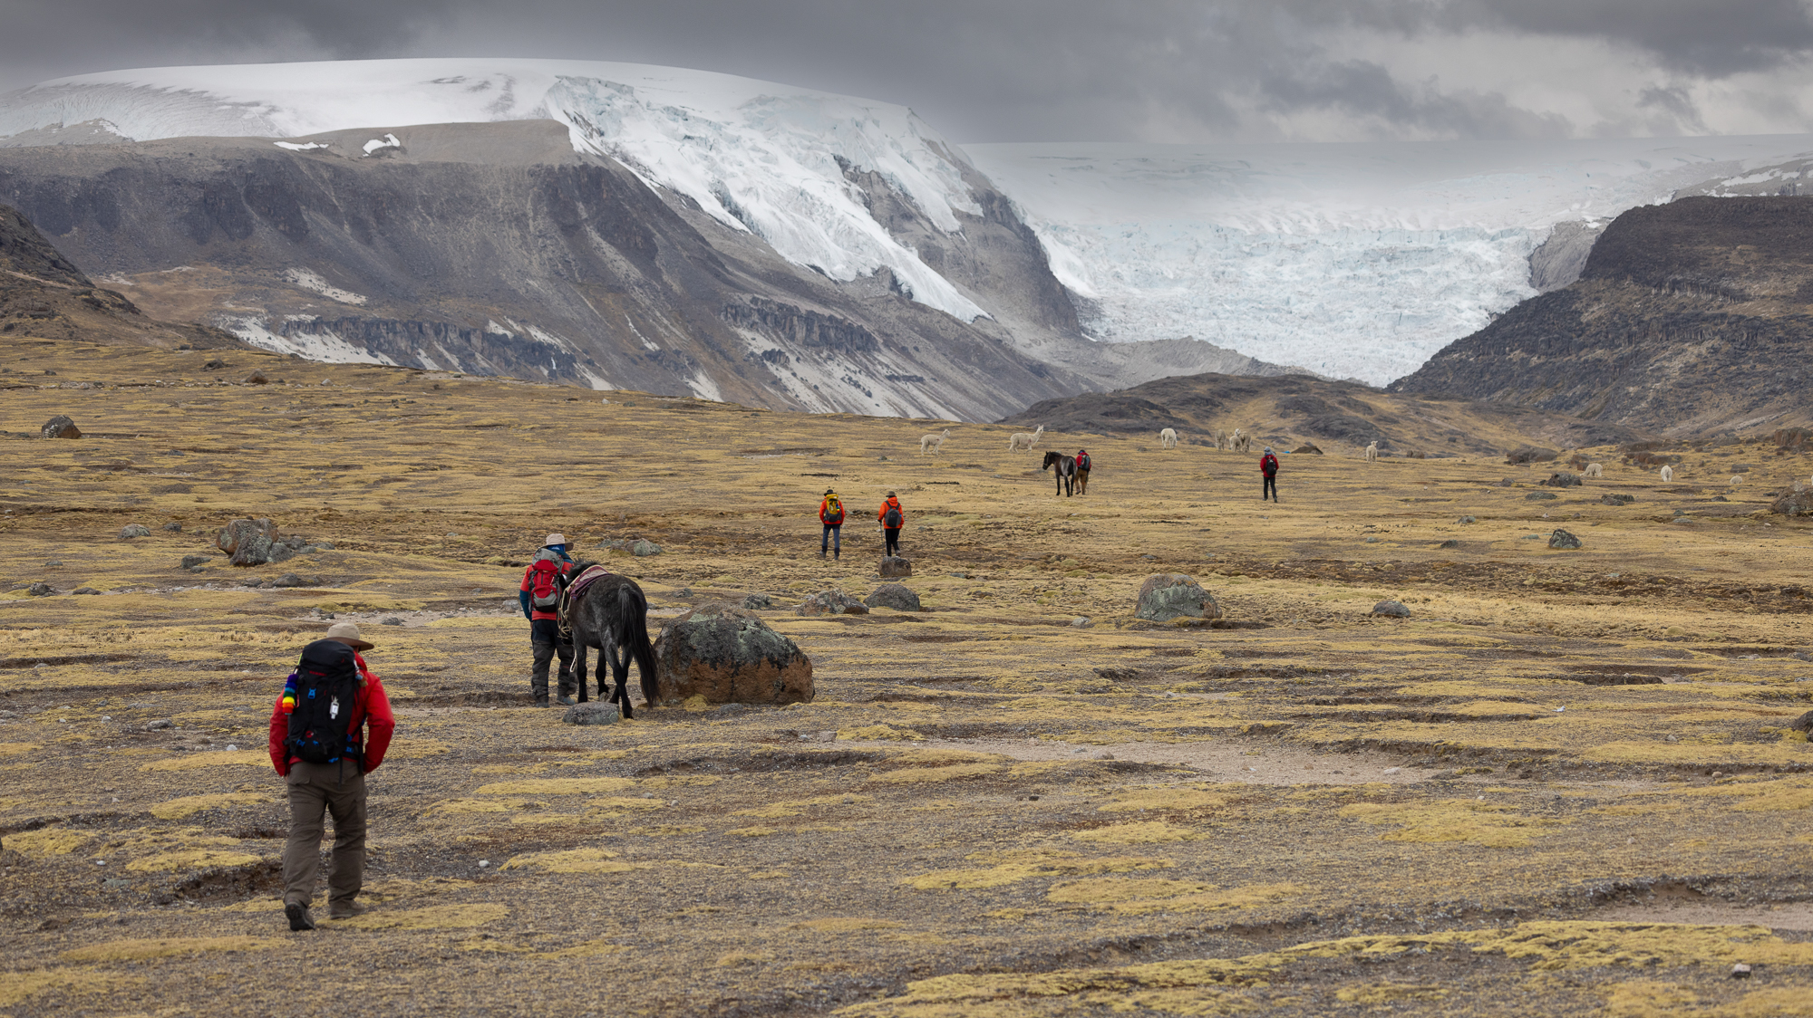
QUELCCAYA ICE CAP
VOLCANIC PLATEAU
OUTLET GLACIER
Photo: Mariusz Potocki

Slide 14
End Presentation
INTRODUCTION
Photo: Mariusz Potocki
INTRODUCTION
The Quelccaya Region
What is the Quelccaya?
What is the Quelccaya?
An ice cap (5764 masl) sat atop a volcanic plateau (approx. 5300 masl)
Ice caps are large, relatively flat, bodies of ice that feed multiple glaciers.
Two main domes:
North Dome
Summit Dome (drilled)
Back to Main Menu
Next: Why Ice Cores?
Contact me!
Check out my abstract here!

Slide 16
End Presentation
INTRODUCTION
Photo: Mariusz Potocki
INTRODUCTION
Why Ice Cores?
Snow precipitation
Ice coring
Summit Dome
North Dome
Dust transport and dry deposition
Ice Cap
Volcanic Plateau
Outlet glaciers
Contact me!
Check out my abstract here!

Slide 17
End Presentation
INTRODUCTION
Photo: Mariusz Potocki
INTRODUCTION
Why Ice Cores?
Ice coring
Summit Dome
North Dome
Let’s dive into the ice core
Click it!
Ice Cap
Volcanic Plateau
Outlet glaciers
Contact me!
Check out my abstract here!

Slide 19
End Presentation
INTRODUCTION
Photo: Mariusz Potocki
INTRODUCTION
Why Ice Cores?
Ice core
Atmospheric chemistry
RECORDS OF:
Dust deposition
High time resolution:
season, years
Climatic changes (both regional and continental, sometimes global, polar ice cores)
Contact me!
Check out my abstract here!

Slide 20
End Presentation
INTRODUCTION
Photo: Mariusz Potocki
INTRODUCTION
Why Ice Cores?
Ice core
Atmospheric chemistry
RECORDS OF:
Dust deposition
High time resolution:
season, years
Climatic changes (both regional and continental, sometimes global, polar ice cores)
Back to Main Menu
Next: Air mass circulation
Contact me!
Check out my abstract here!

Slide 22
End Presentation
INTRODUCTION
Photo: Mariusz Potocki
INTRODUCTION
Air Mass Circulation
How is the precipitation seasonality in the Quelccaya region?
ERA5 Data
Highest precipitation during summer months (December, January, February)
Lowest precipitation during winter months (June, July, August)
Contact me!
Check out my abstract here!

Slide 23
End Presentation
INTRODUCTION
Photo: Mariusz Potocki
INTRODUCTION
ERA5 Data
Highest precipitation during summer months (December, January, February)
Lowest precipitation during winter months (June, July, August)
Back to Main Menu
Click here to see back trajectories simulations
Contact me!
Check out my abstract here!

Slide 25
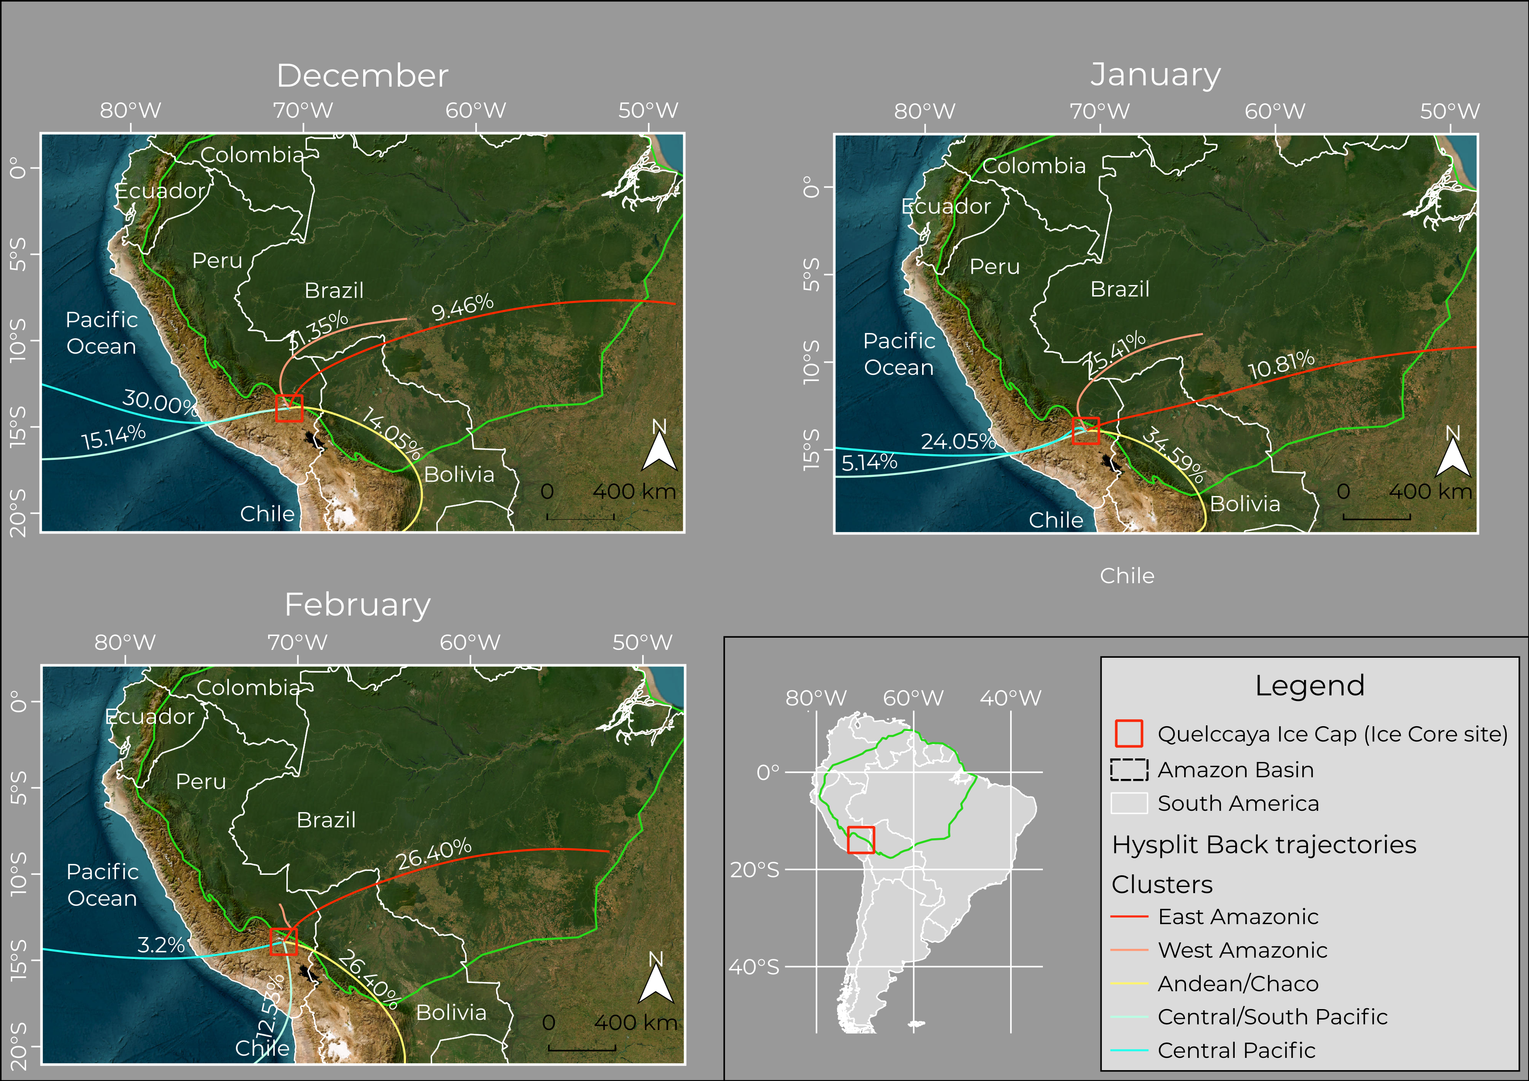
End Presentation
INTRODUCTION
Photo: Mariusz Potocki
INTRODUCTION
For the summer months, it is possible to basically discriminate 3 different main source areas:
Tropical rainforest (Amazonic)
Oceanic (Pacific)
Desertic/Mountainous
Summer Months Back Trajectories
Contact me!
Check out my abstract here!

Slide 26
End Presentation
INTRODUCTION
Photo: Mariusz Potocki
INTRODUCTION
Summer Months Back Trajectories
For the summer months, it is possible to basically discriminate 3 different main source areas:
Tropical rainforest (Amazonic)
Oceanic (Pacific)
Desertic/Mountainous
Back to Main Menu
Click here to check out the spring months
Contact me!
Check out my abstract here!

Slide 28
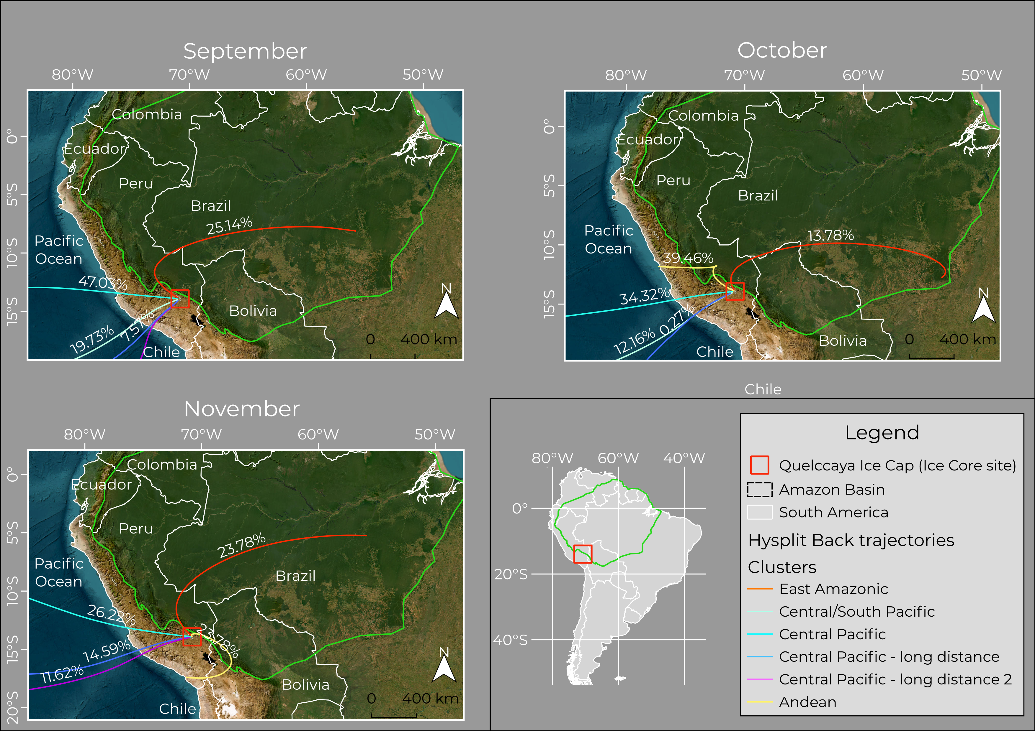
End Presentation
INTRODUCTION
Photo: Mariusz Potocki
INTRODUCTION
For the spring months, it is possible to basically discriminate 3 different main source areas:
Tropical rainforest (Amazonic): weakened
Oceanic (Pacific): long-distance transport
Desertic/Mountainous: more local
Spring Months Back Trajectories
Contact me!
Check out my abstract here!

Slide 29
End Presentation
INTRODUCTION
Photo: Mariusz Potocki
INTRODUCTION
Spring Months Back Trajectories
For the spring months, it is possible to basically discriminate 3 different main source areas:
Tropical rainforest (Amazonic): weakened
Oceanic (Pacific): long-distance transport
Desertic/Mountainous: more local
Back to Main Menu
Next Section: Methodologies
Contact me!
Check out my abstract here!

Slide 31
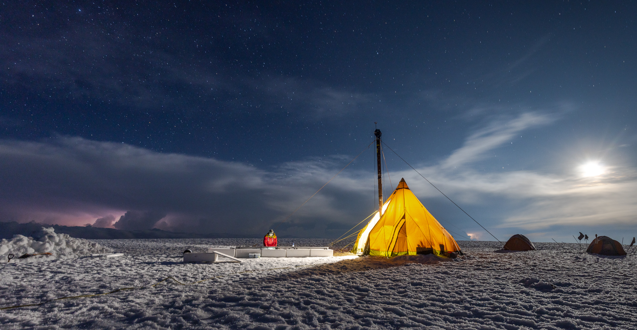
End Presentation
Photo: Mariusz Potocki
METHODOLOGIES
METHODOLOGIES

Slide 32
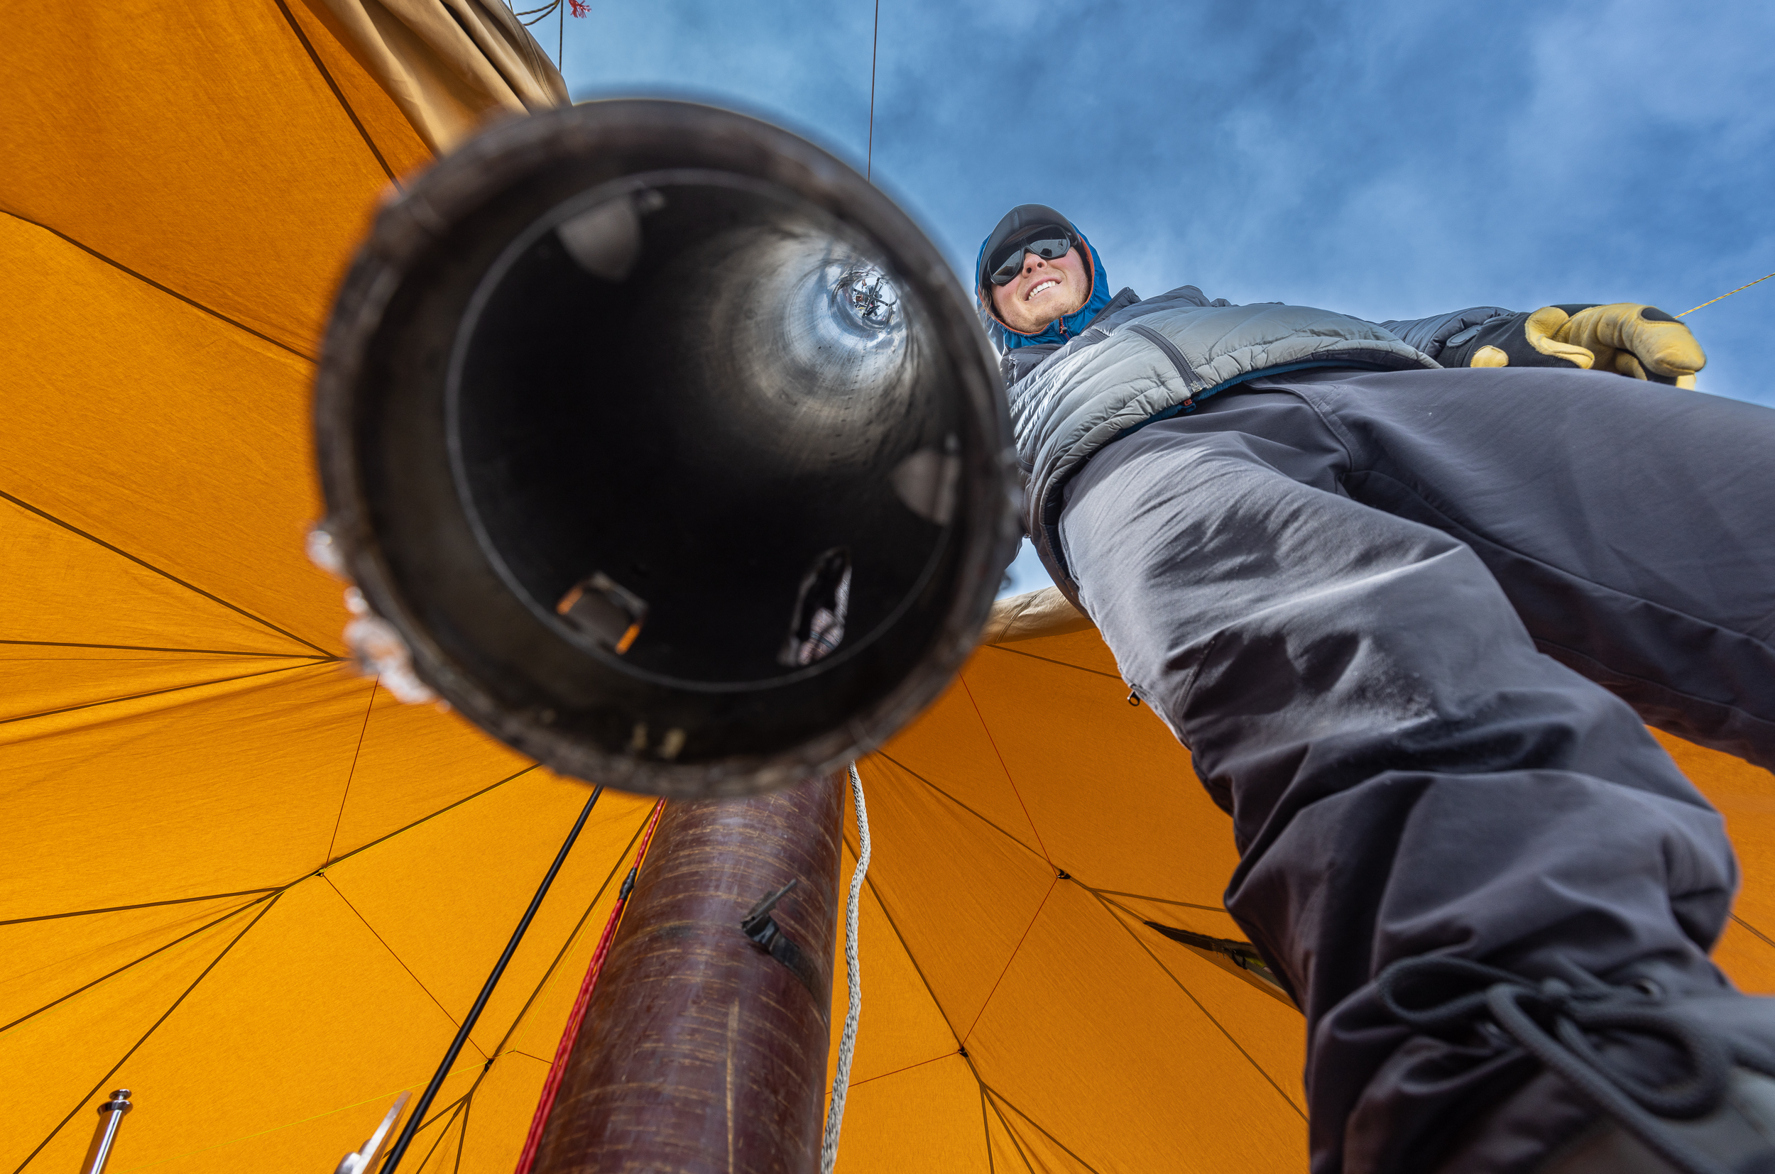
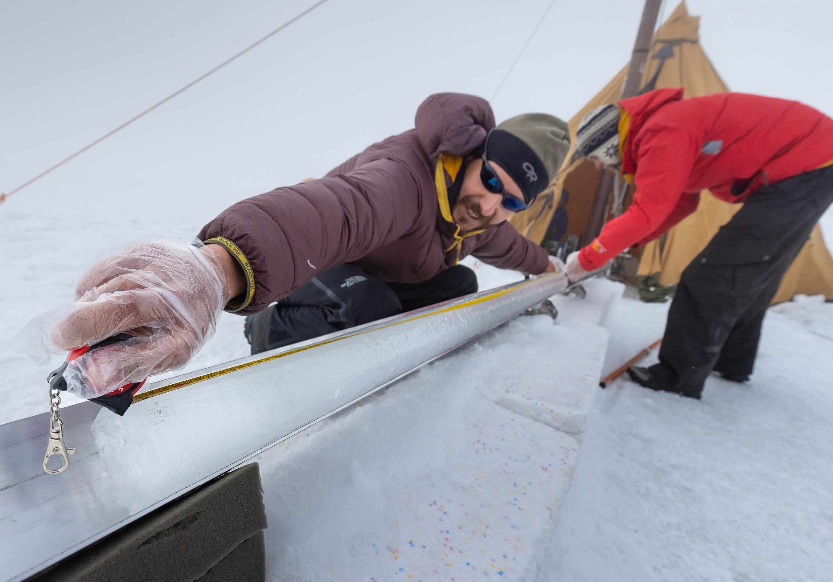
End Presentation
Photo: Mariusz Potocki
Ice Coring
In 2022 an ice core was drilled using a thermal drill
The ice core is 128.3 meter-long and it goes from surface to bedrock
METHODOLOGIES
METHODOLOGIES
Photo: Mariusz Potocki
Photo: Mariusz Potocki
Contact me!
Check out my abstract here!

Slide 33
End Presentation
METHODOLOGIES
Photo: Mariusz Potocki
METHODOLOGIES
Ice Coring
In 2022 an ice core was drilled using a thermal drill
The ice core is 128.3 meter-long and it goes from surface to bedrock
Photo: Mariusz Potocki
Photo: Mariusz Potocki
Back to Main Menu
Next
Contact me!
Check out my abstract here!

Slide 35
End Presentation
METHODOLOGIES
Photo: Mariusz Potocki
METHODOLOGIES
Melting & Subsampling
1m
Laminar Flow Bench
Vials filled with the drops coming out from the melting
The melting sessions took place at the Climate Change Institute (University of Maine) in 2023
Heated Ultrapure Nickel Plate
1 mL
Freezer
Cables
Contact me!
Check out my abstract here!

Slide 36
End Presentation
METHODOLOGIES
Photo: Mariusz Potocki
METHODOLOGIES
Melting & Subsampling
1m
Vias filled with the drops coming out from the melting
The melting sessions took place at the Climate Change Institute (University of Maine) in 2023
Heated Ultrapure Nickel Plate
1 mL
Freezer
Cables
Back to Main Menu
Next
Contact me!
Check out my abstract here!

Slide 38
End Presentation
METHODOLOGIES
Photo: Mariusz Potocki
METHODOLOGIES
Levoglucosan
Triple Quadrupole mass spectrometer
20 μL of spike solution (labeled levoglucosan)
HPLC
100 μL of sample
1 mL
Contact me!
Check out my abstract here!

Slide 39
End Presentation
METHODOLOGIES
Photo: Mariusz Potocki
METHODOLOGIES
Levoglucosan
Triple Quadrupole mass spectrometer
HPLC
100 μL of sample
1 mL
Back to Main Menu
Next
Contact me!
Check out my abstract here!

Slide 41
End Presentation
METHODOLOGIES
Photo: Mariusz Potocki
METHODOLOGIES
Inorganic & Organic Ions
Cations and major anions
HPLC
Mass spectrometer
(for some anions and organic acids)
100 μL of sample
1 mL
Contact me!
Check out my abstract here!

Slide 42
End Presentation
METHODOLOGIES
Photo: Mariusz Potocki
METHODOLOGIES
Inorganic & Organic Ions
Cations and major anions
HPLC
Mass spectrometer
(for some anions and organic acids)
100 μL of sample
1 mL
Back to Main Menu
Next Section: Results & Discussions
Contact me!
Check out my abstract here!

Slide 44
End Presentation
Photo: João Ilha
RESULTS & DISCUSSIONS
RESULTS & DISCUSSIONS

Slide 45
End Presentation
Photo: João Ilha
The Dating Problematics
Ice cores are difficult to date
Seasonality not as strong as in the poles
RESULTS & DISCUSSIONS
RESULTS & DISCUSSIONS
Chemical purity
Stable Isotopes are usually used, however melting happens!
Particulate seasonality (Black Carbon & Dust)
Beta Activity & Tritium Peaks
Contact me!
Check out my abstract here!

Slide 46
End Presentation
RESULTS & DISCUSSIONS
RESULTS & DISCUSSIONS
Photo: João Ilha
The Dating Problematics
Ice cores are difficult to date
Seasonality not as strong as in the poles
Chemical purity
Stable Isotopes are usually used, however melting happens!
Particulate seasonality (Black Carbon & Dust)
Beta Activity & Tritium Peaks
Back to Main Menu
Next
Contact me!
Check out my abstract here!

Slide 48
End Presentation
RESULTS & DISCUSSIONS
RESULTS & DISCUSSIONS
Photo: João Ilha
Levoglucosan
Great biomass burning proxy
Could be related to Amazonic wildfires
Could also come from altiplanic wildfires
Isomers (mannosan & galactosan) could help differentiate those source areas
Moving average (n=3)
Moving average (n=10)
Contact me!
Check out my abstract here!

Slide 49
End Presentation
RESULTS & DISCUSSIONS
RESULTS & DISCUSSIONS
Photo: João Ilha
Levoglucosan
Great biomass burning proxy
Could be related to Amazonic wildfires
Could also come from altiplanic wildfires
Isomers (mannosan & galactosan) could help differentiate those source areas
Moving average (n=3)
Moving average (n=10)
Back to Main Menu
Next
Contact me!
Check out my abstract here!

Slide 51
End Presentation
RESULTS & DISCUSSIONS
RESULTS & DISCUSSIONS
Photo: João Ilha
Inorganic & Organic Ions
Oceanic (Sodium) vs Continental (Cl/Na > 2) input
Continental
inputs
Oceanic
inputs
Moving average (n=3)
Moving average (n=3)
Moving average (n=10)
Moving average (n=10)
Contact me!
Check out my abstract here!

Slide 52
End Presentation
RESULTS & DISCUSSIONS
RESULTS & DISCUSSIONS
Photo: João Ilha
Inorganic & Organic Ions
Oceanic (Sodium) vs Continental (Cl/Na > 2) input
Oceanic
inputs
Moving average (n=3)
Moving average (n=3)
Moving average (n=10)
Moving average (n=10)
Back to Main Menu
Next
Contact me!
Check out my abstract here!

Slide 54
End Presentation
RESULTS & DISCUSSIONS
RESULTS & DISCUSSIONS
Photo: João Ilha
Inorganic & Organic Ions
Other proxies
Non-sea salt sulfate (volcanism, anthropic activity, biomass emissions)
Non-sea salt potassium (biomass burning, continental dust)
Calcium (mainly continental dust)
Moving average (n=3)
Moving average (n=10)
Moving average (n=3)
Moving average (n=10)
Moving average (n=3)
Moving average (n=10)
Contact me!
Check out my abstract here!

Slide 55
End Presentation
RESULTS & DISCUSSIONS
RESULTS & DISCUSSIONS
Photo: João Ilha
Inorganic & Organic Ions
Other proxies
Calcium (mainly continental dust)
Moving average (n=3)
Moving average (n=10)
Back to Main Menu
Next Section: Conclusions
Contact me!
Check out my abstract here!

Slide 57
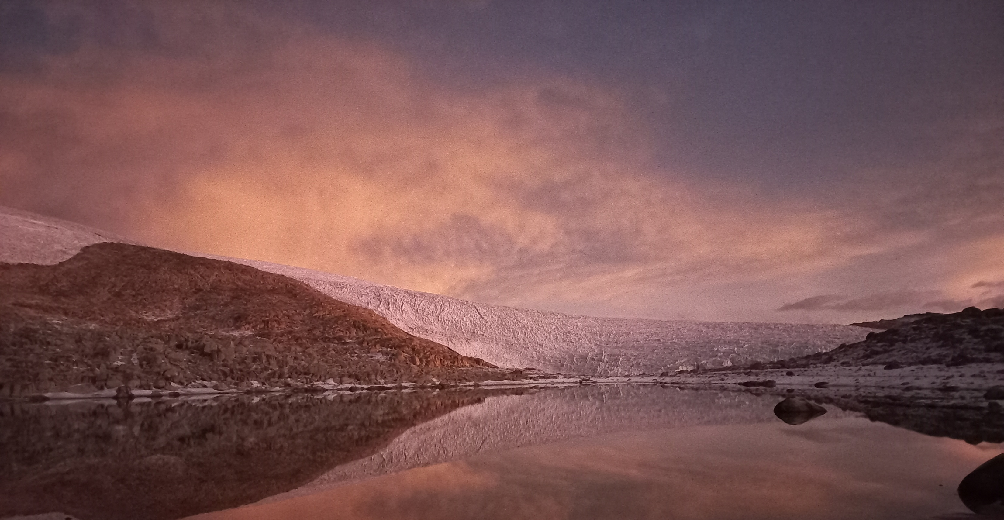
End Presentation
Photo: João Ilha
Dating
Peak counting for the particulate seems a reasonable way of dating (at least the younger part)
Nonetheless, having reference horizons would be great for backing-up the peak counting
β-activity, ³H, volcanic sulfur
CONCLUSIONS
CONCLUSIONS
Currently being analyzed
Contact me!
Check out my abstract here!

Slide 58
End Presentation
Photo: João Ilha
CONCLUSIONS
CONCLUSIONS
Dating
Peak counting for the particulate seems a reasonable way of dating (at least the younger part)
Nonetheless, having reference horizons would be great for backing-up the peak counting
β-activity, ³H, volcanic sulfur
Currently being analyzed
Back to Main Menu
Next
Contact me!
Check out my abstract here!

Slide 60
End Presentation
Photo: João Ilha
CONCLUSIONS
CONCLUSIONS
Proxies
Even though there’s the presence of relevant melt and percolation, most of the ions maintain an inhomogeneous record
At least for most species
The results so far are promising for climatic interpretation of the region
It’s possible to identify both continental and oceanic-type chemical signals
Identifying that part of the continental signal is Amazonic is challenging
However, previous results of organic compounds suggest that there’s a very real possibility of Amazonic record being recorded in the Quelccaya Ice Cap
Firn Package
Moving average (n=3)
Moving average (n=10)
Contact me!
Check out my abstract here!

Slide 61
End Presentation
Photo: João Ilha
CONCLUSIONS
CONCLUSIONS
Proxies
Even though there’s the presence of relevant melt and percolation, most of the ions maintain an inhomogeneous record
At least for most species
The results so far are promising for climatic interpretation of the region
It’s possible to identify both continental and oceanic-type chemical signals
Identifying that part of the continental signal is Amazonic is challenging
However, previous results of organic compounds suggest that there’s a very real possibility of Amazonic record being recorded in the Quelccaya Ice Cap
Back to Main Menu
Next
Contact me!
Check out my abstract here!

Slide 63
End Presentation
Photo: João Ilha
CONCLUSIONS
CONCLUSIONS
Next Steps
After β-activity and ³H analysis are done, proceed with the determination of the age-depth scale
Analyze levoglucosan isomers (mannosan & galactosan) to have further environmental and ecological information
Finish analyzing all the samples
Deepen the air mass circulation models and other models that could be useful
Perform statistical analyzes
Contact me!
Check out my abstract here!

Slide 64
End Presentation
Photo: João Ilha
CONCLUSIONS
CONCLUSIONS
Next Steps
After β-activity and ³H analysis are done, proceed with the determination of the age-depth scale
Analyze levoglucosan isomers (mannosan & galactosan) to have further environmental and ecological information
Finish analyzing all the samples
Deepen the air mass circulation models and other models that could be useful
Perform statistical analyzes
Back to Main Menu
Next
Contact me!
Check out my abstract here!

Slide 66
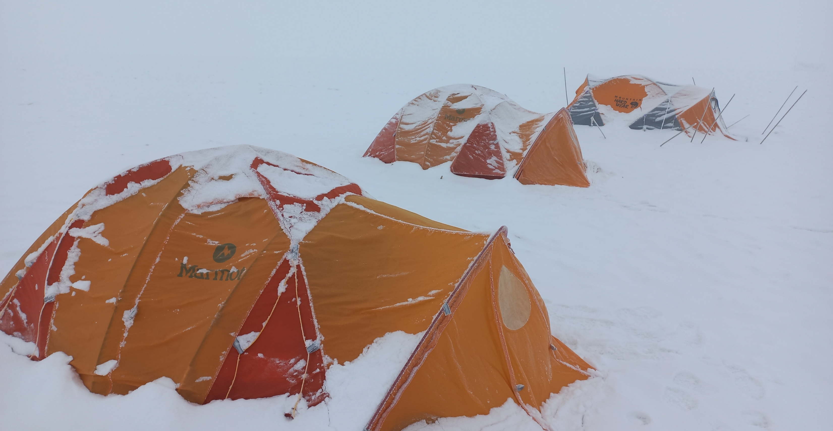
Photo: João Ilha
THANK YOU!
THANK YOU!
Don’t forget to access my abstract page!
Back to Start Page
Contact me!
Check out my abstract here!

