Slide 1
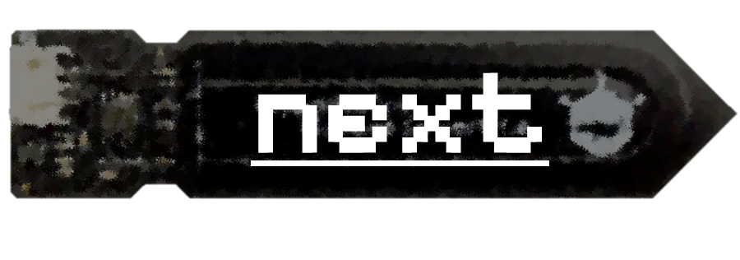
Development of a Low-Cost Soil Moisture Sensor Station for Hydrological Monitoring
Veethahavya Kootanoor Sheshadrivasan,
Jakub Langhammer.
Faculty of Science, Charles University, Prague
veethahavya@natur.cuni.cz
0/26 · gallery · development · tests · deployment

Slide 2
micro SD card module
Microcontroller
Status LED
Analog Ports (SMS)
Custom
3D Printed
Housing
RTC module
Digital Port (OW/DHT)
1/26 · home · gallery · development · tests · deployment

Slide 3
Exposed
Electronic
Components
3D Printed
Enclosure
Filled with
Epoxy Resin
2/26 · home · gallery · development · tests · deployment

Slide 4
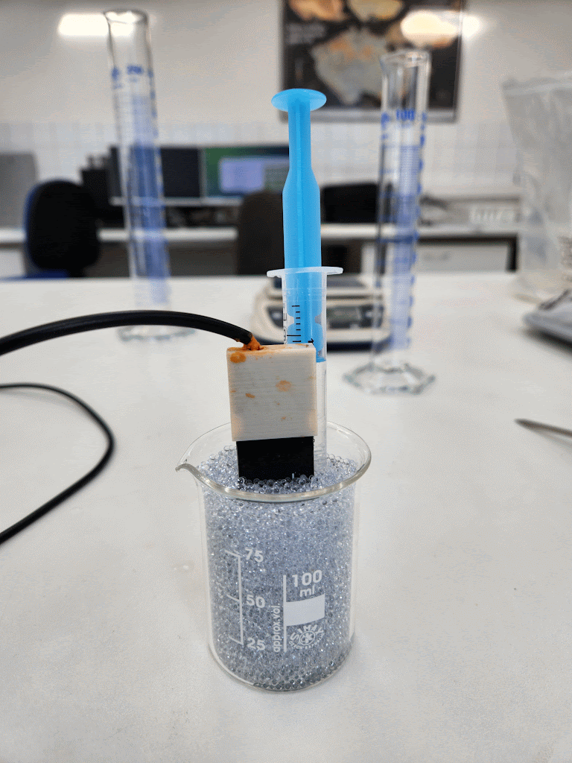
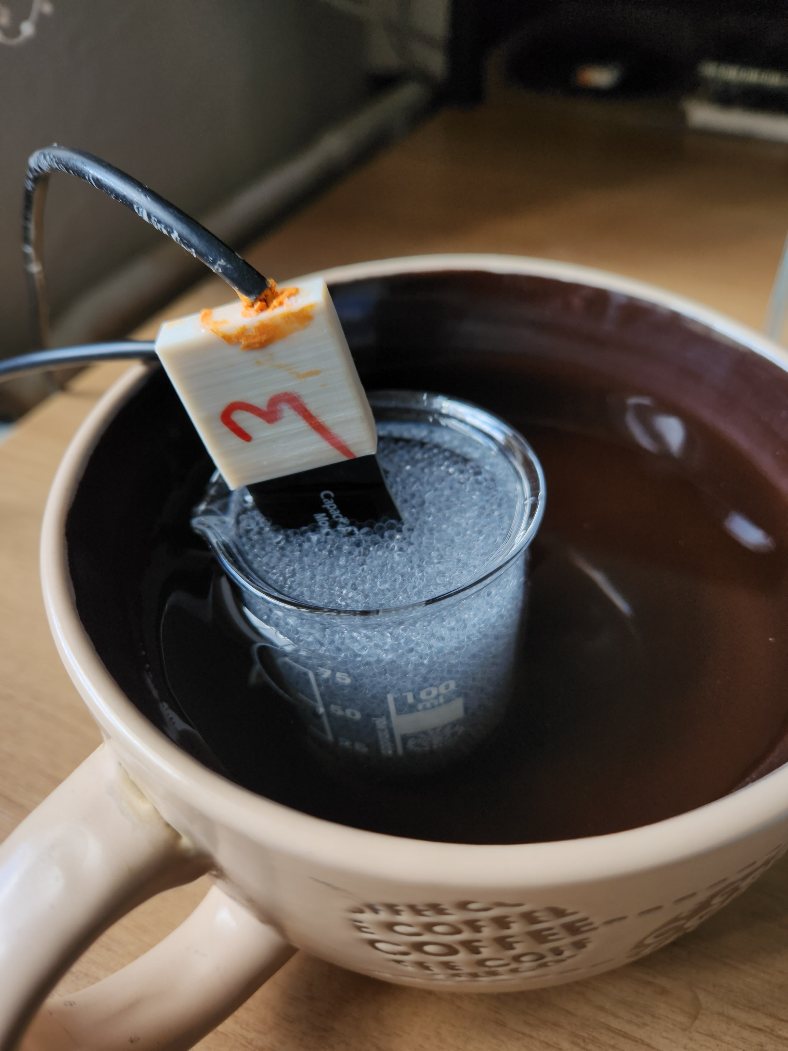
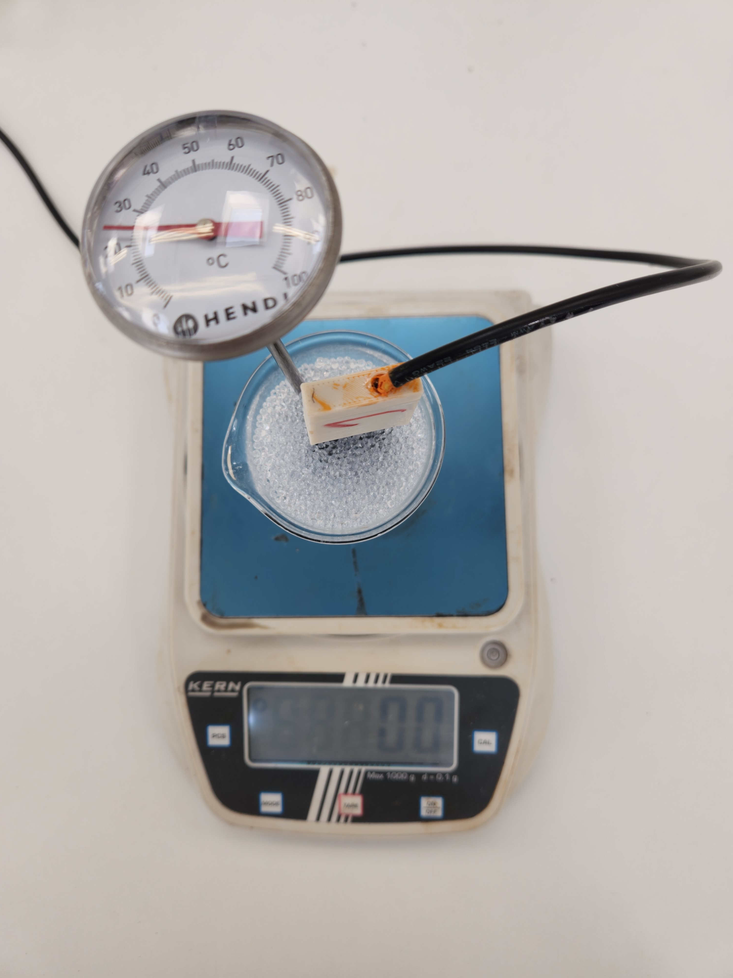
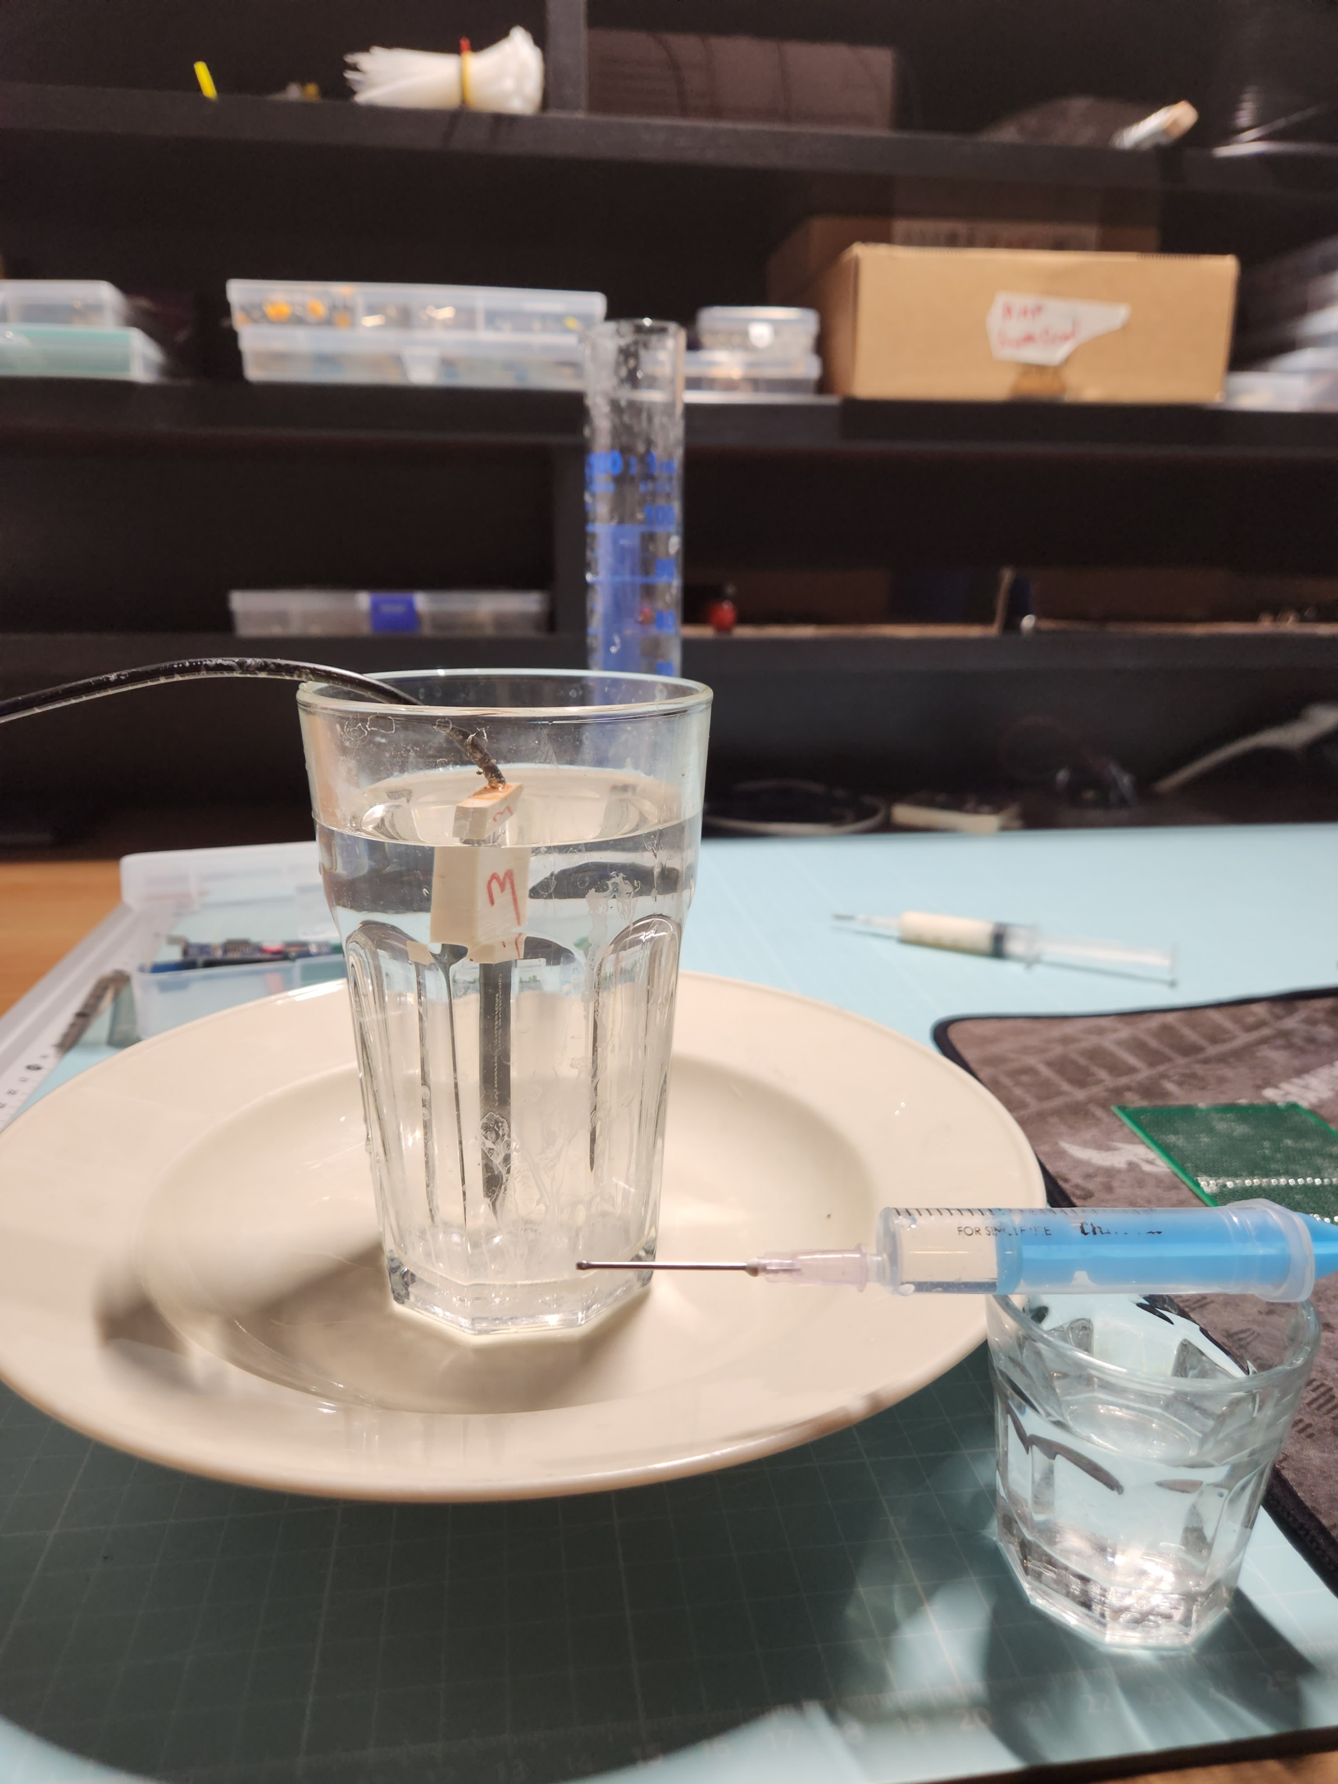
Testing Salinity
Response
Testing Saturation Response
Testing
Temperature Response
3/26 · home · gallery · development · tests · deployment

Slide 5
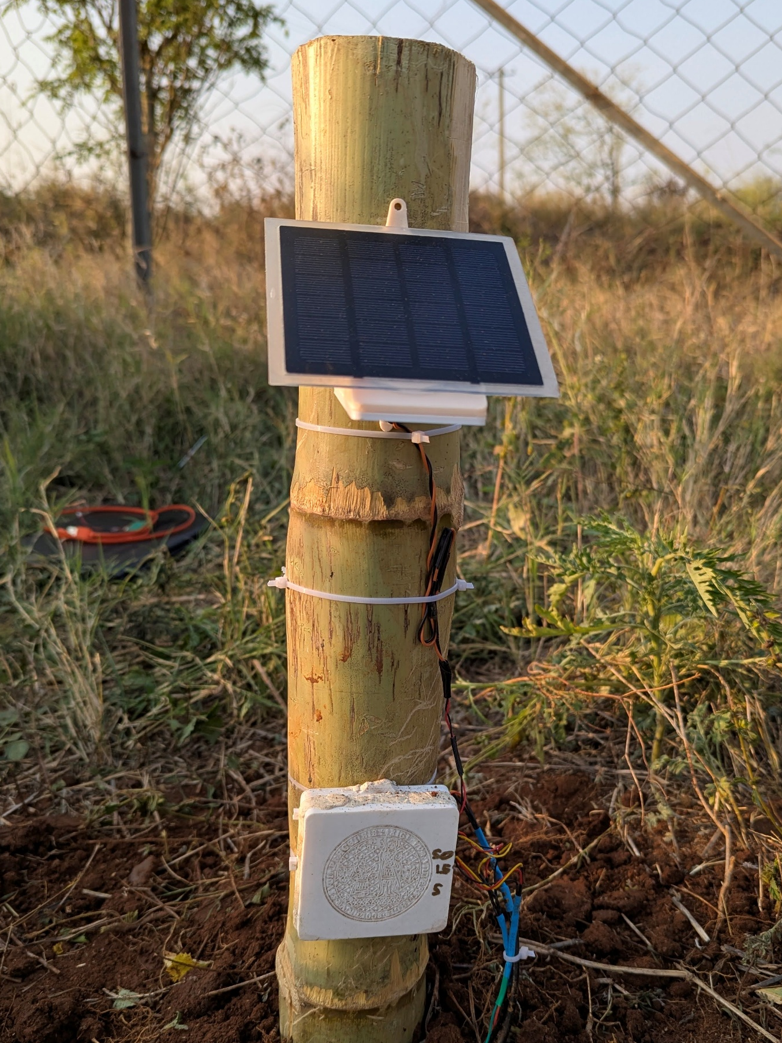
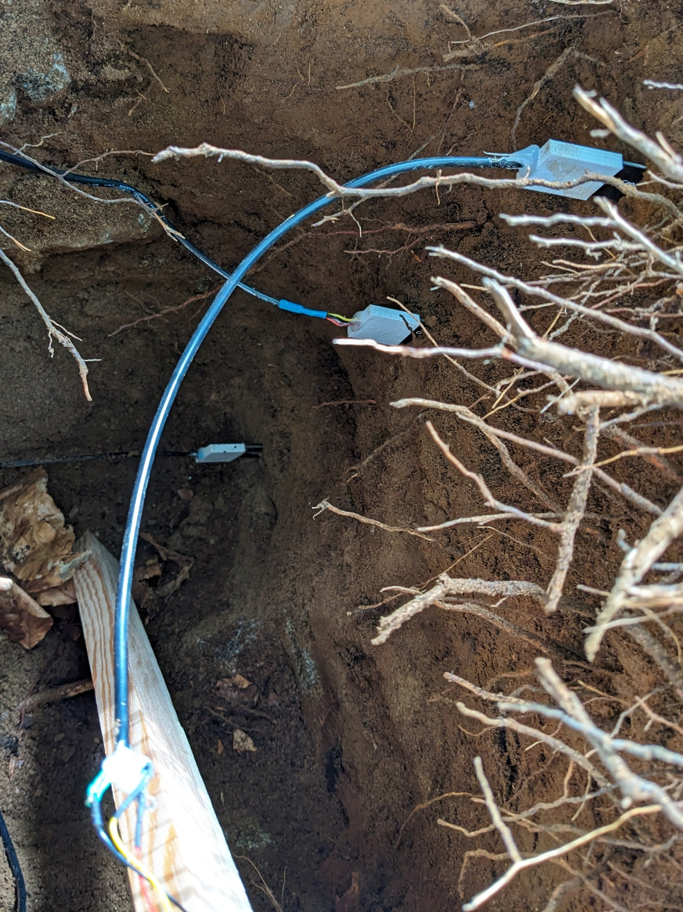
In Peat,
Šumava
Czechia
In
Beech-Stand,
Šumava,
Czechia
In Semi-Arid
Farmland,
Deccan India
4/26 · home · gallery · development · tests · deployment

Slide 6
Development of the Sensor Station
Testing · Debugging · Iterative Design
5/26 · home · gallery · development · tests · deployment

Slide 7
Attributes anticipated before development
Reasonably accurate (± 5% VWC)
Low-cost
Easy to program
Low-power usage, to be battery powered
Robust for outdoor use
Reproducible
6/26 · home · gallery · development · tests · deployment

Slide 8
Choice of Hardware: Core
Soil Moisture Sensor: DFRobot SEN0193
Capacitive Measurement
Analog Output
! Not waterproof – fixed by waterproofing with epoxy
Microcontroller: Raspberry Pi Pico
Widely used
Inbuilt ADC (x3)
Easy to program on micropython
Low-power on deep-sleep
! Deep-sleep not easy to achieve
7/26 · home · gallery · development · tests · deployment

Slide 9
Choice of Hardware: Peripheral
Storage: micro SD Card module, SPI
Ensured data integrity
! Relatively complex setup
Clock: Real-time clock module, I2C
Robust time management, even on power-off
! Relatively complex setup
Power:
LiPo Battery: provides required voltage, expensive
Solar Panel: enables uninterrupted operation
DFRobot Solar LiPo Charging module: protected battery charging circuit
8/26 · home · gallery · development · tests · deployment

Slide 10
Optional Peripherals
Subsurface Temperature Sensor: ‘OneWire’ DS18B20
Can help with calibration
Air Temperature and Humidity Sensor: DHT11/DHT22
Useful for hydrological modelling applications
9/26 · home · gallery · development · tests · deployment

Slide 11
Assessing the Response of Capacitive Soil Moisture Sensors
Saturation · Temperature · Salinity
10/26 · home · gallery · development · tests · deployment

Slide 12
Testing Salinity
Response
Testing Saturation Response
Testing
Temperature Response
11/26 · home · gallery · development · tests · deployment

Slide 13
Measuring Principle of Capacitive Soil Moisture Sensors
Non-contact Measurement via Dielectric Constant change
Sensor body = Capacitor with Soil as Dielectric
Sensor forms part of RC circuit → Frequency shift
Microcontroller measures voltage output ∝ moisture
↑Moisture⇒ ↑Dielectric constant⇒ ↑Capacitance⇒ ↓Value
RC time constant: τ = R⋅C (time to charge capacitor to ~63% of final voltage)
Capacitance Relation: C = ε_{r}​ε₀​ (A/d)​
12/26 · home · gallery · development · tests · deployment

Slide 14
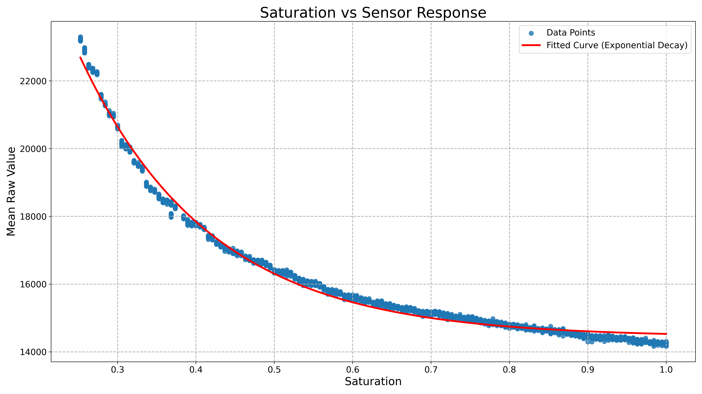
Saturation vs Sensor Response
Not linear
Exponential Decay
In line with what one expects from the measuring principle
13/26 · home · gallery · development · tests · deployment

Slide 15
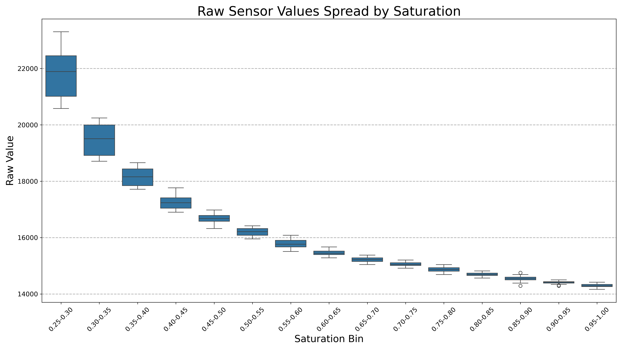
Saturation vs Sensor Response …
Due to the testing method, the sensor was not sensitive to saturation <0.26
More noise at lower saturation, possibly from contact establishment
14/26 · home · gallery · development · tests · deployment

Slide 16
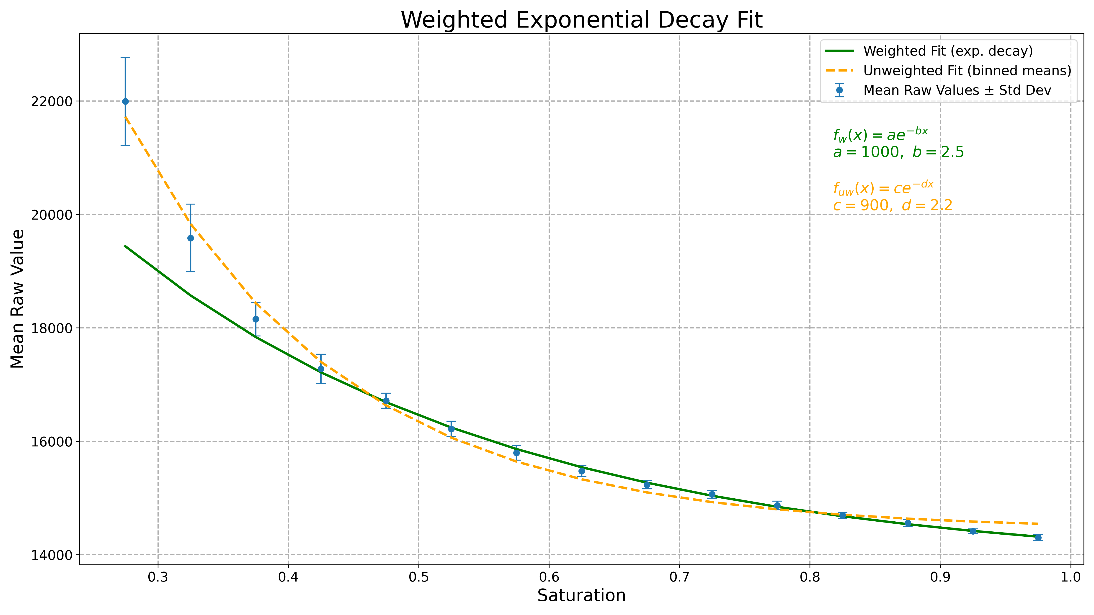
Saturation vs Sensor Response …
A better relationship that takes into account the uncertainty at lower saturation
Better validation results
15/26 · home · gallery · development · tests · deployment

Slide 17
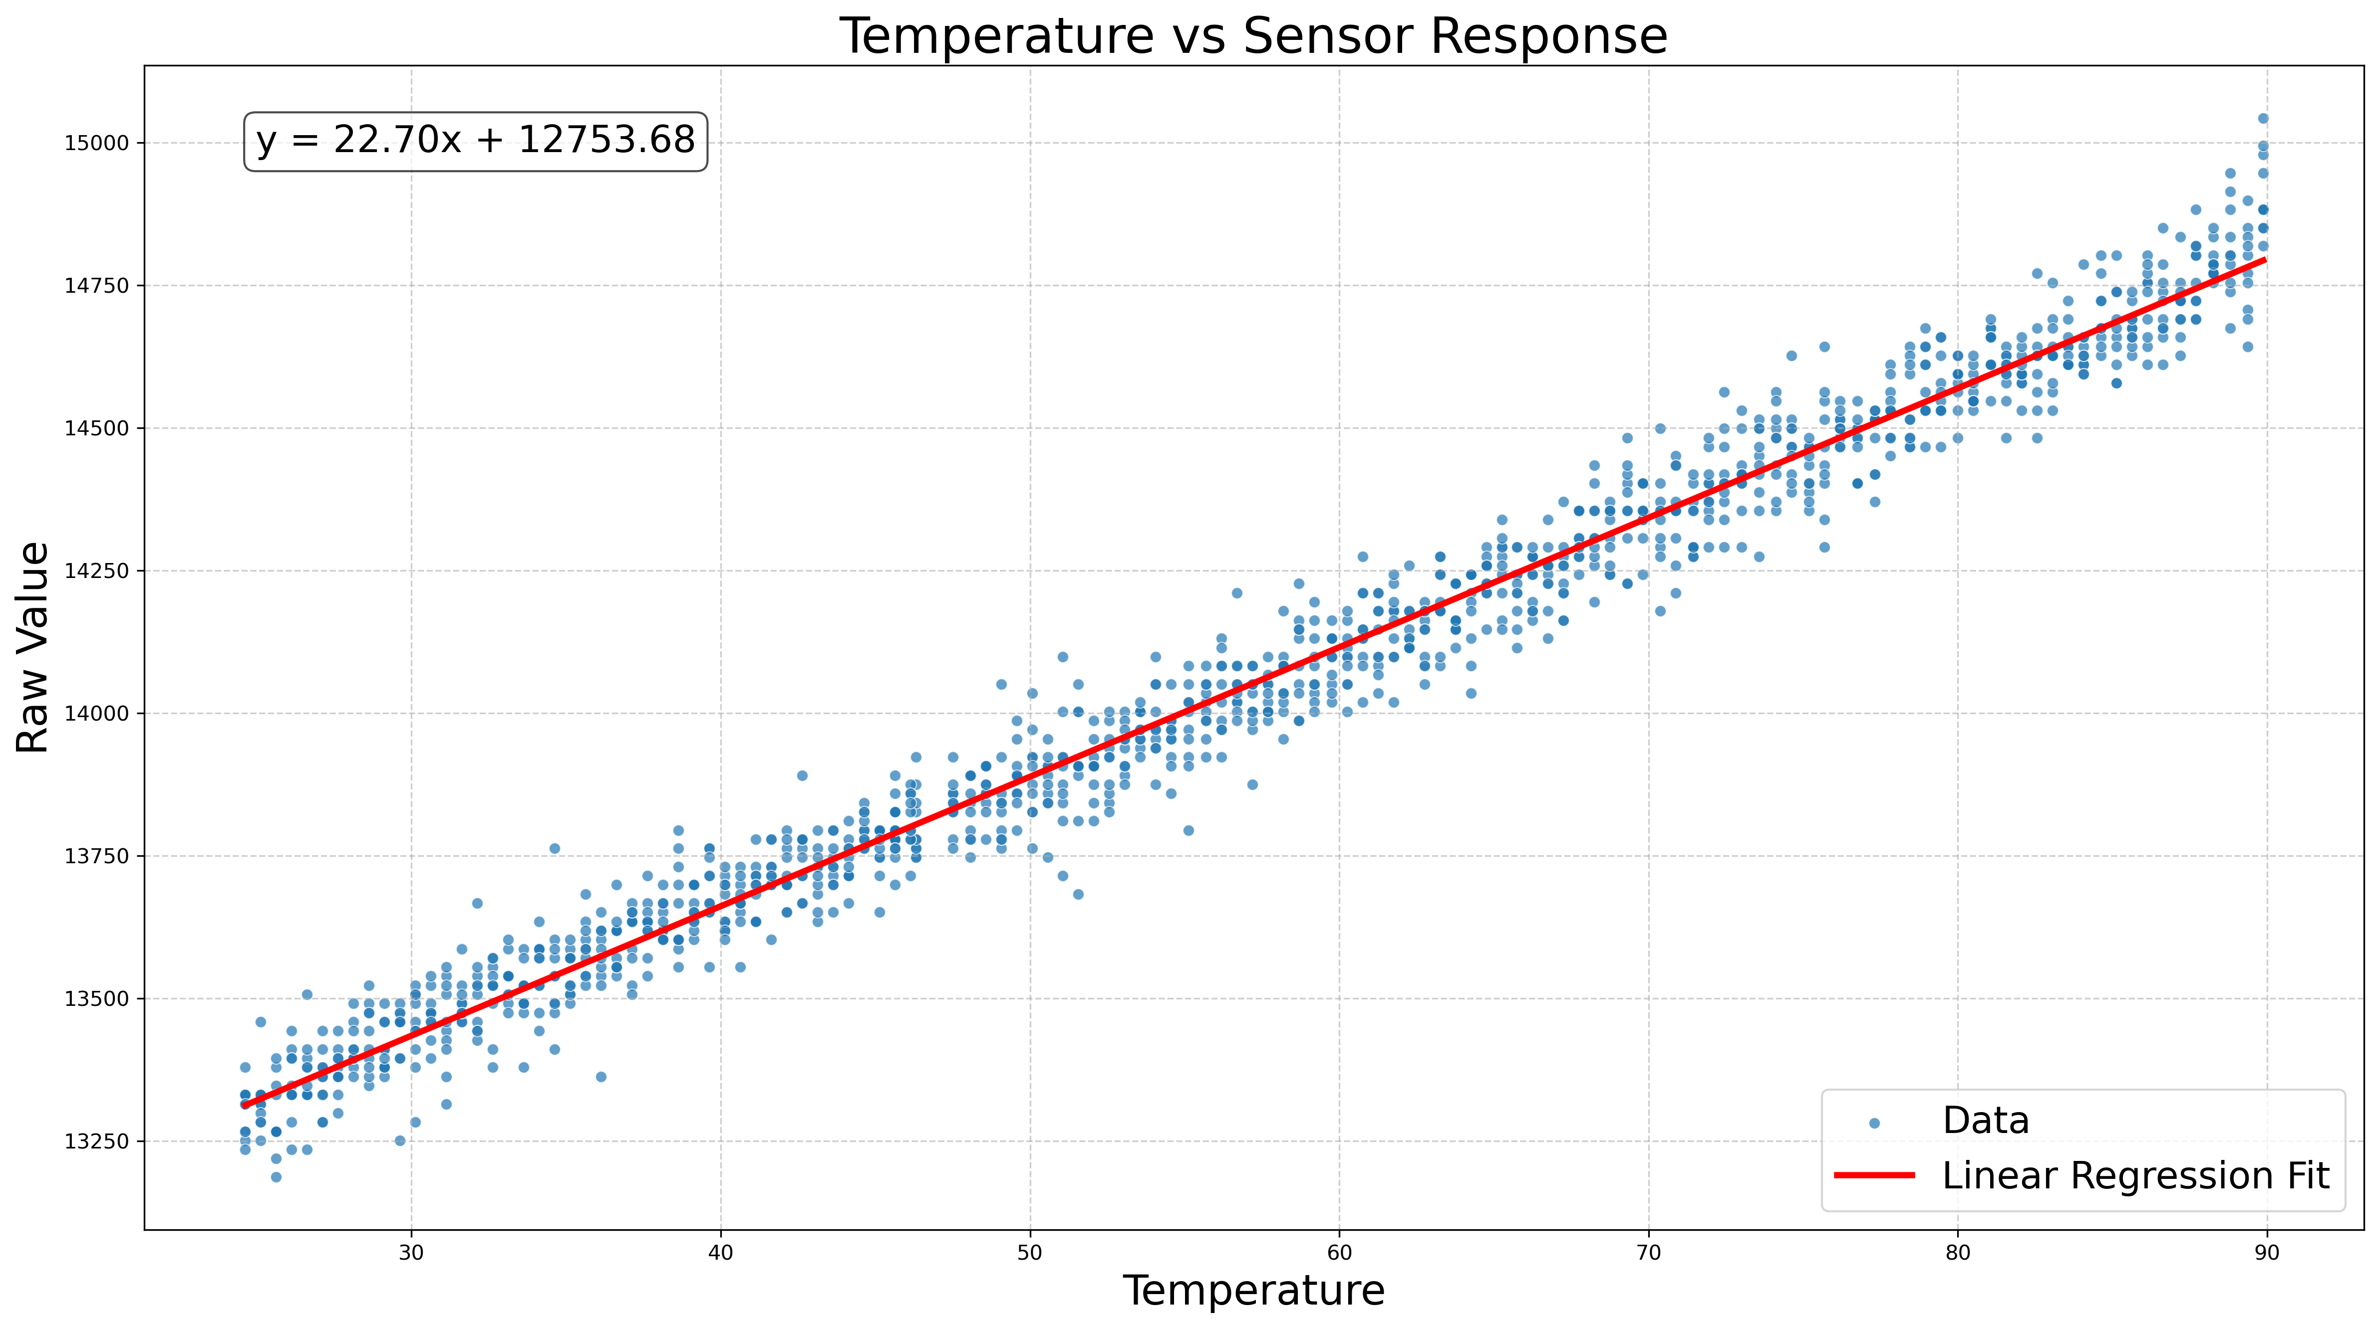
Temperature vs Sensor Response
Satisfyingly Linear Response
In line with what can be expected from the measuring principle of the device.
16/26 · home · gallery · development · tests · deployment

Slide 18
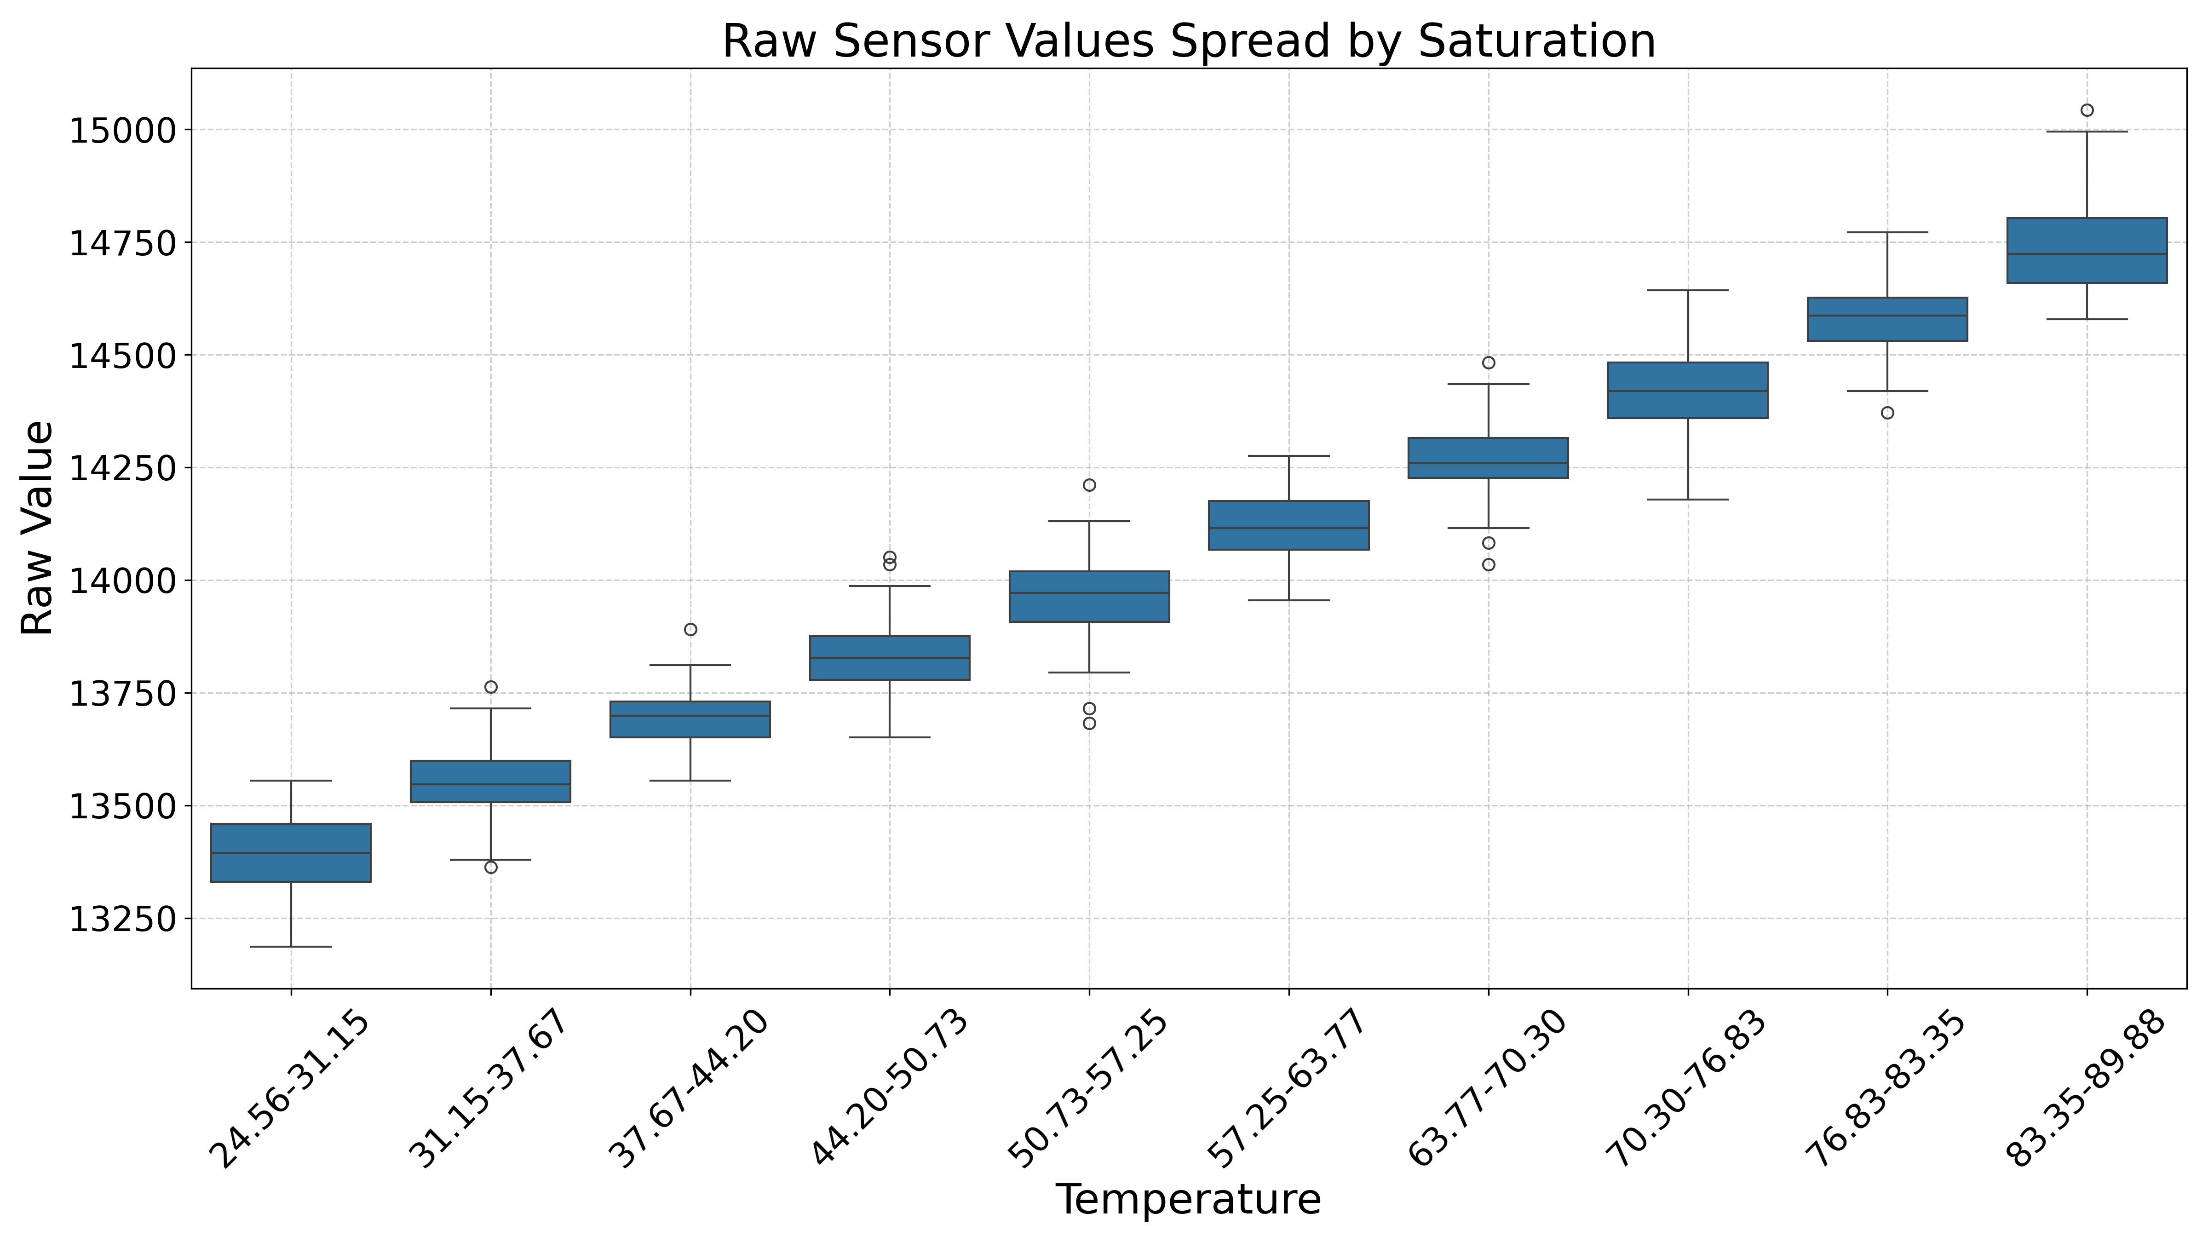
Temperature vs Sensor Response …
Satisfyingly even spread of sensor response across temperatures
Some outliers may be attributed to the not-so robust ADC on Rpi Pico
17/26 · home · gallery · development · tests · deployment

Slide 19
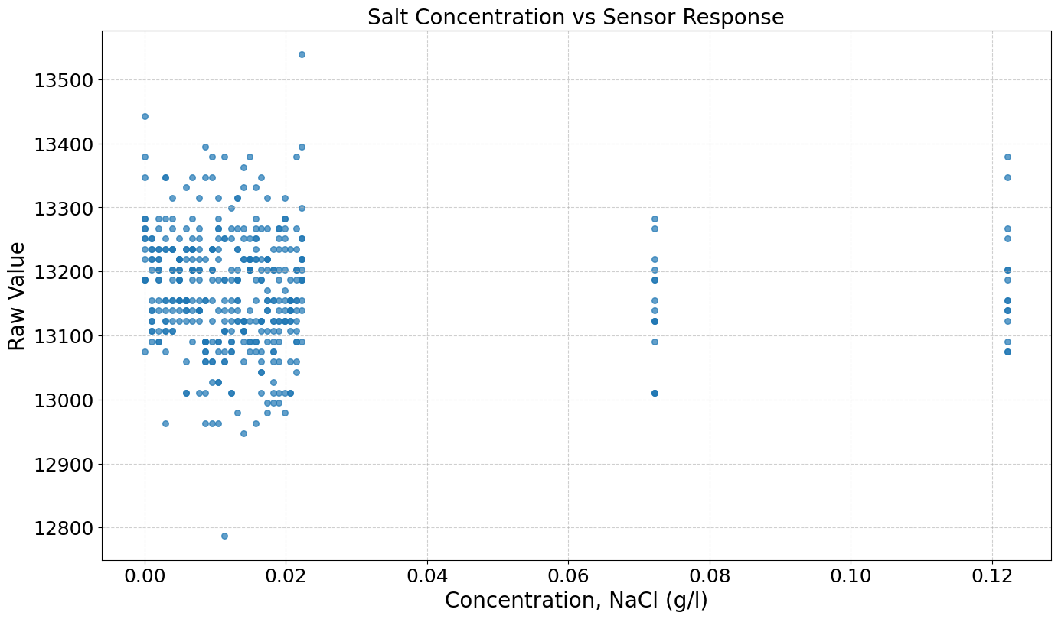
Salinity vs Sensor Response
Low magnitude noise
No discernible relationship
18/26 · home · gallery · development · tests · deployment

Slide 20
Field Deployment and Validation
Rokytka Catchment, Sumava, Czechia · Berembadi Catchment, Deccan India
19/26 · home · gallery · development · tests · deployment

Slide 21
In Peat,
Šumava
Czechia
In
Beech-Stand,
Šumava,
Czechia
In Semi-Arid
Farmland,
Deccan India
20/26 · home · gallery · development · tests · deployment

Slide 22
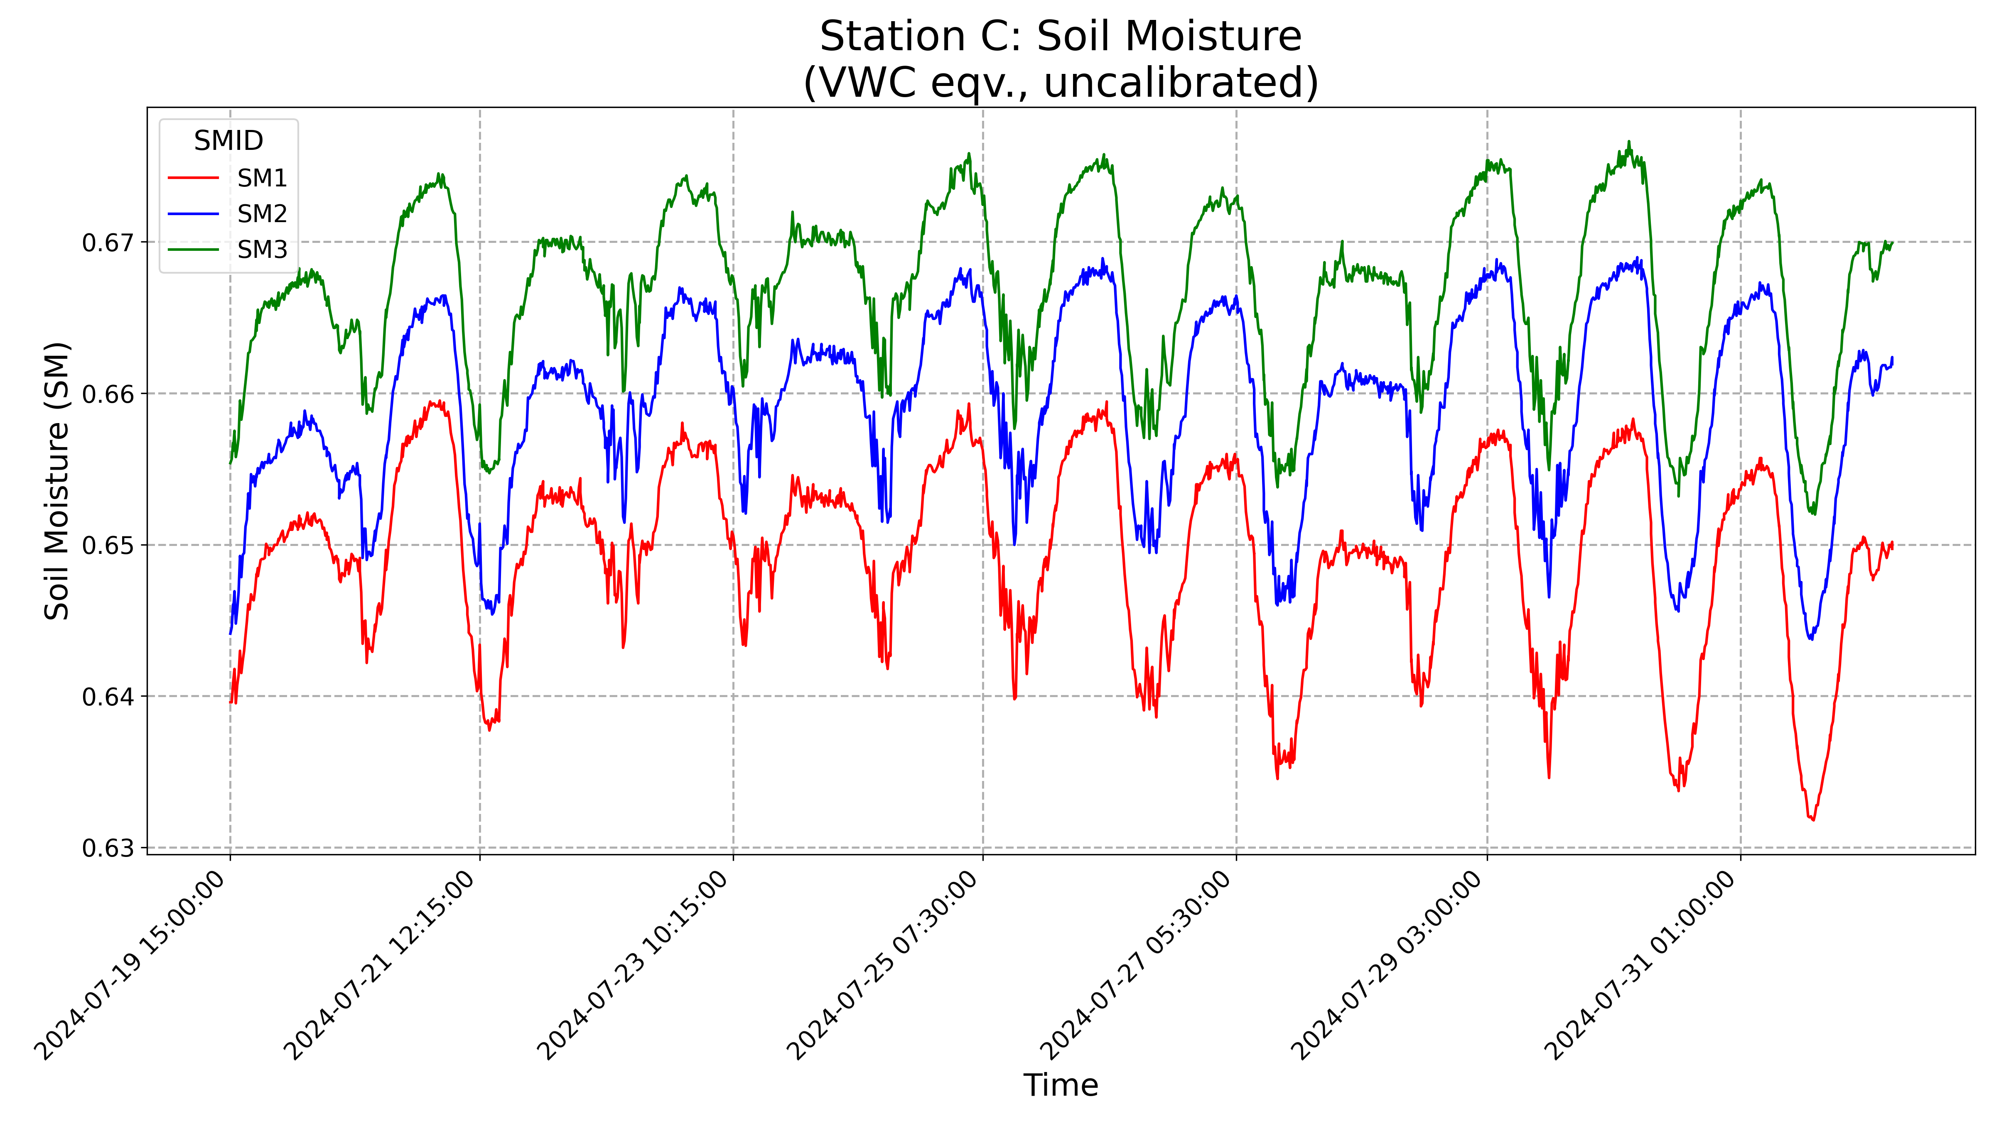
Measurements from Rokytka
Beech Stand
Depths:
SM1 – 20 cm
SM2 – 40 cm
SM3 – 60 cm
21/26 · home · gallery · development · tests · deployment

Slide 23
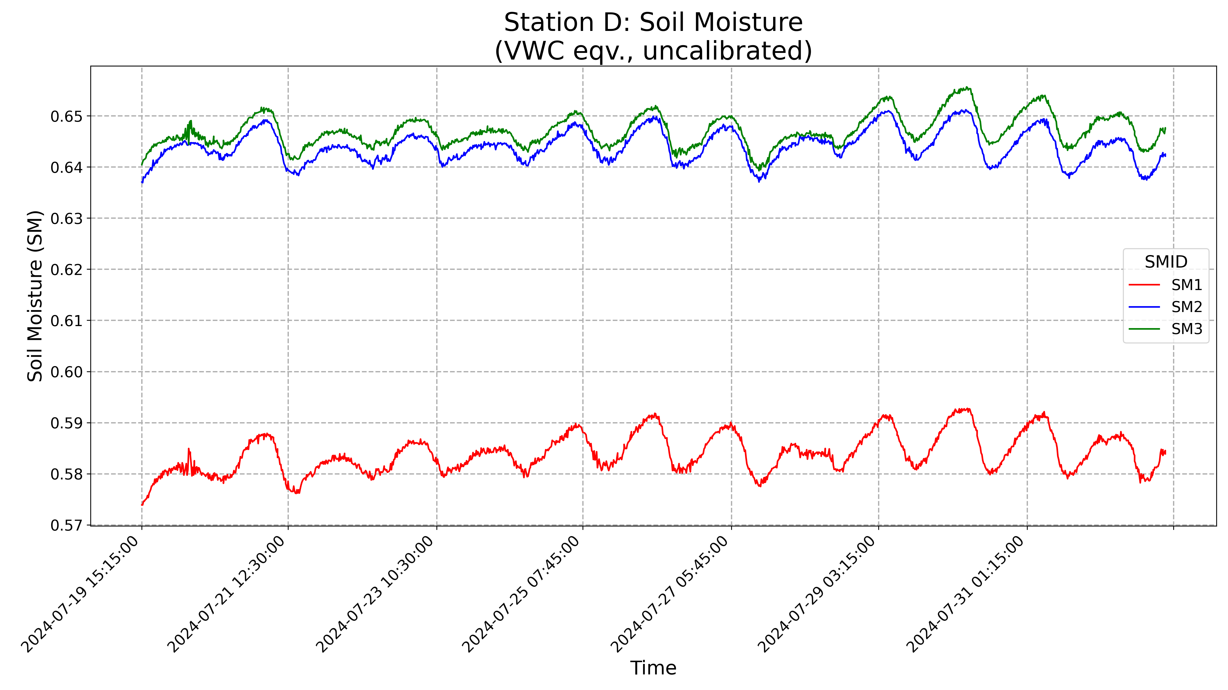
Measurements from Rokytka …
Peat, Down
Away from drainage
Depths:
SM1 – 10 cm
SM2 – 20 cm
SM3 – 40 cm
22/26 · home · gallery · development · tests · deployment

Slide 24
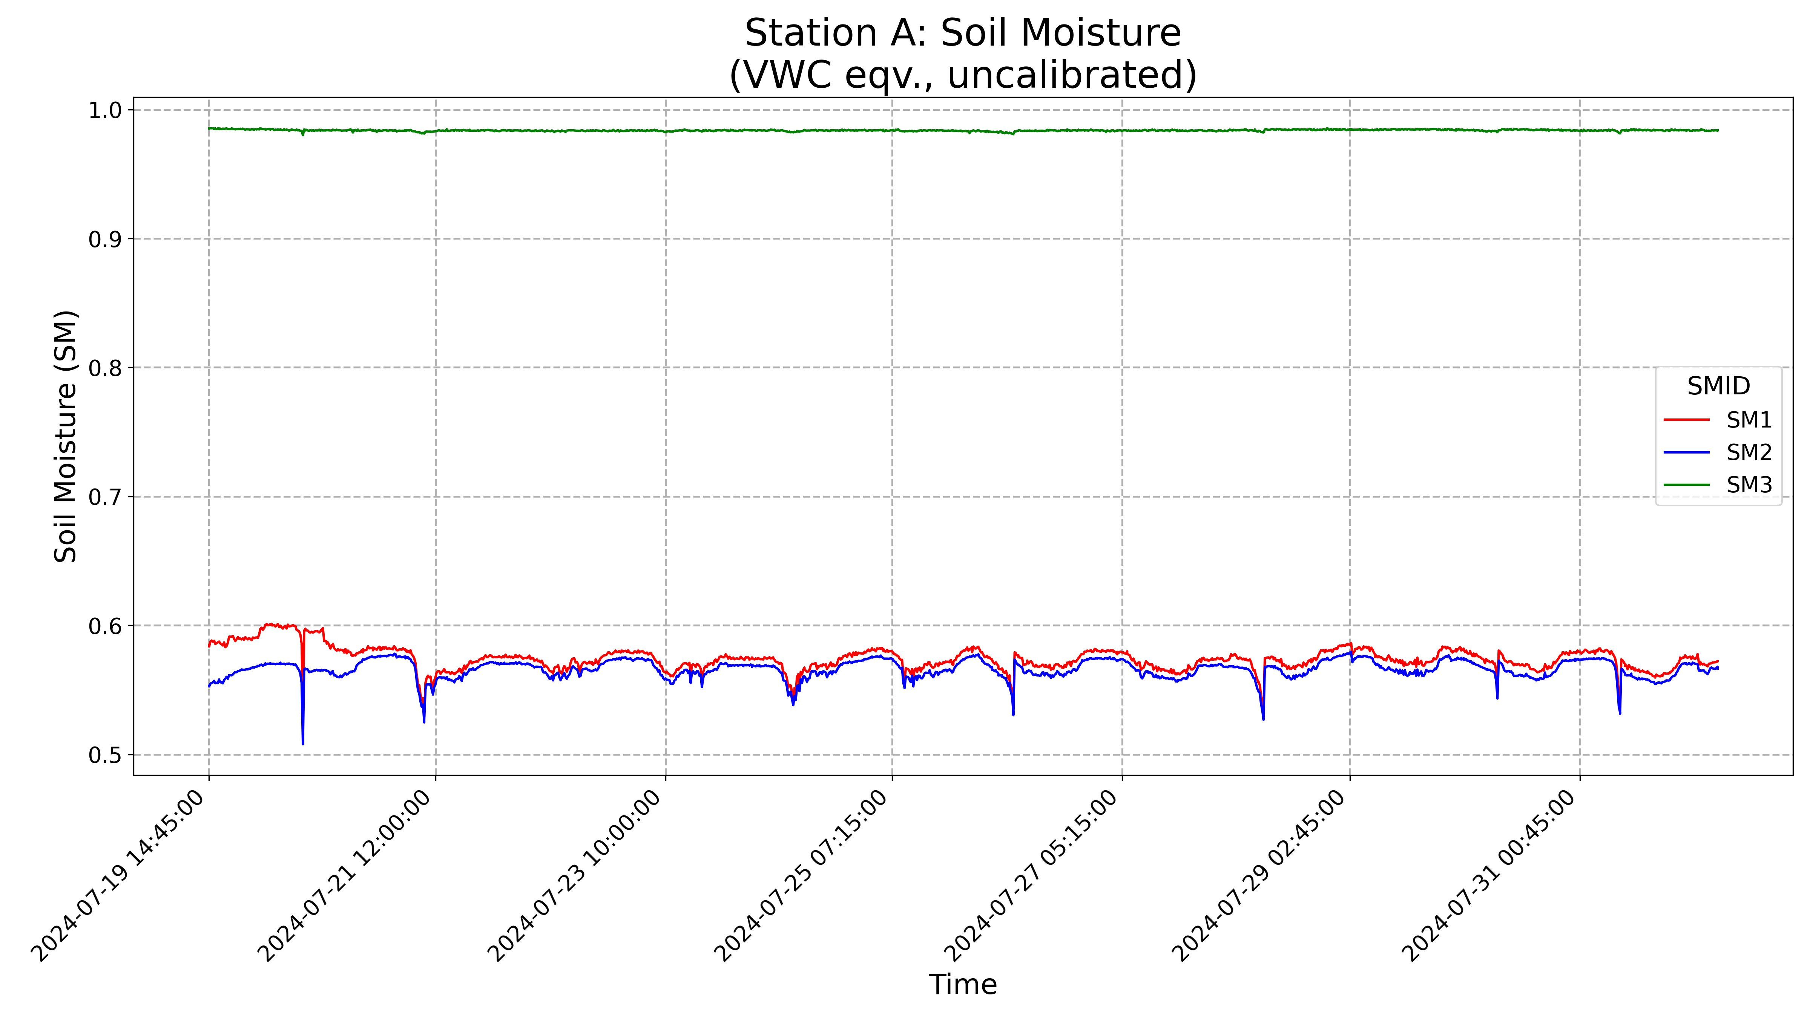
Measurements from Rokytka …
Peat, Down
Near drainage
Depths:
SM1 – 10 cm
SM2 – 20 cm
SM3 – 40 cm
23/26 · home · gallery · development · tests · deployment

Slide 25
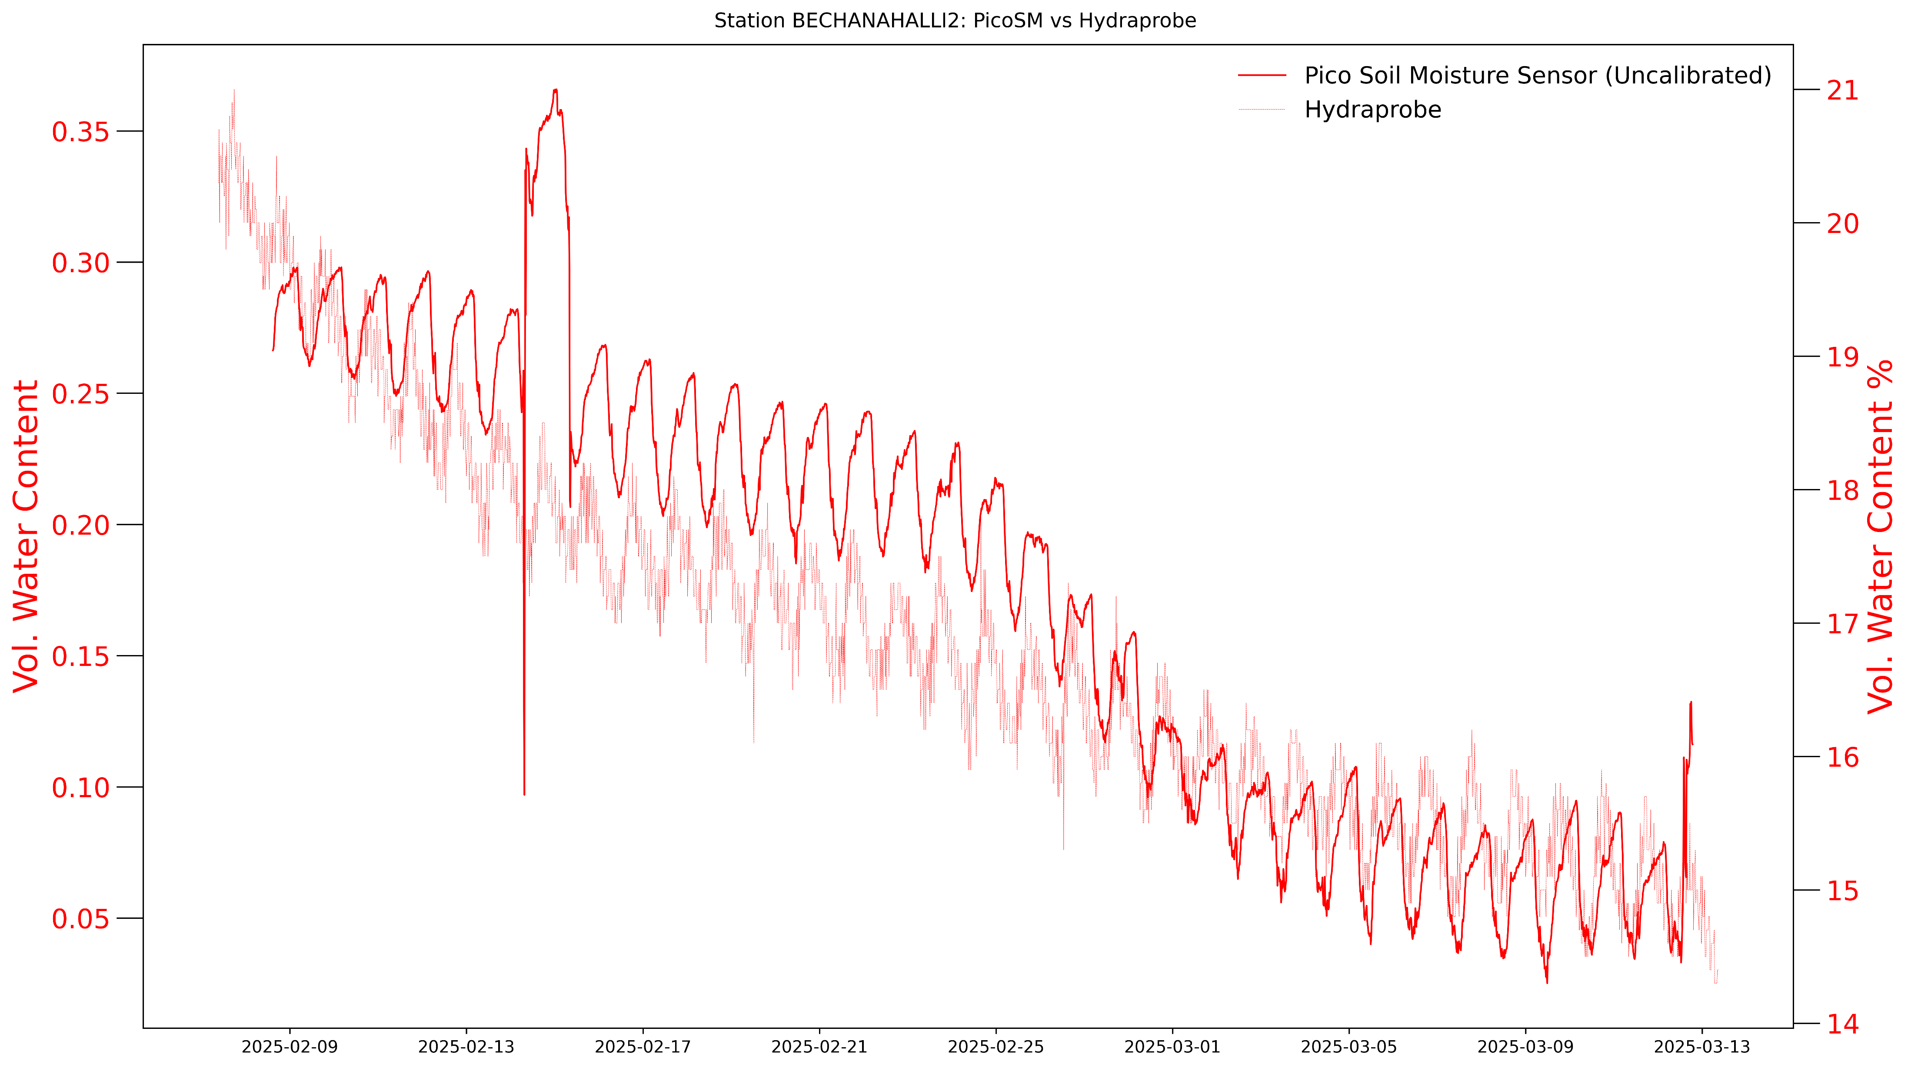
Measurements from Berembadi
Depth – 5 cm
Uncalibrated values still demonstrate the sensor’s ability as seen from the agreeable match in the trend
24/26 · home · gallery · development · tests · deployment

Slide 26
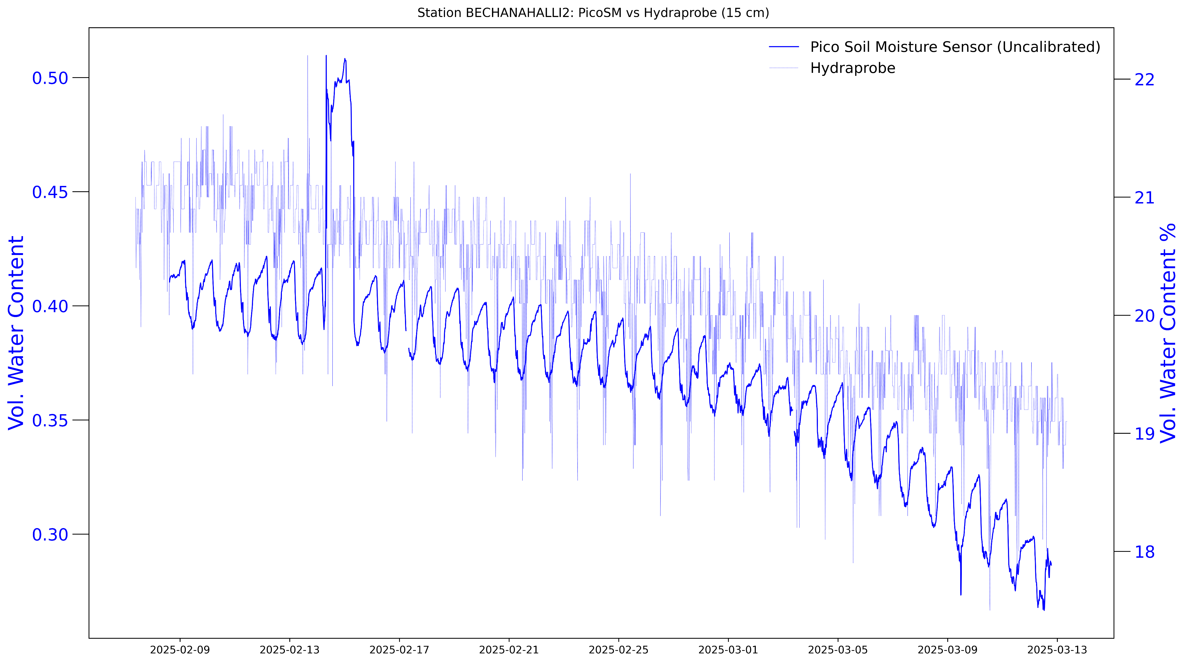
Measurements from Berembadi …
Depth – 15 cm
Shows the need for multivariate calibration – in line with lab tests
25/26 · home · gallery · development · tests · deployment

Slide 27
Thank You
Contact me at veethahavya@natur.cuni.cz for more details
26/26 · home · gallery · development · tests · deployment

