Slide 1
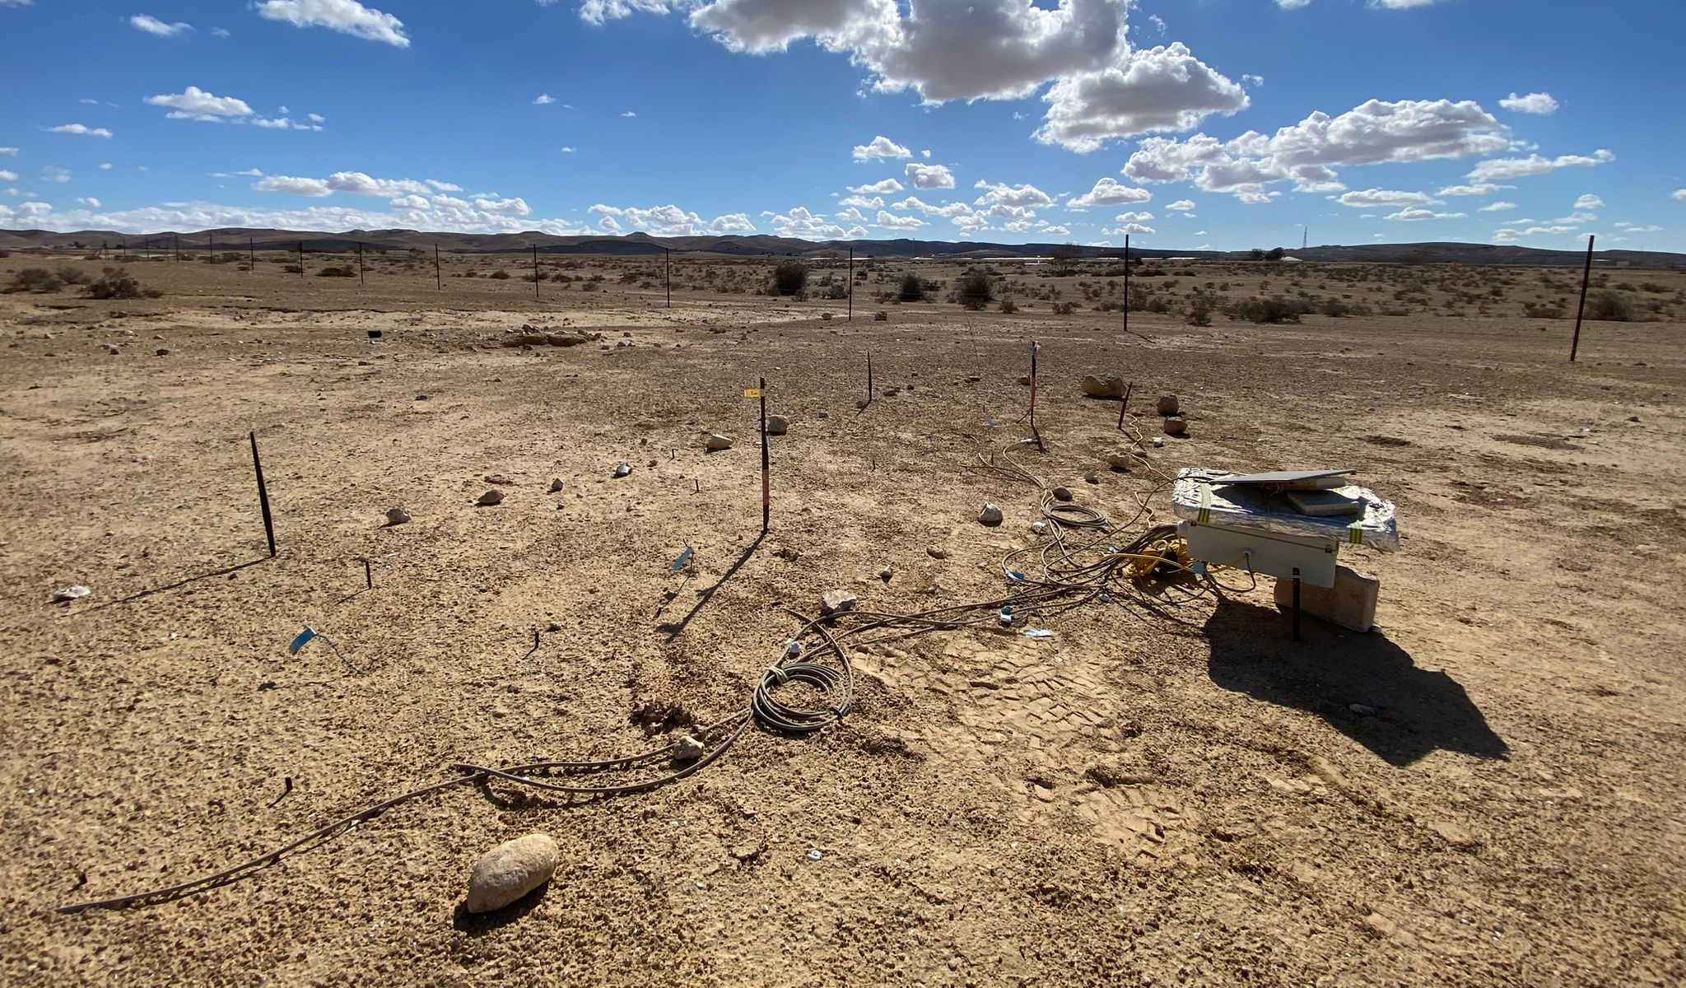
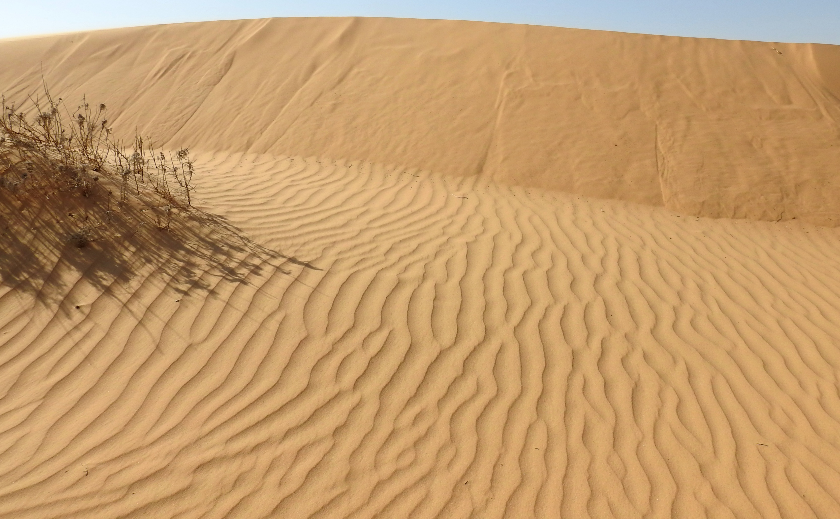
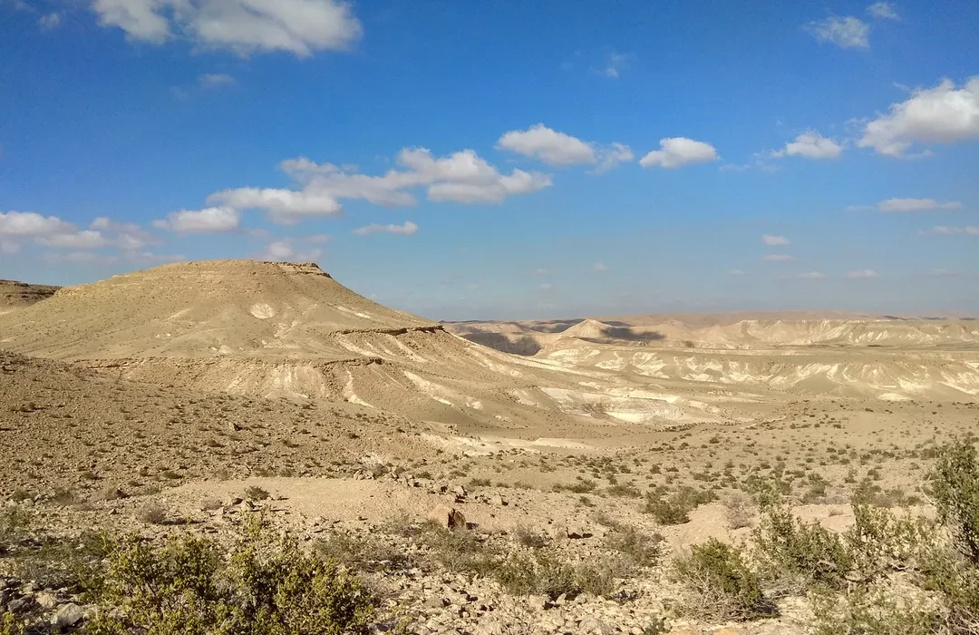
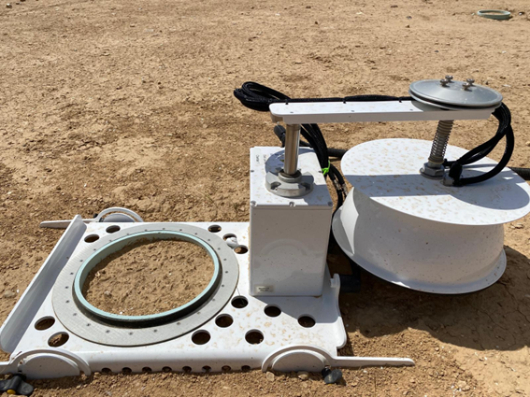
A comparative study of soil CO₂ uptake in arid soils
Thi Thuc Nguyen, Nadav Bekin, Nurit Agam, Elad Levintal
The Jacob Blaustein Institutes for Desert Research, Ben-Gurion University of the Negev, Israel
Notes:
Hi everyone, my name is Thuc. Today I’d like to present a comparative study of soil Co2 uptake in arid soils. To be specific, arid soils in the Negev desert. The title changed but I hope you find the insights from the talk today as interesting

Slide 2
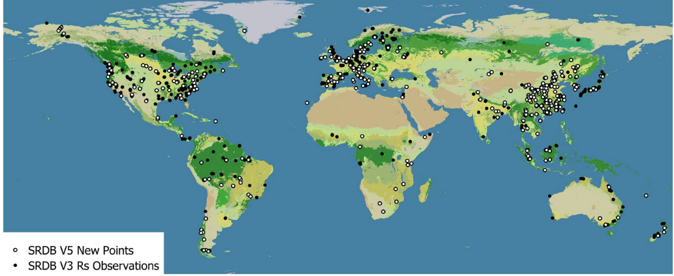
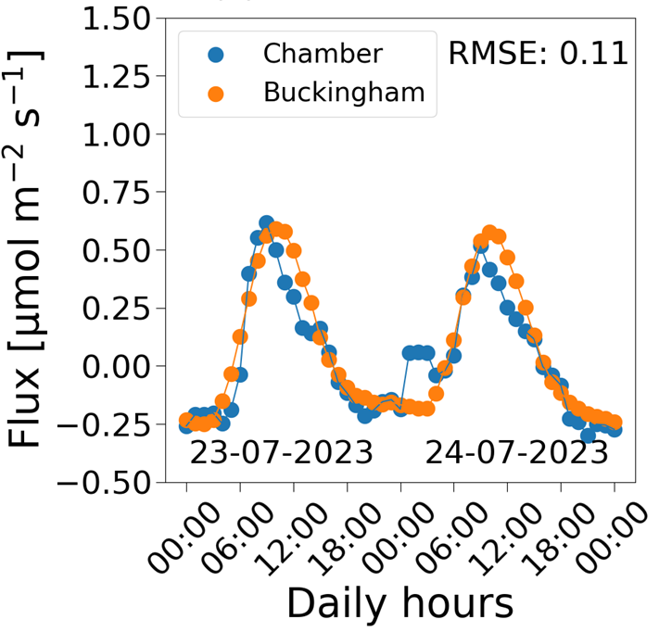
Arid soils cover 26% of the global terrestrial area but have < 2% of global F_{S} observation
CO₂ exchange from arid soils and nocturnal CO₂ uptake
Mojave, Sonoran, Chihuahuan
Taklimakan desert
Negev desert
Tabernas
Nguyen et al, under revision
Jian et al., (2021)
Notes:
We are looking at a global map with scatter points are flux observations. If you look right the the center of the map, the sahara desert, there is no observations here. Arid soils cover 26% of the global terrestrial area but there is only less than 2% of global fs observation. From a few studies, in both arid and semi-arid, nighttime Co2 uptake was observed. The reason behind this phenomena will be discussed in the presentation today.

Slide 3
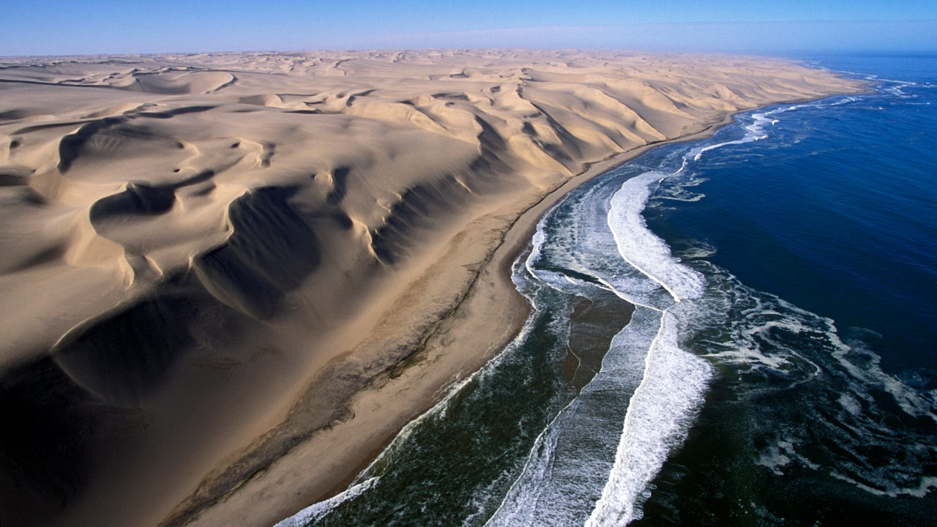
The link between nocturnal water vapor and CO2 uptake
Water vapor absorbs to dry soils
Dry soil
Moist air
The link between 2 fluxes were observed in Tabernas Desert, Spain + Sahara desert, Morocco
(Lopez-Canfin et al., 2022 , Bekin and Agam, under review).
Notes:
So, one of the common hypotheses for the nighttime Co2 uptake is the dissolution of Co2. but for dissolution to occur, water is needed.
So where water is coming from? The known water source for many deserts is non-rainfall water uptake, mainly from nighttime water vapor absorption.
At night, water vapor absorbs, and with lower temperature at nighttime, dissolution of CO2 in the gas phase occur, reducing co2 concentration and create a gradient for co2 to move from atmosphere into the soil. The link between water and CO2 was observed in tabernas desert spain, also in sahara desert morroco. But there is no studies that do comparative study to see how effect of water vapor absorption varies with different arids soil and how this variation affect Co2 flux?

Slide 4
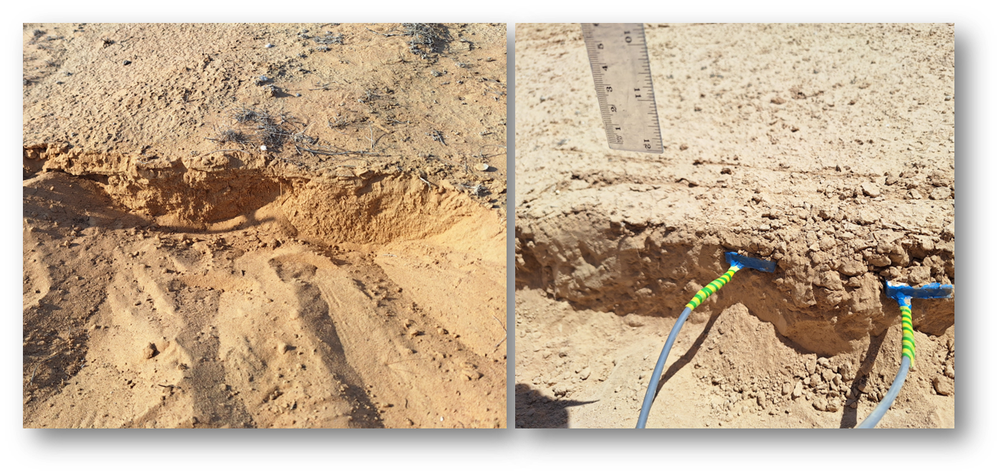
Objectives
How does CO₂ uptake vary with different arid soils?
Distance from the sea
Soil texture
Mashash
56km
Neot Smadar
100km
Nizzana
Sand
Mashash
Loess
vs
vs
Nizzana
52km
Sand
Mashash
56km
Loess
Neot Smadar
100km
Loess
Notes:
With that question, we explored two main variables. One. Distance from the sea (comparing 2 sites, Mashash, 56km and neot smadra 100km from the sea). And 2 soil texture (Mashash loess and Nizzana in a stabilized sand dune.

Slide 5
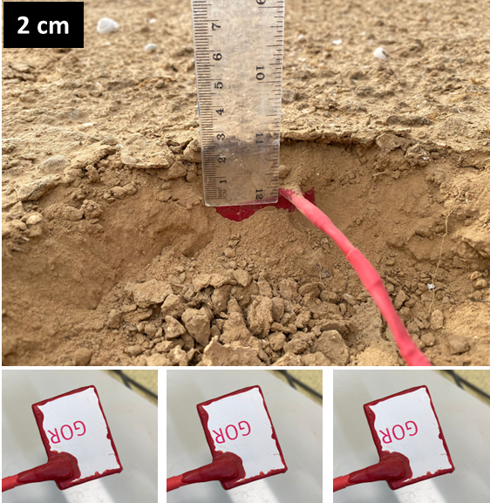
Experimental design
Sensors
LICOR chamber
+ Soil + Air CO2 concentration (ppmv)
+ Soil + Air temperature (ºC)
+ Soil + Air relative humidity (%)
+ Soil CO2 flux (Chamber + gradient method)
+ Meteorological conditions
CO2 concentration
CO2 flux
Fick’s law :
$F_{S}={−D}_{s}ρ_{a}\frac{dC}{dz}$
https://egusphere.copernicus.org/preprints/2024 /egusphere-2024-3156/
Notes:
We measured soil co2 concentration, t and rh using affordable system where we published a preprint. The low cost of the system allows us to monitor 3 sites, simultaneously, with high measurement frequency. Concentration, and flux was calibrated and validated using licor gas analyser.

Slide 6
Distance from the sea
56 km
100 km
Nocturnal CO2 influx and water vapor influx occurred at both side
There was a synchronization between CO2 flux and water vapor flux
At site closer to the sea, fluctuation of CO2 and water flux was greater
Notes:
So here is the results. First, let’s see how the distance from the sea affects the co2 flux. The first plot, is Mashash, 56km and second neot Smadar 100km. Water vapor flux is in blue and co2 flux is in black. We see that nocturnal water and co2 uptake occur at both site. Like other site in tabernas and sahara desert, we also found a synchronization between water and Co2 flux.
At site closer to the sea, as you can guess, the fluctuation of water is greater, more absorption and therefore, more desorption. Same for fluctuation of CO2.

Slide 7
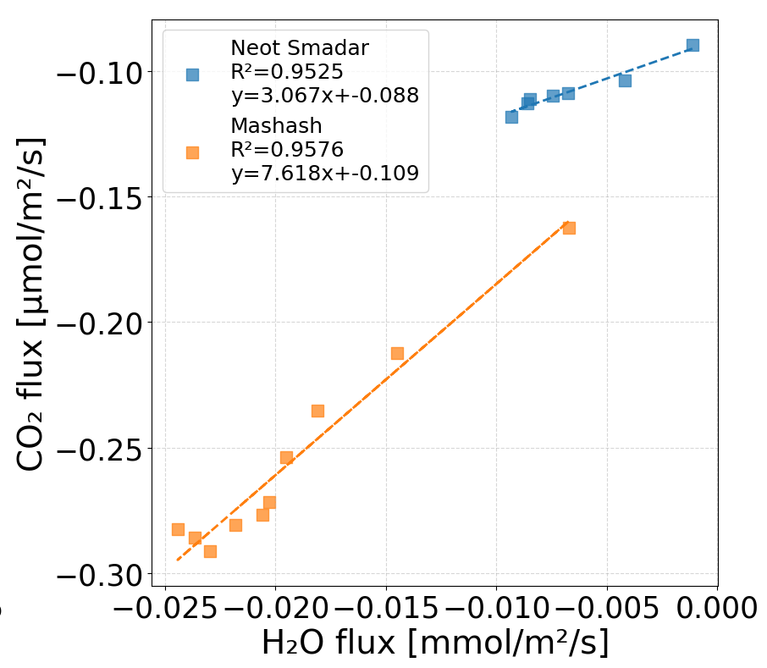
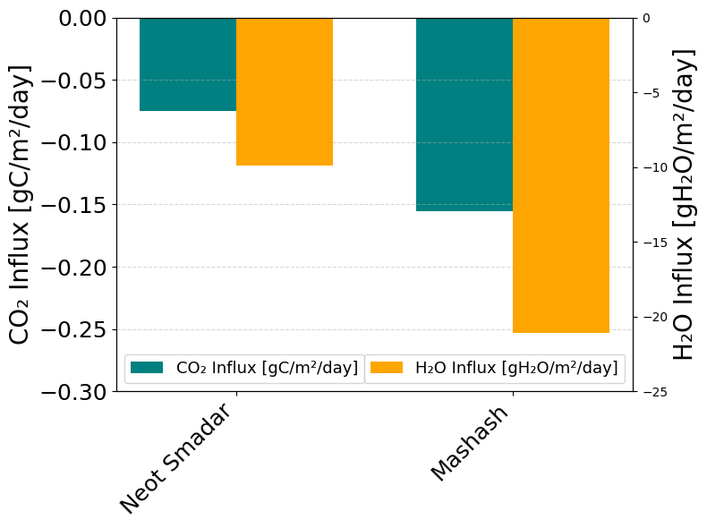
Distance from the sea
Average hourly uptake during night hours
Average daily accumulative uptake
CO2
water
CO2
water
56km
100km
More water vapor uptake leads to more CO2 uptake
Since Mashash is closer to the sea, it has more water vapor absorption --> more CO2 uptake
Notes:
To elaborate, I plot here co2 uptake as a function of water uptake, a positive linear correlation was observed in both site.
This plot shows that on the site with more accumulative water uptake also has more Co2 uptake.

Slide 8
Soil texture
Loess: Total SSA = 57.17 m2/g
Sand: Total SSA = 4.44 m2/g
At the site with a higher specific surface area, fluctuation of water and CO2 flux was greater

Slide 9
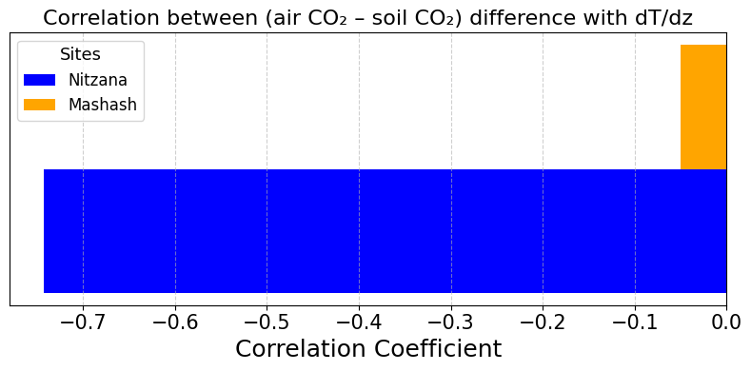
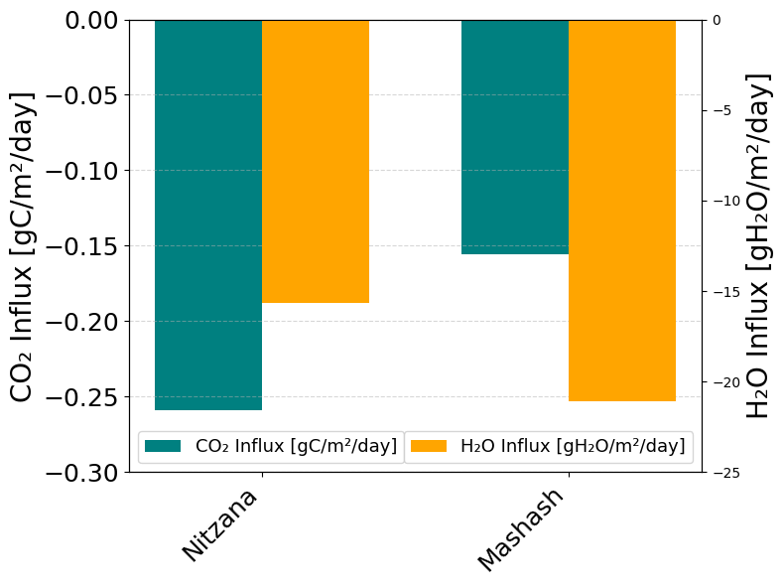
Soil texture
CO2
water
CO2
water
Thermal convection → CO2 uptake
Sand
Loess
Low CaCO3 content in sand
less water consumption on CaCO3 dissolution
More water to enhance CO2 solubility

Slide 10
Conclusion
Upcoming …
Distance from the sea
Soil texture
Soil CO2 project
5 arid sites
Automated LICOR chamber & DIY chamber
Profiles of Vaisala sensor & low-cost sensors
Isotopic analysis
Modelling
Mashash
56km
Loess
>
Mashash
56km
Loess
Nizzana
52km
Sand
Effects of rain pulse/soil texture
Biotic/abiotic partitioning
Negev desert, source or sink
Neot Smadar
100km
Loess
Notes:
So, a conclusion for this presentation, the site closer to the sea receives more water vapor and, therefore, more soil CO2 uptake at nighttime. However, the soil with finer texture has higher water vapor uptake but not Co2 uptake. And again, I would love to hear more suggestions and ideas from you about this.

Slide 11
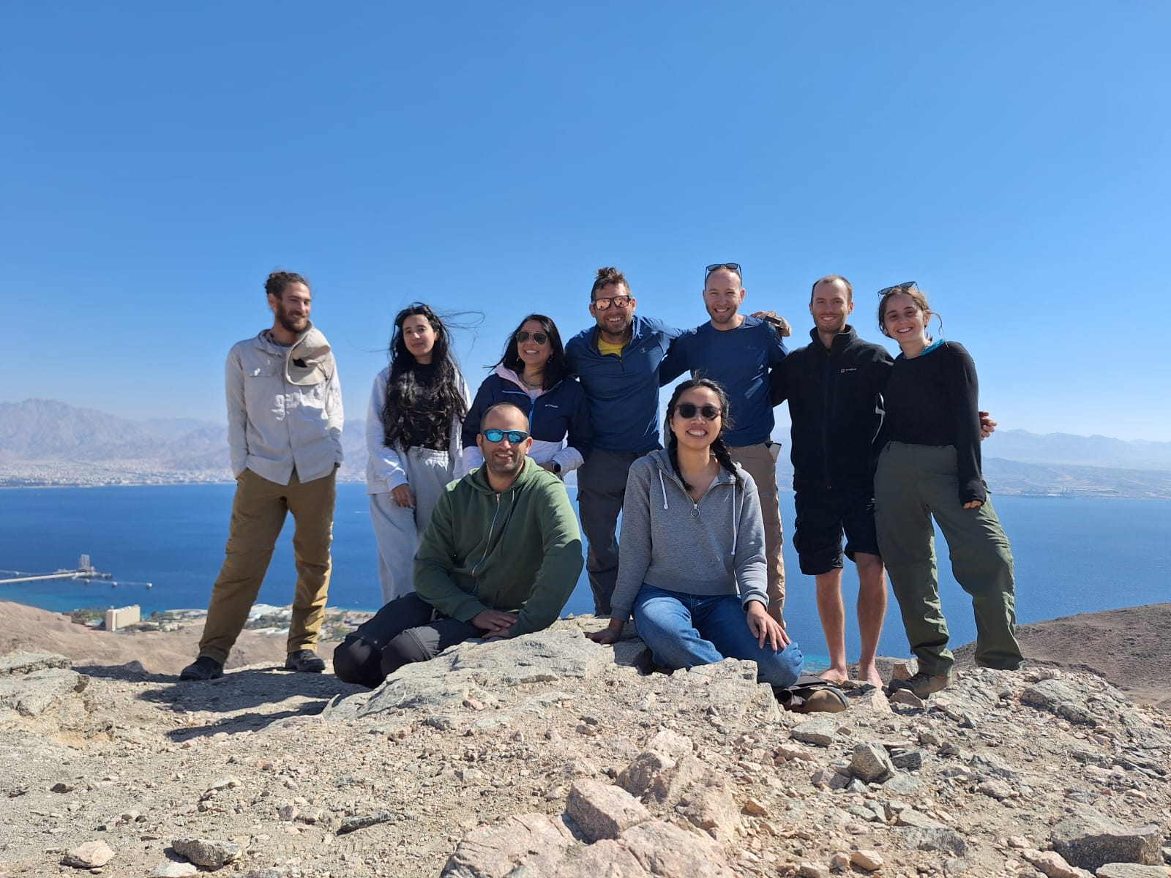
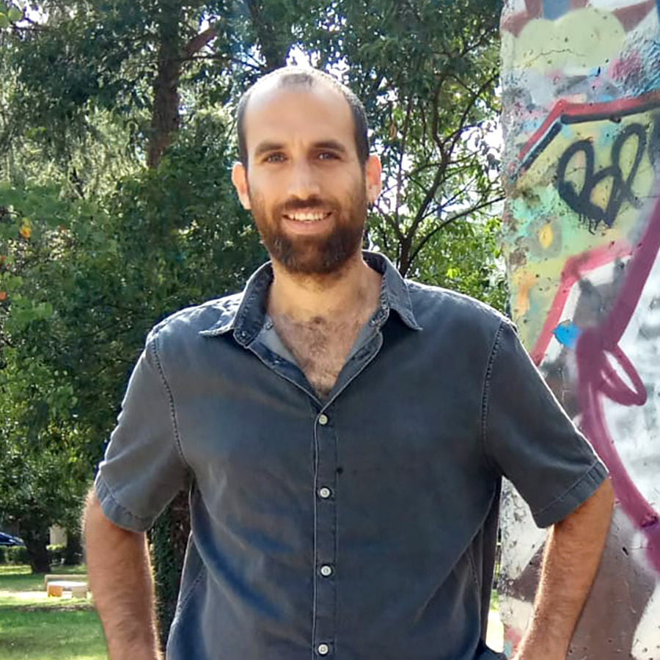
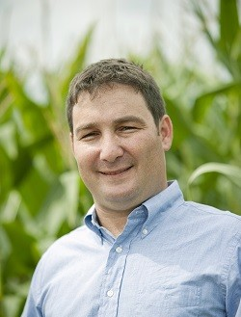
Contact us
Emails:
Nguyan@post.bgu.ac.il
Levintal@bgu.ac.il
X
Website
This project is funded by Koshland & Israel Science Foundation funding

Slide 12
Soil texture
More water vapor uptake → more CO2 uptake

