Slide 1
Refining Hydrogen Emission Measurements: Methodological Insights and Pilot Findings
Malgven Roudot ¹, Victoria Krohl ¹, Tomas Mikoviny ^{2,3}, Felix Piel ², Nikita Sobolev ³, Armin Wisthaler ^{2,3}
Equinor ASA, Oslo, Norway
Advanced Monitoring Solutions (adMS), Oslo, Norway
Department of Chemistry, University of Oslo, Oslo, Norway

Slide 2
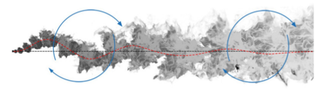
Raising the standard of trust for hydrogen in the energy transition
2023 : Phase 1
2024-2026: Phase 2
2025 - 2026
Objectives :
Choose the instrument / technology
Test instrument at 1-2 industrial sites
Objectives :
Quantify H₂ emissions from 2-3 industrial facilities (tracer ratio method, land-based & airborne)
Objectives :
Improve H₂ release scenarios
Communicate results and conclusions with relevant policymakers and stakeholders
Wind
Known tracer emission rate

Slide 3
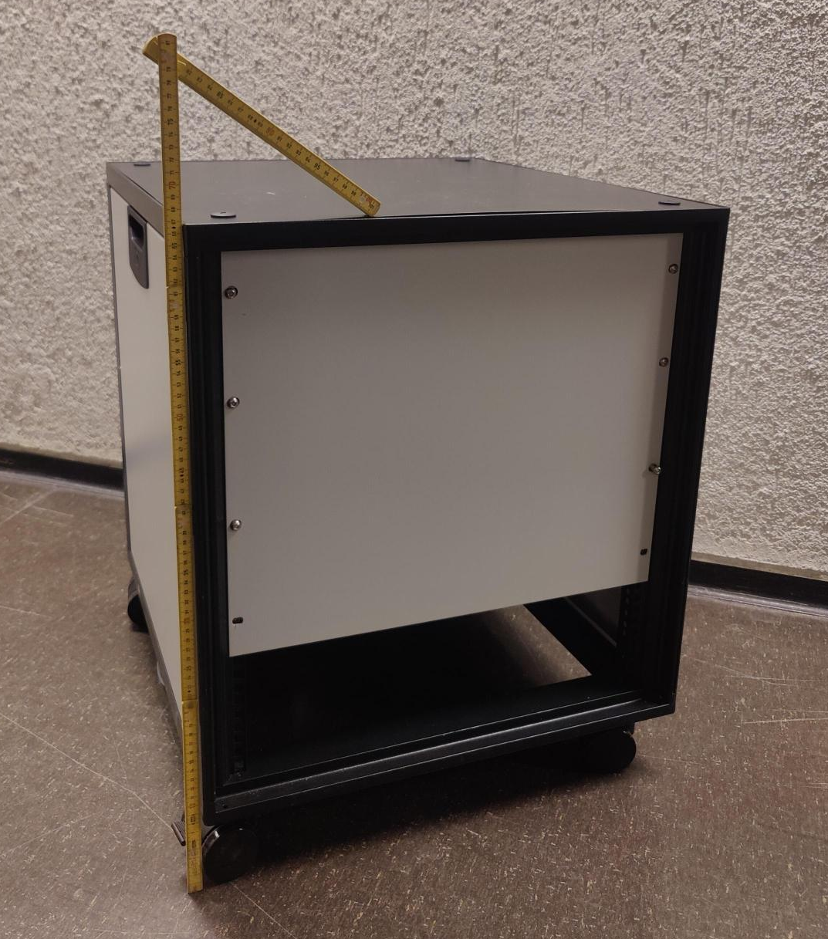
H2MS
Mass spectrometer optimized to measure small concentrations of hydrogen in the atmosphere
Field data comparison: Performance equivalent to CH₄ analyser (Picarro G2311-f)
Patent application submitted
67 cm
1 ppm
H₂ (ppm)
CH₄ (ppm)

Slide 4
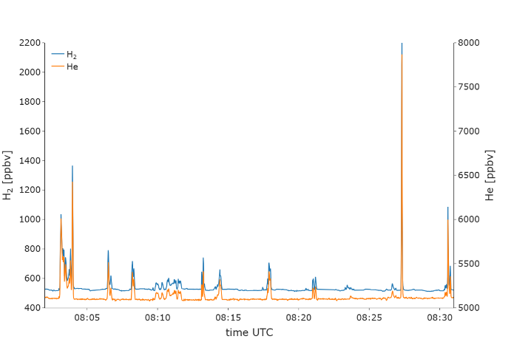
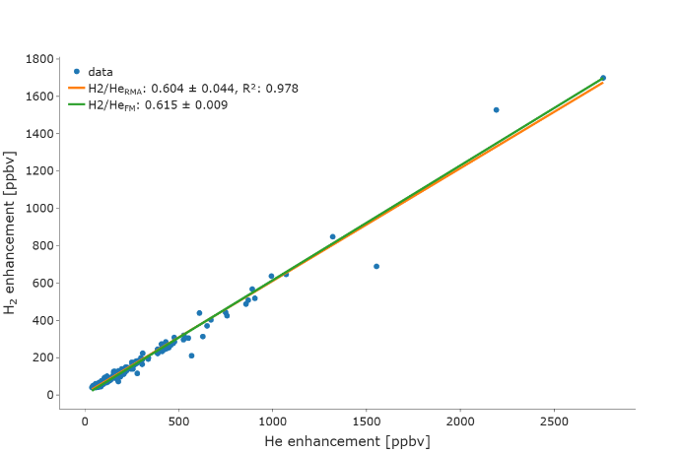
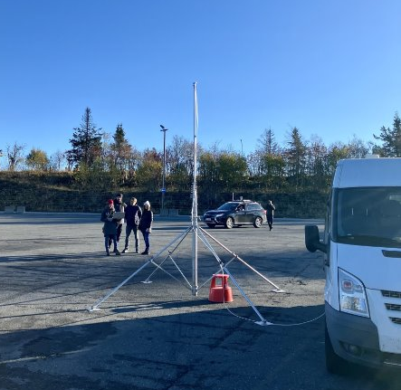
Demonstration experiment in Oslo Tracer ratio system test – co-located controlled-release
H₂ flow rate: 0.0075 kg / hour *
Ratio H₂/He: 0.615 ± 0.009
Release of H₂ and He mixture
Air sampling
H₂ flow rate: 0.0074 kg / hour *
Ratio H₂/He: 0.604 ± 0.044
Error ≈ 2%
* At 20 °C

Slide 5
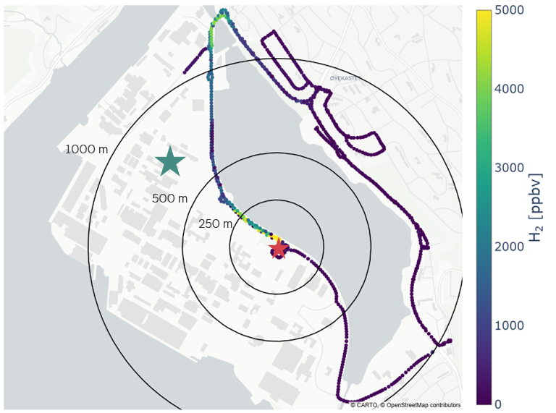
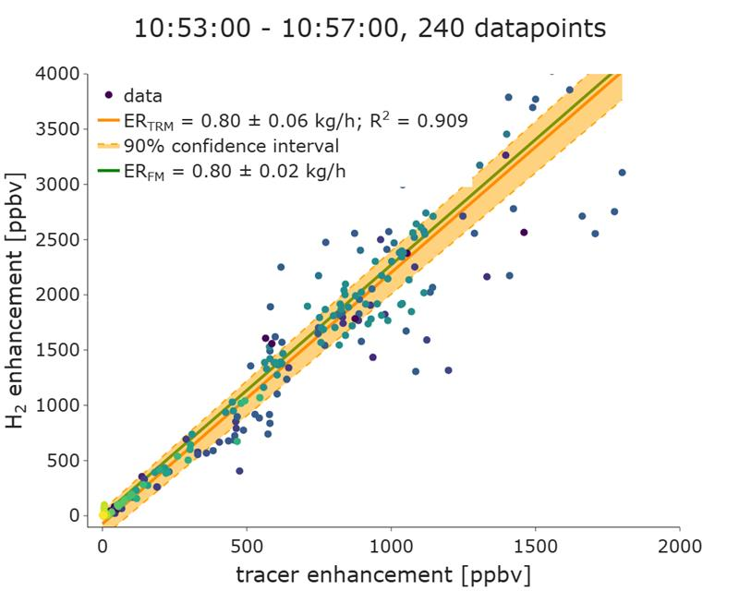
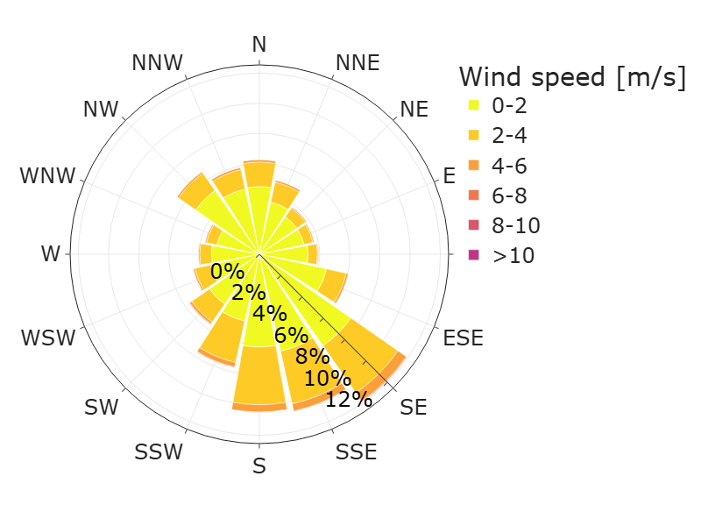
Validation experiment in industrial environment with
Operator H₂ flow rate: 0.8 ± 0.02 kg / hour
Estimated H₂ flow rate: 0.8 ± 0.06 kg / hour

Slide 6
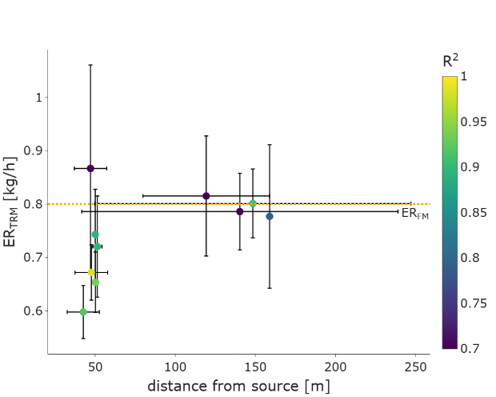
Validation experiment in industrial environment with
Operator H₂ flow rate: 0.8 ± 0.02 kg / hour
Error ≤ 25 %
Error ≤ 3 %

Slide 7
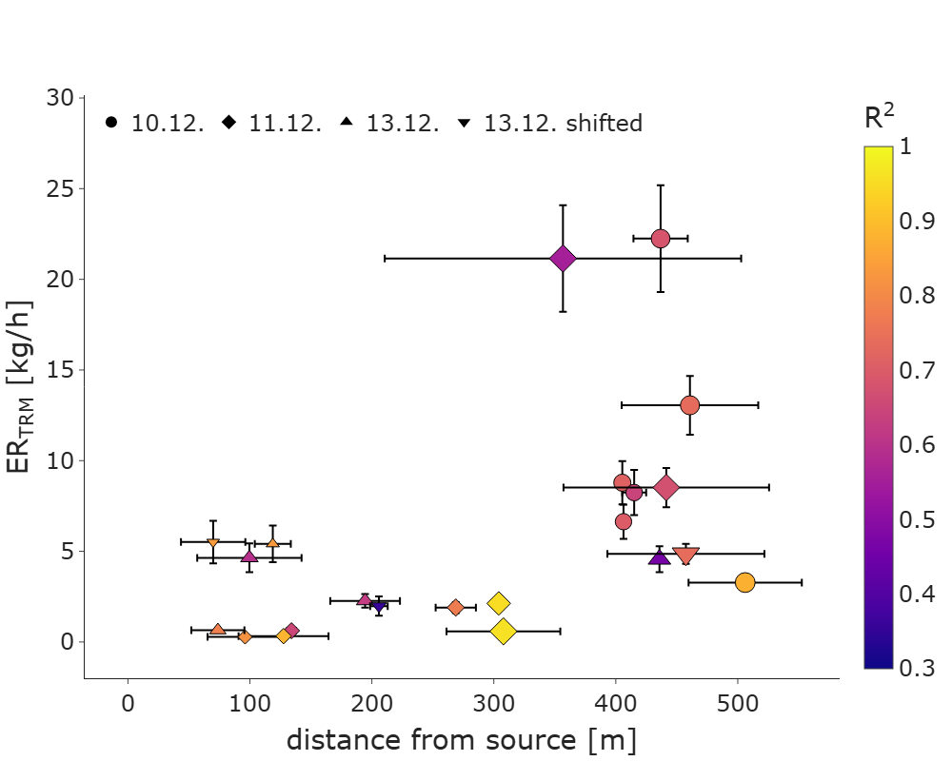
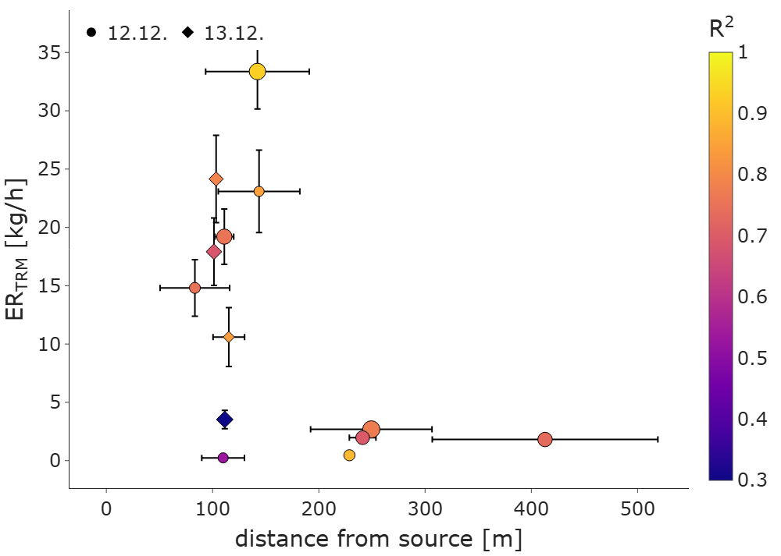
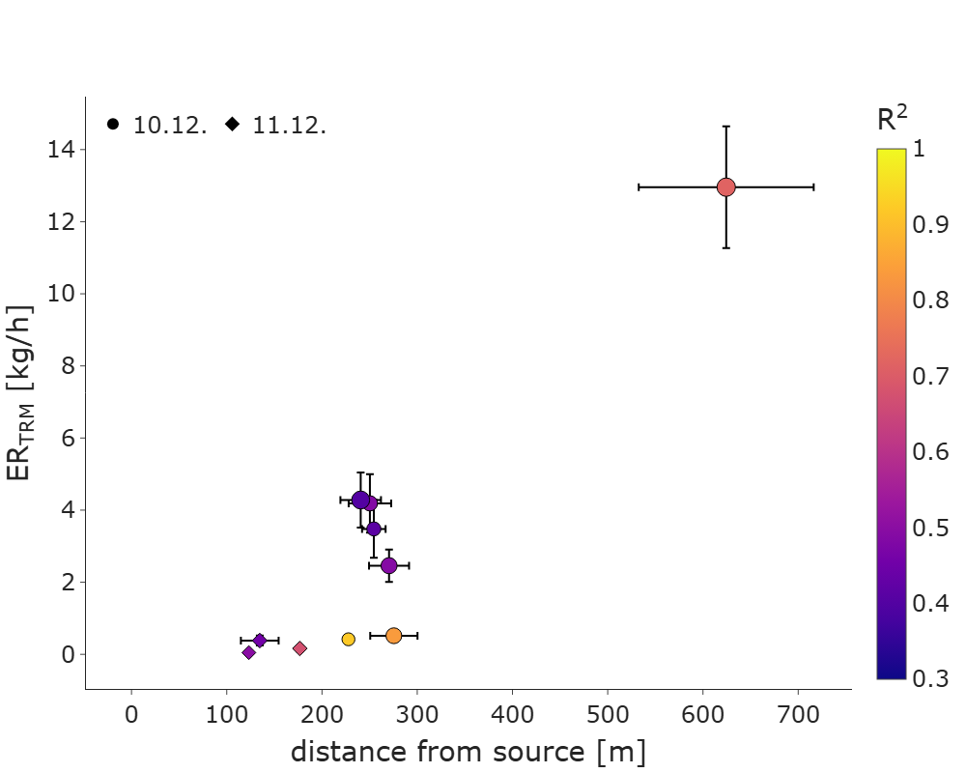
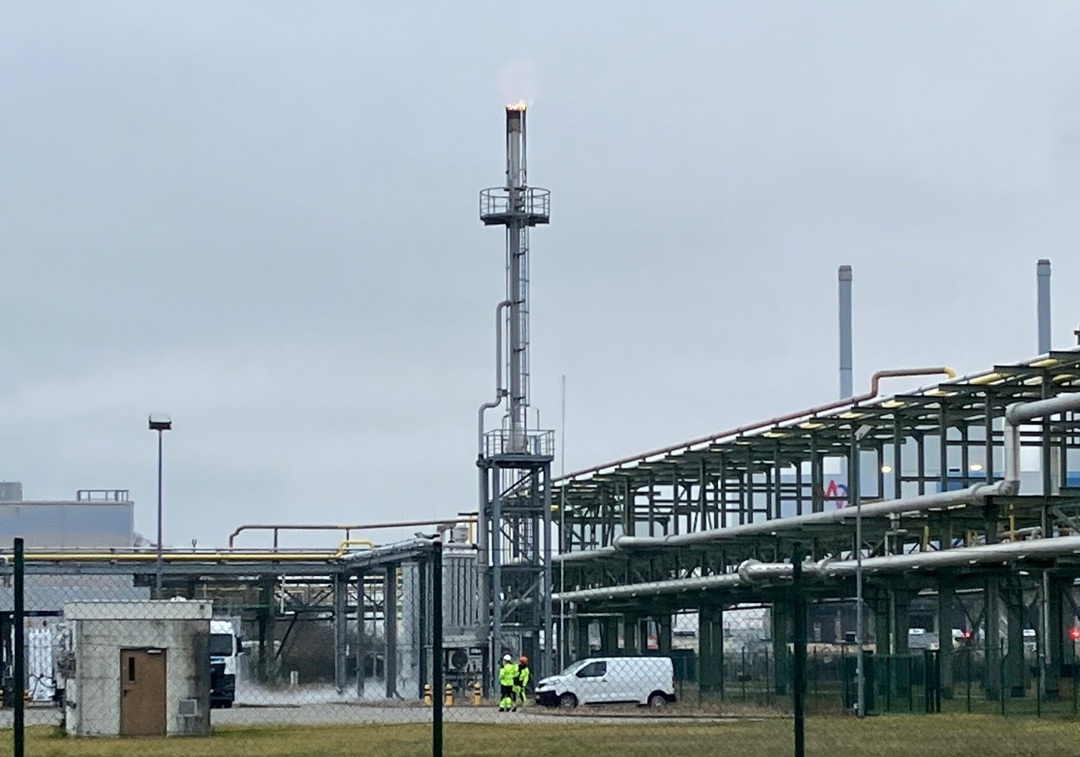
Full-scale campaign at hydrogen processing plant
Cold Vent
Steam Methane Reformer (SMR)
Flare
3 experiments over 3 days
Point source
Distance H₂ source to tracer release point
Horizontal ~ 55 m (south)
Vertical < 5 m
2 experiments
Fugitive emissions
Distance H₂ source to tracer release point
Unknown (< 150 m)
2 experiments
Point source
Distance H₂ source to tracer release point
Horizontal ~ 15 m (east)
Vertical ~ 20 m

Slide 8
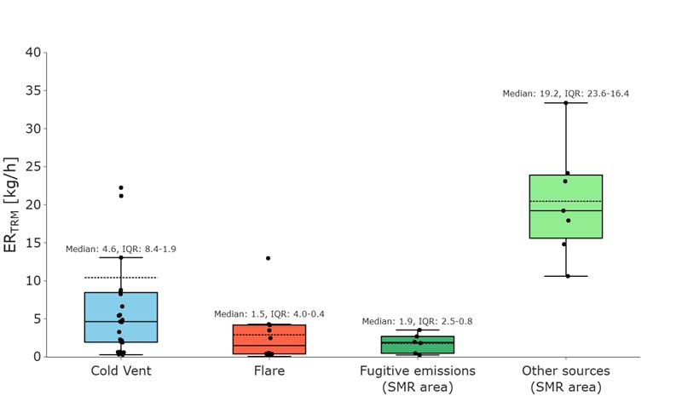
First full-scale campaign at hydrogen processing plant
Average production during campaign: 3862 kg/h
Confidently assigned to production site
H₂ emissions related to production rate
Sum of median values
Sum of (Weighted average of all plumes
(number of points x R²))
Sum of (median value + (max rate * 1 h/day))
8 kg/h | 15 kg/h | 13.4 kg/h
0.21 % | 0.39% | 0.35%
27.2 kg/h | 38.5 kg/h | 34 kg/h
0.7 % | 1 % | 0.88%
If all measured emissions assigned to production site
Preliminary results

Slide 9
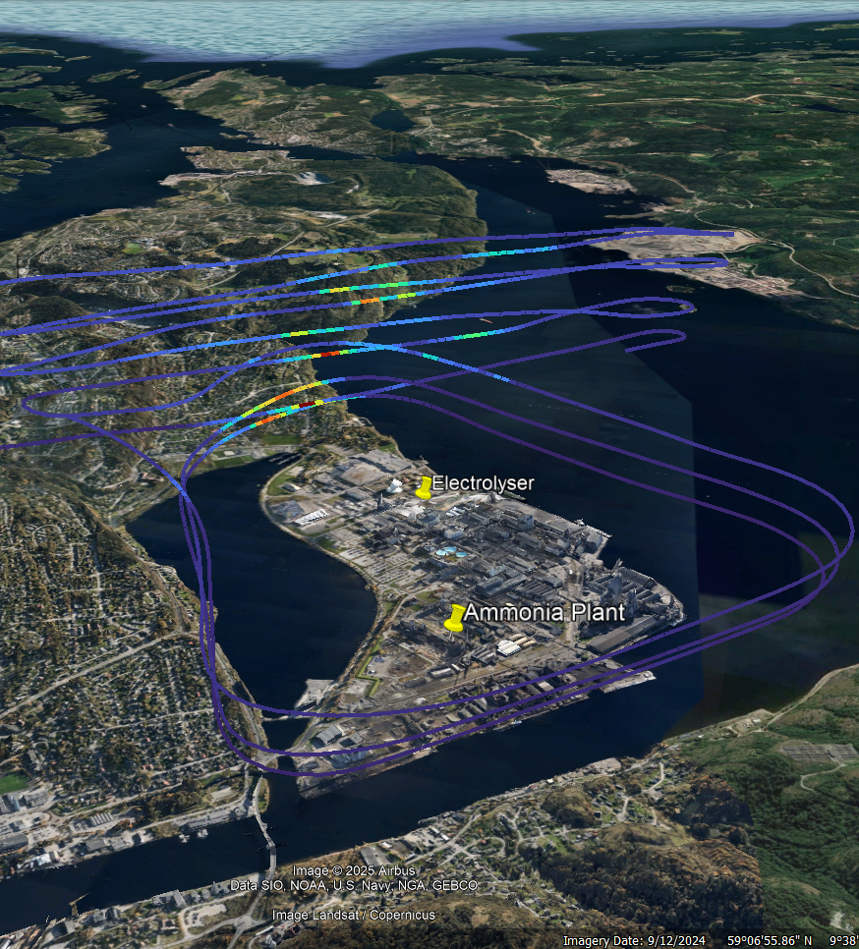
Take-aways and way forward
First test flight (31/03/2025)
HEQ method shows good performance
Initial results from SMR production sites show low hydrogen emissions (< 1%)
Wind conditions and road access limitations are a challenge
Test airborne approach for integrated site emissions
Emissions from other parts of the value chain
Scientific publication coming soon
* * * * *
WIND

Slide 10
Refining Hydrogen Emission Measurements: Methodological Insights and Pilot Findings
Acknowledgments:
Malgven Roudot ¹, Victoria Krohl ¹, Tomas Mikoviny ^{2,3}, Felix Piel ², Nikita Sobolev ³, Armin Wisthaler ^{2,3}
Equinor ASA, Oslo, Norway
Advanced Monitoring Solutions (adMS), Oslo, Norway
Department of Chemistry, University of Oslo, Oslo, Norway

