Slide 1
Association between Exposure to Fine Particulate Matter from Different Emission Sources and Mental Health Outcomes in India
Payel Kundu (srz228378@iitd.ac.in),¹ Sagnik Dey,^{2,3} Anand Krishnan,⁴ Santu Ghosh,⁵ Girish N Rao,⁶ Vivek Benegal,⁷ Mathew Varghese,^{5,7,8} and Gopalkrishna Gururaj⁶
¹School of Interdisciplinary Research, Indian Institute of Technology Delhi, India;
²Centre for Atmospheric Sciences, Indian Institute of Technology Delhi, India;
³Adjunct Faculty, Department of Health, Policy and Management, Korea University, Seoul, South Korea;
⁴Centre for Community Medicine, All India Institute of Medical Sciences, India;
⁵St. John’s Medical College, Bangalore, India;
⁶Department of Epidemiology, Centre for Public Health, National Institute of Mental Health, and Neurosciences, Bengaluru, India;
⁷Department of Psychiatry, Centre for Addiction Medicine, National Institute of Mental Health, and Neurosciences, Bengaluru, India;
⁸Kasturba Medical College, Manipal, India
ITS2.4/CL0.5
EGU25-687

Slide 2
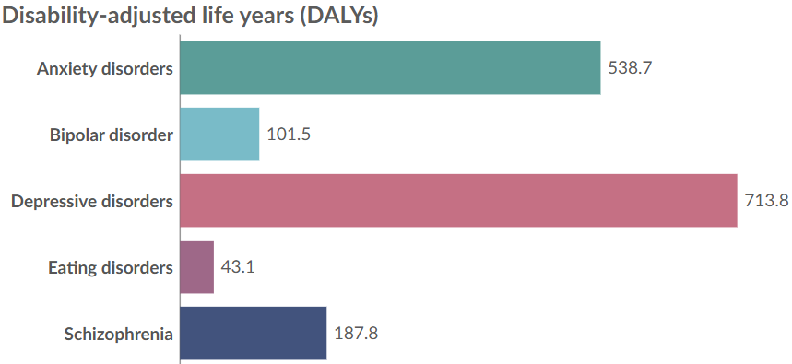
Mental Health: A Global and National Concern
13.9%
of the world’s population experienced mental disorders in 2021.
Mental disorders are among the top 10 leading causes of health loss worldwide
Age-standardized DALYs increased from 2010 to 2021:
Depressive disorder
Anxiety disorder
16·4%
16·7%
GBD 2021
1 in 7 Indians were affected by mental disorders of varying severity in 2017 (Sagar et al, 2020)
Figure 1: Estimated number of DALYs per 100,000 people
Source: GBD 2021

Slide 3
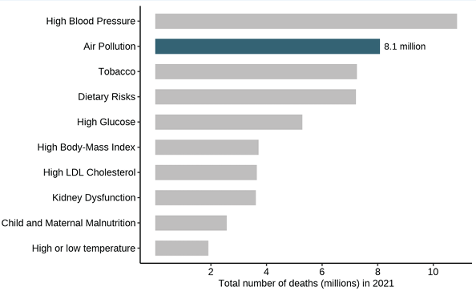
Air Pollution: The Biggest Threat
Air pollution was the 2nd leading risk factor for death worldwide in 2021.
12% of the total global deaths in 2021- nearly 1 in 8 deaths – were linked to exposure to air pollution.
PM_{2.5} is the largest contributor to the global burden of disease
7.8 million deaths- worldwide
2.1 million deaths- India
Figure 2: Global ranking of risk factors by total number of deaths in 2021

Slide 4
Potential Mechanism and Objective
Figure 3: Potential mechanism of the impact of PM_{2.5} exposure on mental health
Research Gaps:
Ambient PM_{2.5} has been linked to mental disorders (Block and Calderón-Garcidueñas, 2009). However, it remains unclear whether exposure to PM_{2.5} from different emission sources is differentially associated with mental health outcomes, especially in LMICs.
Existing research is mainly focused on Western countries, with limited data from India, which has severe air pollution and mental health burdens.
Objective:
To examine the associations of long- and short-term exposure to total and source-specific PM_{2.5} with depression and anxiety in Indian adults

Slide 5
Data and Methodology
34802 National Mental Health Survey (NMHS-1) participants (18+ years) during 2015-16 in 12 Indian States across 6 regions
Exposure Data
Satellite-derived PM_{2.5} Resolution: 1km X 1km
Dey, et al. 2020
State > District > Taluka > Household > Participants
Model output
PM_{2.5} sectors
Singh et al 2021
Health outcomes: Depression (F32–F33) & Anxiety (F40–F48) were assessed using the Mini-International Neuropsychiatric Interview (M.I.N.I V6.0.)
To estimate the mass concentration of source-specific PM_{2.5}:
Gururaj et al, 2017
$$Mi= \frac{Mi,model}{PM2.5,model}X PM2.5, satellite$$
Exposure matching
Chaudhary et al 2023
We calculated the exposure for all the 720 clusters in NMHS
1-month (short-term) and 1-year (long-term) average exposures prior to the interview date were assigned to NMHS participants’ addresses.

Slide 6
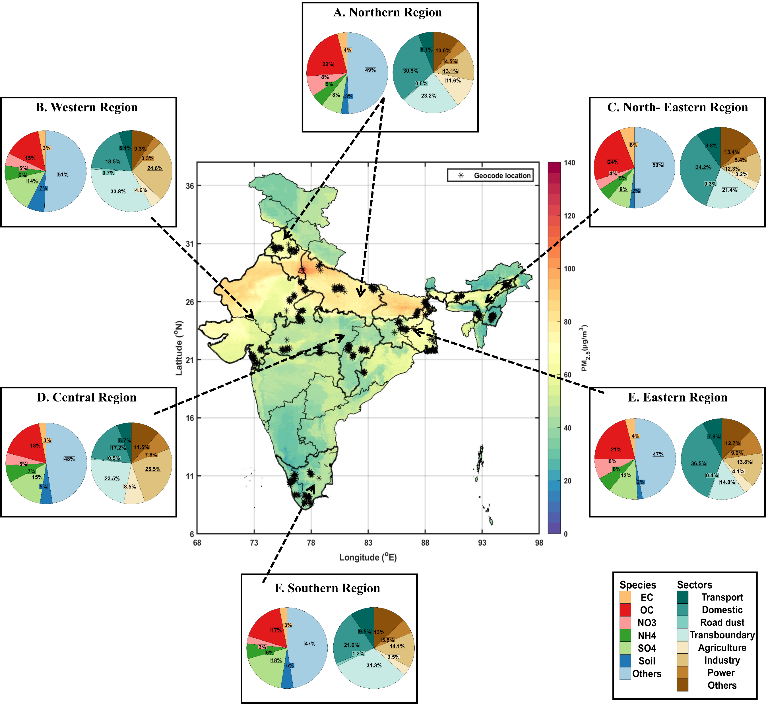
Figure 4: Spatial distribution of annual PM_{2.5} (2015-16) along with the species and sectoral contribution to PM_{2.5} (for one-year exposure window) and the geolocation of NMHS clusters.

Slide 7
Prevalence of Mental Disorders
National prevalence = 2.68%
National prevalence = 2.95%
Figure 5: District-wise and national prevalence of depression and anxiety in 12 Indian States

Slide 8
Association between Source-specific PM_{2.5} and Depression and Anxiety
Source
Source
Figure 6: Odds ratios (ORs) of (A) Depression or (B) Anxiety associated with a per IQR increase of source-specific PM_{2.5} exposures with 95% confidence interval (CI)
PM_{2.5}
1.10 (95% CI: 1.09 – 1.12) for 1-week
1.03 (95% CI: 1.02 – 1.04) for 1-week
The major mental health risk is posed by PM2.5 originating from transport, domestic, and power sectors

Slide 9
Exposure-Response curve
1-month
1-year
Figure 7: Exposure-response curves for depression and anxiety against PM_{2.5} levels. The shaded region represents a 95% confidence interval.
Exposure-response curves are observed to be mostly non-linear and non-monotonic

Slide 10
Exposure-Response curve
A. Depression
B. Anxiety
1-month
1-year
1-month
1-year
* Others – Divorced/separated/widowed
Figure 8: Subgroup analysis of the association of depression and anxiety per IQR increase in PM_{2.5} levels.

Slide 11
Summary and Conclusion
Higher PM₂.₅ exposure was associated with increased odds of depression and anxiety, with stronger effects for long-term (1-year) exposure.
Source-specific analyses showed that PM₂.₅ from transport, domestic, industrial, and power sectors was linked to higher odds of depression, particularly with long-term exposure.
For anxiety, stronger associations were observed with short-term (1-month) exposure to transport, domestic, and power sector emissions.
The exposure-concentration curve indicates that elevated PM_{2.5} exposure markedly enhances the probability of anxiety, but a more gradual increase was noted for depression.
The associations were heterogeneous across regions, with stronger associations were observed in the Eastern region for depression and the Western region for anxiety.
Individuals with the lowest income, residing in urban metropolitan areas, and those who were divorced, separated, or widowed exhibited greater susceptibility to both depression and anxiety associated with PM_{2.5} exposure.
Limitations:
Causality direction is unknown, and all confounders may not have been adjusted.
We assumed that participants’ residential addresses did not change during the study period.

Slide 12
Acknowledgement and References
The work is funded by a research grant from the Clean Air Fund.
I acknowledge the UGC funding for the doctoral fellowship
Reference
Health Effects Institute. 2024. State of Global Air 2024. Special Report. Boston, MA: Health Effects Institute.
The Lancet Psychiatry. Global Burden of Disease 2021: mental health messages. Lancet Psychiatry. 2024
Sagar, R., et al. (2020). The burden of mental disorders across the states of India: the Global Burden of Disease Study 1990–2017. The Lancet Psychiatry
Block, M. L., & Calderón-Garcidueñas, L. (2009). Air pollution: mechanisms of neuroinflammation and CNS disease. Trends in neurosciences.
Liu et al. (2023). Neurodevelopmental toxicity induced by PM2.5 Exposure and its possible role in Neurodegenerative and mental disorders. Human & Experimental Toxicology
Gururaj et al. National Mental Health Survey 2015–16 (Phase 1 dataset). Ministry of Health and Family Welfare, Government of India, and National Institute of Mental Health and Neurosciences, Bengaluru; February 2017. Available from: http://indianmhs.nimhans.ac.in.
Dey, S. et al (2020). A satellite-based high-resolution (1-km) ambient PM2.5 database for India over two decades (2000–2019): applications for air quality management. Remote Sensing
Chaudhary et al (2023). Cumulative effect of PM2.5 components is larger than the effect of PM2.5 mass on child health in India. Nature Communications
“There is no health without mental health”- UN General Secretary
Contact Info:
Email ID: srz228378@iitd.ac.in
Thank You.

