Slide 1

SUBMERSE: turning submarine telecommunications cables into planetary sensors
Chris Atherton, GÉANT
28th Apr 25
EGU25, Vienna, Austria

Slide 2
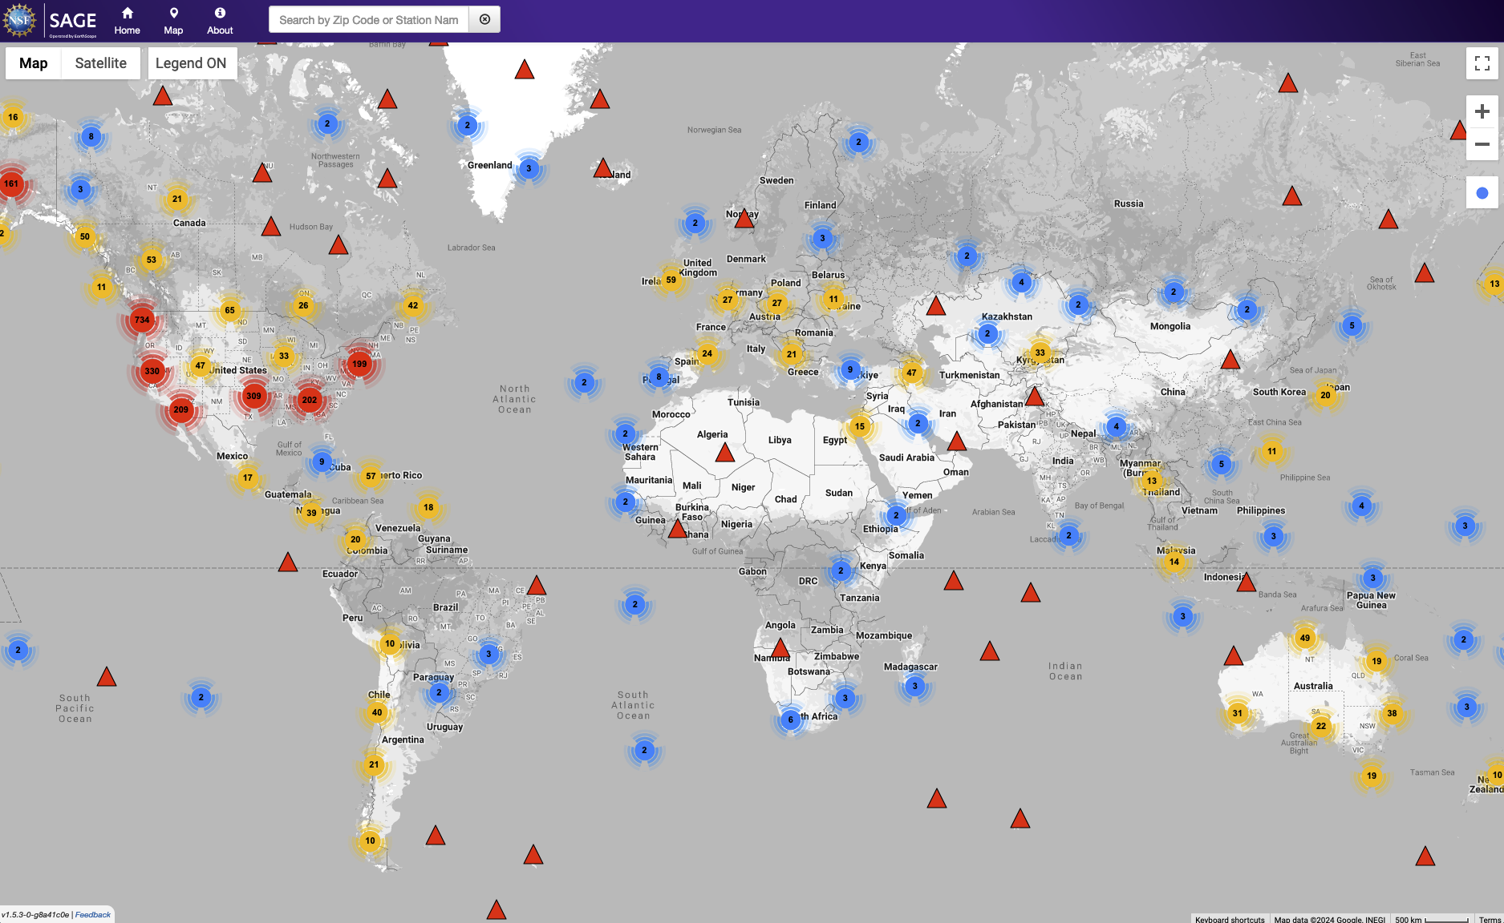

Slide 3
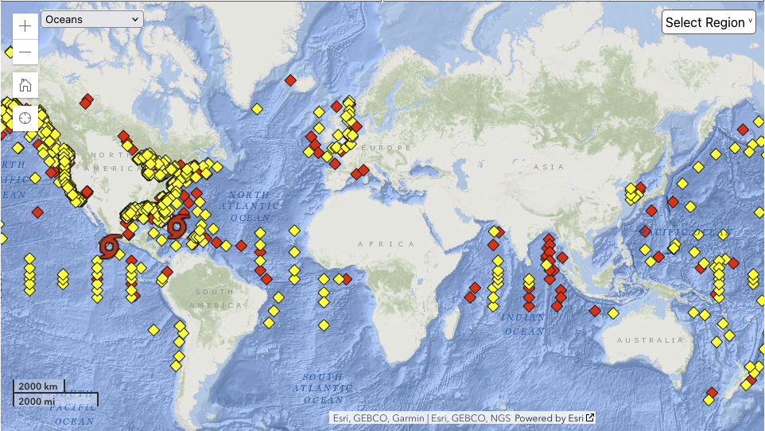
As of 22/10/24

Slide 4
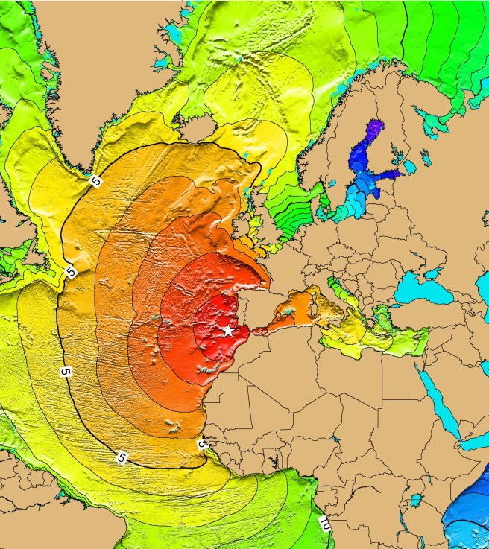
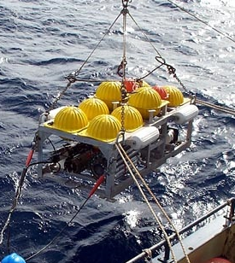
Why
Some of the many global challenges
Credit: Photo by John Whitehead, Woods Hole Oceanographic Institution
Credit: NOAA Tsunami Travel Time Maps

Slide 5
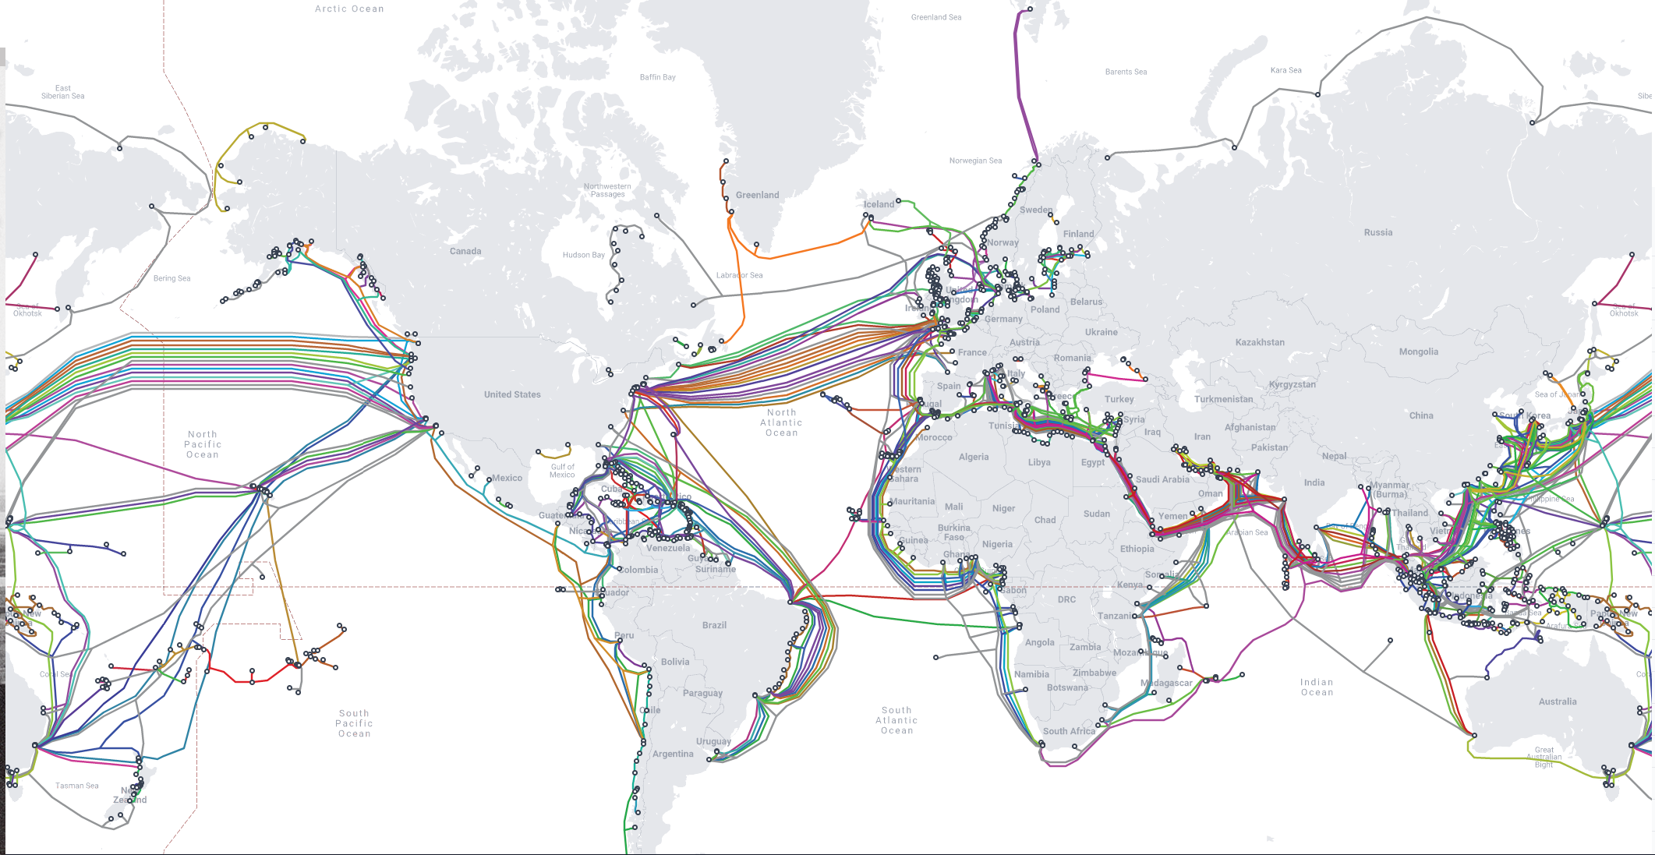
Credit: www.submarinecablemap.com
Notes:
What about submarine telecommunications cables?

Slide 6


Slide 7

Aim
Investigate utilising existing telecom cables, rather than dedicated submarine fibre, for monitoring the earth and oceans, without disrupting the telecoms traffic.
Notes:
Fix this slide
See if we can simplify and increase the size of the letters.
"Standardised architecture" for example
"Roadmap and strategy for sustainable instrument"

Slide 8
Objectives
Standardised architecture
Research-Infra data dissemination
3 geographic locations
Produce open, machine readable, long-term datasets.
Develop in collaboration with research communities.
Defining training and capacity building
Roadmap and strategy for sustainable instrument
Scientifically validate deployments
Notes:
Fix this slide

Slide 9
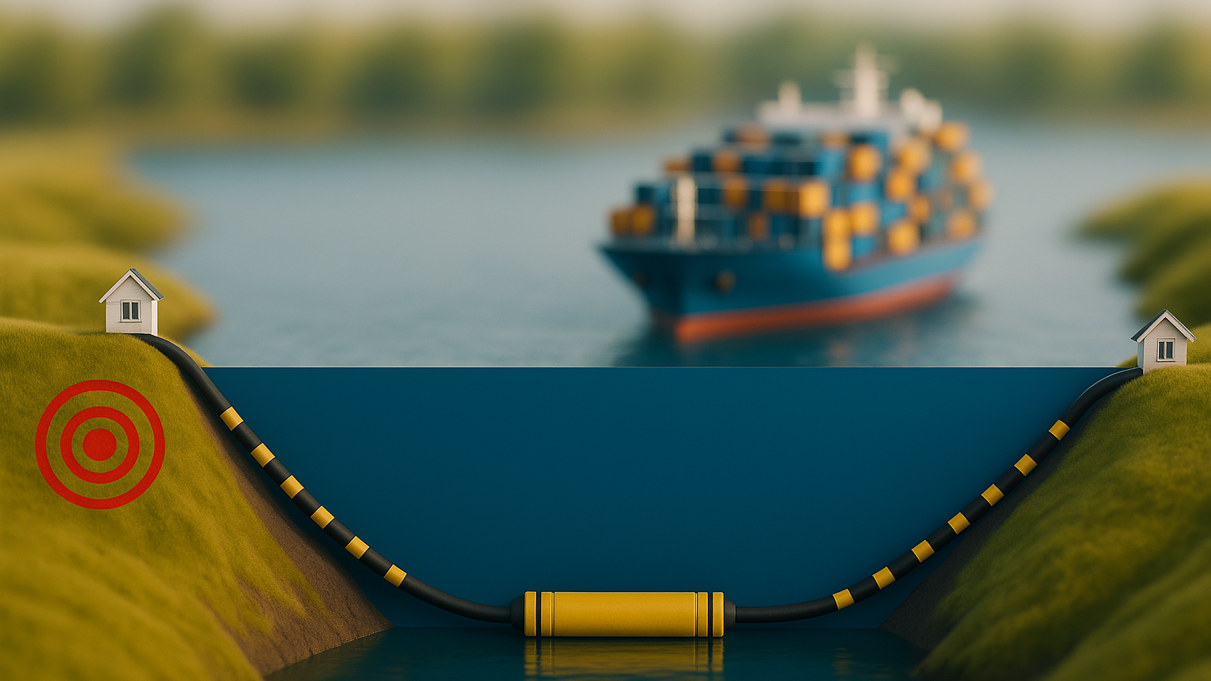

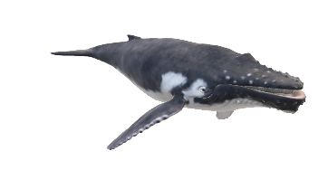

Wet vs Dry Sensing
Dry plant sensing
Submarine telecoms cable
Earthquake
Wet plant sensing
SMART cable sensor
Created using ChatGPT GPT-4.5

Slide 10
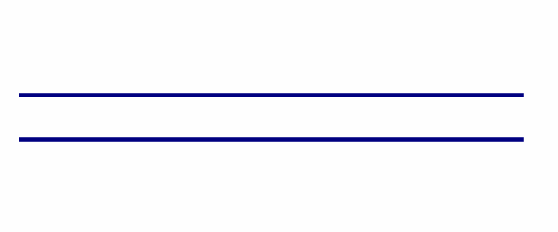
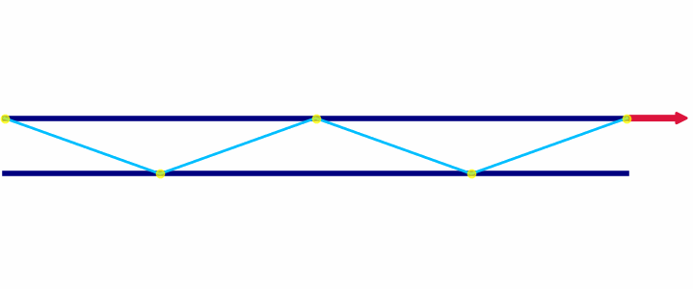
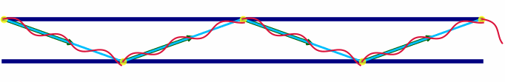
Fibre Sensing techniques
DAS
SOP
IPD
Distributed Accoustic Sensing
State of Polarisation
Introformetric Phase Detection
Uses reflections from impurities in the fibre when a laser light hits the side, to measure stretch and strain.
Uses the changes in position of the laser light as it exits the fibre to detect changes made to the cable the laser light travels through.
Uses the changes in the time of arrival of the laser light when compared against a reference signal to detect changes to the cable

Slide 11
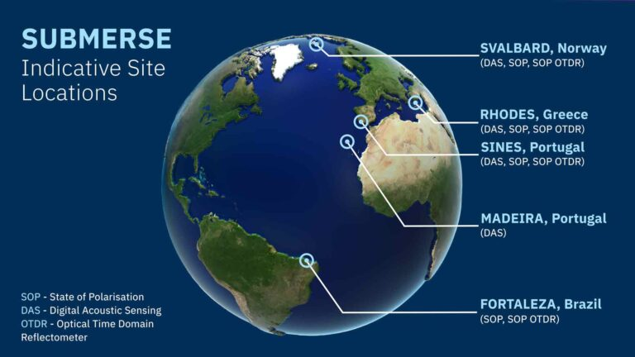
Preveza,

Slide 12
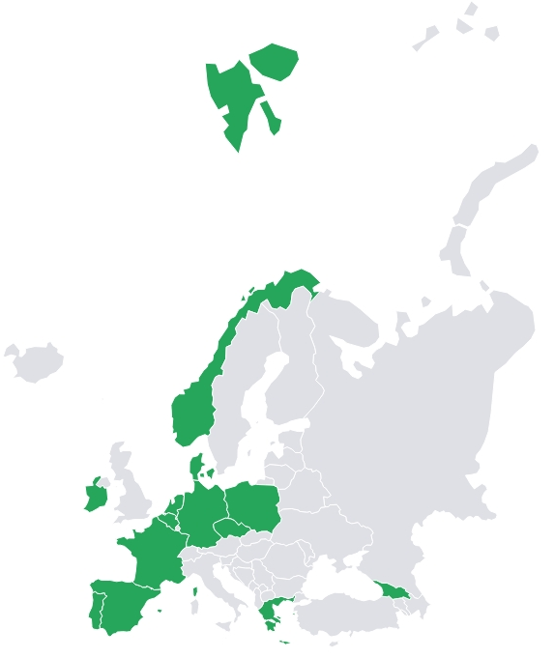













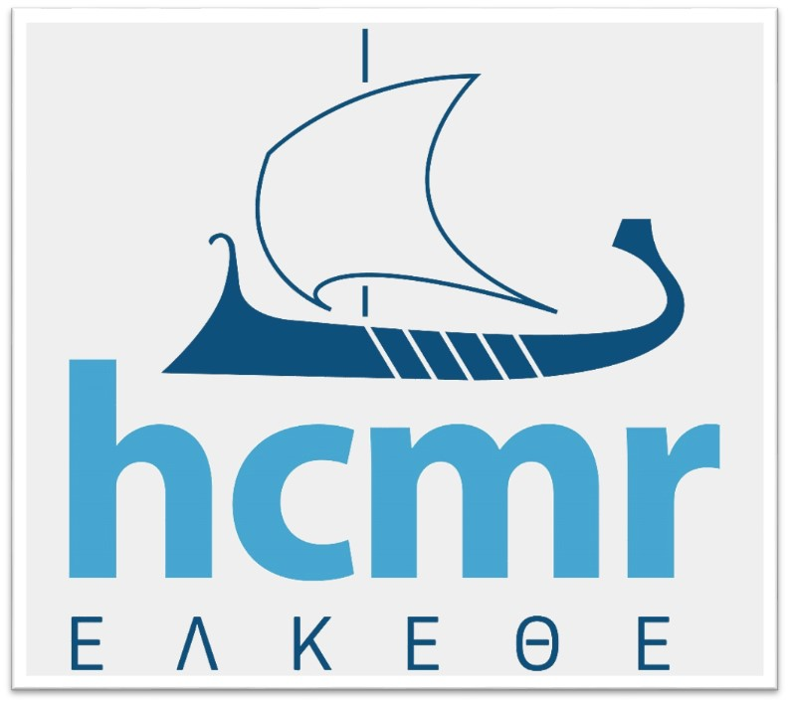

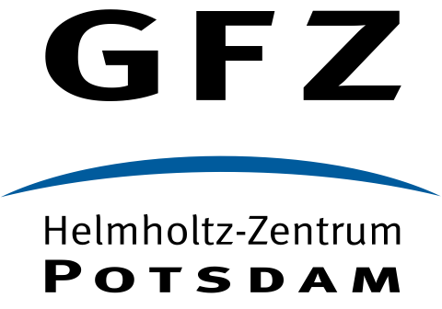



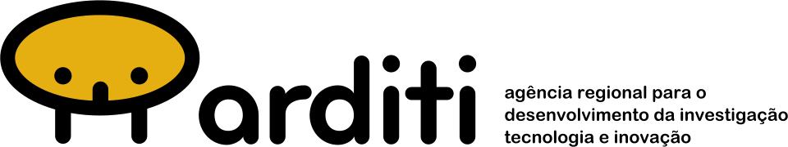


Consortium Members
36 Month Project
Research Organisations
NRENs
Commercial organisations
Notes:
8 NRENs

Slide 13

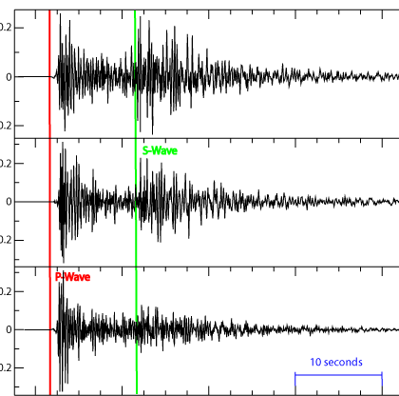
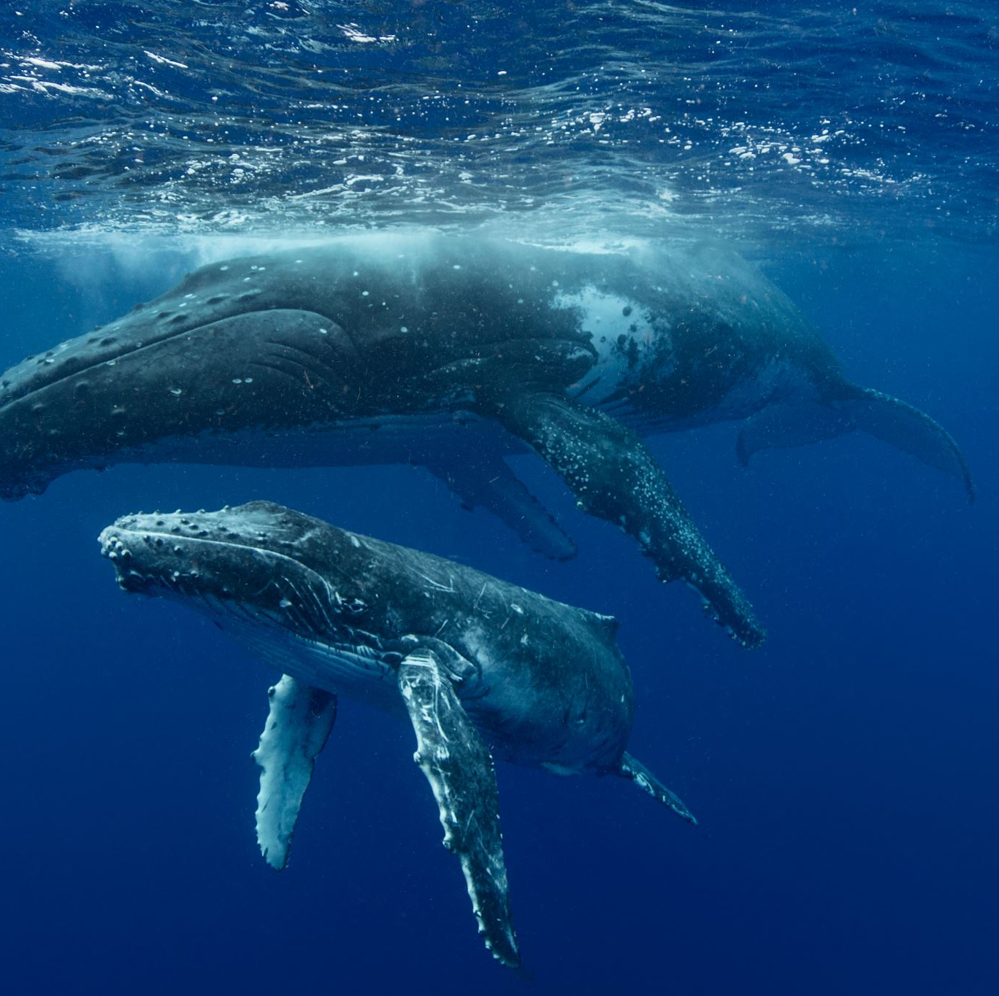
Scientific Communities
Oceanography
Seismology
Marine Biology
Notes:
=

Slide 14
Why ontologies are important
In SUBMERSE we have 4 “communities” and they all speak their own language
Researcher
Operator
Manufacture
Project support
Each role is important
Each has their own language and interpretation
Without a shared interpretation, we’re not able to share information easily.
(This is where the ontology comes in)

Slide 15
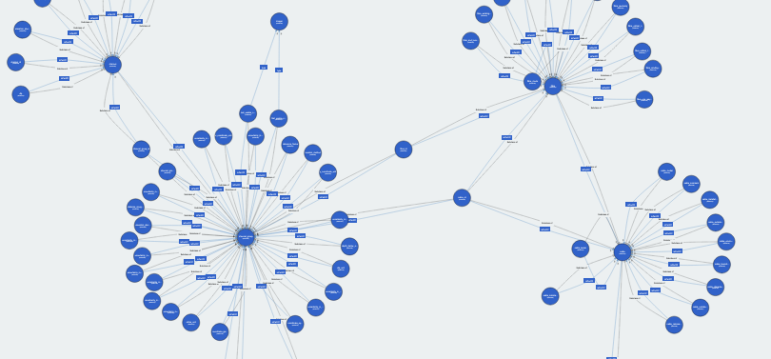
We developed an ontology

Slide 16
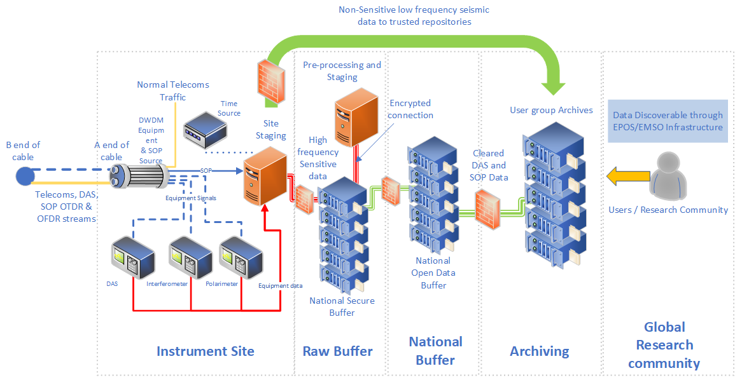


The high-level instrument architecture – per site
National Data Management policies
Open Science Data
Management policies (FAIR)
Notes:
The concept is to investigate integrating DAS, SOP, SOP OTDR and SOP OFDR techniques, then integrating the different infrastructures involved, maximising on each others strengths. The aim is not to create a new parallel research infrastructure but to integrate and compliment existing infrastructures together.
Not for the NRENs or GÉANT to do research into earthquakes, tsunami’s and the likes, but to provide the infrastructure and services necessary for researchers to do their work, in the most easy, scalable and streamlined way possible.
To create a multi domain data source.

Slide 17


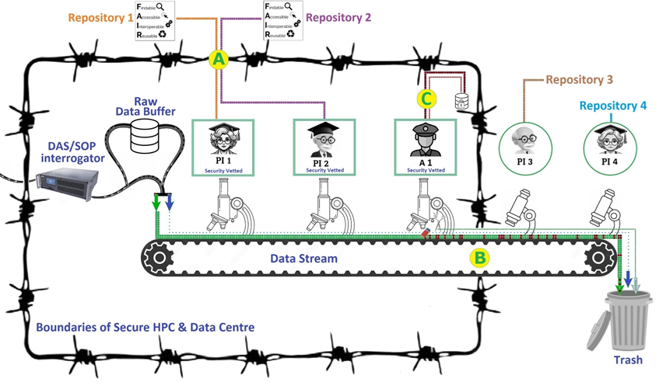


The Secure HPC & Data Centre
Presentation main title heading

Slide 18
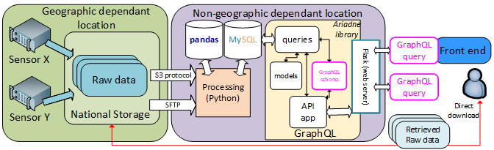
The proposed API architecture
User community
Research Org
S3 Protocol
or
SFTP
This is meant to be improved and iterated upon.

Slide 19
Some of the achievements so far

Slide 20
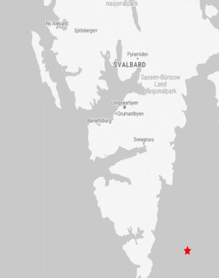
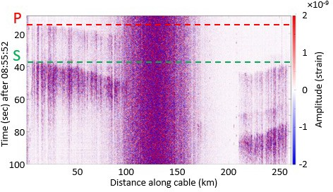
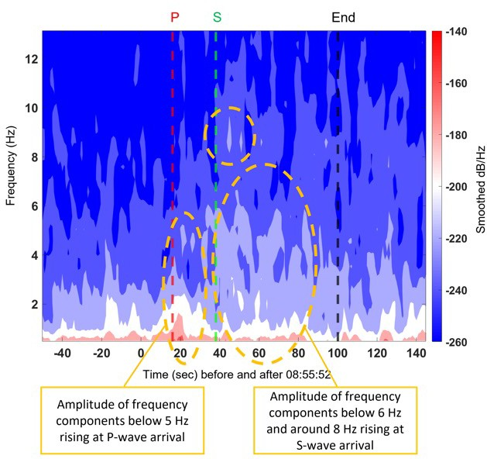





Detection of M2.7 Earthquake with DAS and SOP
-50
Earthquake: M2.70
-60
NORSAR
seismometer
-70
-80
Longyearbyen
Ny-Ålesund
Extract the timing the seismic waves hits the cable from DAS data
-90
Source: Kristina Shizuka Yamase Skarvang et al., Observation of Local Small Magnitude Earthquakes using State Of Polarization Monitoring in a 250km Passive Arctic Submarine Communication Cable, OFC 2023
SOP variation corresponds with the timing of the Earthquake hitting the cable

Slide 21
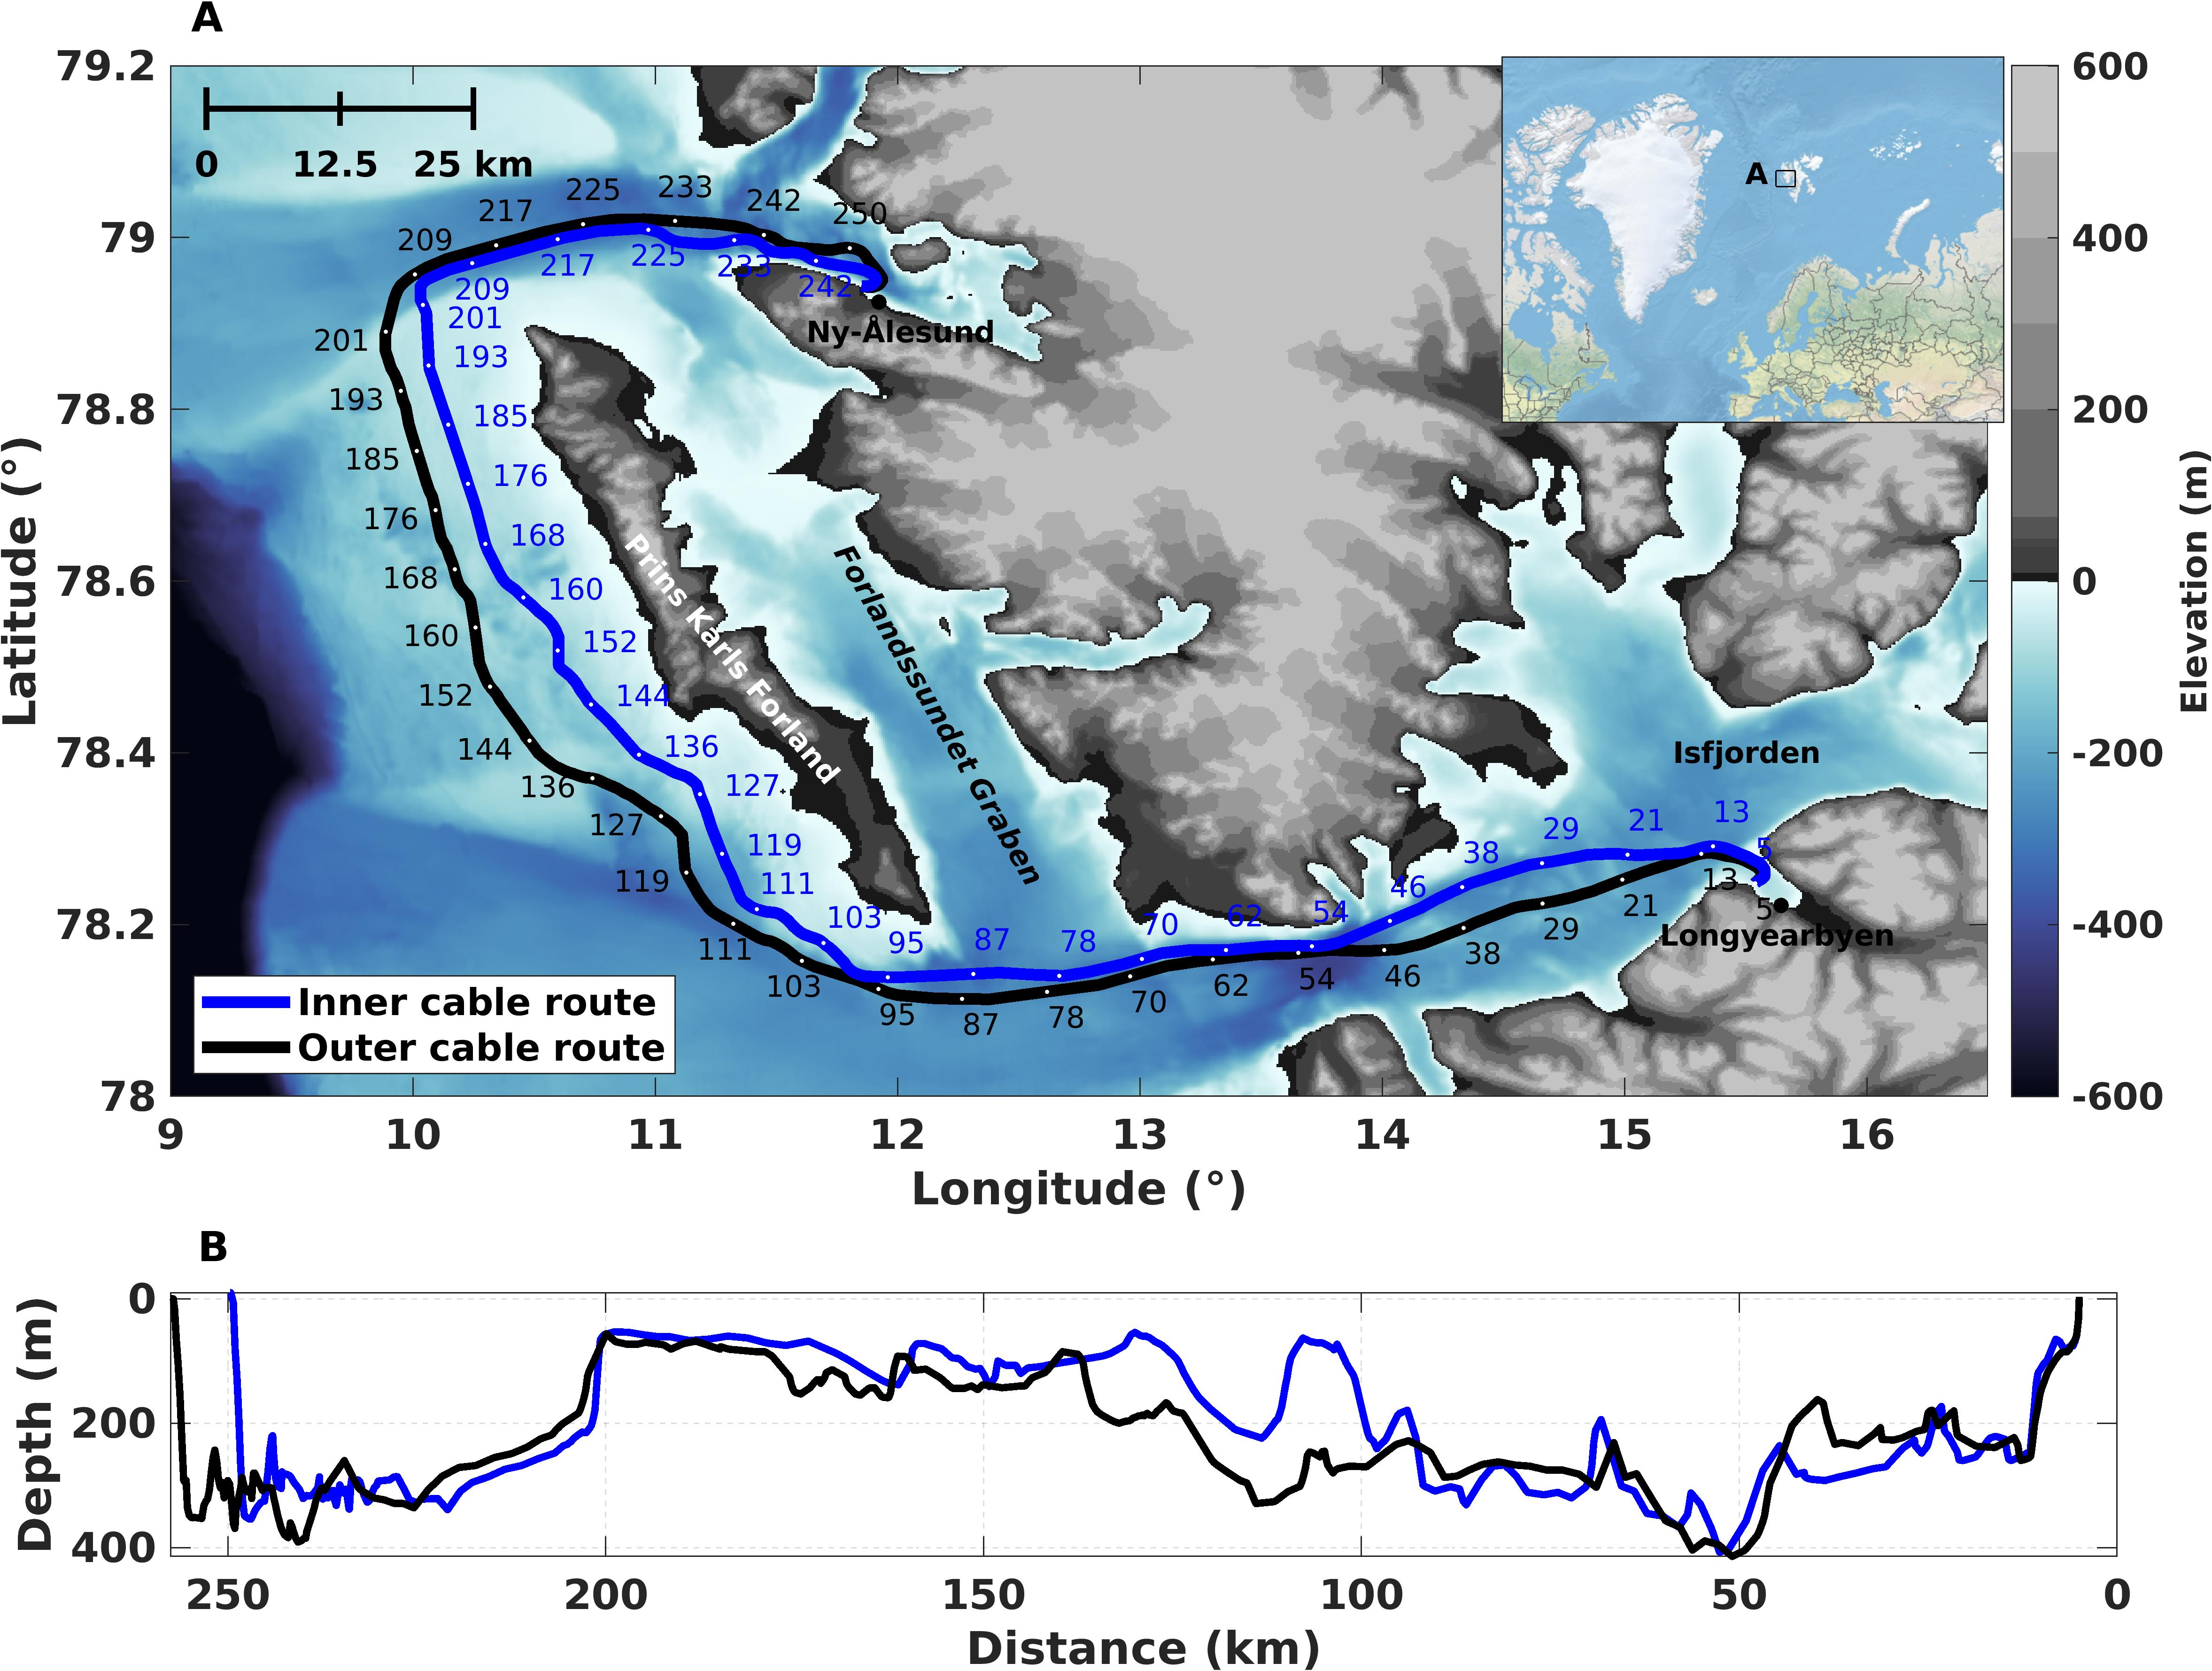







2nd Field Campaign: Svalbard
Polarimeter (PM1000, Novoptel) connected to a live DWDM link
2 x CESNET PolBox (Polarimeters) connected to a live DWDM link
White rabbit protocol running between the two end sites
2 x DAS (OptoDAS, ASN) interrogators connected to DWDM system in L band
DAS (OptoDAS, ASN) interrogators connected to two dedicated fibres in each cable
White
rabbit
White
rabbit
Ny-Ålesund
125 km
125 km
Longyearbyen
DAS signal injected on Rx fibre
DAS
Tx
$$λ_{1}$$
$$λ_{1}$$
Rx
Tx
$$λ_{2}$$
DWDM
EDFA
C/L Filter
EDFA
DWDM
$$λ_{2}$$
Rx
…
100 Gbps per 𝜆
…
SFP
1542.94 nm
Signal multiplexed with other communication traffic
Raman Pump
Polarimeter
250 km
DAS
Dedicated Fibre
DAS

Slide 22
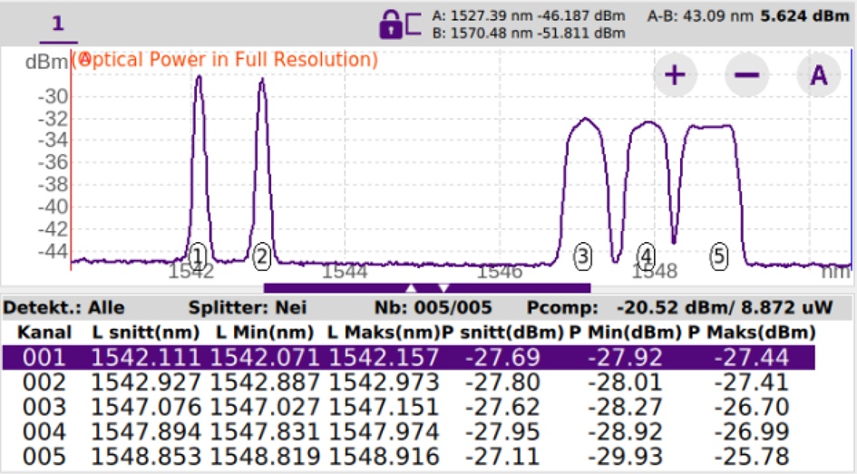
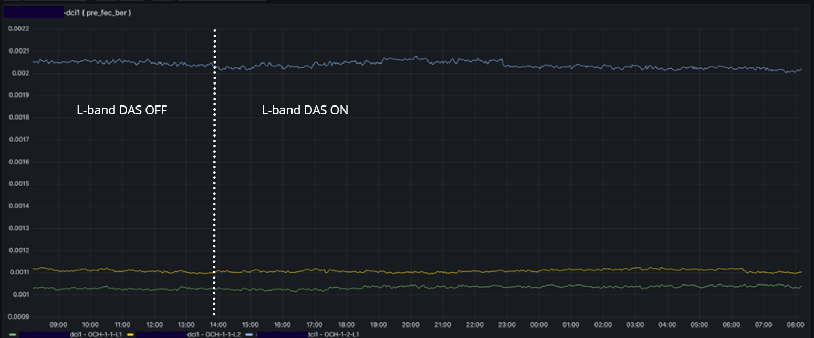
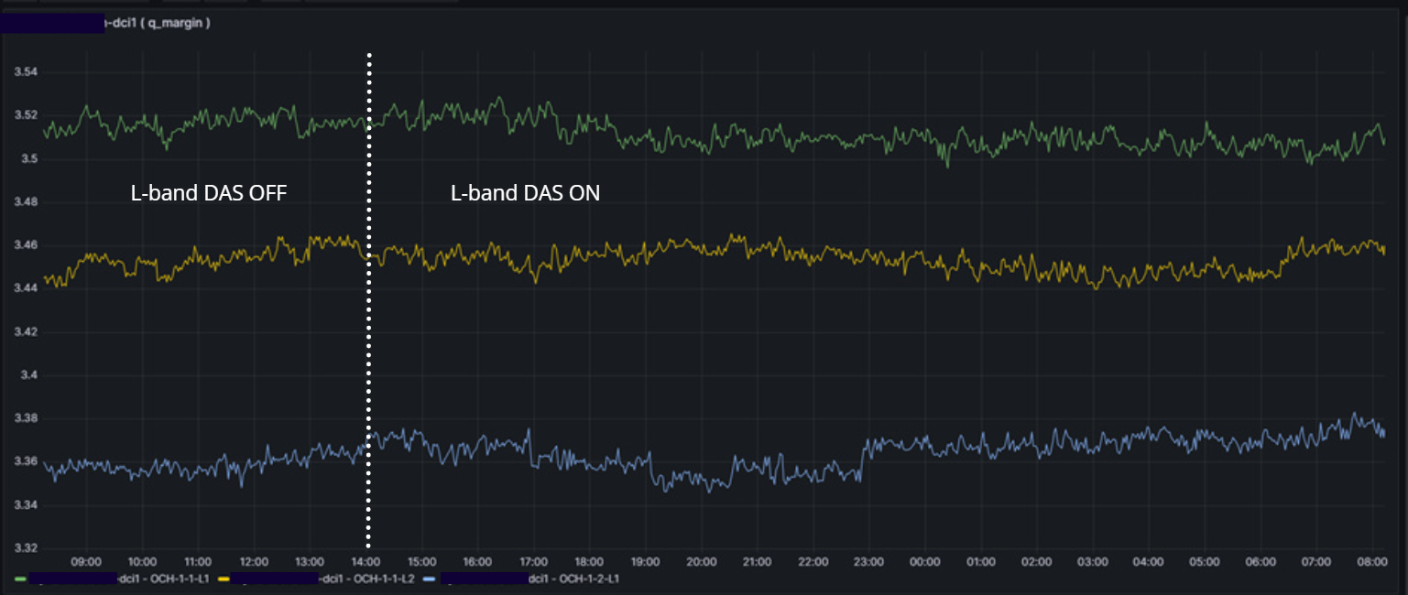
DAS coexistance with DWDM
pre-FEC bit error rate (BER)
24 hour of operation
5 Active wavelengths monitored
1G
1G
200 G
200 G
300 Gbps (Production traffic)
200G (62Gbaud QPSK with SDFEC-G2), 300G (84.23Gbaud 16SQAM with SDFEC-V. Monitored for 14 days in total with no degradation in signal
Q-margin
Credit: K. Bozorgebrahimi and R. Veisllari, SIKT

Slide 23

What is data?
Scientific achievements are still coming.
We have 4 presentations at EGU25
Today @ 17:05 in room K2
Enhancing rapid earthquake location by integration streaming DAS virtual stations.
Tomorrow @ 14:00 in Hall X1, X1.120
Towards Rapid and accurate seismic event detection and localisation using DAS data

Slide 24
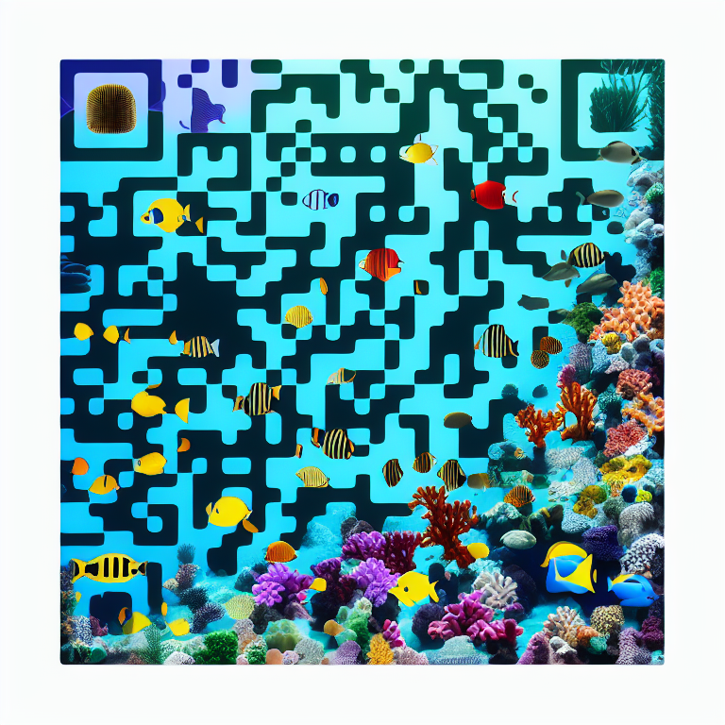
Thank you
Any questions
Follow us on LinkedIn!

