Slide 1
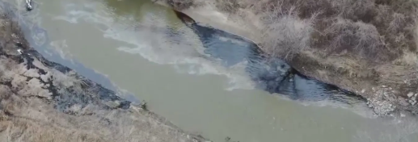
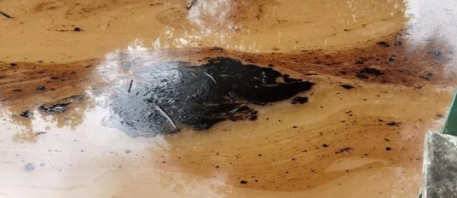
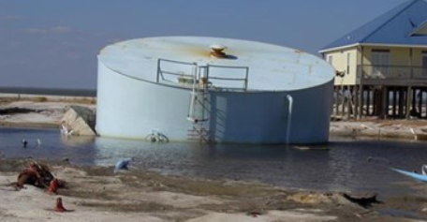
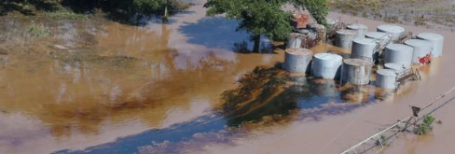
A NEW PHYSICALLY-BASED NUMERICAL MODEL TO SIMULATE RIVER FLOOD TRIGGERED OIL SPILLS
Paola Di Fluri^{1,2}, Matthew D. Wilson^{2,3}, Alessio Domeneghetti¹
1 Department of Civil, Chemical, Environmental and Materials Engineering, Alma Mater Studiorum University of Bologna, Bologna, Italy
2 Geospatial Research Institute | Toi Hangarau, University of Canterbury, New Zealand
3 School of Earth and Environment | Te Kura Aronukurangi, University of Canterbury, New Zealand
Supplementary material for poster presentation A NEW PHYSICALLY-BASED NUMERICAL MODEL TO SIMULATE RIVER FLOOD TRIGGERED OIL SPILLS - EGU European Geoscience Union 2025, 27 April – 2 May Vienna

Slide 2
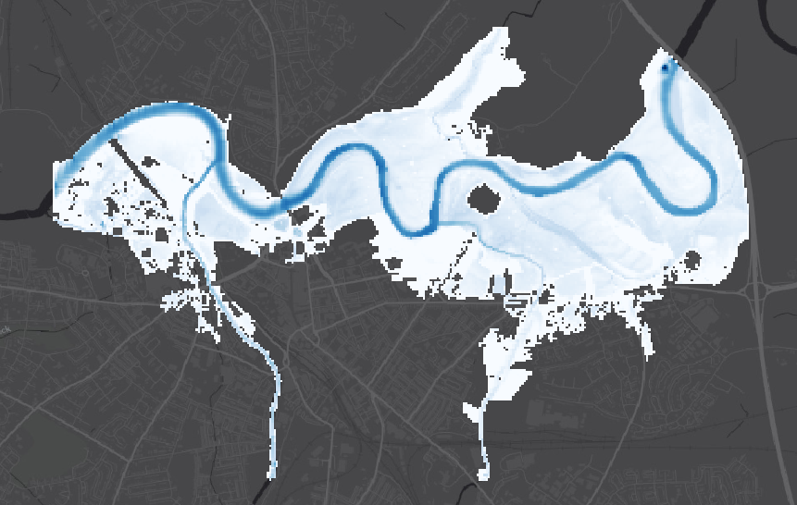
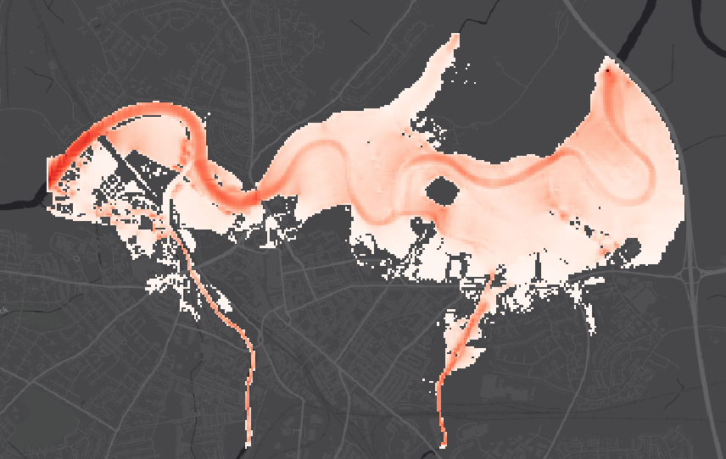
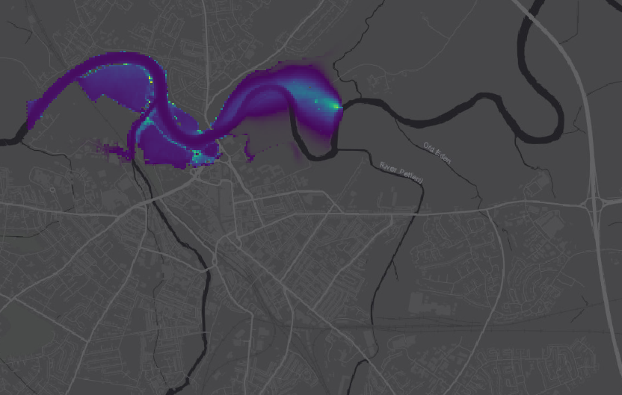
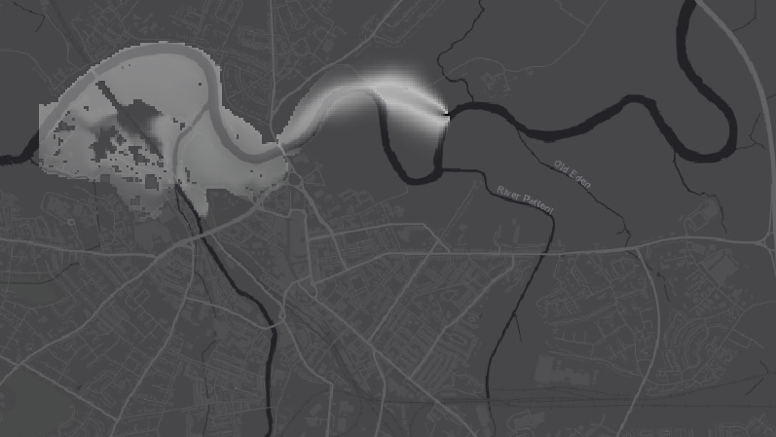
Model Framework: From Input Data to Output Assessment
Visualisation
Data requirement
Caesar-Lisflood model
Output data
TOPOGRAPHIC DATA
Digital Elevation Model (DEM)
Bathymetry
WATER DEPTH
HYDROLOGICAL AND METEOROLOGICAL DATA
River discharge
Rainfall
Tidal
VELOCITY
HYDRAULIC MODEL
Flow velocity
Water depth
FRICTION DATA
Manning’s coefficient
OIL CONCENTRATION
HYDRODINAMIC DATA
Flow velocity
Discharge
OIL DEPTH
OIL DATA
Oil thickness
Area extent
Oil concentration
Mass balance
Density Initial volume
OIL SPILL MODEL
ENVIRONMENTAL DATA
Water temperature
Water density
Wind velocity
Supplementary material for poster presentation A NEW PHYSICALLY-BASED NUMERICAL MODEL TO SIMULATE RIVER FLOOD TRIGGERED OIL SPILLS - EGU European Geoscience Union 2025, 27 April – 2 May Vienna

Slide 3
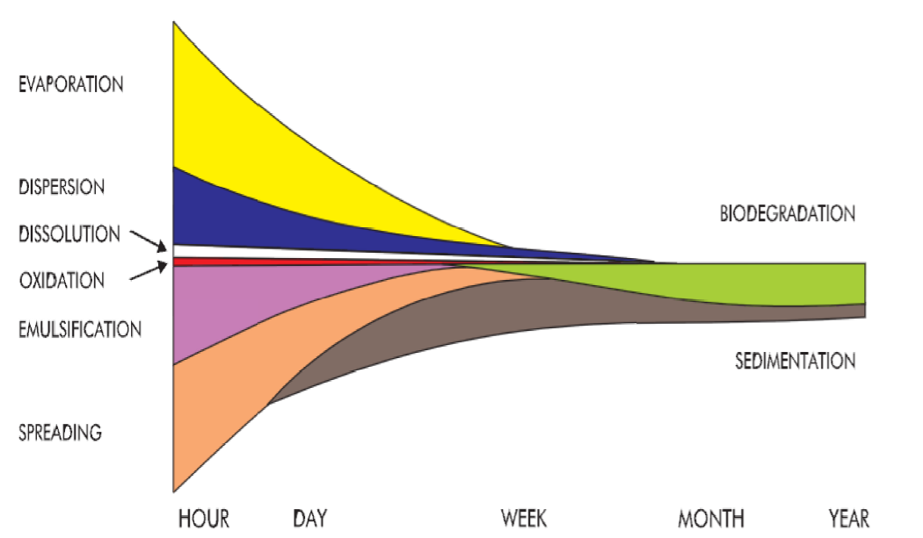
Oil spill module: process selection
Selected processes
Spreading
Advection
Evaporation
Dispersion
Emulsification
Dissolution oxidation
Sedimention
biodegradation
OUR MODEL!
Deterministic model
eulerian model
2D model
Far-field model
Time of occurrence
Supplementary material for poster presentation A NEW PHYSICALLY-BASED NUMERICAL MODEL TO SIMULATE RIVER FLOOD TRIGGERED OIL SPILLS - EGU European Geoscience Union 2025, 27 April – 2 May Vienna

Slide 4
Code implementation: oil input
START
Erodepo()
Assignment of model input
Cycle +=time_factor/60
Oil_spill_input()
no
Oil_check_depth_threshold()
yes
Oil_area()
Oil_evaporation()
Oil_route()
Oil_update()
void oil_spill_input(double local_time_factor)
{
iteration_t += local_time_factor;
for (int x = Math.Min(oil_fromx, oil_tox); x <= Math.Max(oil_fromx, oil_tox); x++)
{
for (int y = Math.Min(oil_fromy, oil_toy); y <= Math.Max(oil_fromy, oil_toy); y++)
{
oil_depth_init = oil_ratev * local_time_factor / (oil_n_cells * DX * DX);
if (iteration_t > oil_spillt)
{
oil_ratev = 0;
}
oil_depth[x, y] += oil_ratev * local_time_factor / (oil_n_cells * DX * DX);
}
}
}
END
Supplementary material for poster presentation A NEW PHYSICALLY-BASED NUMERICAL MODEL TO SIMULATE RIVER FLOOD TRIGGERED OIL SPILLS - EGU European Geoscience Union 2025, 27 April – 2 May Vienna

Slide 5
Code implementation: triggering condition
START
Erodepo()
Triggering condition – the oil spill starts when a certain water depth threshold is exceeded
Cycle +=time_factor/60
Oil_spill_input()
INPUT CELL
no
Oil_check_depth_threshold()
yes
Oil_area()
Oil_evaporation()
Oil_route()
Oil_update()
// check triggering of event
if (cycle > oil_startt && oil_check_depth_threshold() == true)
{
oil_eventtriggered = true;
} bool oil_check_depth_threshold()
{
for (int x = Math.Min(oil_fromx, oil_tox); x <= Math.Max(oil_fromx, oil_tox); x++)
{
for (int y = Math.Min(oil_fromy, oil_toy); y <= Math.Max(oil_fromy, oil_toy); y++)
{
if (water_depth[x, y] > oil_starth) return true;
}
}
return false;
}
END
Supplementary material for poster presentation A NEW PHYSICALLY-BASED NUMERICAL MODEL TO SIMULATE RIVER FLOOD TRIGGERED OIL SPILLS - EGU European Geoscience Union 2025, 27 April – 2 May Vienna

Slide 6
Code implementation: oil spill area computation
START
Erodepo()
Cycle +=time_factor/60
Cell count containing oil and calculation of the oil spill area
Oil_spill_input()
no
Oil_check_depth_threshold()
yes
Oil_area()
Oil_evaporation()
Oil_route()
Oil_update()
void oil_area()
{
count_cells = 0;
for (int x = 1; x < xmax; x++)
{
for (int y = 1; y < ymax; y++)
{
if (oil_depth[x, y] > 0)
{
count_cells++;
}
oil_S = count_cells * DX * DX;
}
}//);
}
END
Supplementary material for poster presentation A NEW PHYSICALLY-BASED NUMERICAL MODEL TO SIMULATE RIVER FLOOD TRIGGERED OIL SPILLS - EGU European Geoscience Union 2025, 27 April – 2 May Vienna

Slide 7
Code implementation: oil evaporation 1/3
START
Implementation of the Mackey and Fingas formula for calculating the evaporation rate.
Erodepo()
Cycle +=time_factor/60
Oil_spill_input()
no
Oil_check_depth_threshold()
yes
Oil_area()
Oil_evaporation()
Oil_route()
Oil_update()
void oil_evaporation(double local_time_factor)
{
var options = new ParallelOptions { MaxDegreeOfParallelism = Environment.ProcessorCount * 4 };
Parallel.For(1, ymax + 1, options, delegate (int y)
{
int inc = 1;
while (down_scan[y, inc] > 0)
{
int x = down_scan[y, inc];
inc++
if (oil_depth[x, y] > 0)
{
iteration_t += local_time_factor;
//evaporation exposure
oil_exp = oil_transf_coeff * oil_S * (local_time_factor) / oil_totalv;
Ev = (oil_T / (oil_B * oil_Tg)) * Math.Log(oil_exp * (oil_B * oil_Tg / oil_T) * Math.Exp(oil_A - (oil_B * oil_To / oil_T)) + 1);
}
}
END
Supplementary material for poster presentation A NEW PHYSICALLY-BASED NUMERICAL MODEL TO SIMULATE RIVER FLOOD TRIGGERED OIL SPILLS - EGU European Geoscience Union 2025, 27 April – 2 May Vienna
Notes:
Definition of the evaporation process.
Need to track the evaporated oil quantity to ensure accurate mass balance calculations.

Slide 8
Code implementation: oil evaporation 2/3
START
Implementation of the Mackey and Fingas formula for calculating the evaporation rate.
Erodepo()
Cycle +=time_factor/60
Oil_spill_input()
no
Oil_check_depth_threshold()
yes
Oil_area()
Oil_evaporation()
Oil_route()
Oil_update()
Advection + spreading
Evaporation (Mackey method)
Advection + spreading
Evaporation (Fingas method)
Advection + spreading
$$\%Ev=\left(\frac{T}{B ∙T_{g}}\right)∙ln\left(θ∙\left(\frac{B∙T_{g}}{T}\right)∙exp\left(A−B∙\frac{T_{0}}{T}\right)+1\right)$$
$$\% EV=T \ln{(t)}$$
END
Supplementary material for poster presentation A NEW PHYSICALLY-BASED NUMERICAL MODEL TO SIMULATE RIVER FLOOD TRIGGERED OIL SPILLS - EGU European Geoscience Union 2025, 27 April – 2 May Vienna
Notes:
Development and comparison of two different evaporation formulations.
Fingas's simplified formula: Depends on temperature and time, derived from laboratory experiments.
Mackay model considerations: Accounts for oil properties and wind influence → more complex but more reliable (not many parameter needed)

Slide 9
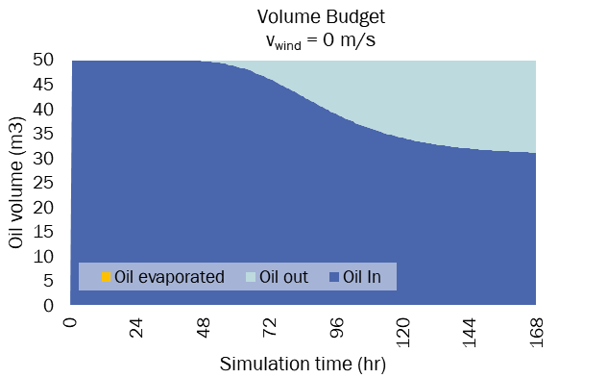
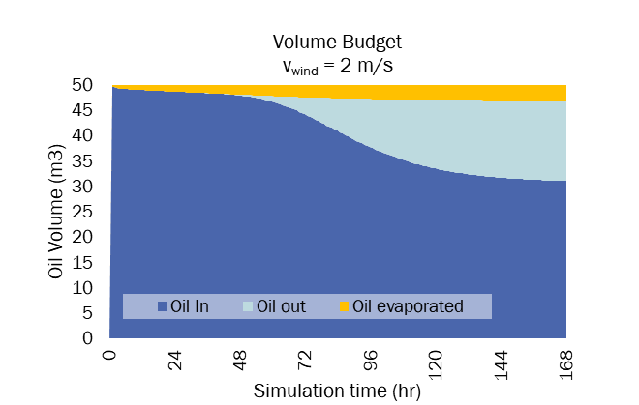
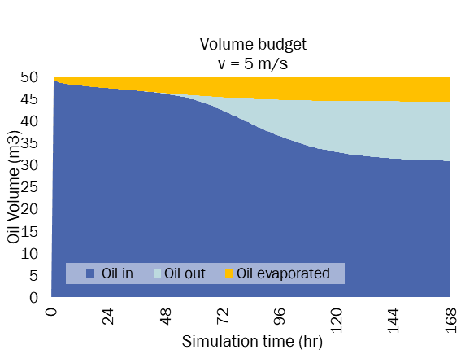
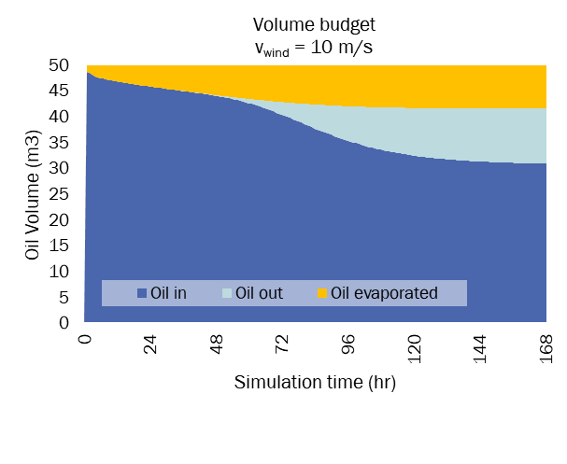
Code implementation: oil evaporation 3/3
START
Erodepo()
Implementation of the Mackey’s formula
Wind influence on evaporation
Cycle +=time_factor/60
Oil_spill_input()
no
Oil_check_depth_threshold()
yes
Oil_area()
Oil_evaporation()
Oil_route()
Oil_update()
END
Supplementary material for poster presentation A NEW PHYSICALLY-BASED NUMERICAL MODEL TO SIMULATE RIVER FLOOD TRIGGERED OIL SPILLS - EGU European Geoscience Union 2025, 27 April – 2 May Vienna

Slide 10
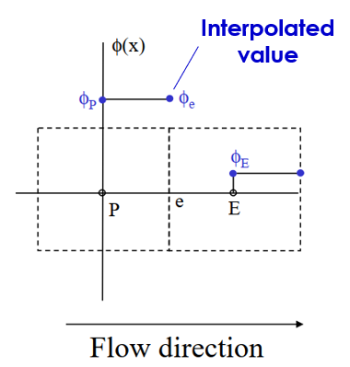
Code implementation: advection-dispersion equation
START
Erodepo()
Cycle +=time_factor/60
$$\frac{∂h}{∂t}=u\frac{∂h}{∂x}−\frac{∂}{∂x}\left(D∙\frac{∂h}{∂x}\right)+S$$
Oil_spill_input()
no
Oil_check_depth_threshold()
FIRST ORDER UPWIND INTERPOLATION SCHEME
yes
Oil_area()
Oil_evaporation()
Oil_route()
Oil_update()
$$h_{t+∆t}=h_{t}−∆t\left[\frac{∂h}{∂x}u−\frac{∂}{∂x}\left(D∙\frac{∂h}{∂x}\right)\right]−\%Ev∙h_{t}$$
END
Supplementary material for poster presentation A NEW PHYSICALLY-BASED NUMERICAL MODEL TO SIMULATE RIVER FLOOD TRIGGERED OIL SPILLS - EGU European Geoscience Union 2025, 27 April – 2 May Vienna

Slide 11
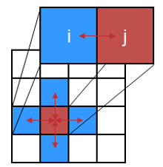
Code implementation: oil depth update
START
Erodepo()
Cycle +=time_factor/60
Update of the oil depth in the cell and oil concentration calculation
Oil_spill_input()
no
Oil_check_depth_threshold()
void oil_update()
{
var options = new ParallelOptions { MaxDegreeOfParallelism = Environment.ProcessorCount * 4 };
Parallel.For(1, ymax + 1, options, delegate (int y)
{
int inc = 1;
while (down_scan[y, inc] > 0)
{
int x = down_scan[y, inc];
inc++;
if (elev[x, y] > -9999 )
{
oil_depth_prev[x, y] = oil_depth[x, y];
oil_depth[x, y] += (oil_hx[x + 1, y] - oil_hx[x, y] + oil_hy[x, y + 1] - oil_hy[x, y]);
// oil concentration
oil_conc[x, y] = (((oil_depth[x, y] * oil_density ) / (oil_depth[x, y] * oil_density + water_depth[x, y] * ro_water)) * oil_density) ; // g/L
if (oil_conc[x, y] > 0)
{
oil_concentration[x, y] = oil_conc[x, y];
}
yes
Oil_area()
Oil_evaporation()
Oil_route()
Oil_update()
END
Supplementary material for poster presentation A NEW PHYSICALLY-BASED NUMERICAL MODEL TO SIMULATE RIVER FLOOD TRIGGERED OIL SPILLS - EGU European Geoscience Union 2025, 27 April – 2 May Vienna
Notes:
Update of oil thickness in each cell by calculating incoming and outgoing oil.
Calculation of oil concentration within the same cell.

Slide 12
Results and visualisation: how it should be

Slide 13
Any feedback or question is welcome!
paola.difluri2@unibo.it
Supplementary material for poster presentation A NEW PHYSICALLY-BASED NUMERICAL MODEL TO SIMULATE RIVER FLOOD TRIGGERED OIL SPILLS - EGU European Geoscience Union 2025, 27 April – 2 May Vienna

