Slide 1
Addressing common Inconsistencies in Sewer network data
Haydar, B., Chahinian, N., and Pasquier, C.: Addressing Common Inconsistencies in Sewer Networks Data, EGU General Assembly 2025, Vienna, Austria, 27 Apr–2 May 2025, EGU25-7012, https://doi.org/10.5194/egusphere-egu25-7012, 2025.

Slide 2
Ontology-Based data access system
User Queries
OBDA is an approach that allows users to query relational databases through an ontology, without requiring any changes to the underlying databases.
Uses an ontology as a conceptual view over the data sources
Defines mappings between the ontology and database schemas
Translates queries over the ontology into queries over the databases
Conceptual Layer
Mapping
Data Layer
Notes:
The idea is to use an ontology, which presents to users a semantically rich conceptual model of the problem domain. The users formulate their information requirements (that is, queries) in terms of the ontology, and then receive the answers in the same intelligible form. These requests should be executed over the data automatically, without an IT-expert’s intervention.

Slide 3
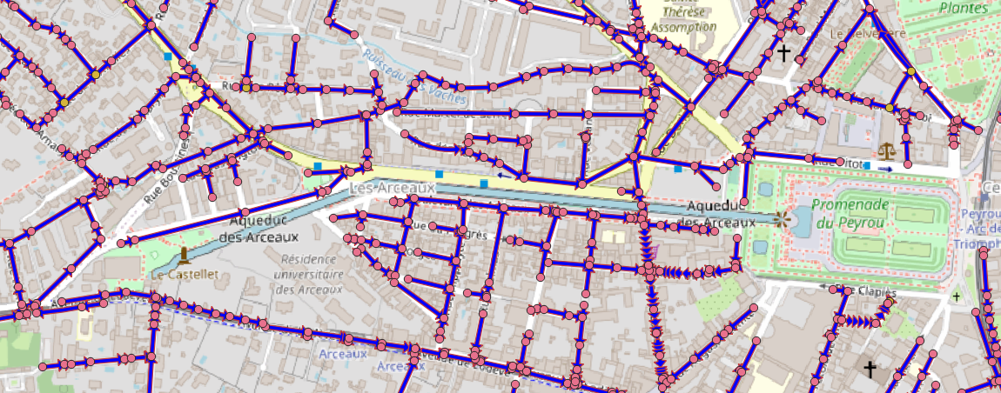
DATA LAYER for wastewater network
Montpellier Metropole Open Data for wastewater networks
Pipe
Diameter
Material
Length
Ztn
Zr
Shape
circulation
Pipes represented spatially as Lines
Structure
Manhole
Pumping Station
Appurtenance
Treatment Station
Storm overflow
typeStructure
Geocode
ID
Diameter
Material
Length
Ztn
Zr
ID
StationName
Geocode
typeApp
Geocode
ID
ID
StationName
Geocode
Diameter
Material
Type
Ztn
Zr
Nodes represented spatially as points
Notes:
Explain the data we have , the different tables and how they are not related to each other just by the geometry
The different format available of data
Montpellier metropole database
How to set up the database

Slide 4
Sink Node
Isolated Node
Source Node
Isolated Pipe

