Slide 1
Changes in hourly rainfall return levels due to temperature shifts: global assessment of the TENAX model
Ella Thomas, Marco Borga, Petr Vohnicky, Eleonora Dallan, and Francesco Marra

Slide 2
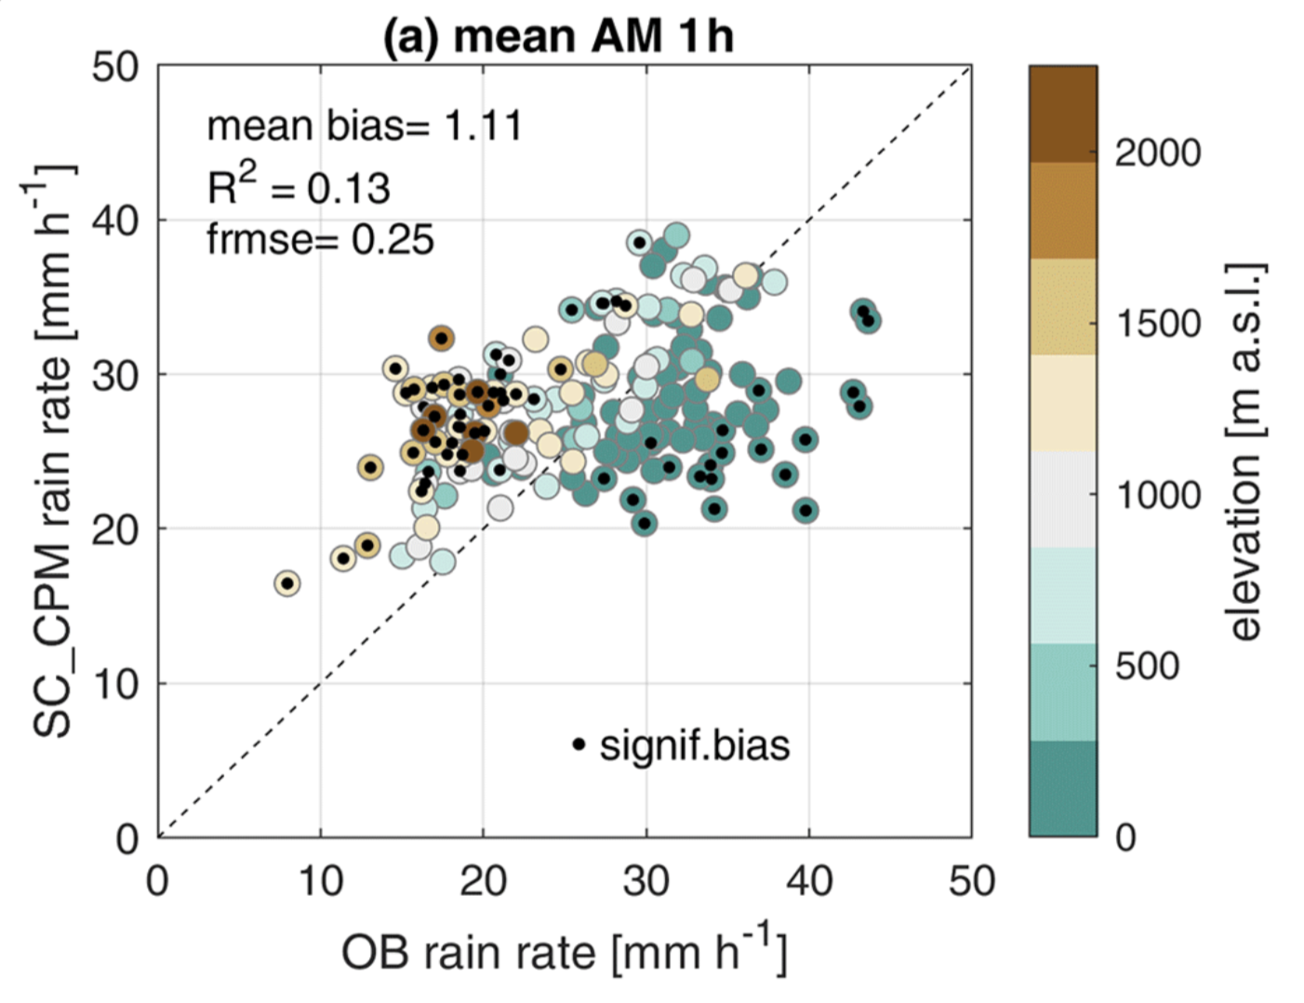
Motivation
Extremes are changing
Large-scale parameterised models provide enough data, do not fully represent convective rainfall.
Convection-permitting models only provide short time-frames. Still have biases in short duration rainfall.
Observations are the “truest” measure. Need statistical extrapolation based on physical arguments.
Fig from Dallan, E. et al., HESS, 2023.

Slide 3
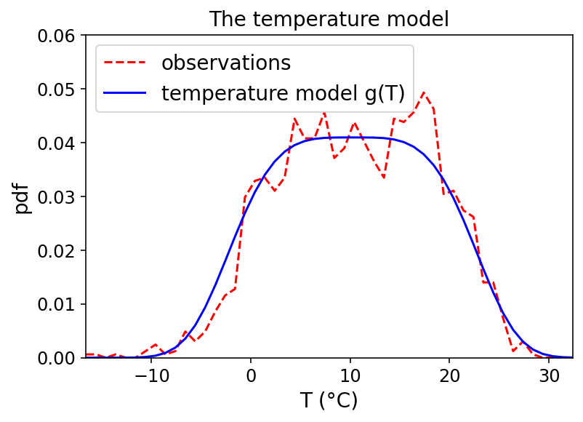
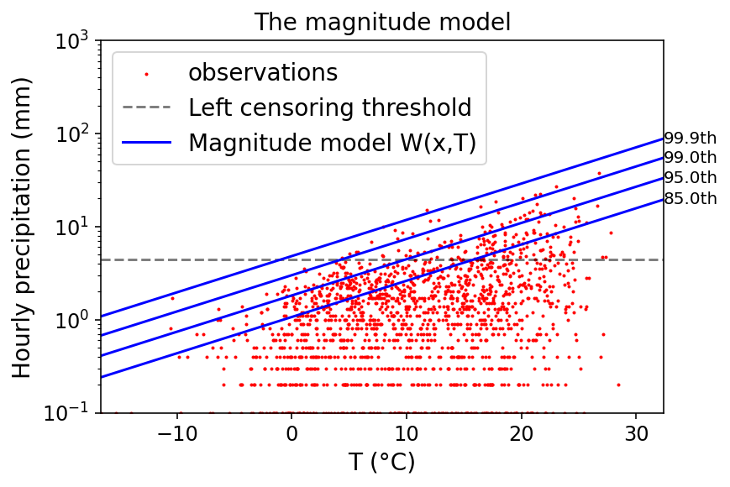
The TENAX model
Combines temperature-precipitation scaling with statistical models for extreme precipitation.
Hindcast
TENAX prediction
Has been tested on 10-minute data in the alps (fig from Marra et al., HESS, 2024)
Our objective is to understand how to set up the models globally, and test TENAX in a variety of climate types.

Slide 4
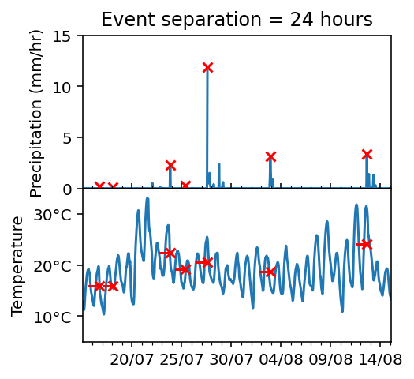
Methods
GSDR dataset (Lewis et al., J.Clim, 2019)
We focus on Germany, Japan, USA.
Highest number of “complete” years
Range of climate types
ERA5-land temperature
Fig from Beck, H. E. et al., Sci. Data, 2018
less than 10% missing data
Identify ordinary events
Independent, separated by at least 24 hours.
Temperature averaged 24 hours before the peak precipitation of each event.
Complete years

Slide 5
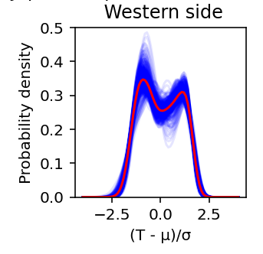
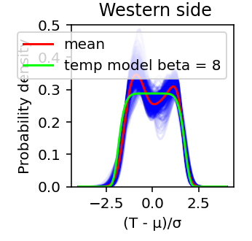
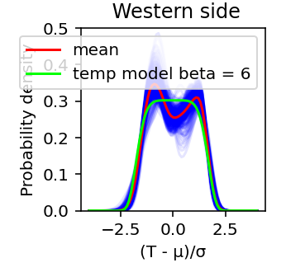
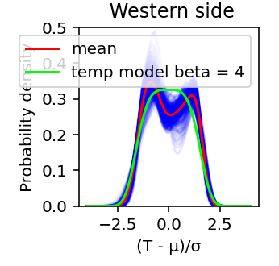
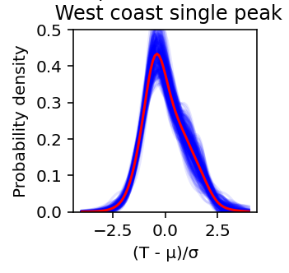
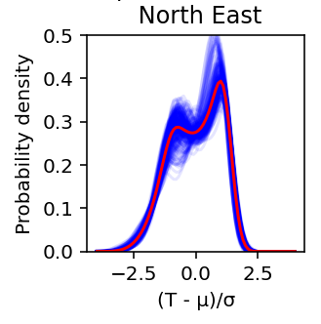
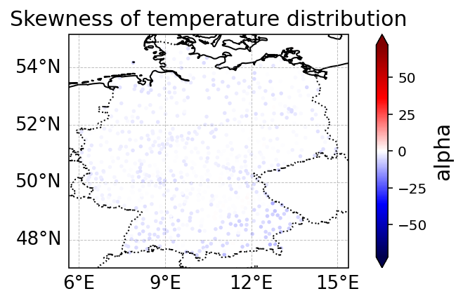
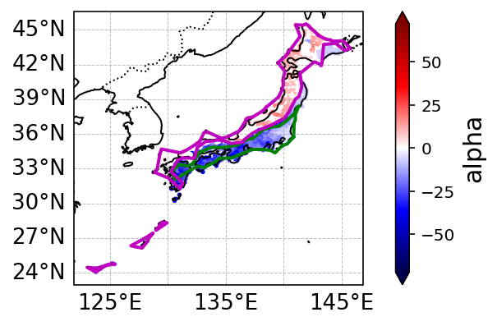
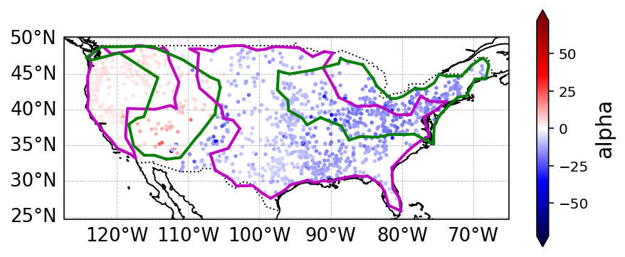
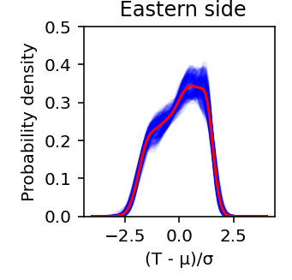
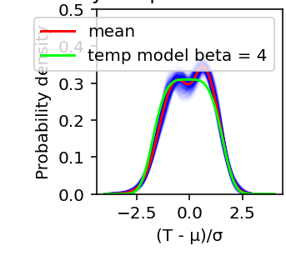
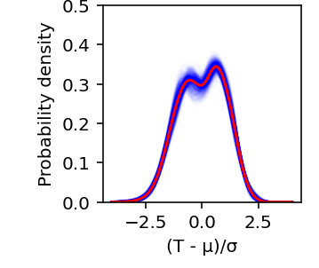
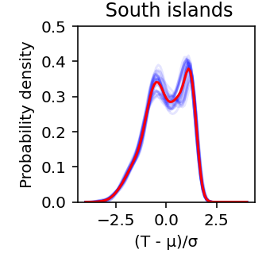
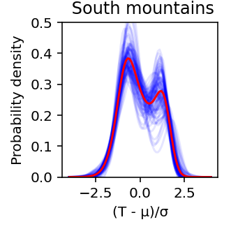
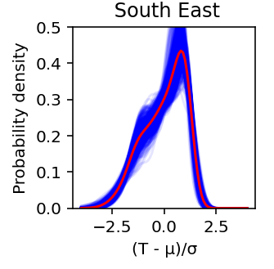
The temperature model

Slide 6
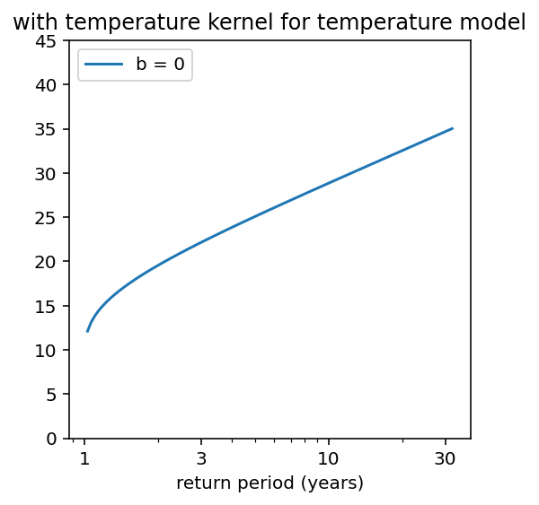
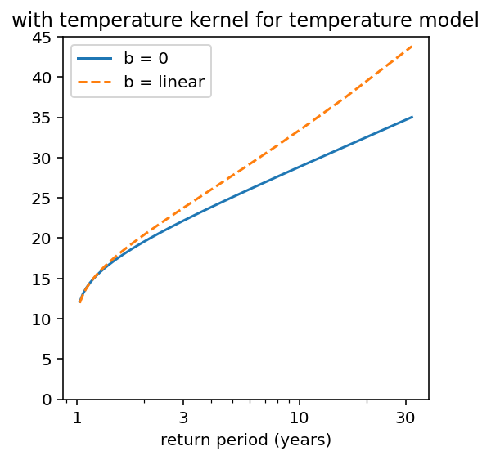
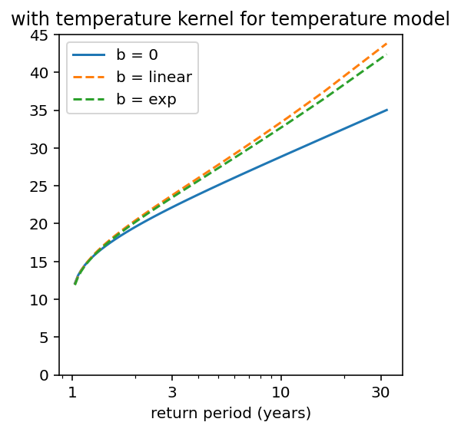
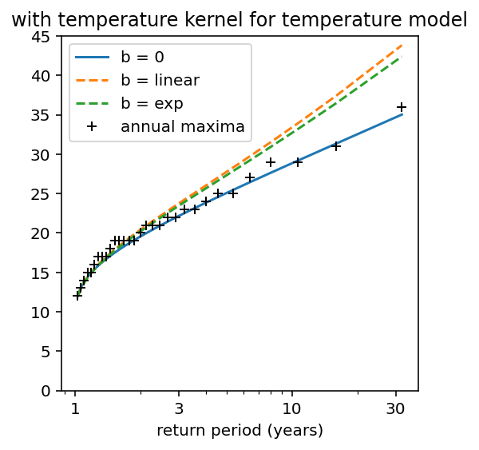
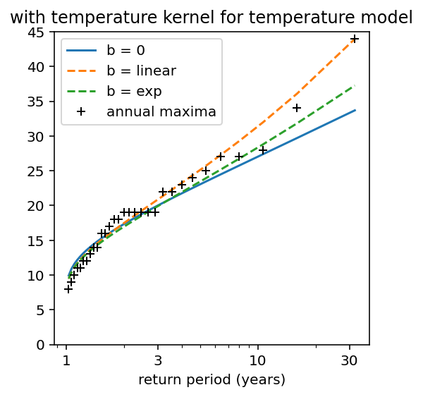
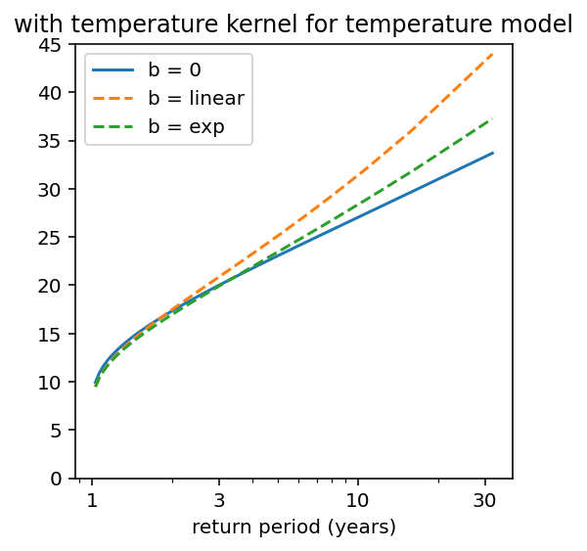
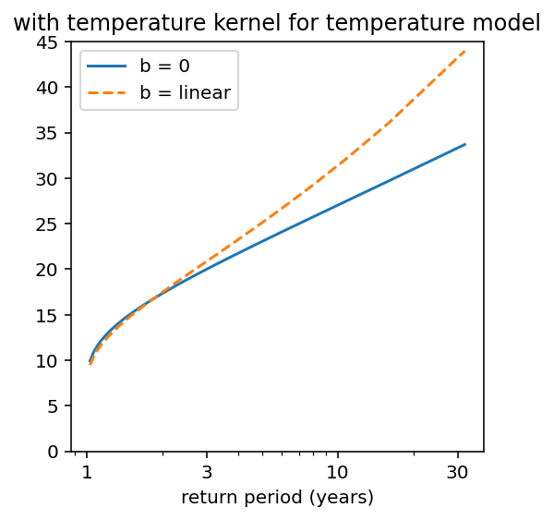
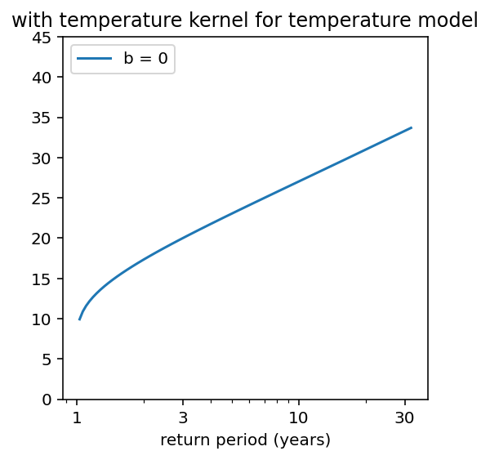
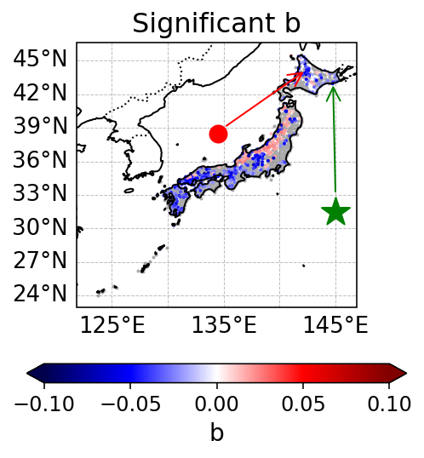
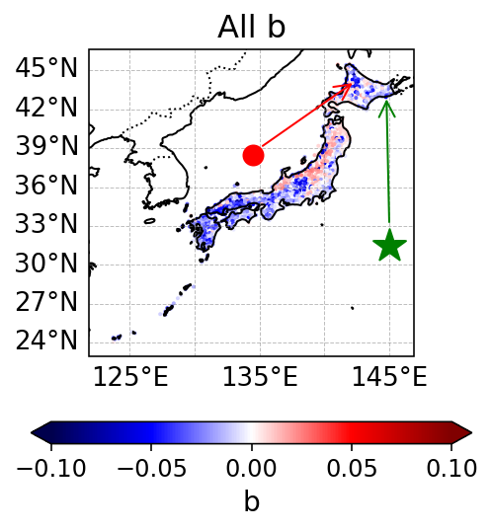
The magnitude model: Non-stationary Weibull $W\left(x;T\right)=1 −e^{\left\{−{\left(\frac{x}{λ(T)}\right)}^{κ\left(T\right)}\right\}}$
$$κ\left(T\right)=κ_{0}+bT$$
$$κ\left(T\right)=κ_{0}e^{bT}$$
$$λ\left(T\right)=λ_{0}e^{aT}$$
Precipitation (mm/hr)
Precipitation (mm/hr)
Shape parameter $κ$ and scale parameter $λ$
Scale parameter follows temperature exponentially because Clausius Clapeyron relation.
36% stations have significant b at 5% significance

Slide 7
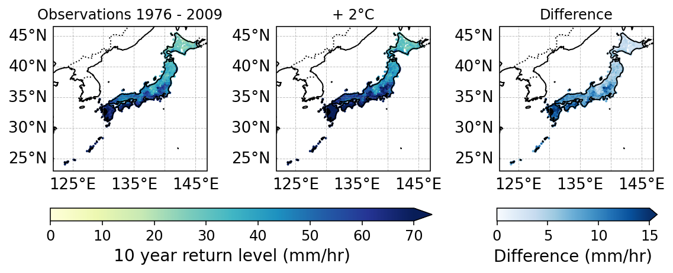
Return levels

Slide 8
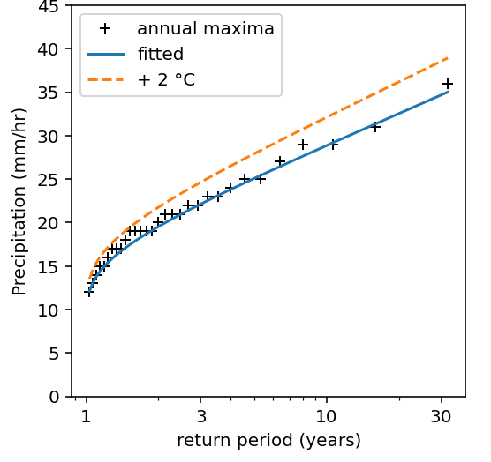
Summary
TENAX combines statistics of extreme precipitation with physics of precipitation-temperature scaling.
Consists of a temperature model and magnitude model
Fairly simple to fit in some regions
Global rules difficult to find, but can find local rules for both models.
Shape parameter probably temperature dependent, but difficult to estimate.
Future steps: future predictions, different “temperature” options (dew-point, accounting for radiation)
Thank you for listening!
ella.thomas@unipd.it

Slide 11
Bib
Beck, H.E. et al. (2018) ‘Present and future Köppen-Geiger climate classification maps at 1-km resolution’, Scientific Data, 5(1), p. 180214. Available at: https://doi.org/10.1038/sdata.2018.214.
Dallan, E. et al. (2023) ‘How well does a convection-permitting regional climate model represent the reverse orographic effect of extreme hourly precipitation?’, Hydrology and Earth System Sciences, 27(5), pp. 1133–1149. Available at: https://doi.org/10.5194/hess-27-1133-2023.
Lewis, E. et al. (2019) ‘GSDR: A Global Sub-Daily Rainfall Dataset’. Available at: https://doi.org/10.1175/JCLI-D-18-0143.1.
Marra, F. et al. (2024) ‘Predicting extreme sub-hourly precipitation intensification based on temperature shifts’, Hydrology and Earth System Sciences, 28(2), pp. 375–389. Available at: https://doi.org/10.5194/hess-28-375-2024.

