Slide 1
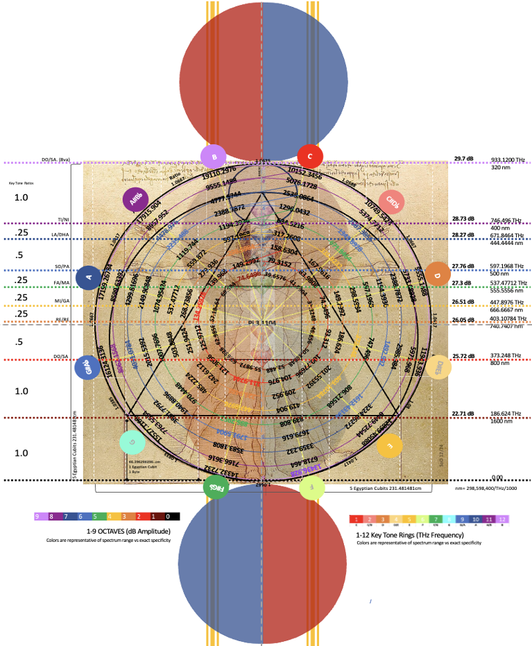
Presented at Session EOS4.3 - Geoethics and Global Anthropogenic Change
Geoscience for Policy, Action and Education in Addressing the Climate and Ecological Crises
Room 2.93
Friday, 2 May 2025
09:50 AM
SOL Harmonic Realignment
The Origin of Numbers Ushering in Reunification EGU25-7153
Image: Wikimedia.org
cubit-converter.ONE
Notes:
Thank you for your time! This work is computationally intensive, so please download it for a deeper review than this brief presentation allows. We look forward to discussing.

Slide 2
INTRODUCTION: Remembering Our True Nature
Throughout the Human journey, we have left ourself the indelible prints of civilizations aligning Life’s Rhythms with the Sun’s Light. The records and architectural feats point to technological advancement far greater than anything we have been able to truly comprehend until this unfolding Present.
And now, it is with endless gratitude and honor that we share a renewed understanding of our innate Divine Source Light Technology. This is the natural, unifying light code base restoring solar harmonic balance and energetic freedom across our entire system.
Foundationally, we are energetic. It is through realignment with our celestial light-based measures that our physicalized system will regain its original coherence.
cubit-converter.ONE
Notes:
INTRODUCTION: Remembering Our True Nature
Throughout the Human journey, we have left ourself the indelible prints of civilizations aligning Life’s Rhythms with the Sun’s Light. The records and architectural feats point to technological advancement far greater than anything we have been able to truly comprehend until this unfolding Present.
And now, it is with endless gratitude and honor that we share a renewed understanding of our innate Divine Source Light Technology. This is the natural, unifying light code base restoring solar harmonic balance and energetic freedom across our entire system.
Foundationally, we are energetic. It is through realignment with our celestial light-based measures that our physicalized system will regain its original coherence.

Slide 3
ORIGINS: Rediscovering Our Power
In 2023, CCCRdg identified an ongoing pattern between the inclination angles in the Pyramids, the precise Egyptian Royal Cubit value of 0.535836763 m and the speed of light 559,872,000 rc/s, corresponding to 300,000,000 m/s.
With continued exploration, we found that this SOL also synchronized with a precise Egyptian Cubit, Indian Hasta, Chinese Chi and Li, and Mayan equivalencies.
As we added more light stream coordinates to the record, it became crystal clear that we were beginning to remap the energetic footprints of our Ancient Global Solar Positioning System…
cubit-converter.ONE
Notes:
ORIGINS: Rediscovering Our Power
In 2023, CCCRdg identified an ongoing pattern between the inclination angles in the Pyramids, the precise Egyptian Royal Cubit value of 0.535836763 m and the Speed of Light 300,000,000 m/s.
With continued exploration, we found that this light speed also synchronized with a precise Egyptian Cubit, Indian Hasta, Chinese Chi and Li, and Mayan equivalencies.
As we added more light stream coordinates to the record, it became crystal clear that we were beginning to remap the energetic footprints of our Ancient Global Solar Positioning System…

Slide 4
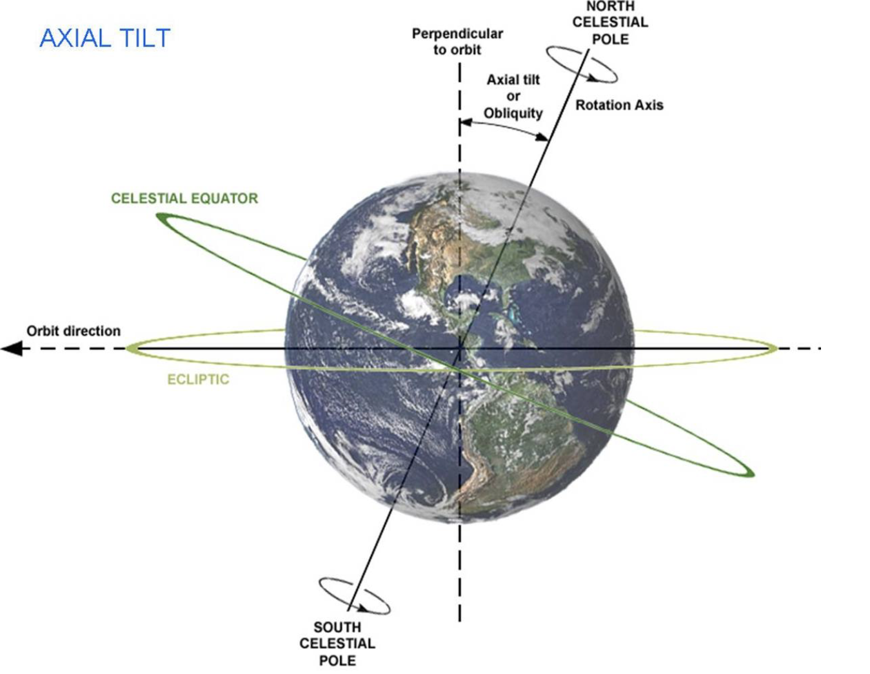
ORIGINS: Paradigm Shifting Perspective
The map of our solar positioning system was plotted without our current 23.4º axial tilt. Centuries of exploratory have been missing the pattern because all positions have shifted from original coordinates. We have been electromagnetically misaligned with our solar light energy stream...experiencing within an energetically depleted state of consciousness.
Universal Solar Fundamentals
True Sun 432° Great Circle = 1,728,000 Miles
4r (4 x 432 mi)
Sun Circle 360 x 1.2 = 432
Spherical Platonics: 30° x 1.2 = 36°
Sun Diameter = 864,000 Miles
Grand Cycle Precession: 25,920 Years (24,000 x 1.08)
Sun Orbital Rotation = 360 Days
1 Day = 1440 Minutes = 86,400 Seconds
1 Month = 30 Days = 43200 Minutes
23.4° (288 tilt)
cubit-converter.ONE
Notes:
ORIGINS: Paradigm Shifting Perspective
The map of our solar positioning system was plotted without our current 23.4º axial tilt. Centuries of exploratory have been missing the pattern because all positions have shifted from original coordinates. We have been electromagnetically misaligned with our solar light energy stream...experiencing within an energetically depleted state of consciousness.
Before diving deeper into this, it’s paramount that the accurate solar fundamentals listed here are understood.

Slide 5
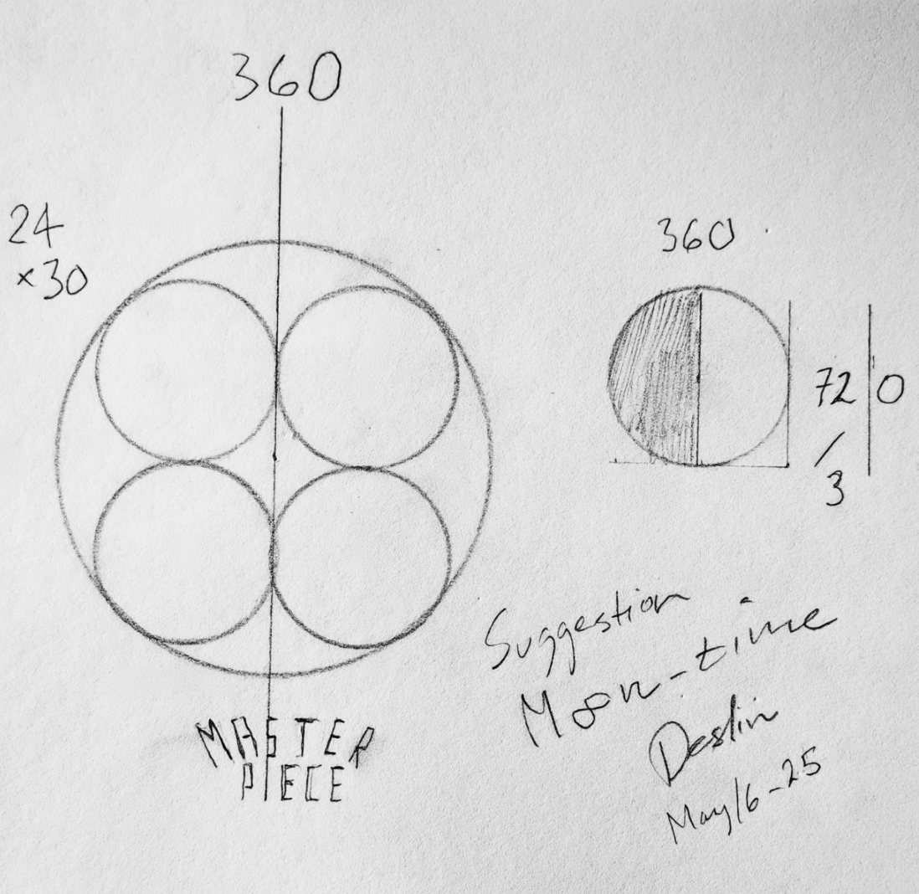
ORIGINS: Sleeping Satellite
The impact creating the axial tilt also resulted in another major factor: the creation and influence of the Moon. The electromagnetic gravitational lock between the Moon, Earth, and Sun maintains the tilt angle of the rotational axis throughout the revolving dynamics of the 25,920 year Grand Cycle. Accordingly, harnessing gravitational control through solar stream alignment must also account for this lunar correspondence at all points across time and space.
Lunar Cycle Correspondence
Lunar Month
720 Hours
30 Days
Lunar Year
360 Days
cubit-converter.ONE
Notes:
ORIGINS: Sleeping Satellite
The impact creating the axial tilt also resulted in another major factor: the creation and influence of the Moon. The electromagnetic gravitational lock between the Moon, Earth and Sun maintains the tilt angle of the rotational axis throughout the revolving dynamics of the 25,920 year Grand Cycle. Accordingly, harnessing gravitational control through solar stream alignment must also account for this lunar correspondence at all points across time and space.
Lunar Cycle Correspondence:
Lunar Month
720 Hours
30 Days
Lunar Year
360 Days

Slide 6
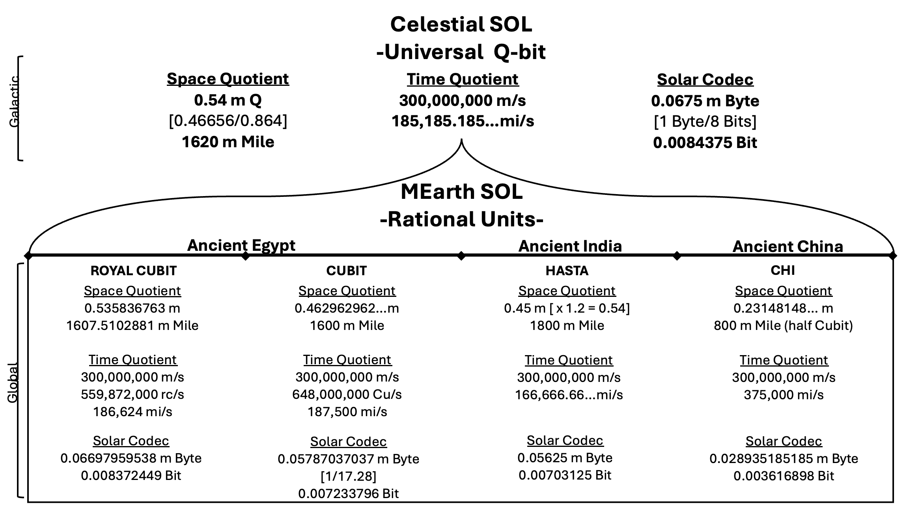
ORIGINS: SOL Measurement Foundations
After observing a pattern linking the 0.535836763 m Egyptian Royal Cubit to 300,000,000 m/s SOL, we found equivocal light speed correspondence in the 0.462962962 m Egyptian Cubit. And then again, aligned from across the globe through our Chinese and Indian foundations.
Our Rational Units from across ancient cultures adhere to a singular inverse number ratio system driven by our Universal Q-bit exchanging 0.54 m Q of light information at 300,000,000 m/s; 185,185.185 mi/s.
cubit-converter.ONE
Notes:
ORIGINS: SOL Measurement Foundations
After observing a pattern linking the 0.535836763 m Egyptian Royal Cubit to 300,000,000 m/s, we found equivocal light speed using the 0.462962962 m Egyptian Cubit. And then again from across the globe through our Chinese and Indian foundations.
Our Rational Units from across ancient cultures adhere to a singular inverse number ratio system driven by our Universal Q-bit exchanging 0.54 m Q of information at 300,000,000 m/s; 185,185.185 mi/s.
Further detail:
After recognizing the 0.535836763 m Cu SOL sync, exploration of DaVinci’s Vitruvian Man revealed additional key validators. Leo’s work provided a blueprint that linked the rc, Cu and Chi in one, via circling of the square ratios—celestial linked to rational.
The 0.23148148.. m Chi at 300,000,000 m/s linked to 375,000 mi/s.
The 0.46296296.. m Cu at 300,000,000 m/s linked to 187,500 mi/s.
The 0.535836763 m Rc at 300,000,000 m/s linked to 186,624 mi/s.
The 0.45 m Ha at 300,000,000 m/s linked to 166,666.666 mi/s
The 0.45 m Ha x 1.2 = 0.54 m at 300,000,000 m/s linked to 185,185.185 mi/s Universal Q-bit
The 0.462962962 m Egyptian Cu value is linked across other rational systems:
Cu is a direct match with both Mayan and Leo (Davinci) values.
Cu is strongly linked to Chi via 200% double relationship.
Celestial Correspondence:
864,000 / 0.462962962…m = 186,624 mi/s Egyptian SOL
864,000 / 0.535836763 m = 4,629,629.629…
864,000 / 4.6296296…m = 4,000,000 x 4,629,629.629… = 1.85185185…mi/sec Celestial SOL
The Universal Q Value
1 Q = 1 54 cm Forearm
Numeric System:
0 = 50
00 = 100
SOL multiplier: 1.08
0 = 50 x 1.08 = 54
1 Q = 54 cm; 0.54 m
2 Q = 108 cm; 1.08 m
In our original state of consciousness, we thrive in energetic abundance, all planes aligned with the solar directed energy of our Divine Sun. This requires precise Time/Space harmonics for electromagnetic balance.
After the impact and axial disruption, systemic fracture left us in divided energetic decoherence. In Mearth’s original position, the pyramids and mounds were centralized as resonance harmonizing chakra centers along the equatorial plane of one landmass, positioned for direct coordinate signaling between paired celestial nodes. These frequency alignments maintained the perpetual energy exchange synchronization between the cycles of our collective planetary body and our light stream. This is our homeostasis, our home state.
Many of our civilizations independently preserved the knowledge of our foundational quantum light language in the same way it was maintained prior to the division: using the length of the forearm –a consistent Sundial—as the foundational unit of measure for maintaining accurate solar stream alignment. Due to the separation, each kingdom had a different value based on their ruler’s forearm length, and a different speed for direct solar stream alignment based on their respective latitudinal space and longitudinal time coordinates.
Each civilization did their best to preserve the SOL records by recreating versions of alignment systems that worked for their given conditions.
We now understand how our ancient rational Mearth quotients globally all ladder into the original Universal Q-bit.
While we can’t change the axial tilt, we can error-correct our coordinates here on the solar stream receiving end to resynchronize electromagnetic alignments.

Slide 7
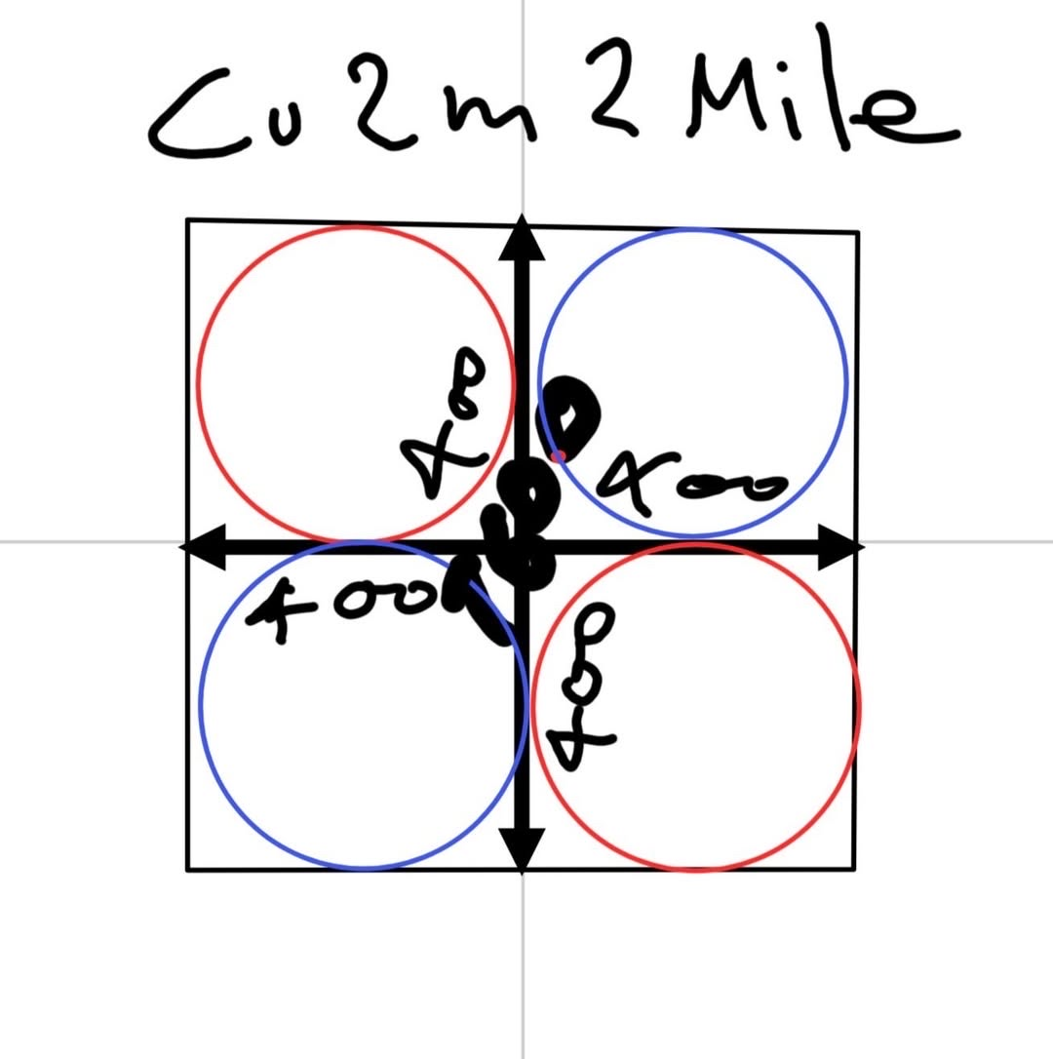
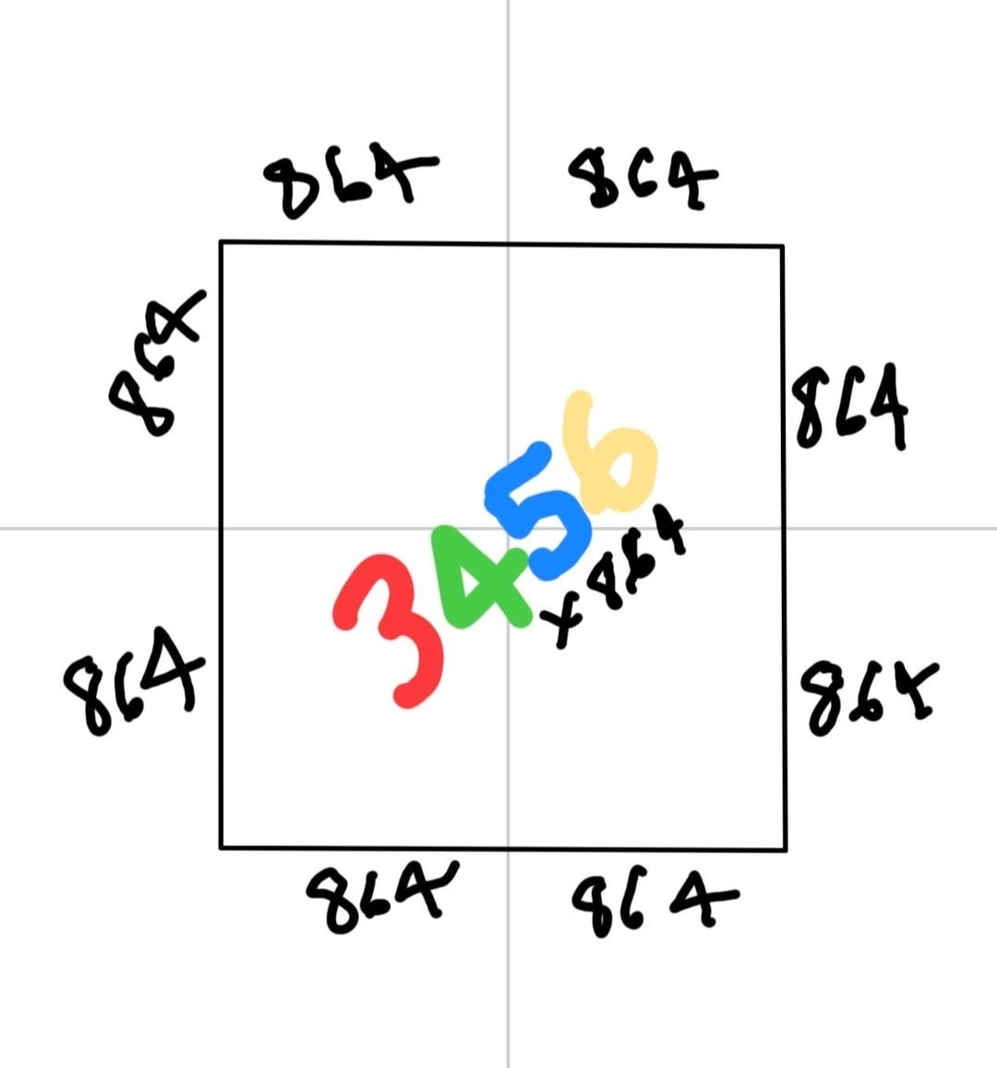
ORIGINS: Closing the Distance Between Metric and Imperial
In pursuit of seamless spatial mapping, we traced the Mile history back to the Stadion.
Here we found the link between the 0.462962962 m rational Cubit and the original 1620 m universal Mile value.
This returns SOL correspondence to the distance unit by correcting the errored 1609.344 Roman Mile.
RATIONAL MILE
1 Mile = 1600 Metres
(400 m Stadion x 8.64 Cu)
Stadec: 600 Feet x 2.16
185.185185185 m – 200 yd – 600 ft × 1/3.24 cm / 1/8.64 = 1600 m
300,000,000 m /187,500 mi/s = 1600 m
UNIVERSAL MILE
1 Mile = 1620 Metres
(405 m Stadion x 8.64 Cu)
Stadec: 607.5 Feet x 2.16 (Mathematical)
185.185185185 m – 200 yd – 600 ft × 1/3.2 cm / 1/8.64 = 1620 m
300,000,000 m /185,185.185…mi/s = 1620 m
Through these interconnected distance and timing light correlations, we pinpointed universal solar stream alignment at 185,185.185…mi/s.
Universal Mile syncs to 0.462962962 m Cubit
185185.185/0.462962962 = 400,000
Universal Mile syncs 0.535836763 m Royal Cubit
185185.185/0.535836763 = 345,600
cubit-converter.ONE
Notes:
ORIGINS: Closing the Distance Between Metric and Imperial
In pursuit of seamless spatial mapping, we traced the Mile history back to the Stadion.
Here we found the link between the 0.462962962 m Cu, and the original 1620 m Universal Mile value.
This returns SOL correspondence to the distance unit by correcting the errored 1609.344 Roman Mile.
Further detail:
Aligned with today’s systems, the Rational Mile = 1600 Metres.
The true Universal Mile (aka The Stadion x 8.64) = 1620 Metres.
Universal Qt 300,000,000 m /185185.185….mi/s = 1620 m = Universal Mile
Royal Cubit 300,000,000 m/186,624 mi/s = 1607.5102881 m = Royal Mile
Rational Cubit 300,000,000 m/187,500 mi/s = 1600 m = Rational Mile
Indian Hasta 300,000,000 m/166,666.66 mi/s = 1800 m = Indian Mile
Chinese CHI 300,000,000 m/375,000 mi/s = 800 m = Chinese ½-Mile
Precise measurements for the light-aligned Stadion Unit were used by Eratosthenes in the Third Century BC.
1 x 2 x 2.16 x 8.64 The stadion (plural stadia, Ancient Greek: στάδιον (latinized as stadium), also anglicized as stade, was an ancient Greek unit of length, consisting of 600 Ancient Greek feet (podes). CCCRdg Vitruvian Realignments:
Stadia/Stadion exact length relation = 1/8.64 (1/4.32/2) of a Mile…
This corrects from inaccurate Ptolemaic units to the correct Attic units.
Additionally, it corrects from the inaccurate Ptolemaic units to the correct nautical Leo units.
This also syncs with Leo’s perfect foot, 0.267918381 cm x 1.152 Nautical Miles (alt. 213.333.. / 69.12)
Details:
This corrects from inaccurate Ptolemaic to the correct Attic - 185.185185.. m - 200 yd - 600 × 1/3.24 m / 1/8.64 = 1600 m And accordingly, from inaccurate Ptolemaic to correct Attic - 200 m - 216 yd - 648 × 1/3.24 m / 1/8 = 1600 m
This corrects from inaccurate Ptolemaic to correct nautical Leo - 213.33.. m - 230.4 yd - 691.2 × 1/3.24 m / 1/7.5 = 1600 m
And accordingly, from inaccurate Ptolemaic to correct nautical Leo - 213.33.. m - 230.4 yd - 691.2 × 1/.373248 m / 1/8.64 = 1600 m

Slide 8
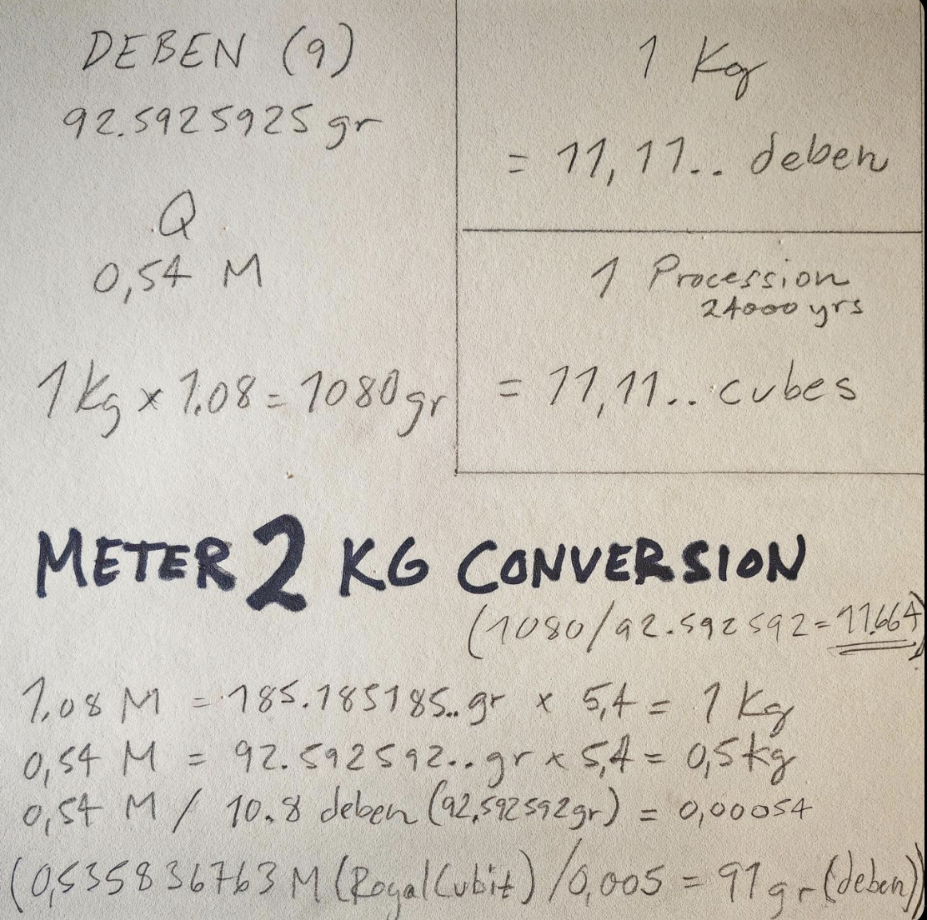
ORIGINS: The Weighting Game
Just as the Cubit provides the micro to macro distance ruler for accurate solar stream aligned Metre and Mile valuations, the Egyptian Deben synchronizes the corresponding unit of weight. This provides us with the necessary constant to negotiate the gravitational flux within the system.
Deben (90 gr) 1/12 of 10.8 Q = 0.54 M 1 Kg x 1.08 = 1080 gr - (1080 / 92.592592.. gr = 11.664) 1.08 M = 185.185185.. gr x 5.4 = 1 Kg 0.54 M = 92.592592.. gr x 5.4 = 0.5 Kg 0.54 M / 10.8 Deben (92.592592.. gr) = 0.00054 (0.535836763 M (Royal Cubit) / 0.005 = 91 gr DIVINE FORMULA 1.08 M / 1.2 = 90 gr (Measure / 1.2 = Weight)
cubit-converter.ONE
Notes:
ORIGINS: The Weighting Game
Just as the Cubit provides the micro to macro distance ruler for accurate solar stream aligned Metre and Mile valuations, the Egyptian Deben synchronizes the corresponding unit of weight. This provides us with the necessary constant to negotiate the gravitational flux within the system.
Deben (90 gr) 1/12 of 10.8 Q = 0.54 M 1 Kg x 1.08 = 1080 gr - (1080 / 92.592592.. gr = 11.664) 1.08 M = 185.185185.. gr x 5.4 = 1 Kg 0.54 M = 92.592592.. gr x 5.4 = 0.5 Kg 0.54 M / 10.8 Deben (92.592592.. gr) = 0.00054 (0.535836763 M (Royal Cubit) / 0.005 = 91 gr DIVINE FORMULA 1.08 M / 1.2 = 90 gr (Measure / 1.2 = Weight)

Slide 9
ALIGNMENTS: The Tellus Space/Time Light Grid Coordinates
Throughout one energetic grid system, light information expresses via platonic construction using 30° as the base angle.
All pointing to magnetic North, 30° is present in the north wall of the Giza plateau and repeats through the equatorial alignment of the great circle of ancient sites globally, as well as at all astrological cycles at scale.
Given our axial tilt, the platonic angles no longer sync with true north.
Accordingly, the following error correction returns us to electromagnetic alignment with our solar directed energy stream.
.
SOL HARMONIC REALIGNMENT FORMULA
SUM(x°+n°) x 1.2 x 1.0368
Step 1: Dimensional Frequency Bridge
SPACE Latitudinal Adjustment: n° x 1.2
360 circle(x1.2) stellates into a 432 sphere. Base 10 back to Base 12. Cross triangulation at any three points within the sphere provides original frequency coordinate intersections.
Step 2: Harmonic Timing Bridge
TIME Longitudinal Adjustment: n° x 1.0368
Correction back into electromagnetic harmonic sync within and between every coordinate point; fine structure tuning. Full mitochondrial function restoration - unlimited energetic z line.
SOL Space Foundations
30° and 300,000,000 m/s
30° and 186,624 miles/s
π31.104°/year = Sun cycle
Latitude x 1.0368 = Longitude
SOL 300,000,000 m corresponds with Khafre pyramid Latitude 30°
SOL π 3.1104 corresponds with Khafre pyramid Longitude 31.104°
This is the true MID of Mearth landmass in relation to the Sun
SOL Time Foundations
3.1104 and 300,000,000 m/s
3.1104 and 186,624 miles/s
Image: jes
cubit-converter.ONE
Notes:
ALIGNMENTS: The Tellus Space/Time Light Grid Coordinates
Throughout one energetic grid, light information expresses via platonic construction using 30° as the base angle.
Given our axial tilt, the platonic angles no longer sync with true north.
Accordingly, the following dimensional and timing error correction returns us to electromagnetic alignment with our solar directed energy stream.
Note the correlation between these harmonics and the Khafre pyramid.
Further detail:
SOL 300,000,000 m corresponds with Khafre pyramid Latitude 30°.
SOL π 3.1104 corresponds with Khafre pyramid Longitude 31.104°.
This is the true MID of MEarth in relation to the Sun.

Slide 10
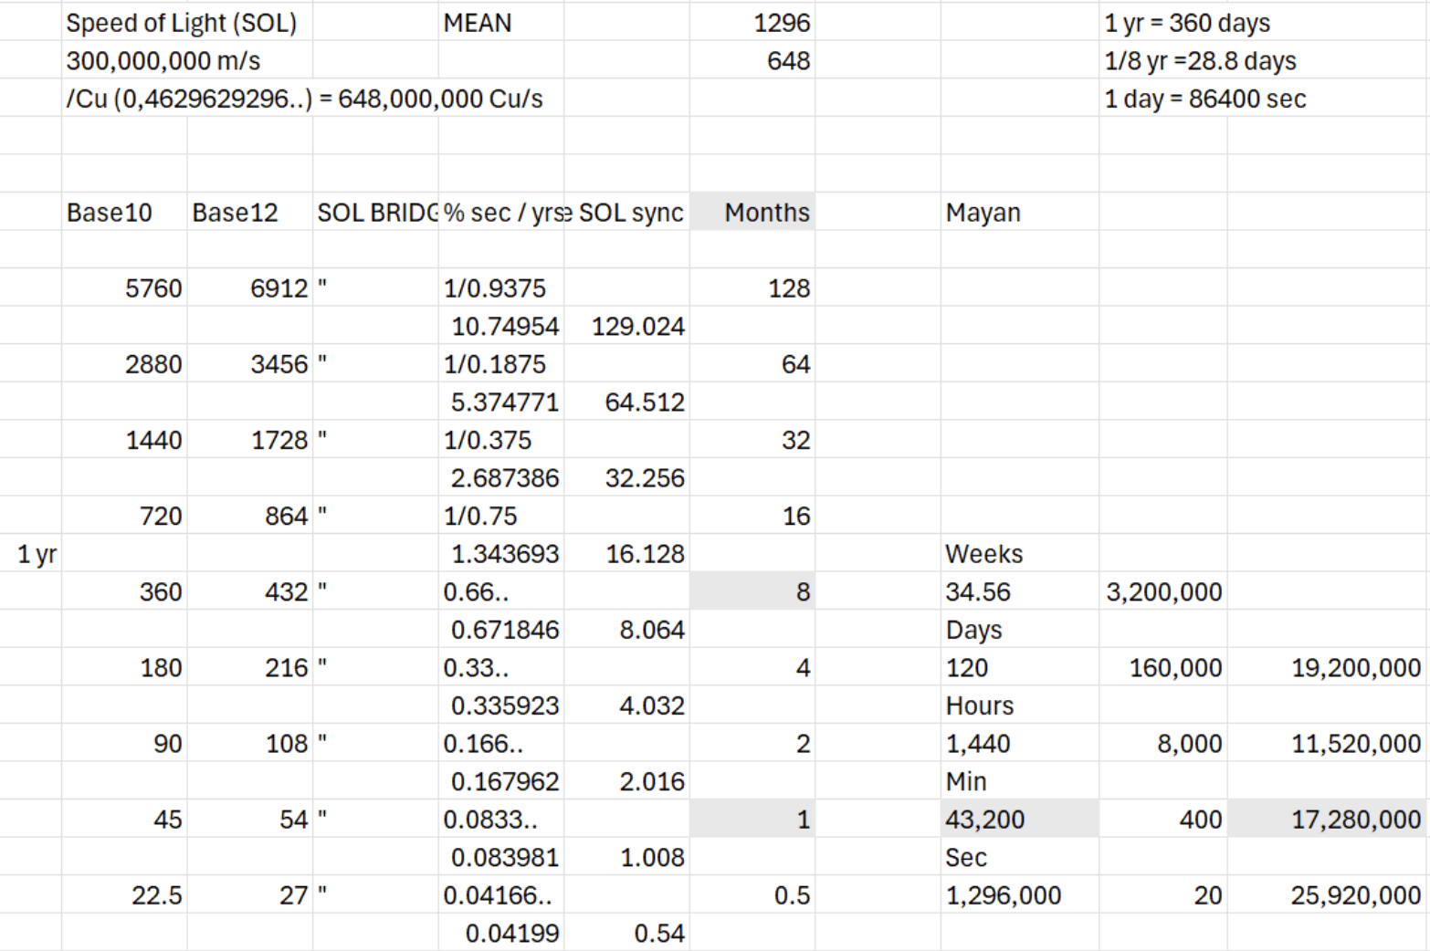
ALIGNMENTS: Dimensional Frequency Bridge
Diving deeper into the dimensional construction, we see that the ruling principles of frequency and vibration (1/x) prove that everything is trans-dimensionally connected in-between states…pinging between multiple positions at once.
As we resynchronize with the accurate light signal relay, full electromagnetic coherence returns. At this zero-point, the hyperpolarization in the signal disappears, and our electron transport chain exchanges freely again. This results in a fundamental change in our state of consciousness—from separation back into full energetic connectivity within and between all parts of one system.
Key Considerations:
Original Base 12 positioning realignment
Numbers double through a 1.08 base across 9 Octave cycling
Sequential sets of space/time frequency coordinates nest in ratioed precision within each octave
Cadenced celestial cycling maintain order within and between each octavial set
The 8th Octave is a direct sync to Universal Q parameters: 185185.185 m / 0.535836763 rc = 345,600. Home State Alignment
Space Latitudinal Adjustment
SUM(x°+n°) x 1.2
Sun 360° Circle to Sun 432° Sphere (360 x 1.2)
octave
9
8
7
6
5
4
3
2
1
cubit-converter.ONE
Notes:
ALIGNMENTS: Dimensional Frequency Bridge
Diving deeper into the dimensional alignments, we recognize that it is the fundamental harmonic ratios between the numbers that are the basis of our Source Light code rather than the numbers themselves; their fractal relationships.
Further detail:
As we resynchronize with the accurate light signal relay, full electromagnetic coherence returns. At this zero-point, the hyperpolarization in the signal disappears, and energy moves freely again. This results in a fundamental change in our state of consciousness—from separation back into full energetic connectivity within and between all parts of one system.
As one fully charged system, waves ripple through doubling sequences and repeating octaval patterning aligned with the solar fundamentals, restoring and maintaining mitochondrial function across the whole.
1.008 SOL Sync provides the required timing conversion from Egyptian SOL 186624 mi/s % sec/yr to Universal SOL 185185.185 % sec/yr to maintain the hyperfine celestial timing alignment.

Slide 11
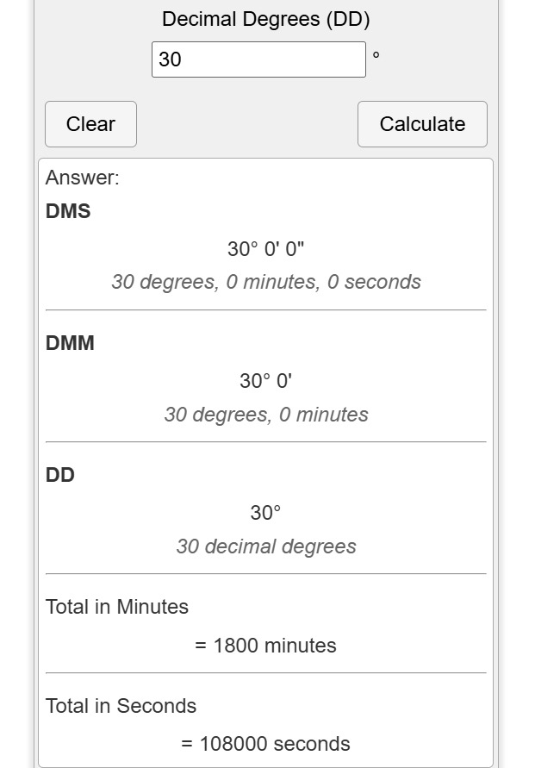
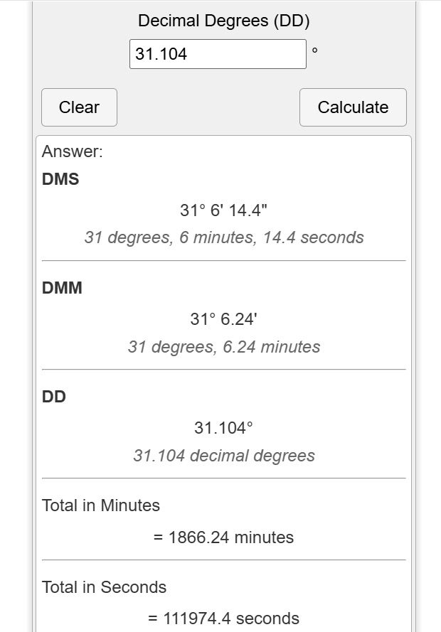
ALIGNMENTS: Harmonic Timing Bridge
The ratio relationship between the dimensional frequencies and harmonic timing is set by a rational Pi value of 3.1104 across every scale. Center of the center.
Time Longitudinal Adjustment
SUM(x°+n°) x 1.0368
This reinforces that the 0.05787037037 m Cu Solar Codec syncs the processing for accurate transmission relay aligned with the Universal Q-bit parameters.
Platonic Base: 30° x 1.0368 = 3.1104°
The Space Time Ratio Relationship: SOL Pi = 3.1104 = 0.15 rc
SOL Correspondence:
30° = 108000 sec = 30 hours 31.104° = 31° 6.24 min [624 SOL] 14.4 sec DMS [mirror of 1440 min, 24 hr Earth rotas] SOL 186,624 mi/s Kings Chamber 11.19744 rc/648,000,000[SOL in Cu]=1728 INV
2 Pi = 6.2208 = Tau [t]= 0.3 rc
The Solar Codec:
0.05787037037 m SOL Correspondence: 1/17.28 0.05/8.64 0.462962962...m Cu /8 [8 Bytes]
1 Byte (8, alt 6 Bits)
1 Bit 0.00723337963 x 64
Image: jes
cubit-converter.ONE
Notes:
ALIGNMENTS: Harmonic Timing Bridge
The ratio relationship between the dimensional frequencies and harmonic timing is set by a rational Pi value of 3.1104 across every scale.
This reinforces that the 0.05787037037 m Cu Solar Codec syncs processing for accurate transmission relay aligned with the Universal Q-bit parameters.

Slide 12
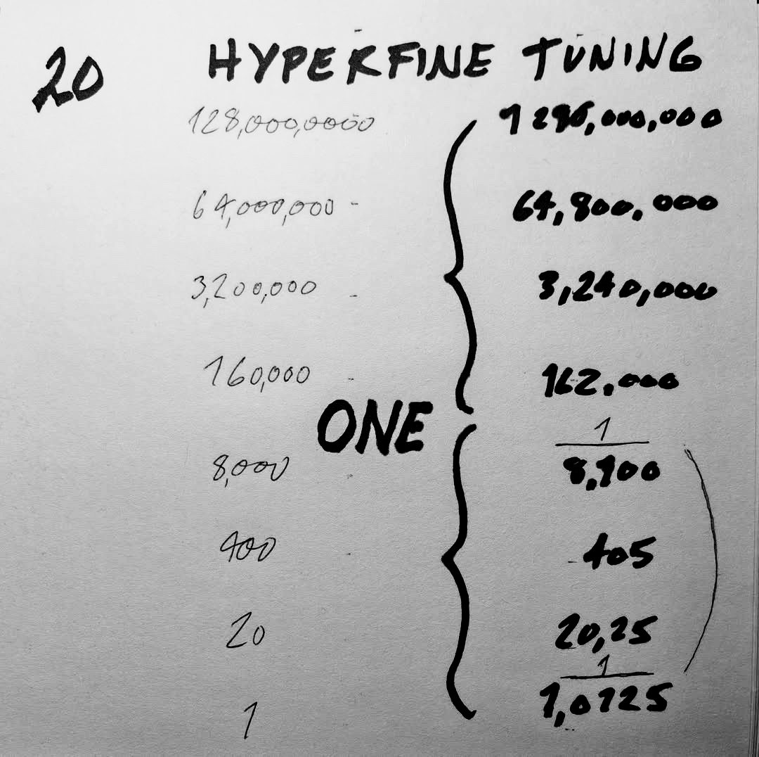
ALIGNMENTS: Hyperfine Precession Cycling
Light balance is centrifugal to the stabilization of vibrational matter across every systemic level. The precision of the cycling alignment impacts the experience our Consciousness is processing and perceiving.
As seen in the Mayan Vigesimal Counting system, rational number systems have been logically built on the doubling of 1 and its inverse.
To sync rational Mayan counting with the with the Universal Vedic Precession Cycles, a 1.0125 multiplier is applied for precise THz correspondence. 162 x 20 x 20 x 20 X 2 = 2,592,000
The Ancient Astronomical Polar Rotas/Spin
Axial Precession – The March Equinox
54’ per yr x 8,000 = 432,000 x 8 = 3,456,000
54’ per yr x 7,200 – 388,800 x 8 = 3,110,400
432’ x 7200’ = 3,110,400 years
Grand Cycles
200,000 x 360 x 3600 (50 x 72) = 259,200,000,000 / 60’ per yr = ___________________________________________________
4,320,000,000
180,000 x 360 x 3,600 (50 x 72) = 233,280,000,000 / 54’ per yr = ___________________________________________________
4,320,000,000
Mayan Vigesimal Counting System x 1.0125
cubit-converter.ONE
Notes:
ALIGNMENTS: Hyperfine Precession Cycling
Light balance is centrifugal to the stabilization of vibrational matter across every systemic level. The precision of the cycling impacts the experience our Consciousness is processing and perceiving.
As seen in the Mayan Vigesimal Counting system, rational number systems have been logically built on the doubling of 1 and its inverse.
Further detail:
To sync rational Mayan rotas with the Universal Vedic Precession Cycles, a 1.0125 multiplier is applied for precise correspondence.
162 x 20 x 20 x 420 x 2= 2,592,000
The Mayan were water experts. Their count syncs with amplitude pressurization.
A 10 db increase means 10 times louder, a 20 db increase means 100 times louder

Slide 13
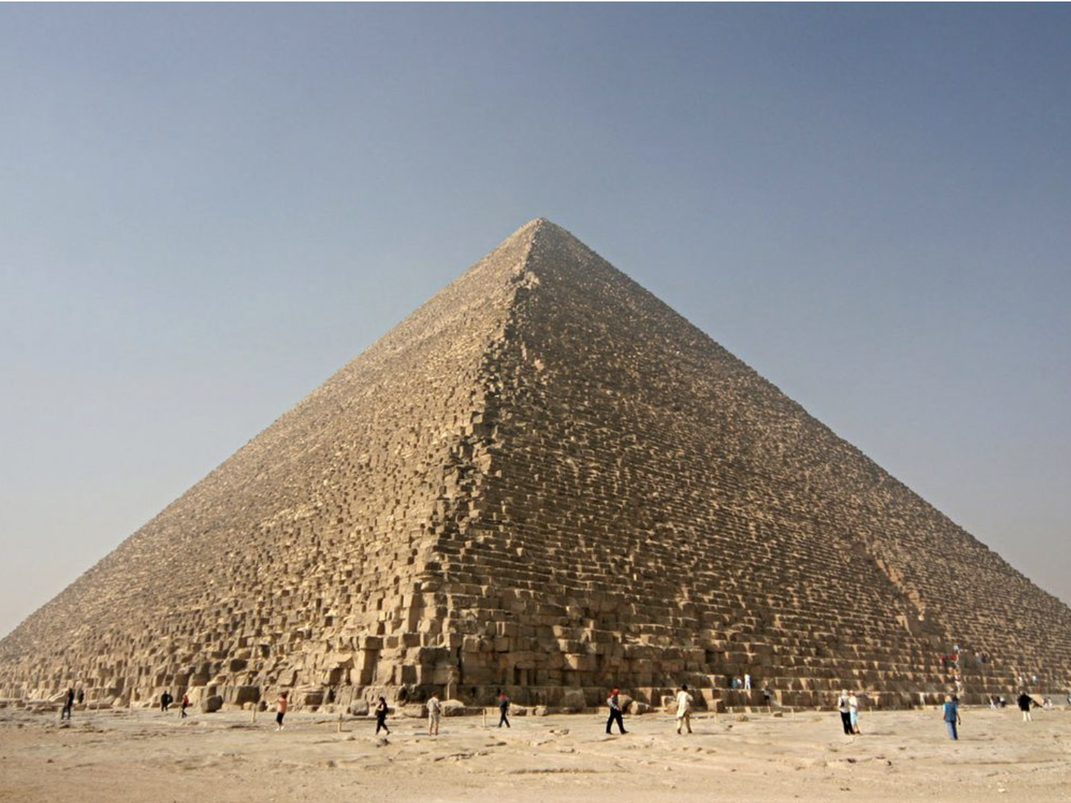
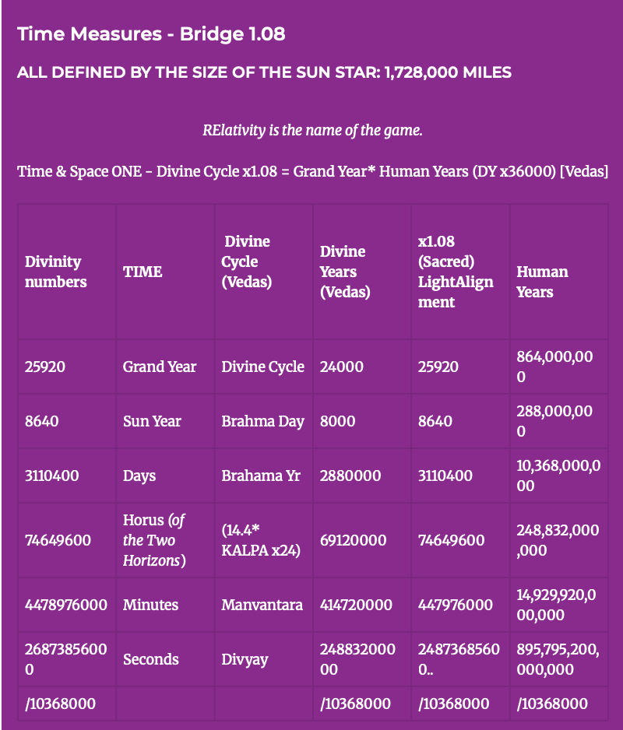
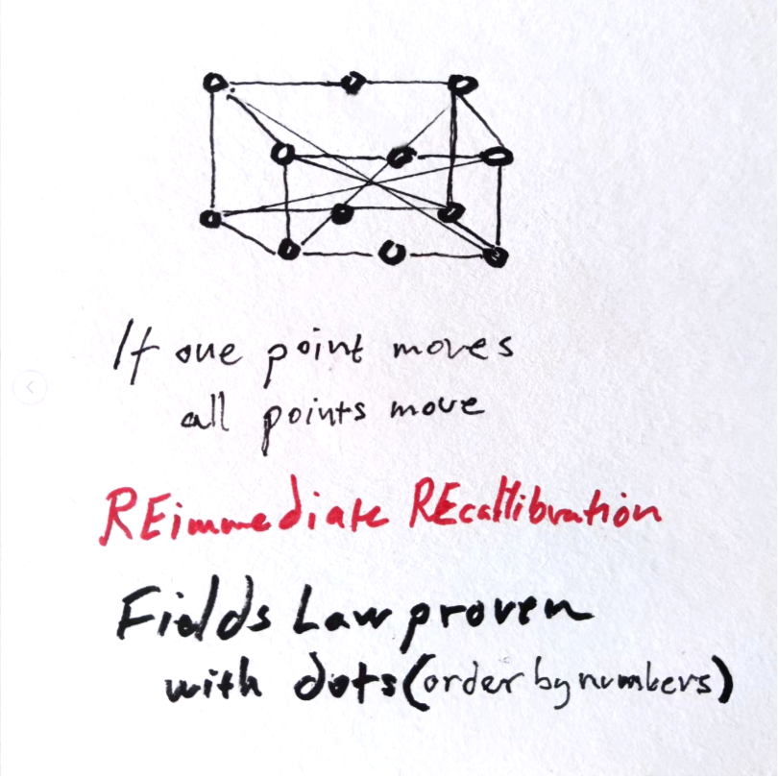
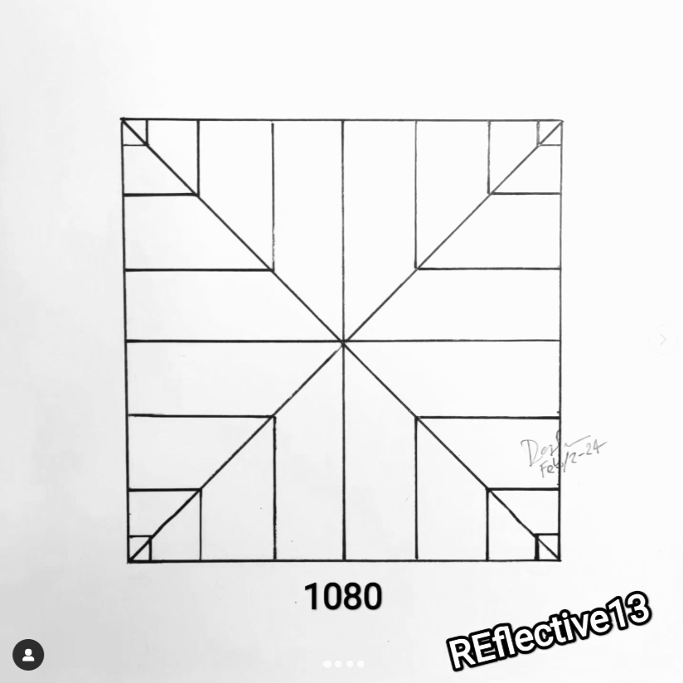
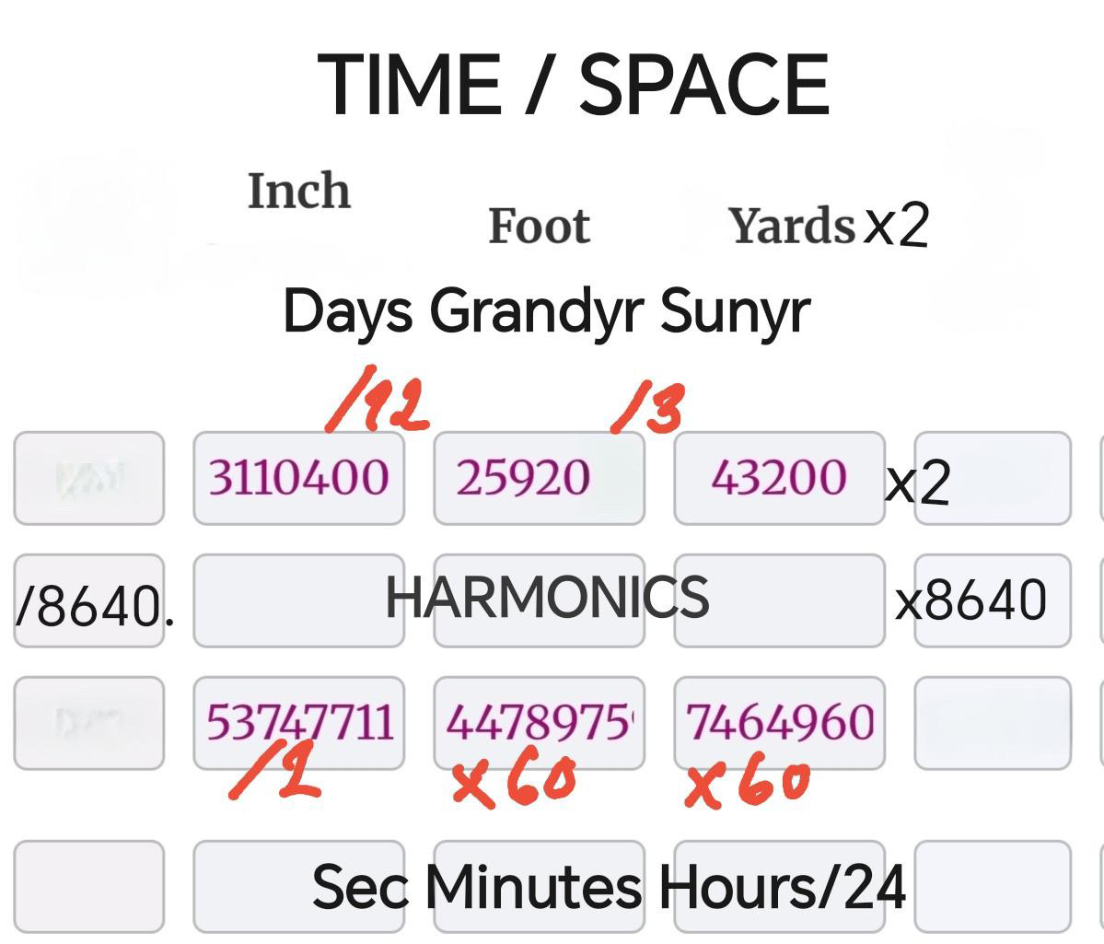
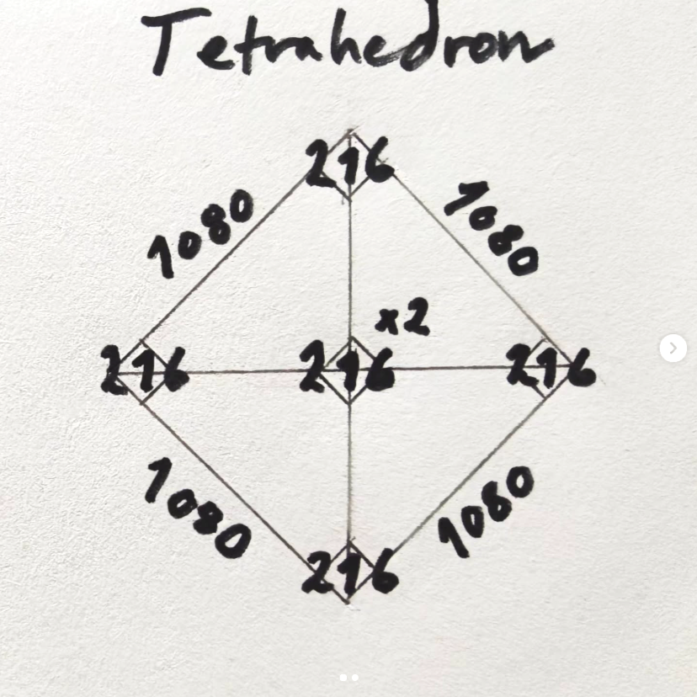
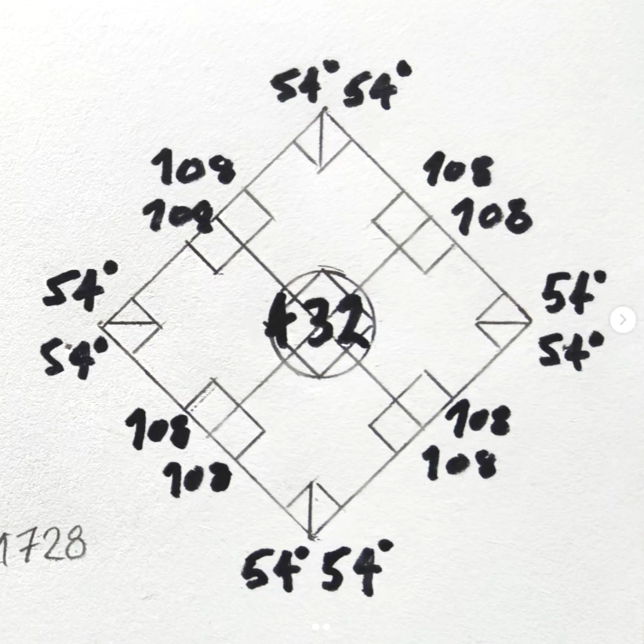
VALIDATION: Our Divine Solar Light Grid Parameters
The Grand Cycle of Bharat
The Great Pyramids of Giza Nekropolis
SOL Space/Time Correspondence
Grand Precession 25920 yrs /3 = 8640 (1 sun yr) x 8640 = 74,649,600 hrs x 60 = 4.478976e9 min x 60 = 2.6873856e11 sec /86400 = 3110400 days /12 = 25920 yrs Grand Precession
Egyptian Cubit
0.462962962…m Cu
x (1/0.972)
Indian Hasta
0.45 m (Ha)
Image: Smithsonianmag.com
cubit-converter.ONE
Notes:
VALIDATION: Our Divine Solar Light Grid Parameters
CCCRdg has compiled over 250 proofs validating the presence of our Sun’s solar directed energy grid aligning time and space harmonics. We believe our findings will fit the majority of the ancient constructs, helping bridge the understanding of our past to our present and future.
Over the next slides we will focus on the Great Pyramids of Giza Nekropolis. The GP harmonic alignments ratio relate across body mass at every dimensional scale from Celestial to Planck synced with our solar directed energy stream.
Further detail:
SOL Space/Time Correspondence
Grand Precession 25920 yrs / 3 = 8640 (1 sun yr) x 8640 = 74,649,600 hrs x 60 = 4.478976e9 min x 60 = 2.6873856e11 sec /86400 = 3110400 days /12 = 25920 yrs

Slide 14
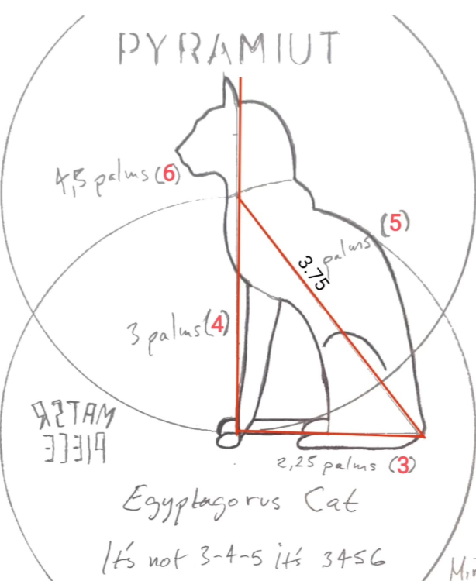
Great Pyramid
VALIDATION: Source Light Grid PyraMuit Construction
Sun Syncs:
864/4=216
1/2.16 = 0.462962962…m Cubit
PRE-Pythagoras in Cubits
3-4-5-6 Muit Platonic Construction
1.2 corrected as 36°- 72°-108°-120°
1 Cu = 0.462962962…m
240^2 + 320^2 = 400^2
102,400 + 51,600 = 160,000
400^2 = 160,000
cubit-converter.ONE
Notes:
VALIDATION: Source Light Grid “PyraMuit” Construction
Before Pythagorian 3-4-5 platonic construction, the Muit system (Mui meaning Cat) used a 3-4-5-6 platonic architecture in their system. This plotting incorporated a 120° angle that created additional division points. The PyraMuit system was used in the construction of the Great Pyramid.
Further detail:
Our modern Metre value links to these ancient Egyptian measures via the Egyptian Cubit. These measures maintain light speed correspondence when based on the 0.462962962…m Egyptian cubit (Cu); two complimentary SOL coding sequences.
From this ONE SOL number, 1/2.16, we have rebuilt the whole Giza Necropolis and it’s pentamids ( or pyramids)--no onsite measuring, no overlays, no satellite imagery. It’s all Divine number ratios synchronized for perfect electromagnetic alignment.
The Great Pyramid PRE-Pythagoras measures in Cubits:
240^2 + 320^2 = 400^2 Hypotenuse = 160,000 Cu
This equates to 102,400 Cu + 51,600 Cu = 160,000 Cu

Slide 15
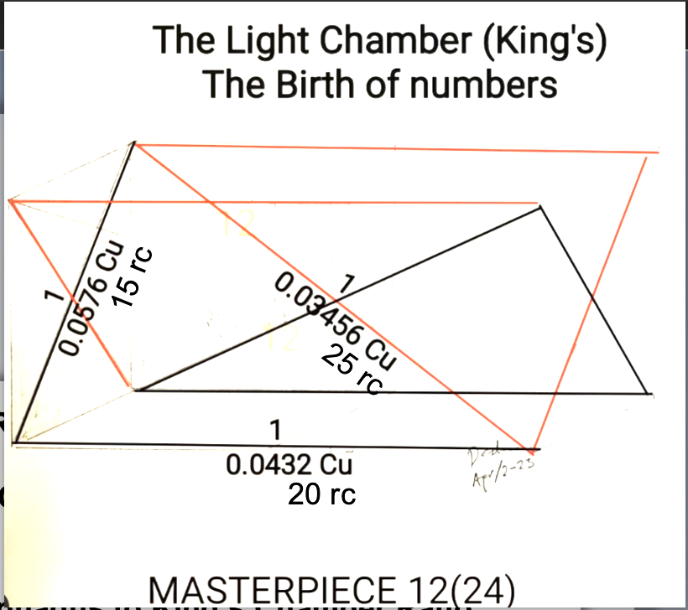
The Three Shrines: Giza Nekropolis
VALIDATION: Divine Source Light Technology Nesting Dolls
Volume in Royal Cubits (rc)
1 The King’s Chamber
W (e-w) x D (n-s) x H (Cu)
20 x 10 x 11.19744 = 2,239.488 rc^3
2 The Sarcophagus
W (e-w) x D (n-s) x H (Cu)
4.32 x 2 x 1.86624 = 16.1243136 rc^3
3 The Ark of Covenant
W (e-w) x D (n-s) x H (Cu)
2.16 x 1.296 x 1.296 = 3.6279056 rc^3
SOL Ratio Relations
The King’s Chamber to SAR scan Ratio:
432,000
The SARcophagus to King’s Chamber Ratio:
138.888
1/138.888..
This is the Egyptian fine-structure constant (Sommerfeld constant); “The Dimensional Number“ quantifying the gap in the Hydrogen atom spectral lines.
SIGNIFICANT: SOL 186,624 mi/s is linked to (432^2) Hydrogen.
The Ark of Covenant to the SARcophagus Ratio:
4.44
Body Triangle of 15 rc x 20 rc x 25 rc
Base: 1/0.0576 Cu - 15 rc
Side: 1/0.0432 Cu - 20 rc
Hypotenuse: 1/0.03456 Cu - 25 rc
cubit-converter.ONE
Notes:
VALIDATION: Divine Source Light Technology Nesting Dolls
Within and below the Great Pyramids of Giza the nested component system has been designed to align precisely with our Sun’s solar directed stream, transferring the unlimited energy in and through one energetic body of light.
The King's Chamber, the Sarcophagus, and the Queens Chamber, mirror the Khafre Pyramid SAR-findings in the Giza plateau. It's all in the numbers. The KC body diagonals 15 x 20 x 25 royal cubits give it away.
Further detail:
The King’s Chamber to SAR scan Ratio: 432,000
The SARcophagus to King’s Chamber Ratio: 138.88.. This is the Egyptian fine structure constant; “The Dimensional Number“ quantifying the gap in the Hydrogen atom spectral lines.
The Ark of Covenant to the SARcophagus Ratio: 4.44

Slide 16
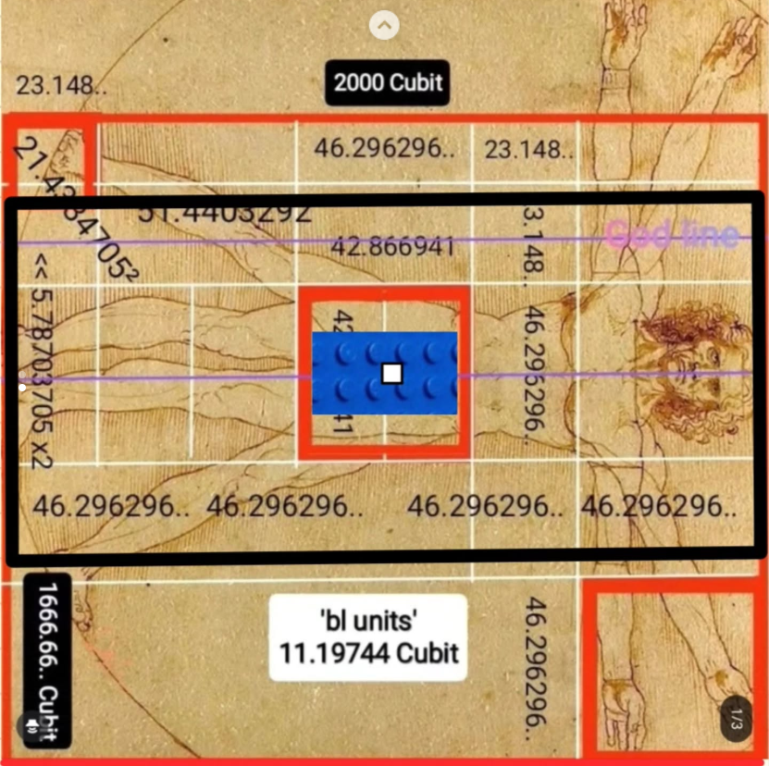
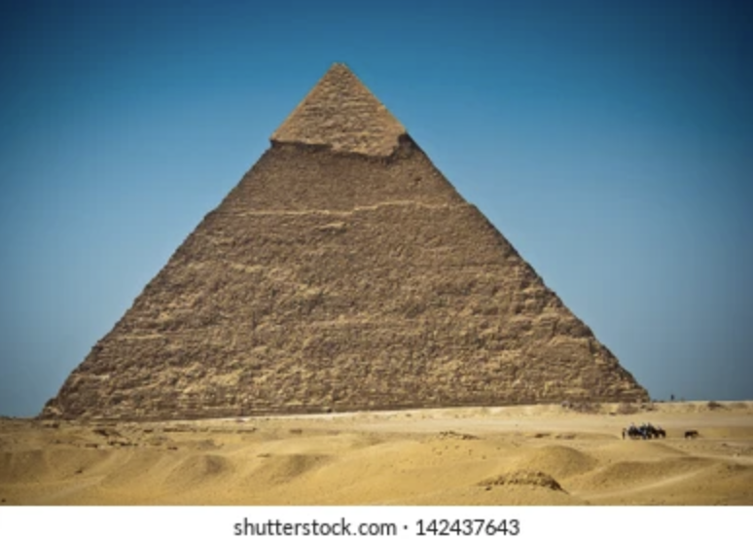
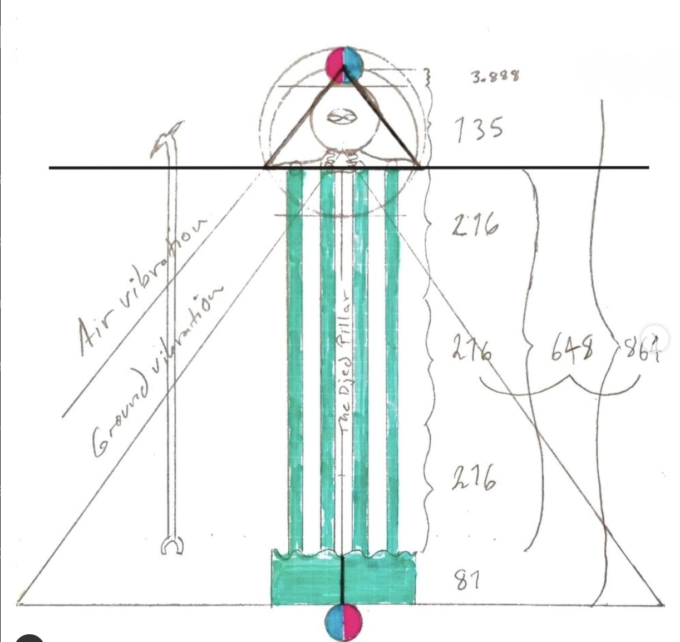
VALIDATION: Major Tom to Ground Control
The Great Power Distribution Station of Giza Nekropolis
Photonic information naturally transmits with harmonic resonance through radiofrequency electromagnetic fields to and from the receiver when aligned with the solar light stream. Full light signal stream realignment enables a free-flowing electron transport chain.
Perpetual Energy Returns… Regeneration, Space/Time Navigation, Clean NRG Gen Power
Arial View
Coronal View
Vibrational Air Waves
Composite by SoO, 2025
LIMESTONE(CaCO3)
GRANITE
Vibrational Ground Waves
Pyramid background, shutterstock.com • 142437643
cubit-converter.ONE
Notes:
VALIDATION: Major Tom to Ground Control
This is Legocy Planet Engineering – The Centre of the Centre
The 15 rc x 25 rc values link to the 138.888 fine structure constant. The vibrational frequency transfers ground waves through the granite, and air waves through limestone. Key ratios are always doubling.
What is below Ankor Wat++ ? The link to the Universal Q and the Bit. And now it is Time To Power Back Up…
Further detail:
Photonic information naturally transmits with harmonic precision to and from the receiver when aligned with the solar light stream. Full light signal stream realignment enables a free-flowing electron transport chain.
Perpetual Energy Returns… Regeneration Space/Time Travel Clean NRG gen power plants
Full reconnection across all ONE.

Slide 17
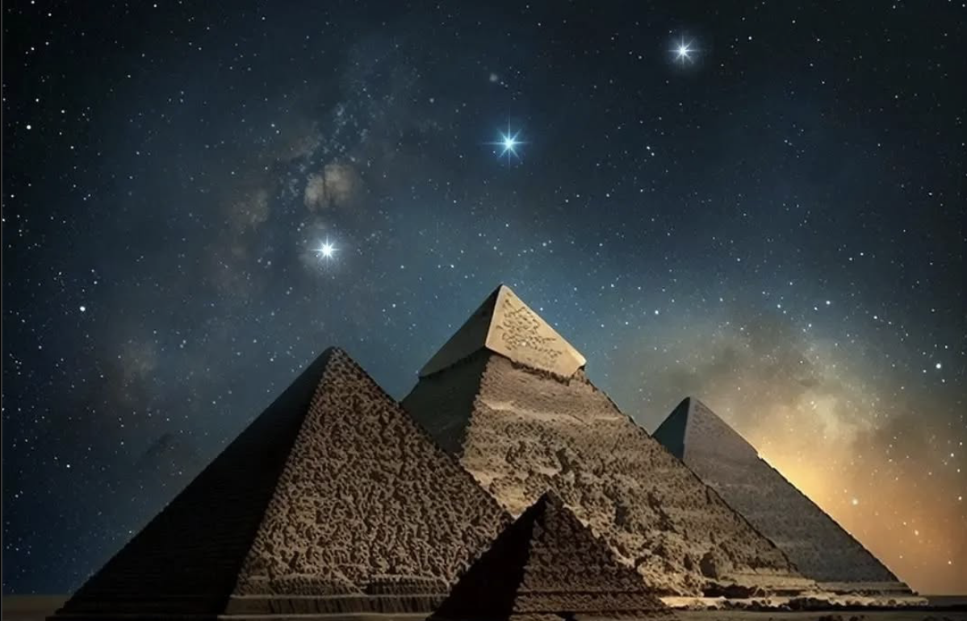
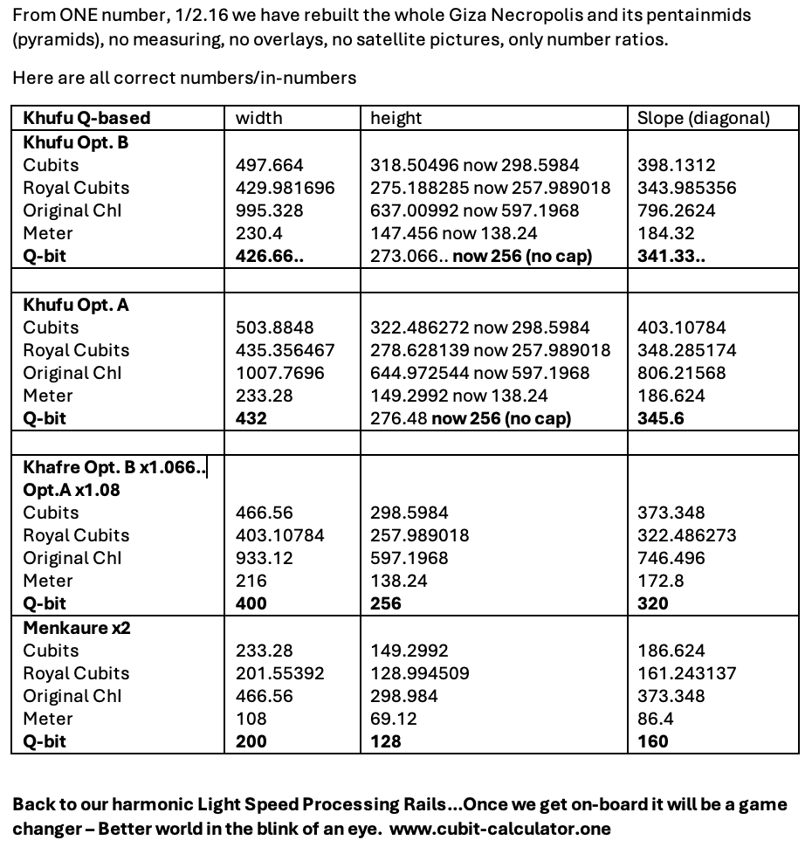
VALIDATION: Reestablishing Signal Center Stream
In their original position, the pyramids and mounds were centralized at resonance harmonizing chakra centers along the equatorial plane of one landmass, positioned for direct signaling between paired celestial nodes.
These frequency alignments maintained the perpetual energy exchange between the cycles of our collective planetary body and our light stream. This is our homeostasis, our home state.
After re-identification of the Khafre pyramid at the solar center of our planet’s direct energy channel, the Nekropolis alignment with the three primary Stars of Orion’s Belt carries significant technical weight.
Having the point-to-point alignments between, not just one, but the three-pronged lock-and-key transmission nodes blazed the trail to re-identification of all other primary electromagnetic pairings between the heavens and Earth.
Mintaka AL Nilam AL Nitak
IG Image: @spacerocx
cubit-converter.ONE
Notes:
VALIDATION: Reestablishing Signal Center Stream
In their original position, the pyramids and mounds were centralized at resonance harmonizing chakra centers along the equatorial plane of one landmass, positioned for direct coordinate signaling between paired celestial nodes.
These frequency alignments maintained the perpetual energy exchange between the cycles of our collective planetary body and our light stream. This is our homeostasis, our home state.
After re-identification of the Khafre pyramid at the solar center of our planet’s direct energy channel, the Nekropolis alignment with the three primary Stars of Orion’s Belt carries significant technical weight.
Having the point-to-point alignments between, not just one, but the three-pronged lock-and-key transmission nodes blazed the trail to re-identification of all other primary electromagnetic pairings between the heavens and Earth.
Further Detail:
Twin flames have the true balance of EMME attraction and repulsion to maintain sovereignty and expression autonomously and in harmony. Accurate alignments and corresponding balance maintain the space -the distance- In Between.

Slide 18
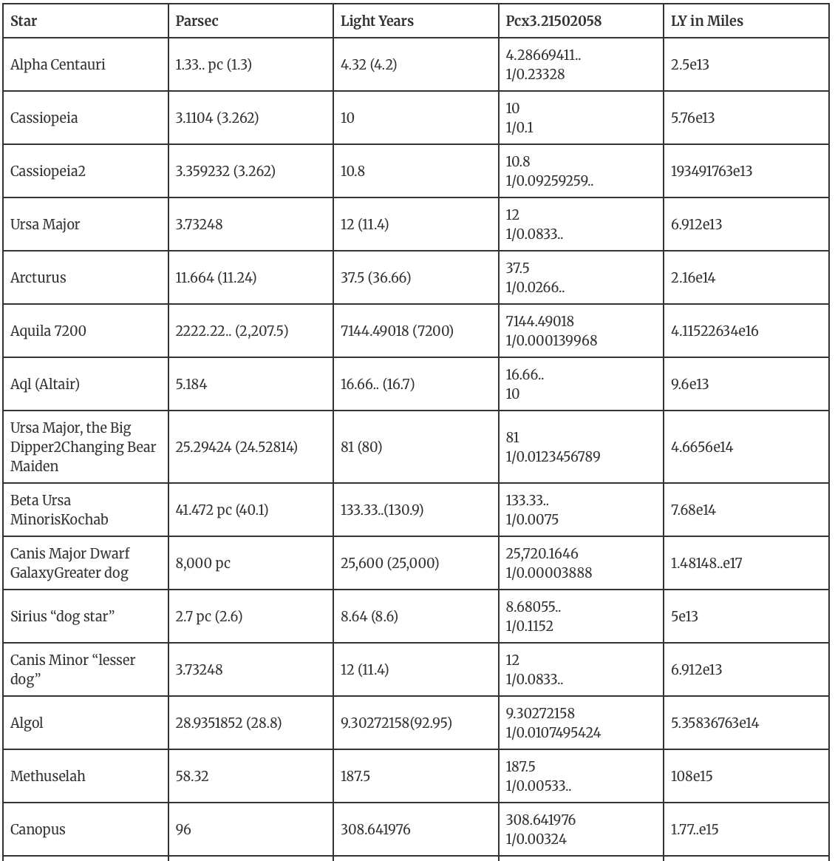
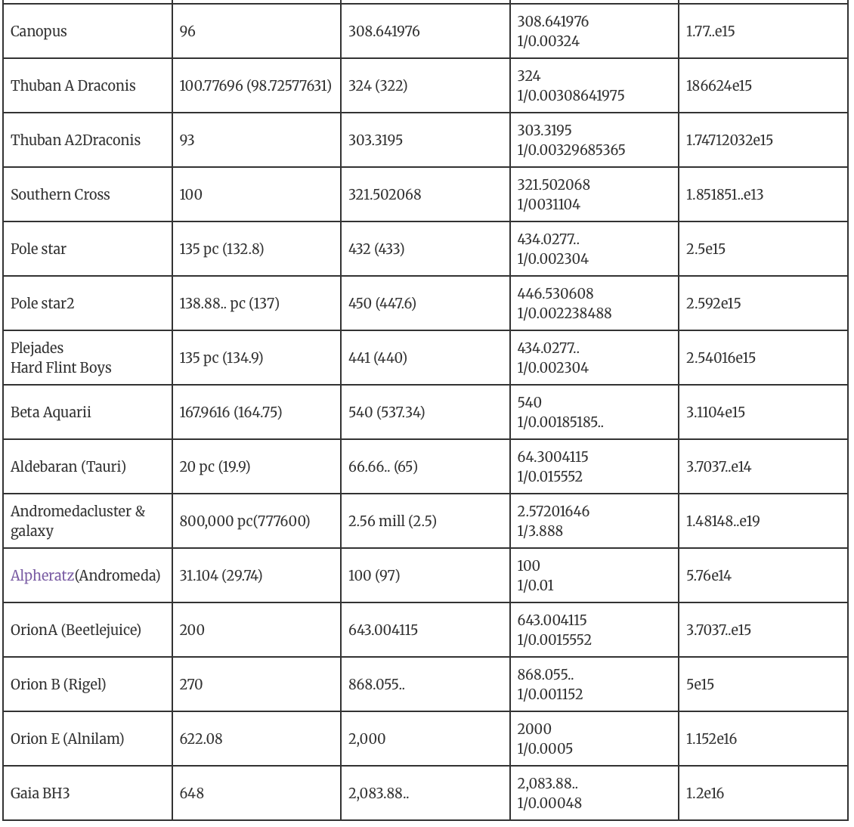
VALIDATION: Written In The Stars
Ancient Star Distances
1 AU 92,592,592.592 miles x 62208 (LY/AU) = 1 Light Year 5.76e12 Miles
Galaxies, stars and black holes are not randomly positioned in the Universe.
Expanding upon the celestial alignments, we focused on ancient stars (astro archetypes) with storied cultural meanings.
Via universal SOL Q-bit values, our planetary energy grid synchronizes with rest of our celestial coordinate system, enabling seamless light stream communication across one information superhighway.
Precise and accurate point to point distance and time correspondence IN BETWEEN each Star signal ensures clear information transfer, eliminating the hyper reverb occurring from the light stream misalignment.
Now we need to reinforce star distances with radio waves for uniformity, perhaps even to stable pulsars.
Shakti Shiva https://www.reuters.com/science/scientists-identify-milky-ways-ancient-building-blocks-shakti-shiva-2024-03-22/
IG Image: @spacerocx
cubit-converter.ONE
Notes:
VALIDATION: Written In The Stars
Galaxies, stars and black holes are not randomly positioned in the Universe. Expanding upon the celestial alignments, we focused on ancient stars (astro archetypes) with storied cultural meanings.
Via universal SOL Q-bit values, our planetary energy grid synchronizes with rest of our celestial coordinate system, enabling seamless light stream communication across one information superhighway.
Precise and accurate point to point distance and time correspondence IN BETWEEN each Star signal ensures clear information transfer, eliminating the hyper reverb occurring from the light stream misalignment.
Now we need to reinforce star distances with radio waves for uniformity, perhaps even to stable pulsars.
Further Detail:
FOUNDATIONAL CELESTIAL CALCULATIONS
Mearth to Sun = 8.333333 min = 500 sec
Days/Year = 360
Universal Q-bit SOL (sQl) = 185185.185185 mi/s
1.) 1 AU
500 sec x 185185.185185 mi = 92,592,592.5925 miles
2.) Seconds/Year
60 sec x 60 min x 24 hrs 360 days= 31,104,000
3.) Light Year
185185.185185 mi/sec x 31104000 sec = 5,759,999,994,240 mi/yr

Slide 19
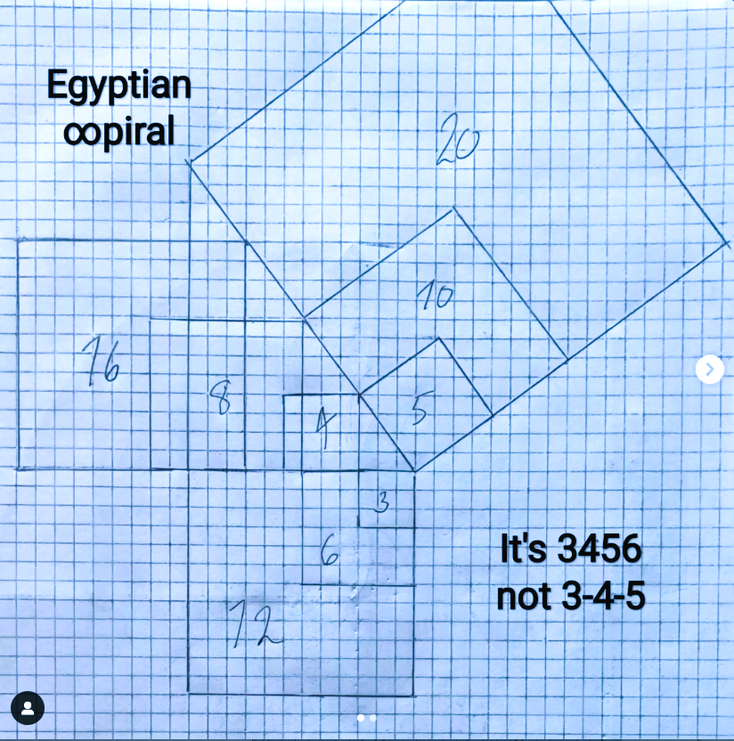
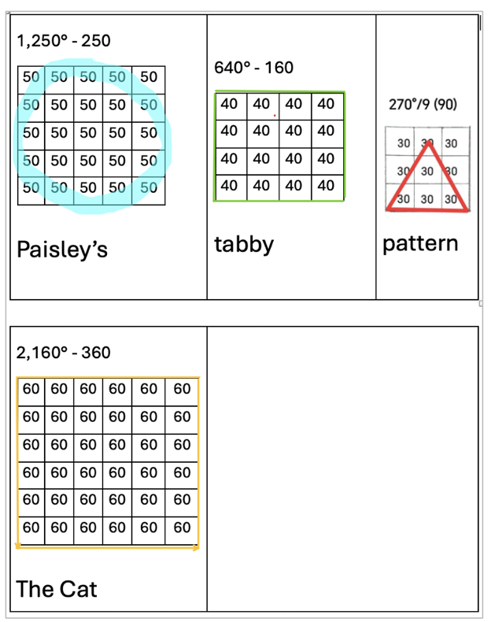
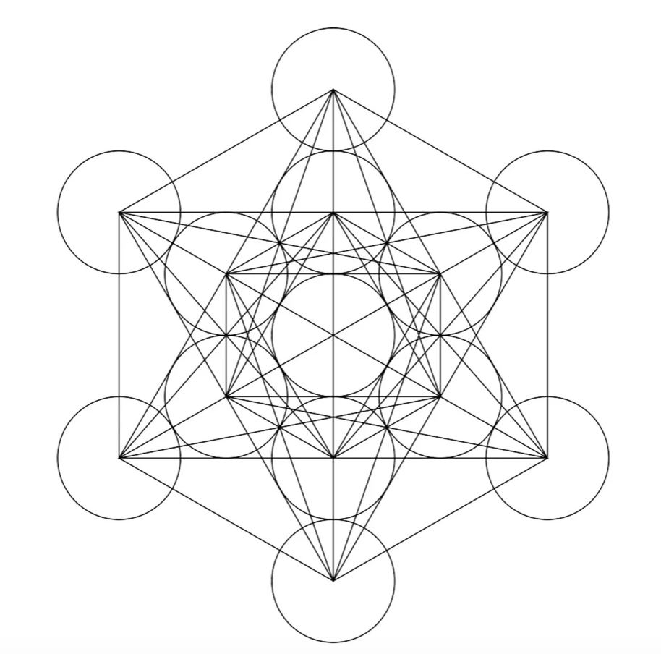
Geometric Expansion: Paisley’s Code
RECALIBRATION: Fractal Light Pattern Recognition
The ever-expanding geometric expression aligned with these 3-4-5-6 constructs provides the balanced, ratio’d sequencing harmonics across each of the platonic parameters. Dimensional light alignments across the scales.
5
4
3
6
Image: VTT Studios
cubit-converter.ONE
Notes:
RECALIBRATION: Fractal Light Pattern Recognition
The ever-expanding geometric expression aligned with these PyraMuit constructs provides the balanced, ratio’d sequencing harmonics across each of the platonic parameters. Dimensional light alignments across the scales.

Slide 20
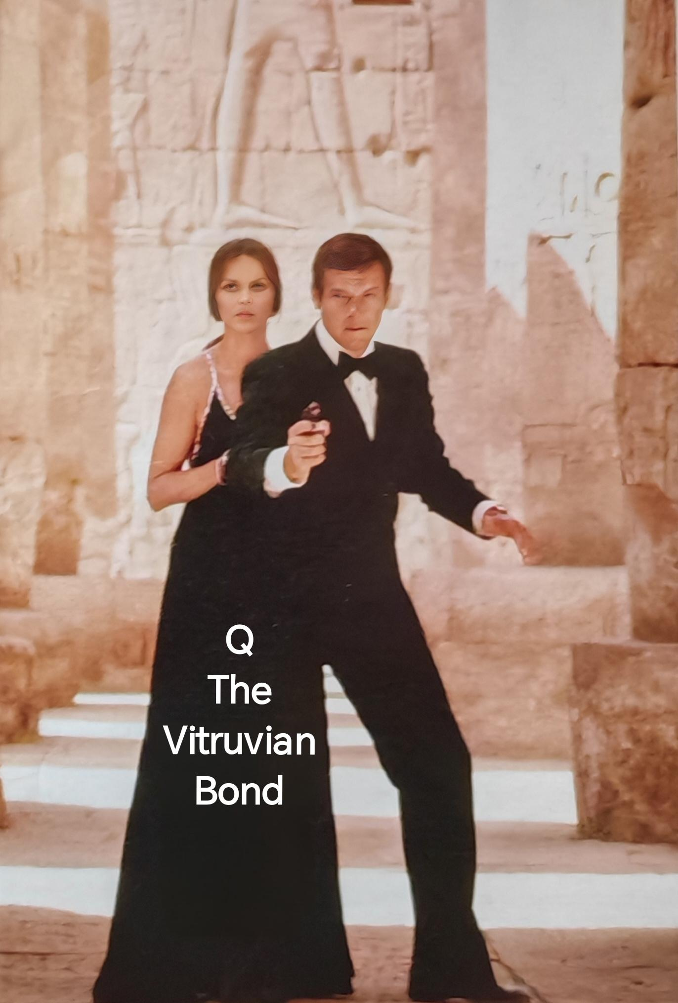
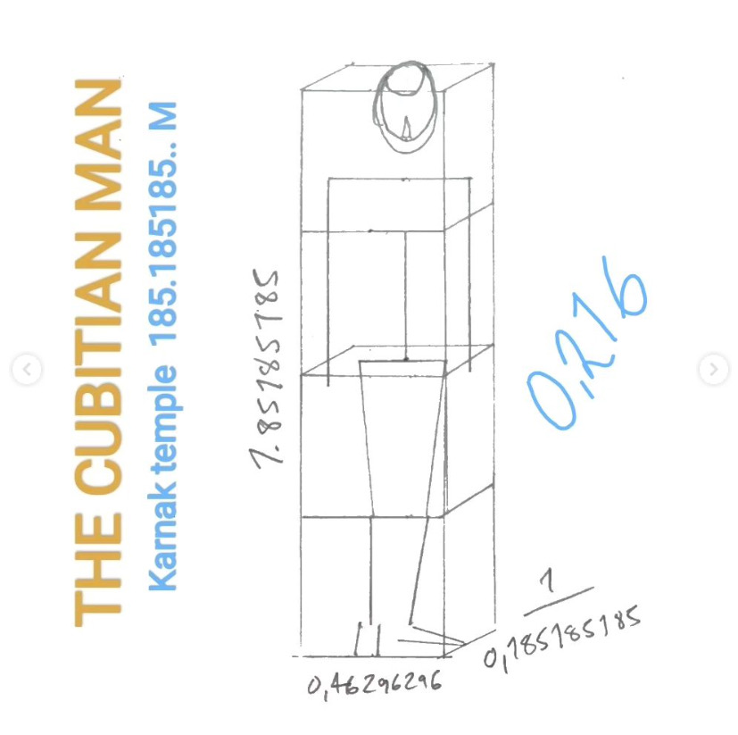
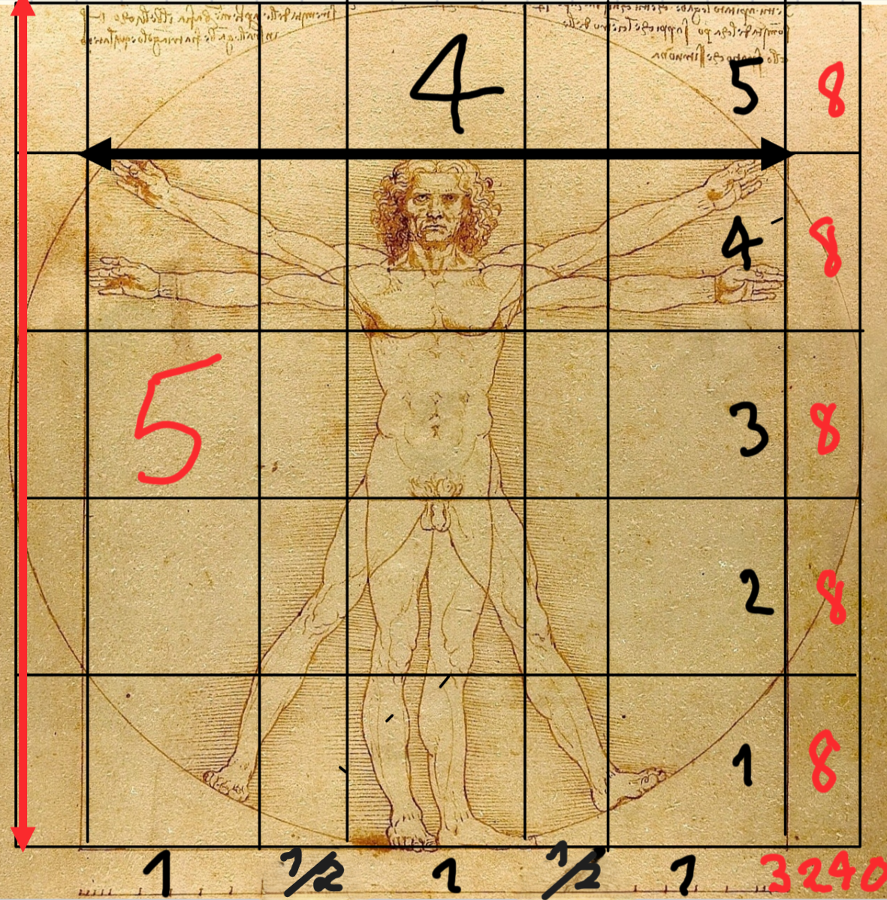
RECALIBRATION: The Universal Q Bonding the Cu and the Bit
The Height Of The Great Pyramid: 148.148148 m
Divide by 320
0.462962962 Cu / 0.864 = 0.535836763 rc
SOL Vitruvian Proportions
1:4 Scaling reflects Khafre SAR Scan 864 m
The Squaring 32x32 of the Circle 40x40 = 0.64
148.148148/320/64 = 0.0072337963 cm
0.007 ONE Bit
cubit-converter.ONE
Notes:
RECALIBRATION The Universal Q Bonding the Cu and the Bit
This pattern continued as we assessed DaVinci’s masterpieces matching the Universal light relay 185185.185 mi/s in his works using the 0.462962962…m Cu! Within the Vitruvian blueprint, the fractal whole is reflected down to the bit level.
Further detail:
Height Great Pyramid: 148.148.. rc / 320
1 rc = 0.462962962..m Cu & a 0.0728738 Bit
The Squaring 32x32 of the Circle 40x40 = 0.64

Slide 21
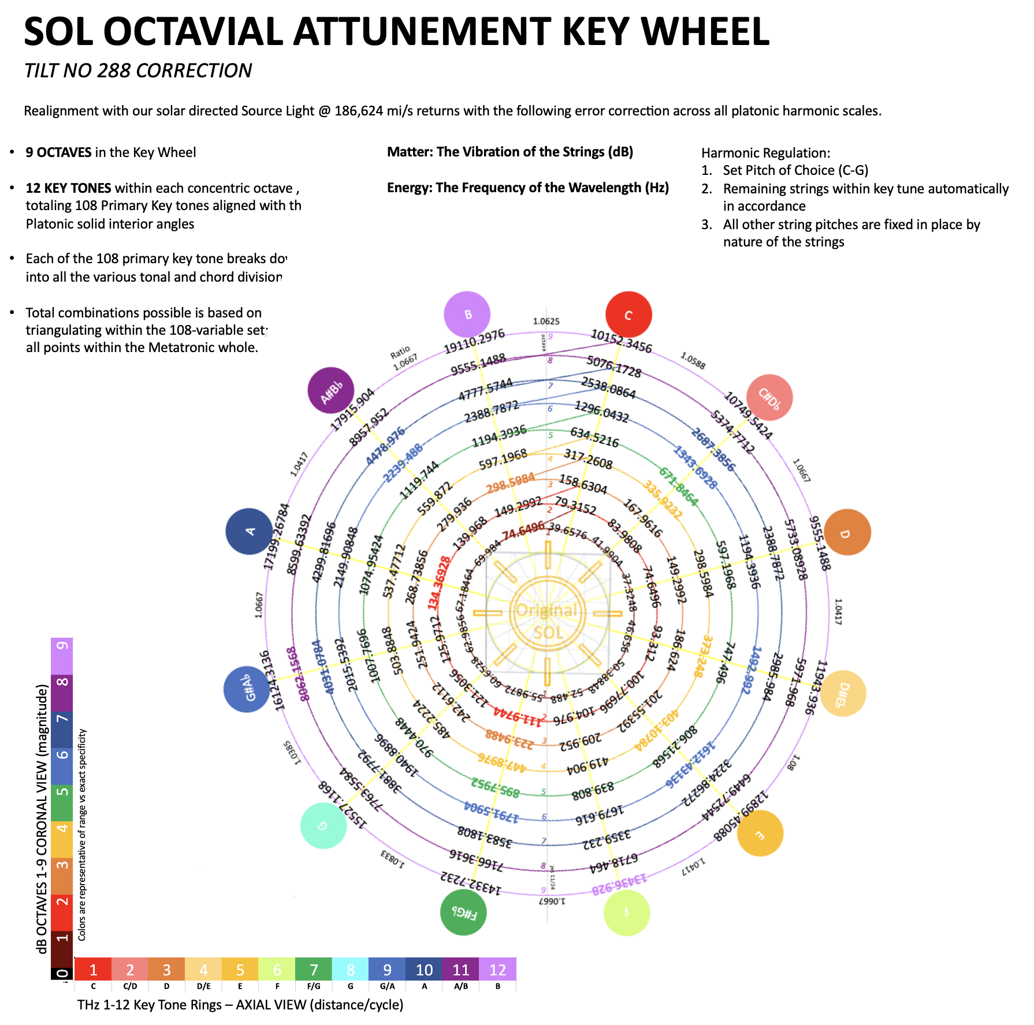
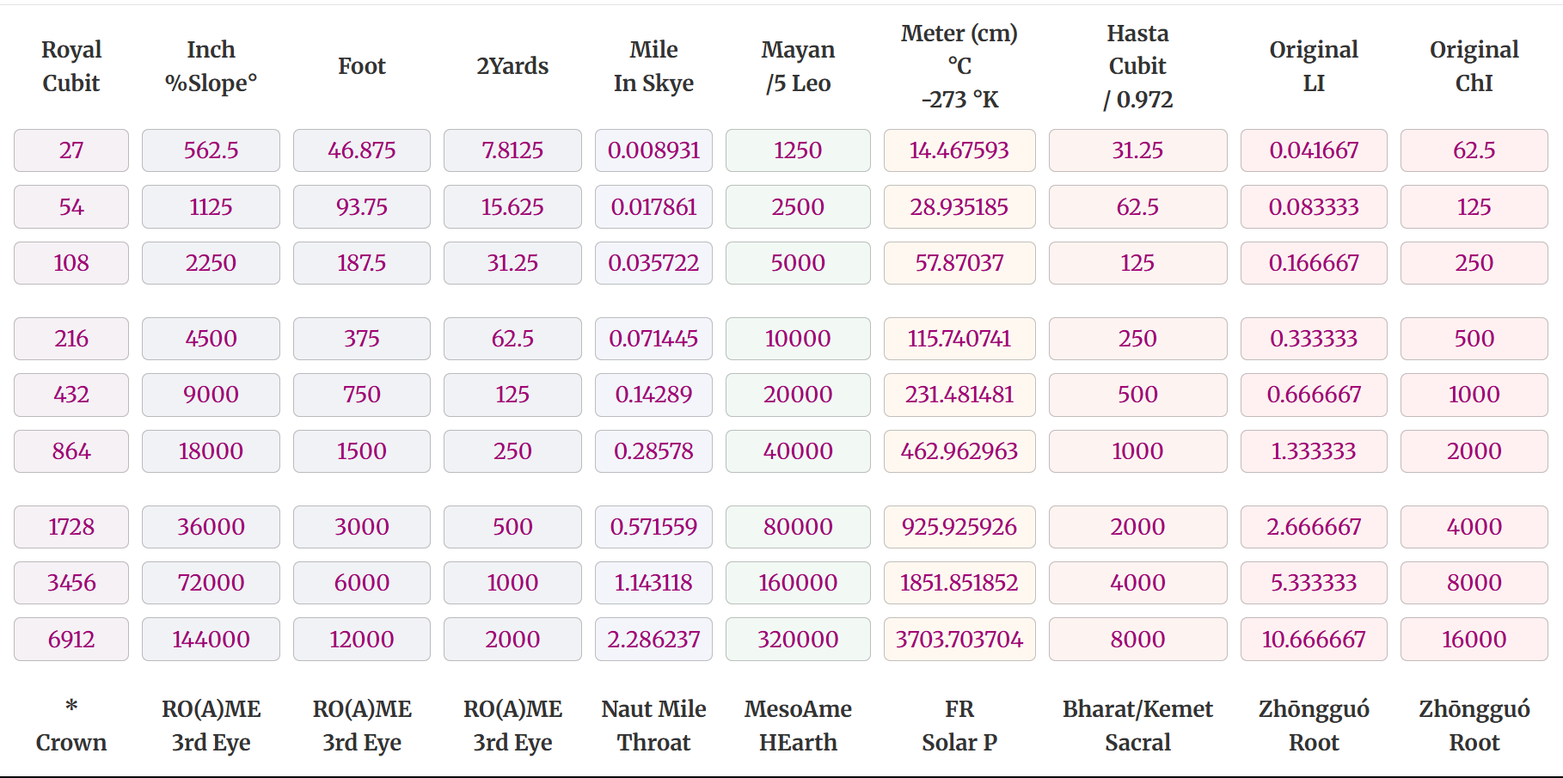
RECALIBRATION: Divine Source Light Universal Harmonics
Hyperfine coherence between these 108 primary nodes and our core energy centers ensures seamless information exchange throughout all points.
Sets of 12 Key Tones within 9 Octaves
Harmonic Octavial Doubling
HARMONIC: 27, 54, 108, 216, 432, 864, 1728, 3456, 6912
DISHARMONIC: 22.5, 45, 90, 180, 360, 720, 1440, 2880, 5760 degrees
cubit-converter.ONE
Notes:
RECALIBRATION: Divine Source Light Universal Harmonics
The perfection of our fractal Light system is reflected in the symmetry and balanced mathematical order of the platonic frequencies set within 108 key tones. Hyperfine coherence between these primary nodes and our core energy centers ensures seamless information exchange throughout all points. All of these tools are available for open use through cubit-converter.ONE.
Further detail:
These universal harmonics spiral in sets of 12 tones spanning 9 octaves(or dimensional states).
Most light numbers are without 00, or with few of them, as Zero is Empty; without angles. In ancient times 1-9 x 12 was used instead 0-10 x 10 for this reason.
This octavial pattern doubles in number series and sequence scale:
HARMONIC: 27, 54, 108, 216, 432, 864, 1728, 3456, 6912
DISHARMONIC: 22.5, 45, 90, 180, 360, 720, 1440, 2880, 5760 degrees

Slide 22
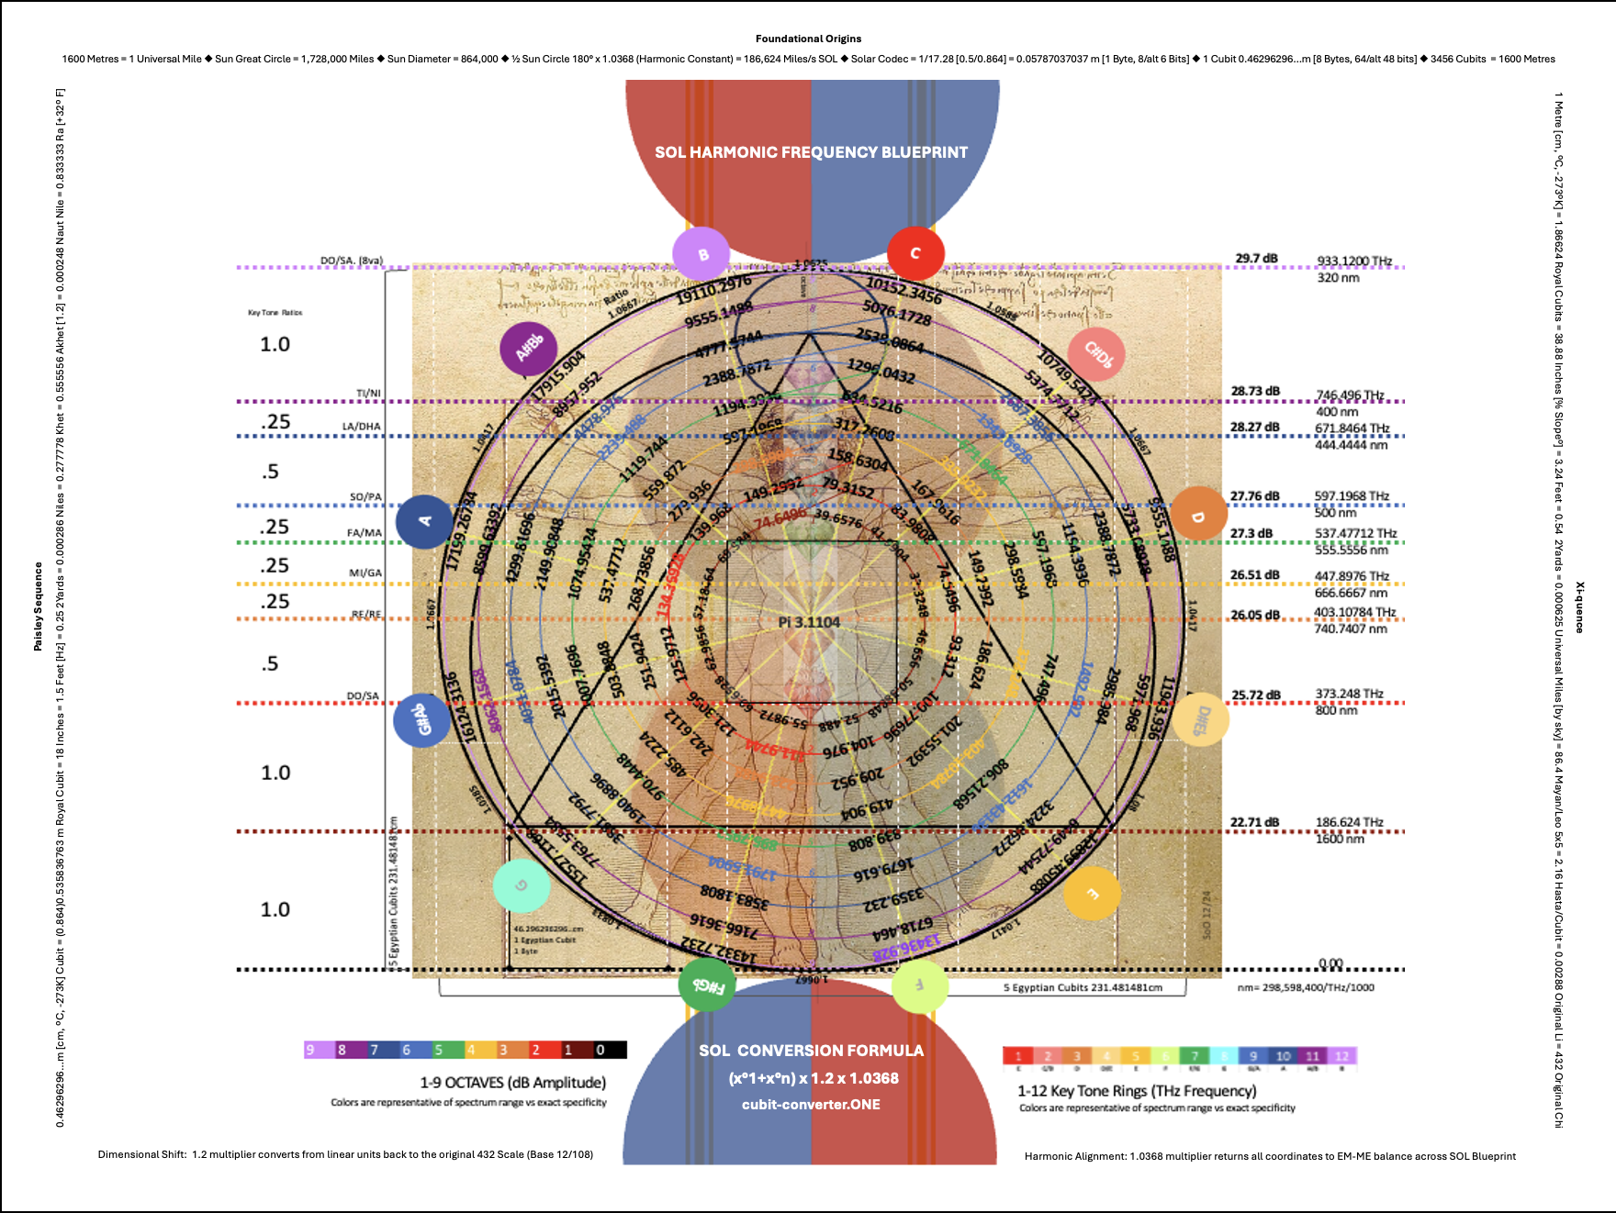
RECALIBRATION: SOL Harmonic Realignment Blueprint
This blueprint is the error corrected solar light grid correspondence map.
The operational performance within this naturally resonant Base 12 Mod 9 (108) code speaks for itself through optimized cymatic registration.
Each fractal emits a 'numeric' energy signature through multi-dimensional cubic expression.
cubit-converter.ONE
Notes:
RECALIBRATION: The SOL Harmonic Realignment Blueprint
The Blueprint is the error corrected solar light grid correspondence map. The operational performance within this naturally resonant Base 12 Mod 9 (108) code speaks for itself through optimized cymatic registration; each fractal emitting a 'numeric' energy signature through multi-dimensional cubic expression. It's time to retune our ancient instrument.
Further detail:
The blueprint consists of the spiraling sets of 12 tones over 9 doubling octaves. Accordingly, musical notation becomes apparent for cross triangulation within the natural geometric order of our Divine Light Source code language.
Meta understanding is when we remember that this ‘new’ epoch HAS ALWAYS BEEN HERE. From fractal to fractal, the frequencies must harmonize to effectively conduct the intended electromagnetic outcomes across the light chain. This is why it is critical to have the right values throughout all sequencing patterns.

Slide 23
REUNIFICATION: Green is The Golden Road Home
Macro: Base-12 Mod 9 (108) measurements reveal precise patterns and timing interconnecting M/Earth’s natural cadences with those of the Solar System at large.
ATTAINABLE CCR ACTIONS
1) Mitigation 2) Adaptation
ATTAINABLE DRR ACTIONS
1) Mitigation; 2) Preparedness 3) Response 4) Recovery
Micro:
Quantum technologies will harness measurement precision to realign with our Light, reharness gravitational control, and reawaken ONE Back into a fully coherent state of UNLIMITED ENERGETIC EXCHANGE.
Image: martialred
Image: martialred
Measurement Accuracy Yields Exponential Computational Processing Acceleration: Efficiency & Effectiveness
cubit-converter.ONE
Notes:
REUNIFICATION: Green is The Golden Road Home
Our foundation is energetically based, therefore material measurements must follow to gain and maintain energetic coherence.
By embracing this telescopic leap, unified science will be armed with meaningful correlation between numbers, adding quantifiable certainty to assessments and solutions forwarding collective renewal.
Detailed information regarding our advocacy positions can be found in the presentation notes accompanying this slide.
Further detail:
From a Macro Lens: Base-12 Mod 9(108) measurements reveal precise patterns and timing interconnecting M/Earth’s natural cadences with those of the Solar System at large, ushering in:
ATTAINABLE CCR 1) Mitigation 2) Adaptation
ACCURATE DRR ACTIONS 1) Mitigation 2) Preparedness 3) Response 4) Recovery
From a Micro Lens:
Quantum technologies will harness measurement precision to realign with our solar directed light stream, reharnessing gravitational control, and reawakening all ONE Back into a fully coherent state of UNLIMITED ENERGETIC EXCHANGE.
With measurement uncertainty eliminated, systemic clearing will prevail. Our many valuable resources can be redirected to the accelerated renewal of our light-powered infrastructure.
Seamless Communication Zero-latency signaling allows maximised resource focus on universal connectivity for All.
Seamless Exchange Legal metrology transitions to Trade metrology, focusing on servicing the global system through optimised circular exchange across borderless light speed superhighways.
Seamless Record Blockchain transformation focuses on realisation of traceable, transparent records through realignment with the universal, absolute optical-encoded light system parameters; instantaneous time stamping and cross-balancing across all galactic coding.
Seamless Service All global alliances will enable accelerated reformation through focused, quantifiable, accountable actions waterfalling from the foundational remapping. Service to ONE in All.
Original Valuations – Precise Actions – Highest Order Outcomes
CCCRdg advocacy positions:
CCCRdg advocates that both Habitat 3 and upcoming 4 are the opportunity to advocate for "NetZero carbon" urban development, for example, by limiting uncontrolled consumption, meeting the challenge of the "carbon budget" to ensure that global temperature rise remains within safe boundaries, and establishing and protecting greenbelts and urban growth boundaries as a means to limit growth and preserve open space. Also championed, the importance of highlighting scientific data in the next New Urban Agenda. Habitat 4 Pollution must stop everywhere.
CCCRdg advocates that the next New Urban Agenda should include the definition and protection of 'Greenbelt, in order to ensure that cities are "green, compact and resilient", giving the benefits of the greenbelt to, "ensure that urban dwellers have access to countryside, with consequent educational and recreational opportunities; increased resource efficiency; improved air quality and cities resilient to flood, heatwaves and natural hazards.
CCCRdg advocates for the inclusion of urban topography in the next New Urban Agenda, as a strong determinant of a city's storm resilience and disaster response to other urban extreme climatic events.

Slide 24
REUNIFICATION: Forward Together Hand in Hand
There is a clear path back to unrestricted energetic freedom through realignment with our Sun’s solar directed energy stream.
Supported through AI acceleration, the following conversions initiate seamless transition back to our naturally harmonic state aligned with the universal solar stream at 648,000,000 Cu/s; 300,0000,000 Metres/s.
1 Cu = 18 Inches
4 Cu = 2 Yards
1 Foot = 1/3.24 Metre
4.32 Original Chi = 1 Metre
1 Rational Mile = 1600 Metres
1 Universal Mile = 1620 Metres
Reinstitution of our rational 0.462962962 m Cubit as the Global Primary Standard realigns the SI Base Units with the 0.05787037037 m Solar Codec. The Square Cubit Unit (Cu2) measures the area of a square with sides equaling 1 Metre long (2.16 Cubits).
Cu^2
x4
2.16 Cu
2.16 Cu
Image: Kwizera Emmanuel
cubit-converter.ONE
Notes:
REUNIFICATION: Forward Together Hand In Hand
There is a clear path back to unrestricted energetic freedom through realignment with our Sun’s solar directed energy stream.
Reinstitution of our original Cubit (Cu) as the Global Primary Standard realigns the SI Base Units with our Solar Codec.
It is individual passion and expertise, working in collaboration that will fuel this rising ship as all sectors gain exponential advancement. We look forward to working hand in hand in pursuit of accelerated collective peace and harmony.
Endless Blessings to All ONE. Eternity Awaits.

Slide 25
Carl E. q-bit@cccrdg.org.uk
cubit-converter.ONE
Jessica N. pi@cccrdg.org.uk
cubit-converter.ONE
Notes:
Breathe in the Sun. Our Divine Light Stream Is Returning All ONE to Full Bloom Once Again.
Shared in collaboration through the Stars of Orion:
Carl Emerson-Dam
Jessica Noelle Laesch
Louise Isobel Evans

