Slide 1
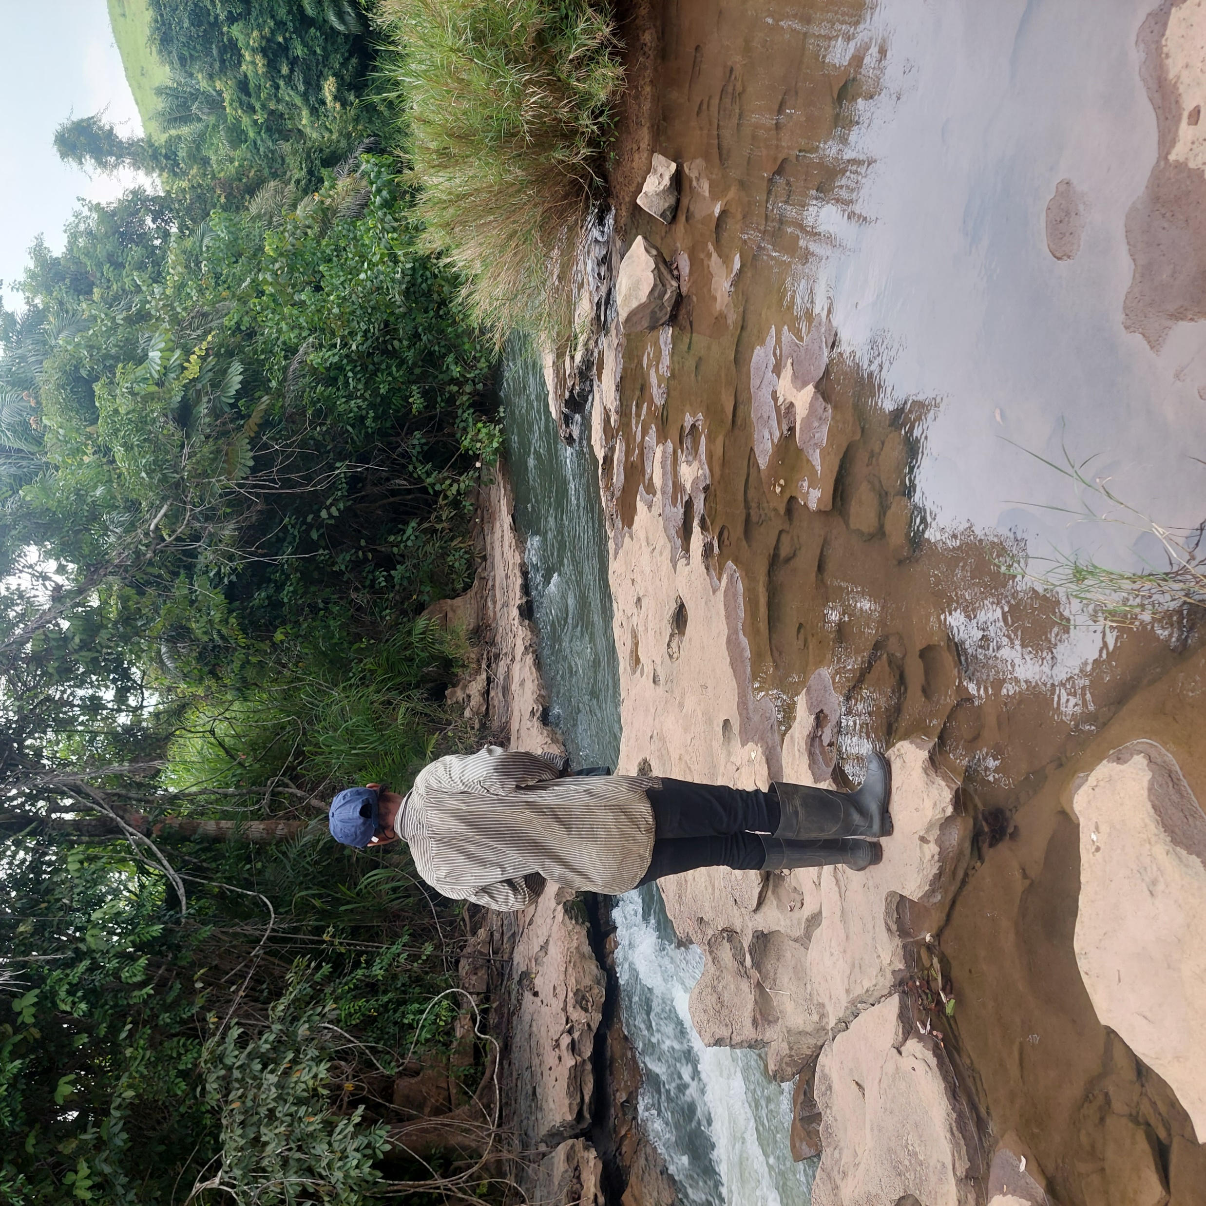
Chemical signature and structural study of a Madingou hydrokarst system, southwest of the Republic of Congo.
SAMBA Prefina ^{1,2} ; BAZEBIZONZA Nicy ^{1,2,4} ; NKODIA Hardy1 ^{1,2} ; BOUDZOUMOU Florent ^{1,3} ; ARFAOUI Imen ² ; LAHOGUE Pascale ²
1.Marien Ngouabi University, Faculty of Sciences and Techniques, Brazzaville, Republic of Congo
2.Royal Museum for Central Africa, Department of Earth Sciences, Geodynamics and Mineral Resources, GeoRes4Dev Project, 13 Leuvensesteenweg, B-3080, Tervuren, Belgium
3.Institute of Research in Exact and Natural Sciences, Brazzaville, Republic of Congo
4.National Geographic Institute, Brazzaville, Republic of Congo
© N. Bazebizonza

Slide 2
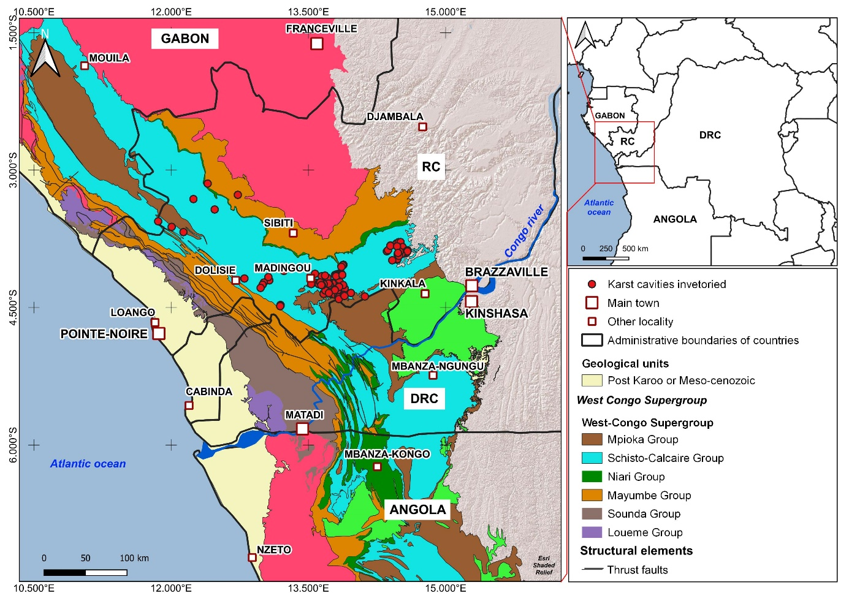
Location of the study area
Karst in the Republic of Congo developed in Niari Basin

Slide 3
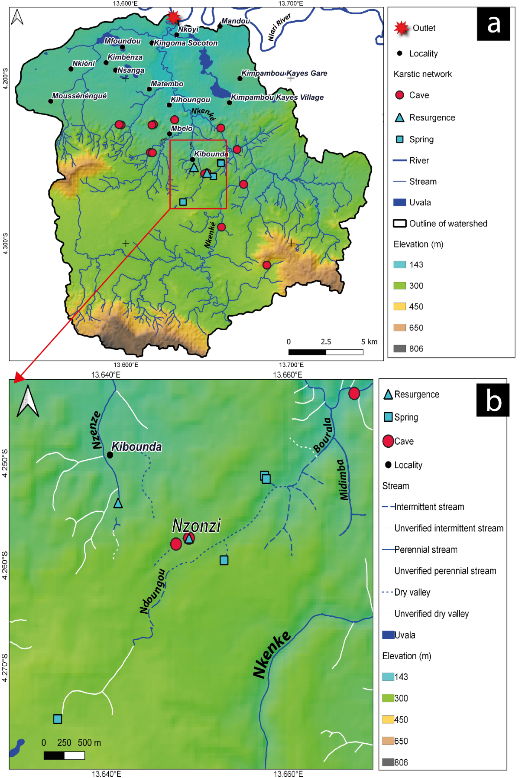
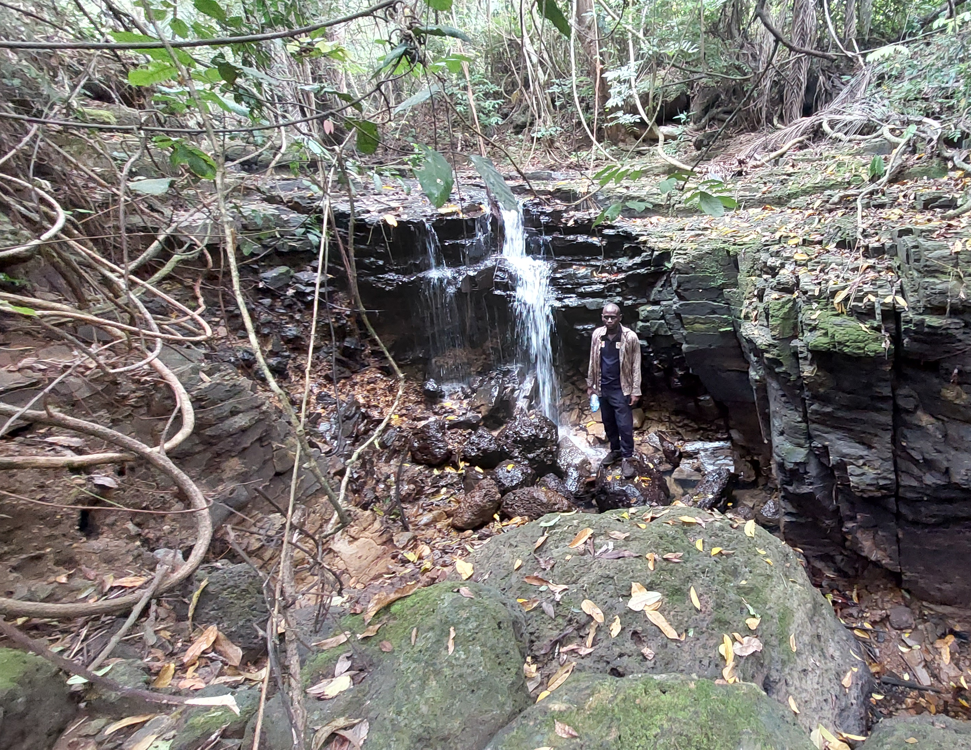
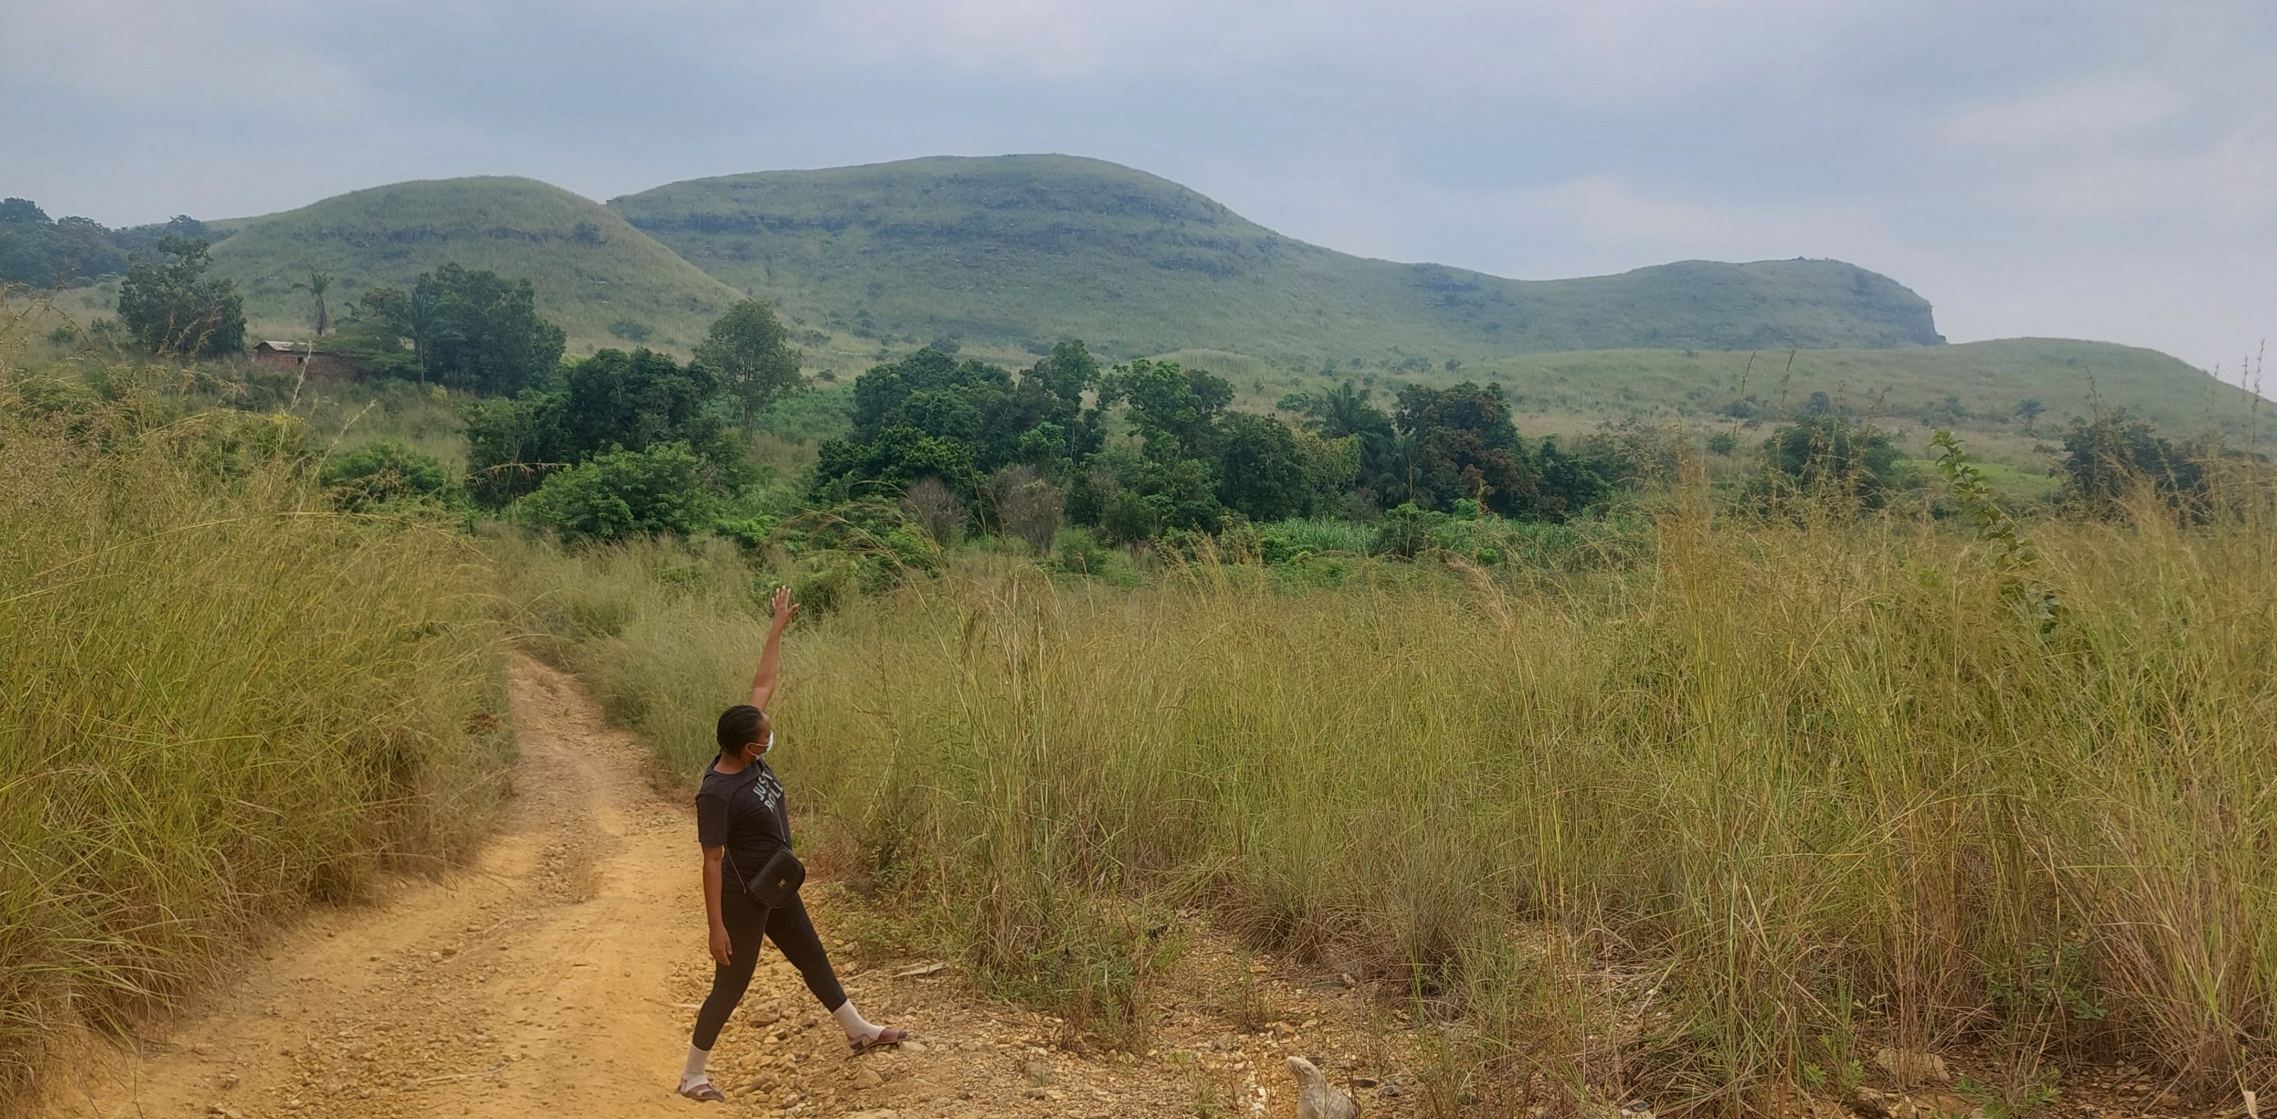
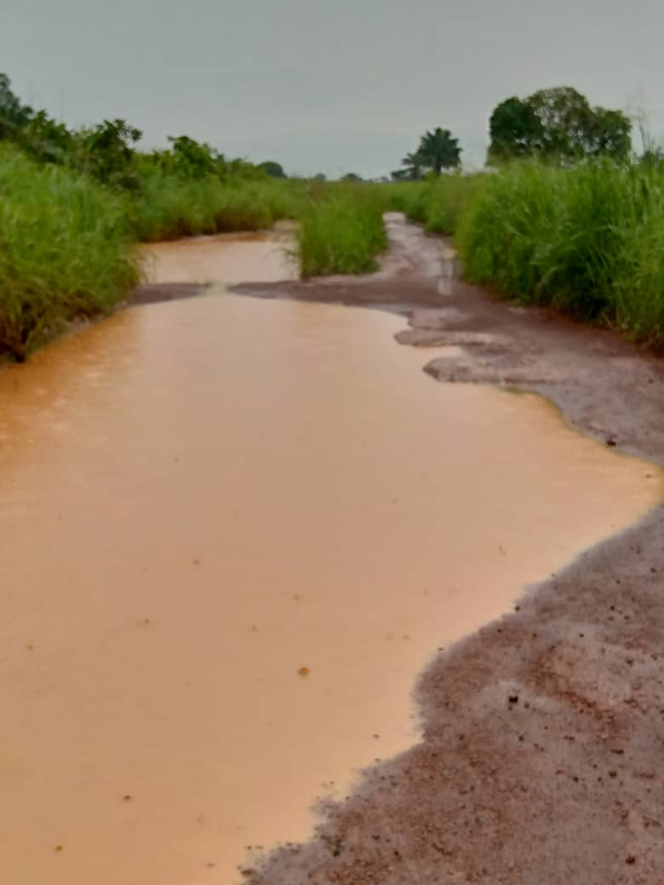
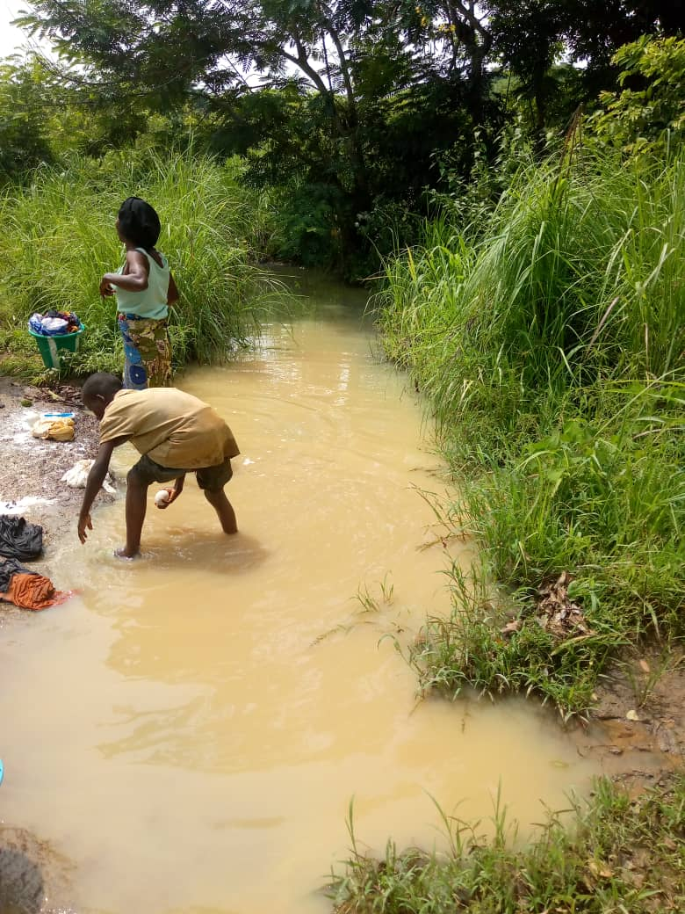
swallow hole
2
Uvala
1
1
kegelkarst
Malembe
Madingou-Kibounda way
E
3
3
Intermittent stream
2
Figure 1. (a) Hydrokarstic network map of Madingou, (b) Simplified karst network map of Kibounda

Slide 4
Climate context
Figure 1. Average monthly rainfall at the Mouyondzi synoptic station
(Source ANAC, 2021-2024)

Slide 5
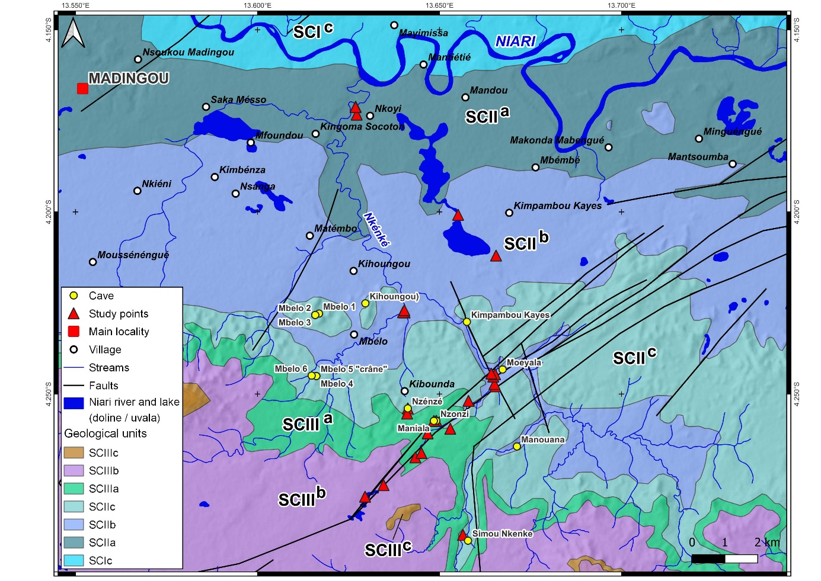
Geological context of the area
Explored points are within SCII and SCIII levels of the Schisto-Calcaire Group.

Slide 6
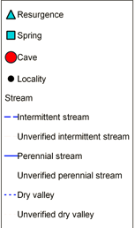
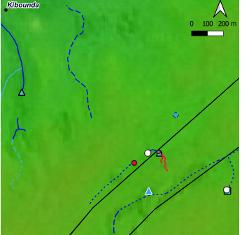
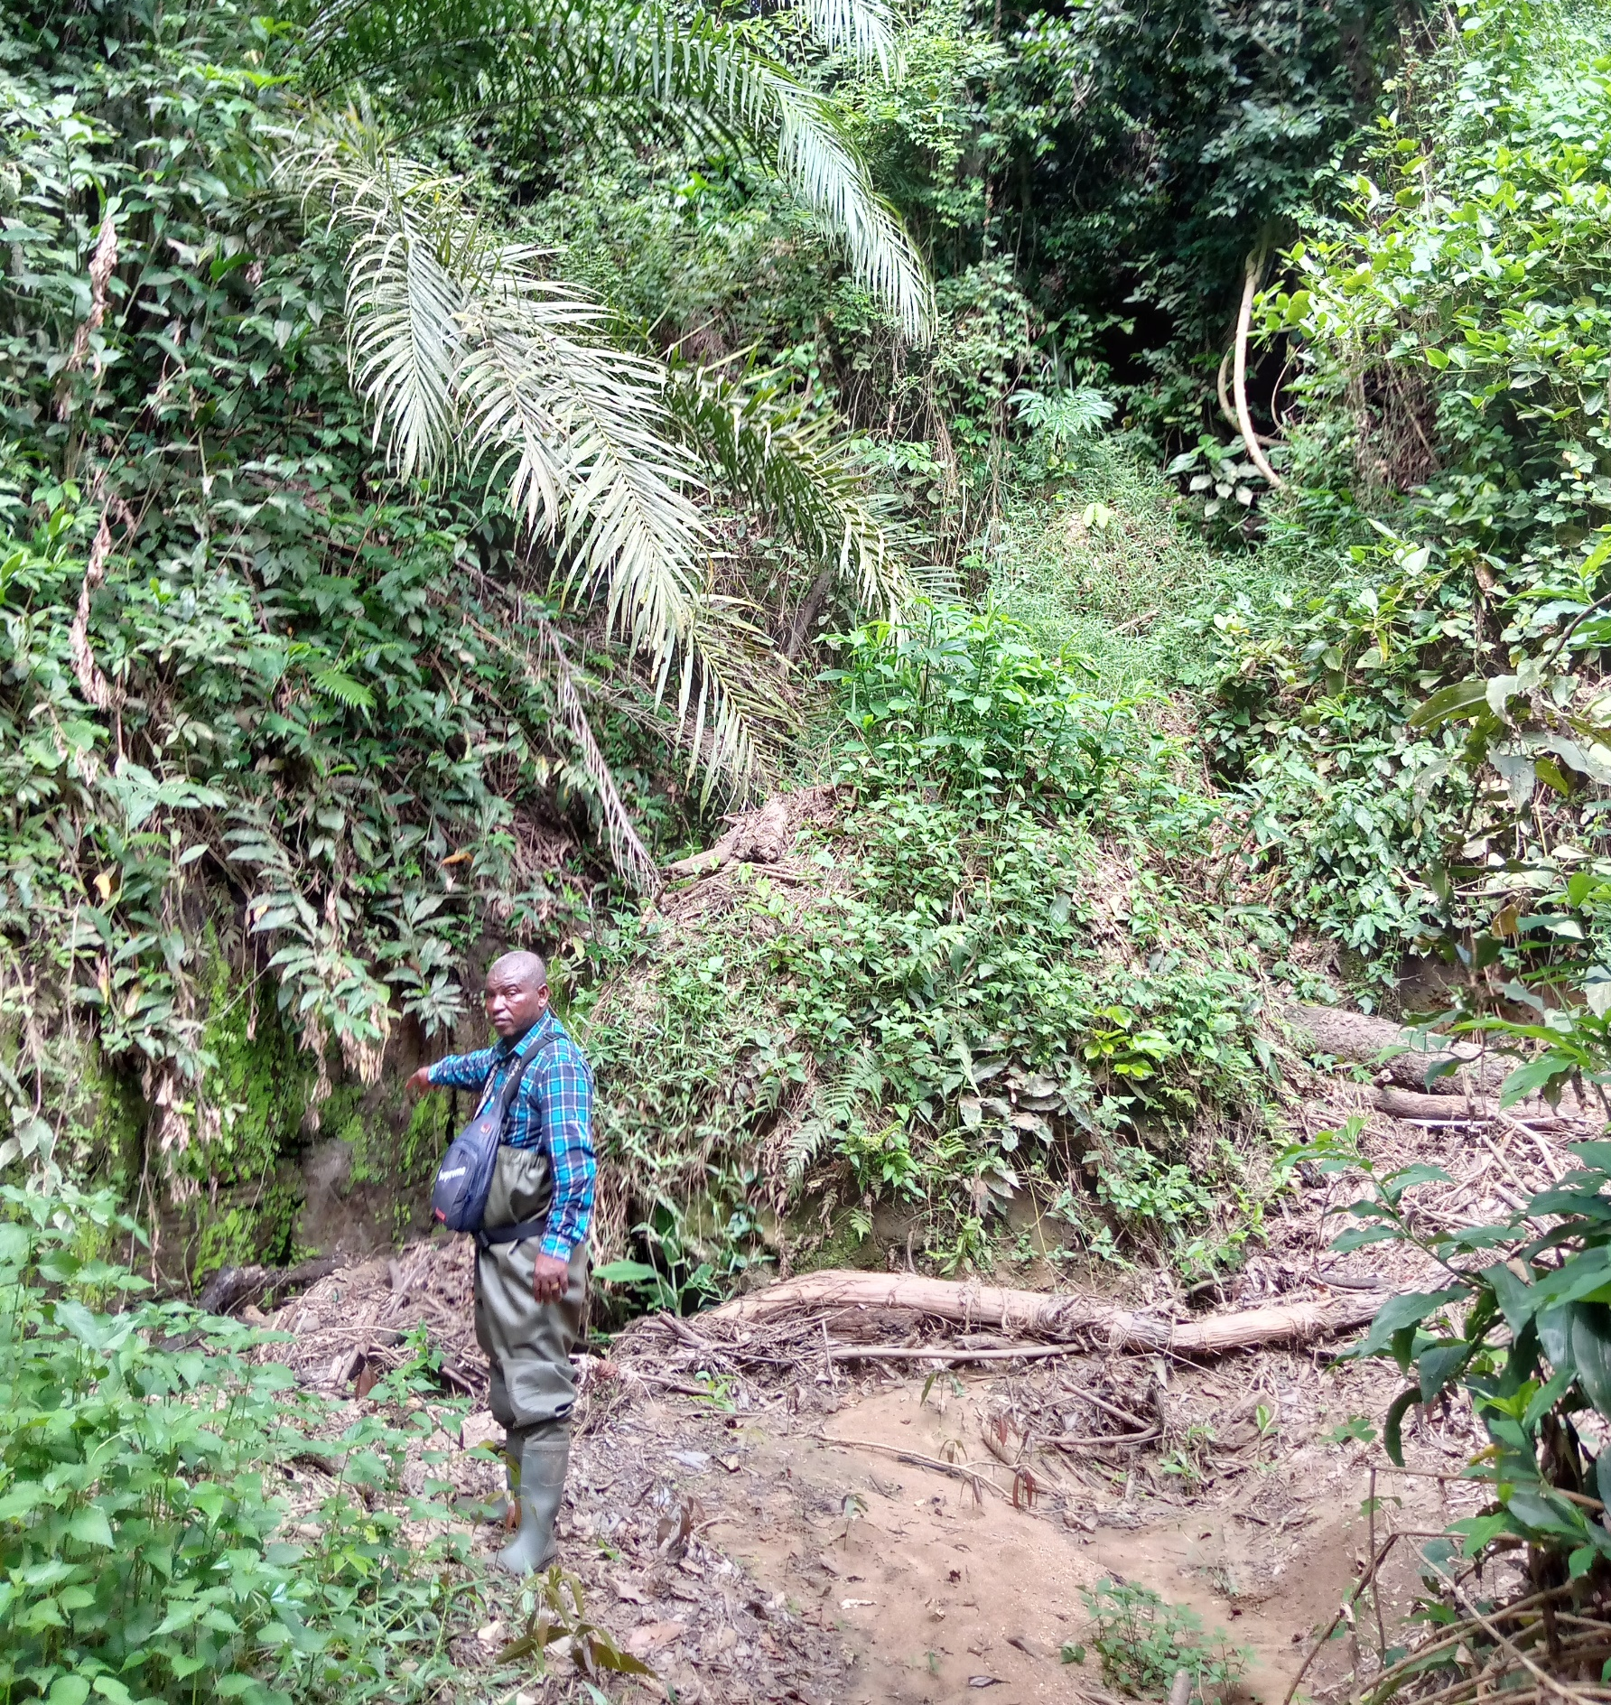
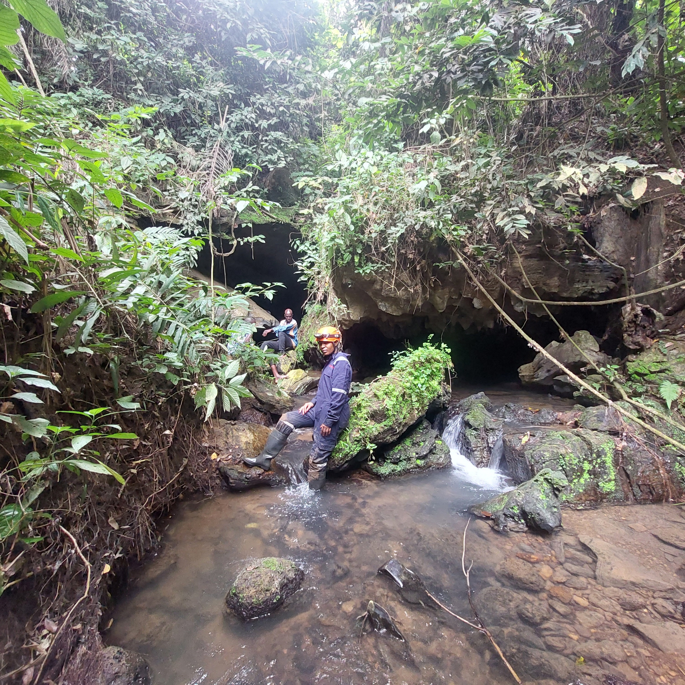
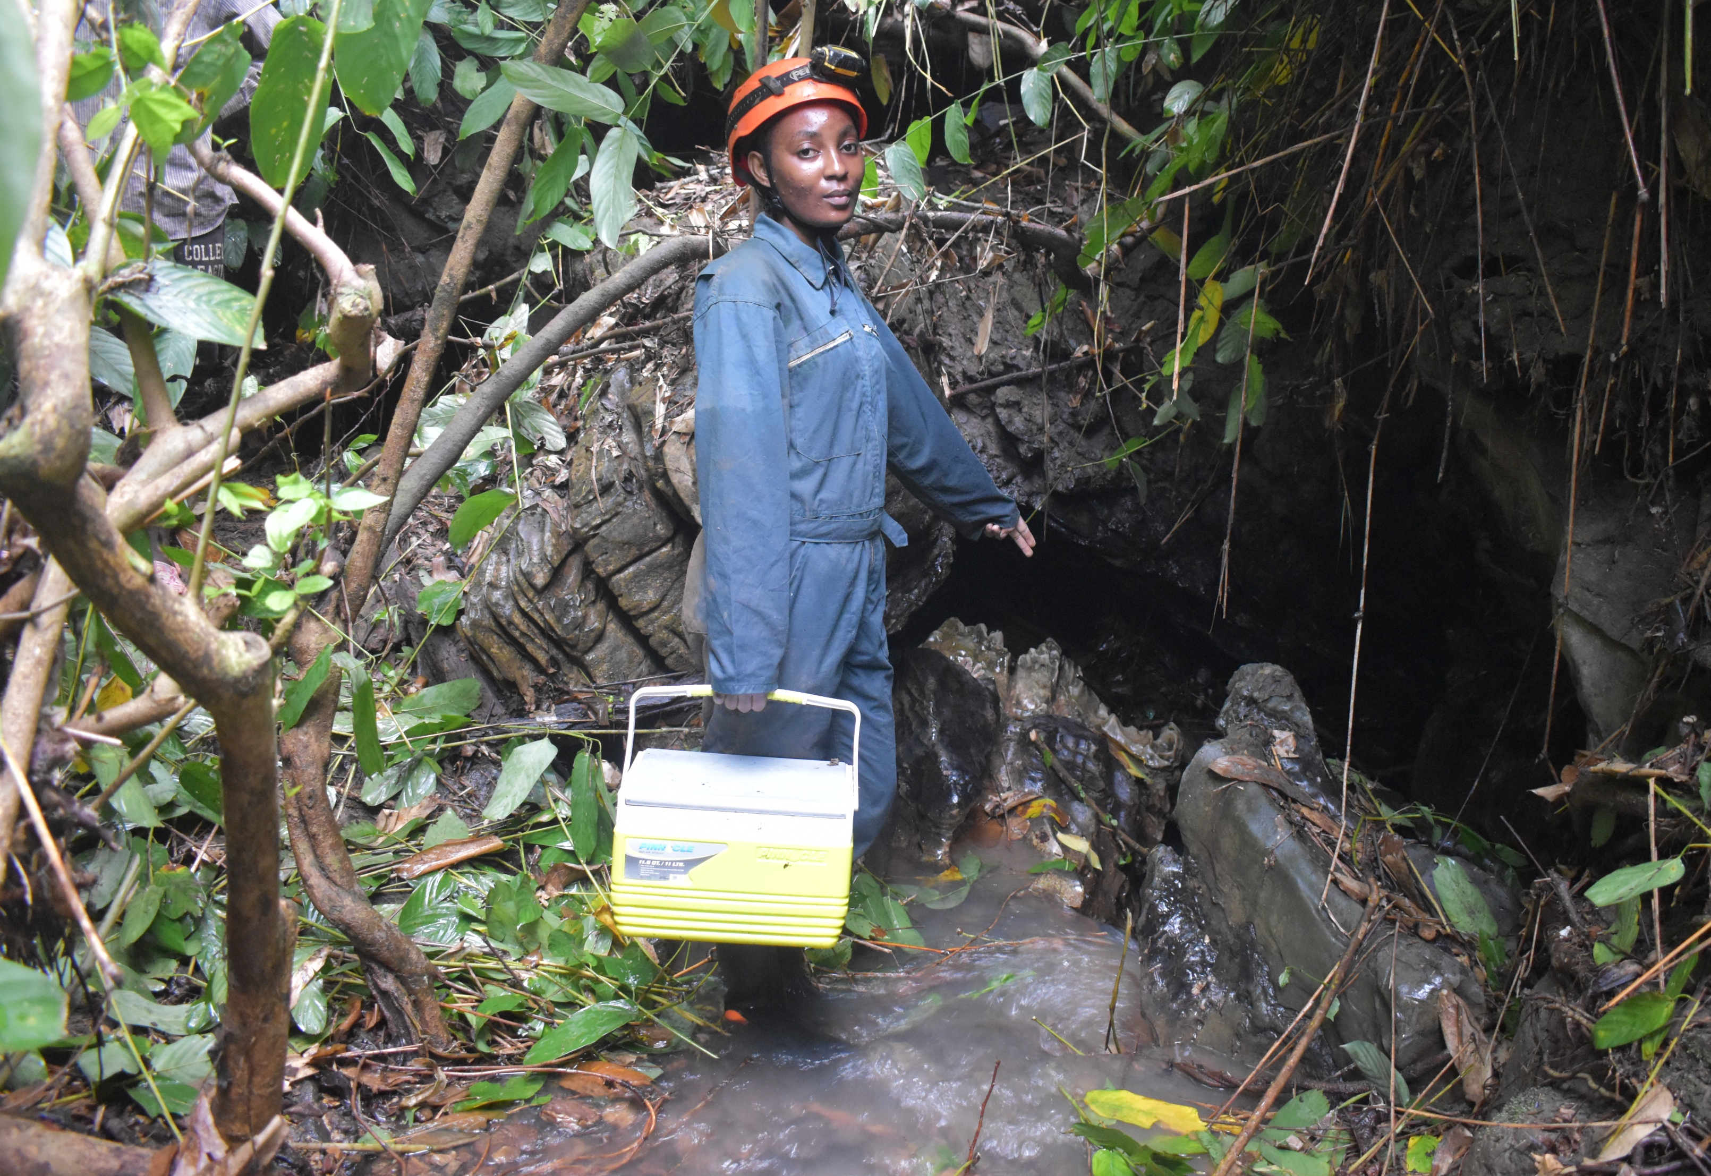
Problem of the Nzonzi karst system
1 : Manhole Probable
Nzenze Resurgence
2: Nzonzi Resurgence
3
2
1
Tsinguidi spring
Ndoungou stream
3: Maniala sink

Slide 7
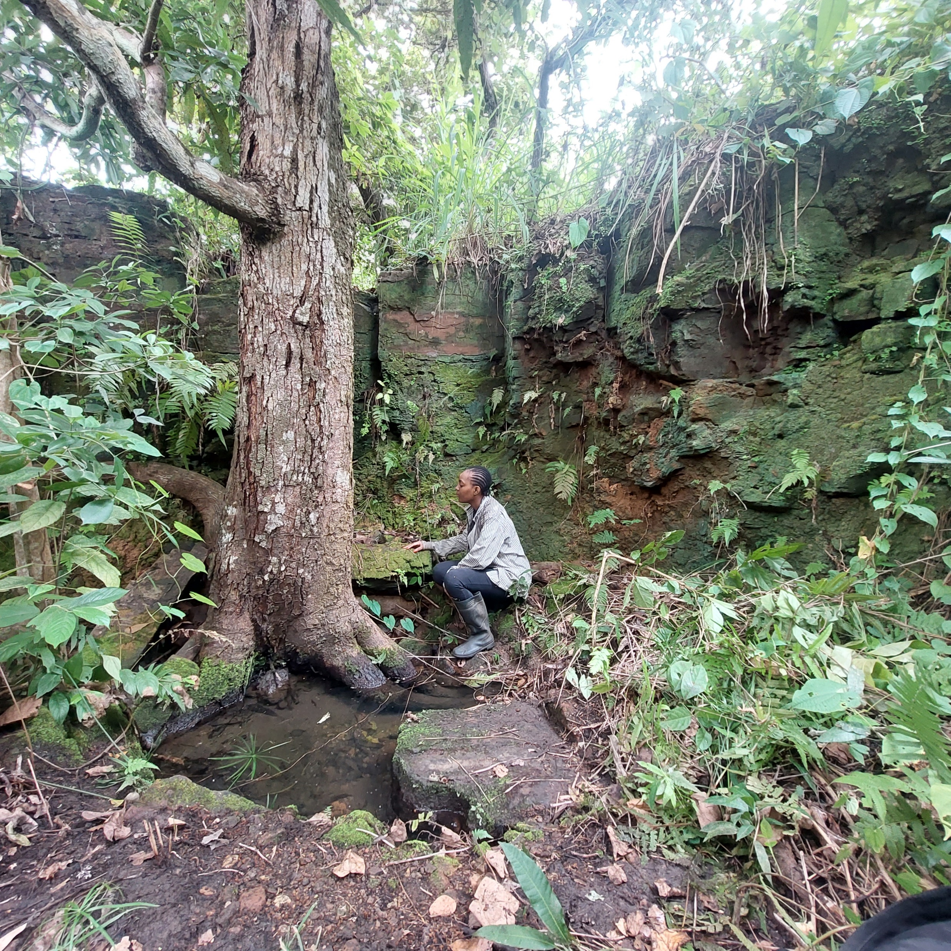
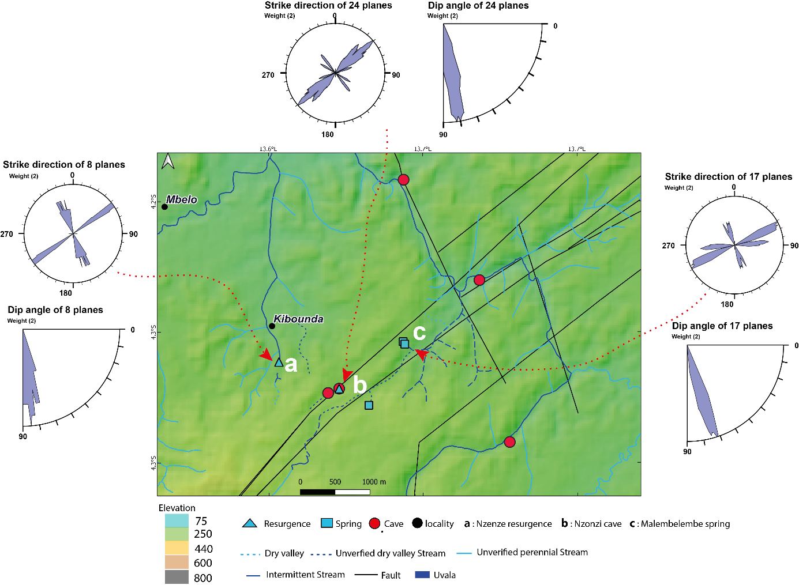
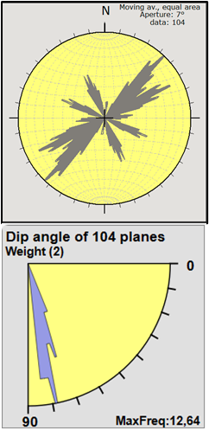
Structural context of Kibounda karst system
Malembe spring
c
Maniala sink
Figure . Structural map of Kibounda

Slide 8
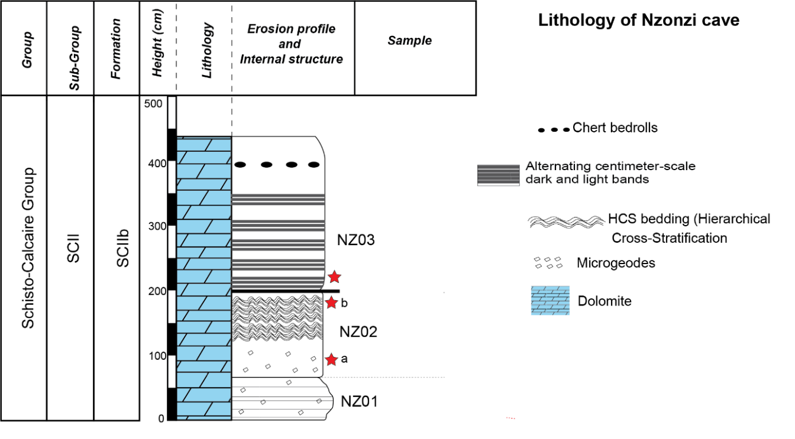
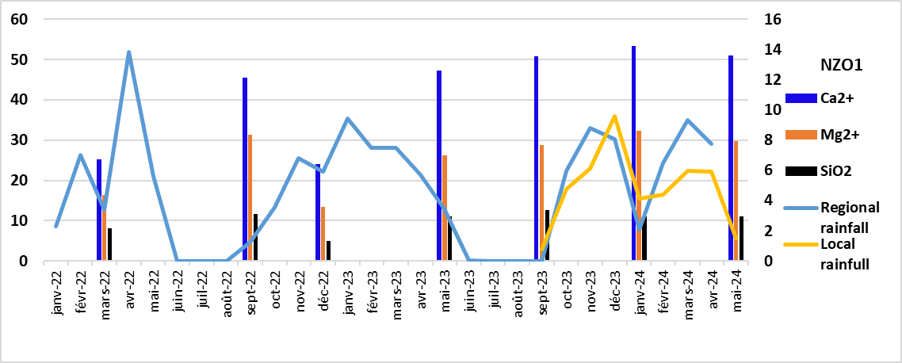
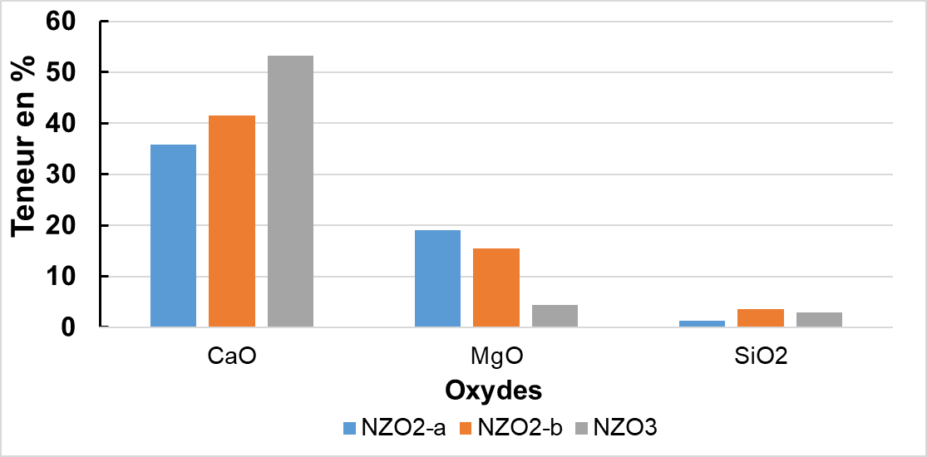
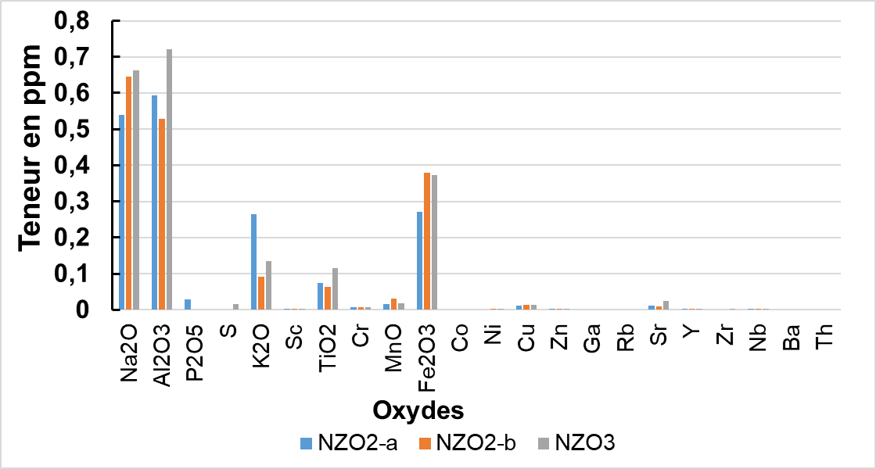
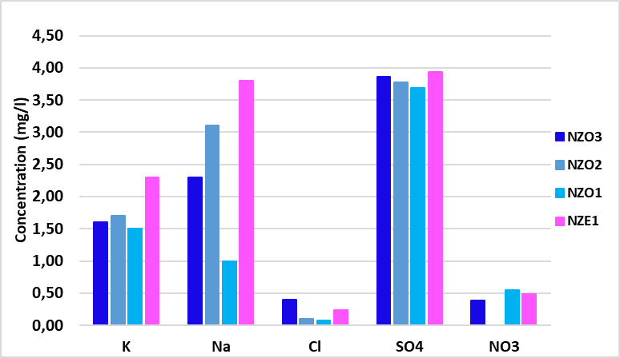
A
a
B
b
NZO3: Upper galery
NZO2 : Lower galery
NZO1 : Nzonzi resurgence
NZE1 : Nzenze resurgence
c
d
Figure. (A) Lithology, (B) geochimistry of rocks and chemical composition of water

Slide 9
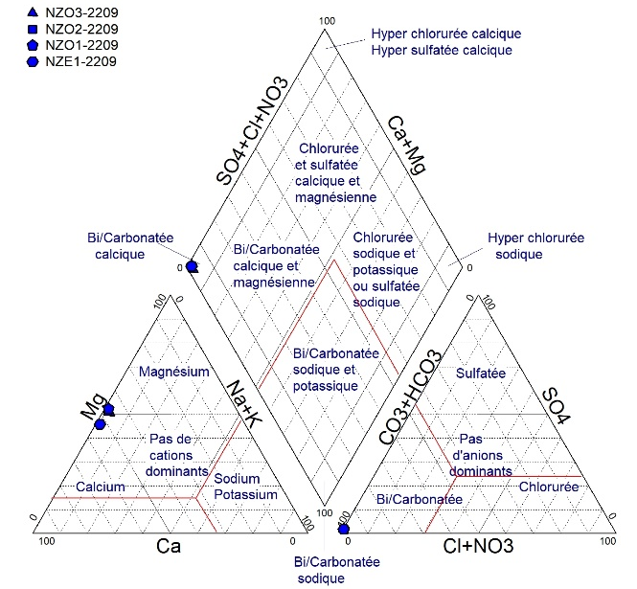
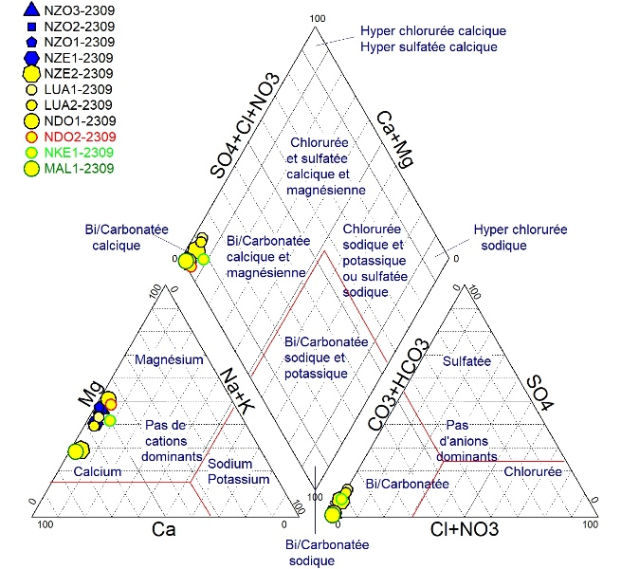
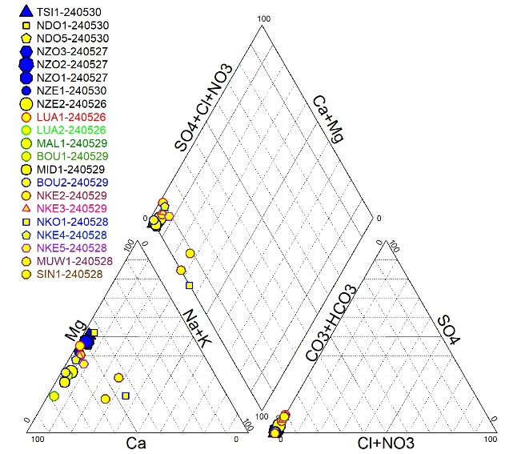
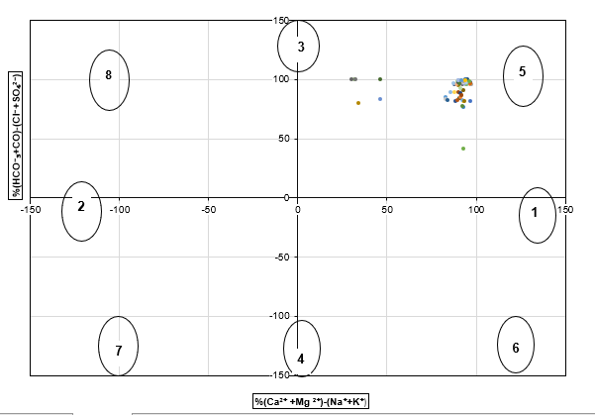
Septembre 2022
Septembre 2023
C
A
2
1
Mai 2024
Figure. (A) Piper Diagram ; (B) Chadha Diagram; (C) Relation Sr/Ca Vs Mg/Sr
B

Slide 10
Conclusion
Piper diagram and Sr/Ca vs. Mg/Ca ratios show that Nzonzi, Ndoungou, and Tsinguidi samples are similar. Malembelembe, Bourala, and Midimba also display similar behavior. This suggests that waters with similar chemistry flowed through reservoirs of the same nature. Piper and Chadha diagrams identify limestone and dolomite dissolution as the main process controlling water chemistry.
Ca and Mg are dominant, followed by SiO₂.
Structural features guide water movement, both at the surface and underground. Fractures connect swallow holes, springs, and resurgences. This is seen at Maniala, Ndoungou, and Malembelembe swallow holes, and at Nzonzi resurgence.

Slide 11
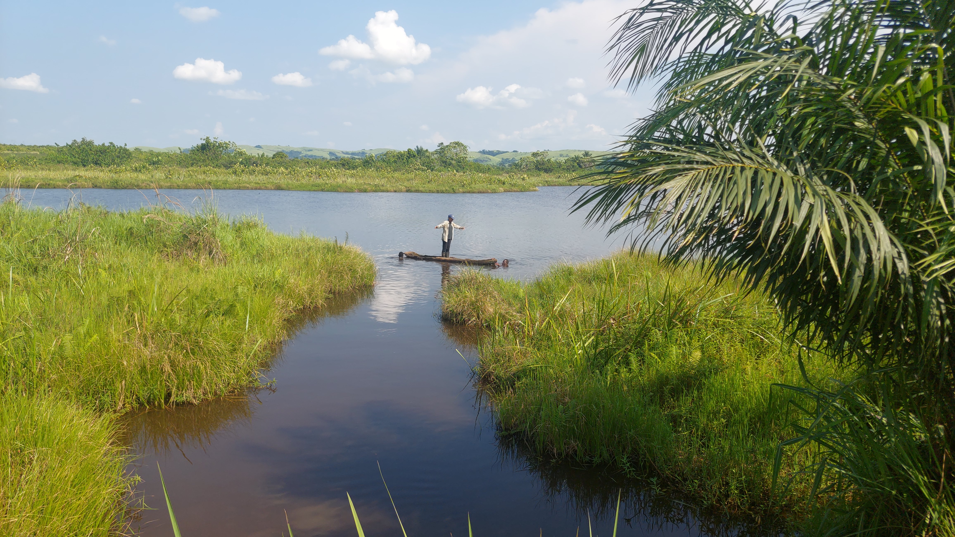
Thank you for your attention!!!

