Slide 1



Combined (DAS/Seismometers) Seismic Analysis of an Underwater Explosion in the Baltic Sea
Aurélien Mordret¹, Tine Larsen¹, Peter Voss¹, Emil Jensen¹, Trine Dahl-Jensen¹, Nicolai Rinds¹, Björn Lund², Michael Roth², Stefanie Donner³, and Andreas Steinberg³

Slide 2
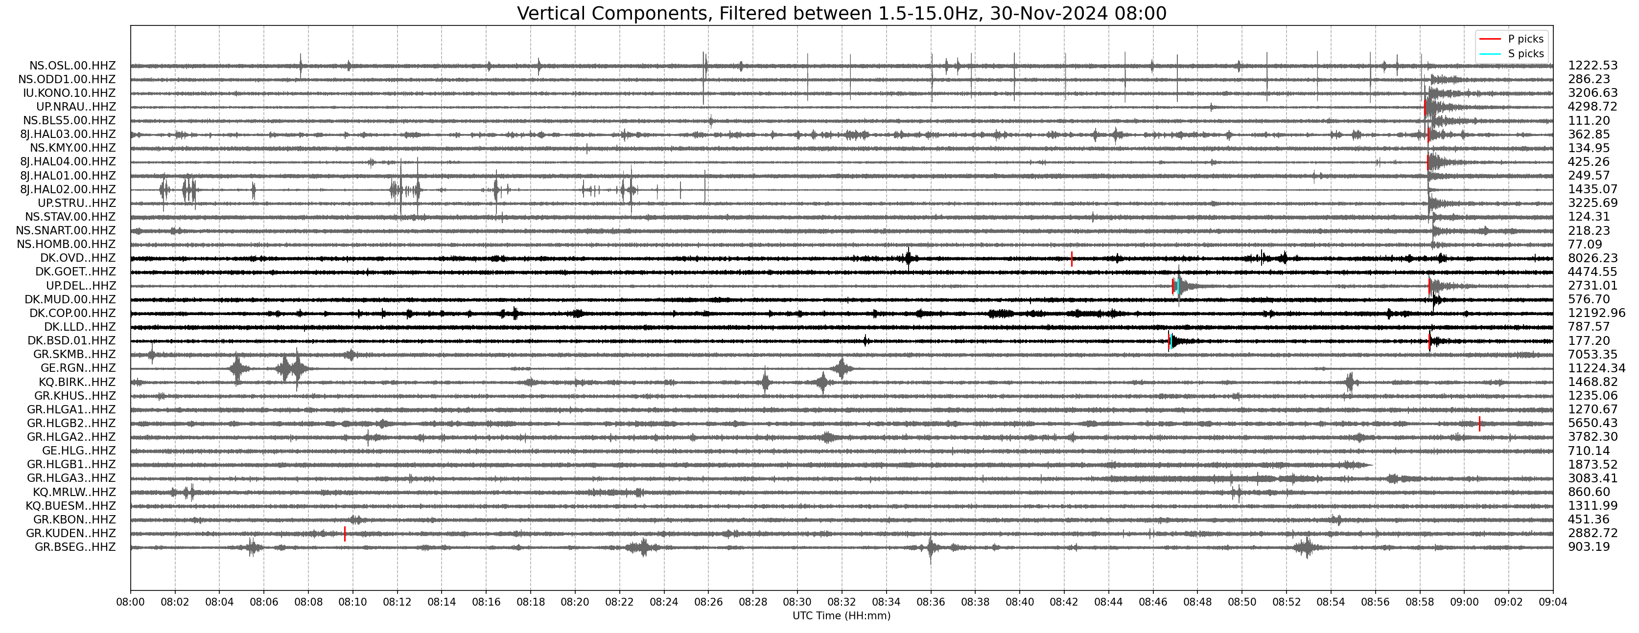
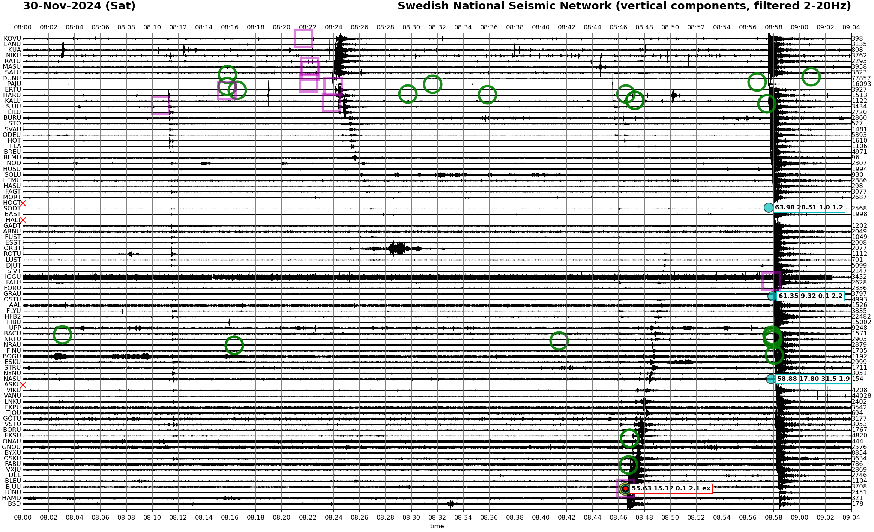
Regional detection
Danish seismic network (black) and neighboring countries (grey)
M5.7 earthquake in Japan
Clear difference in event detectability between Denmark and Sweden networks

Slide 3
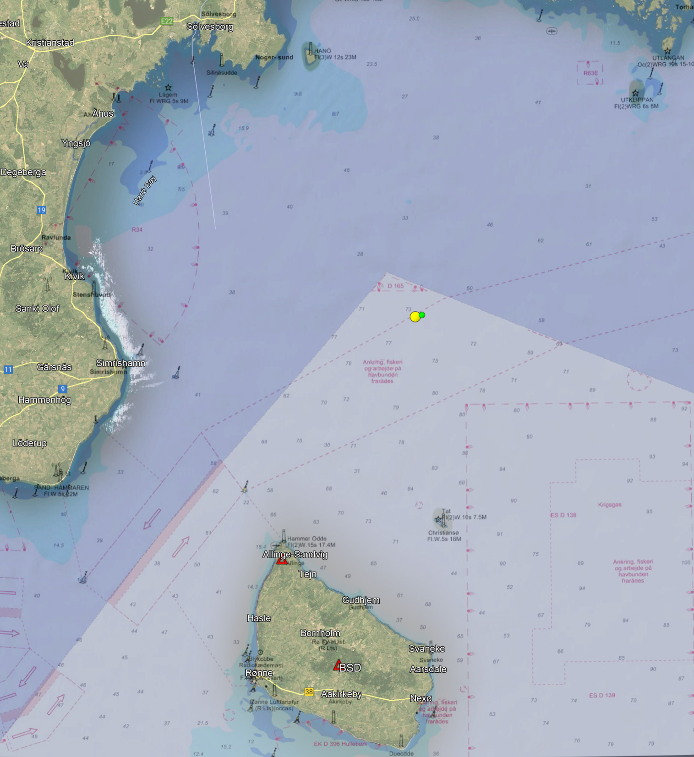
Location and origin-time solutions
GEUS solution (green dot):
LAT = 55.628
LON = 15.134
Depth = 0 km
Magnitude = 1.2
T0 = 08:46:31
SNSN solution (yellow dot):
LAT = 55.6255
LON = 15.1167
Depth = 0.1 km
Magnitude = 2.12
T0 = 08:46:31

Slide 4
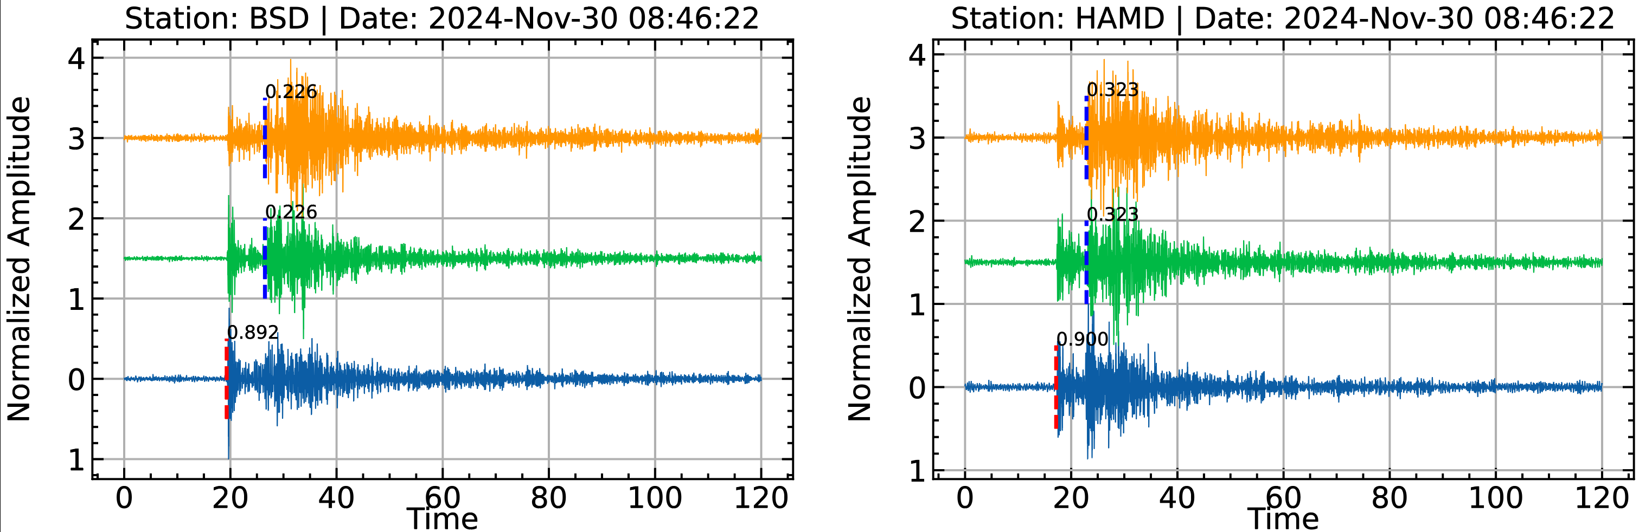
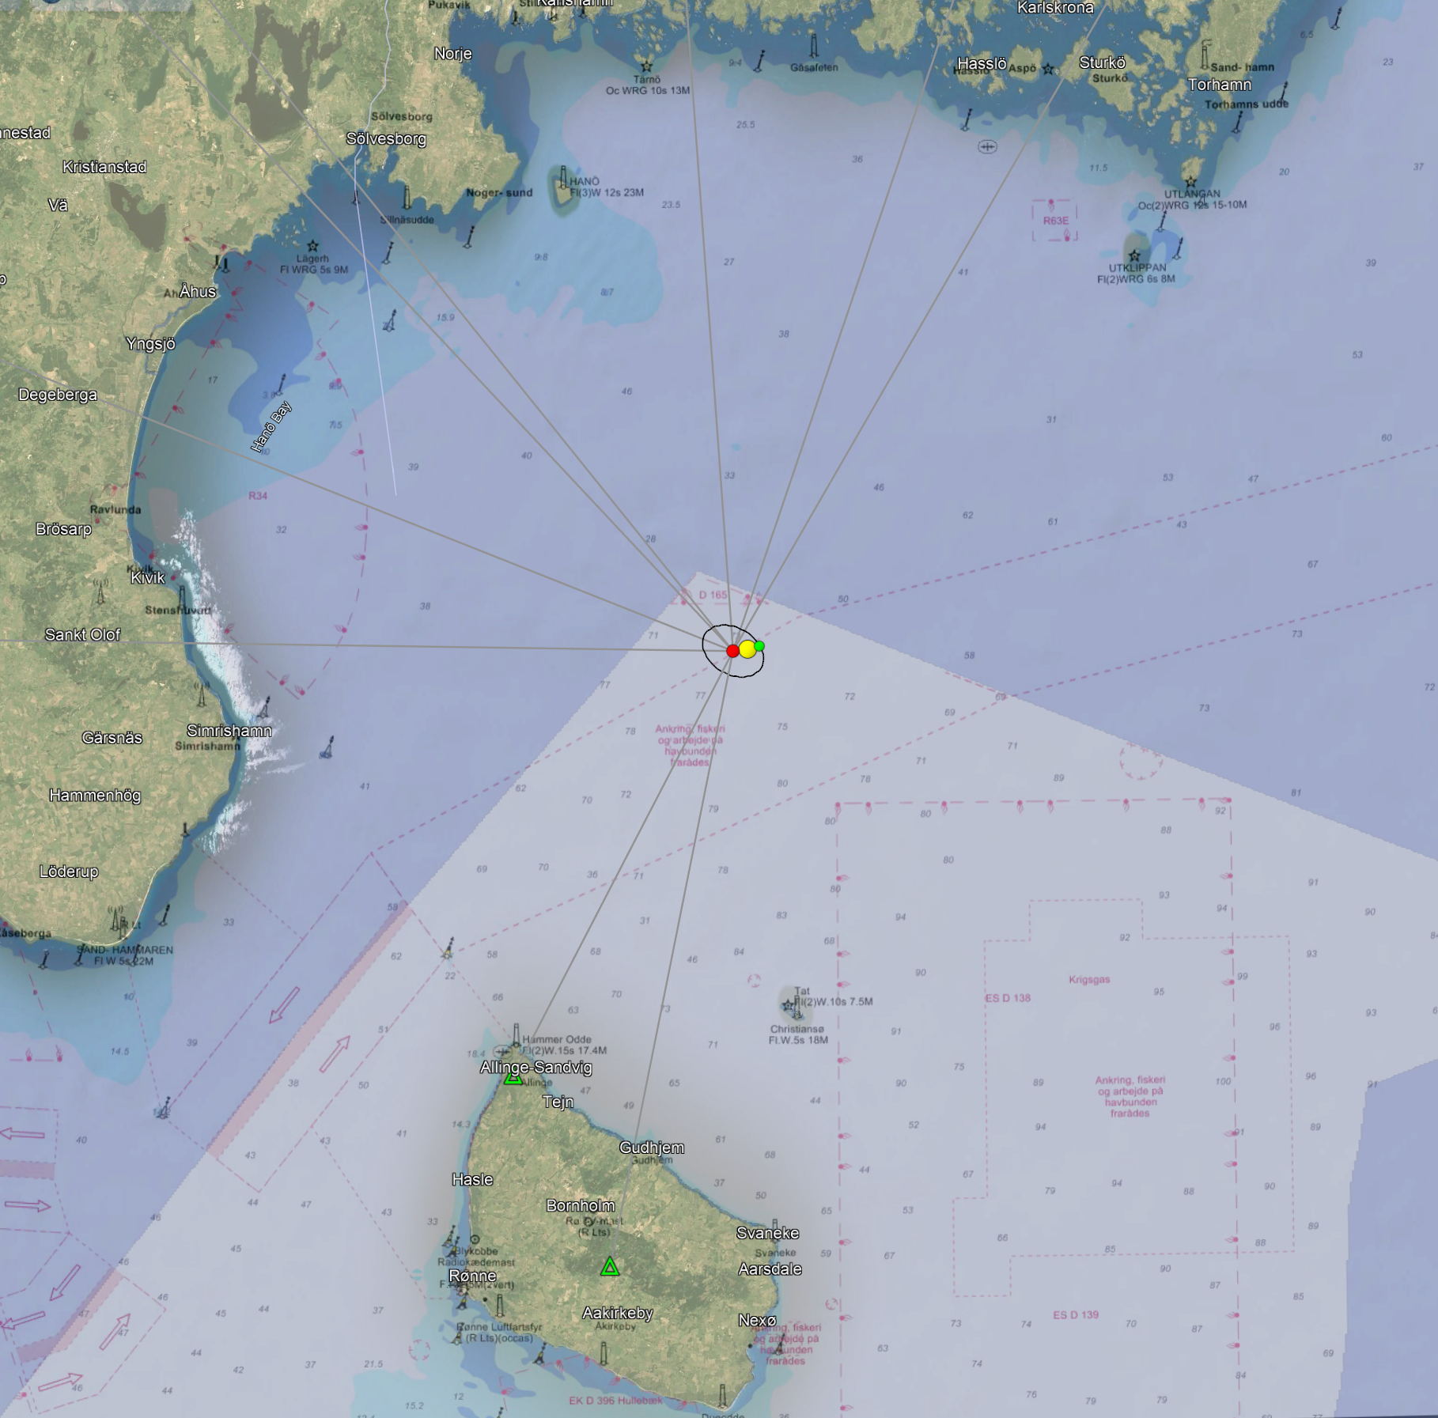
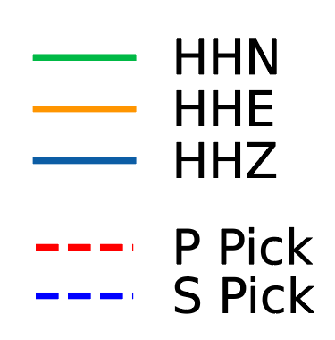
Location and origin-time solutions
2.5 – 10 Hz
GEUS solution (green dot):
LAT = 55.628
LON = 15.134
Depth = 0 km
Magnitude = 1.2
T0 = 08:46:31
SNSN solution (yellow dot):
LAT = 55.6255
LON = 15.1167
Depth = 0.1 km
Magnitude = 2.12
T0 = 08:46:31
Machine-Learning based solution (red dot)
LAT = 55.624
LON = 15.095
Depth = 3.4 km
Magnitude = **
T0 = 08:46:31
6 km
PhaseNet “original”
Using Seisbench

Slide 5
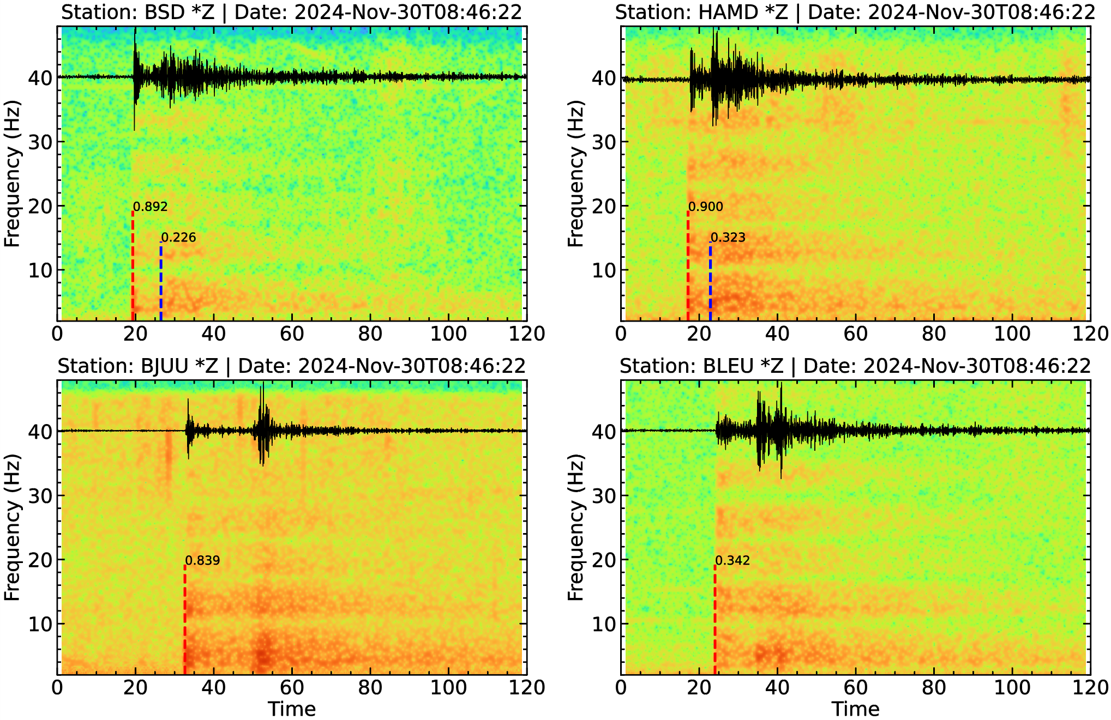
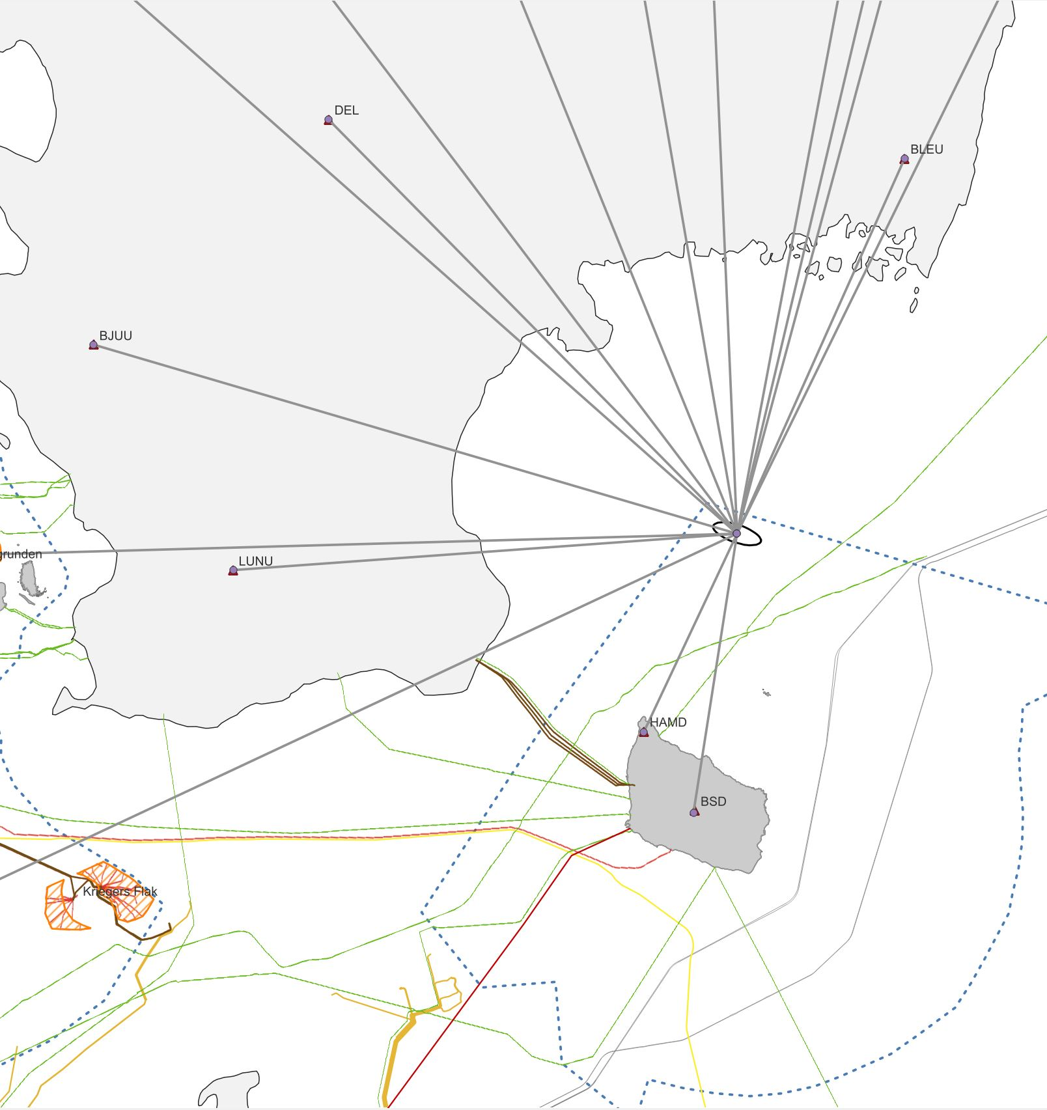
Spectral Analysis
Clear spectral signature at all stations
Characteristic resonance bands from water reverberation

Slide 6
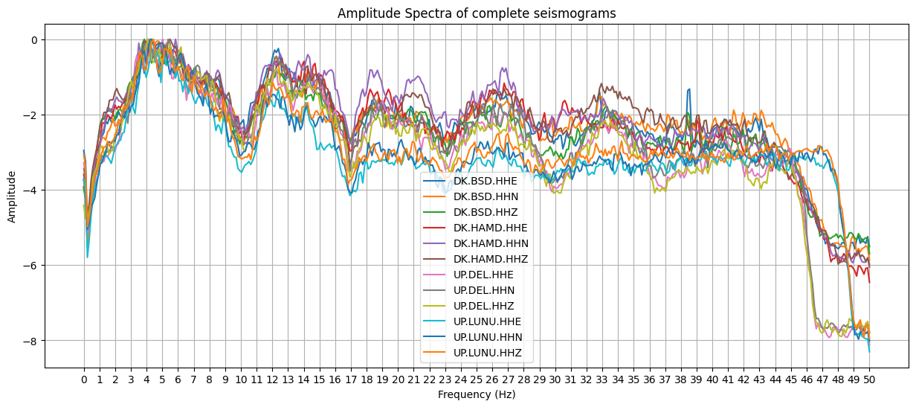
Spectral Analysis
Clear spectral signature at all stations
Characteristic resonance bands from water reverberation

Slide 7
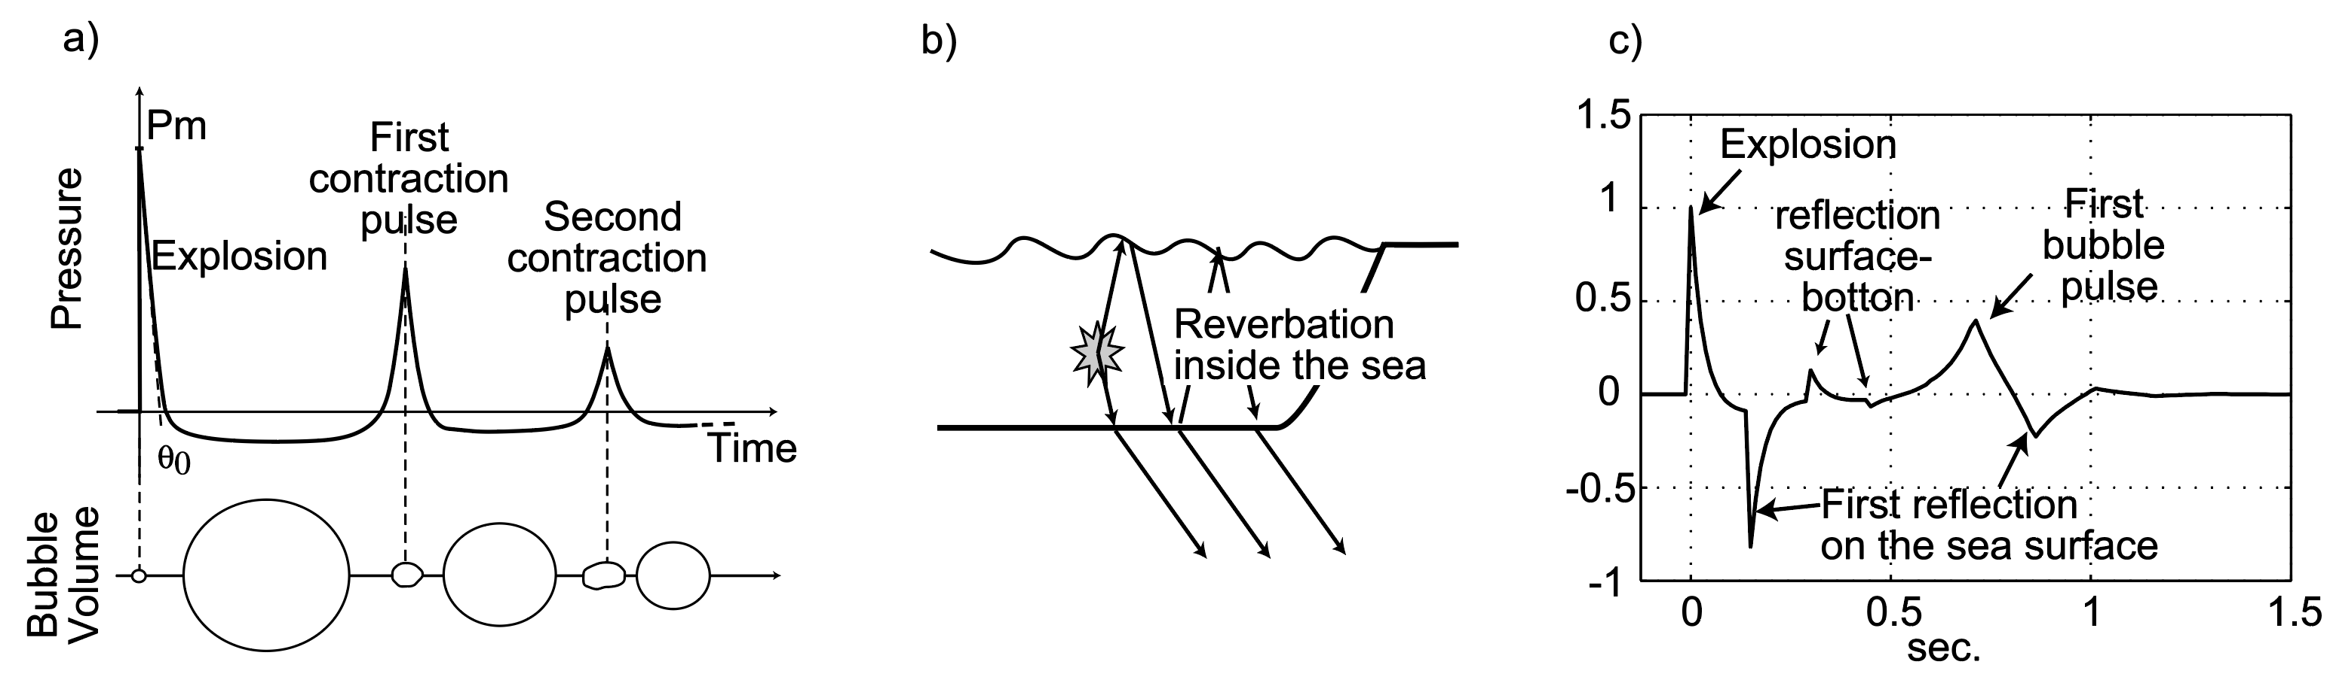
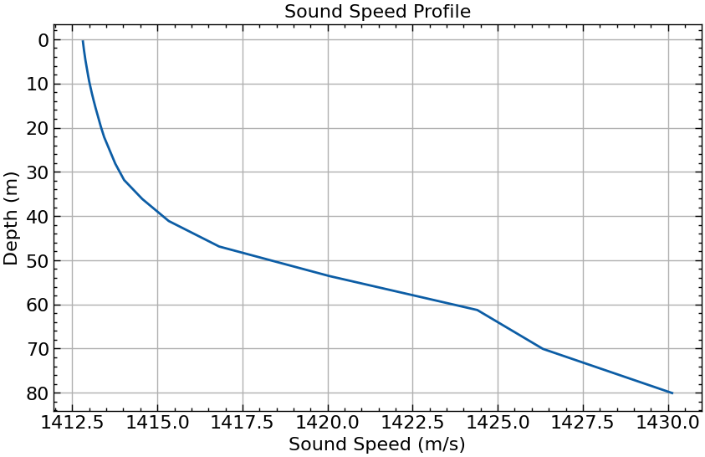
Source parameters estimation
Time of first bubble pulse
1st pulse amplitude ratio
Time of first bubble pulse
Depends on yield
Depends on explosion depth
Time of first surface reflection
Depends on water depth
Depends on explosion depth
Time of first full reverberation
Depends on water depth
Depends on explosion depth
+ water temperature + salinity + impedance contrast of the sea floor + 1st pulse amplitude ratio + etc…
Total of 10 parameters to model the signal at one seismometer

Slide 8
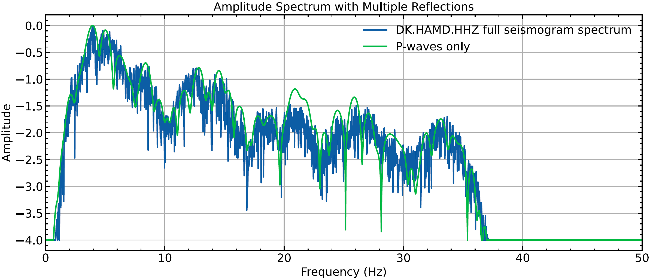
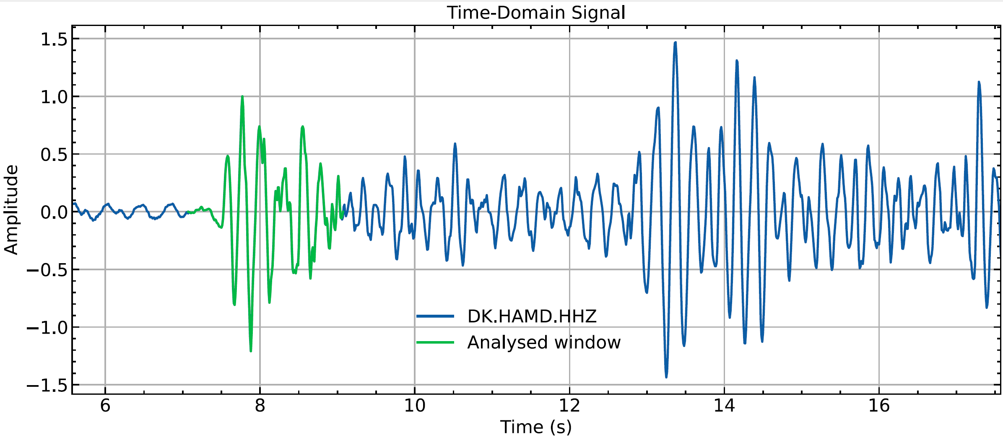
Source parameters estimation
Estimation on HAMD data, the closest station

Slide 9
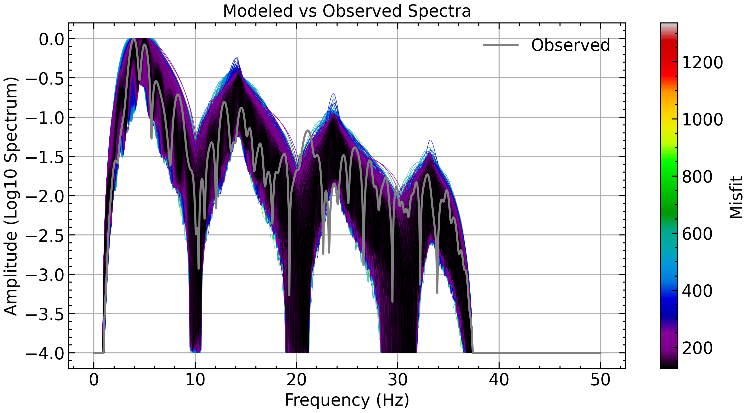
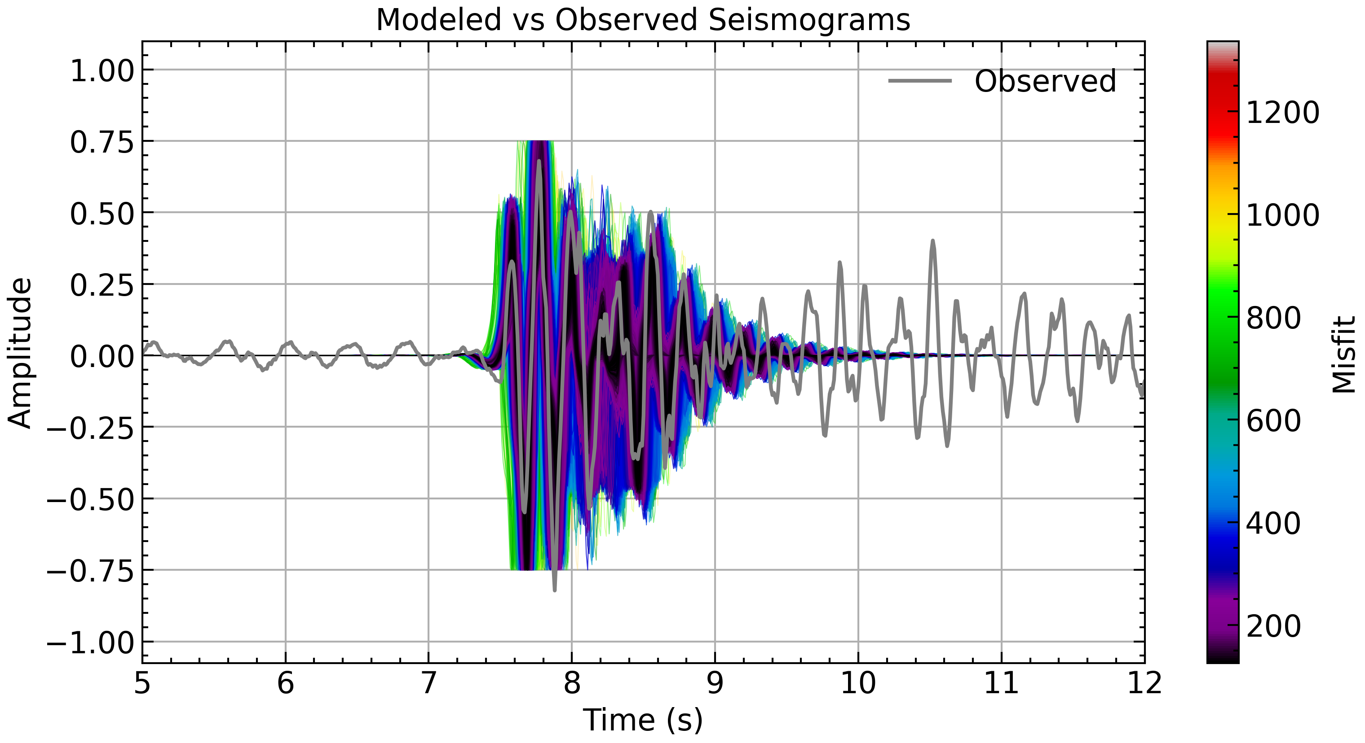
Source parameters estimation
Exploration of 50,000+ models
Verifying which ones fit the best

Slide 10
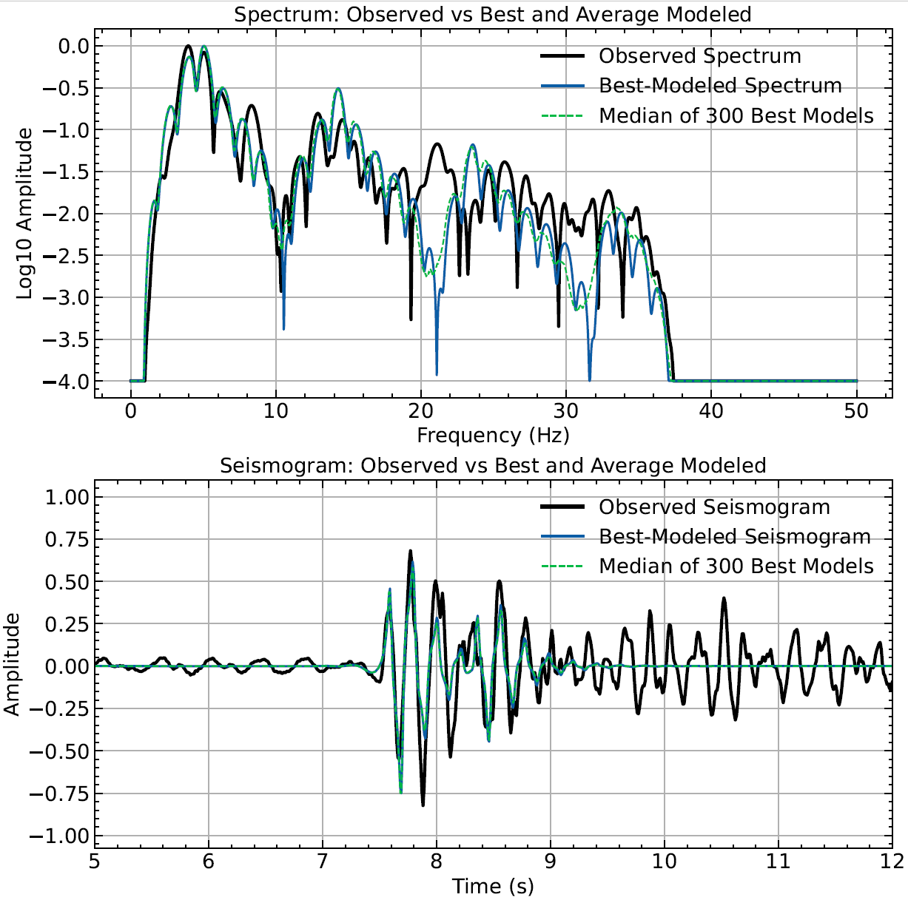
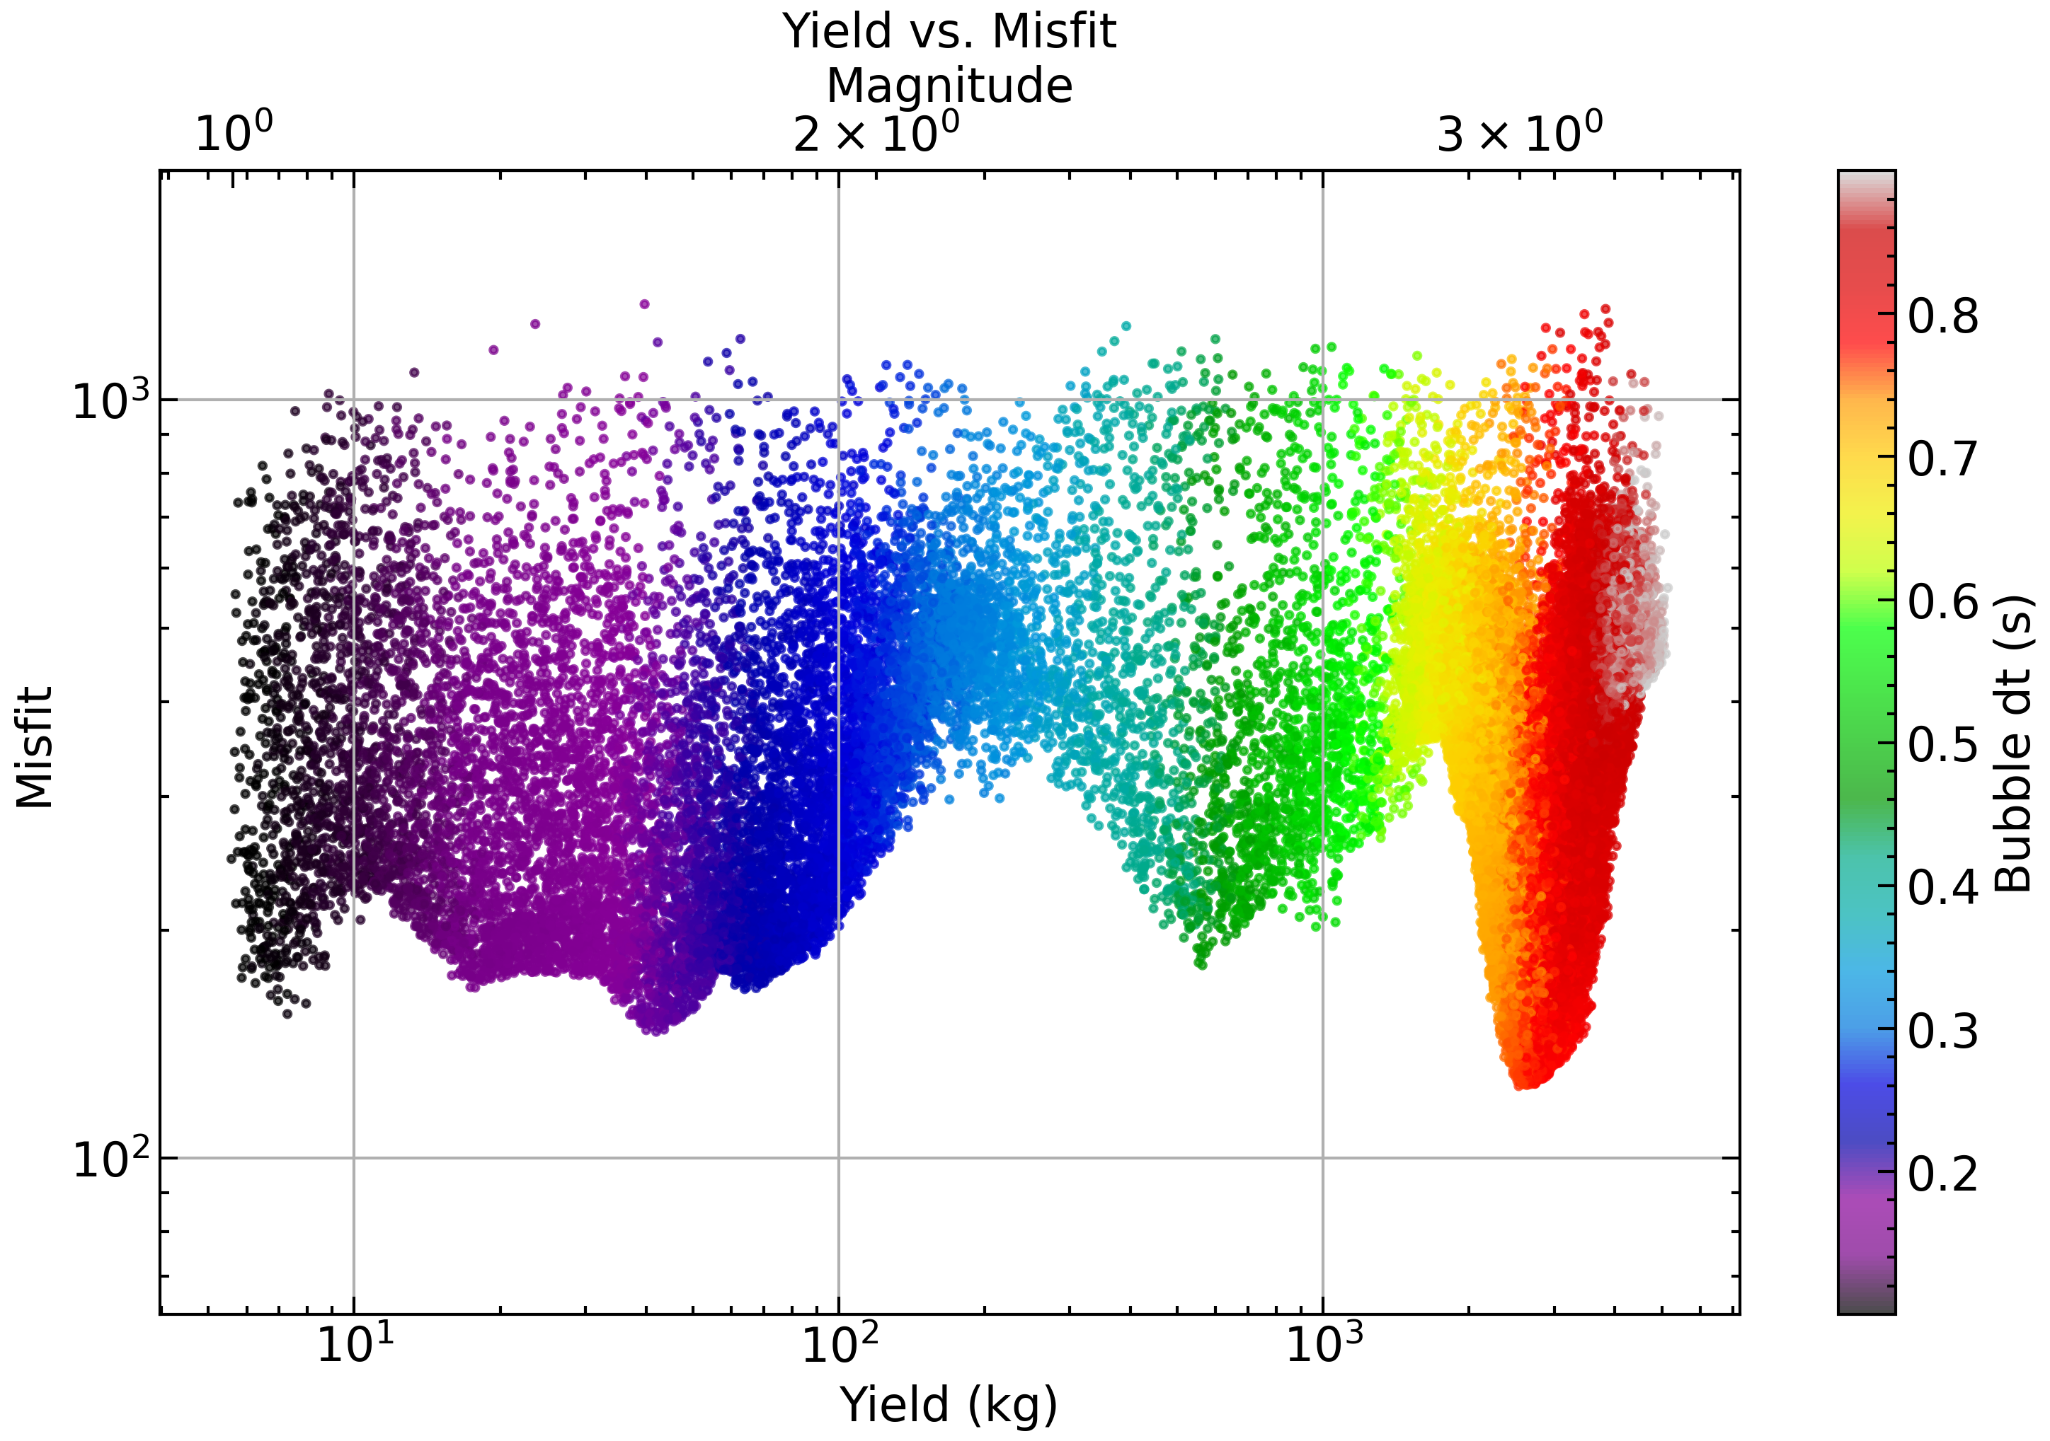
Source parameters estimation
Very good fit obtained
But…
Inconsistent with the measured magnitude!

Slide 11
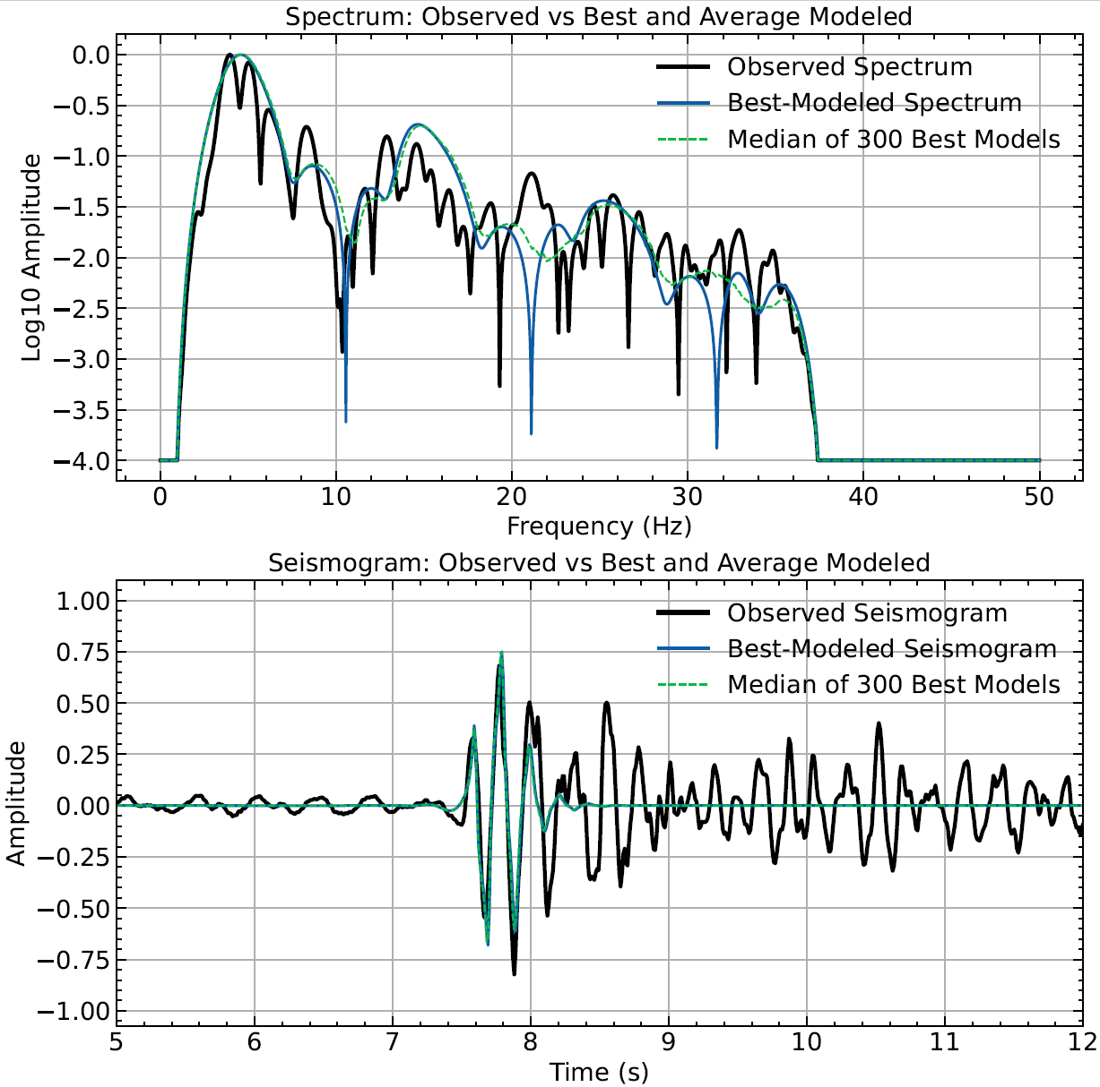
Source parameters estimation
Smaller yield (40 kg) consistent with the magnitude
Good fit of the first pulse but does not explain the second one
What are the other options?

Slide 12
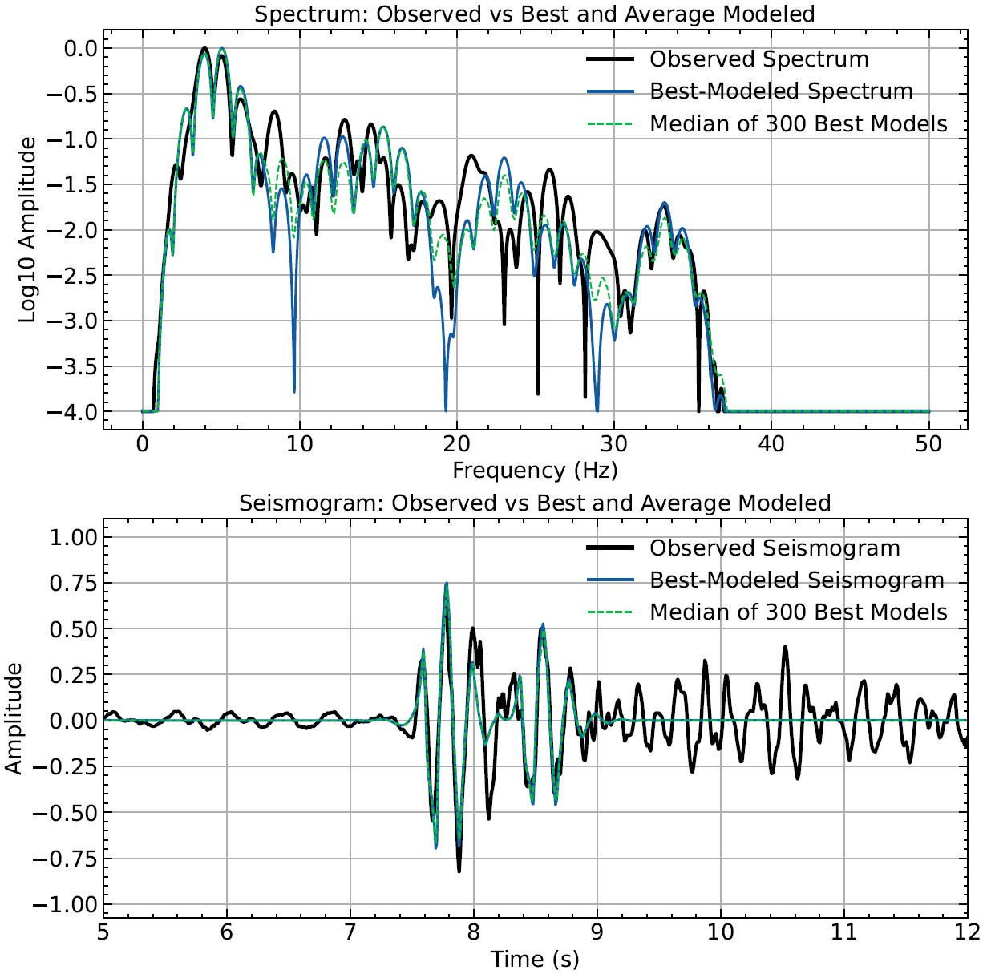
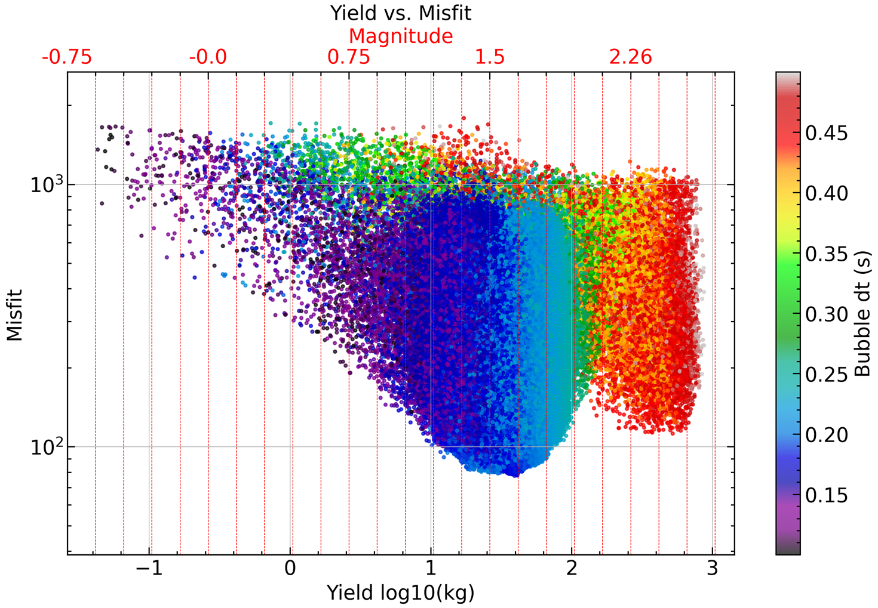
Source parameters estimation
2 explosions separated by ~1sec fit the data the best
About 30-40 kg yield each
About 5-10 m above the sea floor

Slide 13
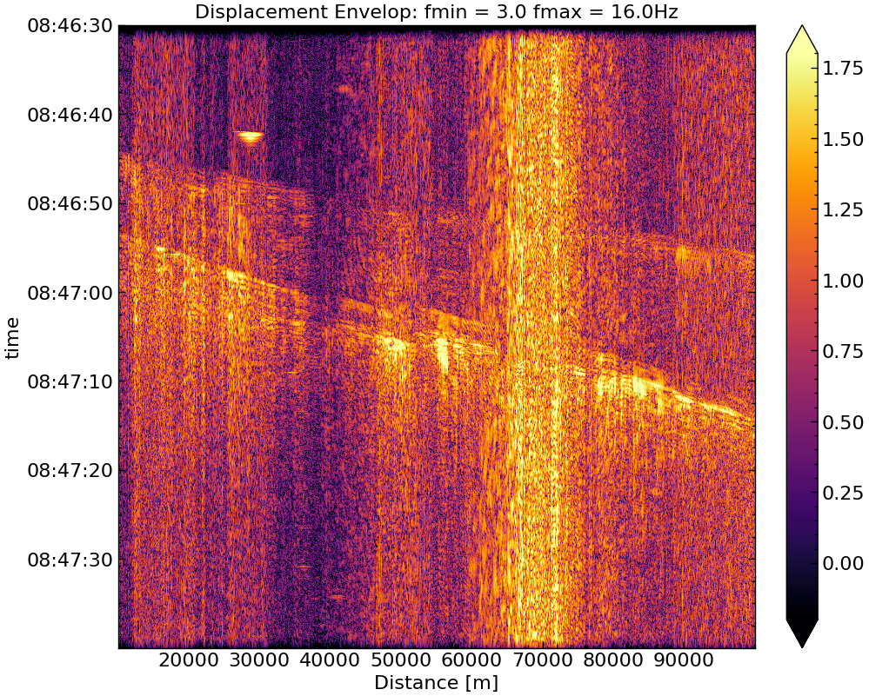
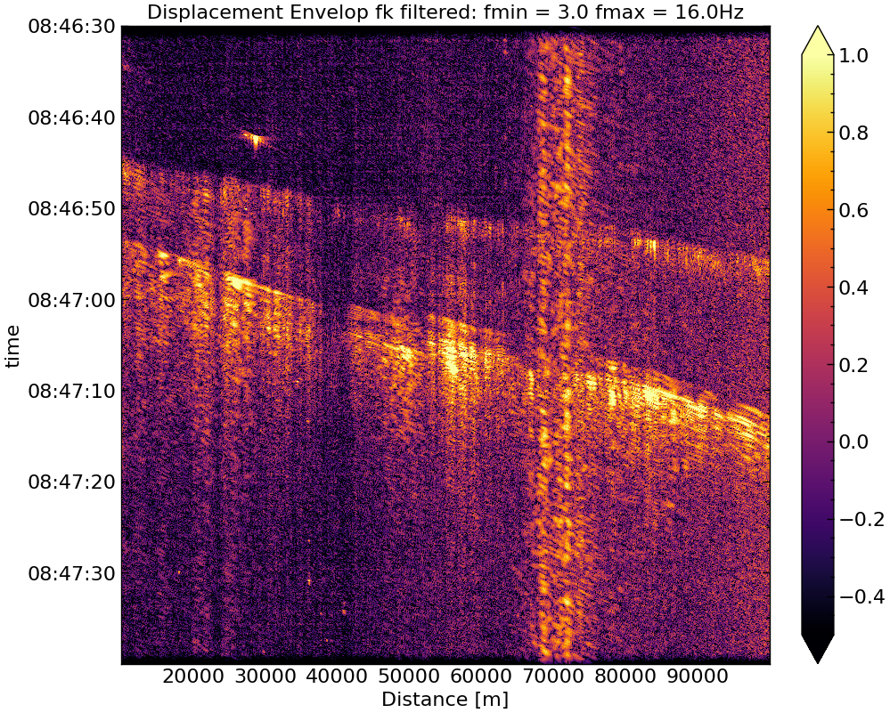
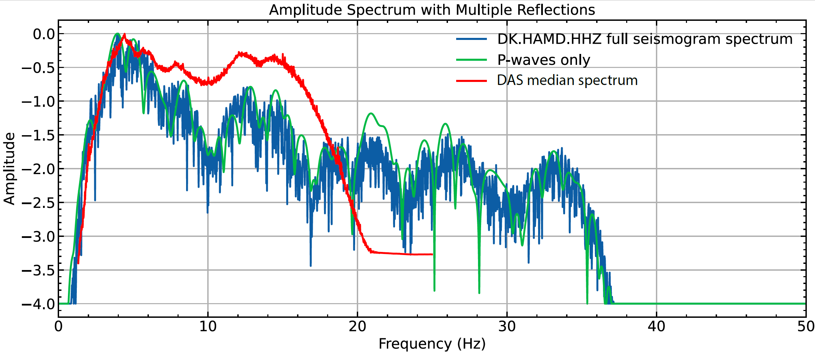
Cleaned record
DAS analysis
Clear record on DAS data
Similar spectral features

Slide 14
Conclusions
Unknow explosions on the sea floor
Well picked by automatic ML algorithms
Two explosions at 1 sec interval, 30-40 kg yield each
Well recorded on DAS
Multiple phases to investigate (in progress)

Slide 15
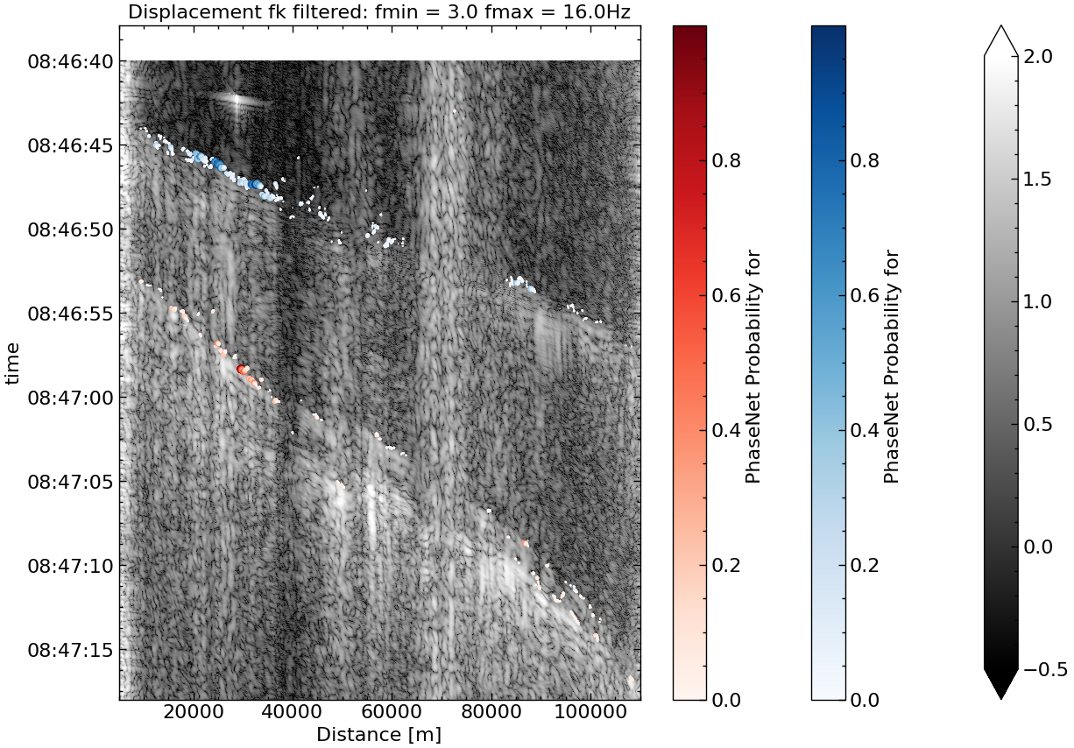
DAS analysis
S
P
Automatic picking with PhaseNet

Slide 16
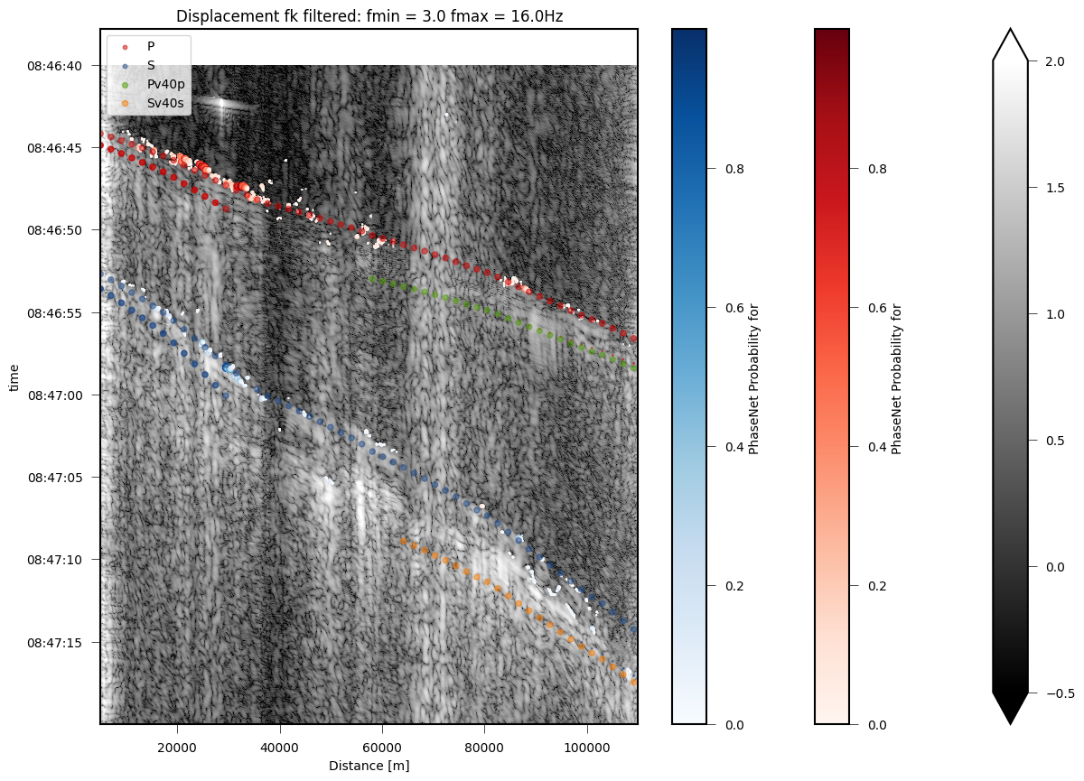
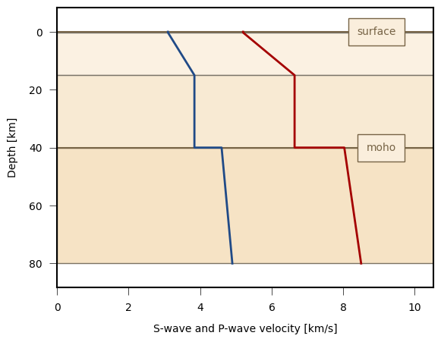
DAS analysis
S
P
Forward modelling of travel-times
Absolute timing problem on DAS

Slide 17
Source parameters estimation
Time of first bubble pulse
1st pulse amplitude ratio
Time of first bubble pulse
Depends on yield
Depends on explosion depth
Time of first surface reflection
Depends on water depth
Depends on explosion depth
Time of first full reverberation
Depends on water depth
Depends on explosion depth
+ water temperature + salinity + impedance contrast of the sea floor + 1st pulse amplitude ratio + etc…
Total of 10 parameters to model the signal at one seismometer

Slide 18
Source parameters estimation
Time of first bubble pulse
1st pulse amplitude ratio
Time of first bubble pulse
Depends on yield
Depends on explosion depth
Time of first surface reflection
Depends on water depth
Depends on explosion depth
Time of first full reverberation
Depends on water depth
Depends on explosion depth
+ water temperature + salinity + impedance contrast of the sea floor + 1st pulse amplitude ratio + etc…
Total of 10 parameters to model the signal at one seismometer

