Slide 1
Ground-level land surface classification and thermal analysis using foundation models
Konlavach Mengsuwan, Masahiro Ryo
Doctoral researcher in the research unit “Artificial Intelligence for Smart Agriculture” at ZALF, Germany
28.04.2025
Notes:
Hello everyone. Today, I am presenting our work titled “Ground-level land surface classification and thermal analysis using foundation models.”
My name is Konlavach Mengsuwan, and I am a doctoral researcher in the “Artificial Intelligence for Smart Agriculture” working group at ZALF in Germany.

Slide 2
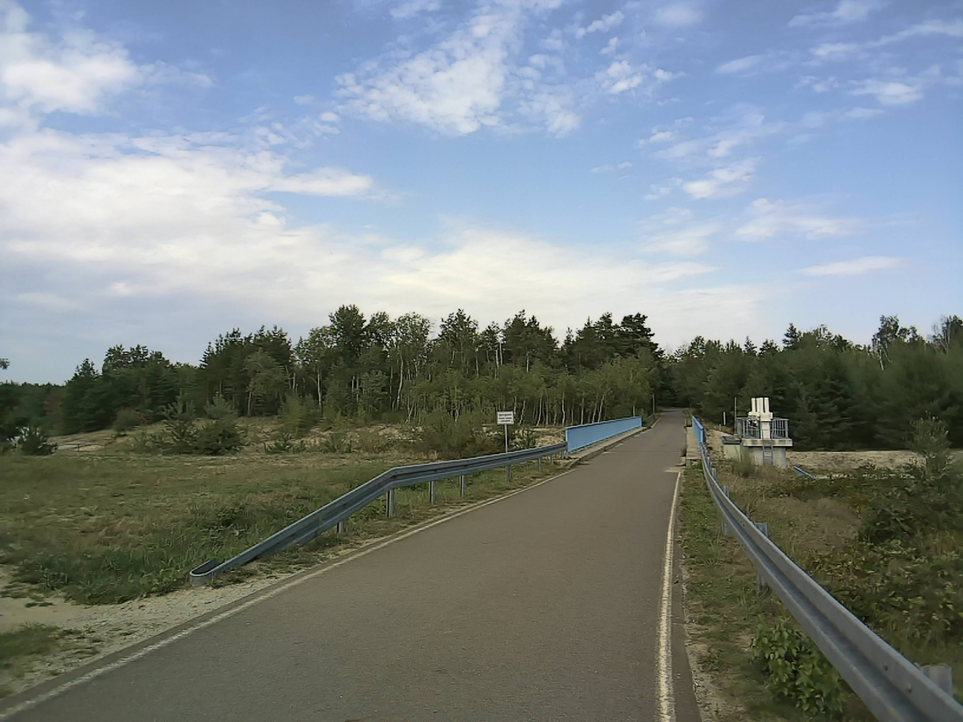
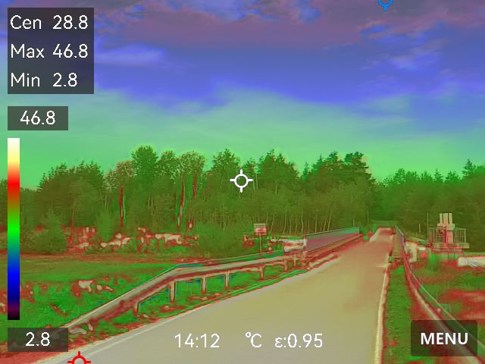
A Practical Tool for Ground-Level Thermal Profiling
Thermal Imaging
Visual Image
Climate change drives intense heat events. Ground-level temperature profile is needed
Why a Handheld Camera?
✓ Human-eye level perspective
✓ Easy to use, portable, and low-cost
✓ Captures fine-scale temperature variations (1–10 cm)
IR Image
But thermal images taken with a handheld camera has been labor-intensive.
Notes:
Climate Change is causing more frequent and intense heat events, affecting cities, farms, and natural ecosystems.
To understand their impacts, we need detailed information about temperature variations at ground level from the human-eye perspective —
because this is where people, plants, and animals actually experience heat.
While satellites and drones are useful, they often miss fine-scale temperature patterns close to the ground due to low resolution or limited coverage.
This is why we turn to handheld thermal cameras. They are portable, affordable, and can capture detailed thermal images directly at ground level.
However, collecting this information with handheld thermal cameras has usually been slow, very time-consuming, especially when done manually.

Slide 3
A Practical Tool for Ground-Level Thermal Profiling
Thermal Imaging
Visual Image
Objective:
To develop a workflow by using multiple foundation models to segment and classify land surfaces and analyze temperature differences from handheld thermal imagery.
IR Image
Notes:
Our objective is to develop a workflow using two foundation models to automatically segment, classify land surfaces, and analyze temperature differences from handheld thermal images.

Slide 4
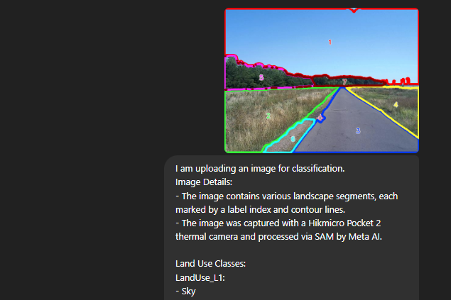
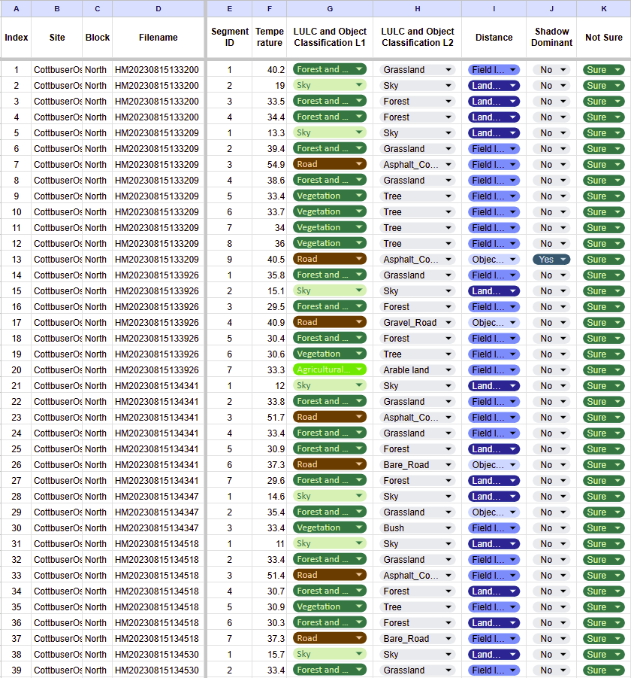
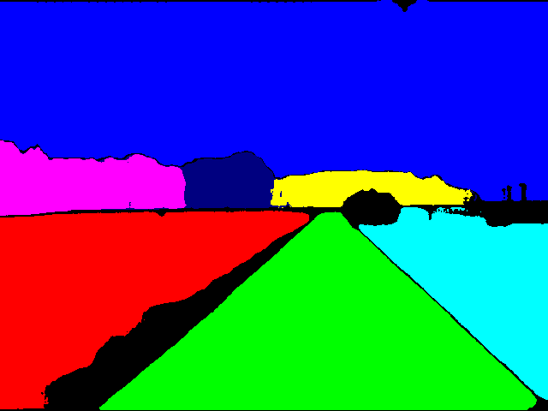
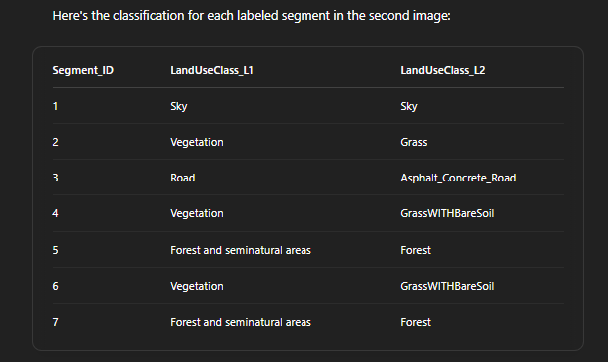
Workflow: From Images to Temperature Profile
Data Collection
Segmentation (SAM)
Classification (GPT-4o)
Validation
RGB + thermal images at eye-level
Segment images into meaningful objects
Assign custom land surface types
Link segments with thermal data
Workflow: From
Image to Temperature Profile
Reveal temperature
differences by land surface
Notes:
This diagram shows our workflow in four steps: First, we collect RGB and thermal images at human-eye level. Second, we segment images into meaningful land surfaces using Segment Anything Model (SAM) foundation model. Third, we classify these segmented land surfaces using GPT-4o, a multimodal foundation model. Finally, we link these classified segments with thermal images to understand how temperatures differ by surface type.

Slide 5
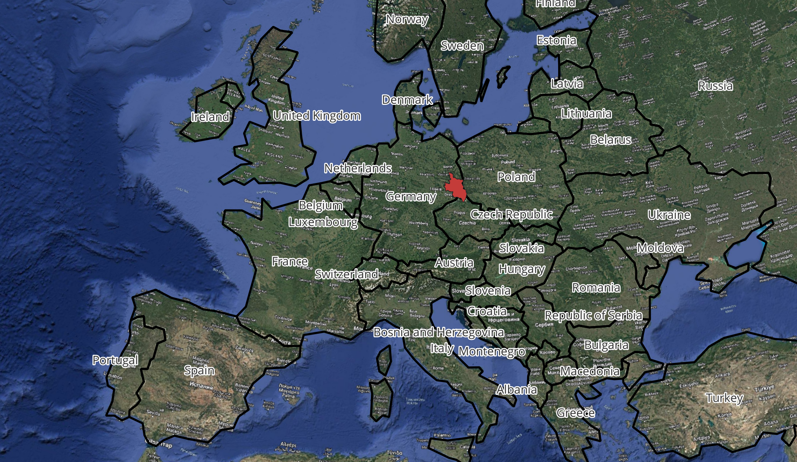
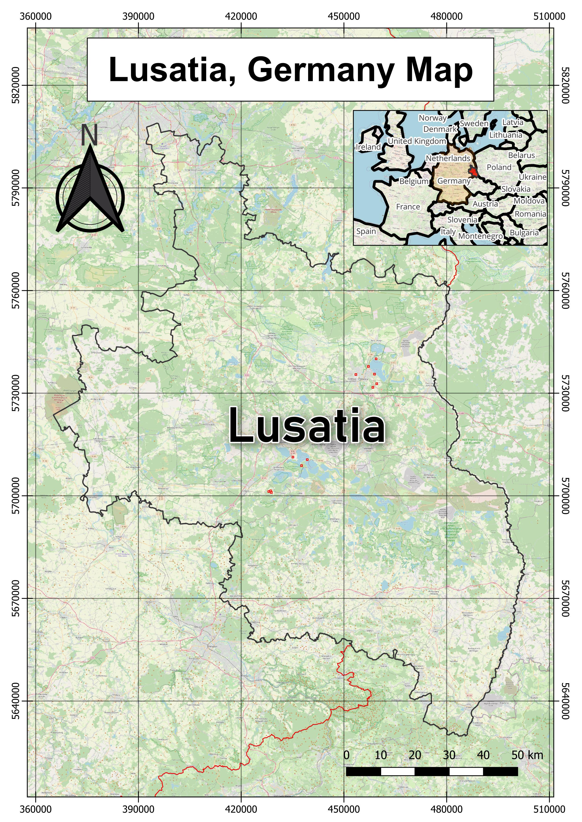
Study Area and Dataset
Summer 2023 hot day
Camera: Hikmicro Pocket 2
Human-eye level, 12:00–18:00
~400 image pairs collected
100 annotated for initial analysis
Notes:
Our study was conducted in Lusatia, Eastern Germany — one of the driest and hottest regions in the country. On a hot summer day in 2023, four field teams collected around 400 pairs of RGB and thermal images using handheld Hikmicro Pocket 2 cameras. We captured data across a variety of landscapes, including urban-rural areas, agricultural fields, water bodies, and post-mining sites, between 12 PM and 6 PM. For this initial analysis, we selected and annotated 100 image pairs to test our workflow.

Slide 6
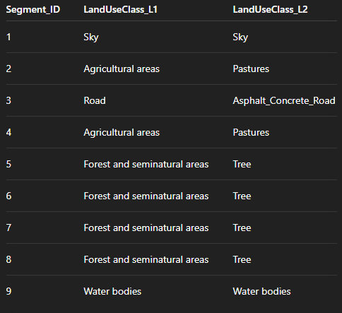
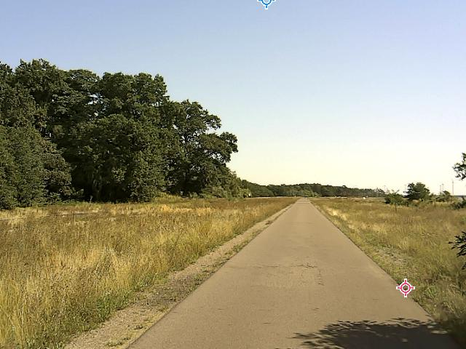
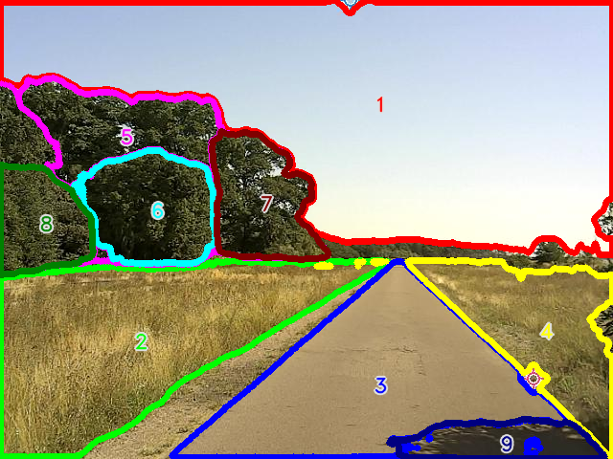
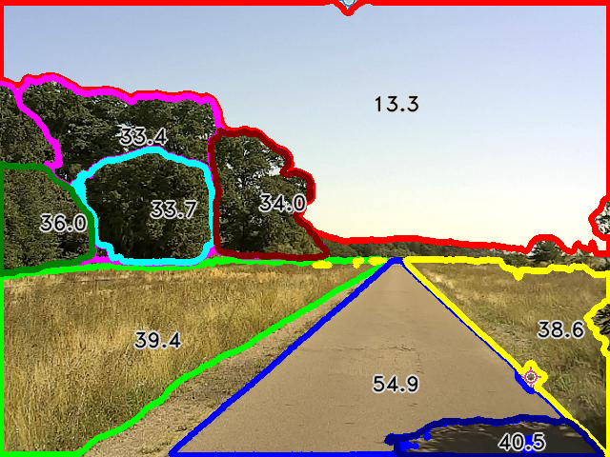
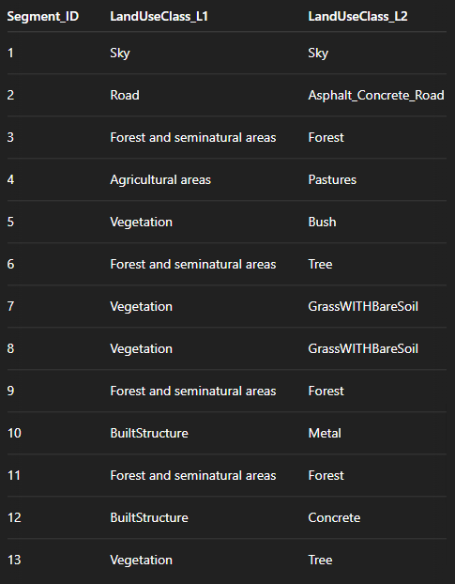
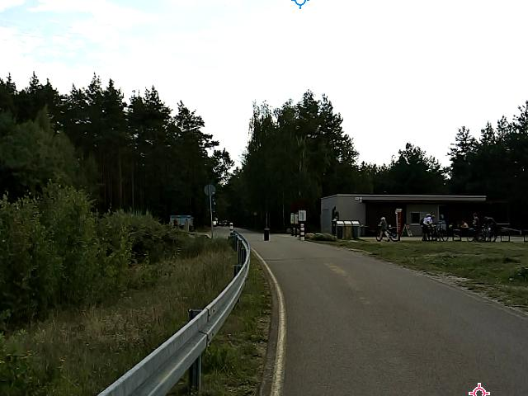
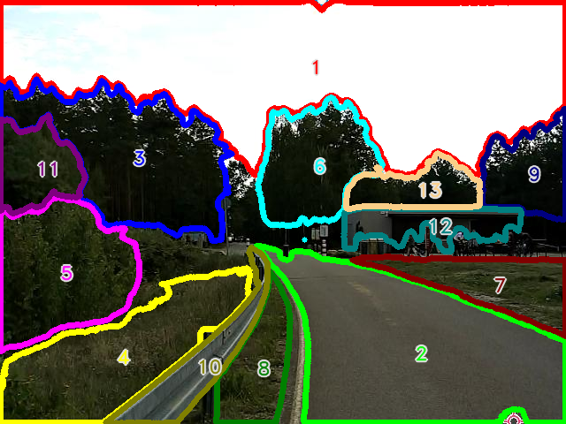
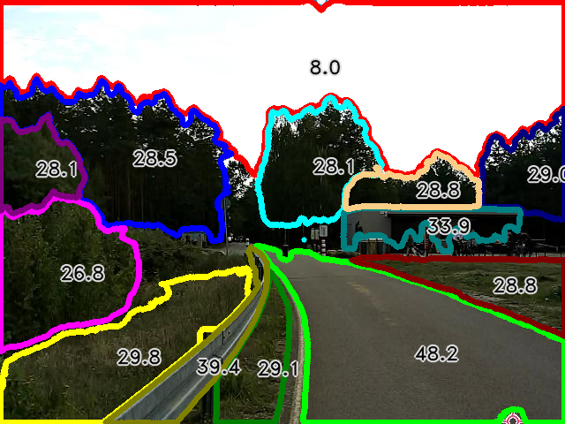
Example Outputs: Land Surface Segmentation & Classification
Example 1
GPT4-o
SAM
RGB Image
Segmentation
Temperature Overlay
Classification
Example 2
GPT4-o
SAM
RGB Image
Segmentation
Temperature Overlay
Classification
Notes:
Here is our first example of results from our workflow. Starting with an RGB image, SAM automatically segmented the image into clear land surfaces with index numbers. Next, GPT-4o classified these segments into predefined land surface categories. Finally, we linked these segments to thermal images, clearly showing temperature differences among the various land surfaces.
This is another example demonstrating the same workflow. Again, SAM effectively segmented the RGB image, GPT-4o classified the segments, and the thermal overlay clearly reveals the temperature variation across different surfaces. This method is fast, automatic, and consistent.

Slide 7
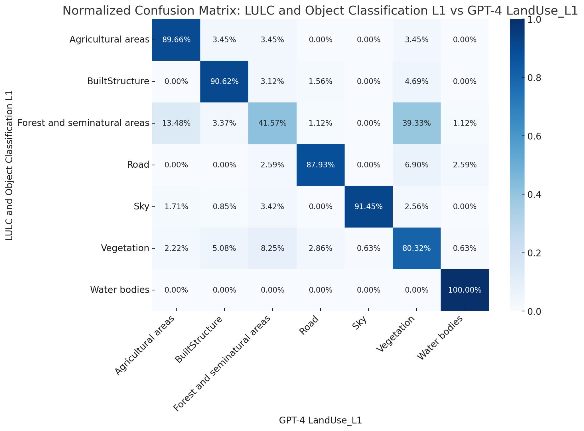
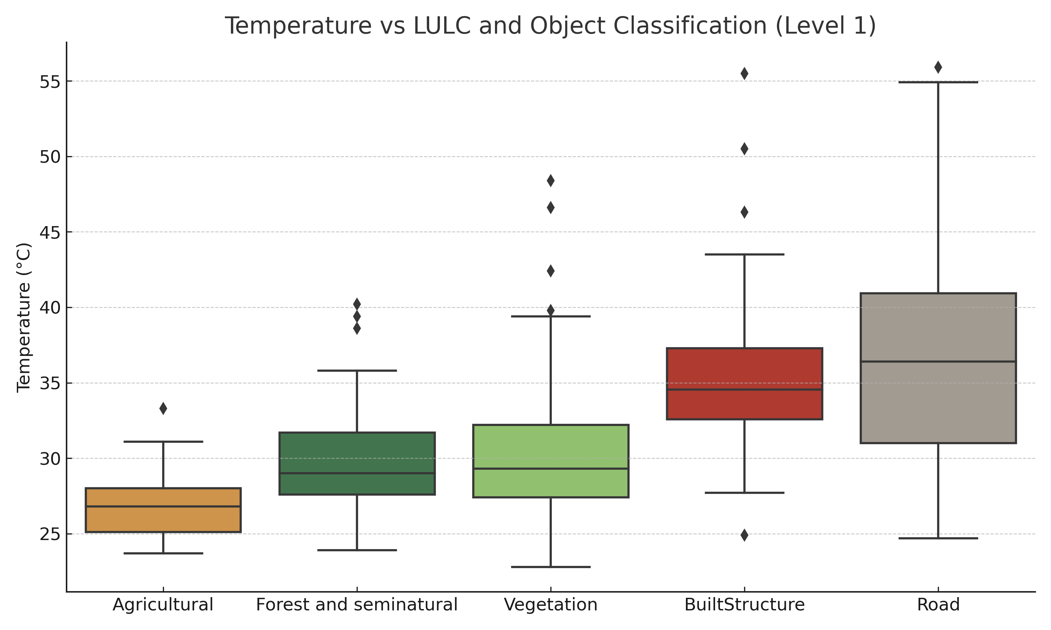
Model Evaluation: Classification Accuracy & Confusion Matrix
Prediction vs. Actual: Broad-Level
Surface Temperature Profiling by Land Surface Type
Confusion matrix: showing strong agreement between predicted and actual broad-level land surface categories.
Broad Classes: Agricultural areas show the lowest surface temperatures.
7
Notes:
We evaluated our workflow by measuring how accurately the GPT-4o classified land surfaces. The confusion matrix shows a strong agreement between predictions and actual classes, with an overall accuracy of 80% for broad land categories.
We also analyzed temperature differences across these classified surfaces. As shown, agricultural areas consistently had the lowest temperatures, while roads and built structure were much hotter. This highlights how our workflow can reveal important heat patterns to support better planning and climate adaptation.

Slide 8
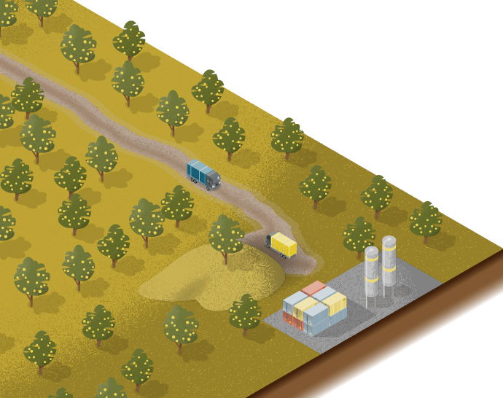
Conclusion & Takeaways
We introduced a novel workflow combining SAM + GPT-4o for fine-scale LST profiling.
Key Achievements: Achieved ~80% classification accuracy (broad) and revealed land use–temperature patterns.
Why it Matters: Enables accessible, scalable environmental monitoring using portable, low-cost devices.
FMs
Notes:
In conclusion, we introduced an accessible, scalable method for detailed temperature profiling using handheld thermal imagery and foundation models.
This approach significantly enhances our ability to monitor and understand local temperature variations, which are important for climate adaptation strategies.

Slide 9
Thank you for your attention.
Travel support for attending EGU2025 was generously provided by BTU Graduate Research School and AIA ZALF
Contact:
Konlavach Mengsuwan, Konlavach.Mengsuwan@zalf.de
EGU25-7220
LinkedIn
Notes:
Thank you very much for your attention. I'm happy to discuss any questions or further clarifications.

