Slide 1


Scenario Simulations for Estimating Environmental Impacts of Canadian Oil Sands Emissions – Supplemental Information
European Geosciences Union AS3.28 / EGU25-7253, Thursday, May 1, 2025 (room M2)
Paul Makar¹, Sepehr Fathi¹, Stefan Miller¹, Colin Lee¹, Craig Stroud¹, Mahtab Majdzadeh¹, Junhua Zhang¹, Ali Katal¹, Mohammad Koushafar¹, Wanmin Gong¹, Oumarou Nikiema², Veronique Brosseau-Couture², Ivana Popadic², Hazel Cathcart¹, Greg Wentworth³, Stephanie Connor³, Craig Mahoney^{3,} Yayne-Abeba Aklilu³, Amanda Cole¹, Qiong Zheng¹, and Mathieu Rouleau⁴
Air Quality Research Division, Environment and Climate Change Canada
Air Quality Policy-Issue Response Section
Alberta Environment and Protected Areas
Health Canada

Slide 2
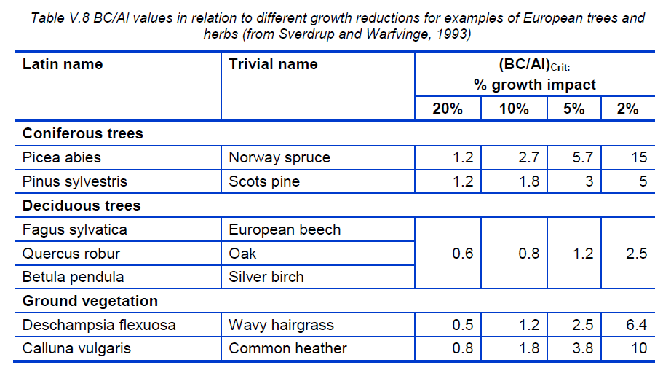

Terrestrial ecosystem critical loads depend on the type of vegetation, the source of vegetation data, and on a choice of impact level
Dose-response curve for Norway Spruce.
Severely reduced growth
No change in growth
e.g. if a 20% growth reduction is deemed acceptable, then the value of BC/Al_{crit} is smaller than for a 2% growth reduction, hence CL_{max}S is larger, and more S deposition can happen before the critical load is exceeded.
$${(Bc/Al)}_{crit}$$
…on the other hand, if only a 2% growth reduction is considered acceptable, the values of BC/Alcrit is larger, the value of CLmaxS is smaller, and less S deposition is required for the critical load to be exceeded.

Slide 3
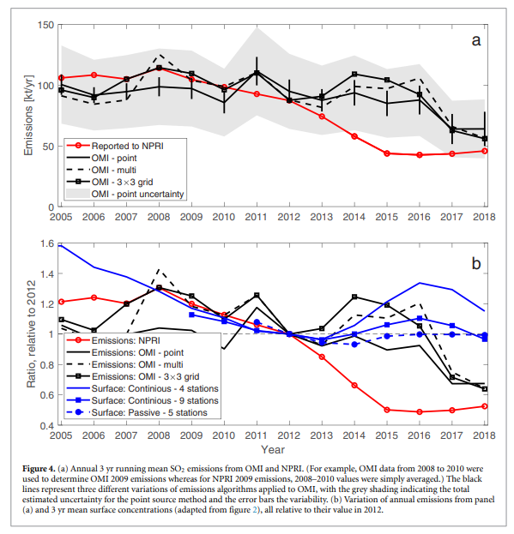
Alberta Environment and Protected Areas Critical Load Exceedances for Terrestrial Ecosystems
Methodology changed considerably subsequent to Makar et al (2018):
  Simple Mass Balance model used.
  Details from Yayne!
Some vegetation types previously considered to be very sensitive are now much less sensitive (choices and updates since 2018 paper).
Also - sulphur emissions have decreased between the 2013 values used in Makar et al. (2018) and the GEM-MACH Run 5 values (see McLinden et al, Env. Res. Lett., 2021, at right). So some decreases in exceedances might be expected.

Slide 4
ECCC Critical Load Exceedances
ECCC Terrestrial Ecosystem and Aquatic critical load estimates have been recently updated.
Terrestrial Ecosystems for mineral soils followed Cathcart et al., 2025, https://doi.org/10.5194/bg-22-535-2025) :
  Simple mass balance model,
  Canada-wide, 250m x 250m resolution,
  site-specific Bc/Al_{crit} ratios,
  BC_{w} approximated using soil texture data,
  base cation and nitrogen uptake via harvesting & grazing included.
Aquatic ecosystems:
  Several thousand lake surveys
  Steady-State Water Chemistry (SSWC) and First Order Acidity (FAB) critical load models (Sverdrup et al., 1990; Aherne and Jeffries (2015).
  CL calculations followed a hierarchy based on the available information for individual lakes:
    eg. catchment runoff rates were determined by isotope mass balance estimates preferred over GIS map-based approach using regional datasets, and
    When dissolved organic carbon estimates were available, an organic-acid-adjusted limiting value of the acid-neutralizing capacity was used to include the influence of organic acids in the lake in preference to a fixed value of 40 μeq. L⁻¹.
  SSWC: exceedances with respect to Sulphur deposition only.
  FAB: exceedances with respect to both Sulphur and Nitrogen deposition.
Preliminary values shown here.

Slide 5
Bog Eutrophication (N) Exceedances
Estimate for bog eutrophication (N) exceedance of 3 kg N ha⁻¹ yr⁻¹ from the work of Kelman Wieder et al.
Craig Mahoney (AEPA) combined bog land use data and GEM-MACH N deposition to estimate locations where bogs were in exceedance of N critical loads at 2018 N emissions levels
Data is specifically for Northern Alberta (might be worth checking with Saskatchewan to see if they have similar bog land use location data)
Comparisons of Run 5 base case versus OS zero-out scenario results were used to estimate the relative impact of OS emissions on critical load exceedances bog eutrophication.
Note that on-the-ground bog measurements are showing:
  A significant association between bog porewater N and GEM-MACH-OS estimated N deposition
  More shrubs have been observed at sites with higher predicted N deposition.
  The model results are broadly consistent with observed changes.

Slide 6
Estimates of Oil Sands emissions impacts on Human Mortality
GEM-MACH-OS air concentrations of O₃, NO₂, and PM2.5 were used to generate human mortality metric scores based on (AQBAT; https://health-infobase.canada.ca/aqbat/).
Terminology:
  Attributable Mortality: absolute number of deaths attributable to air pollution in a calendar year.
  Attributable Mortality per 100K: number of deaths attributable to air pollution normalized to 100,000 people.
  Deaths attributable to Oil Sands pollution (Base Case – OS zero), and percentage of air pollution deaths attributable to Oil Sands pollution will be shown.

Slide 7
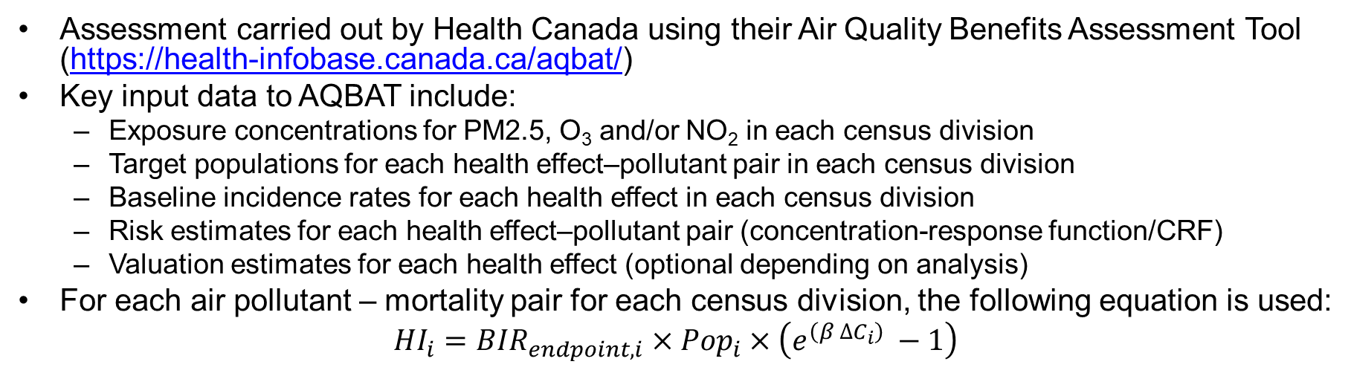
Health Impacts of Oil Sands
Assessment carried out by Health Canada using their Air Quality Benefits Assessment Tool (https://health-infobase.canada.ca/aqbat/)
Key input data to AQBAT include:
  Exposure concentrations for PM2.5, O₃ and/or NO₂ in each census division
  Target populations for each health effect–pollutant pair in each census division
  Baseline incidence rates for each health effect in each census division
  Risk estimates for each health effect–pollutant pair (concentration-response function/CRF)
  Valuation estimates for each health effect (optional depending on analysis)
For each air pollutant – mortality pair for each census division, the following equation is used:
$${HI}_{i}={BIR}_{endpoint,i}×{Pop}_{i}×\left(e^{\left(β ∆C_{i}\right) }−1\right)$$
HI_{i}: health impacts linked to air pollution in region i, in number of outcomes
BIR_{endpoint,i}: the “state of health”; the baseline incidence rate for the endpoint (mortality), in events per million population
Pop_{i}: target population for a health endpoint – pollutant pair in region i.
β_{i}: risk estimate for the health endpoint-pollutant pair (concentration-response function or CRF) per unit change in concentration.
ΔC_{i}: exposure concentration of PM2.5, O₃ or NO₂ in region i.

Slide 8
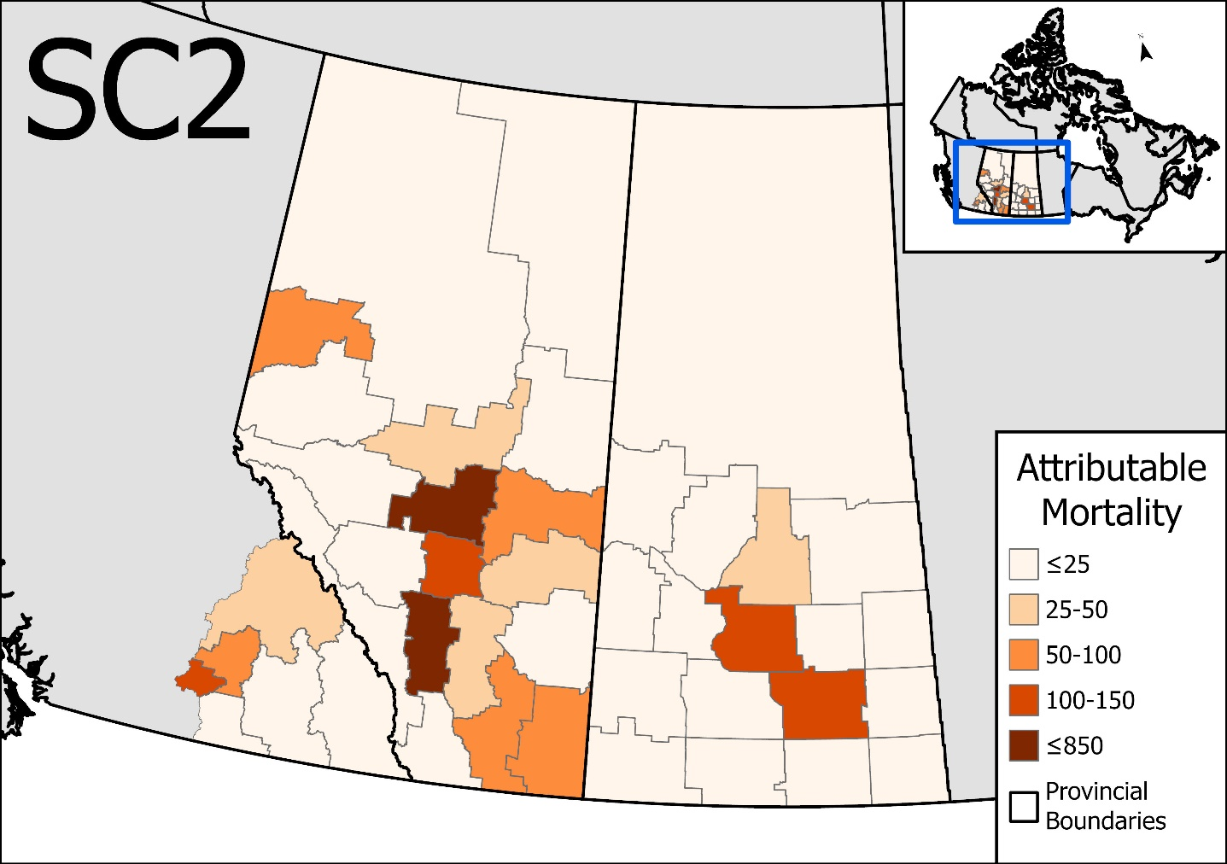
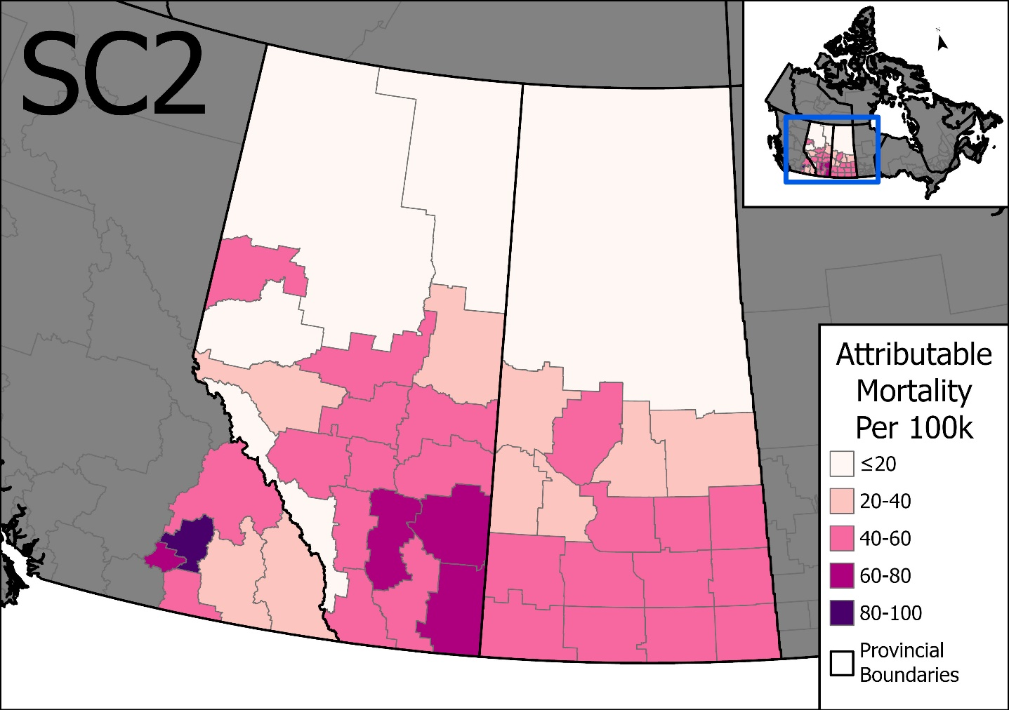
Absolute and Population Normalized Mortality attributed to All Anthropogenic emissions
Important! Note the change in the colour scales compared to the previous slide: here, the background lower values start at $≤25$ Attributable deaths and $≤20$ Attributable Deaths per 100K.
Health Canada summary:
Across the entire domain, the Oil Sands contributes 3% or less of air pollution deaths overall.
However, the Oil Sands contributes higher percentages of the air pollution related deaths in some CD’s: 55% for Fort McMurray and Fort McKay, 12% for Saskatchewan CD4718, 5% for Alberta CD4817.
Notes:
HC notes:
Overall, OS seems to contribute 3% or less of air pollution deaths across CDs in the domain.
However, CD4816 is a notable exception, where 55% of the air pollution health impacts are linked to the OS.
Compare to 12% in Saskatachewan CD4718, and 5% in Alberta CD4817.

Slide 9
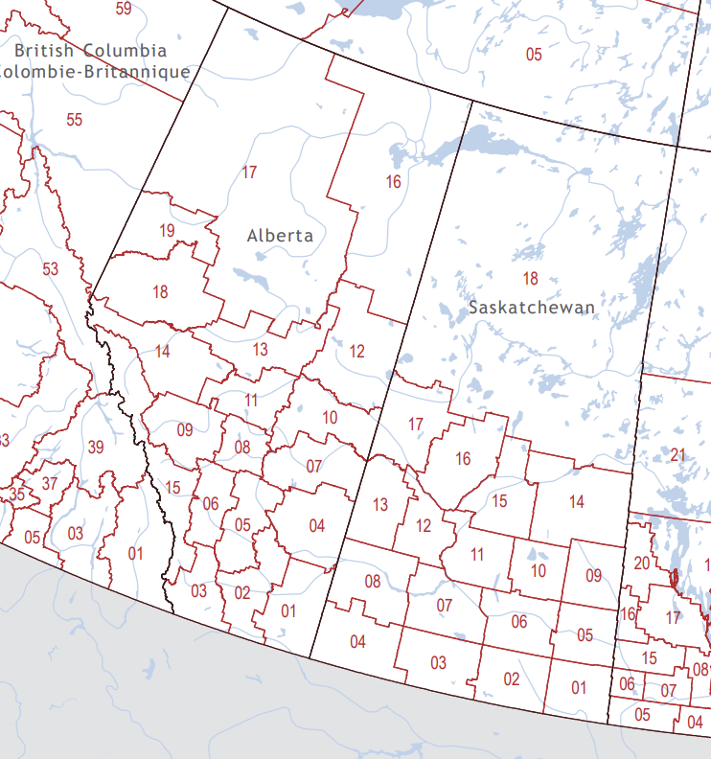
Census division Map (for reference)

Slide 10
Next Steps
Further work on CLE, including Model-Measurement fusion.
Writing up two papers on the runs up to Run 5.
  Comparison to observations
  Scenario simulations and impacts.

Slide 11
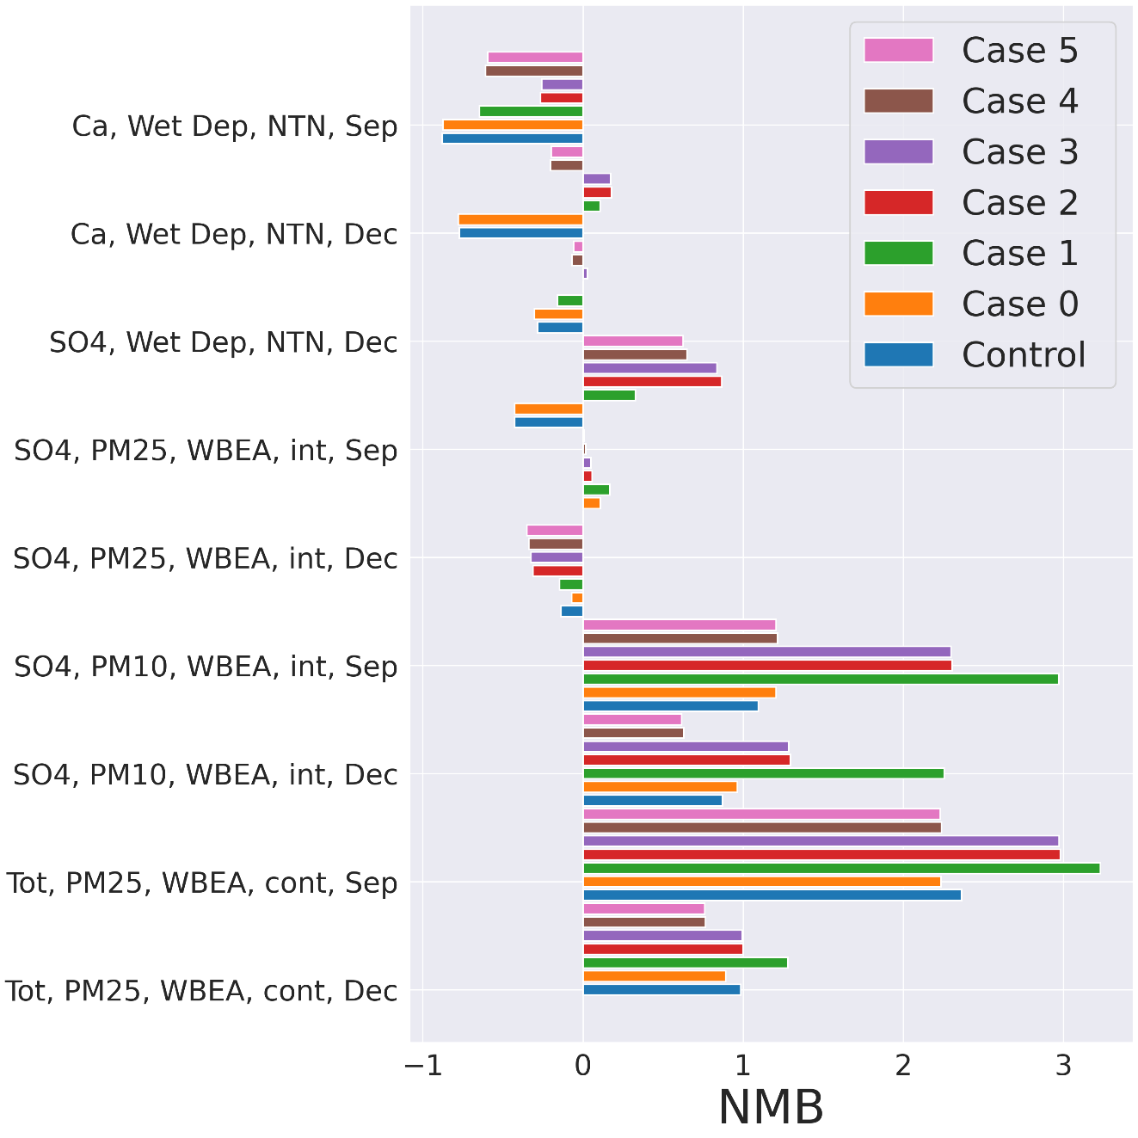
Next steps… moving into Run 6
Summary of Normalized Mean Bias Results for ongoing September (Sep) and December (Dec) tests
Moving into emissions and meteorology year 2022.
Collecting observation data with WBEA assistance for evaluation (though new model version will also be evaluated against 2018 observations).
New GEM version as base model, updated meteorology.
Working on further improvements to chemistry based on comparison to 2018 observations.
(1) Testing meteorological modulation of fugitive dust emissions and improved below-cloud scaling. Example NMB scores from December and September tests, at right.
  To improve particle base cation and cations-in precipitation performance.

Slide 12
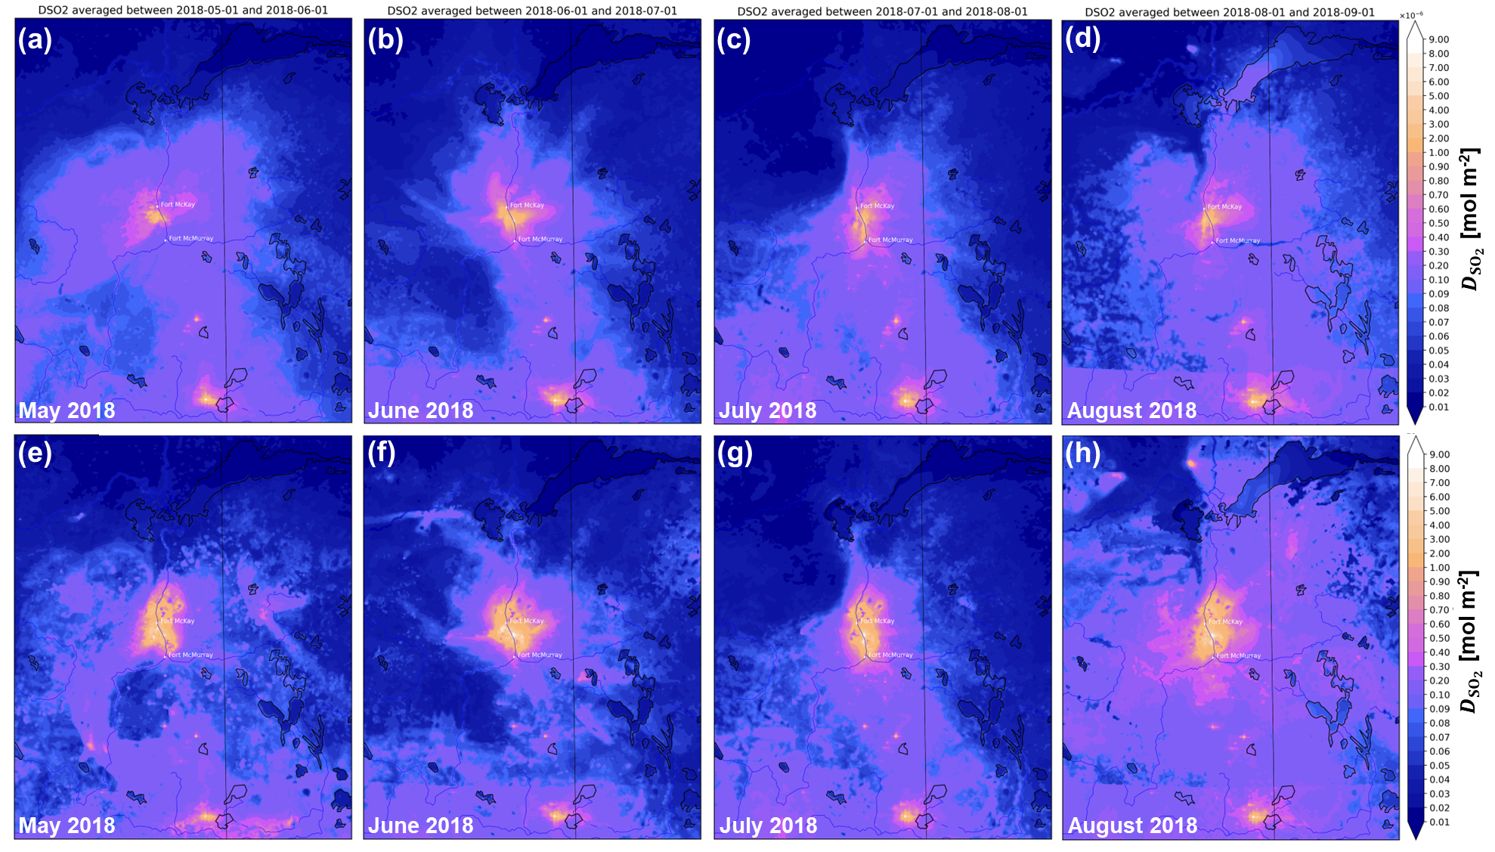
Next steps… moving into Run 6
Include impacts of leaf surface pH on deposition of SO₂ and other gases, and diagnostics for deposition to foliage vs other surfaces (post-doctoral fellow Stefan Miller’s work)
→ This has a considerable impact on SO₂ dry deposition fluxes close to the Oil Sands
Run 5 SO₂ dry deposition flux, different months
SO₂ dry deposition flux when including base cation co-deposition effects.

Slide 13
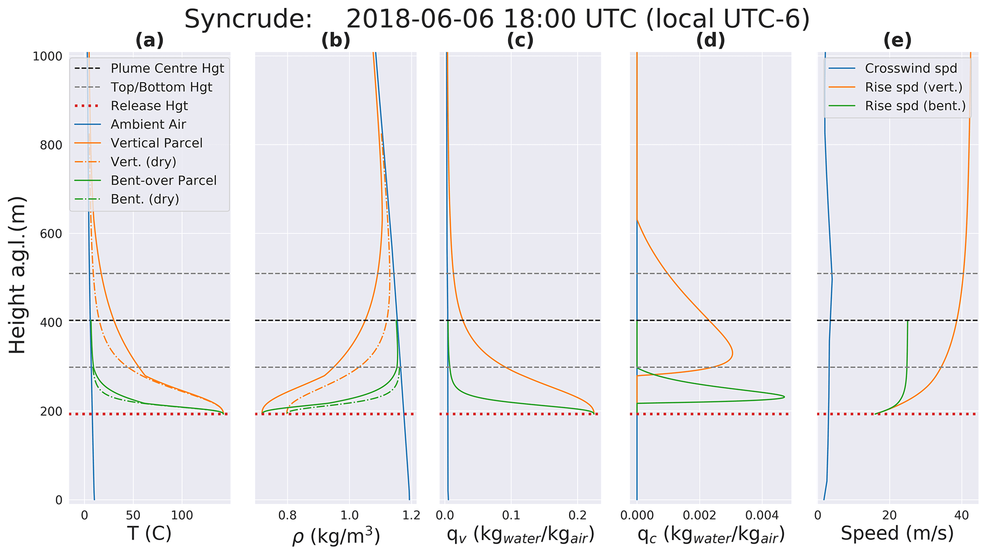
Next steps… moving into Run 6
Condensed water in Syncrude plume
(3) Include the effects of aqueous chemistry in major point source plumes
Fathi et al (2025): Oil Sands stack plumes include large amounts of water from combustion.
This water condenses during plume rise – which affects the plume height.
The water remains in the condensed phase for several minutes – this is sufficient duration enough for cloud droplet formation, aqueous phase chemistry, evaporation and particle formation to occur.
A vertically rising plume would have water droplets over a 300m extent.
A bent over plume would have condensed water for about 80m

Slide 14
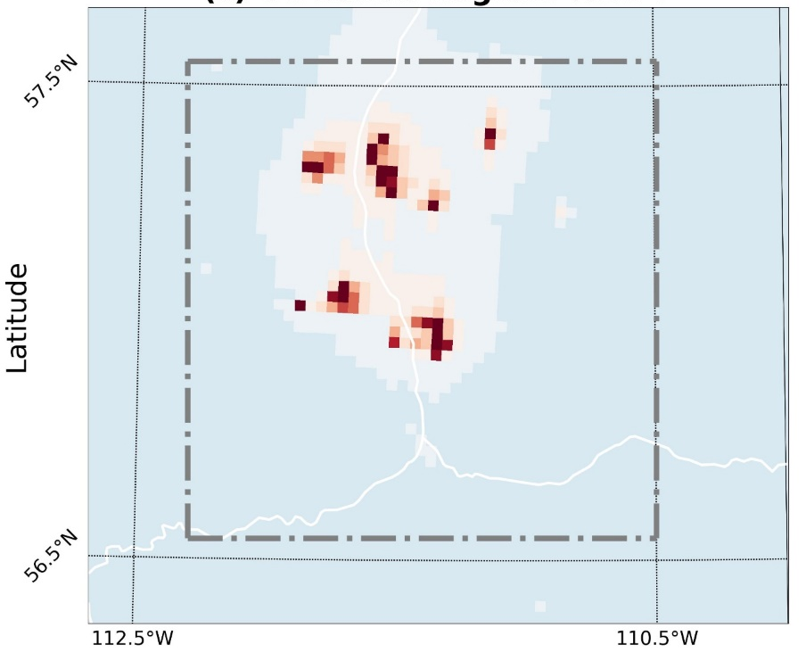
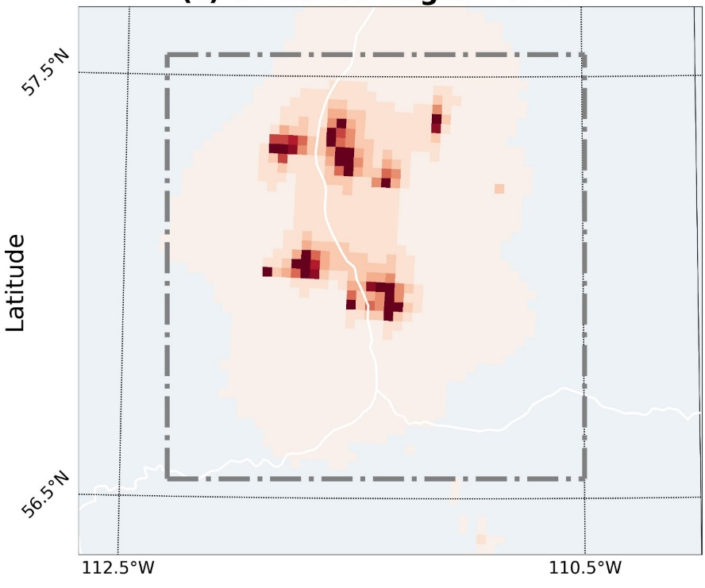
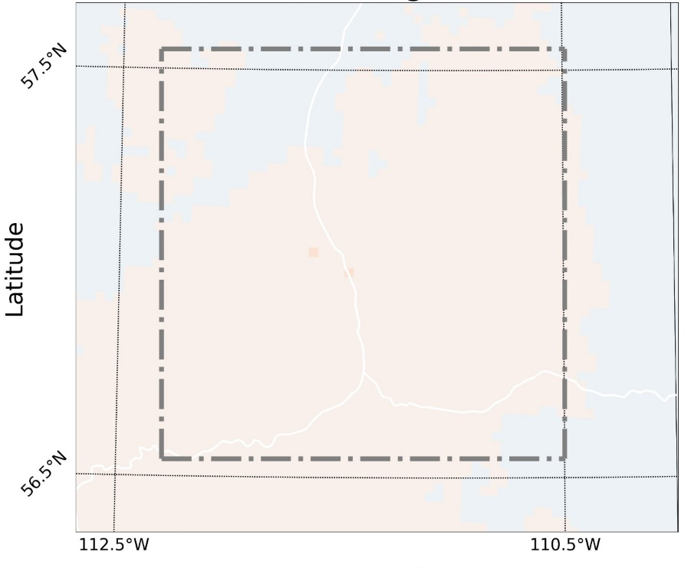


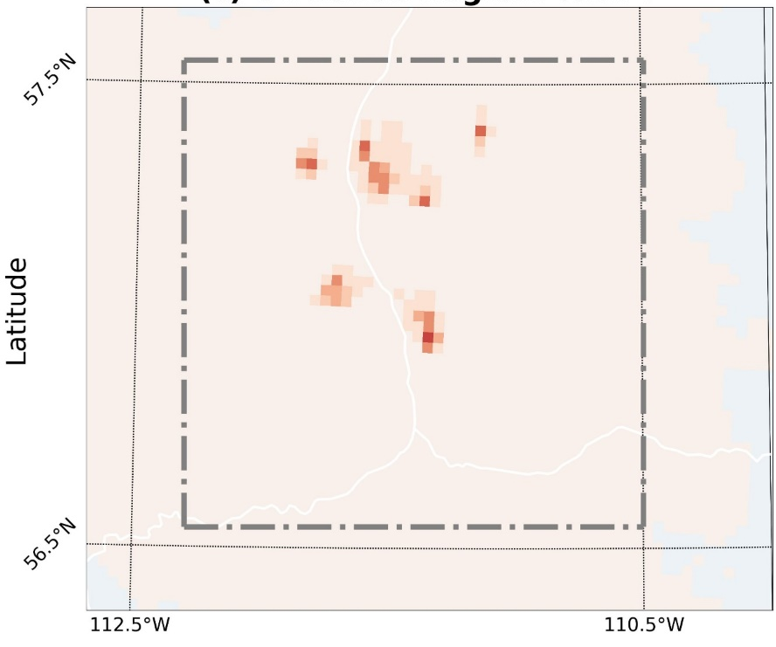
Impacts on air concentrations of O₃ (% O₃ concentration change by scenario)
Anthropogenic Zero-Out
Oil Sands Zero-Out
Major Point Zero-Out
Fleet Zero-Out
Fleet to Tier 4
All of the scenarios result in very local increases in the O₃ concentration to background levels.
Less NOx titration.
Other scenarios: minimal impact

Slide 15
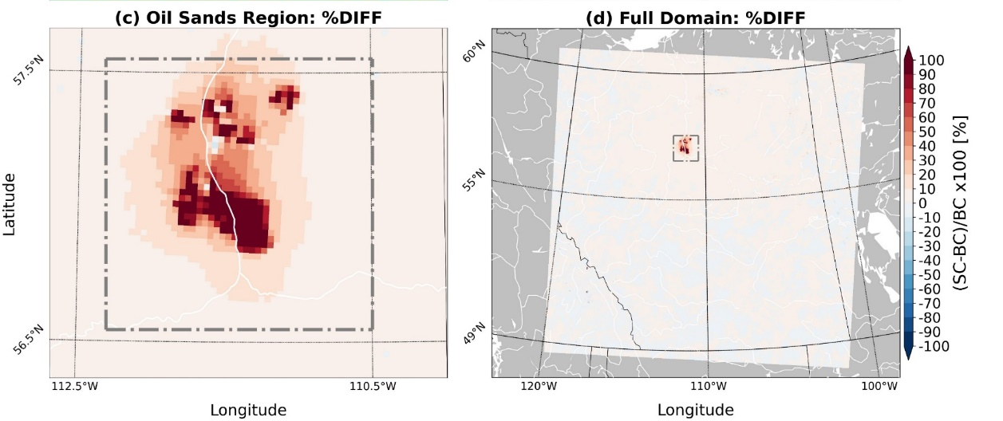
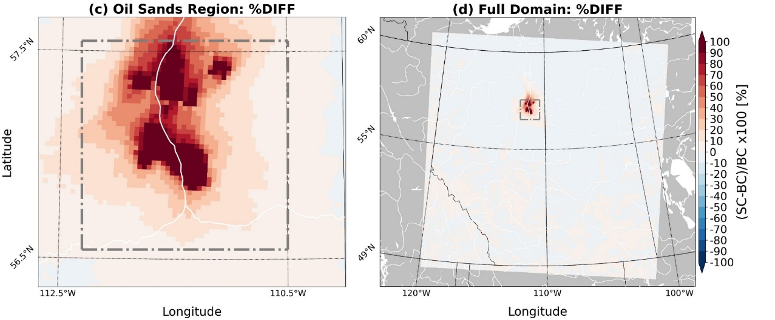
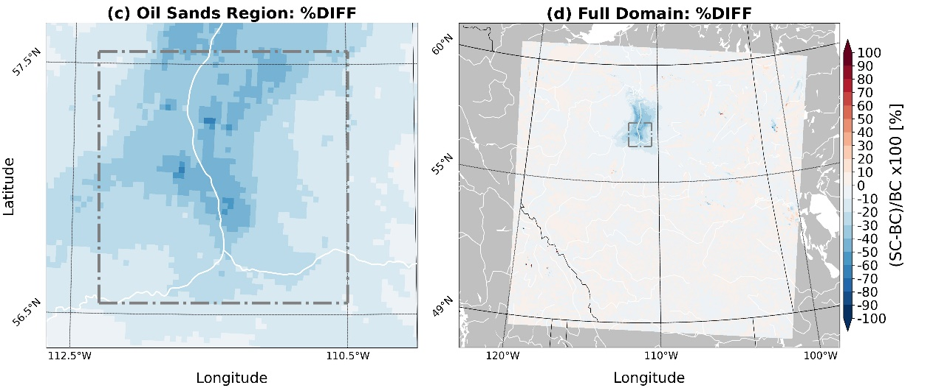
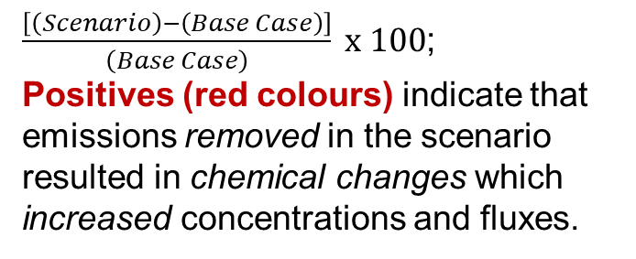
Removing all fugitive dust from Oil Sands open Pit mines
Percent change in particle ammonium dry deposition flux
Fort MacKay
$\frac{\left[\left(Scenario\right)−\left(Base Case\right)\right]}{\left(Base Case\right)} x 100$;
Positives (red colours) indicate that emissions removed in the scenario resulted in chemical changes which increased concentrations and fluxes.
Edmonton
Fort McMurray
Calgary
When fugitive dust is removed, the species contributing to N deposition change.
Removal of base cations means less particle nitrate, more particle ammonium, and more nitrate remains as nitric acid (HNO₃).
However, the total N deposition does not change (not shown) – just the type of N being deposited.
Percent change in HNO₃ dry deposition flux
Fort MacKay
Edmonton
Fort McMurray
Calgary
Percent change in in dry particle nitrate deposition flux
Fort MacKay
Edmonton
Fort McMurray
Calgary
15

Slide 16
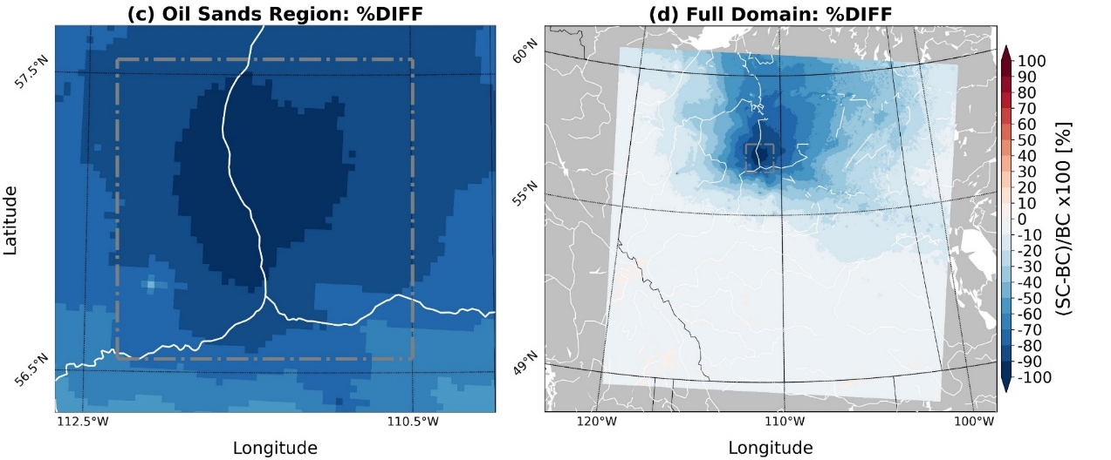
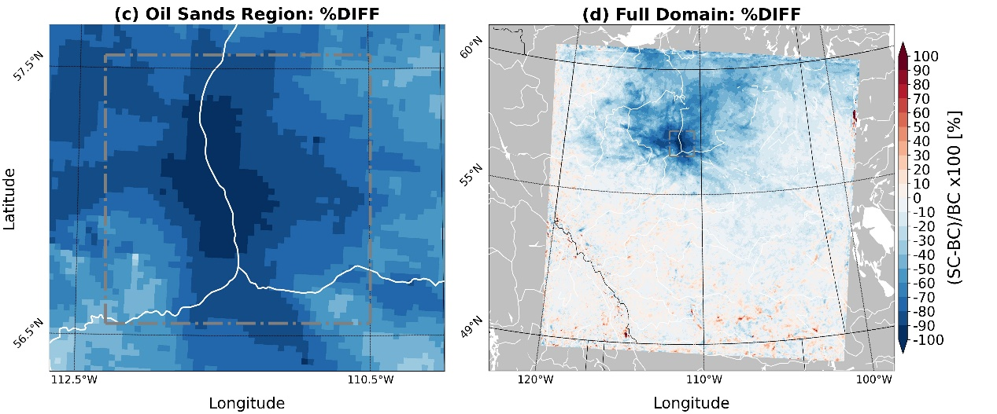
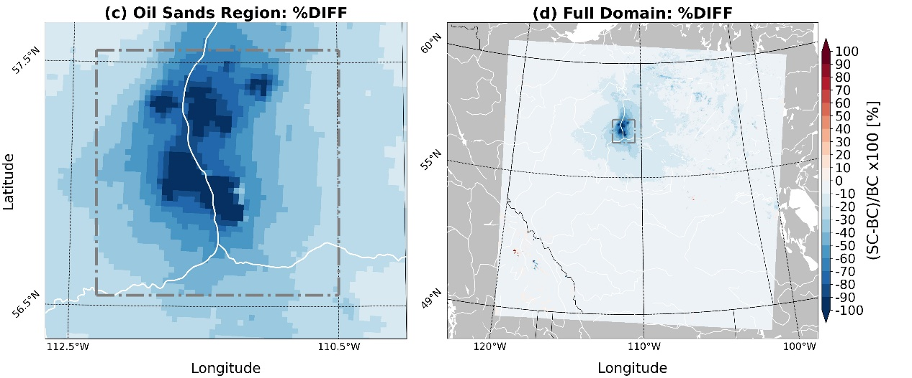
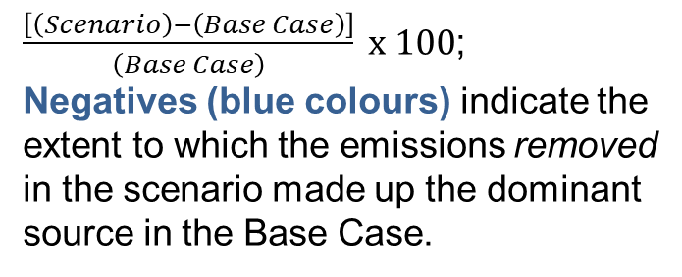
Oil Sands Zero-Out Scenario
Percent change in total SO₂ dry deposition flux
$\frac{\left[\left(Scenario\right)−\left(Base Case\right)\right]}{\left(Base Case\right)} x 100$;
Negatives (blue colours) indicate the extent to which the emissions removed in the scenario made up the dominant source in the Base Case.
Fort MacKay
Edmonton
Fort McMurray
Calgary
The chemical composition of Oil Sands species contributing to S deposition changes with distance from the sources.
  SO₂ dry deposition and HSO₃⁻ wet deposition have a larger influence further from the sources.
  Particle sulphate dry deposition is more localized, closer to the sources.
  SO₂ and HSO₃⁻ result more from large stack emissions, particle sulphate also has a significant fugitive dust component (not shown).
Percent change in HSO₃⁻ wet deposition flux
Fort MacKay
Edmonton
Fort McMurray
Calgary
Percent change in particulate sulphate dry deposition flux
Fort MacKay
Edmonton
Fort McMurray
Calgary
16

Slide 17



Base Case and 9 Scenarios
The Oil Sands has multiple sources of surface and elevated (stack) emissions.
10 one-year simulations were carried out to identify their relative impact:
  Base Case
  Oil Sands emissions Zero-out (removes all Oil Sands emissions)
  Mine Fleet Exhaust to Tier 4 (mine fleet converted to low emissions vehicles)
  Fugitive Dust Zero-Out (removes all fugitive dust from open pit mine operations: perfect dust control scenario)
  Mine Fleet Zero-Out
  Anthropogenic Zero-Out
  Major Point Source Zero-Out
  Tailings Pond Zero-Out
  Wetlands land use modification
  Co-Deposition of SO₂ and base cations
Not discussed here due to time constraints - but all post-processed output from the model runs is available at the following link:
https://data-donnees.az.ec.gc.ca/data/air/monitor/ambient-air-quality-oil-sands-region/modelled-concentration-deposition-fluxes-and-deposition-velocities-database-global-environmental-multiscale-modelling-ai-quality-and-chemistry-model-oil-sands-region?lang=en
$$\frac{\left[\left(Scenario\right)−\left(Base Case\right)\right]}{\left(Base Case\right)} x 100 ⇒Impact of the given source sector…$$
Two types of analyses will be shown here:
$$…on deposition fluxes$$
$$…on air concentrations$$
$\left[F\left(Base Case\right)−F\left(Scenario\right)\right]⇒Impact of the given source sector…$
$$…on exceedances of critical loads$$
$$…on human health dose−response$$
Evaluation of GEM-MACH-OS: See Fathi et al (Wednesday) poster: X5.33 | EGU25-7297

