Slide 1
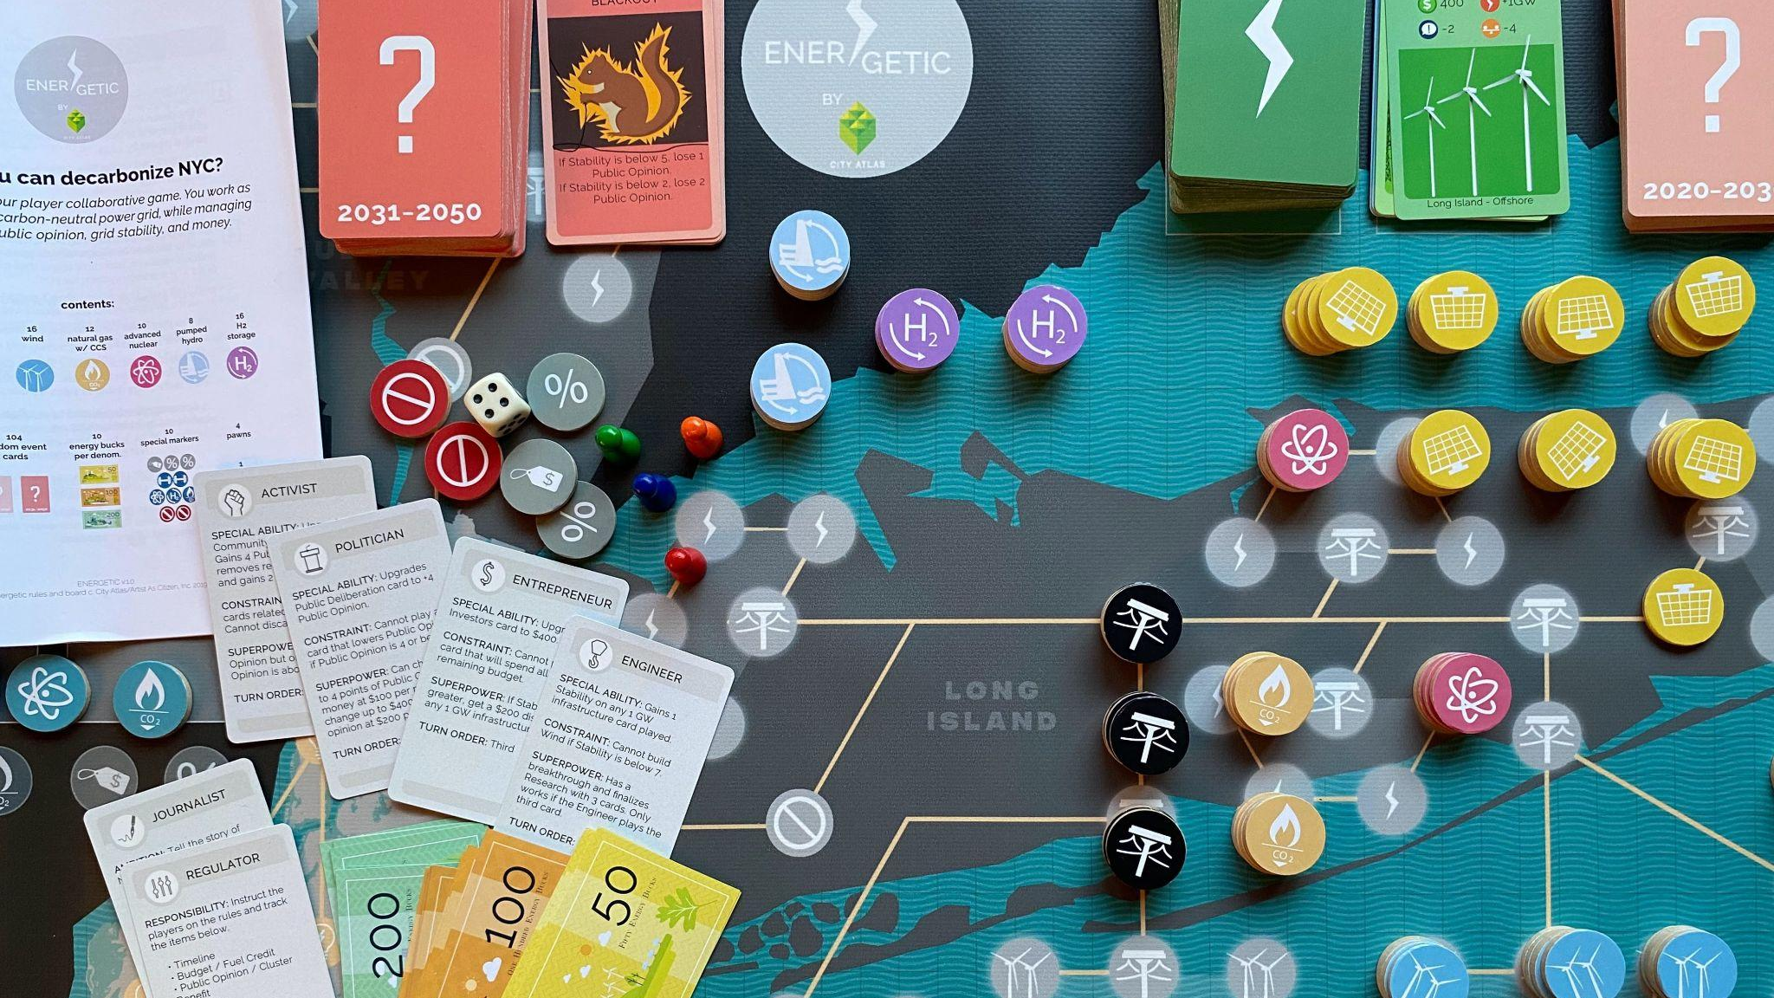

Slide 2
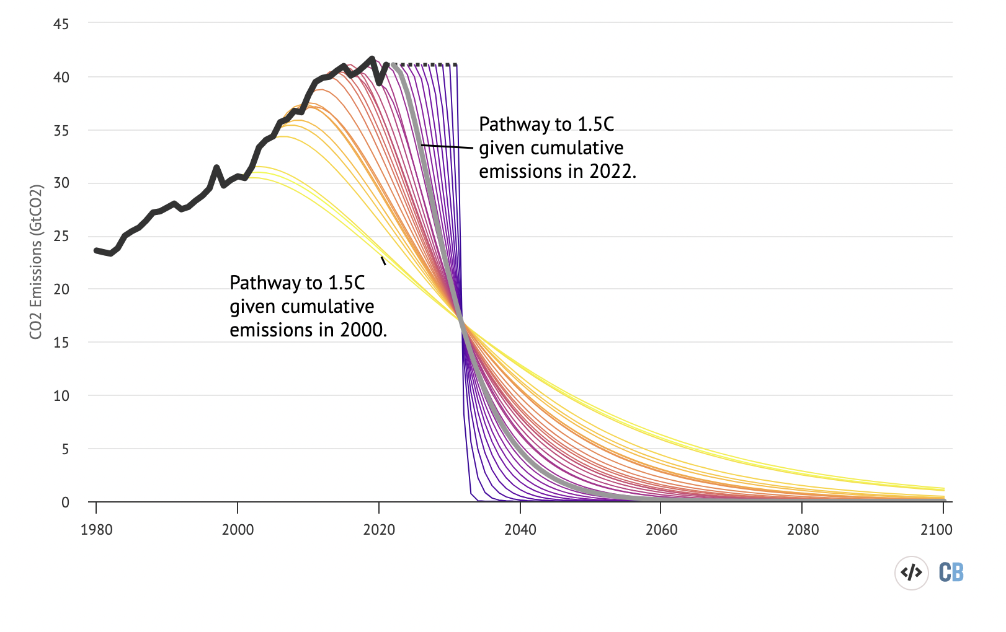
THE PROBLEM
Meeting climate goals requires rapid action on clean energy infrastructure
Rapid action requires broad public support
Cooperation between government, businesses, & the public
Games as public spaces for practice
Carbon Brief, October 2022
Notes:
Note: At further scale, we want to provide opportunities to build communities, explore further learning and develop climate-tech/other solutions.

Slide 3

LEARNING TO MANAGE COMPLEX SYSTEMS
Intuition is a poor guide to managing complex systems
Simulations and games as practice spaces
Trial-and-error develops skill at balancing multiple objectives

Slide 4
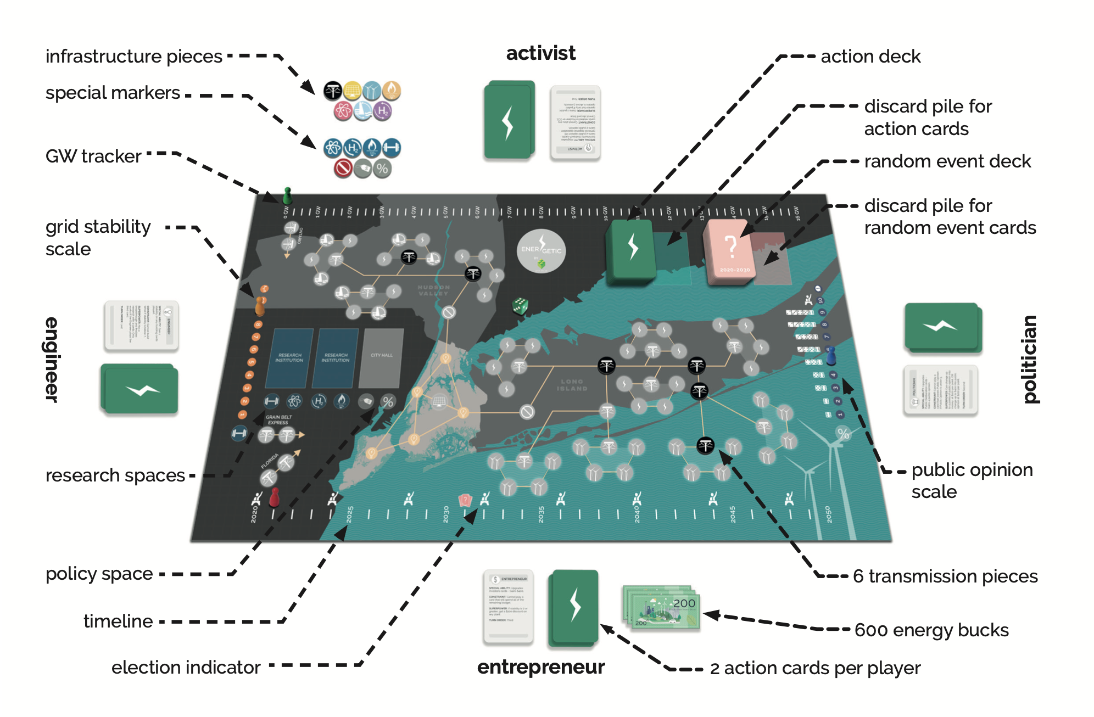
ENERGETIC: CAN YOU KEEP THE LIGHTS ON IN 2035?
4-6 players work cooperatively to deliver 16 GW of clean electricity to New York City by 2035
Must manage:
Budget
Public approval
Grid stability (no blackouts)

Slide 5
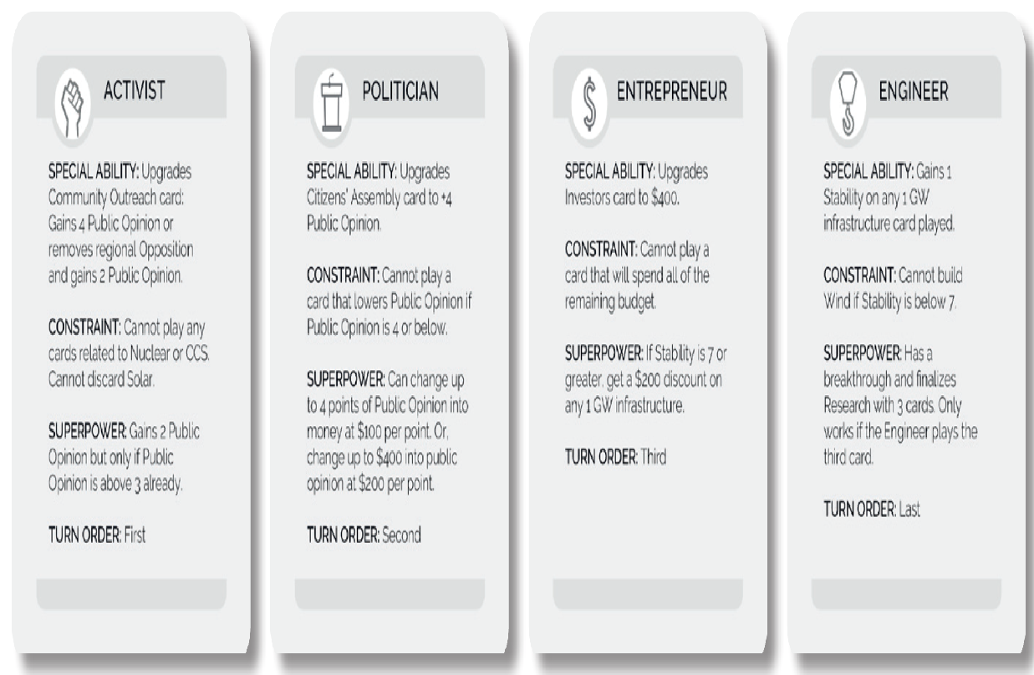
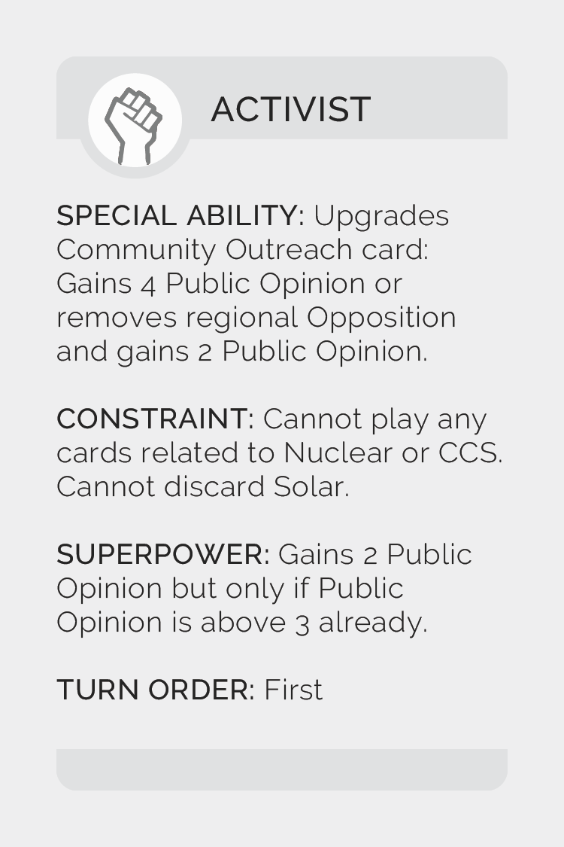
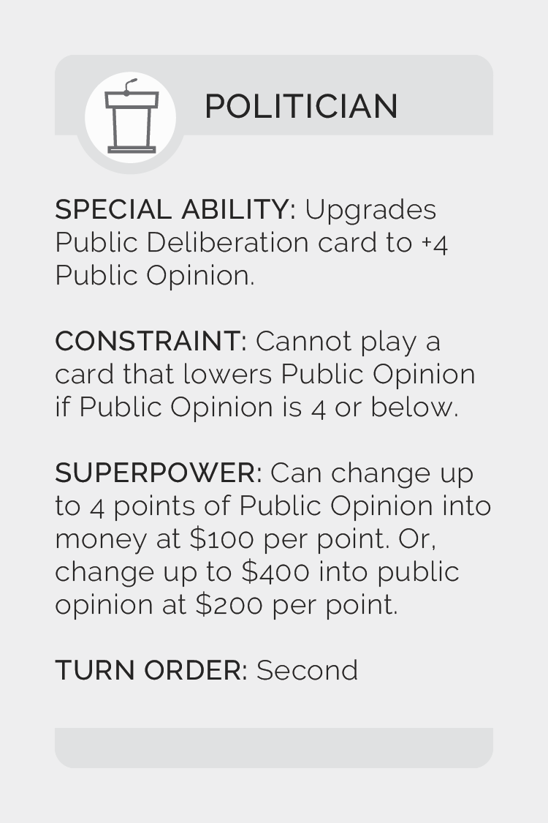
COOPERATIVE GAME: 4-6 PLAYERS
Activist
Politician
Entrepreneur
Engineer
Optional roles:
Regulator
Journalist

Slide 6
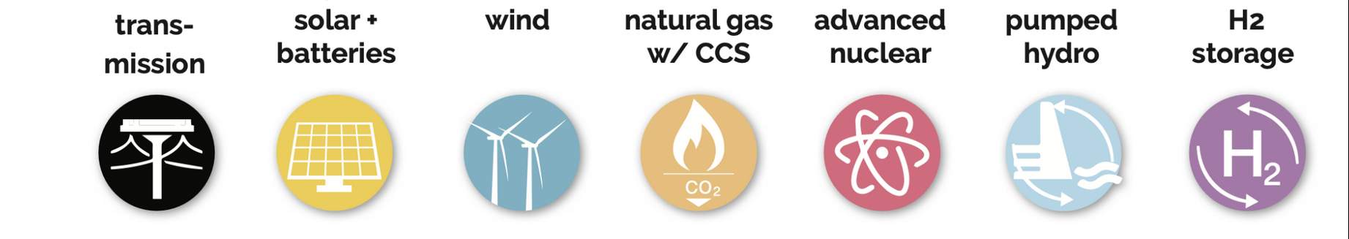
INFRASTRUCTURE
Build solar, wind, and other clean energy
Pumped hydro for storage
Gas with CCS, advanced nuclear, & H2 storage require research
Build transmission capacity
Each type of infrastructure has
Cost
Affects:
Grid stability
Public opinion
Some have geographic constraints

Slide 7
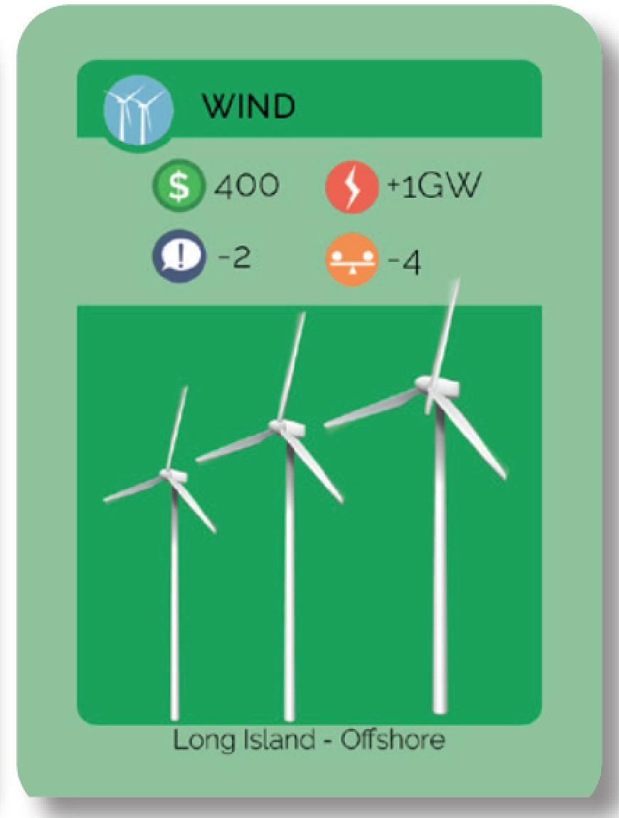
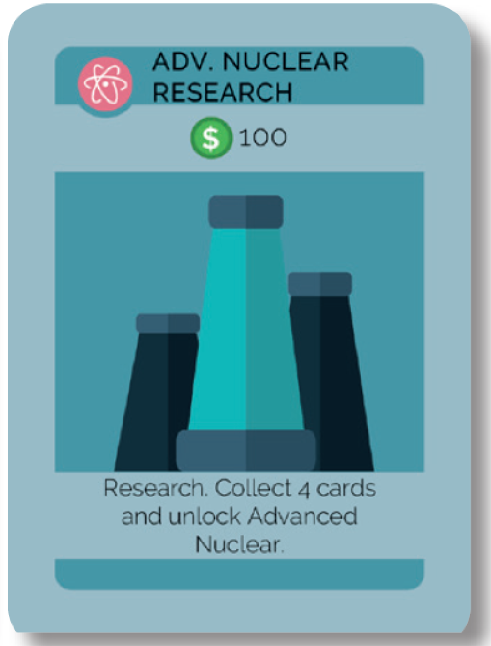


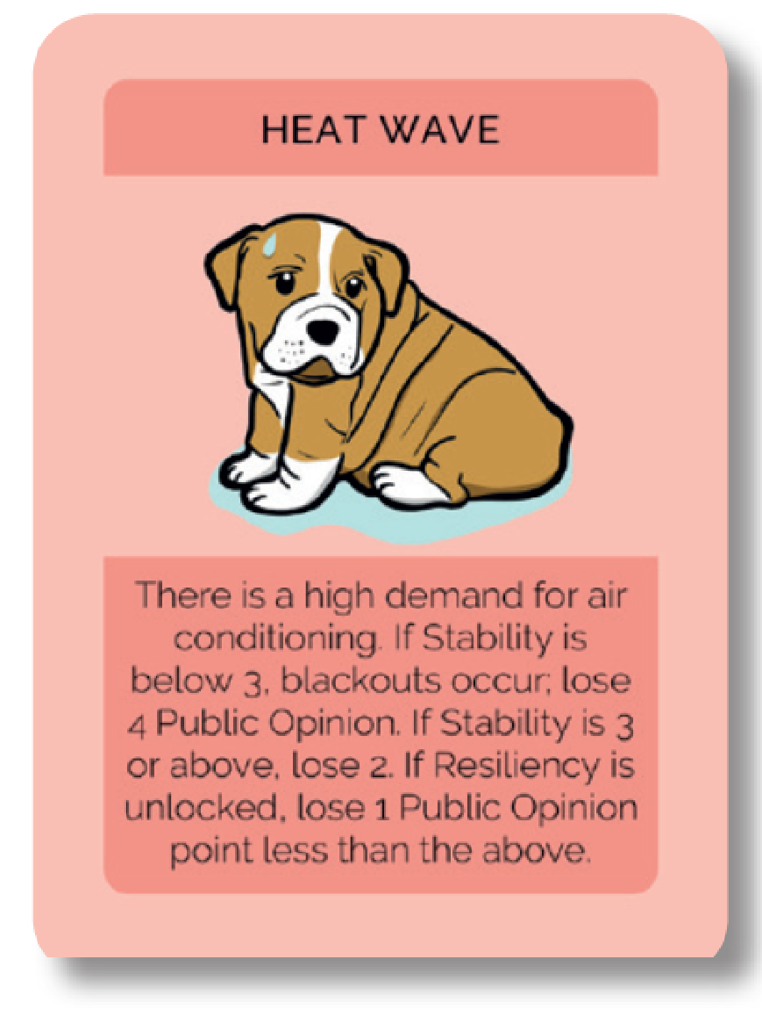
GAME PLAY
Each turn is one year, beginning in 2021
Each player plays an action card
Infrastructure, research, campaign
Each player has:
Constraints
Special ability (each turn)
Superpower (once per election cycle)
At end of turn, draw a random event card
Election every 4 years
Re-election chances depend on public opinion
Losing election slows progress

Slide 8
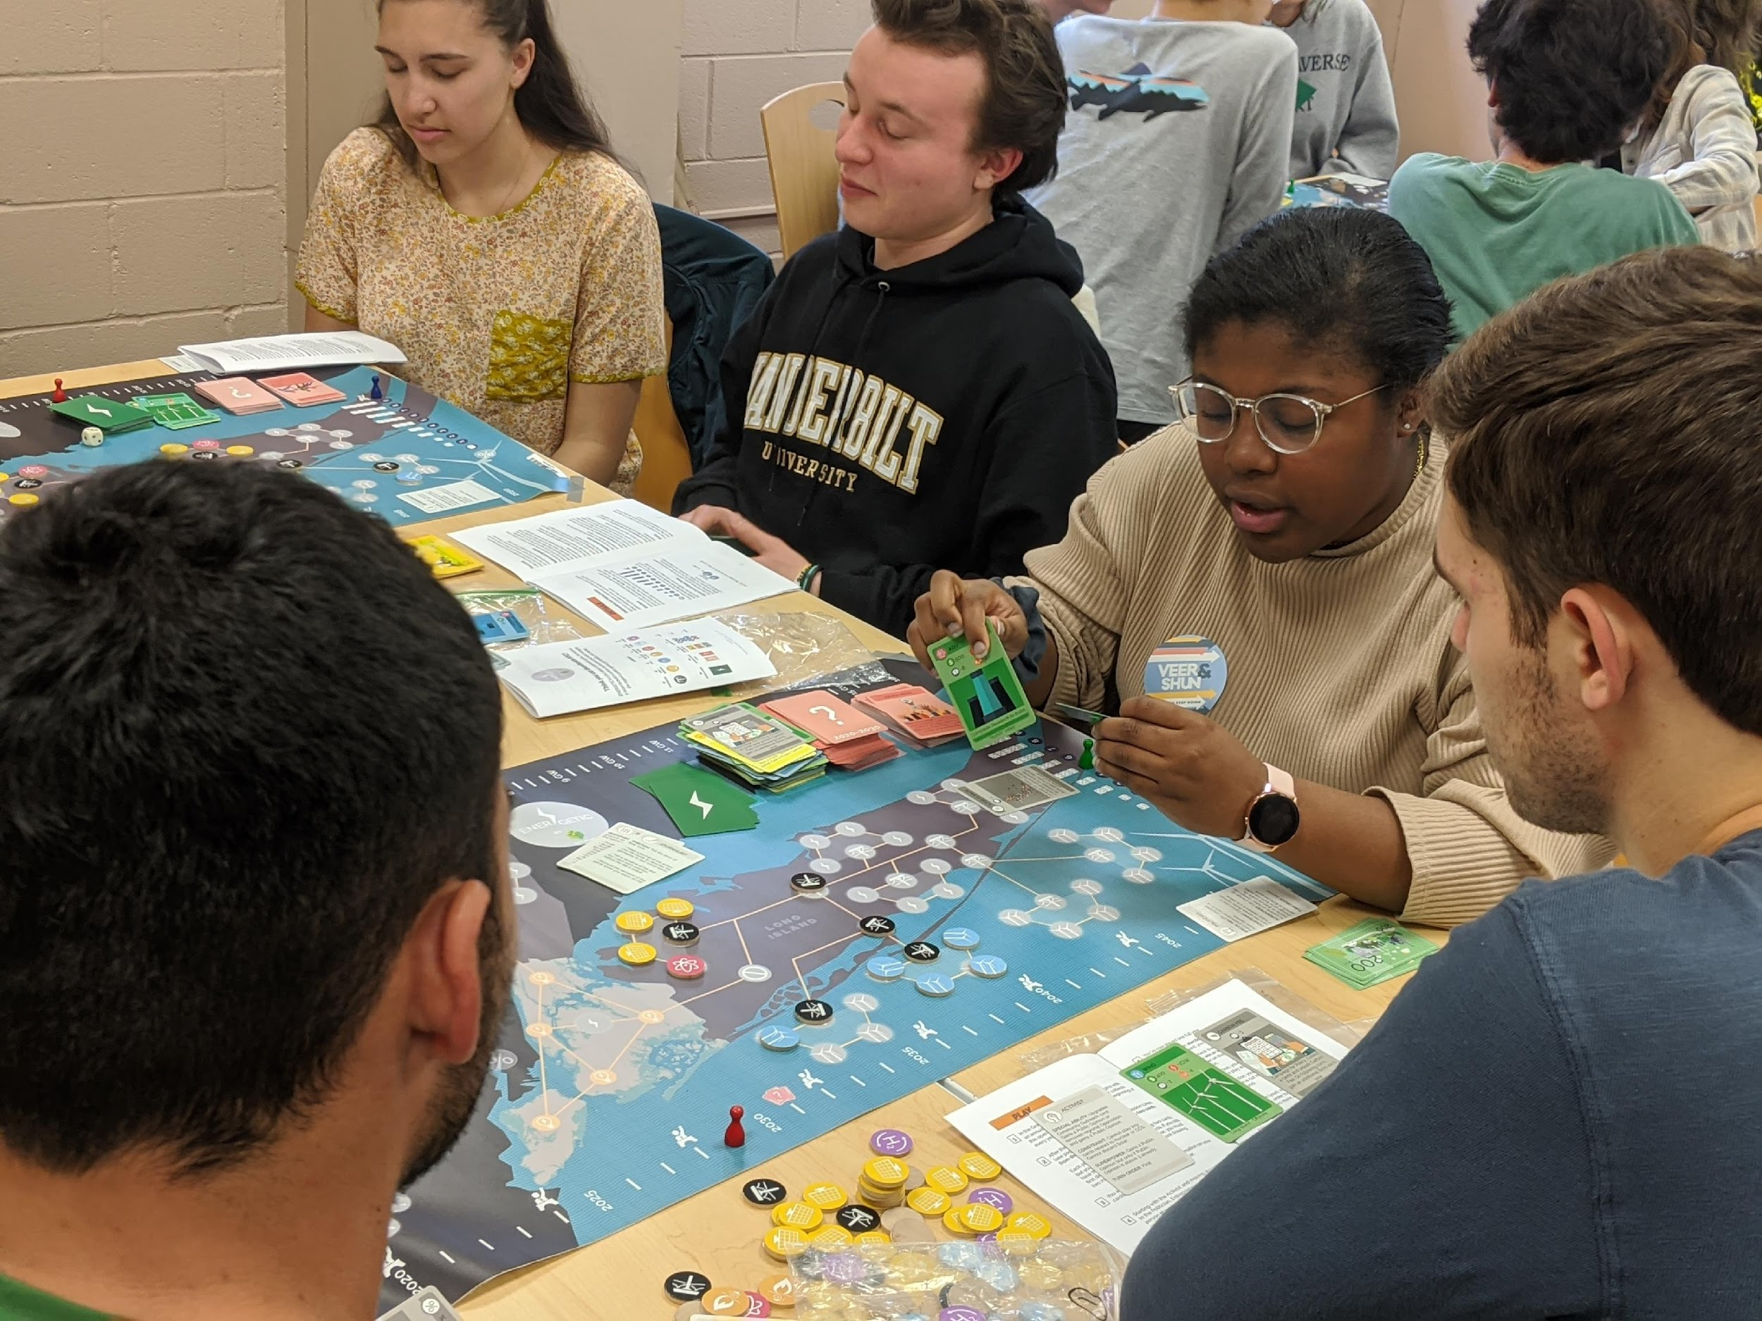
GAME IN USE
Over 700 game sets distributed
30 universities in US, UK, Ireland, India
30 high schools
businesses, utility companies, community organizations
Free online version via Tabletop Simulator
Mass production of 1200 sets for distribution in 2025

Slide 9











used in courses at:
used in events at:

Slide 10




INDUSTRY USE OF ENERGETIC
A power markets executive at a think tank in India said:
“It’s hard to explain this stuff to the uninitiated.
Now, I have found a way to explain ‘systems stability’….. This gives me a model to explain it, how much it costs, the cost to the environment, the politics around it, etc… there’s great recall value to this product.”

Slide 11
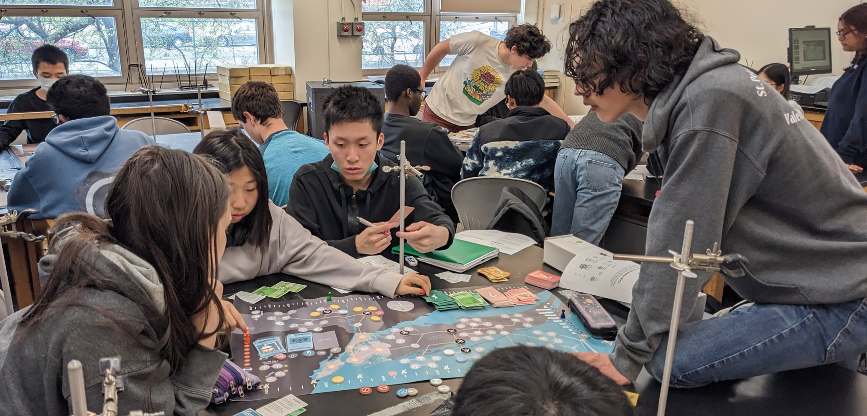
FIELD-TESTS IN SCHOOLS
NEW YORK
Before and after comparison from Matthew Sarker’s two AP Physics classes at Bronx Science. They played one game of Energetic. 60 completed responses; 3/31/23

Slide 12
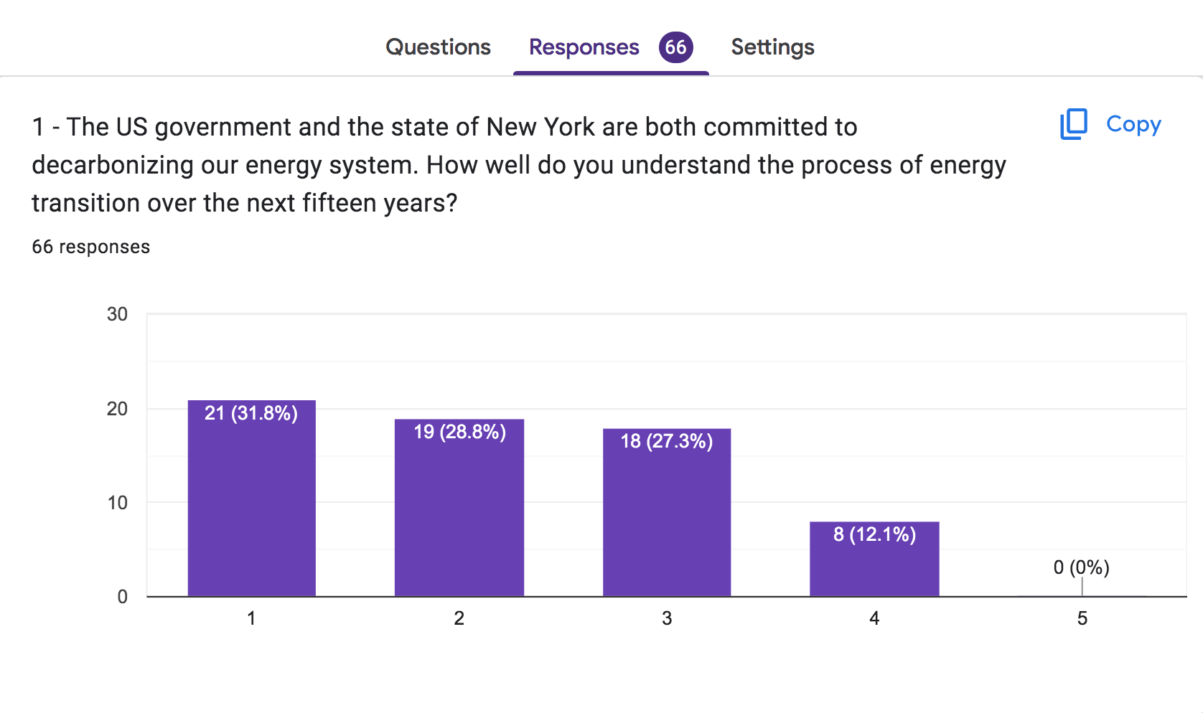
BEFORE PLAYING ENERGETIC
“I have no idea what may happen” “I have a clear idea what may happen”

Slide 13
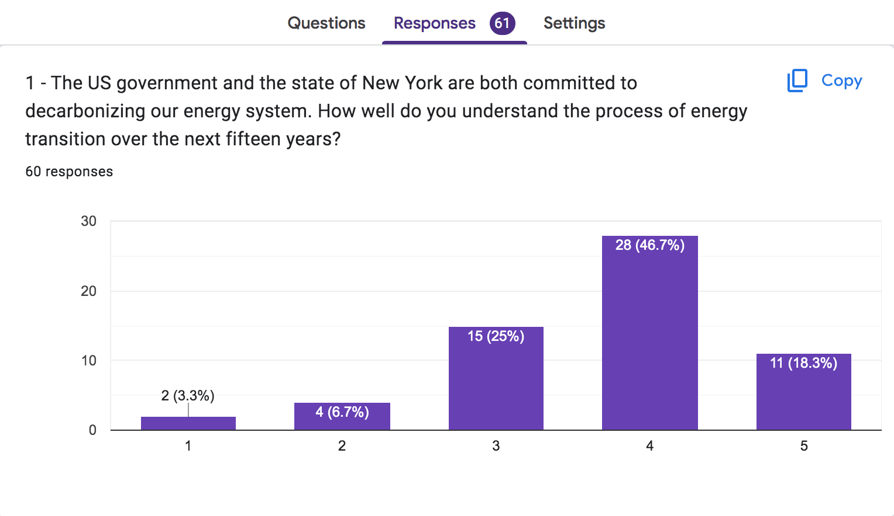
AFTER PLAYING ENERGETIC
“I have no idea what may happen” “I have a clear idea what may happen”

Slide 14
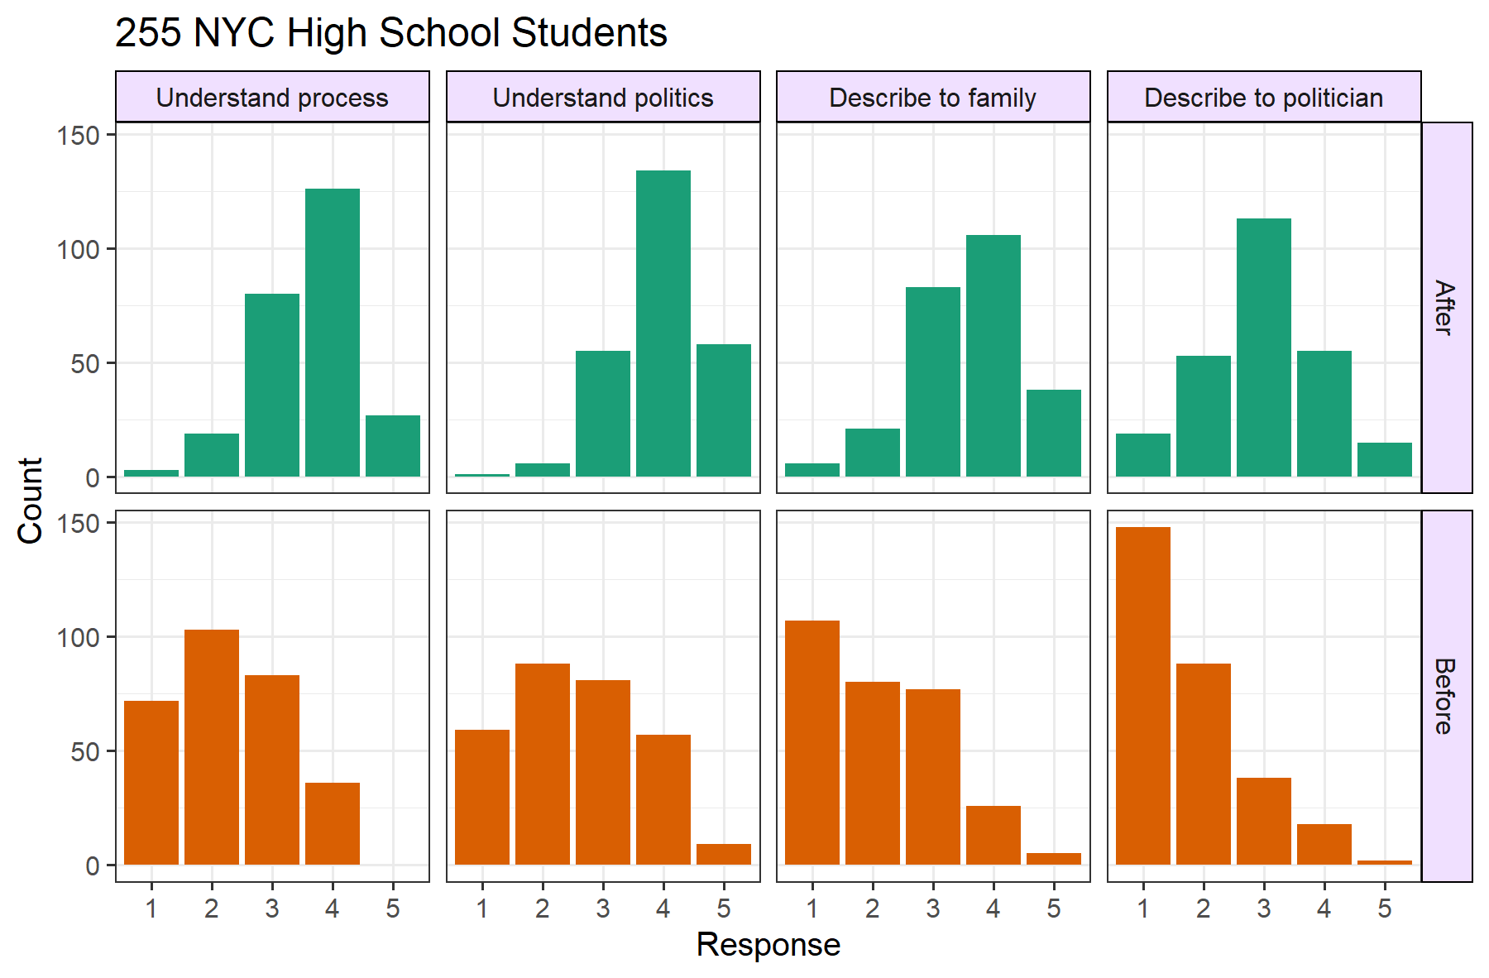
EMPOWERING STUDENTS TO TALK ABOUT CLIMATE AND CLEAN ENERGY
Notes:
Tested on 255 students at 6 NYC high schools
Before and after surveys on confidence about 4 aspects:
Technical infrastructure process
Interactions with politics, public opinion
Ability to describe clean-energy transition to family
Ability to describe it to politicians
1 (least confident) to 5 (most confident)

Slide 15
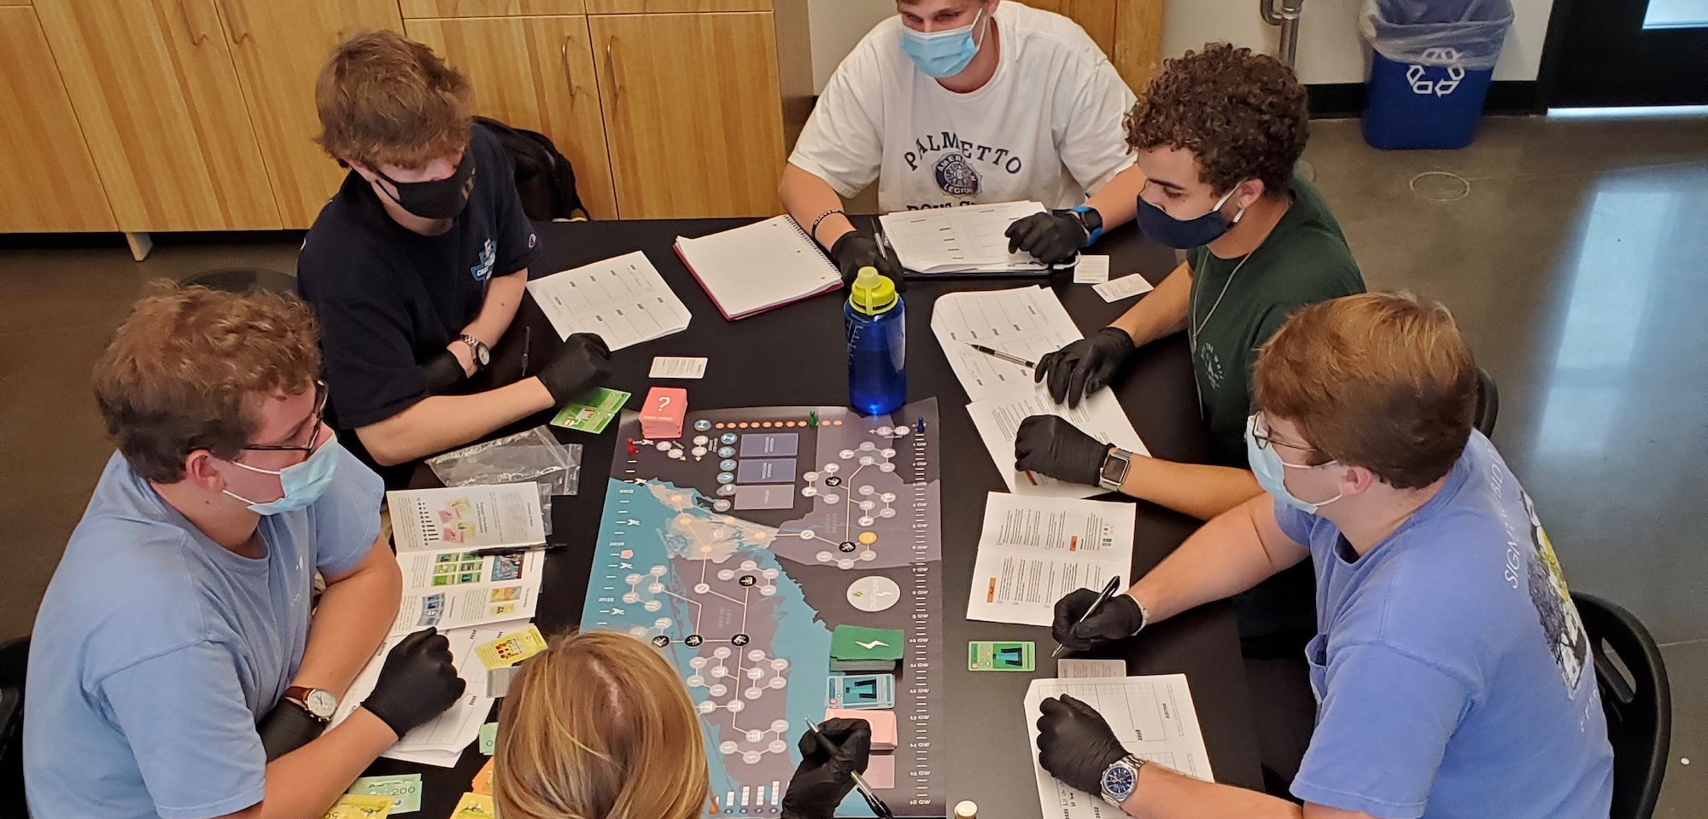
SOUTH CAROLINA
Undergraduate Environmental Science class, Wofford College
Spartanburg, SC. Coursework includes Energetic, 2021 to present

Slide 16
CROSSING POLITICAL DIVIDES
Integrated into J. Bradham’s semester-long environmental science course at Wofford College, South Carolina
Many students have conservative political views, and are skeptical of climate change
Many of these leave interested in climate change, eager to talk to families
Playing Energetic helps them develop informed views about the challenges and feasibility of decarbonizing the grid, and helps them articulate their political views on different policies
Many students who begin the semester with negative views of science get excited about the game
‘I keep thinking “You told me you hated science, but here you are actively and strategically thinking about one of the most important environmental issues of our time!”’

Slide 17
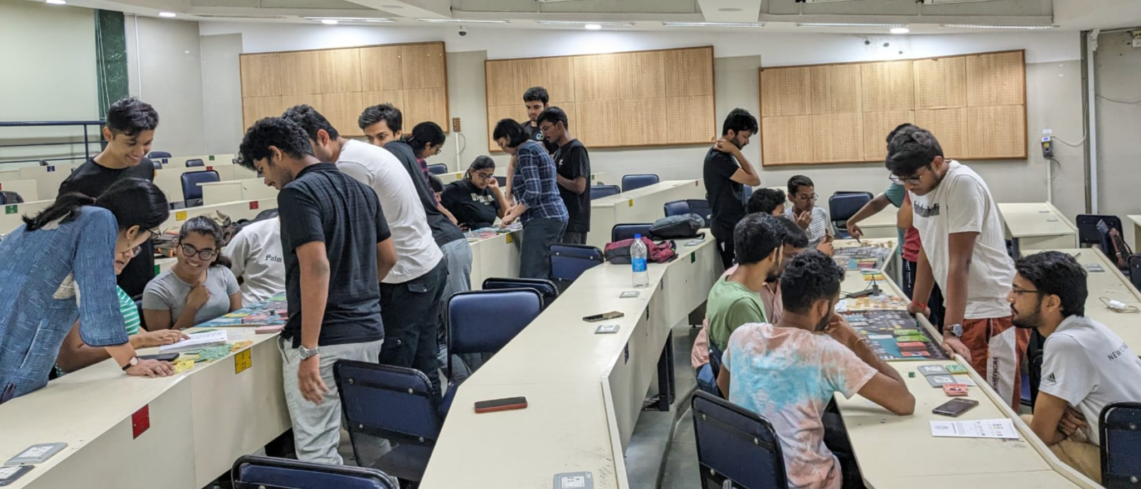
MUMBAI
Before and after comparison after one game of Energetic at IIT Bombay
3/23/24

Slide 18
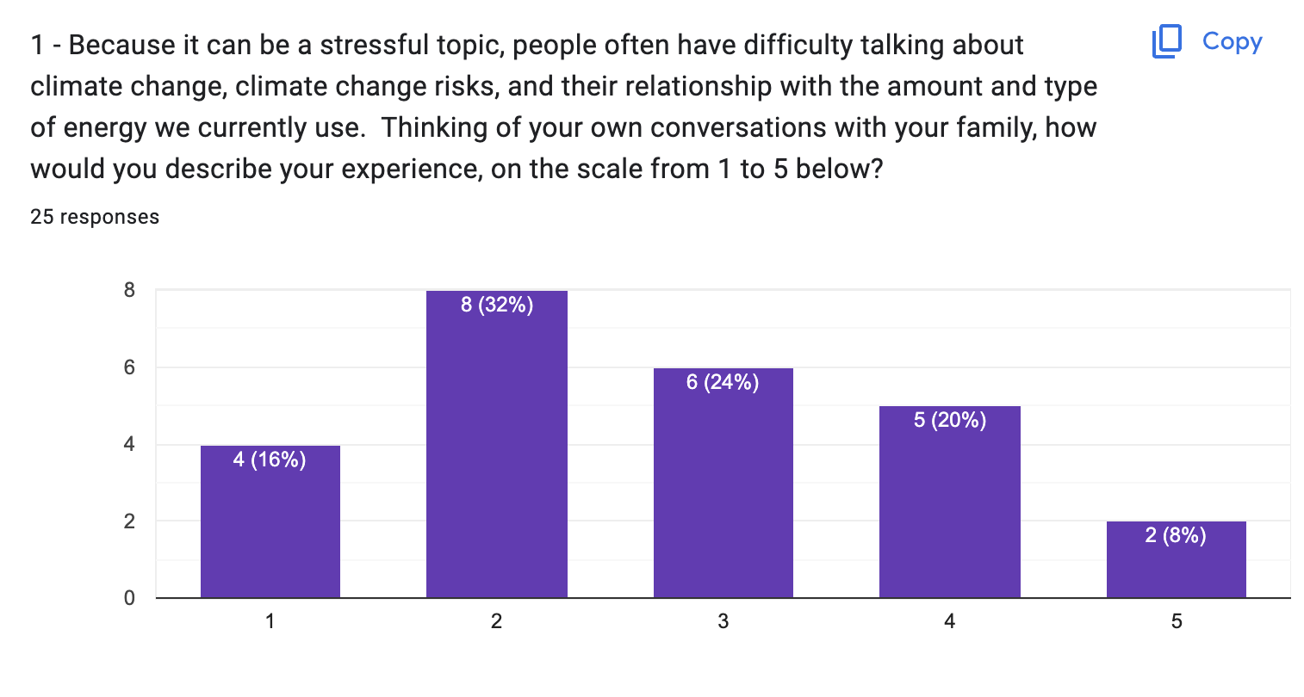

BASELINE
We never talk about climate change We talk about climate change often

Slide 19
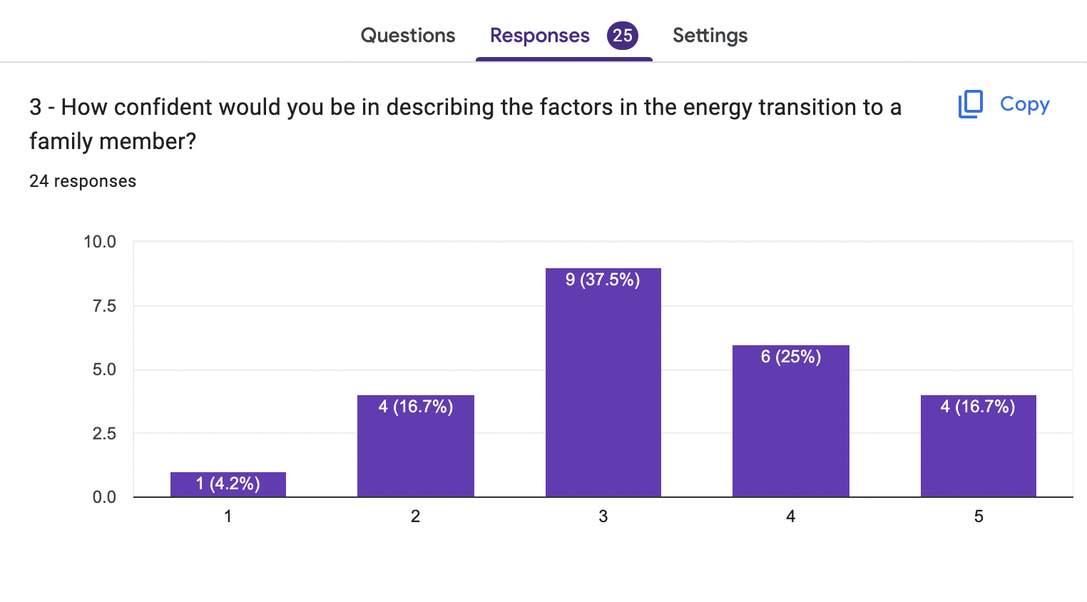
BEFORE PLAYING
I would not be at all confident I would be very confident

Slide 20
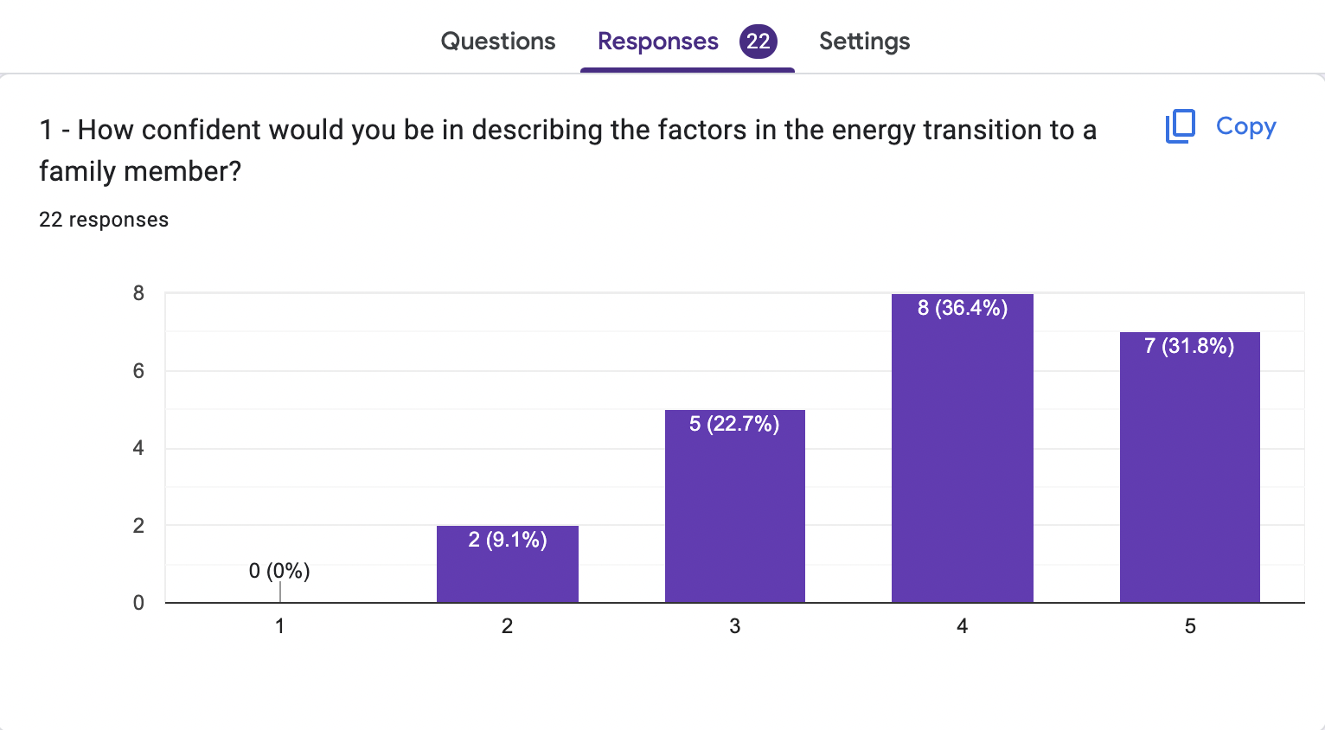
AFTER PLAYING
I would not be at all confident I would be very confident

Slide 21
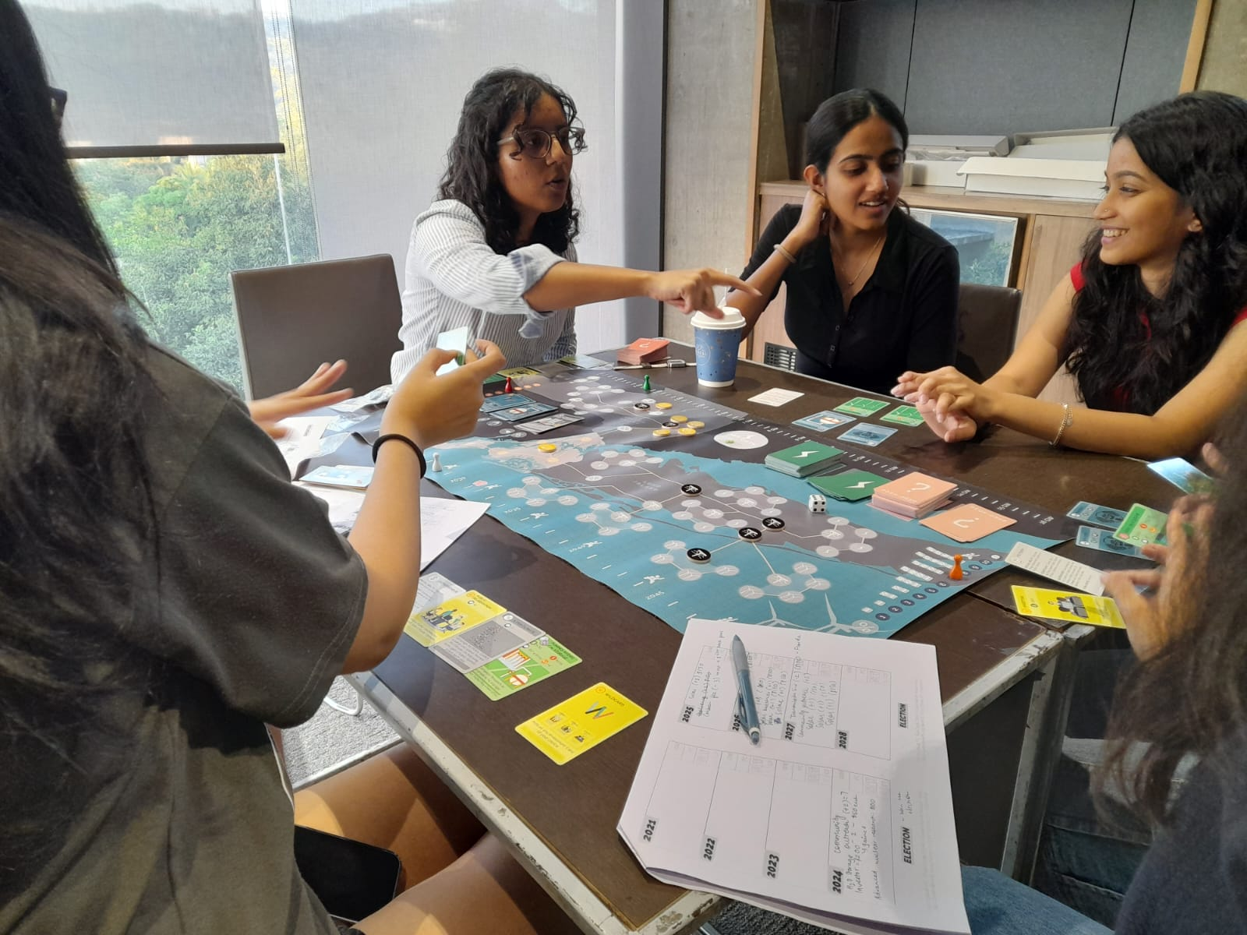
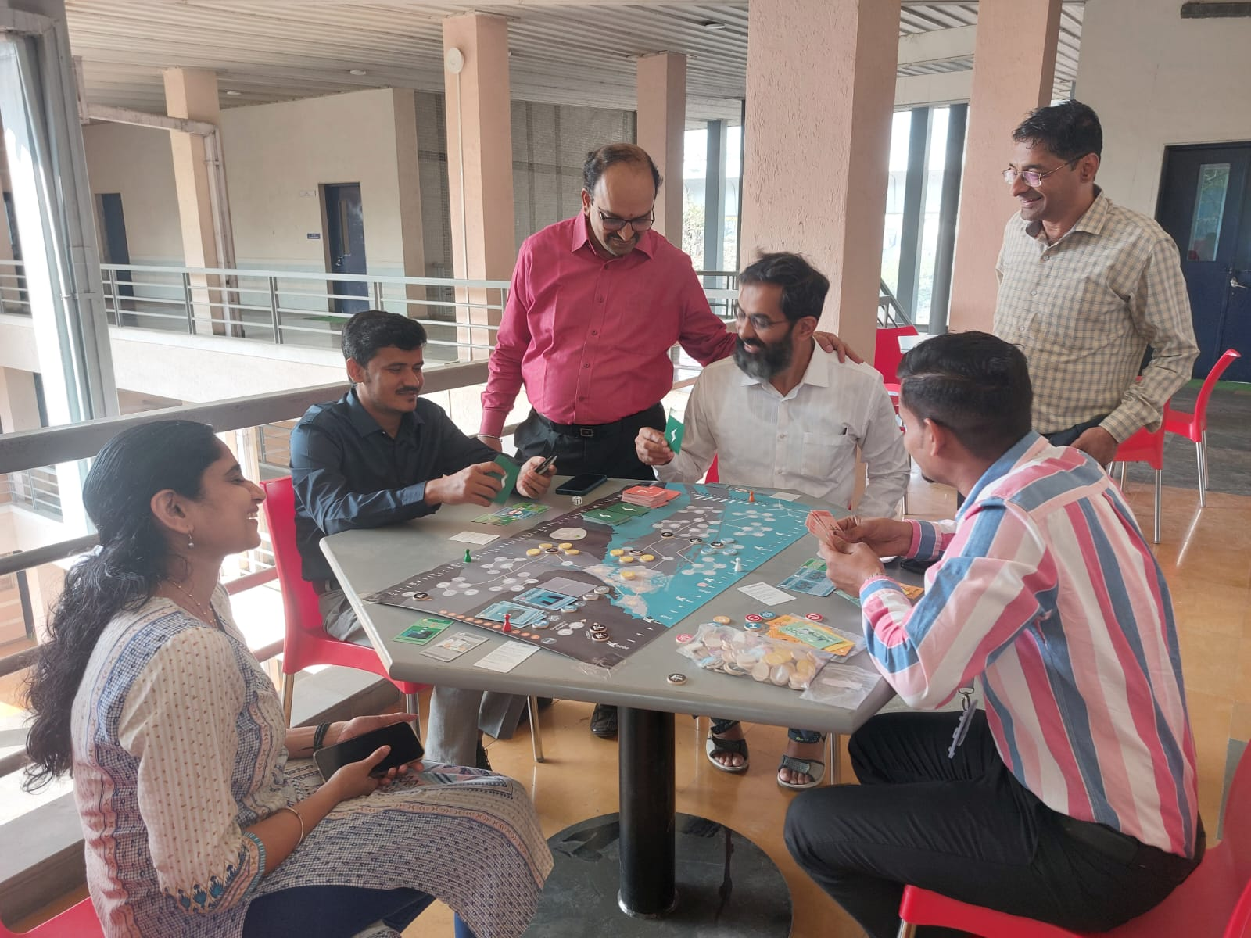
EXAMPLES FROM A TYPICAL GAME
high energy, low stability:
16GW from solar and wind.
blackout from low grid stability.
demand met, but grid unstable.
shows need and scale for grid storage.
budget without build:
an NGO group collected budget early.
couldn’t build due to low stability.
research failed midway.
real-life: limited time before energy insecurity hits.

Slide 22
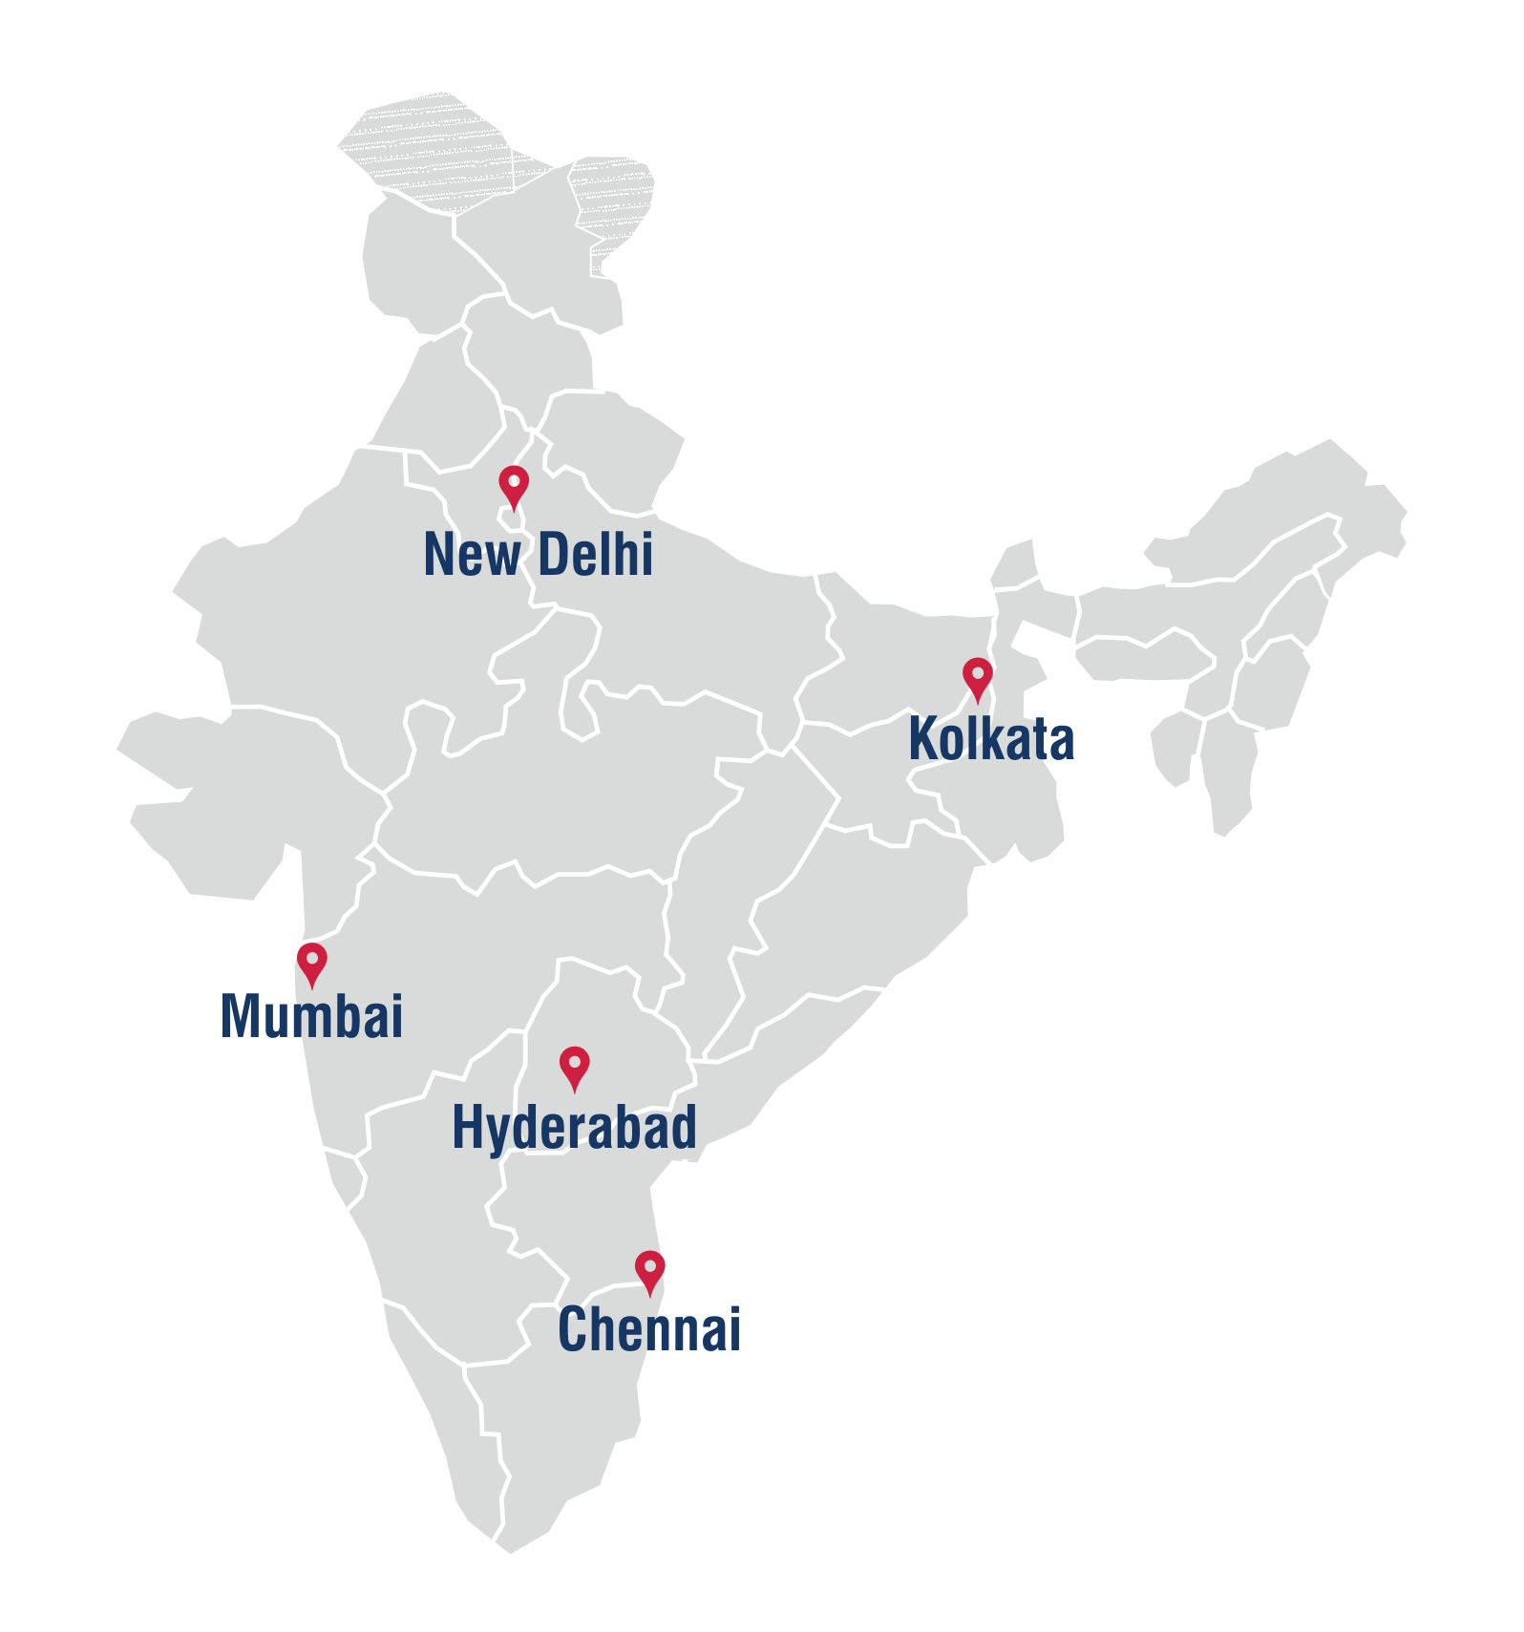
2025 SUMMER RESEARCH: INDIA
using Energetic and other climate games to study impacts on high school students.
focus: how climate literacy influences career and major choices.
aim: show how early awareness can push students toward sustainable futures.

Slide 23

NEW USE CASE: BRINGING ENERGETIC TO TEAMS
semi-professional football player and coach.
recently completed role as director of sustainability at Rebels Football Club.
background in physics, data analysis, and community engagement.
Notes:
Thank you Pratibha!
Hi, I am Ahana Pairee, and I am a Fellow with City Atlas exploring how Energetic can help drive climate action in sports.
I love football! In the photo you see me with the women I coach, who are all working professionals, family managers, mothers, _____________. They come together to play and learn recreationally once a week.
Until recently I also served as the Director of Sustainability at Rebels Football Club in Bangalore.

Slide 24

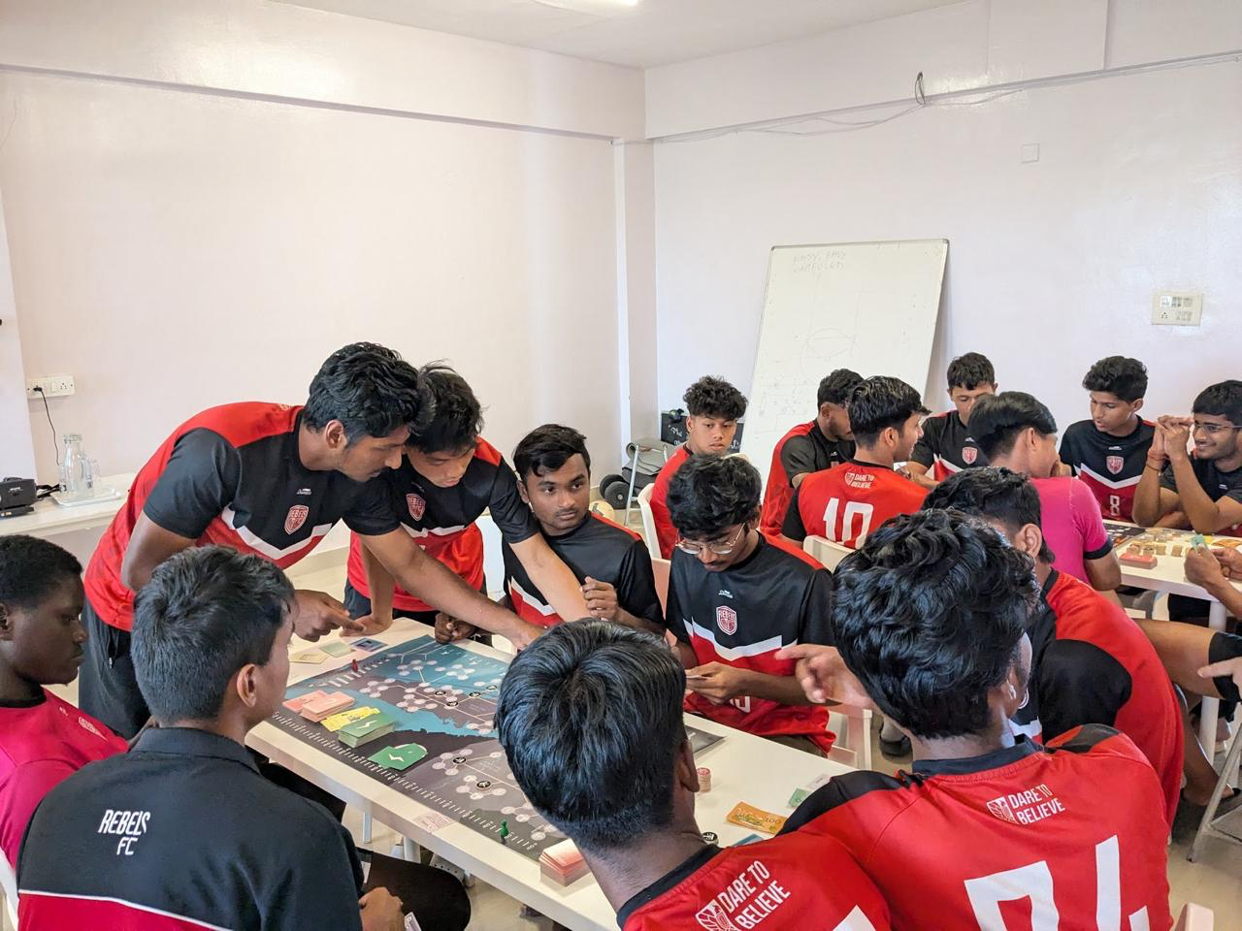
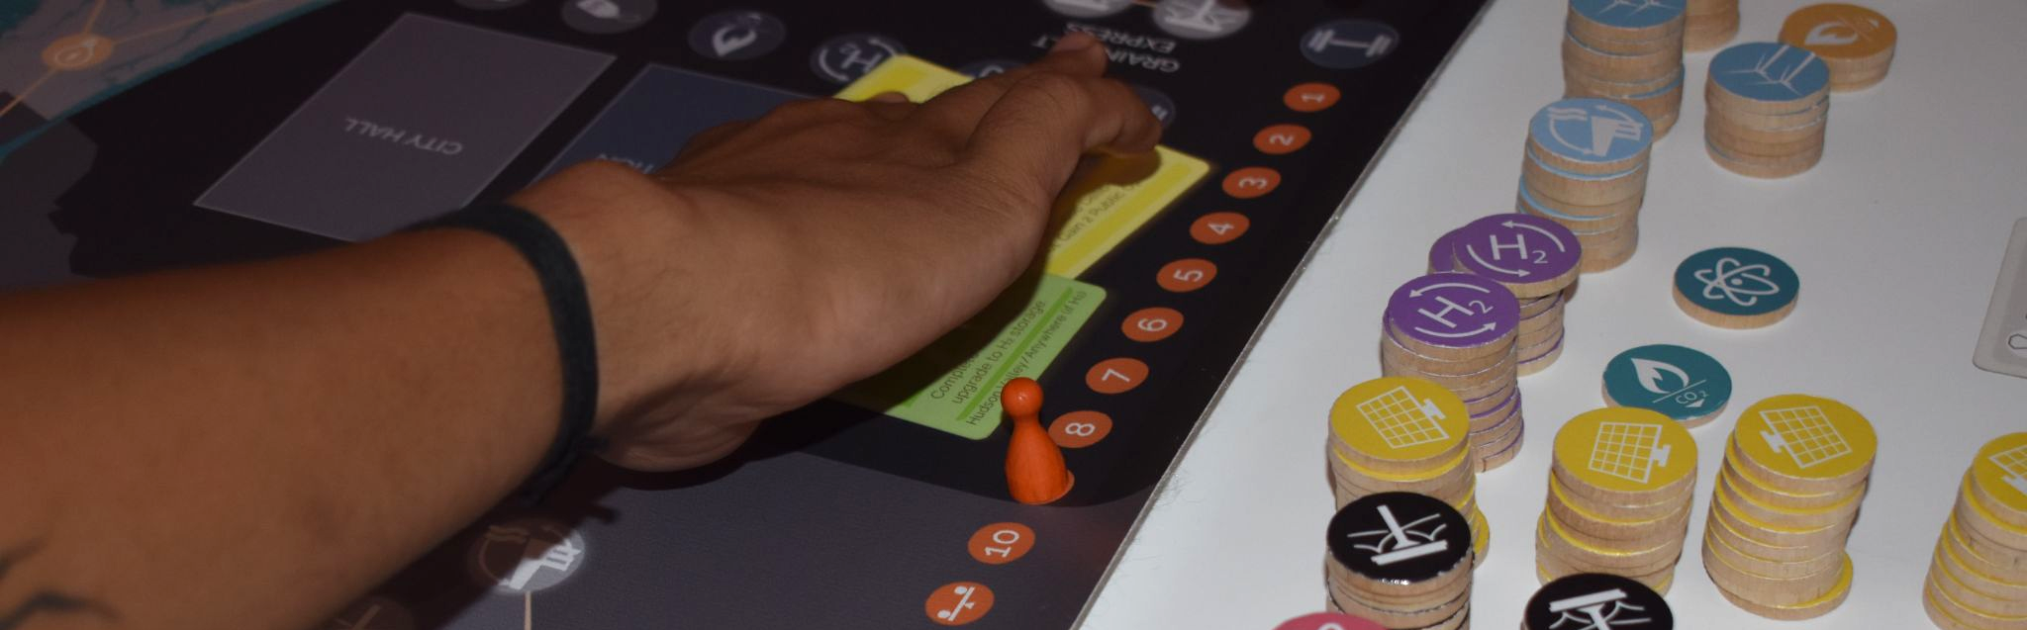
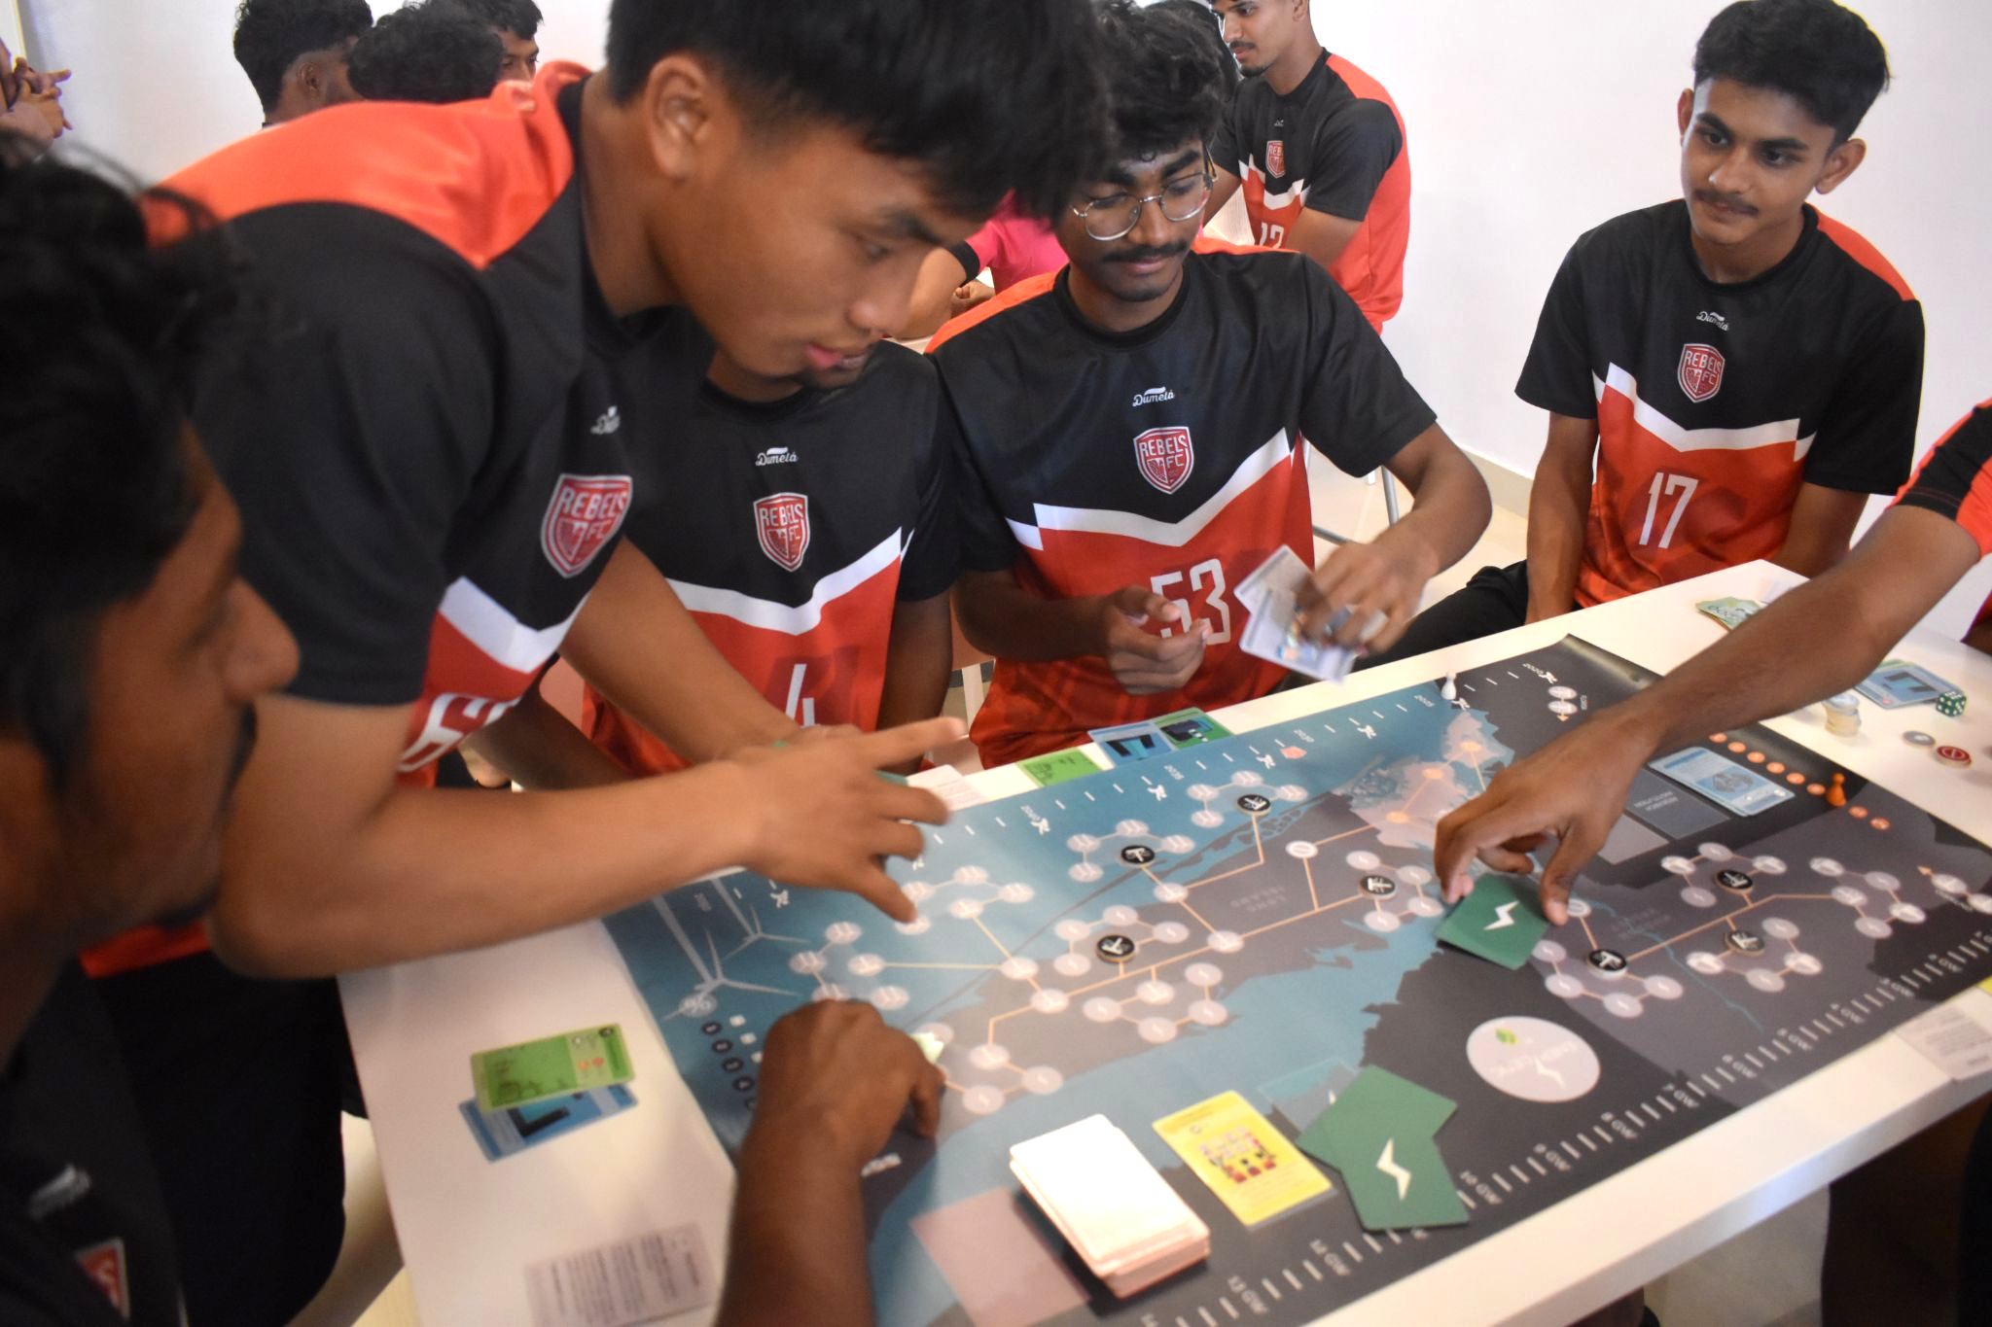
CASE STUDY: REBELS FOOTBALL CLUB
Game helped explain the climate crisis in in accessible, engaging way.
Players became more open to the club’s green transition plans.
24 players (ages 16–24)
Post gameplay, we introduced climate challenges and RFC’s sustainability roadmap.
Players discussed ways to engage in RFC’s green transition plans.
Recognized their own role as key stakeholders in shaping a sustainable sports culture.

Slide 25
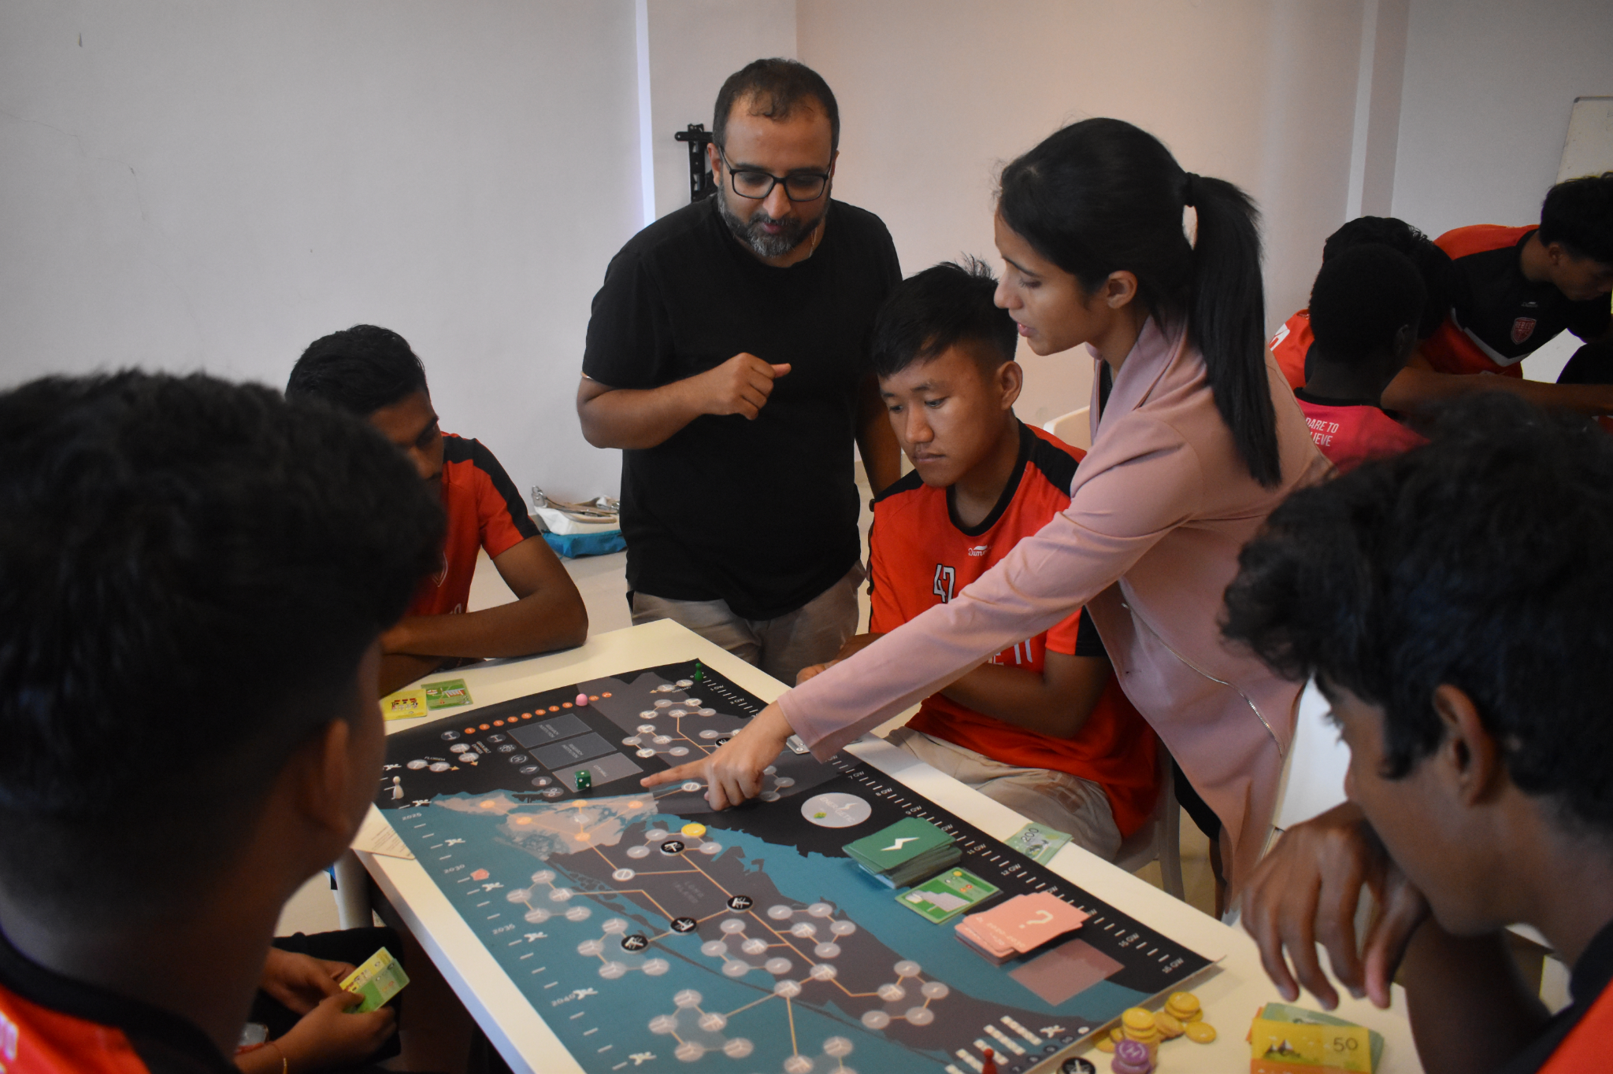
EXPANDING & CREATING NEW ADVOCATES
Where: Bangalore, India
Who: Recreational and professional footballers
What: Gameplay sessions using Energetic to introduce systems thinking and climate concepts
Why: Enable footballers as advocates for sustainability action in their communities and beyond
Insights from this pilot → scale to other sports and cities globally.

Slide 26
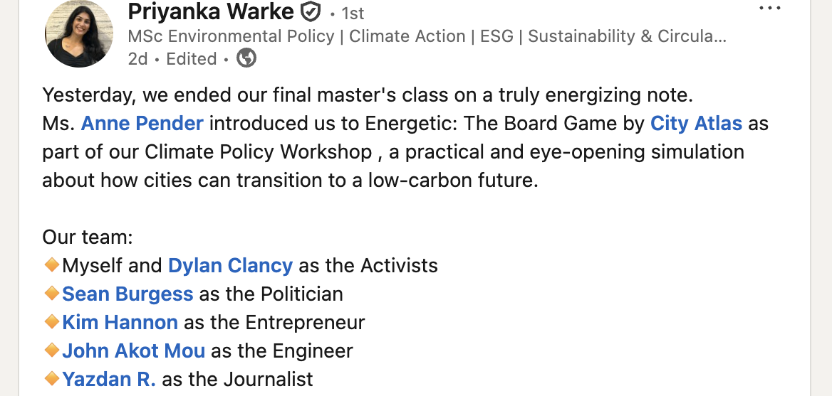
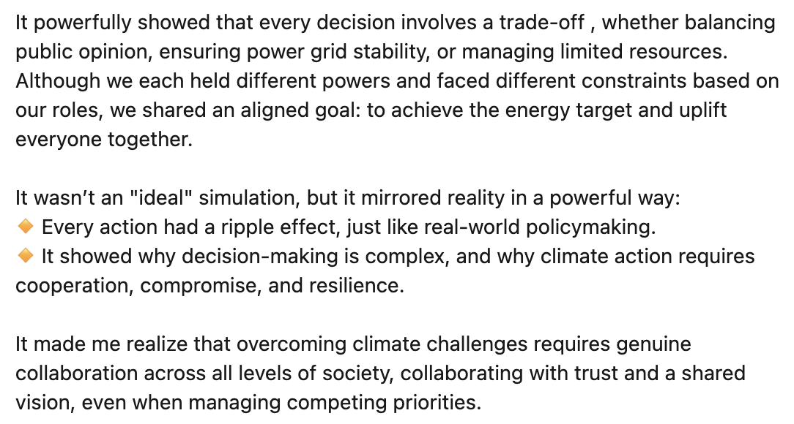
DUBLIN
Masters of Science in Environmental Policy, University College Dublin
plays Energetic for the last day of class,
April, 2025

Slide 27
NEXT STEPS
Explore fully web-based platform capable of multiple city development
Explore adaptation to a red state (Tennessee)
ENERGETIC BUILDINGS, building-scale decarbonization
ENERGETIC BAY AREA
ENERGETIC MUMBAI
GLOBALIZE TO OTHER MAJOR CITIES

Slide 28
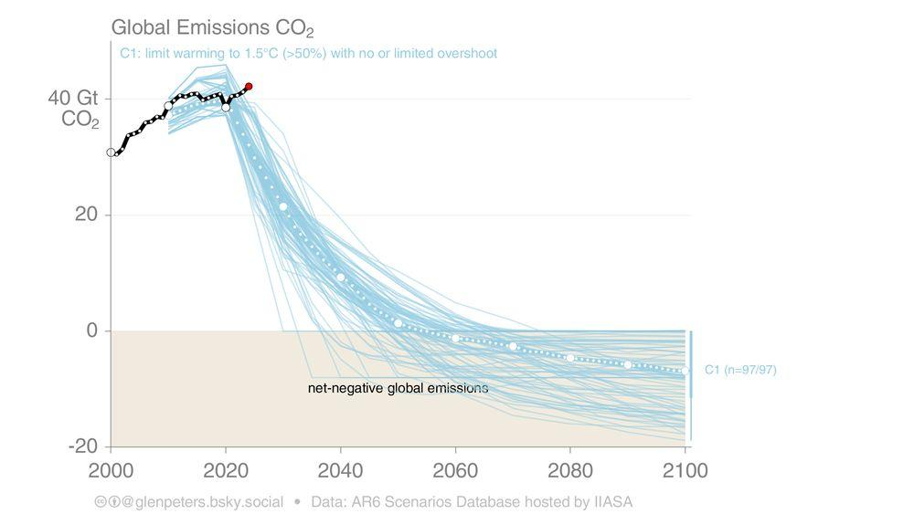
SPEED COUNTS.
https://bsky.app/profile/glenpeters.bsky.social/post/3lmwiggo5w22o

Slide 29

THANK YOU
Game Development:
Creative directors: Isil Akgul, Richard Reiss
Global development: Deepak Sridhar
Game design: Ashley Brown, Connor Haseley, Truly Johnson, Janet Tam
Program management and digital development: Julian Bernard, Archie Kinnane, Yuchen Liu, Theo Miller, Isadora Nogueira, Lalo Remes
Beta testing and technical advice: Jesse Jenkins, Eric Hittinger
J. Gilligan’s work on Tennessee adaptation supported by NSF grant #SRS-RN 2115392
energetic.thecityatlas.org
richard@thecityatlas.org | deepak@thecityatlas.org
linkedin.com/company/city-atlas

