Slide 1

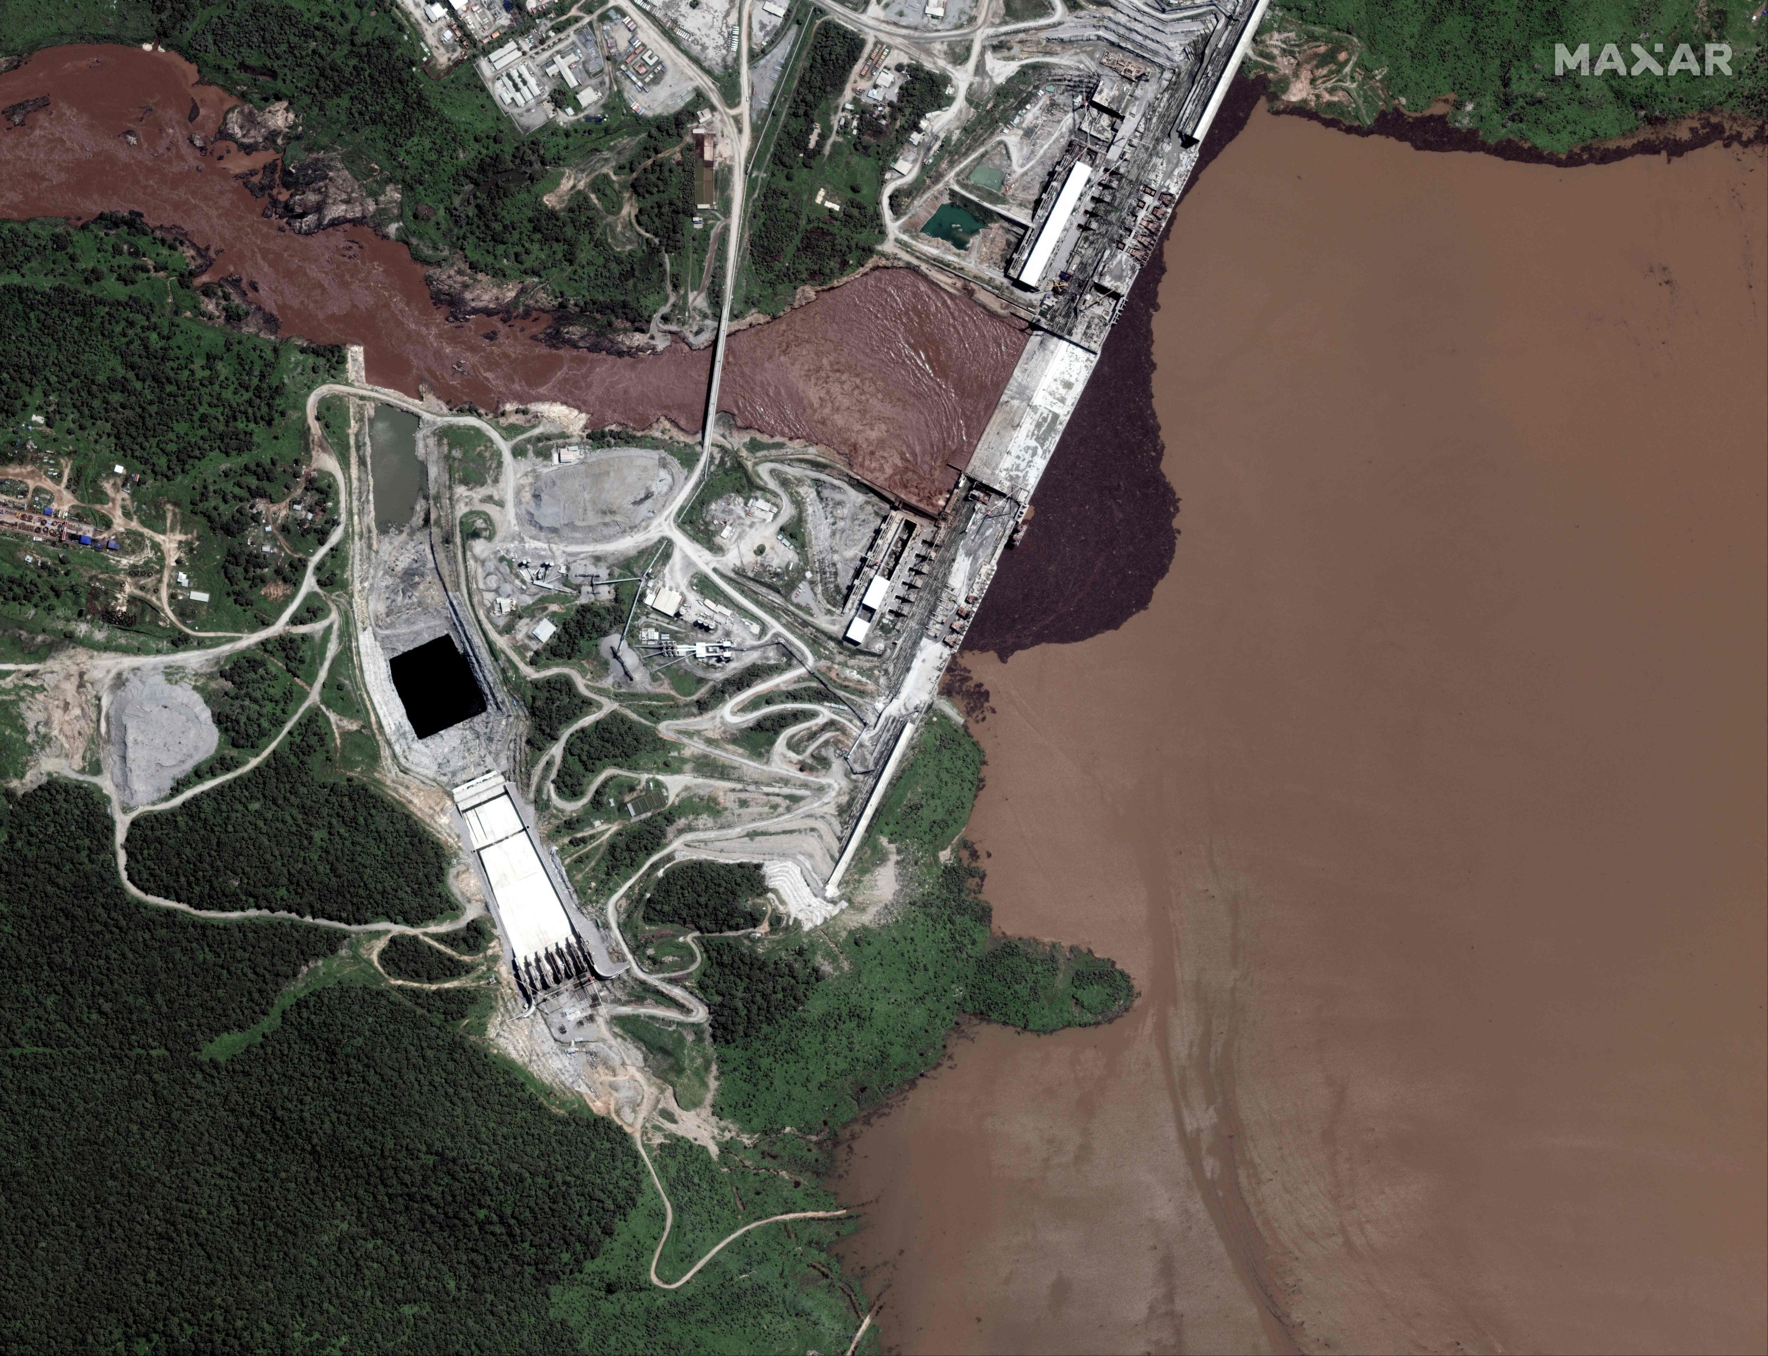

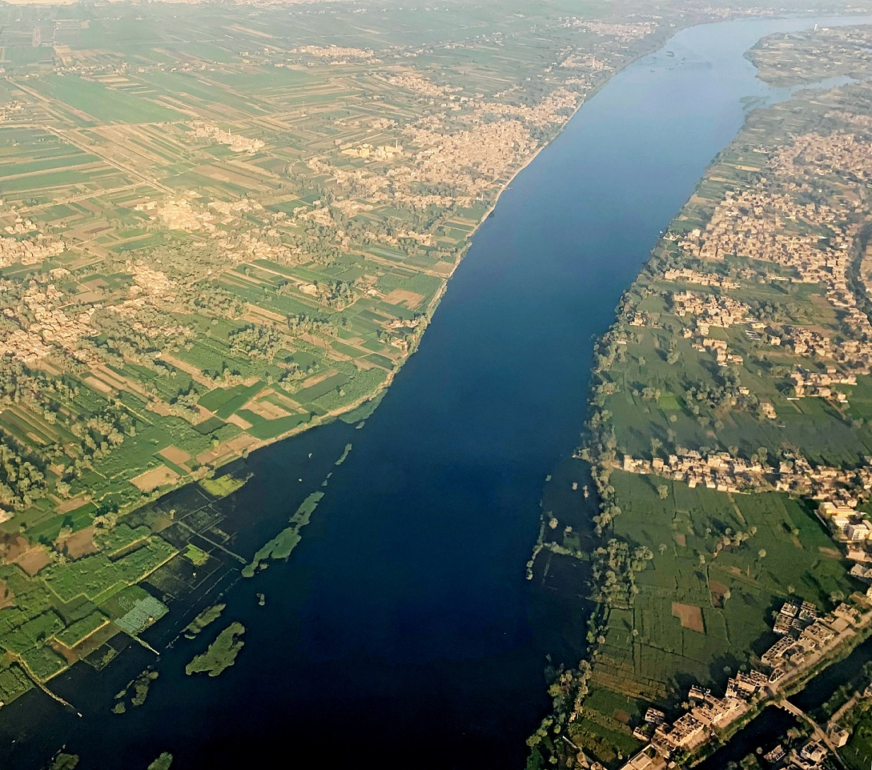

A Feature Selection Framework for Enhancing Interpretability and Performance in Multi-Objective Water Systems Operations
Guang Yang, Matteo Giuliani, Andrea Castelletti,
Zengchuan Dong
May 01, 2025
guang.yang@hhu.edu.cn

Slide 2
Reservoir operation model optimization
Given a finite set of states S and actions A, the reward can be obtained at each state-action pair: r(s,a).
Find a best action series such that:
C(Θ)
inflow
Reservoir
Release
Constraint
（hydroclimatic predictions and demand estimations）
Reservoir operation
Decision-making
O(Yt)
Q(i,t)
Power generation,
water supply
Reservoir inflow
S(Ri,t)
F(i,t)
Reservoir storage
Inflow forecasts
  Multiple factors effecting the reservoir operation decision-making

Slide 3
Why we need feature selection in water systems operation?
Single reservoir operation
Cascade reservoir operation
Cascade reservoir operation
with input variable selection
Q^{t}_{out}=Q(τ_{t}, S_{t}, Q^{t}_{in})
Q^{t}_{out}=Q(τ_{t}, S¹_{t}, S²_{t} , Q^{t}_{in}, Q^{t}+¹_{in}…)
τ_{t} Seasonal information S_{t} Reservoir storage Q^{t}_{in} Reservoir inflow
Water resources
development
Feature selection
Inflow
Storage
Season
Low-dimensional
High-dimensional
Median-dimensional
Conventional input variables
Relevant input variables
Selected input variables
  Reduce the dimensionality in reservoir operation optimization

Slide 4
Case study descriptions
Reservoirs operation system in the Nile River Basin
12 relevant variables
(h_{GERD}, h_{MER}, h_{HAD}, Q_{GERD}, Q_{WN}, …)
3 Reservoirs
(GERD, MER, HAD)
5 objectives
(HP_{GERD}, HP_{MER}, HP_{HAD}, Irr_{Sudan}, Irr_{HAD})
Hydropower generation (HP)
Irrigation water supply (Irr)

Slide 5
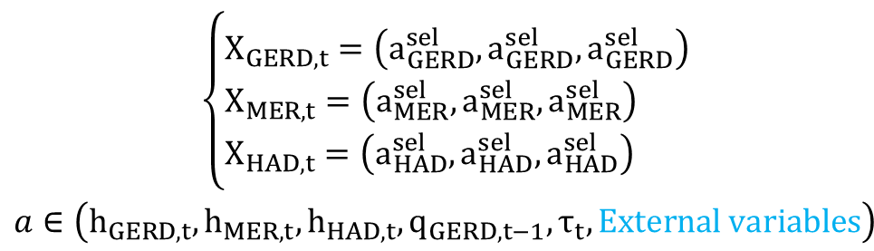
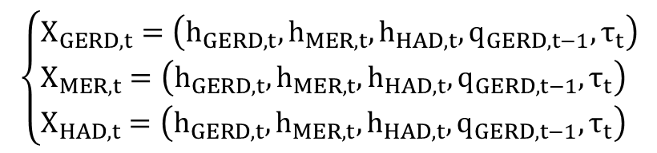
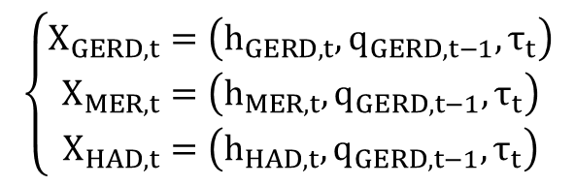
Input variables in the Nile system operation
Conventional inputs
$$\left\{\begin{matrix}X_{GERD,t}=\left(h_{GERD,t},q_{GERD,t−1},τ_{t}\right) \\ X_{MER,t}=\left(h_{MER,t},q_{GERD,t−1},τ_{t}\right) \\ X_{HAD,t}=\left(h_{HAD,t},q_{GERD,t−1},τ_{t}\right)\end{matrix}\right.$$
F1
Coordinated conventional inputs
$$\left\{\begin{aligned}&X_{GERD,t}=\left(h_{GERD,t},h_{MER,t},h_{HAD,t},q_{GERD,t−1},τ_{t}\right) \\ &X_{MER,t}=\left(h_{GERD,t},h_{MER,t},h_{HAD,t},q_{GERD,t−1},τ_{t}\right) \\ &X_{HAD,t}=\left(h_{GERD,t},h_{MER,t},h_{HAD,t},q_{GERD,t−1},τ_{t}\right)\end{aligned}\right.$$
F2
Selected inputs
$$\begin{matrix}\left\{\begin{aligned}&X_{GERD,t}=\left(a_{GERD}^{sel},a_{GERD}^{sel},a_{GERD}^{sel}\right) \\ &X_{MER,t}=\left(a_{MER}^{sel},a_{MER}^{sel},a_{MER}^{sel}\right) \\ &X_{HAD,t}=\left(a_{HAD}^{sel},a_{HAD}^{sel},a_{HAD}^{sel}\right)\end{aligned}\right. \\ a∈\left(h_{GERD,t},h_{MER,t},h_{HAD,t},q_{GERD,t−1},τ_{t},External variables\right)\end{matrix}$$
F3

Slide 6
Candidate input variables
Variable name | Definition
h_GERD | GERD reservoir water level at the current time step
h_MER | MER reservoir water level at the current time step
h_HAD | HAD reservoir water level at the current time step
moy | Month of the year
qIn_GERDs | GERD reservoir inflow in the previous time period
qIn_WNs | White Nile inflow in the previous time period
qIn_Atbs | Atbara inflow in the previous time period
qIn_DinRas | Dinder+Rahad inflow in the previous time period
demandSUD1s | Water demand of irrigation district 1 in the current time period
demandSUD2s | Water demand of irrigation district 2 in the current time period
demandSUD3s | Water demand of irrigation district 3 in the current time period
WtHADs | Water demand downstream of HAD in the current time period

Slide 7
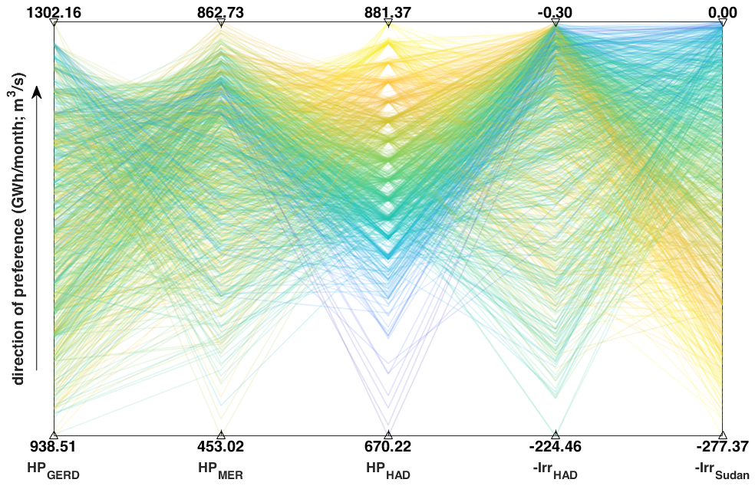
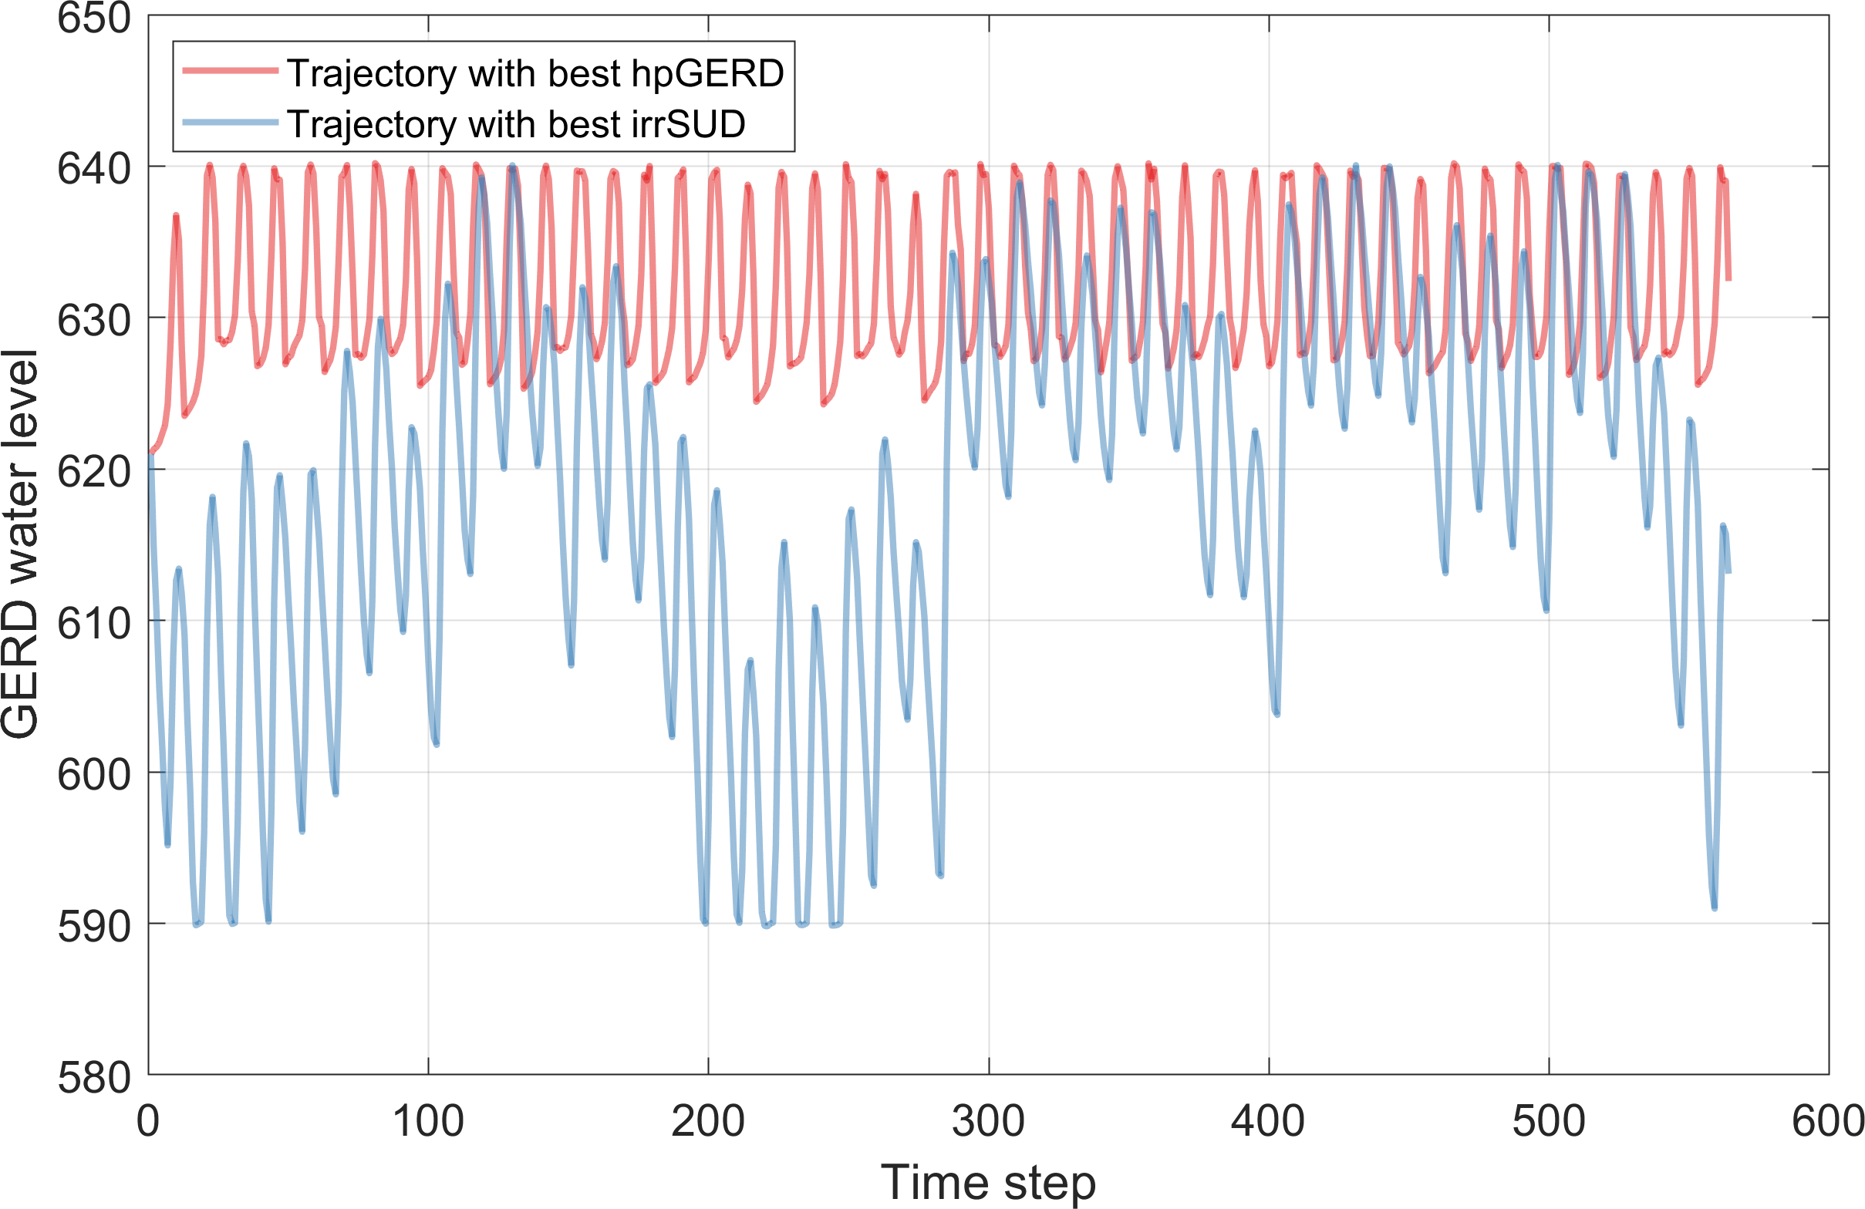
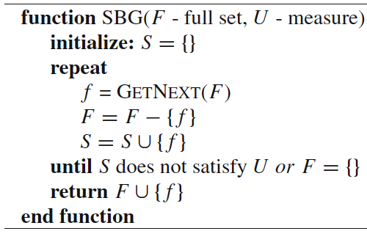
Feature selection in multi-purpose water systems
Select input variables for each reservoir by integrating Recursive Feature Elimination (RFE) with Evolutionary Multi-Objective Direct Policy Search.
Rules optimization
Rules simulation
Feature selection
Multi-objective optimization
Water system operation
Recursive Feature Elimination

Slide 8
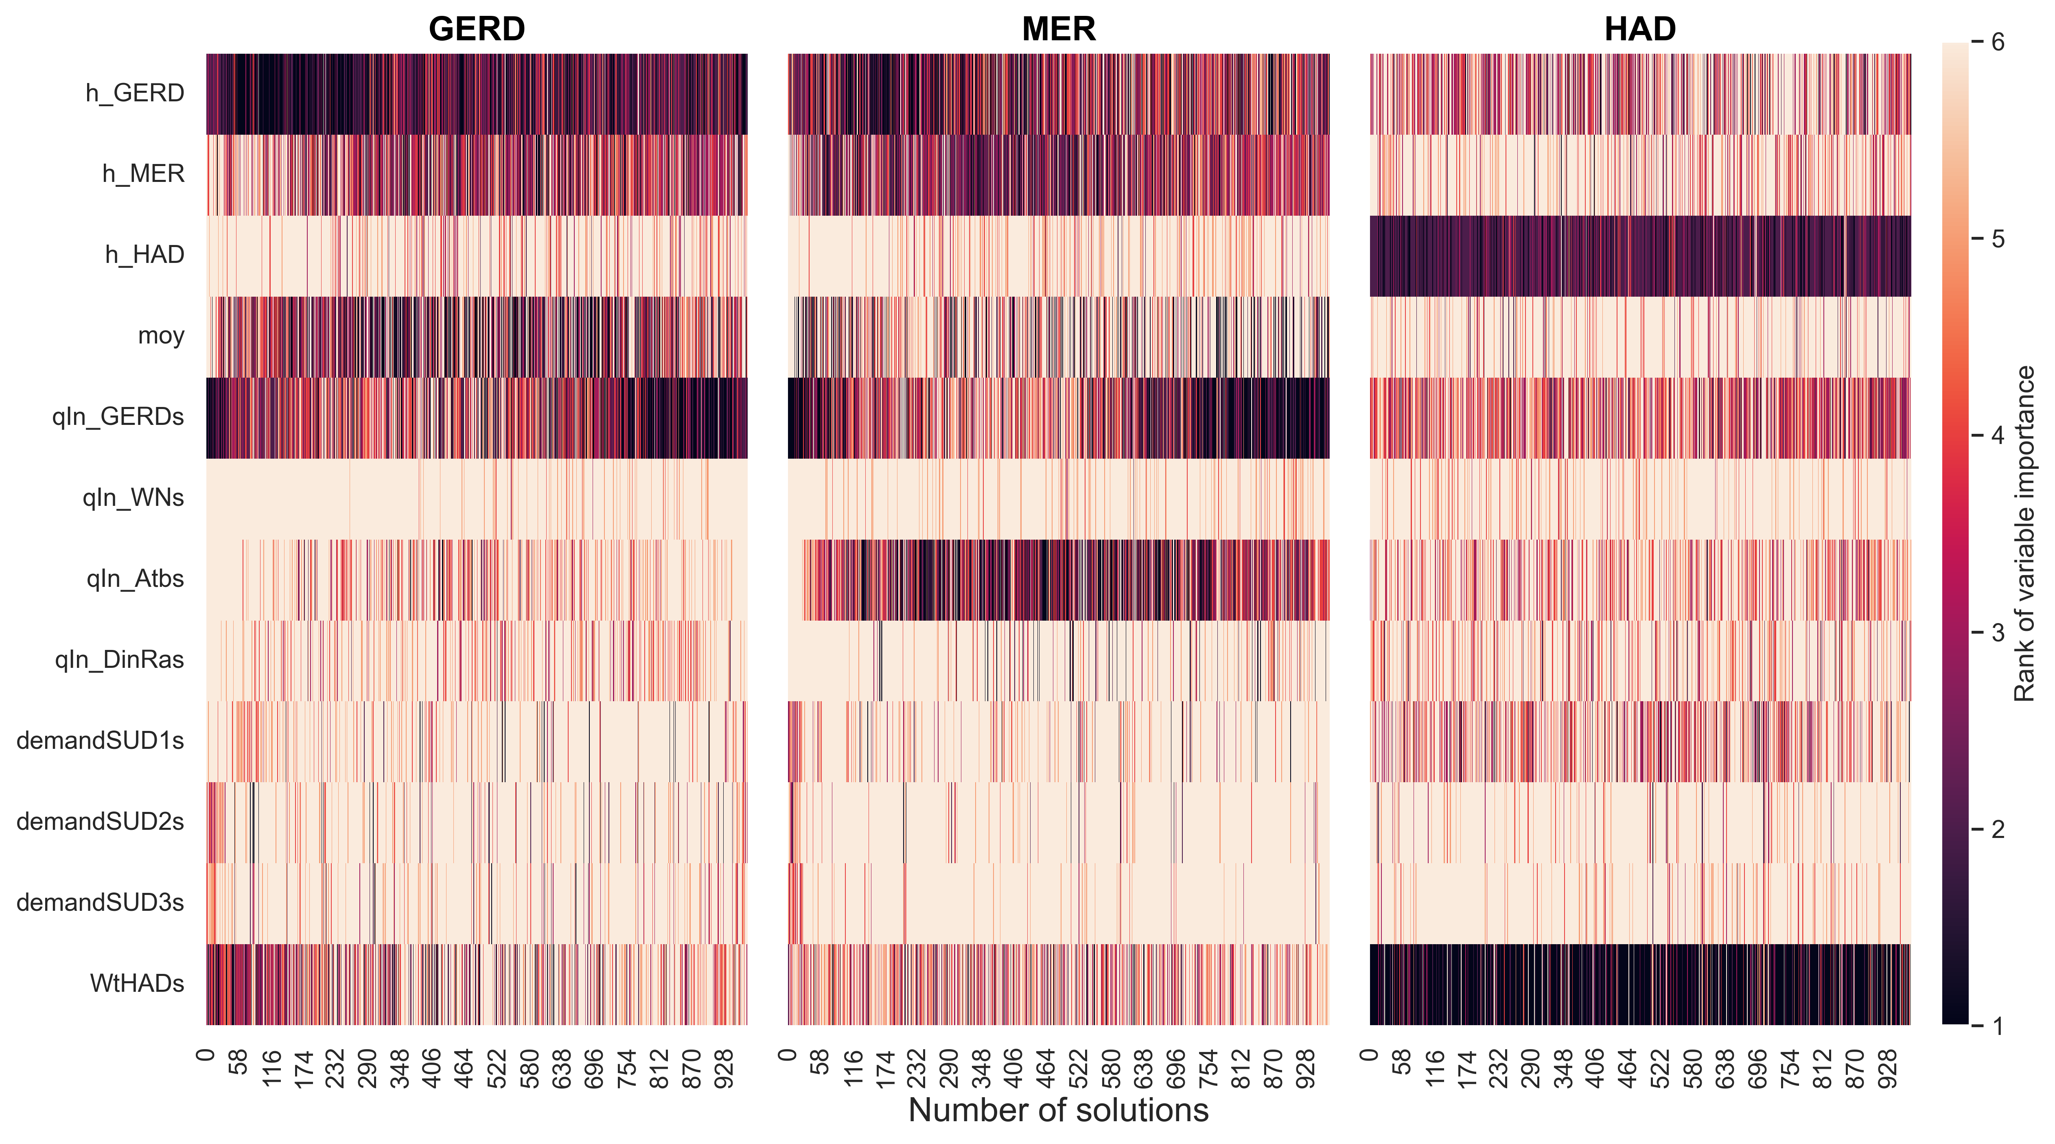
Input variables selections in multi-objective Nile operation
Water levels
Water levels
Water level
Month of year
Inflow
Inflow
Inflow
Interval basin flow
Water demand

Slide 9
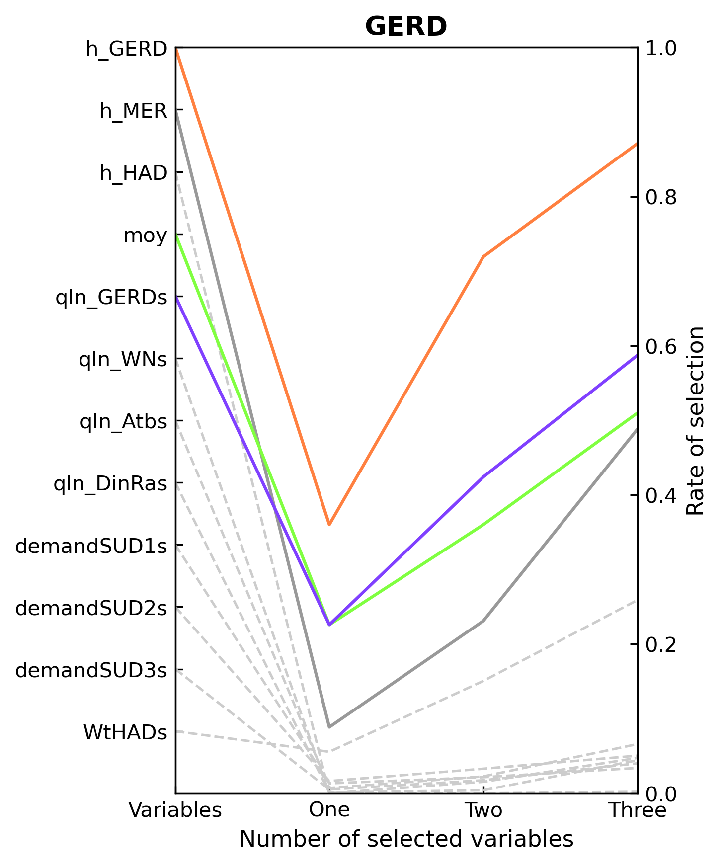
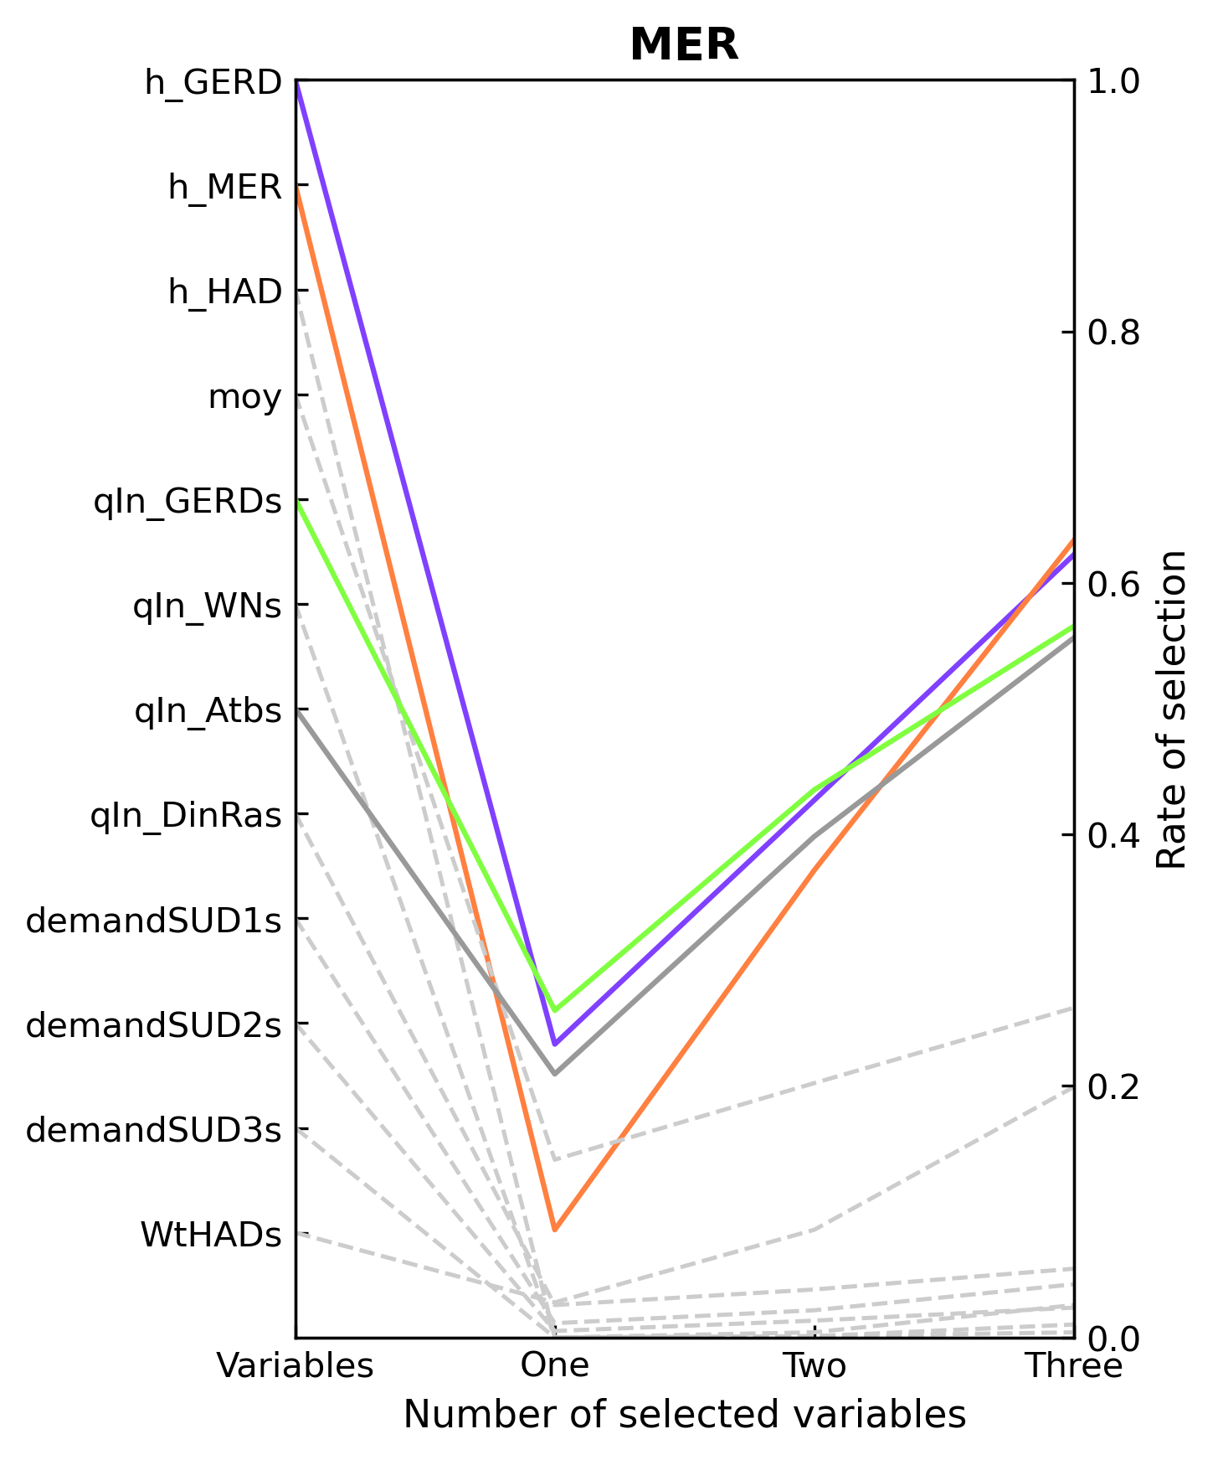
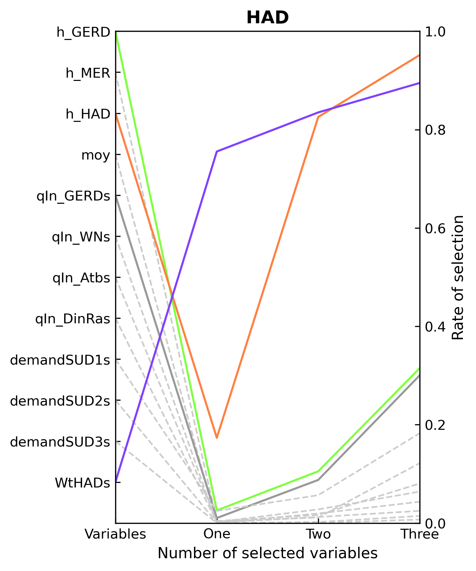
Input variables selections in multi-objective Nile operation

Slide 10
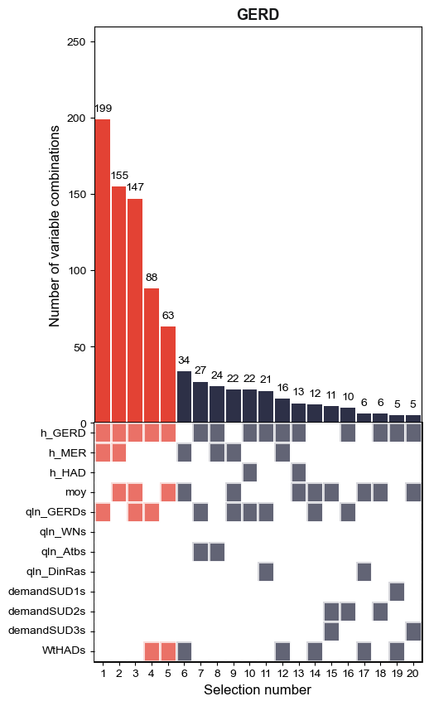
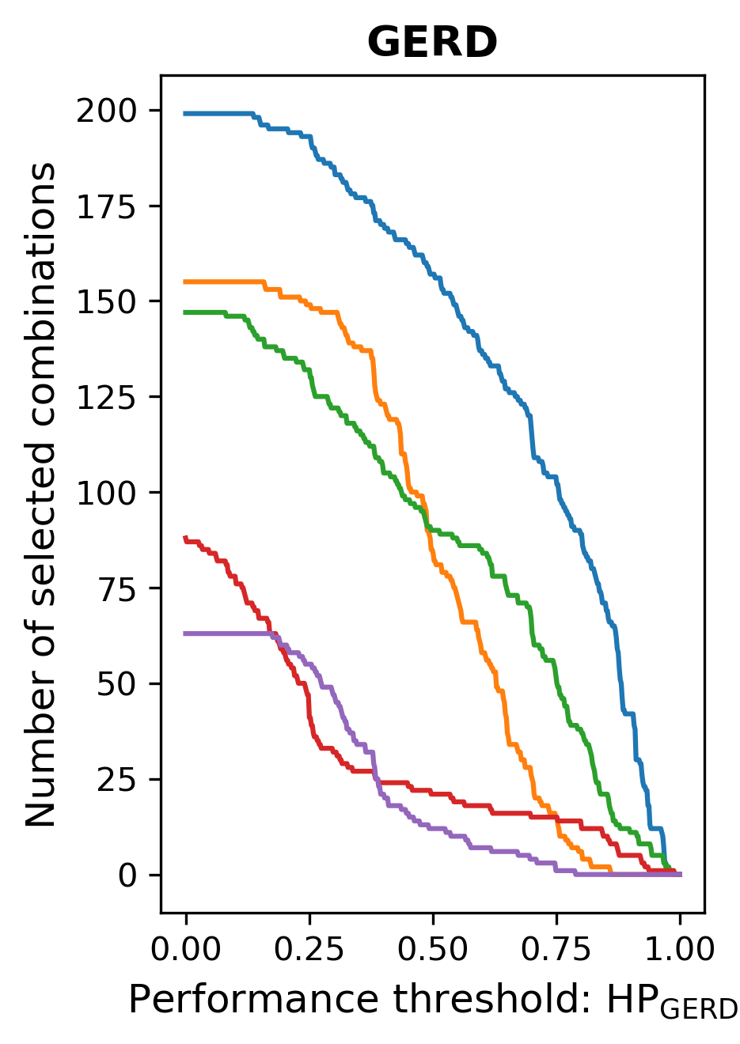
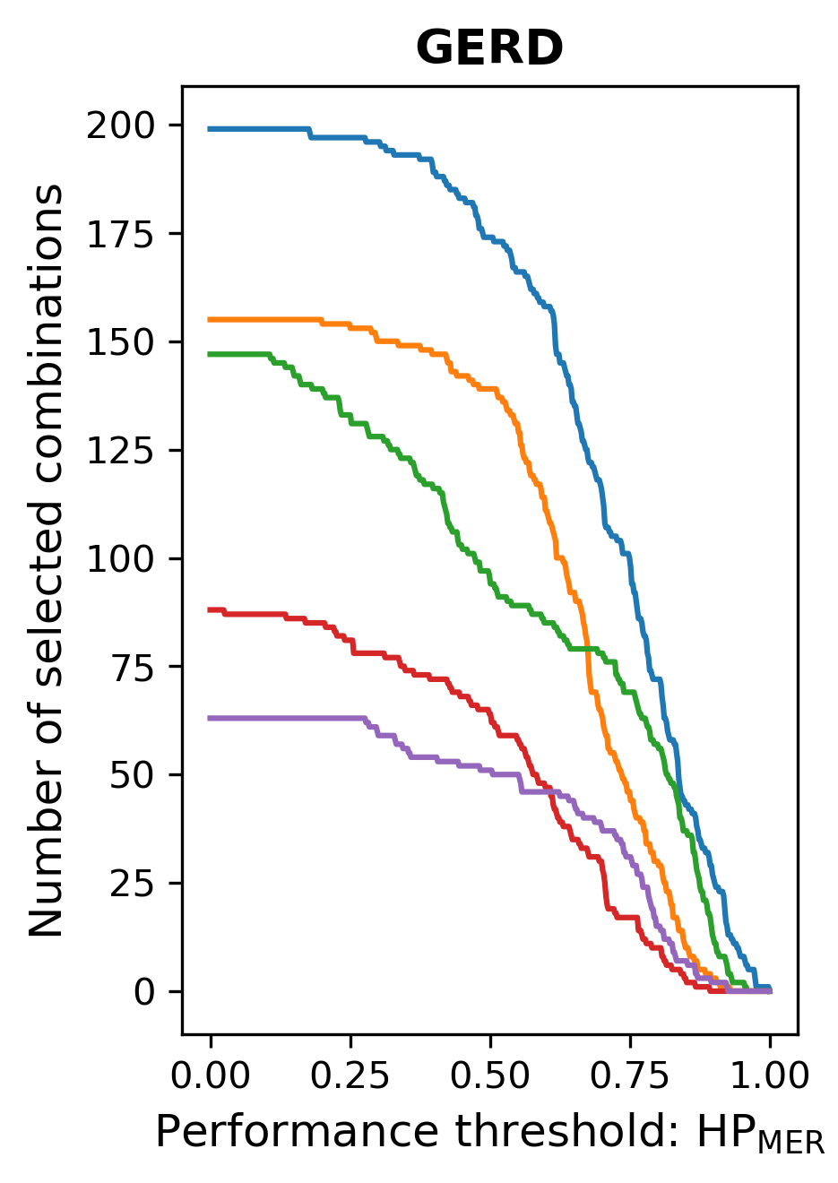
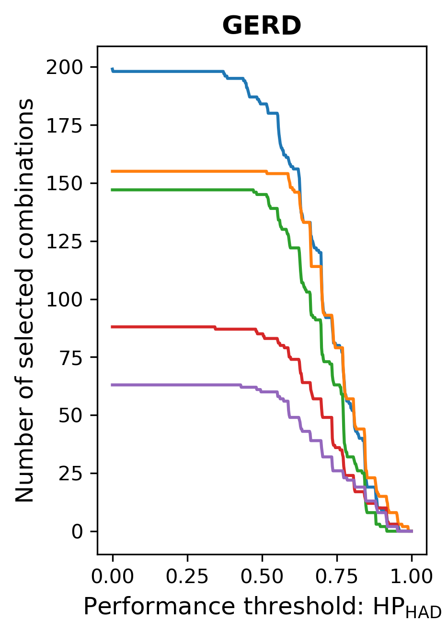
Input variables selections considering DM preferences
HP_{GERD}-preferred
HP_{MER}-preferred
HP_{HAD}-preferred
h_{GERD}
h_{MER}
Qin_{GERD}
h_{GERD}
h_{MER}
Qin_{GERD}
h_{GERD}
h_{MER}
Month of year

Slide 11
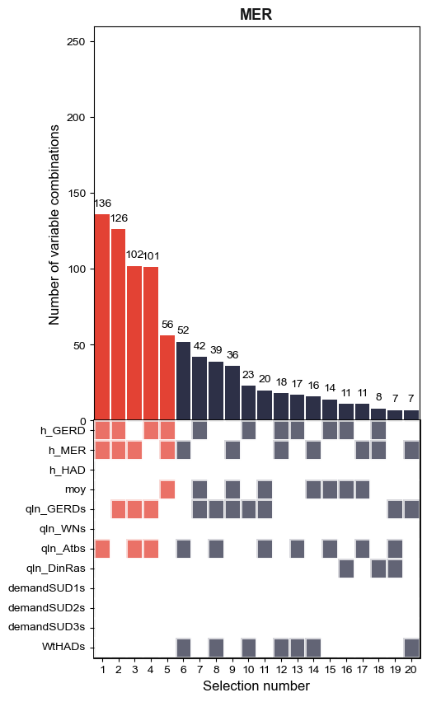
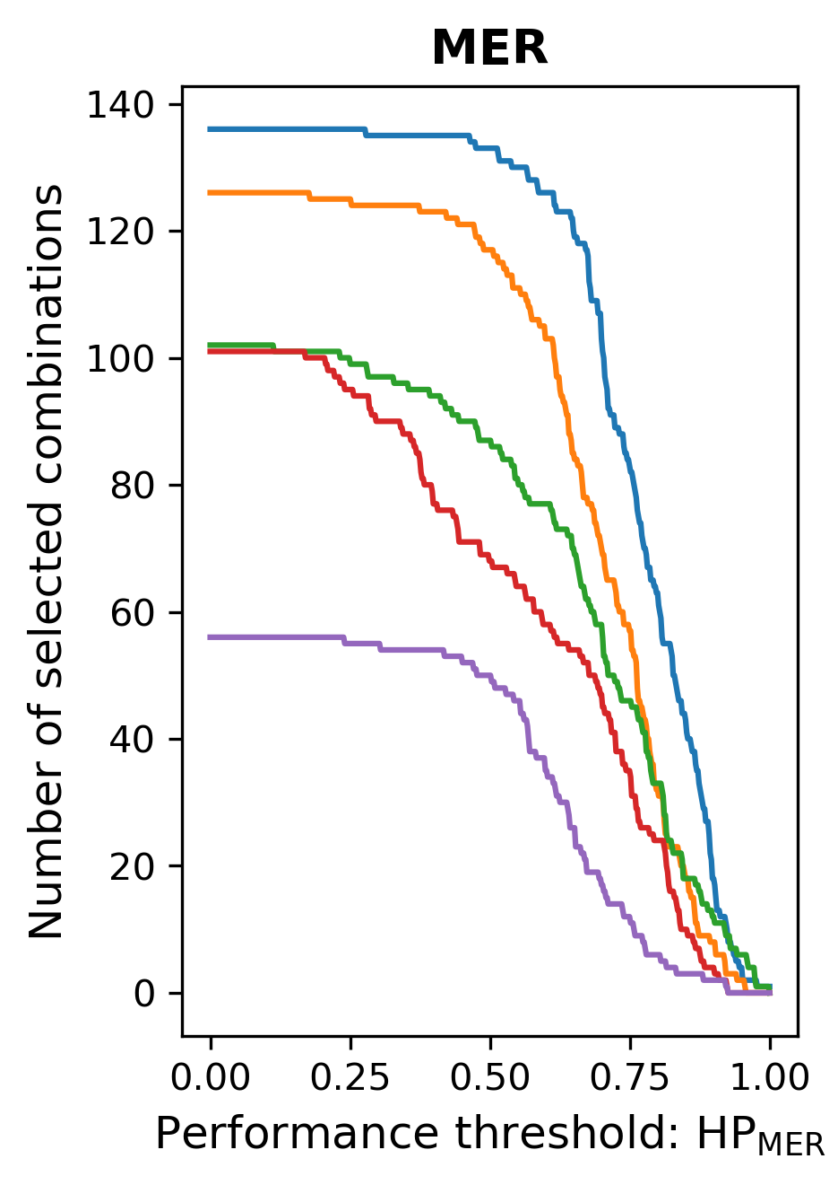
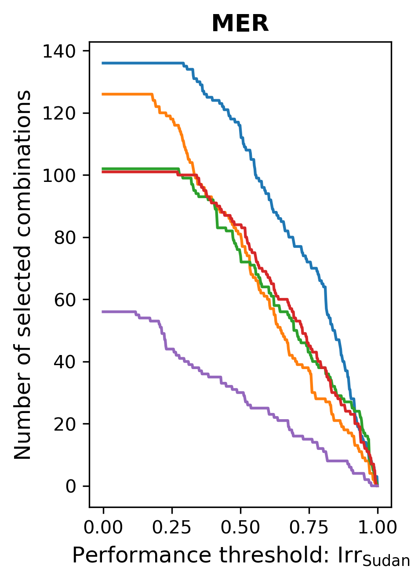
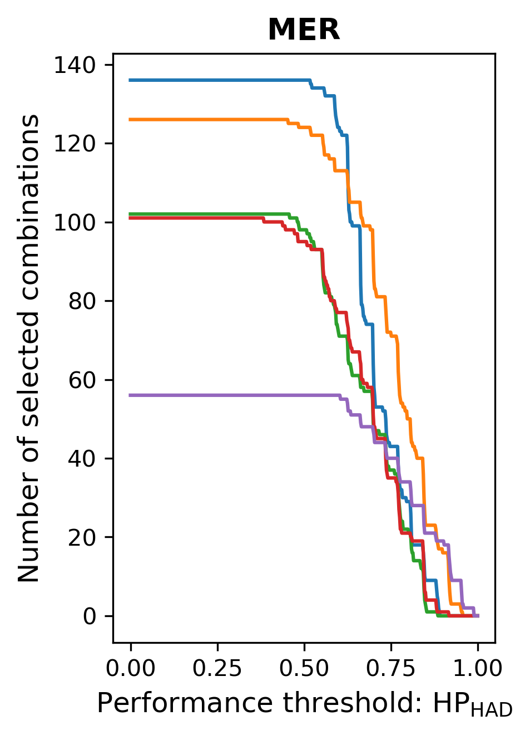
Input variables selections considering DM preferences
HP_{MER}-preferred
Irr_{Sudan}-preferred
HP_{HAD}-preferred
h_{GERD}
h_{MER}
Qin_{Atbs}
h_{GERD}
h_{MER}
Qin_{Atbs}
h_{GERD}
h_{MER}
Qin_{GERD}

Slide 12
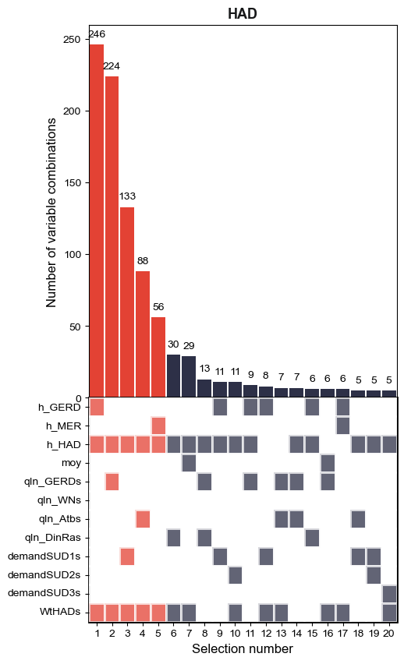
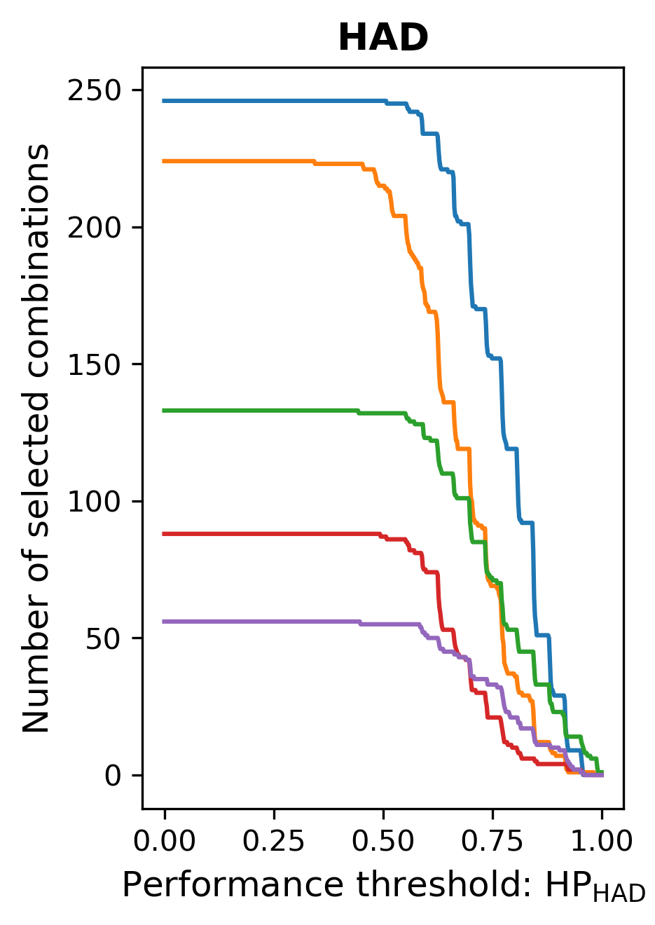
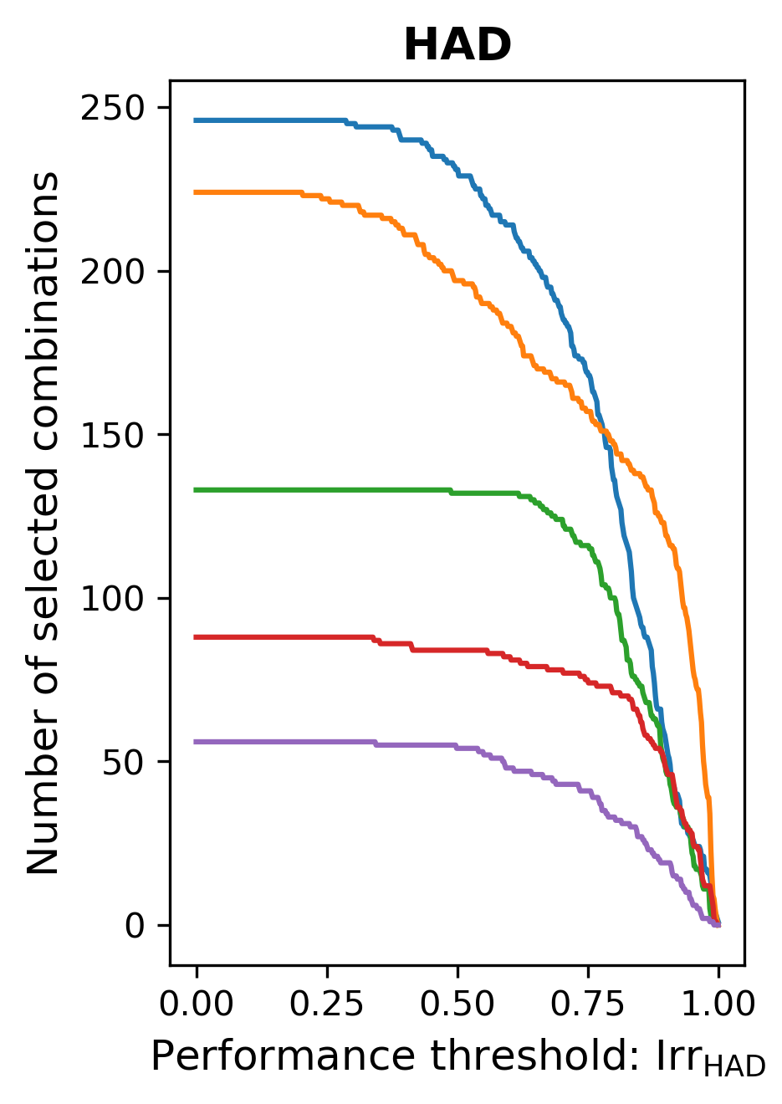
Input variables selections considering DM preferences
HP_{HAD}-preferred
Irr_{HAD}-preferred
Wt_{HADs}
h_{HAD}
h_{GERD}
Wt_{HADs}
h_{HAD}
Qin_{GERD}

Slide 13
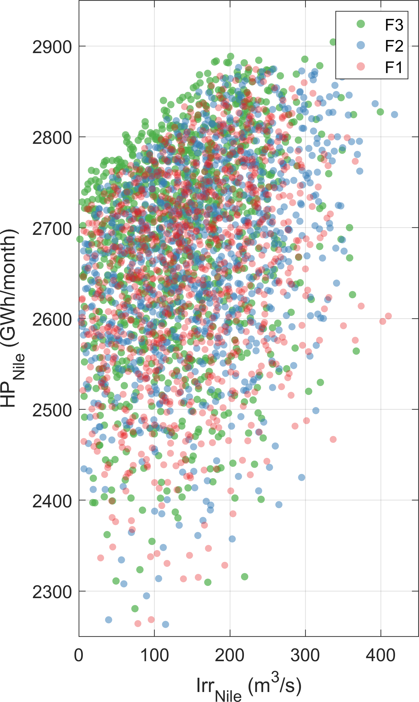

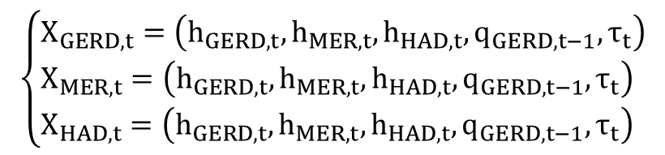
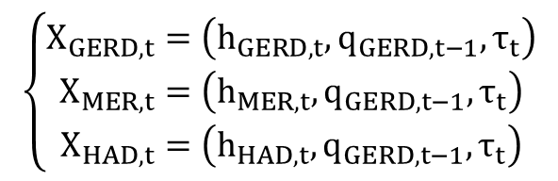
Multi-objective optimization with various input variables
Conventional inputs
$$\left\{\begin{matrix}X_{GERD,t}=\left(h_{GERD,t},q_{GERD,t−1},τ_{t}\right) \\ X_{MER,t}=\left(h_{MER,t},q_{GERD,t−1},τ_{t}\right) \\ X_{HAD,t}=\left(h_{HAD,t},q_{GERD,t−1},τ_{t}\right)\end{matrix}\right.$$
F1
Coordinated conventional inputs
$$\left\{\begin{aligned}&X_{GERD,t}=\left(h_{GERD,t},h_{MER,t},h_{HAD,t},q_{GERD,t−1},τ_{t}\right) \\ &X_{MER,t}=\left(h_{GERD,t},h_{MER,t},h_{HAD,t},q_{GERD,t−1},τ_{t}\right) \\ &X_{HAD,t}=\left(h_{GERD,t},h_{MER,t},h_{HAD,t},q_{GERD,t−1},τ_{t}\right)\end{aligned}\right.$$
F2
Selected inputs
$$\begin{matrix}\left\{\begin{aligned}&X_{GERD,t}=\left(a_{GERD}^{sel},a_{GERD}^{sel},a_{GERD}^{sel}\right) \\ &X_{MER,t}=\left(a_{MER}^{sel},a_{MER}^{sel},a_{MER}^{sel}\right) \\ &X_{HAD,t}=\left(a_{HAD}^{sel},a_{HAD}^{sel},a_{HAD}^{sel}\right)\end{aligned}\right. \\ a∈\left(h_{GERD,t},h_{MER,t},h_{HAD,t},q_{GERD,t−1},τ_{t},External variables\right)\end{matrix}$$
F3-F5

Slide 14
Summary and Highlights
Variables that reflect collaborative operations among different reservoirs consistently received higher importance rankings in the selection process.
The selected input variables of each reservoir can vary with decision-making preferences, allowing for rules design that aligns with shifting goals and priorities.
The operating rules using selected input variables can improve the performance of Nile operation and mitigate power generation and water supply conflicts.

Slide 15

Guang Yang
Hohai University, Nanjing, China
Email: guang.yang@hhu.edu; gyang82@gatech.edu
THANKS!

