Slide 1
Super-adiabatic asthenosphere in Southeast Asia : its tectonic and magmatic implications
EGU25-7565
Rupak Banerjee, Chujie Liu, Stephen P. Grand, Eric Sandvol, Supriyo Mitra, Xiaofeng Liang and Shengji Wei

Slide 2
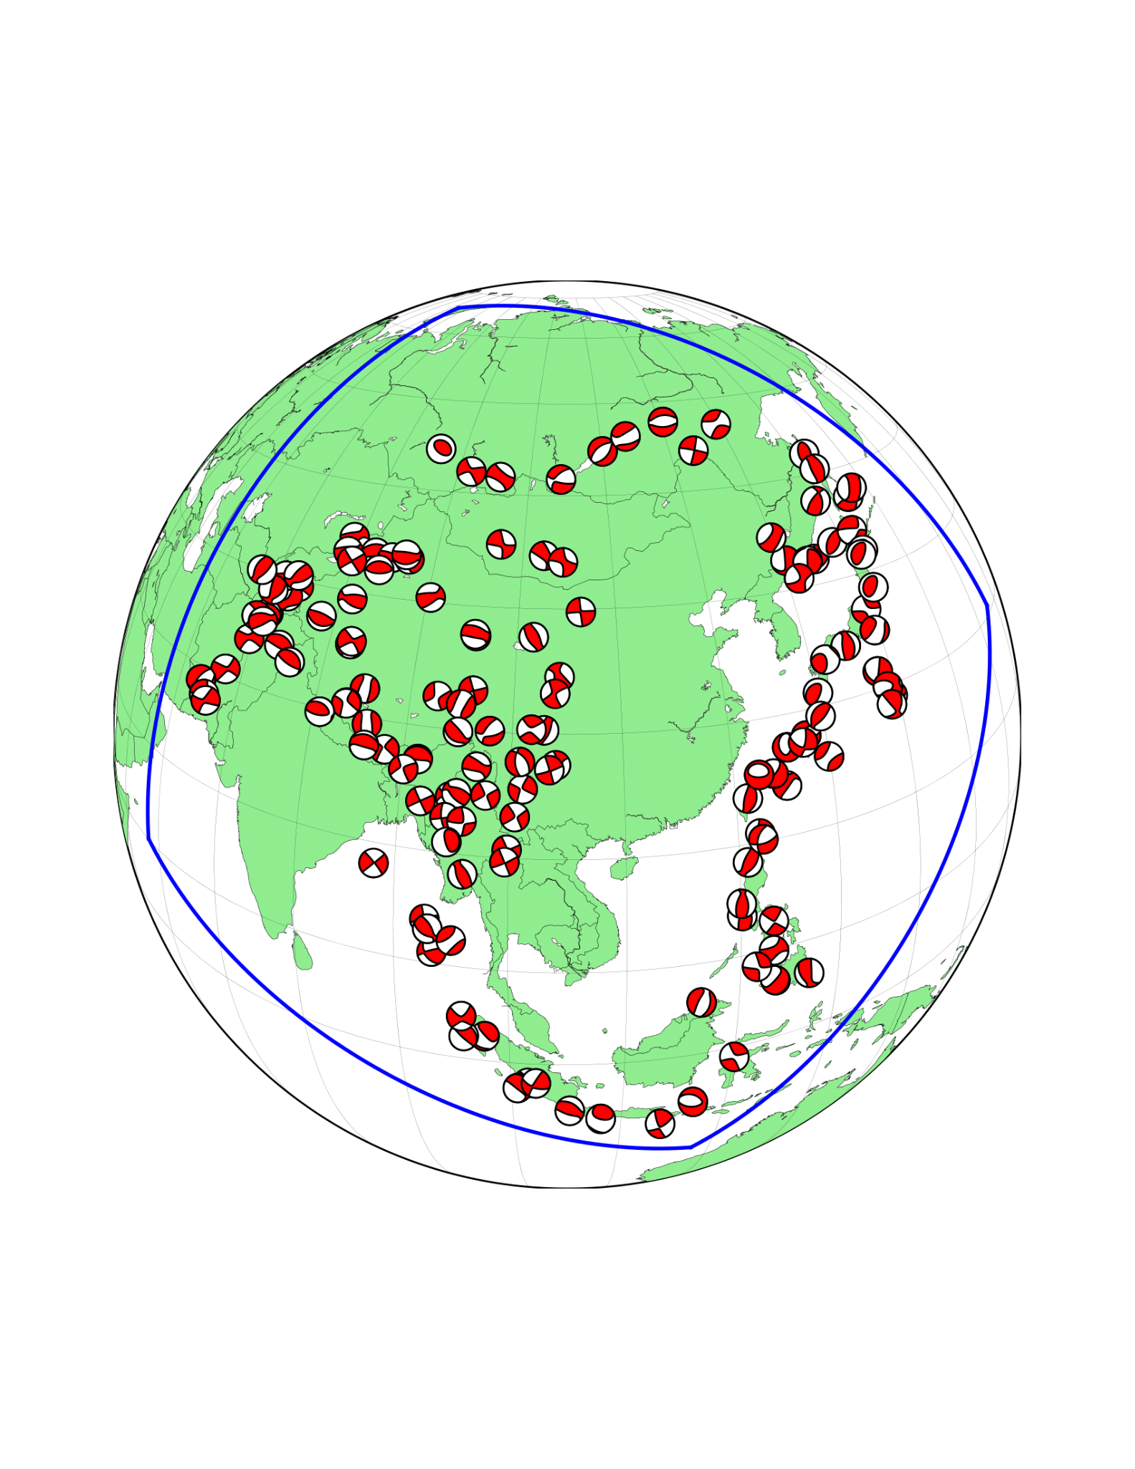
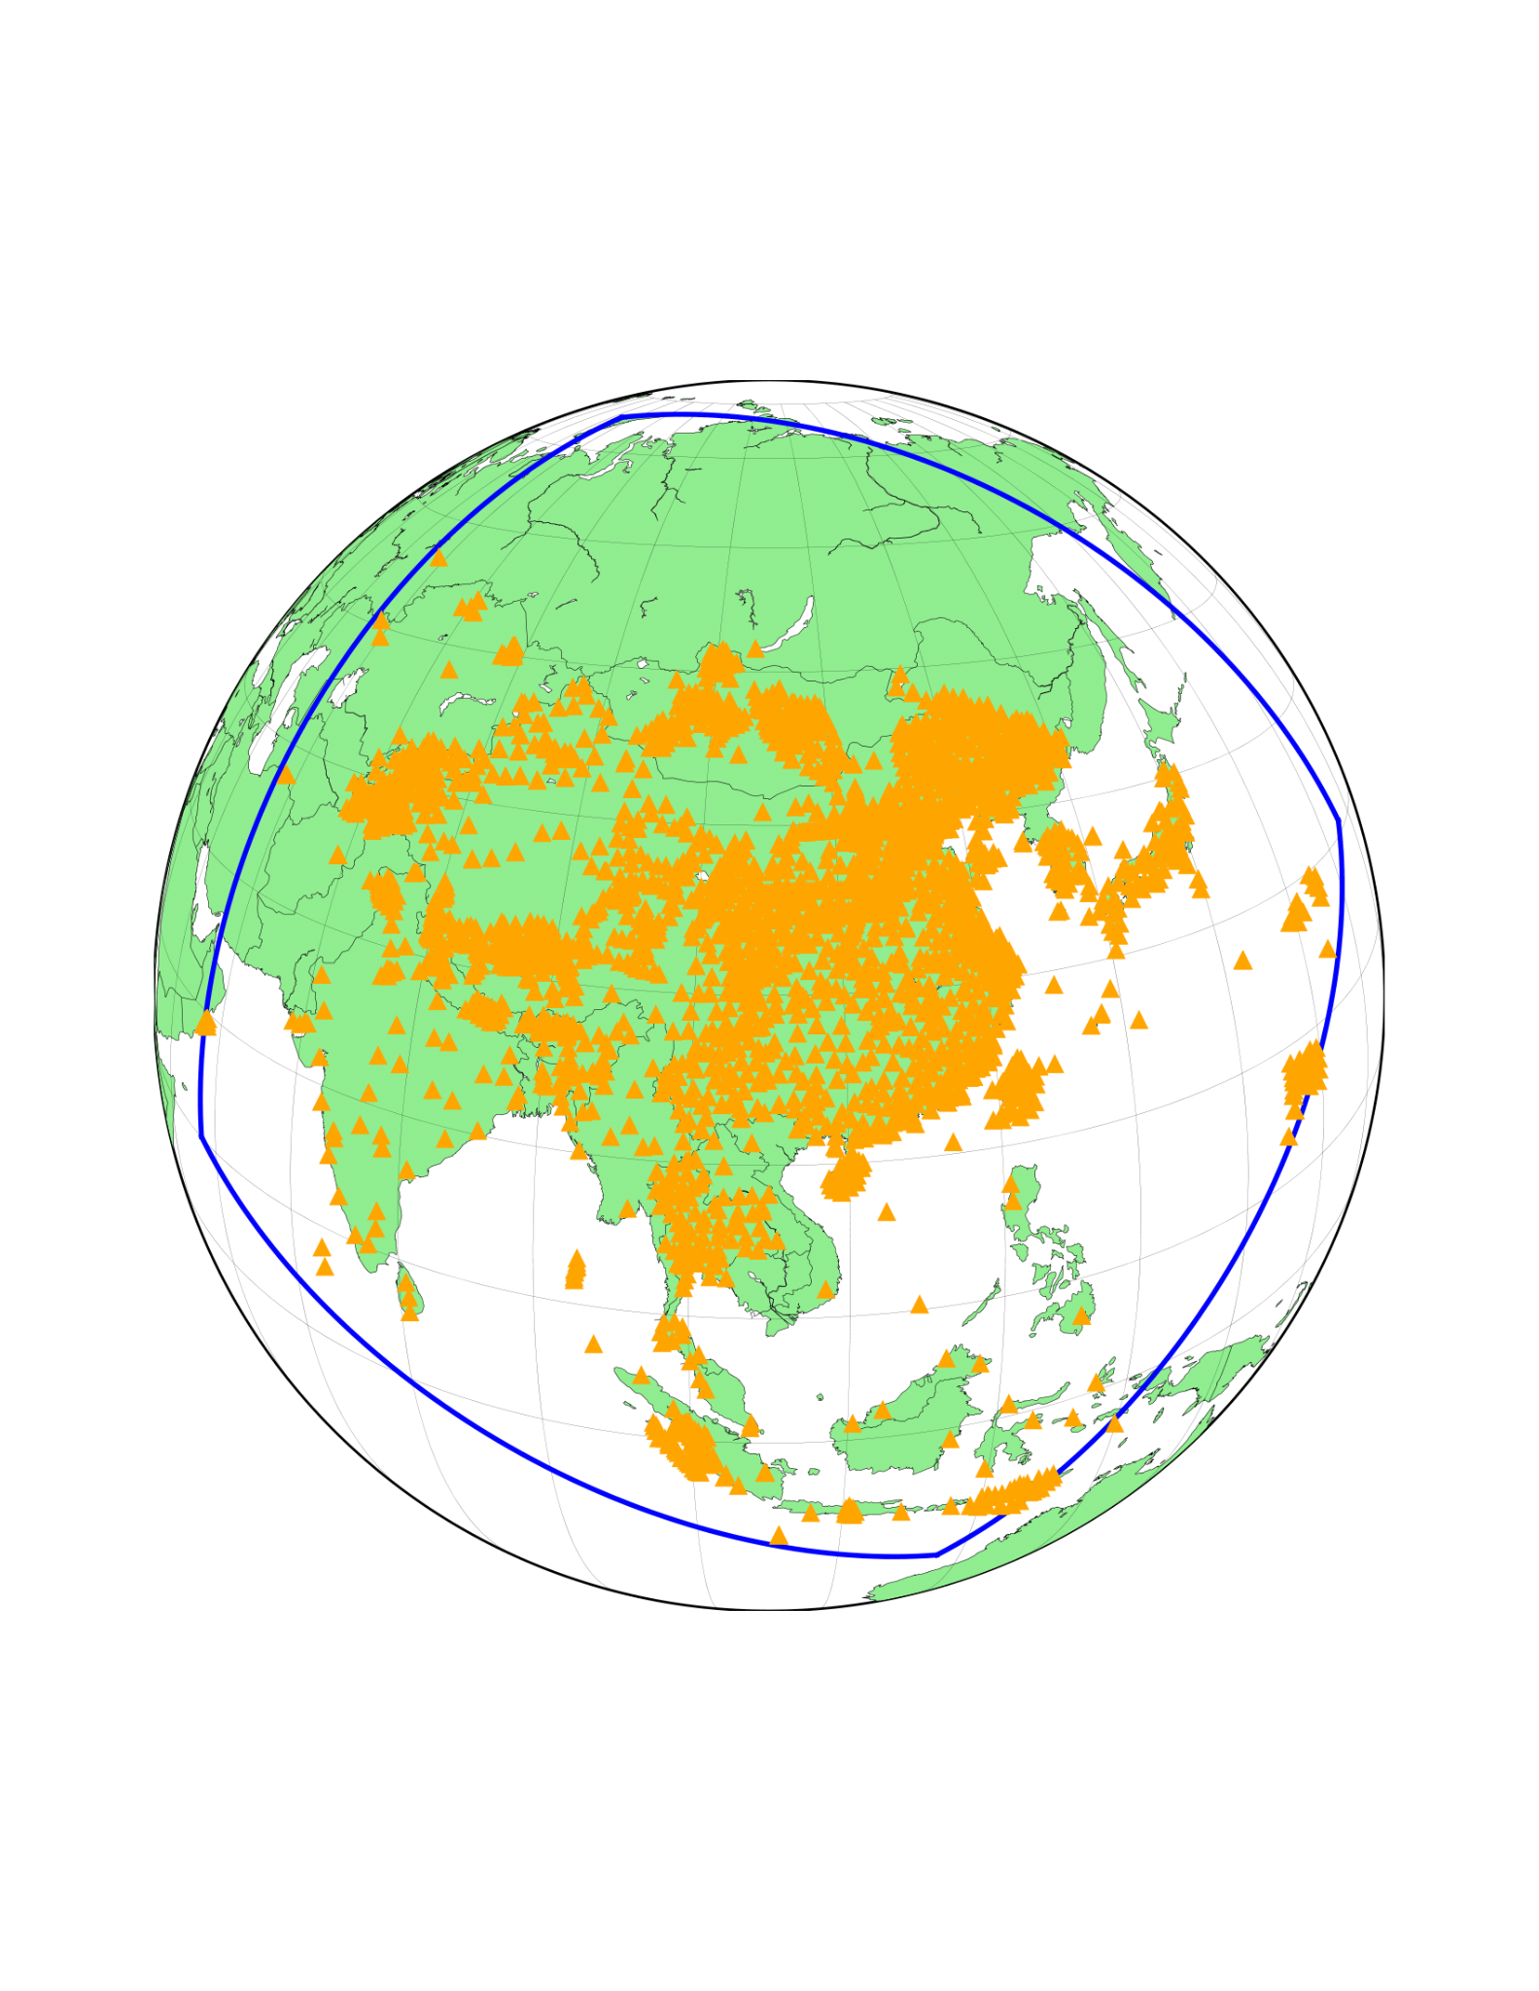
Objective: To image the seismic structure beneath Asia
Methodology:
Dataset:
Finite frequency tomography
based on Adjoint method
using Full waveforms
Misfit Function:
141 earthquakes; 5000+ stations; 1.5 million seismograms.
Starting model: FWEA18 (Tao et al., 2018) + EARA2014 (Chen et al., 2015)
Source and structure inversion in consecutive stages.
Body waves (15-100s) and Surface waves (25-130s)

Slide 3
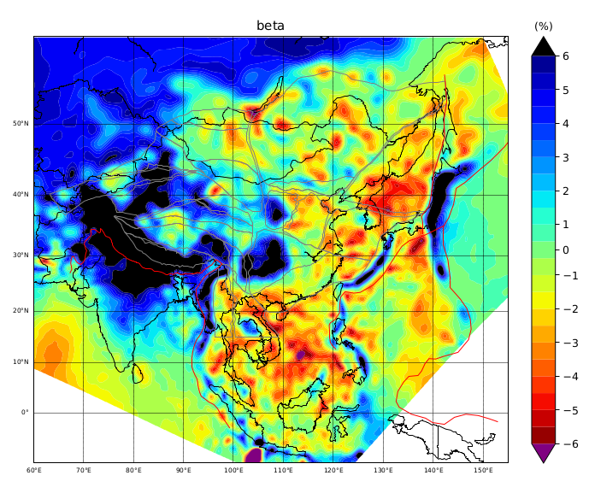
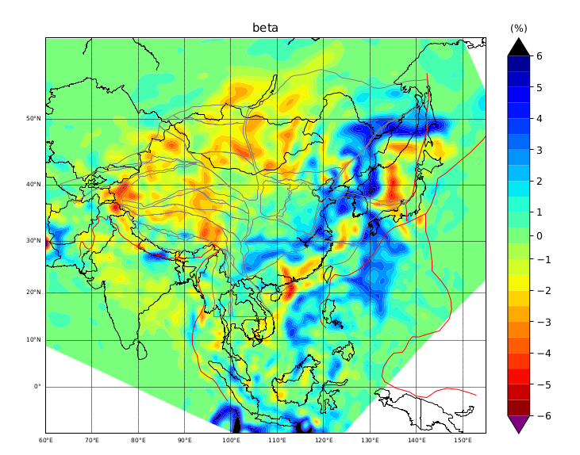
THE MODEL:
D1
D2
150km
600km

Slide 4
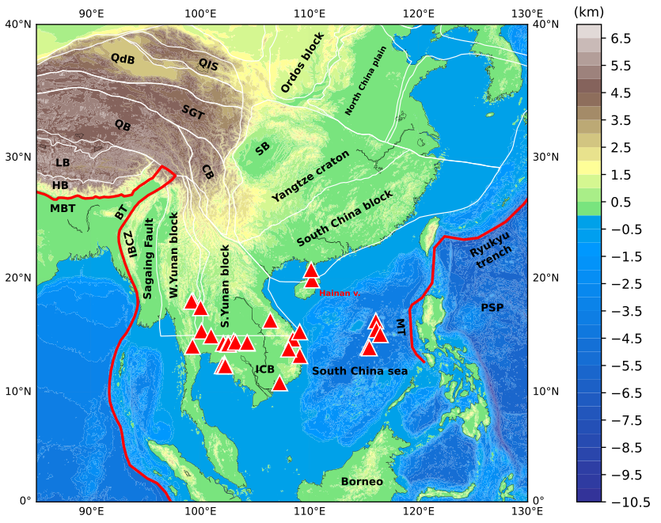
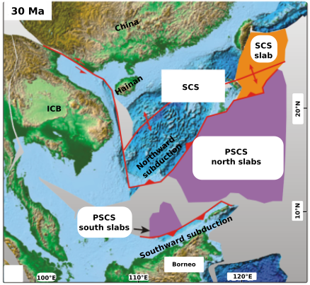
Motivation:
Outstanding questions:
d1
Wu and Suppe 2018
Origin of the intraplate volcanism?
How to explain the genetic relationship of the SABP volcanics?
Double subduction – southward (at 10°N and 110°-120°E)
and northward (15°N-20°N and 110°-120°E)
SCS opening ceased at ~16 Ma
Red triangles indicate intraplate volcanoes younger than 15 Ma.
Genetically, the volcanics at the Hainan island, SCS and the ICB are related and constitute the South Asian Basaltic province.

Slide 5
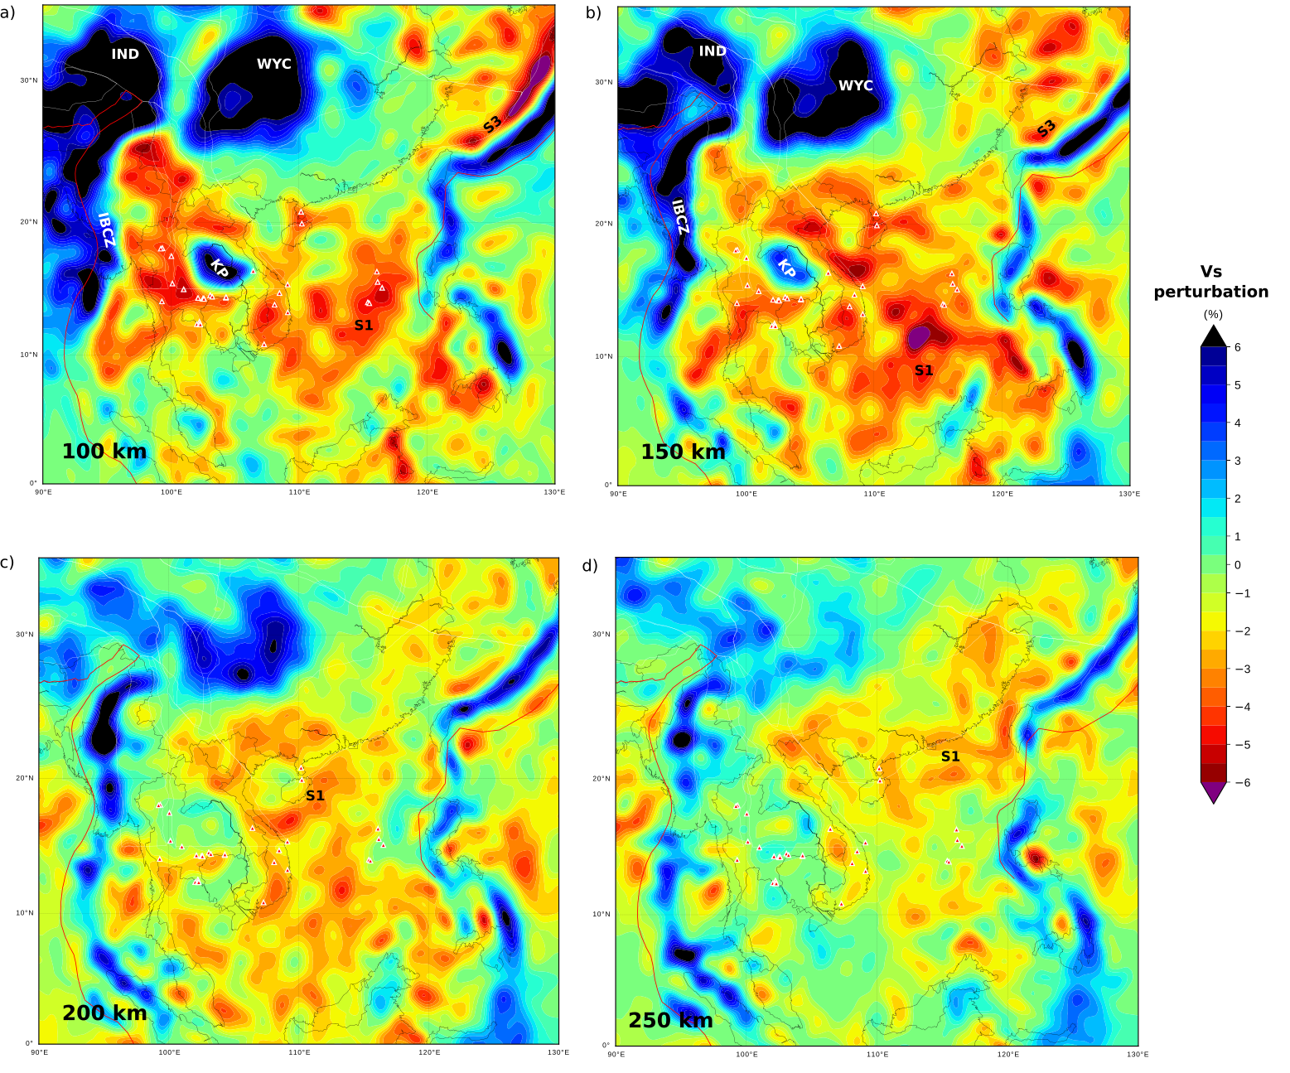
Shallow mantle in Southeast Asia:
Slow anomaly widely spread beneath most of Southeast Asia upto 200 km.
Prominent Slabs and cratonic roots

Slide 6
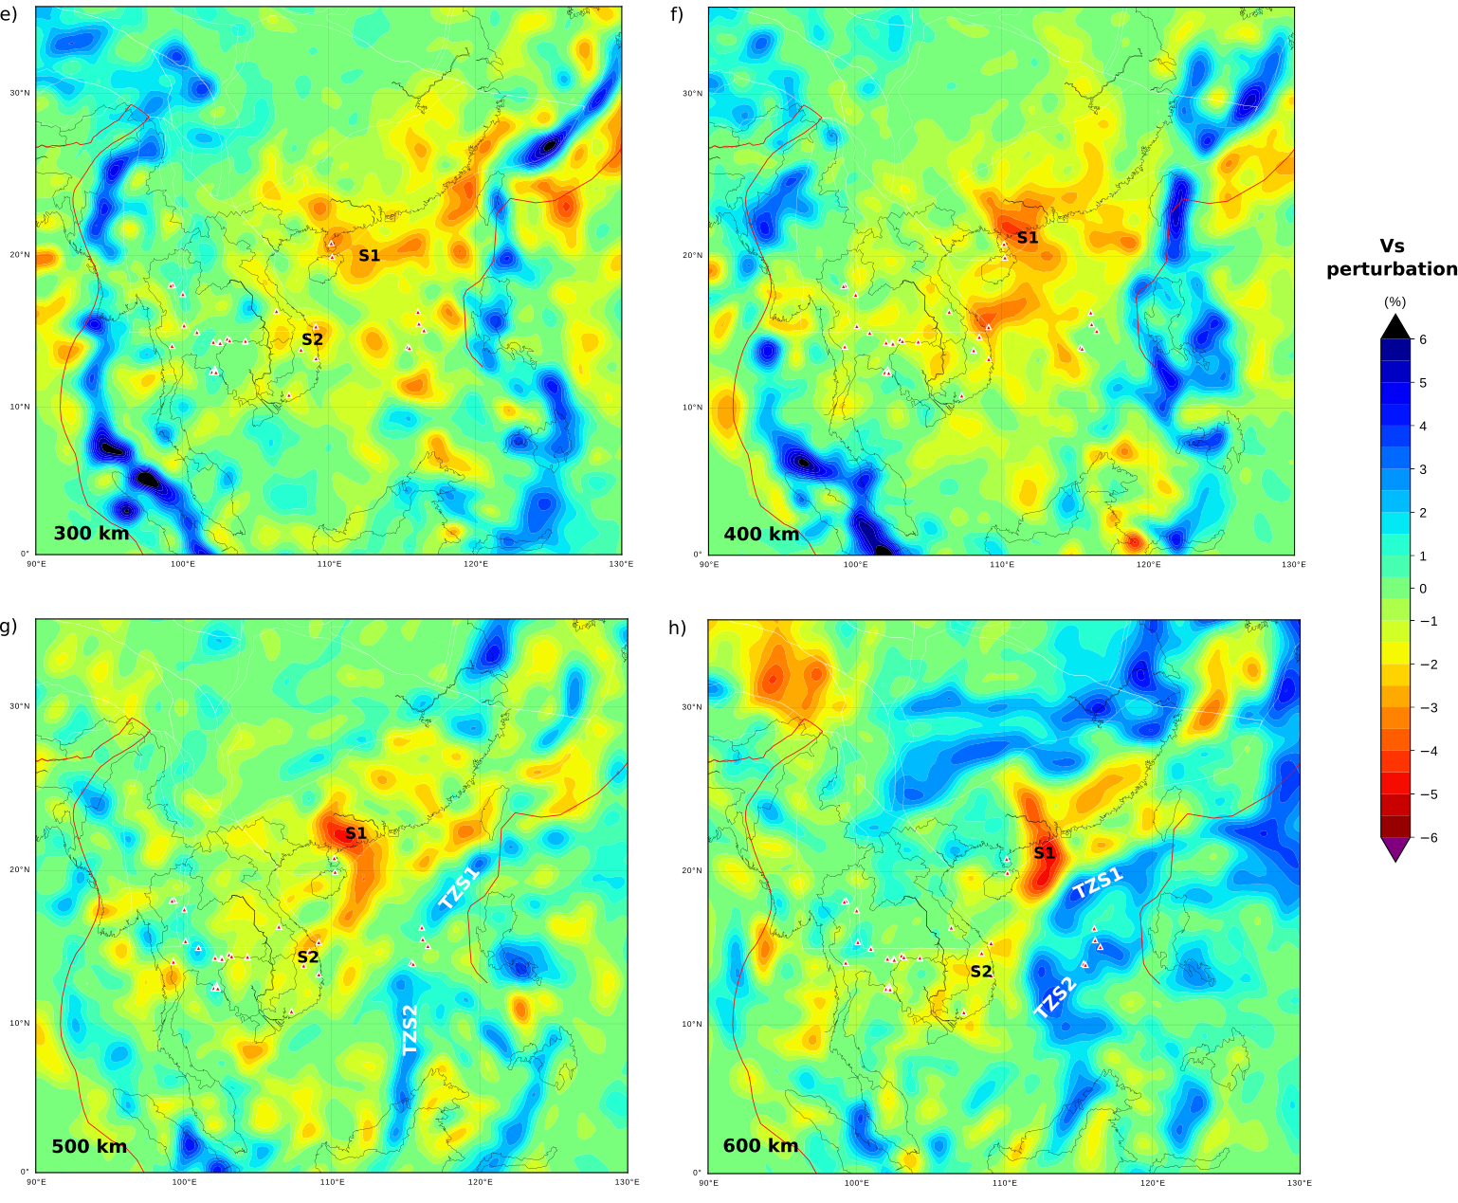
Deeper mantle in Southeast Asia:
Two anomalies (S1 and S2) appear narrow at depths > 300 km : S1 being the stronger is present east of Hainan island

Slide 7
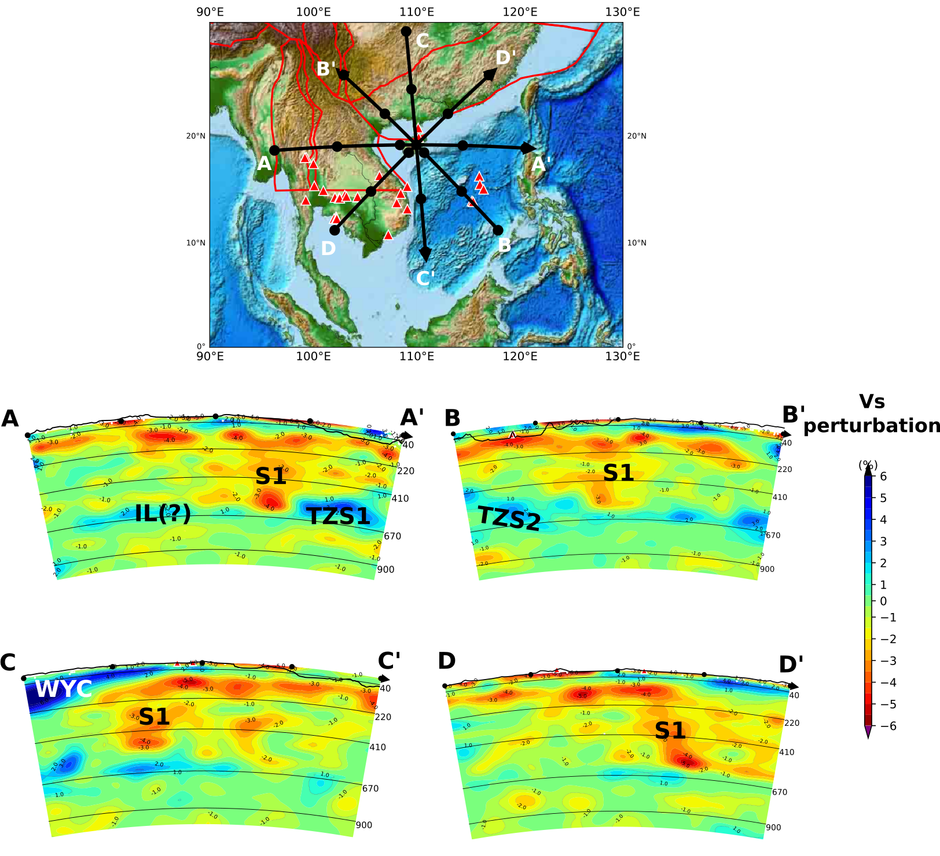
The Model in cross sections :
SEISMOLOGICAL IMAGING
LOW VELOCITY ANOMALY
PLUME(s)

Slide 8
The Asthenospheric Vs structure in Southeast Asia:
Vertically averaged asthenospheric Vs (100-220 km)

Slide 9
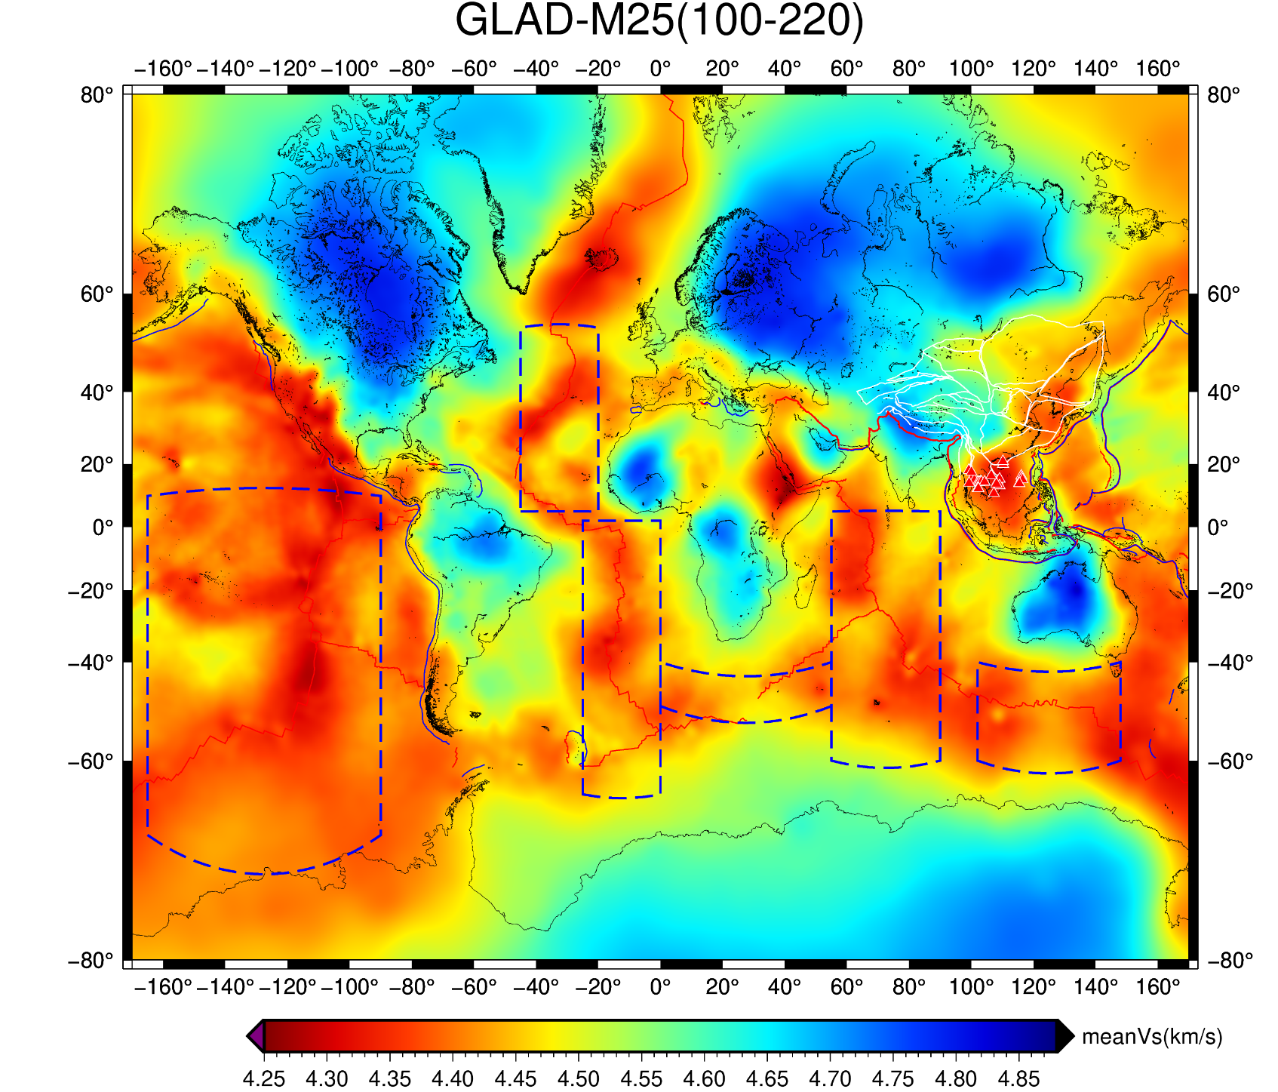
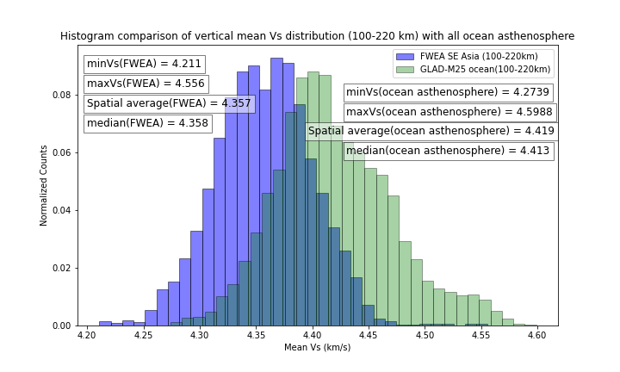
Comparing Southeast Asia asthenosphere with the global adiabat:
The asthenosphere (100-220 km) in Southeast Asia is ~1.4% slower than the global adiabat.

Slide 10
Plume affected mantle comparison:
Deep plume Vs < SE Asia Vs < Global Adiabat

Slide 11
Cause of slowness:
Slow mantle Vs
hot
wet
Gu et al., 2019 estimated water content of the mantle source of Hainan basalts to be 84-360 ppm H₂O.
Seismological imaging and geochemical proxies identify presence of plume (s).
Nature of the plume:
Global tomography (Obayashi et al., 2013, Ritsema et al., 2011, Chang et al., 2015) do not show slow velocities in the deepest mantle beneath the Hainan region.
No age correlated linear volcanic track.
The volume of lava for the SABP volcanics ~0.0097 Mkm³
Thus, not generated from the Core Mantle boundary

Slide 12
Origin of the plume:
Remnant flat slabs acts as an insulator at the base of the MTZ.
Heat is trapped in lower mantle gradually increasing its
potential T and facilitate partial melting.
Super-adiabatic upwelling ascends through the slab gaps.
The upwellings rise up and spread laterally in the depths
< 200 km causing these intraplate magmatism.

Slide 13
Supplementary

Slide 14
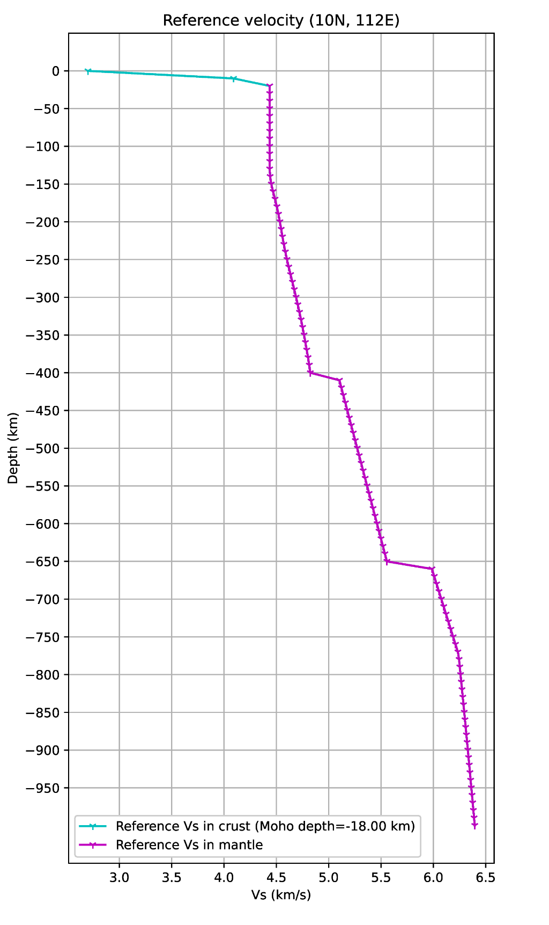
1-D Reference Model:

Slide 15
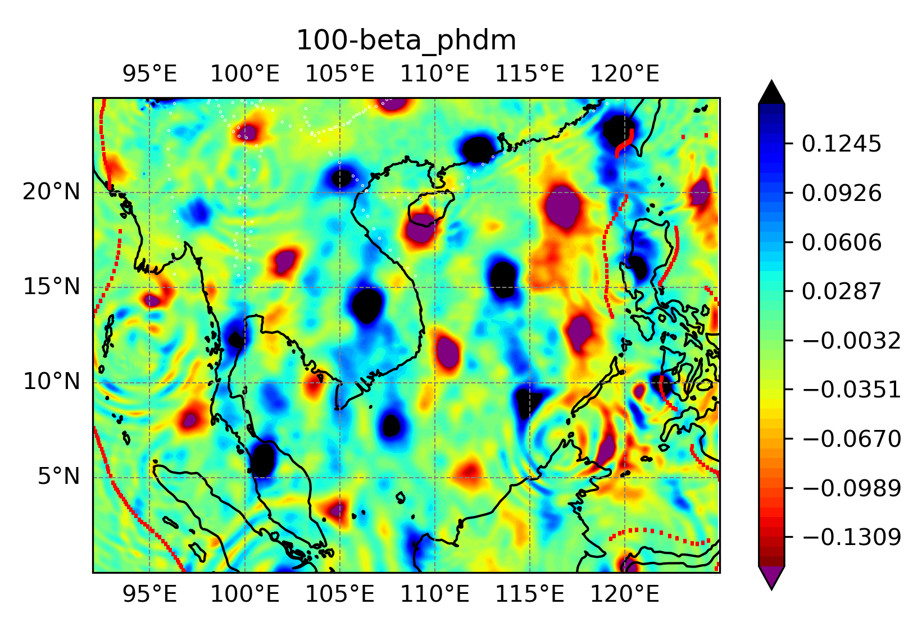
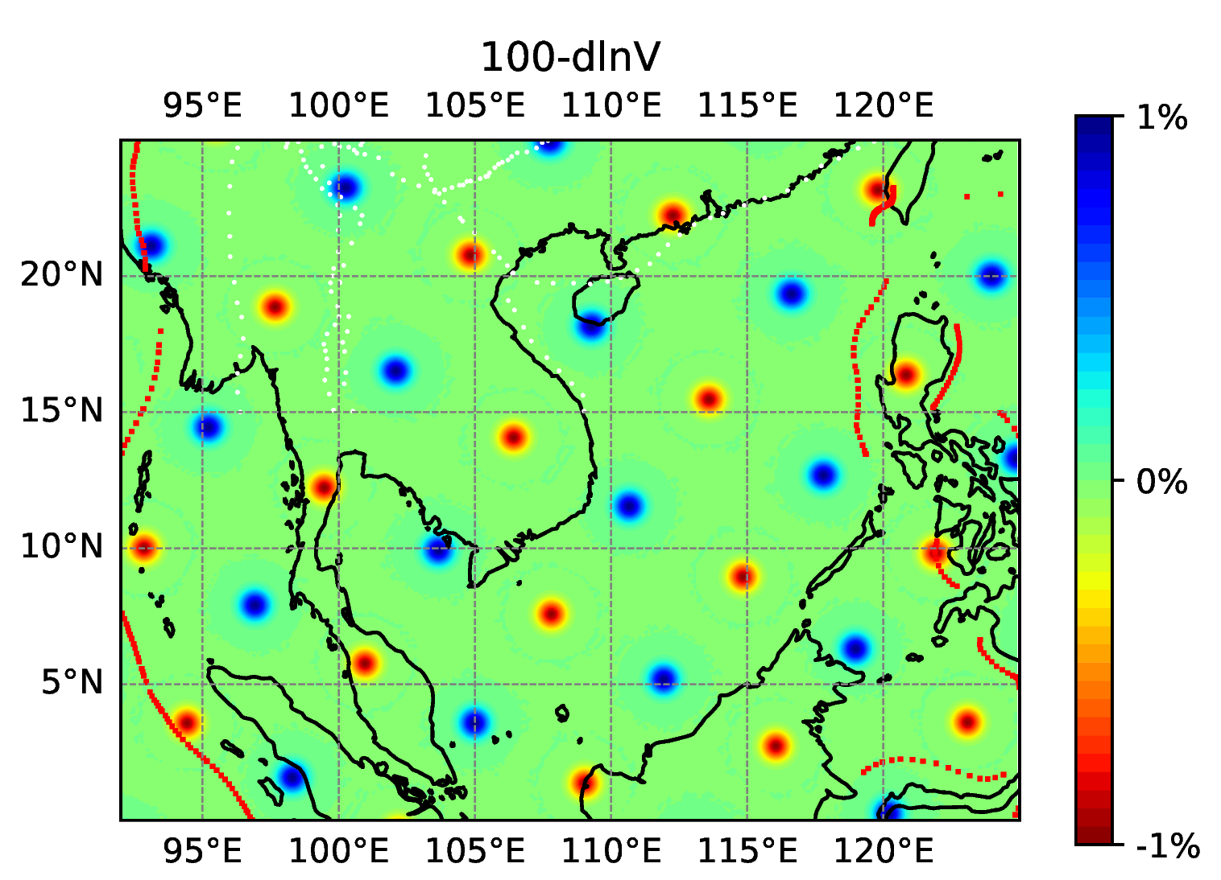
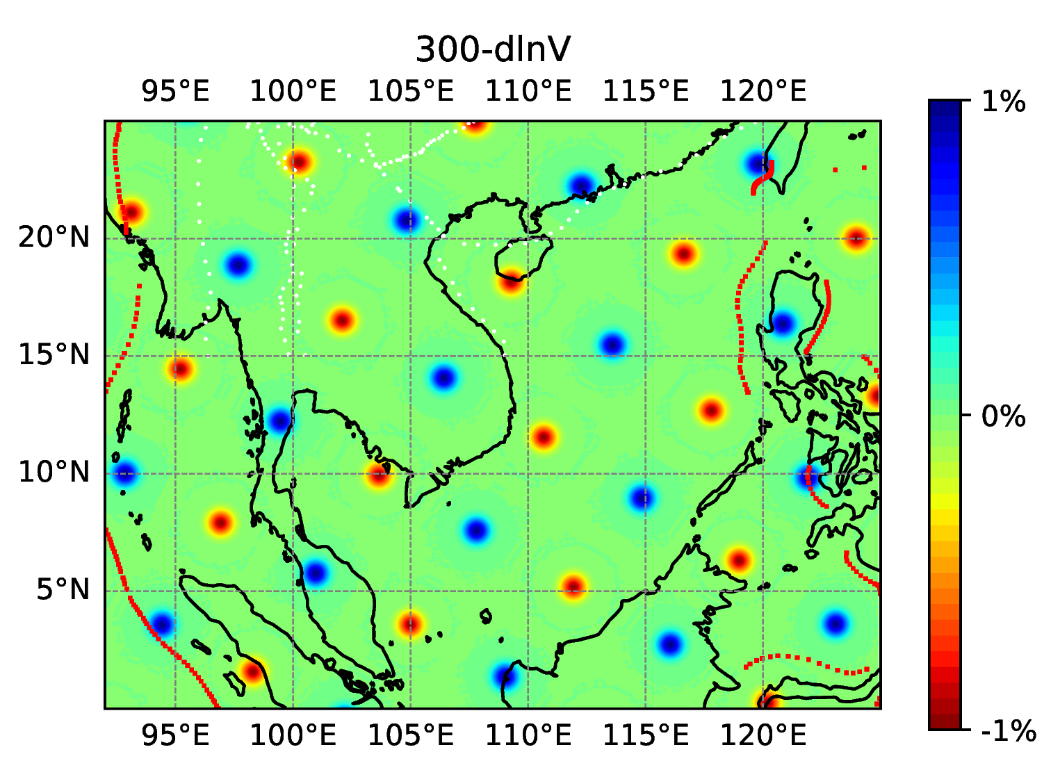
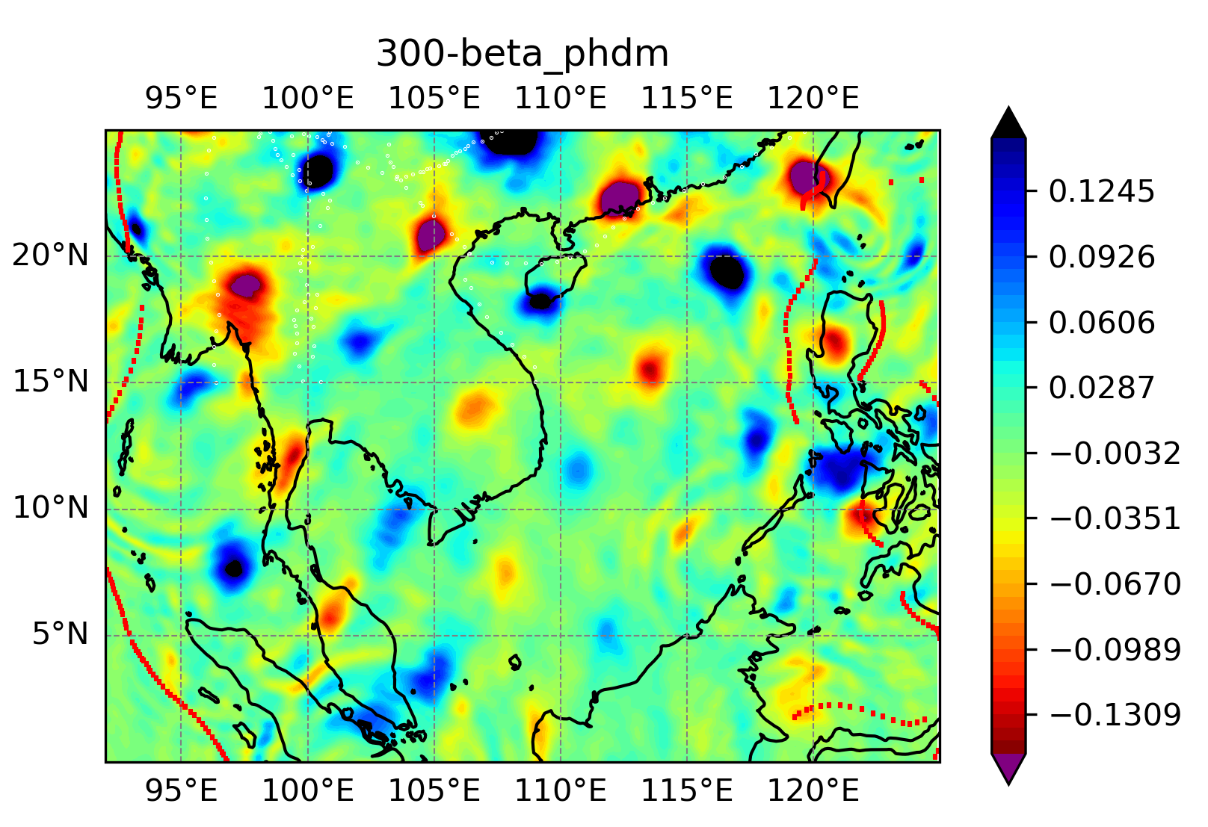
Point Spread Function test:

Slide 16
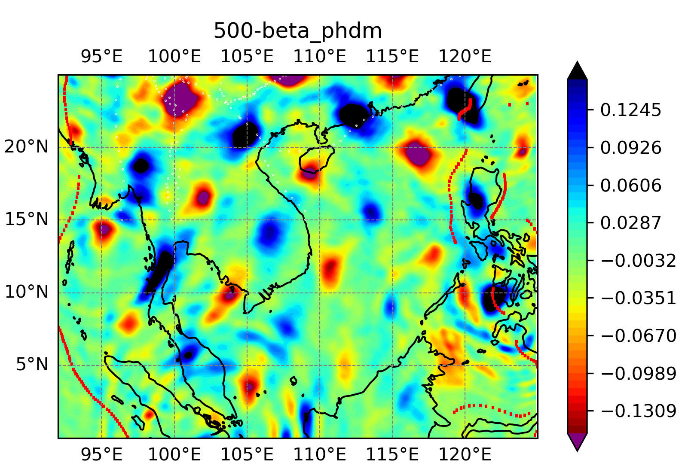
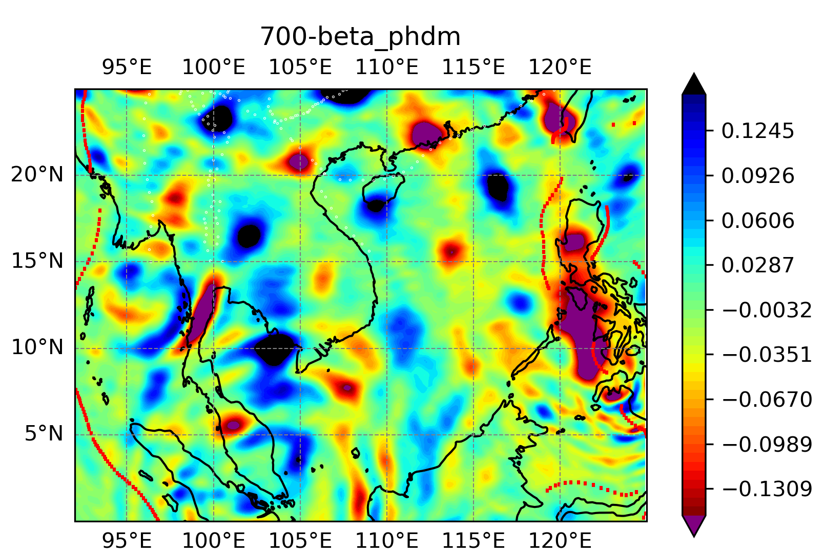

Slide 17
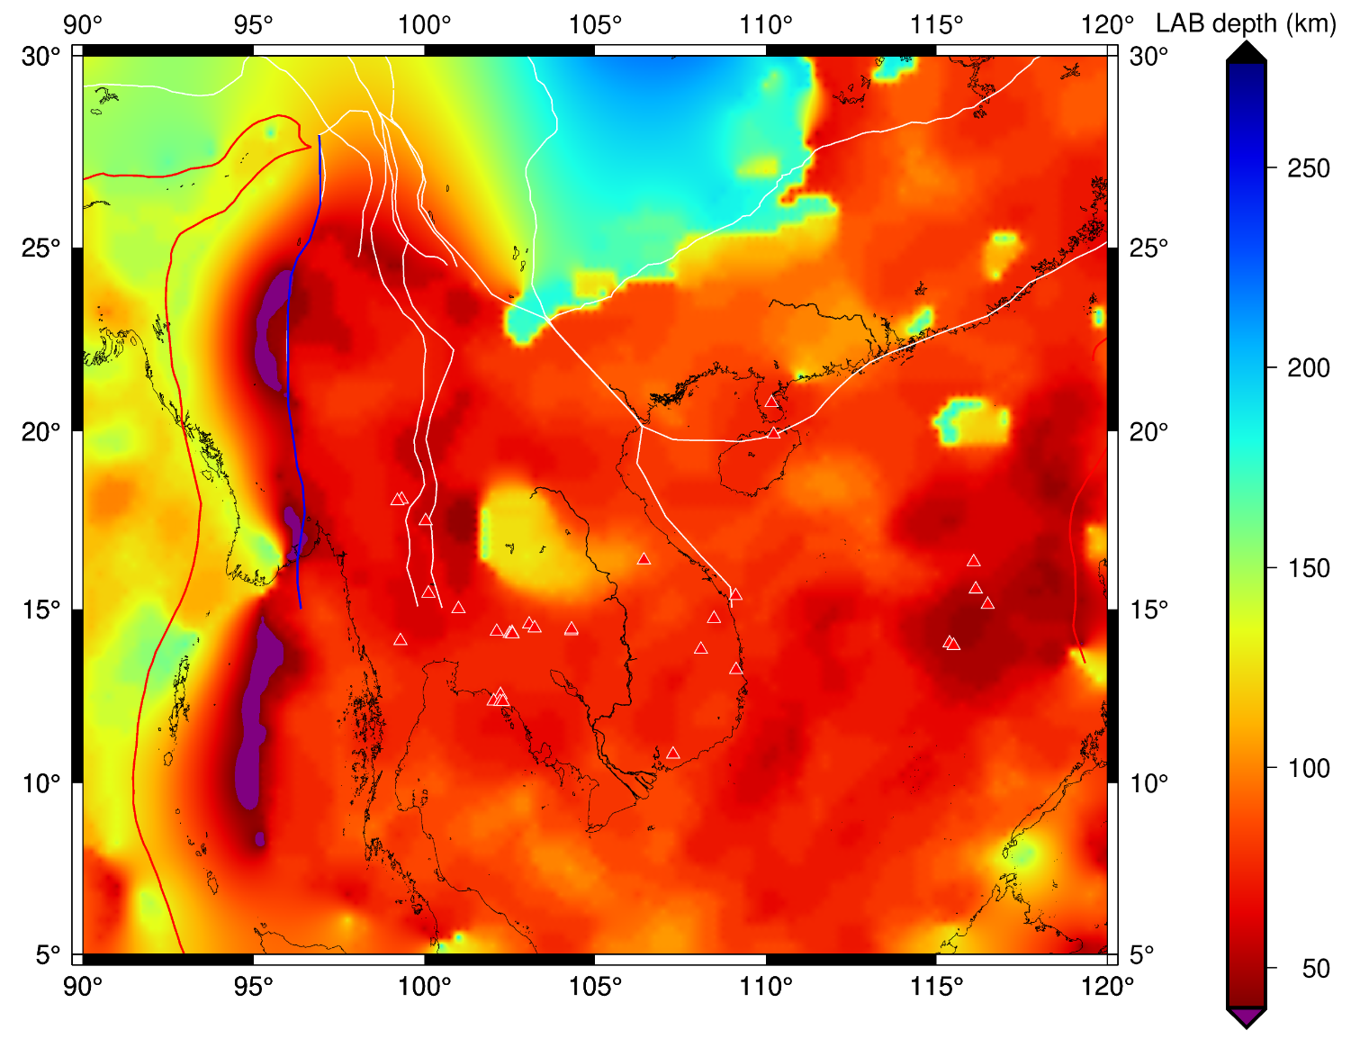
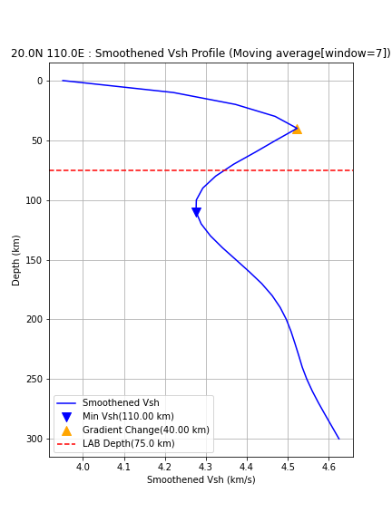
Seismic Lithosphere-Asthenosphere Boundary (LAB) depth :
Fig: Seismic LAB depth in southeast Asia
Fig: LAB depth at the 20N 110 E node

