Slide 1
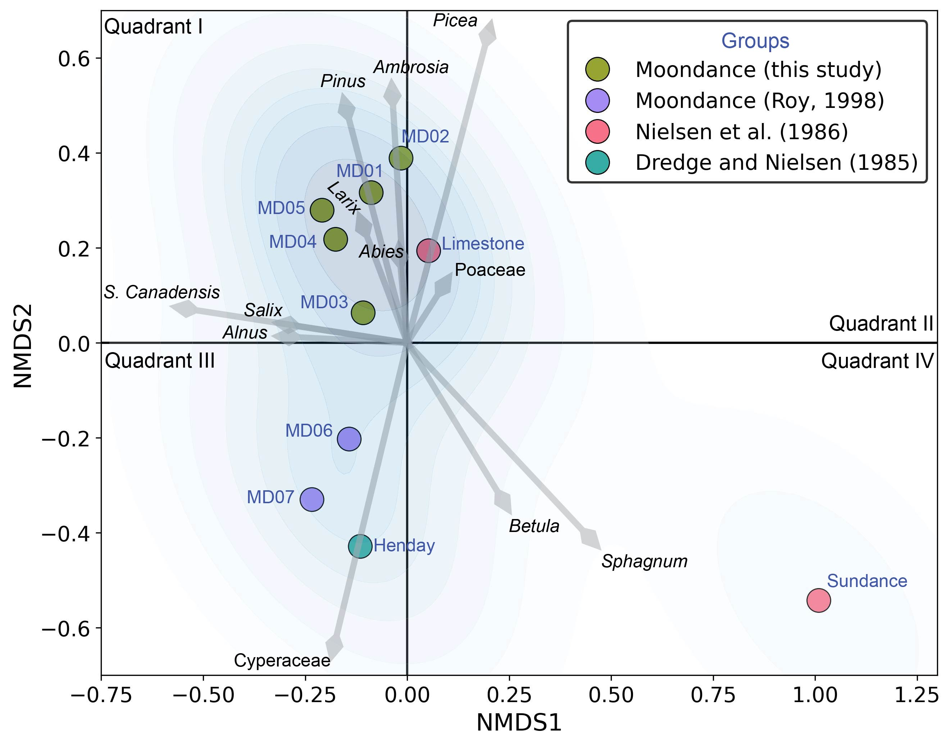
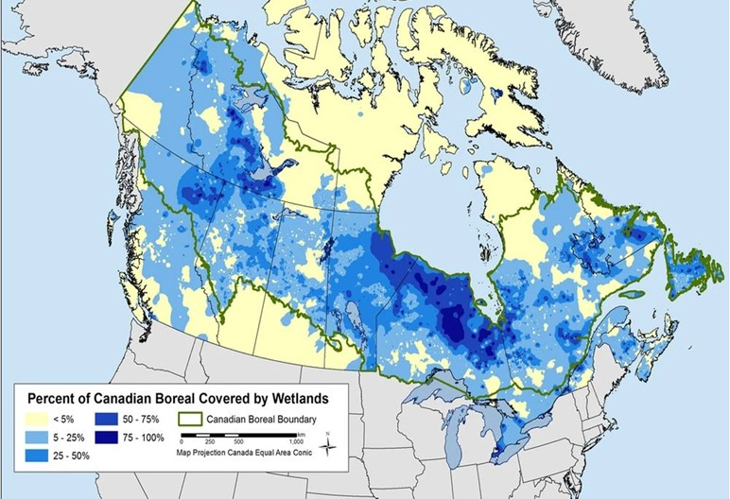
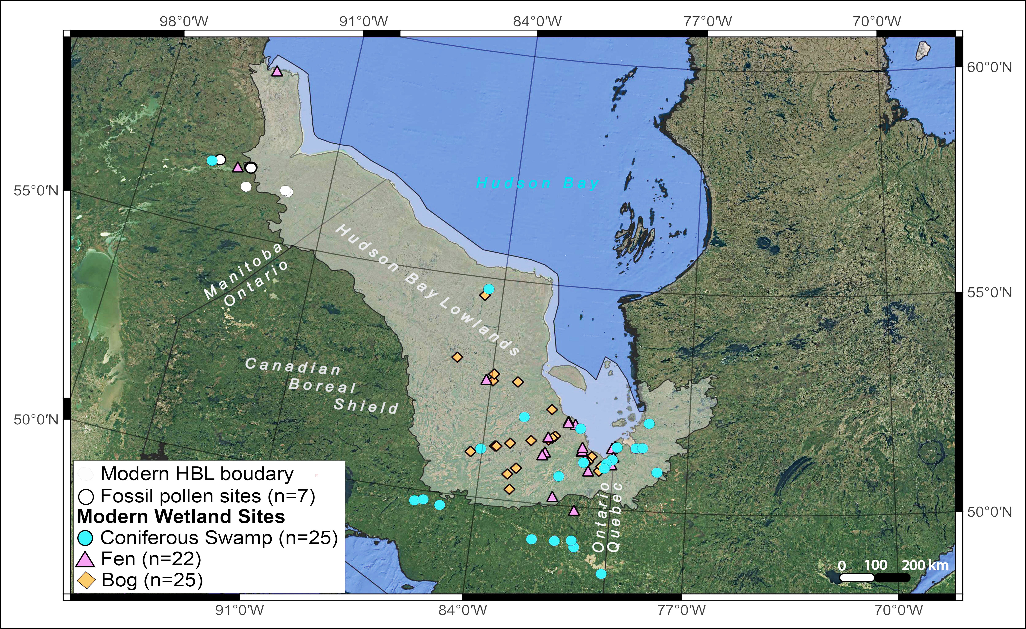
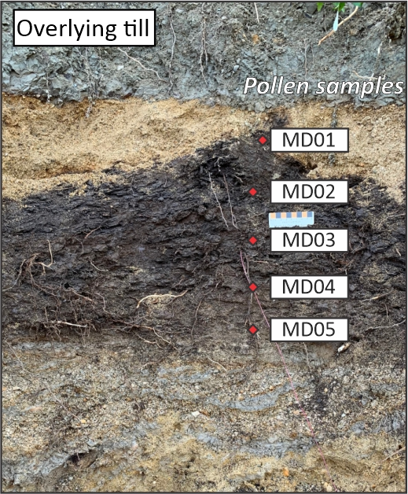
Identifying wetland types of ice-free intervals prior to the Last Glacial Maximum: first insights into pre-LGM carbon dynamics from the Hudson Bay Lowlands, Canada
Julia Hathaway¹, Tyler Hodder^{2,3}, Michelle Gauthier^{2,3}, Minna Väliranta⁴, April S. Dalton⁵, Sarah A. Finkelstein¹
¹Department of Earth Sciences, University of Toronto ²Manitoba Geologic Survey ³Department of Earth and Environmental Sciences, University of Waterloo
⁴Ecosystems and Environmental Research Programme, ECRU, University of Helsinki ⁵Centre Geotop, Université du Québec à Montréal
Background
Objective
Results
Canada’s Hudson Bay Lowlands (HBL) are globally significant for existing carbon (C) stocks and ongoing C sinks, storing roughly 30 +/-6 Pg C¹, mostly in climate sensitive wetlands. Yet, wetland response to projected climate change is uncertain, including their roles as critical terrestrial C sinks².
Extract paleo wetland carbon information through identification of specific wetland types using combined modern and fossil pollen and a random forest classification model.
Figure 5. Ordination by NMDS biplot for fossil pollen (n=10). Species vectors are shown by gray arrows. Blue region shows samples within each cluster.
Methods
NMDS 1 captures clear gradient between treed or forested environments (main density cluster, lower values) and more open, bryophyte and shrub dominated environments (higher values).
Figure 1. Percent of Canadian Boreal Covered by Wetlands
75-100%
<5%
Figure 4. Map of modern and fossil pollen sample locations within the Hudson Bay Lowlands of northeastern Manitoba, northern Ontario, and western Quebec, central Canada.
NMDS 2 differentiates between wetter, sedge-dominated fen environment and drier zone with better drained substrates, possibly close to riverbanks.
Random Forest Model Report
50% of modern samples were correctly classified
Every sample the model predicted as Coniferous Swamp was correct
F1-scores for bog and fen were below 0.5, suggesting the model struggled to differentiate them
International Boreal Conservation Campaign
Past interglacial periods provide important opportunities to evaluate wetland C dynamics under potentially warmer and drier climate conditions³. Despite palynological and paleontological evidence that wetlands existed during ice-free periods prior to the Last Glacial Maximum (LGM)^{4,5,6}, their C dynamics are poorly understood. This is in part because pre-LGM deposits are very rare in central Canada and often preserved in fluvial contexts, making them difficult to compare with Holocene peat deposits. Holocene HBL peatlands are dominated by bogs, fens, and conifer swamps. Swamps have lower C accumulation rates but, along with fens, have the potential to emit up to 700% more CH₄ than late successional bogs⁷. Key differences in plant communities linked to hydrology and C availability make wetland type a strong predictor of CH₄ flux rates and net soil carbon accumulation during previous interglacial periods^{7,8}.
Table 1. Confusion matrices showing performance of Random Forest Model for classifying wetland types using modern pollen assemblages from the HBL. Overall model accuracy for classification of individual biomes was calculated as the number of correct predictions to the total number of predictions.
Bog | C Swamp | Fen
Sundance | MD02 | MD01
 | MD03 | MD05
 | MD04 | MD06
 | Limestone | MD07
 |  | Henday
Compiled a suite of modern pollen assemblages⁹ spanning the HBL and adjacent boreal forest from existing publications. We contributed additional assemblages from recently collected and analyzed peat surface samples.
Assigned wetland type labels by projecting modern pollen assemblages onto the Far North Land Cover¹⁰ dataset in ArcGIS.
Built the supervised Random Forest Classification Model using the RandomForestClassifier module in the scikit-learn ensemble for Python and optimized it using GridSearchCV in the same ensemble.
Assessed our models’ performance using evaluation metrics on a set of training samples: recall, precision, and F1-score.
Processed pre-LGM sediments for fossil pollen (Figure 3; white circles).
Performed primary data analysis on pollen assemblages to test if pollen assemblages could be differentiated by depositional environments using ordination by non-metric multidimensional scaling (NMDS) with Bray-Curtis dissimilarity.
 |  | Predicted Wetland |  |  | Evaluation Metrics
Model accuracy 0.50 |  | Bog | C Swamp | Fen | Precision | Recall | F1-Score
Actual Wetland | Bog | 3 | 0 | 3 | 0.50 | 0.40 | 0.44
 | C Swamp | 0 | 2 | 2 | 1.00 | 0.50 | 0.67
 | Fen | 2 | 0 | 3 | 0.38 | 0.60 | 0.46
Table 2. Wetland classification of fossil pollen samples using Random Forest model.
Gods River, Manitoba, Canada
Discussion and Key Conclusions
Holocene Peat
NMDS analysis and modern Random Forest classifier revealed that the relative abundance of tree pollen appears to be a strong distinguishing feature of wetland type (Figure 5).
The Randon Forest Model classified most fossil pollen assemblages as either coniferous swamp or fen. The model precision for coniferous swamp suggests confidence in this assignment for the fossil assemblages (Table 1).
Accurate wetland classification is reliant on an adequate training dataset. This is illustrated by the low number of modern pollen records for each wetland type given the size and complexity of the HBL.
The vegetation classification system also impacts model performance. The Far North Land Cover covers a highly heterogenous landscape where vegetation is not distributed evenly across the landscape.
While previous work on the Holocene showed that wetland types can be used to infer paleo-C dynamics, to apply this to pre-LGM, improved land cover data and more high-resolution modern data are needed
Pre-LGM sediments
~40+ m
Acknowledgements
Figure 2. Section along the Gods River in northeastern Manitoba sampled for fossil pollen. Figure 3. Moondance exposure on the Nelson River in northeastern Manitoba showing sampling locations for pollen macrofossils.
Mushkegowuk Council for collaborative work on HBL peatlands; NSERC, ECCC, Parks Canada funding; Dr. Cecilia Cordero Oviedo for compiling modern pollen data
References 1. Li et al. (2025) GRS; 2. Harris et al. (2022) FEE; 3. Batchelor et al. (2024) GRL; 4. Roy (1998); 5. Nielsen et al. (1986) CJES; 6. Dredge et al. (1985) GSC; 7. Treat et al. (2018) GCB; 8. Treat et al. (2021) QSR; 9. Wihitmore et al. (2007); 10. OMNR (2014)

