Slide 1
Applying of Gridless Method in Data Assimilation System
Xinpeng YUAN and Xudong LIANG
State Key Laboratory of Severe Weather Meteorological Science and Technology, Chinese Academy of Meteorological Sciences, China Meteorological Administration, Beijing 100081, China

Slide 2
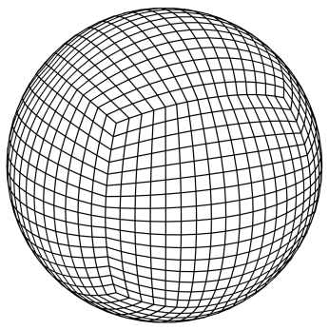
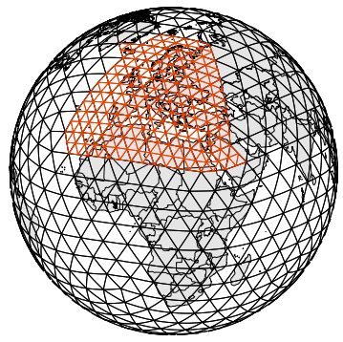
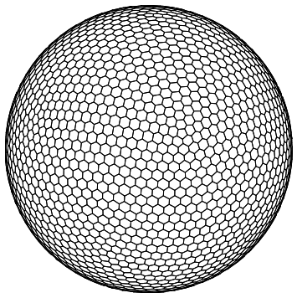
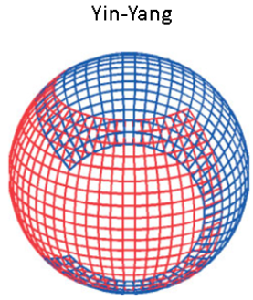
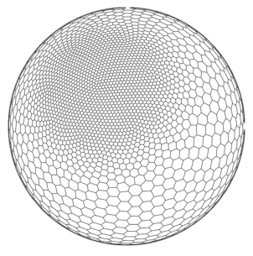
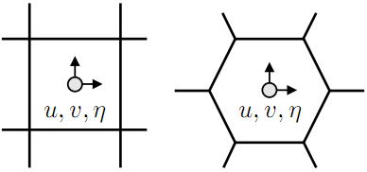
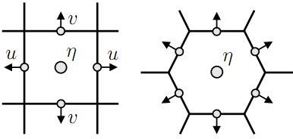
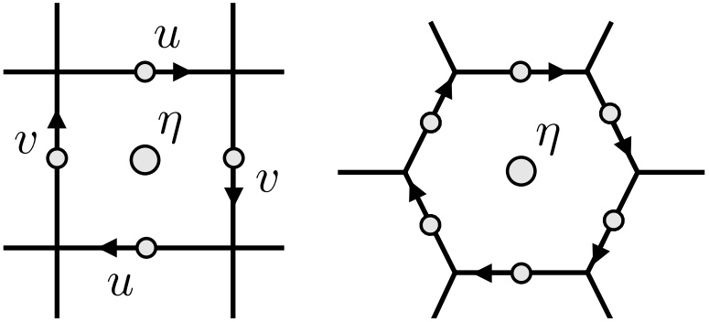
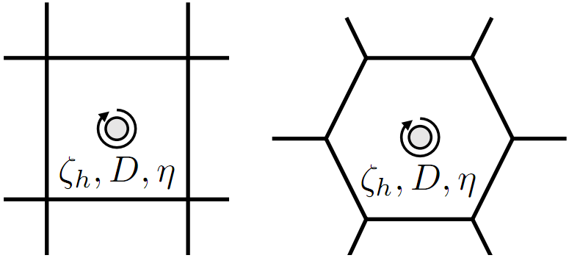
Background: In recent years, unstructured meshes have received much attention in the development of numerical models, and various mesh structures have been proposed.
The dynamic framework algorithms of quasi-uniform meshes include: A-grid, C-grid, D-grid, Z-grid, and so on.
A-mesh：ACME-A
C-mesh:
ICON,MPAS
D-mesh：FV3
Z-mesh:CSU

Slide 3
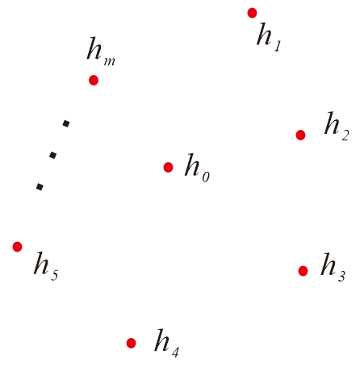
Incremental form of 3DVAR：
The observation operator adopts Cressman interpolation：
where：
Processing of background error covariance：
The handling of background error covariance ：

Slide 4
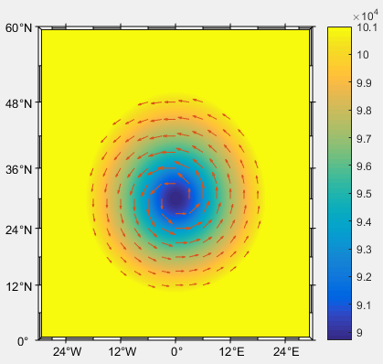
Conduct tests for the Rankine vortex.
Here, v is the tangential velocity,
which satisfies the geostrophic
balance relationship.

Slide 5
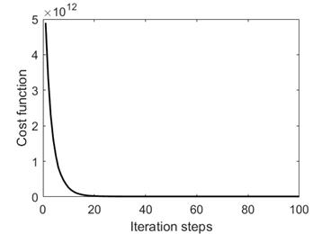
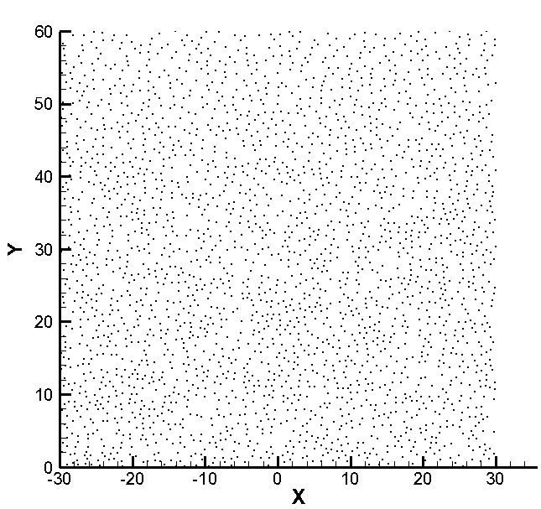
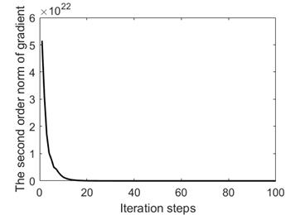
It is known that for the observed pressure field, the background field of the wind field is 0, and the background field of the pressure is the standard atmospheric pressure.
Cost function
Computational domain

Slide 6
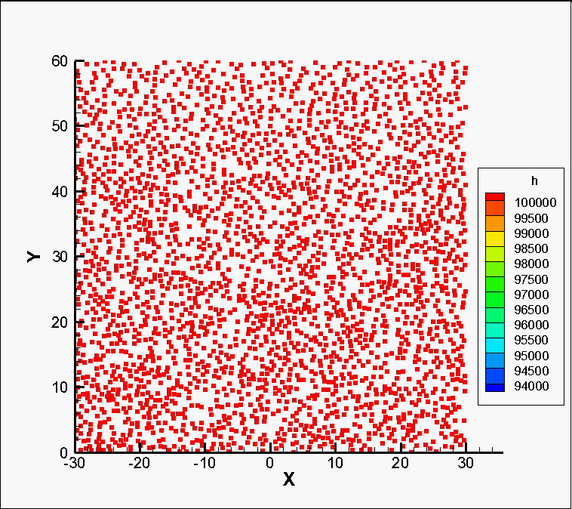
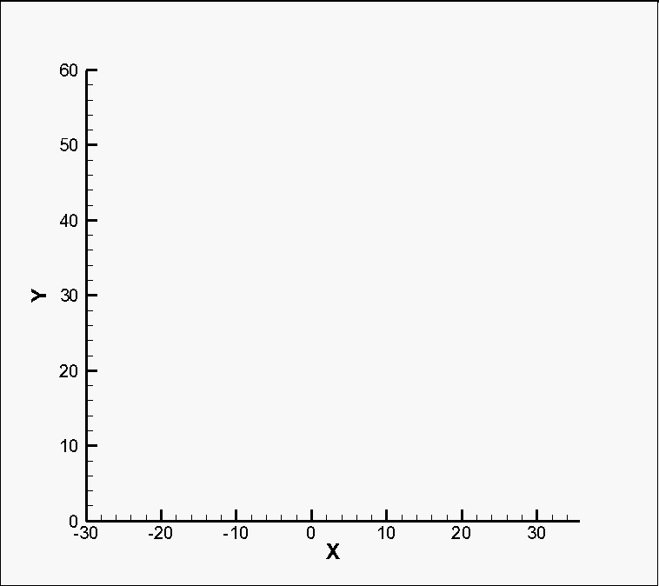
It is known that for the observed pressure field, the background field of the wind field is 0, and the background field of the pressure is the standard atmospheric pressure.
The assimilated wind field The assimilated pressure field

Slide 7
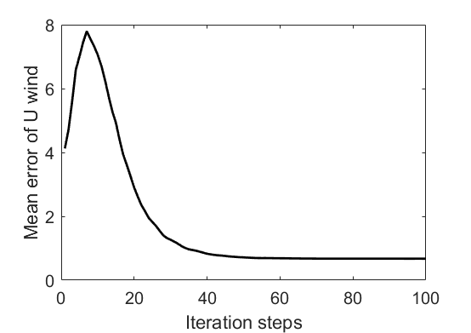
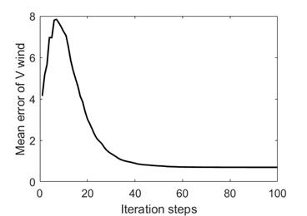
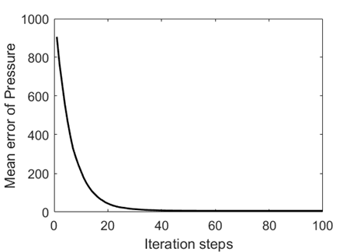
The evolution of the average error of the analysis field.
 | The results of data assimilation for irregularly distributed data
 | U wind | V wind | Pressure
Mean background error | 4.125 | 4.142 | 906.086
Mean analysis error | 0.674 | 0.696 | 6.193
Percentage error reduction | 83.6% | 83.2% | 99.4%

Slide 8
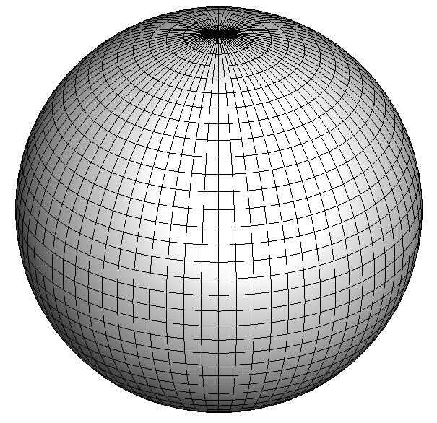
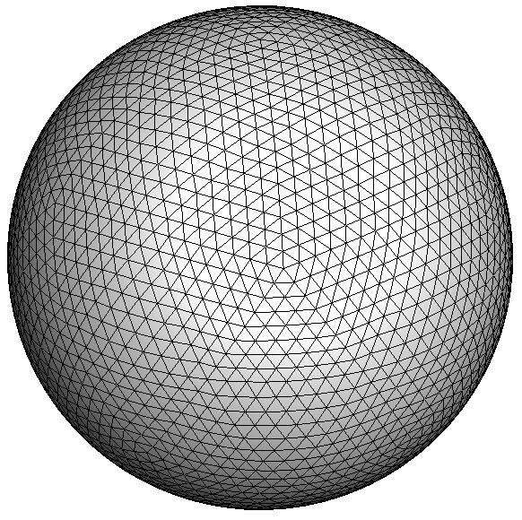
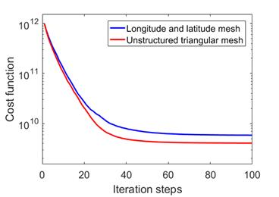
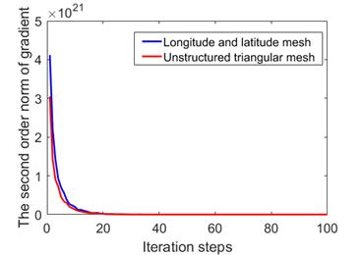
Further tests are carried out for the latitude-longitude grid and the unstructured triangular grid.
The cost function for the test

Slide 9
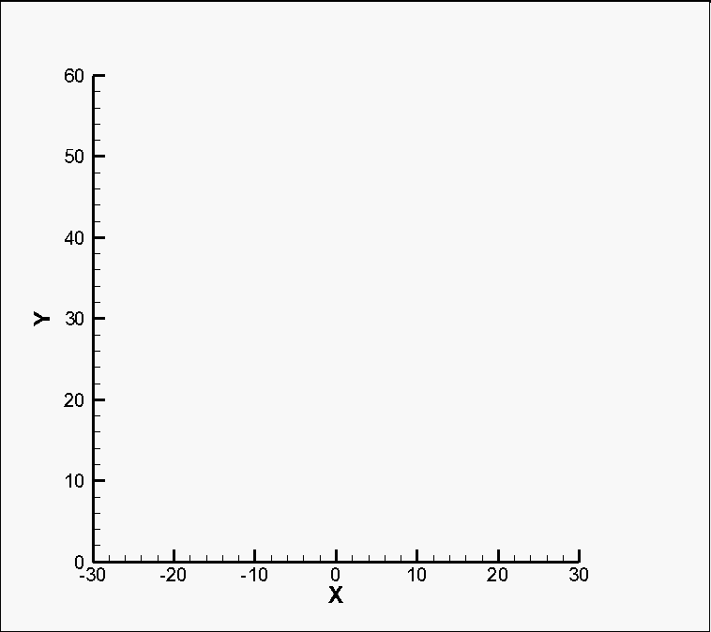
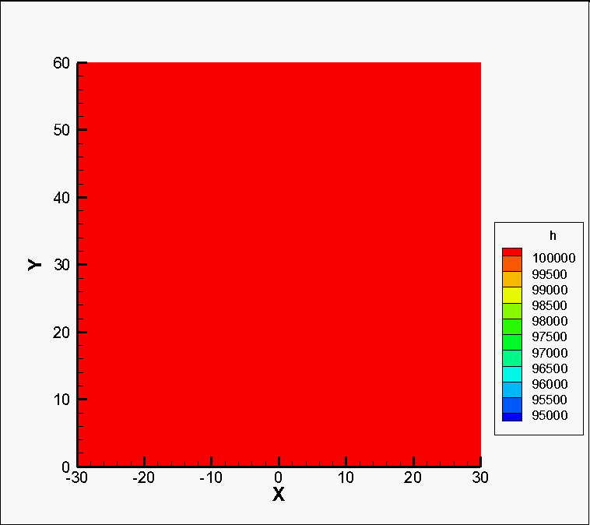
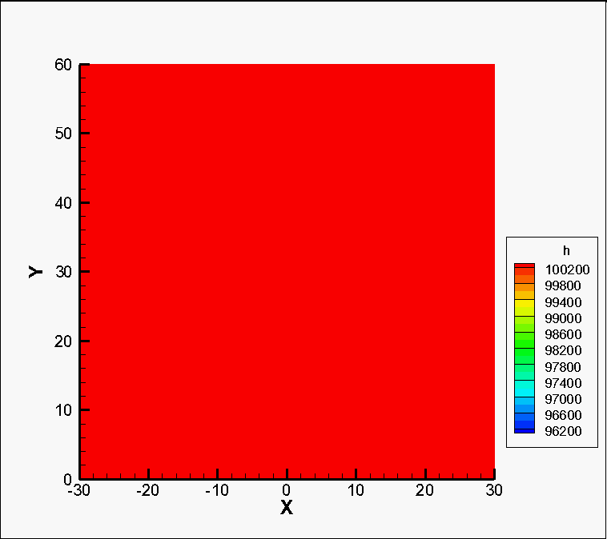

Slide 10
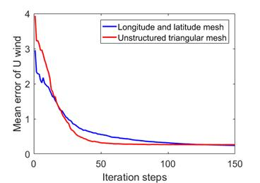
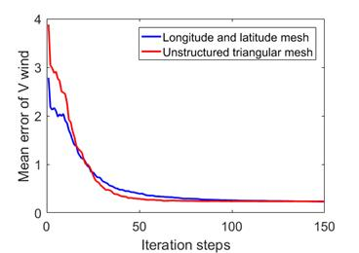
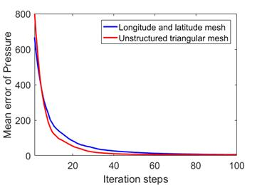
The results of data assimilation
 | Longitude and latitude grids |  |  | Unstructured triangular grids
 | U wind | V wind | Pressure | U wind | V wind | Pressure
Mean background error | 2.955 | 2.784 | 705.116 | 3.935 | 3.881 | 864.977
Mean analysis error | 0.226 | 0.220 | 4.331 | 0.263 | 0.237 | 5.197
Percentage error reduction | 92.4% | 92.1% | 99.4% | 93.3% | 93.9% | 99.4%

Slide 11
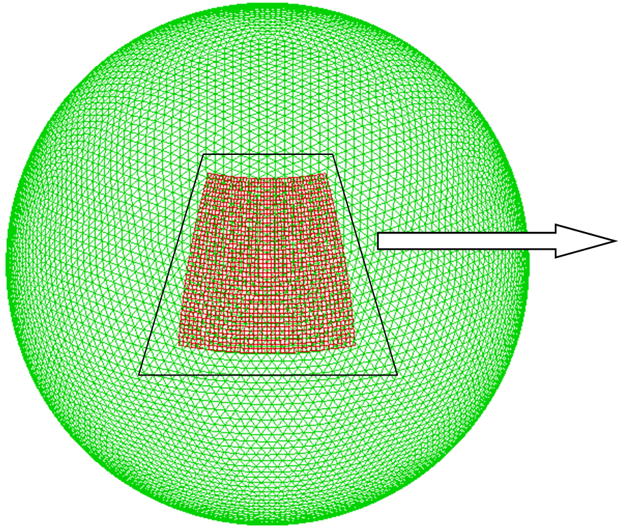
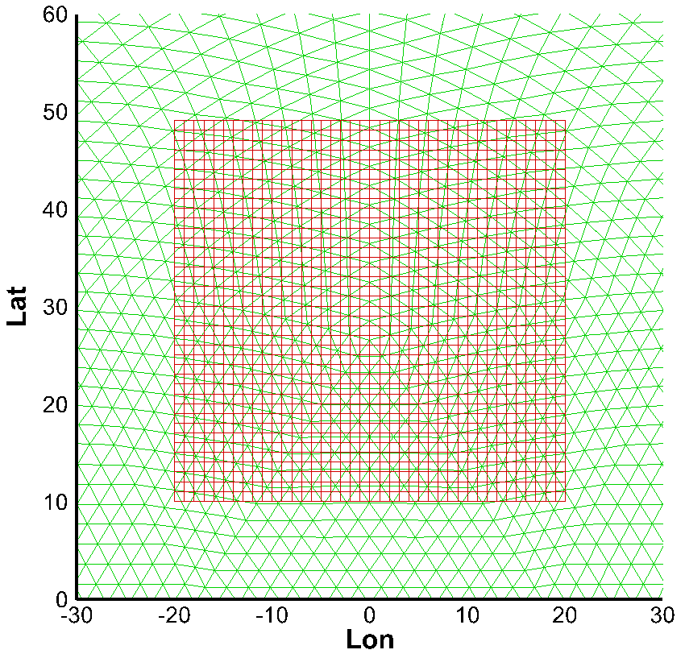
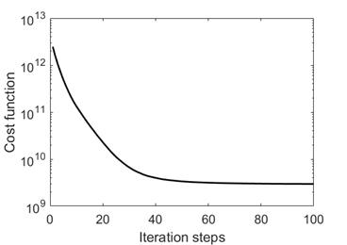
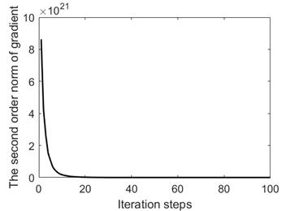
A coarse grid with 10,242 triangular meshes is adopted globally, with a resolution of 6.3 degrees. And a coarse grid with a resolution of 1 degree is adopted in

Slide 12
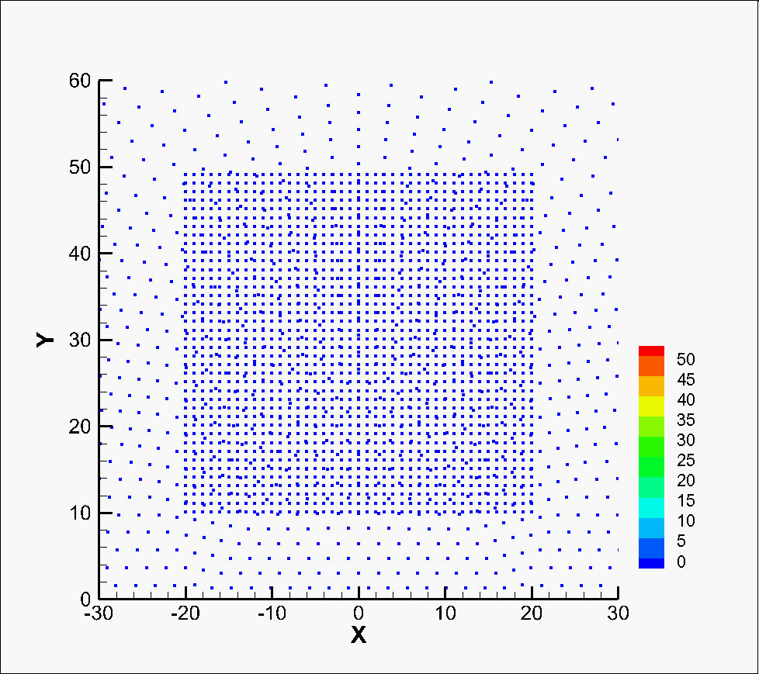
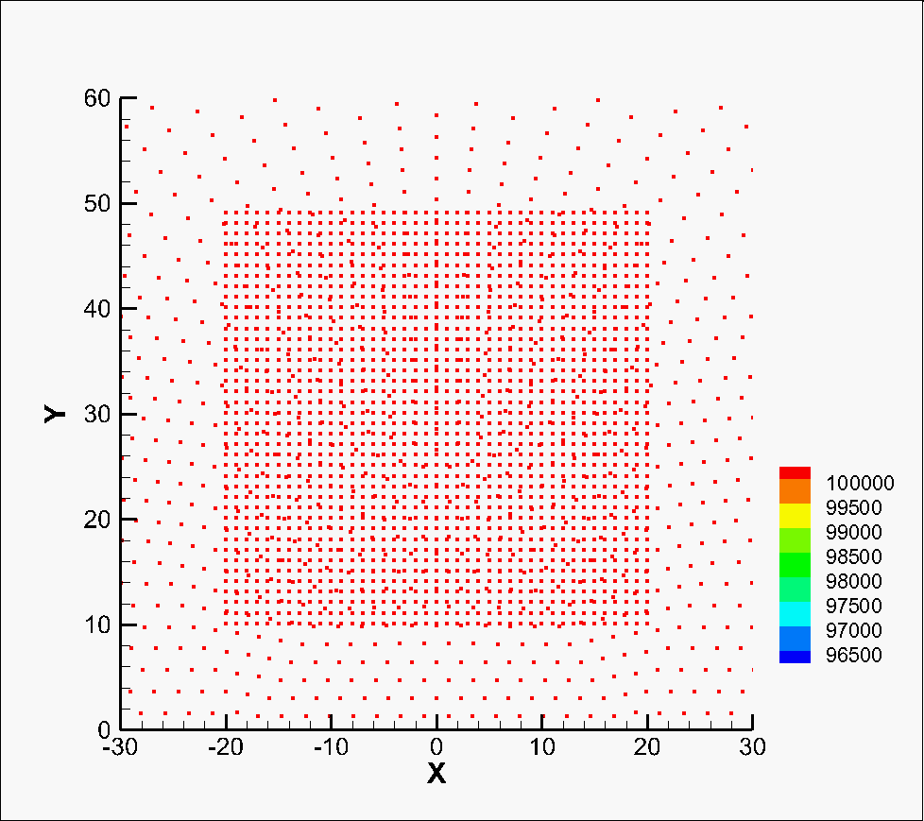
The assimilated wind field The assimilated pressure field

Slide 13
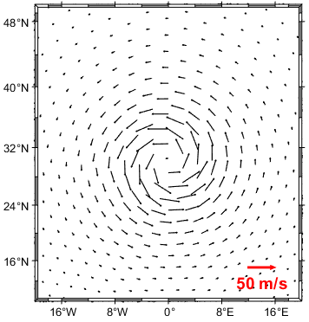
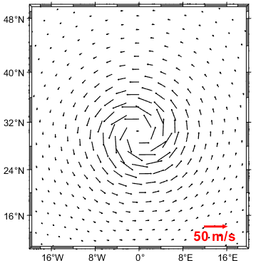
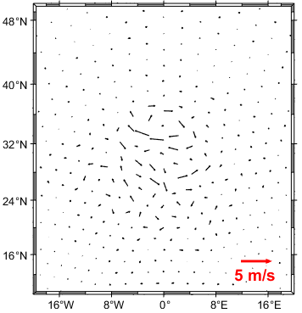
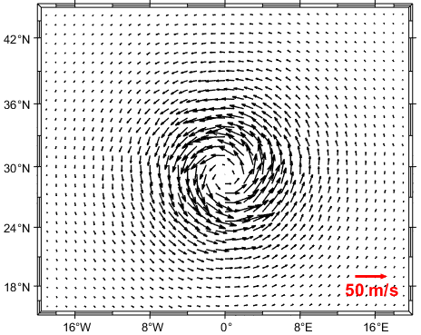
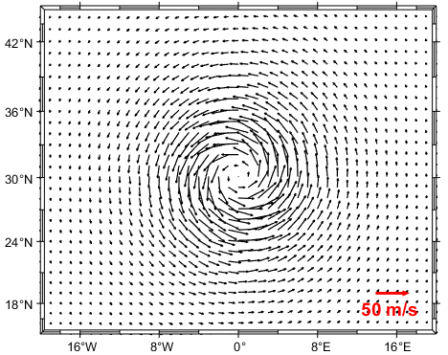
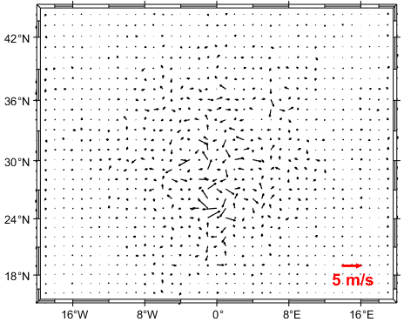

Slide 14
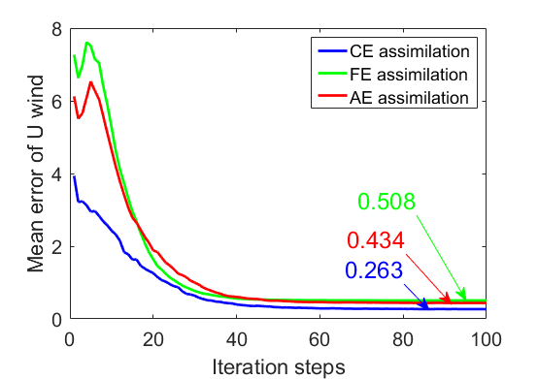
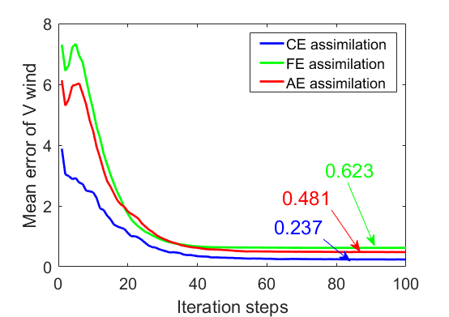
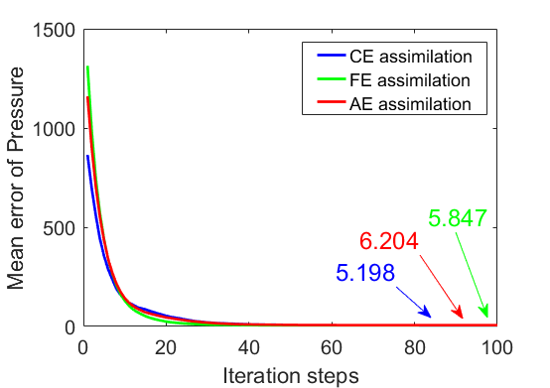
Correlation coefficient between fine resolution interpolation results and coarse resolution assimilation results
 | Separate assimilation | Simultaneous assimilation
U wind | 0.9902 | 0.9921
V wind | 0.9932 | 0.9950
Wind speed | 0.9885 | 0.9911

Slide 15
Thank you! Your comments and corrections are sincerely welcomed!

