Slide 1
Ecosystem Services Trade-Offs in the Chaohu Lake Basin Based on Land-Use Scenario Simulations
School of Landscape Architecture, Beijing Forestry University
Aibo Jin
April 2025
Notes:
Good afternoon, everyone. I’m Jin Aibo from Beijing Forestry University. Today, I would like to introduce our recent study on ecosystem services trade-offs in the Chaohu Lake Basin through land-use scenario simulations.

Slide 2
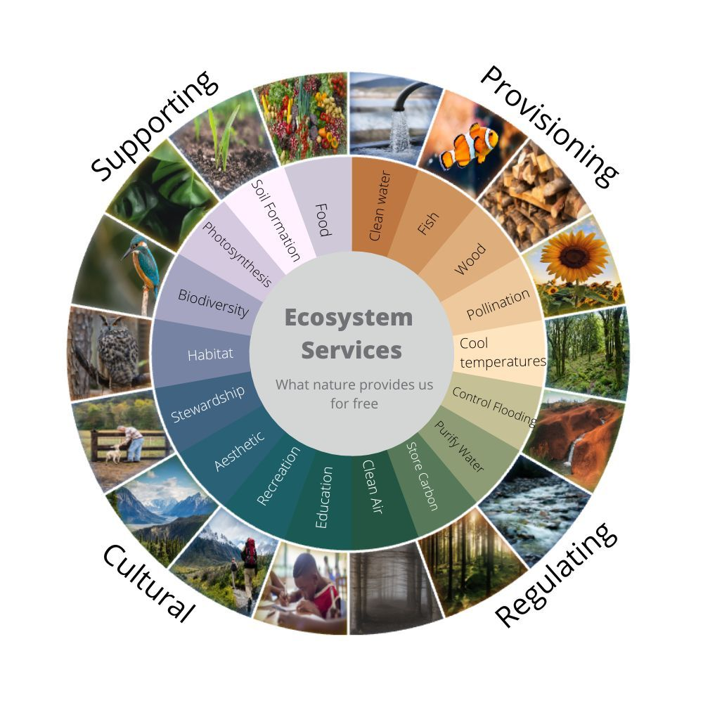
Research Background
Importance of Ecosystem Services (ESs):
Ecosystem services (ESs) are the various benefits that humans derive from ecosystems, forming the fundamental basis for sustaining human survival and development.
With the rapid economic development and continuous population growth in the 21st century, land-use and land-cover (LULC) patterns have changed significantly, leading to profound negative impacts on ESs.
Global and Regional Challenges:
At the basin scale, these changes have triggered a series of environmental challenges, such as habitat loss, diminished water purification capacity, increased soil erosion, and more frequent flooding.
The Chaohu Lake Basin (CLB), as the fifth largest freshwater lake in China, is experiencing rapid socio-economic development alongside significant ecological challenges.
image ©Visionlearning - Inspired by graphic from TEEB Europe
Notes:
Let me start with a brief background. Ecosystem services are the benefits provided by ecosystems to humans, including clean water, fertile soils, and biodiversity. Yet, rapid economic growth and ongoing population expansion in the 21st century have led to dramatic changes in global land-use patterns.

Slide 3
Research Background
Current Research:
Focuses on static quantification of ecosystem services (ESs), with limited dynamic scenario-based projections.
Lacks analysis of spatial correlations, interdependencies, and cumulative impacts among multiple ESs.
Key Research Gaps:
How to assess complex interactions and future dynamics of multiple ESs under different scenarios?
How to integrate predictive modeling with ES bundle (ESB) analysis for spatiotemporal sustainability planning?
Link to SDGs (2030 Agenda):
Addressing these gaps is critical for achieving SDG 15 (Life on Land) and SDG 6 (Clean Water) by ensuring resilient ecosystems. Scenario-based ES modeling can directly support SDG 13 (Climate Action) and SDG 11 (Sustainable Cities) through informed land-use policies.
image ©upmercosur.org
Notes:
Addressing this gap is not only a scientific pursuit, but also essential for achieving Sustainable Development Goals, such as SDG 6 for Clean Water, SDG 15 for Life on Land, and SDG 11 for Sustainable Cities.

Slide 4
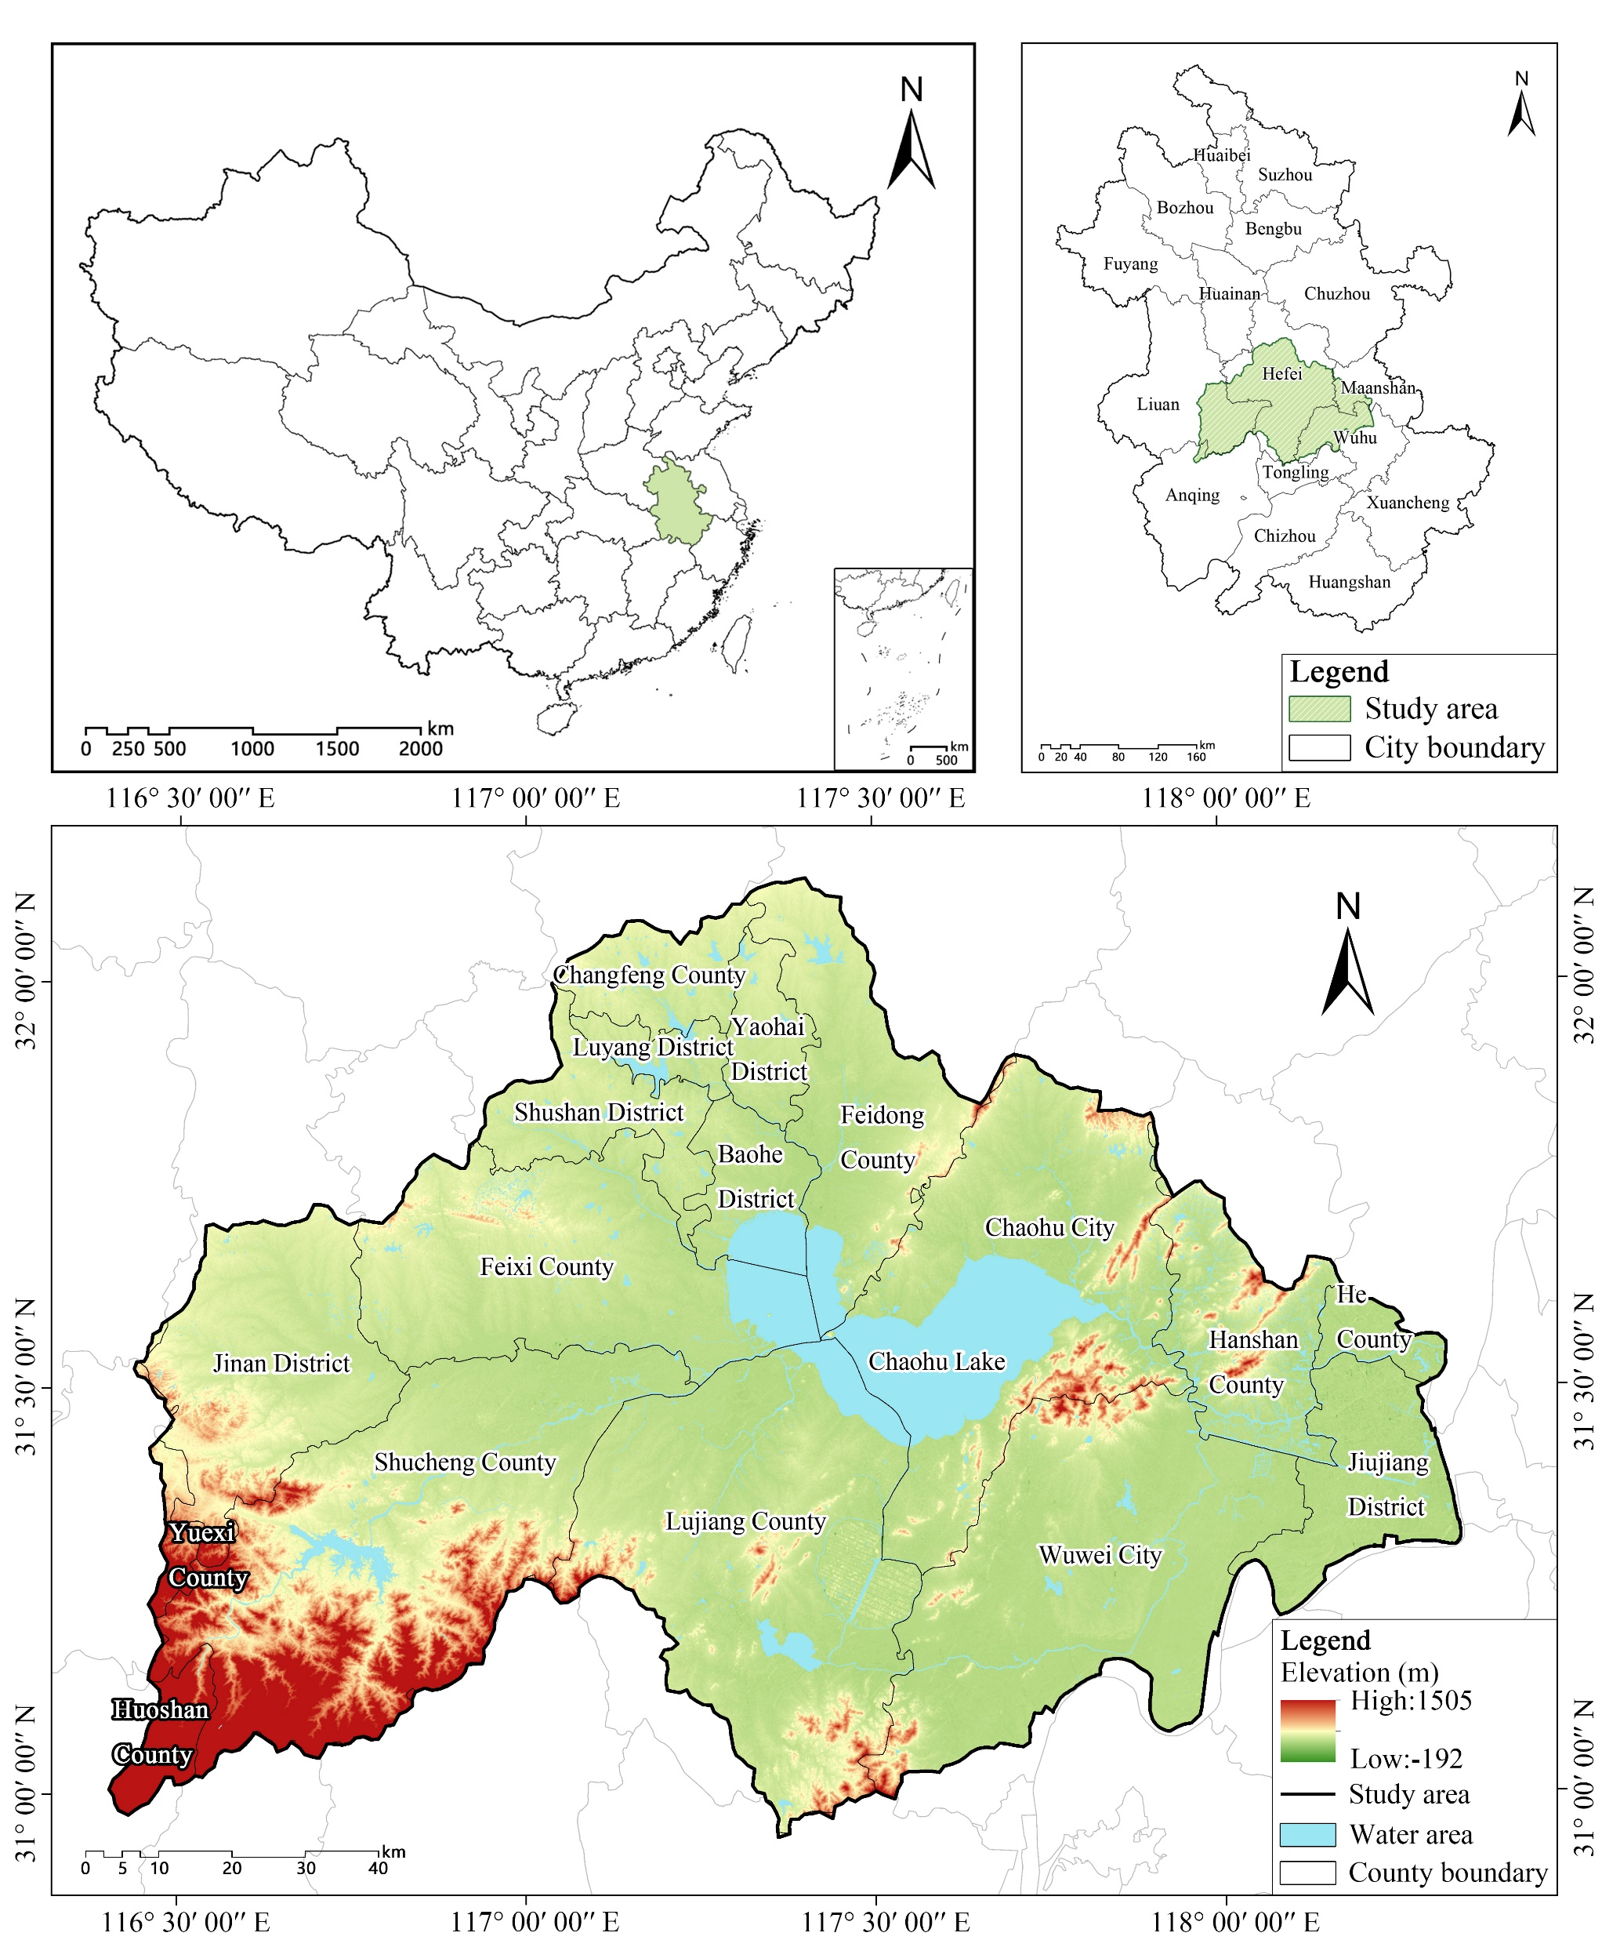
Research Background
Diverse Ecosystems in the Chaohu Lake Basin :
As a critical component of the Yangtze River Delta Economic Zone, the Chaohu Lake Basin agriculture, industry, and tourism sectors have contributed substantially to regional economic growth.
Ecological Challenges:
The basin faces escalating ecological and environmental challenges, including poor water resource management, land-use conflicts, and localized degradation of ESs.
Additional pressures such as agricultural non-point source pollution, unstable hydro-ecological functions, and insufficient flood management have further threatened the region’s ecological health and sustainable development.
Notes:
In China, the Chaohu Lake Basin—the country’s fifth-largest freshwater basin—is facing rapid socio-economic development alongside severe ecological pressures, such as poor water management, land-use conflicts, and agricultural pollution. Although many studies have examined ecosystem services, most focus only on static assessments at specific moments. What remains lacking are dynamic, scenario-based projections that capture how multiple services interact and change over time.

Slide 5
Research Background
Research
Objective
Overall Objective:
To conduct a comprehensive analysis of the spatial and temporal changes in ESs in the CLB under different scenarios for the years 2010, 2020, and 2030, as well as the complex relationships among various types of ESs, providing a scientific basis for the sustainable development and optimal management of ESs in the CLB.
Specific Objectives:
To simulate land-use and land-cover changes (LULC) under different scenarios using the PLUS model.
To evaluate the spatial and temporal distribution of various types of ESs and analyze the trade-offs and synergistic relationships among them in the CLB using the InVEST model.
To identify the ESs in the CLB and explore their spatial differences under future scenarios.
To integrate historical changes with future trends and propose optimization recommendations for the ecological management and land-use planning of the CLB.
Notes:
With that context, our study aimed to analyze how ecosystem services in the Chaohu Lake Basin have changed over time and how they might evolve under different land-use scenarios. In particular, we simulated land use in 2030 under four scenarios—Natural Development, Economic Priority, Ecological Protection, and Sustainable Development—and assessed key ecosystem services using the InVEST model. We then explored trade-offs and synergies among services, identified ecosystem service bundles, and proposed strategies for sustainable management.

Slide 6
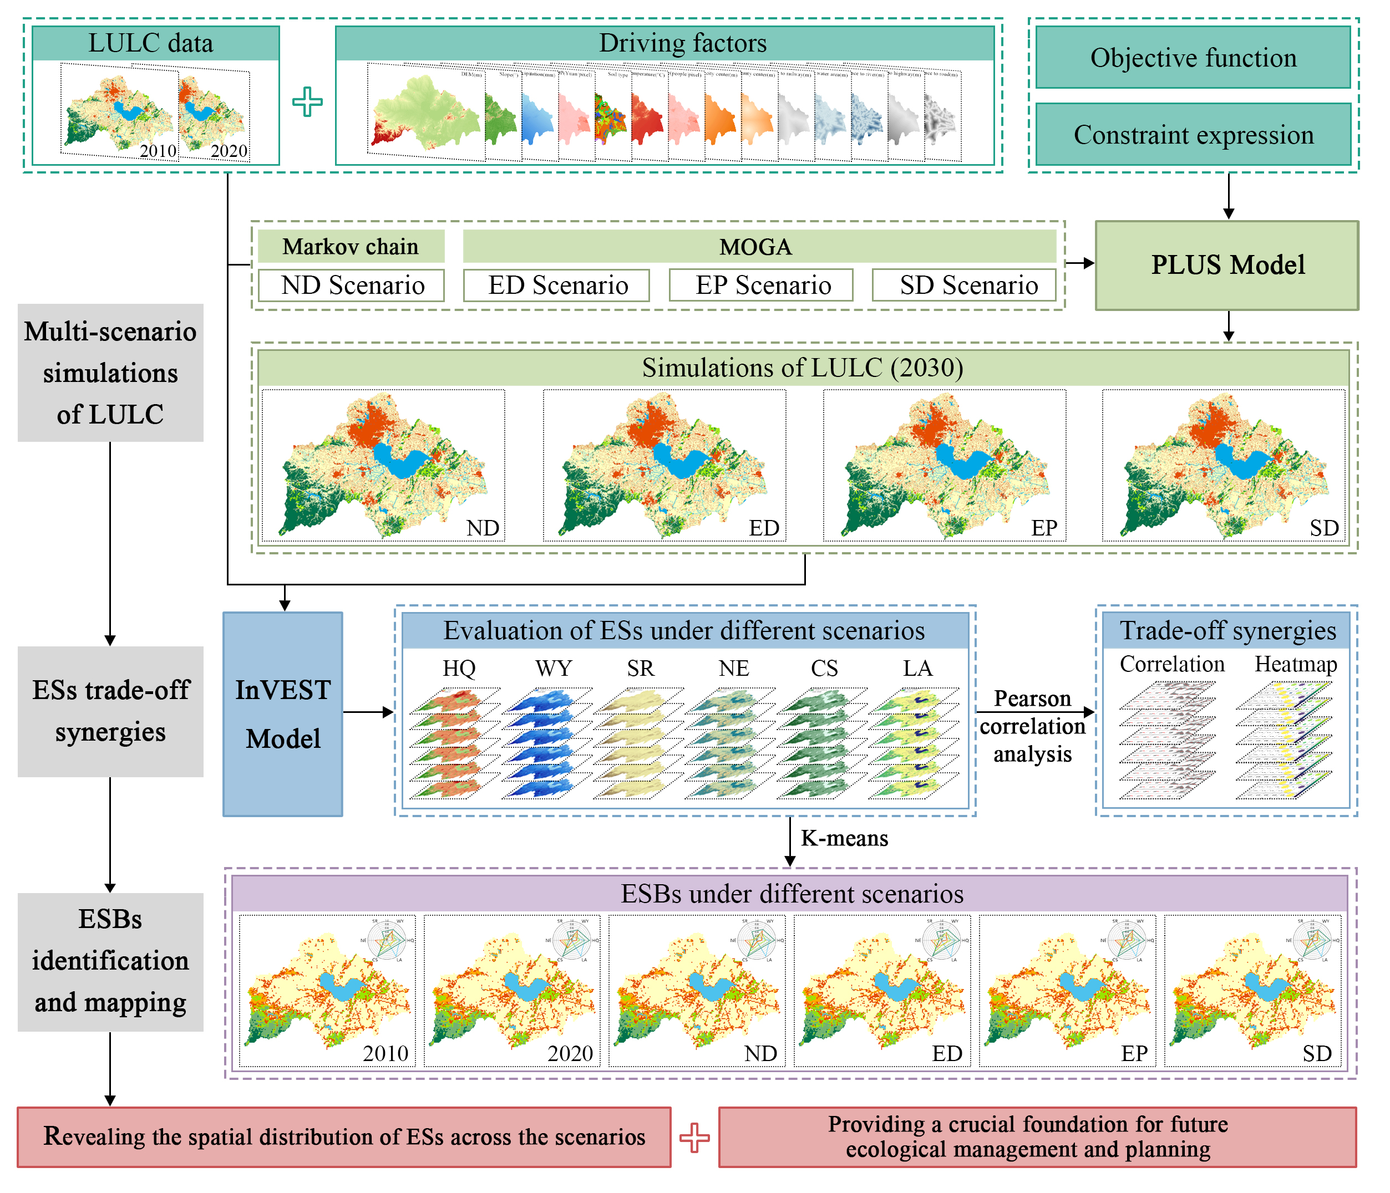
Research Background
Research
Objective
Research
Methods
Scenario Simulation of LULC:
Use the PLUS model and multi-objective genetic algorithm (MOGA) to simulate land-use changes for 2030.
Four scenarios are considered: Natural development (ND), Economic priority (ED), Ecological protection (EP), and Sustainable development (SD).
Assessment of ESs:
Use the InVEST model to quantify the spatial and temporal distribution of these ESs.
Six key indicators are selected: Water Yield (WY), Nitrogen Export (NE), Soil Retention (SR), Carbon Storage (CS), Habitat Quality (HQ), and Landscape Aesthetics (LA).
Trade-offs and Synergies Among ESs:
Apply Pearson correlation analysis to explore the relationships between different ESs.
Identification and Mapping of ESBs :
Use the K-means clustering algorithm to identify bundles of ESs.
Notes:
To simulate future land-use changes, we combined the PLUS model with a multi-objective genetic algorithm, allowing us to predict patterns under different policy scenarios. We then assessed six key ecosystem services—Water Yield, Nitrogen Export, Soil Retention, Carbon Storage, Habitat Quality, and Landscape Aesthetics—and examined their interactions using Pearson correlation analysis. Finally, we applied K-means clustering to identify ecosystem service bundles, linking land-use dynamics directly to ecosystem function.

Slide 7
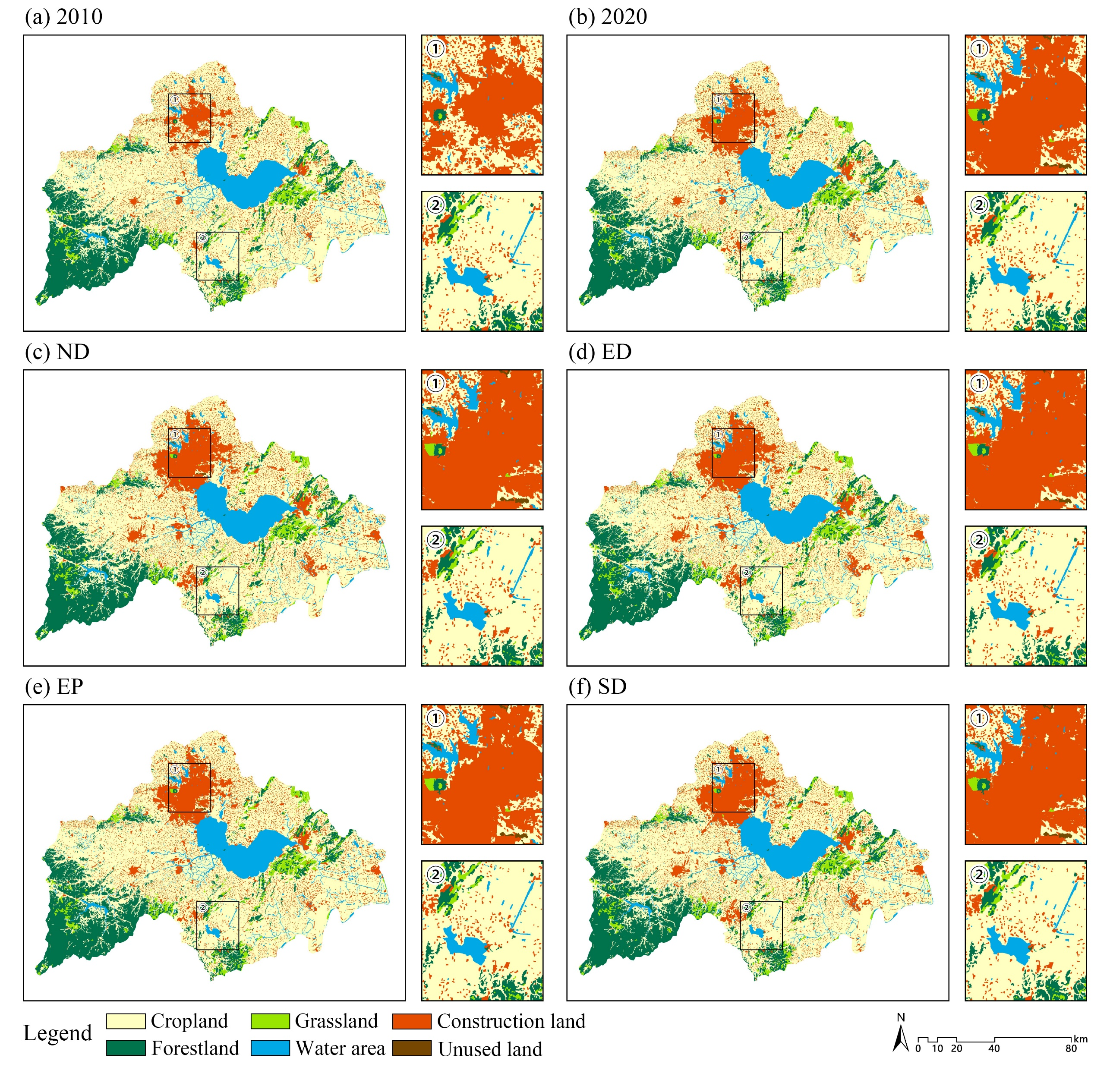
Research Background
Research
Objective
Research
Methods
Research
Findings
Land Use Area Projections:
Cropland decreased significantly in the ND and ED scenarios but slightly increased in EP scenario.
Forestland decreased in the ND and EP scenarios but remained stable in the SD scenario.
Construction land expanded in the ND and ED scenarios but was controlled in the EP and SD scenarios.
Unused land decreased sharply in the ED scenario but showed minimal changes in other scenarios.
Spatial Dynamics of Land Use Changes:
Construction land expansion was concentrated in Hefei and surrounding areas, encroaching on cropland and forestland.
Cropland was partially converted to construction land or unused land, especially in urban centers.
Forestland was partially converted to grassland or construction land, particularly in mountainous regions.
The ND and ED scenarios showed significant land-use changes, while the EP and SD scenarios exhibited more stable patterns.
Notes:
Now, moving to the key findings. First, about land use: Between 2010 and 2020, we observed a steady decline in cropland and forestland, while construction land expanded rapidly, especially around Hefei City. Looking ahead to 2030, cropland loss and construction land expansion continue under Natural Development and Economic Priority scenarios, but are significantly reduced under the Ecological Protection scenario, with Sustainable Development achieving a balanced pattern. Spatially, most construction land expansion has occurred at the expense of cropland and even some mountainous forest areas.

Slide 8
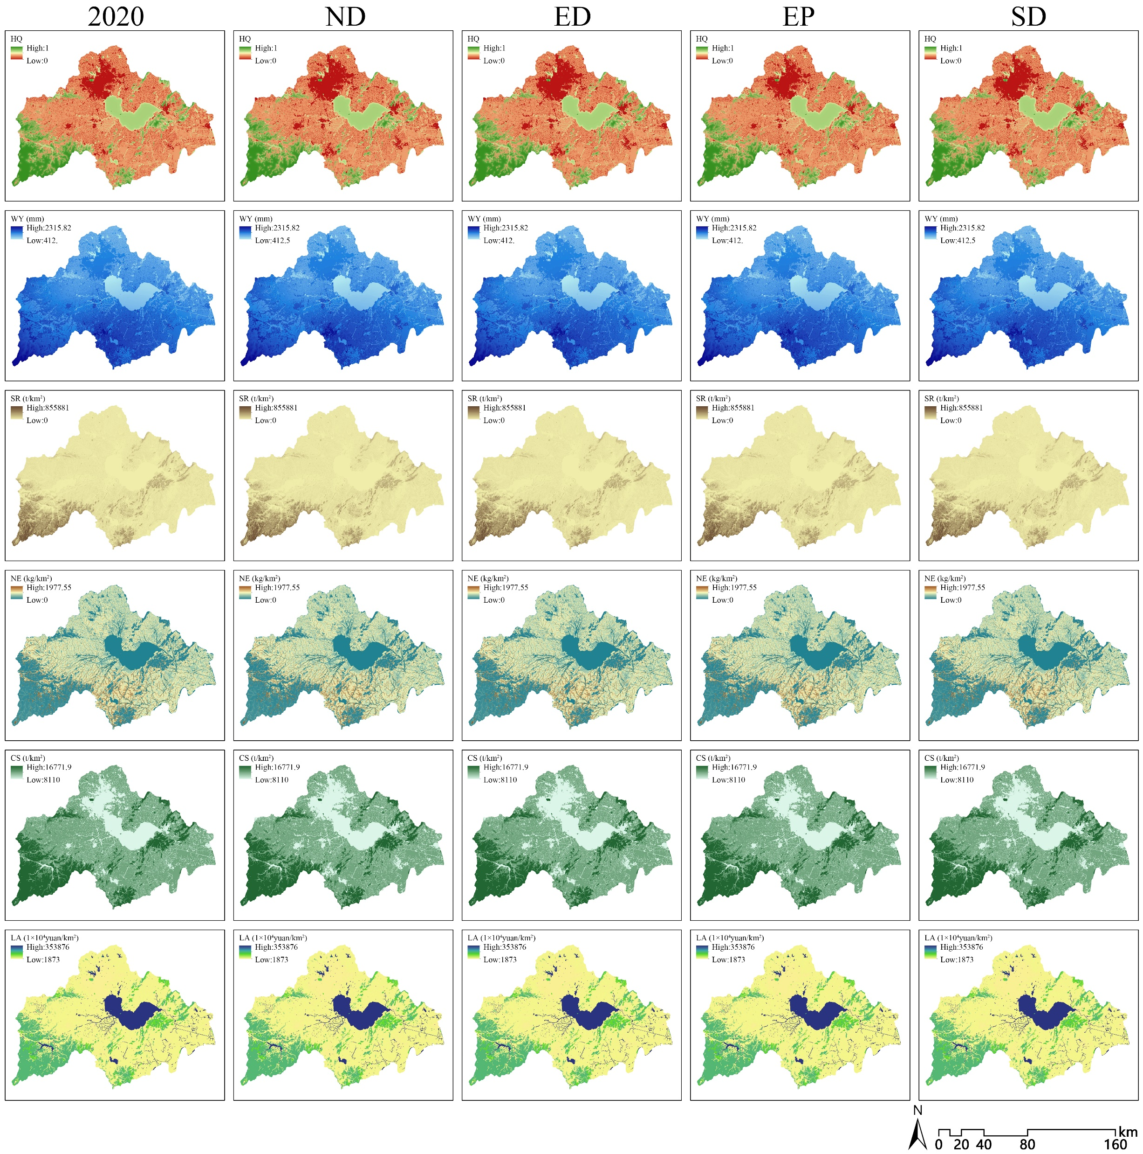
Research Background
Research
Objective
Research
Methods
Research
Findings
Habitat Quality (HQ):
Declined (2010–2020), especially in urban areas. Recovered/stabilized under EP & SD scenarios.
Water Yield (WY)：
Increased (2010–2020), highest in ED, lowest in EP.
Soil Retention (SR):
Similar trend to WY, highest in ED, lower in EP.
Nitrogen export (NE):
Increased (2010–2020), decreased (2020–2030) in most scenarios. High near runoff sources (e.g., paddy fields).
Carbon Storage (CS):
Declined in ND & ED due to land-use change. Stabilized in EP & SD (effective conservation).
Landscape Aesthetics (LA):
Declined similarly to HQ. Stabilized under EP & SD.
Notes:
Second, regarding ecosystem services:
From 2010 to 2020, Habitat Quality, Carbon Storage, and Landscape Aesthetics declined, while Water Yield and Soil Retention showed slight increases, likely due to urban expansion and flood control efforts. Looking ahead, under the Economic Priority scenario, key services like Habitat Quality and Carbon Storage would continue to decline. In contrast, the Ecological Protection scenario helps stabilize these services, and the Sustainable Development scenario supports moderate improvements.

Slide 9
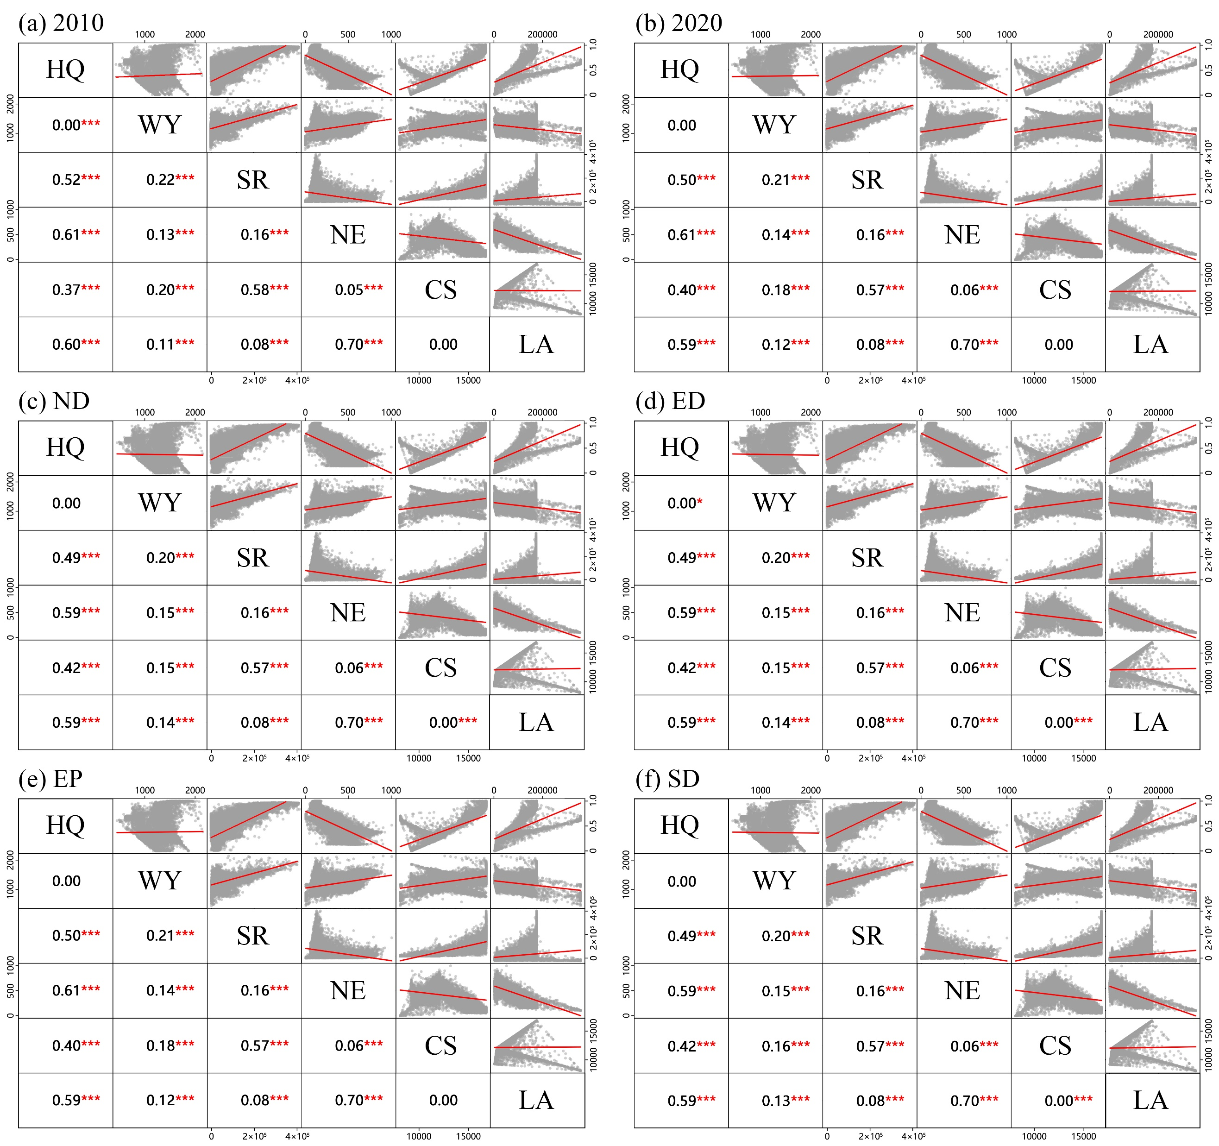
Research Background
Research
Objective
Research
Methods
Research
Findings
Trade-offs in ESs:
NE exhibited significant trade-offs with HQ & LA, with correlation coefficients of -0.83 and -0.78, respectively. This indicates that increases in NE, often due to agricultural runoff, can lead to declines in HQ and LA.
Synergies in ESs:
Significant synergies were observed between HQ and SR (r = 0.76), as well as between HQ and CS (r = 0.61). These relationships highlight that improvements in one service can positively influence others, suggesting that conservation efforts can yield multiple benefits.
Scenario-Based Variations:
While the overall patterns of trade-offs and synergies remained consistent across scenarios, slight variations were noted. For instance, the relationships between HQ and WY, and between CS and LA, showed minor changes in correlation strength under different scenarios, indicating that land-use policies can influence the balance of ESs.
Notes:
Third, about trade-offs and synergies among services: We found strong trade-offs between Nitrogen Export and both Habitat Quality and Landscape Aesthetics, with Pearson correlation coefficients of minus 0.83 and minus 0.78 for each. This suggests that agricultural runoff not only impacts water quality but also degrades landscapes and habitats. Meanwhile, strong synergies were observed, such as a positive correlation of 0.76 between Habitat Quality and Soil Retention, and 0.61 between Habitat Quality and Carbon Storage, highlighting opportunities for co-benefits through integrated management.

Slide 10
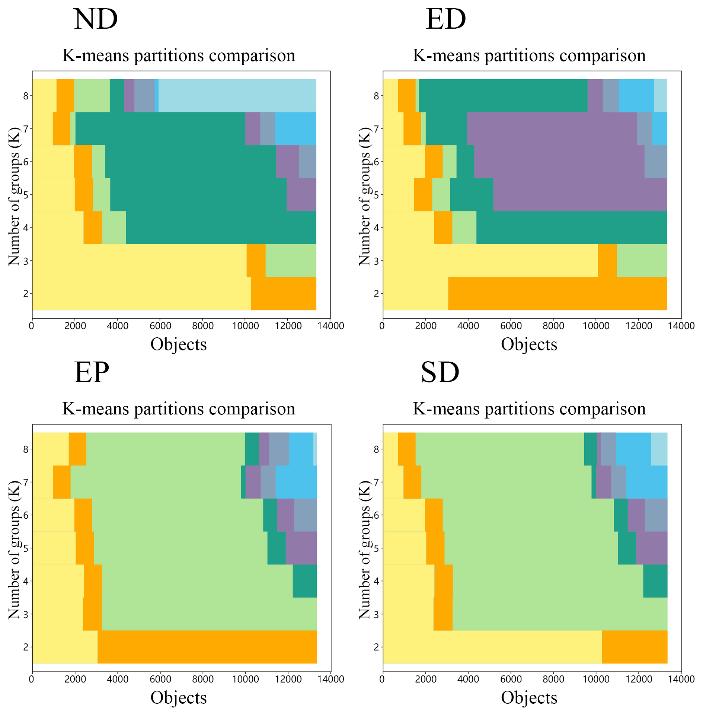
Research Background
Research
Objective
Research
Methods
Research
Findings
ESs Bundles:
Inefficient Purification Bundle (Bundle 1): Poor water purification and weaker performance in other functions, mainly found in cropland and construction land in plain areas.
Water Regulating Bundle (Bundle 2): Excels in water yield and resource management but has limited water purification capacity.
Integrated Median Bundle (Bundle 3): Balanced across all ecosystem services with no single function standing out.
Efficient Habitat Bundle (Bundle 4): Strong performance in habitat quality and carbon storage, with high scores in water yield and soil retention.
Strong Carbon Storage Bundle (Bundle 5): Excellent carbon storage and habitat quality with well-rounded functionality.
Carbon and Water Balance Bundle (Bundle 6): Balanced carbon storage and water yield with moderate performance in other functions.
Landscape Aesthetics Bundle (Bundle 7): Primarily focused on landscape aesthetics but weak in other ecosystem services.
Notes:
Finally, we explored ecosystem service bundles.
Using K-means clustering, we identified seven bundles:

Slide 11
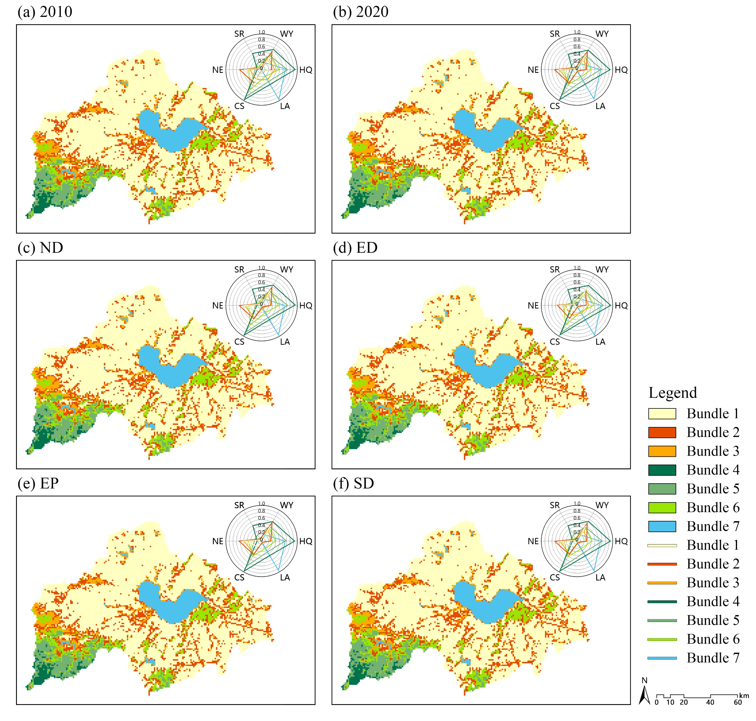
Research Background
Research
Objective
Research
Methods
Research
Findings
Spatial Distribution of ESBs:
Bundle 1: Dominant in cropland and construction land in plain areas.
Bundles 2 and 3: Widely distributed around water bodies and valleys, encompassing diverse land-use types.
Bundles 4–7: Concentrated in mountainous regions and around water bodies, with Bundle 4 dominated by forestland and Bundles 5–7 primarily consisting of forestland and grassland.
Changes in ESBs Across Scenarios:
ND Scenario: Bundles 1 and 3 continued to decline, while Bundle 4 significantly increased.
ED Scenario: Bundles 1 and 6 increased, while Bundles 2, 3, 4, and 5 decreased.
EP Scenario: ESB distribution remained consistent with 2020.
SD Scenario: Bundles 3, 4, and 5 decreased, while Bundle 6 increased, and others remained stable.
Notes:
Bundles 1 to 3, dominated by cropland and construction land, exhibited poor overall ecosystem performance, while Bundles 4 to 7, mainly in mountainous and water-rich areas, performed much better, especially in habitat quality, carbon storage, and landscape aesthetics. Under the Economic Priority scenario, degraded bundles expanded significantly. In contrast, under the Ecological Protection and Sustainable Development scenarios, high-performing bundles remained stable or even slightly increased.

Slide 12
Research Background
Research
Objective
Research
Methods
Recommendations & Future Research
Spatial Heterogeneity and Land-Use Impact on ESs:
Mismatches between ES supply and demand occur spatially. Urban areas demand high water purification and aesthetics, but land-use changes reduce supply capacity, causing supply-demand gaps.
Habitat fragmentation from urban expansion reduces biodiversity and ecosystem connectivity. Land-use changes (e.g., converting cropland to urban land) alter ecosystem structure and function, degrading ES such as CS and SR.
Rational land planning optimizes land-use layouts, reduces ecosystem degradation, and enhances ES supply. Limiting urban expansion and protecting key ecological zones can improve HQ and LA.
Trade-offs and Synergies Among ESs Under Future Land-Use Scenarios:
ED scenarios show urban expansion reducing ES supply, especially HQ and LA.
EP scenarios demonstrate strict urban limits can stabilize ecosystems, proving policies enhance ES supply.
SD scenarios balance ecological and economic goals, maintaining stable ES provision and illustrating how well-designed policies achieve ecological-economic win-wins.
Notes:
Based on these findings, we recommend limiting urban expansion, protecting key ecological zones, promoting eco-friendly agriculture, enhancing land restoration, and establishing eco-compensation schemes to support conservation efforts. We also suggest integrating remote sensing data with ecological models to enable more adaptive management strategies. Looking ahead, future research should improve climate and land-use projections, explore nonlinear interactions among services, and better incorporate socio-economic drivers.

Slide 13
Research Background
Research
Objective
Research
Methods
Recommendations & Future Research
Policy Recommendations:
Integrate remote sensing and ecological modeling for adaptive lake ecosystem management.
Foster cross-sectoral and regional collaboration for unified conservation and land-use planning.
Expand ecological farming, land reclamation, and fallow systems to boost ecosystem services.
Implement eco-compensation schemes (e.g., subsidies) to encourage conservation-friendly practices.
Future Research Directions:
Improve predictive capabilities for future climate and land-use changes through field validation and model refinement.
Investigate complex nonlinear relationships among ES and integrate socio-economic and ecological drivers for comprehensive watershed management support.
Enhance analysis of multi-scale environmental characteristics to accurately assess the impacts of environmental scale factors on ES.
Notes:
To wrap up,
Our study clearly shows that land-use decisions have profound impacts on the trade-offs and synergies among ecosystem services.
Choosing sustainable pathways can help maintain ecosystem functionality while supporting economic development.
We hope that our findings can offer valuable insights for policy-makers and planners, not only for the Chaohu Lake Basin but also for similar regions worldwide.

Slide 14
Thanks !
School of Landscape Architecture, Beijing Forestry University
Aibo Jin
jinaibo@bjfu.edu.cn
April 2025
Notes:
Thank you very much for your attention!

