Slide 1
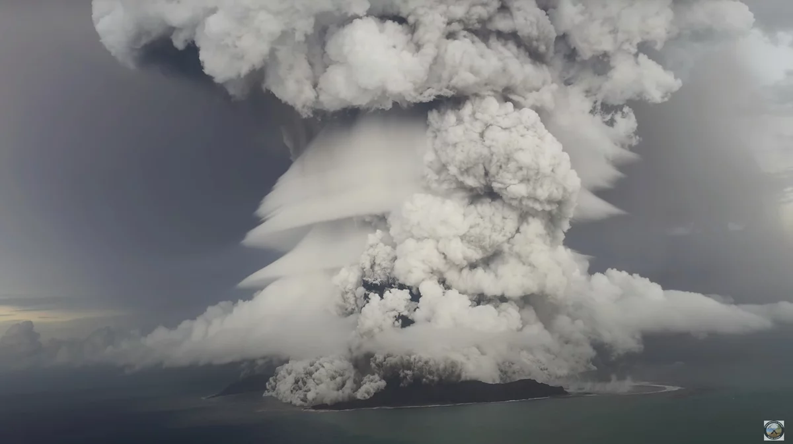



A comprehensive discussion on the tsunami amplification effect of the 2022 Tonga volcanic tsunamis
Tso-Ren Wu¹ 吳祚任¹
Po-Yuan Yang¹ Jun-Wei Lin¹ Mei-Hui Chuang¹
¹Graduate Institute of Hydrological and Oceanic Sciences, National Central University
TAIWAM
國立中央大學 水文與海洋科學研究所

Slide 2
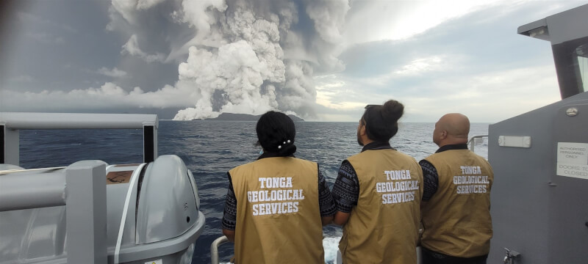
15m Tsunami on Tonga Volcano https://www.cna.com.tw/news/aopl/202201190056.aspx
火山噴發掀15公尺海嘯 東加政府：釀前所未見災難
南太平洋島國東加15日海底火山噴發，澳洲專家推測可能是火山岩漿帶有氣體及大量水蒸氣瞬間受壓，造成強大的噴發威力。（圖取自facebook.com/tongageologicalservice）

Slide 3
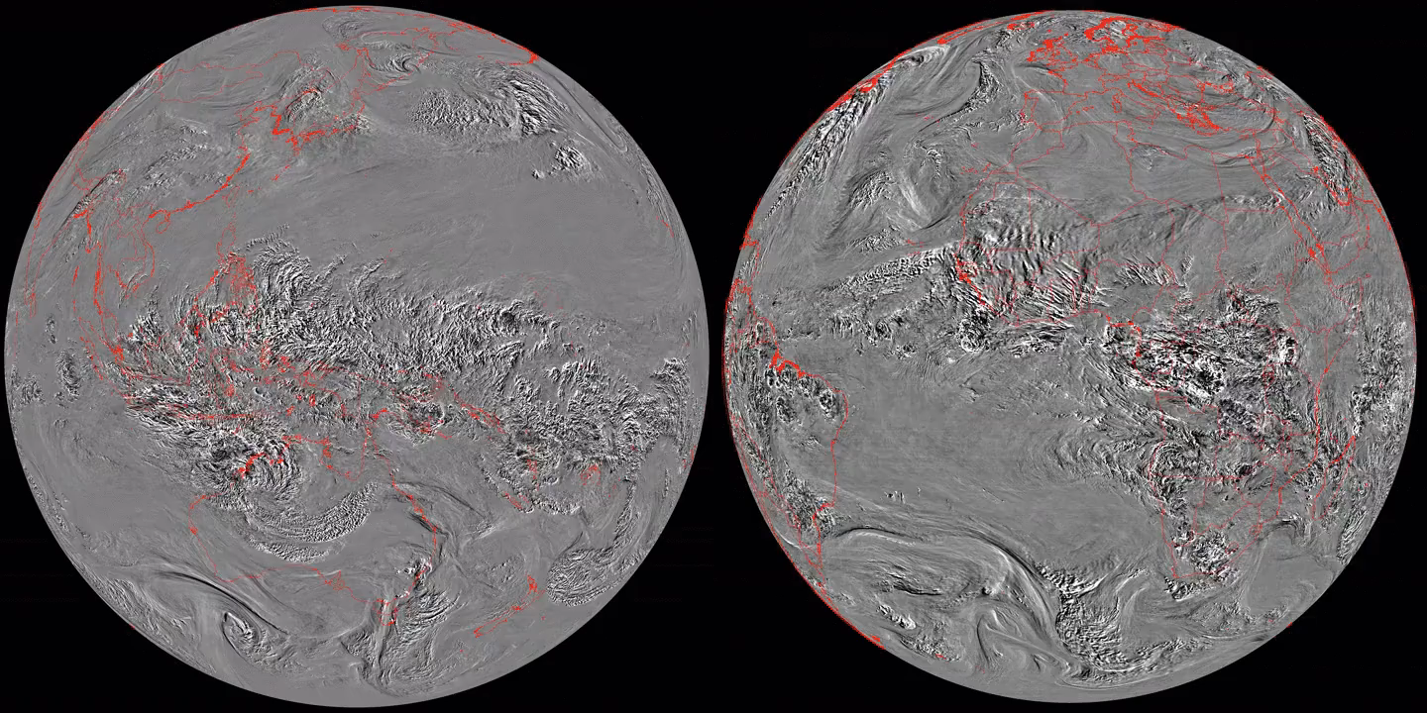
Himarwari-8 (left) and Meteosat-11 (right) imagery of the shockwave (from 15 January 13:30 UTC to 16 January 02:30 UTC, in 15-minutes time-steps). Credit: Simon Proud/National Centre for Earth Observation.
Notes:
Himarwari-8 (left) and Meteosat-11 (right) imagery of the shockwave. Credit: Simon Proud/National Centre for Earth Observation.
The Meteosat-11 animation (Figure 12) captures the movement of shockwaves from 15 January 13:30 UTC to 16 January 02:30 UTC, in 15-minutes time-steps. Image is centred to 0˚ longitude. It shows how the circular shaped wave was oscillating between the volcano located in Pacific Ocean and a north Africa inflexion point.
https://www.eumetsat.int/hunga-tonga-hunga-haapai_2022

Slide 4
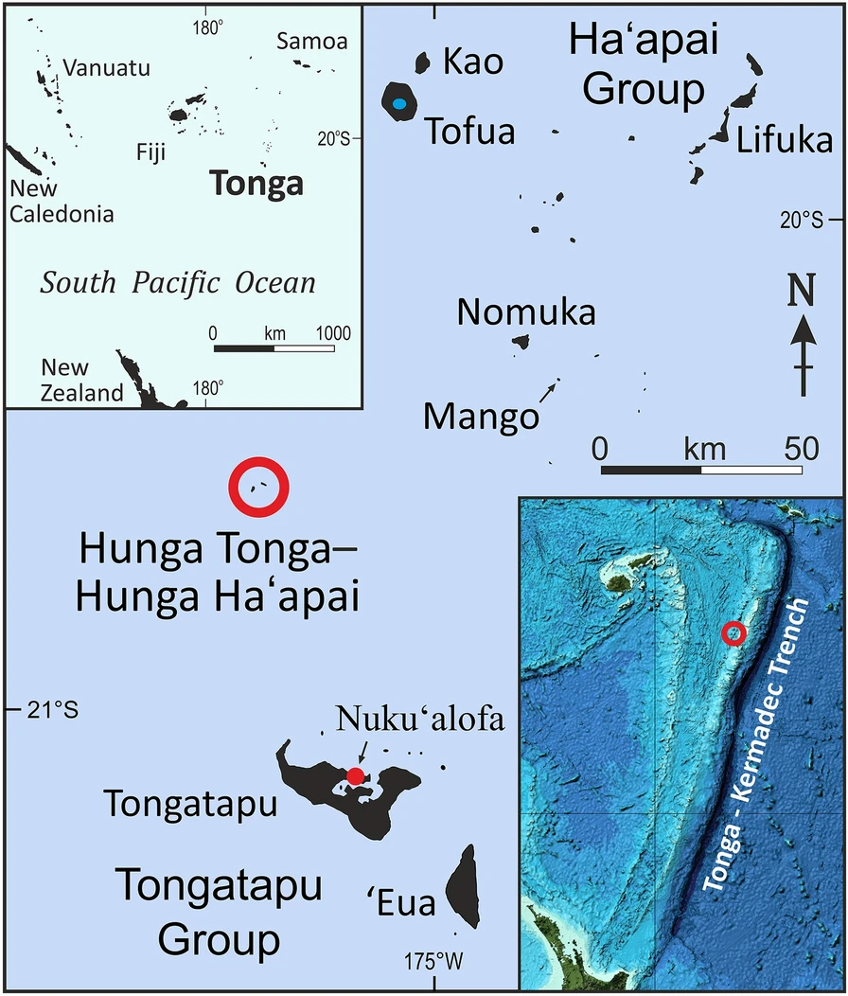
Introduction
On 15 January 2022 at 04:15 UTC, the Hunga Tonga-Hunga Ha’apai (HTHH) volcano erupted and generated a large and unique tsunami with global reach.
dual-mechanisms: 雙動力機制
  Meteotsunami 氣壓波海嘯:
    generated by the atmospheric pressure wave
    由大氣壓力波所引起
    Transoceanic, but less destructive.
    越洋海嘯，但是破壞力較小
  Volcanic tsunami 火山海嘯:
    eruption-induced water mass displacement.
    由噴發所引起大規模質量錯動
    limited in scope, but powerful and destructive.
    範圍較小，但破壞力較強
4 deaths in Tonga, 2 deaths in Peru.
The location of Tonga volcano and the Tonga-Kermadec submarine trench in the Pacific Ocean. (Terry et al., 2022)
Notes:
其名稱為露出海表面之Hunga Tonga島以及Hunga Ha’apai島之合稱，此處位於Tonga–Kermadec submarine trench ，為世界上地震活動十分頻繁的隱沒板塊邊界

Slide 5
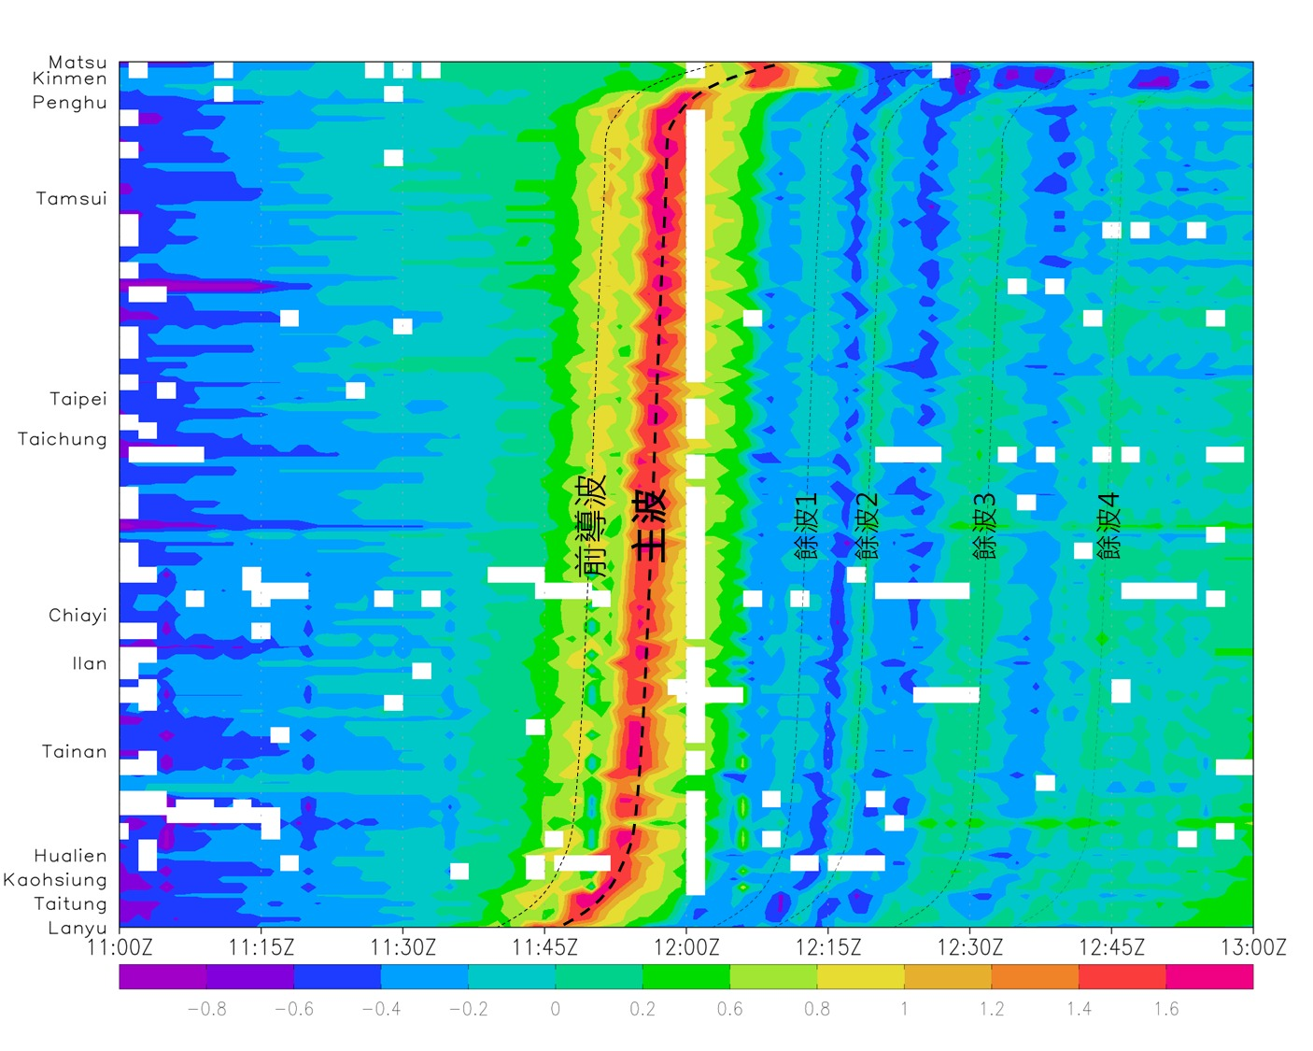
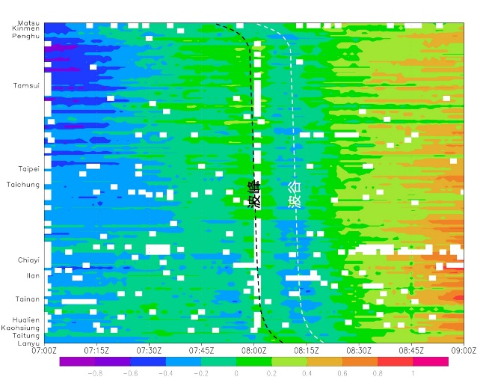
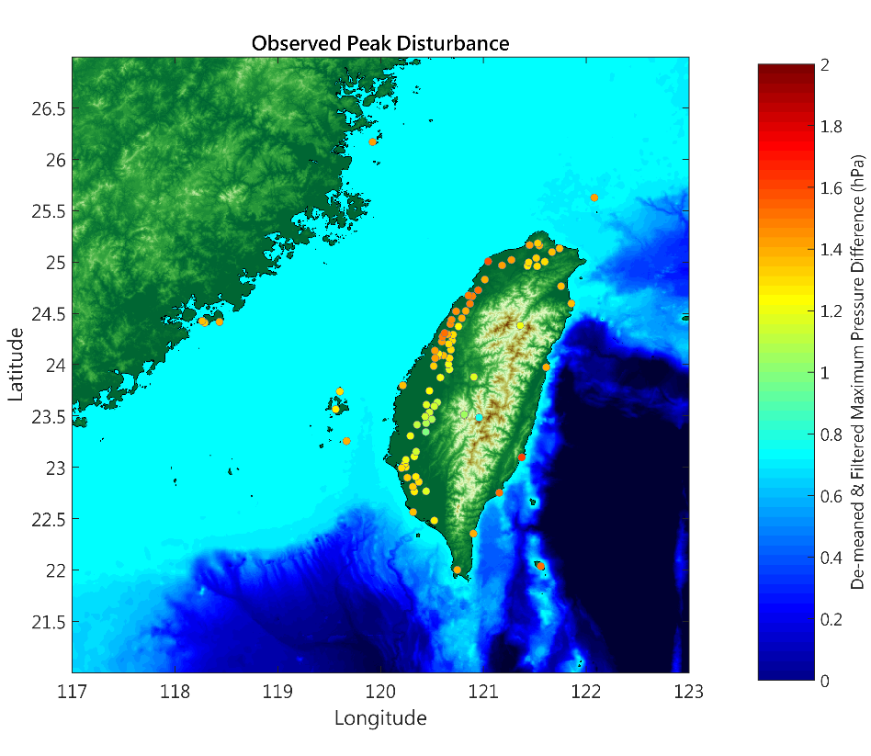
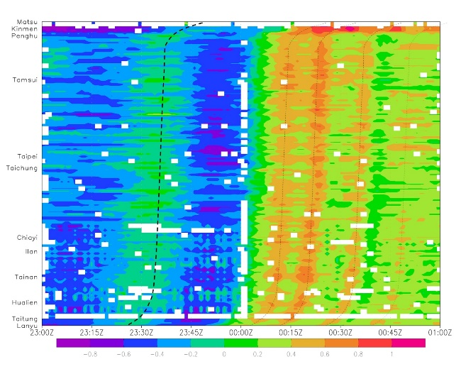
Ground Station Observation (Lin, 2022)
中央氣象局氣壓觀測資料
紅色帶寬約40公里
CWB, 黃椿喜 (2022)

Slide 6
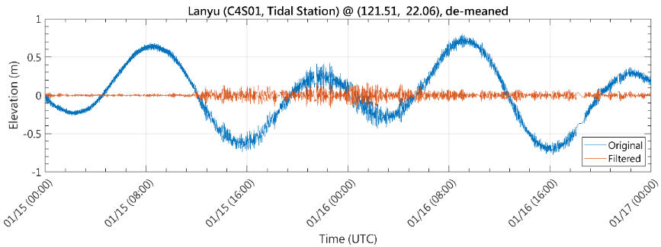
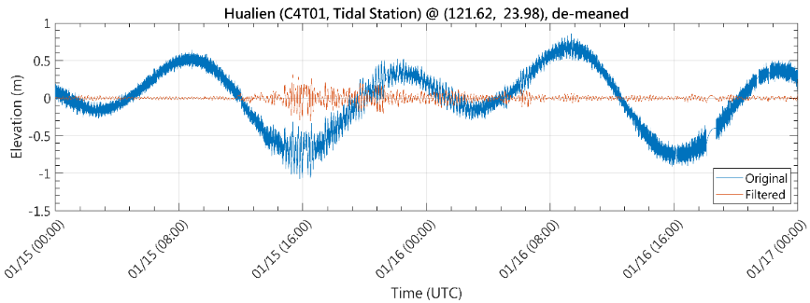
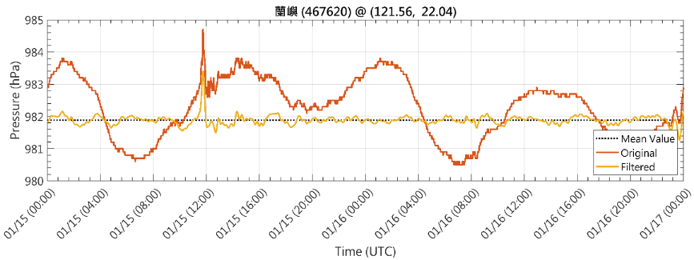
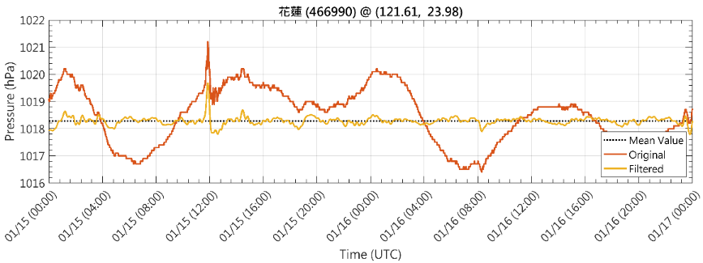
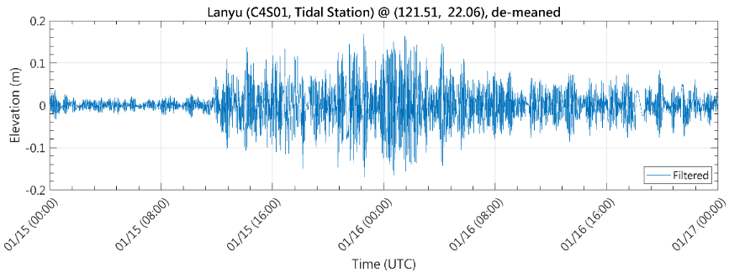
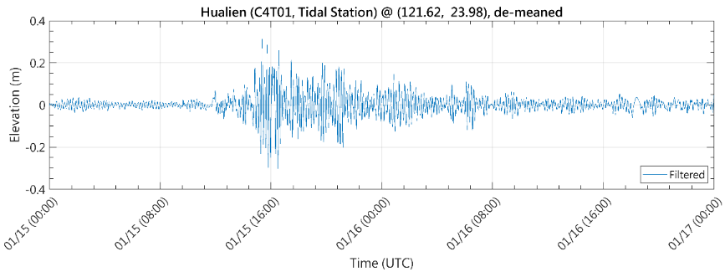
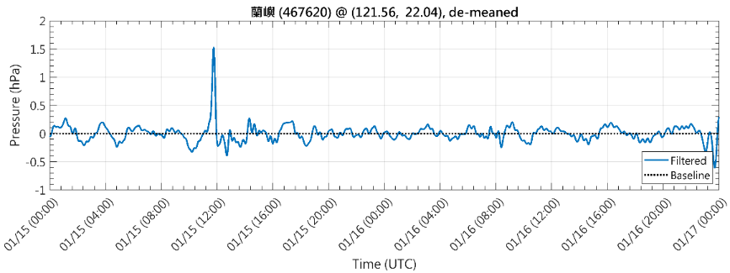
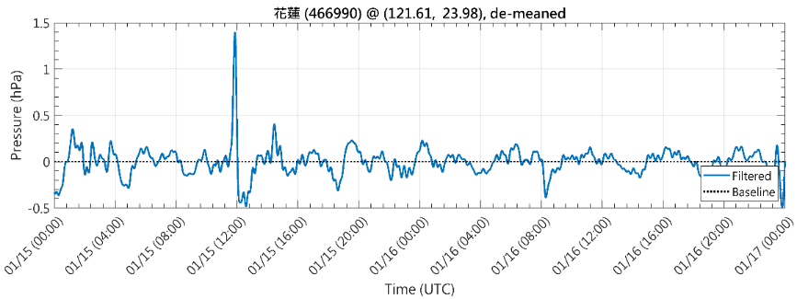
Time-series Tsunami Height
（CWB, 2022）
Time-series Air Pressure
（CWB, 2022）
Filter Time-series Tsunami Height
Filted Time-series Air Pressure

Slide 7
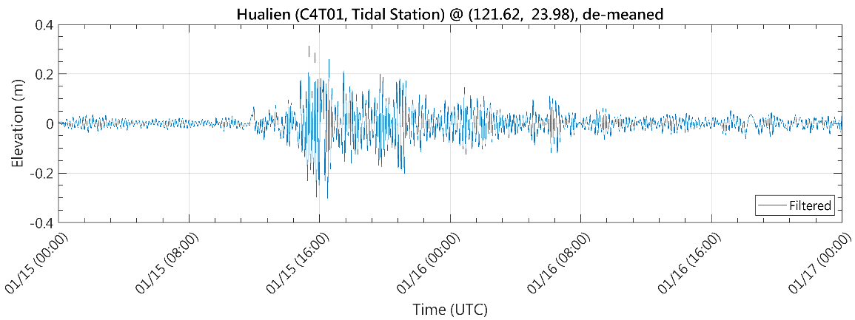
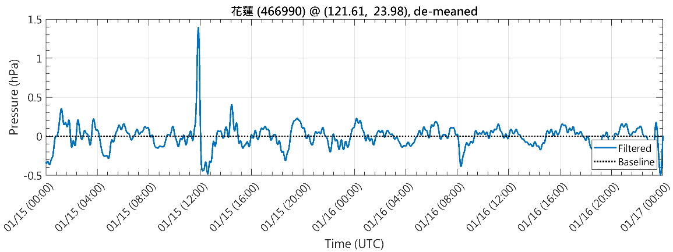

In the case of Tonga, the moving pressure was about 2hPa, Fr ~1.5; the leading wave height was expected to be smaller than 2cm.
However, the wave height of the Meteotsunami was about 20cm.
Time-series tsunami height from
tidal gauge （CWB, 2022）
←3. Gravity tsunami arrived
5. About 20cm meteotsunami →
←2. Meteotsunami arrived
1. Shoch wave arrived→
Time-series air pressure
（CWB, 2022）
← 4. Pressure disturbance was about 2hPa. Equivalent to a 2cm draft.

Slide 8
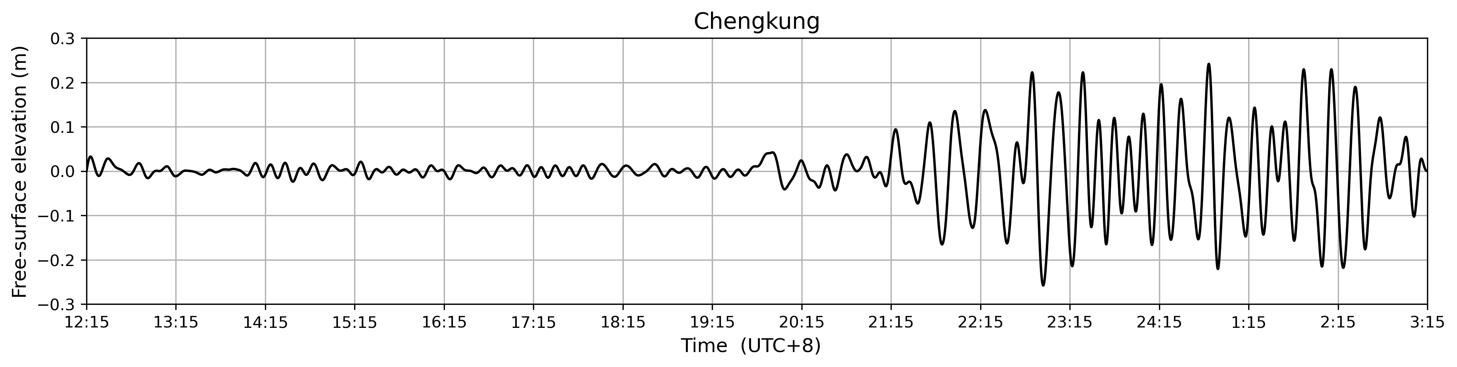
Motivation: Unexpected Rise in Wave Height
Explore the phenomenon observed in tide gauge data across Taiwan, where the amplitude does not decrease but even amplifies after the passage of atmospheric pressure waves
Notes:
探討台灣各潮位站觀測資料上，於氣壓波經過後呈現振幅不減甚至放大之現象， 以及解釋氣壓波序列中跟隨主波之數個餘波對於潮位站水位變動之貢獻。
本研究基於中央氣象署(CWA)的氣壓資料，直接將濾波處理過的觀測數據帶入數值模擬中。不使用過於簡化的公式，氣壓公式盡量接近濾波後的數值。將模擬結果與台灣沿海潮位站之去潮觀測數據做比對，分析氣壓波序列中不同波速對於海水變動的影響，並且針對台灣潮位站中隨時間振幅持續變大的現象做解釋。

Slide 9
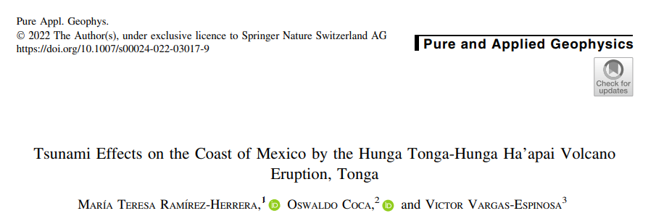
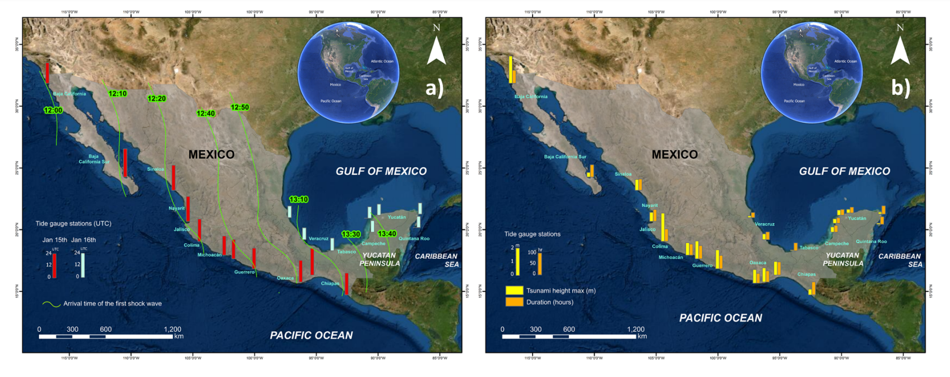

Slide 10
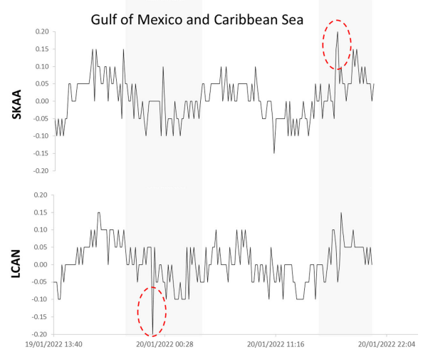
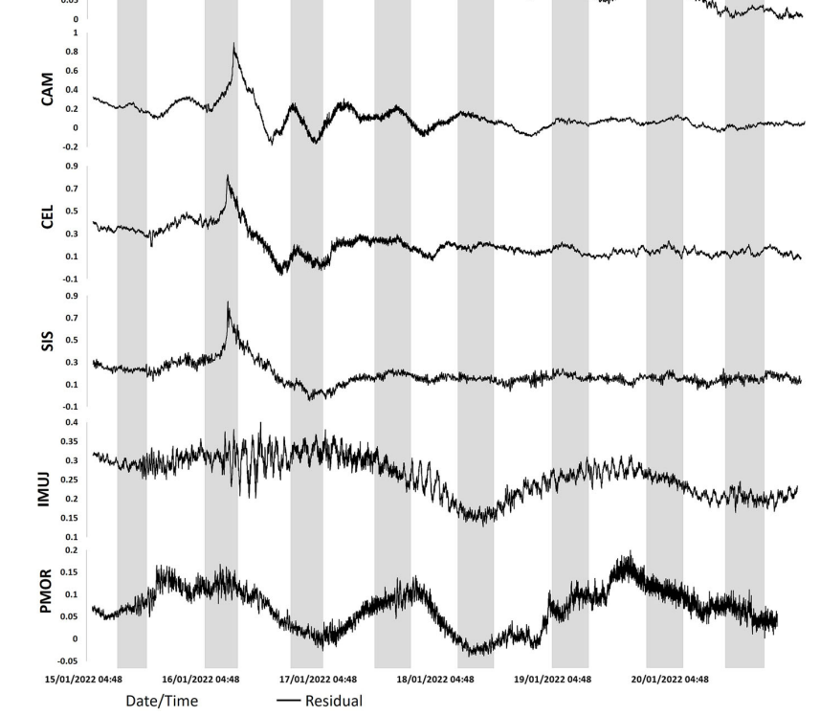
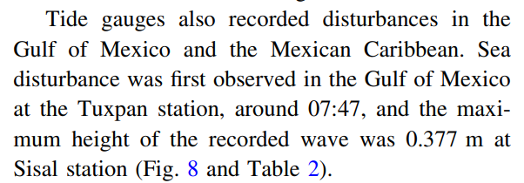
Gulf of Mexico and Caribbean Sea Tide gauge stations.

Slide 11
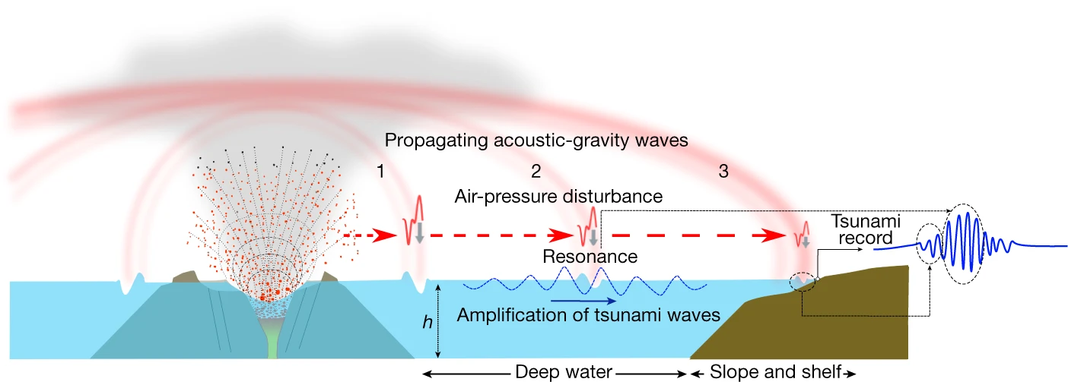
Meteorological tsunami 氣壓波海嘯
From Nature (2022)
Produced by phase-coupling with atmospheric shock waves.與氣壓波的相位耦合產生之海嘯
The shock waves were radiating outward, contain different wave categories according to their frequency and arrival time as Lamb wave, gravity wave and acoustic wave.氣壓波以接近音速之速度向外傳播，並於平流層中以似同心圓方式圍繞地球。
The Lamb wave, which is a long wave and the most prominent among those waves with the largest amplitude.蘭姆波為一種長波，是此事件中壓力誘發海嘯波之產生的主要原因
(Omira et al., 2022)
Notes:
此事件之氣象海嘯為透過與大氣衝擊波的相位耦合產生之海嘯。
爆發所產生之大氣衝擊波以接近音速之速度向外傳播，並於平流層中以似同心圓方式圍繞地球。
此衝擊波複合蘭姆波、聲波、重力波，其中又以蘭姆波為振幅中最大者。蘭姆波為一種長波，是此事件中壓力誘發海嘯波之產生的主要原因。

Slide 12
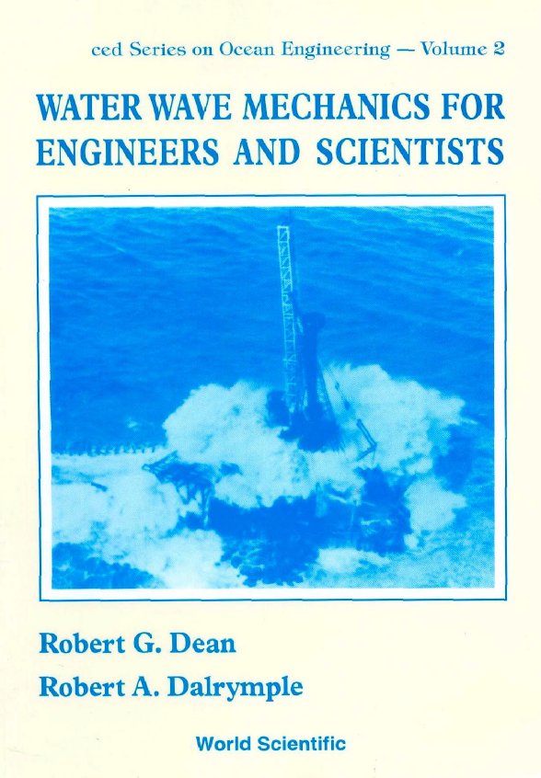
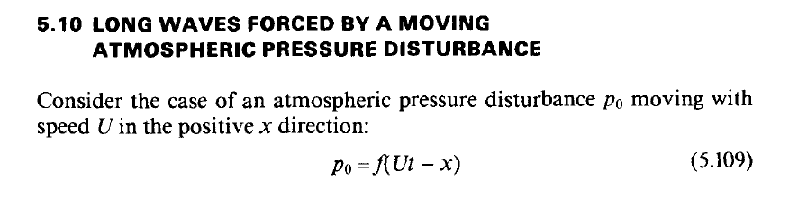
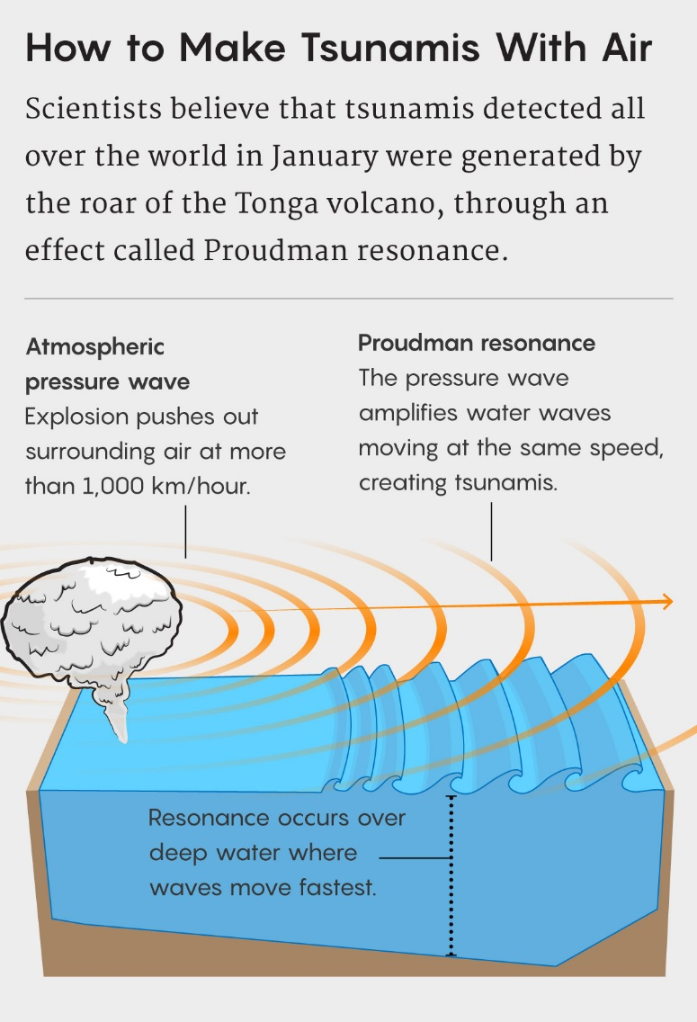
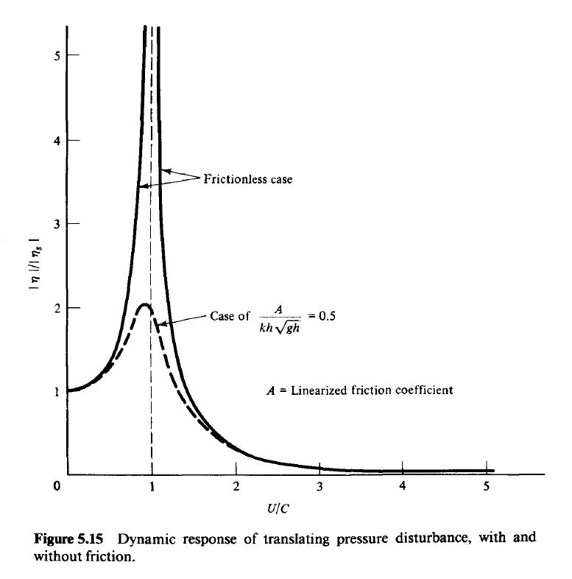
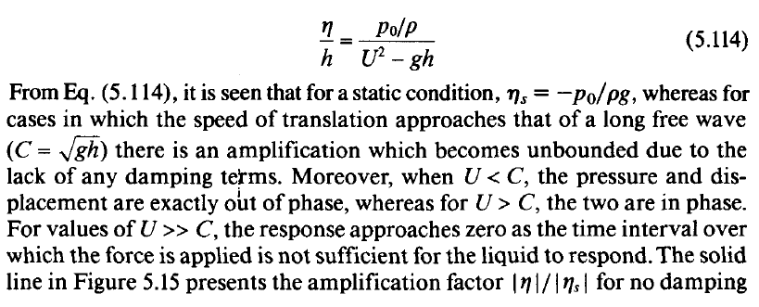
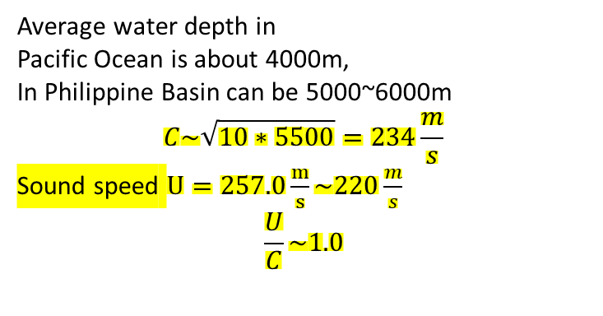
Proudman resonant effect
Average water depth in
Pacific Ocean is about 4000m,
In Philippine Basin can be 5000~6000m
$$C\sim \sqrt{10∗5500}=234\frac{m}{s}$$
Sound speed $U=257.0\frac{m}{s}\sim 220\frac{m}{s}$
$$\frac{U}{C}\sim 1.0$$
https://twitter.com/QuantaMagazine/status/1524080330378035207
11

Slide 13
However
The speed of Lamb wave is around 300-350 km/hrs.
The water depth for the Resonance of tsunamis is around 9~12km. Only trenches with narrow width can have this deep depth.
The Lamb wave shall not be the main mechanisms for magnifying the tsunamis.

Slide 14
The components of the shock waves observed from Himarwari-8 (left) and Meteosat-11
Atmospheric Lamb wave:
  290 m/s~310 m/s, the max displacement was approximately 2 hPa (Taiwan and Japan).
  A special type of atmospheric gravity waves. Nondispersive wave.
  Amplitude: little to no change in the vertical direction.
  Period: 25~30 min.
Atmospheric gravity waves:
  190 m/s~310 m/s, the max displacement was approximately 0.3~0.5 hPa (Taiwan and Japan).
  Dispersive wave.
  Amplitude: decays exponentially with increasing height.
  Pekeris wave: 200 m/s~250 m/s, close to the speed of a tsunami, Proudman resonance.
Notes:
為特殊類型的大氣重力波，以近音速傳播。非頻散波、其能量可以有效地遠距離傳輸，並在遠離源頭的地方佔主導地位。具有純粹的水平運動，其垂直速度為0。假設對流層是等溫的，蘭姆波的相速度 CT 只受氣溫影響。 (Amores et al., 2022)
蘭姆波振幅，垂直方向上幾乎沒有變化，因此可以繞地球傳播數圈。
與海嘯長波的速度接近，因此可以產生 Proudman 共振現象。

Slide 15
Lamb wave & Pekeris wave
Feature | Lamb Wave | Pekeris Wave (Internal Mode)
Type | Compressional wave | Normal mode dominated by gravity wave characteristics (internal gravity–Rossby–RG mode)
Propagation Direction | Purely horizontal propagation | Mainly horizontal propagation, but with vertical structural variations
Dispersion | Nondispersive | Strongly dispersive (frequency depends on wavenumber)
Speed | Fast; typical phase speed follows √gh​, e.g., for h∼10 km, approx. 300 m/s | Relatively slow; phase speed corresponds to h∼5.8~8 km, generally slower than Lamb wave
Surface Pressure Observations | Frequently observed and confirmed, e.g., the 1883 Krakatoa eruption and the 2022 Tonga eruption | Generally difficult to distinguish; clearly identified for the first time after the Tonga event as a preceding wavefront
14
Notes:
Paper title : First Detection of the Pekeris Internal Global Atmospheric Resonance: Evidence from the 2022 Tonga Eruption and from Global Reanalysis Data
APA : Watanabe, S., Hamilton, K., Sakazaki, T., & Nakano, M. (2022). First detection of the Pekeris internal global atmospheric resonance: Evidence from the 2022 Tonga eruption and from global reanalysis data. Journal of the Atmospheric Sciences, 79(11), 3027-3043.

Slide 16
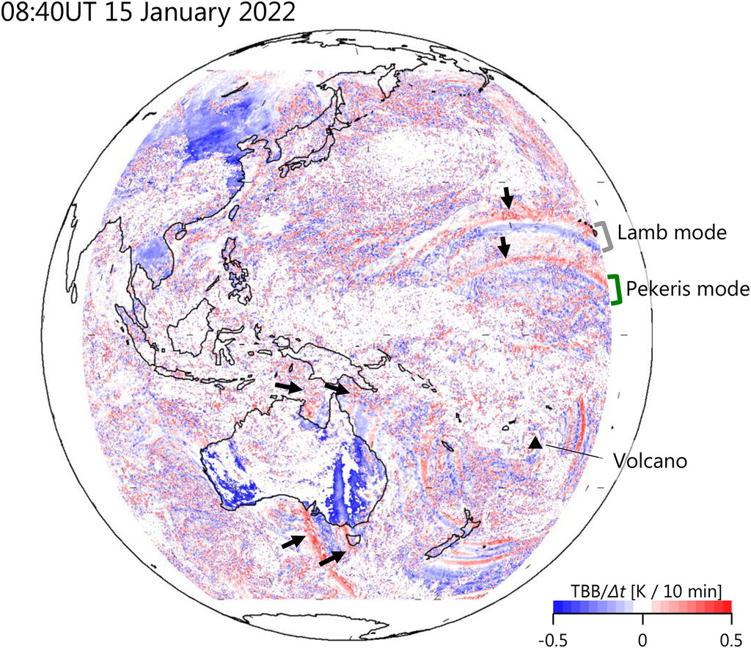
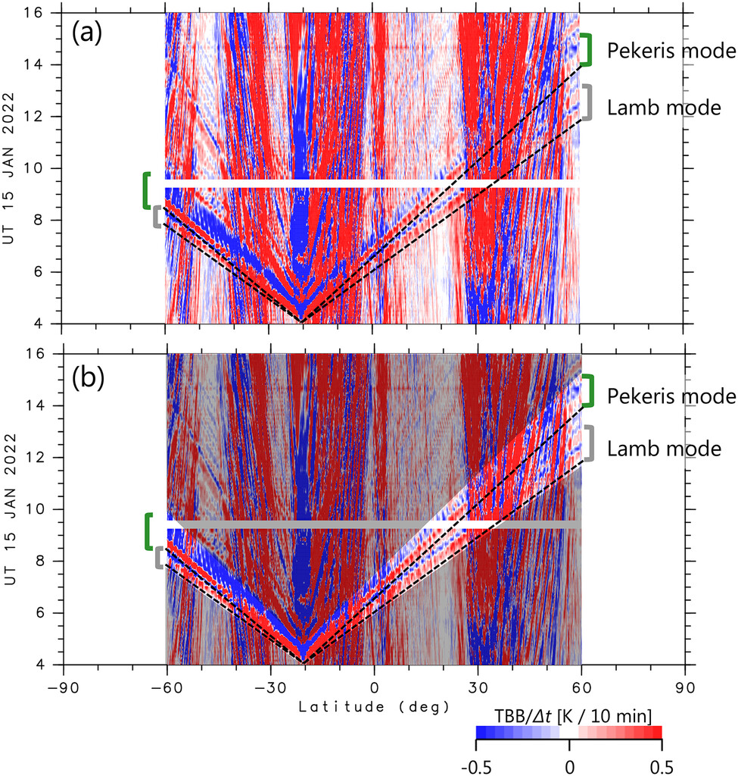
Observed by Himawari-8 plotted about 4 h after the eruption
(Watanabe et al., 2022)
15
Notes:
在距離火山約 5000 公里處，可以清楚地看到一對正值和負值環，以及一對半徑稍小、結構相似的環。
右圖：通過火山子午線的 Himawari-8 衛星 9.6 μm 頻段亮溫差異的緯度–時間剖面圖。圖中明顯可見數個脈衝狀訊號，正從火山噴發緯度向外擴散。另一個明顯、但速度較慢的波脈衝也可觀察到，橫跨整個南緯 60 度至北緯 60 度區域傳播。該脈衝同樣包含正值與負值，在遠場中延續約 40 分鐘。圖中也比較了此脈衝與主觀判定的恆定相速度：向北為 245 公尺每秒，向南為 270 公尺每秒。這兩個波脈衝在傳播過程中大致保持完整，雖然可能有輕微的頻散現象。

Slide 17
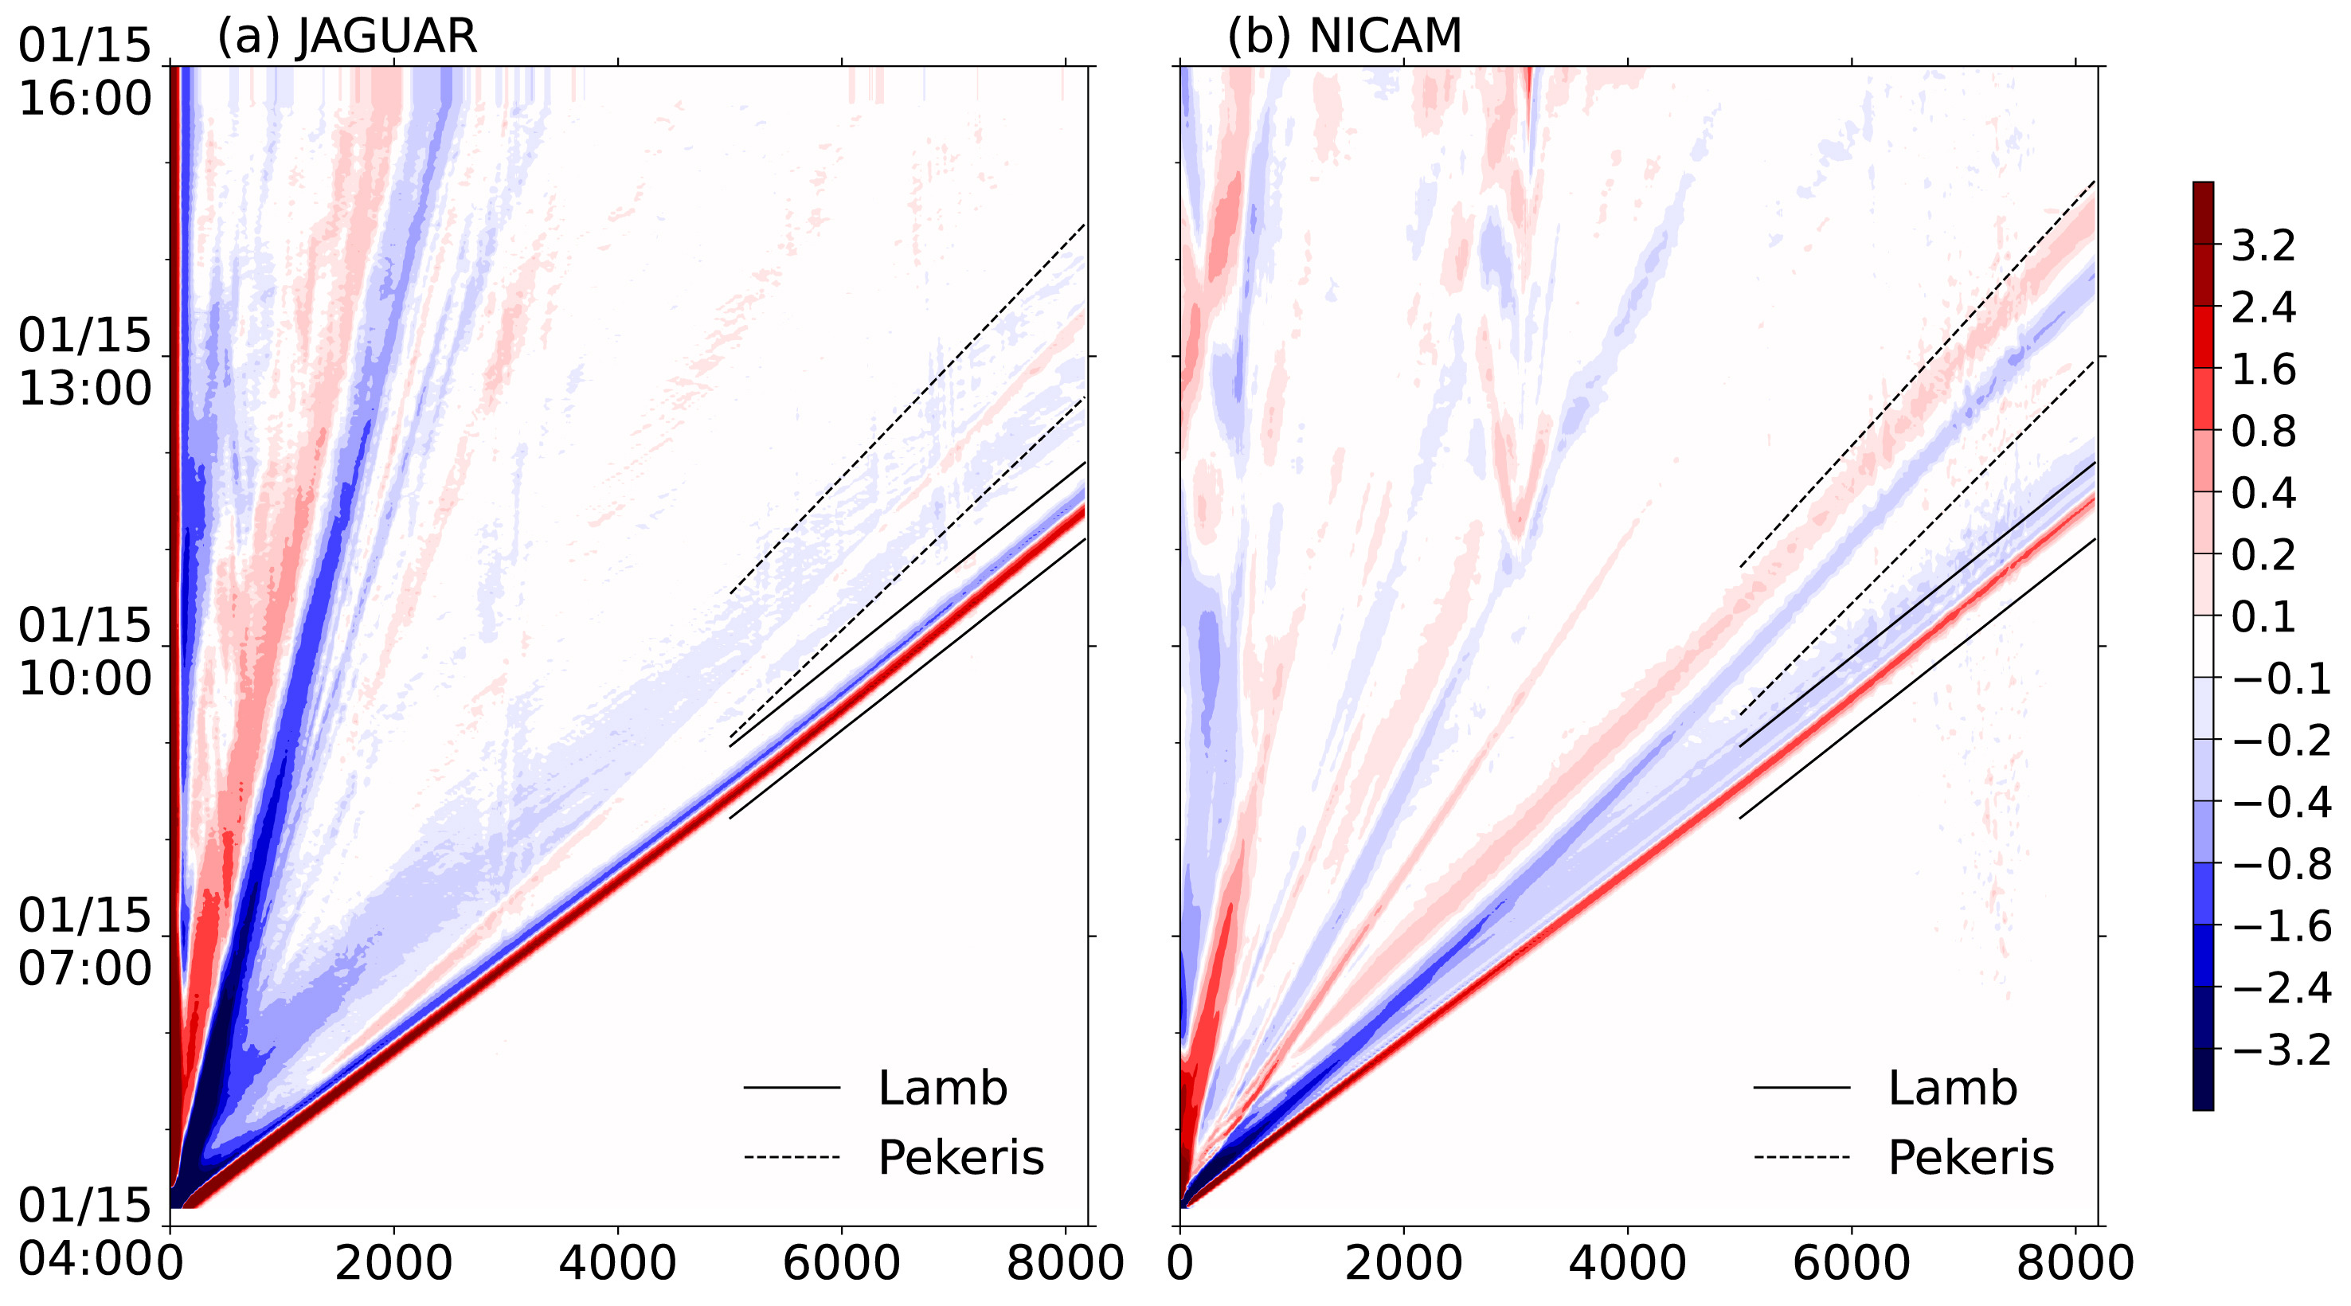
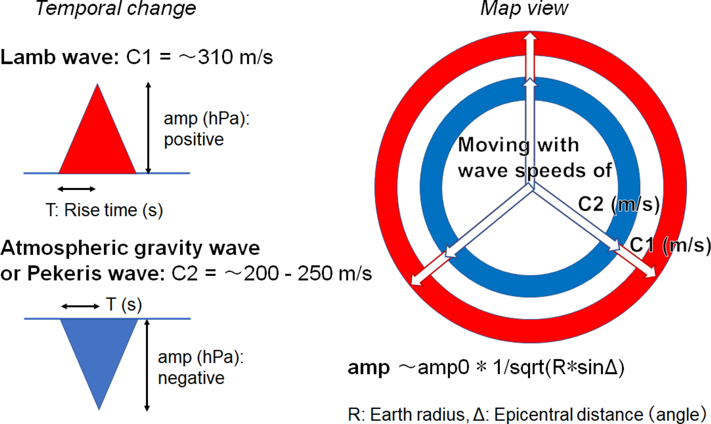
The upper dashed lines: 220 m/s
The lower dashed lines: 240 m/s
The upper solid lines: 300 m/s
The lower solid lines: 305 m/s
(Fujii & Satake, 2024)
16
Notes:
Paper: Fujii, Y., & Satake, K. (2024). Modeling the 2022 Tonga eruption tsunami recorded on ocean bottom pressure and tide gauges around the Pacific. Pure and Applied Geophysics, 181(6), 1793-1809.
JAGUAR跟NUCAM是兩個日本的大氣環流模式
左圖是從東加到日本釧路(Kushiro)之間的海表面氣壓擾動(hPa)距離–時間剖面圖
右圖：是這篇paper用來帶入模式的大氣模型。會設置正振幅與負振幅是因為，Watanabe 等(2022)與 Suzuki 等(2023)理論與觀測皆指出：310 m/s的蘭姆波具有正振幅，而較慢的 Pekeris 波(速度約為 200–250 m/s)則為負振幅。

Slide 18
Himarwari-8 (left) and Meteosat-11 (right) imagery of the shockwave (from 15 January 13:30 UTC to 16 January 02:30 UTC, in 15-minutes time-steps). Credit: Simon Proud/National Centre for Earth Observation.
Notes:
Himarwari-8 (left) and Meteosat-11 (right) imagery of the shockwave. Credit: Simon Proud/National Centre for Earth Observation.
The Meteosat-11 animation (Figure 12) captures the movement of shockwaves from 15 January 13:30 UTC to 16 January 02:30 UTC, in 15-minutes time-steps. Image is centred to 0˚ longitude. It shows how the circular shaped wave was oscillating between the volcano located in Pacific Ocean and a north Africa inflexion point.
https://www.eumetsat.int/hunga-tonga-hunga-haapai_2022

Slide 19
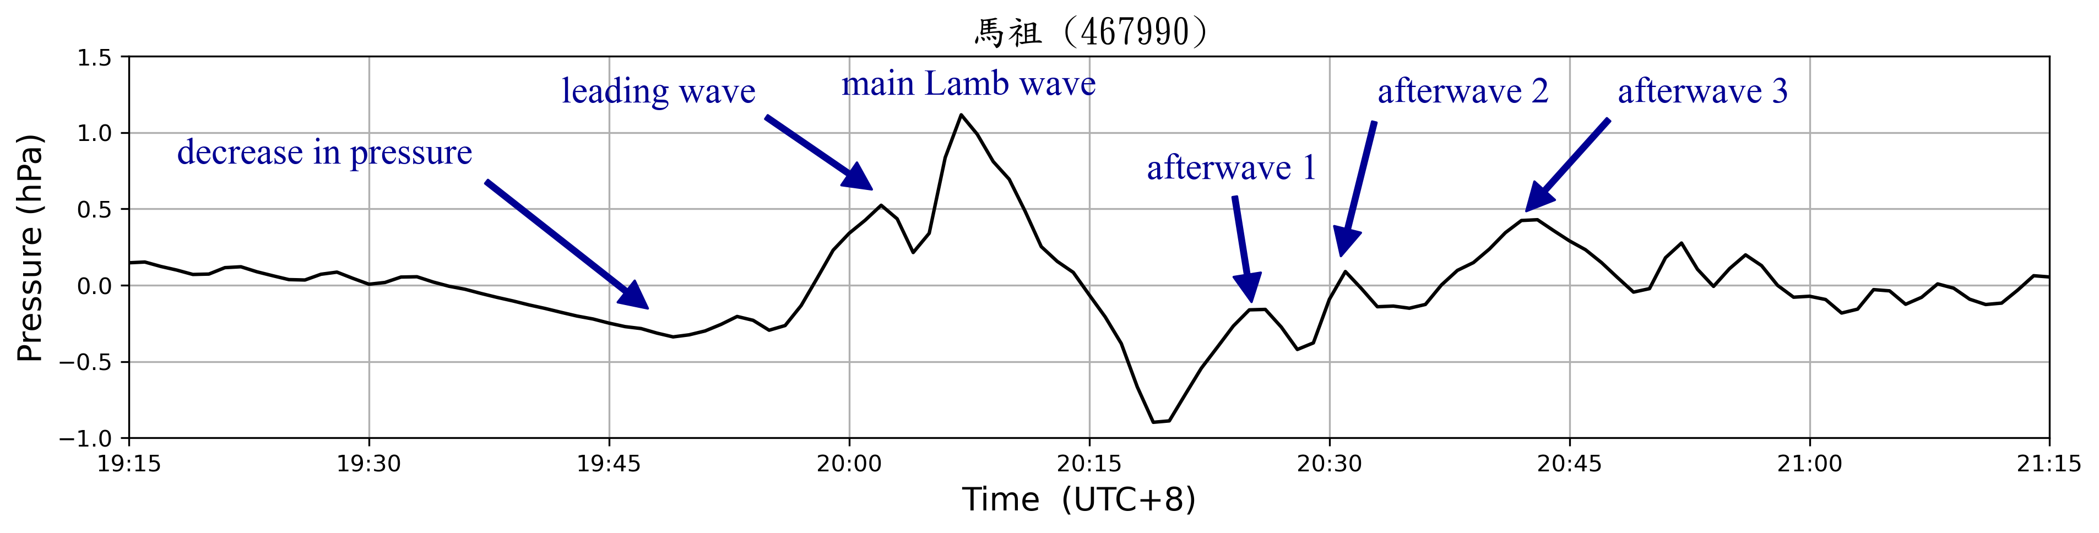
Time series of the atmospheric pressure waves
About 50 min
V ≈ 308.25 m/s
CWA, 黃椿喜 (2022)
Notes:
馬祖距離火山約8730km，波速約為1110km/h

Slide 20
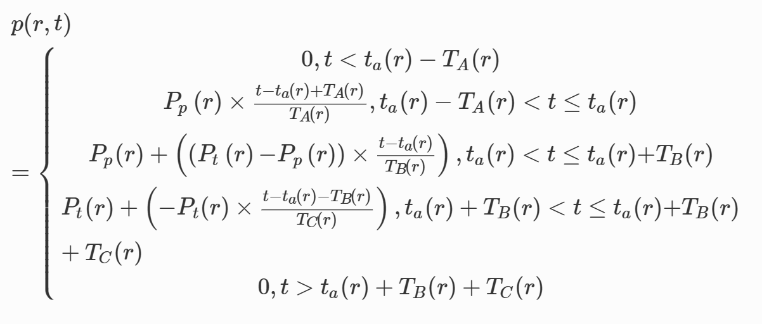
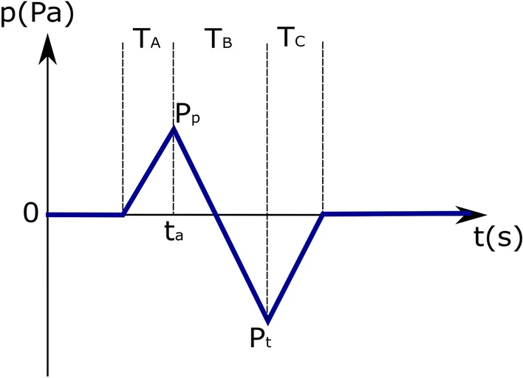
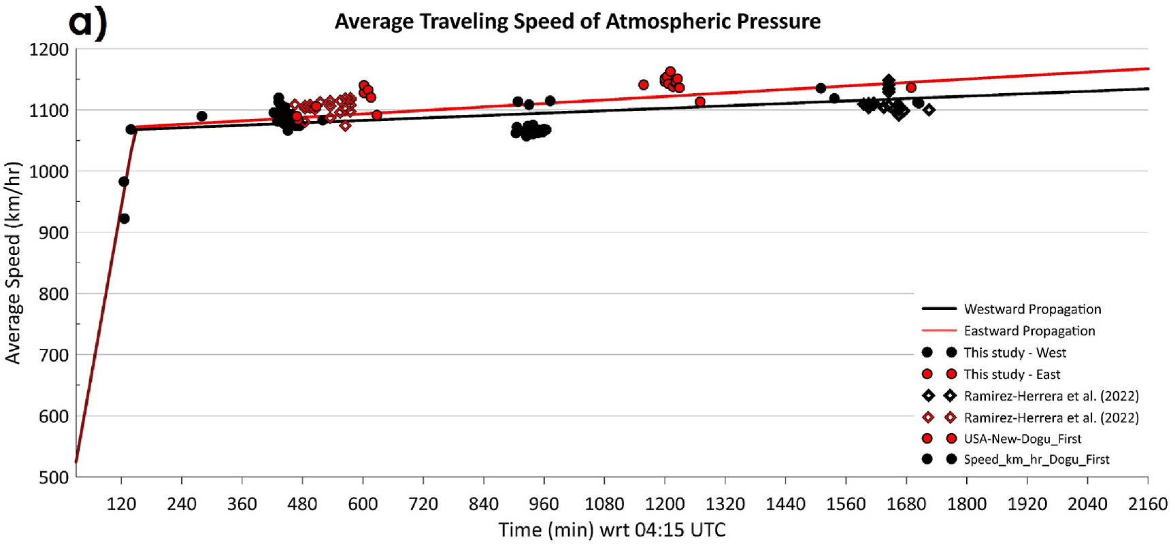
Atmospheric Pressure Waves
The pressure wave formula used by Gusman et al. (Gusman et al., 2022)
The pressure wave pattern (Gusman et al., 2022)
The pressure wave velocity proposed by Dogan et al. (Dogan et al., 2023)
Notes:
左圖：Gusman 等提出之氣壓波型。
右上：Gusman 等使用之氣壓波公式
右下：Dogan提出之氣壓波速度變化圖

Slide 21
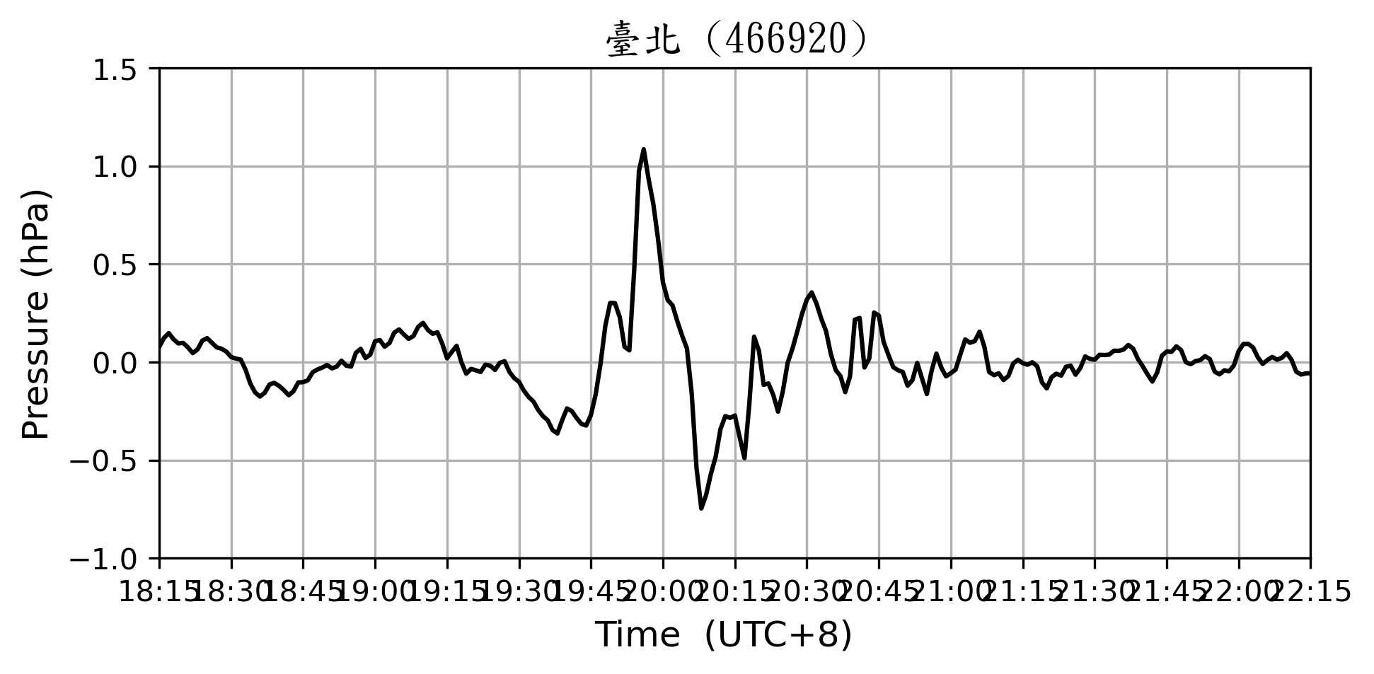
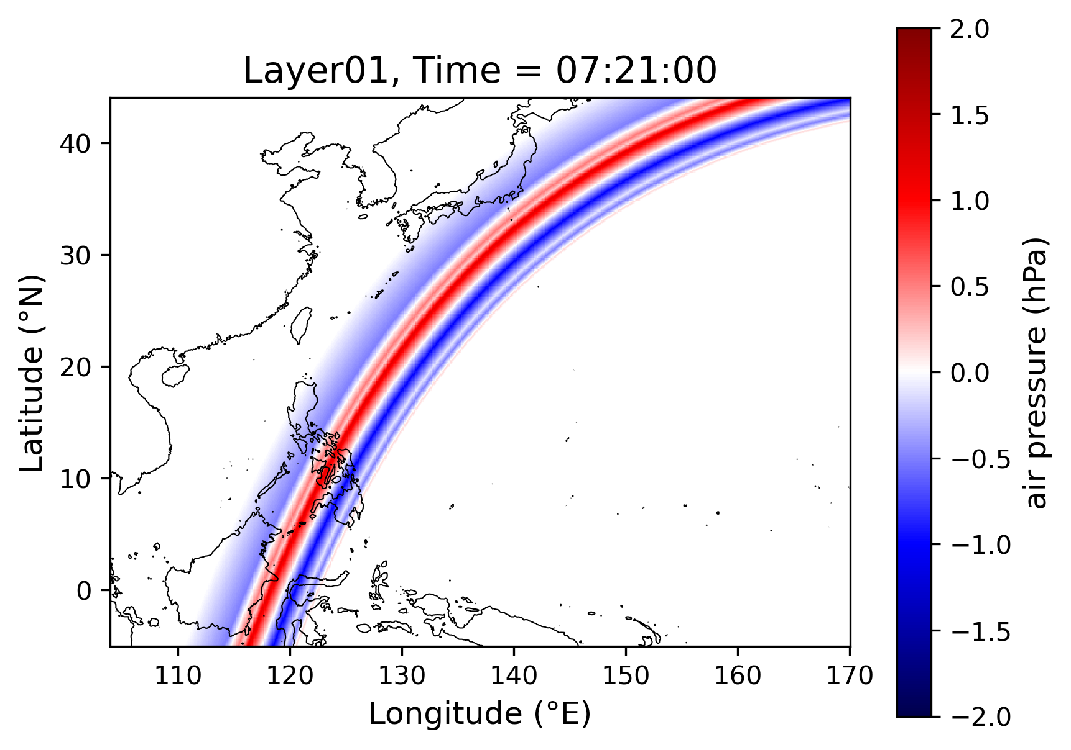
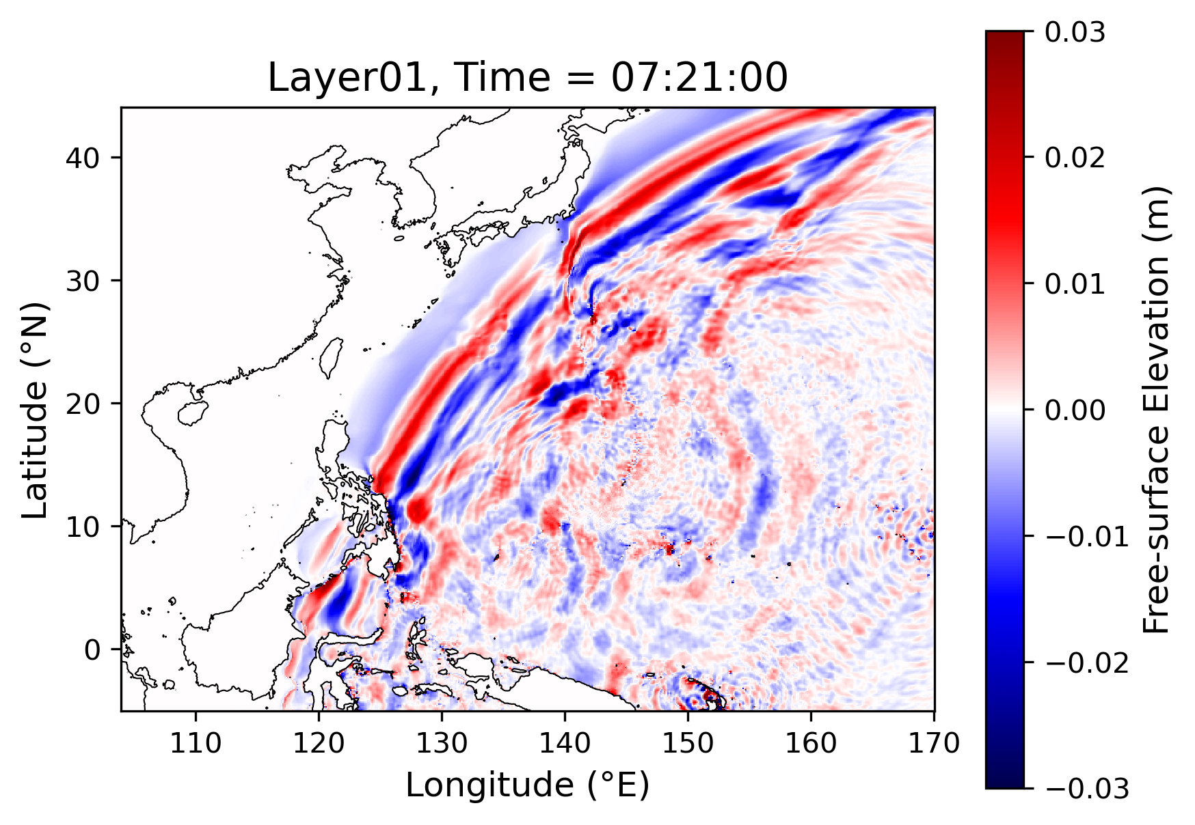
Method
Observation data analysis & De-tide / Filtering process
  Atmospheric pressure data & tide gauge station data
2. Numerical simulation
  COMCOT simulation
3. Parameter sensitivity analysis
  Different Atmospheric pressure wave speed
  Lamb wave only
  Lamb waves and gravity waves
4. Results & Discussion

Slide 22
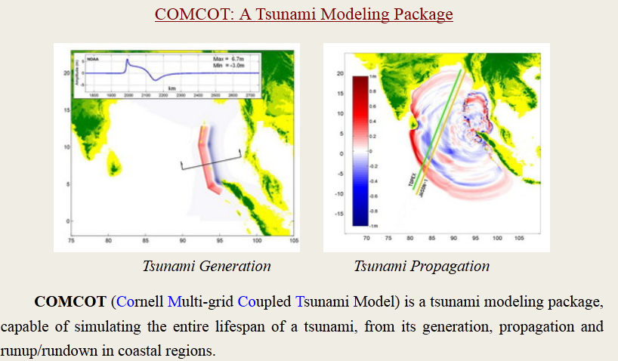
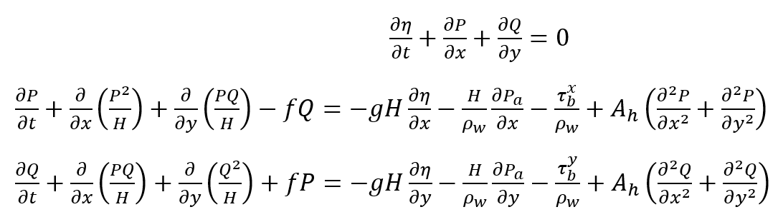
Numerical simulation
Introduction of COMCOT
(Cornell Multi-grid Coupled Tsunami model)
Solve shallow water equations on both spherical and Cartesian coordinate systems.
Explicit leapfrog Finite Difference Method for stable and high speed calculation system.
Multi/Nested-grid system for multiple shallow water wave scales.
Moving Boundary Scheme for inundation.
High-speed efficiency.
Notes:
COMCOT:
康乃爾大學多重網格耦合海嘯模式
可同時求解球座標與卡氏座標之非線性淺水波方程式
COMCOT具有移動邊界(Moving boundary)之功能，可處理海嘯波溢淹時之乾濕邊界問題。
Moving boundary:算溢淹範圍,因為濕潤邊界一直在變動,故若無moving boundary的話水無法跳到下一個時間步
蛙跳法:可高速計算且確保準確性(時間的倒函數可以增加一階且很穩定 非線性有用)
巢狀網格:可以局部加密,不重要的地方用粗解析度

Slide 23
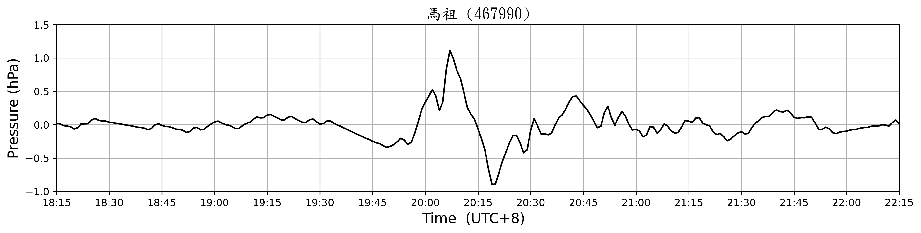
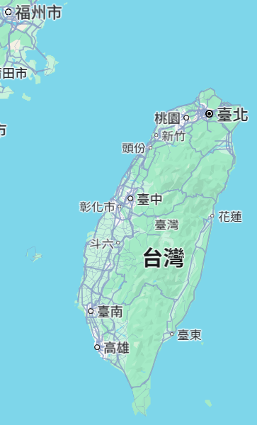
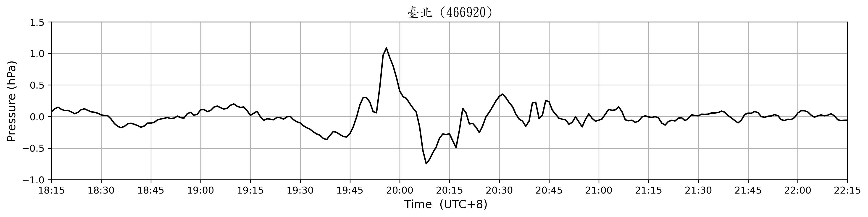
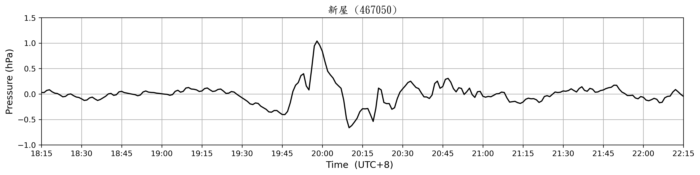
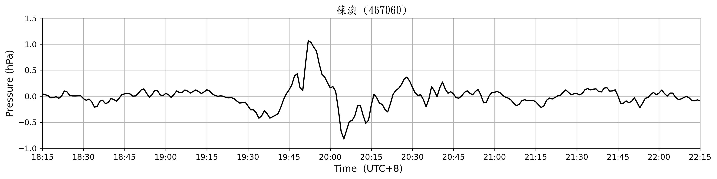
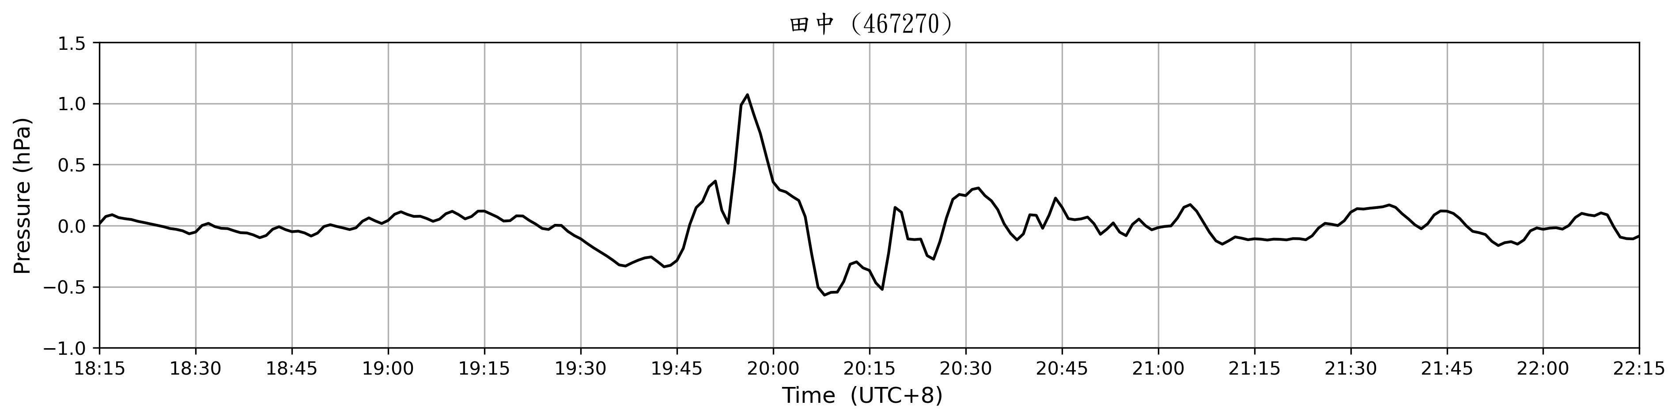



Atmospheric pressure data
Propagation direction of the pressure wave
Notes:
選用馬祖站的氣壓觀測值作為模擬波型的數值依據，因為其濾波完波形具有突出之特徵，可明顯觀察到大氣蘭姆波主波之氣壓差約為2 hPa，以及後續餘波的波形易於辨識

Slide 24


Atmospheric pressure data
CWA
sampling rate: 1 min
7th-order Butterworth filter
3min ~ 60min bandpass
Raw data
Approximately 7 hrs
Filtered
UTC 4:15 explosion
Notes:
使用7階Butterworth濾波器做濾波，取帶通濾波
圖中為UTC+8，12:15為爆炸初始時間

Slide 25

Tide gauge station data for water waves
2
3
1
4
5
6
7
8
9
16
10
15
14
13
11
12

Slide 26

Tide gauge station data for water waves
CWA
sampling rate: 1 sec
3th-order Butterworth filter
10min ~ 90min bandpass
10.
Raw data
10.
Filtered
UTC 4:15 explosion
Notes:
使用3階Butterworth濾波器做濾波，取帶通濾波

Slide 27

Top-Hat Atmospheric gravity wave tests

Slide 28




Tsunami Resonance Tests
V = 100 m/s
V = 200 m/s
V = 250 m/s
V = 300 m/s
27

Slide 29





Numerical simulation of the Lamb waves & Pekeris waves
Lamb wave
Pressure model of the Lamb wave
Pekeris wave 1
Pekeris wave 3
Pekeris wave 4
Pekeris wave 2
Pressure model of the gravity wave
28

Slide 30







Gauge time series
Result of synthesis wave
Result of Lamb wave
Results of the Pekeris waves
29

Slide 31



Results summation of Lamb waves and Pekeris waves
30

Slide 32



Results summation of Lamb waves and Pekeris waves
31

Slide 33
Conclusion
Lamb wave only:
  The results in the earlier part show good results and align with the observation data.
Pekeris waves contribute to the section where the amplitude is amplified in the latter part.
The results show that the tsunami amplification mainly comes from the resonance of Pekeris wave 4 with a phase speed at 227.35 m/s, not from the ocean trench.
In the simulation cases of 300 m/s, 250 m/s, 200 m/s, 100 m/s, the waves under the atmosphere pressures are:
  > 250 m/s: Positive water waves
  < 250 m/s: Negative water waves
Thanks for Listening.
Questions for Prof. Wu?
32
Notes:
在海嘯傳播動畫裡可以發現，氣壓波行經海溝並不能引起普曼共振，反而是氣壓波行經水深約4000m的菲律賓海時振幅增高

