Slide 1





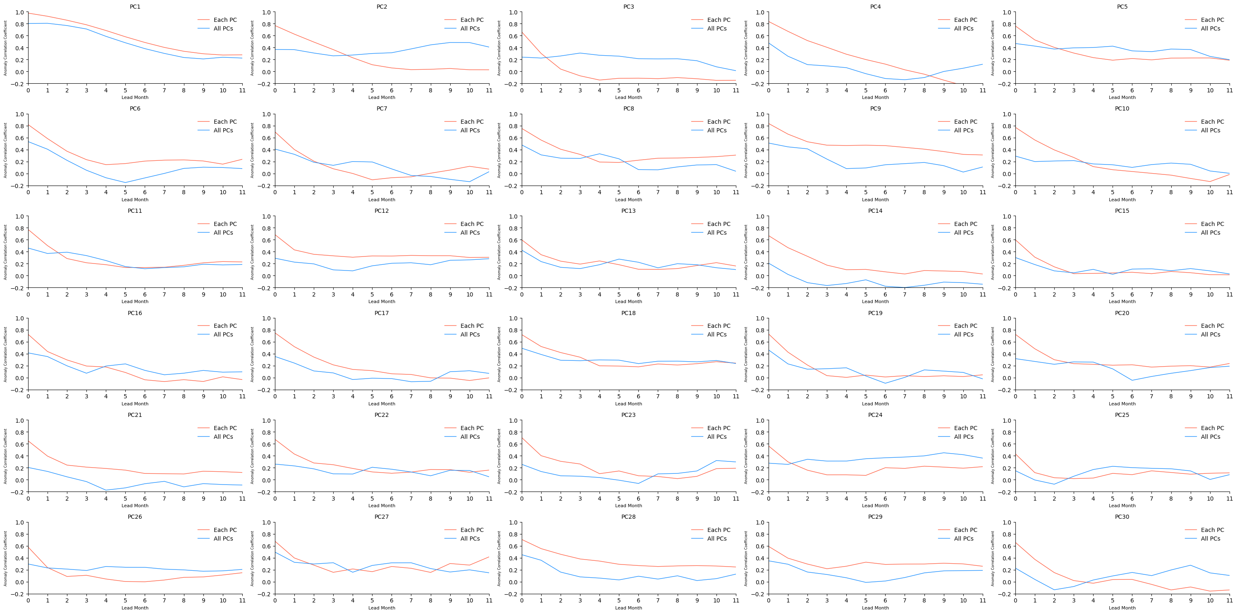
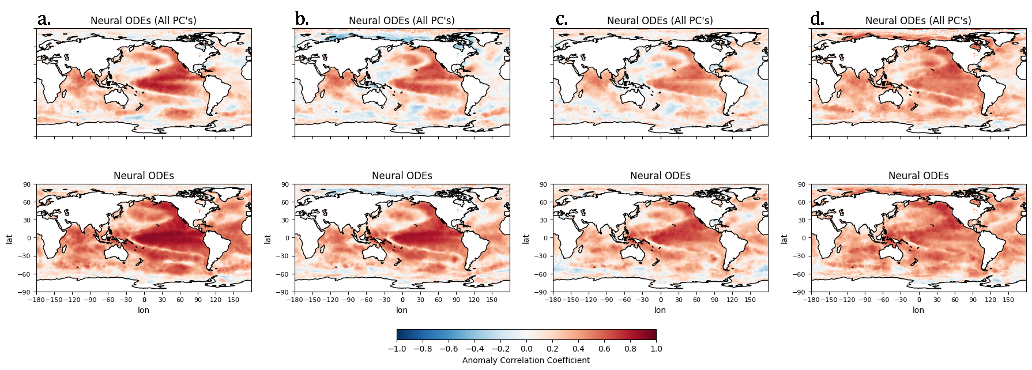
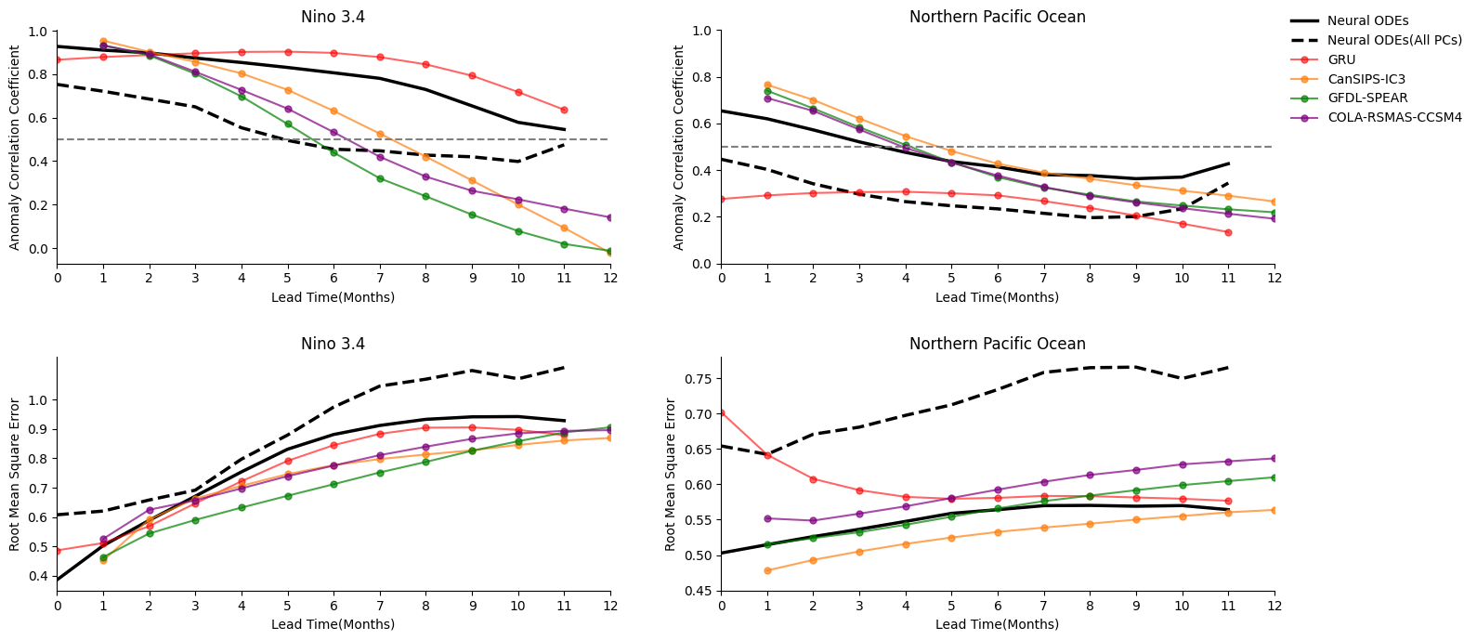
Seasonal Forecast of Sea Surface Temperature Anomaly via Neural ODEs(Supplementary)
Jonghan Lee¹, Woosok Moon¹
¹Division of Earth Environmental System Sciences, Pukyong National University, Busan, Republic of Korea
Email : jh112008@pukyong.ac.kr , woosok.moon@gmail.com
Supplementary
The ACC maps also show improved performance when each PC is predicted independently.
The figure compares the prediction performance of each principal component (PC) when modeled individually versus using all PCs together (blue line).
In most cases, training each PC separately resulted in better performance.
As seen in the Niño 3.4 region, the effective prediction lead time even decreased to just 5 months.
In the case of the North Pacific, the model failed to make meaningful predictions.
The RMSE is also the worst among all models in comparison.
EGU25-7861

