Slide 1


Observation and Comparison of Precipitation and Water Abstraction Data in Taiwan, Japan, and South Korea
Outline and Navigation
This is the same file as the PICO presentation, intended for those who were not able to attend.
Introduction
Methodology
Main Results
Annual Linear Correlation
Monthly Scale: Taiwan
Monthly Scale: Japan
Monthly Scale: Korea
Daily scale
Chung LU Advisor: Jiing-Yun YOU Department of Civil and Environmental Engineering, National Taiwan University, Taiwan

Slide 2

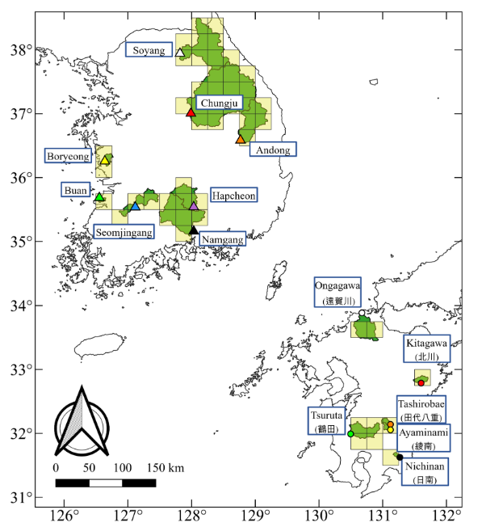
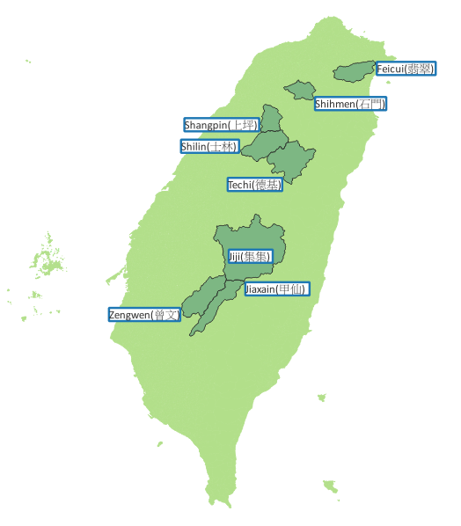
Introduction
Back to outline
The Study sites in Taiwan, Japan and Korea
This study examines the relationship between near-surface air temperature and water abstraction.
This study aims to understand the dynamics behind abstraction, providing new insights into both hydrological process and water resource management.
This figure is adapted from: “Equilibrium states of humid catchments satisfying both energy and mass conservations”, Yoo, Choi, Paik et al., 2025

Slide 3
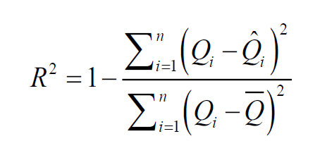
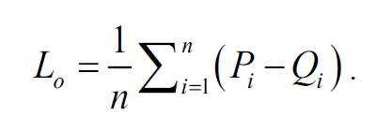
Methodology
Back to outline
Simplified water balance equation:
For the analyses of annual scale, Yoo et al., 2025
For the analyses of monthly scale:
Linear regression
related statistical analyses
P : rain
Q : runoff
L : abstraction (including evapotranspiration, infiltration……)
L_{o} : average annual abstraction
P_{i} : runoff
Q_{i} : abstraction
: fitted runoff, = P_{i} – L_{o}
: mean annual runoff
We followed the methodology from: “Equilibrium states of humid catchments satisfying both energy and mass conservations”, Yoo, Choi, Paik et al., 2025

Slide 4
Main Results
Back to outline
The average rain and temperature of studying sites
The annual linear correlation between rain and runoff(Temperature of sites from 23.91˚C to 14.17 ˚C)
Sites in Japan
Sites in Korea
Sites in Taiwan
On the annual scale, the abstraction in Taiwan deviates from the overall trend.
An additional analysis will explore the influence of humidity on abstraction.

Slide 5
Main Results
Back to outline
The daily profile from 2007 November-2008 October(Zengwen, Taiwan)
The annual abstraction of Zengwen and Jiaxain reseverior, Taiwan
Typhoon Kalmaegi
year | Zengwen | rank | Jiaxain | rank | rank_sum
2001 | 606.2041 | 7 | 448.4809 | 12 | 19
2002 | 739.9993 | 5 | 595.7653 | 8 | 13
2003 | 945.856 | 1 | 505.6418 | 10 | 11
2004 | 638.5078 | 6 | -221.576 | 14 | 20
2005 | -40.309 | 16 | -235.546 | 15 | 31
2006 | 506.3959 | 10 | -300.27 | 17 | 27
2007 | 464.5354 | 11 | 491.3655 | 11 | 22
2008 | 283.7088 | 15 | -290.511 | 16 | 31
2009 | -142.32 | 17 | 2081.471 | 2 | 19
2010 | 838.8342 | 2 | 2096.04 | 1 | 3
2011 | 780.3474 | 3 | 337.346 | 13 | 16
2012 | 344.0525 | 14 | 604.4061 | 7 | 21
2013 | 588.9042 | 9 | 1096.344 | 3 | 12
2014 | 775.632 | 4 | 525.2585 | 9 | 13
2015 | 388.082 | 13 | 841.2371 | 5 | 18
2016 | 595.1414 | 8 | 1088.825 | 4 | 12
2017 | 427.145 | 12 | 717.064 | 6 | 18
Typhoon Sinlaku
Typhoon Fung-wong
Typhoon Jangmi
Significant negative abstraction were observed in all scale.
Reservoirs in Taiwan exhibit significant groundwater exchange.

Slide 6

Thank You
Chung LU
Advisor: Jiing-Yun YOU Department of Civil Engineering,
National Taiwan University, Taiwan
OSPP-abstract

Slide 7
Annual Linear Correlation
Back to outline
The annual linear correlation between rain and runoff(Temperature of sites from 23.91˚C to 14.17 ˚C)
 | zengwen | jiaxain | nichinan | feicui | ayaminami | ongagawa | tsuruda | tashirobae | kitagawa | shihmen | jiji
Rain | 3205.3471 | 3245.118 | 3542.853 | 3956.309 | 2814.765 | 1853.124 | 2968.07 | 3069.708 | 2441.287 | 2588.011 | 3118.351
Temperature | 23.91 | 20.75 | 17.06 | 16.03 | 15.97 | 15.94 | 15.78 | 15.49 | 14.69 | 14.56 | 14.17
Abstraction | 514.1598 | 610.6672 | 970.1762 | 505.492 | 681.2321 | 768.1723 | 792.0533 | 640.3549 | 530.9685 | 529.4385 | 632.7279
r^2 | 0.9172 | 0.6830 | 0.8803 | 0.8269 | 0.8901 | 0.8941 | 0.9646 | 0.8722 | 0.9596 | 0.8871 | *-2.129

Slide 8
Annual Linear Correlation
Back to outline
The annual linear correlation between rain and runoff(Temperature of sites from 13.31˚C to 10.02 ˚C)
 | namgang | booahn | boryeong | hapcheon | daecheong | shilin | seomjingang | shangpin | andong | chungju | techi
Rain | 1549.235 | 1292 | 1293.074 | 1280.118 | 1163.7 | 2653.383 | 1352.959 | 2654.26 | 1166.171 | 1246.435 | 2350.0871
Temperature | 13.31 | 13.06 | 12.91 | 12.11 | 11.78 | 11.5 | 11.45 | 11.43 | 11.04 | 10.19 | 10.02
Abstraction | 551.2539 | 555.6963 | 553.5943 | 595.8559 | 526.0403 | 587.782 | 588.6751 | 244.0629 | 562.2694 | 493.9129 | 664.1856
r^2 | 0.9262 | 0.8775 | 0.8488 | 0.9382 | 0.9624 | 0.7890 | 0.9322 | 0.5146 | 0.9697 | 0.9754 | 0.8315

Slide 9
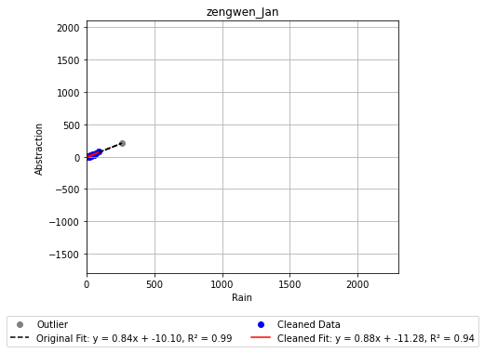
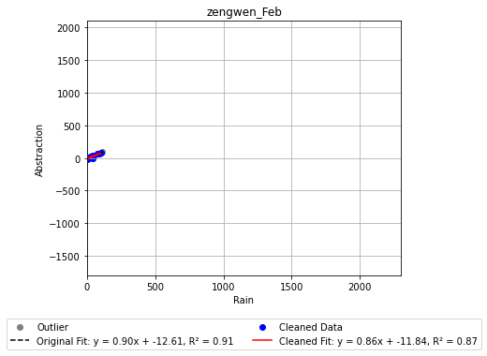
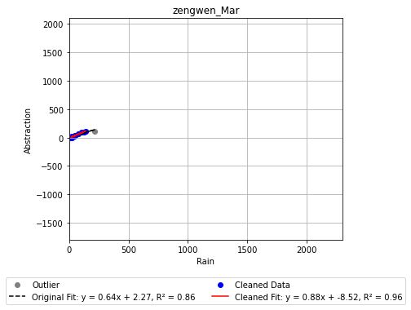
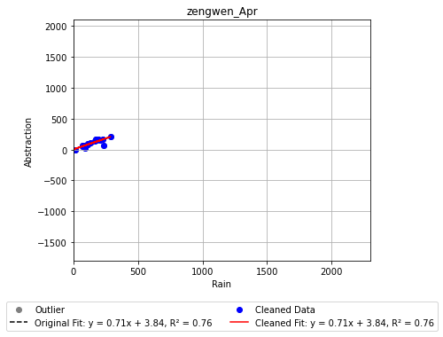
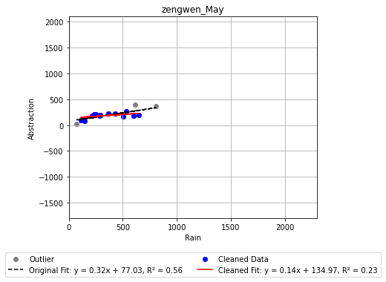
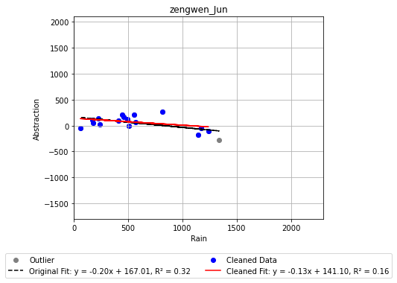
Monthly Scale: Taiwan
Back to outline
The linear correlation between rain and abstraction of every same months from 2001-2017

Slide 10
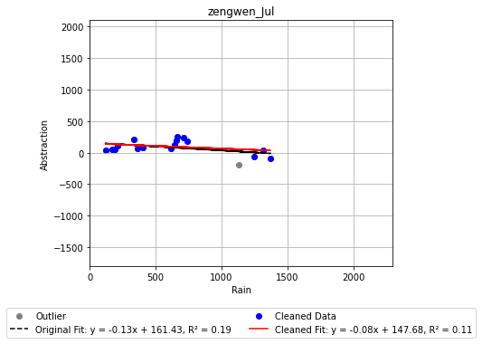
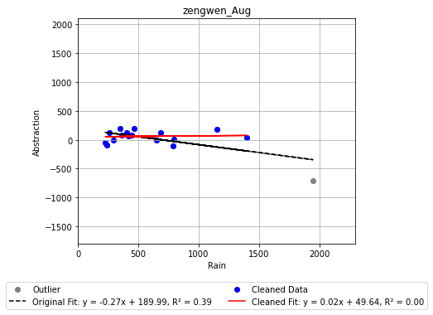
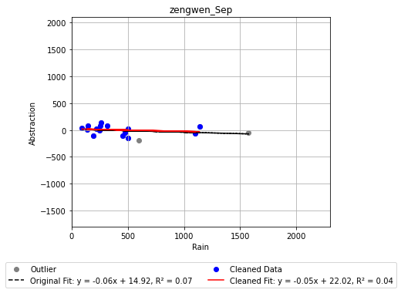
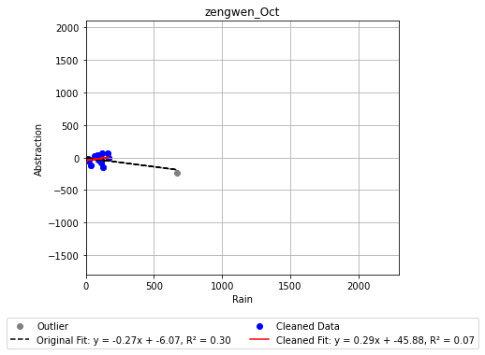
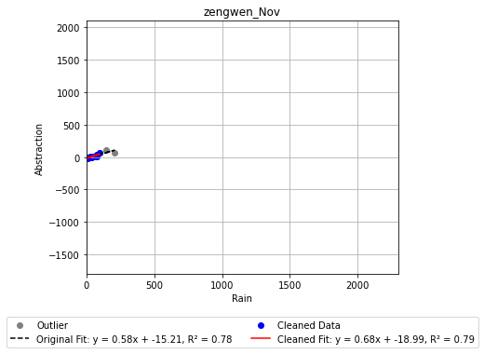

Monthly Scale: Taiwan
Back to outline
The linear correlation between rain and abstraction of every same months from 2001-2017

Slide 11
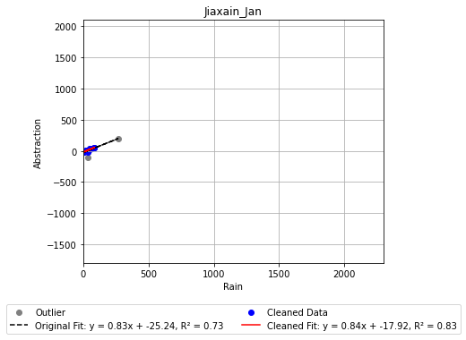
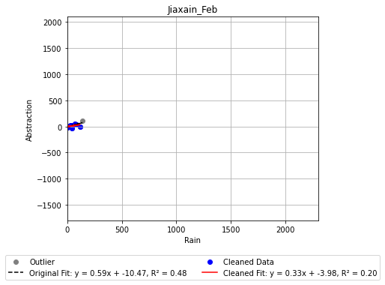
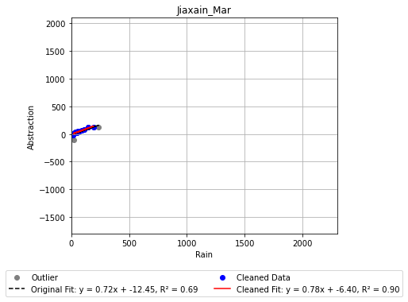
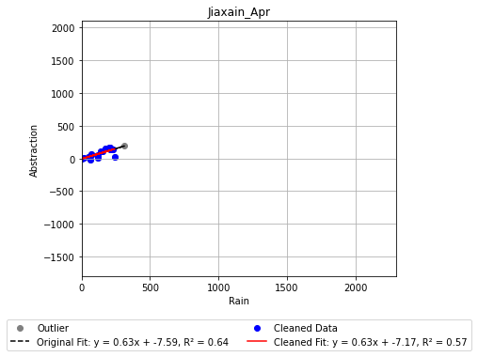
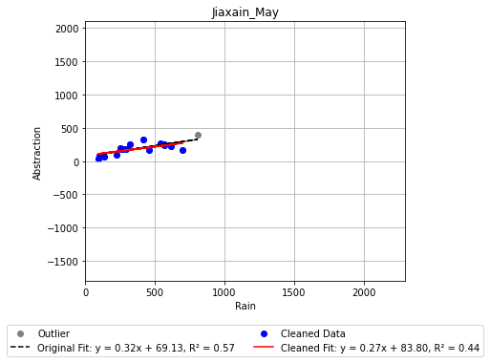
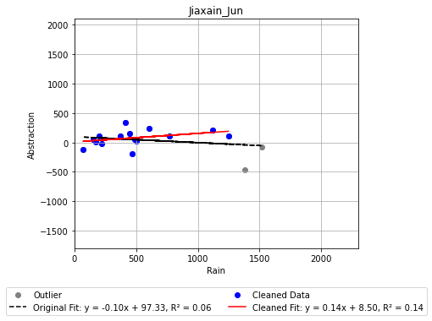
Monthly Scale: Taiwan
Back to outline
The linear correlation between rain and abstraction of every same months from 2001-2017

Slide 12
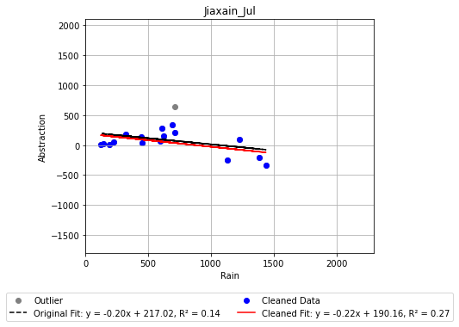
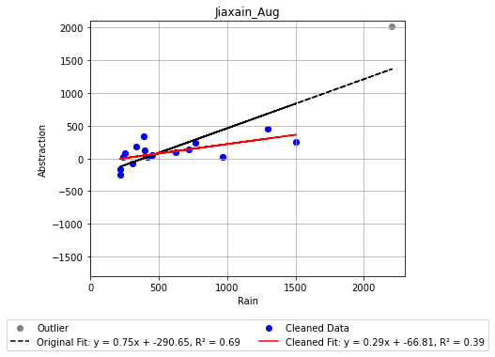
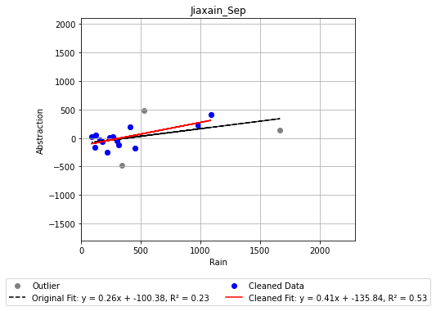
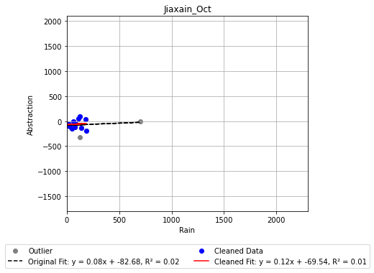
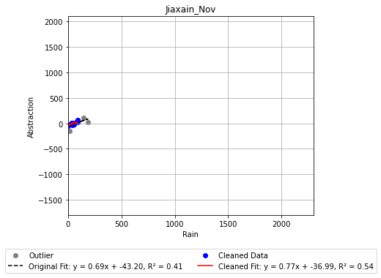
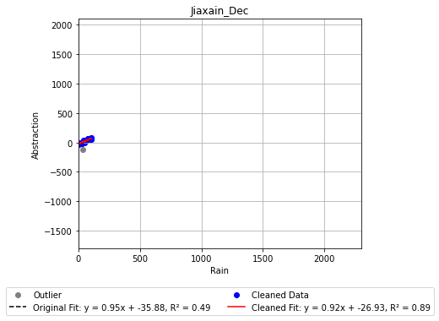
Monthly Scale: Taiwan
Back to outline
The linear correlation between rain and abstraction of every same months from 2001-2017

Slide 13
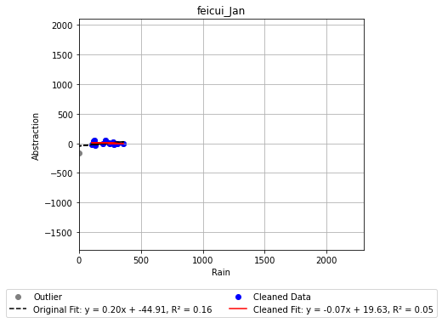
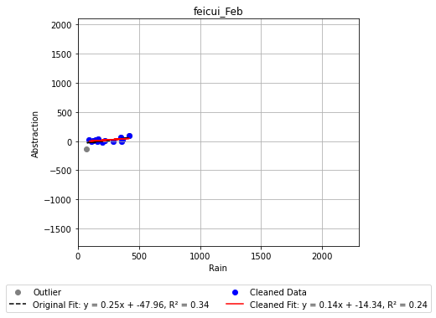
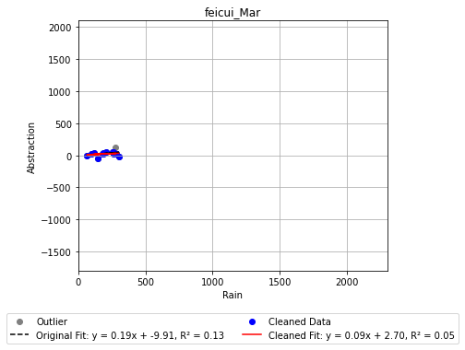
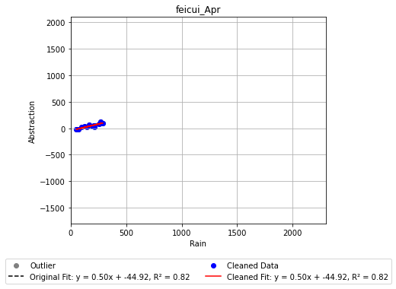
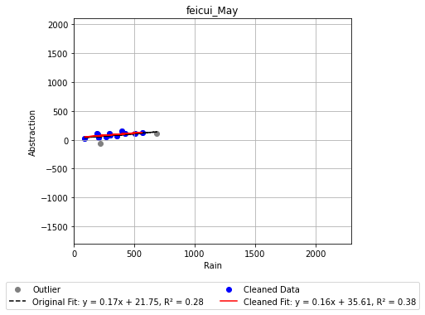
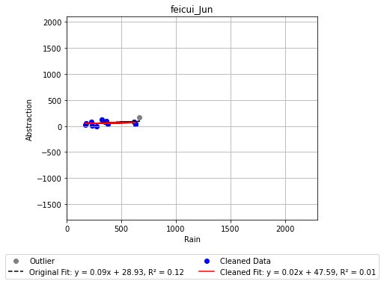
Monthly Scale: Taiwan
Back to outline
The linear correlation between rain and abstraction of every same months from 2001-2017

Slide 14
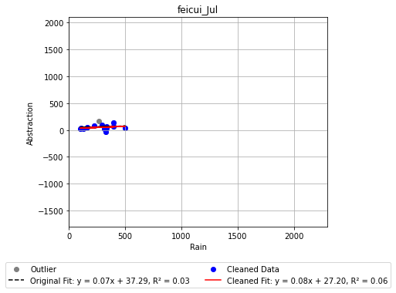
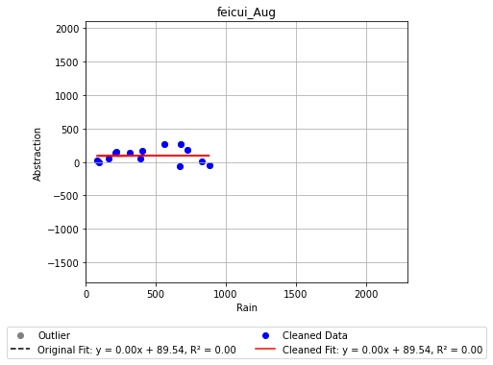
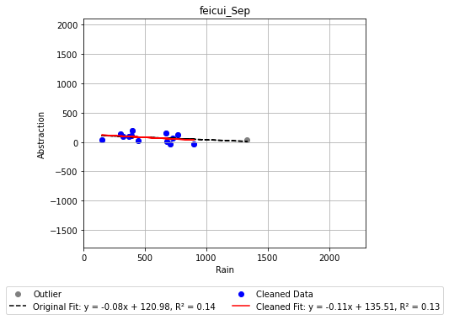
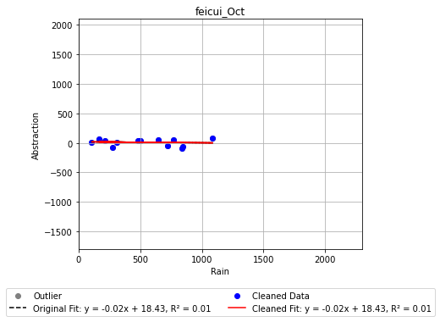
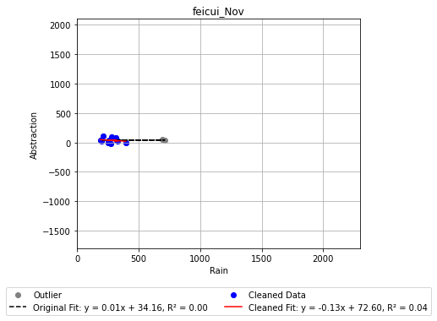
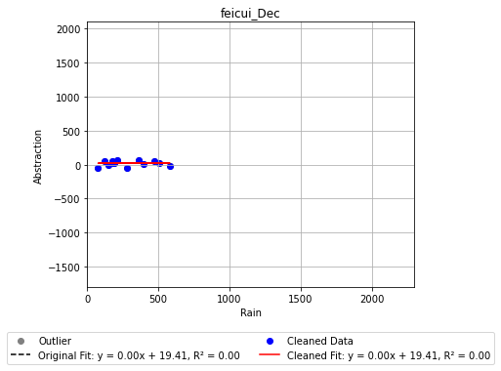
Monthly Scale: Taiwan
Back to outline
The linear correlation between rain and abstraction of every same months from 2001-2017

Slide 15
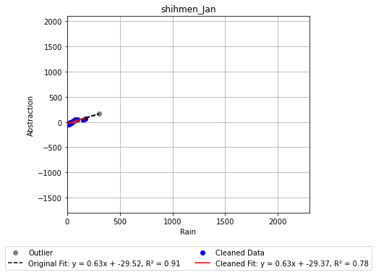
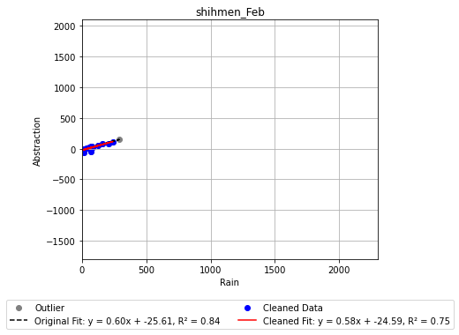
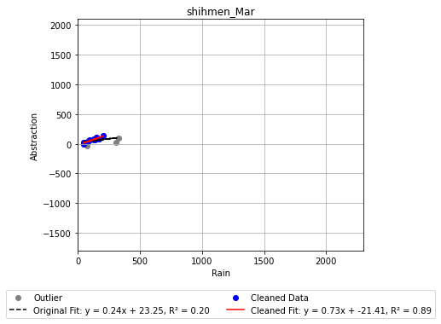
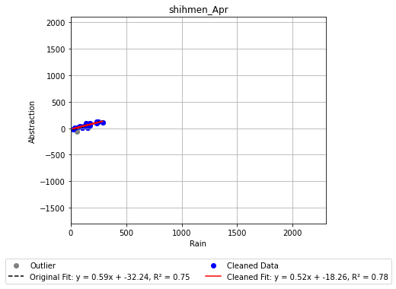
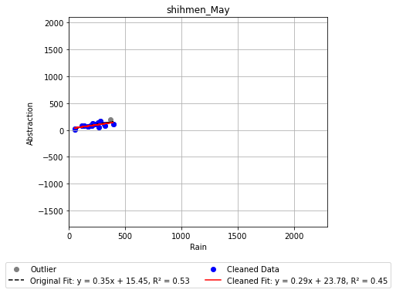

Monthly Scale: Taiwan
Back to outline
The linear correlation between rain and abstraction of every same months from 2001-2017

Slide 16

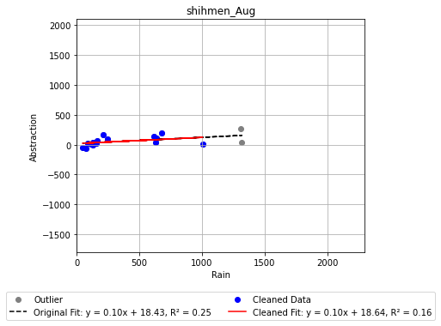
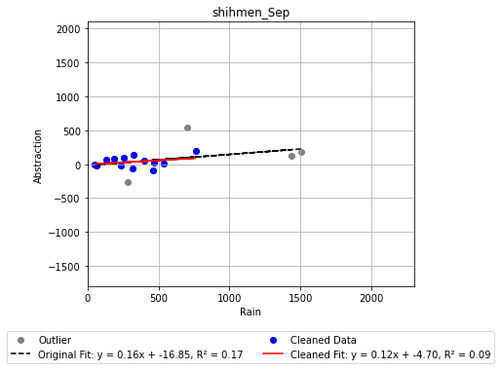
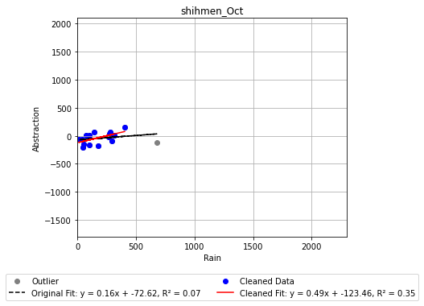
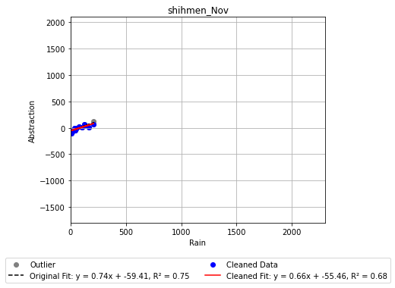

Monthly Scale: Taiwan
Back to outline
The linear correlation between rain and abstraction of every same months from 2001-2017

Slide 17
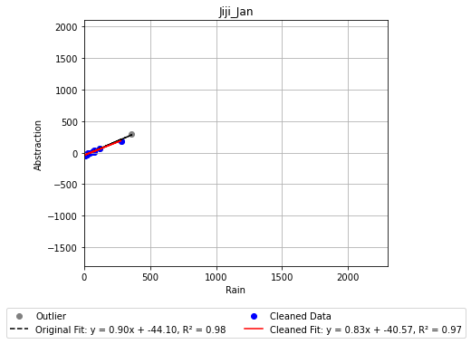
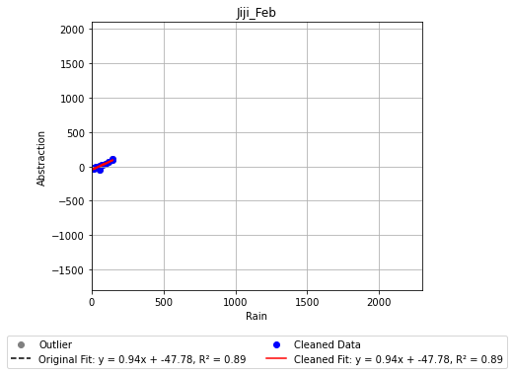




Monthly Scale: Taiwan
Back to outline
The linear correlation between rain and abstraction of every same months from 2001-2017

Slide 18






Monthly Scale: Taiwan
Back to outline
The linear correlation between rain and abstraction of every same months from 2001-2017

Slide 19






Monthly Scale: Taiwan
Back to outline
The linear correlation between rain and abstraction of every same months from 2001-2017

Slide 20






Monthly Scale: Taiwan
Back to outline
The linear correlation between rain and abstraction of every same months from 2001-2017

Slide 21






Monthly Scale: Taiwan
Back to outline
The linear correlation between rain and abstraction of every same months from 2001-2017

Slide 22






Monthly Scale: Taiwan
Back to outline
The linear correlation between rain and abstraction of every same months from 2001-2017

Slide 23






Monthly Scale: Taiwan
Back to outline
The linear correlation between rain and abstraction of every same months from 2001-2017

Slide 24






Monthly Scale: Taiwan
Back to outline
The linear correlation between rain and abstraction of every same months from 2001-2017

Slide 25






Monthly Scale: Japan
Back to outline
The linear correlation between rain and abstraction of every same months from 2001-2017

Slide 26






Monthly Scale: Japan
Back to outline
The linear correlation between rain and abstraction of every same months from 2001-2017

Slide 27






Monthly Scale: Japan
Back to outline
The linear correlation between rain and abstraction of every same months from 2001-2017

Slide 28






Monthly Scale: Japan
Back to outline
The linear correlation between rain and abstraction of every same months from 2001-2017

Slide 29






Monthly Scale: Japan
Back to outline
The linear correlation between rain and abstraction of every same months from 2001-2017

Slide 30






Monthly Scale: Japan
Back to outline
The linear correlation between rain and abstraction of every same months from 2001-2017

Slide 31






Monthly Scale: Japan
Back to outline
The linear correlation between rain and abstraction of every same months from 2001-2017

Slide 32






Monthly Scale: Japan
Back to outline
The linear correlation between rain and abstraction of every same months from 2001-2017

Slide 33






Monthly Scale: Japan
Back to outline
The linear correlation between rain and abstraction of every same months from 2001-2017

Slide 34






Monthly Scale: Japan
Back to outline
The linear correlation between rain and abstraction of every same months from 2001-2017

Slide 35






Monthly Scale: Japan
Back to outline
The linear correlation between rain and abstraction of every same months from 2001-2017

Slide 36






Monthly Scale: Japan
Back to outline
The linear correlation between rain and abstraction of every same months from 2001-2017

Slide 37






Monthly Scale: Korea
Back to outline
The linear correlation between rain and abstraction of every same months from 2001-2017

Slide 38






Monthly Scale: Korea
Back to outline
The linear correlation between rain and abstraction of every same months from 2001-2017

Slide 39






Monthly Scale: Korea
Back to outline
The linear correlation between rain and abstraction of every same months from 2001-2017

Slide 40






Monthly Scale: Korea
Back to outline
The linear correlation between rain and abstraction of every same months from 2001-2017

Slide 41






Monthly Scale: Korea
Back to outline
The linear correlation between rain and abstraction of every same months from 2001-2017

Slide 42






Monthly Scale: Korea
Back to outline
The linear correlation between rain and abstraction of every same months from 2001-2017

Slide 43






Monthly Scale: Korea
Back to outline
The linear correlation between rain and abstraction of every same months from 2001-2017

Slide 44






Monthly Scale: Korea
Back to outline
The linear correlation between rain and abstraction of every same months from 2001-2017

Slide 45






Monthly Scale: Korea
Back to outline
The linear correlation between rain and abstraction of every same months from 2001-2017

Slide 46






Monthly Scale: Korea
Back to outline
The linear correlation between rain and abstraction of every same months from 2001-2017

Slide 47






Monthly Scale: Korea
Back to outline
The linear correlation between rain and abstraction of every same months from 2001-2017

Slide 48






Monthly Scale: Korea
Back to outline
The linear correlation between rain and abstraction of every same months from 2001-2017

Slide 49






Monthly Scale: Korea
Back to outline
The linear correlation between rain and abstraction of every same months from 2001-2017

Slide 50






Monthly Scale: Korea
Back to outline
The linear correlation between rain and abstraction of every same months from 2001-2017

Slide 51






Monthly Scale: Korea
Back to outline
The linear correlation between rain and abstraction of every same months from 2001-2017

Slide 52






Monthly Scale: Korea
Back to outline
The linear correlation between rain and abstraction of every same months from 2001-2017

Slide 53
Daily Scale
Back to outline
The daily profile of rain, runoff and abstraction from 2007 November-2008 October (Taiwan)
Typhoon Kalmaegi
Typhoon Sinlaku
Typhoon Fung-wong
Typhoon Jangmi

Slide 54
Daily Scale
Back to outline
The daily profile of rain, runoff and abstraction from 2007 November-2008 October (Taiwan)
Typhoon Fung-wong
Typhoon Sinlaku
Typhoon Jangmi

Slide 55
Daily Scale
Back to outline
The daily profile of rain, runoff and abstraction from 2007 November-2008 October (Taiwan)
Typhoon Fung-wong
Typhoon Sinlaku
Typhoon Jangmi

Slide 56
Daily Scale
Back to outline
The daily profile of rain, runoff and abstraction from 2007 November-2008 October (Korea)

Slide 57
Daily Scale
Back to outline
The daily profile of rain, runoff and abstraction from 2007 November-2008 October (Taiwan)

