Slide 1
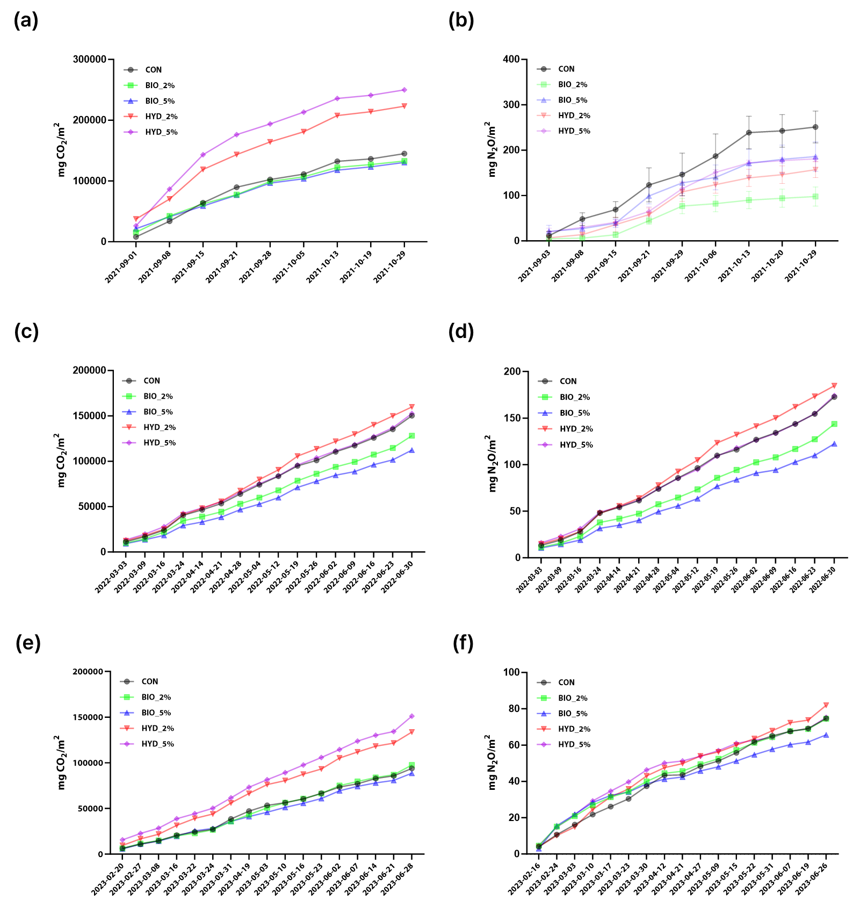
Cumulative Emissions
2021
2022
2023

Slide 2
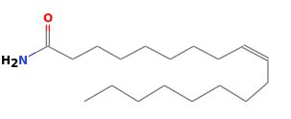
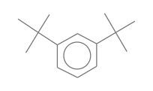
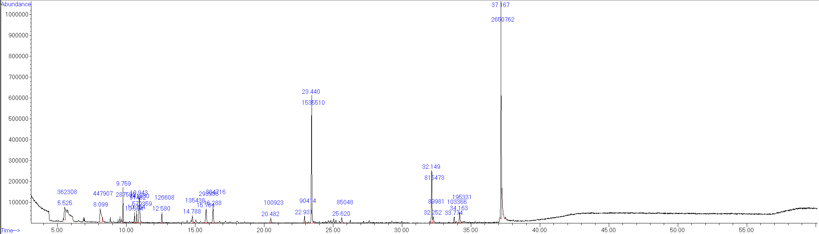
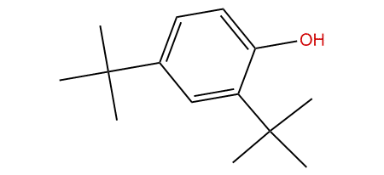

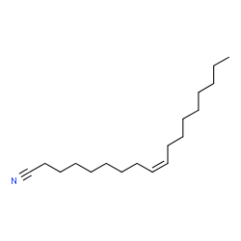
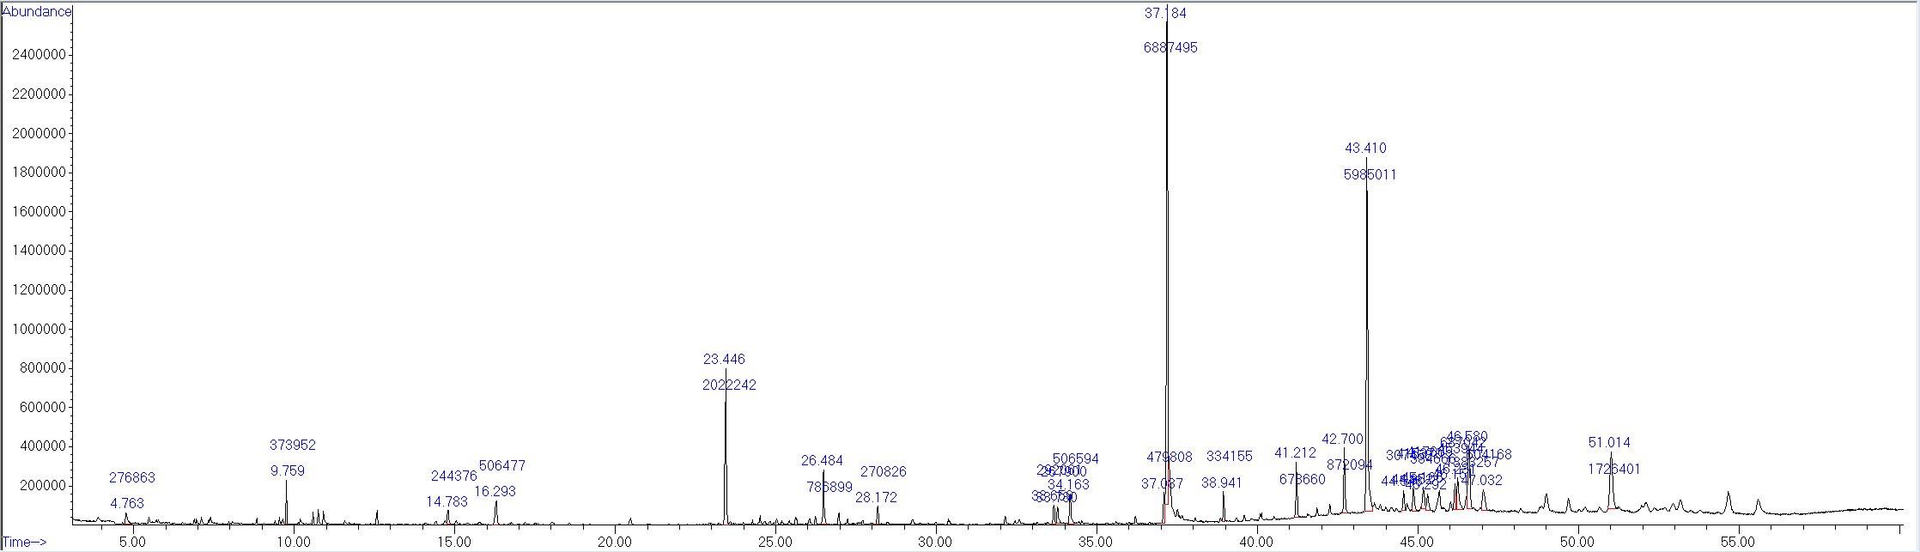
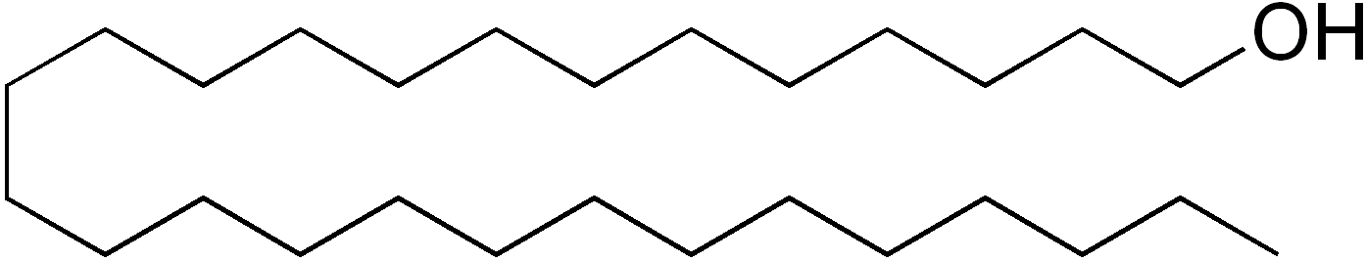
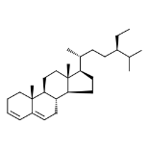
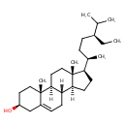
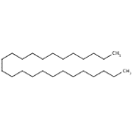
Functional group analysis:
Hexane Extraction
1) Biochar-TC
Phenol, 2,4-bis-(1,1-dimethylethyl)
9-Octadecenamide
Benzene, 1,3-bis(1,1-dimethylethyl)-
Dodecyl ester
Oleonitrile
2) Biochar-HTC
1-Heptacosanol
Stigmastan-3,5-diene
Vitamin E
Sitosterol
Heptacosane
Pentacosane

Slide 3
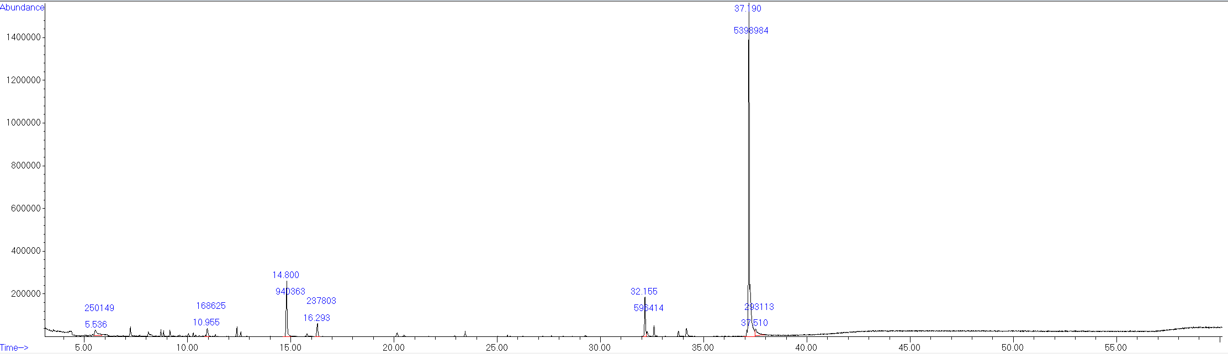
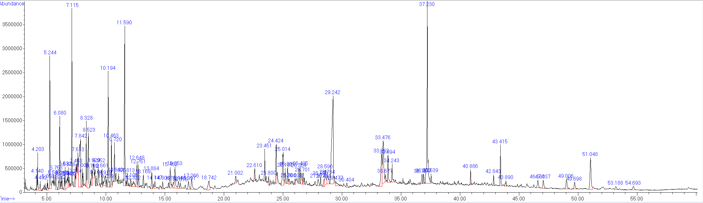
Functional group analysis:
Methanol Extraction
1) Biochar-TC
Olenitrile
2) Biochar-HTC
Sitosterol
Hexadecanoic acid

Slide 4
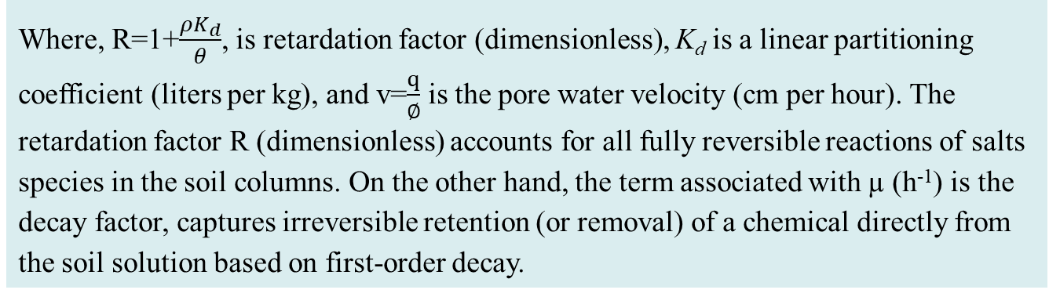

Bromide BTC in column for a) soil (control), b) soil + pyrochar, and c) soil + hydrochar columns. Solid lines are fitting with the CXTFIT model.
$$R\frac{∂C}{∂t}=D\frac{∂^{2}C}{∂z^{2}}−v\frac{∂C}{∂z}−μC$$
Where, R=1+$\frac{ρK_{d}}{θ}$, is retardation factor (dimensionless), K_{d} is a linear partitioning coefficient (liters per kg), and v=$\frac{q}{∅}$ is the pore water velocity (cm per hour). The retardation factor R (dimensionless) accounts for all fully reversible reactions of salts species in the soil columns. On the other hand, the term associated with µ (h⁻¹) is the decay factor, captures irreversible retention (or removal) of a chemical directly from the soil solution based on first-order decay.

Slide 5
Soil Physical Parameters and Experimental Conditions in the Miscible Displacement Column Experiments.
 | Bulk Density, ρ | Moisture Content, ө | Pore Water Velocity | Pulse Input, Pore Volume |  | Dispersion Coefficient, D*
Column Type | g cm⁻³ | cm³ cm⁻³ | cm h⁻¹ | Br | Ca/ Mg/ Na/ S | cm² h⁻¹
Soil | 1.687 | 0.363 | 0.617 | 1.25 | 4.25/4.27/6.208/6.24 | 0.318
Soil +HC | 1.838 | 306 | 0.589 | 1.32 | 7.91/5.91/11.12/5.58 | 0.129
Soil +PC | 1.521 | 0.462 | 0.597 | 1.34 | 3.28/3.28/5.09/6.07 | 0.052

Slide 6
The goodness of Fit of CXTFIT Model Variations in the bromide BTC with the influence of pyrochar and hydrochar application.
Sample | RMSE | r² | R* | µ (h⁻¹)**
Soil | 5.54 x 10⁻⁴ | 0.996699 | 7.997±0.015 | 0.4702±0.0376
Soil -PC Br | 7.13 x 10⁻³ | 0.962757 | 0.4036±0.06706 | 0.009129±0.0523
Soil HC Br | 1.26 x 10⁻³ | 0.984897 | 0.6056±0.0513 | 0.03728±0.0187
Model parameters estimated (with 95% confidence interval), Root Mean Squared Error (RMSE), and r² values. *Retardation factor, **Decay factor.

Slide 7
The goodness of fit of the MRTM model constant on salt BTC under the different treatments in soil columns.
Salt type | Column Type | RMSE* | r²* | k₁ | k₂ | k₃
Ca | Soil | 0.080 | 0.919 | 1.013 ± 0.492 | 0.328 ± 0.182 | 0.021 ± 0.003
 | Soil+Hydrochar | 0.118 | 0.789 | 0.597 ± 0.179 | 0.157 ± 0.059 | 0.005 ± 0.002
 | Soil+Pyrochar | 0.041 | 0.919 | 0.625 ± 0.102 | 0.148 ± 0.036 | 0.029 ± 0.004
Mg | Soil | 0.025 | 0.996 | 0.996 ± 0.102 | 0.507 ± 0.058 | 0.022 ± 0.001
 | Soil+Hydrochar | 0.116 | 0.611 | 12.77 ± 1.022 | 1.493 ± 0.128 | 0.015 ± 0.001
 | Soil+Pyrochar | 0.037 | 0.970 | 8.955 ± 0.166 | 3.796 ± 0.095 | 0.011 ±0.0002
Na | Soil | 0.106 | 0.876 | 6.328 ± 7.329 | 1.101 ± 1.316 | 0.011 ± 0.00097
 | Soil+Hydrochar | 0.075 | 0.916 | 12.96 ± 1.816 | 0.773 ± 0.107 | 0.005 ± 0.0002
 | Soil+Pyrochar | 0.062 | 0.922 | 1.034 ± 0.211 | 0.156 ± 0.041 | 0.013 ± 0.001
S | Soil | 0.130 | 0.847 | 1.680 ± 1.079 | 0.198 ± 0.140 | 0.005 ± 0.001
 | Soil+Hydrochar | 0.066 | 0.875 | 0.398 ± 0.026 | 0.016 ± 0.0014 | 0.000001 ± 0.00012
 | Soil+Pyrochar | 0.074 | 0.873 | 0.400 ± 0.067 | 0.0207 ± 0.008 | 0.0007 ± 0.0016

