Slide 1
Evaluation of Hourly Solar Radiation
Products for Solar Energy Applications over China
Han Wang, Yawen Wang *
Ocean University of China, Qingdao, China; Email: wh1636@stu.ouc.edu.cn
Notes:
Good morning everyone, my name is WH, I am a graduate student from Ocean University of China. It is my great honor to share my research with you here. My research is about the Evaluation of Hourly Solar Radiation Products for Solar Energy Applications over China.

Slide 2
1 Background
Carbon neutrality
(United Nations, 2020)
mid-21st century
Ground observation
→ reference
Satellite-based or reanalysis products
→ validation
Clean energy
photovoltaic (PV)
surface solar irradiance (SSI)
Solar energy
concentrating solar power
(CSP)
direct irradiance
diffuse irradiance
direct horizontal irradiance (DHI)
Direct Normal Irradiance (DNI)
Hourly data
models for accurate potential of power generation
$DHI=DNI∙\cos{θ}$
Notes:
To achieve carbon neutrality, we need transition to clean energy like solar power, which is typically harnessed through photovoltaic and concentrating solar power. Hourly radiation data is often required in models to assess accurate power generation potential. SSI is the total solar irradiance reaching the surface. Direct irradiance, the part of SSI neither scattered nor absorbed, is usually provided as DNI and DHI. The DHI is the irradiance reaching a horizontal plane at the surface. Among these variables SSI and DHI estimations are validated, as they had direct impacts on PV and CSP. Ground observations, as measured values, but limited in spatial coverage, are used as the reference to validate products.

Slide 3
1 Background 丨Validation
Hourly SSI:
Time Range | Chinese Stations | Products | Reference
1992–2018 | 2 | Solcast, CAMS-RAD, NSRDB, SARAH-2, SARAH-E, CERES-SYN1deg, ERA5, MERRA-2, | (Yang and Bright, 2020)
2007 | 98 | ERA5 | (Jiang et al, 2020)
2001, 2004, 2005, 2010 | 4 | CERES-SYN1deg, SARAH-E, ERA5, MERRA-2 | (Cao et al., 2022)
 |  | ......
Limitation of region or time
hourly test
accuracy & trend consistency
temporal and spatial range—96 stations, 22 years
Limited trend consistency test
DHI:
Time Resolution | Time Range | Products | Reference
hourly | 2007 | ERA5 | (Jiang et al., 2020)
daily | 2001, 2006 | CERES-SYN1deg, SARAH-E, ERA5 | (Cao et al., 2022)
 |  | ......
Scarcity
Notes:
There have been many works evaluating SSI datasets. But it is uncommon to verify hourly data in China. As shown in the table above, hourly validation were subject to time or region constraints. Besides, there was not much consideration about trend consistency. The validation of DHI is even less. The only validations in China involve only 3 years, and hourly validation is only carried out for ERA5. This study, therefore, aims to further validate both accuracy and trend consistency of hourly SSI and DHI estimations, using 22 years of observations from 96 stations.

Slide 4
2 Research Structure丨Validated data
Reanalysis and remote sensing data:
hourly
cover China
long time series (>10 years)
Product | Spatial Resolution | Time Range | Spatial Coverage | variable | Reference
ERA5 | 0.25°×0.25° | 1940–present | Global | SSR & DHI | https://cds.climate.copernicus.eu/
MERRA-2 | 0.5°×0.625° | 1980–present | Global | SSR | https://disc.gsfc.nasa.gov/
SARAH-E | 0.05°×0.05° | 1999–2016 | 65°S–65°N, 8°W–128°E | SSR & DHI | https://wui.cmsaf.eu/
CERES-SYN1deg | 1°×1° | 2000.3–present | Global | SSR & DHI | https://ceres.larc.nasa.gov/
Solcast | 2km×2km | 2007–present | Global | SSR & DHI | https://solcast.com/
Notes:
As for validated data, we selected five long-term hourly SSI and DHI products in this Table, which meet the following three criteria: (1) providing hourly data; (2) covering most regions of China; (3) offering a long time series of no less than 10 years up to present.

Slide 5
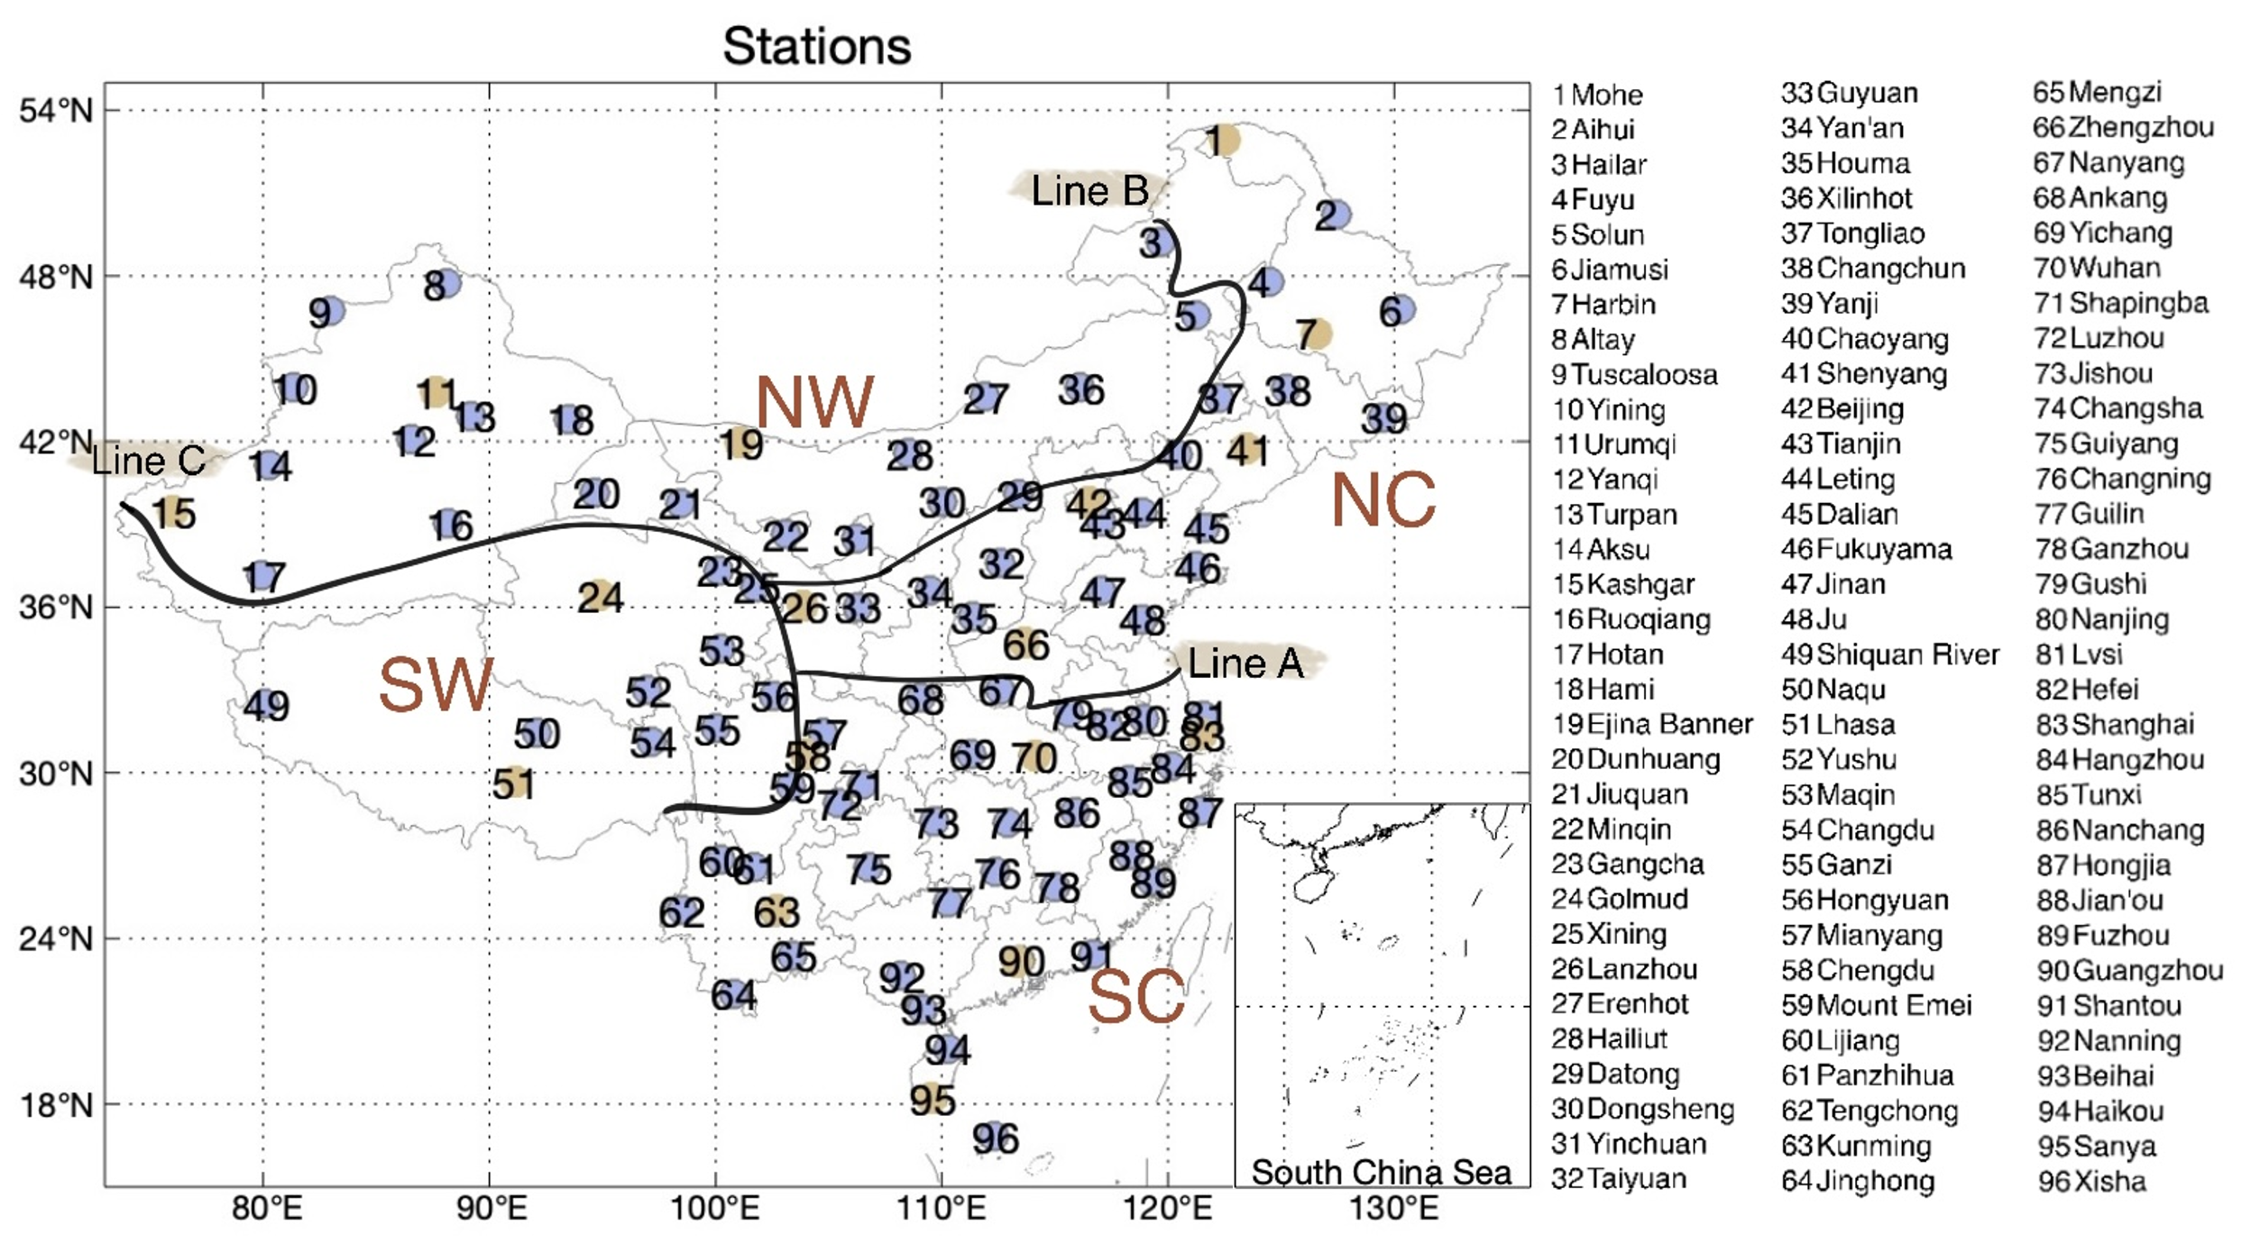
2 Research Structure丨Reference data
Ground Observations: China Meteorological Data Service Center of the China Meteorological Administration (http://data.cma.cn, CMA)
SSI 96 stations (including 17 DHI stations)
Notes:
Then, we chose 22-year hourly observations from CMA as our reference data. All the 96 stations in this map provide SSI observations, and the 17 orange ones also provide DHI data. The stations were divided into four regions according to their geographical characteristics.

Slide 6
2 Research Structure丨Method
a. Diurnal Accuracy
(1). SSI overall
(2). SSI seasonal
(3). SSI regional
(4). Difference of SSI and DHI estimations
1.normalized Mean Bias Deviation
$$nMBD=\frac{1}{nE(x)}\sum_{i=1}^{n}{(p_{i}−x_{i})}$$
2.normalized Mean Absolute Bias Deviation
$$nMABD=\frac{1}{nE(x)}\sum_{i=1}^{n}{\left|p_{i}−x_{i}\right|}$$
3.normalized Root Mean Square Deviation
$$nRMSD=\frac{1}{E(x)}\sqrt{\frac{1}{n}\sum_{i=1}^{n}{{\left(p_{i}−x_{i}\right)}^{2}}}$$
b. Diurnal Trend Consistency:
Absolute Bias of Decadal Trends
(based on relative anomalies)
Notes:
Since the estimations of SSI and DHI share similar patterns, in this report, I will use SSI as example to summarise the estimation features at the diurnal pattern of annual and national scale, seasonal scale, and regional scale, then the difference of variables. Each parts include both accuracy and the trend consistency. Specifically, Trend Consistency analysis mainly based on the absolute bias of decadal trends, calculated from the relative SSI and DHI anomalies. we selected three indices for the accuracy test on the right. The nMBD reflects the over or underestimation of the products. nMABD reflects the absolute magnitude of the bias, and nRMSD reflects the dispersion of the estimation bias.

Slide 7
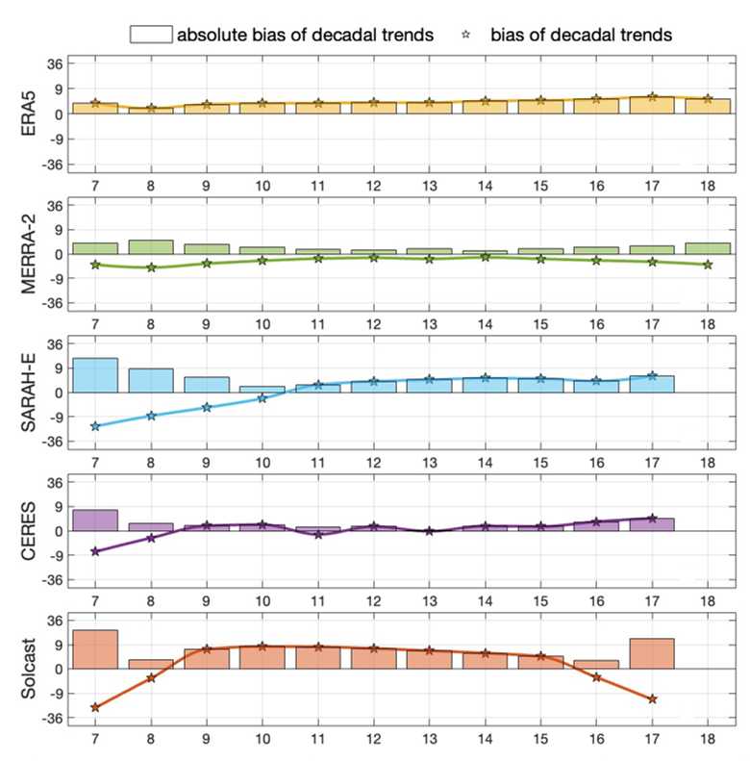
3 Results丨(1) Overall diurnal pattern
larger bias at sunrise & sunset
overestimation at each hour
accuracy: MERRA-2<ERA5<SARAH-E<CERES<Solcast
trend consistency: Solcast<SARAH-E<CERES<ERA5<MERRA-2
Notes:
Our results starts on this page. First, we got the hourly accuracy indices on the left panel. The pentagrams and bars in right panel represent the trend biases and absolute trend biases of estimations.
① It is observed that larger deviations occur at sunrise and sunset with lower solar elevation angles. This may be mainly attributed to extended light paths, which amplify the impact of atmospheric constituents on light attenuation.
② As for accuracy, nMBD in subfigure (a) shows that all products overestimate the variables.
③ Among the five products, accuracy improves from MERRA-2, ERA5, SARAH-E, and CERES, to Solcast. While trend consistency improves from Solcast, SARAH-E, CERES, ERA5, to MERRA-2.

Slide 8
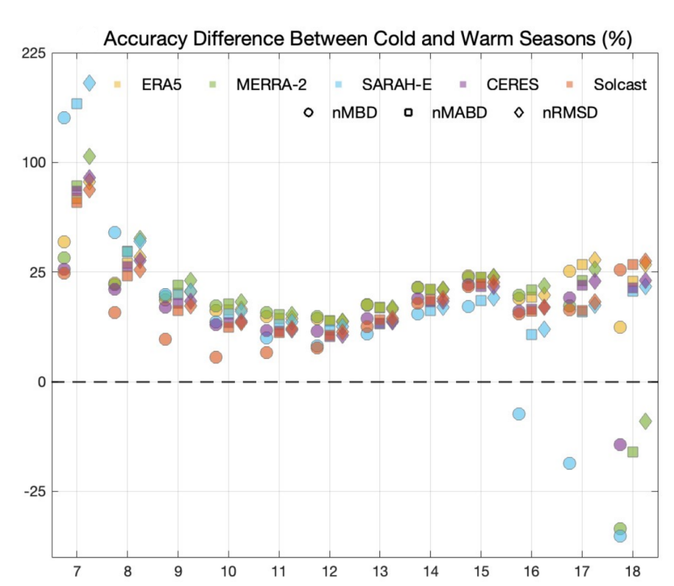
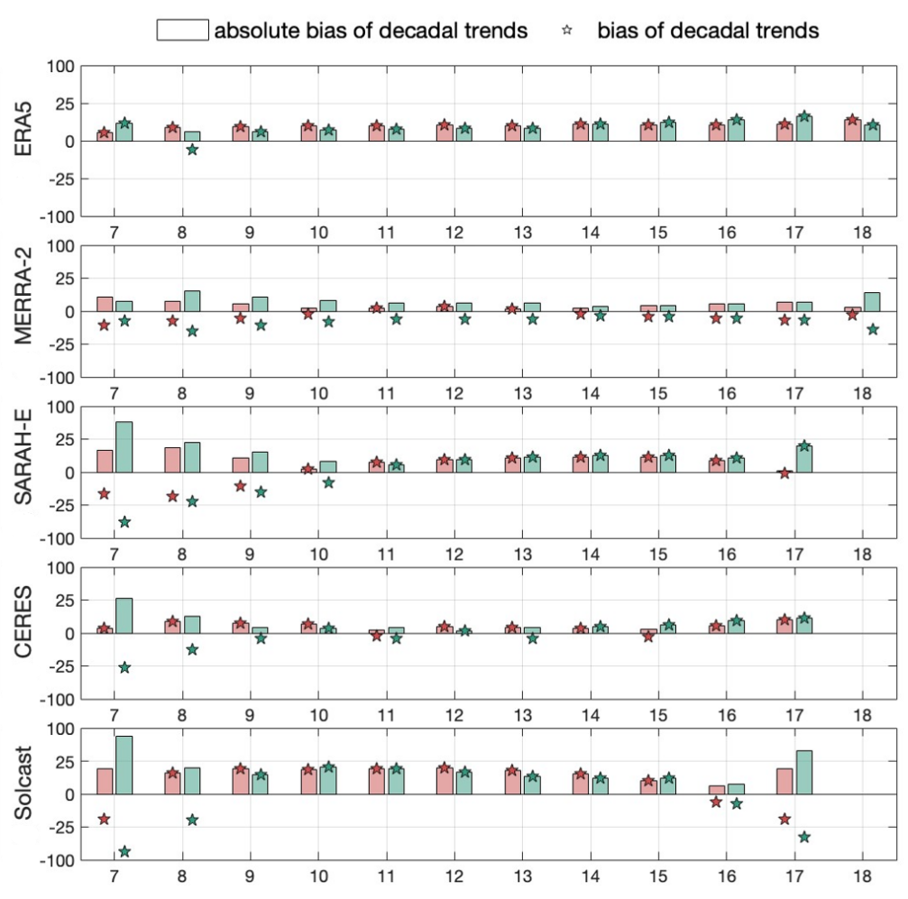
3 Results丨(2) Seasonal scale
Accuracy & trend consistency is lower in the cold season
→ surface reflectance & aerosol
Notes:
For seasonal test. We defined the warm season as April to September, and the cold season as October to next March. Given the similar diurnal patterns of accuracy in both seasons, we subtracted the indices of cold season from that of warm season, as illustrated on the left. Most of the values are larger than 0, indicating that accuracy is lower in the cold season. The green bars on the right panel, higher than the red ones, indicating that the trend consistency is also lower in the cold season, when the surface reflectance enhanced because of snow, and aerosol concentrations get higher because of the heat supply.

Slide 9
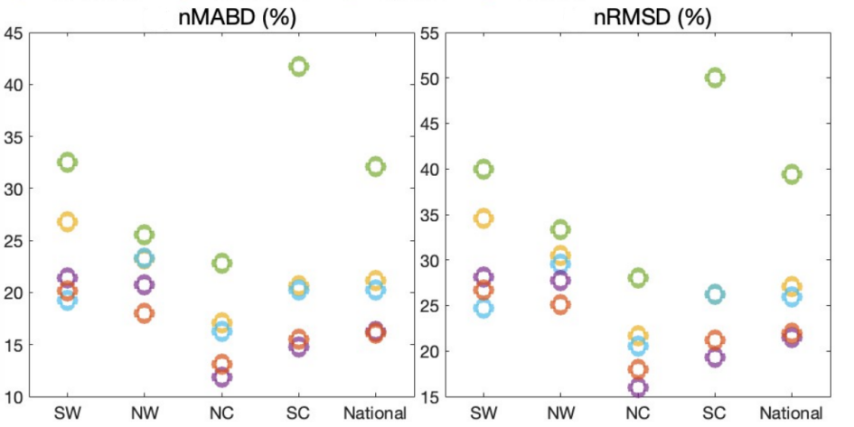
3 Results丨(3) Regional scale
lower accuracy and trend consistency
SC—aerosol and cloud
SW——terrain and cloud
Notes:
Based on the partition in the upper left, the three figures in the second line summarize the accuracy and trend consistency across 4 regions. Overall, the estimation of south China SC and southwestern SW has greater potential to improve. ① SC is characterized by dense populations and monsoonal climate, thereby high levels of aerosol and cloud. ② SW is characterized by rugged plateau terrain and highly variable cloud cover. This illustrates an inadequate consideration about cloud, aerosols, and terrain in radiation estimation.

Slide 10
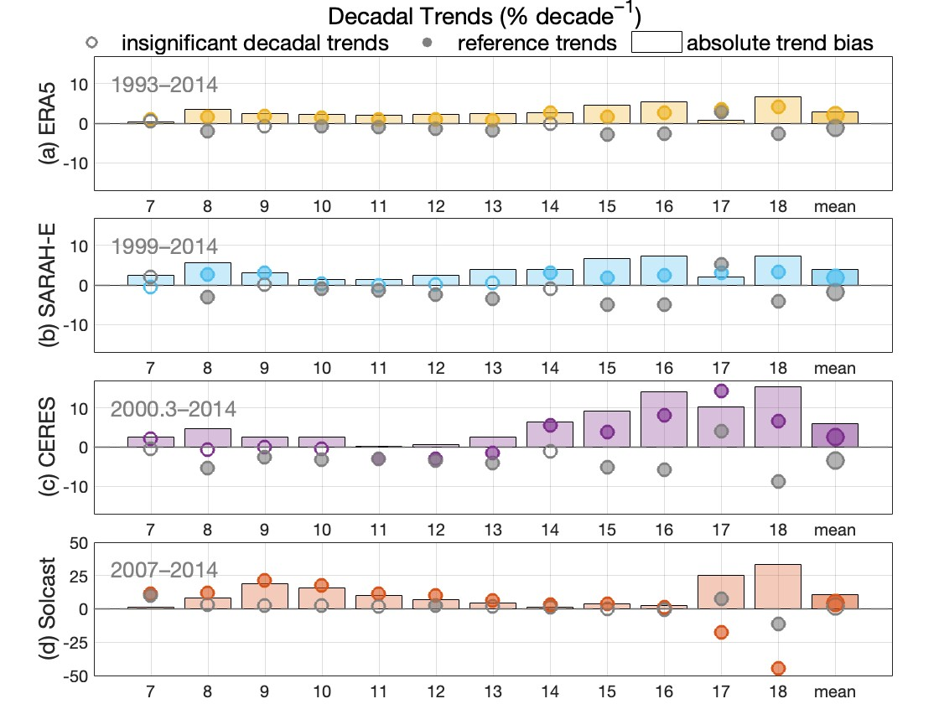
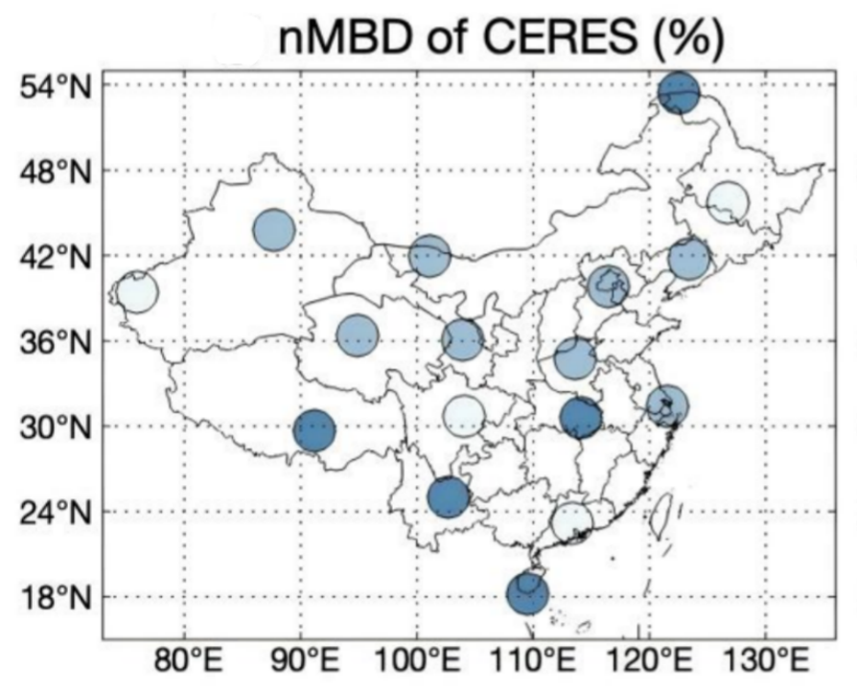
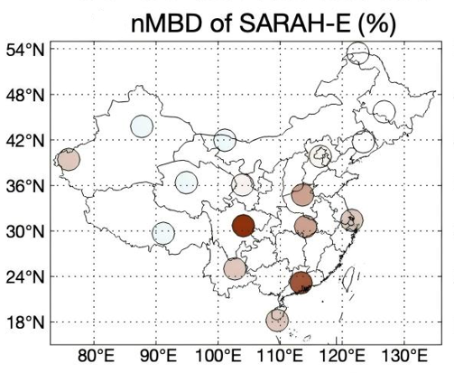
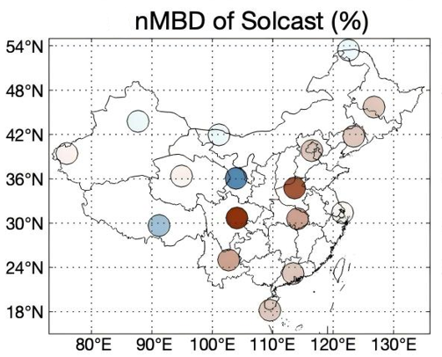
3 Results丨(4) Differences of variables
Direct Horizontal Irradiance:
Ranking of products
accuracy: ERA5<Solcast<SARAH-E<CERES
trend consistency: Solcast<CERES<SARAH-E<ERA5
More underestimation
CERES, Solcast, SARAH-E
Notes:
In addition to the results mentioned above, DHI estimations have different characteristics from SSI. ① First of all, the ranking of products changes. Accuracy of DHI estimations improves from ERA5, Solcast, to SARAH-E and CERES, and trend consistency improves from Solcast, CERES, SARAH-E, to ERA5.
② Besides, while SSI is overestimated by all products. More underestimations were found in the DHI test. CERES are totally underestimated. SARAH-E and Solcast also show underestimations in the western region.

Slide 11
5 Conclusions
Variable |  | ERA5 |  | MERRA-2 | SARAH-E |  | CERES |  | SOLCAST
 |  | SSI | DHI | SSI | SSI | DHI | SSI | DHI | SSI | DHI
Accuracy | nMABD (%) | 37.2 | 68.7 | 49.8 | 35.4 | 58.5 | 30.8 | 48.0 | 27.0 | 61.7
Trend Consistency | absolute trend bias (% decade⁻¹) | 2.1 | 2.9 | 0.9 | 4.3 | 4.0 | 1.2 | 5.9 | 7.1 | 10.9
SSI:
accuracy: MERRA-2<ERA5<SARAH-E<CERES<Solcast
trend consistency: Solcast<SARAH-E<CERES<ERA5<MERRA-2
High Accuracy: CERES
High Trend Consistency: ERA5, MERRA-2
DHI:
accuracy: ERA5<Solcast<SARAH-E<CERES
trend consistency: Solcast< CERES<SARAH-E<ERA5
Notes:
Last, average evaluation indices for each product are shown in this table. The bold red data are the best product performance. Bold black ones are the second best. The rankings of product performance are listed below. Overall, CERES demonstrate the highest accuracy, while ERA5 and MERRA-2 demonstrate the highest trend consistency. Though reasons for performance may need further confirmation, hopefully these exact data about hourly SSI and DHI estimations could provide a reference for selecting the most suitable hourly irradiation datasets.

Slide 12
Thank You ！
Publication：
Wang, H.; Wang, Y. Validation of Hourly Direct Horizontal Irradiance from Satellite-derived and Reanalysis Products over China: Accuracy and Trend Consistency. (in preparation)
Wang, H.; Wang, Y. Evaluation of the Accuracy and Trend Consistency of Hourly Surface Solar Radiation Datasets of ERA5, MERRA-2, SARAH-E, CERES, and Solcast over China. Remote Sens. 2025, 17, 1317. https://doi.org/10.3390/rs17071317
Han Wang, Yawen Wang *
Ocean University of China, Qingdao, China;
Email: wh1636@stu.ouc.edu.cn
Notes:
That’s all, Thank you for your kind attention.

