Slide 1


The Impact of Organic Solvent Oil Extraction on Shale Pore System-Key Issues in Shale Pore Evaluation
Xinbin Zhao Min Wang
China University of Petroleum(East China)
2025.04.28

Slide 2
01
Background & Questions
02
Experiments & Results
03
Conclusions

Slide 3

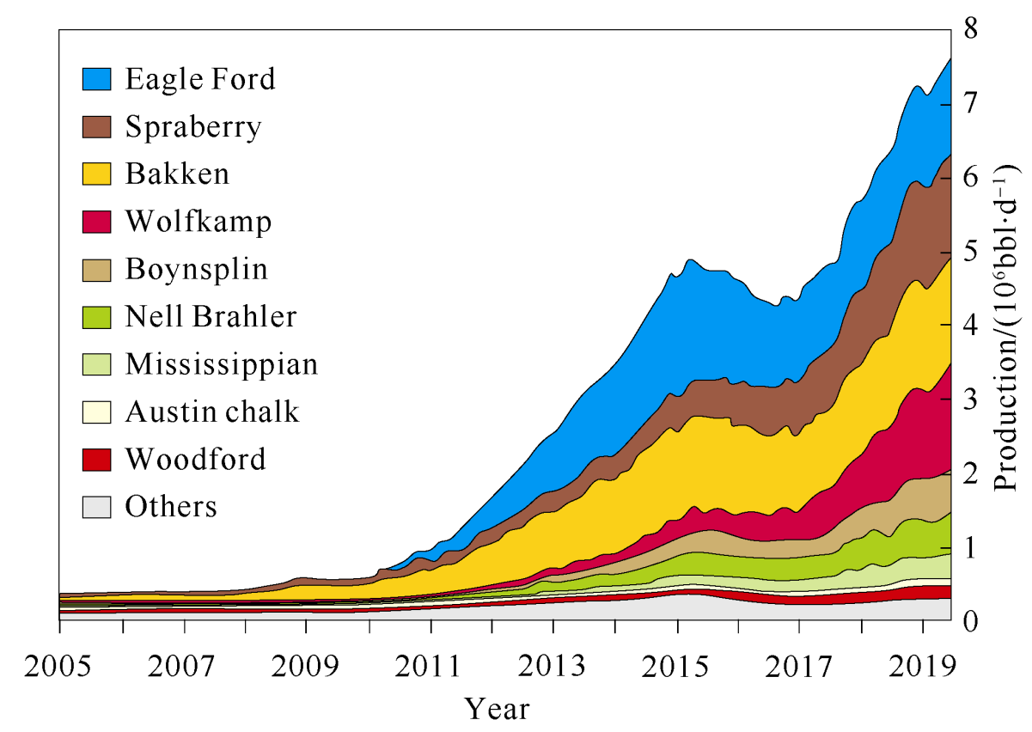
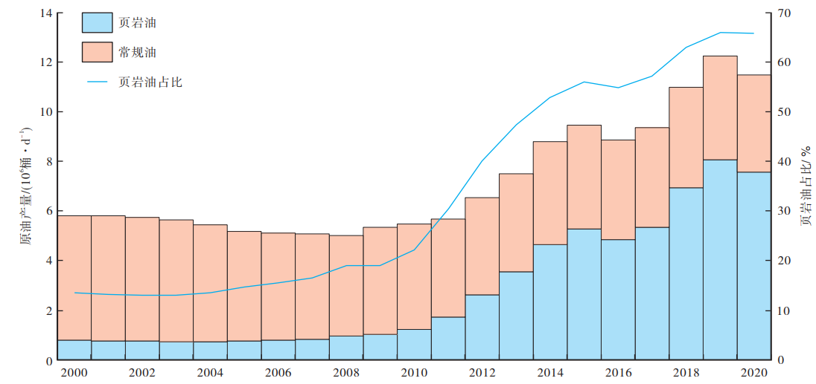
1. Background & Questions
The shale oil and gas resources in the United States have already achieved large-scale development. Especially shale oil, whose production increase progressively year by year has become the main force in oil production in the US. Shale oil and gas are wide globally distributed with enormous reserves and broad prospects.
Shale Oil Proportion
Conventional Oil
Shale Oil Proportion/%
Shale Oil Production/10⁶bbl*d⁻¹
Shale Oil
Shale oil production increase year by year in the US
The proportion of shale oil is over 60% of the oil production in the US

Slide 4
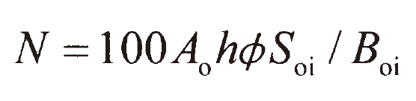
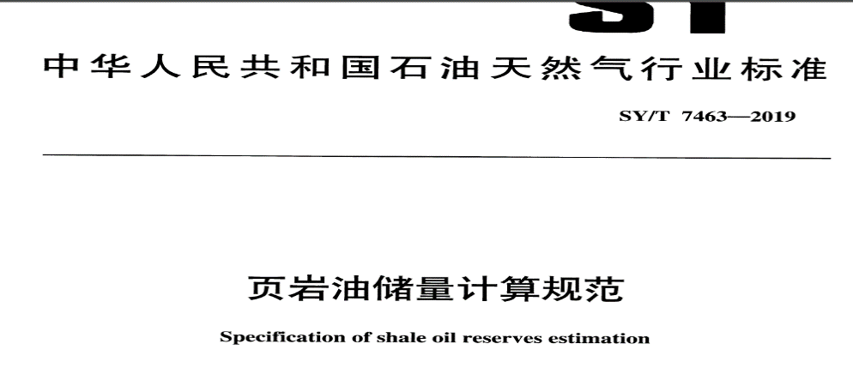
1. Background & Questions
Shale oil is mainly preserved in micro- and nanopores, which makes the pore evaluation extremely important. Additionally, the porosity of shale oil reservoirs is a key parameter in resource and reserve evaluation models.
Porosity
Specification of shale oil reserves estimation

Slide 5
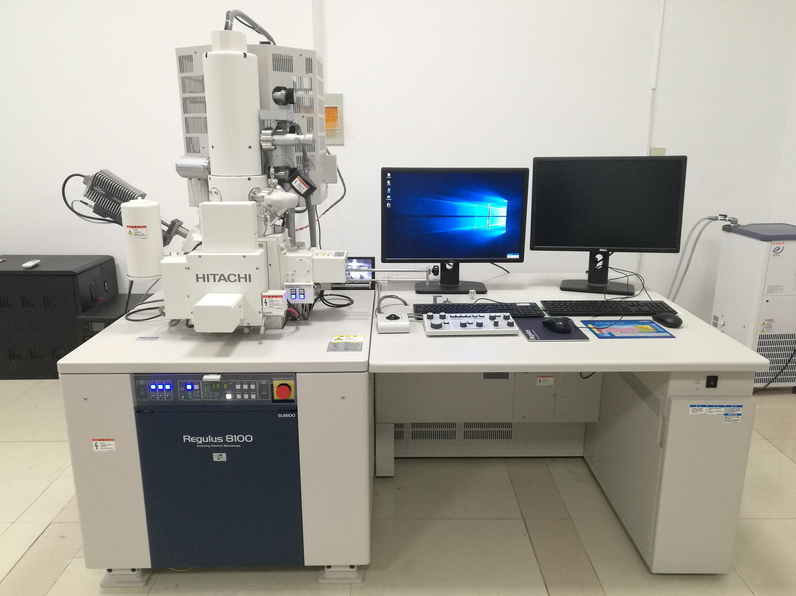
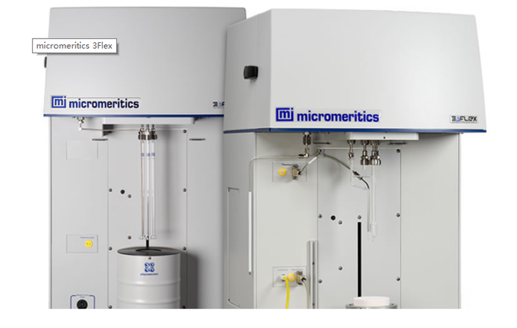
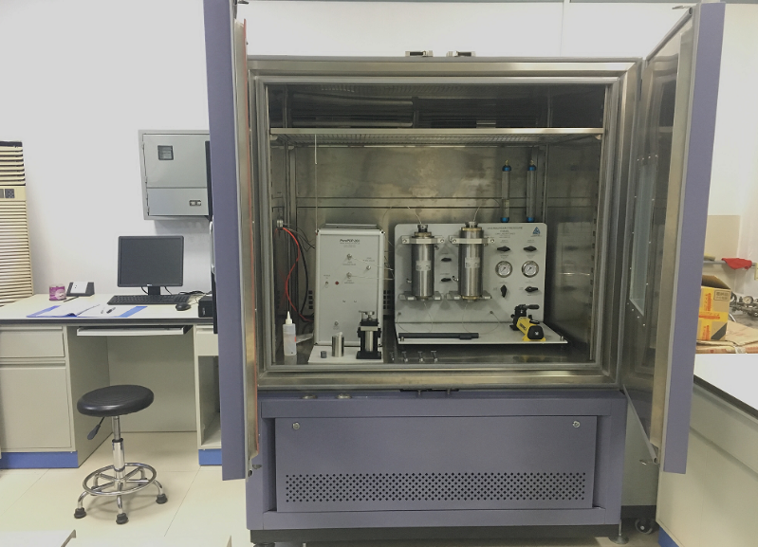
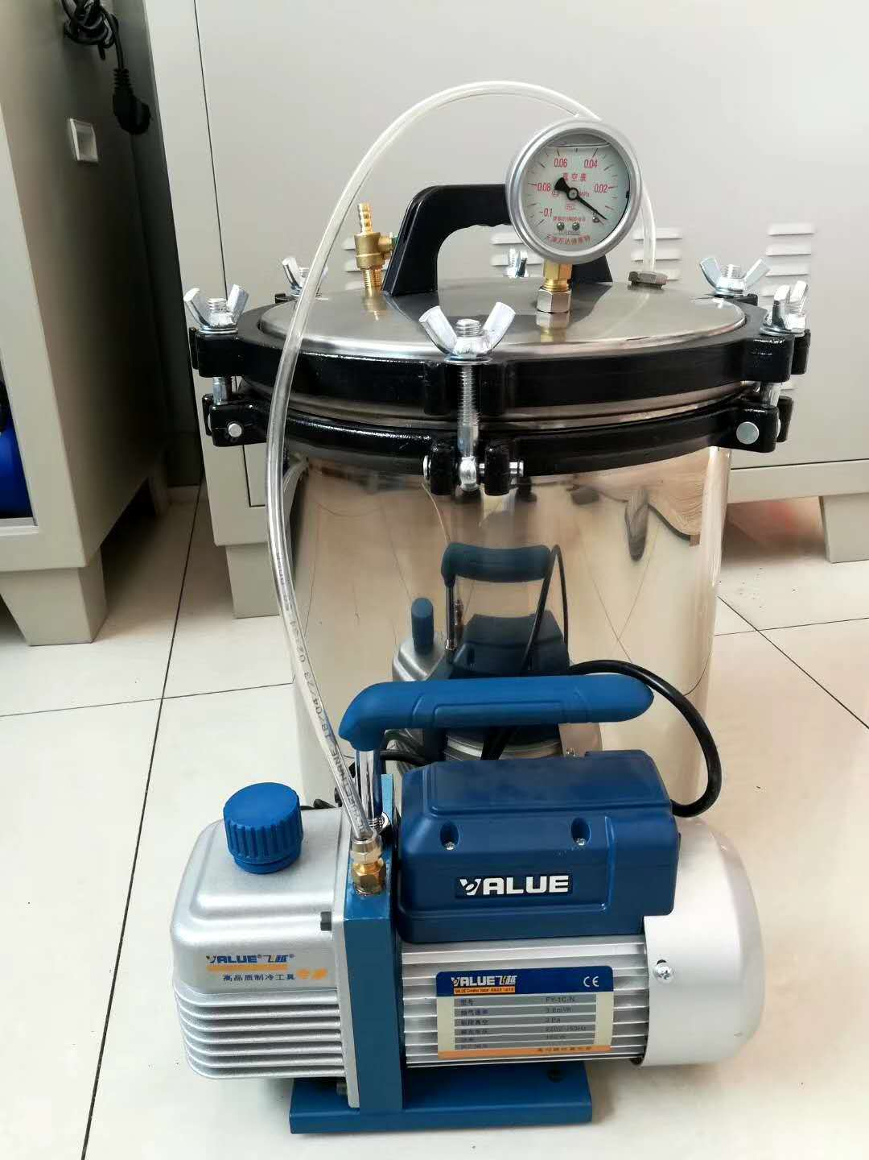
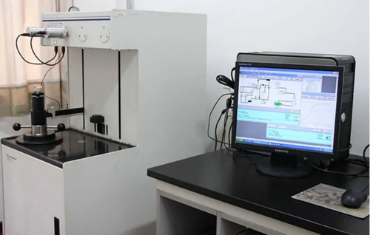
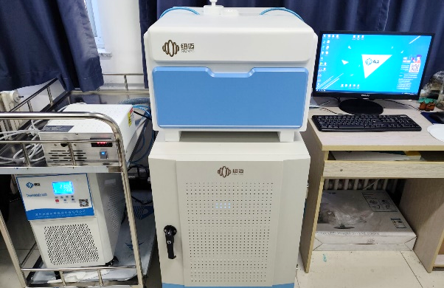
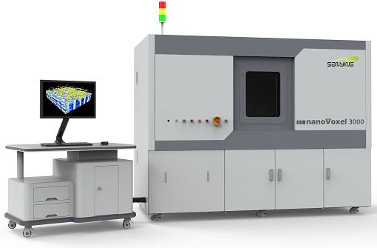
1. Background & Questions
Lots of methods are applied to evaluate the porosity of shale reservoirs, such as the image processing methods and fluid intrusion methods. For these methods, solvent extraction (oil washing) is required to expose the pores before the experiments.
SEM-FIB
BET
GIP
WIP
MIP
CT
NMR
Image processing methods
Fluid intrusion methods

Slide 6
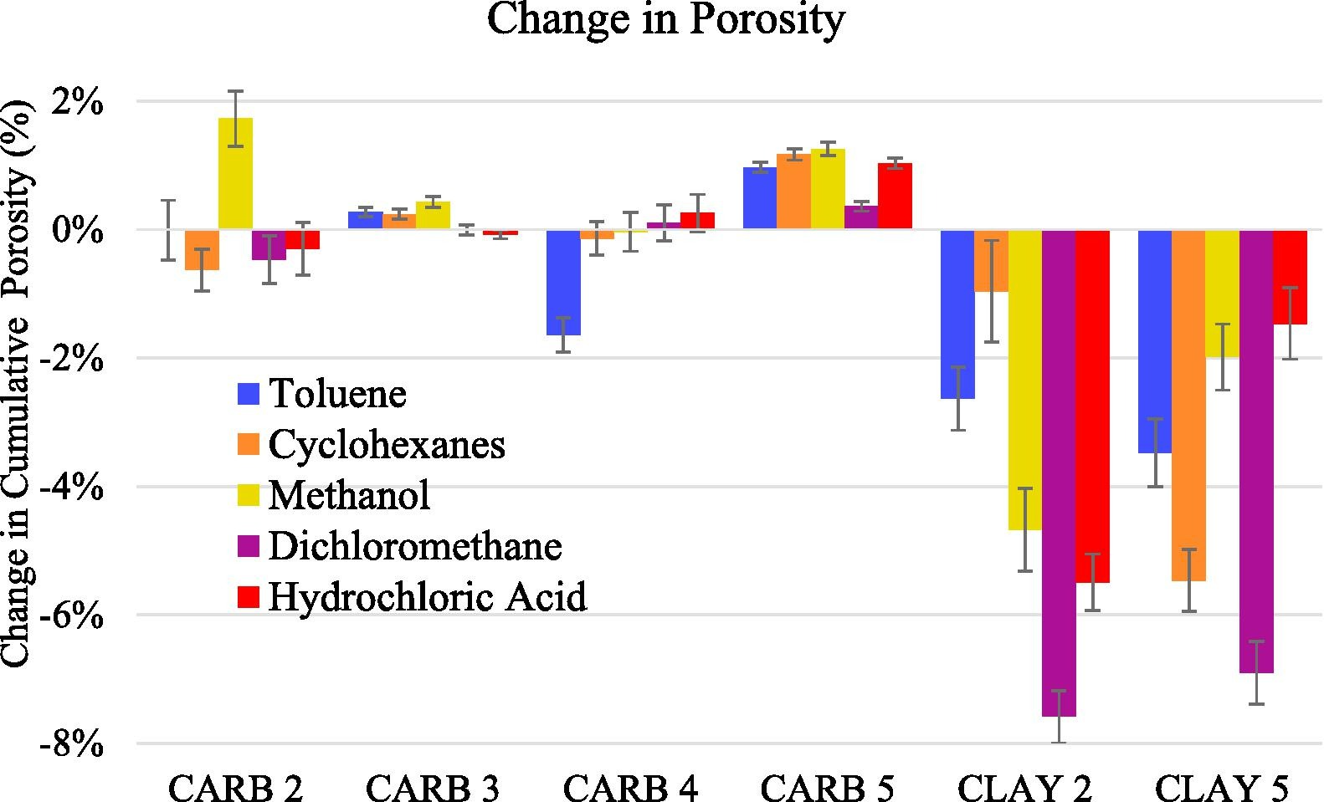
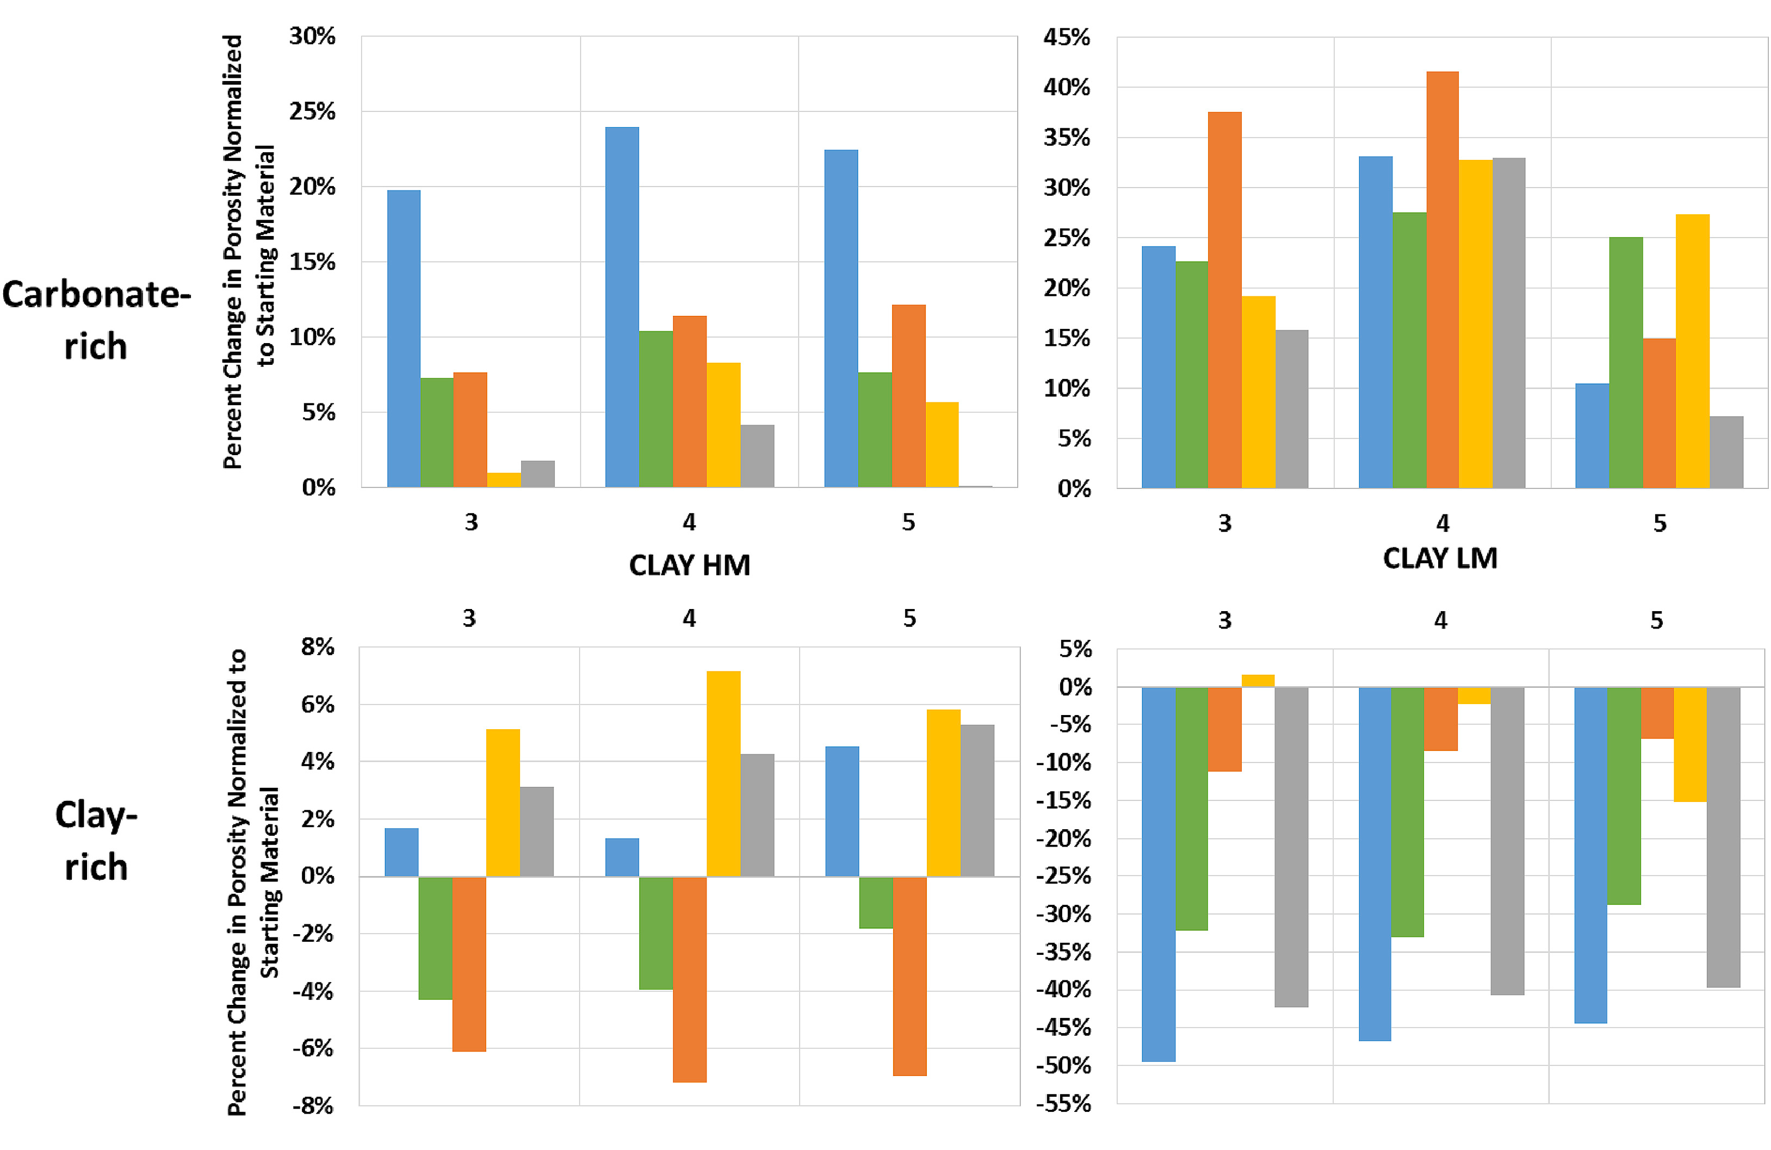

1. Background & Questions
Researchers found that：
1. after solvent extraction, not all shale porosities increase（porosity increases in carbonate-rich shale, but decrease in clay-rich shale）
2. the porosity increments after solvent extraction are various with different solvents, and some solvents may even lead to a reduction in porosity
High Maturity
Low Maturity
DiStefano.2019
Carbonaterich
Questions：
Clay-
rich
How does shale porosity change after solvent extraction?
What causes the reduction in shale porosity after solvent extraction?
DiStefano.2016

Slide 7
01
Background & Questions
02
Experiments & Results
03
Conclusions

Slide 8
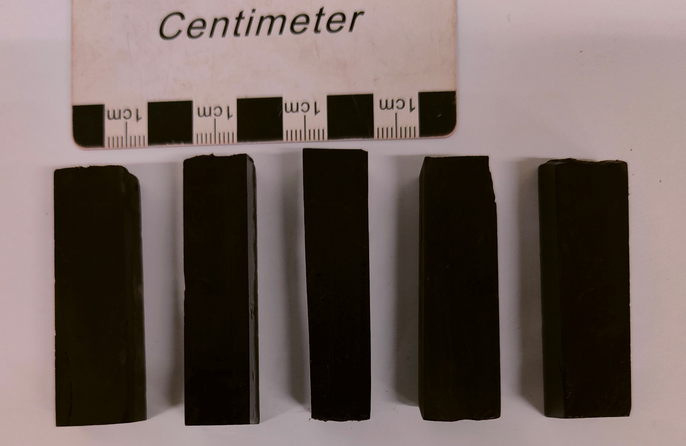
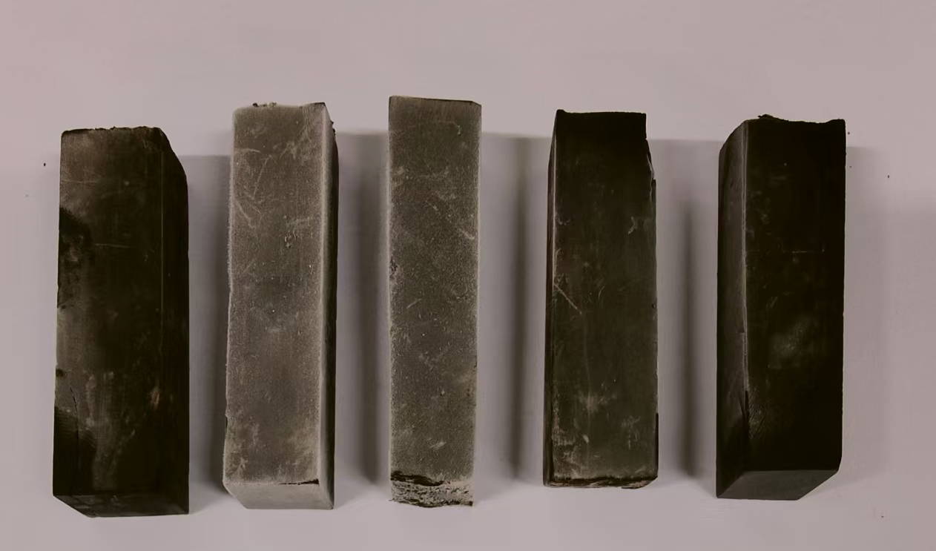
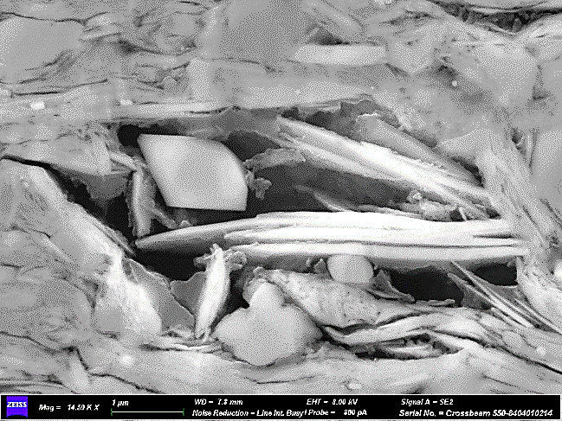
2. Experiments & Results
Samples
Sample A
SAMPLE INFORMATION
Sample | A | B
TOC | 1.74 | 3.00
Ro | 0.86 | 1.67
S₁/mg/g | 1.86 | 2.72
S₂/mg/g | 4.72 | 7.44
clay /% | 11.5 | 47.8
quartz/% | 15.1 | 22.5
calcite/% | 46.6 | 3.4
Ro=0.86%
Bohai Bay Basin, Jiyang Depression, Dongying Sag, Shahejie Formation
Low to medium maturity, carbonate-rich shale with moderate organic matter
Sample B
Ro=1.67%
Songliao Basin, Gulong Sag, Qingshankou Formation
Medium to high maturity, organic-rich and clay-rich shale

Slide 9
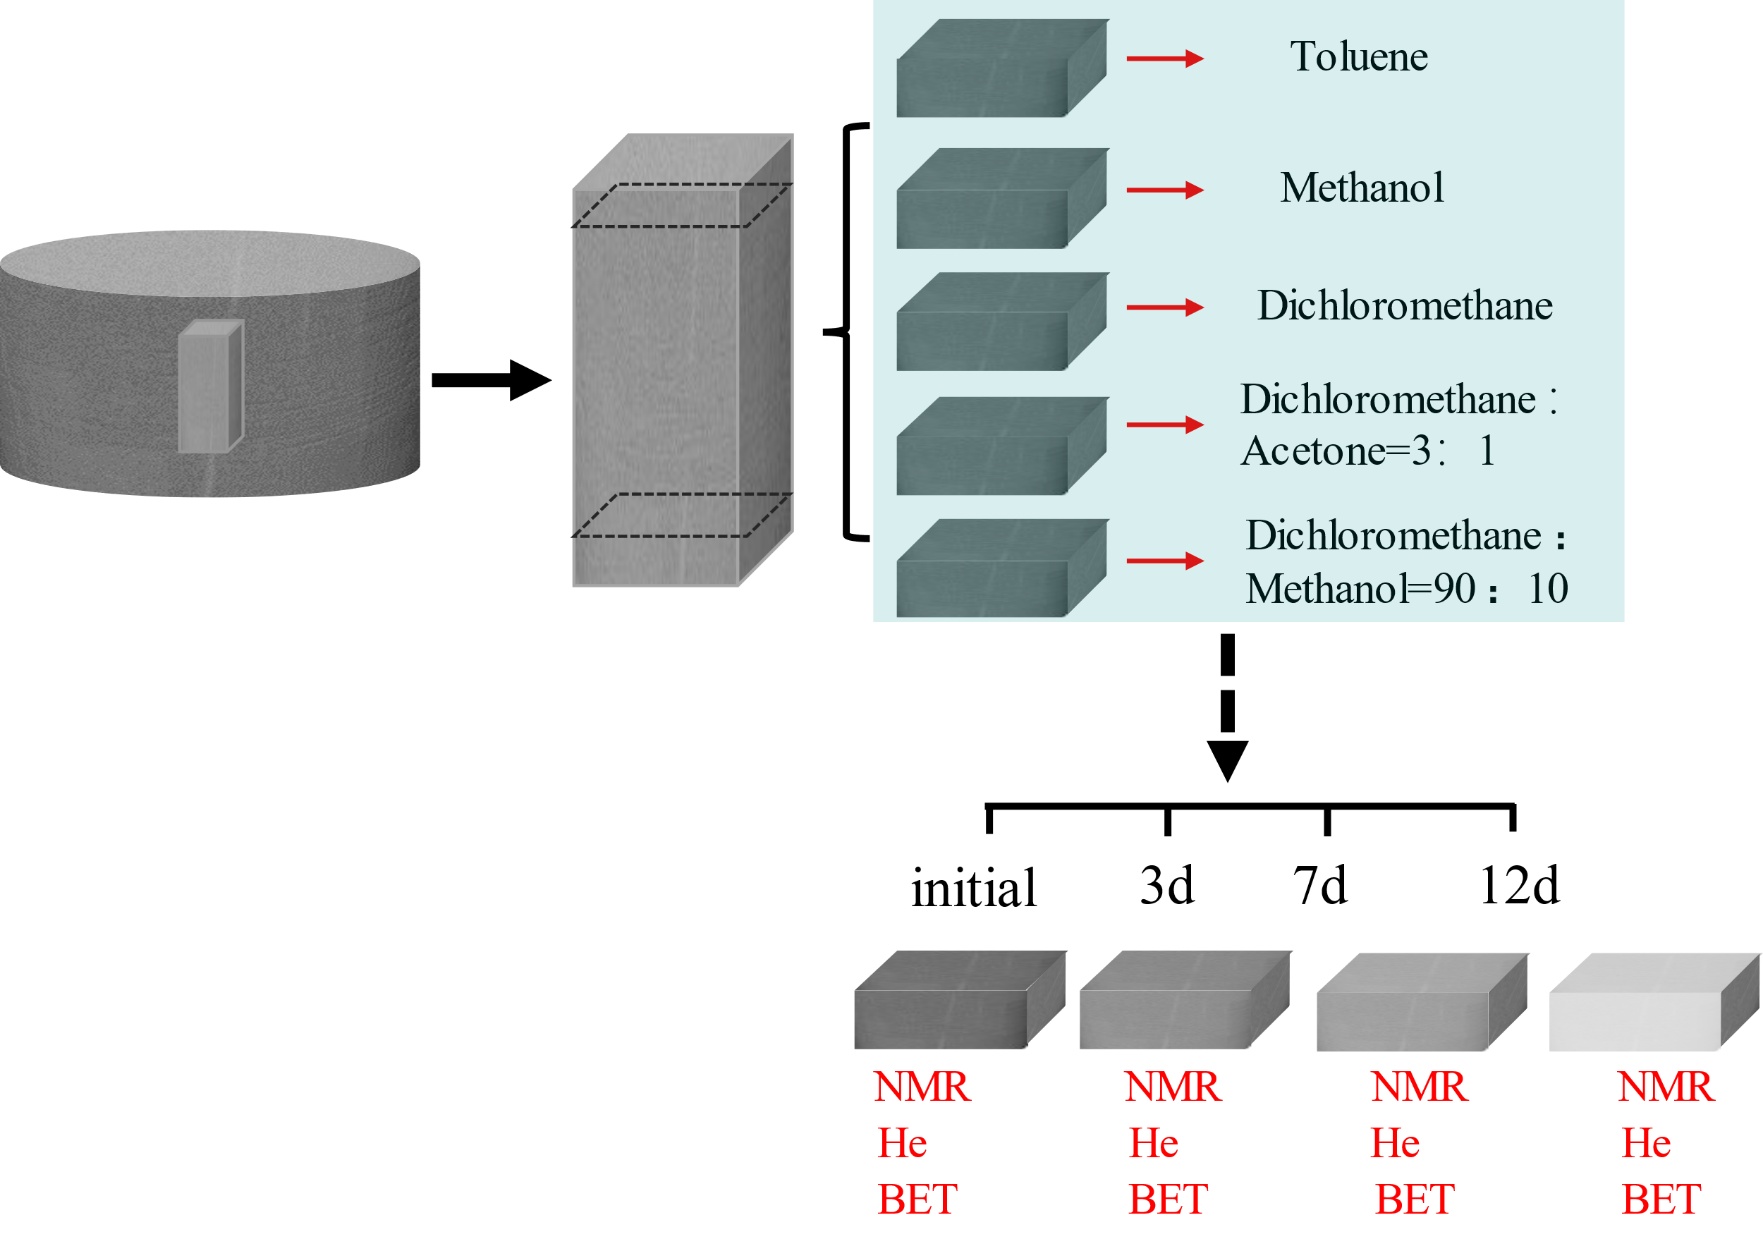
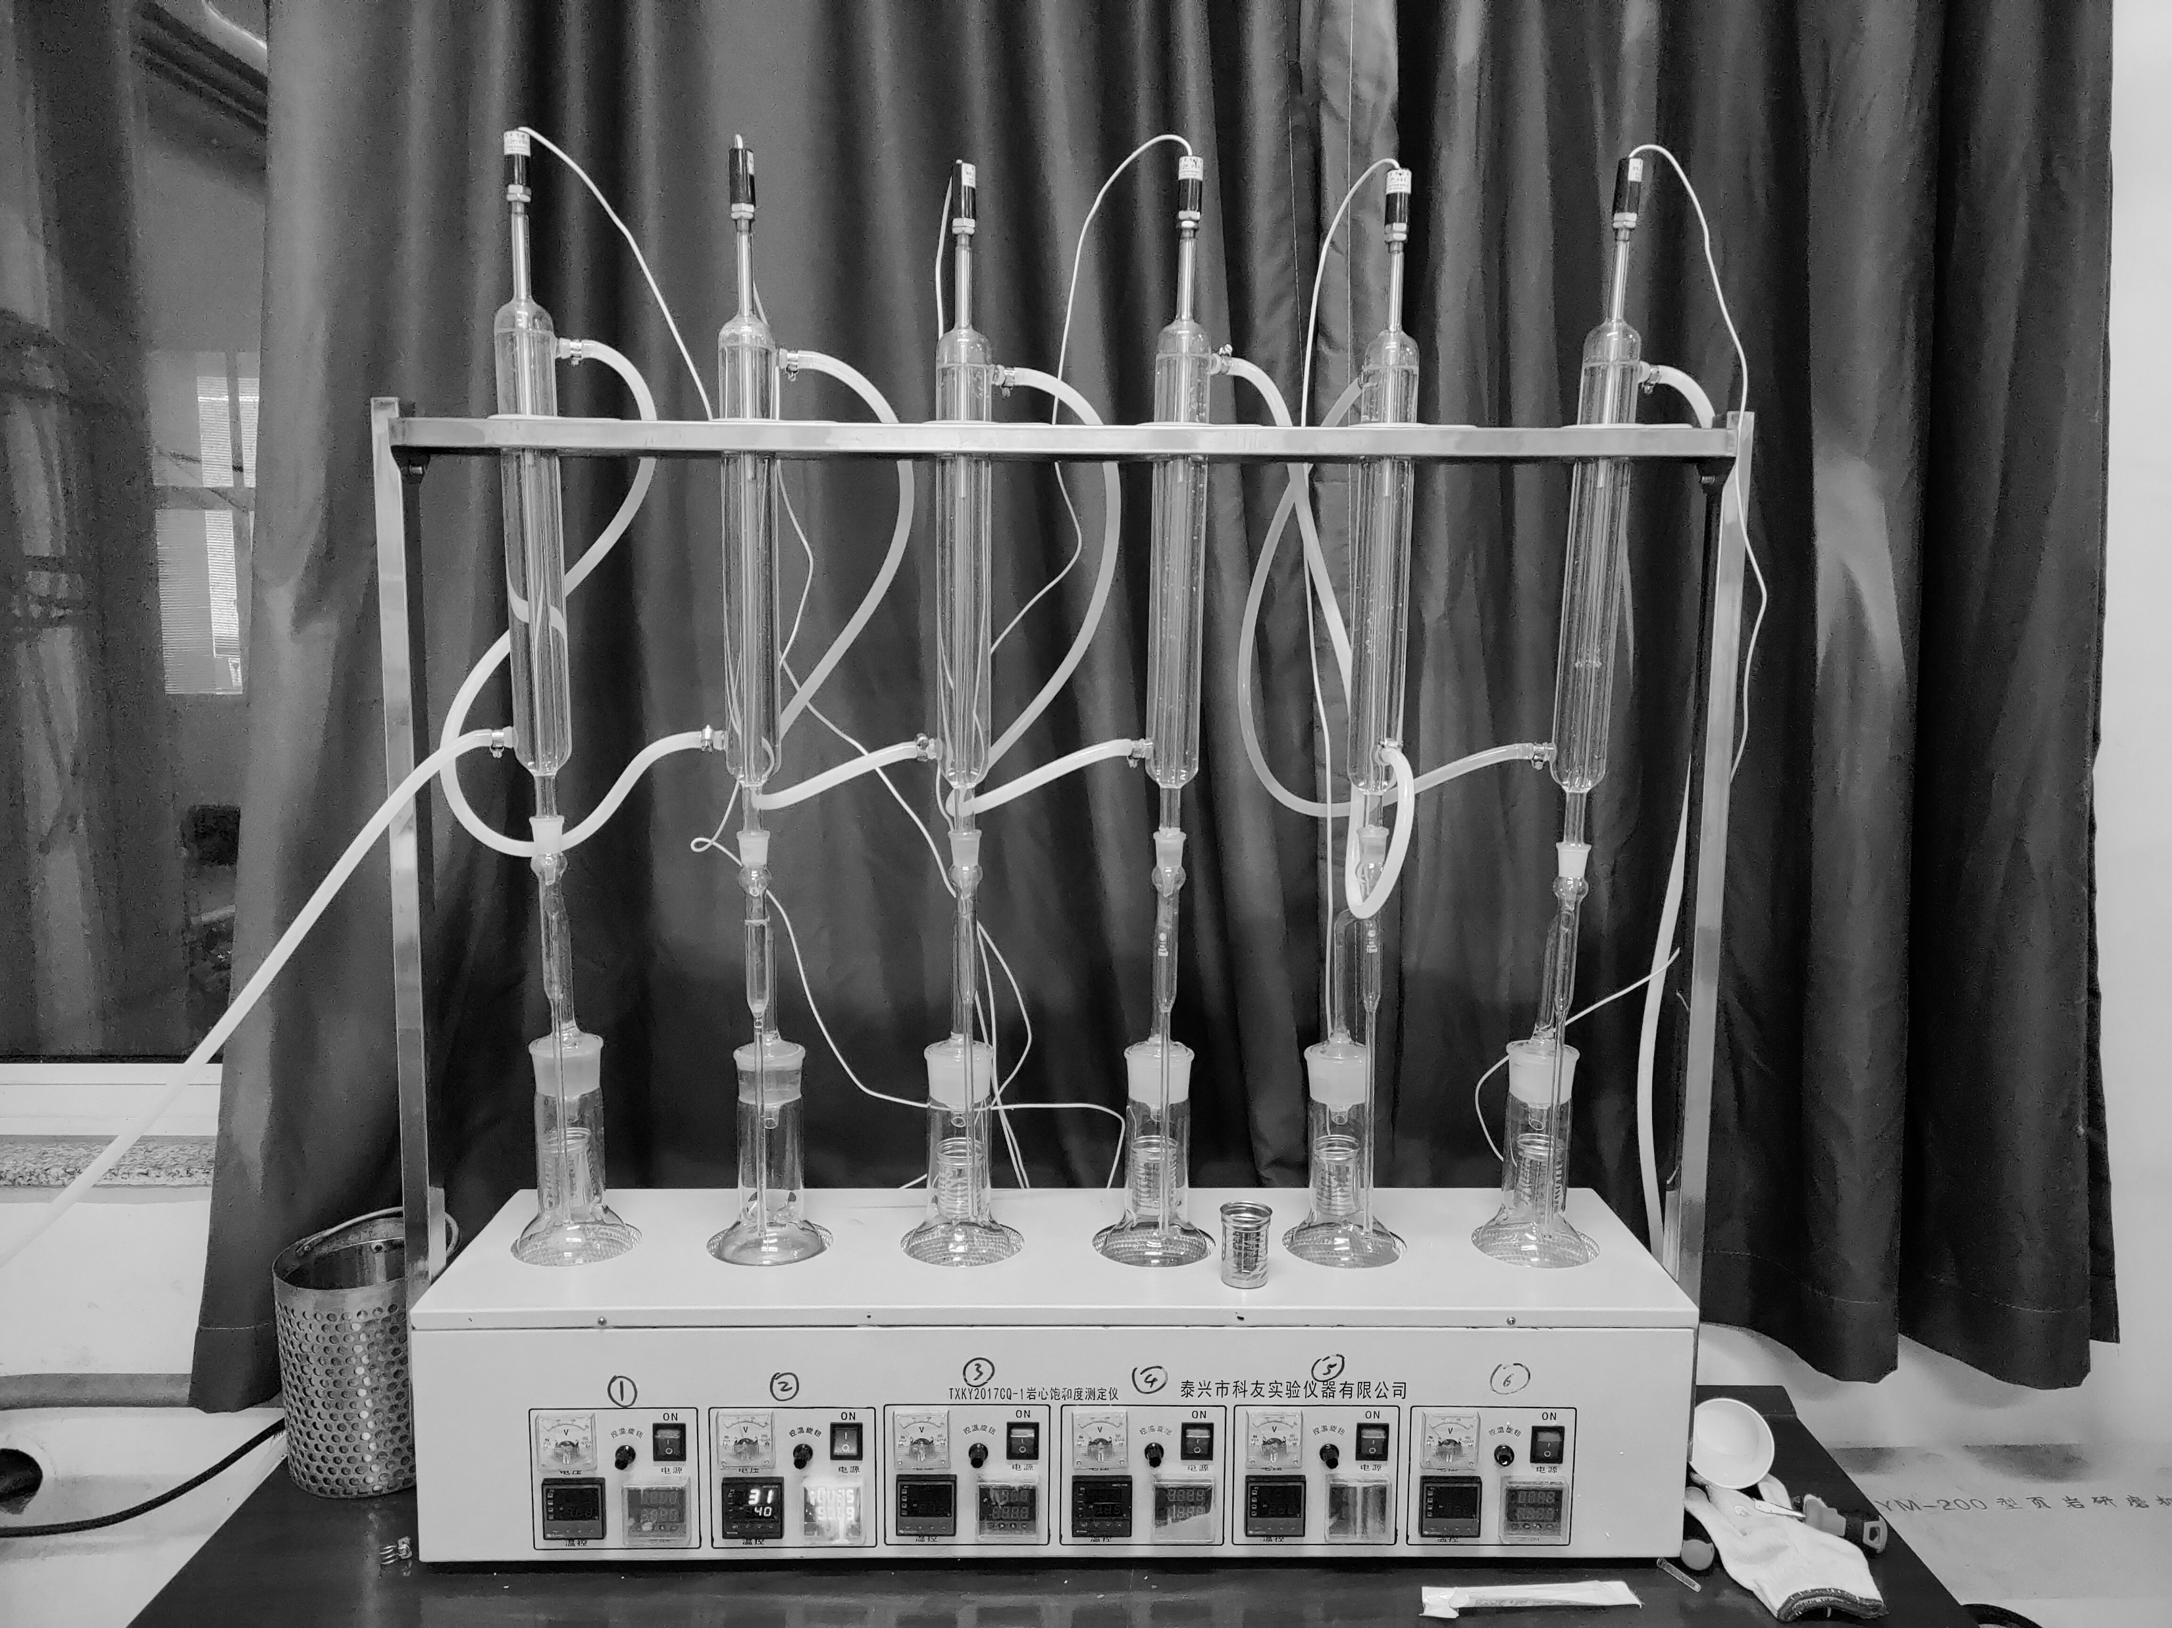
2. Experiments & Results
1. Distillation extraction apparatus was used for solvent extraction
2. Shale samples were divided into five equal parts, and five different solvents were used for the solvent extraction, separately.
3. NMR, helium porosity, and nitrogen adsorption experiments were conducted at 3, 7, and 12 days of solvent extraction

Slide 10
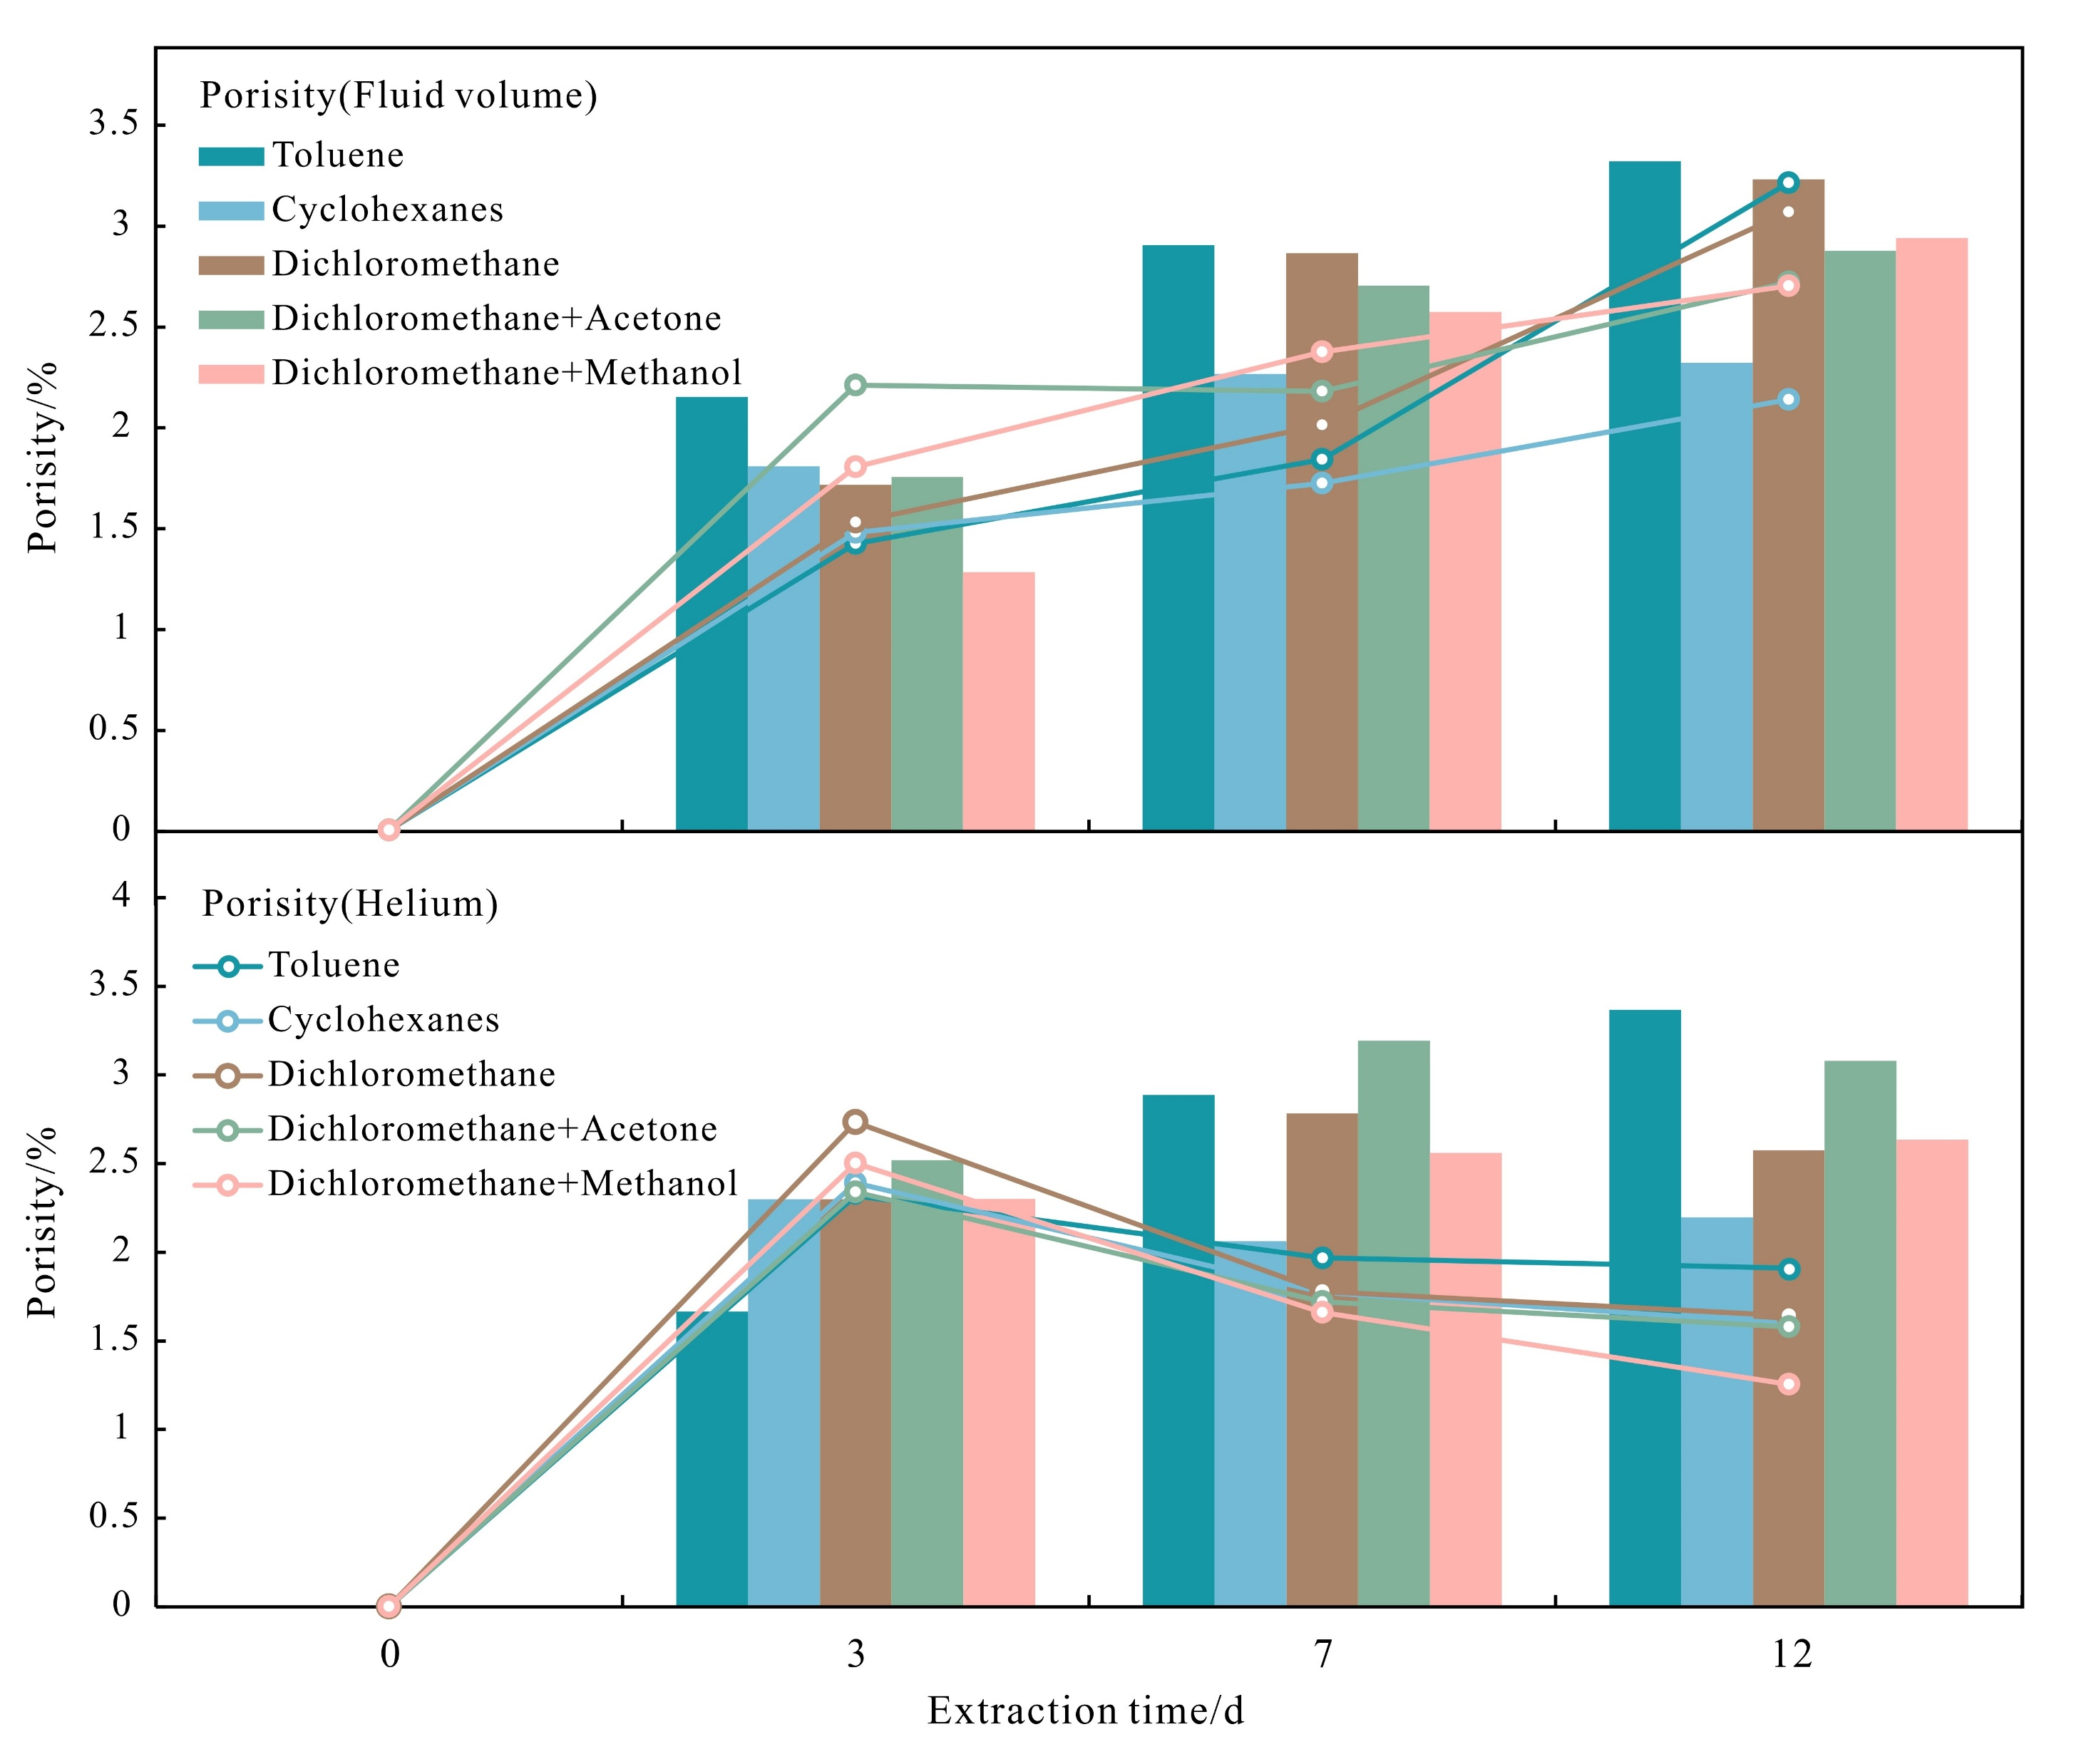
2. Experiments & Results
As the extraction time increased, the volume of extracted fluid gradually increased for both samples.
In Sample A, He porosity increased with the extraction time. The pore volume increment roughly equal to the volume of extracted fluid.
In Sample B, the porosity increment initially increased and then decreased with extraction time. After 7 days, He porosity weas lower than the extracted fluid porosity.
Extracted fluid ф（increase）
He ф（increase）
Porosity increment/%
Sample A
He ф（increase then decrease）
Extracted fluid ф（increase）
Porosity increment/%
Sample B
Extraction time/d

Slide 11
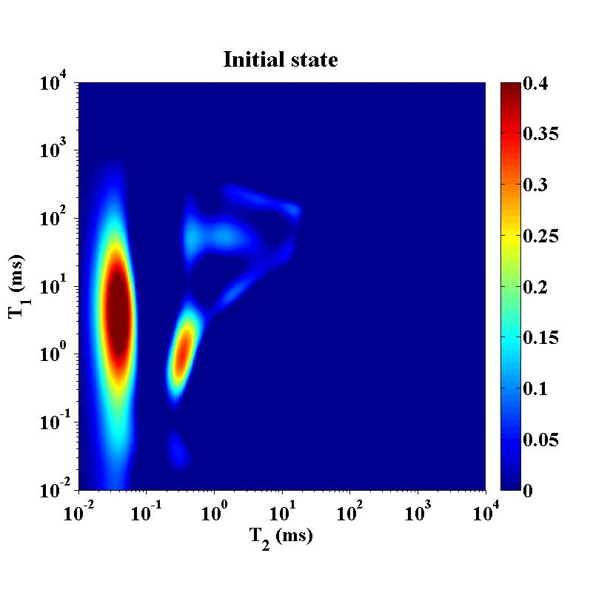
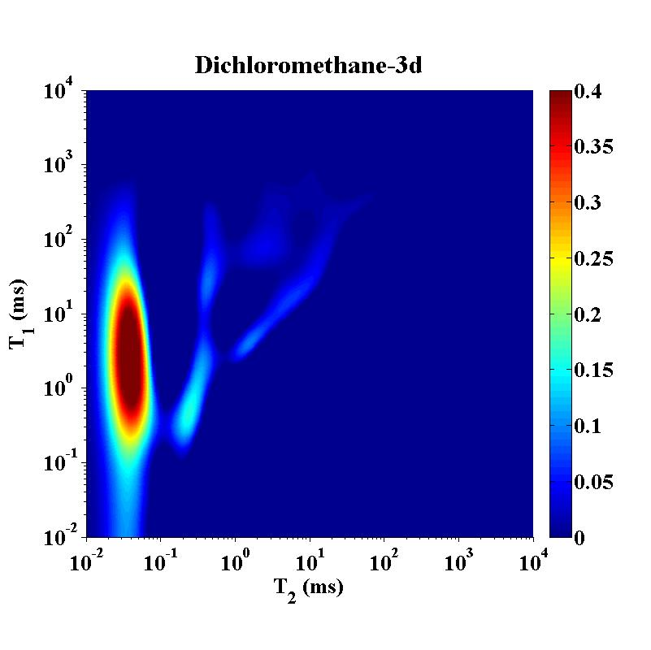
2. Experiments & Results
As the extraction time increased, the volume of extracted fluid gradually increased for both samples.
In Sample A, He porosity increased with the extraction time. The pore volume increment roughly equal to the volume of extracted fluid.
In Sample B, the porosity increment initially increased and then decreased with extraction time. After 7 days, He porosity weas lower than the extracted fluid porosity.
Before
N_{o1}
ΔN_{o}=N_{o1}-N_{o2}
ΔN_{o}=N_{o1}-N_{o2}
N_{w1}
N_{o2}
Fluid porosity：
N_{w2}
Extraction, 3days

Slide 12
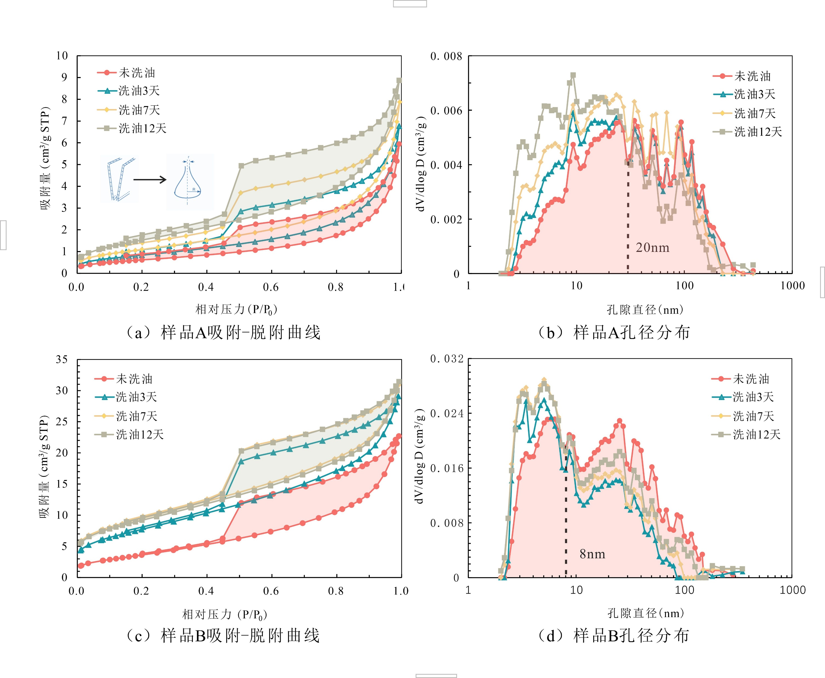




2. Experiments & Results
Why solvent extraction decrease the pore volume?
Pore structure changes after extraction
Sample A
Sample A
1. Based on the adsorption-desorption isotherms, solvent extraction increased the pore volume of the samples compared with the original state
Sample B
Sample B

Slide 13
2. Experiments & Results
Why solvent extraction decrease the pore volume?
Pore structure changes after extraction
Sample A
Sample A
2. With the increase of extraction time, in Sample A, pores < 20 nm gradually increased, while pores > 20 nm gradually decreased.
3. With the increase of extraction time, in Sample B, pores < 8 nm increased, and pore > 8 nm decreased and then increased
Sample B
Sample B

Slide 14
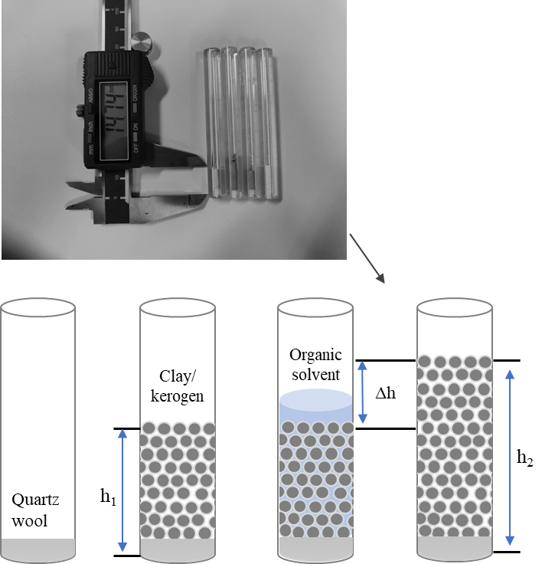
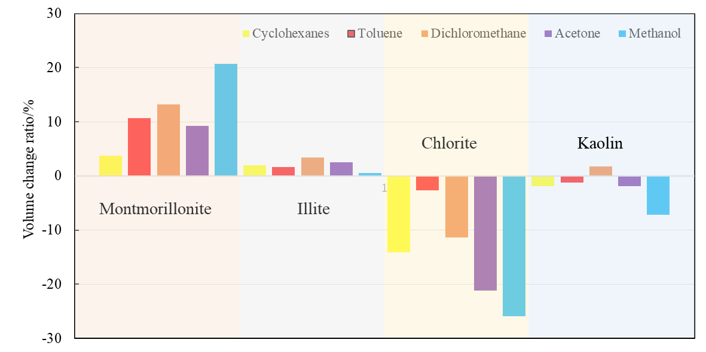
2. Experiments & Results
Reason 1: Clay minerals could absorb organic solvents, especially alcohol-based solvents, which caused the clay volume expansion. Such expansion could occupy the pore space and decrease the pore volume.
1. The volume of illite and montmorillonite increased after solvent absorption, with montmorillonite showing the most significant increase.
2. The volume of chlorite decreased the most significantly, may due to solidification.
Quantitative analysis of the expansion phenomenon of clay minerals (Height method) after contact with solvents
Alcohol-based solvents
Solidification

Slide 15
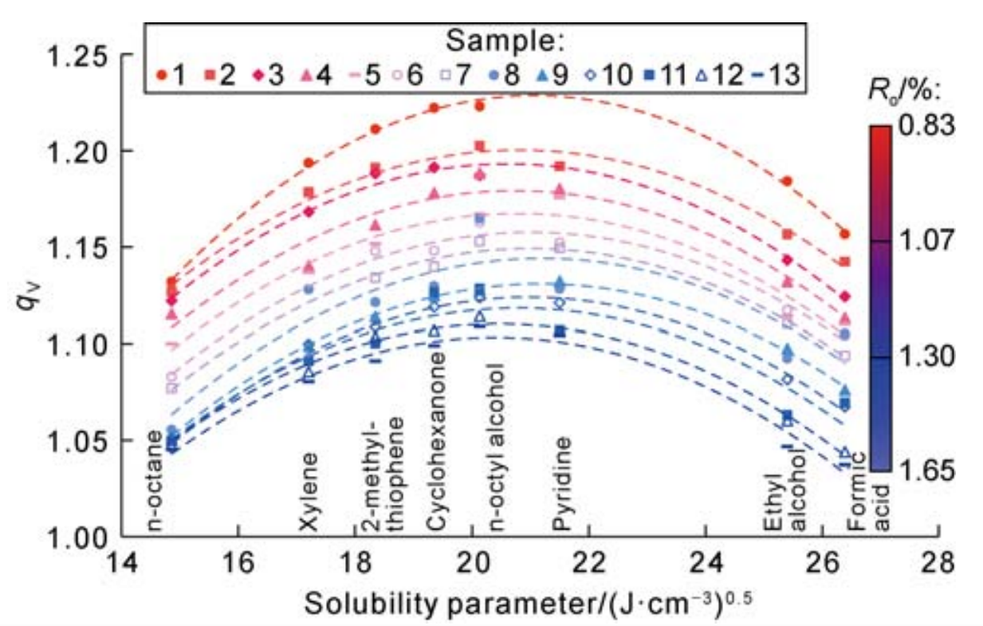
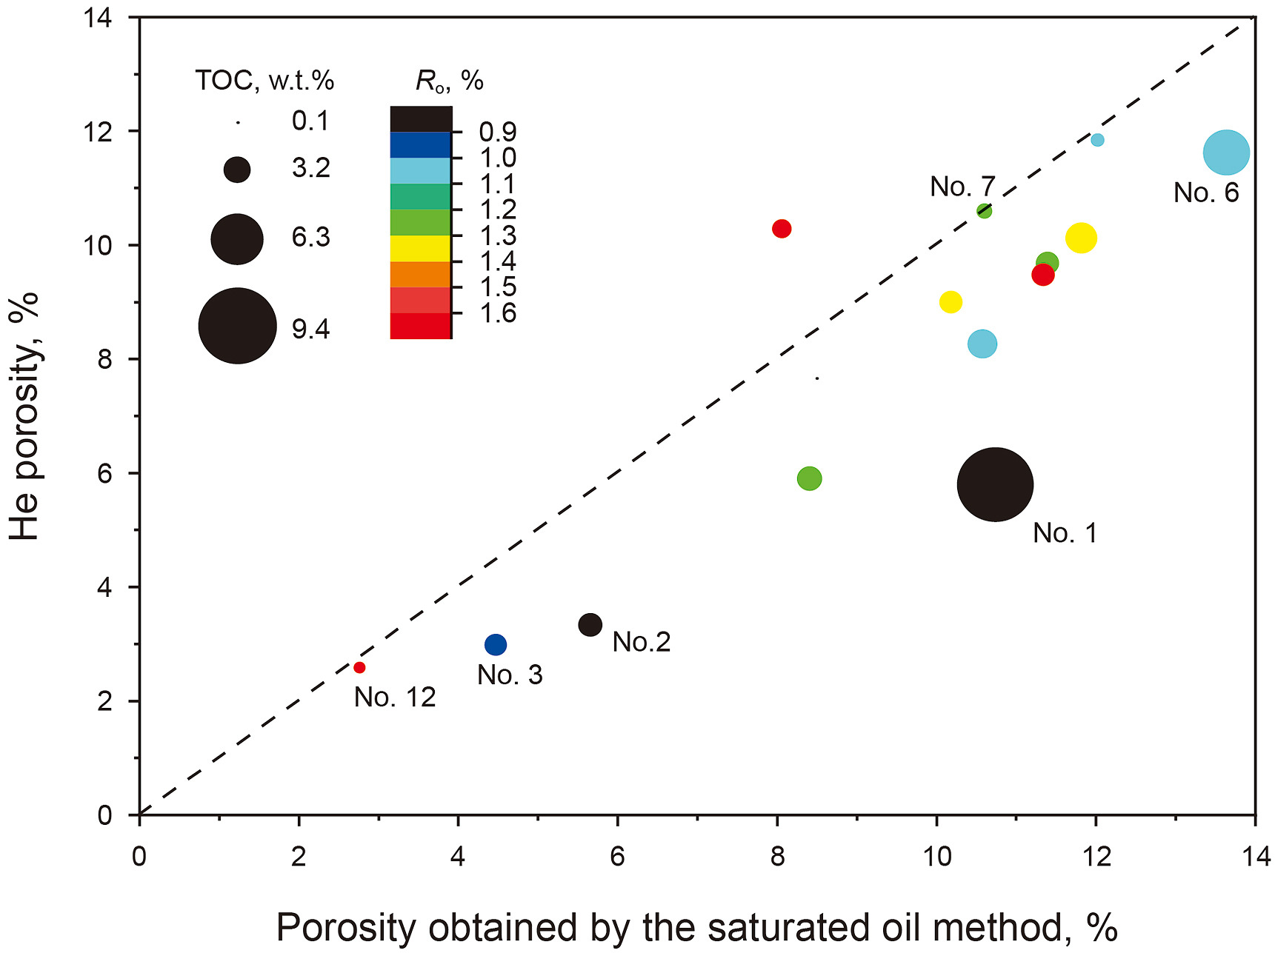
2. Experiments & Results
Reason 2：
1. Kerogen expansion after absorbing organic solvents, which occupies pores and decrease pore volume
2. The higher the maturity, the lower the expansion coefficient; different organic solvents have different expansion coefficients.

Slide 16
2. Experiments & Results
Reason 2：
3. A comparison of helium porosity and saturated oil porosity indicates that the saturated oil method overestimates shale porosity, with the overestimation more pronounced in shales with higher TOC and lower maturity.

Slide 17
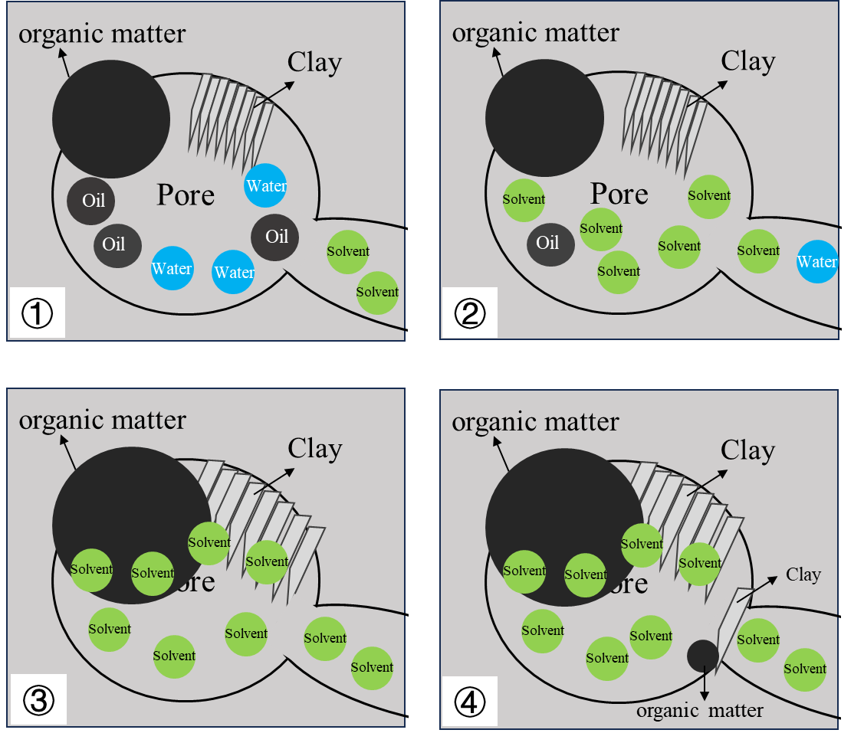
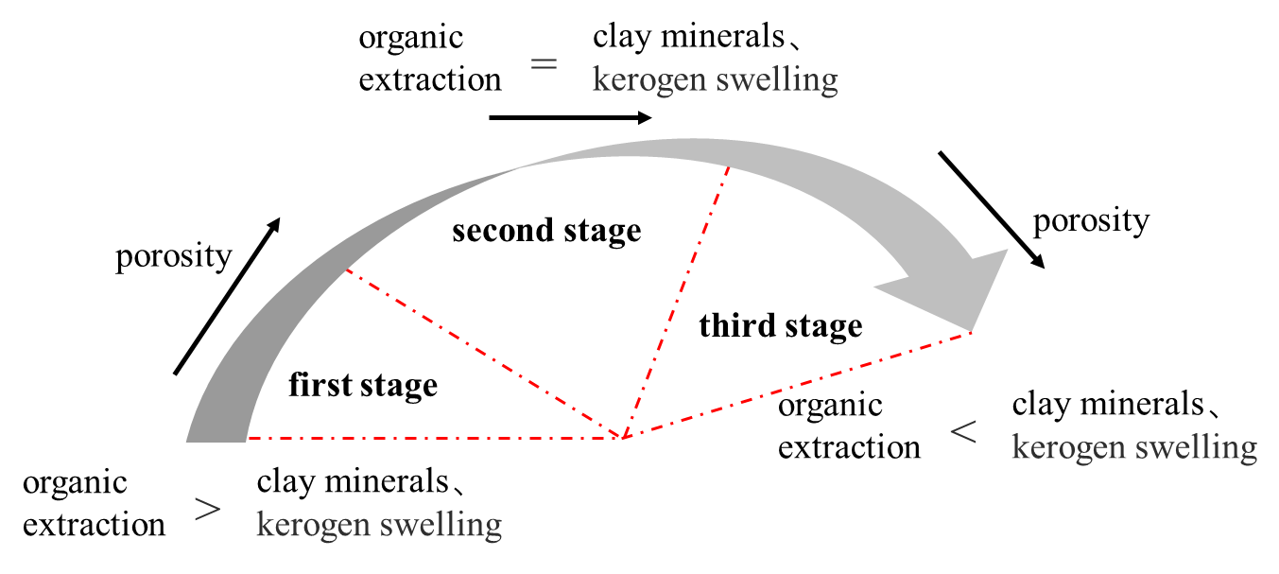
2. Experiments & Results
Model of pore changes during the extraction
①coexistence of oil, water, and organic matter in pores
②solvent extract the oil and water
The actual change in porosity during the solvent extraction depends on the balance between fluid extraction increasing pore volume and mineral expansion decreasing pore volume.
③expansion of organic matter and clay minerals after contacting with the solvent
④the extracted organic matter and mineral fragments block the pores

Slide 18
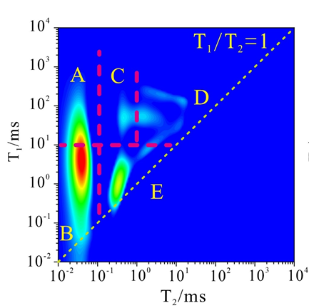
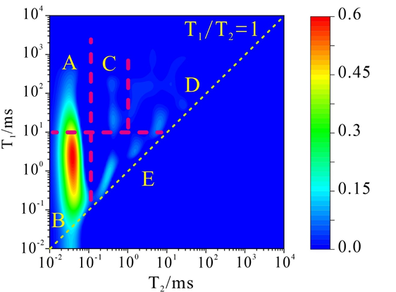
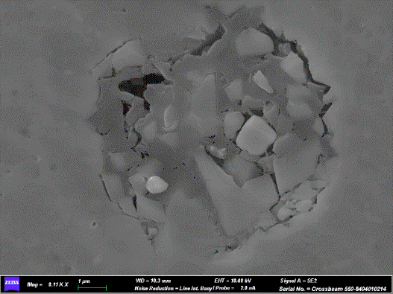
2. Experiments & Results
In addition to the structural changes caused by solvent extraction, it is challenging to completely remove fluids in micro- and nanopores during the process.
Before extraction
Sample A
(Low to medium maturity, carbonate-rich shale with moderate organic matter)
Solvent: Dichloromethane
Extraction duration: 12 days
T₁-T₂ map
SEM
After extraction

Slide 19
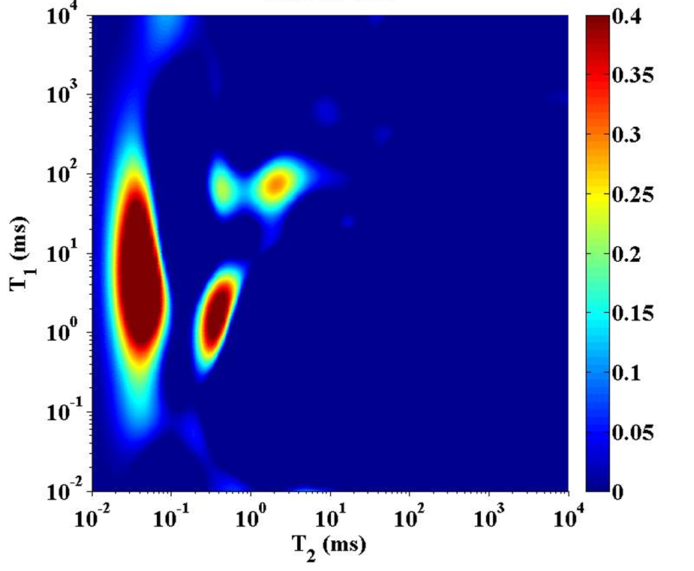
2. Experiments & Results
To avoid the aforementioned issues, NMR technology is proposed for evaluating shale porosity without solvent extraction
1. Sealed coring shale samples
Fuld volume calculation
C_{o}
Classification and quantification of oil and water NMR signals.（C_{o}、C_{w}）
When the sealed cores are effective
C_{w}
Establishment of conversion relationship（k_{o}、k_{w}）
Porosity evaluation

Slide 20
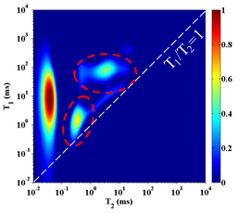
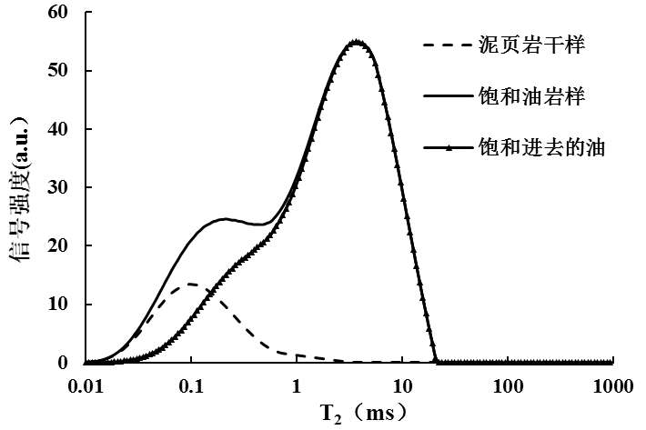

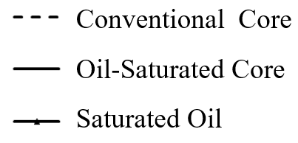
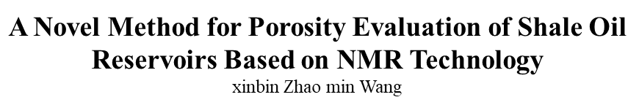
2. Experiments & Results
To avoid the aforementioned issues, NMR technology is proposed for evaluating shale porosity without solvent extraction
2、conventional coring shale samples,
N_{o}
N_{w}
N_{s}
Residual fluid porosity(Փ₁)
Fluid saturated porosity (Փ₂)
③Shale porosity（Փ₁+ Փ₂ ）
AAPG Bulletin submitted

Slide 21
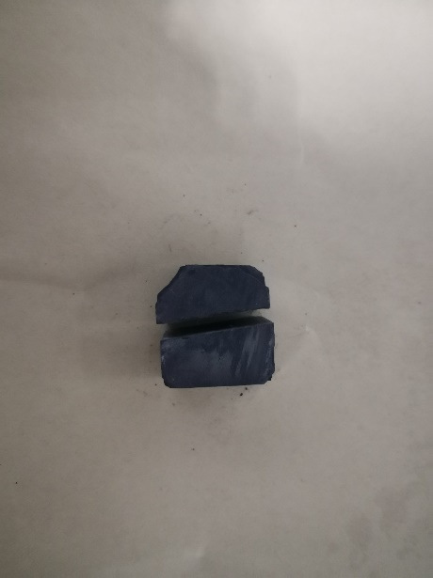
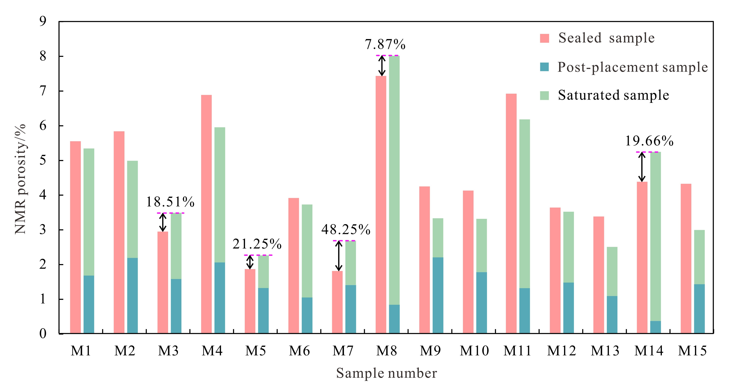
2. Experiments & Results
The porosities by NMR in conventional coring and sealed coring samples are generally the same
Porosity 1
Porosity 1
Porosity 2
Sealed sample
Porosity 3
Storage for 90 Days
Post-placement sample
Porosity 2
Saturated Fluid
Porosity 3
Saturated sample

Slide 22
01
Background & Questions
02
Experiments & Results
03
Conclusions

Slide 23
3. Conclusions
In clay-rich shale, porosity increases and then decreases during the extraction.
In solvent extraction, the removal of fluids from the shale pores increases pore volume. However, the expansion of clay minerals and swelling of kerogen could lead to the reduction of pore volume
Solvent extraction of low to medium maturity shale is more challenging with an efficiency generally around 60%
For both sealed coring and conventional coring shale samples, it is recommended to use an NMR-based porosity evaluation method without solvent extraction.

Slide 24

Thanks for listening!

