Slide 1


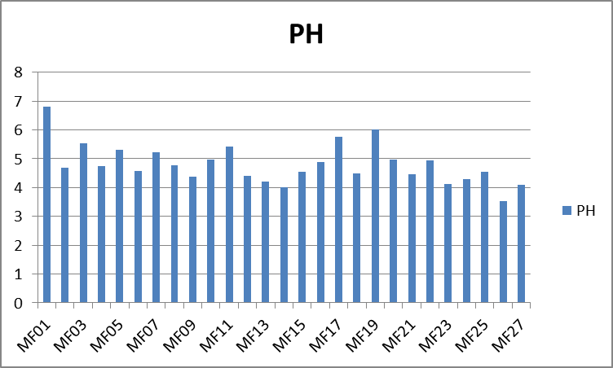
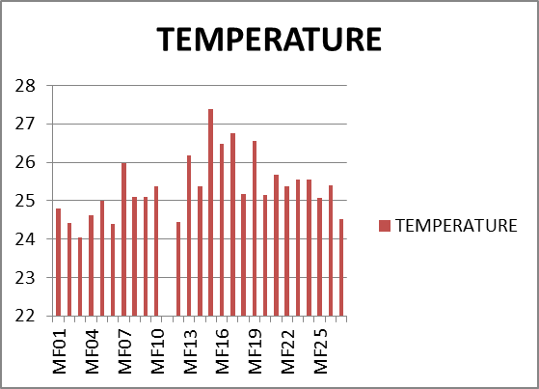
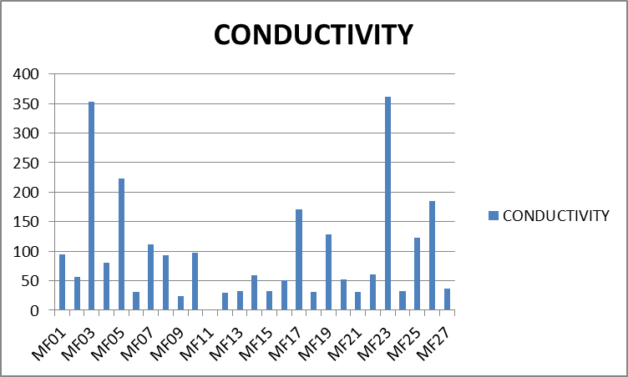
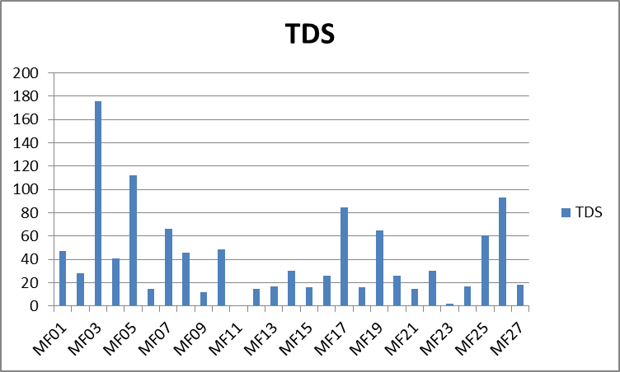
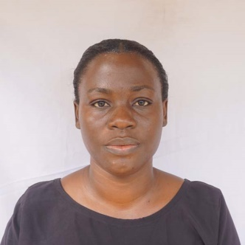

Preliminary Results of Bio-physicochemical Characterization of Wells and Borehole Waters and Their Health Implication, Mfou-Centre Region, Cameroon
1 Department of Earth Sciences University of Yaounde I, 2 Department of Geology University of Buea
Introduction
Water quality is a crucial factor for public health, especially in regions relying on groundwater sources. This study assesses the bio-physicochemical characteristics of well and borehole waters in Mfou, Centre Region, Cameroon, and their potential health implications.
Objective
To analyze the physical, chemical, and biological parameters of groundwater sources., evaluate the compliance of water quality with WHO standards and assess the potential health risks associated with detected contaminants
Study area location:
(Mfou) is located in the Mefou and Afamba Division South-Eastern part of Yaounde. It lies between latitudes 3⁰40’’ and 3⁰45’N and longitude 11⁰35’ and 11⁰40’E, covering an estimated area of 85km² (Kamtchueng et al., 2015), soils ferralitic and hydromphic (Bekoa, 1994) in Kalla, (2007), climate is humid tropical marked four seasons.
Methodology
Sampling: 27 Water samples were collected from selected wells and boreholes across Mfou preserved in a cooler and sent to the lab within 24hours
Physicochemical Analysis: pH, temperature, turbidity, and electrical conductivity, total dissolved solids (TDS) were measured using standard analytical techniques.
Biological Analysis: Total coliforms and E. coli were analyzed using membrane filtration methods.
Health Risk Assessment: Potential impacts of contaminants were evaluated based on WHO guidelines.
Results
Discussions
The presence of pathogenic bacteria in some of the drinking water poses serious health risks, particularly for vulnerable populations.
Contaminants from anthropogenic activities, agricultural runoff, and poor sanitation practices contribute to water quality deterioration.
Conclusion/recommendations
Urgent interventions, such as proper well construction, periodic water treatment, and public awareness programs, detailed seasonal variation studies are needed.
Nanje Mosere Felicia1,
Menti Agbor Nelson2
PhD student , University of Yaounde I
nanjefelicia89@yahoo.com

