Slide 1
2025
Session BG8.7
PICO1.10 | EGU25-8129
Modelling soybean growth processes in the land surface model ORCHIDEE-CROP
Xianglin Zhang¹, Daniel Goll², Philippe Ciais², Yang Su^{1, 2, 3}, Ronny Lauerwald¹
¹UMR ECOSYS, INRAE AgroParisTech, Université Paris-Saclay, 91120 Palaiseau, France
²Laboratoire des Sciences du Climat et de l’Environnement, LSCE/IPSL, CEA-CNRS-UVSQ, Université Paris-Saclay, 91191 Gif-sur-Yvette, France
³Département d’Informatique, Ecole Normale Supérieure—PSL, 75005 Paris, France
2025.04.28 Vienna
Notes:
PICO1.10 | EGU25-8129

Slide 2
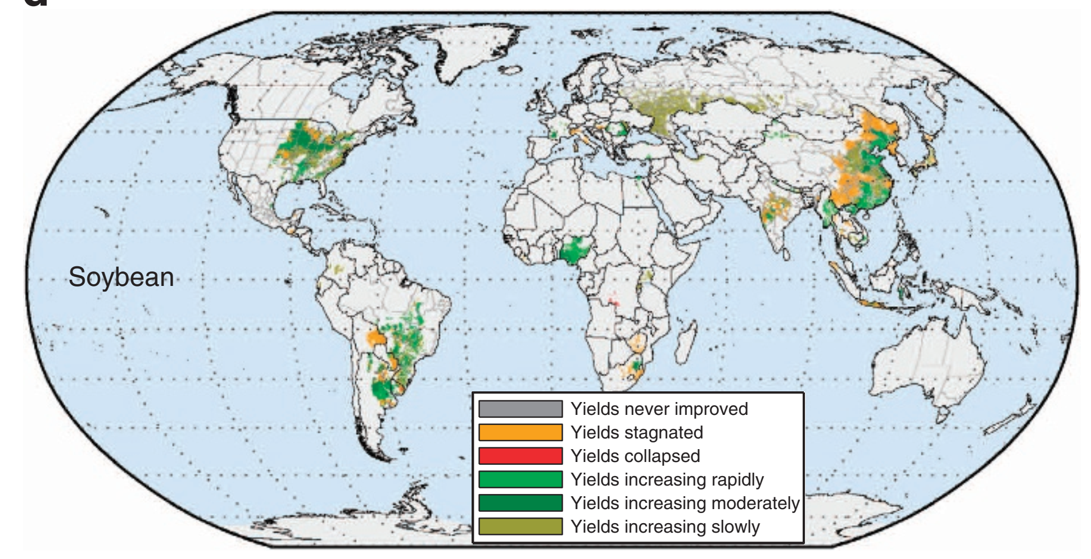
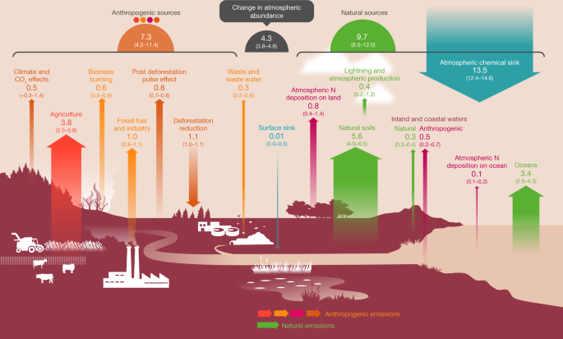
The agricultural and ecological role of soybean and other legume crops
The largest source of protein for animal feed and the second largest source of vegetable oil
Distribute over the world, with over planting area of 127 million ha and over yield of 361 million tons
Symbiosis with rhizobia, fix about 130 million tons of nitrogen each year
Reduce fertilizer use due to biological nitrogen fixation and associated reductions in GHGs emissions
Increase yield of the subsequent crop and reduces occurrence of weeds and pathogens
Europe imports most of its soybean; Increasing self-sufficiency encouraged, potential impacts on environment
Global maps of soybean yield trends from 1961-2008
Ray et al. (2012), Nature Communications
The source of global N₂O budget
Tian et al. (2020), Nature
Sustainable Development Goals
United Nations (2015), SDGs
Background | Materials and methods | Results and discussion 2

Slide 3
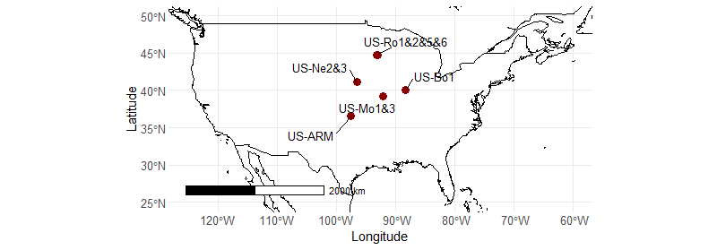
Develop and calibrate soybean plant functional type in ORCHIDEE-CROP
Collect the meteorological, biological and ancillary data in soybean flux sites
Introduce soybean physiological parameters from STICS
Use the STICS model to derive a nitrogen fertilization response function
Calibrate phenology, photosynthesis and allocation, respiration parameters
Evaluate performance using GPP, ET, LAI and yield versus observations
Flux meteorological and ancillary data
FluxNet, AmeriFlux and ICOS
Range of physiological parameters
Publications and STICS model
Collect and clear data
Derive the nitrogen fertilization function with STICS
Morris test and calibrate parameter based on RMSE
Develop soybean PFT and calibrate parameters
GPP, ET, LAI, yield between simulation and observation
r, RMSE
Evaluate model performance
Framework of the soybean PFT development
Spatial distribution of the soybean flux sites
Background | Materials and methods | Results and discussion 3

Slide 4
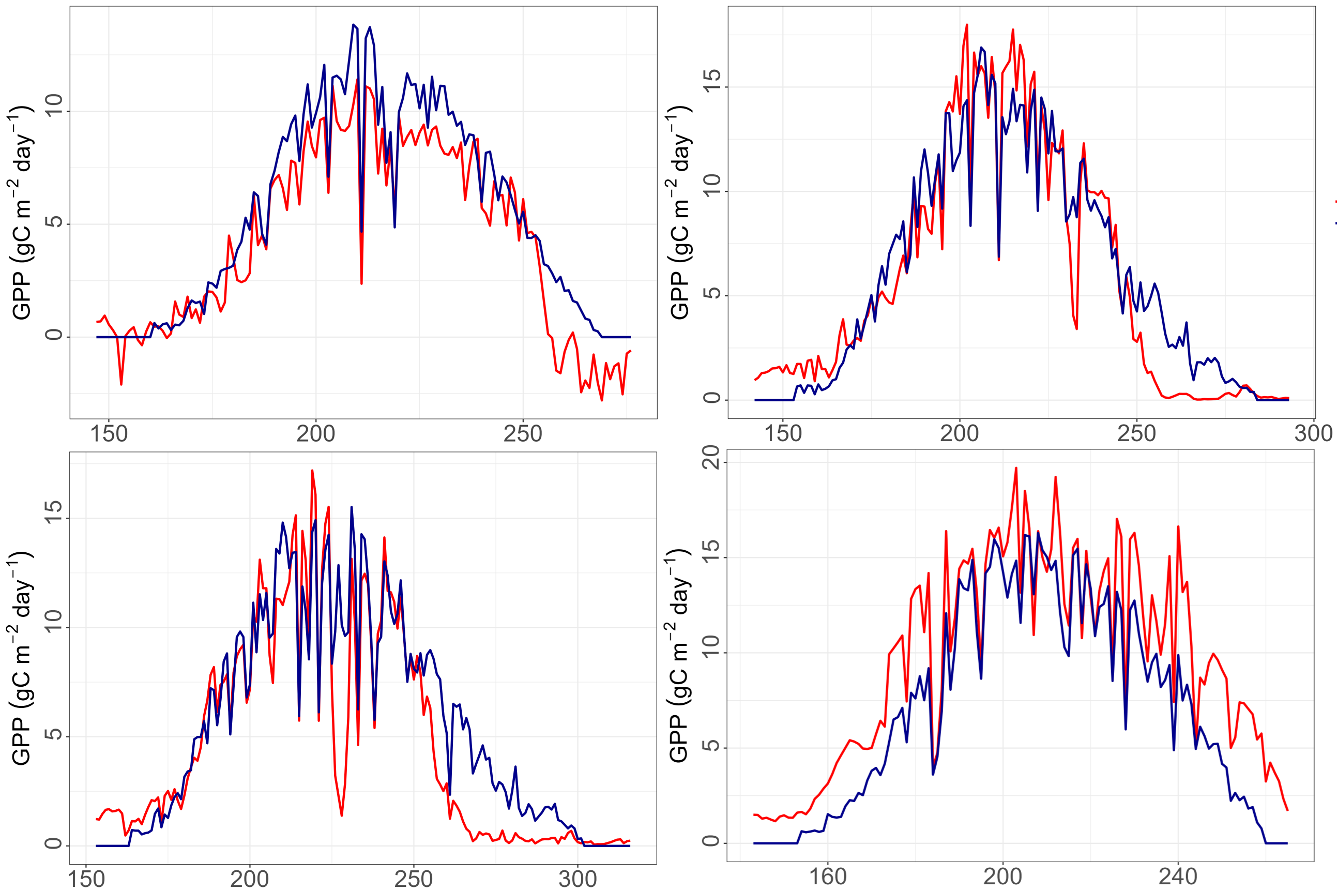
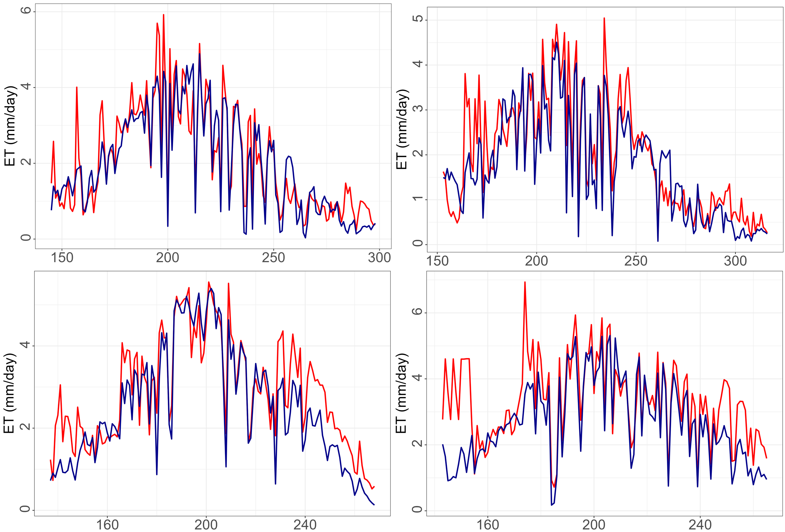
Performance of soybean PFT
The developed soybean PFT can capture the temporal dynamics of crop growth and water cycling
The overall RMSE and r for GPP are 2.95 g C m⁻² day⁻¹ and 0.83, respectively
The overall RMSE and r for ET are 1.11 mm day⁻¹ and 0.77, respectively
Bo1-2018
RMSE: 1.68
r: 0.93
Ro1-2010
RMSE: 1.76
r: 0.95
Ro1-2016
RMSE: 0.58
r: 0.91
Ro5-2017
RMSE: 0.60
r: 0.90
Ro5-2017
RMSE: 2.23
r: 0.90
Mo3-2016
RMSE: 2.94
r: 0.95
Mo1-2017
RMSE: 0.67
r: 0.62
Mo3-2016
RMSE: 1.06
r: 0.77
Observation
ORCHIDEE
Comparison of observed and simulated GPP
Comparison of observed and simulated ET
Background | Materials and methods | Results and discussion 4

Slide 5
2025
Session BG8.7
PICO1.10 | EGU25-8129
Thanks for your attention
Xianglin Zhang¹, Daniel Goll², Philippe Ciais², Yang Su^{1, 2, 3}, Ronny Lauerwald¹
¹UMR ECOSYS, INRAE AgroParisTech, Université Paris-Saclay, 91120 Palaiseau, France
²Laboratoire des Sciences du Climat et de l’Environnement, LSCE/IPSL, CEA-CNRS-UVSQ, Université Paris-Saclay, 91191 Gif-sur-Yvette, France
³Département d’Informatique, Ecole Normale Supérieure—PSL, 75005 Paris, France
2025.04.28 Vienna

