Slide 1
Study site 2022
Area: Fen 5 ha, site 1 ha
36 plots in 12 spatial blocks
Mean temperatures
Annual 0.9 °C
January -11.4 °C
July 16.5 °C
Total annual precipitation
528.8 mm
Plot-scale pH
6.74–7.38
Mean: 7.0
Water table depth
-9.3 cm–7.0 cm
Orthomosaic © Petra Korhonen 2024

Slide 2
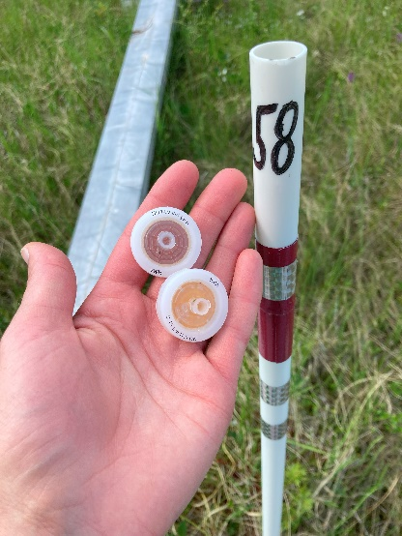
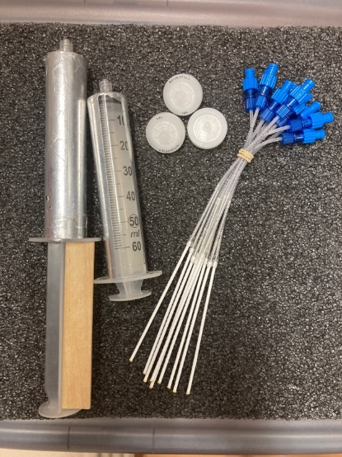
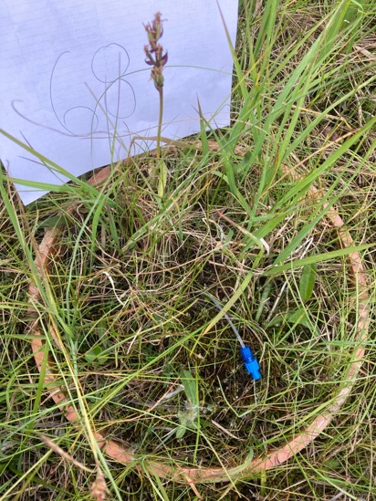
Studied environmental variables
Water table depth
Soil temperature at 5 cm depth
Peat layer thickness
Pore-water chemistry
pH, DOC, DIC, DON, NH₄, NO₂ + NO₃
Litter coverage

Slide 3
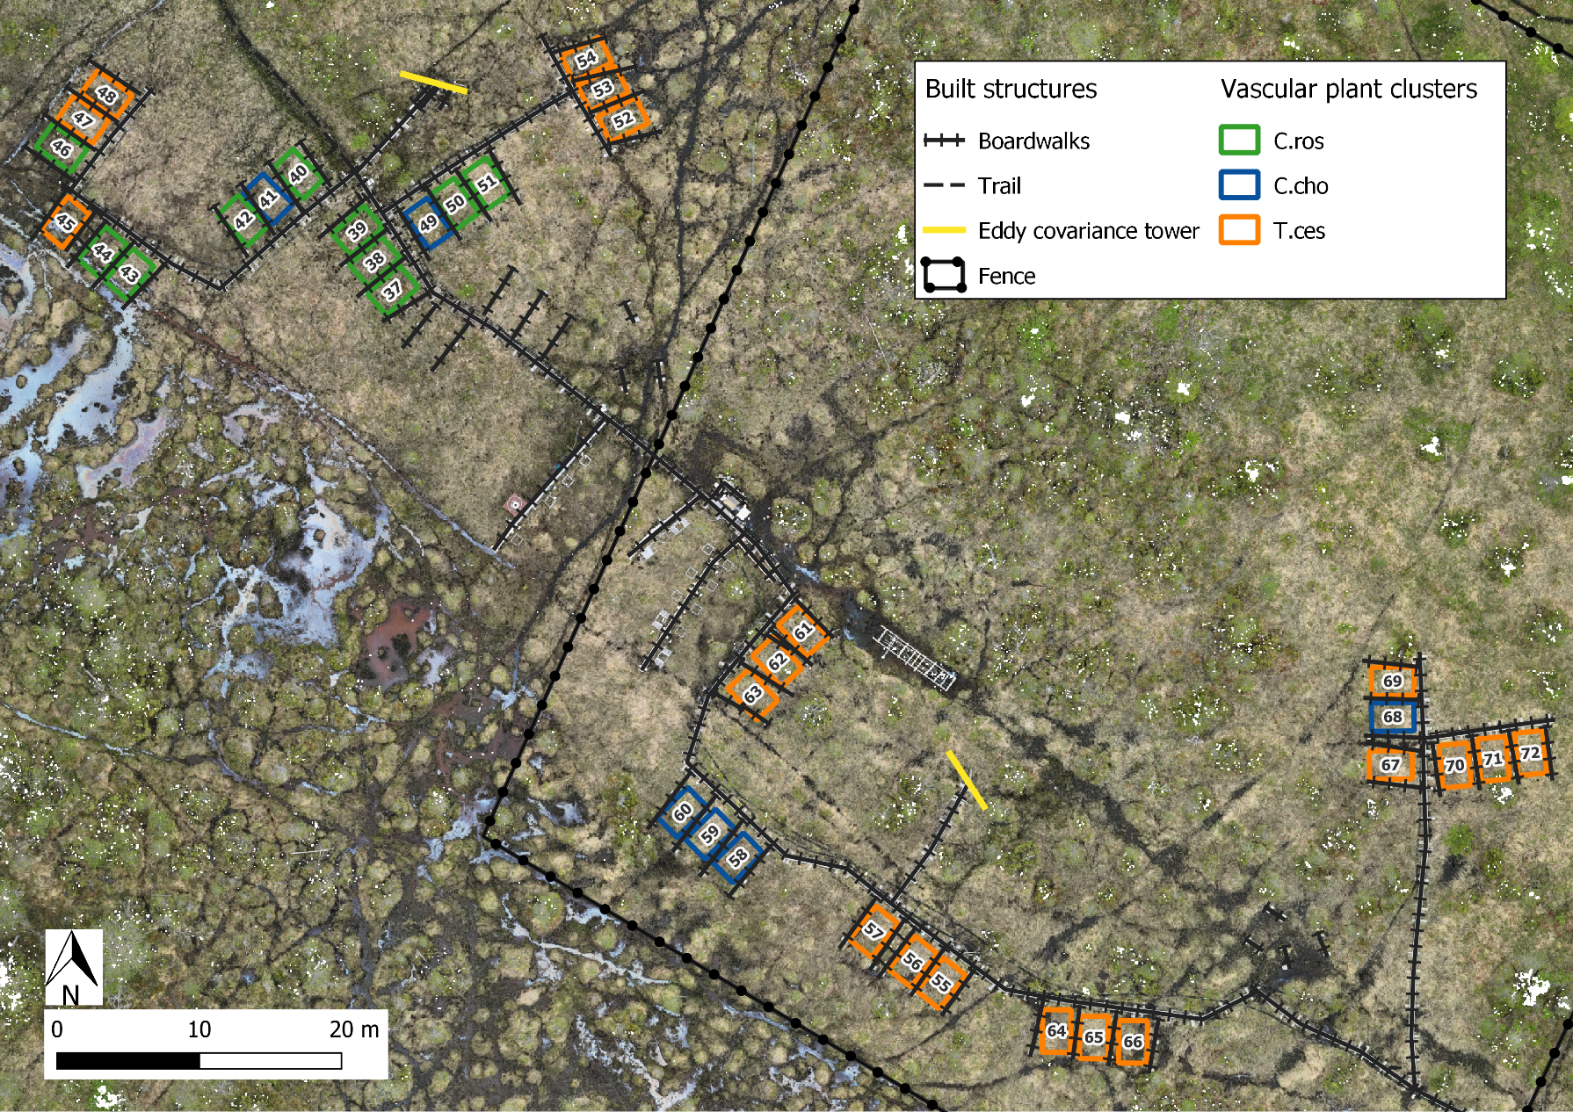
Distribution of
plant community types
across the study site
Strongest indicator of the community:
C.ros = Carex rostrata
C.cho = Carex chordorrhiza
T.ces = Trichophorum cespitosum

Slide 4
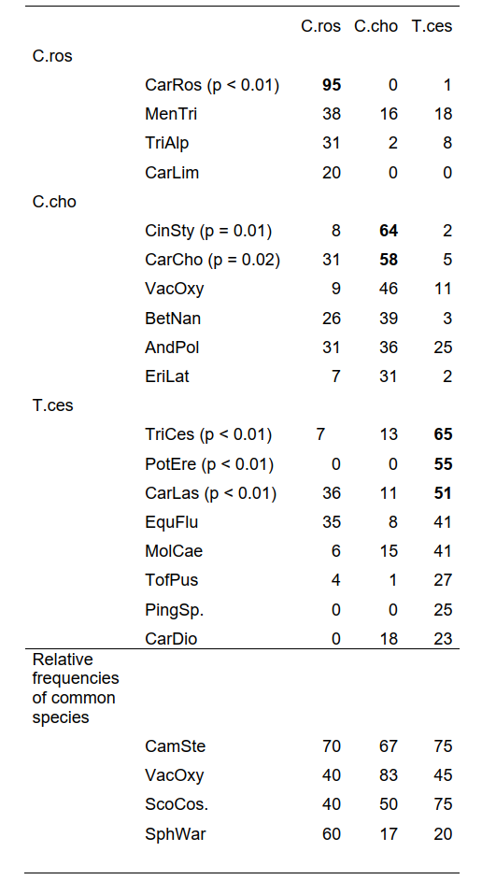
Community types connected mostly with different sedges
Indicator values of species in vascular plant communities
Only three species
were common in
all community types

Slide 5
Canonical Correspondence Analysis
Vascular plant communities and
Snow-free CH₄ → r = -0.856
Year-round CH₄ → r = -0.866
Snow season CH₄ → r = -0.402
VP:BRYO biomass ratio → r = -0.730
Peat layer depth → r = -0.580
NO₃+NO₂ → r = -0.453

Slide 6
Correlations with methane
Significant relationships of snow-free season CH₄ flux and environmental variables.
Curves fitted with LOESS regression.
r = 0.54
r = 0.57
r = 0.60
r = -0.38
r = 0.45
r = 0.34

Slide 7
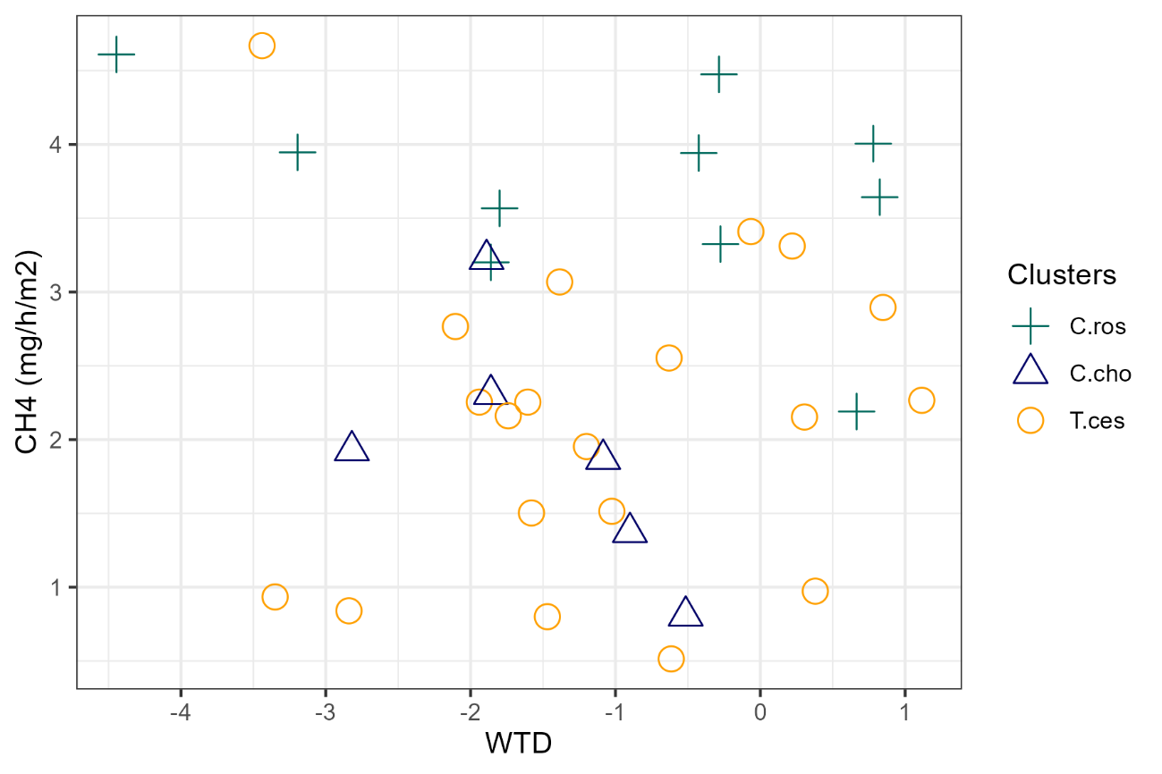
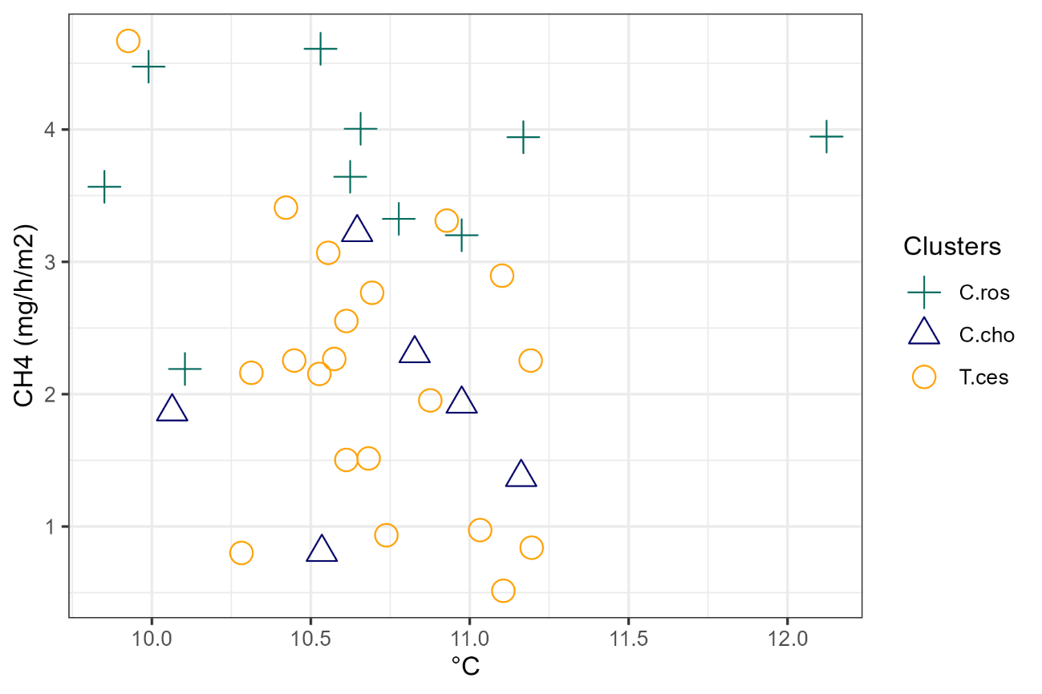
Non-significant correlations with methane
Water table depth r = -0.06
Soil temperature r = 0.06

Slide 8
Correlation matrix
 | CH4_y | CH4_sf | CH4_s | WTD | pH | NO3+NO2 | NH4 | TOTN | TOC | IC | BMratio | BMvp | BMbryo | BMsed | BMsph | Peat | Litter | C.Ros | SoilT_y | SoilT_sf | SoilT_s
CH4_y |  | 0.99*** | 0.60*** | -0.05 | -0.41* | 0.34* | 0.17 | 0.21 | 0.24 | -0.08 | 0.45** | 0.54*** | 0.03 | 0.57*** | 0.16 | 0.09 | 0.12 | 0.61*** | 0.22 | 0.06 | -0.29
CH4_sf | 0.99*** |  | 0.55*** | -0.06 | -0.38* | 0.34* | 0.17 | 0.22 | 0.22 | -0.08 | 0.45** | 0.54*** | 0.05 | 0.57*** | 0.19 | 0.07 | 0.12 | 0.60*** | 0.17 | 0.06 | -0.27
CH4_s | 0.60*** | 0.55*** |  |  |  |  |  |  |  |  | 0.24 | 0.16 | -0.19 | 0.21 | 0.11 | 0.17 | 0.09 | 0.20 | 0.23 | 0.24 | -0.14
WTD | -0.05 | -0.06 |  |  | -0.48** | 0.15 | -0.18 | 0.10 | 0.07 | 0.13 | -0.13 | -0.17 | -0.13 | -0.15 | -0.59*** | -0.20 | 0.00 | -0.23 | 0.19 | 0.21 | -0.21
pH | -0.41* | -0.38* |  | -0.48** |  | -0.11 | 0.23 | -0.21 | -0.28 | -0.05 | -0.30 | -0.26 | 0.16 | -0.35 | 0.55*** | 0.12 | -0.15 | -0.22 | -0.25 | -0.07 | 0.36*
NO3+NO2 | 0.34* | 0.34* |  | 0.15 | -0.11 |  | 0.20 | -0.18 | 0.05 | 0.24 | 0.13 | 0.14 | -0.07 | 0.14 | -0.09 | 0.28 | -0.03 | 0.24 | 0.07 | 0.03 | -0.12
NH4 | 0.17 | 0.17 |  | -0.18 | 0.23 | 0.20 |  | -0.04 | -0.07 | 0.03 | -0.13 | -0.10 | 0.13 | -0.09 | 0.13 | 0.15 | -0.34* | 0.01 | -0.01 | -0.15 | 0.28
TOTN | 0.21 | 0.22 |  | 0.10 | -0.21 | -0.18 | -0.04 |  | 0.08 | -0.14 | 0.36* | 0.23 | -0.16 | 0.24 | -0.09 | 0.12 | 0.09 | 0.29 | 0.06 | 0.10 | -0.19
TOC | 0.24 | 0.22 |  | 0.07 | -0.28 | 0.05 | -0.07 | 0.08 |  | 0.41* | 0.28 | 0.22 | -0.10 | 0.19 | -0.03 | 0.34* | -0.03 | 0.13 | -0.01 | -0.10 | -0.09
IC | -0.08 | -0.08 |  | 0.13 | -0.05 | 0.24 | 0.03 | -0.14 | 0.41* |  | 0.09 | 0.20 | 0.17 | 0.15 | -0.17 | 0.31 | 0.20 | 0.11 | -0.13 | -0.21 | 0.07
BMratio | 0.45** | 0.45** | 0.24 | -0.13 | -0.30 | 0.13 | -0.13 | 0.36* | 0.28 | 0.09 |  | 0.81*** | -0.46** | 0.78*** | -0.02 | 0.37* | 0.46** | 0.71*** | -0.06 | -0.14 | -0.15
BMvp | 0.53*** | 0.54*** | 0.16 | -0.17 | -0.26 | 0.14 | -0.10 | 0.23 | 0.22 | 0.20 | 0.81*** |  | 0.11 | 0.98*** | 0.13 | 0.37* | 0.59*** | 0.93*** | 0.03 | -0.08 | -0.09
BMbryo | 0.03 | 0.05 | -0.19 | -0.13 | 0.16 | -0.07 | 0.13 | -0.16 | -0.10 | 0.17 | -0.46** | 0.11 |  | 0.14 | 0.22 | -0.03 | 0.06 | 0.19 | 0.03 | 0.06 | 0.16
Bmsedg | 0.57*** | 0.57*** | 0.21 | -0.15 | -0.35* | 0.14 | -0.09 | 0.24 | 0.19 | 0.15 | 0.78*** | 0.98*** | 0.14 |  | 0.06 | 0.34* | 0.62*** | 0.93*** | 0.01 | -0.12 | -0.14
BMsph | 0.16 | 0.19 | 0.11 | -0.59*** | 0.55*** | -0.09 | 0.13 | -0.09 | -0.03 | -0.17 | -0.02 | 0.13 | 0.22 | 0.06 |  | 0.12 | -0.02 | 0.16 | -0.12 | 0.02 | 0.22
Peat | 0.09 | 0.07 | 0.17 | -0.20 | 0.12 | 0.28 | 0.15 | 0.12 | 0.34* | 0.31 | 0.37* | 0.37* | -0.03 | 0.34* | 0.12 |  | 0.22 | 0.40* | -0.01 | -0.06 | 0.09
Litter | 0.12 | 0.12 | 0.09 | 0.00 | -0.15 | -0.03 | -0.34* | 0.09 | -0.03 | 0.20 | 0.46** | 0.59*** | 0.06 | 0.62*** | -0.02 | 0.22 |  | 0.48** | -0.25 | -0.23 | -0.22
C.Ros | 0.61*** | 0.60*** | 0.20 | -0.23 | -0.22 | 0.24 | 0.01 | 0.29 | 0.13 | 0.11 | 0.71*** | 0.93*** | 0.19 | 0.93*** | 0.16 | 0.40* | 0.48** |  | 0.11 | -0.08 | -0.13
SoilT_y | 0.22 | 0.17 | 0.23 | 0.19 | -0.25 | 0.07 | -0.01 | 0.06 | -0.01 | -0.13 | -0.06 | 0.03 | 0.03 | 0.01 | -0.12 | -0.01 | -0.25 | 0.11 |  | 0.62*** | 0.03
SoilT_sf | 0.06 | 0.06 | 0.24 | 0.21 | -0.07 | 0.03 | -0.15 | 0.10 | -0.10 | -0.21 | -0.14 | -0.08 | 0.06 | -0.12 | 0.02 | -0.06 | -0.23 | -0.08 | 0.62*** |  | 0.09
SoilT_s | -0.29 | -0.27 | -0.14 | -0.21 | 0.36 | -0.12 | 0.28 | -0.19 | -0.09 | 0.07 | -0.15 | -0.09 | 0.16 | -0.14 | 0.22 | 0.09 | -0.22 | -0.13 | 0.03 | 0.09

Slide 9
Contact
PREPRINT
Eeva Järvi-Laturi
Doctoral researcher - Peatland ecology
Hydrology and Water Quality Research Group, University of Oulu
Email: eeva.jarvi-laturi@oulu.fi
Järvi-Laturi, E., Tahvanainen, T., Koskinen, E., López-Blanco, E., Lämsä, J., Marttila, H., Mastepanov, M., Paavola, R., Väisänen, M., and Christensen, T. R.: Plant community composition controls spatial variation in year-round methane fluxes in a boreal rich fen, EGUsphere [preprint], https://doi.org/10.5194/egusphere-2025-217, 2025.

