Slide 1
Was the Western European rainfall of July 2021 the worst case scenario?
Vikki Thompson
Rikke Stoffels, Hylke de Vries, Geert Lenderink, Erich Fischer, Dim Coumou, Sarah Kew
Notes:
I'm Vikki Thompson, and I work jointly within the attribution team at KNMI and the Climate Extremes team at IVM, VU Amsterdam. For the last two years a lot of my work has been using analogues methods – not only on extratropical storms but also on other extreme weather events.
My background is not in storms – I have researched monthly rainfall, heatwaves, cut-off lows, wildfire … I am not fussy about the type of extreme weather which I work on. I am also not fussy about the method – although usually statistically based (such as UNSEEN and analogues) I am also dabbling in ensemble boosting and pseudo global warming methods.
But today I will (mostly) stick with European storms that caused flooding. My current funding is based on the Western European flood events of July 2021 (which I am likely to refer to as the Limburg flood event – the region of Netherlands it most impacted) - but I like to get distracted by many other events too.

Slide 2
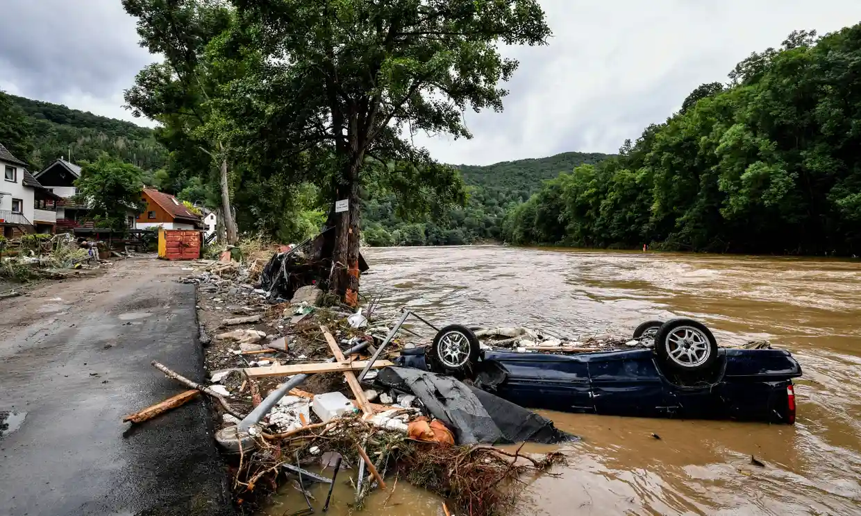
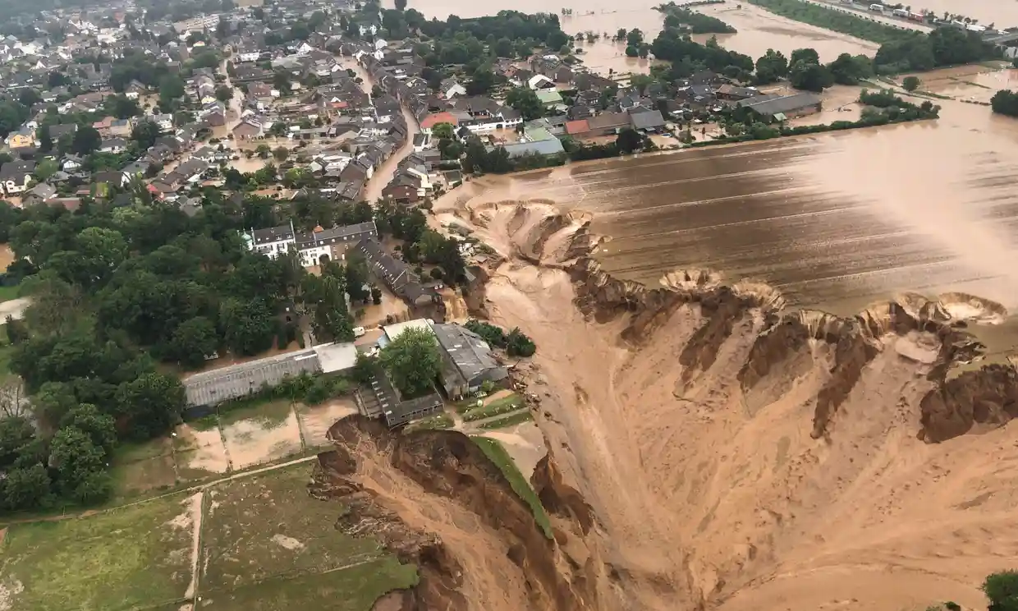
14th July 2021
vikki.thompson@knmi.nl

Slide 3
14th July 2021
vikki.thompson@knmi.nl

Slide 4
Earlier work has shown:​
Circulation analogues do not capture the rainfall magnitude
How important are the large scale dynamics?
I examine this, using three datasets:
1. Forecast Ensemble 2. Boosted CESM Ensemble 3. Pseudo Global Warming

Slide 5
Earlier work has shown:​
Circulation analogues do not capture the rainfall magnitude
How important are the large scale dynamics?
I examine this, using three datasets:
1. Forecast Ensemble 2. Boosted CESM Ensemble 3. Pseudo Global Warming

Slide 6
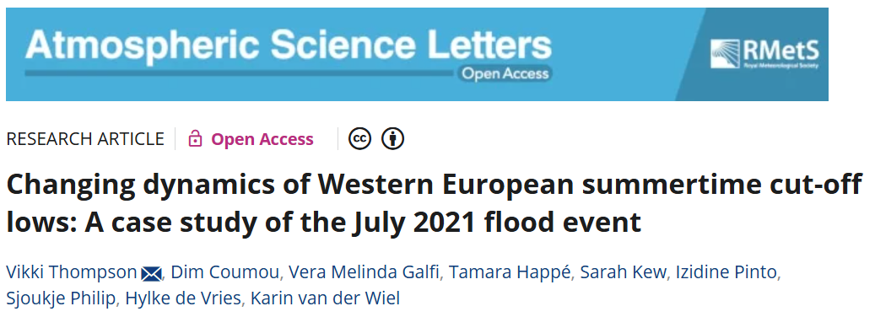

Slide 7
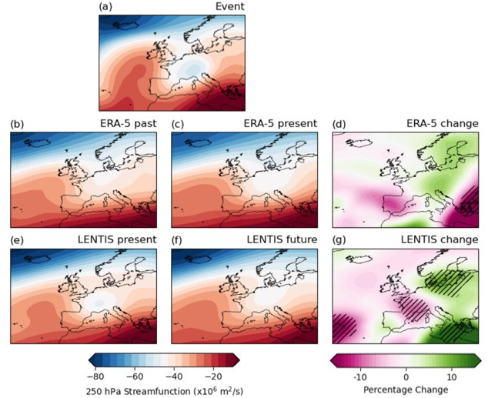
Deepening Low
1993-2022
Circulation analogues suggest such cut-off lows have deepened (1950-1979 to 1993-2022)
We also show evidence that such events have increased in frequency

Slide 8
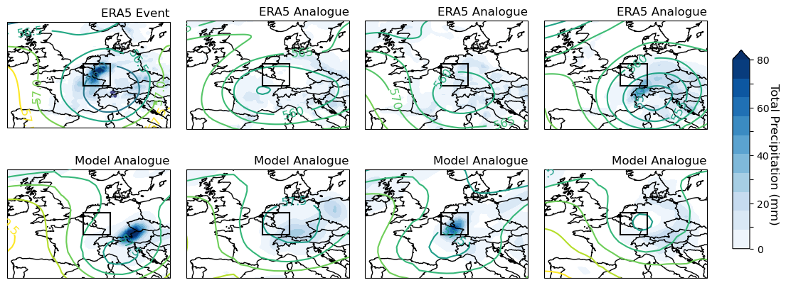
vikki.thompson@knmi.nl
Dynamics alone do not determine
the extreme rainfall
8

Slide 9
vikki.thompson@knmi.nl
Dynamics alone do not determine
the extreme rainfall
9

Slide 10
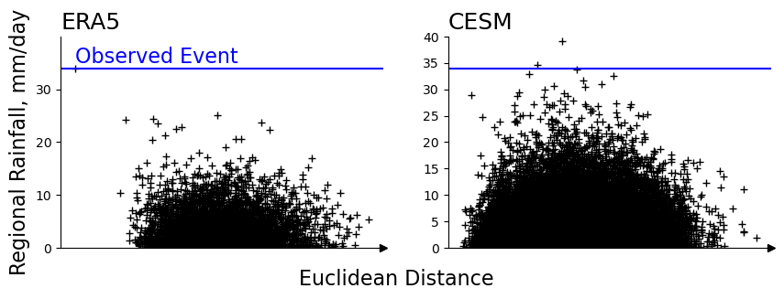
vikki.thompson@knmi.nl
High rainfall events tend to have stronger analogues
10
10
10
10
10

Slide 11
vikki.thompson@knmi.nl
High rainfall events tend to have stronger analogues
11
11
11
11
11

Slide 12
vikki.thompson@knmi.nl
High rainfall events tend to have stronger analogues but some low rainfall events do too
12
12
12
12
12

Slide 13
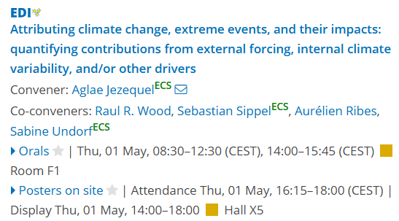
vikki.thompson@knmi.nl
Analogue methods work better for other event types
14:00 Thursday Poster X5.171

Slide 14
vikki.thompson@knmi.nl
High rainfall events tend to have stronger analogues but some low rainfall events do too
14
14
14
Unprecedented events in CESM not identified as analogues
14
14

Slide 15
vikki.thompson@knmi.nl
Unprecedented events in model
Other dynamics can also lead to extreme rainfall
Notes:
/usr/people/thompson/WP1/wetVdry/CESM_scatter_26032025.ipynb

Slide 16
vikki.thompson@knmi.nl
Earlier work has shown:​
Circulation analogues do not capture the rainfall magnitude
How important are the large scale dynamics?
I examine this, using three datasets:
1. Forecast Ensemble 2. Boosted CESM Ensemble 3. Pseudo Global Warming

Slide 17
vikki.thompson@knmi.nl
Earlier work has shown:​
Circulation analogues do not capture the rainfall magnitude
How important are the large scale dynamics?
I examine this, using three datasets:
1. Forecast Ensemble 2. Boosted CESM Ensemble 3. Pseudo Global Warming

Slide 18
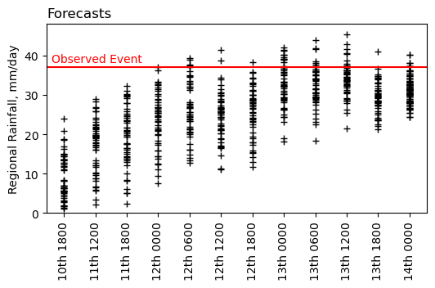
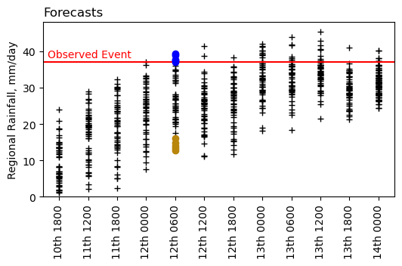
vikki.thompson@knmi.nl
Event was forecast a few days ahead
Forecasts for 14th July daily rainfall
Notes:
Figure: /usr/people/thompson/WP1/wetVdry/IFS_limburg/ifs_24hr_19022025.ipynb

Slide 19
vikki.thompson@knmi.nl
Event was forecast a few days ahead
Forecasts for 14th July daily rainfall
Take the 5 wettest and driest ensemble members at first forecast with members above the event total
Notes:
Figure: /usr/people/thompson/WP1/wetVdry/IFS_limburg/ifs_24hr_19022025.ipynb

Slide 20
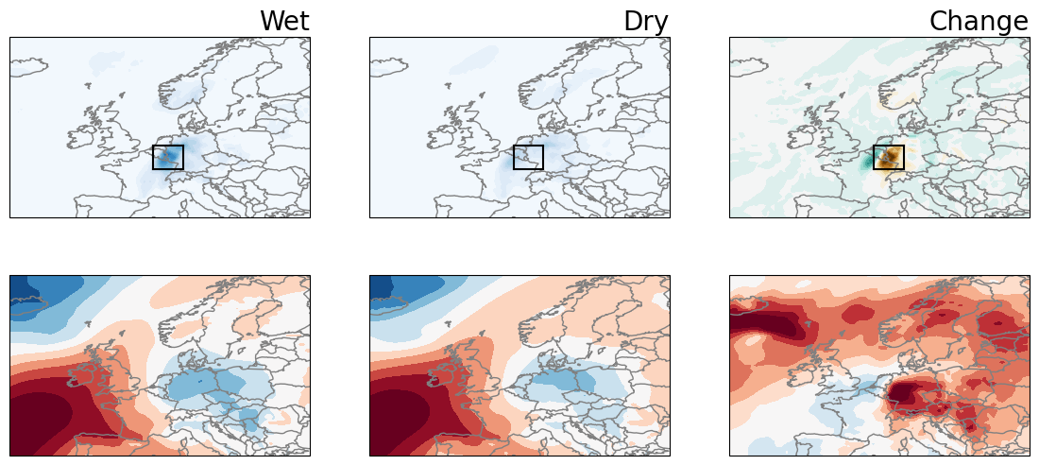
vikki.thompson@knmi.nl
Event was forecast a few days ahead
Dynamical shift: deeper cut-off low in wettest 10% of ensemble compared to driest.
20
Notes:
Figure: /usr/people/thompson/WP1/wetVdry/IFS_limburg/ifs_24hr_19022025.ipynb

Slide 21
vikki.thompson@knmi.nl
Earlier work has shown:​
Circulation analogues do not capture the rainfall magnitude
How important are the large scale dynamics?
I examine this, using three datasets:
1. Forecast Ensemble 2. Boosted CESM Ensemble 3. Pseudo Global Warming

Slide 22
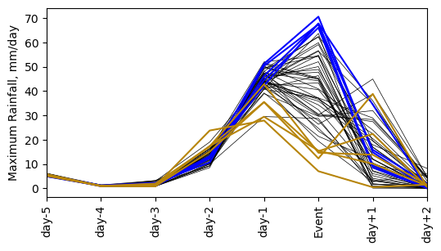
vikki.thompson@knmi.nl
Creating a boosted ensemble
Ensemble boosted from a model analogue chosen for both dynamics and rainfall
Model reinitialised, 7-21 days before event with a tiny perturbation
Notes:
/usr/people/thompson/WP1/boosting/wetdry_paperfigure_26032025.ipynb

Slide 23
vikki.thompson@knmi.nl
Creating a boosted ensemble
Ensemble boosted from a model analogue chosen for both dynamics and rainfall
Model reinitialised, 7-21 days before event with a tiny perturbation
Take the 5 wettest and driest ensemble members at 10 day lead
Notes:
/usr/people/thompson/WP1/boosting/wetdry_paperfigure_26032025.ipynb

Slide 24
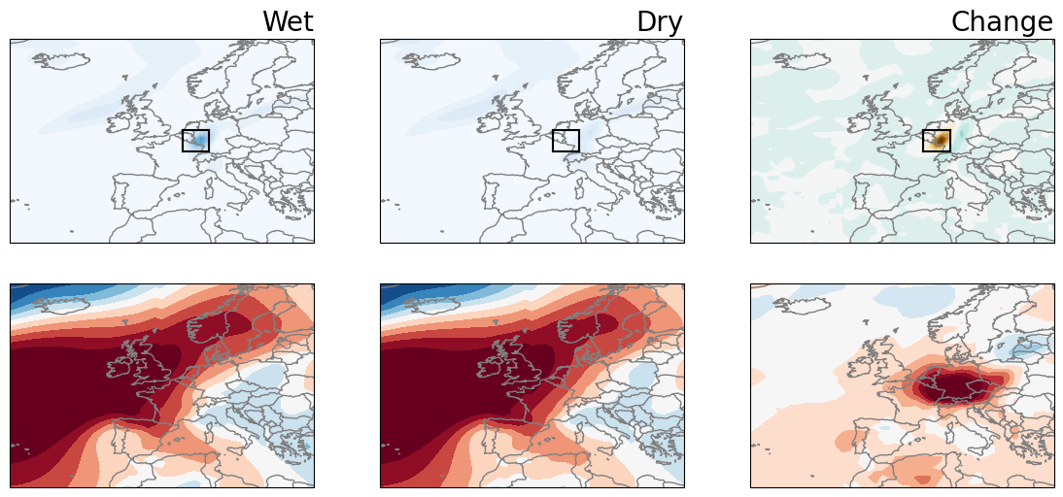
vikki.thompson@knmi.nl
Boosted ensemble
Dynamical shift: deeper cut-off low in wettest 10% of ensemble compared to driest.
Notes:
/usr/people/thompson/WP1/boosting/wetdry_paperfigure_26032025.ipynb

Slide 25
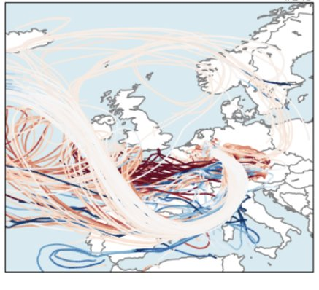
vikki.thompson@knmi.nl
Backward parcel tracking
To investigate the processes, we can track back the air parcels that have been transported to the event region

Slide 26
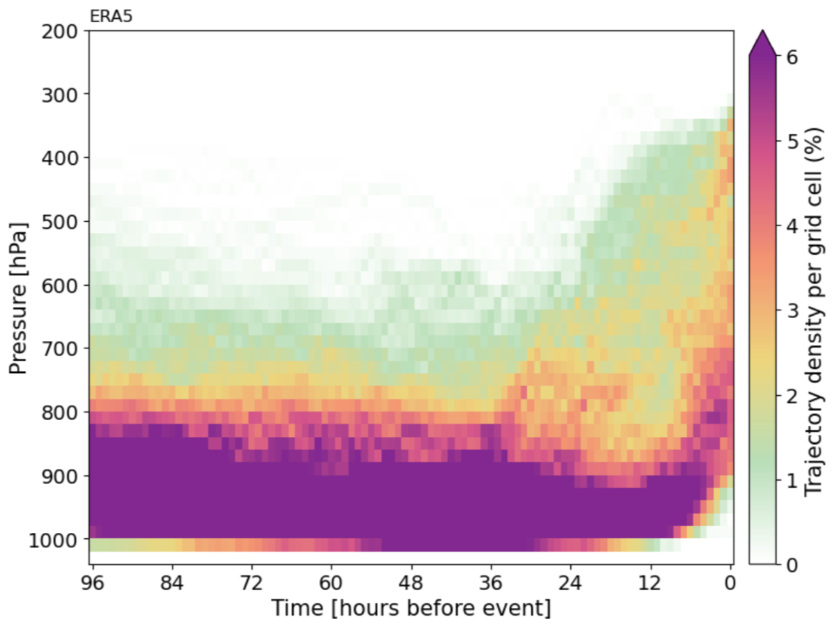
vikki.thompson@knmi.nl
Location of air parcels vertically
ERA5 and WET ensemble show similar patterns.
ERA5
WET
DRY ensemble behaves differently

Slide 27
vikki.thompson@knmi.nl
Location of air parcels vertically
ERA5 and WET ensemble show similar patterns. Air parcels that reach the region have travelled at lower levels, enabling moisture accumulation.
ERA5
WET
DRY ensemble behaves differently

Slide 28
vikki.thompson@knmi.nl
Location of air parcels vertically
ERA5 and WET ensemble show similar patterns. Air parcels that reach the region have travelled at lower levels, enabling moisture accumulation. They then rise rapidly leading to the extreme rainfall.
ERA5
WET
DRY ensemble behaves differently

Slide 29
vikki.thompson@knmi.nl
Location of air parcels vertically
ERA5 and WET ensemble show similar patterns. Air parcels that reach the region have travelled at lower levels, enabling moisture accumulation. They then rise rapidly leading to the extreme rainfall.
ERA5
WET
DRY
DRY ensemble behaves differently

Slide 30
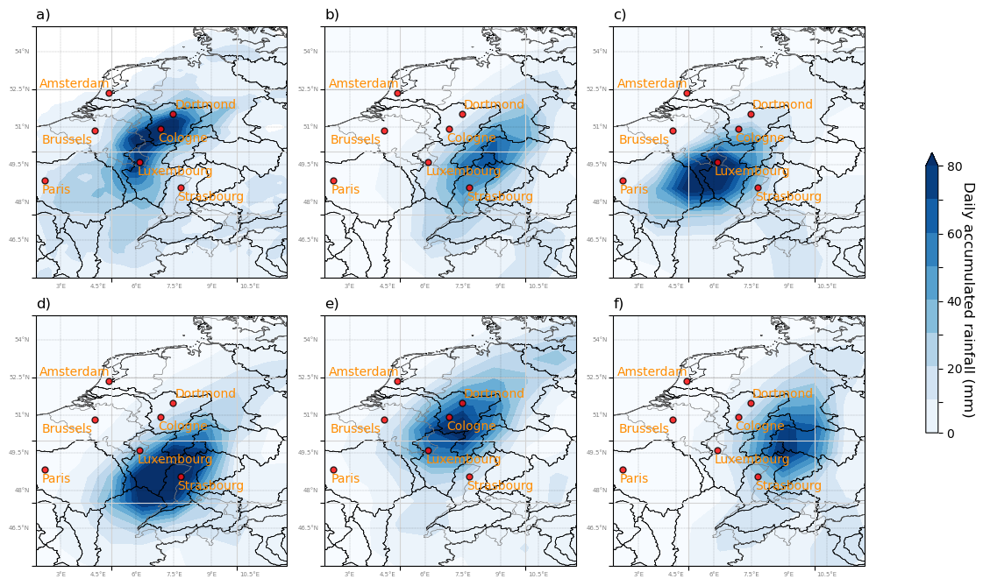
vikki.thompson@knmi.nl
Some boosted members give alternative storylines that could lead to greater impacts
11:08 Thursday PICO spot 3
Thompson et al. (under review)

Slide 31
vikki.thompson@knmi.nl
Earlier work has shown:​
Circulation analogues do not capture the rainfall magnitude
How important are the large scale dynamics?
I examine this, using three datasets:
1. Forecast Ensemble 2. Boosted CESM Ensemble 3. Pseudo Global Warming

Slide 32
vikki.thompson@knmi.nl
Pseudo global warming
PAST
-1K
PRESENT
FUTURE
+1K
FUTURE
+3K
Notes:
The system consists of continuous short-term forecast cycles (3 days long starting each day at midnight) running a small set of 12 km resolution simulations for the present-day climate, a cooler past climate, and three warmer climates.
We note that the perturbations include a small circulation change as derived from the CMIP models.

Slide 33
vikki.thompson@knmi.nl
Pseudo global warming
rainfall
SLP
Notes:
/usr/people/thompson/WP2/limburg/PGW_plots_forEGU_25032025.ipynb

Slide 34
vikki.thompson@knmi.nl
Pseudo global warming
rainfall
SLP
rainfall
change
SLP
change
Notes:
/usr/people/thompson/WP2/limburg/PGW_plots_forEGU_25032025.ipynb

Slide 35
vikki.thompson@knmi.nl
Pseudo global warming
Dynamical shift: future events have a weaker cut-off low.
rainfall
Rainfall weaker in future scenarios
SLP
rainfall
change
SLP
change
Notes:
/usr/people/thompson/WP2/limburg/PGW_plots_forEGU_25032025.ipynb

Slide 36
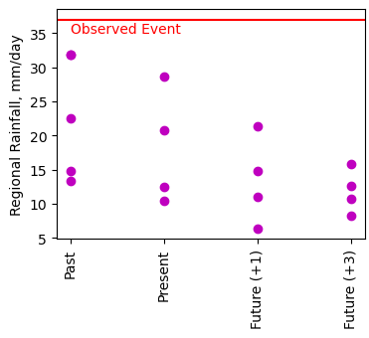
vikki.thompson@knmi.nl
Pseudo global warming
Those simulations have a dynamical adjustment imposed - based on that shown by future projections.

Slide 37
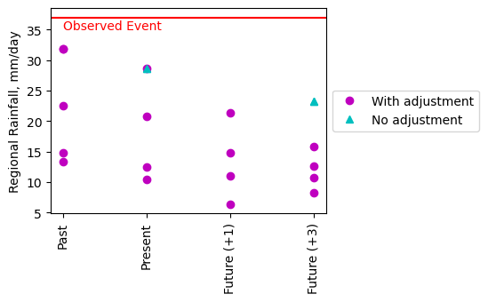
vikki.thompson@knmi.nl
Pseudo global warming
Those simulations have a dynamical adjustment imposed - based on that shown by future projections.
The simulations can be rerun without that dynamical adjustment

Slide 38
vikki.thompson@knmi.nl
Pseudo global warming
Less drying without adjustment
Those simulations have a dynamical adjustment imposed - based on that shown by future projections.
The simulations can be rerun without that dynamical adjustment

Slide 39
vikki.thompson@knmi.nl
Pseudo global warming
Present
Future (+3)
Change
With Adjustment

Slide 40
vikki.thompson@knmi.nl
Pseudo global warming
Present
Future (+3)
Change
Even without enforced dynamical adjustment,
future drier with weaker cut-off low
With Adjustment
No Adjustment

Slide 41
Summary
vikki.thompson@knmi.nl

Slide 42
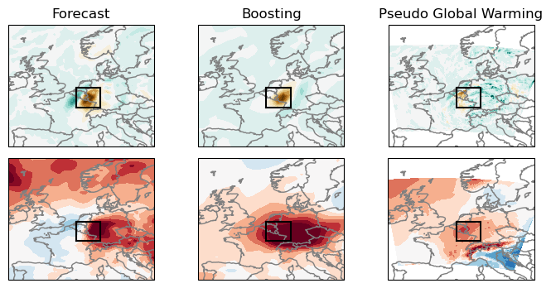
vikki.thompson@knmi.nl
Three different methods all lead to the same conclusion:
Small change in the cut-off low lead to big change in the rainfall
Notes:
/usr/people/thompson/WP1/wetVdry/summary_11042025.ipynb

Slide 43
Take away messages
vikki.thompson@knmi.nl
@vikkithompson.bsky.social
For this event small shifts in the dynamics can act to reduce the rainfall
For this event future changes may be dominated by dynamical shift (reducing rain) rather than thermodynamics (increasing rain)
Event was the 'perfect' combination of dynamics and moisture availability – close to worst possible given the dynamics

Slide 44
References
Analogues:
Thompson et al (2024) https://doi.org/10.1002/asl.1260
Faranda et al (2022) https://doi.org/10.5194/wcd-3-1311-2022
Boosting:
Fischer et al (2023) https://doi.org/10.1038/s41467-023-40112-4
Pseudo global warming:
Lenderink et al, preprint http://dx.doi.org/10.2139/ssrn.5122288

Slide 45
Take away messages
vikki.thompson@knmi.nl
For this event small shifts in the dynamics can act to reduce the rainfall
For this event future changes may be dominated by dynamical shift (reducing rain) rather than thermodynamics (increasing rain)
Event was the 'perfect' combination
of dynamics and moisture availability
@vikkithompson.bsky.social

