Slide 1
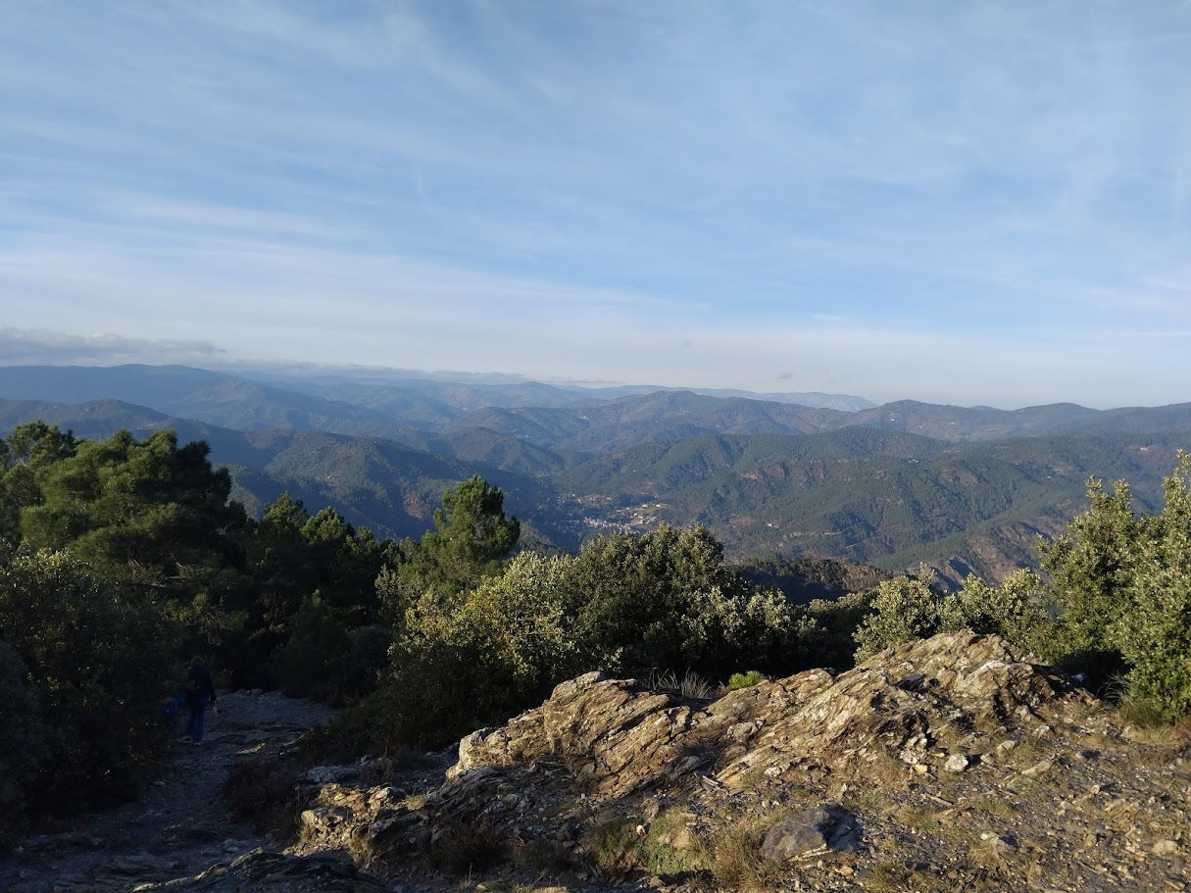
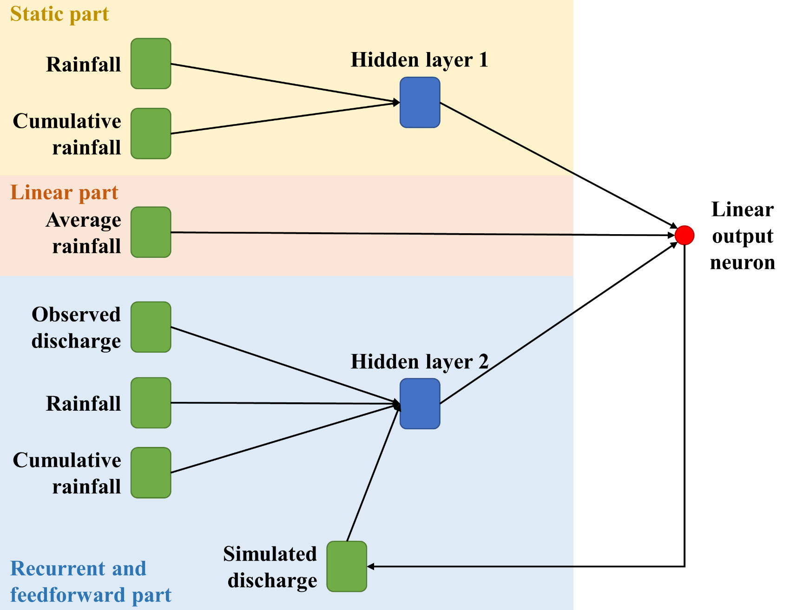
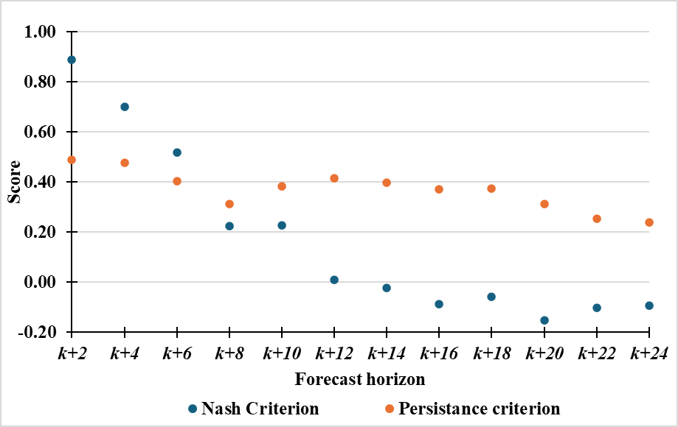
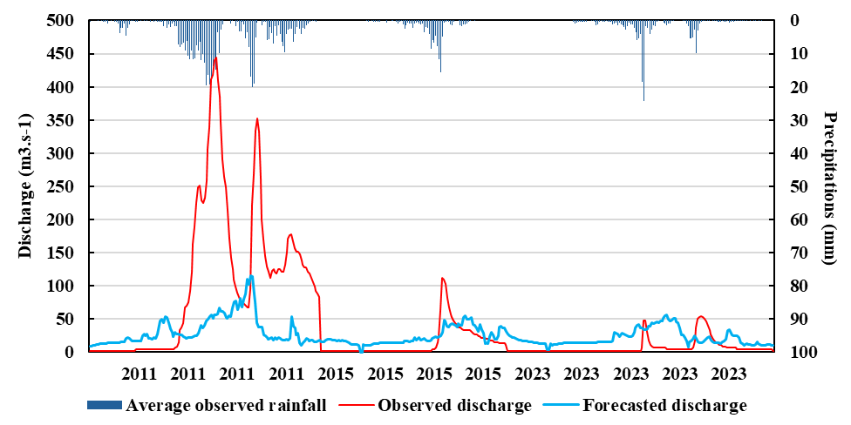
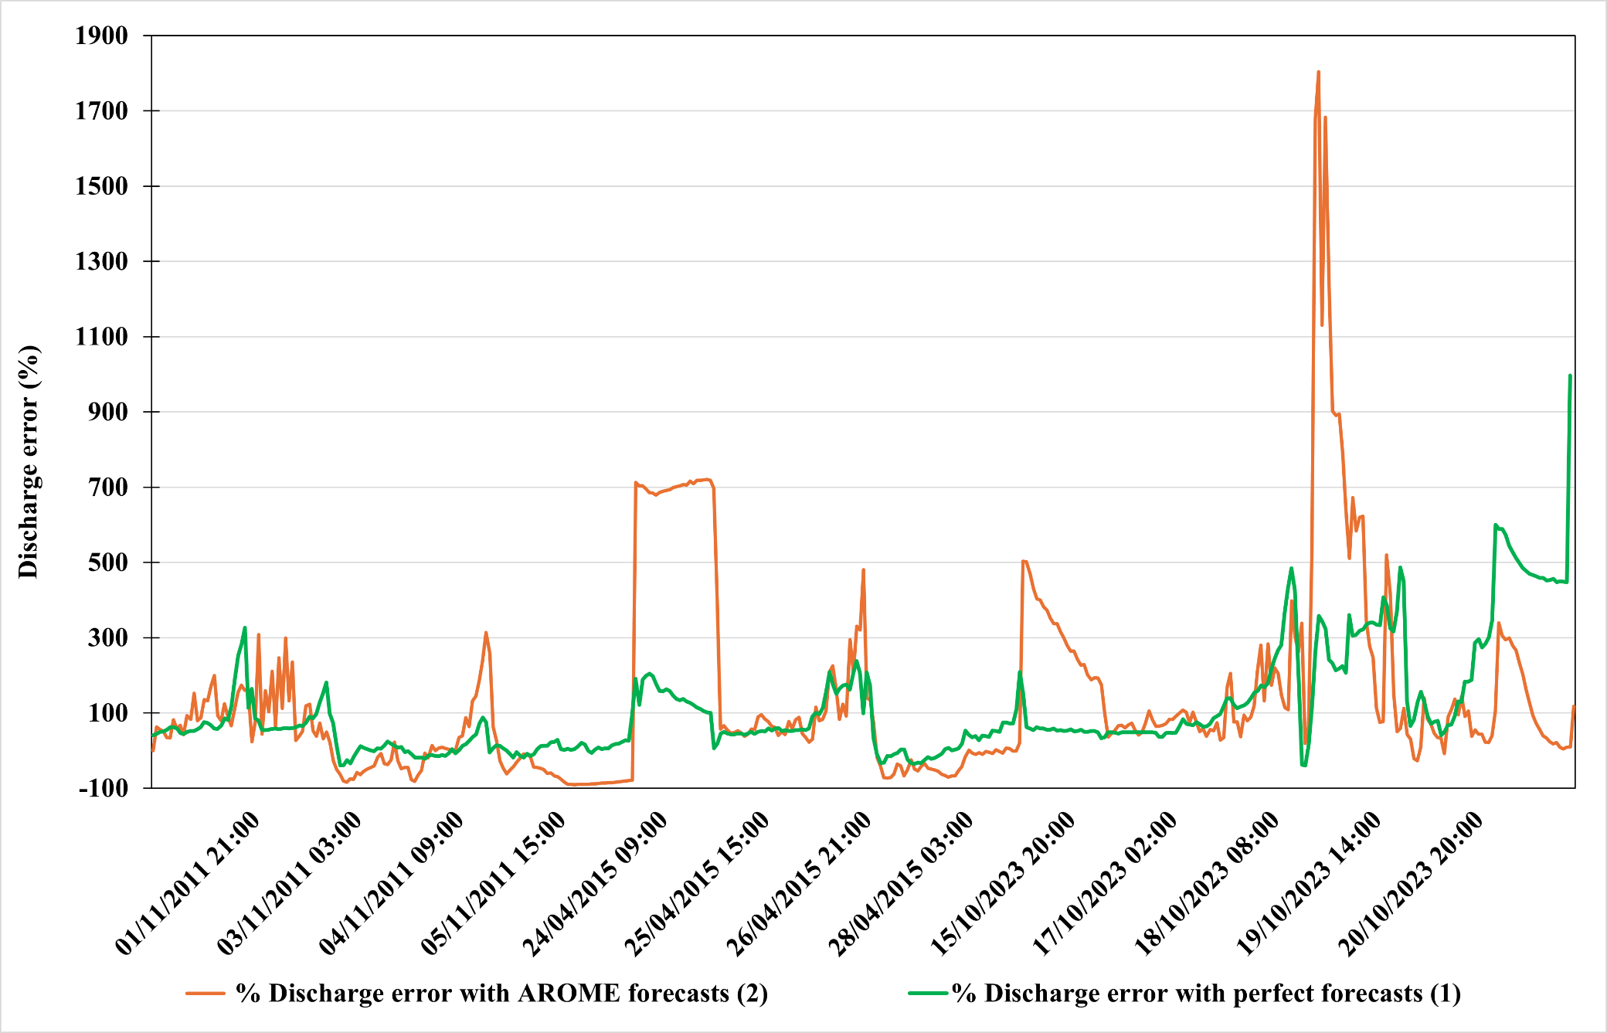
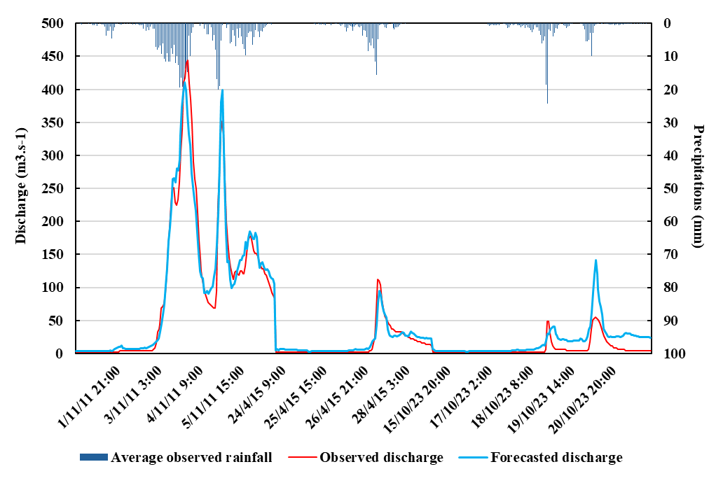
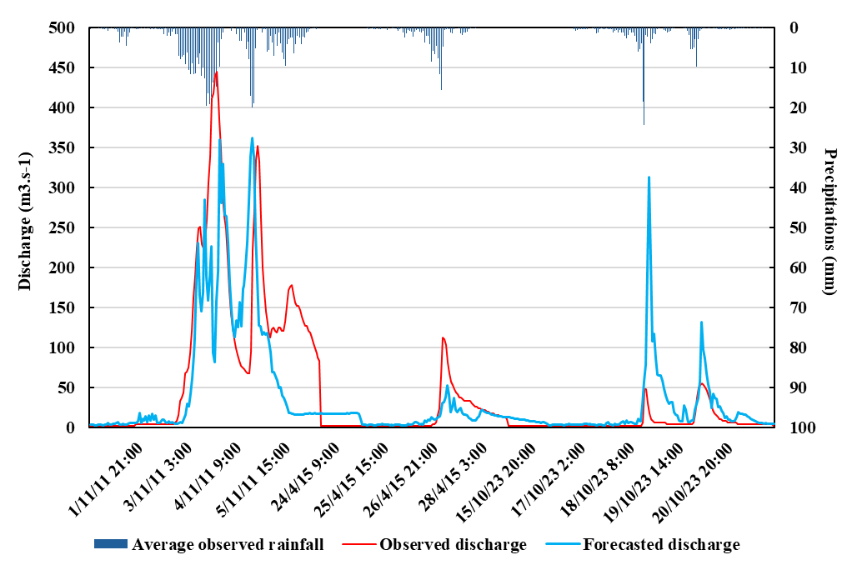
Coupling high resolution meteorological models with neural networks for flash flood forecasting : implementation on a Southern France basin
Introduction
Material & methods
Objective: use of meteorological forecasts for flash flood forecasting with a 24-hour lead time
Study site: a Southern France basin, the Gardon de Mialet basin (Fig.1)
Affected by cévenol épisodes: intense meteorological phenomena of short duration
Basin response time around 4 hours
Coméphore data: hourly radar water level corrected with rain gauge measurements at a resolution of 1 km, producted by Météo France
Meteorological forecasts: AROME
Short-range deterministic forecasts producted by Météo France
4 hourly forecasts per day, with a maximum lead time of 48 hours and a resolution of around 1.3 km
Use of a multilayer perceptron (MLP) due to its universal approximation and parsimony properties
Combined model: a combination of a static part, linear part and a recurrent and feedforward part (Fig. 2)
Regularization methods: cross-validation, early stopping and ensemble modelling
Database of 47 events from 2010 to 2023 (over 100 mm during a time window of 48h)
3 types of experience: Lead time of 24h without rainfall forecasts, lead time of 24h with perfect forecasts, lead time of 24h with AROME forecasts
Authors
Fig.1. Study basin : the Gardon de Mialet basin
Fig.2. Generic Architecture of the model used
Sarah Gautier¹
Guillaume Artigue¹
Yves Tramblay²
Anne Johannet¹
¹HSM, Univ Montpellier, IMT Mines Ales, CNRS, IRD, Alès, France
²Espace Dev (Univ. Montpellier, IRD)
Results & interpretations
Overview of the Gardon de Mialet basin
Performance without rainfall forecasts:
Unsurprisingly, performance decreases rapidly as the forecast horizon increases
For a forecasting horizon of k+24, performance without forecasts is very poor
The feedforward part of the model supports the bulk of simulated flow rate
Stakeholders
a
b
Fig. 3. (a) Evolution of model performance as a function of the forecast horizon, (b) Discharge 24h forecast for the three events tested without rainfall forecasts.
Lead time of 24h with perfect forecasts or AROME forecasts
Perfect forecasts correspond to observed data
No operational value, but allow model performance to be assessed, and the proportion of error linked to the hydrological model to be identified
Scores are showing a very good performance (persistence criterion of 0.92 and a Nash criterion of 0.90)
AROME forecasts
Correct timing of peaks, within +/- 3 hours
Medium performance for discharge forecasts (persistence criterion of 0.53 and a Nash criterion of 0.47)
Interesting indication of alert threshold crossings that are useful for crisis management (first level of alert 350 m³/s)
Fig. 5. Percentage error between observed and simulated flows using perfect forecasts (green) and AROME meteorological forecasts (orange)
Estimation of errors related respectively to the hydrological and meteorological models
Difficulties to forecast the smallest peak discharges
The AROME forecasts accentuate hydrological model errors (over or under-estimations) compared with perfect rainfall forecasts.
The difference between (1) and (2) (Fig.5.) reflects the error of the meteorological model
References
Tabary et al. (2012). A 10-year (1997–2006) reanalysis of Quantitative Precipitation Estimation over France: Methodology and first results. International « Wheater Radar and Hydrology », Exeter, IAHS.
a
b
Fig. 4. (a) Discharge 24h forecast for the three events tested with perfect forecasts, (b) with AROME forecasts.
Acknoledgments
Météo France for providing data, the ANR for funding of the project, Synapse for its help for the data storage, Domnique Bertin from Genosis for the development and constant improvement of the RNFPro Software.
Perspectives
The current results show that raw meteorological forecasts can be useful for 24-hour flash flood forecasting. The next steps are:
1- To bias-correct AROME forecasts to improve hydrometeorological coupling performance
2- To apply the same methodology with ARPEGE meteorological forecasts data (Météo France) - 4 runs of hourly forecast per day, (0.1° spatial resolution)
3- Benchmark the MLP model with a widely used conceptual hydrological model (for example GRH5)
4- To test the possibility of generalizing to other basins where flash flood occurs
Contacts : sarah.gautier@mines-ales.fr, guillaume.artigue@mines-ales.fr, yves.tramblay@ird.fr, anne.johannet@mines-ales.fr

