Slide 1
Glacier lagged response dominated the Himalayan water storage depletion
Presenter: | Yiguang Zou, Yuheng Yang & Xixi Lu
National University of Singapore
Apr-30 2025, Vienna
Reconcile the debate on twenty-first century water storage depletion in the Himalayas surroundings

Slide 2
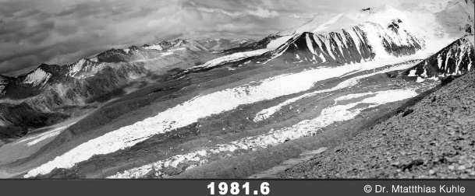
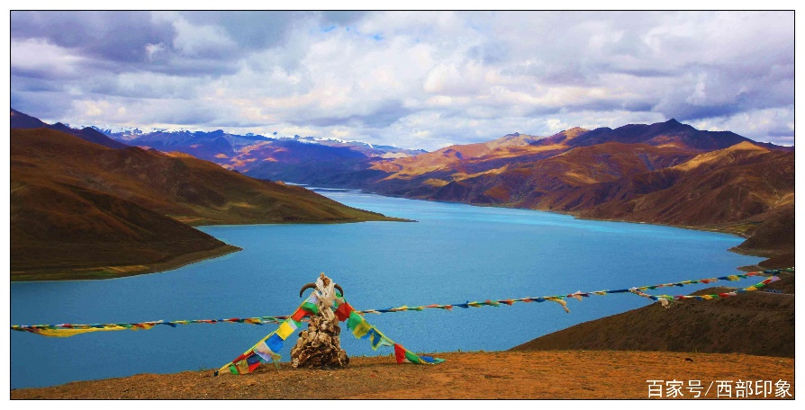
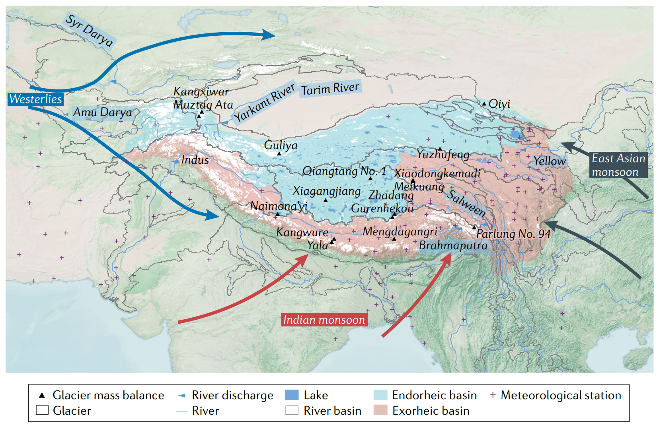
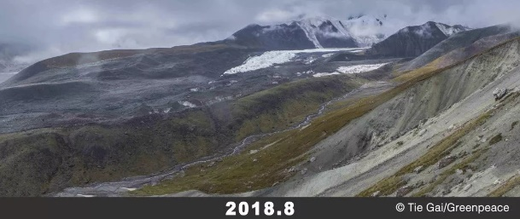
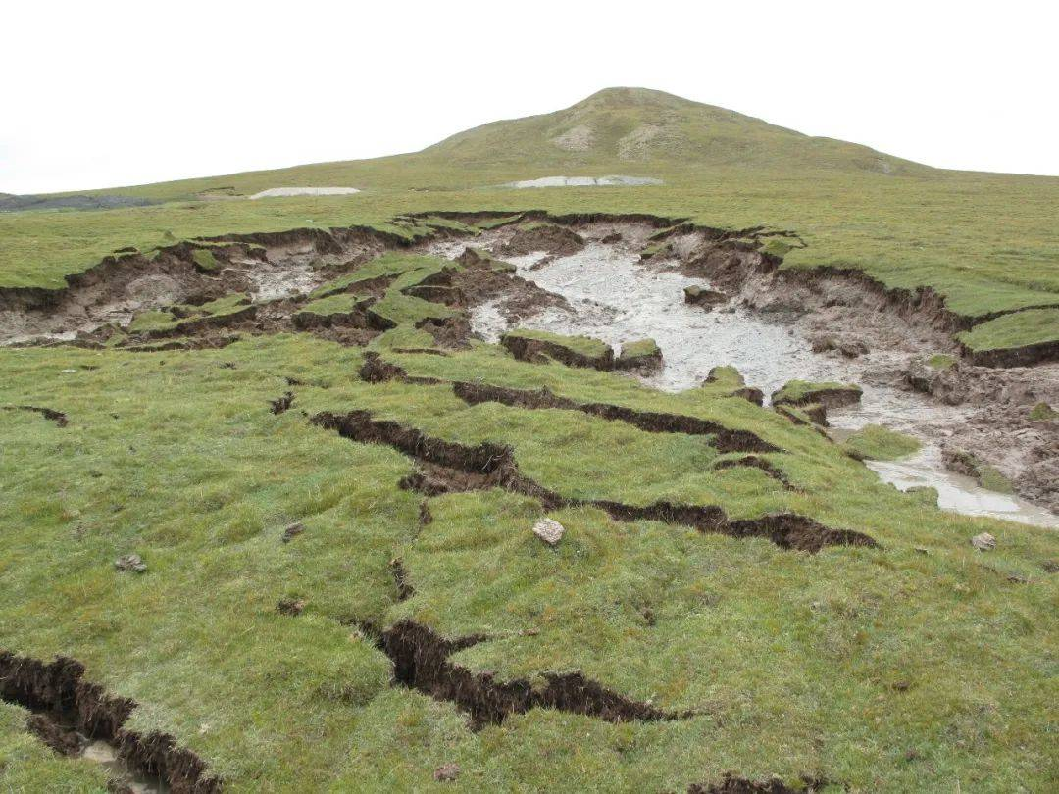
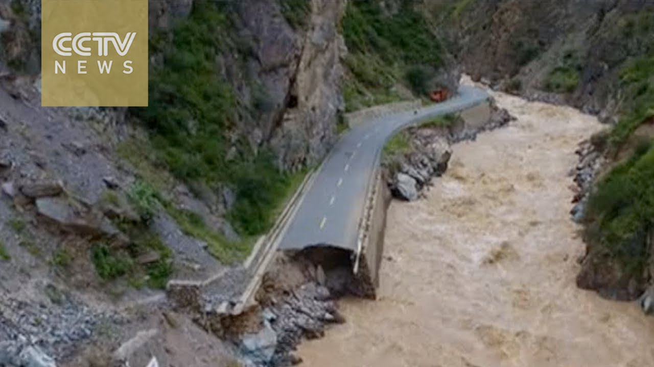
Background
Climate change → Imbalanced “Asian Water Tower”
Glacier retreat
Lake expansion
Yao et. (2022)
Permafrost thaw
Flood/Geohazards
Westerlies-Monsoon modulated
https://www.bing.com/images/

Slide 3
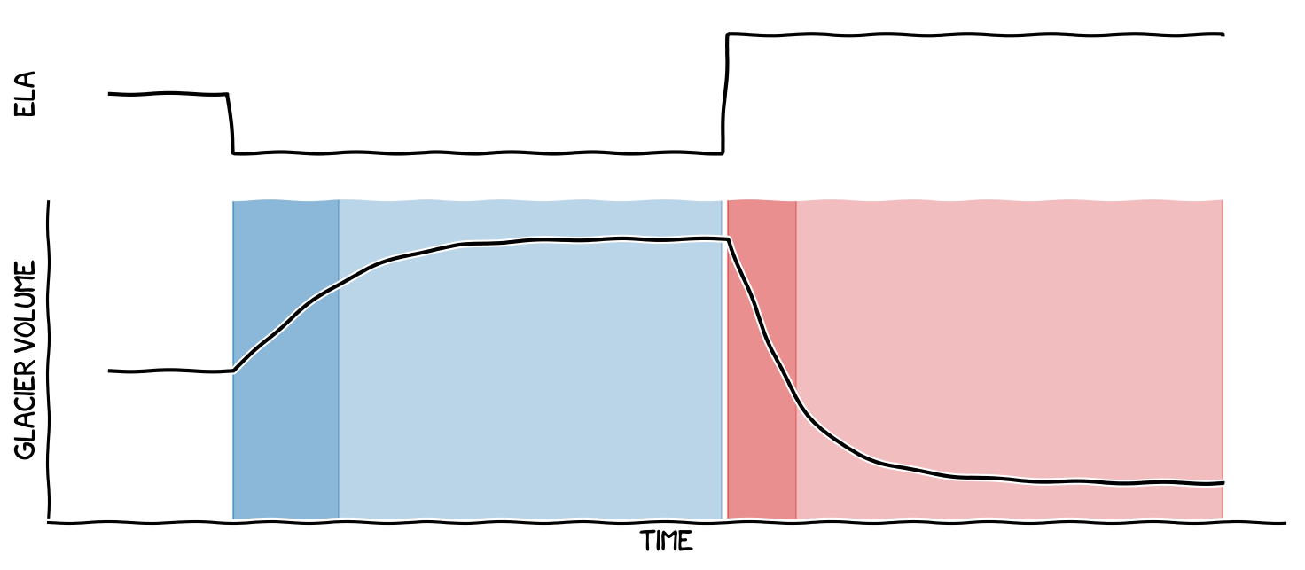
Consensus & Debate
Consensus: TWS (Terrestrial Water Storage ) depletion mainly from glacier mass loss
Debate: on attributions
Contemporary precipitation-evaporation ↓ over Southeast North Atlantic Ocean in 2003-2016 based on statistical correlation (Zhang et al., 2023)
but Zhao et al. (2025) found this correlation decrease to ~0 or even negative when moving to later periods, e.g., 2009-2022
TWS
GRACE
Glacier
DEM
Loomis et al. (2019)
Gap
limited to concurrent climate variables, while overlooking mountain glaciers typically have multidecadal response timescales
climate forcing
glacier volume
https://edu.oggm.org/en/latest/glacier_lowpass.html

Slide 4
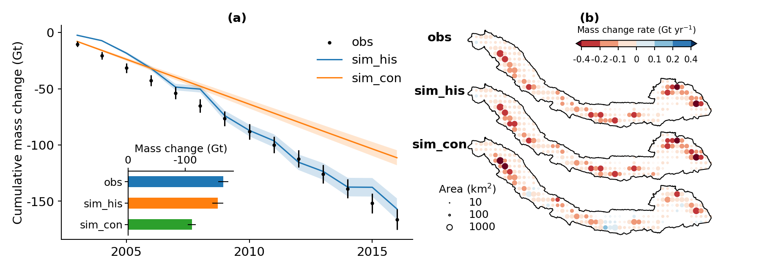
Reaffirm consensus & Reconcile debate
Reconfirm the dominant role of glacier mass loss (-11.54 ± 0.08 Gt yr⁻¹) in TWS depletion (-11.65 ± 0.32 Gt yr⁻¹)
Update water budget
Glacier numerical modeling for 27824 glaciers
71±6% glacier mass loss would occur even if climate kept constant in 2003-2016
TWS depletion in 2003-2016 mainly resulted from glacier lagged response to past climate change, rather than previously claimed concurrent climate change

Slide 5
Consensus & Debate
Consensus: TWS (Terrestrial Water Storage ) depletion mainly from glacier mass loss
Glacier
DEM
TWS
GRACE
Loomis et al. (2019)
Debates: on attributions
Zhang et al. (2023) attributed to precipitation-evaporation (P-E) ↓ over Southeast North Atlantic Ocean (NATO3) in 2003-2016 based on statistical correlation
However, Zhao et al. (2025) found this correlation decrease to ~0 or even negative when moving period to 2009-2022 , question this attribution

Slide 6
climate forcing
Gap
limited to concurrent climate variables, while overlooking mountain glaciers typically have multidecadal response timescales
glacier volume
Question
Whether the early 21st century TWS depletion in the Himalayas mainly resulted from glacier lagged response to past climate change?
https://edu.oggm.org/en/latest/glacier_lowpass.html
Aim
Numerical modeling of glacier mass loss if climate stabilized in 2003-2016
Reconcile current debates from the view of glacier dynamics

Slide 7
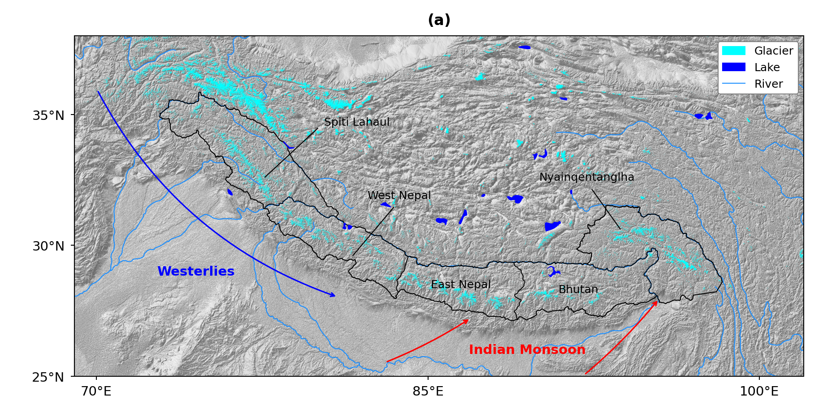
Data & Method
Study area: Himalayas
Study period: 2003-2016
TWS component
analyze main components (glacier, snow & lake) from satellite observations and modeling data
Glacier evolution modeling
simulate 27824 glaciers in the Himalayas under historical & constant climate forcing in 2003-2016, respectively
Atmospheric water budget
moisture budget over southeast NATO using ERA5 reanalysis data

Slide 8
Results
Glacier lagged response in TWS depletion
Dominant role of glacier mass loss (-11.54 ± 0.08 Gt yr⁻¹) in TWS depletion (-11.65 ± 0.32 Gt yr⁻¹)
71±6% glacier mass loss would occur even if climate kept constant in 2003-2016
TWS depletion in 2003-2016 mainly resulted from glacier lagged response to past climate change, rather than previously claimed concurrent climate change

Slide 9
Results
Glacier committed loss by 2100
By 2100, remained glacier mass would be ~52% relative to 2019
~22% of mass loss from small glaciers (< 2 km²)
9674 glaciers would vanish, ~35% of archived glaciers
99.5% are small glaciers (< 2 km²)

Slide 10
Discussion
Do not support previous attribution
TWS depletion mainly from glacier mass loss
Most of the glacier mass loss resulted from lagged response
Our: lagged response to past climate change
×
Previous: concurrent climate variations
Why different?

Slide 11
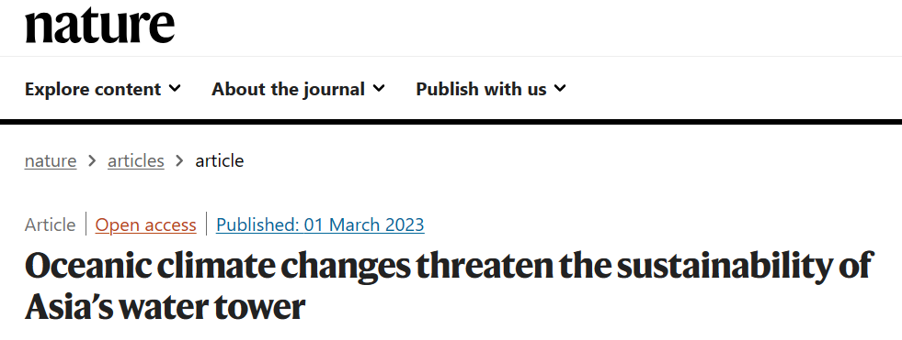
Discussion
correlation-derived attribution
Attributed TWS ↓ in South TP to precipitation-evaporation (P-E) ↓ transported by westerlies from Southeast North Atlantic Ocean (NATO3) based on correlation
(Zhang et al., 2023)

Slide 12
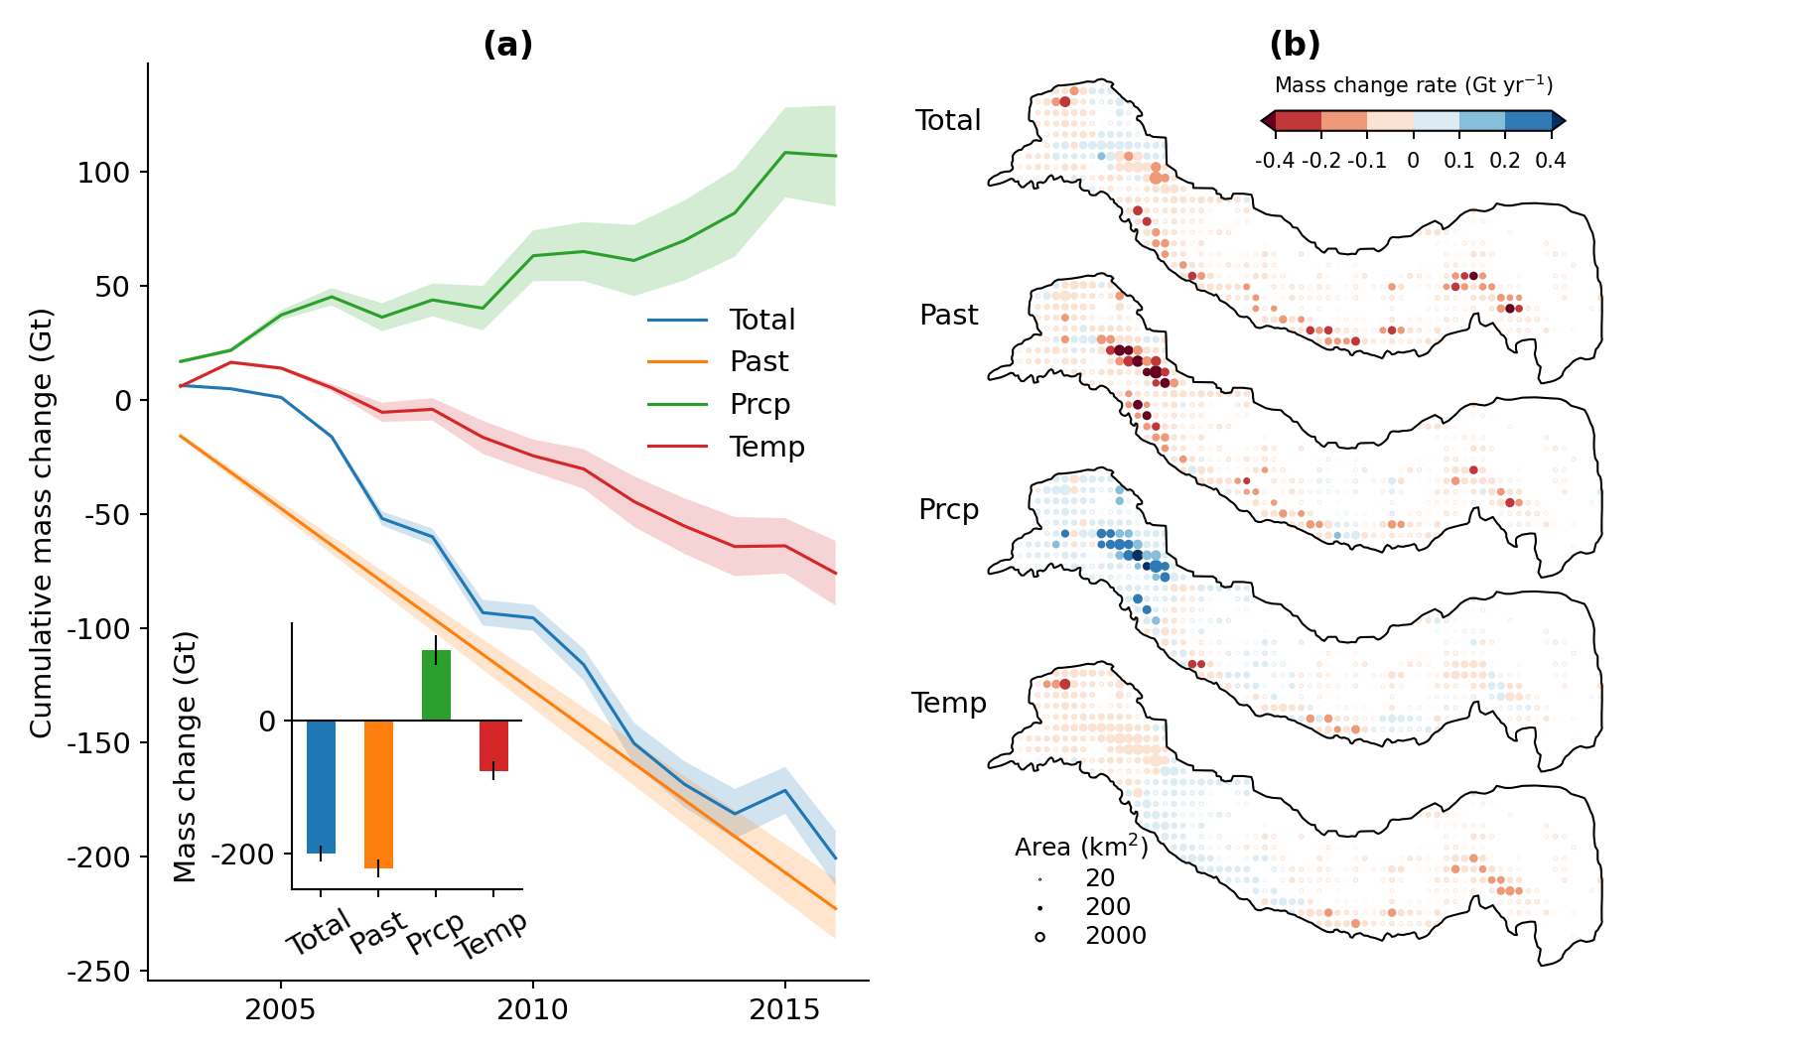
Discussion
Evidence 1 from glacier numerical modeling
Simulate 64713 glacier for Zhang et al. (2023) study area
Prcp (only varied precipitation)
Temp (only varied temperature)
Past (constant precipitation/ temperature)
“Karakoram Anomaly”
precipitation changes in 2003–2016 contributed to a glacier mass gain of 98.07 ±15.33 Gt
What does P-E deficits carried by westerlies in Zhang et al. (2023) mean? Reduced water vapor?
How precipitation sourced from NATO3 changes during 2003–2016?

Slide 13
Discussion
Evidence 2 from moisture tracking simulation
moisture contribution from NATO3 to the Himalayan precipitation did not decrease over the 2003–2016 period but showed an increasing trend (0.21 mm yr⁻¹, p=0.74), albeit statistically insignificant
What does P-E decline over the NATO3 mean in Zhang et al. (2023)?

Slide 14
Discussion
Evidence 3 from atmospheric budget
Atmospheric water budget
horizontal divergence of water vapor:
positive: moisture spreading out
negative: moisture converging
Assuming long-term
0
P-E ↓ means net water vapor ↑ leave from NATO3
How more water vapor leaving from NATO3 could lead to TWS decline in Zhang et al. (2023)?

Slide 15
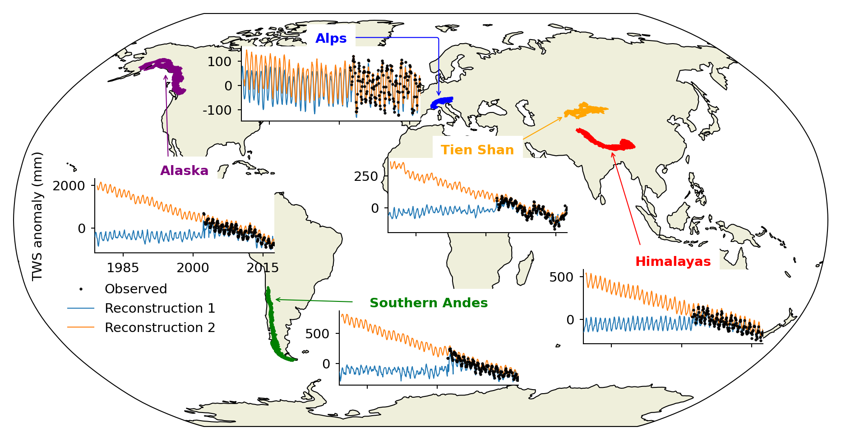
Implication
For TWS reconstruction/prediction in global alpine region
Tendency: use data-driven methods to reconstruct/predict TWS, but different datasets show large difference in alpine regions once into pre-GRACE-era
Use concurrent climate variables to train their models, but overlooked glacier lagged response in alpine regions
Some use climate variables with several months lag as inputs, while that is far enough as glaciers respond decades or longer

Slide 16
Summary
Nearly all TWS depletion (-11.65 ± 0.32 Gt yr⁻¹) in 2003-2016 came from glacier (-11.54 ± 0.08 Gt yr⁻¹) and ~71% of glacier mass loss would happen even if climate kept constant
TWS depletion in 2003-2016 mainly resulted from glacier lagged response to past climate change, rather than previously claimed concurrent climate variations
Need to redesign data-driven framework of TWS reconstruction/prediction in global alpine regions

Slide 17
References
Yao, T. et al. The imbalance of the Asian water tower. Nat Rev Earth Environ 3, 618–632 (2022).
Loomis, B. D. et al. Water Storage Trends in High Mountain Asia. Front. Earth Sci. 7, 235 (2019).
Zhang, Q. et al. Oceanic climate changes threaten the sustainability of Asia’s water tower. Nature 615, 87–93 (2023).
Zhao, Y., Xu, C., Yu, X., Liu, Y. & Ji, X. Atlantic oceanic droughts do not threaten Asian water tower. Nature 638, E13–E15 (2025).
Zhang, Q. et al. Reply to: Atlantic oceanic droughts do not threaten Asian water tower. Nature 638, E16–E18 (2025).
Thanks!
Q&A?

