Slide 1
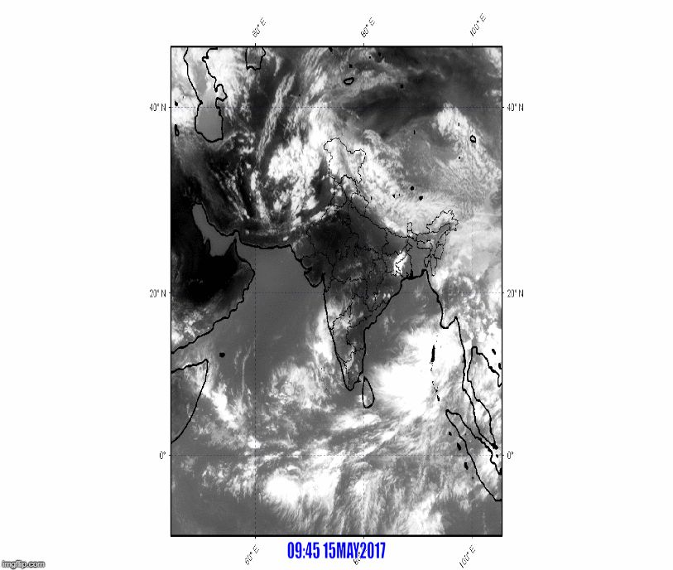
KALPANA IR Images Animation
ITCZ organizaed Convection Depression CS SCS Landfall

