Slide 1

Modeling and propagation evolution
of ocean internal solitary waves
Di Yu (于迪)
Advisor: Jinbao Song (宋金宝)
Ocean College, Zhejiang University,
2025.4.28

Slide 2
Contents
Research Background
Modeling Approaches
Preliminary progress
Conclusion

Slide 3
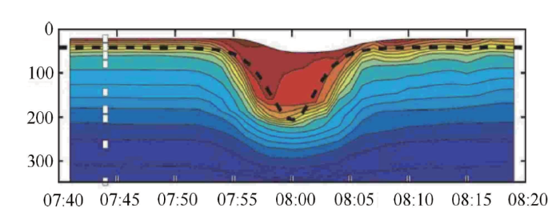
Research Background
What are Internal Solitary Waves (ISWs)?
Characteristics of ISWs：
Amplitude: Typically range from a few meters to tens of meters
Wavelength: Can vary from several hundred meters to kilometers.
Velocity: Propagation speeds can reach up to several meters per second.
ISWs are large amplitude, nonlinear waves that propagate in the ocean's pycnocline
They are characterized by their solitary nature—maintaining their shape over long distances

Slide 4
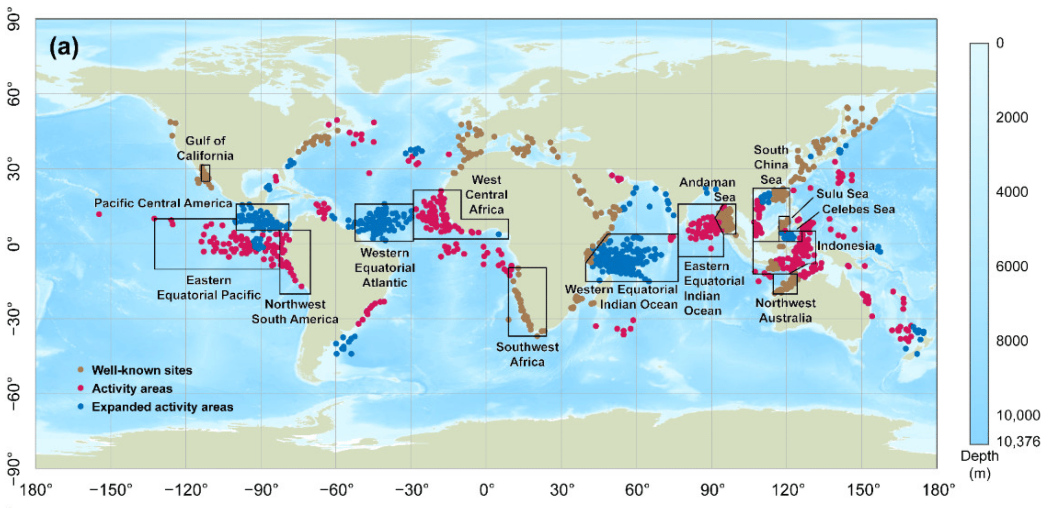
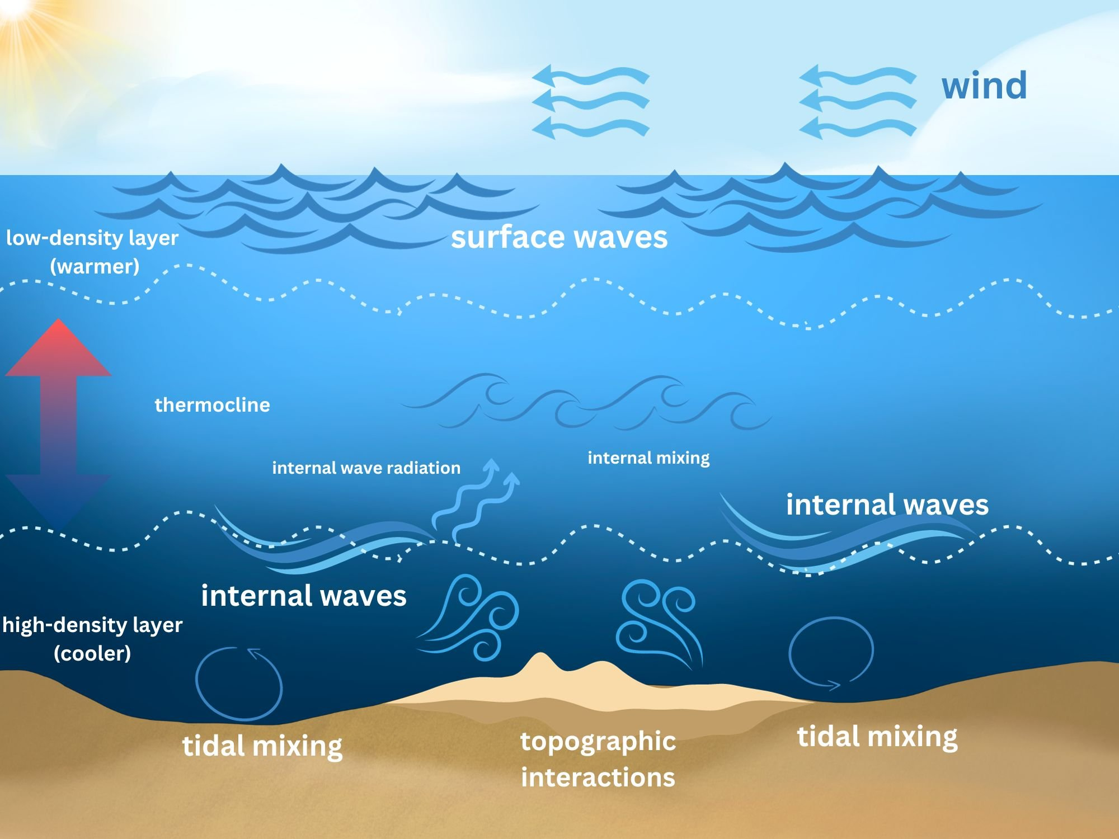
Research Background
Distribution and influence of ISWs
The impact of ISWs on
ocean mixing
energy transfer
marine ecosystems
Global internal waves observed in MODIS imagery from 2002 through 2004. (Chen, 2023)
Notes:
The well-known sites are regions where internal waves have been previously reported and their characteristics well-documented. The activity areas are regions where internal wave activity has been reported but their characteristics have not been determined. The expanded activity areas are regions in which the MODIS survey found a significant amount of internal wave activity where little or no activity had been previously reported.

Slide 5
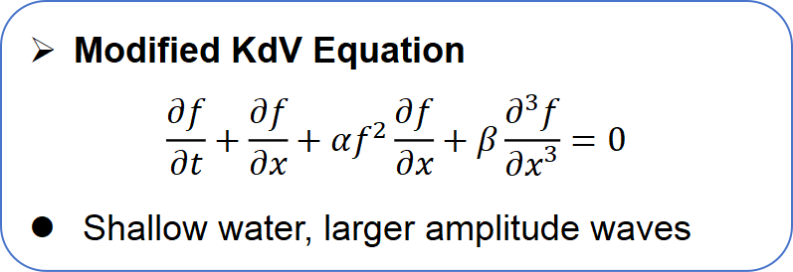
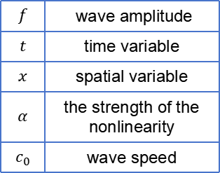
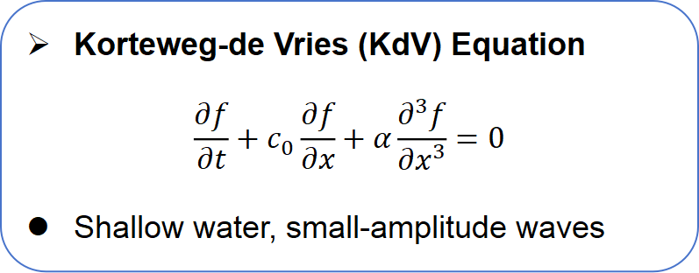
Modeling Approaches
Mathematical Models
wave amplitude increases
Korteweg-de Vries (KdV) Equation
$$\frac{∂f}{∂t}+c_{0}\frac{∂f}{∂x}+α\frac{∂^{3}f}{∂x^{3}}=0$$
Shallow water, small-amplitude waves
however
the influence of the higher-order nonlinear term grows
disrupting the balance between nonlinearity and dispersion
Modified KdV Equation
$$\frac{∂f}{∂t}+\frac{∂f}{∂x}+αf^{2}\frac{∂f}{∂x}+β\frac{∂^{3}f}{∂x^{3}}=0$$
Shallow water, larger amplitude waves
$$f$$ | wave amplitude
$$t$$ | time variable
$$x$$ | spatial variable
$$α$$ | the strength of the nonlinearity
$$c_{0}$$ | wave speed

Slide 6
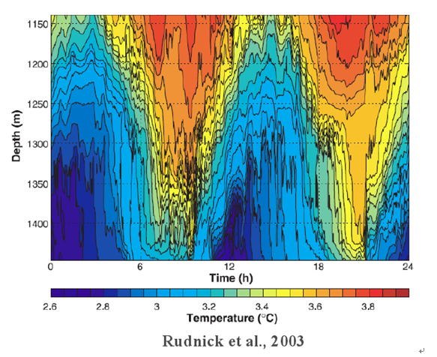
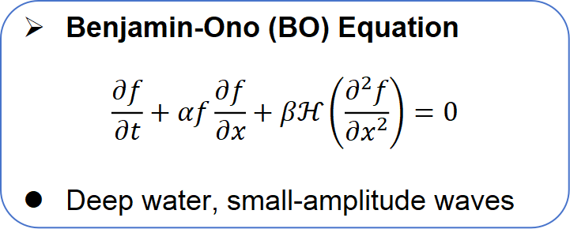
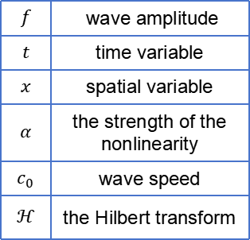
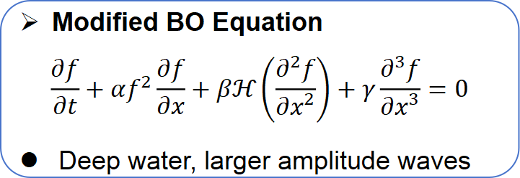
Modeling Approaches
Mathematical Models
Benjamin-Ono (BO) Equation
$$\frac{∂f}{∂t}+αf\frac{∂f}{∂x}+βℋ\left(\frac{∂^{2}f}{∂x^{2}}\right)=0$$
Deep water, small-amplitude waves
perturbation expansion
multi-scale analysis
Modified BO Equation
$$\frac{∂f}{∂t}+αf^{2}\frac{∂f}{∂x}+βℋ\left(\frac{∂^{2}f}{∂x^{2}}\right)+γ\frac{∂^{3}f}{∂x^{3}}=0$$
Deep water, larger amplitude waves
$$f$$ | wave amplitude
$$t$$ | time variable
$$x$$ | spatial variable
$$α$$ | the strength of the nonlinearity
$$c_{0}$$ | wave speed
$$ℋ$$ | the Hilbert transform
Our:

Slide 7
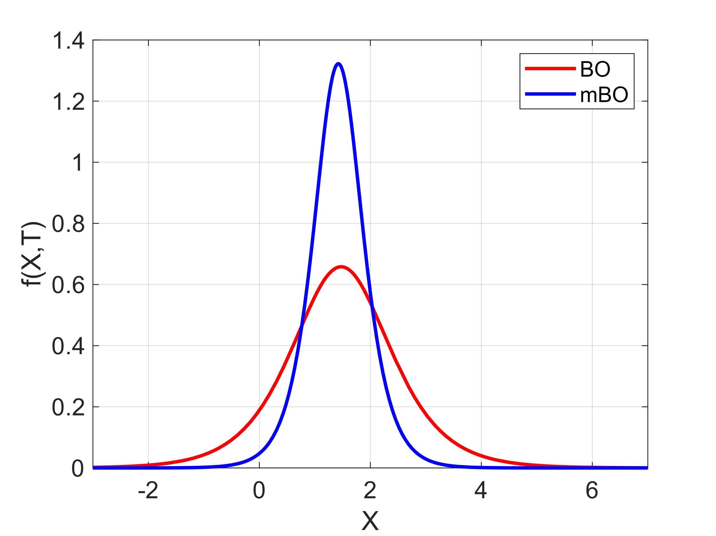
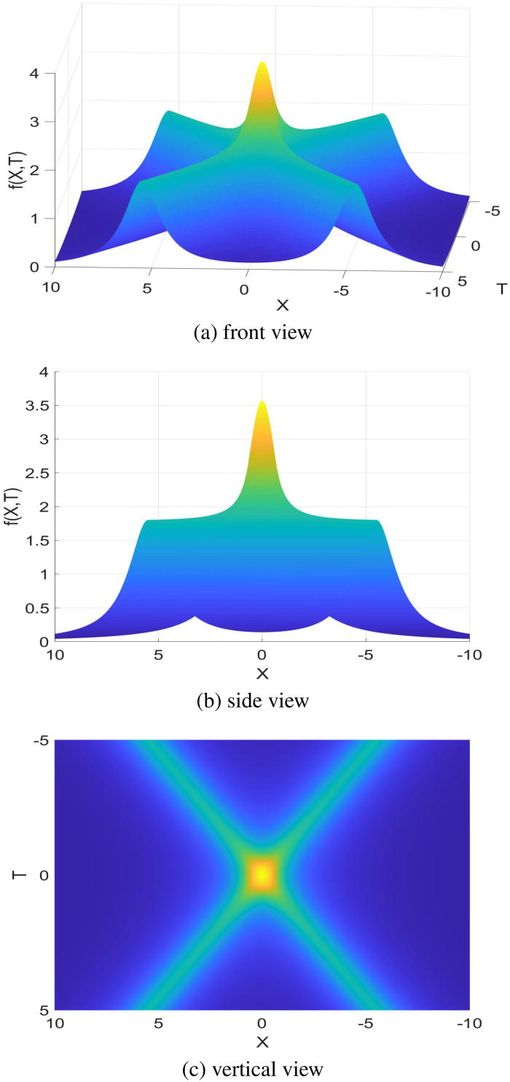
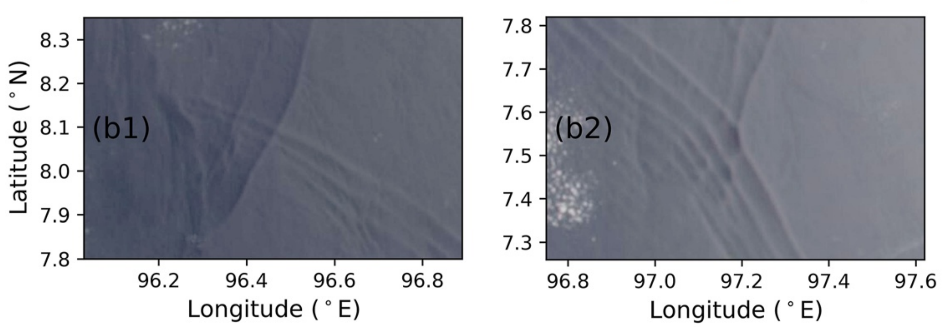
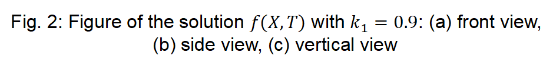
Preliminary progress
Fig. 2: Figure of the solution $f(X,T)$ with $k_{1}=0.9$: (a) front view, (b) side view, (c) vertical view
Fig. 1: Comparison of the one-soliton solution of the BO equation and the mBO equation
higher amplitude
NASA Worldview satellite remote sensing images, captured on August 21, 2020

Slide 8
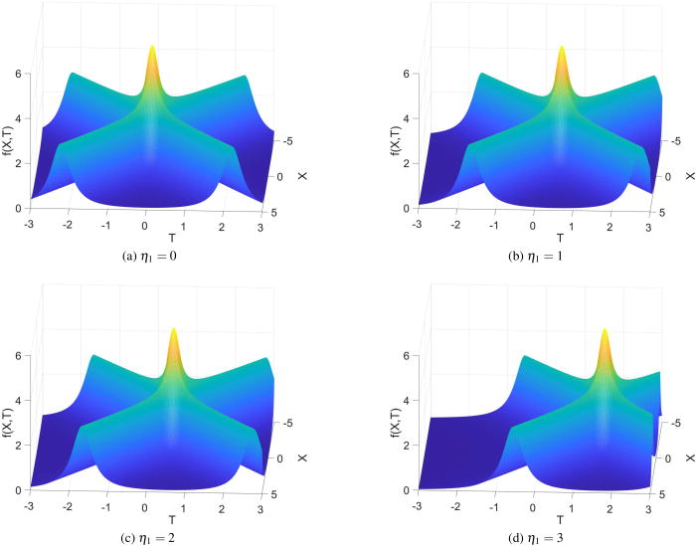
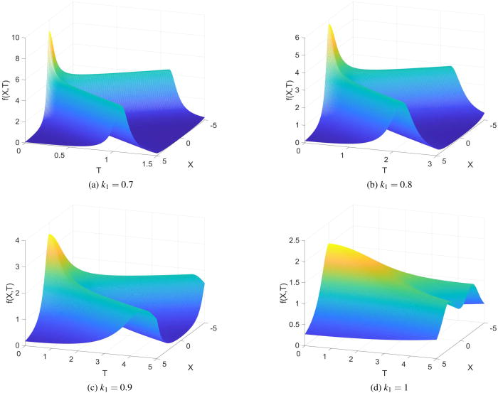
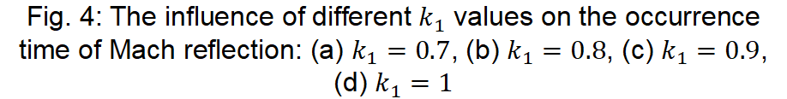
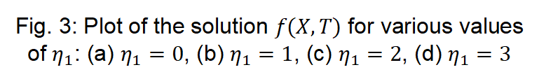
Preliminary progress
Fig. 3: Plot of the solution $f(X,T)$ for various values of $η_{1}$: (a) $η_{1}=0$, (b) $η_{1}=1$, (c) $η_{1}=2$, (d) $η_{1}=3$
Fig. 4: The influence of different $k_{1}$ values on the occurrence time of Mach reflection: (a) $k_{1}=0.7$, (b) $k_{1}=0.8$, (c) $k_{1}=0.9$, (d) $k_{1}=1$

Slide 9
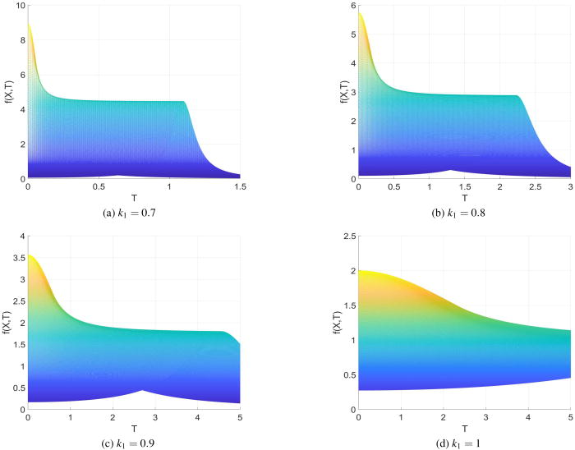
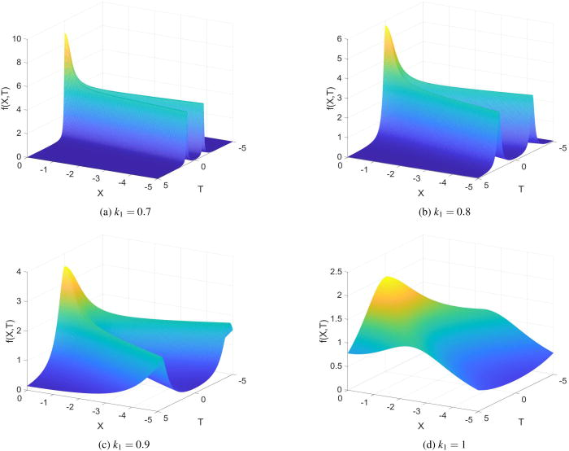
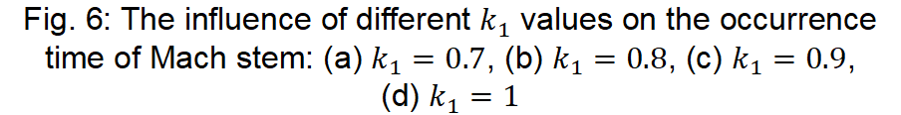
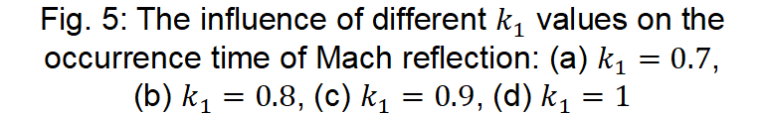
Preliminary progress
Fig. 5: The influence of different $k_{1}$ values on the occurrence time of Mach reflection: (a) $k_{1}=0.7$,
(b) $k_{1}=0.8$, (c) $k_{1}=0.9$, (d) $k_{1}=1$
Fig. 6: The influence of different $k_{1}$ values on the occurrence time of Mach stem: (a) $k_{1}=0.7$, (b) $k_{1}=0.8$, (c) $k_{1}=0.9$,
(d) $k_{1}=1$

Slide 10
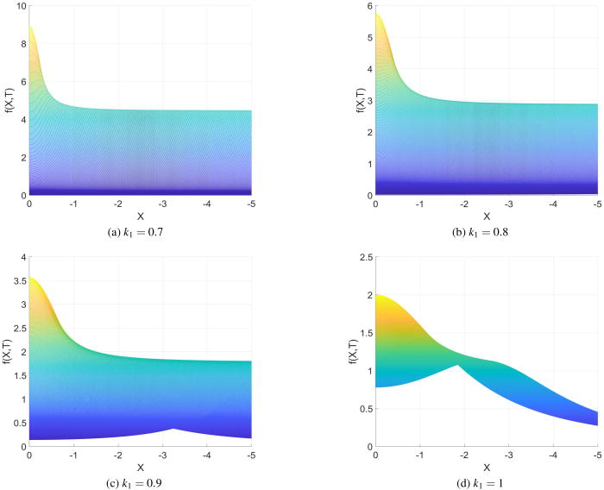
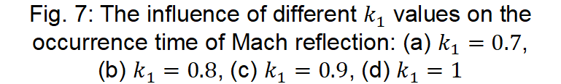
Preliminary progress
Fig. 7: The influence of different $k_{1}$ values on the occurrence time of Mach reflection: (a) $k_{1}=0.7$,
(b) $k_{1}=0.8$, (c) $k_{1}=0.9$, (d) $k_{1}=1$

Slide 11
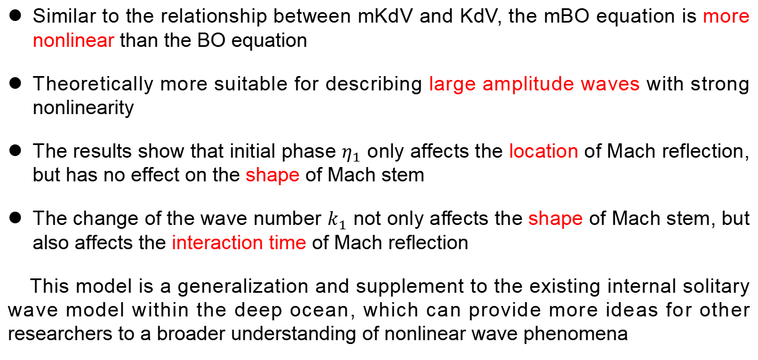
Conclusion
Similar to the relationship between mKdV and KdV, the mBO equation is more nonlinear than the BO equation
Theoretically more suitable for describing large amplitude waves with strong nonlinearity
The results show that initial phase $η_{1}$ only affects the location of Mach reflection, but has no effect on the shape of Mach stem
The change of the wave number $k_{1}$ not only affects the shape of Mach stem, but also affects the interaction time of Mach reflection
This model is a generalization and supplement to the existing internal solitary wave model within the deep ocean, which can provide more ideas for other researchers to a broader understanding of nonlinear wave phenomena

Slide 12
Conclusion
The findings of this research have been published in the journal Physics of Fluids:
D, Yu and J.B. Song, “The modified cubic Benjamin-Ono equation describing internal solitary waves in the deep ocean and its related properties”, Physics of fluids, 2024 (36) 067107. DOI: 10.1063/5.0210945.

Slide 13

THANKS！
2025/4/28

