Slide 1
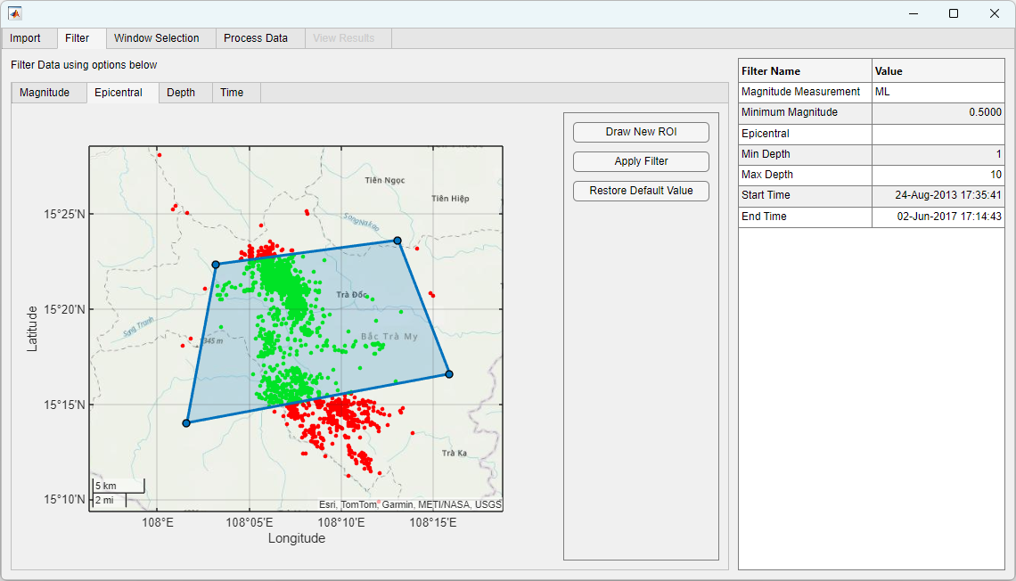
Interactive Time-Dependent Seismic Hazard Assessment with SHAppE Andrew Redfearn¹ and Kostas Leptokaropoulos^{1,2} [1] MathWorks UK [2] University of Southampton
The Seismic Hazard Parameters Evaluation (SHAPE) toolbox
(Leptokaropoulos and Lasocki, SRL, 2020, https://doi.org/10.1785/0220190319)
has evolved into…
SHAppE - An interactive MATLAB app
SHAppE facilitates probabilistic assessment of seismic hazard parameters, including the mean return period (MRP) and exceedance probability (EP) of earthquake magnitudes, along with confidence intervals.

Slide 2
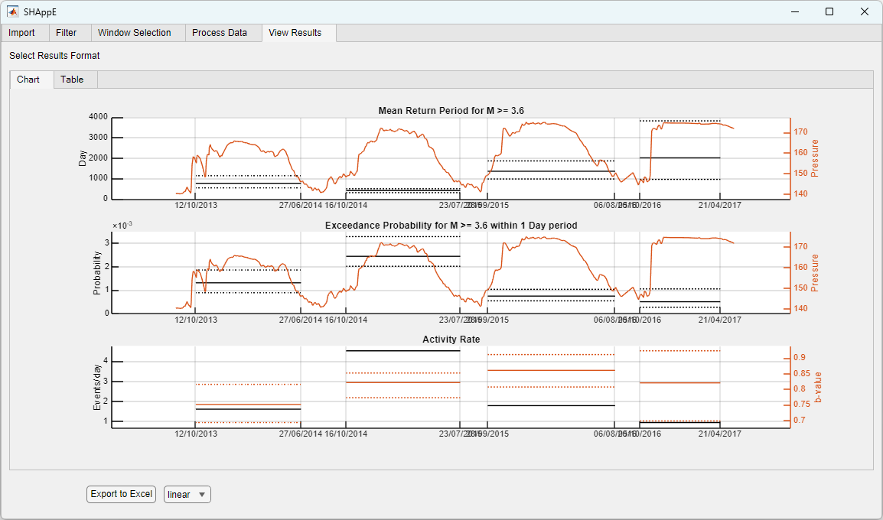
The SHAppE workflow
Import
Filter
Process
Results
Import Seismic and Production Data
Filter data by:
Magnitude
Epicentral Location
Depth
Time
Select time windows and apply unbounded or truncated
Gutenberg-Richter law
non-parametric Kernel density estimation
View results in app and export complete workflow and results to spreadsheet

Slide 3
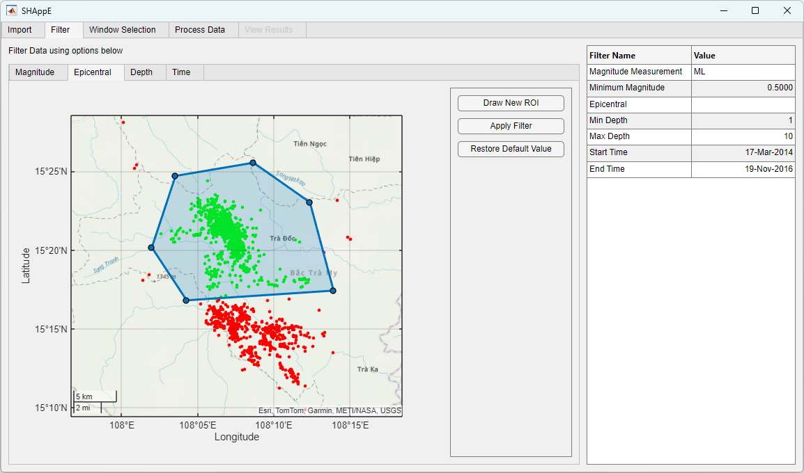
Filtering Options
Magnitude
Epicentral

Slide 4
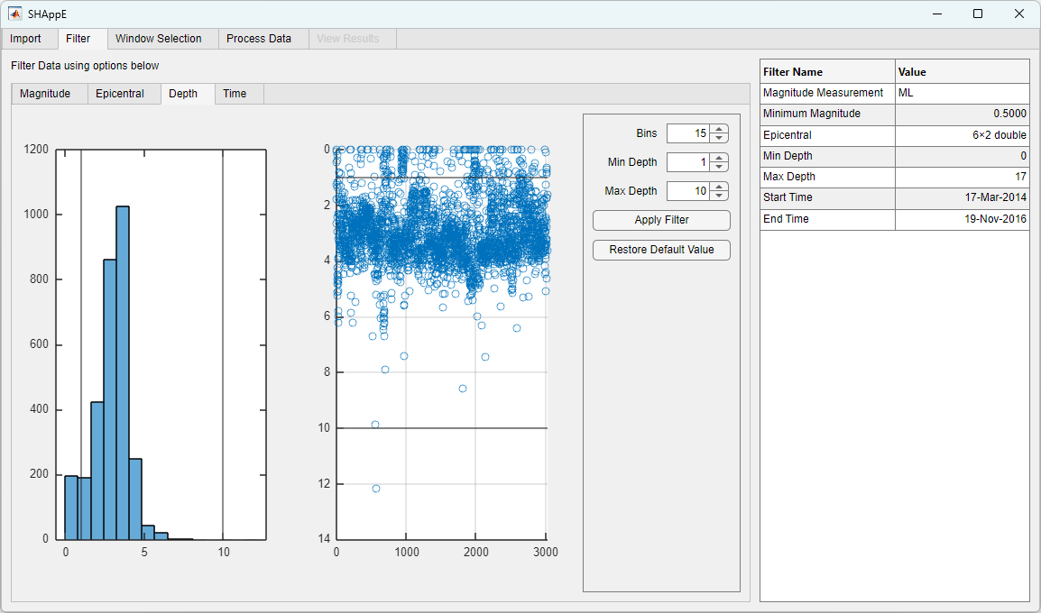
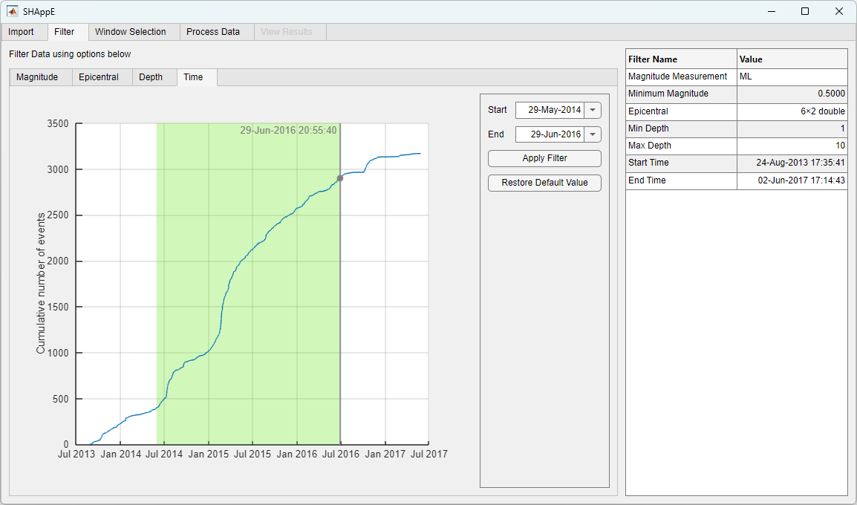
Filtering Options
Depth
Time

Slide 5
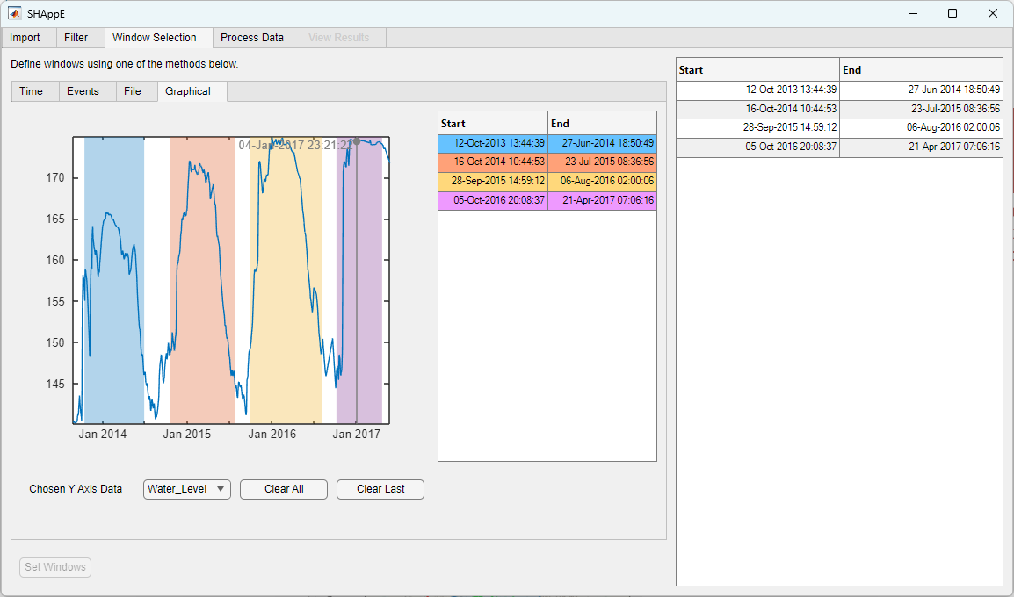
Window Selection
Set windows based on time or events
Dynamic selection
Set windows using file

Slide 6
Processing and Results

Slide 7
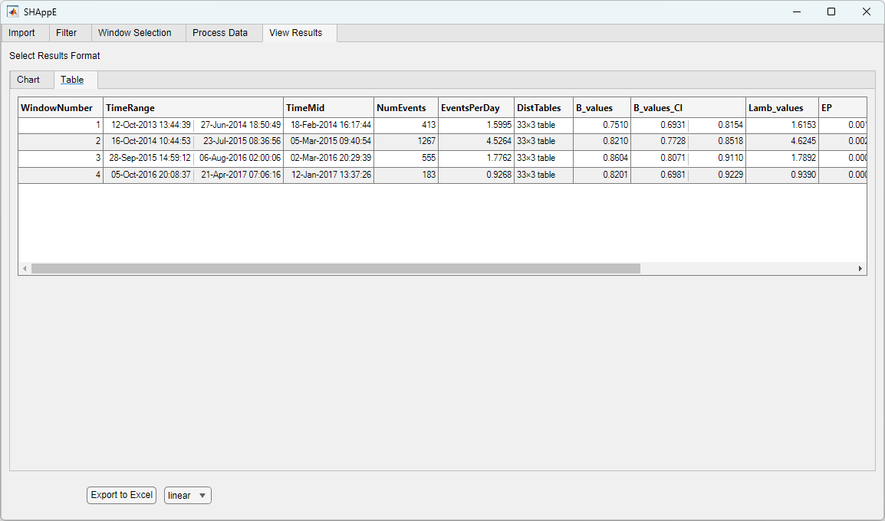
Processing and Results

Slide 8
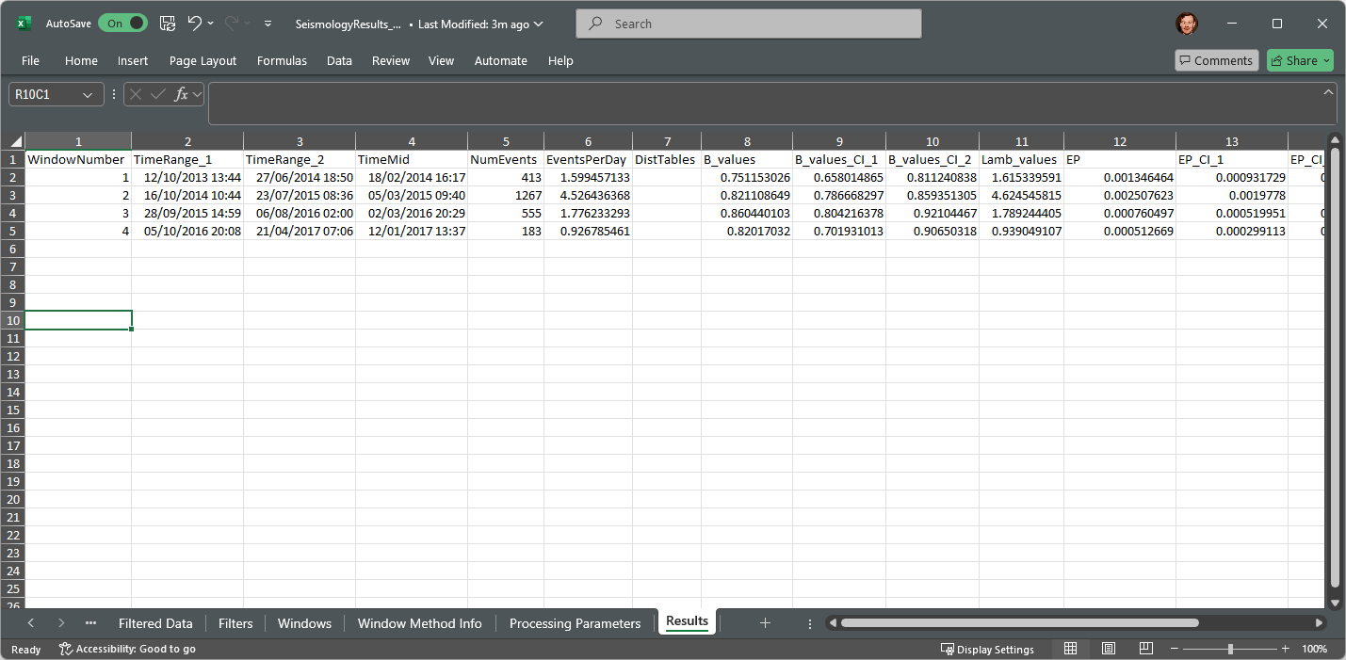
Export as spreadsheet

Slide 9
For a demo of SHAppE visit us at: booth #26 Yellow Level – Ground Floor
Andrew Redfearn
email: aredfear@mathworks.com
Kostas Leptokaropoulos
email: kleptoka@mathworks.com

