Slide 1
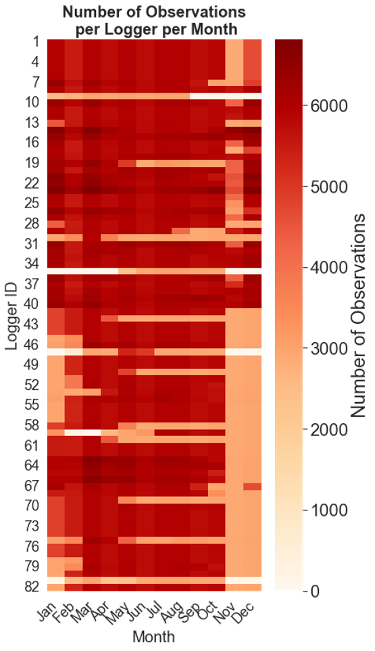
FIGURE S1: The number of datapoints for each groundwater level logger.
The urban area is covered by well logger 1-40 and the rural area by well logger 41-82.
The winter observations are less represented at the rural site.

Slide 2
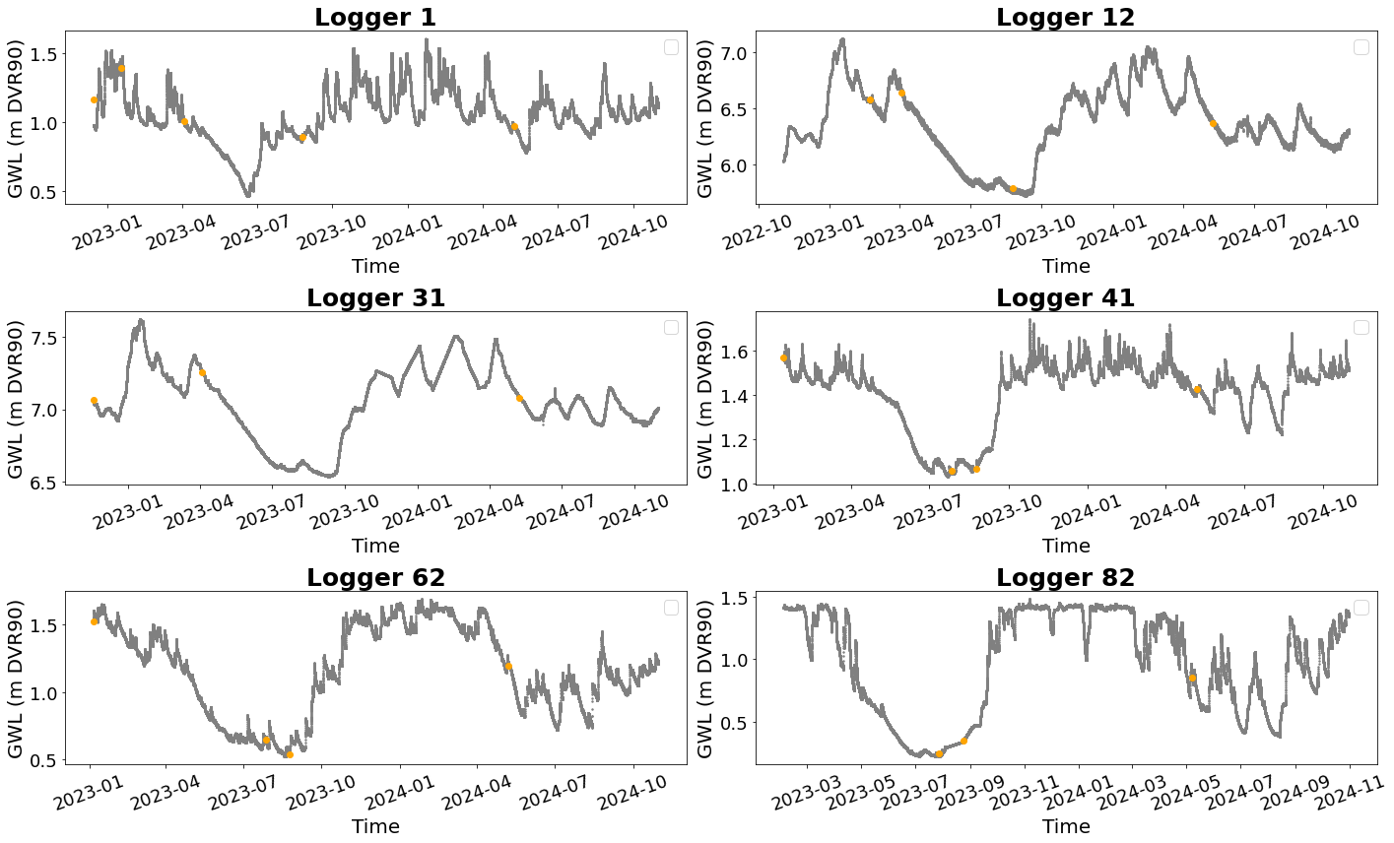
FIGURE S2: Full timeseries of the monitored groundwater level in six wells representing the two study sites; 1, 12, an 31 (urban) and 41, 62, 82 (rural). Orange dots are control measurements.

Slide 3
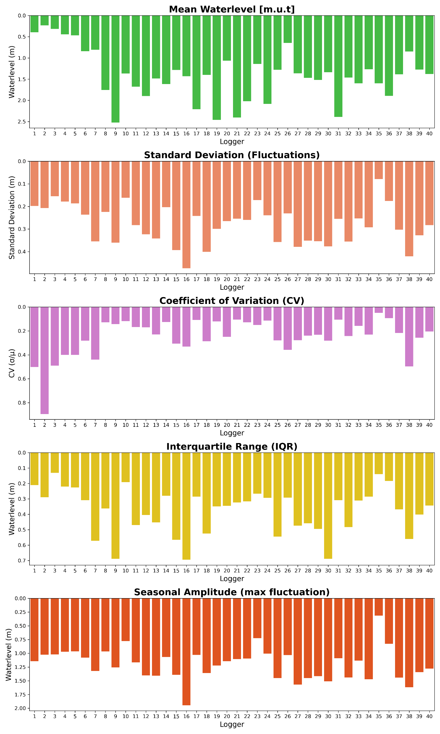
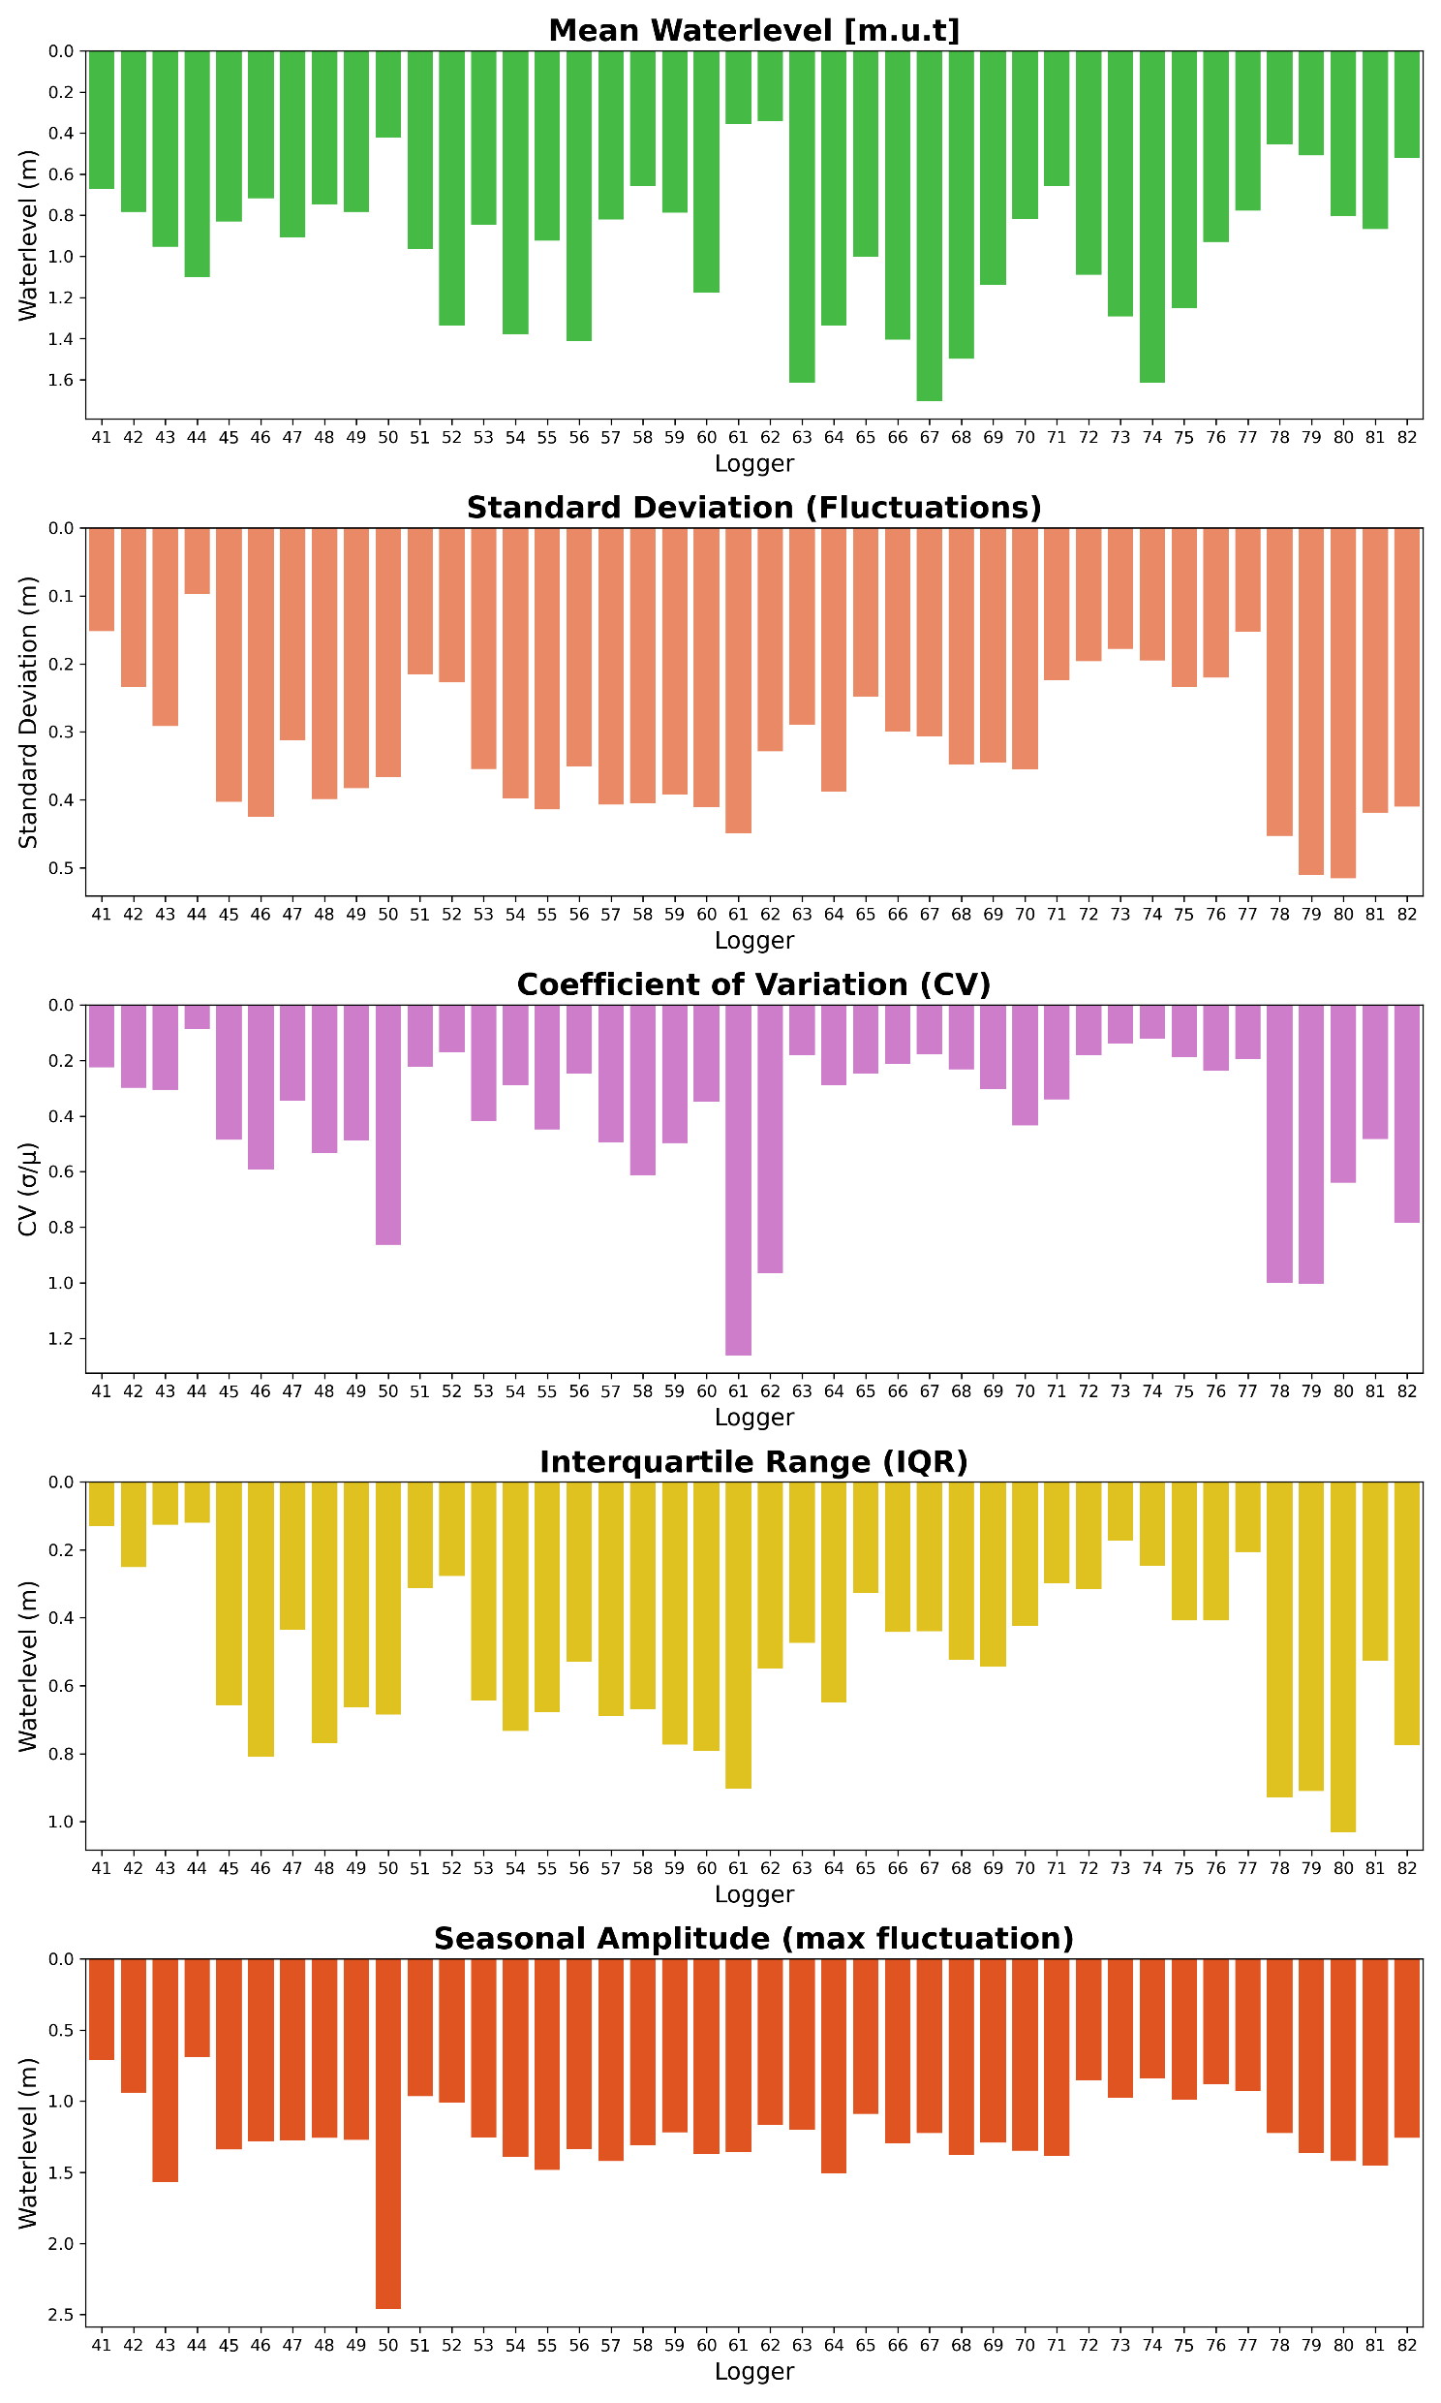
FIGURE S3: General statistical parameters for each well logger at the urban study site (left) and the rural study site (right)

Slide 4
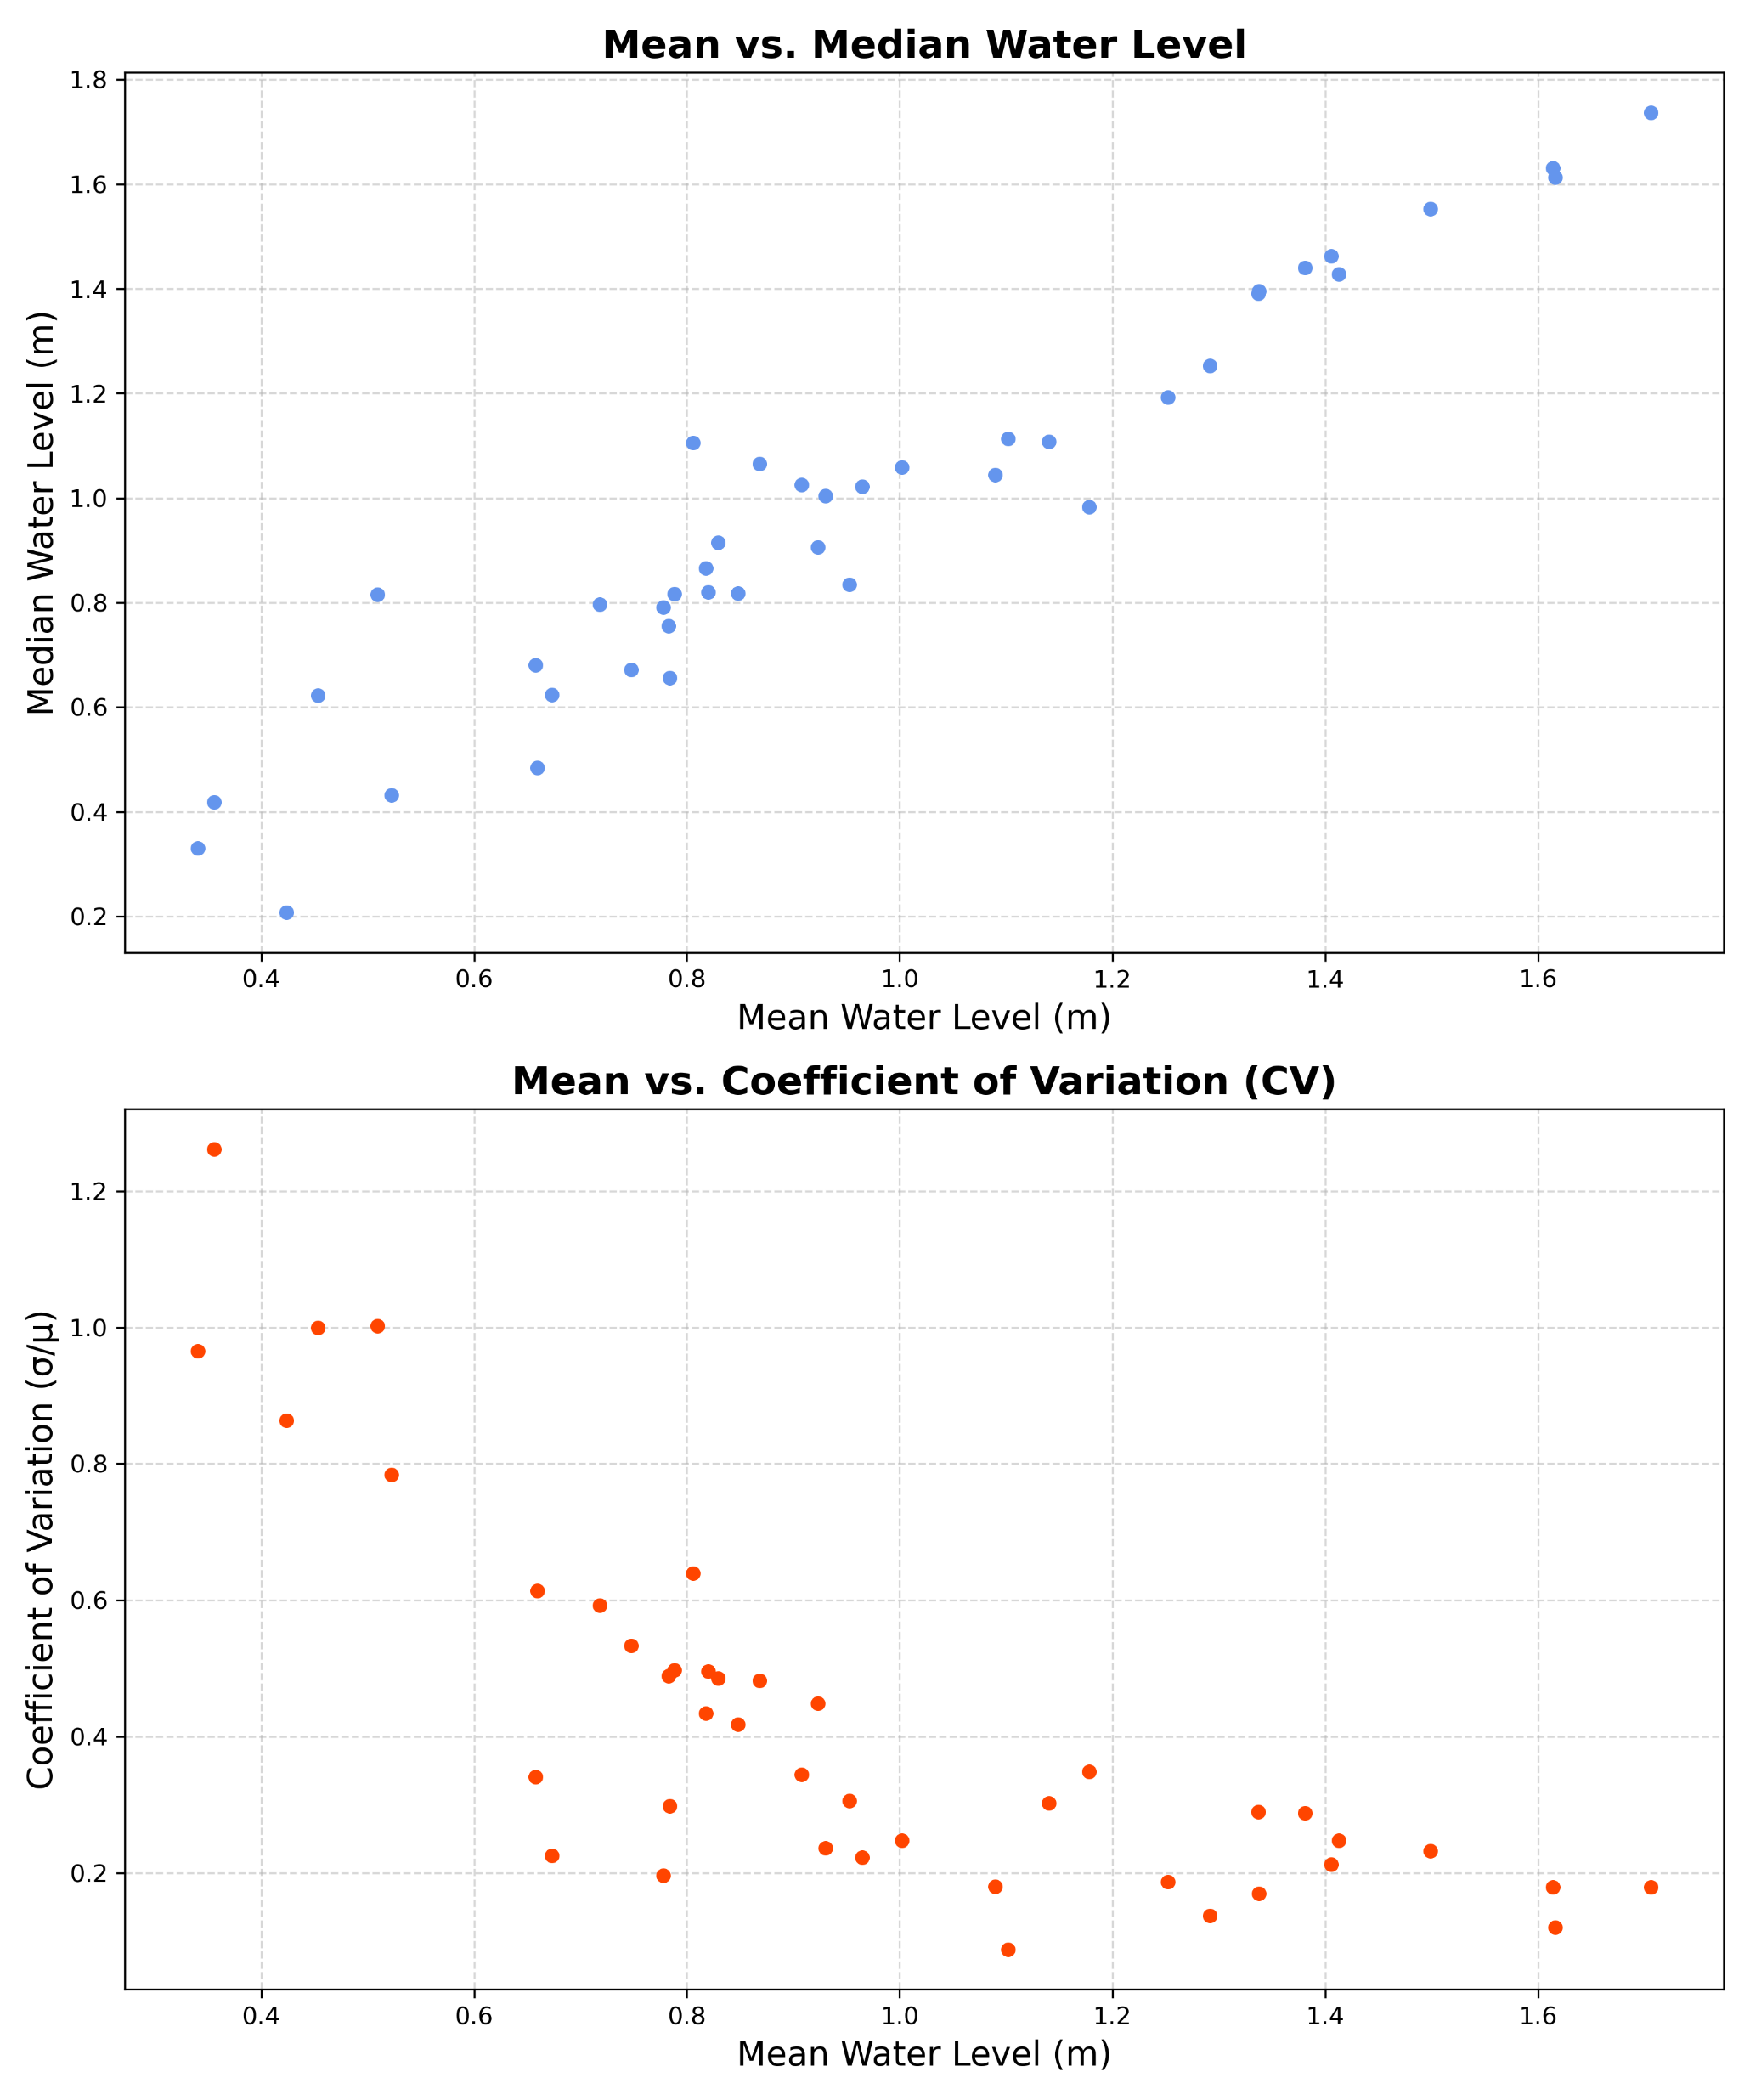
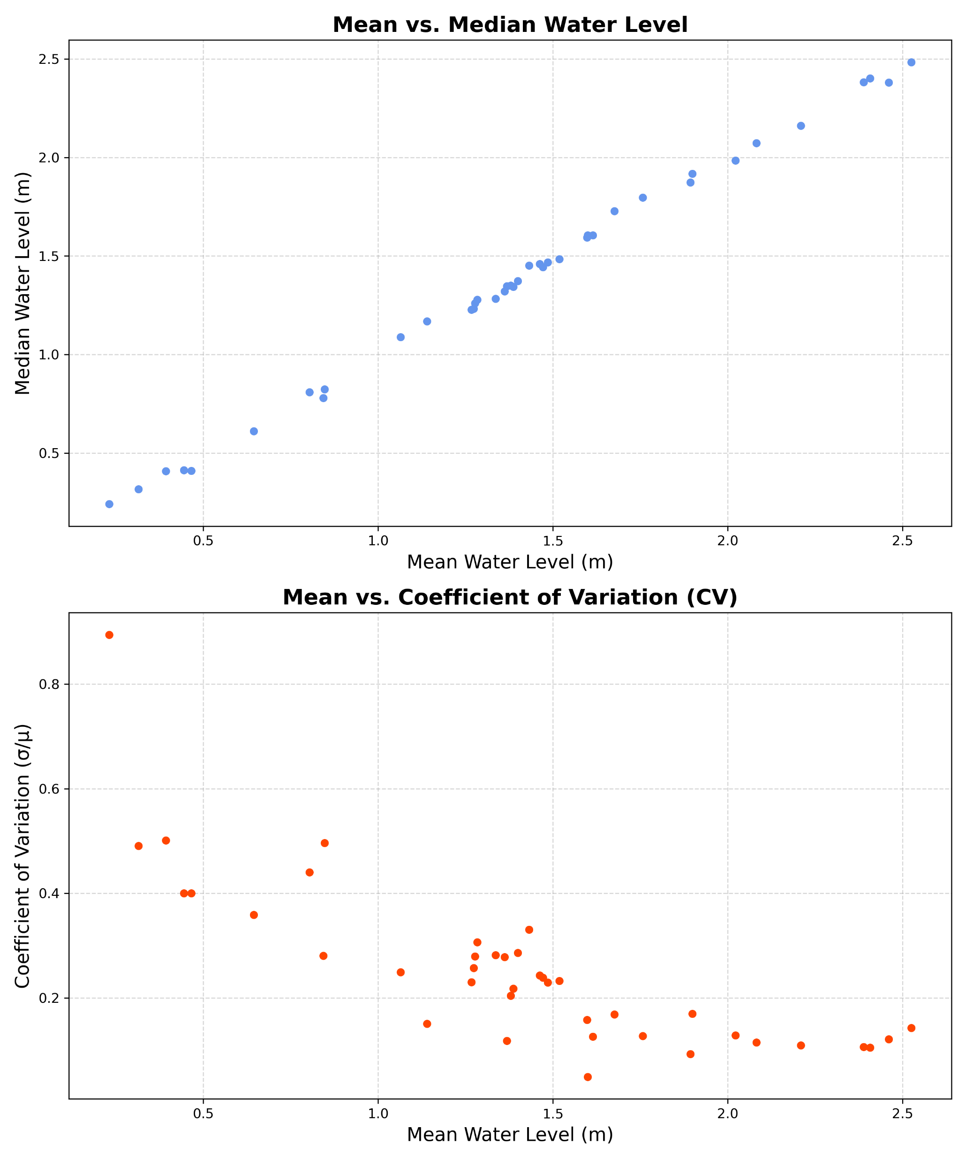
RURAL STUDY SITE URBAN STUDY SITE
FIGURE S4: Scatter plot of the mean water level vs. the median water level, showing a higher degree of deviation close to terrain at the rural site.

Slide 5
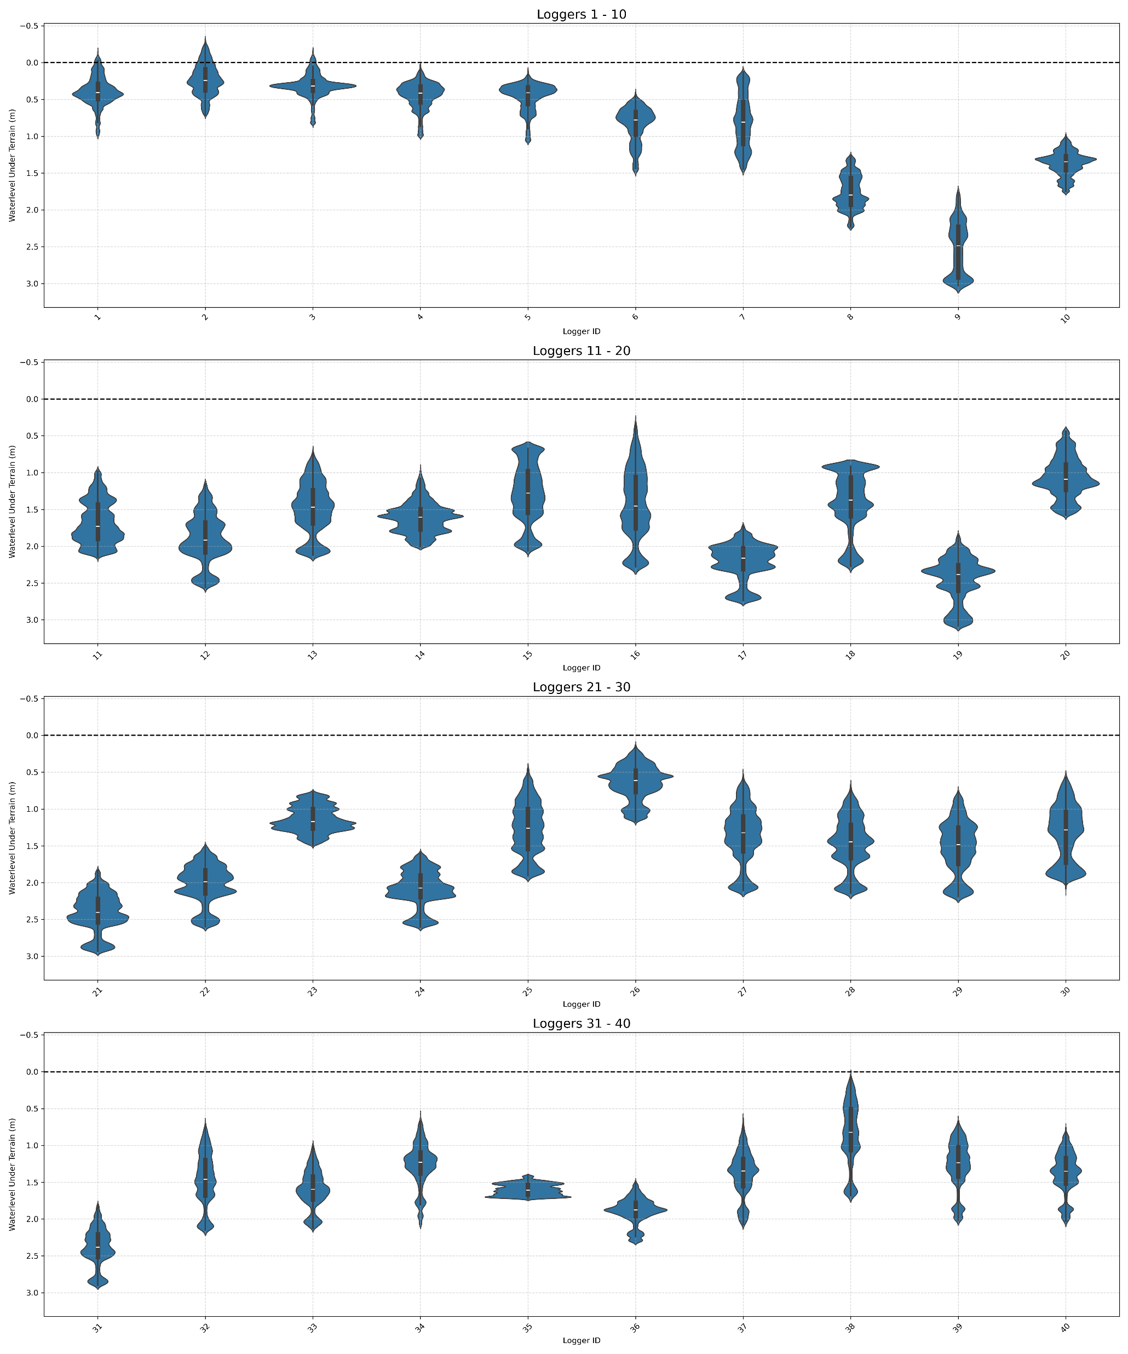
FIGURE S5: Violinplot showing the groundater level in each well during the full monitoring period at the urban study site.

Slide 6
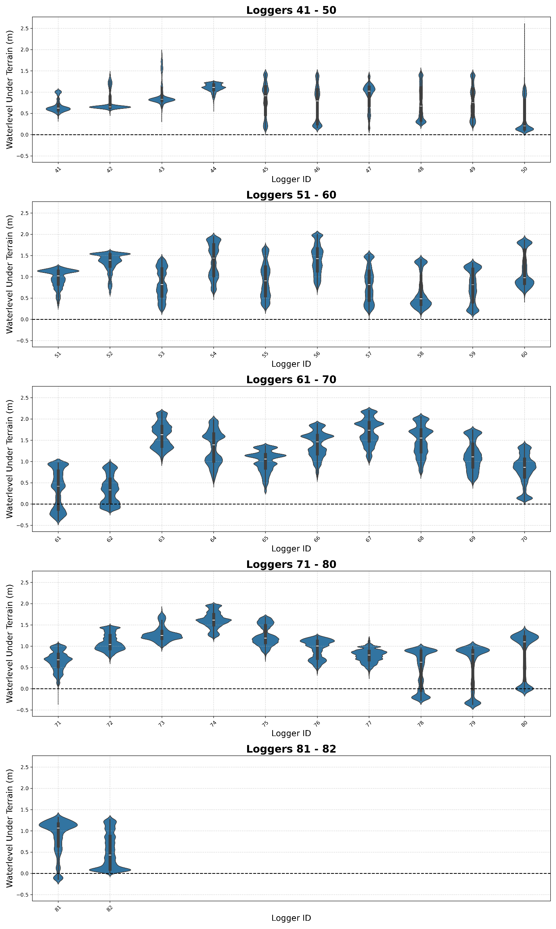
FIGURE S6: Violinplot showing the groundater level in each well during the full monitoring period at the rural study site.

Slide 7
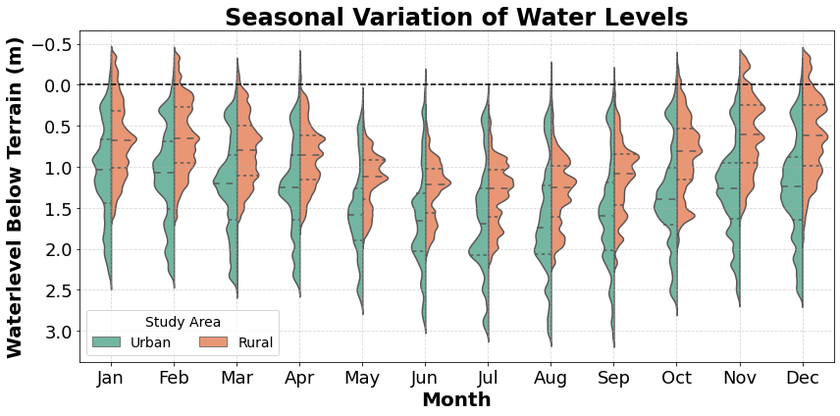
FIGURE S7: Violinplot showing the average monthly groundwater level at the two study site.

Slide 8
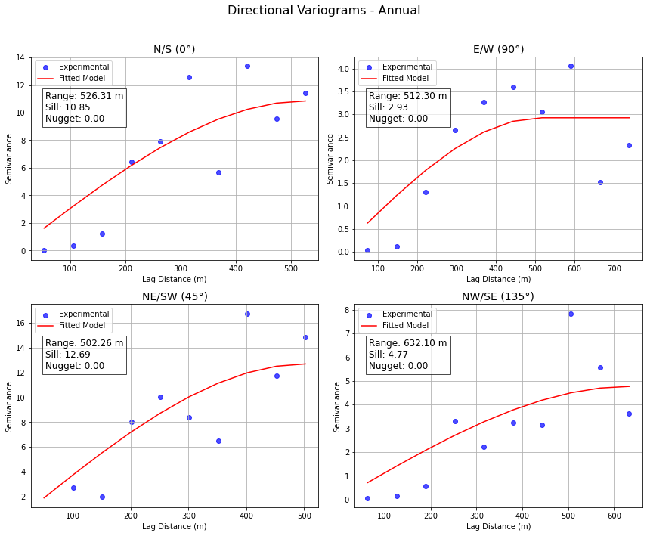
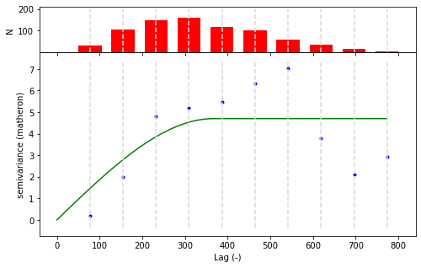
FIGURE S8: Variogram and directional variogram for the full dataset representing the urban study area.

Slide 9
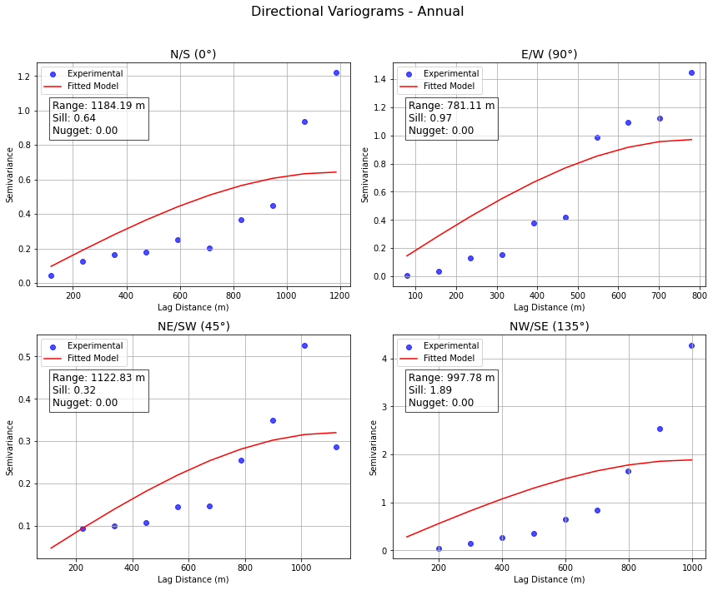
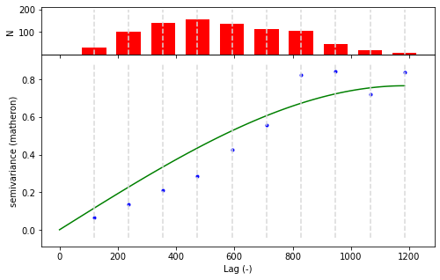
FIGURE S9: Variogram and directional variogram for the full dataset representing the rural study area.

Slide 10
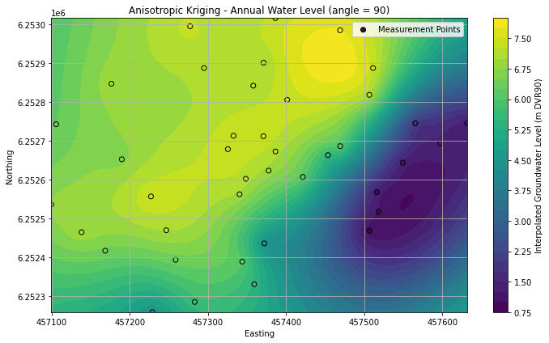
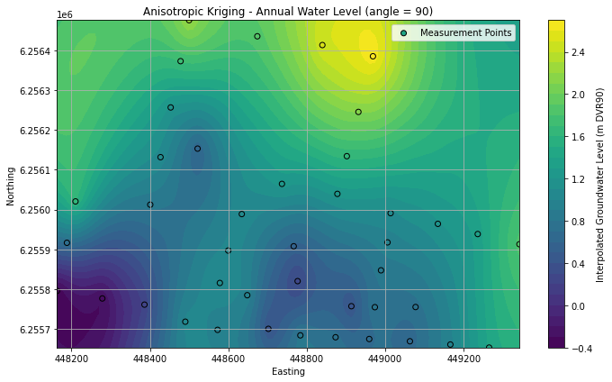
FIGURE S10: Preliminary results showing interpolation of the hydraulic head at the urban study site (left and the rural study site (right). The interpolation method is anisotropic kriging and the hydraulic head represents the average water level during the full monitoring period.

Slide 11
FIGURE S11: Extracted precipitation events from the full monitoring period. The wet events are categorised based on the total precipitation amount the previous week. Antecedent conditions are categorised as wet if the weekly precipitation exceeds 29.5mm which is the average precipitation times two.

Slide 12
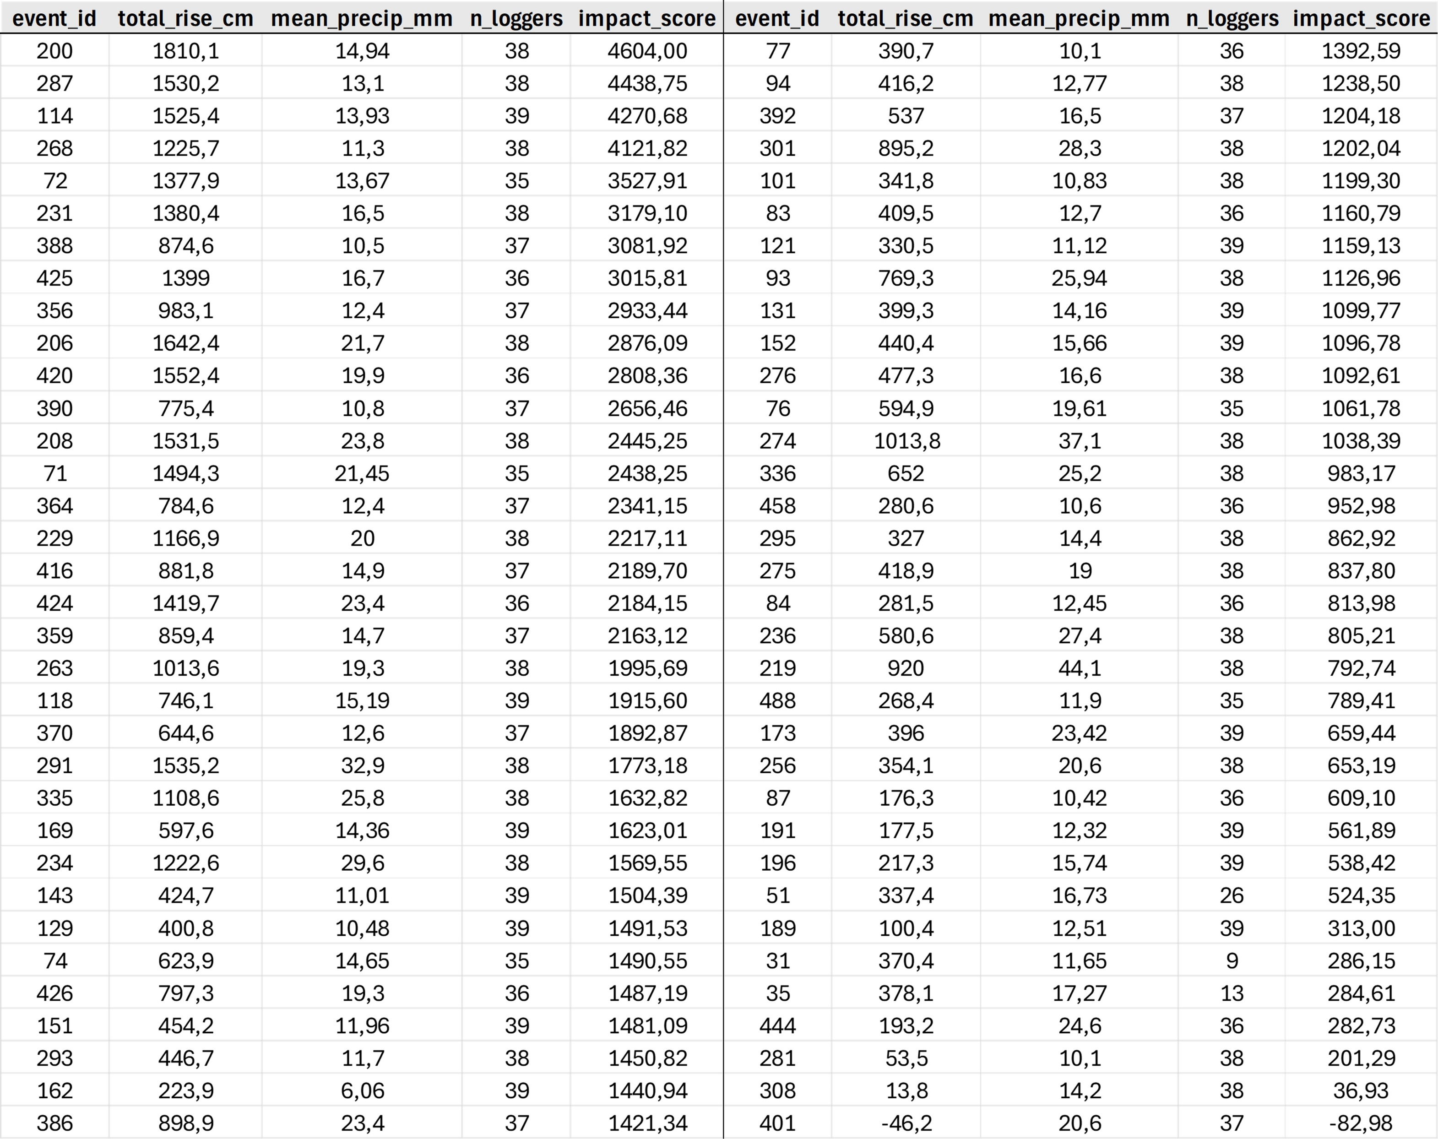
TABLE S1: All the extracted precipitation events ranked by their impact. The impact is calculated by multiplying the total rise with the number of well loggers affected and dividing it by the mean precipitation.

Slide 13
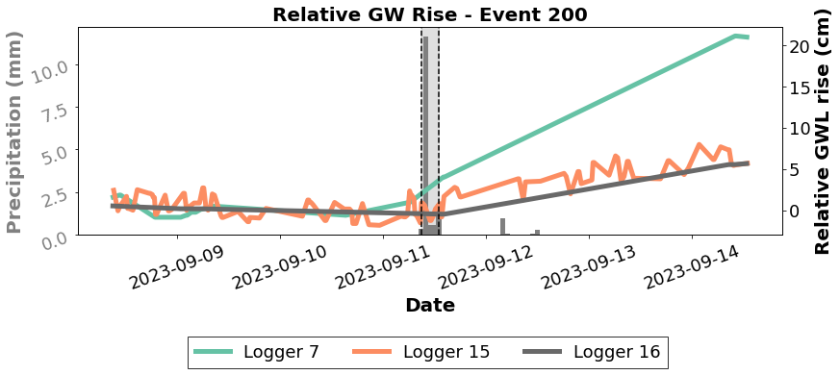
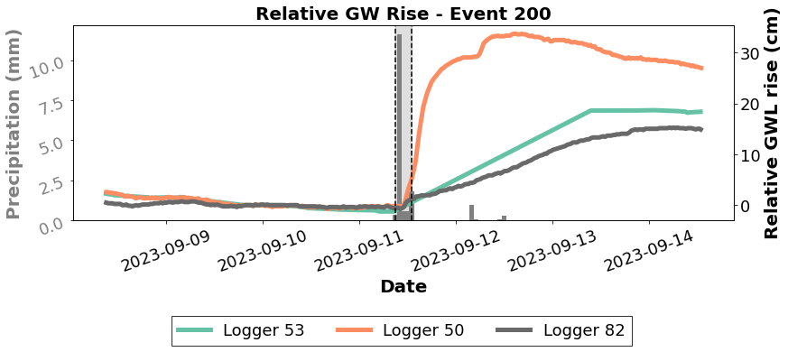
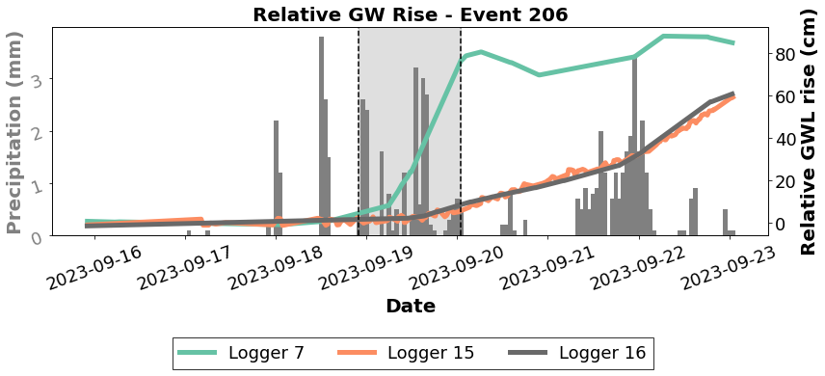
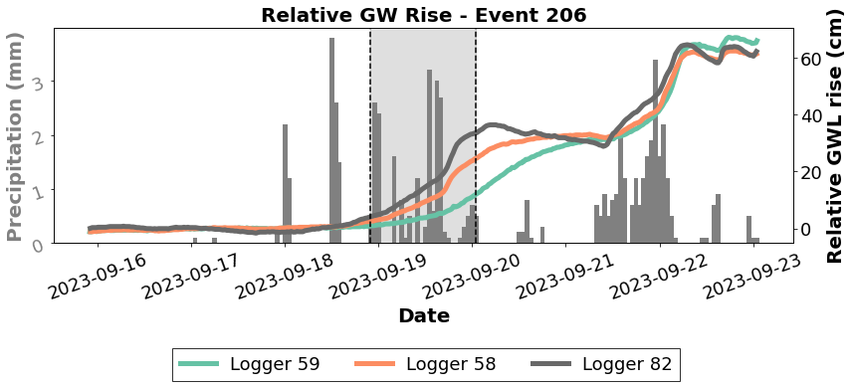
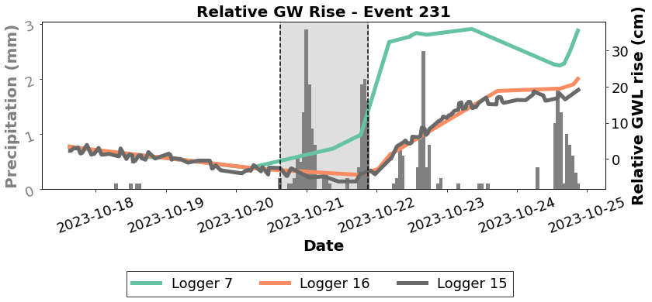
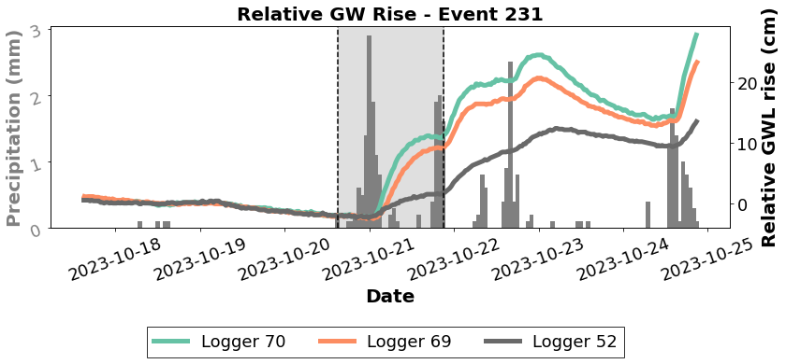
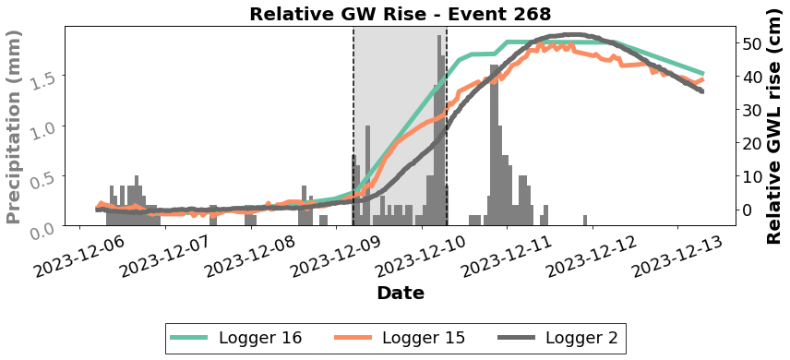
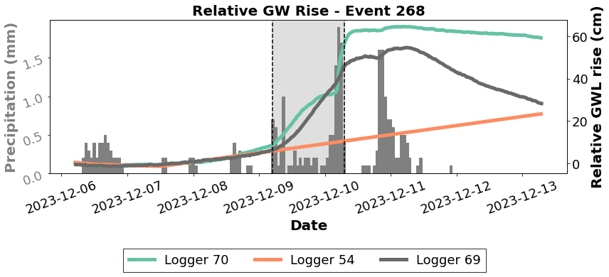
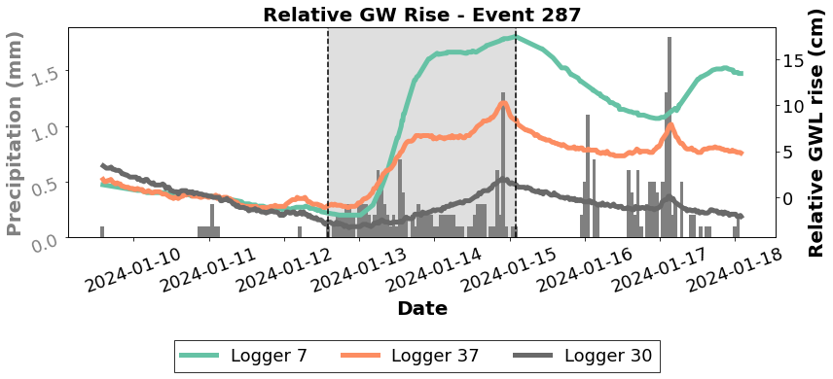
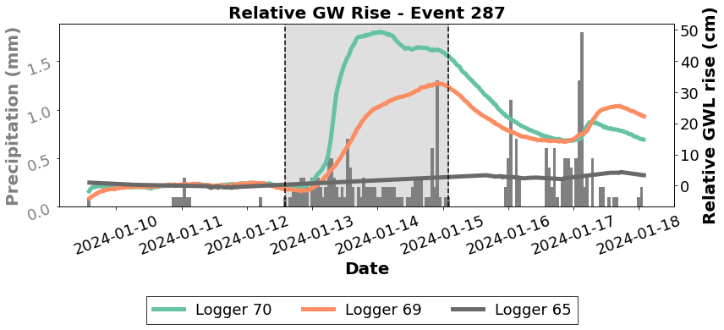
FIGURE S12: An overview of the top five ranked precipitation event and their three best responding well loggers. The time period is three days prior to and three days after the event. The results are preliminary and has not been manually examined yet.

Slide 14
TABLE S2: Table showing the effect of moisture conditions befaore a precipitation event. The conditions are categorized as wet, when the total precipitation amount the previous week exceeds twice the average rainfall during an average week.

Slide 15
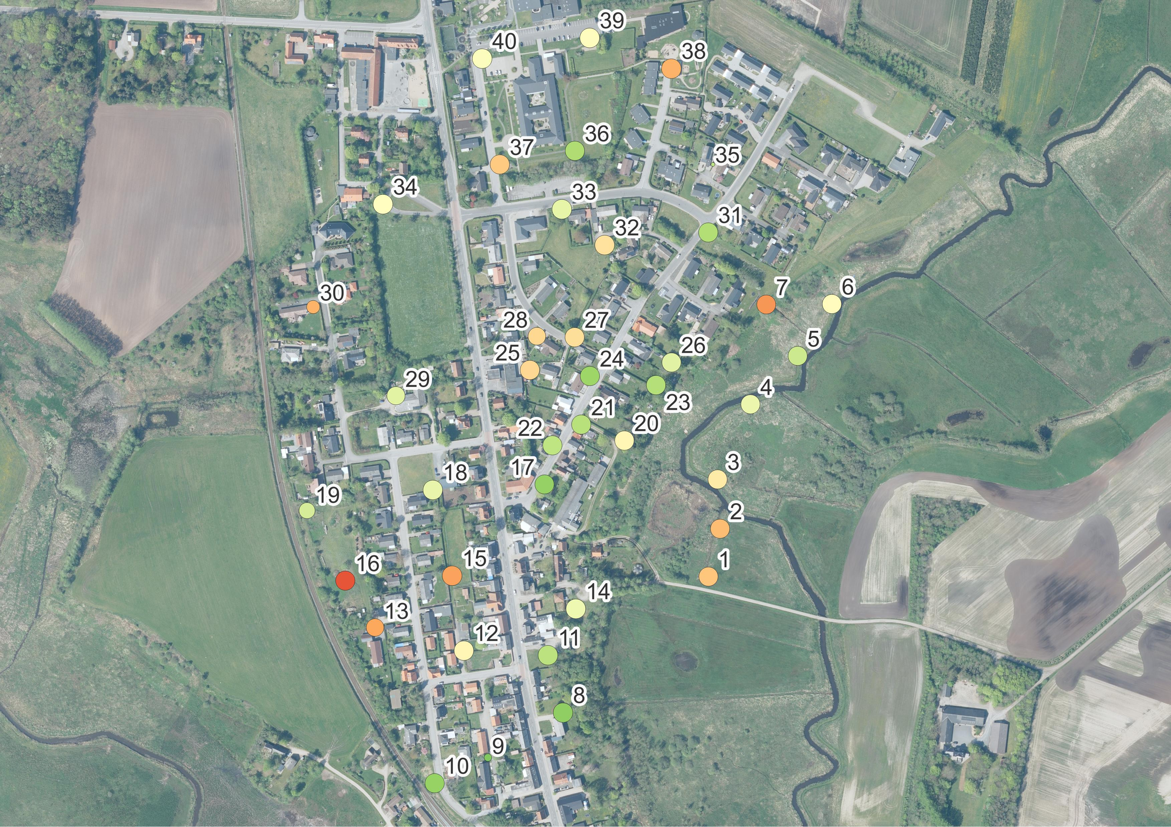
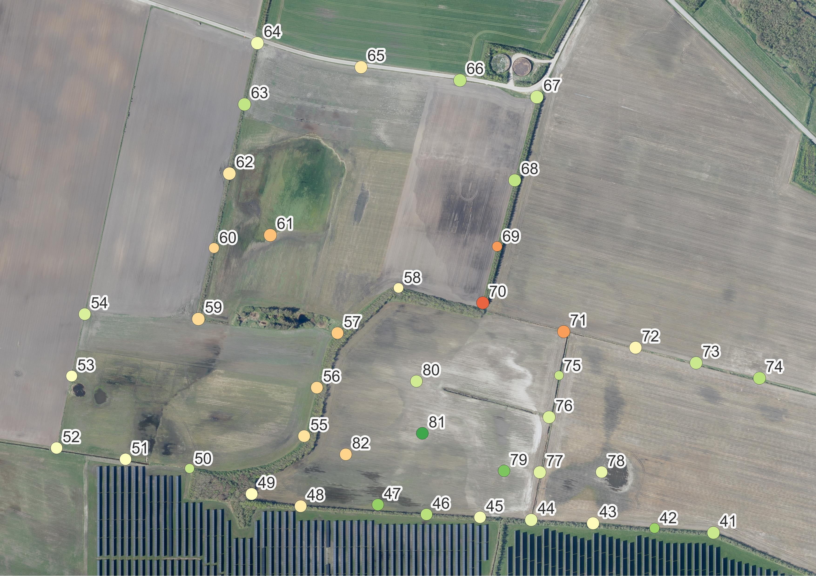
Average rise in GWL [cm]
FIGURE S13: All the logger wells colourcoded based on their average groundwater level rise for each extracted event. The higher rise, the more sensitive to extreme events.

