Slide 1
OceanUCA: Enhancing Coastal Observation and Forecasting in Andalucía (Spain) through Data Visualisation and Communication
J. Carbone (1), J. Vasquez-Rojas (1), A. Izquierdo (1), J. Benavente (2), J. Gómez-Enri (1), T. Fernández-Montblanc (2), C. J. González (1), F. Martins (3), W. D. Cabos Narvaez (4), C. Yagüe (5), C. Román-Cascón (1) & O. Álvarez (1)
EGU General Assembly 2025
ESSI3.4 - Open source software tools in geosciences

Slide 2
Objectives
Main Objective
To develop an OPERATIONAL PLATFORM of oceanographic and atmospheric models + observations for the coast of Andalusia
Specific Objectives
Oceanographic Models
(UCA2D, UCA2.5D y UCA3D)
Observational Data
(Weather Stations & Campaigns)
Atmospheric Model - WRF
(Weather Prediction → 3-day forecast)
OceanUCA Web
(government agencies, authorities, research groups, society)
An open and collaborative platform for everyone!

Slide 3
Index
Objectives
Computational Requirements
Work Plan & Methodology
Observations
Oceanographic Models
Atmospheric Models
Collaboration with Organizations
OceanUCA Web
Impacts & Uses

Slide 4
Objectives
Main Objective
To develop an OPERATIONAL PLATFORM of oceanographic and atmospheric models + observations for the coast of Andalusia

Slide 5
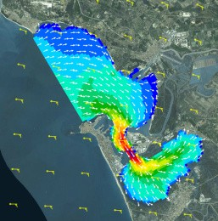
Objectives
Main Objective
To develop an OPERATIONAL PLATFORM of oceanographic and atmospheric models + observations for the coast of Andalusia
Specific Objectives
Oceanographic Models
(UCA2D, UCA2.5D y UCA3D)

Slide 6
Objectives
Main Objective
To develop an OPERATIONAL PLATFORM of oceanographic and atmospheric models + observations for the coast of Andalusia
Specific Objectives
Oceanographic Models
(UCA2D, UCA2.5D y UCA3D)
Observational Data
(Weather Stations & Campaigns)
Oceanographic Observations (currentmeters, tide gauges, CTD, …)
Costal Observations
(weather stations, HF radar, observation campaigns, …)

Slide 7
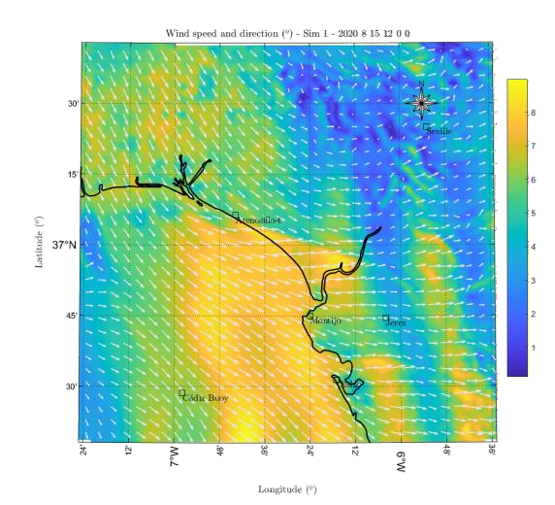
Objectives
Main Objective
To develop an OPERATIONAL PLATFORM of oceanographic and atmospheric models + observations for the coast of Andalusia
Specific Objectives
Oceanographic Models
(UCA2D, UCA2.5D y UCA3D)
Observational Data
(Weather Stations & Campaigns)
Atmospheric Model - WRF
(Weather Prediction → 3-day forecast)

Slide 8
Objectives
Main Objective
To develop an OPERATIONAL PLATFORM of oceanographic and atmospheric models + observations for the coast of Andalusia
Specific Objectives
Oceanographic Models
(UCA2D, UCA2.5D y UCA3D)
Observational Data
(Weather Stations & Campaigns)
Atmospheric Model - WRF
(Weather Prediction → 3-day forecast)
OceanUCA Web
(government agencies, authorities, research groups, society)

Slide 9
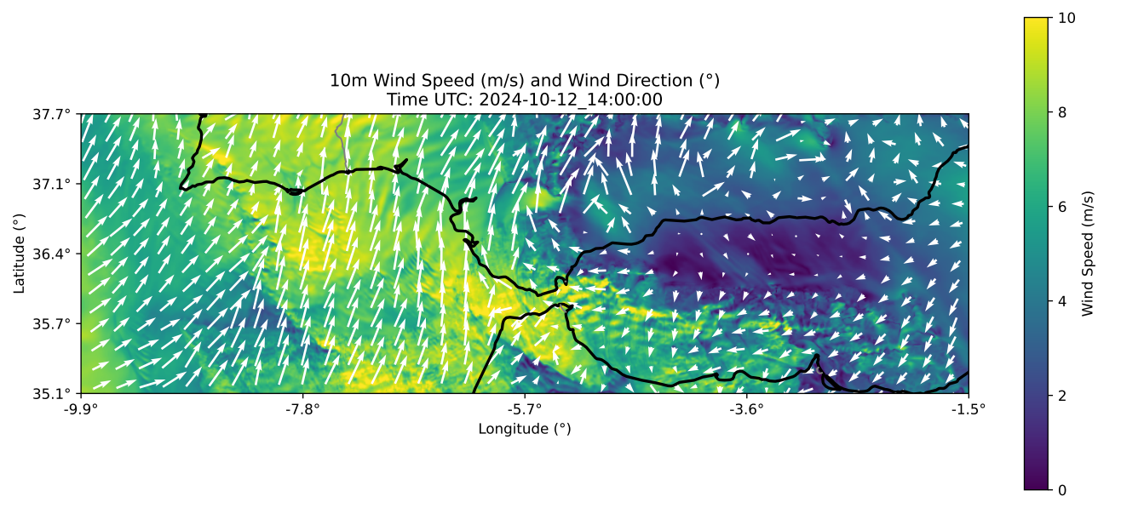
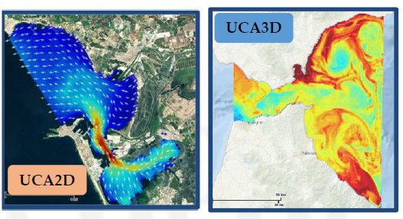
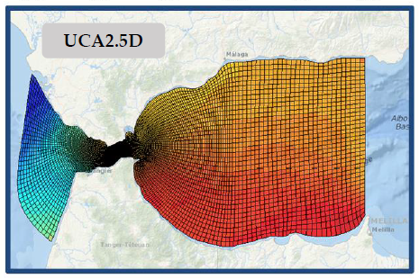
Computational Requirements
Increased Computational Demand
(high-resolution oceanographic and atmospheric models)

Slide 10
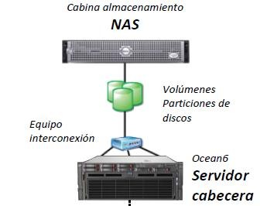
Computational Requirements
Increased Computational Demand
(high-resolution oceanographic and atmospheric models)
Storage Capacity
(historical data: observations + models)

Slide 11
Computational Requirements
Increased Computational Demand
(high-resolution oceanographic and atmospheric models)
Storage Capacity
(historical data: observations + models)
Software & Hardware Upgrades
(supercomputing + web platform)

Slide 12
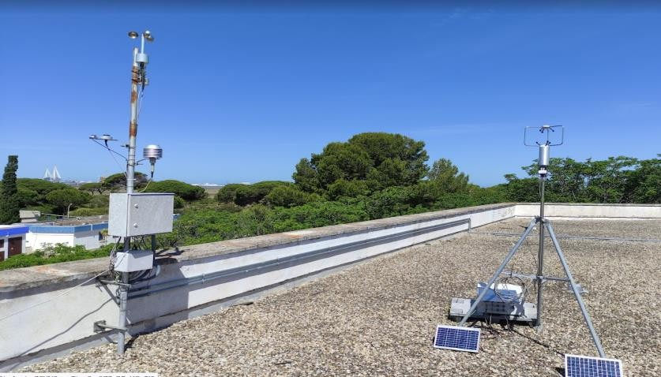
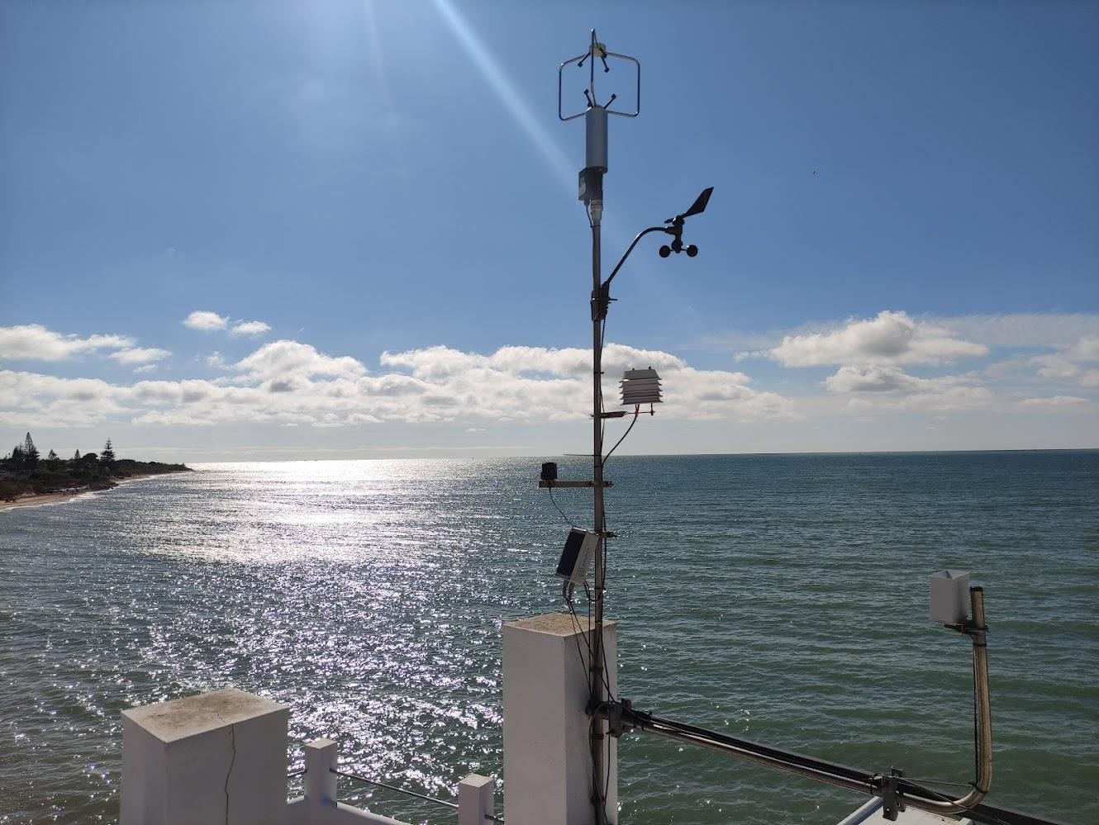
Computational Requirements
Increased Computational Demand
(high-resolution oceanographic and atmospheric models)
Storage Capacity
(historical data: observations + models)
Software & Hardware Upgrades
(supercomputing + web platform)
Real-Time Observations
(buoys, weather stations, surface fluxes, coastal radars, and oceanographic and atmospheric campaigns)

Slide 13
Work Plan & Methodology
Task
1
Task
2
Task
3
Task
4
Task
5
WRF model automation
Continuous evaluation with observations
Collaboration with organizations
National and international initiatives
OceanUCA Web Development
Data management and service
Data policy & FAIR principles
Increased observation capacity
(Gulf of Cádiz)
Adaptation & validation of hydrodynamic models

Slide 14
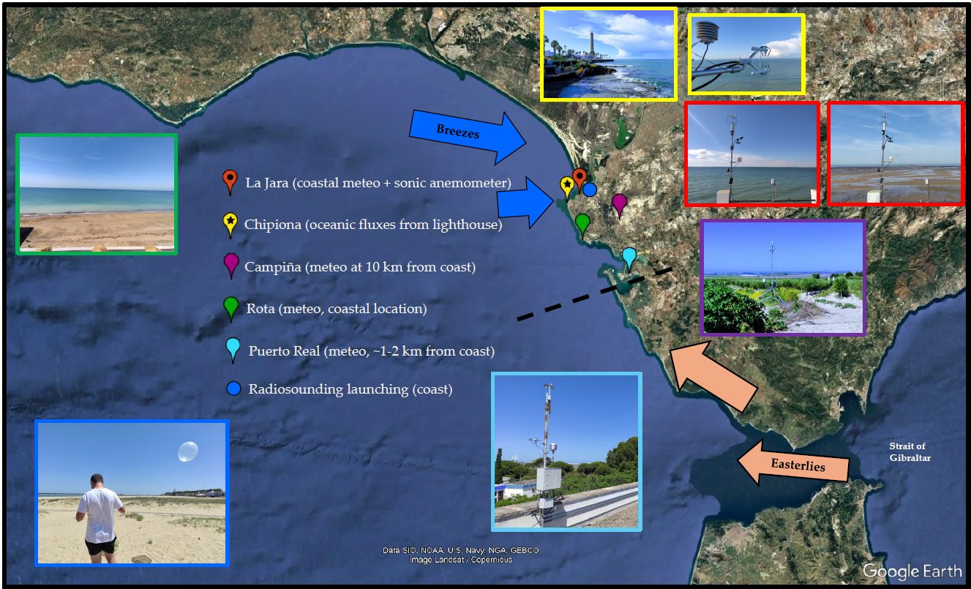
Observations
Task
1
Increased observation capacity
(Gulf of Cádiz)
Observations enable the continuous evaluation of the models

Slide 15
Oceanographic Models
Task
2
Homogeneous output protocols
Model intercomparison
Adaptation & validation of hydrodynamic models

Slide 16
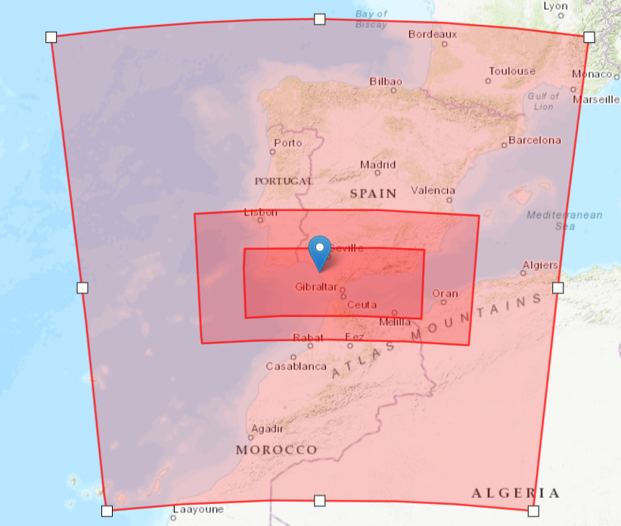
Atmospheric Model
Task
3
Domains WRF Model
WRF model automation
Continuous evaluation with observations
D1 - 9 km
D2 - 3 km
D3 - 1 km

Slide 17
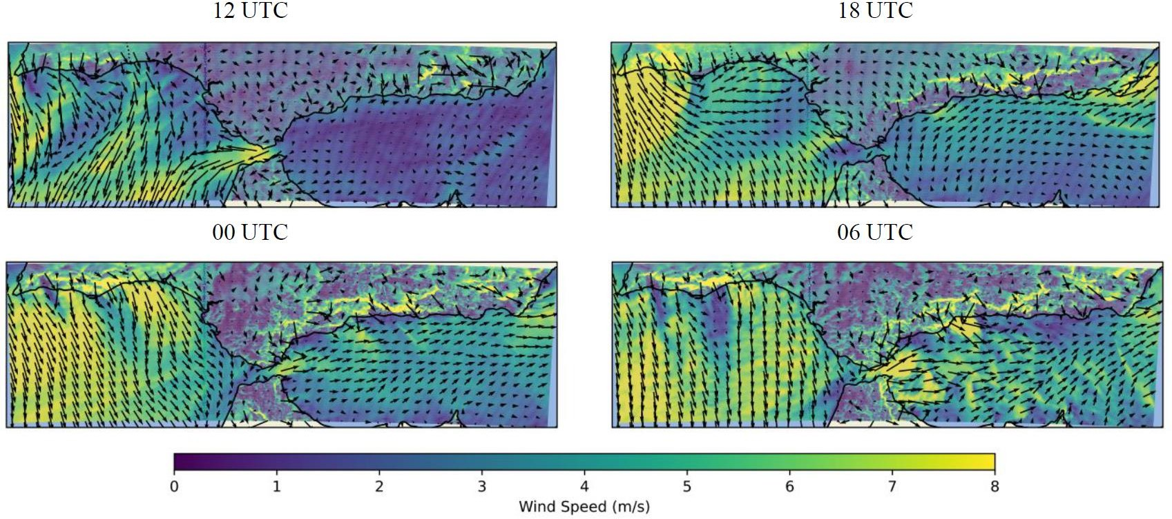
First tests – WRF Model
October 1–2, 2024
Task
3
WRF model automation
Continuous evaluation with observations
Wind speed and direction at 10 m
FORECAST (+72 h) every 24 hours (global model GFS inputs)

Slide 18
First tests – WRF Model
October 1–2, 2024
Task
3
WRF model automation
Continuous evaluation with observations
Improvements
Domains
Vertical & horizontal resolution
Physical parameterizations (boundary layer, microphysics, etc.)
High-resolution land use & land cover
Updated SST
Parallelization (HPC)
Wind speed and direction at 10 m
FORECAST (+72 h) every 24 hours (global model GFS inputs)

Slide 19
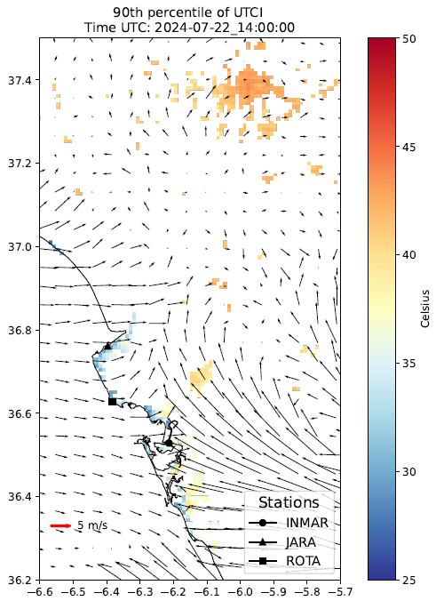
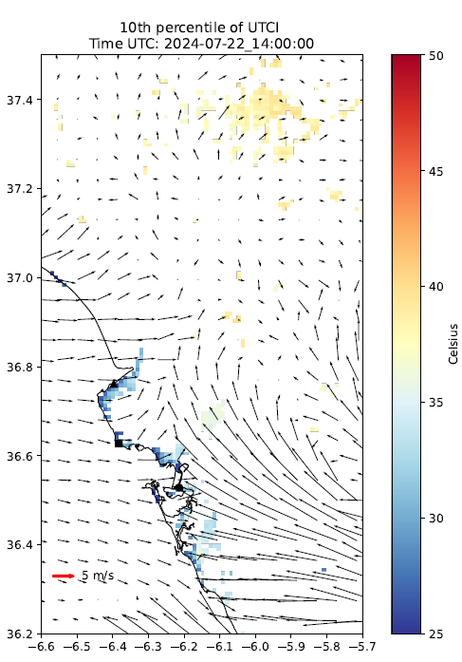
Future Work – WRF Comfort
Task
3
Research on the development
WRF model automation
Continuous evaluation with observations
To assess thermal comfort
Impact of coastal breezes on thermal comfort
90th & 10th percentile of Universal Thermal Comfort Index (UTCI)
(Martilli et al., 2024) → urban parameterization

Slide 20
Collaboration with Organizations
Task
4
Identify end users, groups & institutions
(national & international levels)
Collaboration with organizations
National and international initiatives

Slide 21
Collaboration with Organizations
Task
4
Identify end users, groups & institutions
(national & international levels)
Collaboration with organizations
National and international initiatives
Communication activities
(collaborate & share with organizations)

Slide 22
Collaboration with Organizations
Task
4
Identify end users, groups & institutions
(national & international levels)
Collaboration with organizations
National and international initiatives
Communication activities
(collaborate & share with organizations)
Outreach activities
(engage with and transfer knowledge to society)

Slide 23
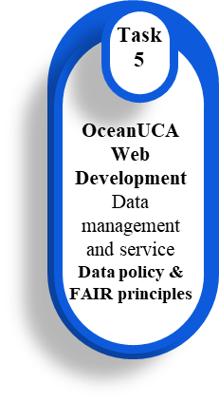
Web OceanUCA
Open and interactive tool
(GIS environment accessible via web)
👉 Click on the photo to access the website!

Slide 24
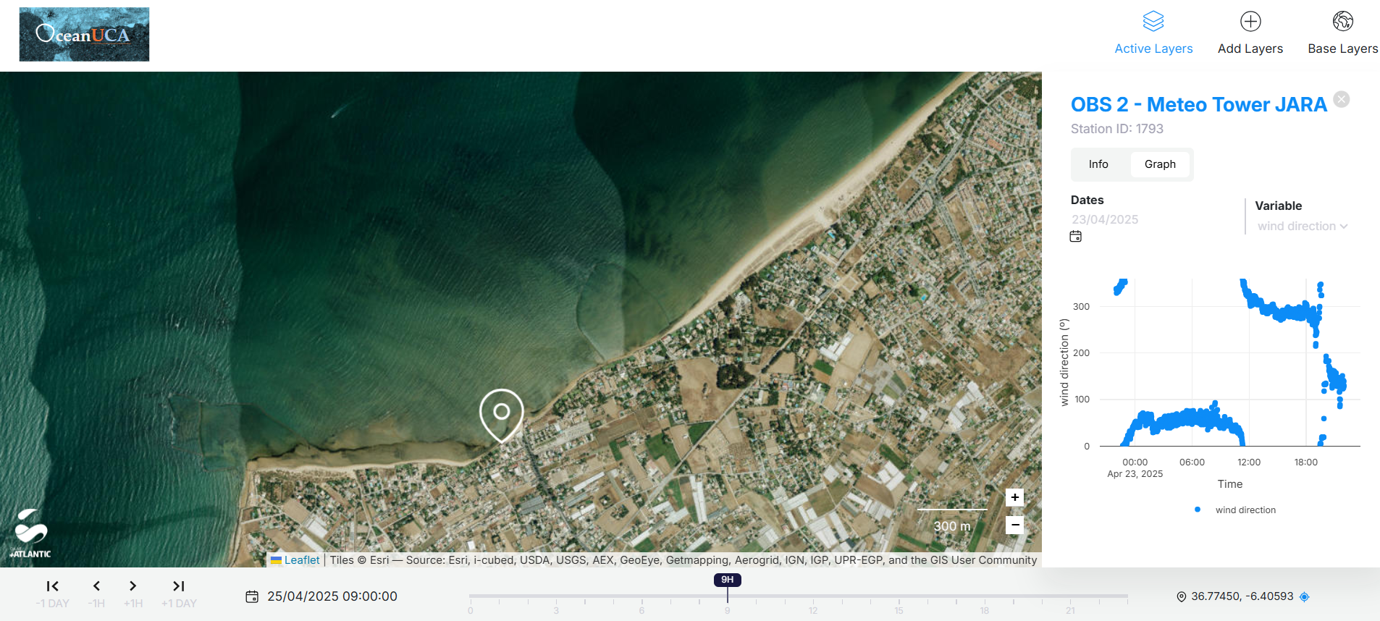
Web OceanUCA
Automatic Weather Station
👉 Great importance of the sea breezes in this area
Tue, 29 Apr, 08:30–10:15 | Hall X5 → Horizontal and vertical analysis of sea breezes in the Gulf of Cádiz (SW Spain) from surface stations and radiosounding data.
Thu, 01 May, 09:45–09:55 | Room 1.61/62 → Dynamics of sea breezes: Analysis of recent events in Southwest Spain

Slide 25
Impacts & Uses
Observation and monitoring of coastal oceanic and atmospheric physical processes
Early warning system for risks and threats
Short/medium-term forecast
Detection of climate change-related effects (long-term research)
Aid in decision-making
(public information)
Monitoring of natural resources and environmental protection

Slide 26
Acknowledgements
OceanUCA project (PCM_00032) funded with resources from the "Next Generation EU" Recovery Fund through the Recovery, Transformation, and Resilience Plan, and co-financed by the Ministry of University, Research, and Innovation of the Andalusian Government. The views and opinions expressed are solely those of the author(s) and do not necessarily reflect those of the European Union or the European Commission. Neither the European Union nor the European Commission are responsible for them.
WIND4US project (CNS2023-144885) (Disentangling the complexity of the WIND systems in coastal areas FOR a better Understanding of their impacts on Society), funded by MICIU/AEI/10.13039/501100011033 and by the “European Union NextGenerationEU/PRTR. Convocatoria 2023 de Proyectos de Consolidación Investigadora. C17, I04.
WINDABL project (PR2022-055) (How are the Surface Thermally Driven Winds influenced by the vertical structure and horizontal inhomogeneities of the Atmospheric Boundary Layer?), funded by Plan Propio de la Universidad de Cádiz, Convocatoria 2022 de Proyectos para investigadores nóveles.

