Slide 1
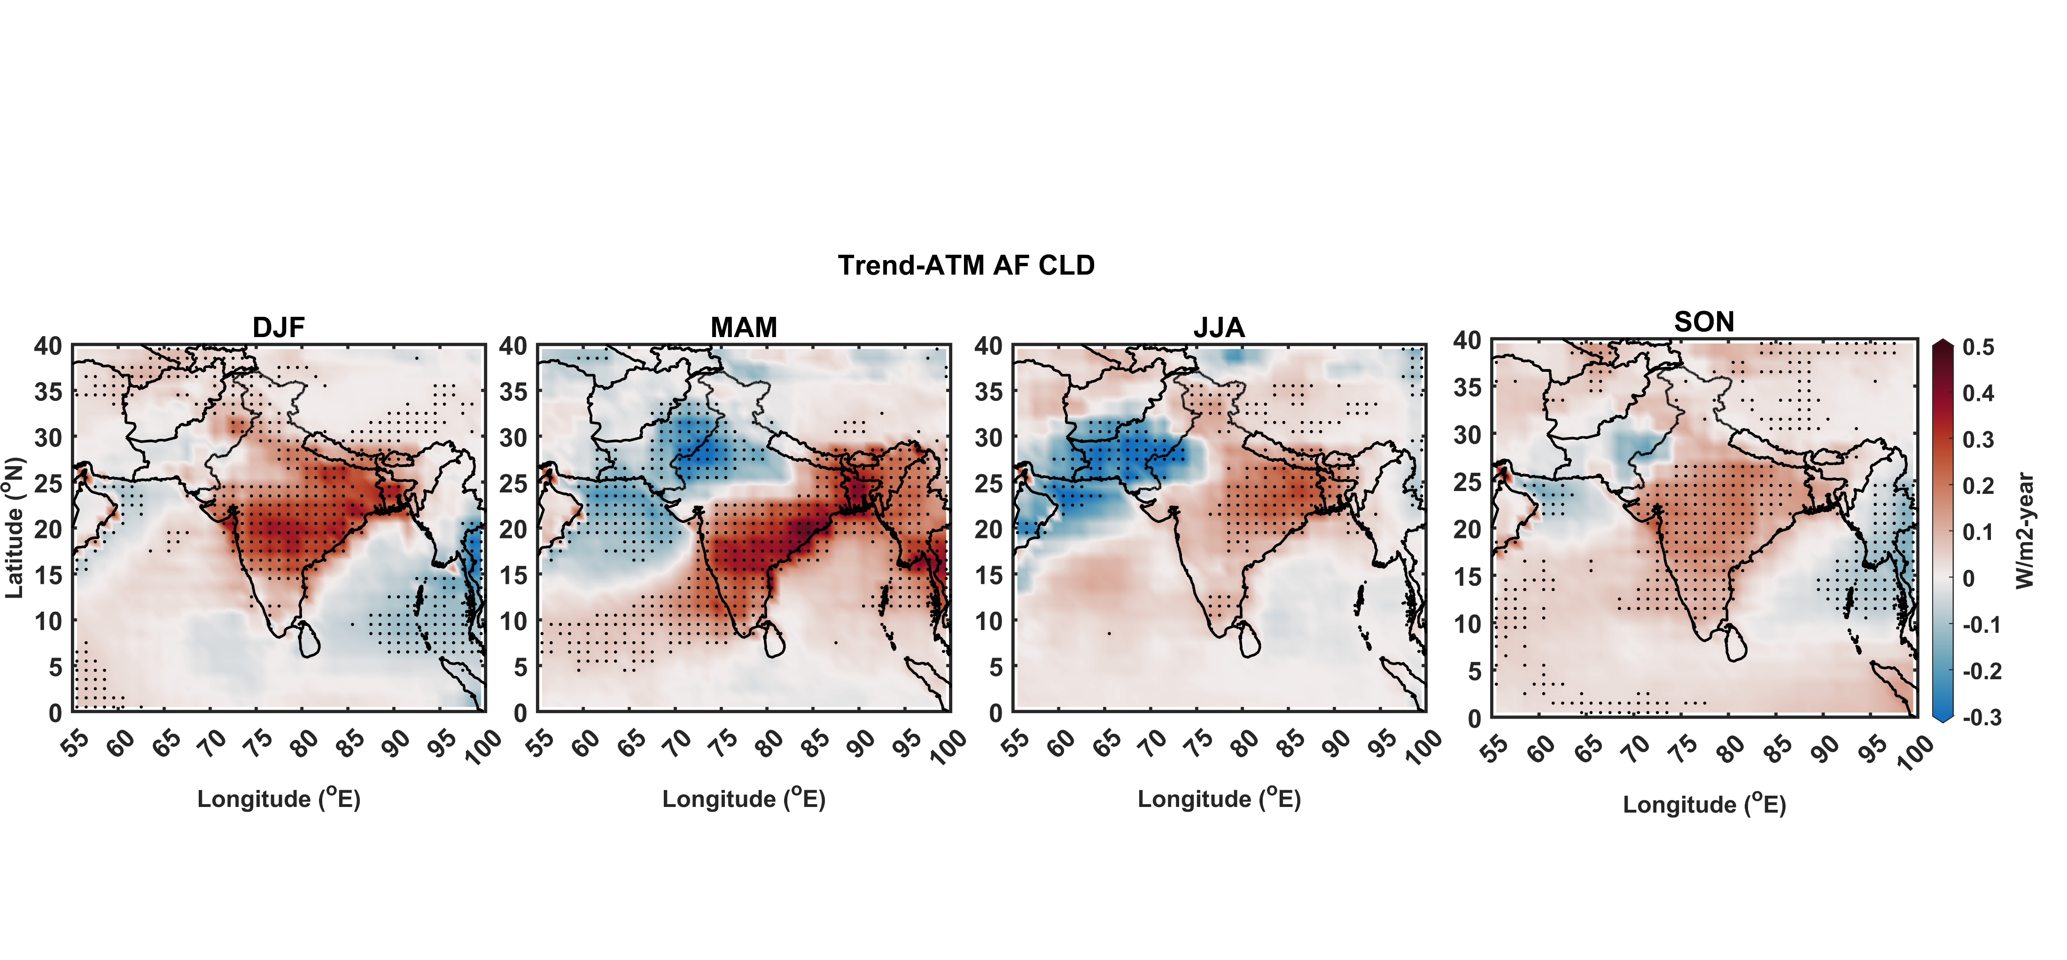
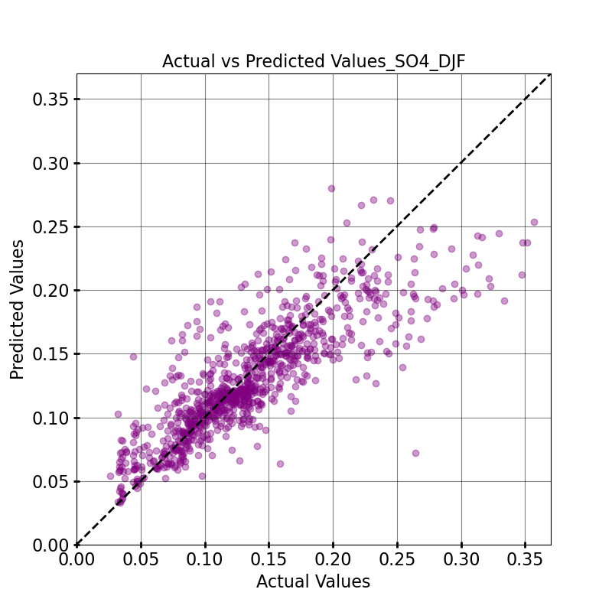
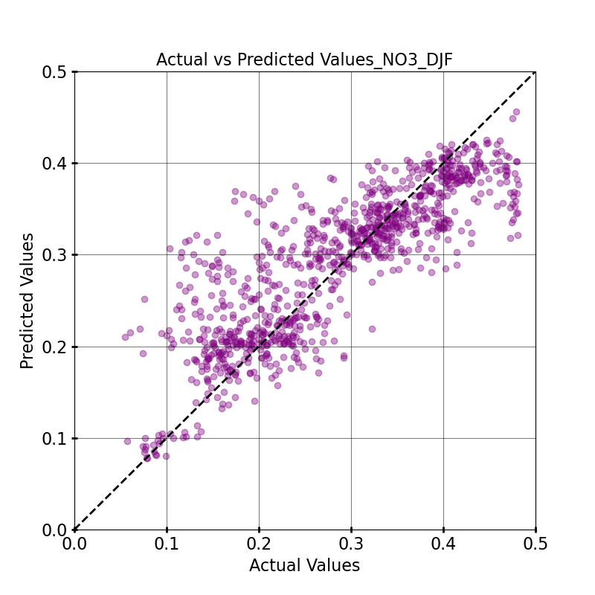
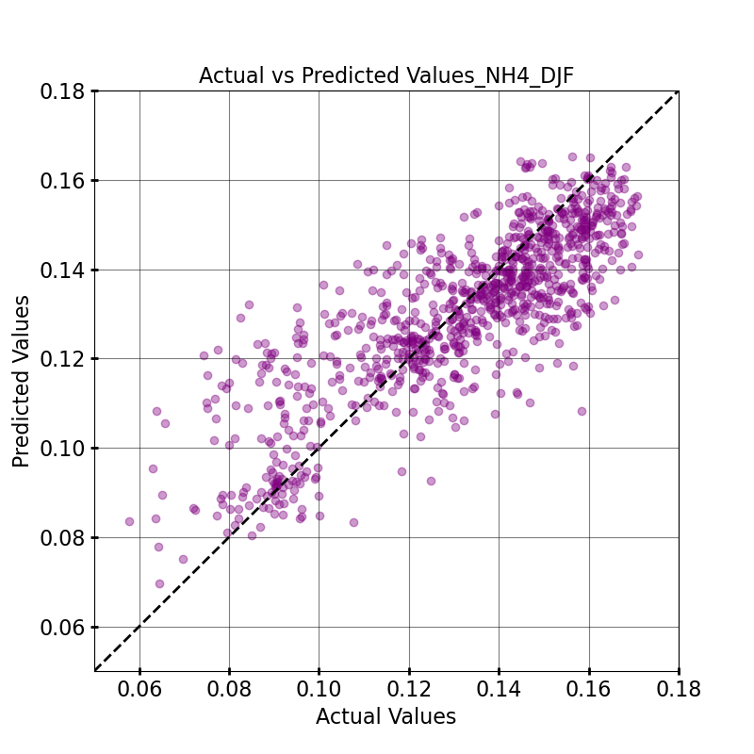
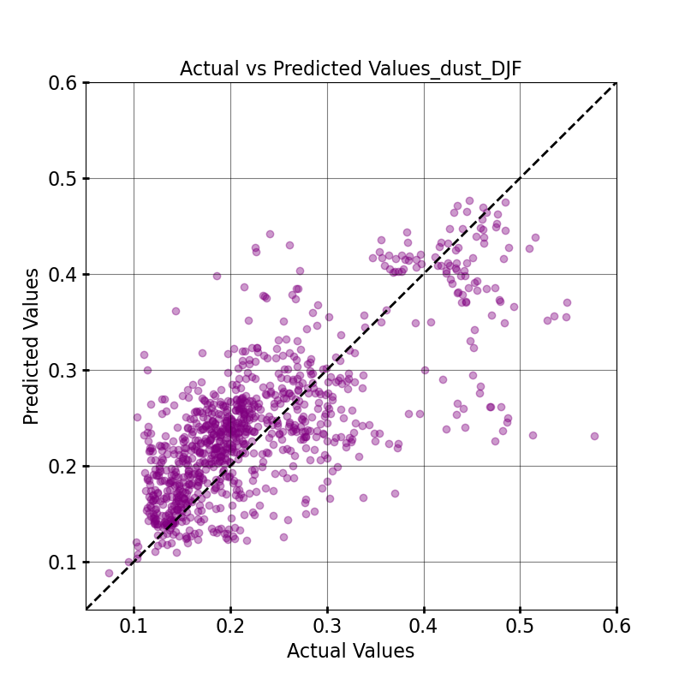
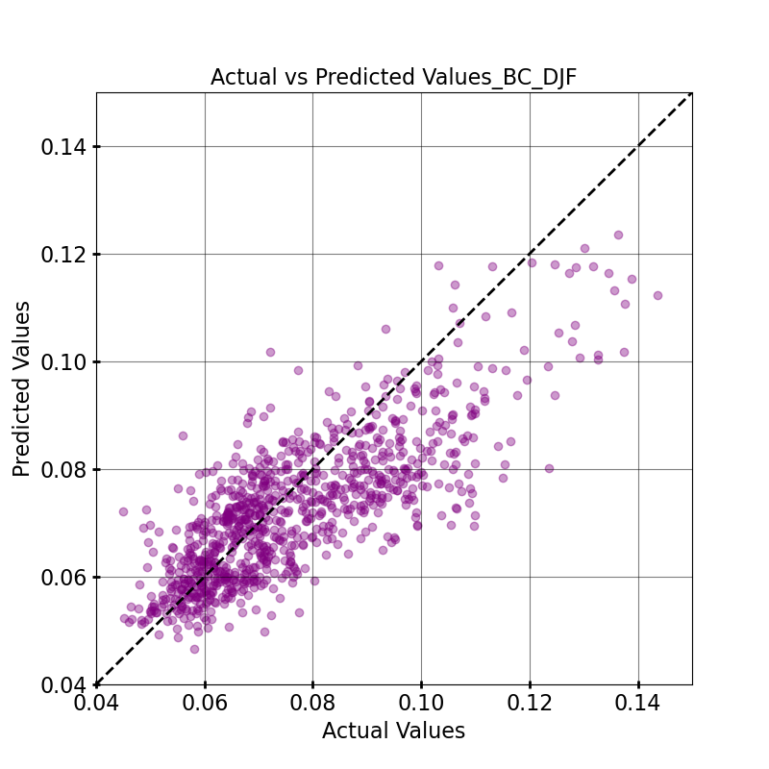
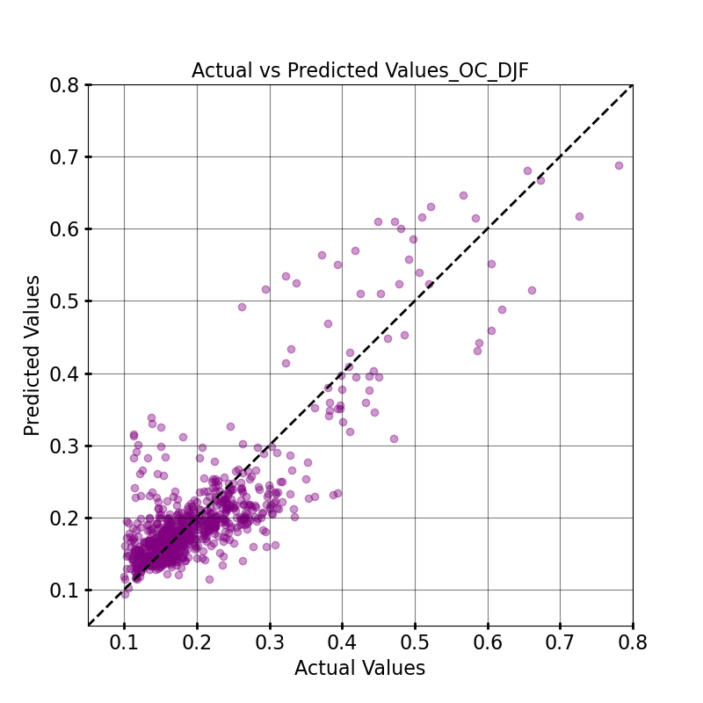
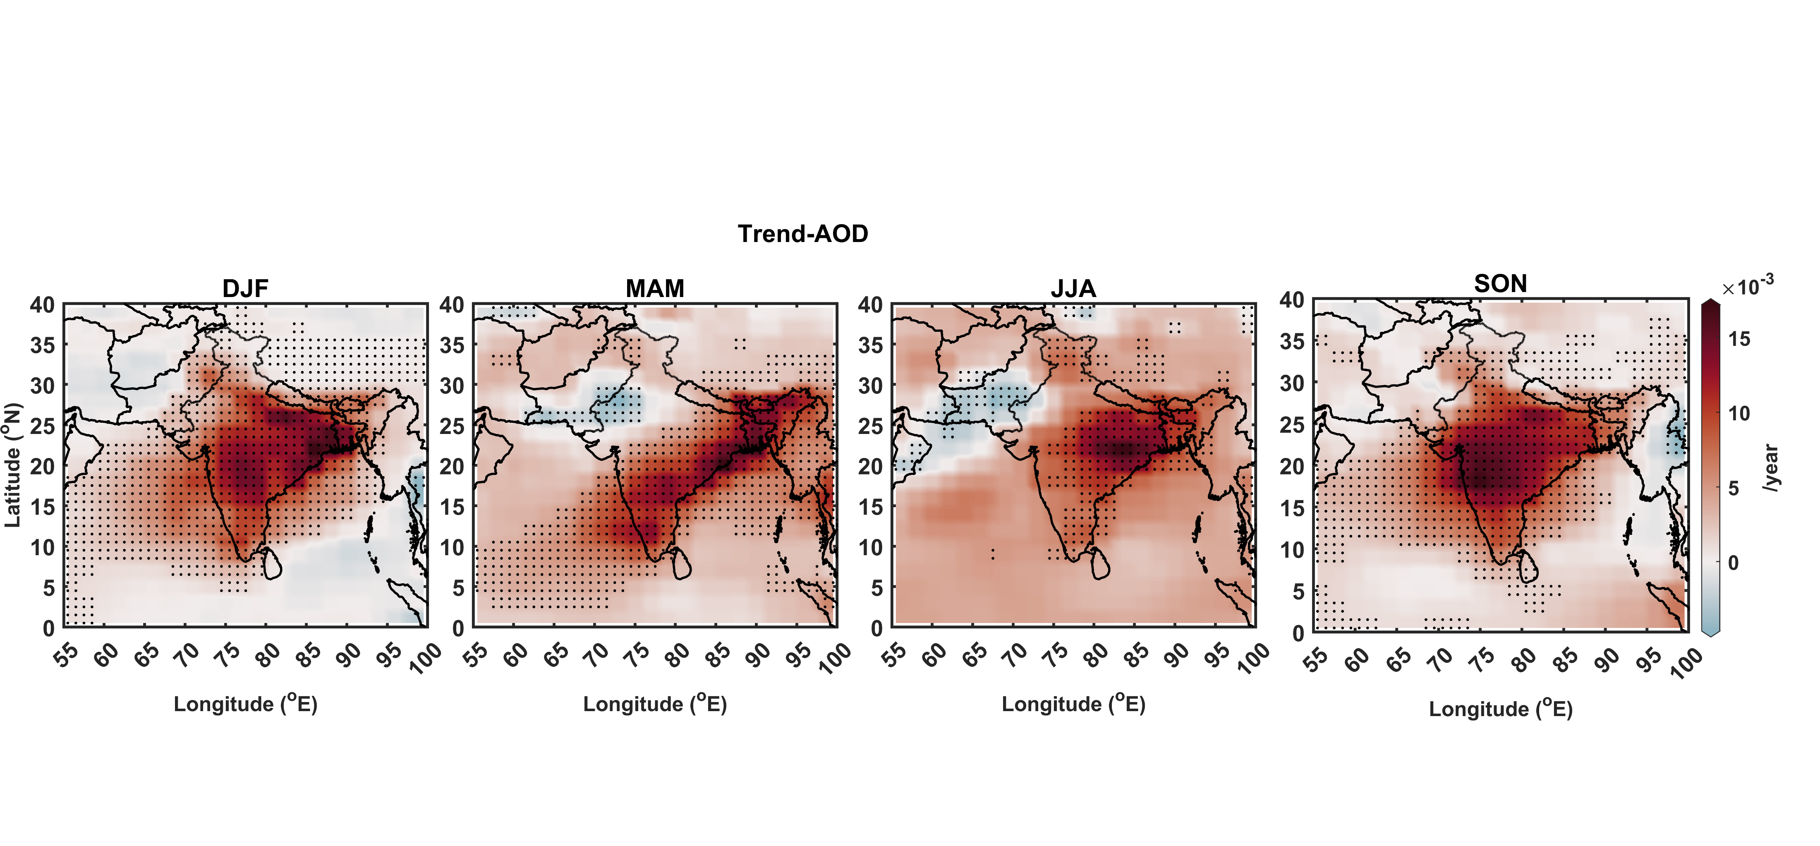
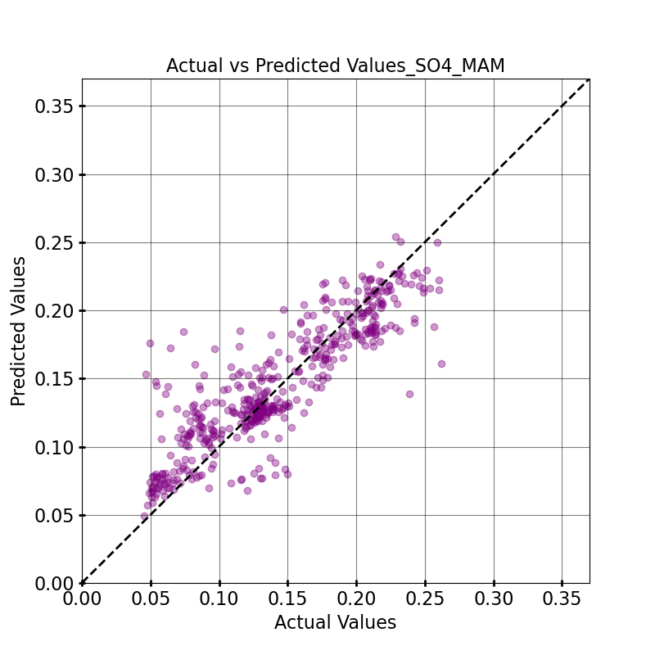
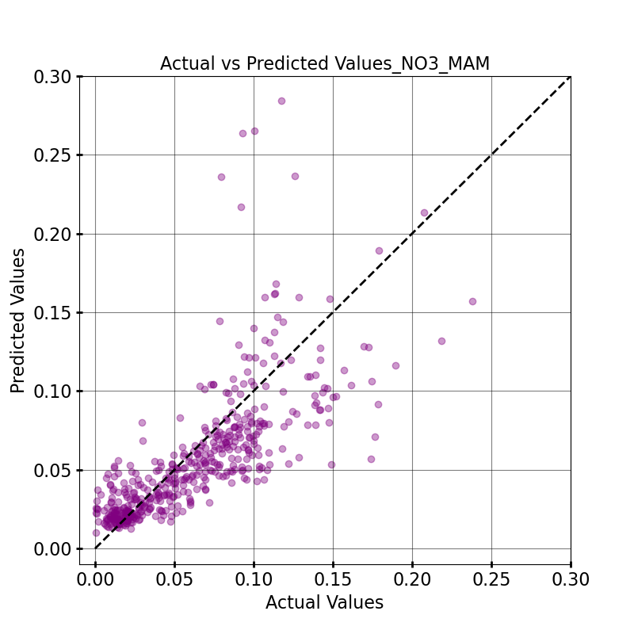
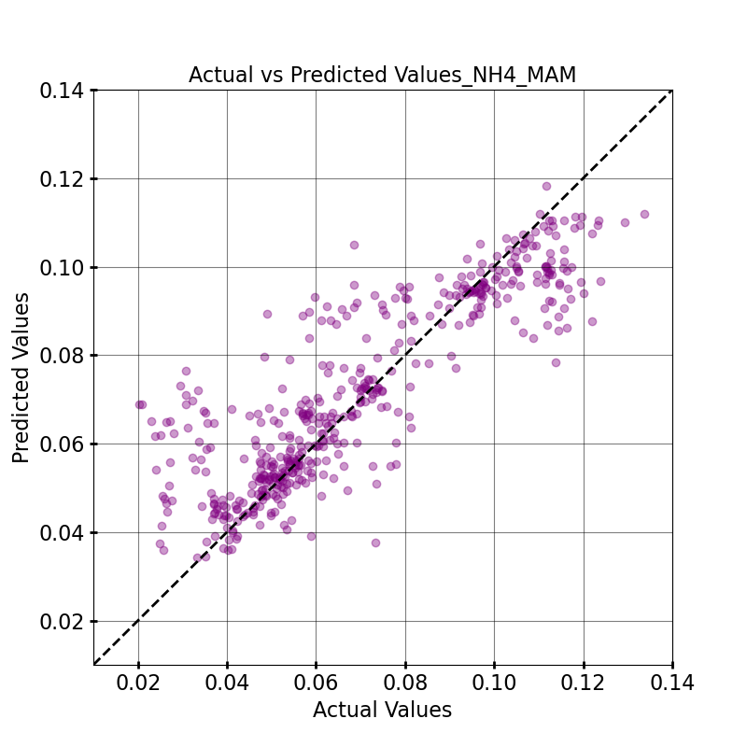
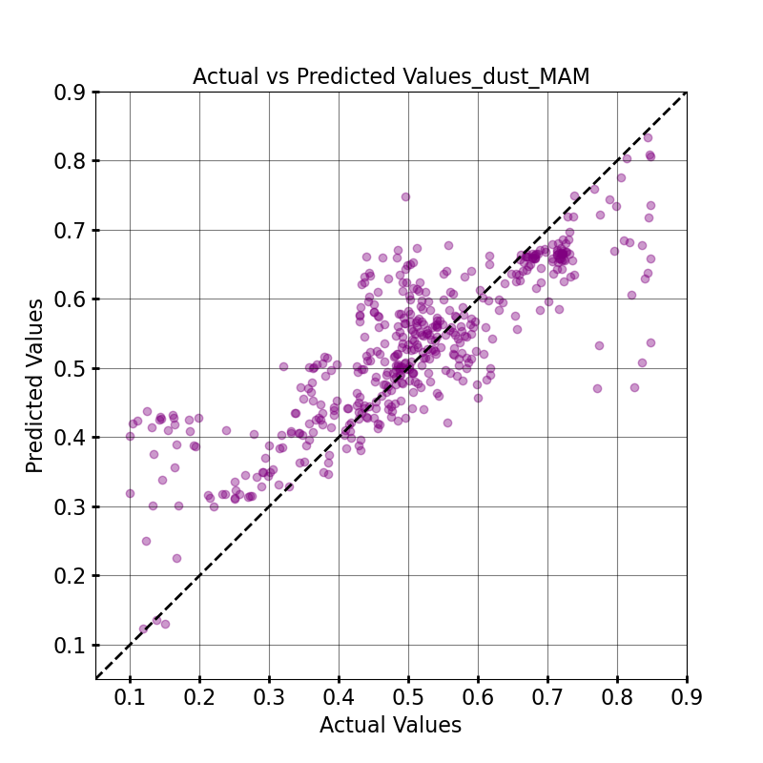
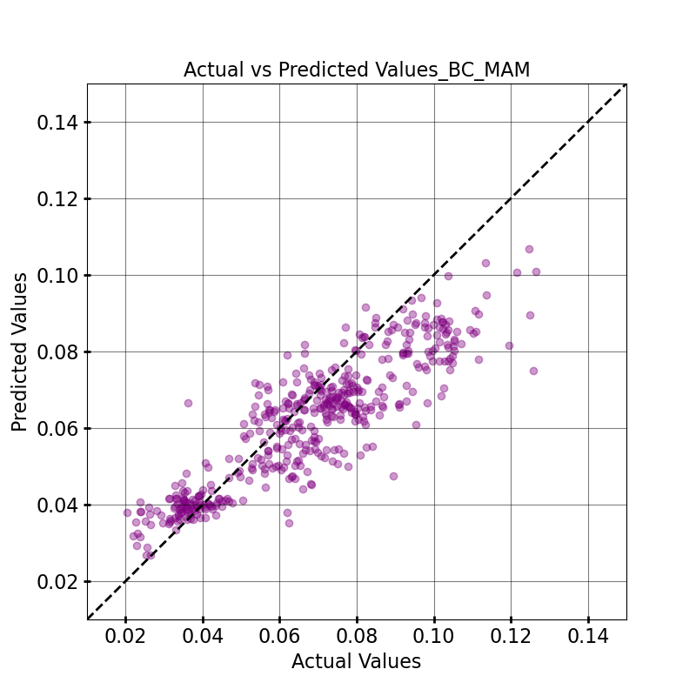
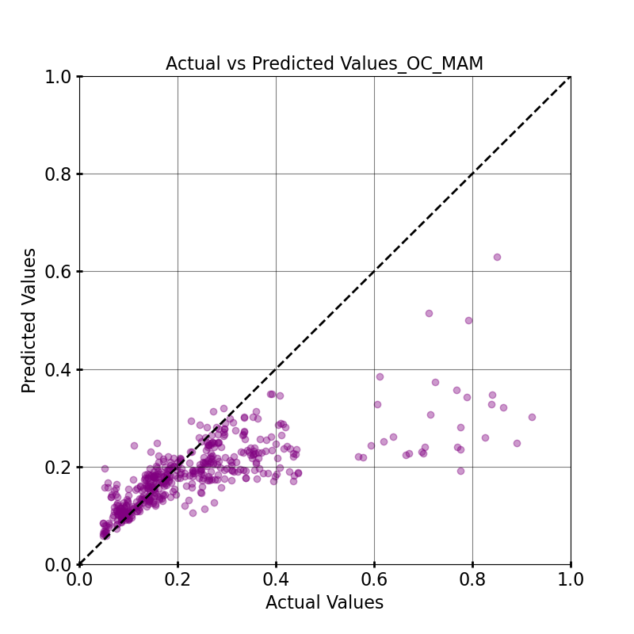
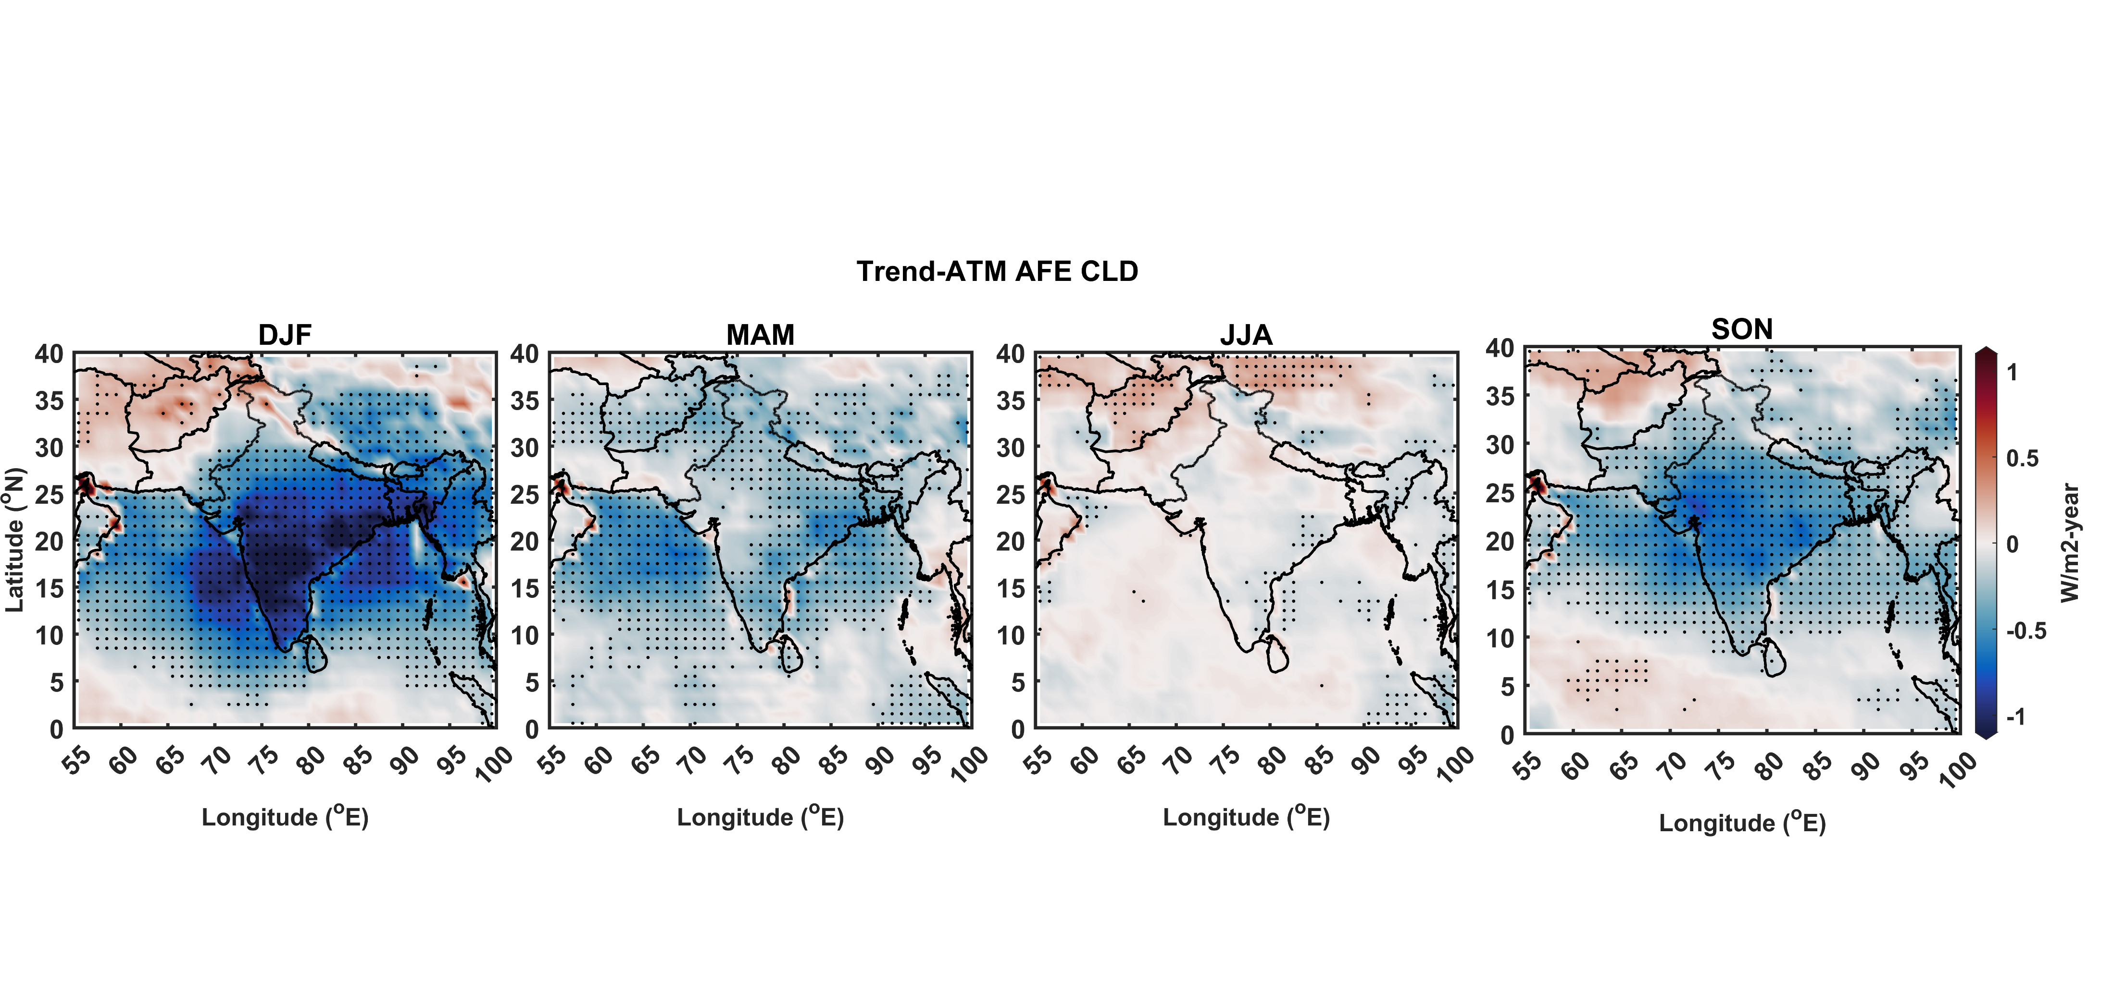
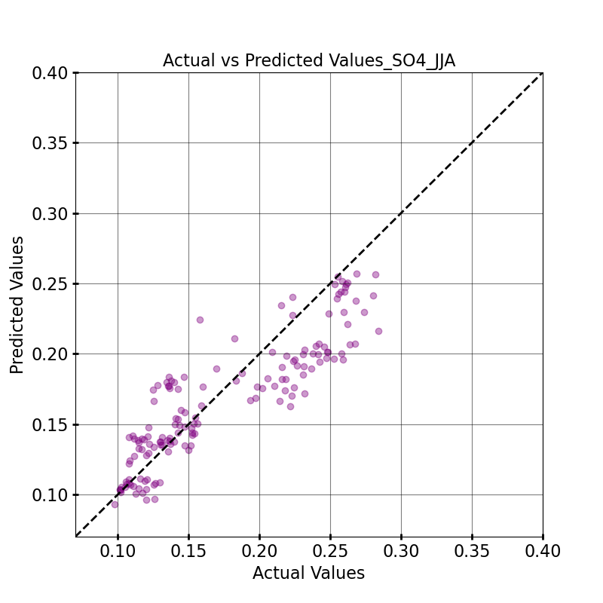
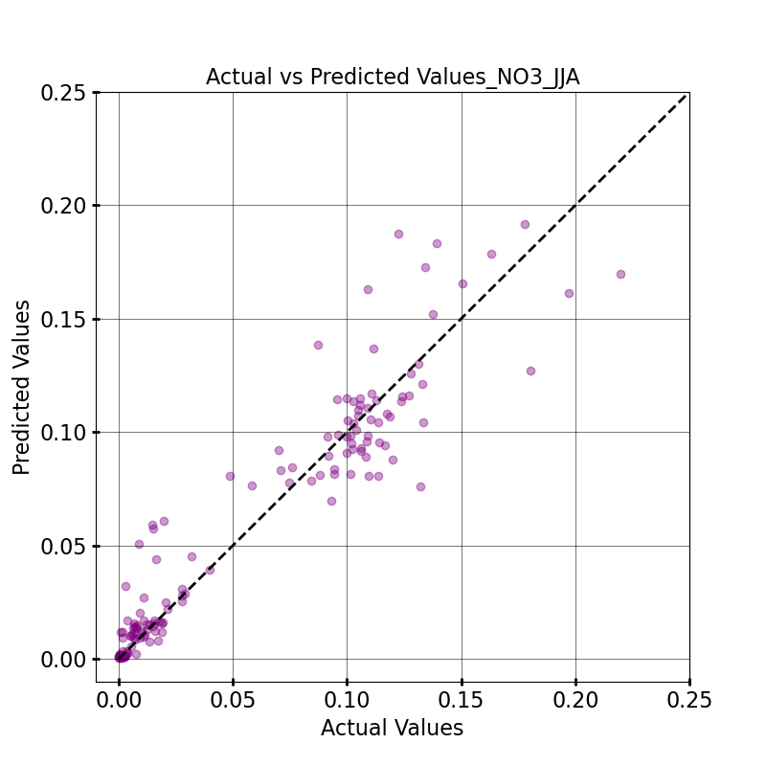
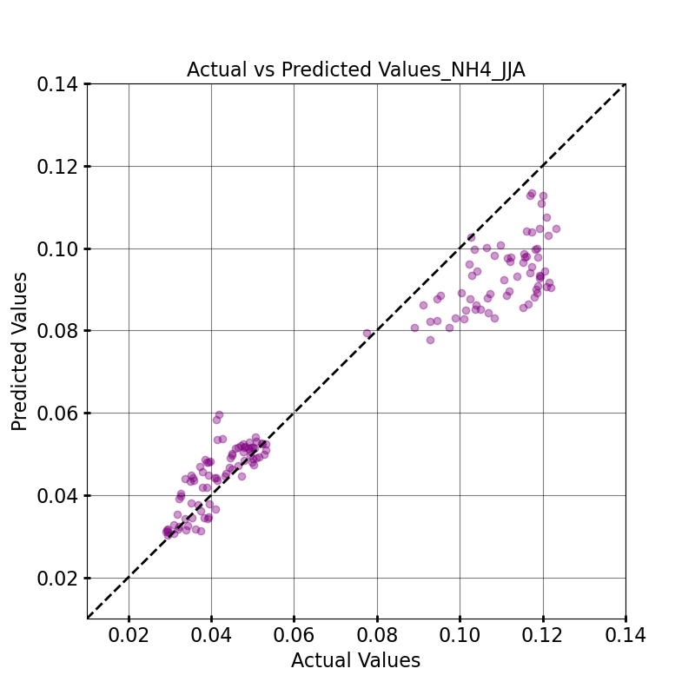
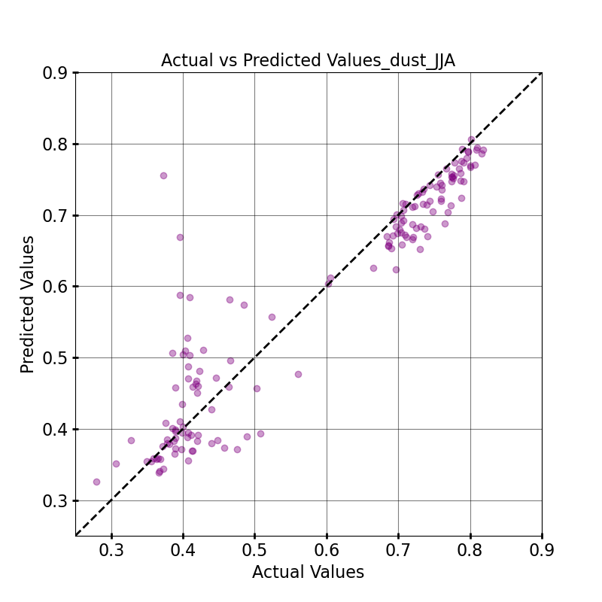
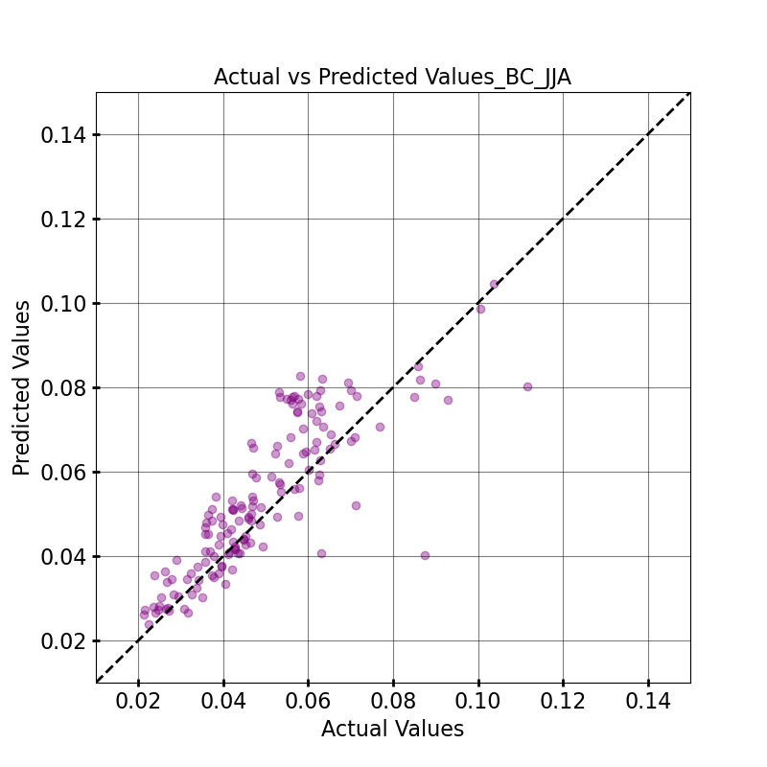
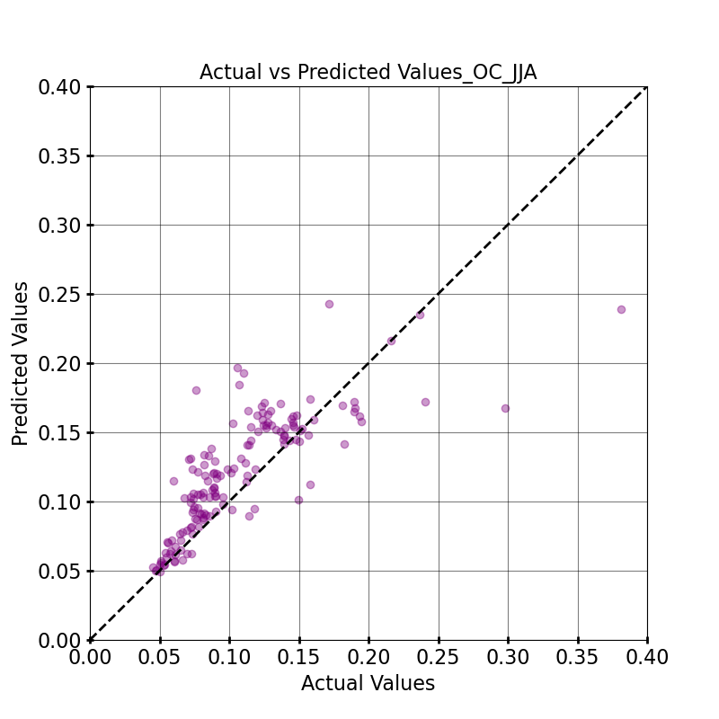
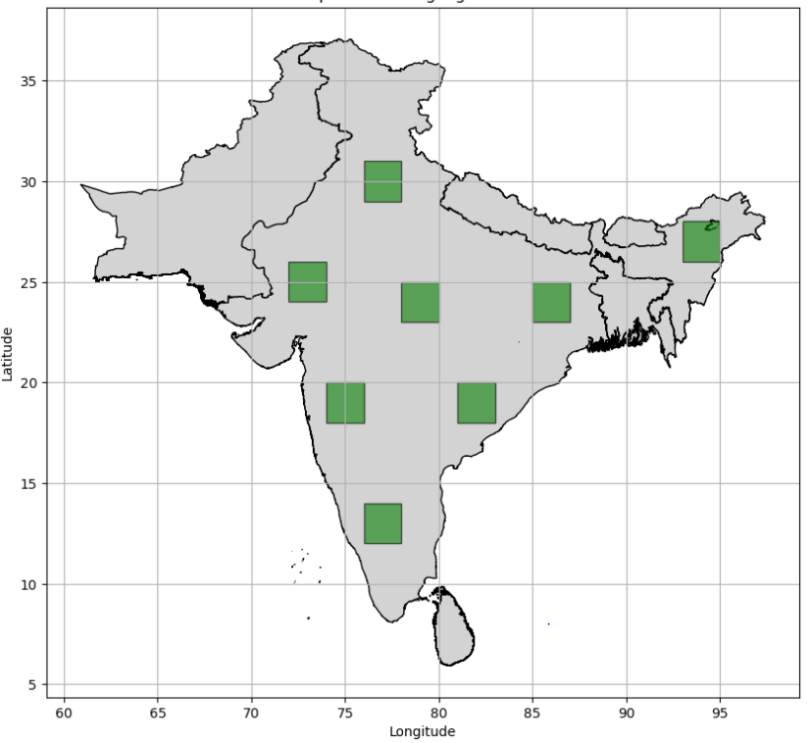
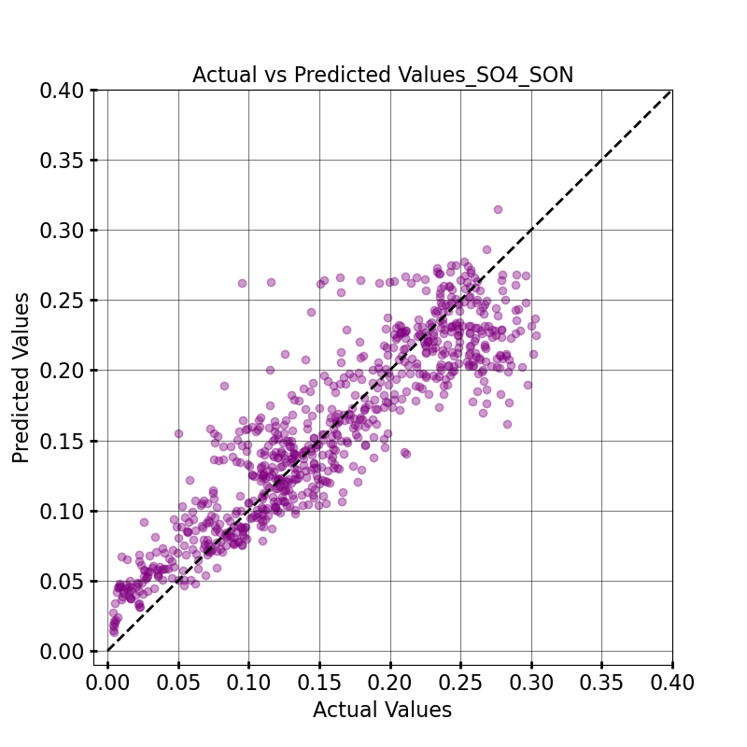
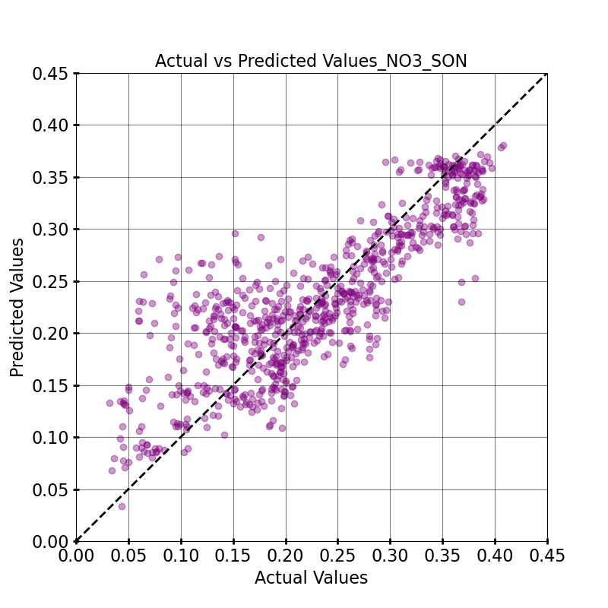
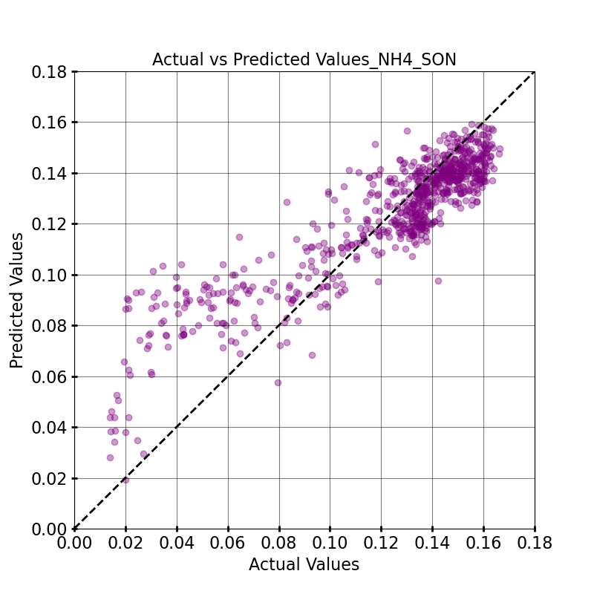
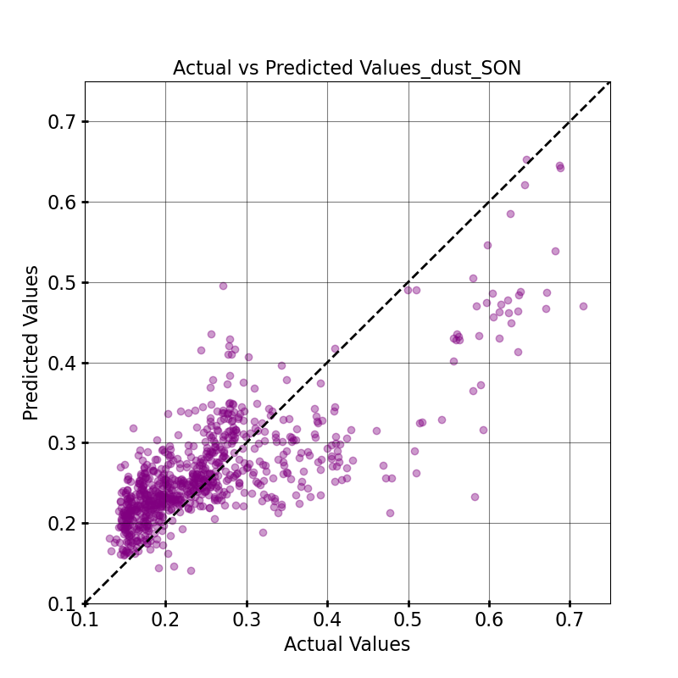
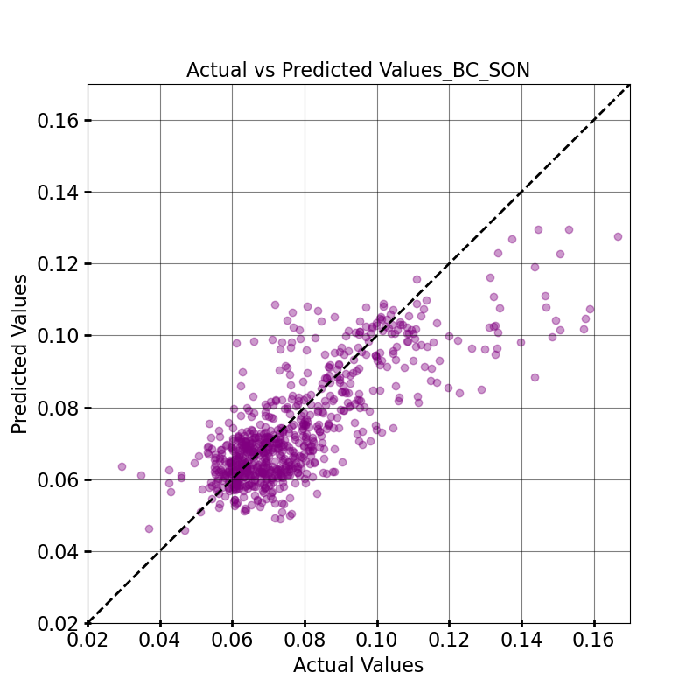
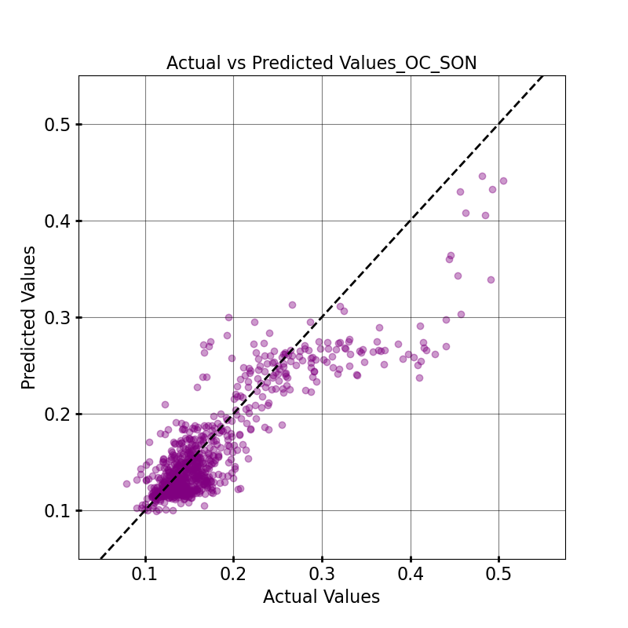
Estimation of surface-based aerosol composition from satellite data-driven machine learning model over south Asia
Shreya Srivastava, Sagnik Dey
CAS, Indian Institute of Technology, Delhi. Email: Shreya.Srivastava@cas.iitd.ac.in
1. Motivation
3. Data & Methodology
4. Results
India has been identified as an aerosol hotspot.
Studies have shown the significant spatio-temporal variability of aerosol characteristics over India (Dey & di Girolamo, 2010; Jethva et al., 2005).
Different aerosol types have distinct effect on climate (Andrews et al., 2006; Satheesh, 2012) and on human health (Kelly & Fussell, 2012; Park et al., 2018).
Information about aerosol composition is scarce and limited to a few campaigns (Gani et al., 2018; Hayes et al., 2013) and a handful of sites (Snider et al., 2015) in India.
Unlike most studies linking columnar AOD to ground-level PM_{2.5}, our method uses MISR aerosol components to estimate aerosol composition.
Our detailed analysis of aerosol radiative forcing over the Indian subcontinent suggest an increasing scattering effects of aerosols (Fig.1).
Data Collection
Total Aerosols
8 Aerosol Models
(based on size, shape and optical properties)
_{74 Aerosol Mixtures}
(Taking up to 3 Aerosol Models in different proportions)
Model grid definition
Data Preprocessing
Align each dataset to model grid and monthly scale
R²=0.69
RMSE=0.03
R²=0.69
RMSE=0.06
R²=0.67
RMSE=0.01
R²=0.52
RMSE=0.07
R²=0.58
RMSE=0.01
R²=0.71
RMSE=0.05
8 Aerosol Models
Train/test split of dataset
R²=0.75
RMSE=0.03
R²=0.49
RMSE=0.03
R²=0.74
RMSE=0.01
R²=0.64
RMSE=0.10
R²=0.70
RMSE=0.01
R²=0.36
RMSE=0.13
Support Vector Regressor
Model fitting
Random Forest
Evaluation of the model performance
(R² & RMSE etc.)
R²=0.75
RMSE=0.03
R²=0.90
RMSE=0.02
R²=0.86
RMSE=0.01
R²=0.87
RMSE=0.06
R²=0.61
RMSE=0.01
R²=0.53
RMSE=0.03
Fig.1 Spatial patterns of annual trends in ADRF in-atmosphere for all-sky (Top Panel) and AOD (Middle Panel), and Atmospheric warming efficiency (Bottom Panel) over 22 years (2000-2021).
(Srivastava & Dey, 2024; under review)
Model Prediction of Mass-fraction for 2016-2021
Test data were selected from different geographic zones, as meteorology and emission sources vary significantly across different parts of India.
R²=0.81
RMSE=0.03
R²=0.69
RMSE=0.05
R²=0.75
RMSE=0.02
R²=0.69
RMSE=0.06
R²=0.58
RMSE=0.01
R²=0.74
RMSE=0.04
Mass Concentration
(1km x 1km)
Fig.2 Scatter plots validating the model on test data for different aerosol species: sulphate, nitrate, ammonium, dust, black carbon, and organic aerosols (from left to right) across seasons: winter, pre-monsoon, monsoon, and post-monsoon (from top to bottom).
2. Objectives
Develop a predictive machine learning model to estimate surface aerosol composition using MISR-derived fractional AODs, meteorological variables, and land use data.
Support climate and health risk assessments by integrating aerosol composition predictions, focusing on their differential impacts in low-income South Asian regions.
Test Data
Calculation of Fractional AODs
Data | Source
Fractional AODs | MISR Level 2 Version 23 (4.4 km x 4.4 km)
Chemical Model output | WRF-Chem (25km x 25km, daily)
Emission | EDGAR (0.1° x 0.1°, monthly)
Meteorology (wind, temp, pblh, RH, cloud) | ERA-5 (0.25° x 0.25°, monthly)
NDVI | MODIS (1 km, monthly)
Elevation | SRTM (DEM) (90m)
Population Density | LandScan Global Population Data (1 km x 1 km, annual)
Permutation feature importance analysis shows that MISR-derived fAODs significantly influence the model's predictions, confirming the feasibility of incorporating MISR data to predict aerosol composition in South Asian countries where sufficient ground data is lacking.
We observe significant seasonal variation in different types of aerosols, resulting from the combined effects of meteorology and emission sources.
Although the trend is less statistically significant, black carbon and organic aerosols show an increasing trend, while dust exhibits a decreasing trend in South Asia from 2016 to 2021.
The estimated mass fraction will be multiplied by the total PM2.5 to calculate the actual concentration of different aerosol types, which will be used to evaluate the model against available ground observations.
where,
AODi is the Fractional AOD
AODmixture j is the AOD of mixture j
Fractioncomponent i in mixture j is the contribution of component i to the total AOD for mixture j
α is Aerosol Retrieval Success Flag Per Mixture; represents whether or not a particular mixture passed the goodness-of-fit tests
α= 1 for a successful mixture,
α=0 for an unsuccessful mixture
5. Summary and Way Forward
7. References
6. Acknowledgement
Dey, S., & di Girolamo, L. (2010). A climatology of aerosol optical and microphysical properties over the Indian subcontinent from 9 years (2000-2008) of Multiangle Imaging Spectroradiometer (MISR) data. Journal of Geophysical Research Atmospheres, 115(15). https://doi.org/10.1029/2009JD013395
Gani, S., Bhandari, S., Seraj, S., Wang, D. S., Patel, K., Soni, P., Arub, Z., Habib, G., Hildebrandt Ruiz, L., & Apte, J. S. (n.d.). Submicron aerosol composition in the world’s most polluted megacity: The Delhi Aerosol Supersite campaign. https://doi.org/10.5194/acp-2018-1066
Jethva, H., Satheesh, S. K., & Srinivasan, J. (2005). Seasonal variability of aerosols over the Indo-Gangetic basin. Journal of Geophysical Research Atmospheres, 110(21), 1–15. https://doi.org/10.1029/2005JD005938
Satheesh, S. K. (2012). Atmospheric chemistry and climate. Current science, 426-439.
Snider, G., et al (2015). SPARTAN: A global network to evaluate and enhance satellite-based estimates of ground-level particulate matter for global health applications. Atmospheric Measurement Techniques, 8(1), 505–521. https://doi.org/10.5194/amt-8-505- 2015
I acknowledge the support and fellowship received from ‘Prime Minister Research Fellowship’ and IIT Delhi for conducting this research. We acknowledge the NASA science team for providing the open-source MISR and MODIS data. We thank IIT Bombay team for providing the Chemical model outputs. We also acknowledge Clean Air Fund used for accessing high performance computing (HPC IITD) for data analysis.
Fig.3 Seasonal climatology and trend of predicted PM_{2.5} mass fraction(%) of six aerosol species- sulphate, nitrate, ammonium, dust, black carbon and organic aerosol respectively (from top to bottom) using the trained Random Forest model with out-of-bag sampling strategy over the period of six years (2016-2021).

