Slide 1


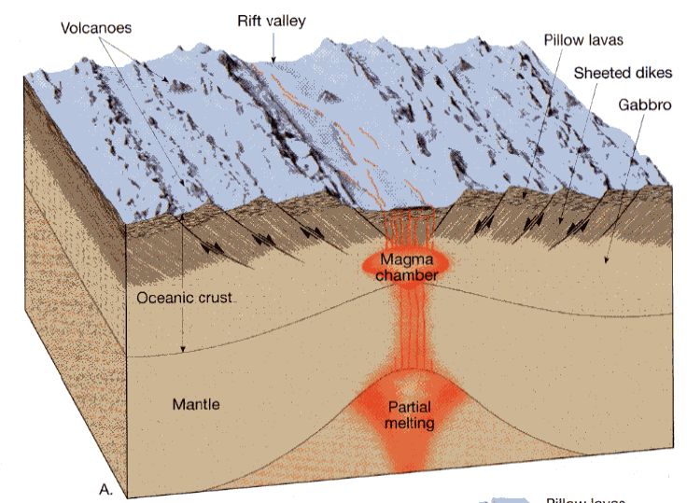
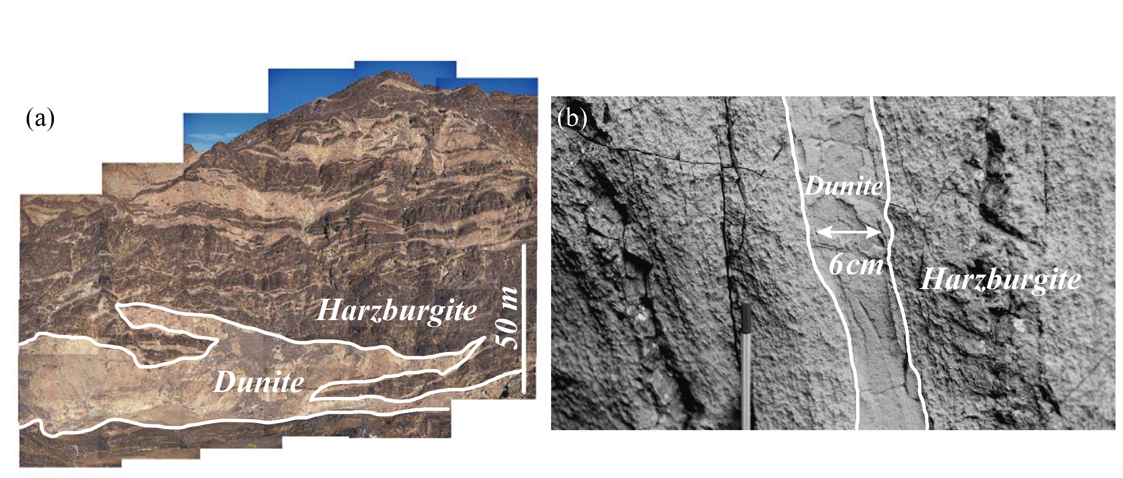
Channels or waves: controls on melt migration through the upper mantle
Min Huang, John Rudge, David Rees Jones
mh2153@cam.ac.uk
Melt transport paths from depth to surface
Reaction-infiltration instability
Melt₁(l) + Pyroxene(s) Melt₂(l) + Olivine(s)
(> 90% olivine)
Brittle fracture – Dikes (~10 km)
7 km
Channelized flow
(olivine + opx)
Diffuse porous flow (> 100 km)
Tarbuck and Lutgens (2005)
Oman Ophiolite (Braun and Kelemen, 2002)
28 Apr 2025

Slide 2
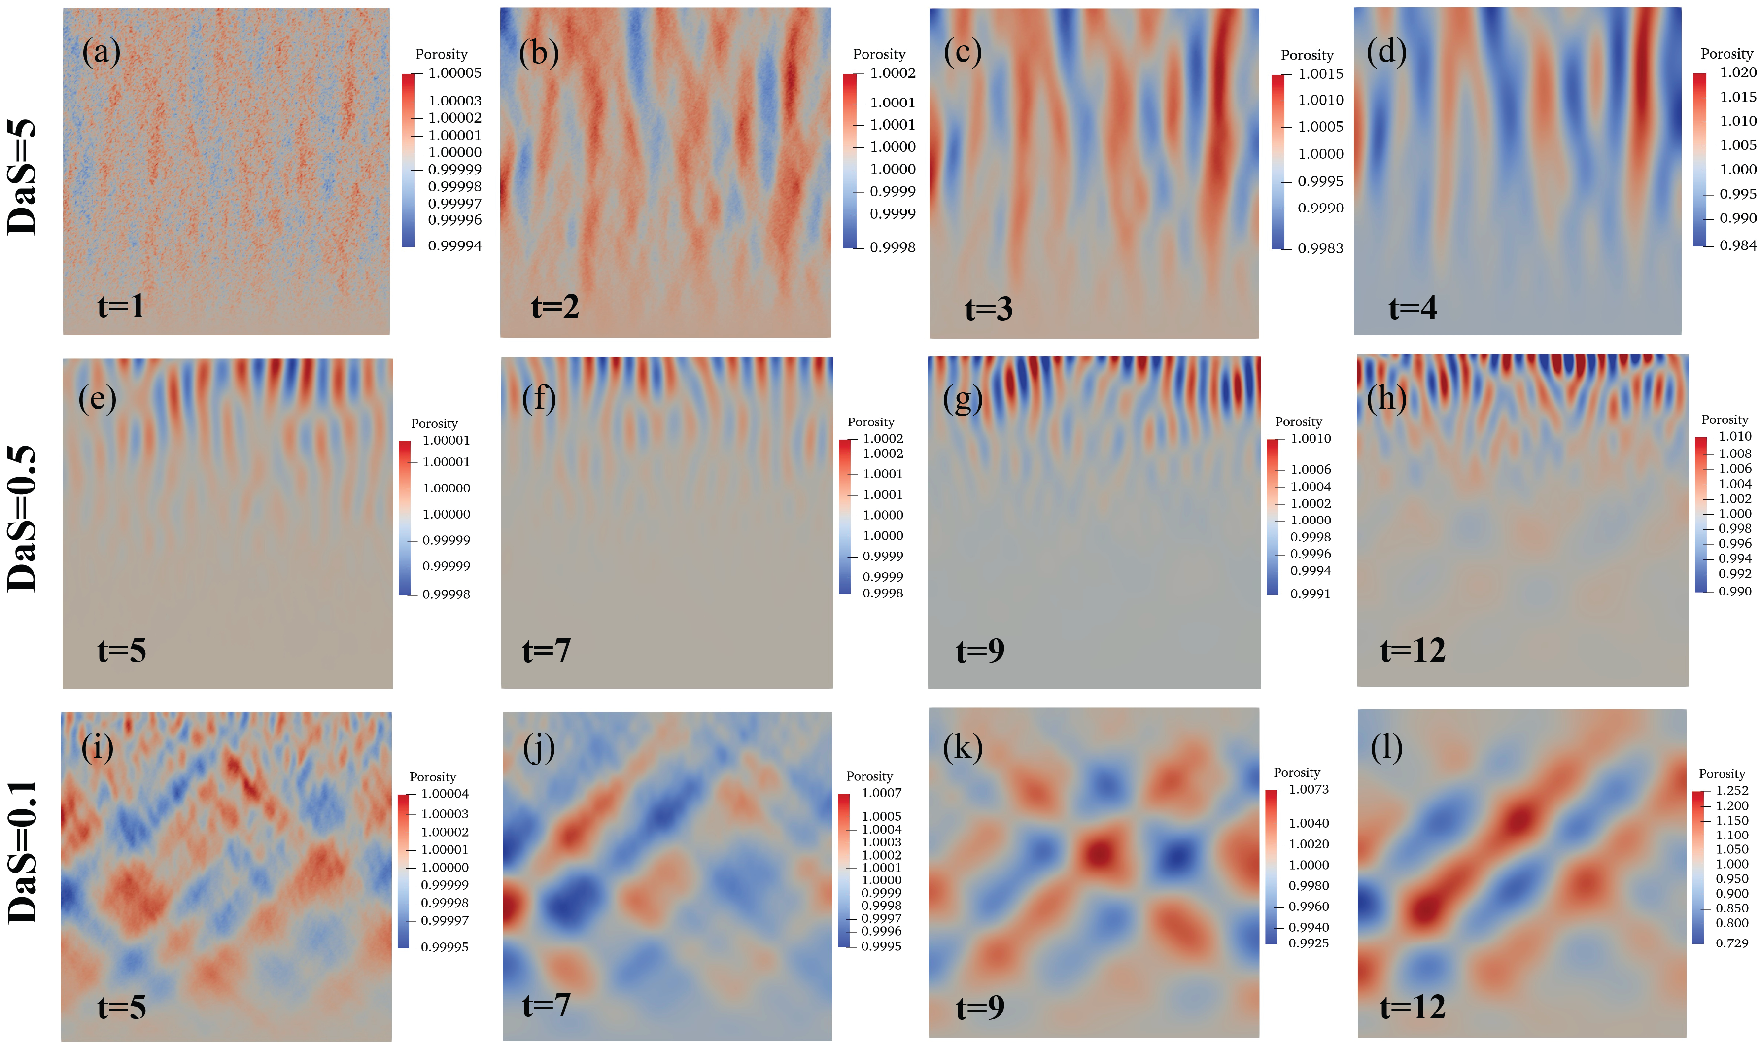
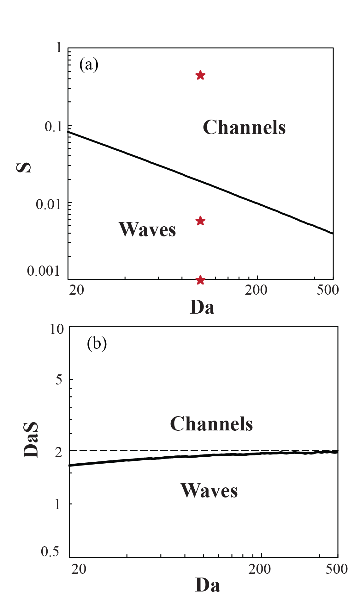
Channels or waves: controls on melt migration through the upper mantle
Min Huang, John Rudge, David Rees Jones
mh2153@cam.ac.uk
High-porosity channels vs Compaction-dissolution waves
Regime diagram by
linear stability analysis
S=0.05
S=0.005
S=0.001
More stories in PICO 1.4 screen
28 Apr 2025

Slide 3





Channels or waves: controls on melt migration through the upper mantle
Min Huang^{1*}, John Rudge¹, David Rees Jones²,
¹Bullard Laboratories, Department of Earth Sciences, University of Cambridge
²School of Mathematics and Statistics, University of St Andrews
*mh2153@cam.ac.uk
Abstract
28 Apr 2025

Slide 4
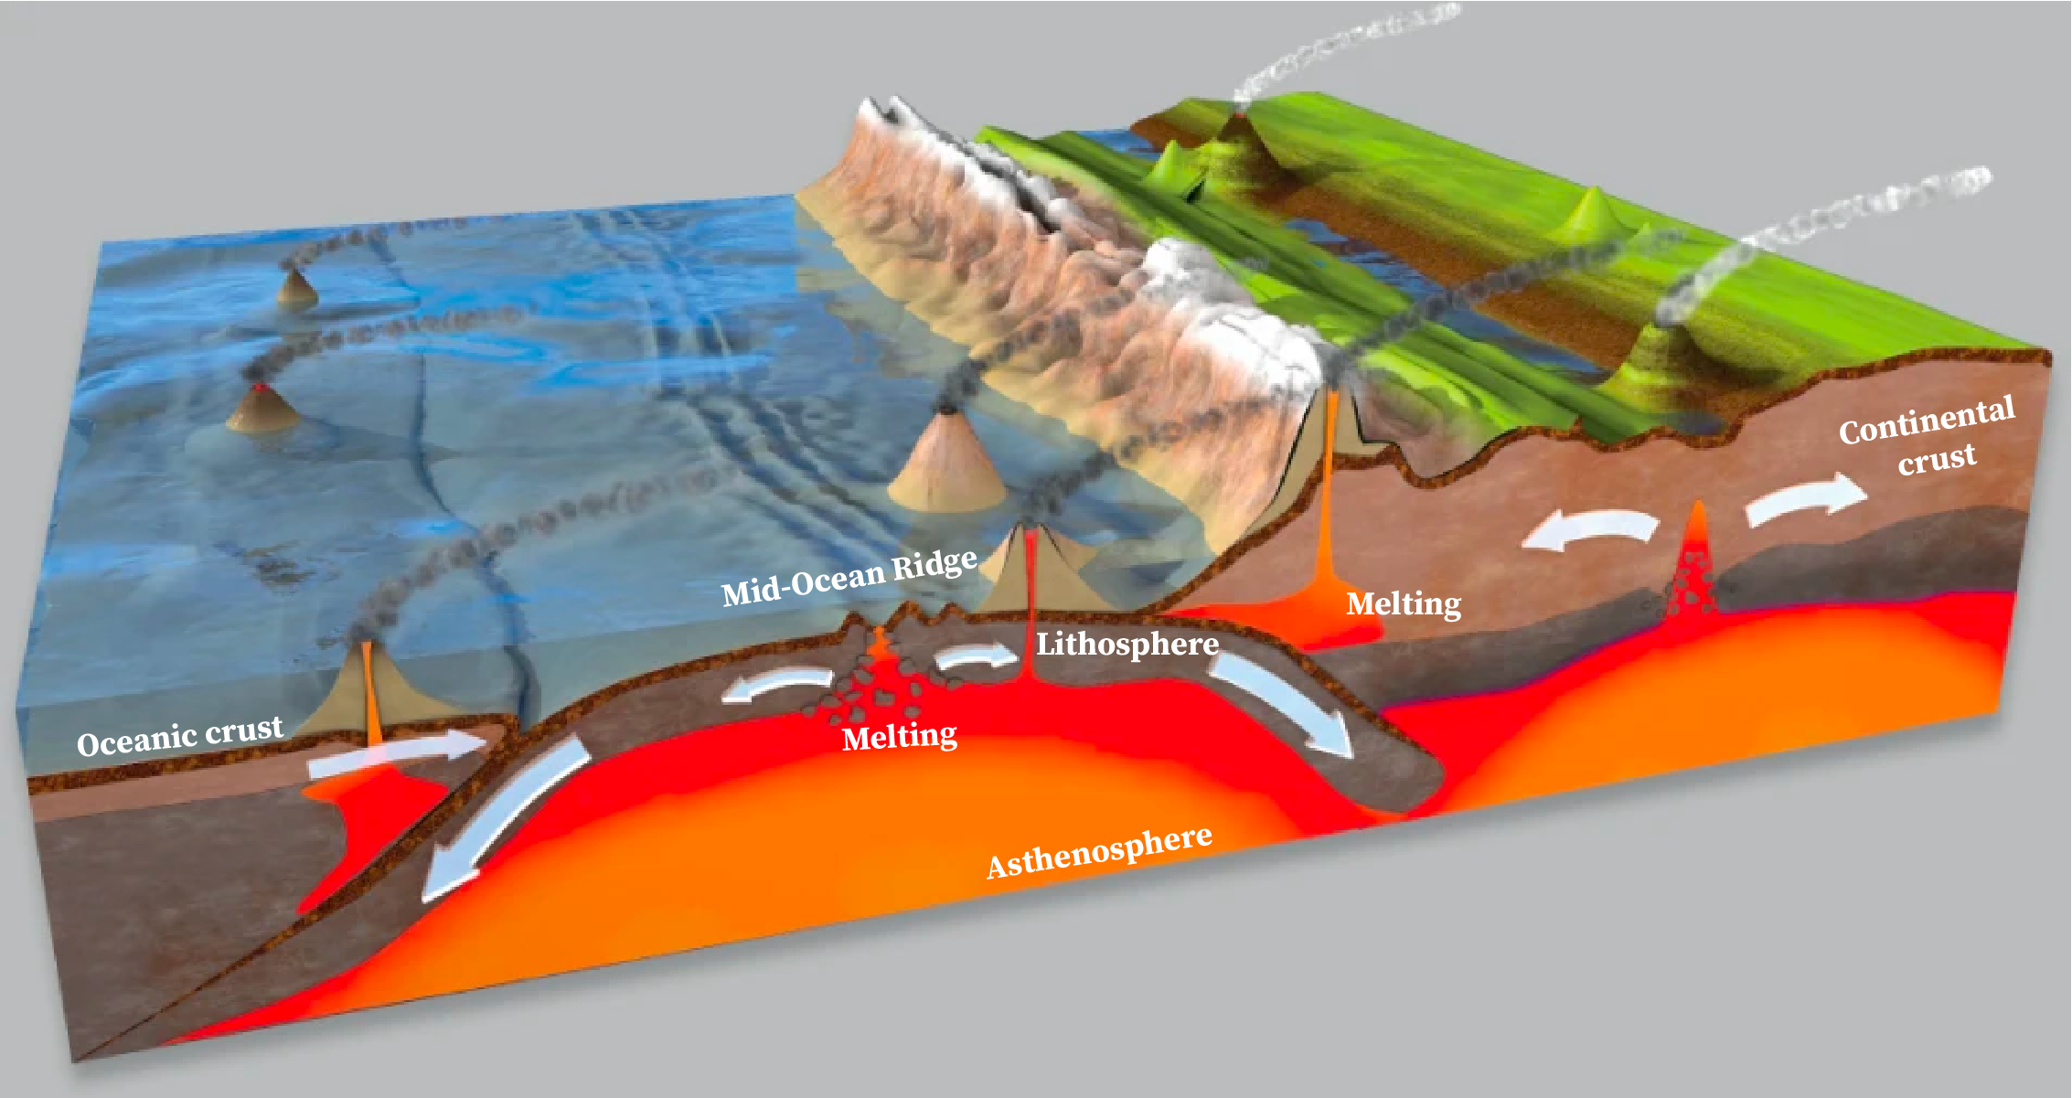
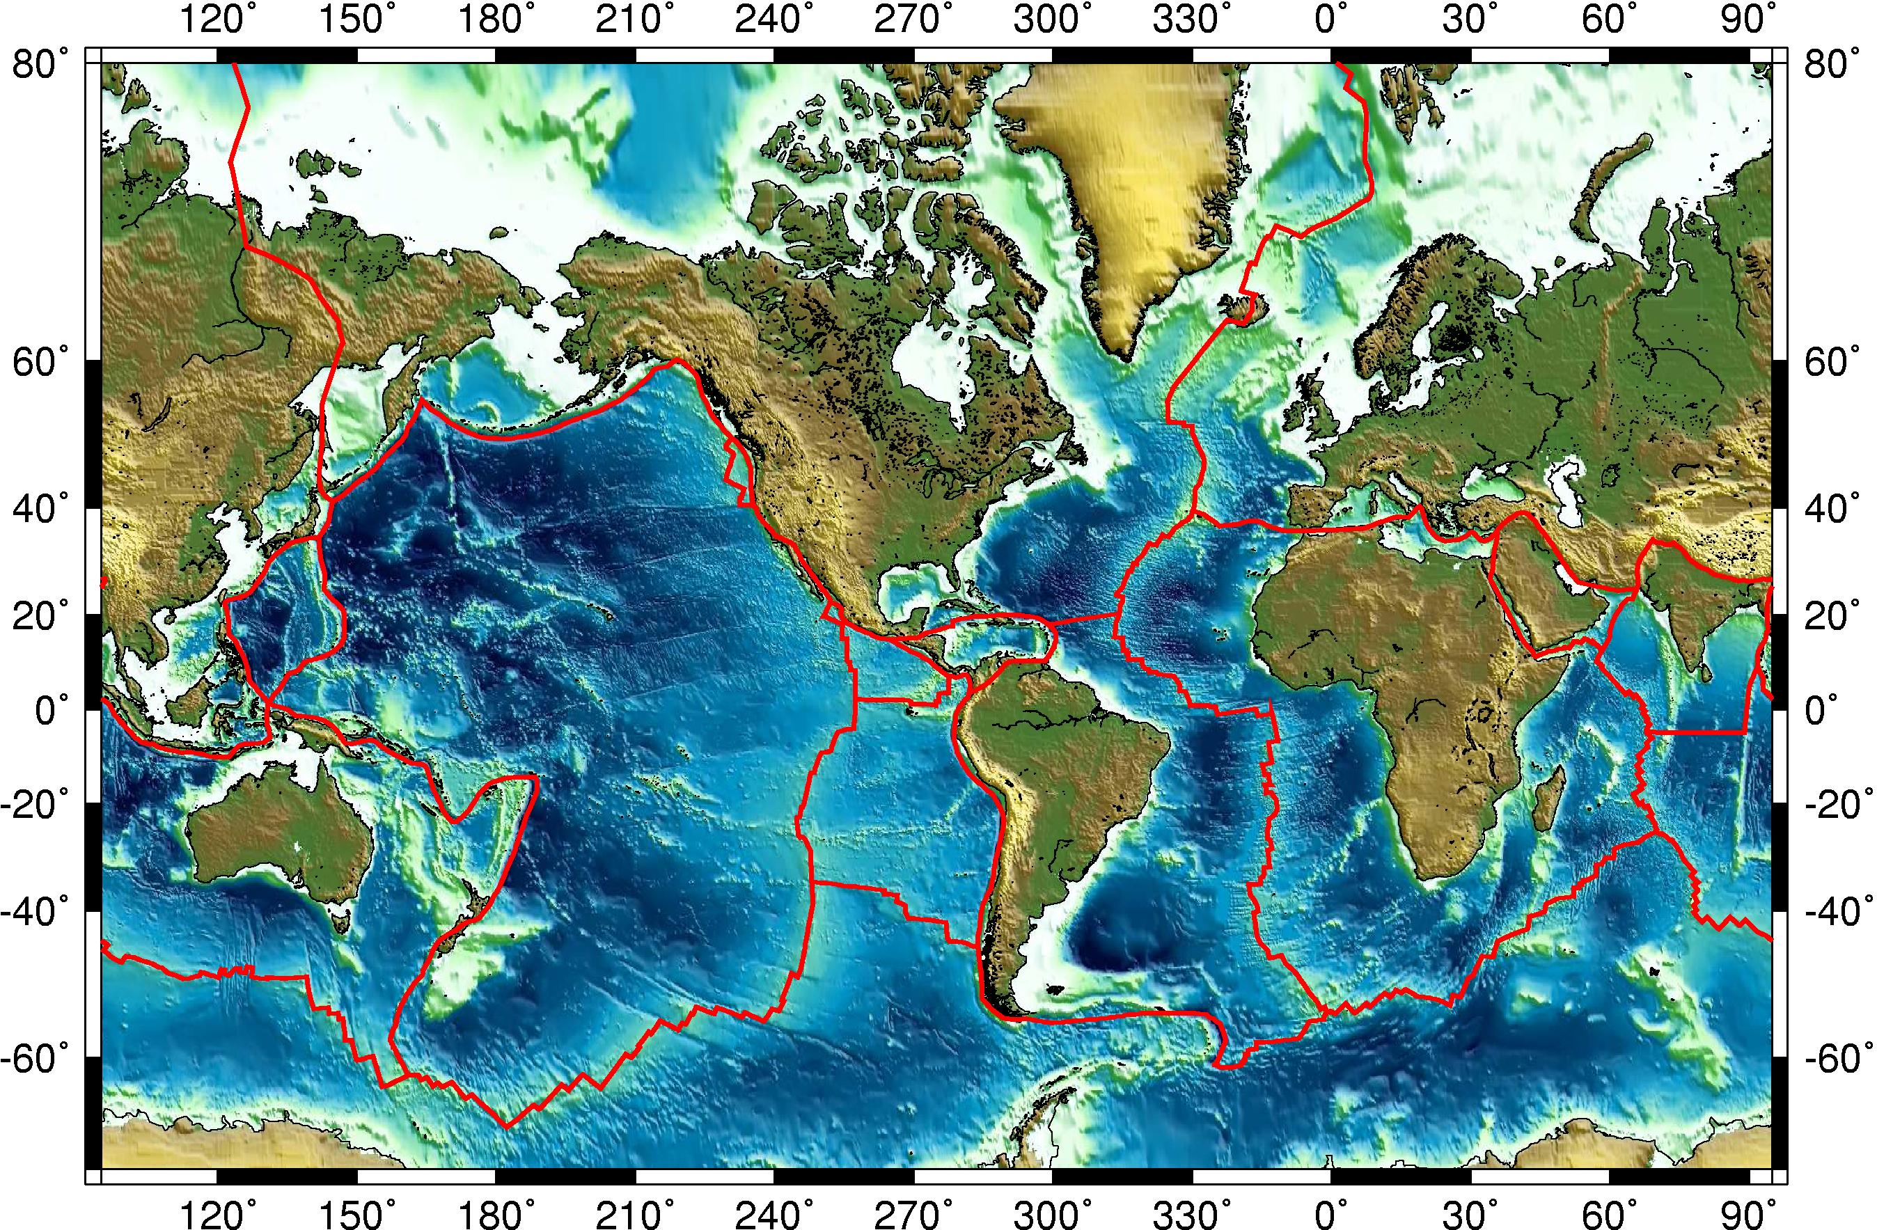
Melt migration pathway
Background
Melt transport paths from depth to surface
Melting in different geological settings
Brittle fracture–Dikes
7 km
Channelized flow
Diffuse porous flow
100 km
Tarbuck and Lutgens (2005)

Slide 5
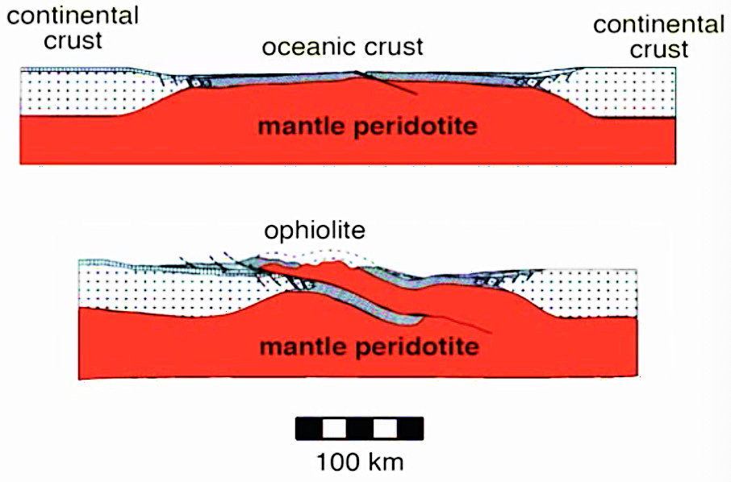
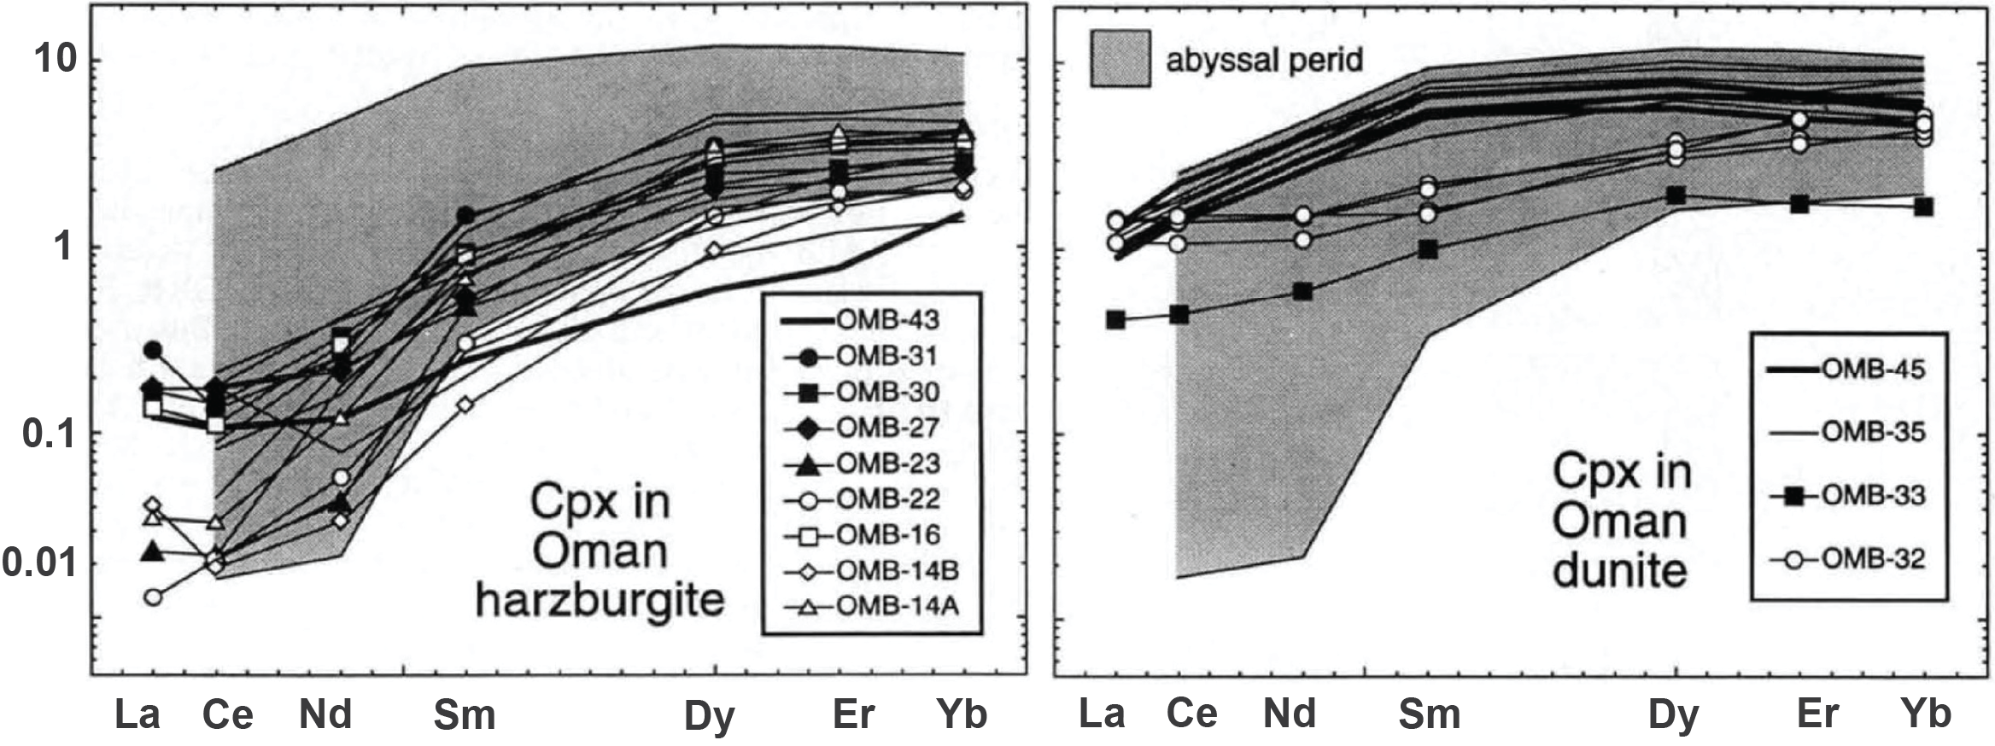
Constraints
Evidence for Channelized Flow
Field observation of ophiolite
Minerals:
MORB-forming magmas at Moho pressure are undersaturated in orthopyroxene.
Trace element:
Oman harzburgites are not in trace element equilibrium with MORBs, while dunites are.
(olivine + opx)
(> 90% olivine)
Oman Ophiolite (Braun and Kelemen, 2002)
(Kelemen, 1997)

Slide 6
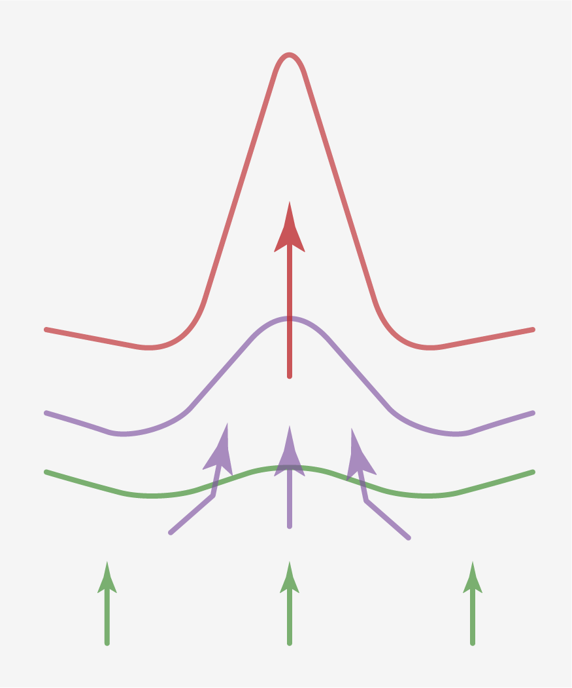
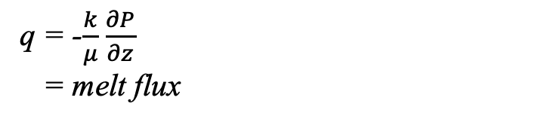
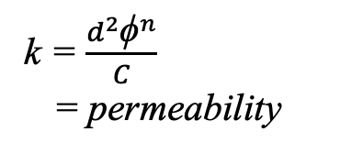
Theory
Reaction-Infiltration Instability - Theory
Melt₁(l) + Pyroxene(s) Melt₂(l) + Olivine(s)
A positive feedback loop between flow and chemical reaction
ϕ = melt fraction (porosity)
(> 90% olivine)
ϕ
q
k
(olivine + opx)
k = $\frac{d^{2}{\text{ϕ}}^{n}}{C}$
= permeability
q = -$\frac{k}{μ}$ $\frac{∂P}{∂z}$
= melt flux
Oman Ophiolite
(Braun and Kelemen, 2002)

Slide 7
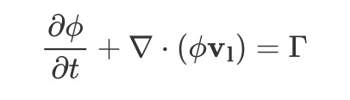
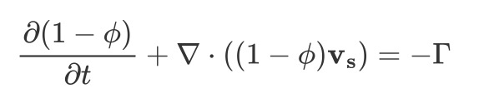
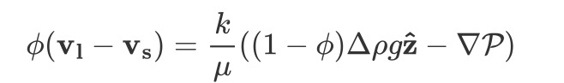
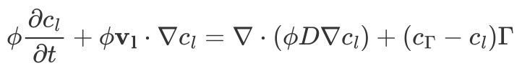
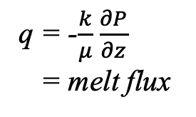
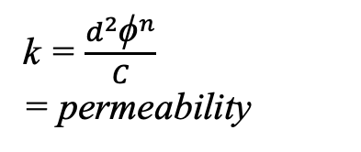
Reaction-Infiltration Instability - Theory
Method
ϕ = melt fraction (porosity)
(McKenzie, 1984; Scott and Stevenson, 1986; Bercovici et al., 2001; Simpson et al., 2010)
ϕ
Ingredients for a magma dynamic theory:
At least two phases (melt + solid)
Allow mass-transfer between phases (𝛤)
The solid must be permeable at some scale (k)
In the absence of liquids, the system must be consistent with mantle convection
q
k
q = -$\frac{k}{μ}$ $\frac{∂P}{∂z}$
= melt flux
k = $\frac{d^{2}{\text{ϕ}}^{n}}{C}$
= permeability
Governing equations:
1. Conservation of Mass: Fluid
2. Conservation of Mass: Solid
3. Conservation of Momentum for fluid: Darcy’s Law
4. Conservation of chemical components for fluid:

Slide 8
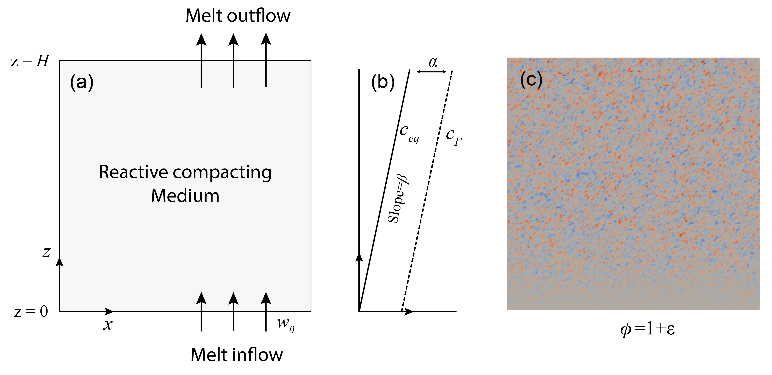

Simulation Model Setup
Method
Melt in a reactive compacting medium
Solubility gradient
Initial Porosity ϕ = 1 + 𝜀
(Gaussian noise)
$c_{eq}$ = $βz$

Slide 9
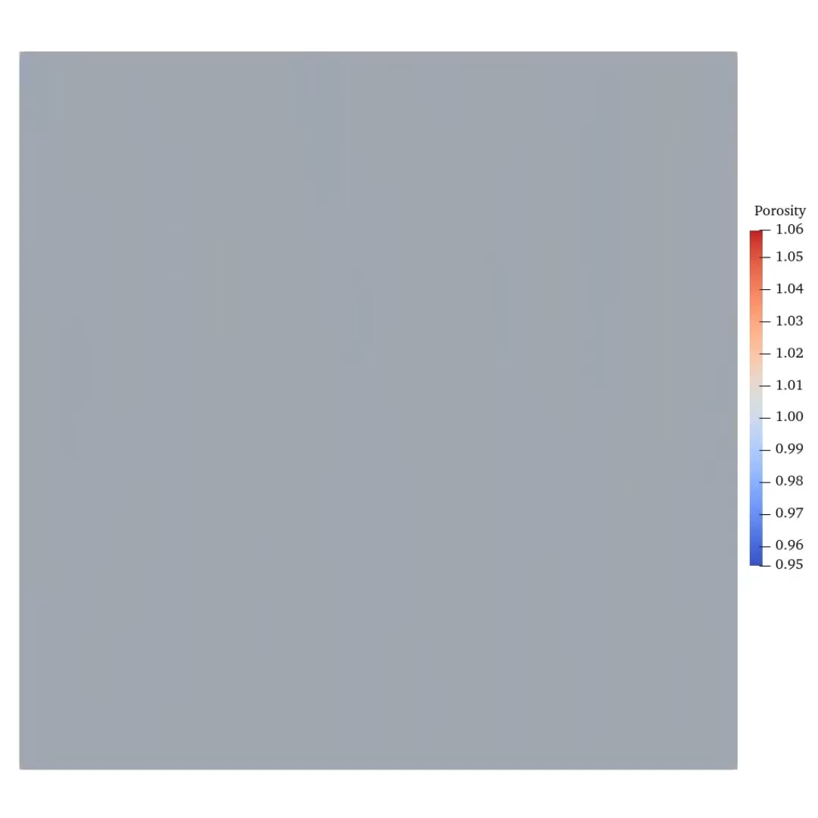
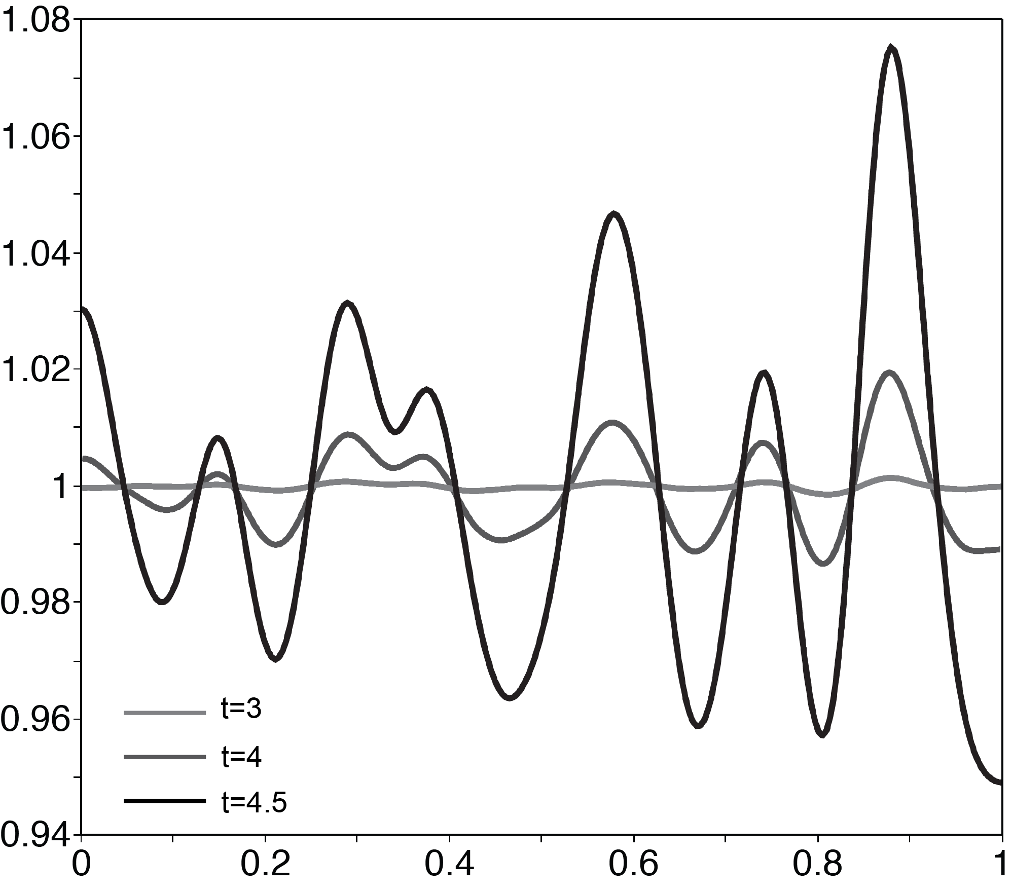
Results
High-porosity channels evolution
porosity
Cross section of porosity at z = 0.8
Movie showing the time-dependent evolution of high-porosity channels

Slide 10
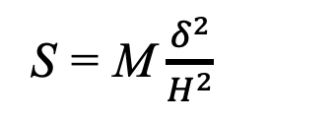
Results
Compaction dissolution waves
S = M $\frac{δ^{2}}{H^{2}}$
Characterizes the reactive potential and rigidity of the medium
Relatively
rigid medium
S=0.05
S=0.005
Compactible
medium
S=0.001
Porosity field with Da=100, Pe=100

Slide 11
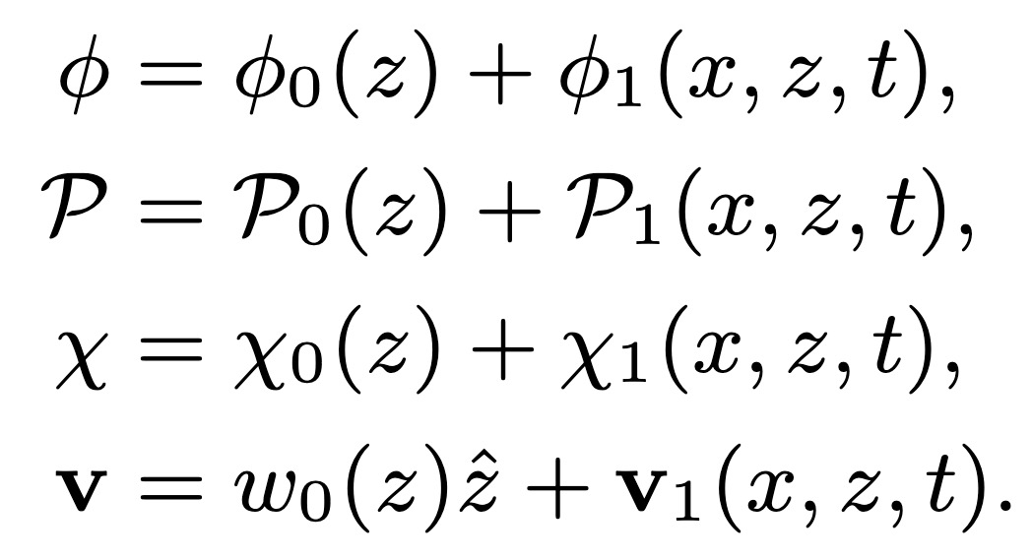
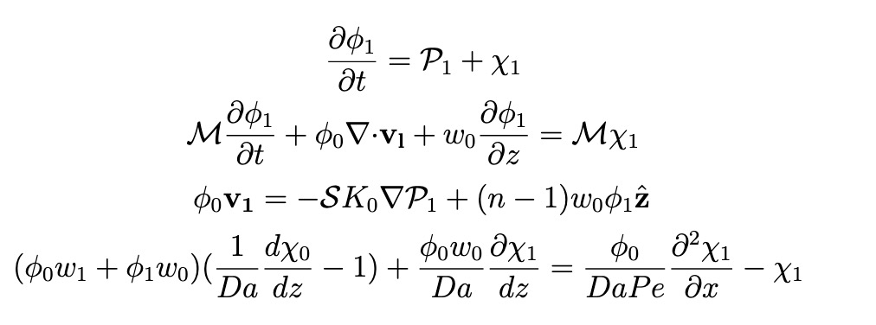

Linear stability analysis
Results
1. Expand the governing equations with a leading term and a perturbation term
3. Normal-mode solution for P₁ and ɸ₁: exponential time dependence e^{σt}
$\text{y}∝{\text{y} \left(z\right)e}^{σt+ikx}$
σ determines growth rate
k is the wavenumber
2. Linearized perturbations equations
4. Eigenvalue problem
Mv = σv
Re(σ) > 0 → instability.
Largest Re(σ) represents the most unstable mode

Slide 12
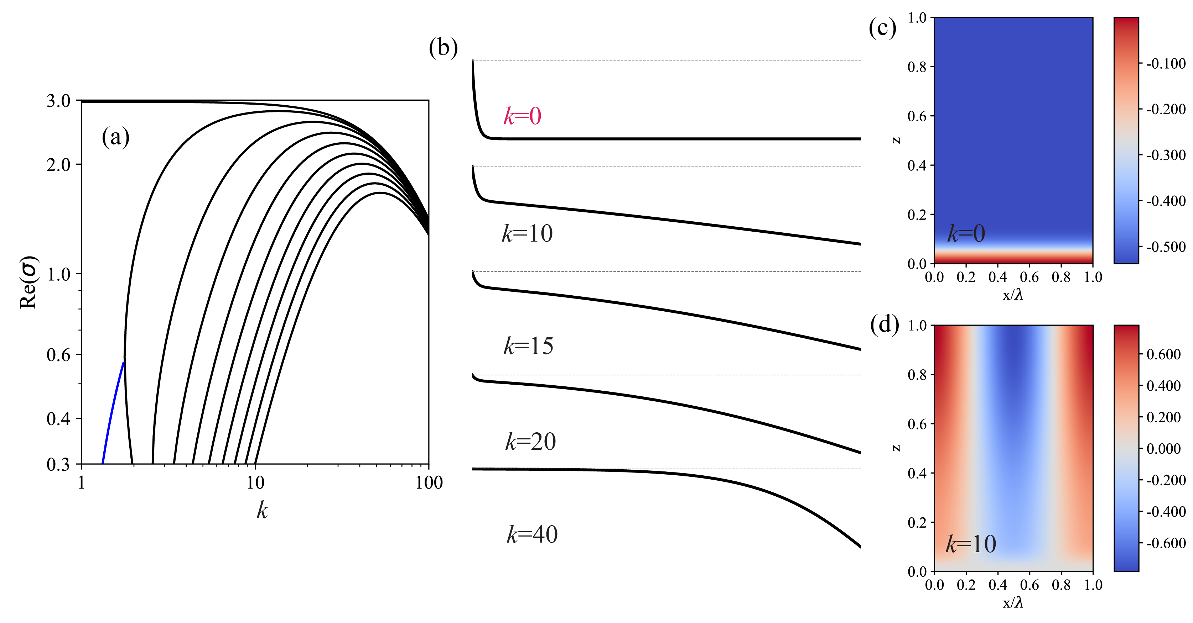
Linear stability analysis
Results
Channel Regime
Relatively rigid medium (S=1)
Porosity perturbations
Dispersion relations
Features:
Largest eigenvalues σ are real
No wavenumber selection
Monotonic growing instability
Proto-channel

Slide 13
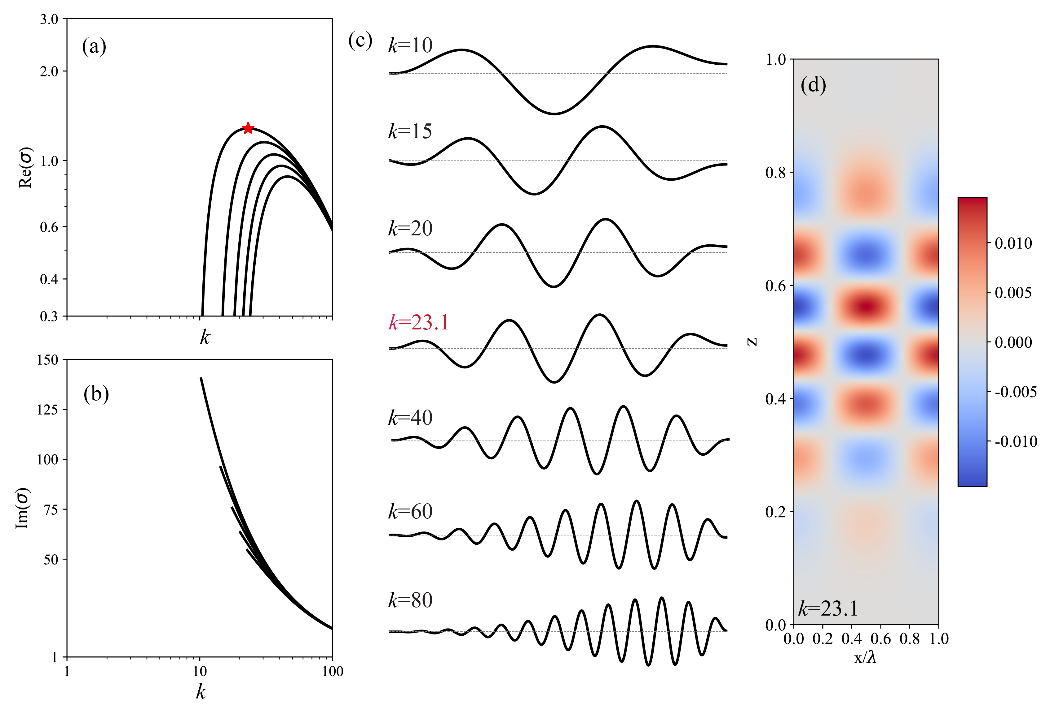
Linear stability analysis
Results
Wave Regime
Compactible medium (S=0.001)
Features:
Eigenvalues σ are purely complex
Strong wavenumber selection (red star)
Oscillatory instability
Compaction-
dissolution wave

Slide 14
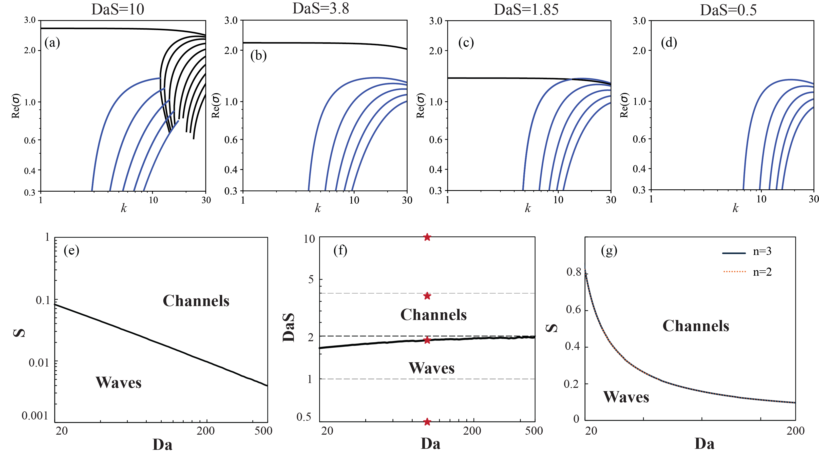
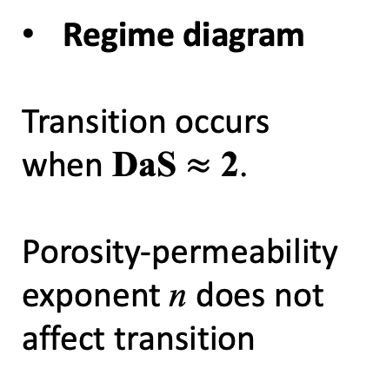
Results
Linear stability analysis
Regime diagram for reaction-infiltration instability
Dispersion relations
Intersection of largest real eigenvalues (black) and complex eigenvalues (blue)
Transition point
Regime diagram
Transition occurs when DaS $≈$ 2.
Porosity-permeability exponent n does not affect transition

Slide 15
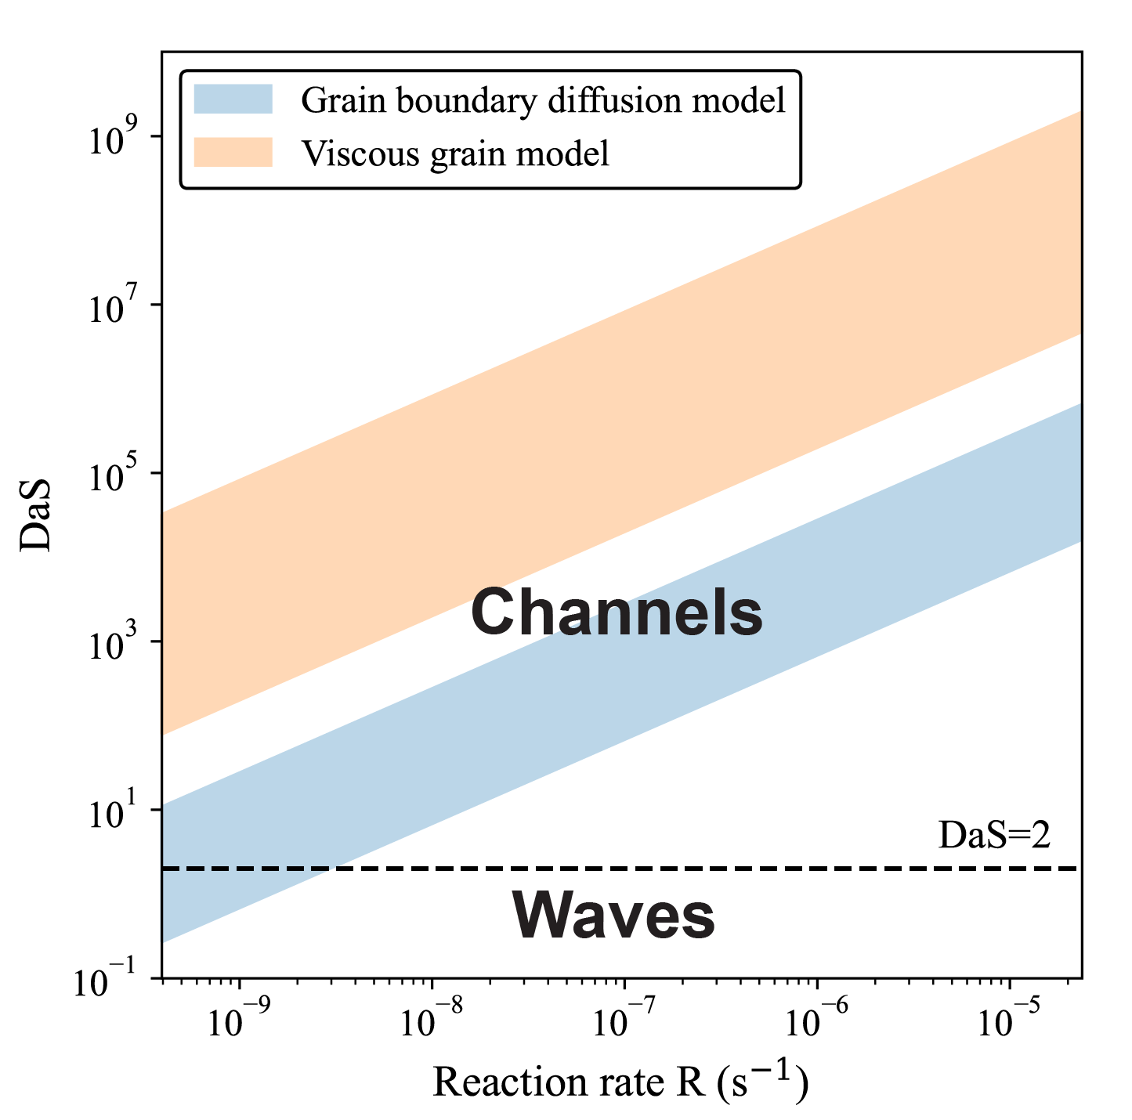
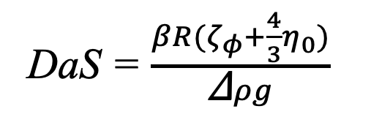
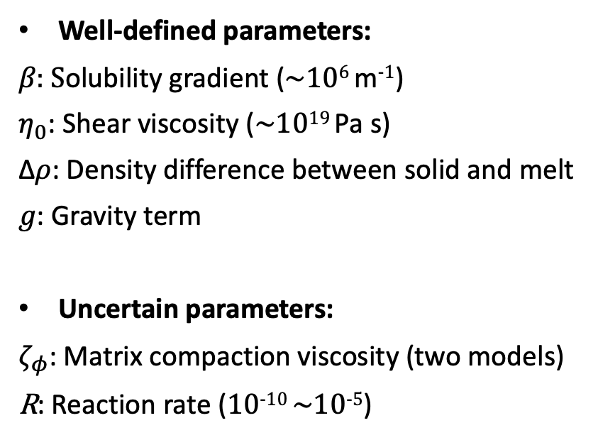
Discussion
Application to the mantle
Geologically relevant parameters in the upper mantle
DaS = $\frac{βR(ζ_{φ}+\frac{4}{3}η_{0})}{\text{Δ}ρg}$
Well-defined parameters:
𝛽: Solubility gradient (~10⁶ m⁻¹)
$η_{0}$: Shear viscosity (~10¹⁹ Pa s)
Δ𝜌: Density difference between solid and melt
𝑔: Gravity term
Uncertain parameters:
$ζ_{φ}$: Matrix compaction viscosity (two models)
R: Reaction rate (10⁻¹⁰ ~10⁻⁵)

Slide 16
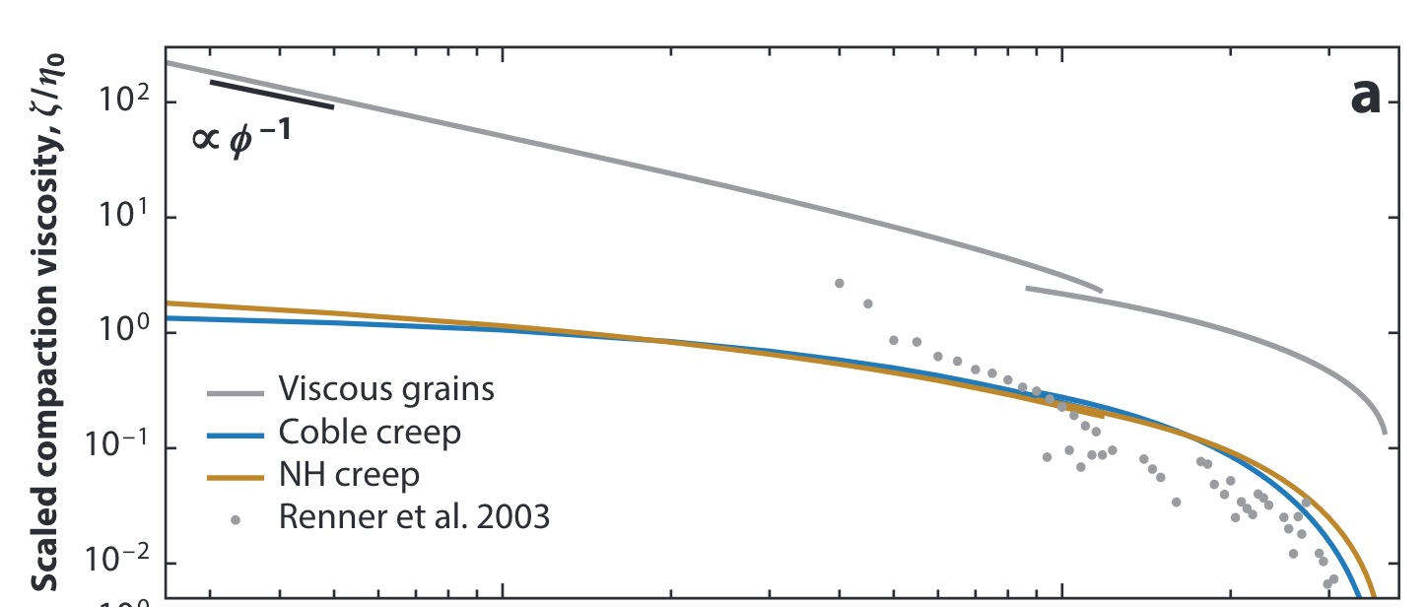
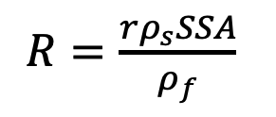
Discussion
Application to the mantle
Geologically relevant parameters in the upper mantle
1. Matrix compaction viscosity ζ
2. Reaction rate R
Viscous-fluid model
(Scott & Stevenson 1986; Sleep 1988)
ζ = η₀ /ɸ₀
$R=\frac{rρ_{s}SSA}{ρ_{f}}$
Grain-boundary diffusion model
(Takei & Holtzman 2009, Rudge 2018)
ζ = 5/3 η₀
R ranges from 10⁻⁵ to 10⁻¹⁰
This uncertainty comes from:
The calculation of linear dissolution rate r (10⁻⁸ m s⁻¹~10⁻¹² m s⁻¹ ).
The internal surface area available for reaction SSA, accounts for grain size d, grain geometry, the ratio of solid-melt surface, and soluble phase fraction.
Katz et al., (2022)

Slide 17
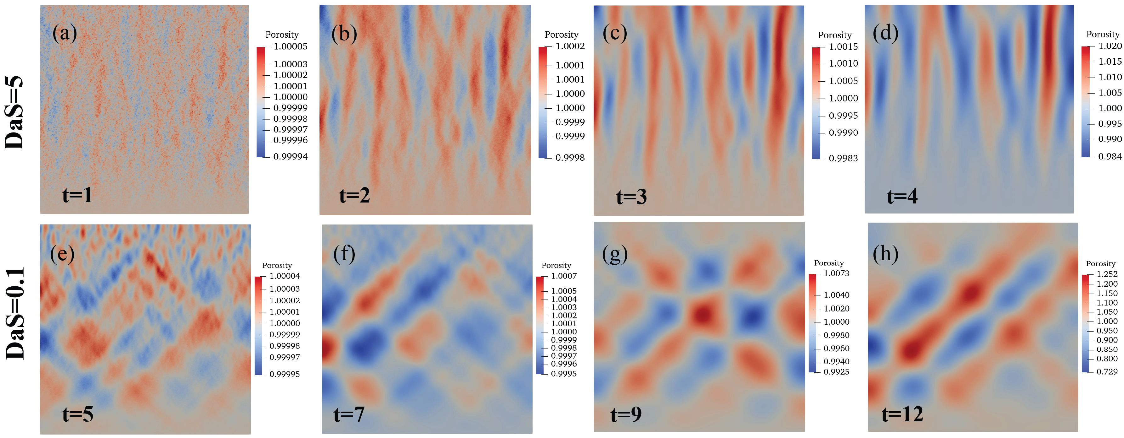
Conclusion
The Take Away
Reaction-infiltration instability can lead to two distinct structures:
(i) compaction-dissolution waves and (ii) high-porosity channels.
A parameter regime diagram shows that high-porosity channels form when DaS ≥ 2, whereas compaction-dissolution waves dominate when DaS < 2.
While high-porosity channels are commonly expected, both channels and waves may develop under the Earth's mantle conditions.
Abstract
*mh2153@cam.ac.uk

Slide 18
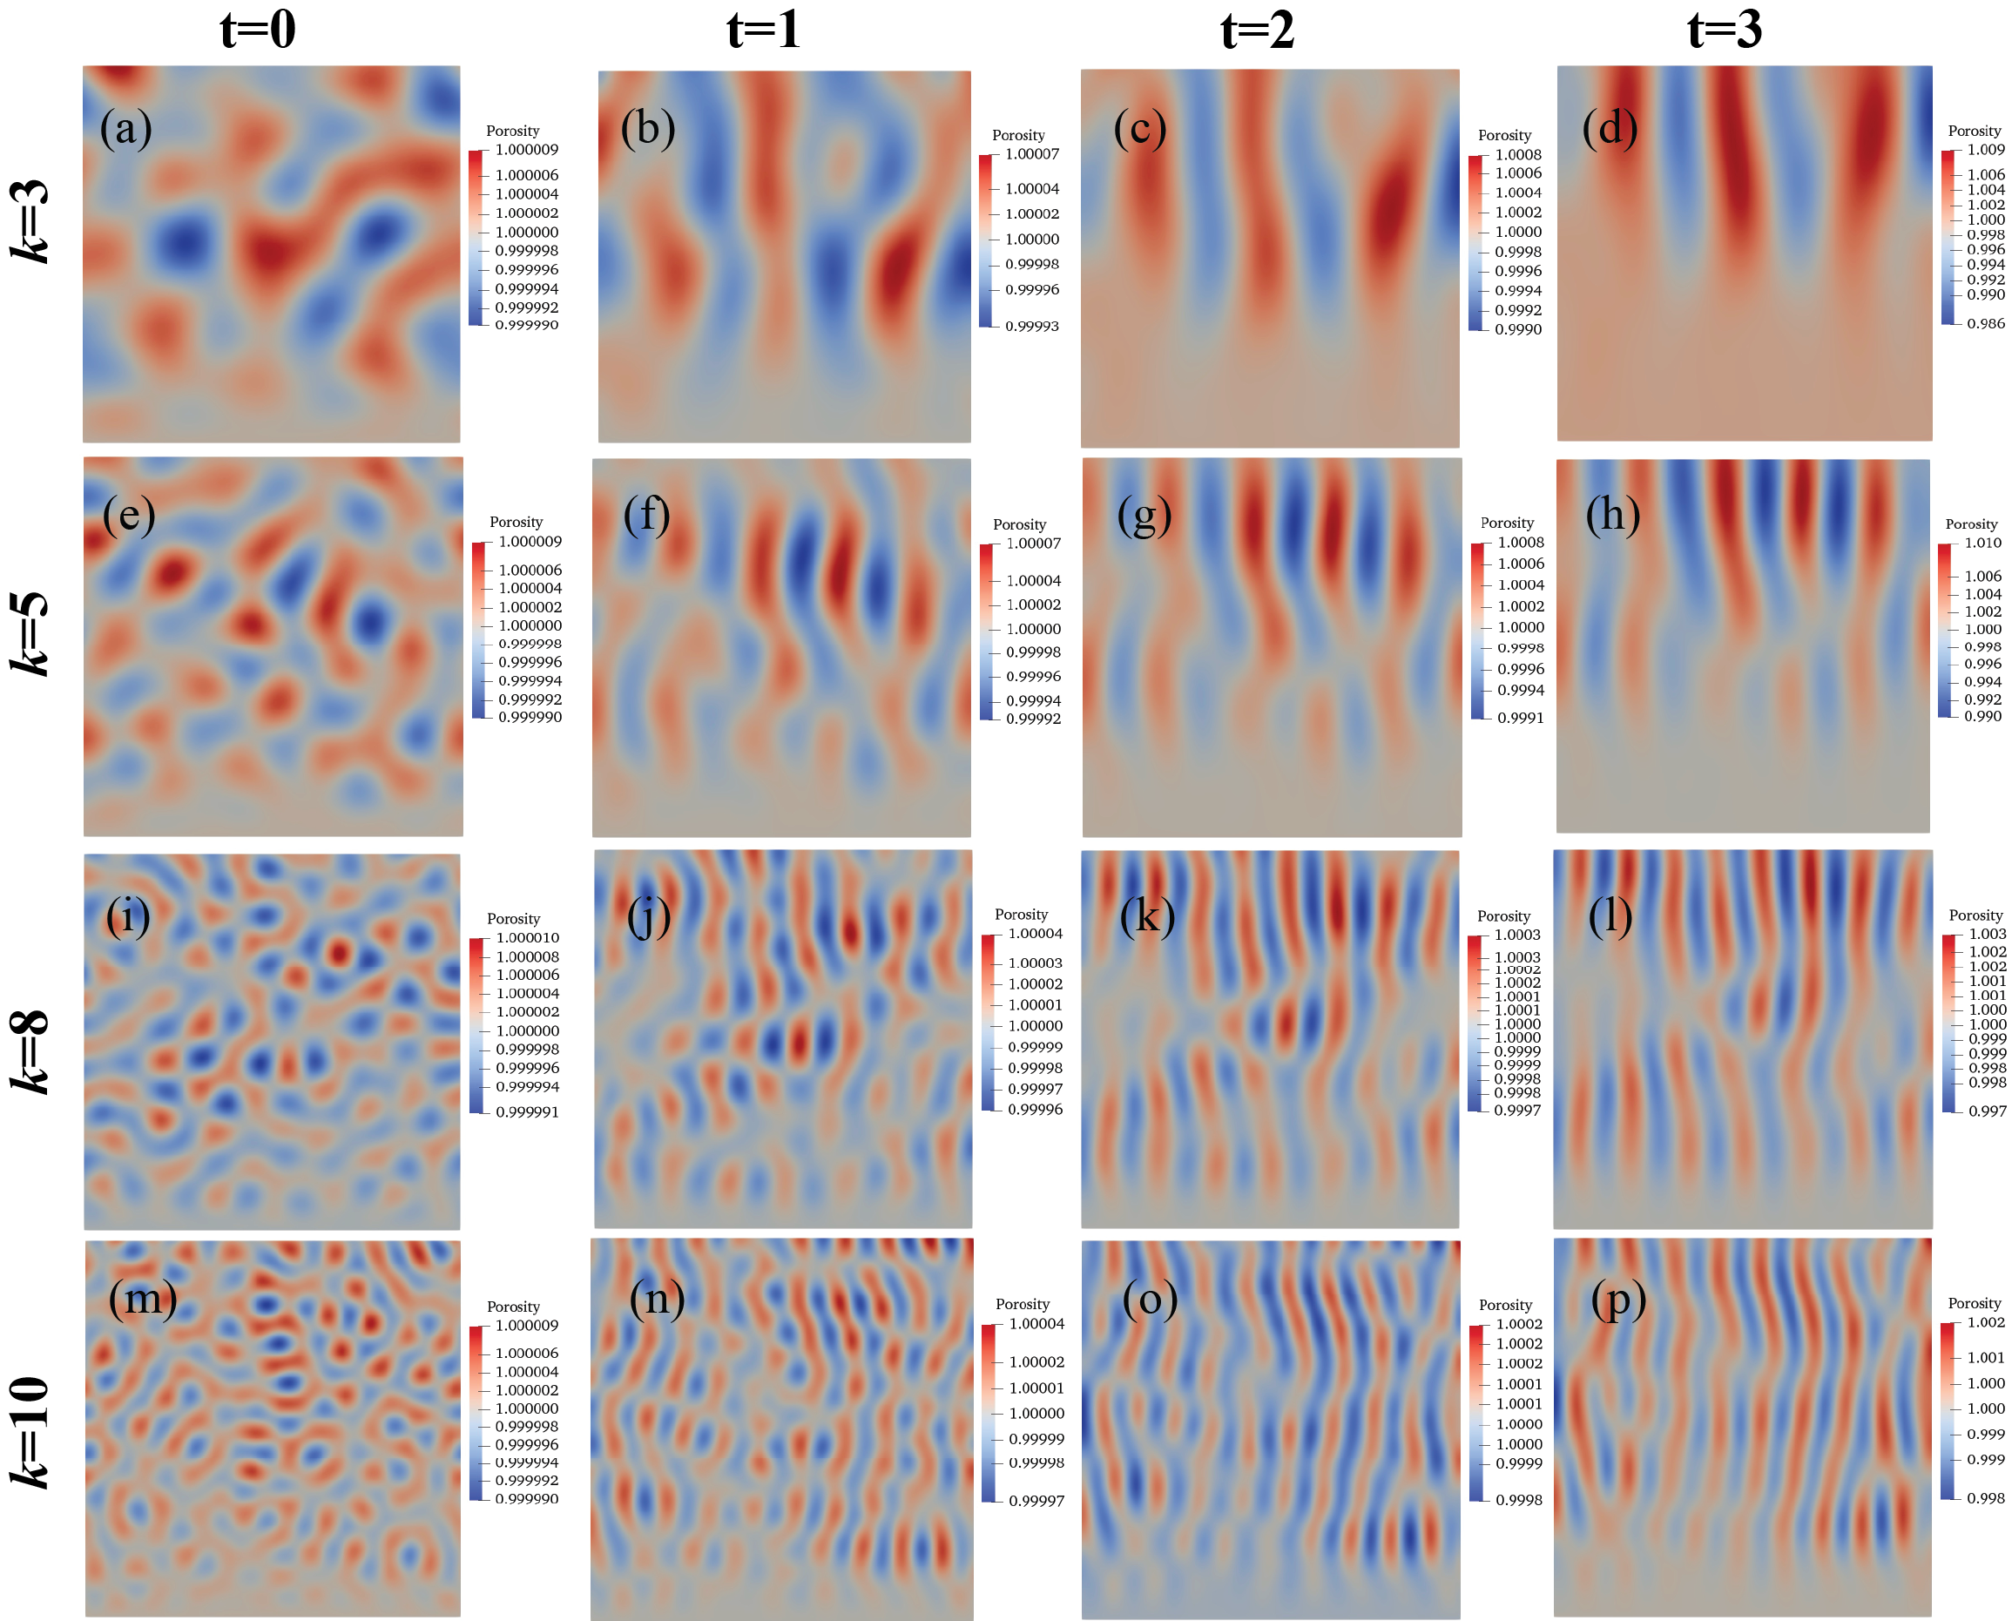
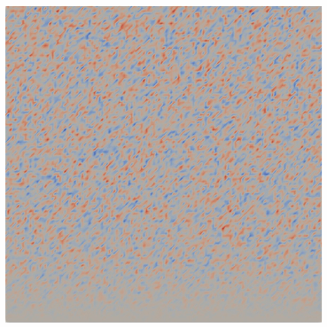
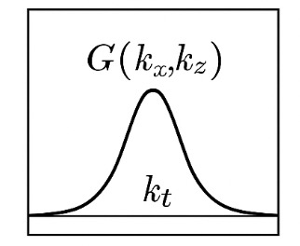
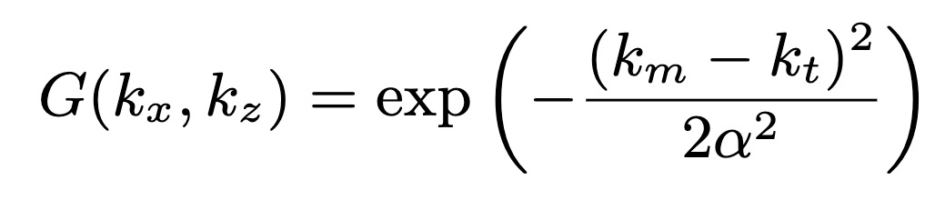
Backup
Spectral control of initial perturbations
Initial Gaussian noise 𝜀(x, z)
Fast Fourier Transform
Transform back and Re-interpolate onto the mesh

Slide 19

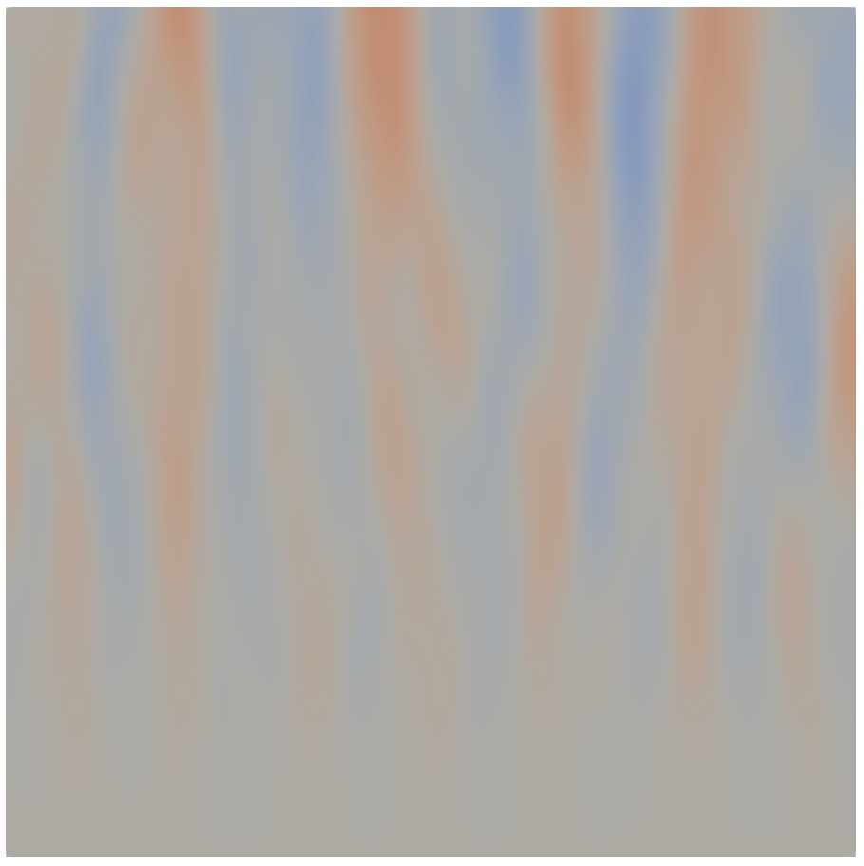
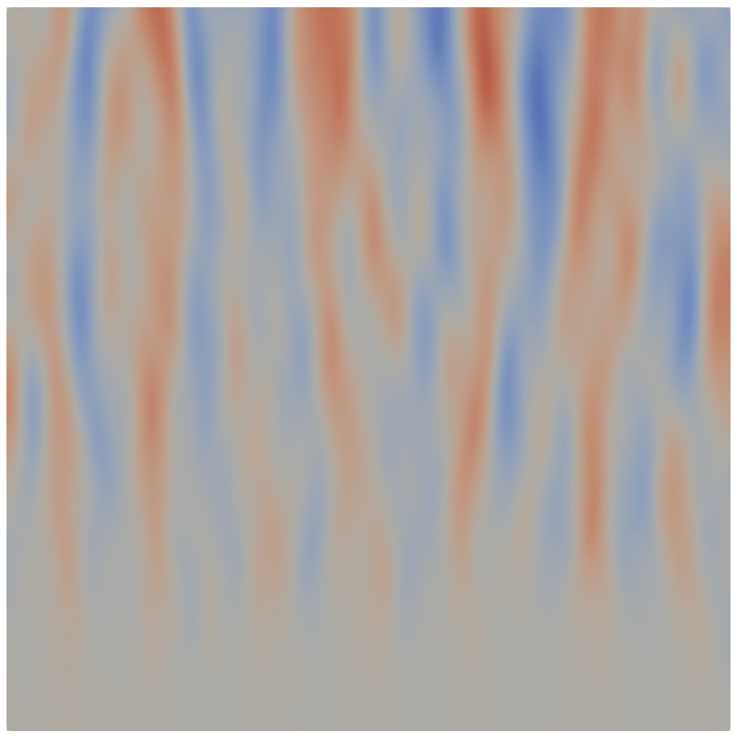
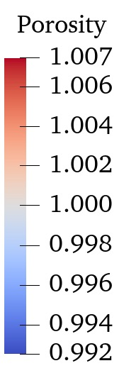
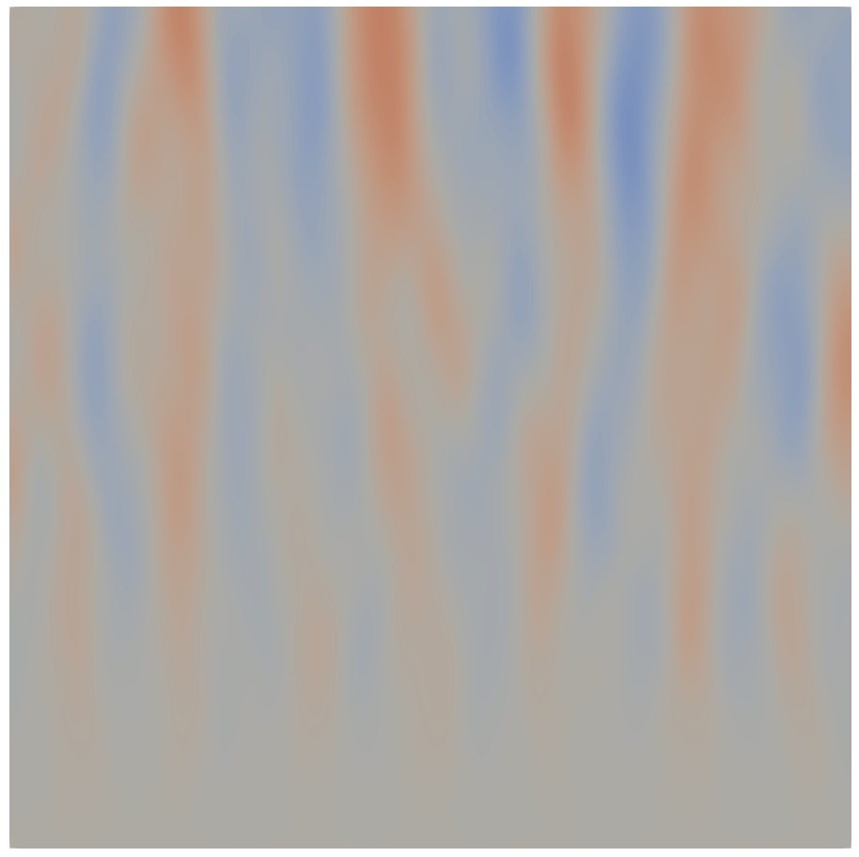
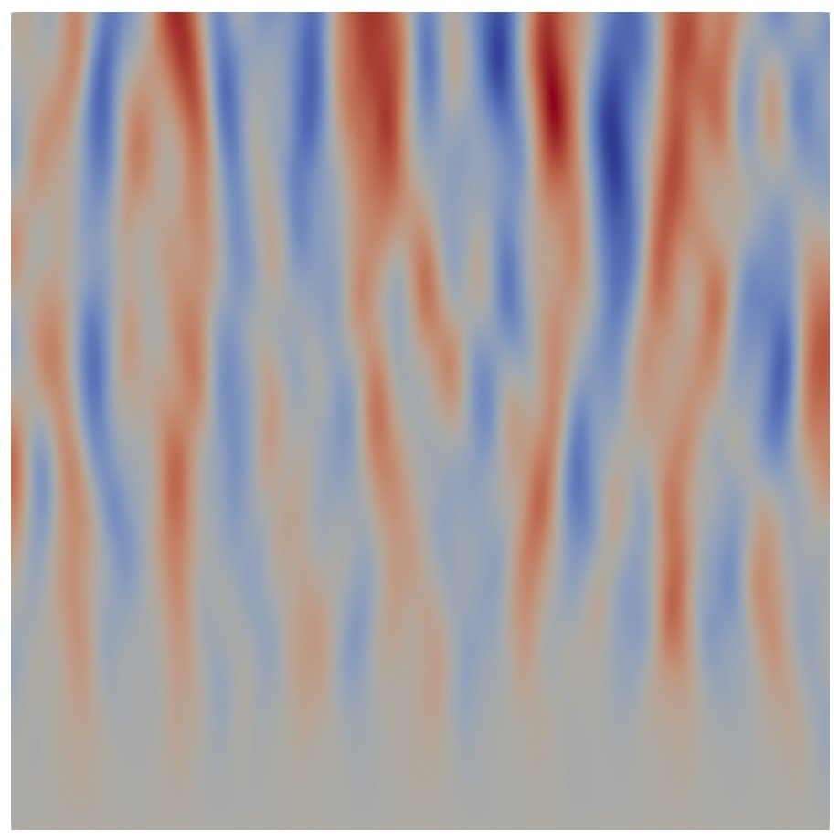
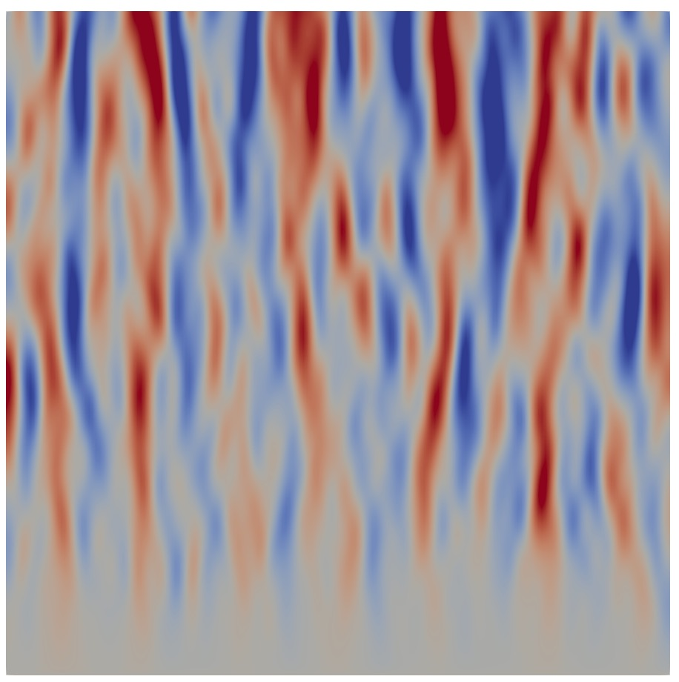
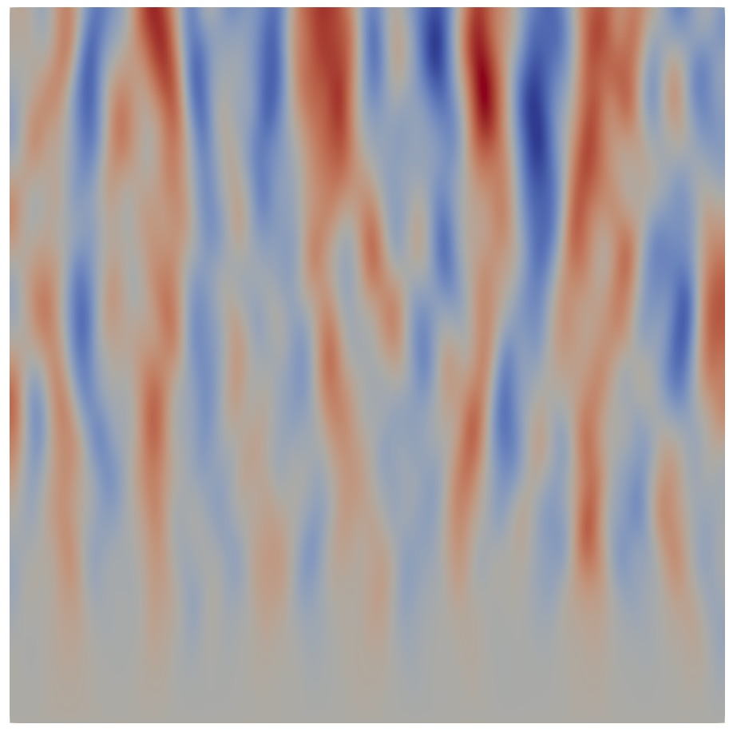
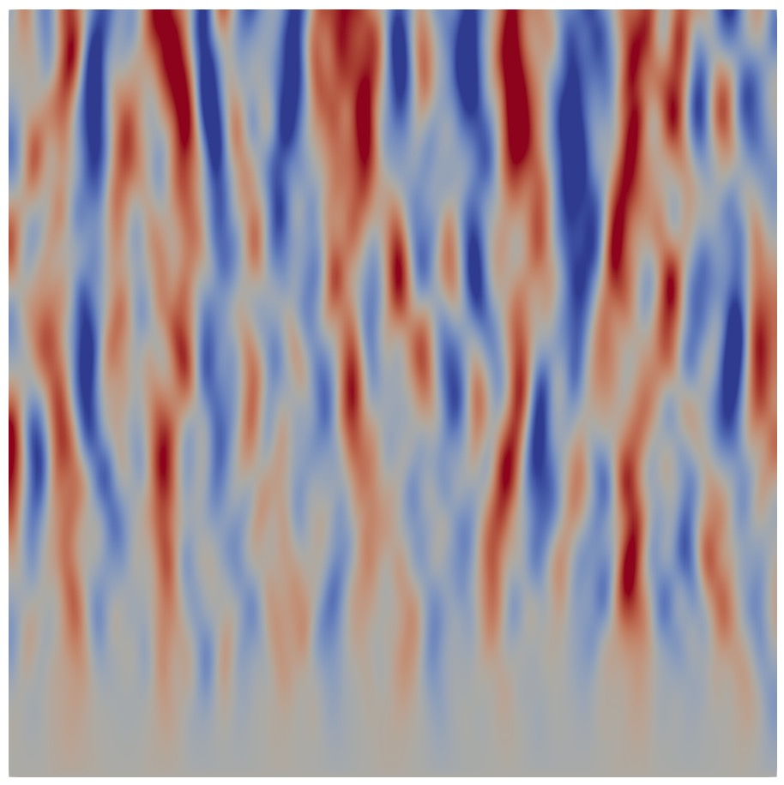
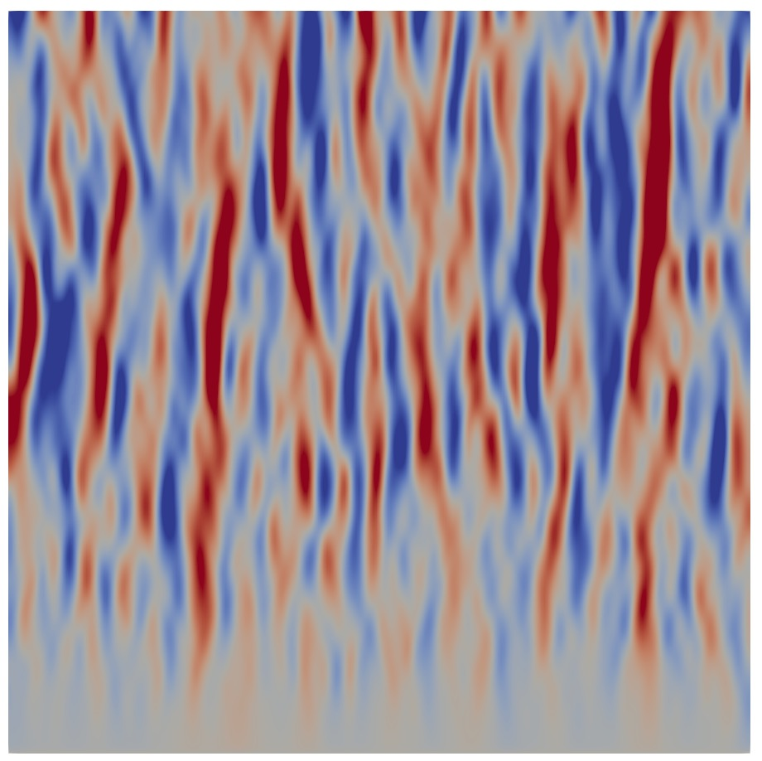
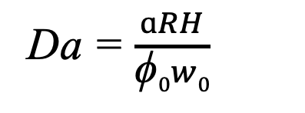
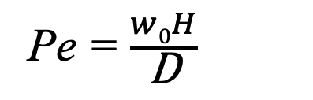
Backup
Parameter test
Peclet number
100
200
400
(a)
(b)
(c)
Da = $\frac{ɑRH}{\text{ϕ}0w0}$
100
Characterizes the rate of reaction relative to advection
(d)
(e)
(f)
Damkohler number
Pe = $\frac{w0H}{\text{D}}$
200
Characterizes the rate of advection relative to diffusion
(g)
(h)
(i)
400
Similar to Spiegelman et al., (2001)

Slide 20
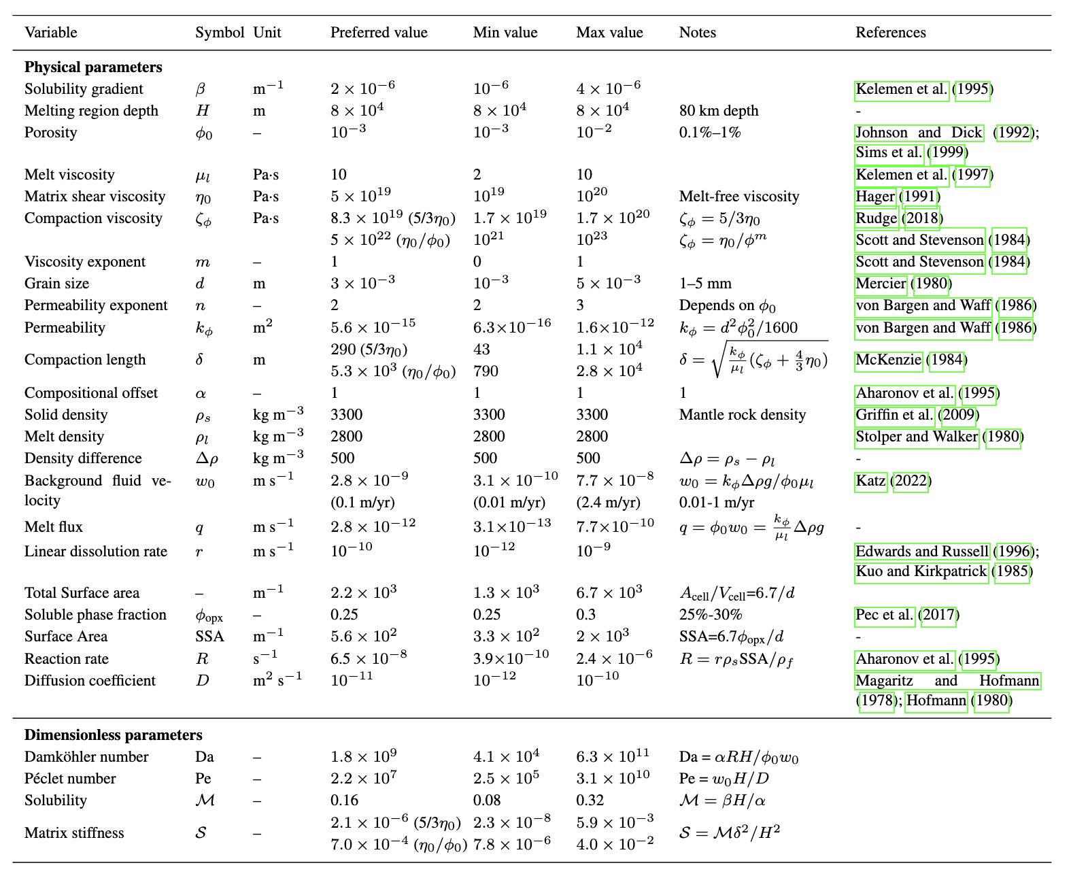
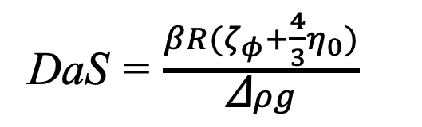
Backup
Geologically-relevant parameters in the mantle
DaS = $\frac{βR(ζ_{φ}+\frac{4}{3}η_{0})}{\text{Δ}ρg}$

