Slide 1
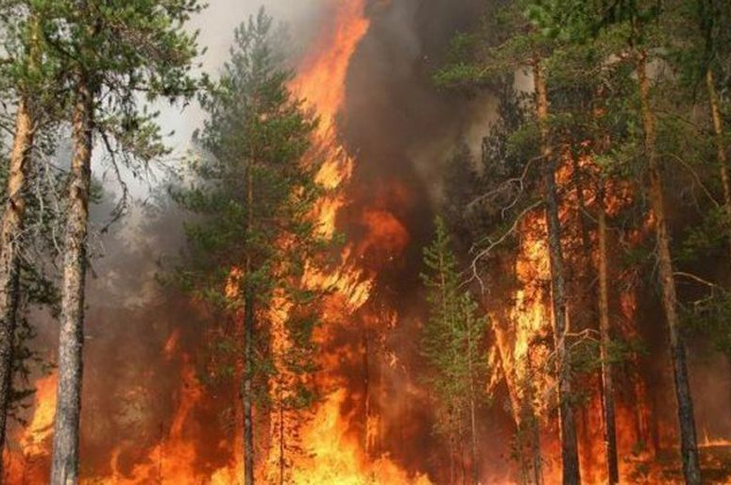
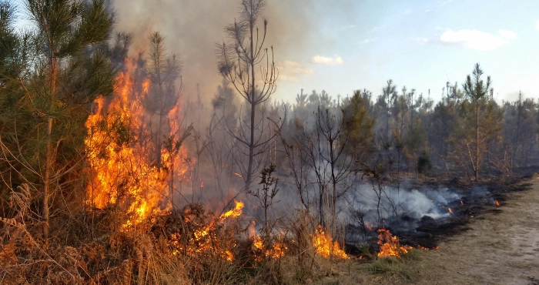
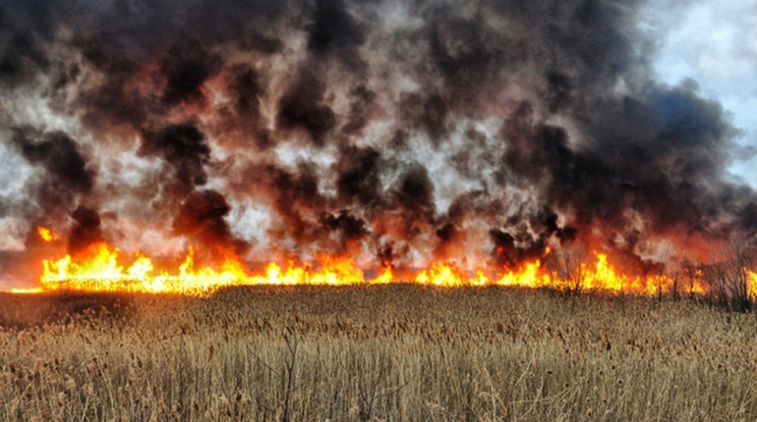
Quantifying greenhouse gas emissions from landscape fires due to the Russo–Ukrainian War and the impact on the carbon sequestration capacity of forests
Roman Vasylyshynª, Rostyslav Bun^{b,c}, Viktor Myroniukª, Lennard de Klerk^{d}, Oleksandr Soshenskyiª, Sergiy Zibtsevª, Svitlana Krakovska^{e}, Linda See^{f}, Mykola Shlapak^{g}, Volodymyr Blyshchykª, Lidiia Kryshtop^{h}, Zoriana Romanchuk^{f,b}, Orysia Yashchun^{f,b}, Eugene Kalchukª, Yuriy Rymarenkoª
ª National University of Life and Environmental Sciences of Ukraine, Kyiv, Ukraine
^{b} Lviv Polytechnic National University, Lviv, Ukraine
^{c} WSB University, Dąbrowa Górnicza, Poland
^{d} Initiative on GHG accounting of war, Irota, Hungary
^{e} Ukrainian Hydrometeorological Institute, Kyiv, Ukraine
^{f} International Institute for Applied Systems Analysis, Laxenburg, Austria
^{g} Initiative on GHG accounting of war, Kherson, Ukraine
^{h} NGO “PreciousLab”, Cherkasy, Ukraine

Slide 2
The project: Background
Research undertaken within the framework of the project “Assessment of the Environmental Impacts of the War Against Ukraine and Options for Remediation”.
Project donors include Finland, France, Germany, Ireland, Luxembourg, Poland, the United Kingdom and the United States of America.
Conflict and Environment Observatory, UK
Specialised charity that undertakes research and advocacy on the environmental dimensions of armed conflicts and military activities.
Zoï Environment Network, Switzerland
Non-profit specialising in the analysis and communication of various environmental issues whose experience in Ukraine dates back to the early 2010s.
Initiative on GHG accounting of war
Collective of carbon experts that joint forces one month after the full-scale invasion to quantify the impact of the war on the climate system.
Other international and Ukrainian stakeholders

Slide 3
Climate damage: Aim
Aim
Quantify the impact of the war on the climate system
Only those sources of greenhouse gas (GHG) emissions emissions are taken into account that can be attributed to the war, i.e. would not have happened in absence of the war
As climate change does not know borders, all (change in) emissions are included and not limited to those originating from Ukraine alone
First ever comprehensive assessment of an armed conflict, methodology being developed on the go
Close cooperation with the Ministry of Environmental Protection and Natural Resource of Ukraine, Ukrainian university, Kyiv School of Economics and other date providers

Slide 4
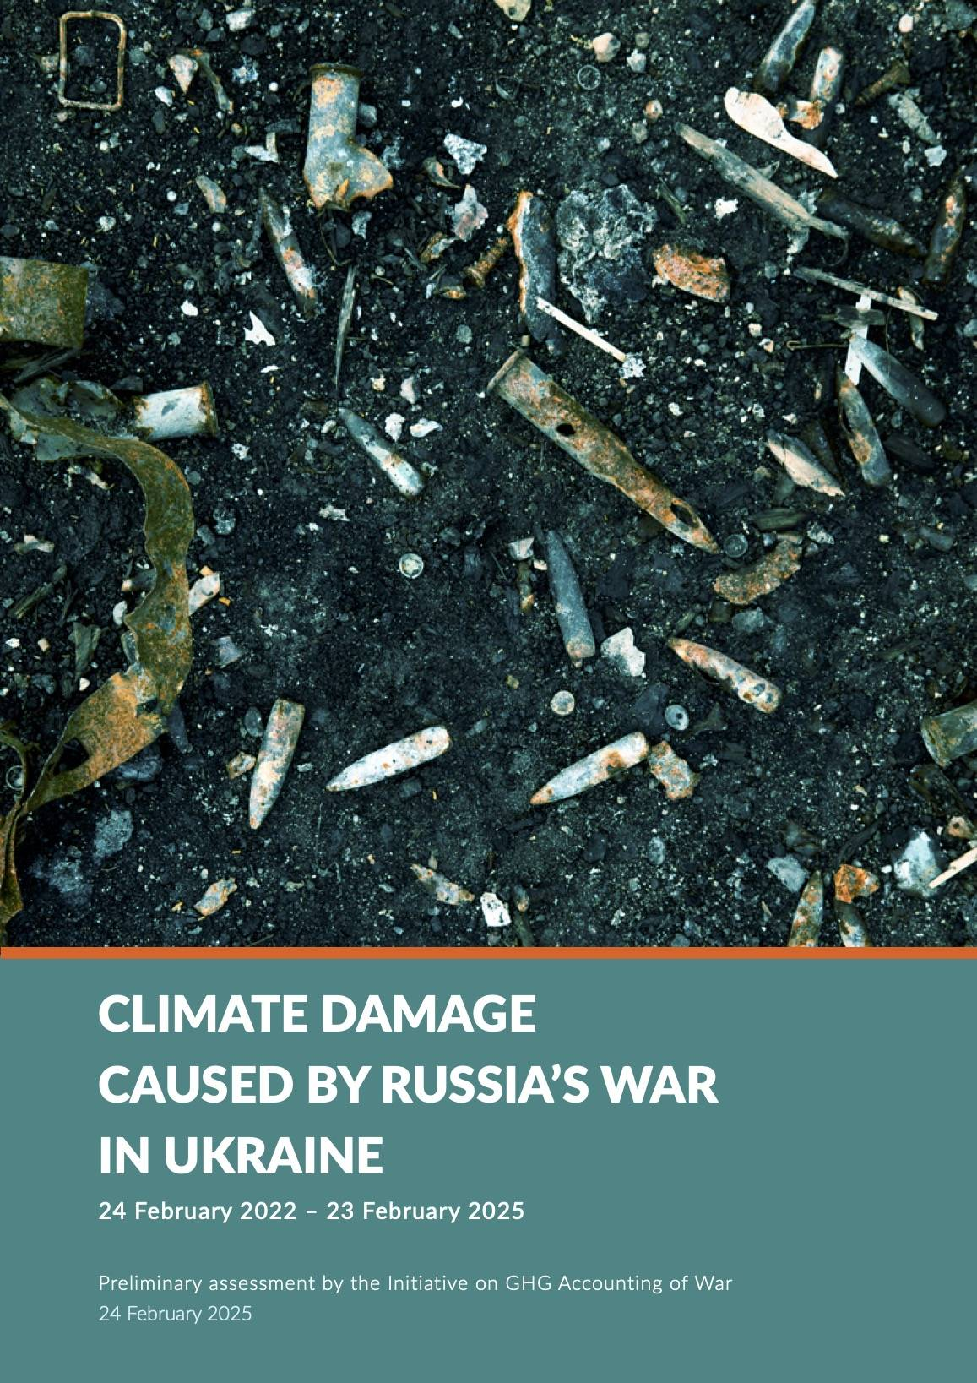
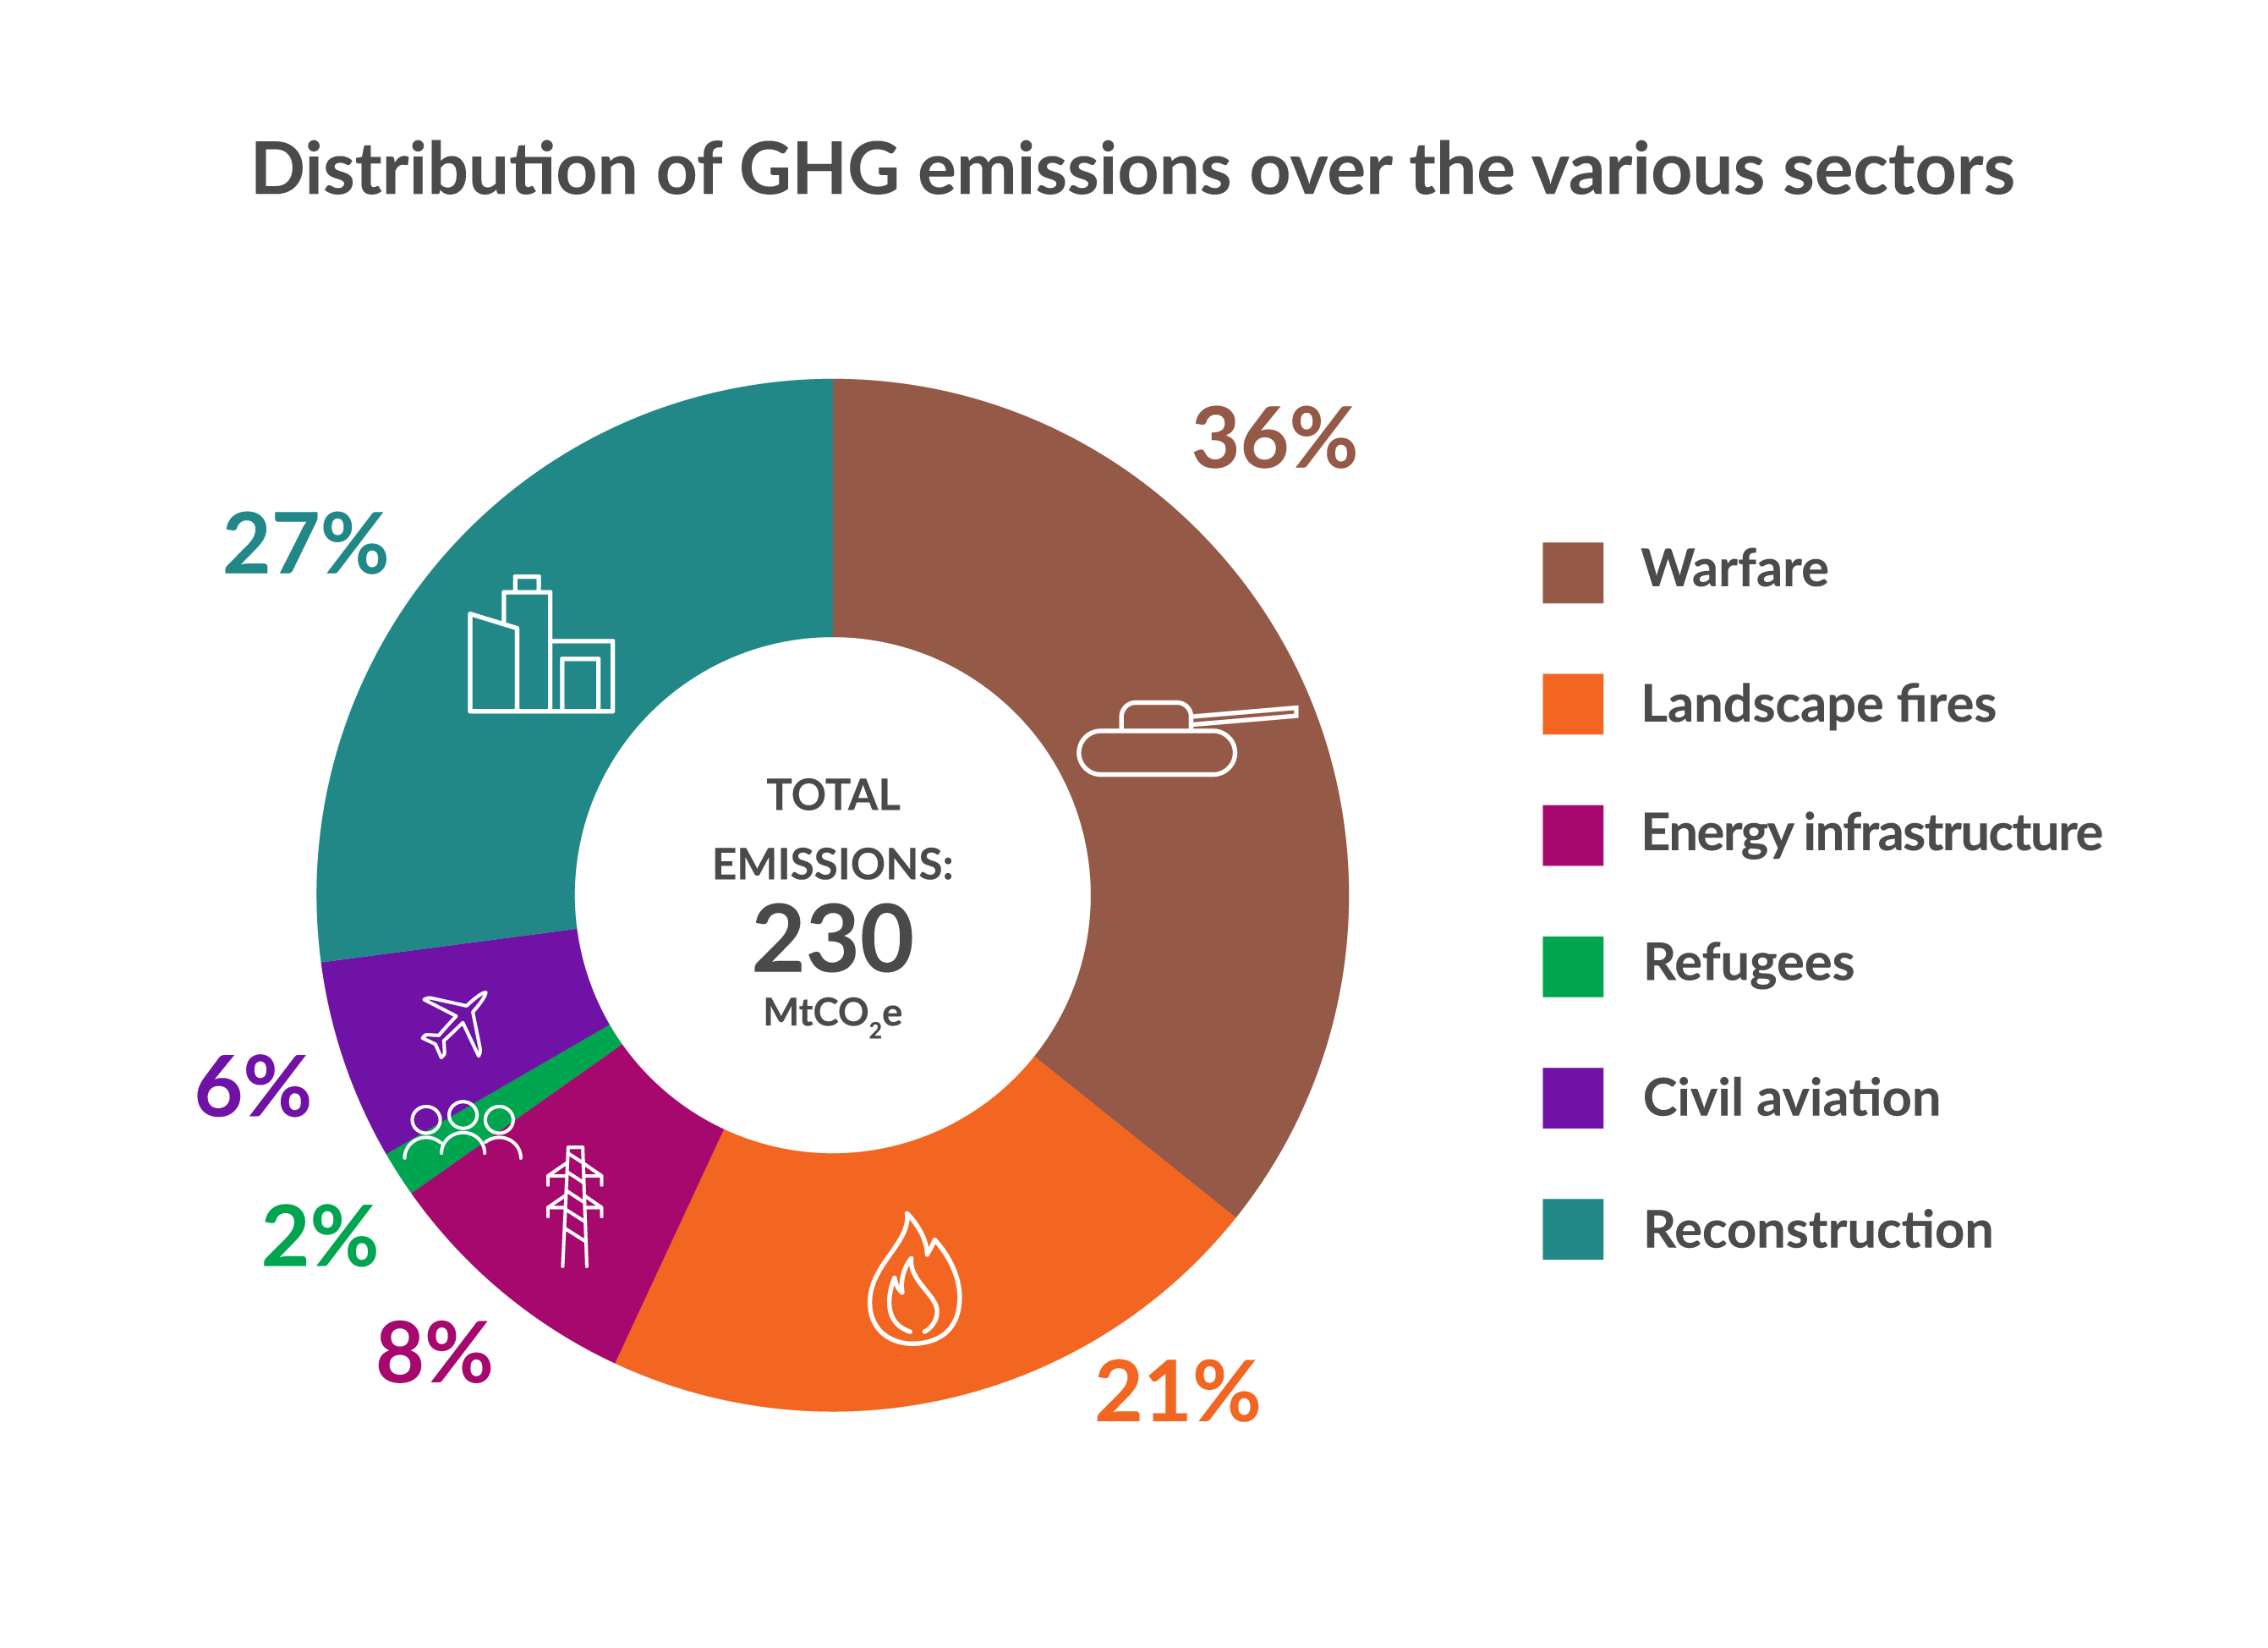
Climate Damage: Three-year assessment (preliminary)

Slide 5
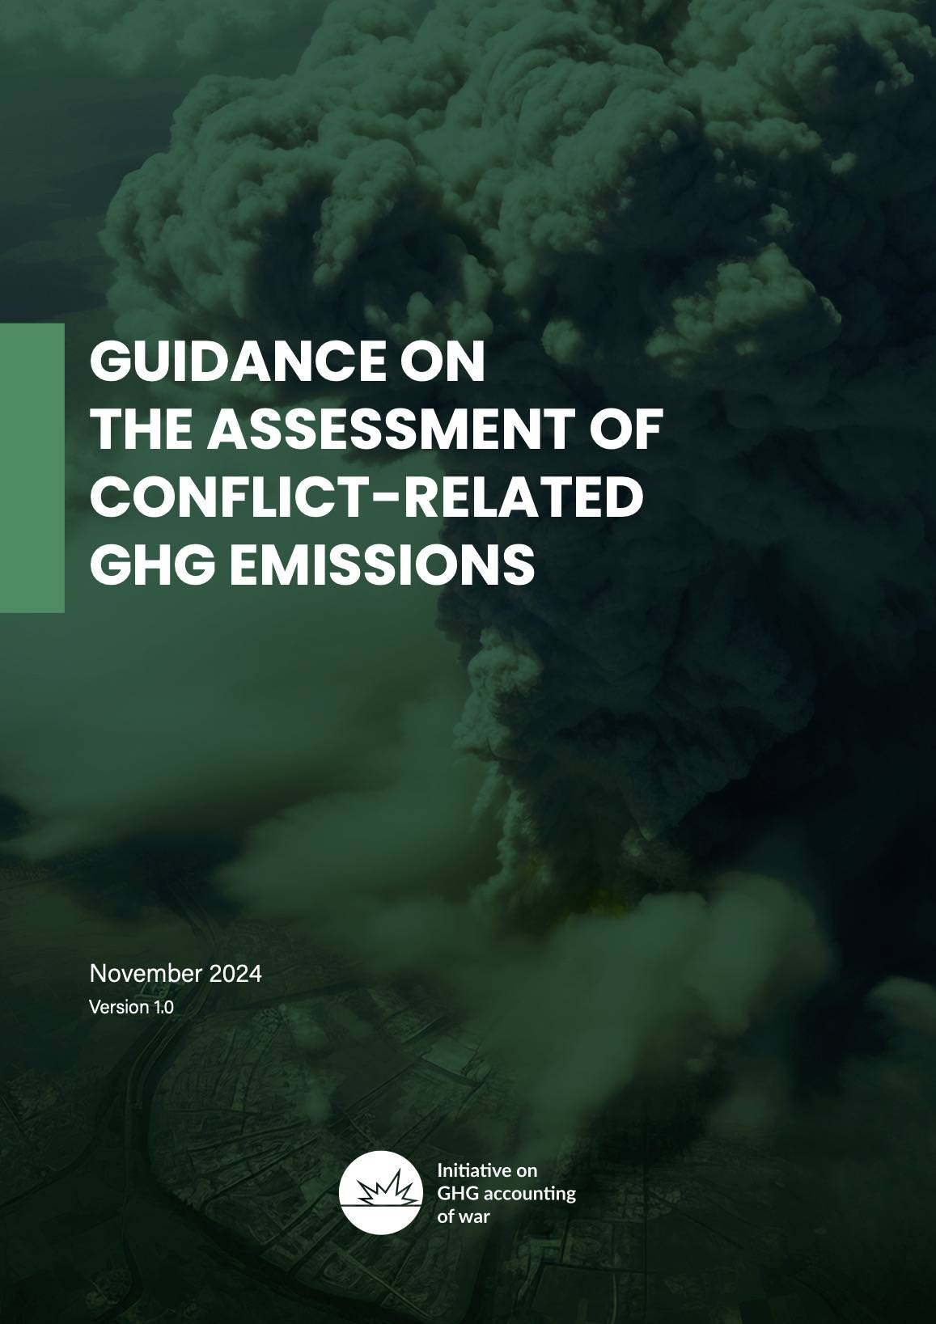
Climate Damage: Methodological guidance
Based on lessons-learnt from Ukraine’s climate damage assessments
Sets guidance for geographical boundaries, timeframe (pre-, during and post-conflict emissions), attribution and emission factors
Specific methodological guidance for 11 impact categories (e.g. Landscape Fires, Use of Ammunition, Reconstruction)
Harmonises and standardises assessments of armed conflicts, of which there are currently over 110 (!) worldwide

Slide 6
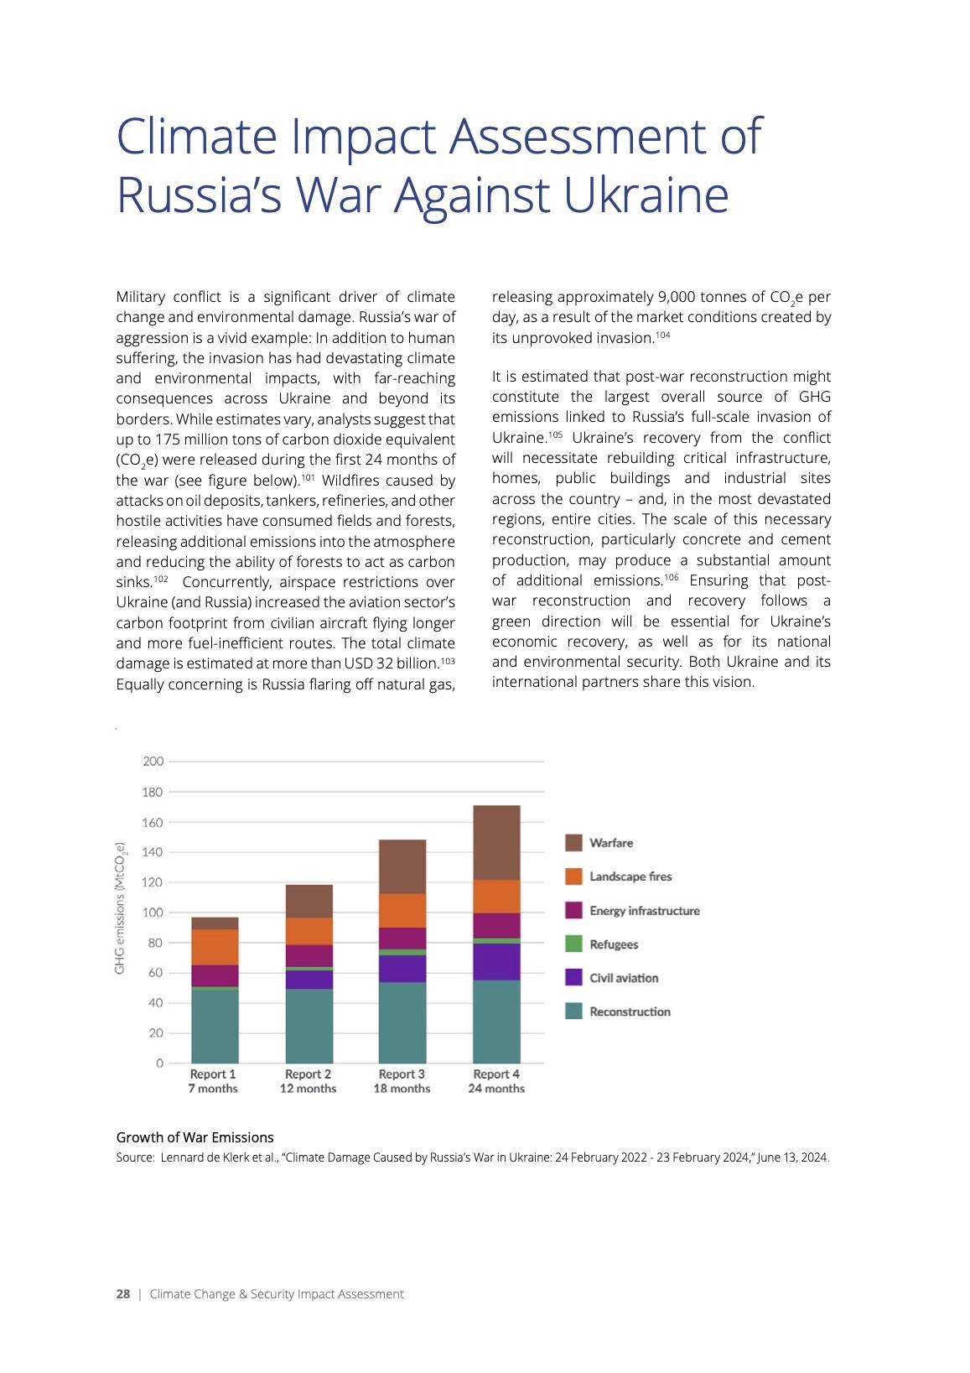
Climate damage: Outreach and awareness
Conferences:
Official UNFCCC side events jointly with Ukraine at COP27, SB58, COP28, URC2024 and COP29
Participation in panel United for Justice, United Conference, Climate Challenges in the Midst of War, Kyiv, October 2023
European Conference of Defence and the Environment, Oslo, June 2024
Round Table on Climate Security, NATO HQ, January 2025
Reports and research:
Results included in NATO’s Climate Change and Security Impact Assessment, 2024
Several references in emerging research papers
Media:
Two year assessment reached 400+ articles in 40 countries and 18+ languages
Podcast for Der Spiegel (Klimakiller Krieg) and BBC (The Climate Question)
Coverage in Politico, Reuters exclusive, CNN, The Guardian, Spiegel, Tagesschau, France24, Libération, SVT, YLI

Slide 7
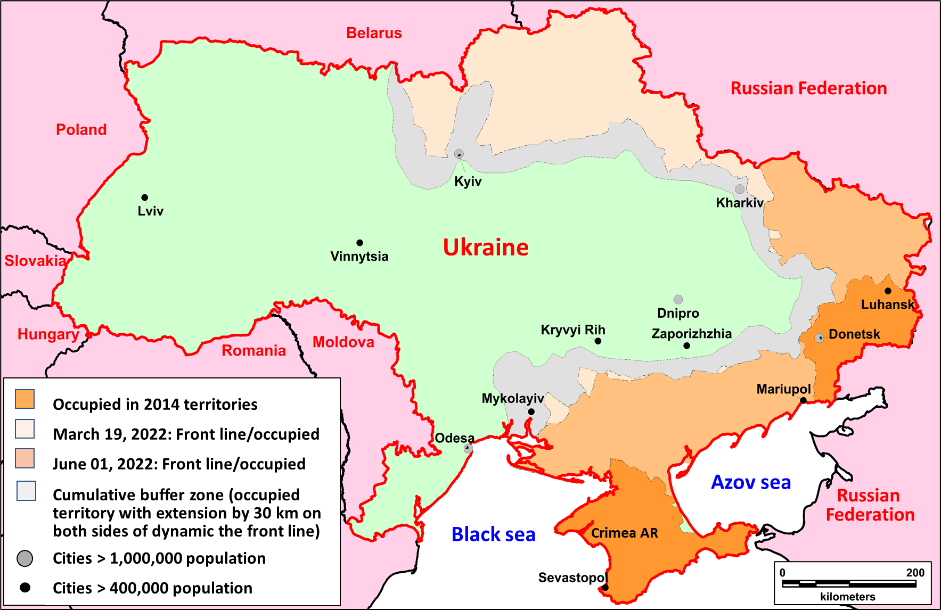
The dynamic front line, the occupied territory,
and the cumulative buffer zone

Slide 8
Fragment of fire areas in the Luhansk region, and the structure of burned landscapes

Slide 9
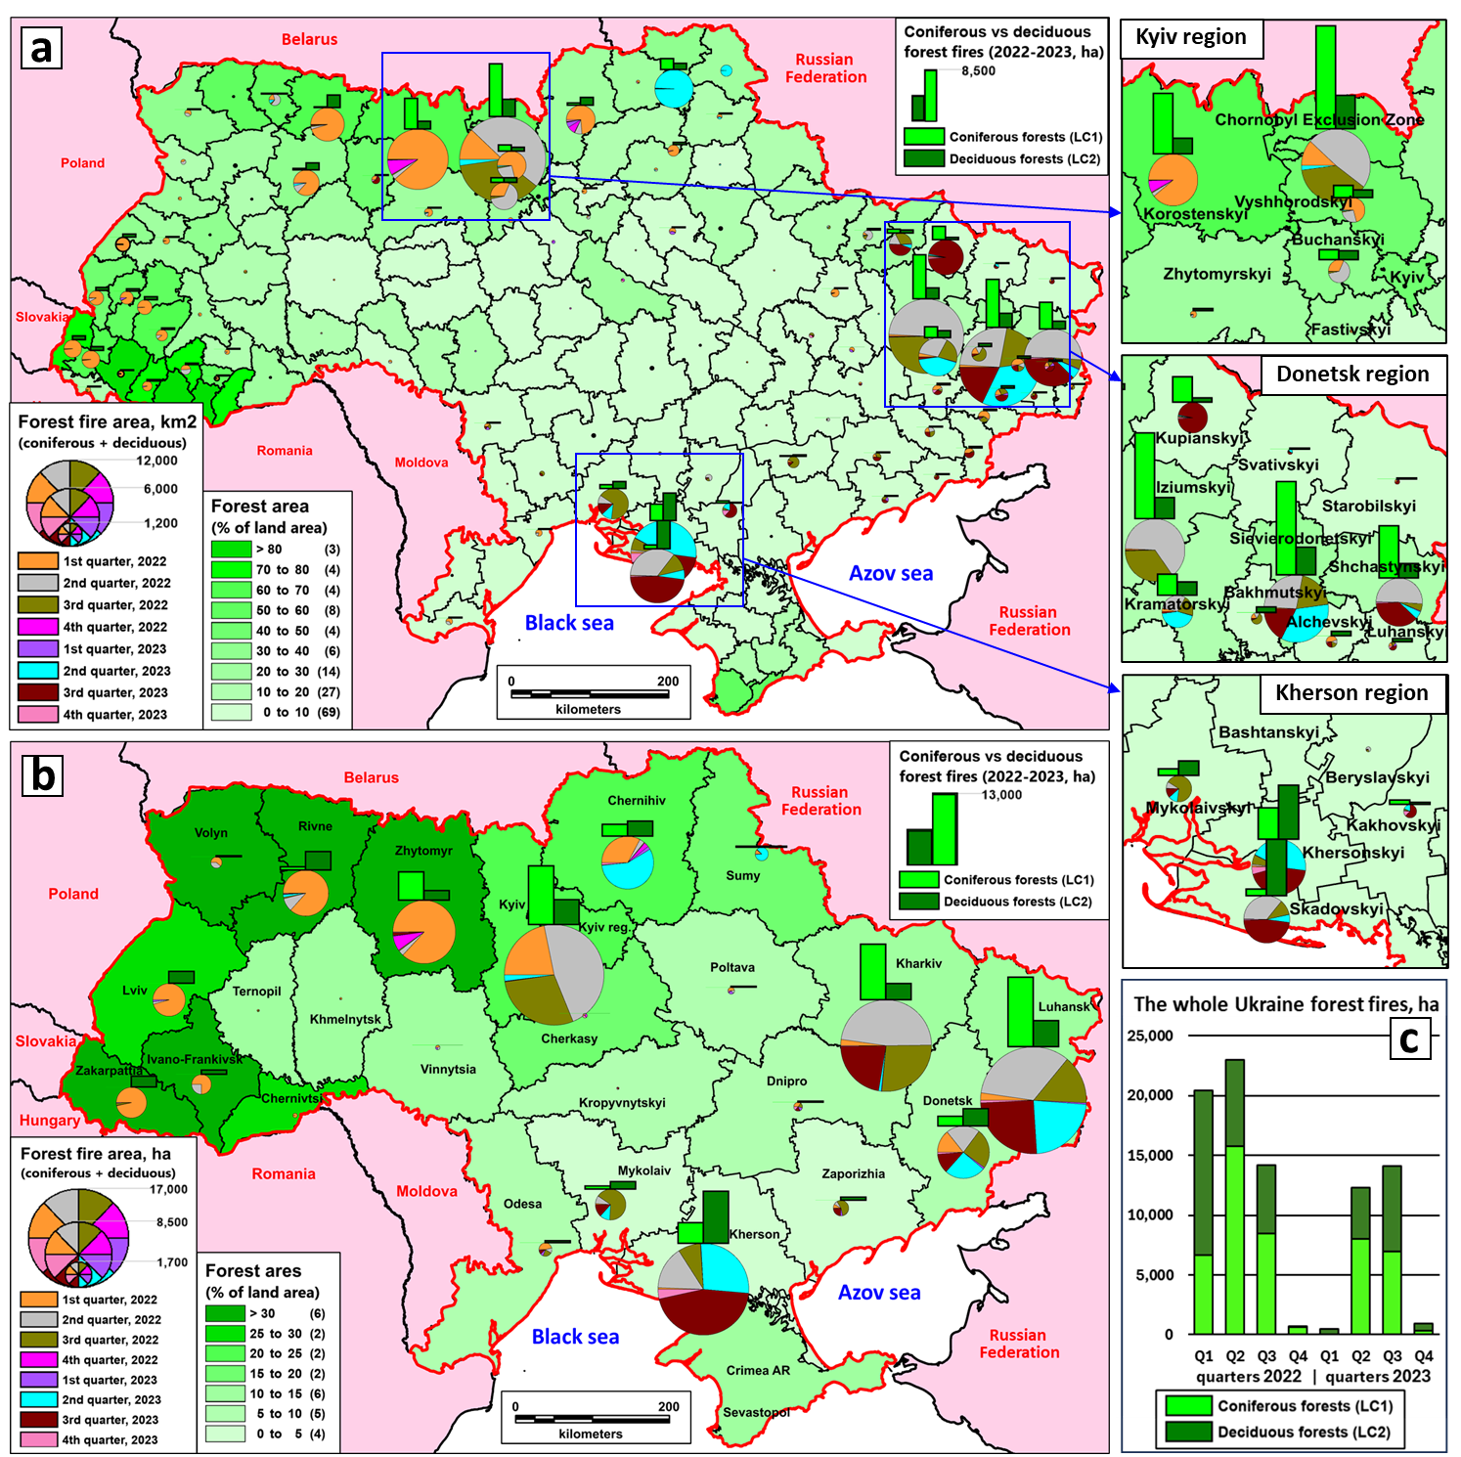
The spatial distribution and area of forest fires by (a) administrative district and (b) region; (c) the area of forest fires by quarter for 2022–2023 affecting coniferous and deciduous forests.

Slide 10
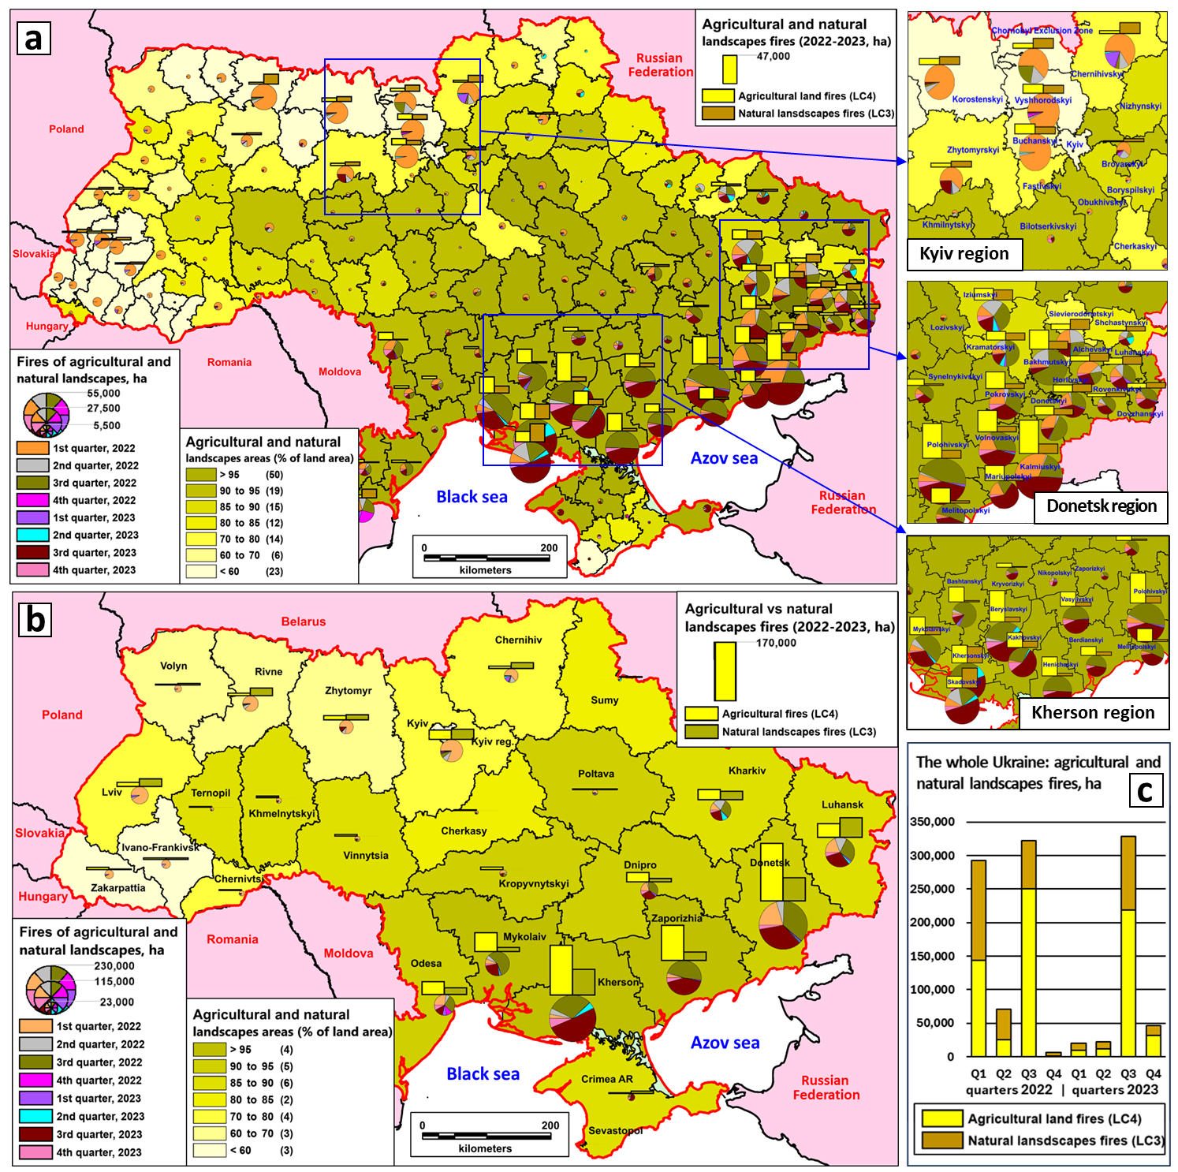
The spatial distribution and area of fires on agricultural and natural landscapes by (a) administrative district and (b) region; (c) the area of fires by quarter for 2022–2023 affecting agricultural and other natural landscapes.

Slide 11
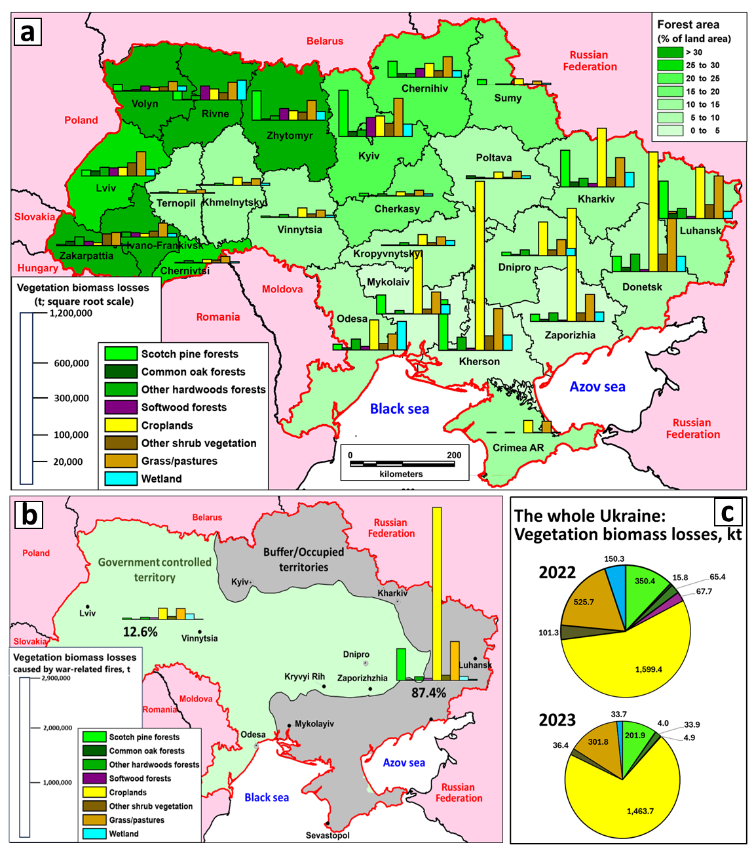
Immediate vegetation biomass losses due to war-related fires (t of dry matter) (a) by landscape classes at the regional scale; (b) for the government-controlled territory versus the buffer zone/occupied territory; and (c) by year. The biomass losses from spruce forests (448 t), beech forests (1,719 t), and hornbeam forests (817 t) are not included due to their relatively low magnitudes.

Slide 12
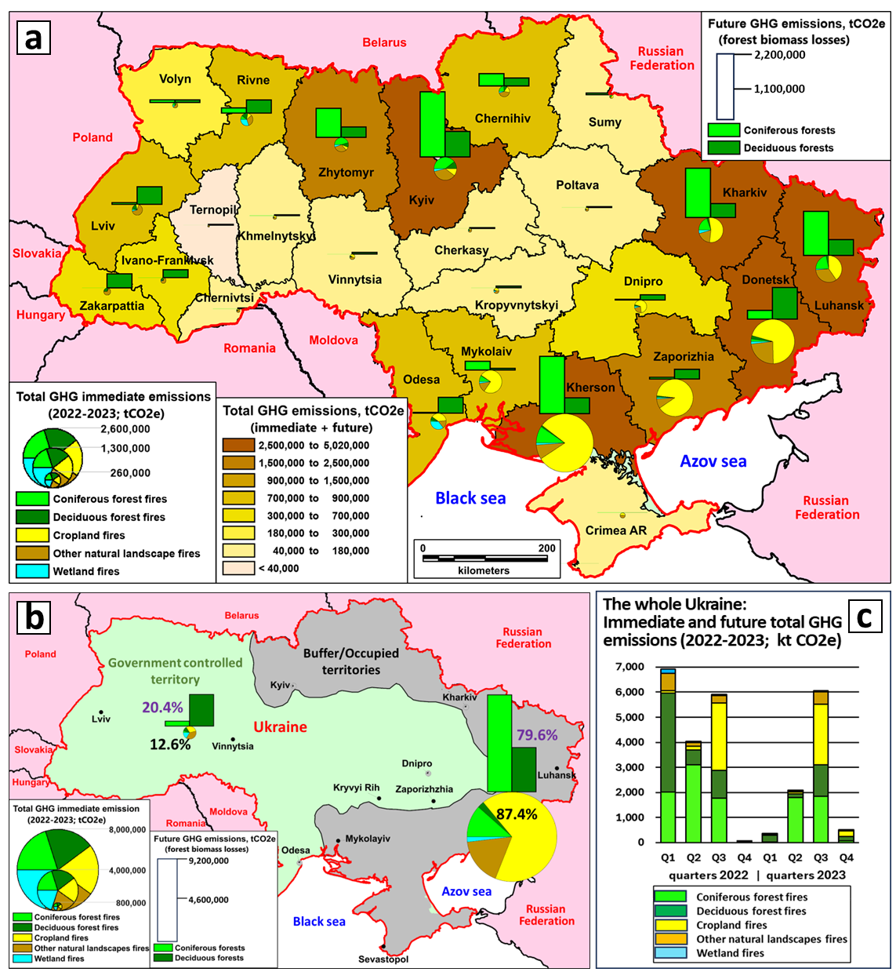
Immediate and future total greenhouse gas (GHG) emissions from war-related landscape fires (a) by region and (b) for the government-controlled territory vs. the buffer zone/occupied territory; (c) by quarter for 2022–2023 by land cover type.

Slide 13
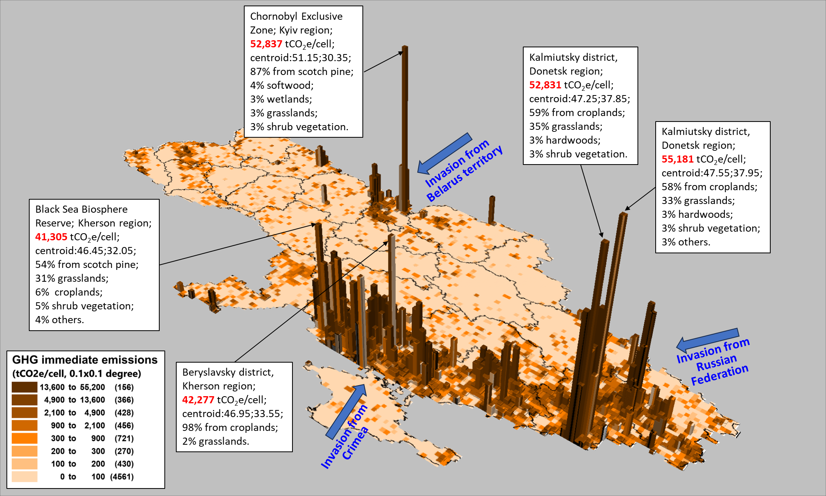
Spatial representation of total greenhouse gas (GHG) emissions from war-related landscape fires that occurred in 2022–2023: The immediate emissions at a 0.1 × 0.1-degree grid scale.

Slide 14
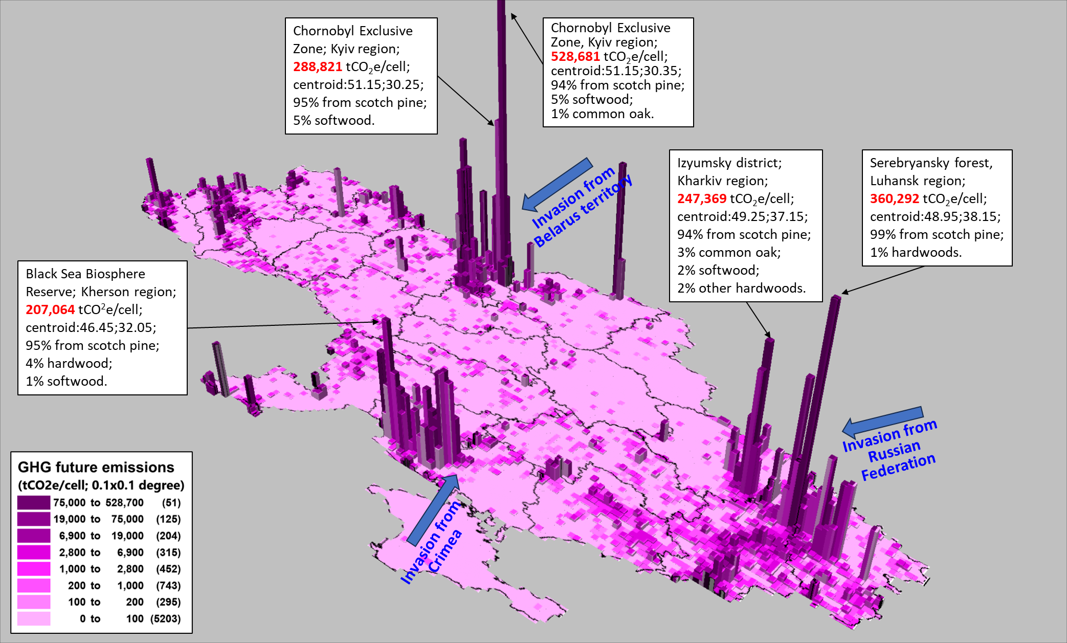
Spatial representation of total greenhouse gas (GHG) emissions from war-related landscape fires that occurred in 2022–2023: The future emissions at a 0.1 × 0.1-degree grid scale.

Slide 15
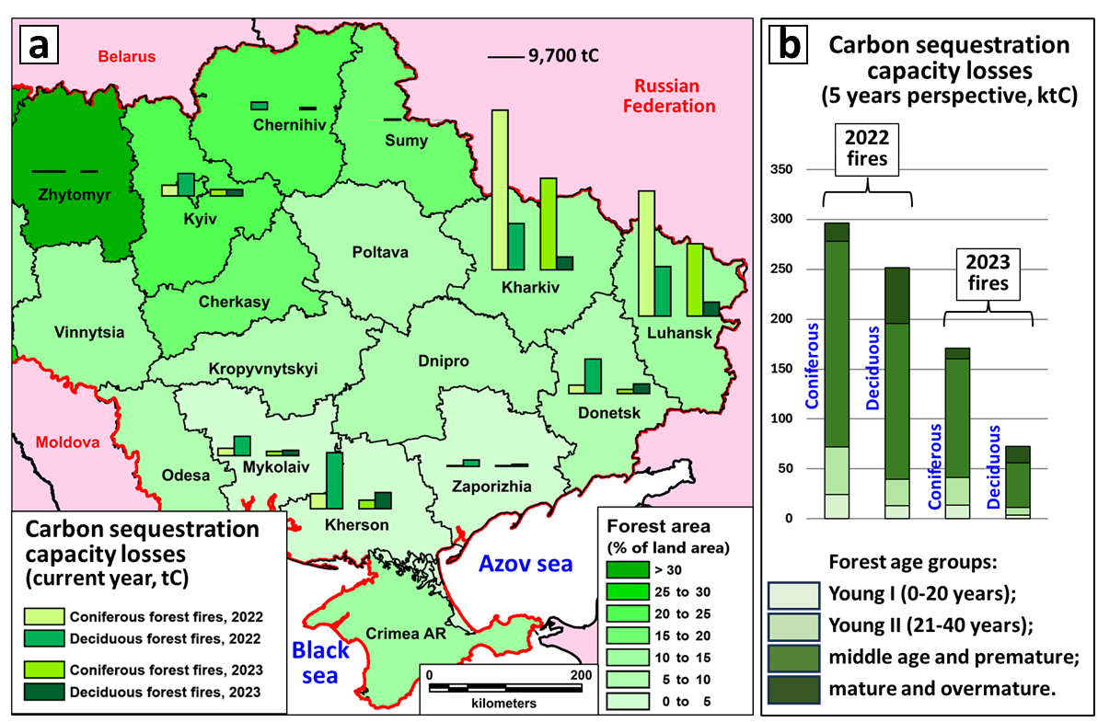
The carbon sequestration capacity losses of forests due to the war-related fires: (a) for the current year at the regional level, and (b) for 5 years after the forest fires, based on the forest age group.

Slide 16
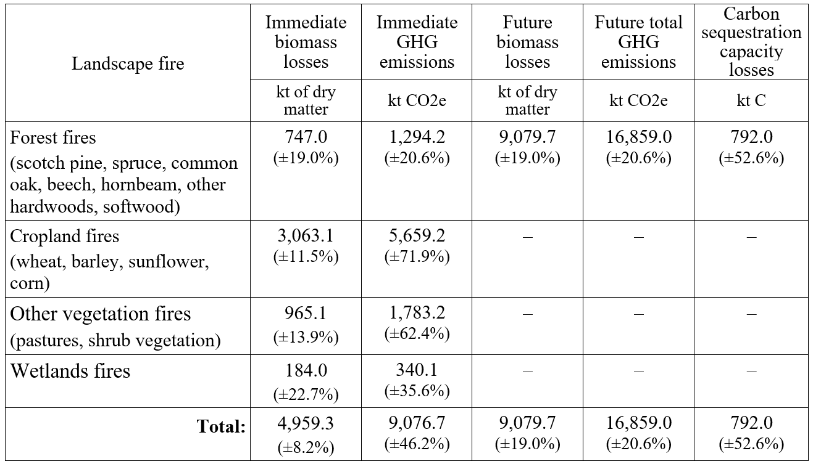
Relative uncertainties (%) in the estimated war-related biomass losses, GHG emissions, and carbon sequestration capacity losses from the landscape fires on the territory of Ukraine during 2022-2023.

Slide 17
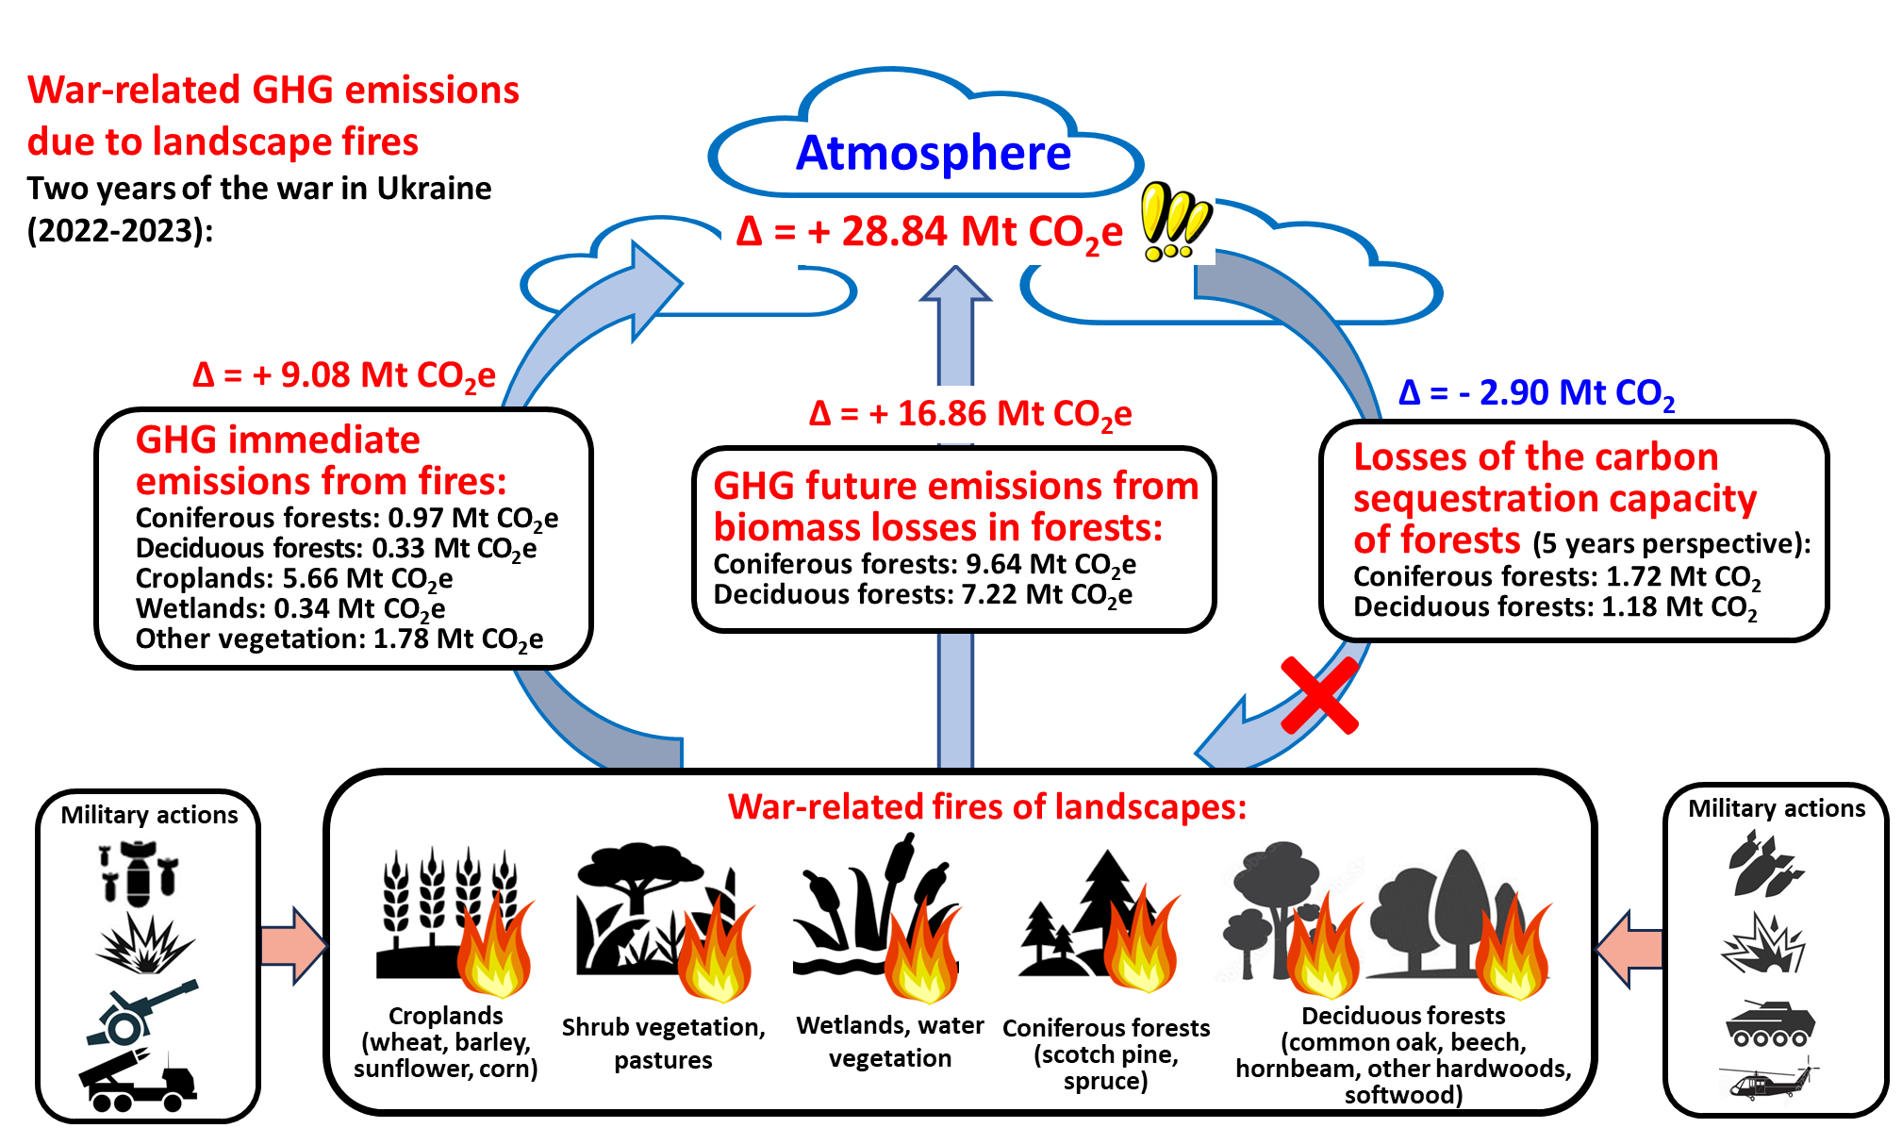
Highlights
GHG emissions from landscape fires increased significantly due to military actions.
Immediate war-related GHG emissions from landscape fires in Ukraine were 9.08 MtCO₂e.
Long-term GHG emissions due to biomass losses in forests will be 16.86 Mt CO₂e.
The estimated carbon sequestration capacity losses of burned forests is 791 kt C.
The estimated relative uncertainty of landscape fire emissions is ±21% (95%CI).

Slide 18
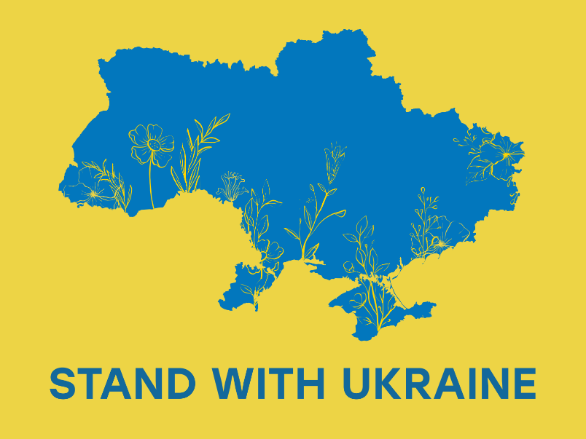
Acknowledgements:
We would like to thank the Armed Forces of Ukraine, local Territory Defense Forces, Volunteers, as well as the entire Ukrainian nation for providing security to perform this work. International support including from EGU is very much appreciated
https://act.greens-efa.eu/ukraine
https://dribbble.com/shots/17636081-Stand-with-Ukraine
28.04.2022

