Slide 1



ERE1.1 Energy, Resources and the Environment-Open session
Fracture-pore facies types and enrichment models of shale oil (tight oil)- A case study of Lucaogou Formation in Jimusaer Sag, Junggar Basin, China
EGU25-9068
Presenting author: Zeyuan Zhang
Co-authors: Rrof. Min Wang, Rrof. Qun Luo
School of Geosciences
China University of Petroleum (East China)
28 April 2025

Slide 2

Talk Outline
Geological setting
Samples and methods
—Macrofractures and Microfractures
— Macropores and Micropores
— Fracture-pore phase facies
Results and Discussion
Summary

Slide 3
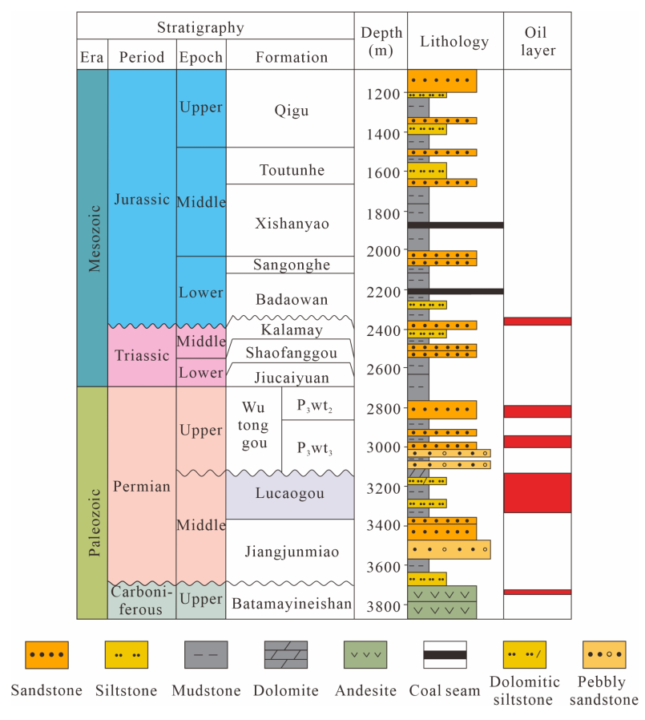
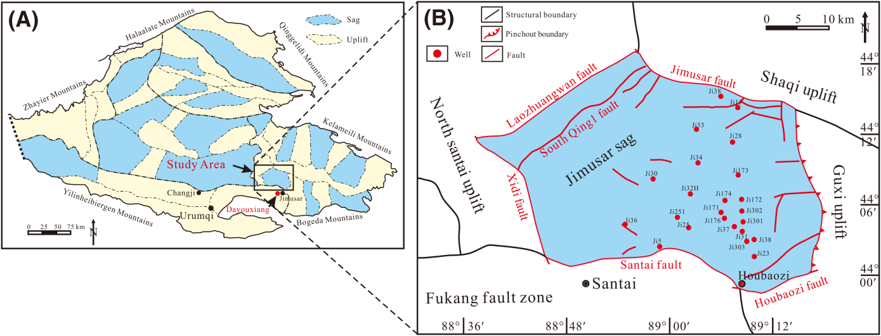
Geological setting
1. Location and stratigraphic chart
The stratigraphic chart in Jimsar Sag
The Jimusar sag is in Junggar Basin, southwest of the Eastern uplift, bounded by the Jimusar fault to the north, the Santai fault to the south, and the Laozhuangwan and Xidi faults to the west. It is elongated east-west, 30 km wide and 60 km long, with a total area of 1278 km²
(Wang et al., 2023)
(Qi et al., 2022)

Slide 4
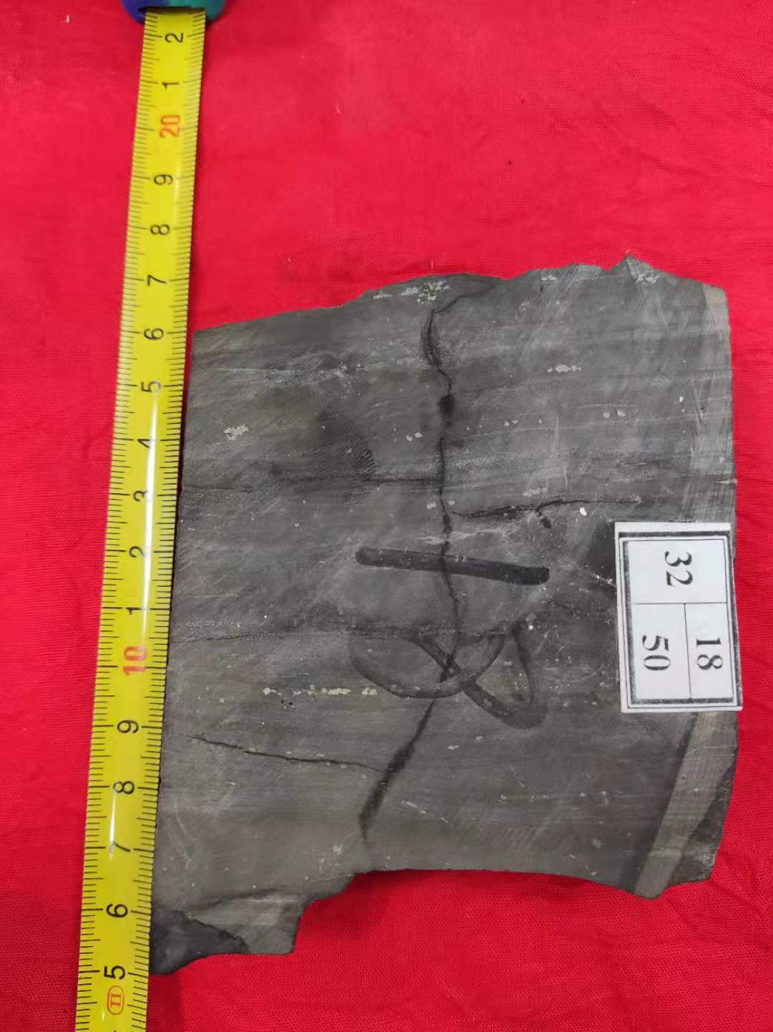
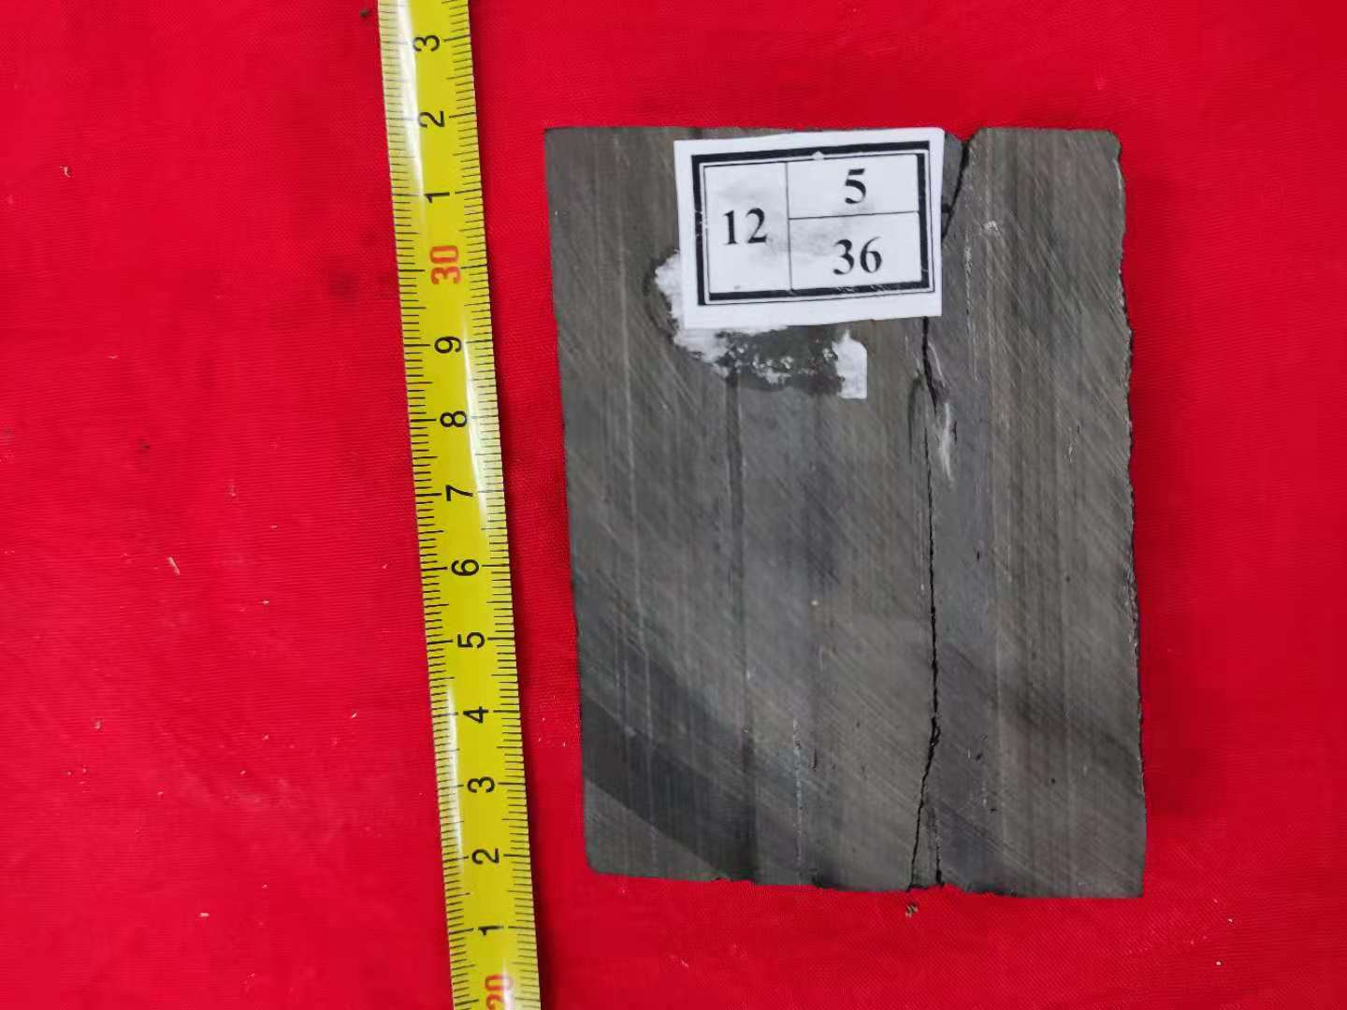
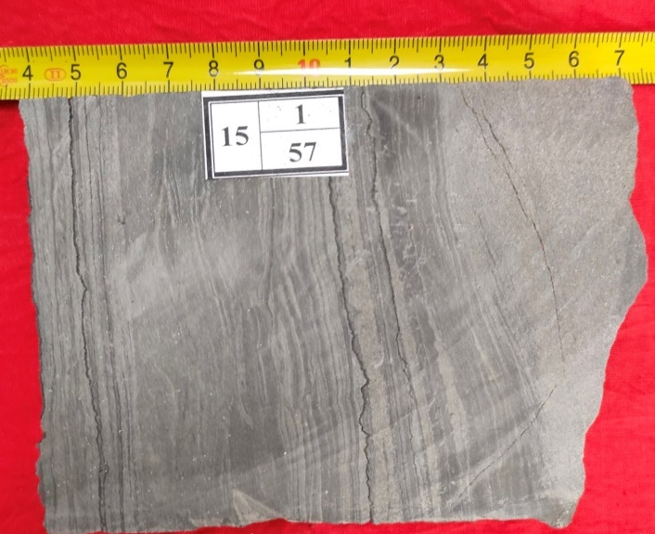
Samples and methods
1. Macrofractures
The Lucaogou Formation demonstrates relatively high fracture development density,
predominantly composed of horizontal and low-angle fractures, with high-angle structural fractures being less common
a
b
c
Note：a）J10025well，3543.67m，Bedding fractures are well-developed；b）J10025well，3543.61m，with both bedding fractures and structural fractures observable；C）J10025well，33711m，along with visible fractures

Slide 5
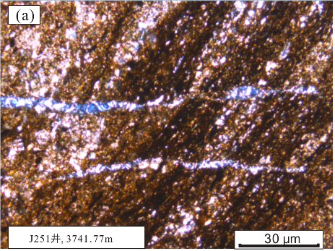
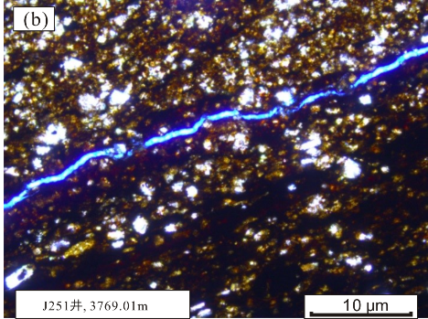
Samples and methods
2. Microfractures
Thin-section analysis reveals that the fracture system in the Lucaogou Formation reservoir is predominantly composed of structural fractures and bedding fractures
Structural fractures
Bedding fractures
J251 well,3741.77m
J251 well,3769.01m

Slide 6
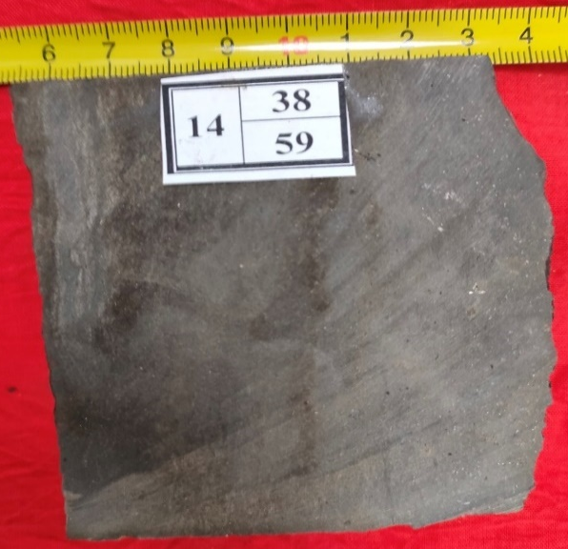
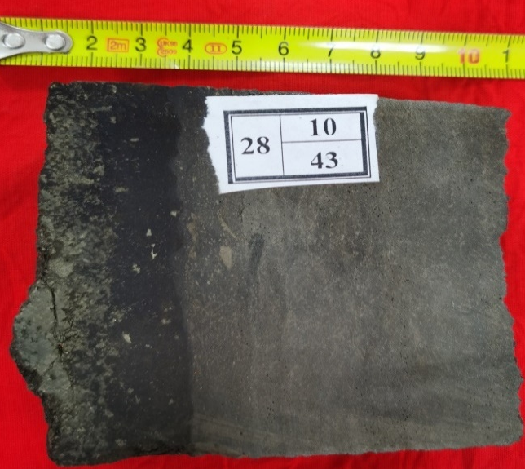
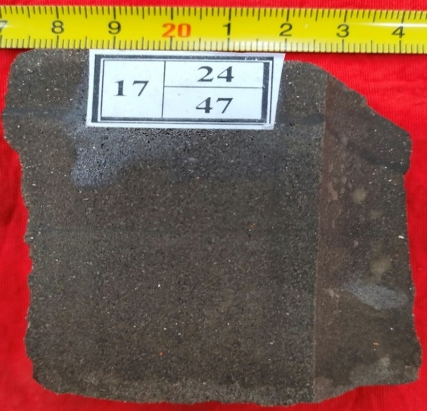
Samples and methods
3. Macropores
Core observations reveal that the Lucaogou Formation exhibits relatively well-developed porosity, predominantly characterized by dissolution pores, with a minor presence of bedding-parallel pores. The pore systems demonstrate effective connectivity with fracture networks
a
b
c
a）J10025 well，3543.97m，exhibits relatively well-developed porosity；b）J10025 well ，3691.28m characterized predominantly by bedding-parallel pores；c）J10025 well ，3556.62，well-developed dissolution pores；

Slide 7
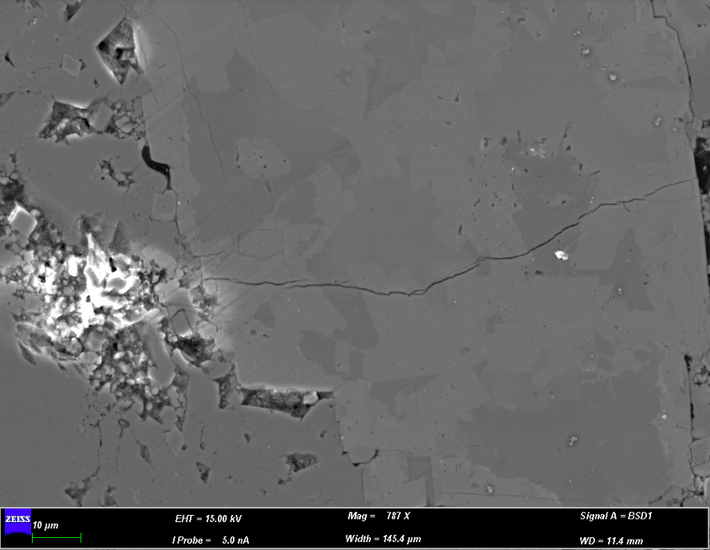
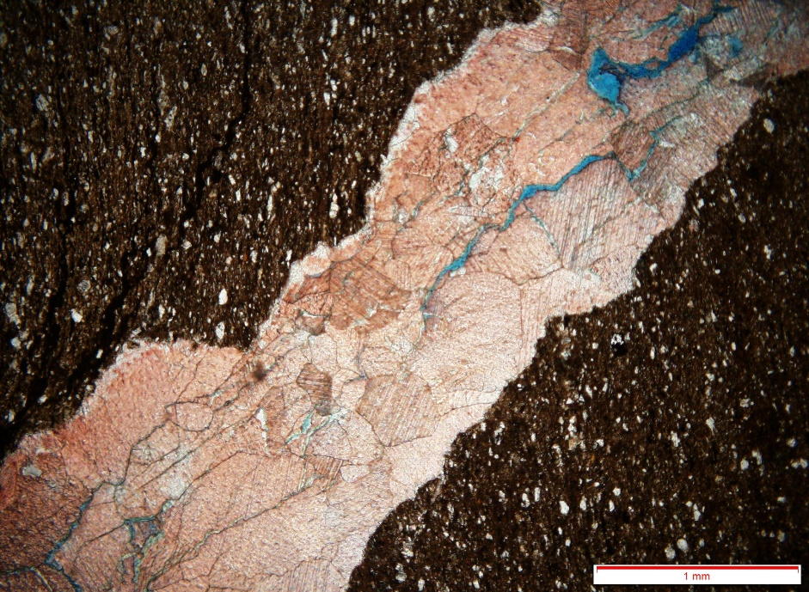
Samples and methods
4. Micropores
Petrographic analysis of thin sections demonstrates that the unconventional reservoir in the Lucaogou Formation is predominantly characterized by dissolution pores
J10025 well, 36113m, Intergranular pores
J10025 well, 3462.15m, Internal dissolution pores of feldspar grains

Slide 8
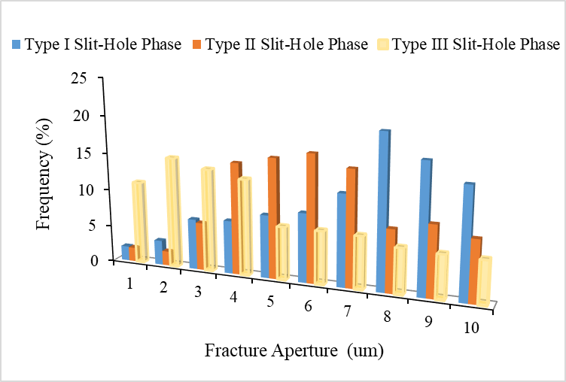
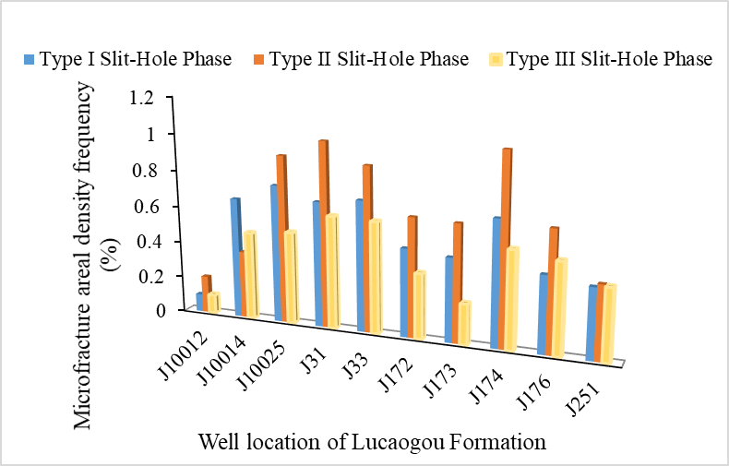
Samples and methods
5. Fracture-pore facies types
The whole fracture-pore facies in the study area is divided into three categories:
Class I: Non-fractured macroporous facies, Micro-fractured medium-to-macroporous facies
Class II: Multi-scale micro-fractured mesoporous facies, Non-fractured small-to-mesoporous facies
Class III: Micro-fractured microporous facies, Non-fractured microporous facies
a
b
Development characteristics of micro-fracture opening and surface density in different types of fracture-pore facies

Slide 9
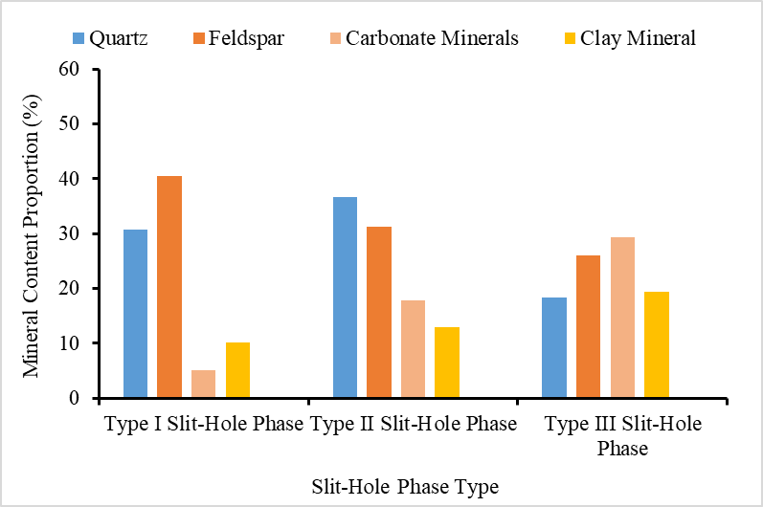
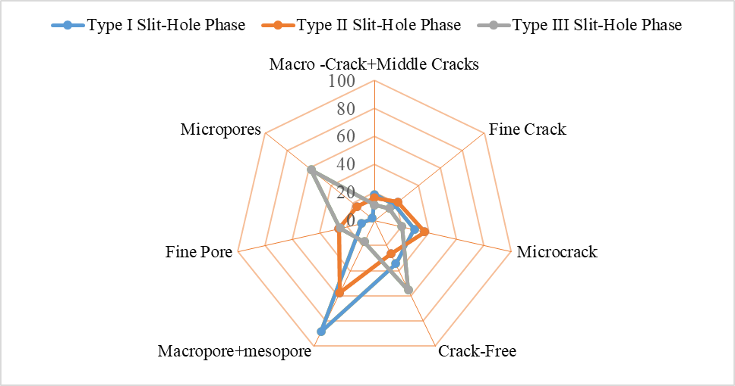
Results and Discussion
1. Mineral characteristics
The formation of distinct fracture-pore facies is closely associated with mineralogical compositions:
Type I facies are predominantly composed of feldspar with subordinate quartz and minimal clay minerals;
Type II facies are quartz-rich with reduced feldspar content;
Type III facies are clay-dominated, containing secondary feldspar and limited brittle mineralsClass III: Micro-fractured microporous facies, Non-fractured microporous facies
a
b

Slide 10
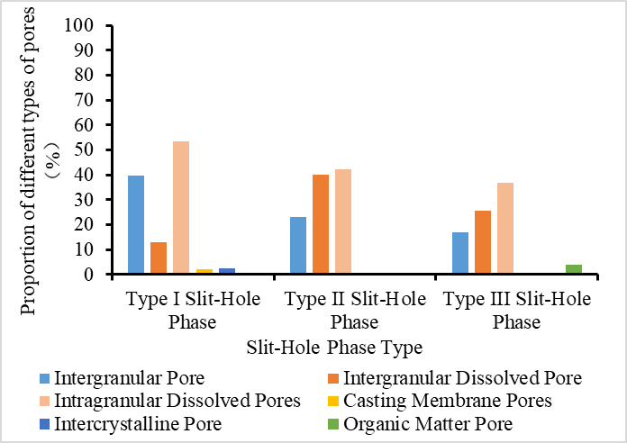
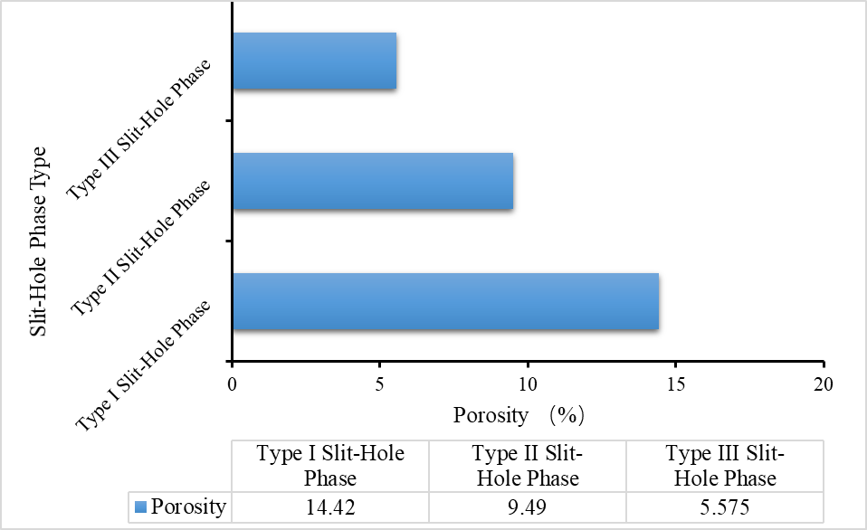
Results and Discussion
2. Petrophysical characteristics of different fracture-pore facies
Type I fracture-pore facies are characterized by abundant macro- to meso-scale fractures with well-developed porosity; Type II facies exhibit favorable development of micro- to small-scale fractures; Type III facies display low fracture density, manifesting as sparse microfractures or an absence of fracturing.
a
b

Slide 11
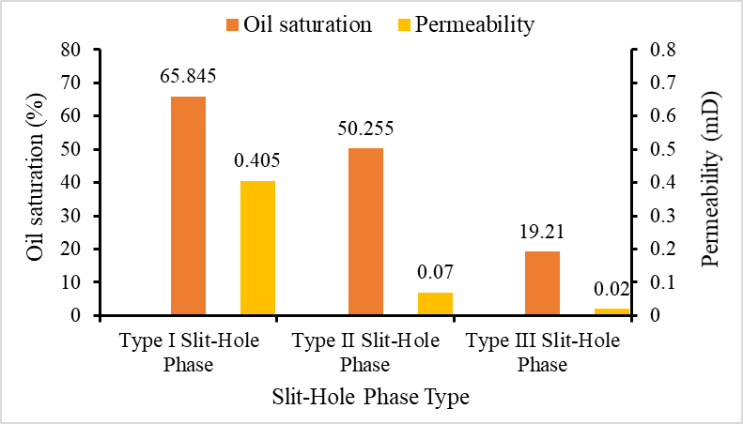
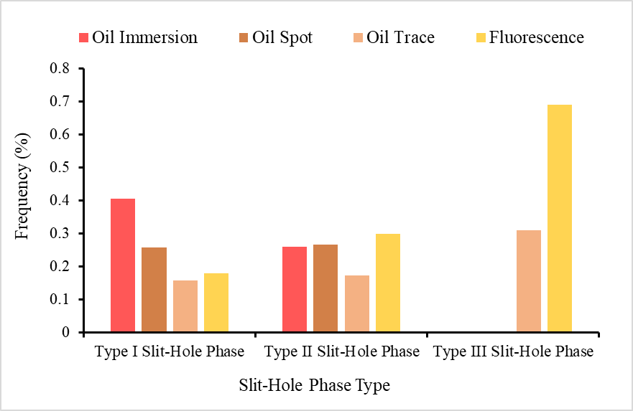
Results and Discussion
3. Characteristics of fluids in different slit and pore phases
Type I fracture-pore facies are characterized by well-connected pore networks and primarily exhibit oil immersion and oil staining levels. Type II fracture-pore facies demonstrate smaller pores with poorer connectivity, dominated by oil staining levels with minor oil immersion occurrences. Type III fracture-pore facies feature poorly developed reservoir pores, with fluorescence being the predominant oil-bearing level
a
b

Slide 12
Results and Discussion
4. Enrichment mode
Three enrichment patterns: ① Non-fractured medium-to-macroporous coupling oil-rich mode;② Composite fracture-pore coupling oil-rich mode③ Single micro-fractured microporous coupling oil-rich mode

Slide 13
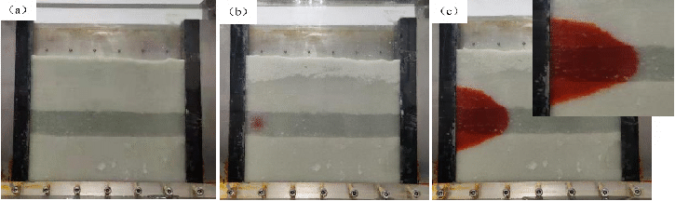
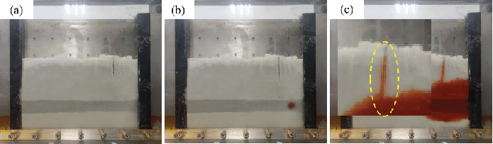
Results and Discussion
5. Characteristics of oil and gas migration and accumulation in different pore facies
In Type I fracture-pore facies with well-developed matrix porosity, hydrocarbons migrate rapidly along fracture orientations. Compared to fracture-absent systems, fracture-pore coupling significantly enhances reservoir permeability and storage efficiency, resulting in superior hydrocarbon saturation and accelerated diffusion rates.
a
b
c
d
e
f

Slide 14
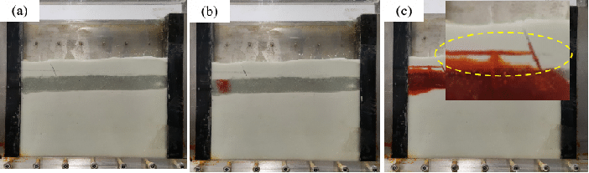
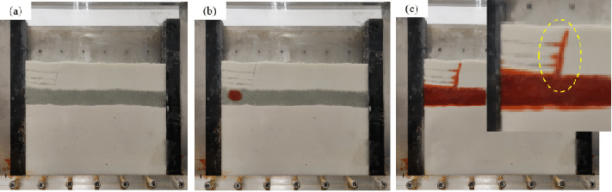
Results and Discussion
5. Characteristics of oil and gas migration and accumulation in different pore facies
In Type II fracture-pore facies, hydrocarbons rapidly migrate and accumulate through fractures within the reservoir. This phenomenon is particularly pronounced in reservoirs with smaller pore sizes and poorer connectivity, where hydrocarbon migration velocities in fracture-free zones are markedly slower compared to fractured regions.
h
i
g
k
l
m

Slide 15
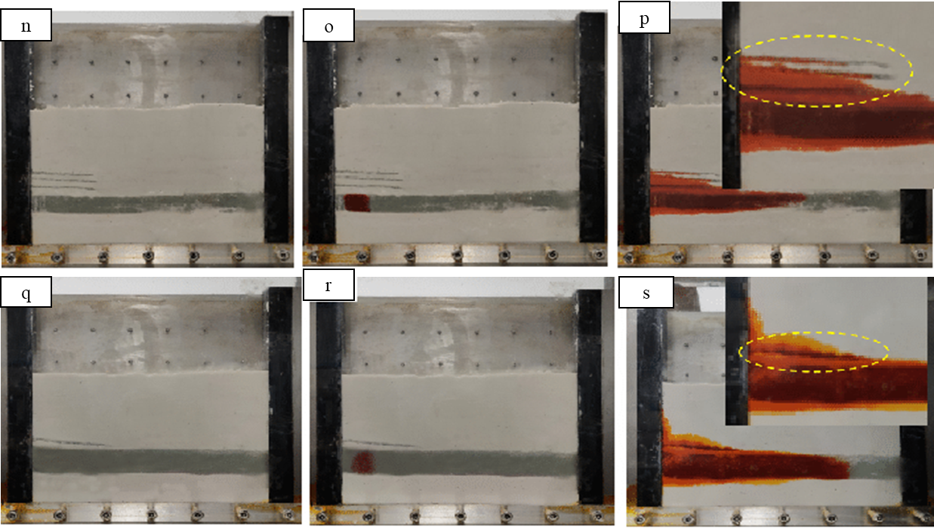
Results and Discussion
5. Characteristics of oil and gas migration and accumulation in different pore facies
In Type III fracture-pore facies, hydrocarbon migration and accumulation are severely hindered or virtually nonexistent in reservoirs with underdeveloped matrix porosity.

Slide 16
Summary
Due to the differences in mineral content and types, the types of fracture-pore facies in the study area are classified into three categories, Class I: Non-fractured macroporous facies, Micro-fractured medium-to-macroporous facies; Class II: Multi-scale micro-fractured mesoporous facies, Non-fractured small-to-mesoporous faciesClass III: Micro-fractured microporous facies, Non-fractured microporous facies
Different fracture-pore facies have significant differences in the movement and accumulation of oil and gas. Among the three types of fracture-pore phases, the first type of fracture-pore phase is the best for the movement and accumulation of oil and gas, followed by the second type, and the third type is the worst.
Three different enrichment models have been summarized:① Non-fractured medium-to-macroporous coupling oil-rich mode;② Composite fracture-pore coupling oil-rich mode③ Single micro-fractured microporous coupling oil-rich mode。

Slide 17

Thank you !
China University of Petroleum (East China)
Qingdao·China
Notes:
thanks for your attention,

