Slide 1
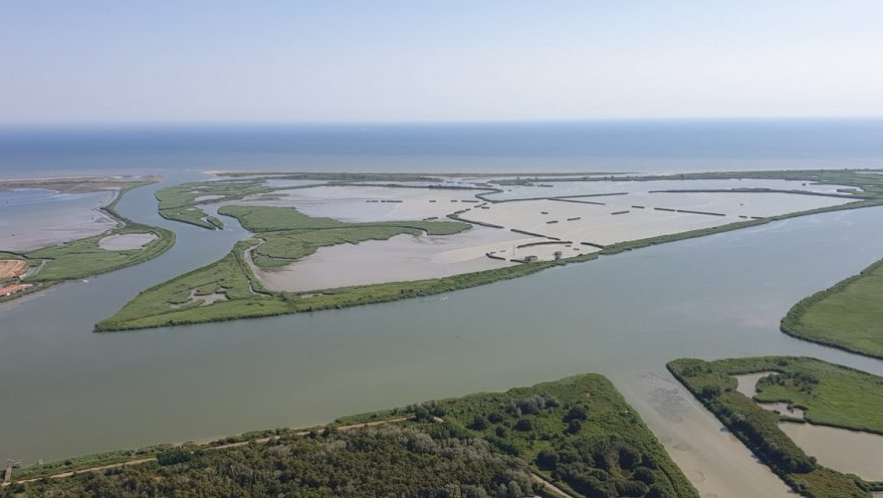
Modeling Wetland Rebuilding After Dyke Failure in Highly Anthropized River Deltas: A Case Study from the Po River Delta, Italy
S. Hadi Shamsnia, Alvise Finotello, Massimiliano Ghinassi, Andrea D’Alpos, Daniele Pietro Viero, Luca Carniello, Valentina Rossi
University of Padova, Italy
27th May 2025
*seyedhadi.shamsnia@unipd.it

Slide 2
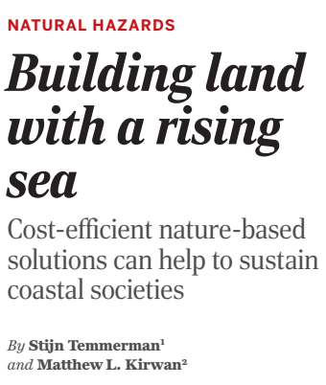
MOTIVATION
Importance
River deltas are large depositional features on Earth and are ecologically and economically important.
Threats
Climate extremes, population growth, human-induced subsidence cause threats to sustainability of deltas.
Classical Solutions
Hard engineering measures (e.g., dams, dikes, and levees) reduce deltaic ecosystems' resilience in the long run:
Altering deltas prevent sediment transport exacerbating.
Alternative Solutions
New approaches designed to “work with the river”, “work with nature”.

Slide 3
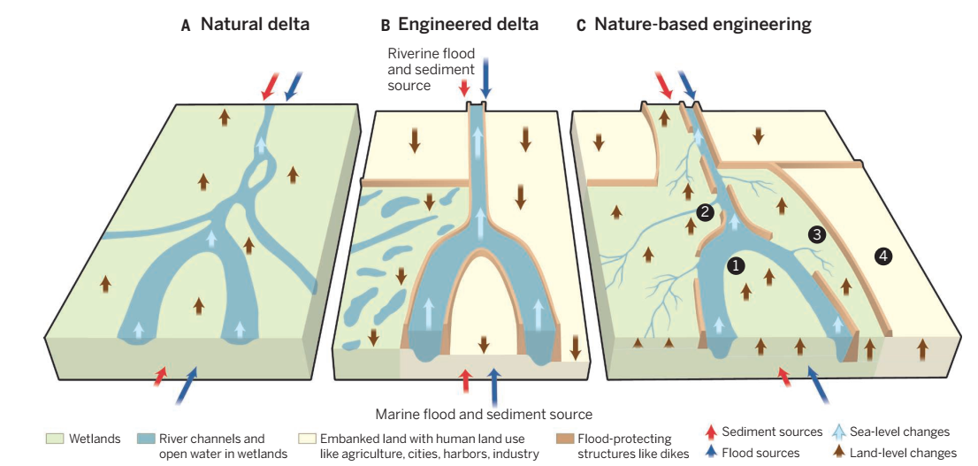
MOTIVATION
To restore deltas and increase resilience, breaching levees and reintroducing natural dynamics are viable strategies. This is especially important for heavily human-modified deltas like the Po.

Slide 4
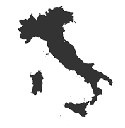
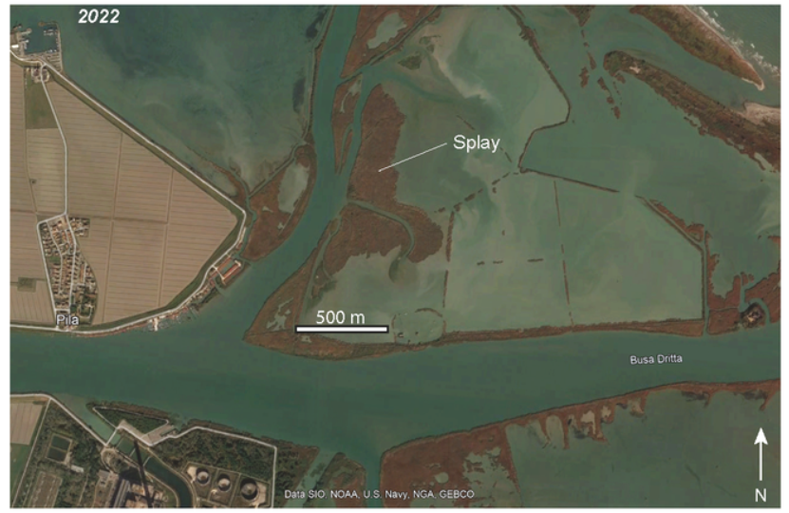
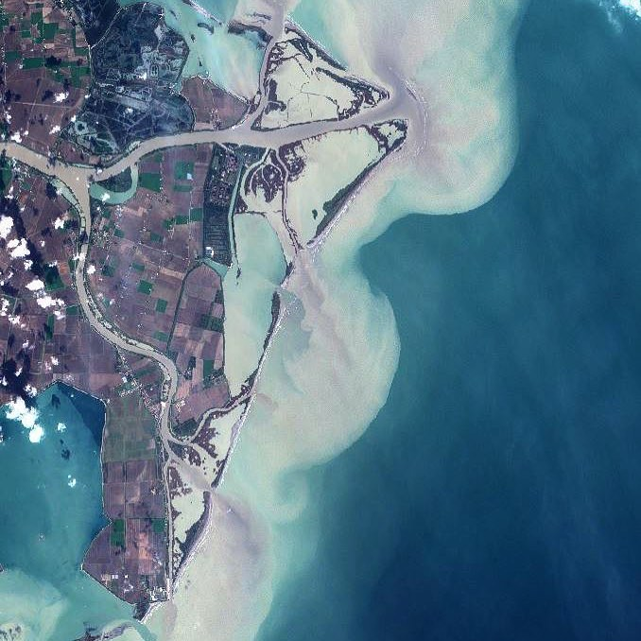
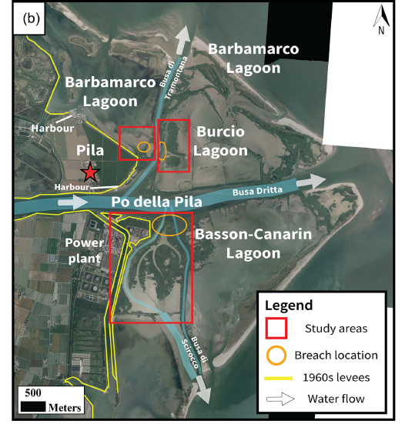
STUDY AREA

Slide 5
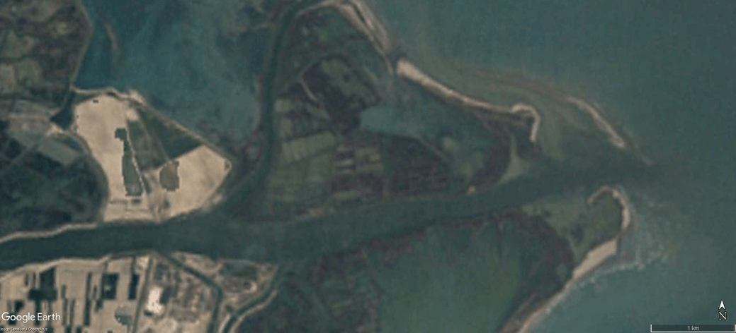
STUDY AREA

Slide 6
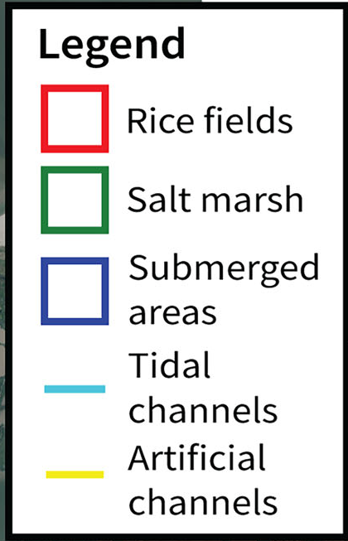
STUDY AREA
The first time interval (1949–1955): land reclamation
Agricultural fields are clearly visible.
Rice fields covered 220 ha out of the total 500 ha of the Burcio Lagoon.
A well-developed marsh covers the Burcio (270 ha).

Slide 7
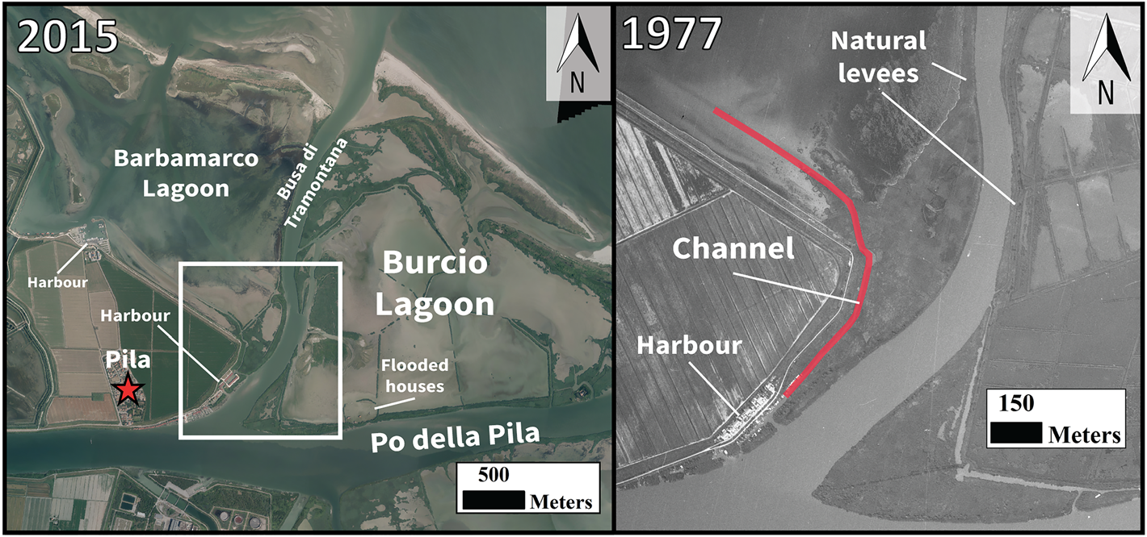
Historical Evolution
The second time interval (1955-1977): extreme events
The agricultural fields of the Burcio Lagoon were also covered by water and consequently abandoned.
No levee breaching occurred; the rice fields and the marshes were flooded by water coming directly from the sea inlets.
The year 1977 was characterised by several large floods.
Marsh loss: peaked in 1989, where the plant coverage of the Burcio Lagoon was diminished to about 170 ha.

Slide 8
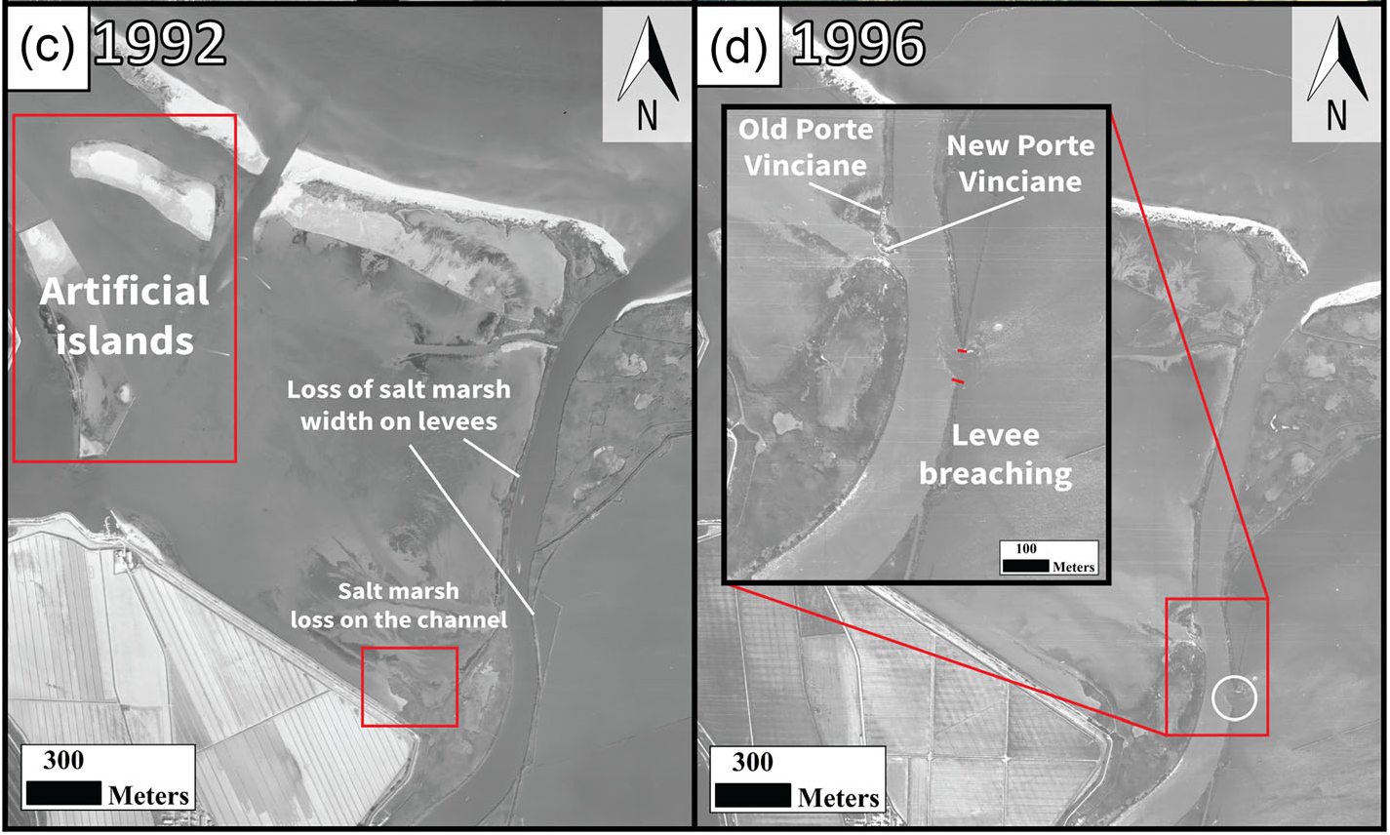
Historical Evolution
The third time interval (1977–1999): Small recovery
After 1983 the marshes separating Burcio Lagoons) from the Busa di Tramontana were gradually decreasing in width.
In 1996, on the opposite side of the Porte Vinciane, the first breach of about 70 m connecting the river branch with the Burcio Lagoon occurred.
The decrease in width of the marsh that separated the lagoon may have contributed to the levee breaching.

Slide 9
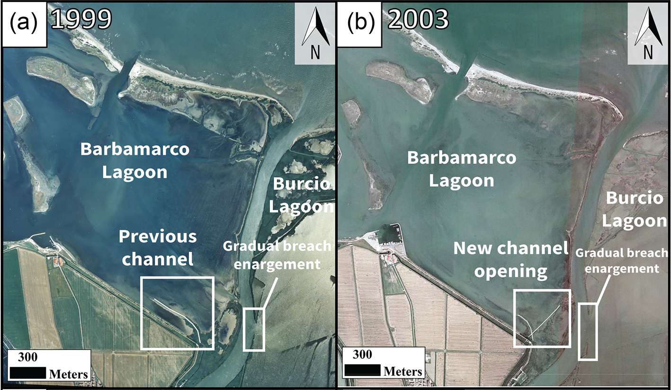
Historical Evolution
The fourth time interval (1999-2020): tidal flat and marsh formation
The breach of the Burcio Lagoon that formed in 1996 underwent an important enlargement, reaching its maximum width of about 250 m in 2003.
After 2010, a STCD of around 20 000 m3/s occurred and strong sedimentation is visible next to the breach of the Burcio Lagoon.

Slide 10
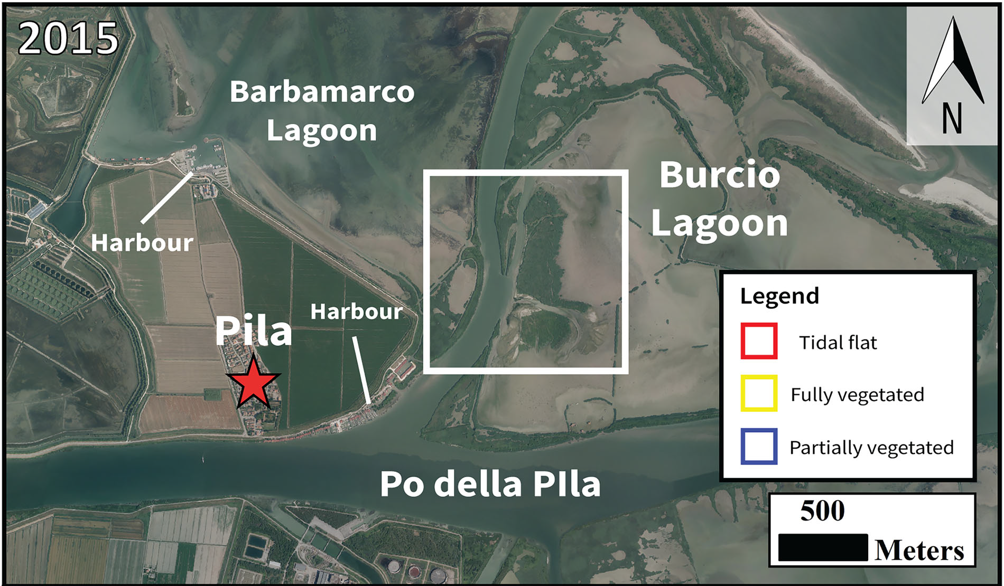
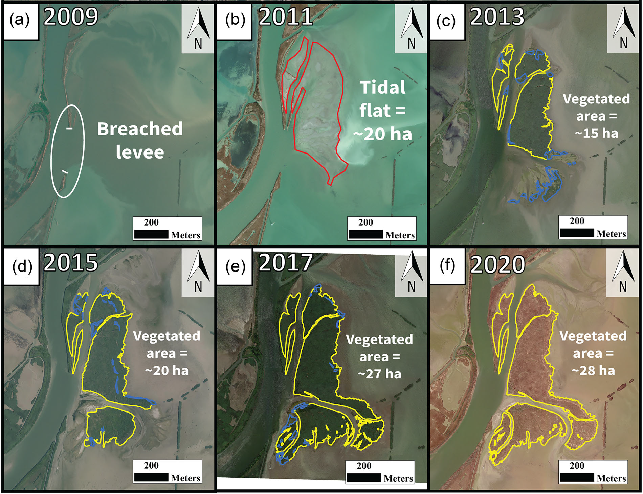
Between 2011 and 2013, this intertidal flat was rapidly covered by reeds, allowing the formation of a marsh of about 15 ha.
This growth continued the following years reaching 28 ha in 2020.
The rates of extension variation decreased substantially compared to its first years of development (from 6 ha/year in 2011–2013 to 0.3 ha/year in 2017–2020).

Slide 11
STUDY AREA
Influence of salinity distribution inside the lagoons
Sediment size
Morphology of the lagoon
Size and location of breaches
Subsidence
Larger breach: More fresh water
Protected from the sea
Effective factors
Sediment transport: Hydrodynamic
Lagoon shape
Initial bathymetry
Breach as a source of sediment and flow flux
1 cm/year

Slide 12
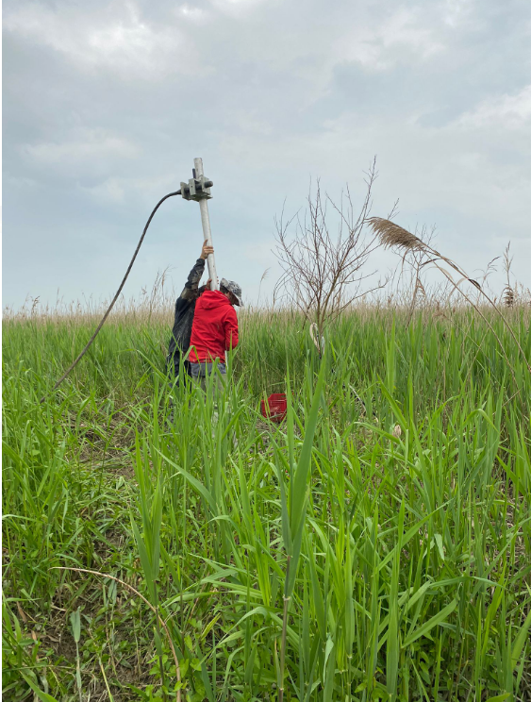
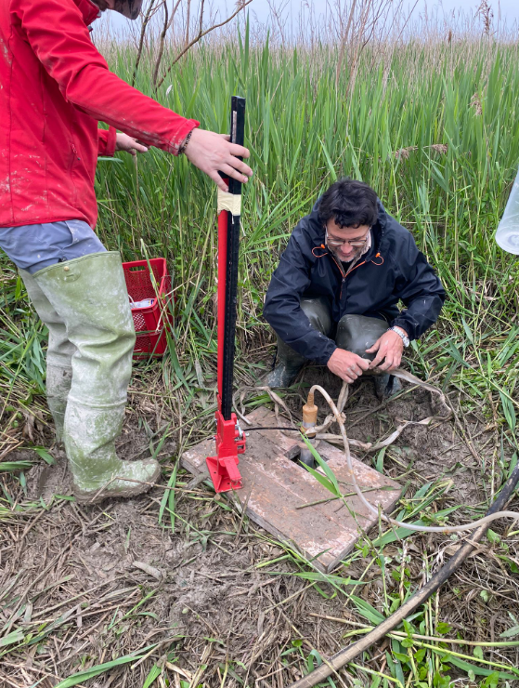
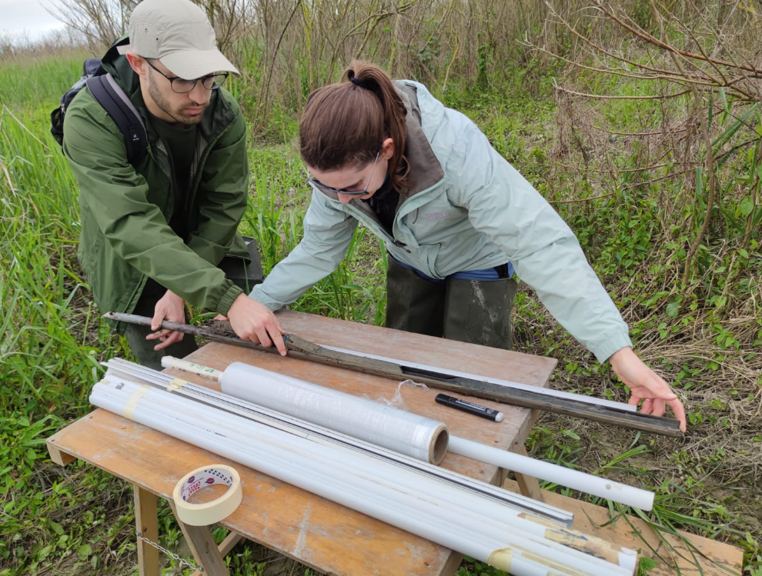
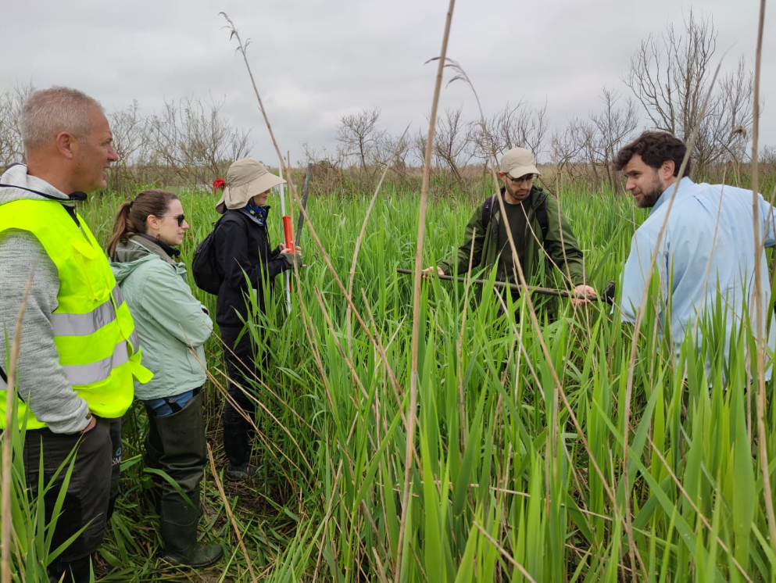
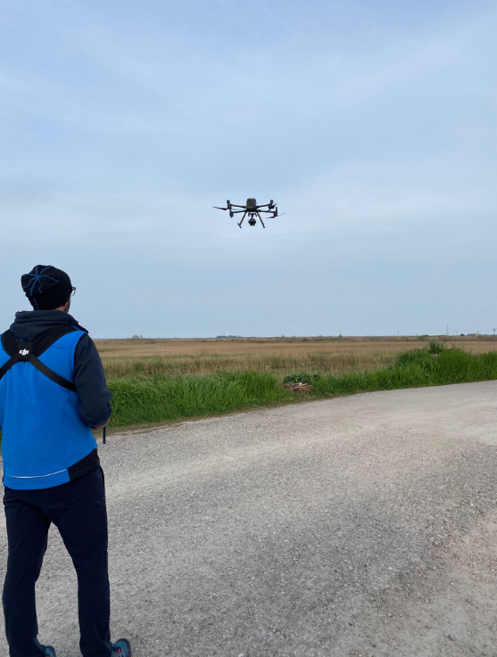
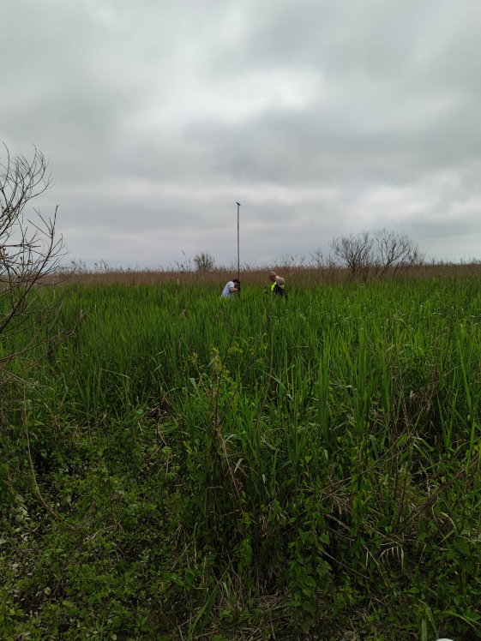
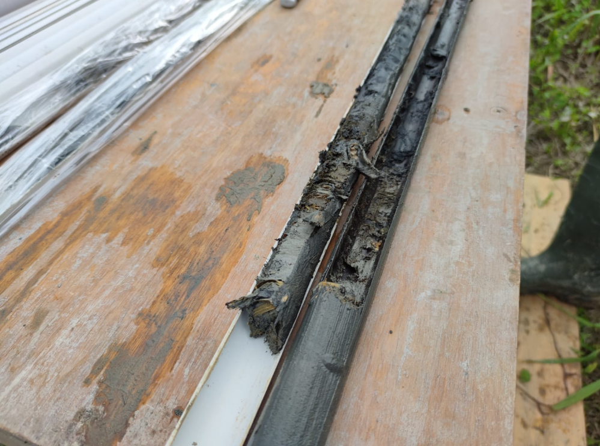
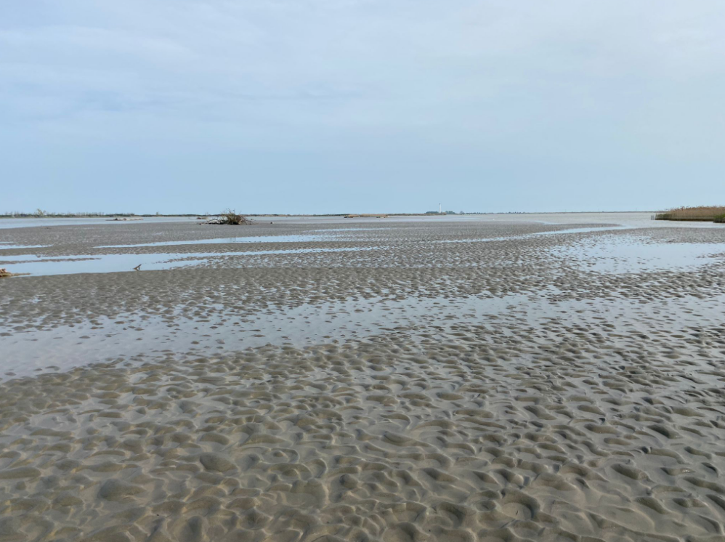
STUDY AREA

Slide 13
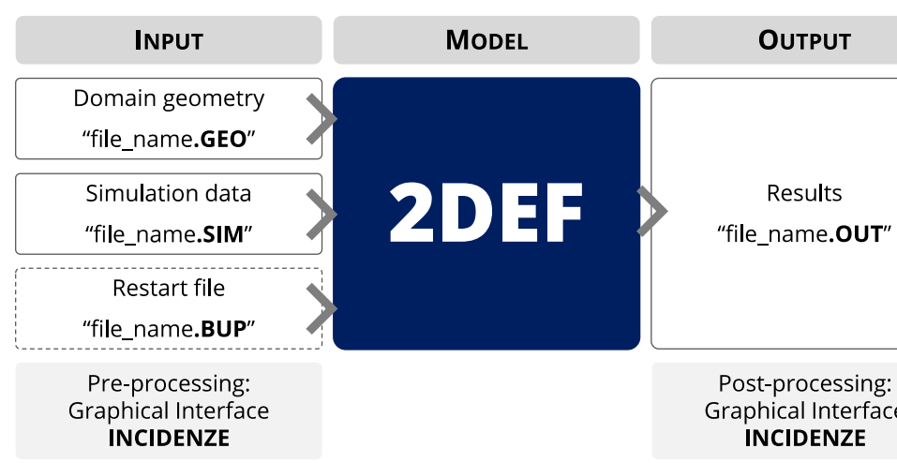
MODEL: 2DEF (Morphodynamics)
METHODOLOGY
Phase averaged Shallow Water Equations (Defina, 2000)
Exner equation: Bedload
Suspended load
Morphology factor: Multiply the erosion/deposition fluxes to the flow

Slide 14
METHODOLOGY
$$\frac{∂h}{∂t}+u\frac{∂h}{∂x}+v\frac{∂h}{∂y}+h\left(\frac{∂u}{∂x}+\frac{∂v}{∂y}\right)=0$$
$$\frac{∂u}{∂t}+u\frac{∂u}{∂x}+v\frac{∂u}{∂y}+g\frac{∂h}{∂x}−fv=0$$
$$\frac{∂v}{∂t}+u\frac{∂v}{∂x}+v\frac{∂v}{∂y}+g\frac{∂h}{∂y}+fu=0$$
Classic Shallow Water Equations (SWE)
What 2DEF solves!
Phase averaged Shallow Water Equations (Defina, 2000)
$$η\frac{∂h}{∂t}+\frac{∂q_{x}}{∂x}+\frac{∂q_{y}}{∂y}=0$$
$$\frac{∂q_{x}}{∂t}+\frac{∂}{∂x}\left(\frac{q_{x}^{2}}{Y}\right)+\frac{∂}{∂y}\left(\frac{q_{x}q_{y}}{Y}\right)+gY\frac{∂h}{∂x}−\left(\frac{∂R_{xx}}{∂x}+\frac{∂R_{yy}}{∂y}\right)+fv−τ_{sx}+τ_{bx}=0$$
$$\frac{∂q_{y}}{∂t}+\frac{∂}{∂x}\left(\frac{q_{x}q_{y}}{Y}\right)+\frac{∂}{∂y}\left(\frac{q_{y}^{2}}{Y}\right)+gY\frac{∂h}{∂y}−\left(\frac{∂R_{xx}}{∂x}+\frac{∂R_{yy}}{∂y}\right)+fv−τ_{sy}+τ_{by}=0$$
$$q_{x}=\int_{−∞}^{h}{Udz},{ q}_{y}=\int_{−∞}^{h}{Vdz}$$
$$U=<φu> =\frac{1}{A}\int{φu dA}$$
$Y=\int_{−∞}^{h}{υdz }:$effective water depth
$υ(x,y,z)$: wet fraction
$$η=υ(x,y,h)$$

Slide 15
METHODOLOGY
$$\left(1−n\right)\frac{∂z_{b}}{∂t}+∇q_{b}=D\left(C\right)−E$$
Exner equation: Bedload
$n$: Porosity
$D:$ Deposition
$E$: Erosion
$$\frac{∂(CY)}{∂t}+∇qC−∇\left(DY∇C\right)=E−D\left(C\right)$$
Suspended load
Morphology factor: The morphological time scale factor is achieved by multiplying the erosion and deposition fluxes to the flow and vice versa at each computational time step.
This allows accelerated bed-level changes to be incorporated dynamically into the hydrodynamic flow calculations.
It means that the hydrodynamics is simulated at an N times faster rate.
Where there is a tidal cycle, the order of events might change!
The suspended load effects are different from the bedload when we have morphological factor!

Slide 16
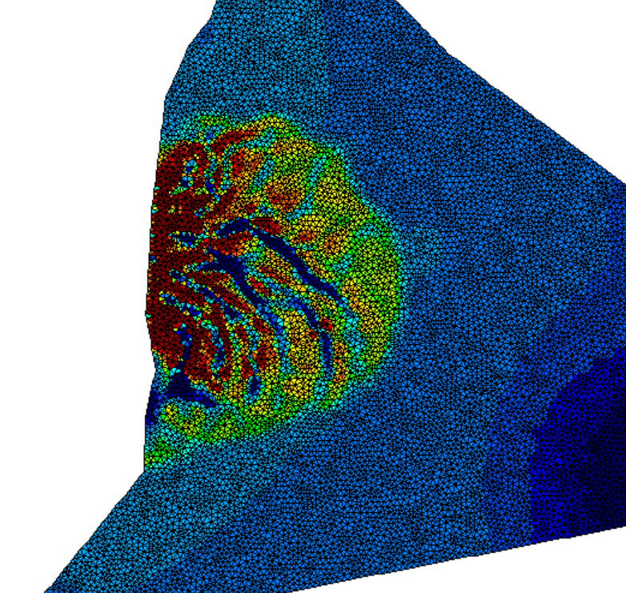
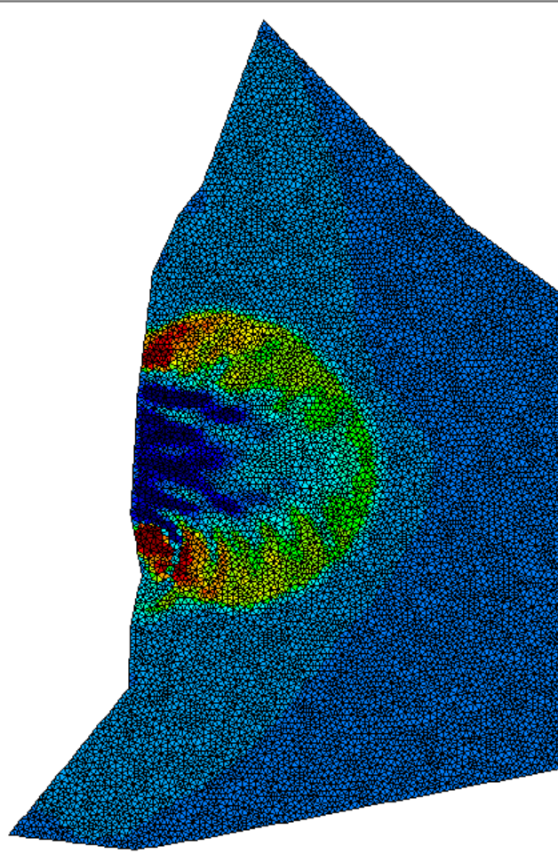
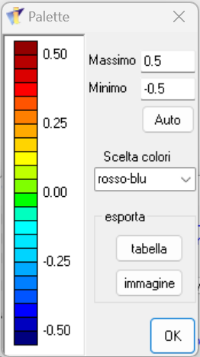
Preliminary
Inflow (upstream) | Outflow (downstream)
Water levels | Water levels
Fixed nodes (unerodable)
1 month test=1*5(morph. Fac.)
Channelised sedimentation
100 h

Slide 17
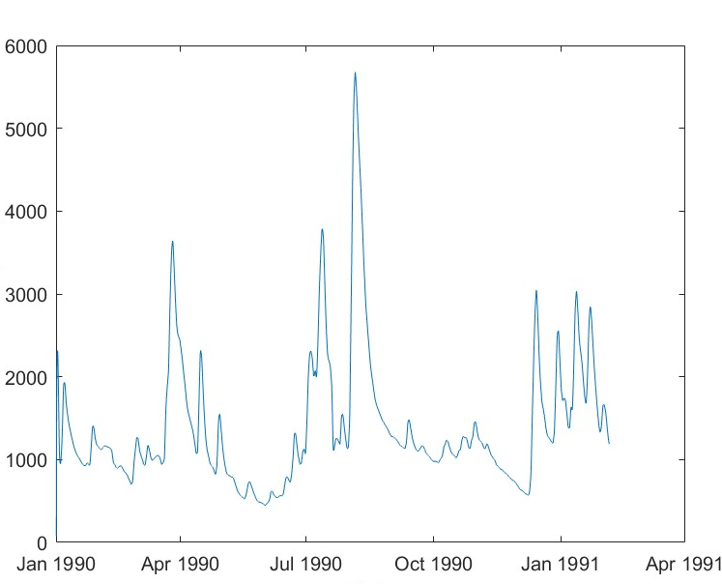
MODEL: 2DEF (Defina, A., 2003) (Morphodynamics)
METHODOLOGY
High peaks
Phase averaged Shallow Equations (Defina, 2000)
Exner equation: Bedload
Suspended load
Morphology factor (10-years)
Discharge [m³/s]
Larger Sim

Slide 18
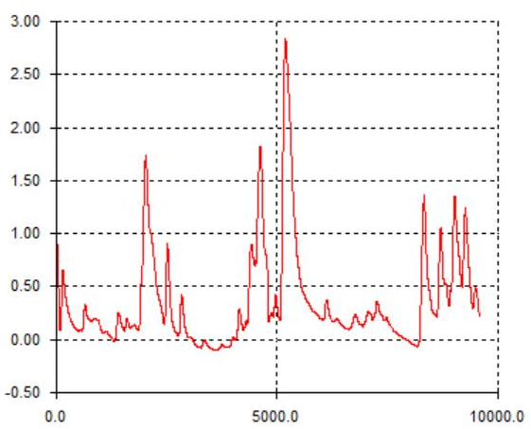
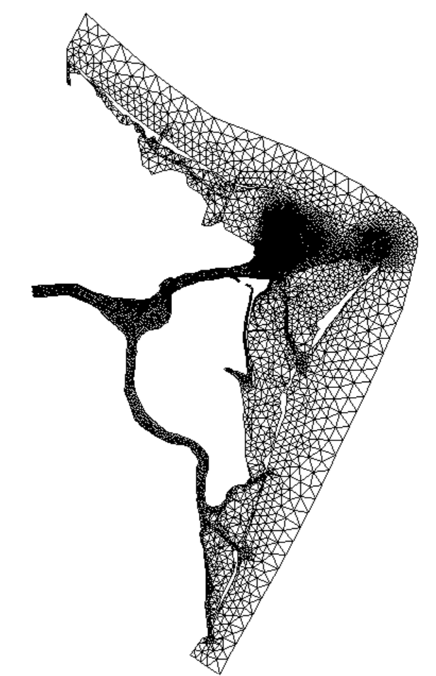
METHODOLOGY
Boundary Conditions
Inflow (upstream)
High peaks
Outflow (downstream)
Discharges
Fixed nodes (unerodable)
Tidal levels
Discharge [m³/s]
H [m]
Larger Sim
Time [hr]

Slide 19
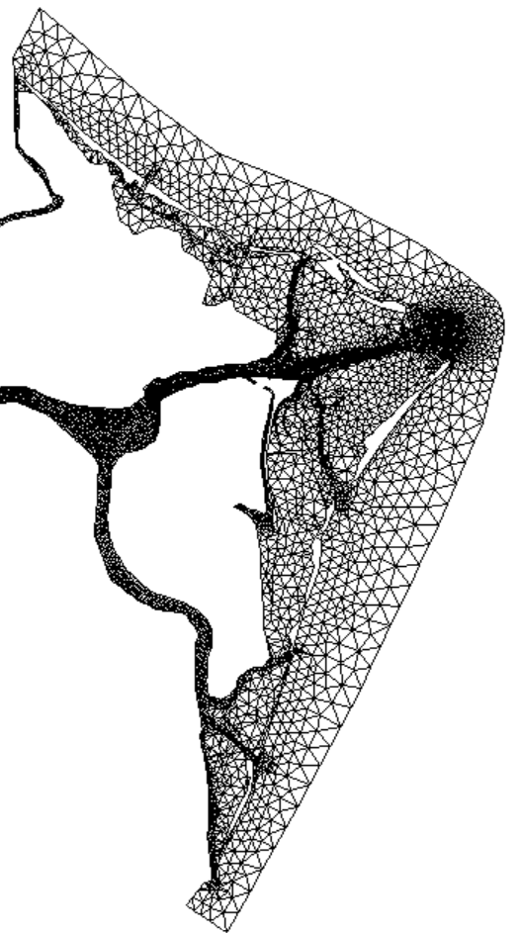
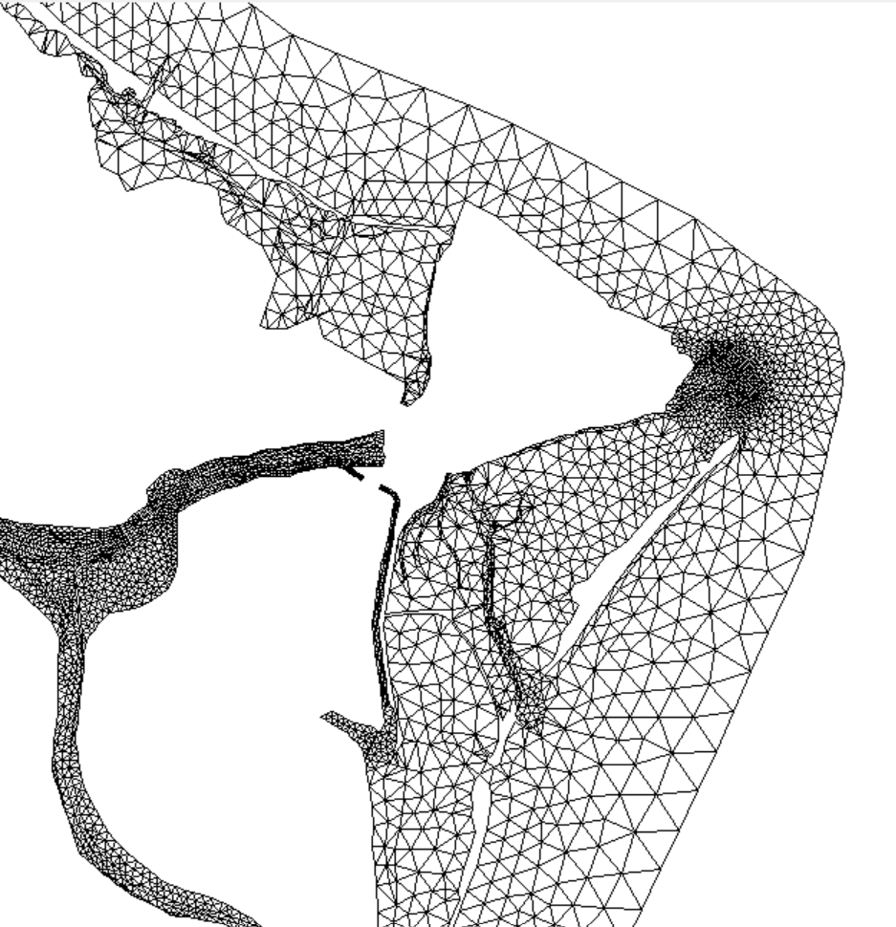
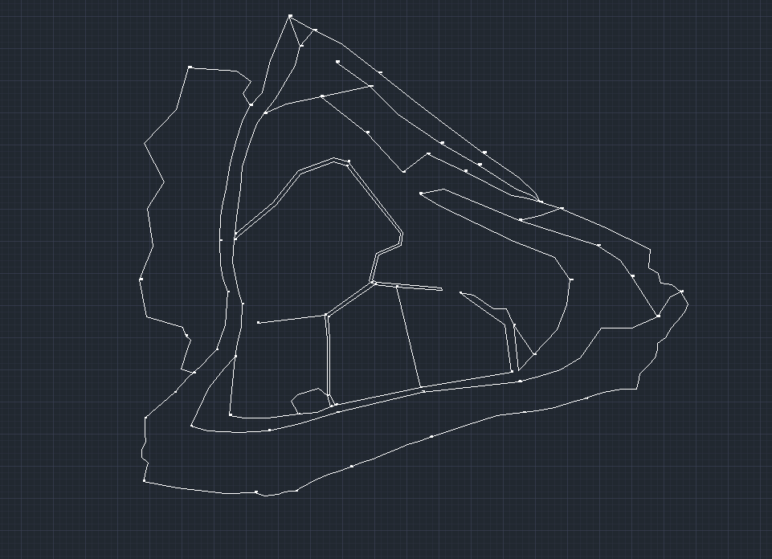
Mesh Generation

Slide 20
PARAMETERS
Porosity
Dgrain
Table: Parameters set on the numerical simulation in the test
Numerical | Dt=-5 | Time step
 | PAR1=3111114 | For Convective computations
Hydrodynamic | T=12*30*24*3600 | Simulation time
 | Ks~30 | Roughness Coeff.
Sediment | Dgrain=0.4 | Sediment grain size
 | Porosity=0.4
 | Ksv=75 | Real roughness Coeff.
Morpho-dynamic | Morph. Factor=9
What could be the other alternatives?

Slide 21
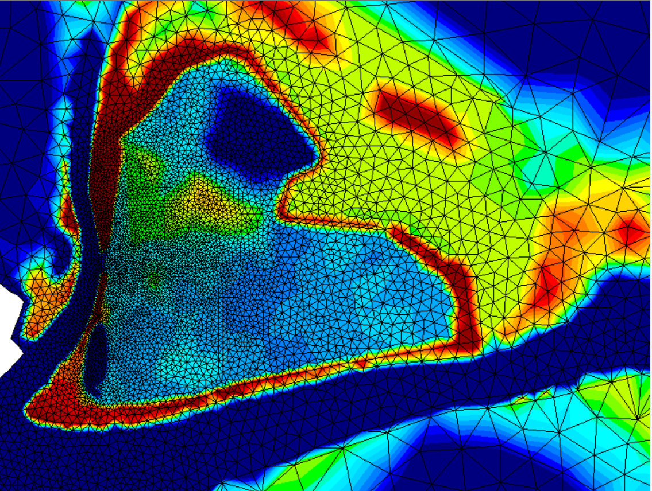
BATHYMETRY
Buttom level [m]

Slide 22
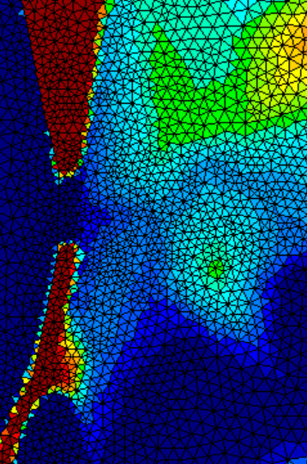
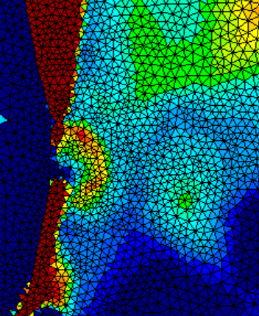
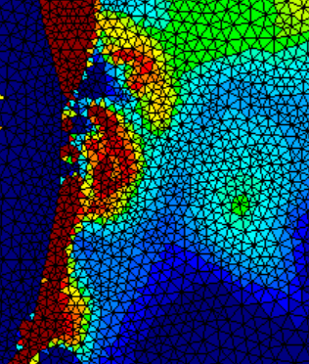
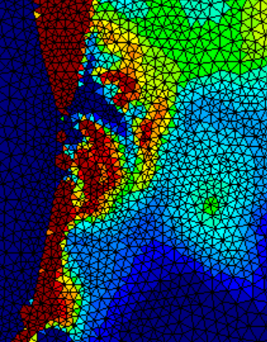
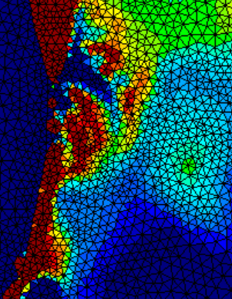
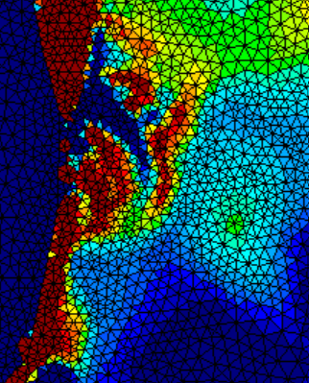
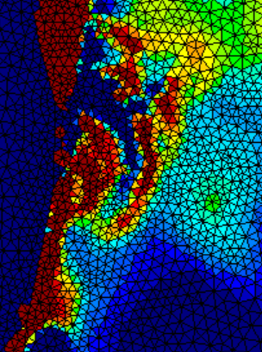
RESULTS
Buttom level [m]
0 hour
1000 hour
2000 hour
3000 hour
4000 hour
6000 hour
5000 hour

Slide 23
Thank you for your attention!

