Slide 1
Wait! Are you sure about me…?
Soil de-compaction for more groundwater recharge
Water puddle in rural areas could be due to compact soil
How much can be recharged? Solve using hydrological models
Here, we show:
Uncertainties in vegetation can largely change model outcomes!
Compact Soil (Barrier for Water Flow)
No more puddle.
More infiltration. More recharge!
Deep Percolation Leading to Groundwater Recharge?
1

Slide 2
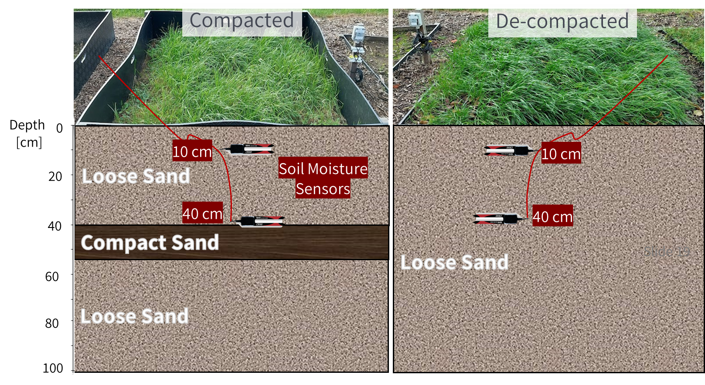
What we did: Experimental Plots
What we did: HYDRUS-1D numerical models
Visit our PICO Spot 4.6!
Compacted
De-compacted
New Transpiration?
New Evaporation?
Change LAI
Transpiration
Evaporation
Loose Sand
LooseSand
Loose Sand
Stored Soil
Moisture
New Stored
Soil Moisture?
Compact Sand
Compact Sand
Change Root
Depth
Loose Sand
Loose Sand
Deep Percolation
(Groundwater Recharge)
New
Deep Percolation?
Presenter: Jayson Pinza

Slide 3
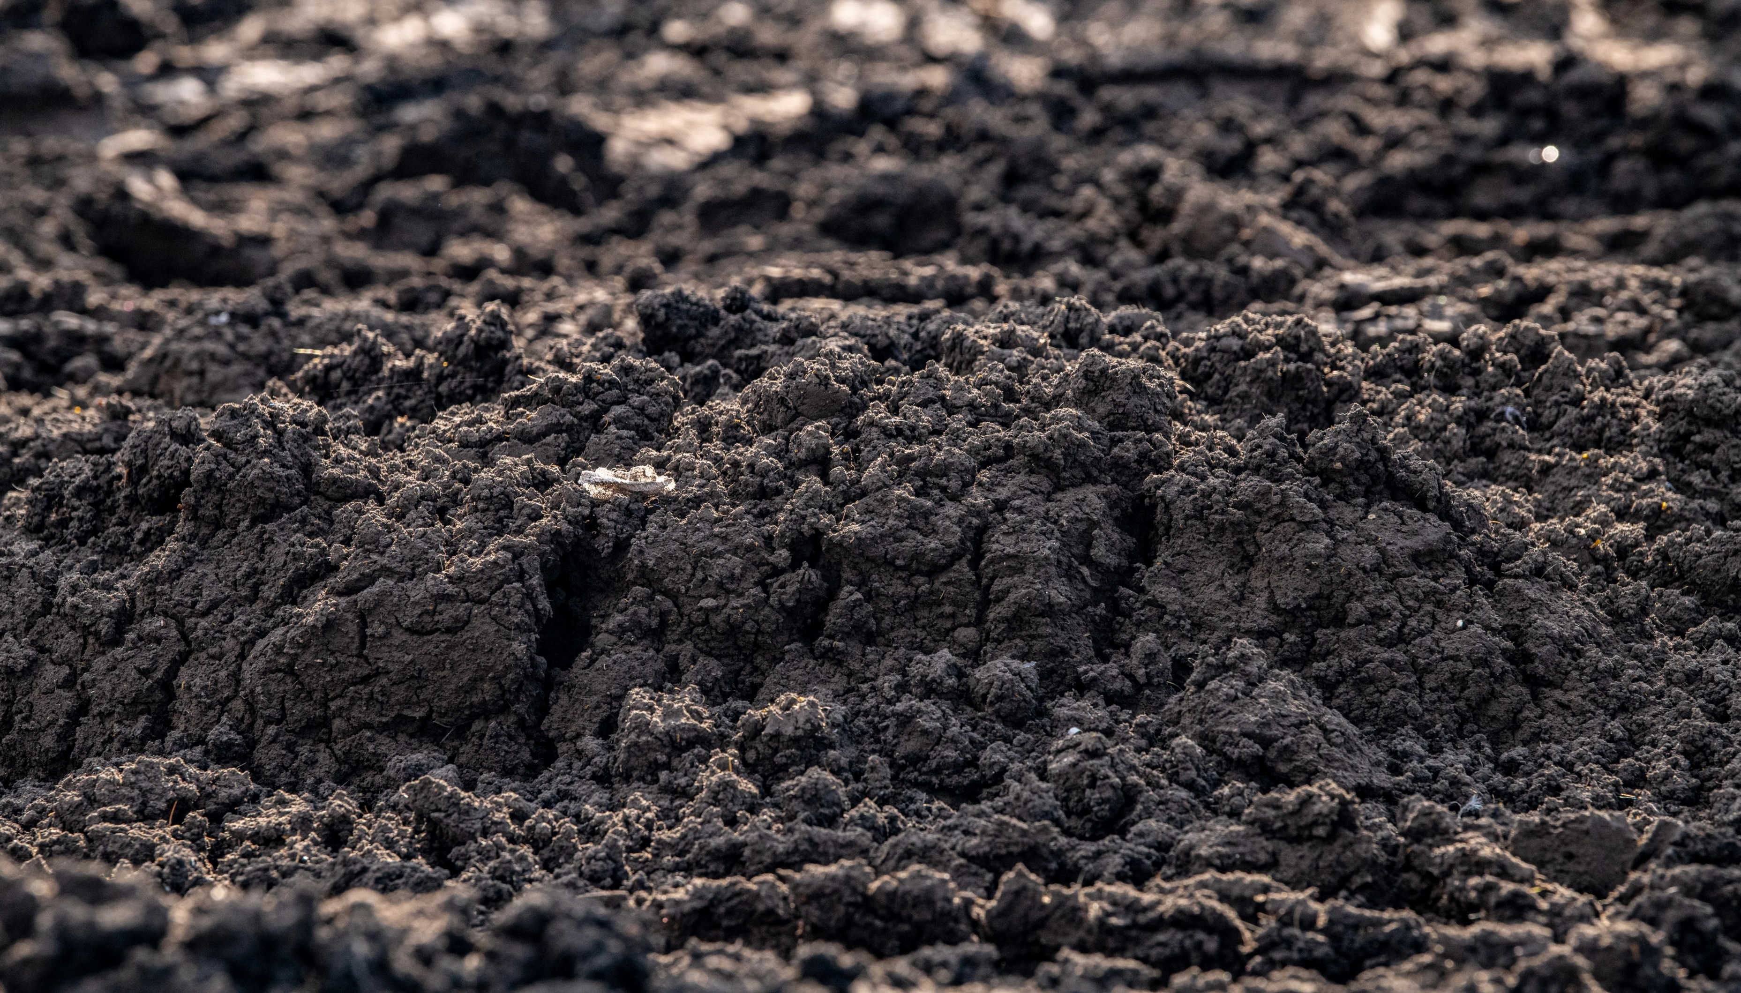
Hydrological impacts of compacted sandy subsoils & soil water flow simulations (importance of vegetation parameterization)
Presenter:
Jayson Gabriel Pinza
University of Antwerp
KU Leuven
Belgium
jayson.pinza@uantwerpen.be
Home Page. Click a section below
(1) Introduction
Co-authors:
Ona-Abeni D. Stoffels
Robrecht Debbaut
Patrick Willems
Jan Vanderborght
Sarah Garré
Jan Staes
(2) Experimental Setup
Scan for the Preprint (under review)!
(3) Numerical Modeling
(4) Conclusion
Scan for the Abstract (OSPP)!
Photo © US Department of Agriculture (n.d.)

Slide 4
Hydrological impacts of compacted sandy subsoils & soil water flow simulations (importance of vegetation parameterization)
Click next to proceed.
Otherwise, either click home or the inactive box for other sections
(1) Introduction
(2) Experimental Setup
(3) Numerical Modeling
(4) Conclusion
Photo © US Department of Agriculture (n.d.)

Slide 5
(1) Introduction
(2) Experimental Setup
(3) Numerical Modeling
(4) Conclusion
Water puddle in rural areas could be due to compact soil
Compact Soil (Barrier for Water Flow)
Photo © Jan Staes, 2022
Photo © Jan Staes (2022)

Slide 6
(1) Introduction
(2) Experimental Setup
(3) Numerical Modeling
(4) Conclusion
Soil de-compaction for more groundwater recharge
Water puddle in rural areas could be due to compact soil
Compact Soil (Barrier for Water Flow)
No more puddle.
More infiltration. More recharge!
Deep Percolation Leading to Groundwater Recharge?
Photo © Jan Staes, 2022
Photo © Jan Staes (2022)

Slide 7
(1) Introduction
(2) Experimental Setup
(3) Numerical Modeling
(4) Conclusion
Soil de-compaction for more groundwater recharge
Water puddle in rural areas could be due to compact soil
How much can be recharged? Solve using hydrological models
No more puddle.
More infiltration. More recharge!
Deep Percolation Leading to Groundwater Recharge?
Photo © Jan Staes, 2022
Photo © Jan Staes (2022)

Slide 8
In these models, however, vegetation is a problem
(1) Introduction
(2) Experimental Setup
(3) Numerical Modeling
(4) Conclusion
Are you sure about me…?
Why? Often parameterized using only:
limited field measurements
literature
derivations from other variables
Adapted from Philip Halling (2022) (Creative Commons License)

Slide 9
Here, we show:
(1) Introduction
(2) Experimental Setup
(3) Numerical Modeling
(4) Conclusion
Check me again, please…
Uncertainties in vegetation can cause large changes in model outcomes!
Adapted from Philip Halling (2022) (Creative Commons License)

Slide 10
Hydrological impacts of compacted sandy subsoils & soil water flow simulations (importance of vegetation parameterization)
Click next to proceed.
Otherwise, either click home or the inactive box for other sections
(1) Introduction
(2) Experimental Setup
(3) Numerical Modeling
(4) Conclusion
Photo © US Department of Agriculture (n.d.)

Slide 11
Hydrological impacts of compacted sandy subsoils & soil water flow simulations (importance of vegetation parameterization)
(1) Introduction
(2) Experimental Setup
(3) Numerical Modeling
(4) Conclusion
Study area
Setting: sandy soils of Campine Region (Northeast Belgium)
More info on the site’s soil profile
Photo © Belgium-mapped-out, 2003

Slide 12
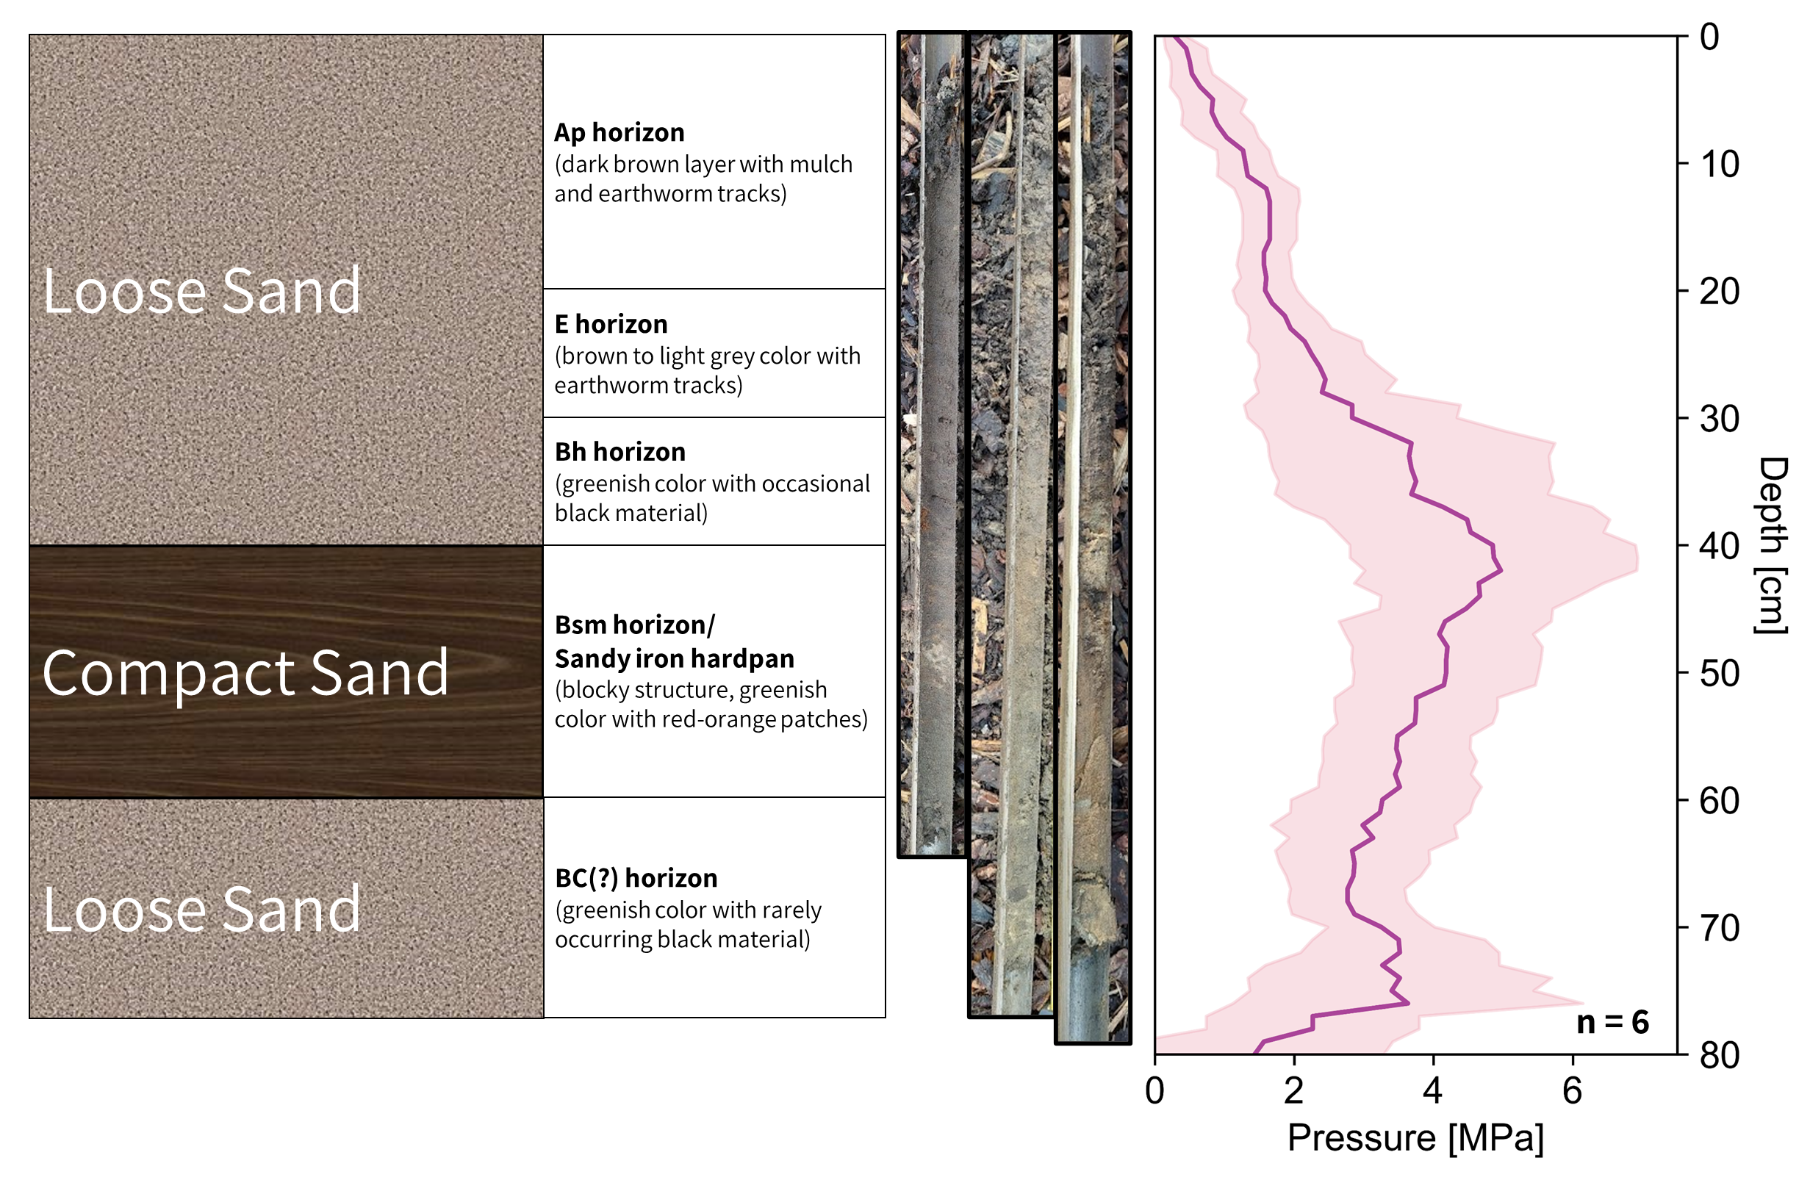
Subsoil compaction has already been present for 50 years
(1) Introduction
(2) Experimental Setup
(3) Numerical Modeling
(4) Conclusion
General Soil Profile
Penetrologger Profile
Depth [cm]

Slide 13
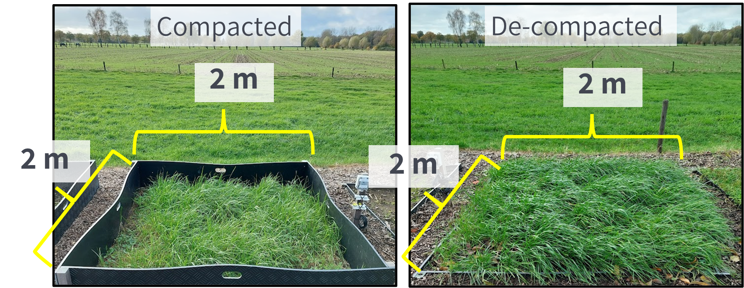
2 setup cases considered:
(1) Introduction
(2) Experimental Setup
(3) Numerical Modeling
(4) Conclusion
Plots have grasses (Italian ryegrass)
Exposed under the sun/rain
Occasionally irrigated and mowed

Slide 14
2 setup cases considered:
(1) Introduction
(2) Experimental Setup
(3) Numerical Modeling
(4) Conclusion
With compact sand (40-55 cm depth)
Only loose sand
More info on
De-compaction
Both have sensors at 10- (near surface) & 40-cm depth (above compact layer)
Sensor Photo
© HOBO, n.d.

Slide 15
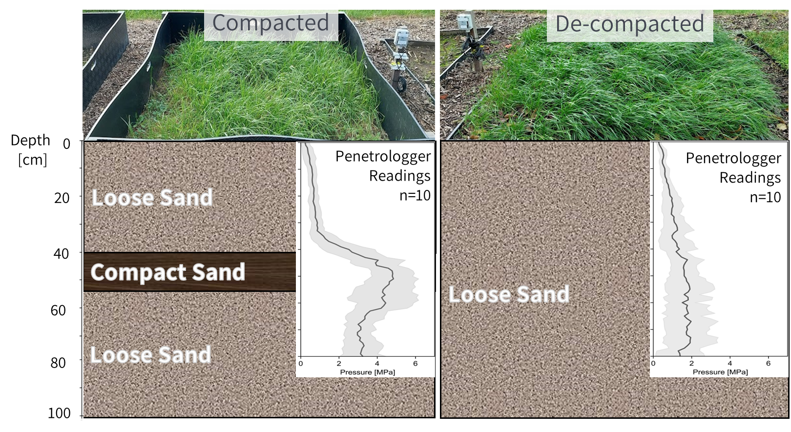
De-compaction had lower penetration resistances across the profile
(1) Introduction
(2) Experimental Setup
(3) Numerical Modeling
(4) Conclusion
More info on De-compaction

Slide 16
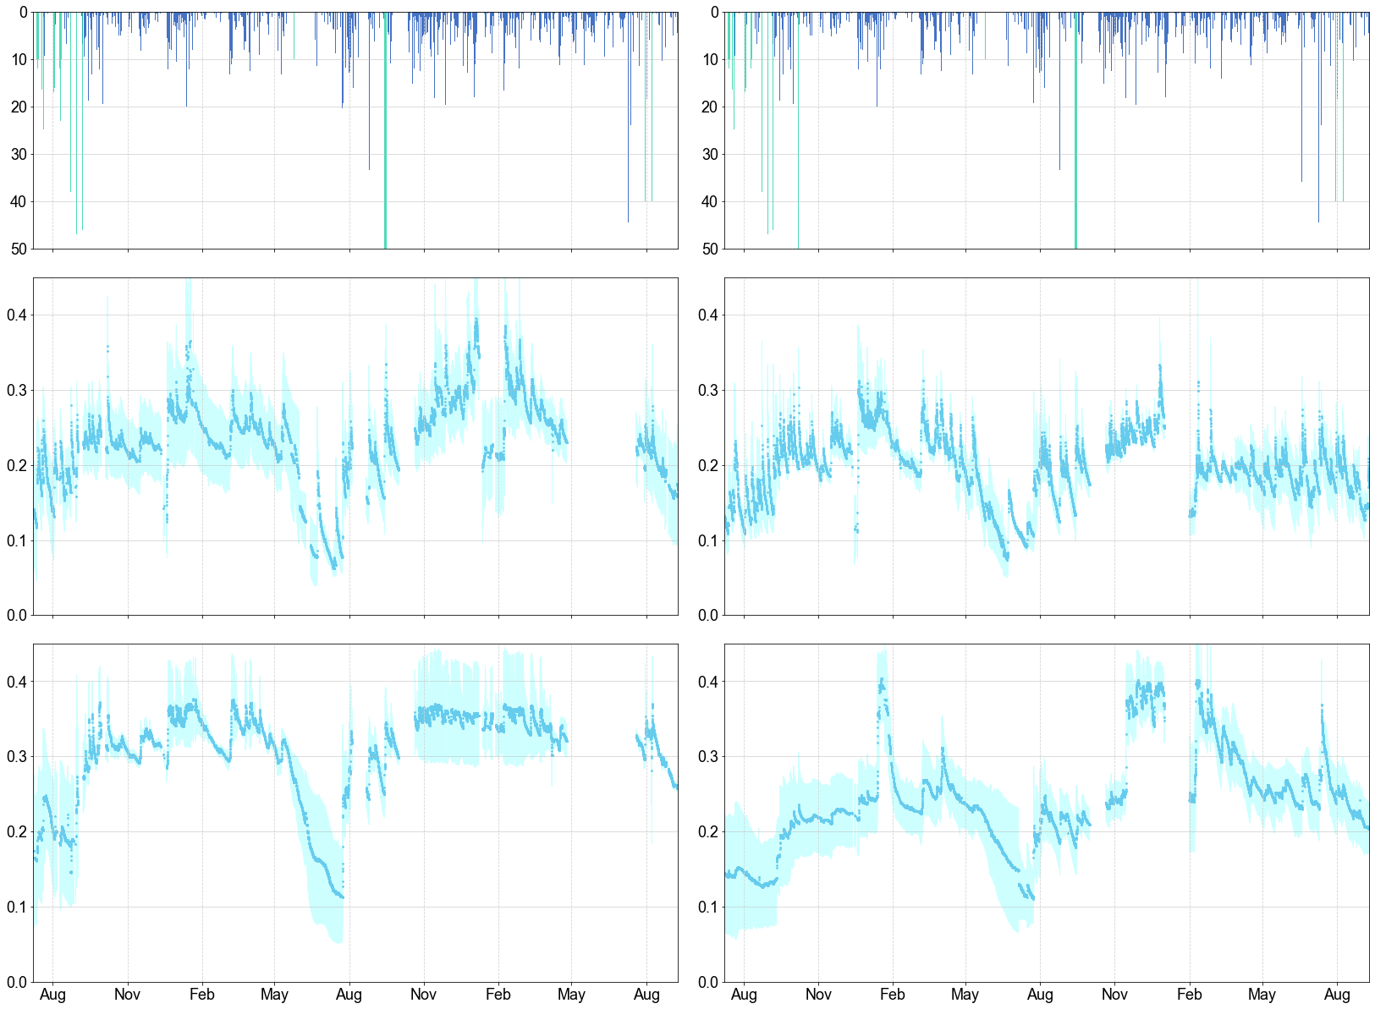
De-compaction had reduced soil moisture content @ 40-cm depth
(1) Introduction
(2) Experimental Setup
(3) Numerical Modeling
(4) Conclusion
Amount [mm]
Compacted
De-compacted
Precipitation
Irrigation
Soil Moisture (cm³/cm³)
10-cm depth
Average ± standard deviation
n = 4
n = 4
40-cm depth (above compact layer)
Average ± standard deviation
n = 4
n = 4

Slide 17
De-compaction had reduced soil moisture content @ 40-cm depth
(1) Introduction
(2) Experimental Setup
(3) Numerical Modeling
(4) Conclusion
Amount [mm]
Compacted
De-compacted
Precipitation
Irrigation
Soil Moisture (cm³/cm³)
10-cm depth
Average ± standard deviation
n = 4
n = 4
More soil moisture
Less soil moisture because “barrier” (compact layer) is removed)
40-cm depth (above compact layer)
Average ± standard deviation
n = 4
n = 4

Slide 18
De-compaction had reduced soil moisture content @ 40-cm depth
(1) Introduction
(2) Experimental Setup
(3) Numerical Modeling
(4) Conclusion
Amount [mm]
Compacted
De-compacted
Precipitation
Irrigation
Soil Moisture (cm³/cm³)
10-cm depth
Average ± standard deviation
n = 4
These are exceptional
(influence of
groundwater?)
n = 4
More soil moisture
Less soil moisture because “barrier” (compact layer) is removed)
40-cm depth (above compact layer)
Average ± standard deviation
n = 4
n = 4

Slide 19
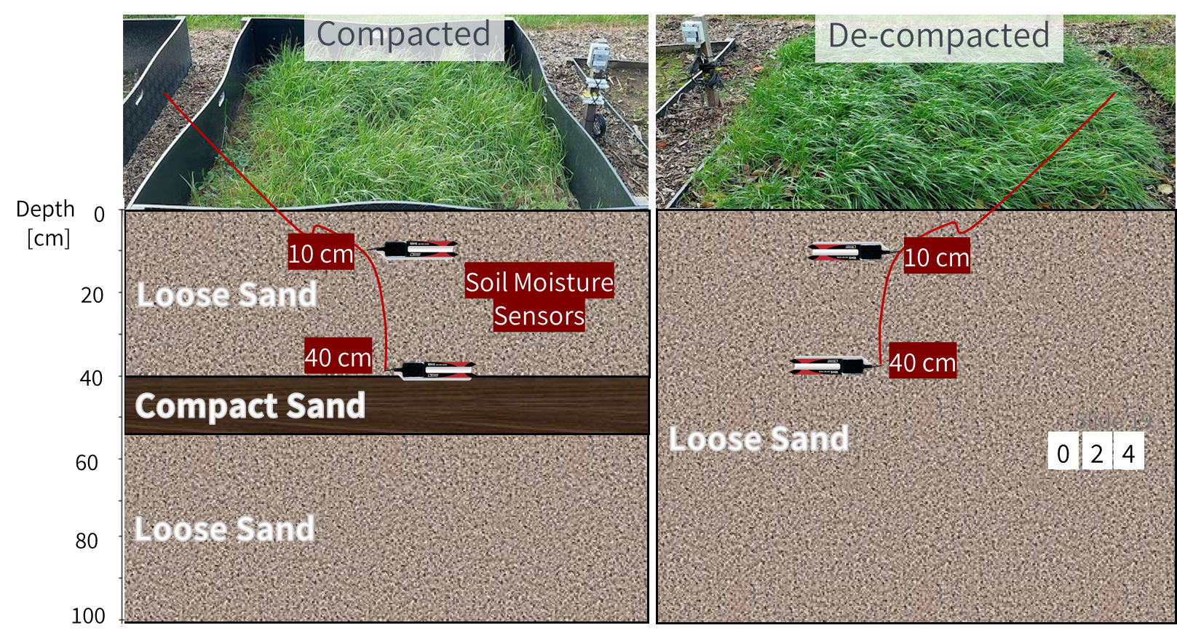
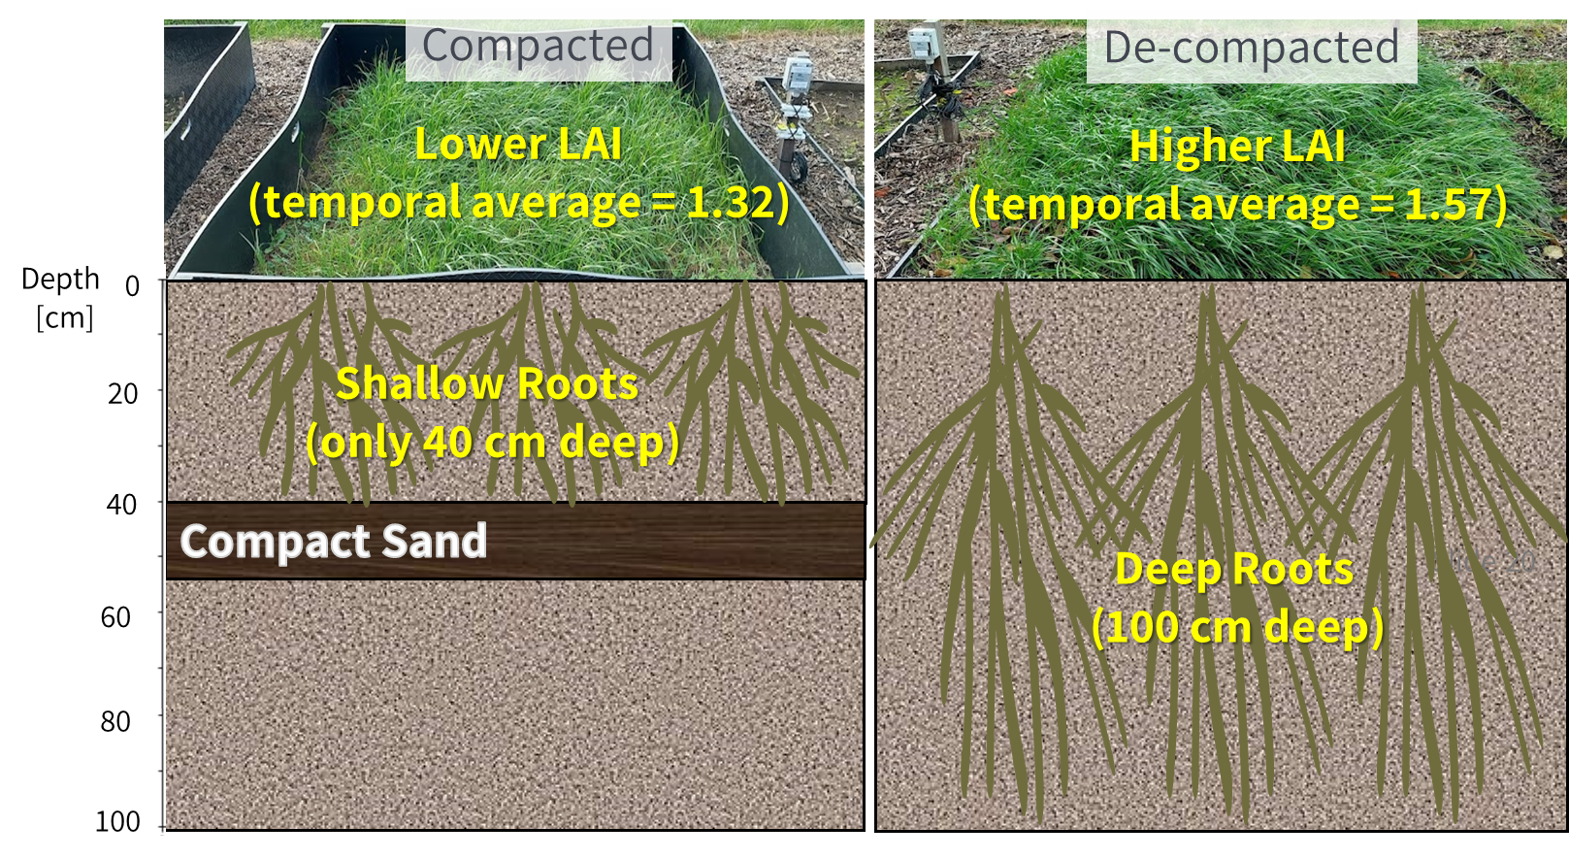
De-compaction increased LAI and root depth
(1) Introduction
(2) Experimental Setup
(3) Numerical Modeling
(4) Conclusion
More info on LAI
More info on
Root Distribution

Slide 20
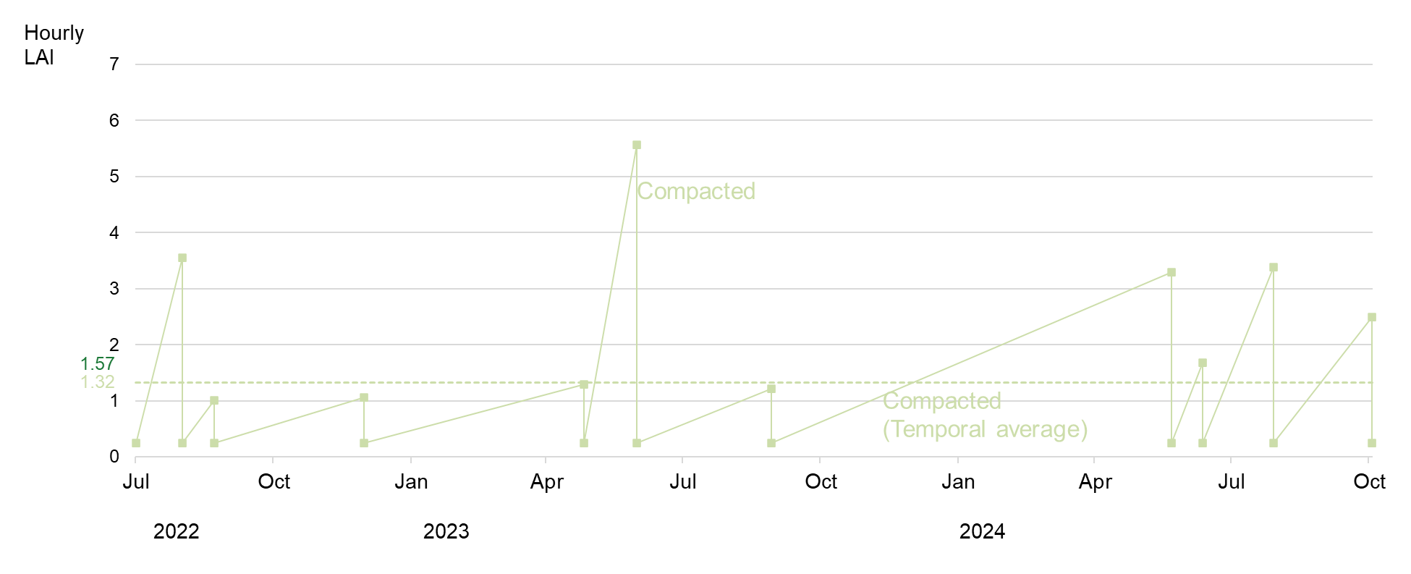
De-compaction increased grass’ LAI
(1) Introduction
(2) Experimental Setup
(3) Numerical Modeling
(4) Conclusion

Slide 21
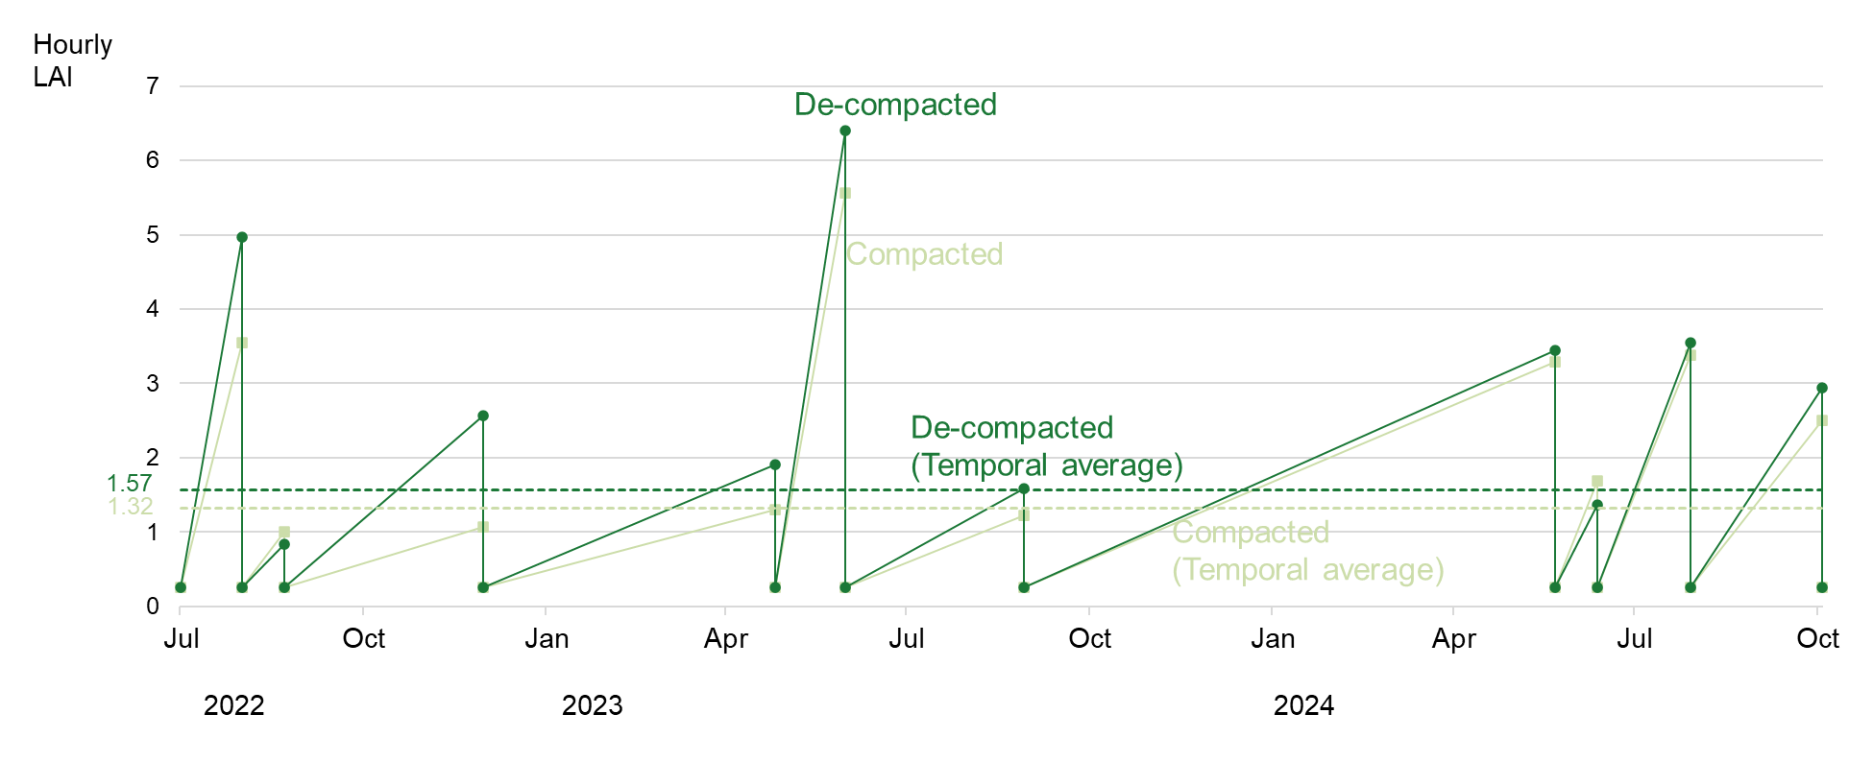
De-compaction increased grass’ LAI
(1) Introduction
(2) Experimental Setup
(3) Numerical Modeling
(4) Conclusion

Slide 22
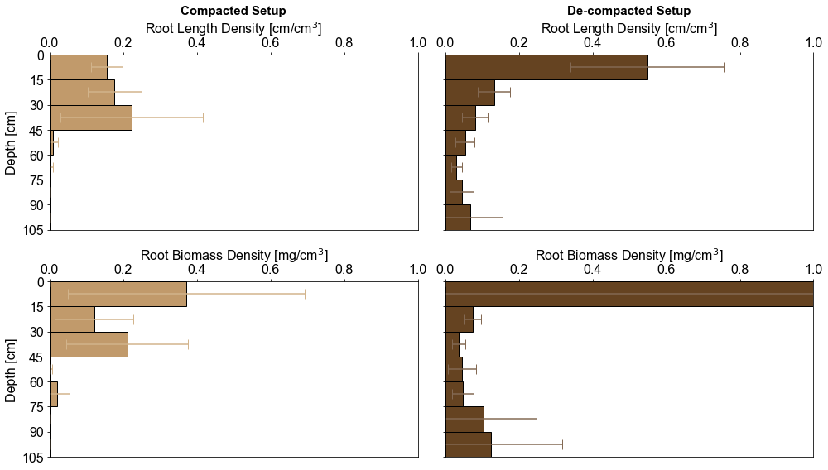
De-compaction increased root depths too
(1) Introduction
(2) Experimental Setup
(3) Numerical Modeling
(4) Conclusion
Depth
[cm]
Still has roots!
No more roots!
n=4
n=4
Depth
[cm]
Still has roots!
Not much roots!
n=4
n=4

Slide 23
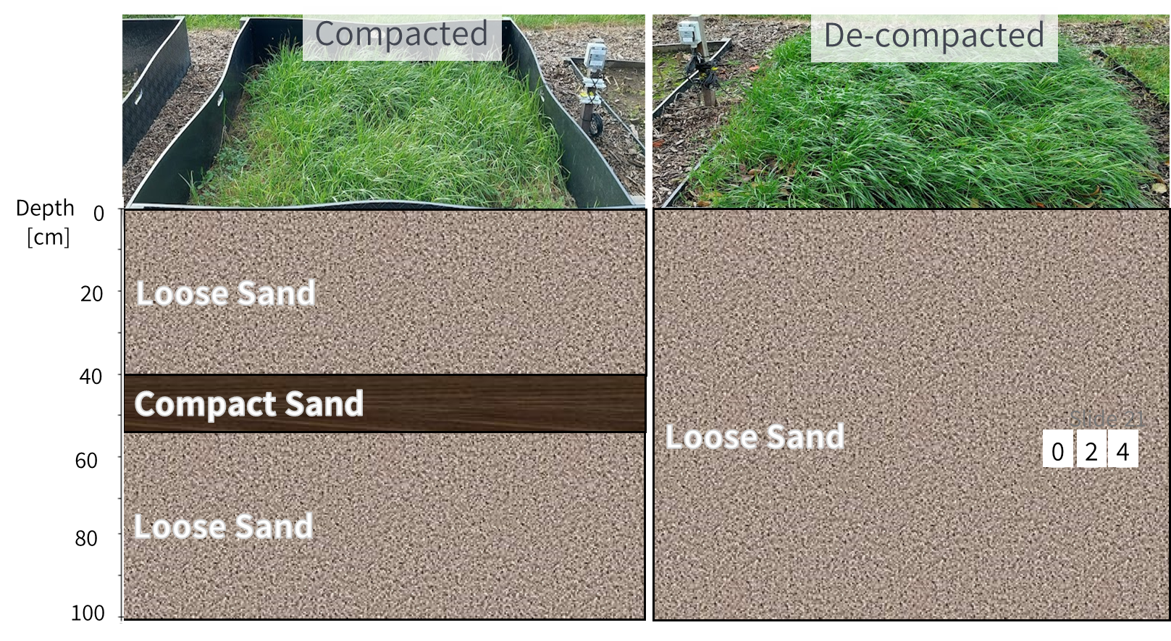
Now, per plot: quantify the hydrological processes
(1) Introduction
(2) Experimental Setup
(3) Numerical Modeling
(4) Conclusion
Transpiration
Evaporation
Stored Soil Moisture
Deep Percolation
(Groundwater Recharge)

Slide 24
Now, per plot: quantify the hydrological processes
(1) Introduction
(2) Experimental Setup
(3) Numerical Modeling
(4) Conclusion
New Transpiration?
New Evaporation?
Transpiration
Evaporation
Stored Soil Moisture
New Stored
Soil Moisture?
New
Deep Percolation?
Deep Percolation
(Groundwater Recharge)

Slide 25
Now, per plot: quantify the hydrological processes
(1) Introduction
(2) Experimental Setup
(3) Numerical Modeling
(4) Conclusion
New Transpiration?
New Evaporation?
Transpiration
Evaporation
Use a 1D numerical model
(HYDRUS-1D)
Stored Soil Moisture
New Stored
Soil Moisture?
New
Deep Percolation?
Deep Percolation
(Groundwater Recharge)

Slide 26
Hydrological impacts of compacted sandy subsoils & soil water flow simulations (importance of vegetation parameterization)
Click next to proceed.
Otherwise, either click home or the inactive box for other sections
(1) Introduction
(2) Experimental Setup
(3) Numerical Modeling
(4) Conclusion
Photo © US Department of Agriculture (n.d.)

Slide 27
1D Model Layers
(1) Introduction
(2) Experimental Setup
(3) Numerical Modeling
(4) Conclusion
Compacted
De-compacted
Saturated
Hydraulic Conductivity
[K_{sat}]
Loose Sand
40 cm
298 cm/day
Compact Sand
1.3 cm/day
(so, it hinders water flow)
15 cm
Loose Sand
45 cm
298 cm/day
All K _{sat} values are obtained
from calibrations by inverse modeling

Slide 28
1D Model Layers
(1) Introduction
(2) Experimental Setup
(3) Numerical Modeling
(4) Conclusion
Compacted
De-compacted
Saturated
Hydraulic Conductivity
[K_{sat}]
Loose Sand
LooseSand
40 cm
298 cm/day
298 cm/day
Compact Sand
1.3 cm/day
(so, it hinders water flow)
Compacted Sand Layer
15 cm
100 cm
Loose Sand
45 cm
298 cm/day
All K _{sat} values are obtained
from calibrations by inverse modeling

Slide 29
1D Model Boundary Conditions
(1) Introduction
(2) Experimental Setup
(3) Numerical Modeling
(4) Conclusion
Upper Boundary:
We permitted atmospheric processes
(e.g., precipitation, evapotranspiration)
Compacted
De-compacted
Loose Sand
LooseSand
Compact Sand
Loose Sand

Slide 30
1D Model Boundary Conditions
(1) Introduction
(2) Experimental Setup
(3) Numerical Modeling
(4) Conclusion
Upper Boundary:
We permitted atmospheric processes
(e.g., precipitation, evapotranspiration)
Compacted
De-compacted
Loose Sand
LooseSand
Compact Sand
Loose Sand
Lower Boundary:
Water drains freely
Assumption: Water Table is deep

Slide 31
2 approaches were considered to parameterize vegetation (grass)
(1) Introduction
(2) Experimental Setup
(3) Numerical Modeling
(4) Conclusion
Approach 1: Same High LAI, Same Shallow Roots
Compacted
De-compacted
Loose Sand
LooseSand
40 cm
40 cm
15 cm
Compact Sand
Loose Sand
60 cm
45 cm
Photo of Grass
© Shmector.com (n.d.)

Slide 32
2 approaches were considered to parameterize vegetation (grass)
(1) Introduction
(2) Experimental Setup
(3) Numerical Modeling
(4) Conclusion
Approach 1: Same High LAI, Same Shallow Roots
Approach 2 (based on field observations) De-compacted has more LAI and deeper roots
Compacted
De-compacted
Compacted
De-compacted
Lower LAI
Loose Sand
LooseSand
Loose Sand
40 cm
40 cm
40 cm
Loose Sand
15 cm
Compact Sand
Compact Sand
100 cm
15 cm
Loose Sand
Loose Sand
60 cm
Deeper Roots
45 cm
45 cm
More info on
Model Performances

Slide 33
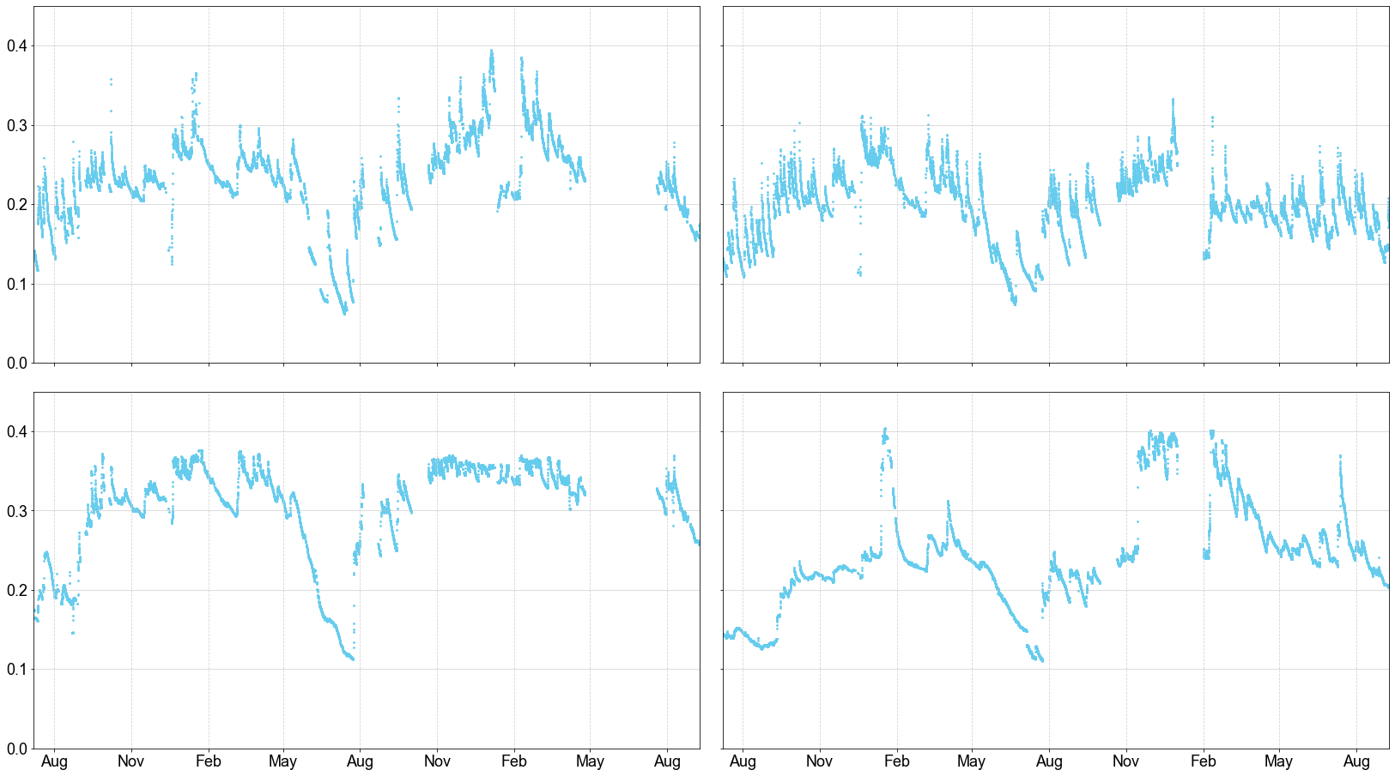
The 1D models from both approaches capture the general soil water behavior
(1) Introduction
(2) Experimental Setup
(3) Numerical Modeling
(4) Conclusion
Soil moisture [cm³/cm³]
Compacted
De-compacted
Observed
10-cm depth
Observed
40-cm depth
Months
2022
2023
2024
2022
2023
2024

Slide 34
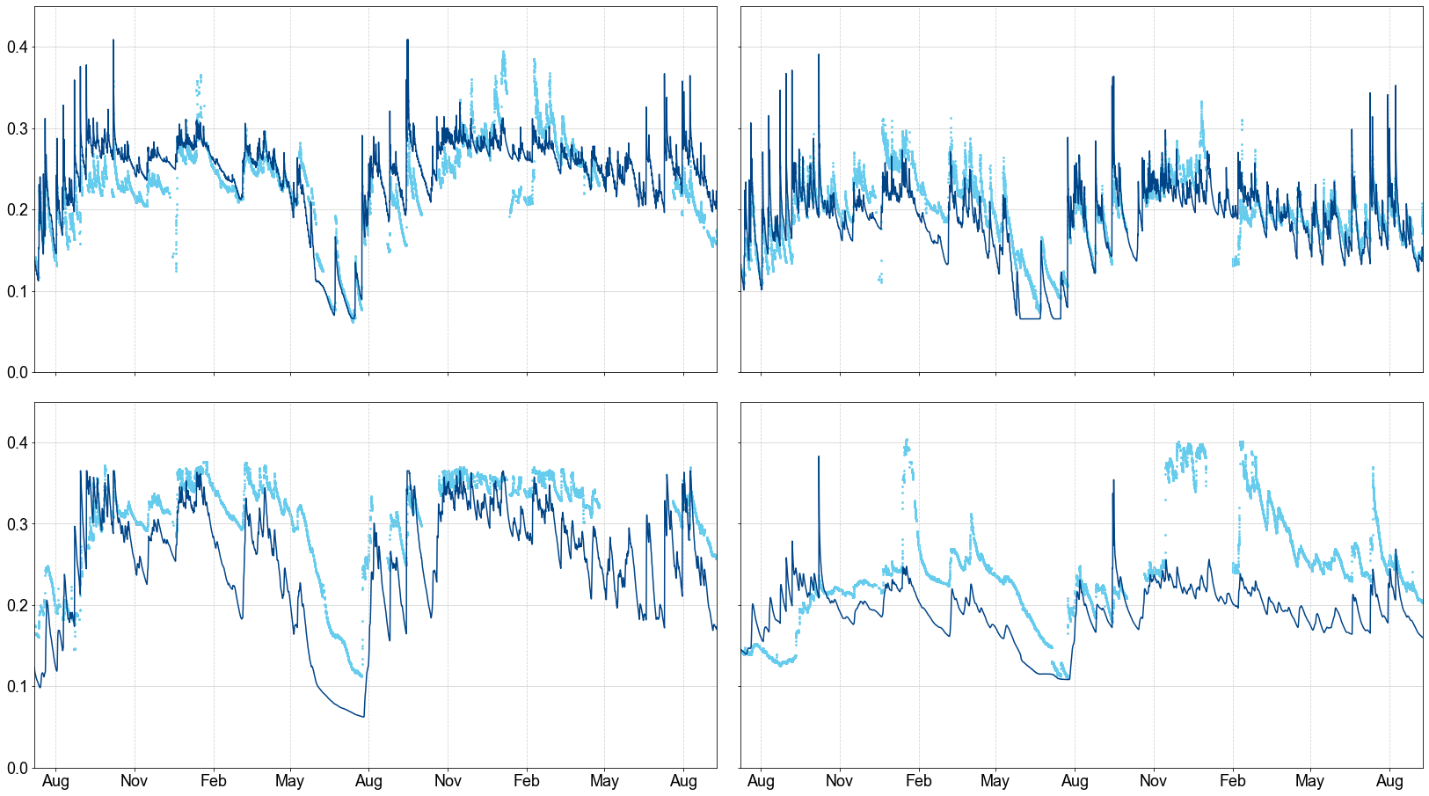
The 1D models from both approaches capture the general soil water behavior
(1) Introduction
(2) Experimental Setup
(3) Numerical Modeling
(4) Conclusion
Soil moisture [cm³/cm³]
Compacted
De-compacted
Observed
10-cm depth
Simulated (Approach1)
Except for these
(influence of
groundwater?)
Observed
40-cm depth
Simulated
(Approach1)
Months
2022
2023
2024
2022
2023
2024

Slide 35
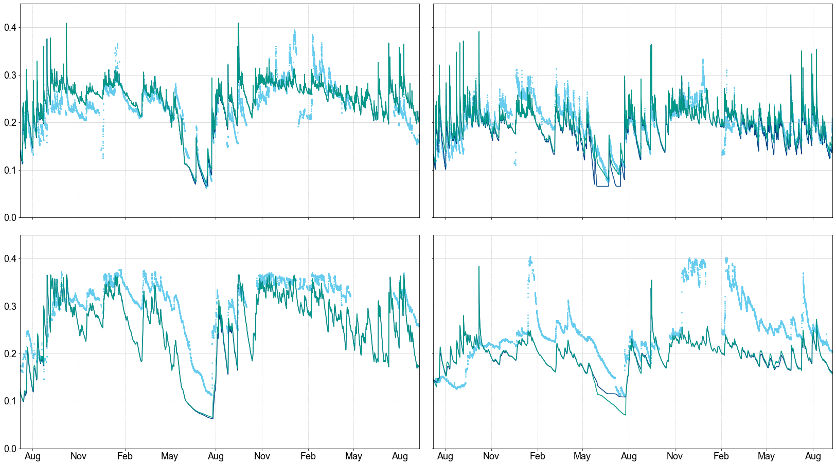
The 1D models from both approaches capture the general soil water behavior
(1) Introduction
(2) Experimental Setup
(3) Numerical Modeling
(4) Conclusion
Soil moisture [cm³/cm³]
Compacted
De-compacted
Observed
10-cm depth
Simulated (Approach1)
Simulated (Approach2)
Except for these
(influence of
groundwater?)
Observed
40-cm depth
Simulated
(Approach1)
Simulated (Approach2)
Months
2022
2023
2024
2022
2023
2024

Slide 36
The 1D models from both approaches capture the general soil water behavior
(1) Introduction
(2) Experimental Setup
(3) Numerical Modeling
(4) Conclusion
Soil moisture [cm³/cm³]
Compacted
De-compacted
We can now use the models
to simulate climate scenarios
(Neglecting groundwater influence)
Observed
10-cm depth
Simulated (Approach1)
Simulated (Approach2)
Except for these
(influence of
groundwater?)
Observed
40-cm depth
Simulated
(Approach1)
Simulated (Approach2)
Months
2022
2023
2024
2022
2023
2024

Slide 37
We simulate under future climate scenarios:
(1) Introduction
(2) Experimental Setup
(3) Numerical Modeling
(4) Conclusion
Amount
[mm]
Annual Precipitation
Annual Potential Evapotranspiration
Historical
(1971–2000)
Future Wet
(2071–2100)
Future Dry
(2071–2100)
Historical
(1971–2000)
Future Wet
(2071–2100)
Future Dry
(2071–2100)
More Info on these Climate Scenarios

Slide 38
More details on the future climate scenarios
(1) Introduction
(2) Experimental Setup
(3) Numerical Modeling
(4) Conclusion
Scenario | Future Wet | Future Dry
Years Covered | 2071–2100 | 2071–2100
Main Basis for Selection | 95 percentile mean annual hydric excess (Precipitation minus Potential Evapotranspiration) | 95 percentile mean annual hydric deficit (Potential Evapotranspiration minus Precipitation)
RCP | RCP4.5 | RCP6.0
Regional Climate Model | HadGEM2-CC-r1 | MIROC-ESM-r1
Statistical Downscaling Method | Quantile Perturbation Method (Willems and Vrac, 2011)* | Quantile Perturbation Method (Willems and Vrac, 2011)*
*Willems, P. and Vrac, M.: Statistical precipitation downscaling for small-scale hydrological impact investigations of climate change, J. Hydrol., 402, 193–205

Slide 39
Result: Decompaction seems to increase deep percolation, thus reducing evaporable and storable water
(1) Introduction
(2) Experimental Setup
(3) Numerical Modeling
(4) Conclusion
Approach 1: Same High LAI, Same Shallow Roots
[mm/yr]
Compacted
De-compacted
(–) Evaporation
(Wet: –37 | Dry: –24)
(=) Transpiration
Loose Sand
LooseSand
(–) Soil Moisture
at 0–40 cm depth
(Wet: –24 | Dry: –18)
Compact Sand
Loose Sand
(+) Deep Percolation
(Wet: +38 | Dry: +21)
Photo of Grass
© Shmector.com (n.d.)

Slide 40
What if we change the vegetation parameterization?
(1) Introduction
(2) Experimental Setup
(3) Numerical Modeling
(4) Conclusion
Approach 1: Same High LAI, Same Shallow Roots
Approach 2 (based on field observations) De-compacted has higher LAI and deeper roots
Compacted
De-compacted
(–) Evaporation
(Wet: –37 | Dry: –24)
Compacted
De-compacted
(=) Transpiration
Loose Sand
LooseSand
Loose Sand
(–) Soil Moisture
at 0–40 cm depth
(Wet: –24 | Dry: –18)
Loose Sand
Compact Sand
Compact Sand
Loose Sand
Loose Sand
(+) Deep Percolation
(Wet: +38 | Dry: +21)
Photo of Grass
© Shmector.com (n.d.)

Slide 41
Result: Considering de-compaction’s impacts to vegetation, more grown vegetation takes up deeper water too
(1) Introduction
(2) Experimental Setup
(3) Numerical Modeling
(4) Conclusion
Approach 1: Same High LAI, Same Shallow Roots
Approach 2 (based on field observations) De-compacted has higher LAI and deeper roots
[mm/yr]
Compacted
De-compacted
(–) Evaporation
(Wet: –37 | Dry: –24)
Compacted
De-compacted
(–) Evaporation
(Wet: –45 | Dry: –32)
(+) Transpiration
(Wet: +36 | Dry: +59)
(=) Transpiration
Loose Sand
LooseSand
Loose Sand
(–) Soil Moisture
at 0–40 cm depth
(Wet: –24 | Dry: –18)
(–) Soil Moisture
at 0–40 cm depth
(Wet: –22 | Dry: –18)
Loose Sand
Compact Sand
Compact Sand
Loose Sand
Loose Sand
(+) Deep Percolation
(Wet: +38 | Dry: +21)
(±) Deep Percolation
(Wet: +7 | Dry: –23)
The boxplots of all values are here
Photo of Grass
© Shmector.com (n.d.)

Slide 42
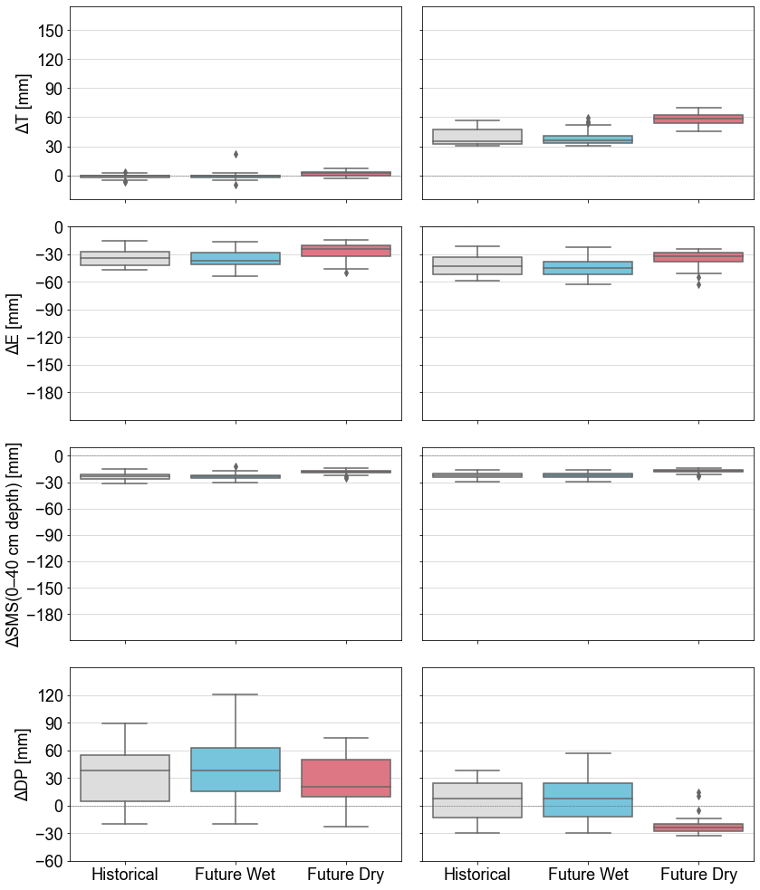
Annual values
(1) Introduction
(2) Experimental Setup
(3) Numerical Modeling
(4) Conclusion
Approach 1: Same High LAI, Same Shallow Roots
Approach 2 (based on field observations) De-compacted has higher LAI and deeper roots
Transpiration
[mm]
De-compacted minus Compacted (+) : De-compacted > Compacted (–) : De-compacted < Compacted
Evaporation
[mm]
Stored Soil
Moisture
(0–40 cm depth)
[mm]
Deep Percolation
[mm]

Slide 43
Hydrological impacts of compacted sandy subsoils & soil water flow simulations (importance of vegetation parameterization)
Click next to proceed.
Otherwise, either click home or the inactive box for other sections
(1) Introduction
(2) Experimental Setup
(3) Numerical Modeling
(4) Conclusion
Photo © US Department of Agriculture (n.d.)

Slide 44
Outcomes on hydrological variables are different! Thus, vegetation parameterization matters a lot!
(1) Introduction
(2) Experimental Setup
(3) Numerical Modeling
(4) Conclusion
Approach 1: Same High LAI, Same Shallow Roots
Approach 2 (based on field observations) De-compacted has more LAI, deeper Roots
Compacted
De-compacted
(–) Evaporation
(Wet: –37 | Dry: –24)
Compacted
De-compacted
(–) Evaporation
(Wet: –45 | Dry: –32)
(+) Transpiration
(Wet: +36 | Dry: +59)
(=) Transpiration
Loose Sand
LooseSand
Loose Sand
(–) Soil Moisture
at 0–40 cm depth
(Wet: –24 | Dry: –18)
(–) Soil Moisture
at 0–40 cm depth
(Wet: –22 | Dry: –18)
Loose Sand
Compact Sand
Compact Sand
Loose Sand
Loose Sand
(+) Deep Percolation
(Wet: +38 | Dry: +21)
(±) Deep Percolation
(Wet: +7 | Dry: –23)
Photo of Grass
© Shmector.com (n.d.)

Slide 45
So what? Differing model approaches? Conflicting water management strategies
(1) Introduction
(2) Experimental Setup
(3) Numerical Modeling
(4) Conclusion
Approach 1: Same High LAI, Same Shallow Roots
Approach 2 (based on field observations) De-compacted has more LAI, deeper Roots
Compacted
De-compacted
(–) Evaporation
(Wet: –37 | Dry: –24)
Compacted
De-compacted
(–) Evaporation
(Wet: –45 | Dry: –32)
(+) Transpiration
(Wet: +36 | Dry: +59)
(=) Transpiration
Loose Sand
LooseSand
Loose Sand
(–) Soil Moisture
at 0–40 cm depth
(Wet: –24 | Dry: –18)
(–) Soil Moisture
at 0–40 cm depth
(Wet: –22 | Dry: –18)
Hey, we must de-compact to have more recharge!
Wait! Maybe better to leave the soil alone…
Loose Sand
Compact Sand
Compact Sand
Loose Sand
Loose Sand
(+) Deep Percolation
(Wet: +38 | Dry: +21)
(±) Deep Percolation
(Wet: +7 | Dry: –23)
Photo of Grass
© Shmector.com (n.d.)

Slide 46
So what? For soil (de-)compaction’s hydrological models:
(1) Introduction
(2) Experimental Setup
(3) Numerical Modeling
(4) Conclusion
I hope you take me more seriously now…
Know how (de-)compaction affects vegetation growth
Field evidence of vegetation growth is vital!
Adapted from Philip Halling (2022) (Creative Commons License)

