Slide 1
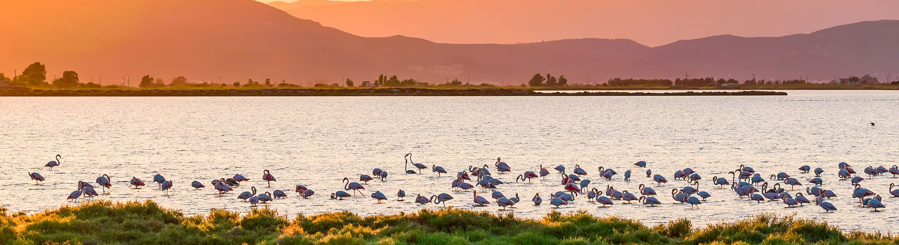
Modelling atmospheric CO2 and CH4 mixing ratios over mixed natural-agricultural wetlands in the Ebre River Delta
Ricard Segura-Barrero¹, Alba Badia^{2*}, Gara Villalba^{1,3}, Ariane Arias-Ortiz⁴
¹Sostenipra Research Group, Institute of Environmental Sciences and Technology(ICTA), Universitat Autònoma de Barcelona(UAB), Barcelona, Spain
²Atmospheric Composition Group, Earth Sciences Department, Barcelona Supercomputing Center, Barcelona, Spain
³Department of Chemical, Biological and Environmental Engineering, Universitat Autònoma de Barcelona (UAB),Barcelona, Spain
⁴Department of Physics, Universitat Autònoma de Barcelona (UAB),Barcelona, Spain

Slide 2
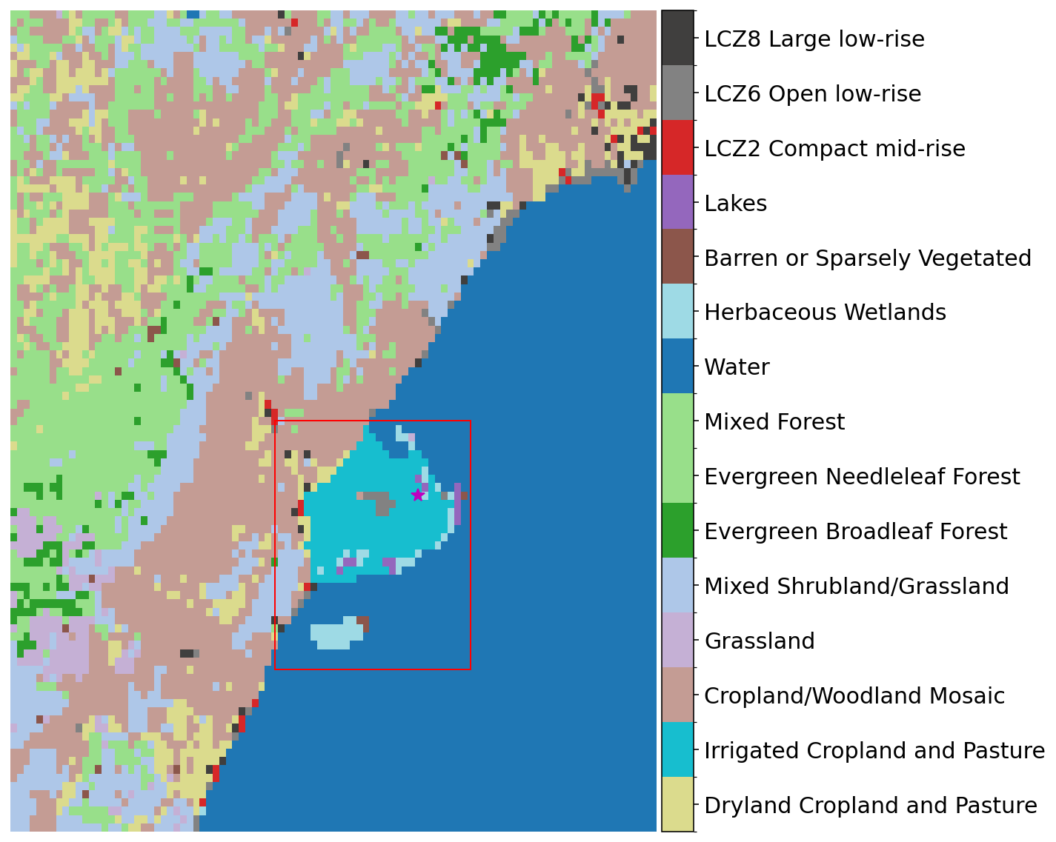
Motivation
Understand the GHG emissions in mixed natural-agricultural wetlands using GHG atmospheric observations.
For CO2 biogenic emissions: Sensitivity analysis is conducted comparing different VPRM configurations including flux parameterization, input satellite-derived vegetation indices and modifications to land cover map
For CH4 wetland emissions, the Kaplan model is applied to determine the natural emissions, while agricultural emissions are obtained from CAMS.
Estimated CO2 and CH4 fluxes are evaluated with atmospheric CO2 and CH4 observations from monitoring network using WRF-Chem in a passive tracer approach.

Slide 3
Vegetation Photosynthesis and Respiration Model
$GEE$ = Gross Ecosystem Exchange
$Reco$ = Ecosystem respiration
$EVI$ = Enhanced vegetation index
$T_{scale}$ = Temperature Scale factor
$P_{scale}$ = Phenology Scale factor
$W_{scale}$ = Water Scale factor
$SW$ = Shortwave radiation
$T_{air}$ = Air temperature
${SM}_{scale}$ = Soil moisture Scale factor
$θ$ = Normalized soil moisture
$T_{ref}$ = 288.15 K
$T_{0}$ = 227.13 K
Default (Mahadevan et al., 2008, Kountouris et al., 2018)
$GEE= λ{∗T}_{scale}∗P_{scale}∗$ $W_{scale}∗\frac{1}{1+\frac{SW}{{SW}_{0}}}∗SW∗EVI$
$$Reco=\left(β+α∗T_{air}\right)$$
Modified (Segura-Barrero et al., 2025)
$GEE= λ∗{{SM}_{scale}∗T}_{scale}∗P_{scale}∗$ $W_{scale}∗\frac{1}{1+\frac{SW}{{SW}_{0}}}∗SW∗EVI$
$${SM}_{scale}= \left\{\begin{aligned}q∗\left(θ−θ^{∗}\right)+1 if θ≤θ^{∗} \\ 1 ifθ>θ^{∗}\end{aligned}\right.$$
$$Reco=\left(R_{0}+k_{2}∗GEE\right)∗tanh⁡(2π∗k_{1}∗θ∗+\operatorname{arctanh}{(γ}))∗exp\left(E_{0}∗\left(\frac{1}{T_{ref}−T_{0}}−\frac{1}{T_{air}−T_{0}}\right)\right)$$
To the 8 plant functional types from the default VPRM (evergreen forests, deciduous forests, mixed forests, shrublands, savannas, croplands, grasslands, other non-vegetated land), 2 new plant-functional types are added (rice paddies and wetlands), and evergreen forests are separated into evergreen needleleaf and evergreen broadleaf forests.

Slide 4
Vegetation Photosynthesis and Respiration Model
In the case of wetlands and rice paddies, ecosystem respiration is corrected using a function from Oikawa et al., (2017) to correct the effect of anaerobic respiration during periods of flooding. Instead of the water table depth, the land surface water index (LSWI) it is used as a proxy of land flooding.
$$Reco=\left(R_{0}+k_{2}∗GEE\right)∗\left(a∗{LSWI}^{2}+b∗LSWI+c\right)∗exp\left(E_{0}∗\left(\frac{1}{T_{ref}−T_{0}}−\frac{1}{T_{air}−T_{0}}\right)\right)$$
The parameters for these plant functional types have been optimized using observational data from Ameriflux Eddy-covariance towers in north-american wetlands and rice paddies with a similar methodology as described in Segura-Barrero et al. (2025).
Rice paddies: US-DS3 (2022), US-RGB (2021, 2022), US-Rgo (2022)
Wetlands: US-Tw4 (2019, 2021), US-Sne (2019, 2020), US-Myb (2019, 2020), US-EDN (2019).

Slide 5
CO2 Biogenic fluxes sensitivity analysis
To determine the uncertainties of the estimated biogenic flux, 5 experiments are set up:
Name | VPRM model | PFT map | Satellite data | Irrigation
VPRM_{DEF, SYNMAP} | Default | SYNMAP (1km) | MODIS (500m) | Yes
VPRM_{DEF, CORINE} | Default | CORINE (500 m) | MODIS (500m) | Yes
VPRM_{MOD, CORINE} | Modified | CORINE (500 m) | MODIS (500m) | Yes
VPRM_{MOD, LOCAL MAP} | Modified | LOCAL MAP (10 m) | Sentinel 2 (10 m) | Yes
VPRM_{MOD, LOCAL MAP noIrrig.} | Modified | LOCAL MAP (10 m) | Sentinel 2 (10 m) | No

Slide 6
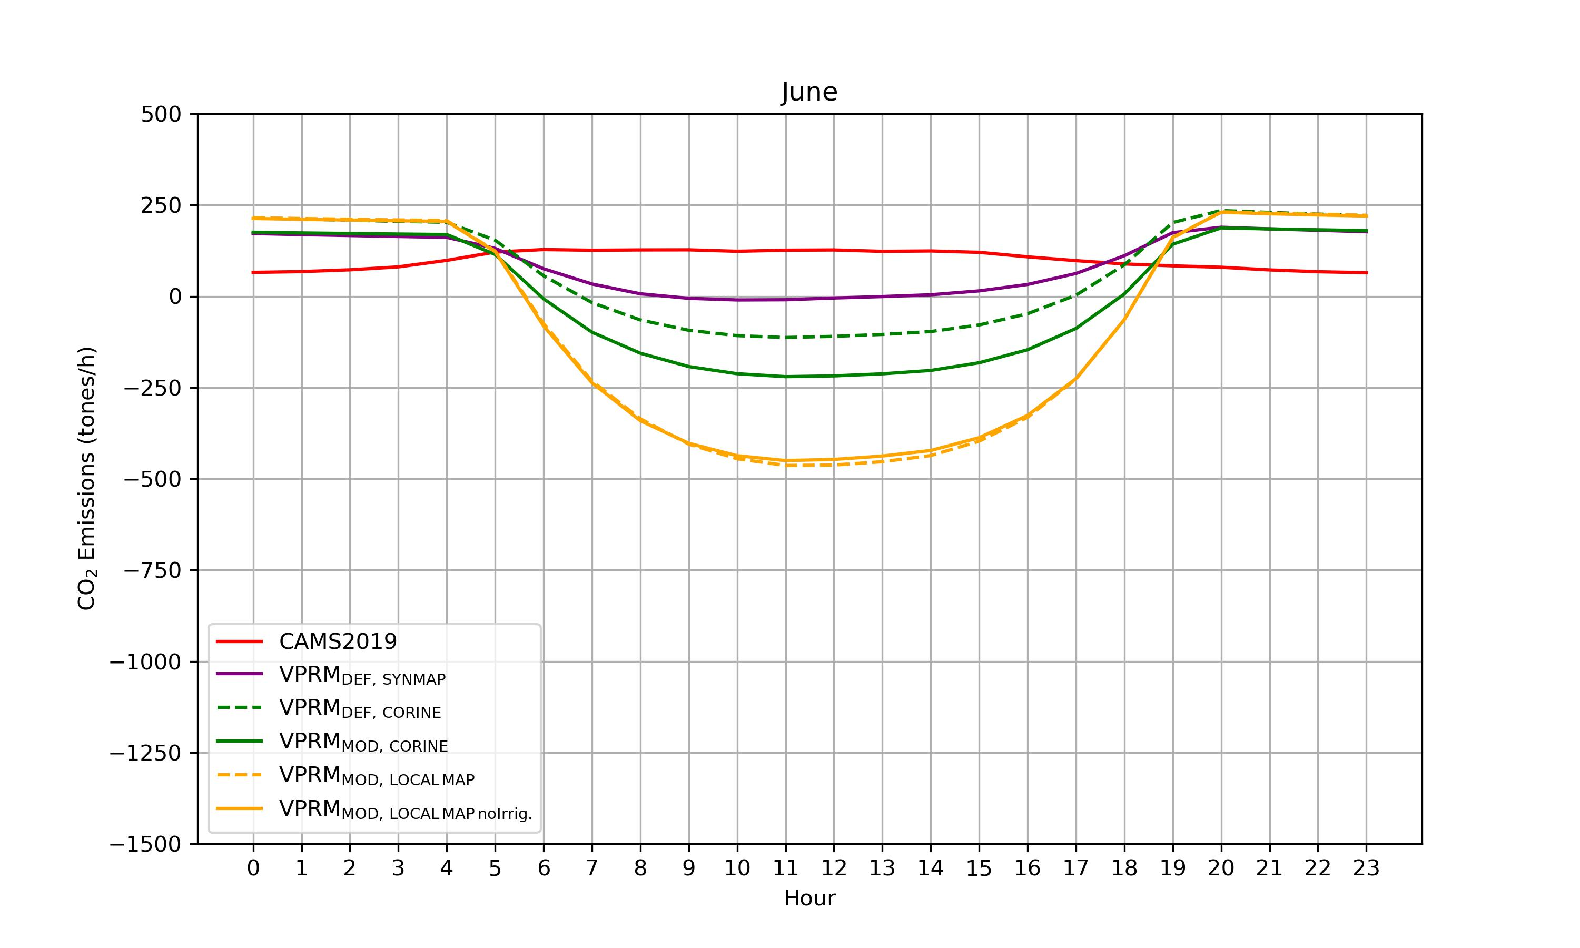
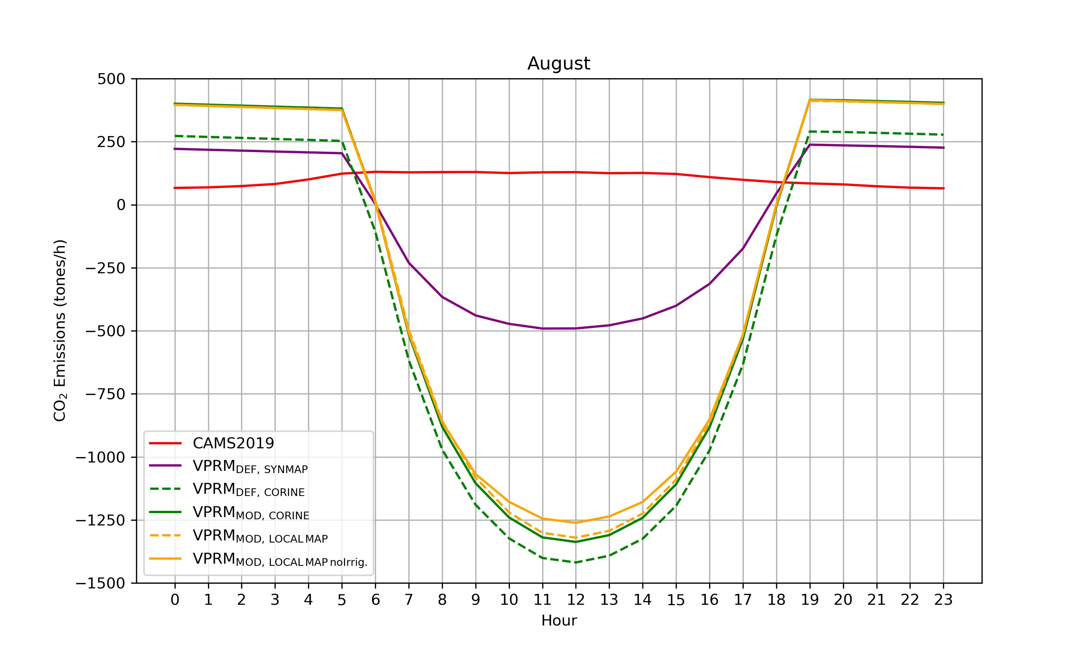
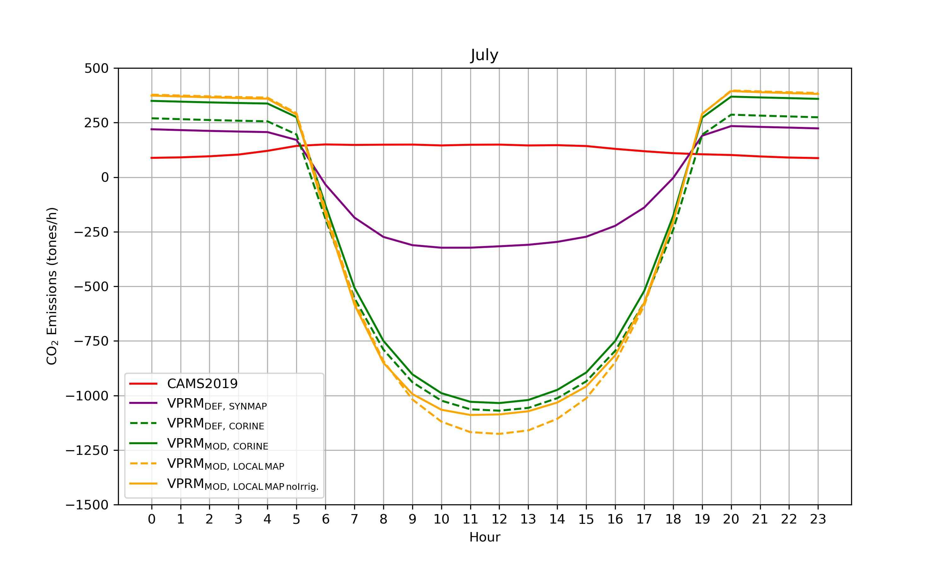
CO2 fluxes pattern
June
August
July
Notes:
more pictures for the hourly distribution of the CO2 emission from bot-up and EDGAR in pic: /data/co2flux/common/Qing/WRF-GHG_emissions/emipic2/
The CAMS-REG (here also referred to as CAMS-REG-ANT) emissions are spatially explicit high resolution emission inventories (resolution of 0.1° x 0.05°, equivalent to ~ 6x6km over central Europe)
EDGAR_2024_GHG_booklet_2024.xlsx C:\Users\luo qing\Qing-UAB\OneDrive - UAB\ICTA\PhD.1\ANTHRO ESP 285Mt /yr ~24Mt/mon 24,000,kt/mon Spatial Results for 2022 ▪ CO2from human respiration: 417.9 kt accounting for 7.2% of total CO2 emission(Julian )

Slide 7
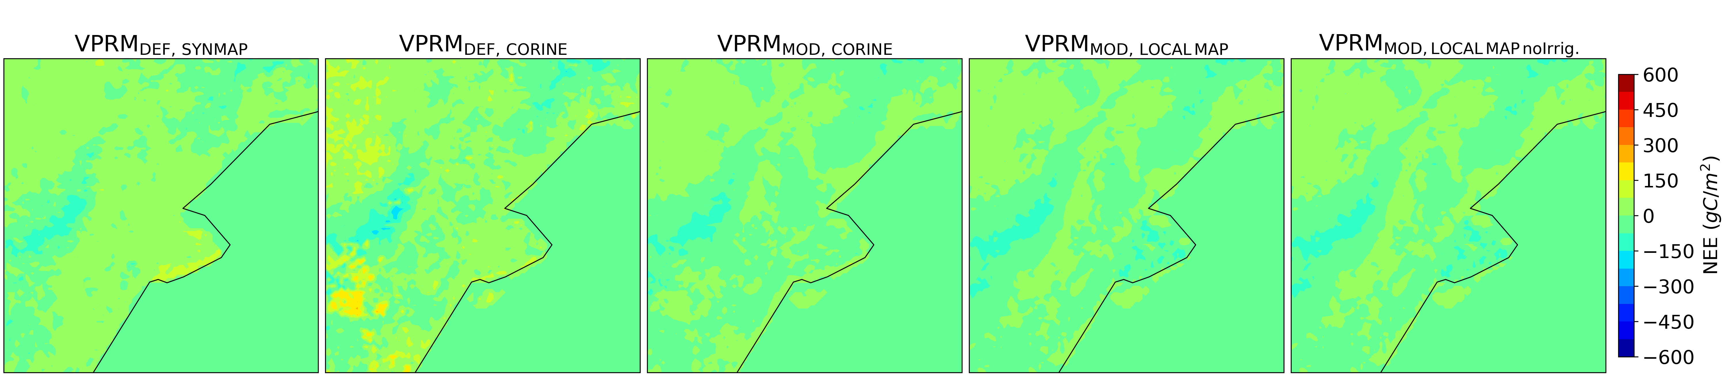
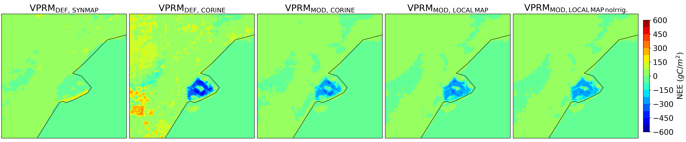
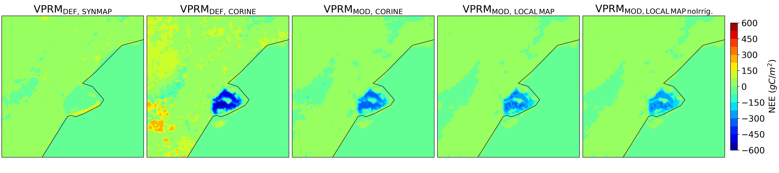
CO2 fluxes pattern
June
July
August
Notes:
more pictures for the hourly distribution of the CO2 emission from bot-up and EDGAR in pic: /data/co2flux/common/Qing/WRF-GHG_emissions/emipic2/
The CAMS-REG (here also referred to as CAMS-REG-ANT) emissions are spatially explicit high resolution emission inventories (resolution of 0.1° x 0.05°, equivalent to ~ 6x6km over central Europe)
EDGAR_2024_GHG_booklet_2024.xlsx C:\Users\luo qing\Qing-UAB\OneDrive - UAB\ICTA\PhD.1\ANTHRO ESP 285Mt /yr ~24Mt/mon 24,000,kt/mon Spatial Results for 2022 ▪ CO2from human respiration: 417.9 kt accounting for 7.2% of total CO2 emission(Julian )

Slide 8
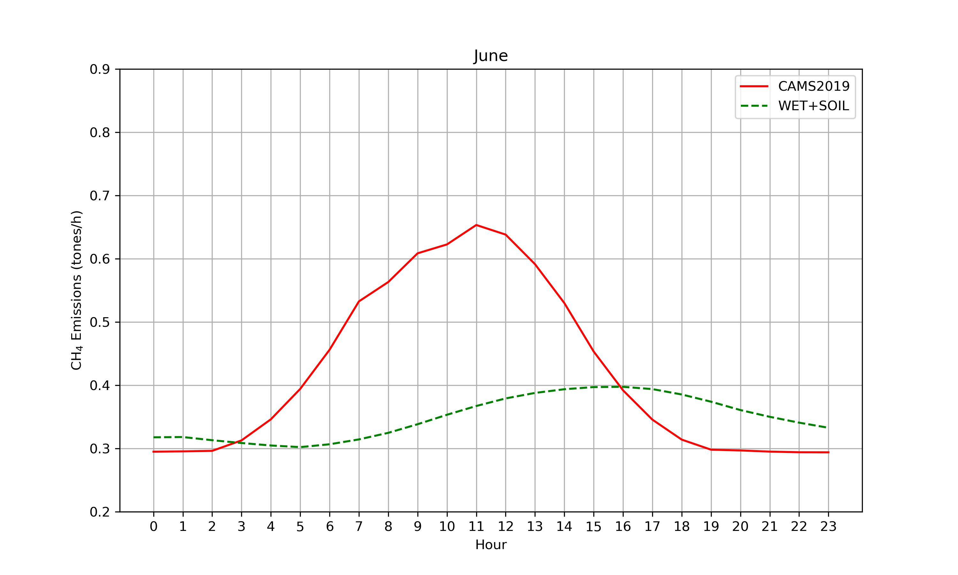
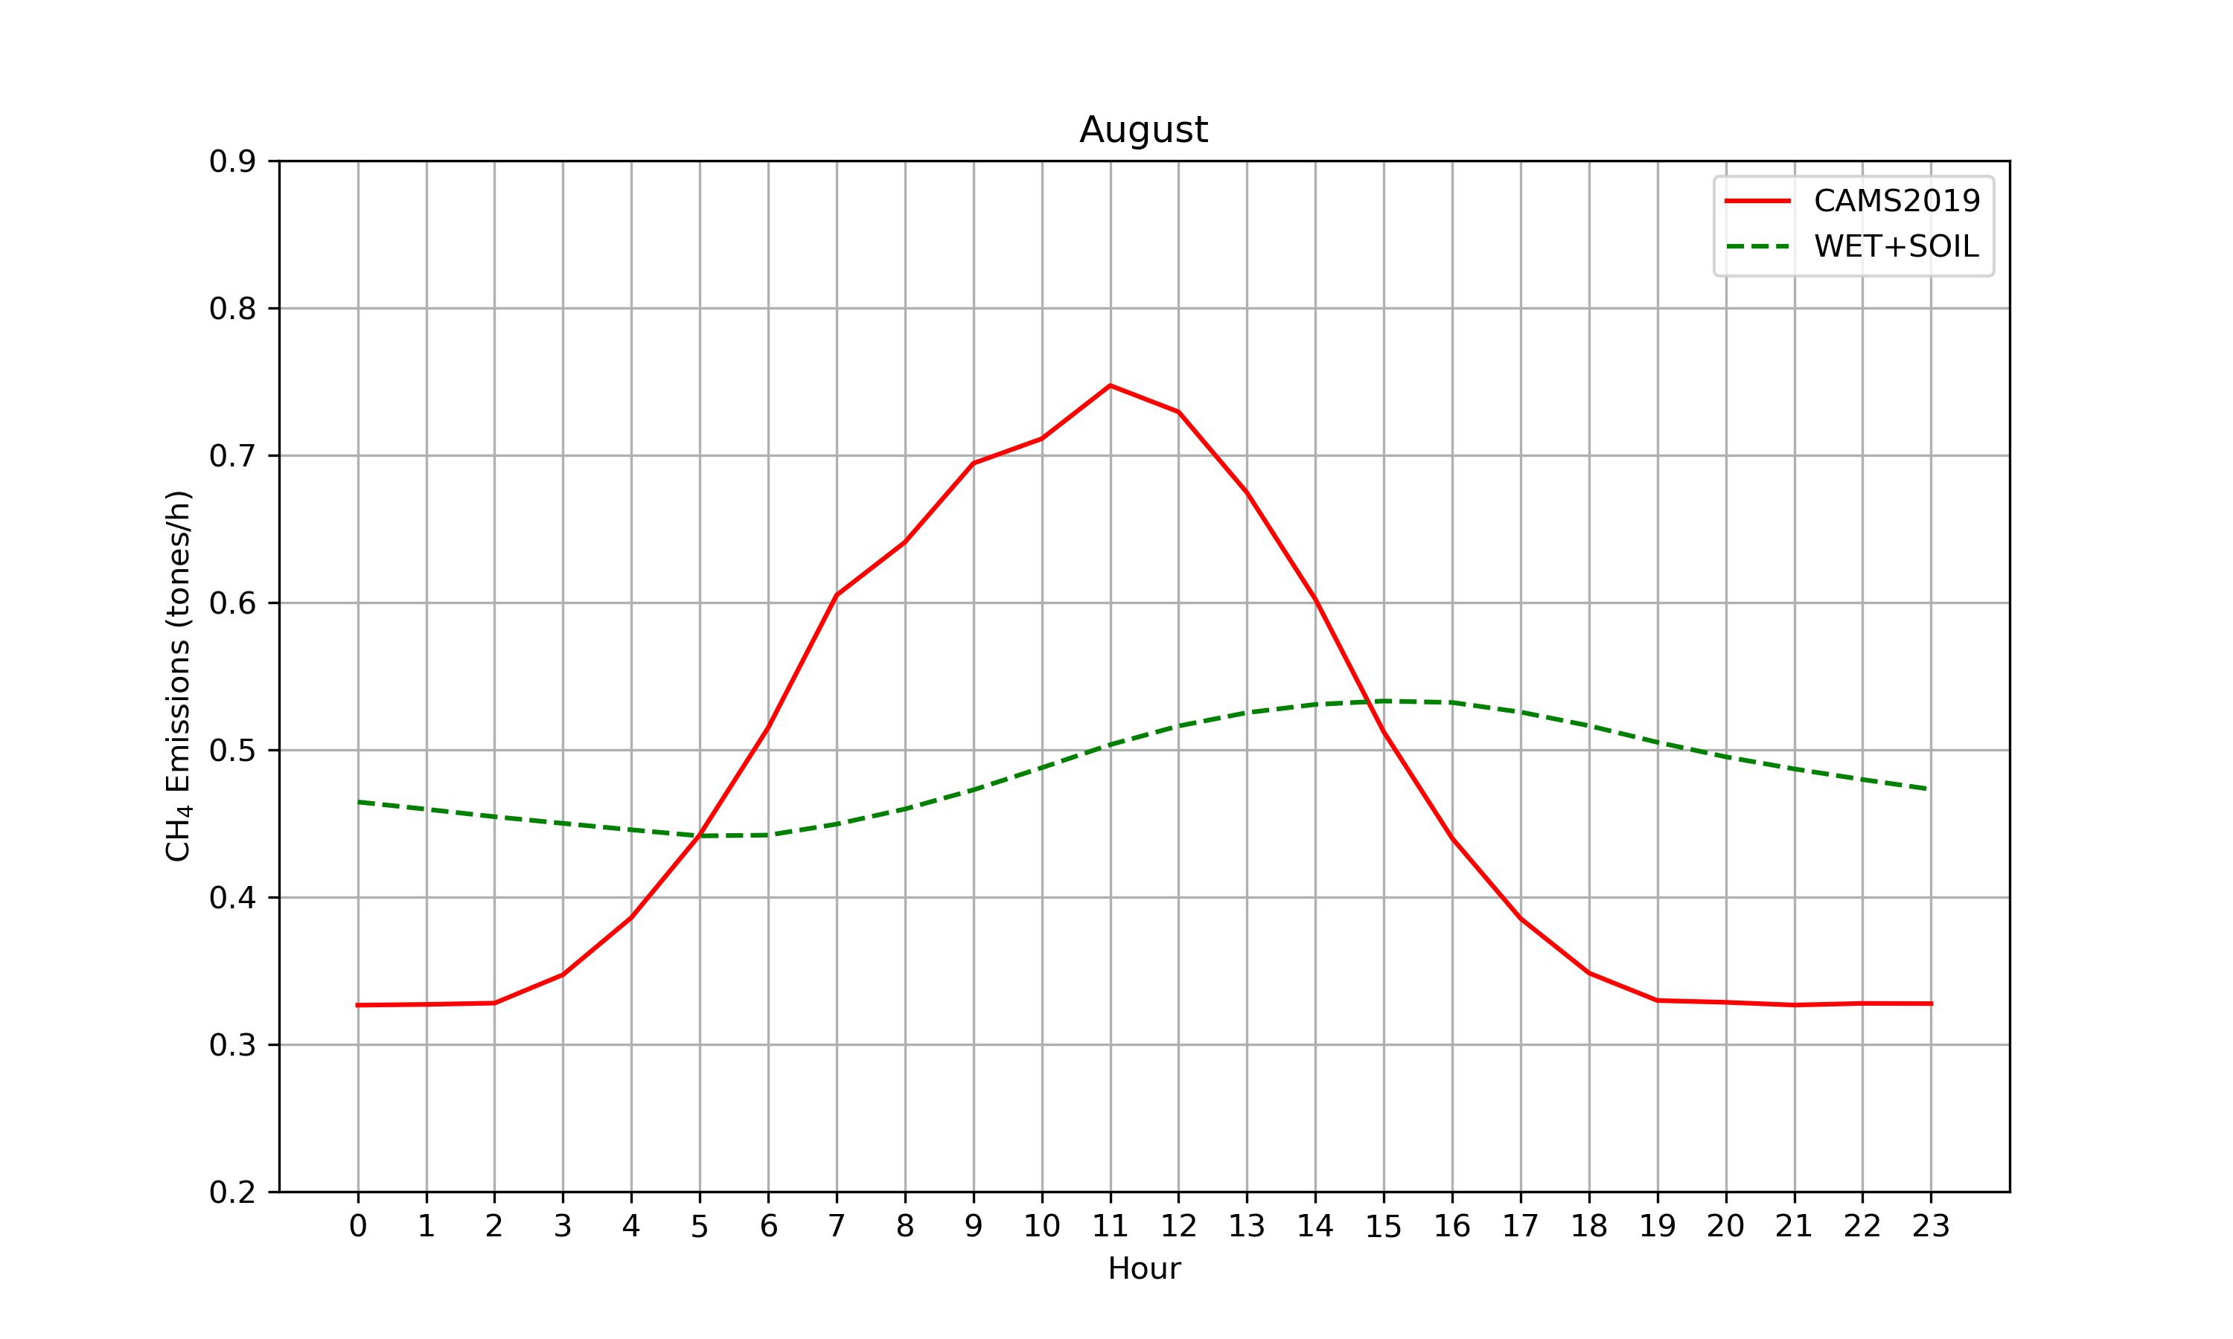
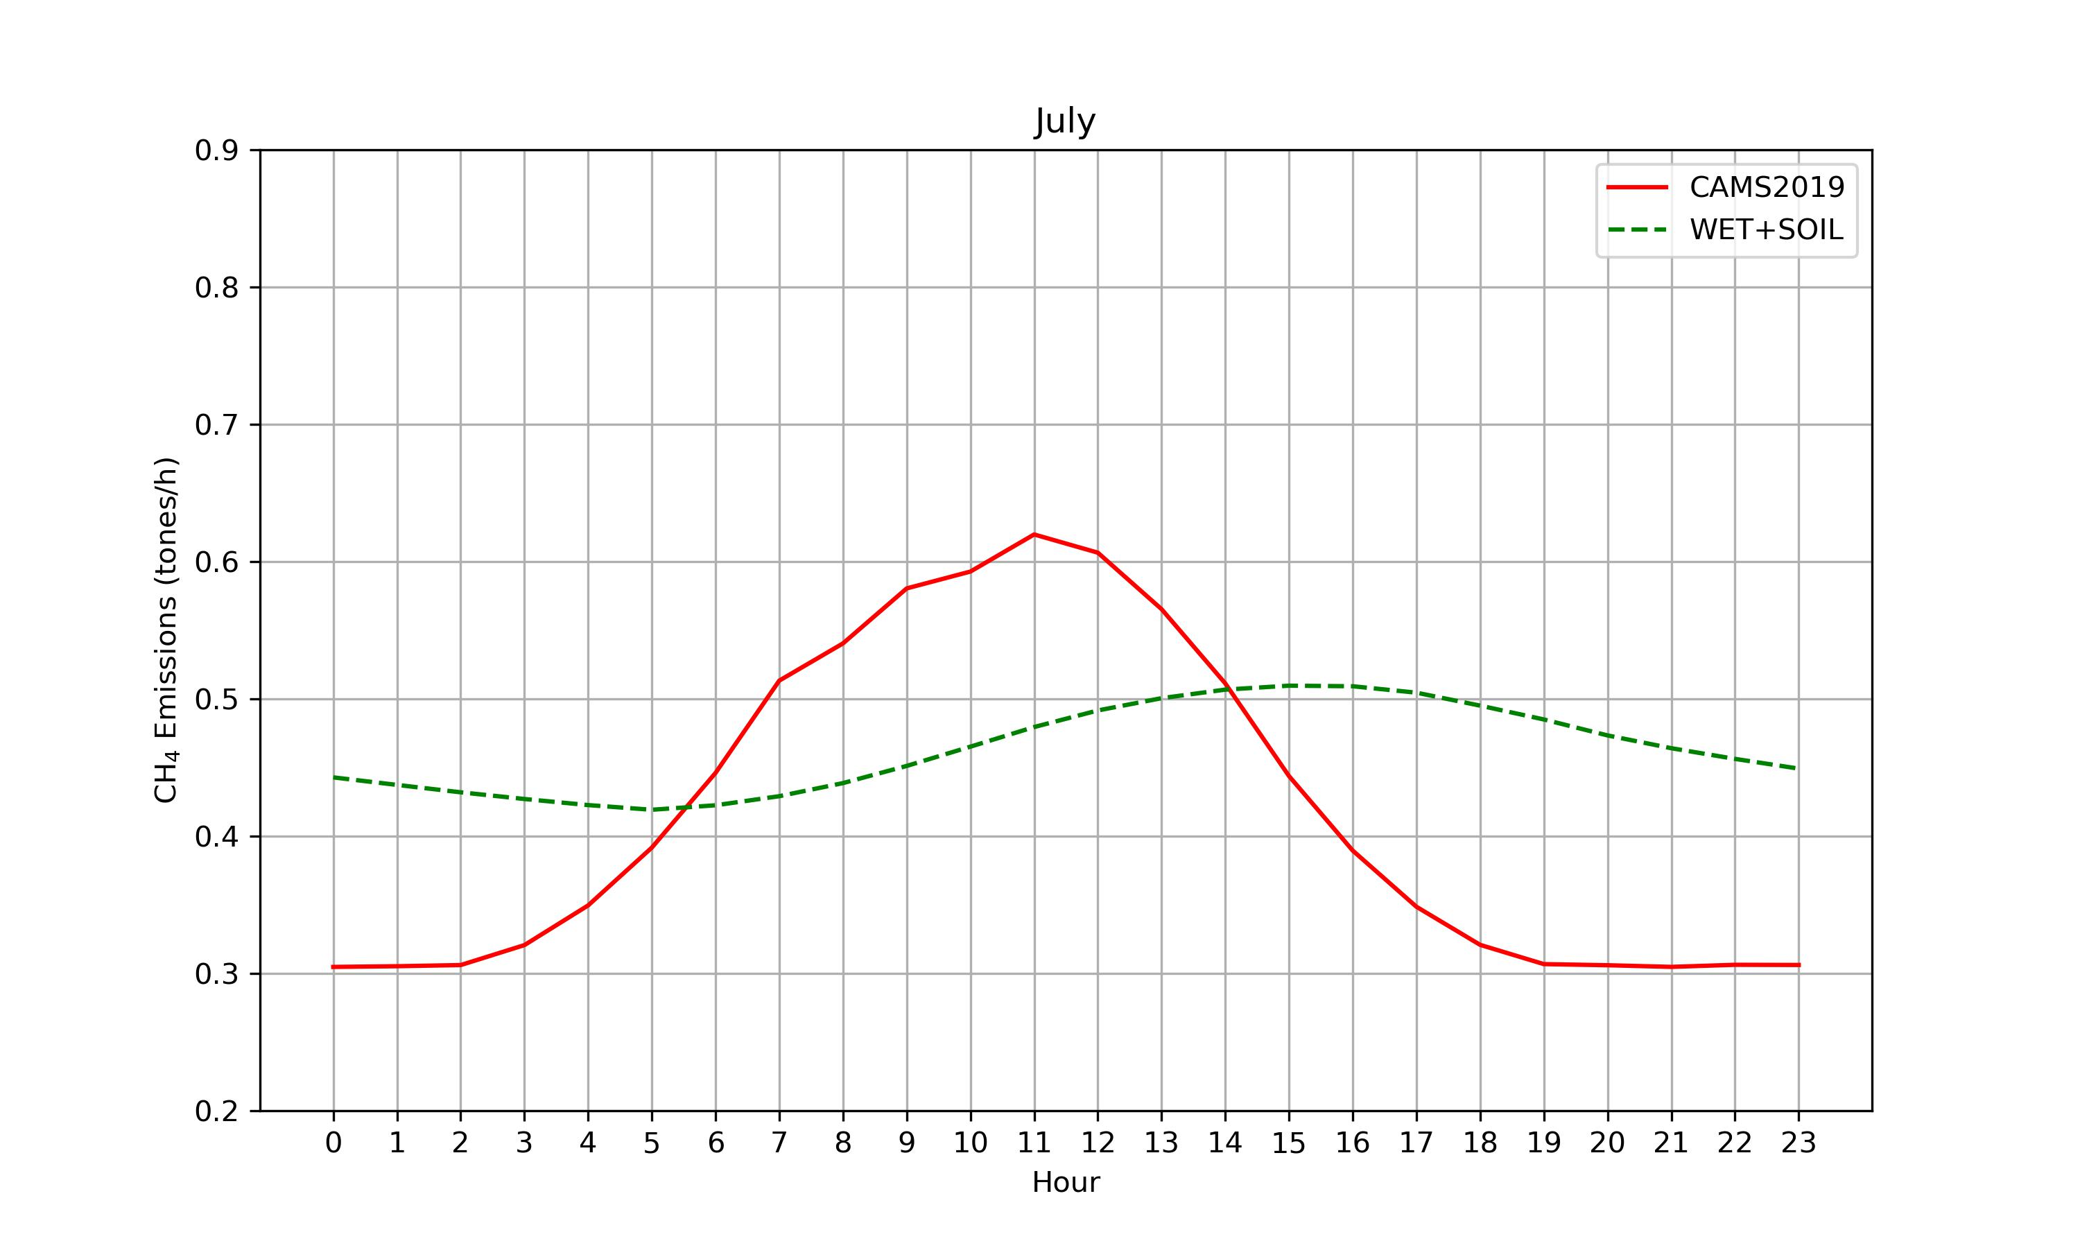
CH4 fluxes pattern
June
August
July
Notes:
more pictures for the hourly distribution of the CO2 emission from bot-up and EDGAR in pic: /data/co2flux/common/Qing/WRF-GHG_emissions/emipic2/
The CAMS-REG (here also referred to as CAMS-REG-ANT) emissions are spatially explicit high resolution emission inventories (resolution of 0.1° x 0.05°, equivalent to ~ 6x6km over central Europe)
EDGAR_2024_GHG_booklet_2024.xlsx C:\Users\luo qing\Qing-UAB\OneDrive - UAB\ICTA\PhD.1\ANTHRO ESP 285Mt /yr ~24Mt/mon 24,000,kt/mon Spatial Results for 2022 ▪ CO2from human respiration: 417.9 kt accounting for 7.2% of total CO2 emission(Julian )

Slide 9
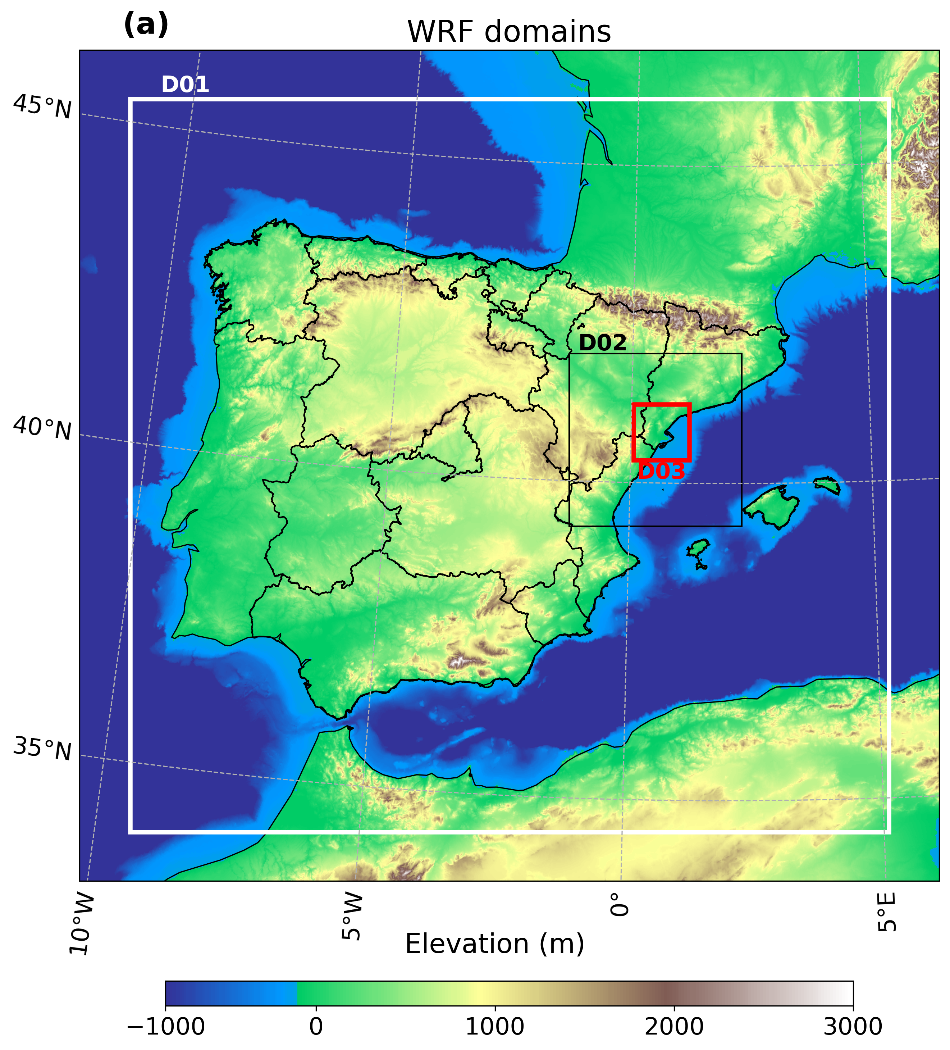
WRF-Chem
Set up
Domain setting | D01 | D02 | D03
resolution(km) | 9 | 3 | 1
horizontal grid | 150 ×145 | 103 ×103 | 100 ×100
Vertical layers | 45
CO2 and CH4 Anthropogenic emission | Cams (2019) 0.05 º x 0.1 º
CO2 Biogenic emission | VPRM
CO2 Ocean emission | ICOS Carbontracker 0.1 º x 0.2 º
CH4 Wetland emission |  | Kaplan Model
Simulation period:
1st June 00:00 UTC,2019 – 31st August 00:00 UTC, 2019
Notes:
The set up of the WRF-GHG, the resolution of 3 domains are 9,3,1km respectively, the simulation period is one week: from 1st May 00:00 UTC– 7th May 00:00 UTC, 2022

Slide 10
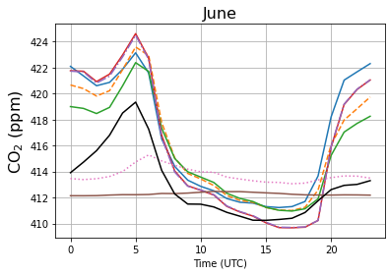
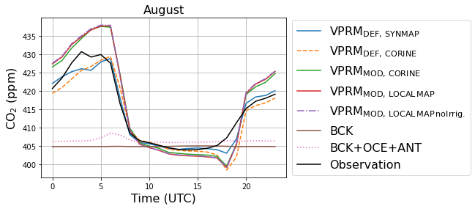
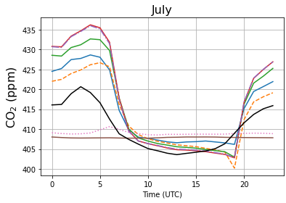
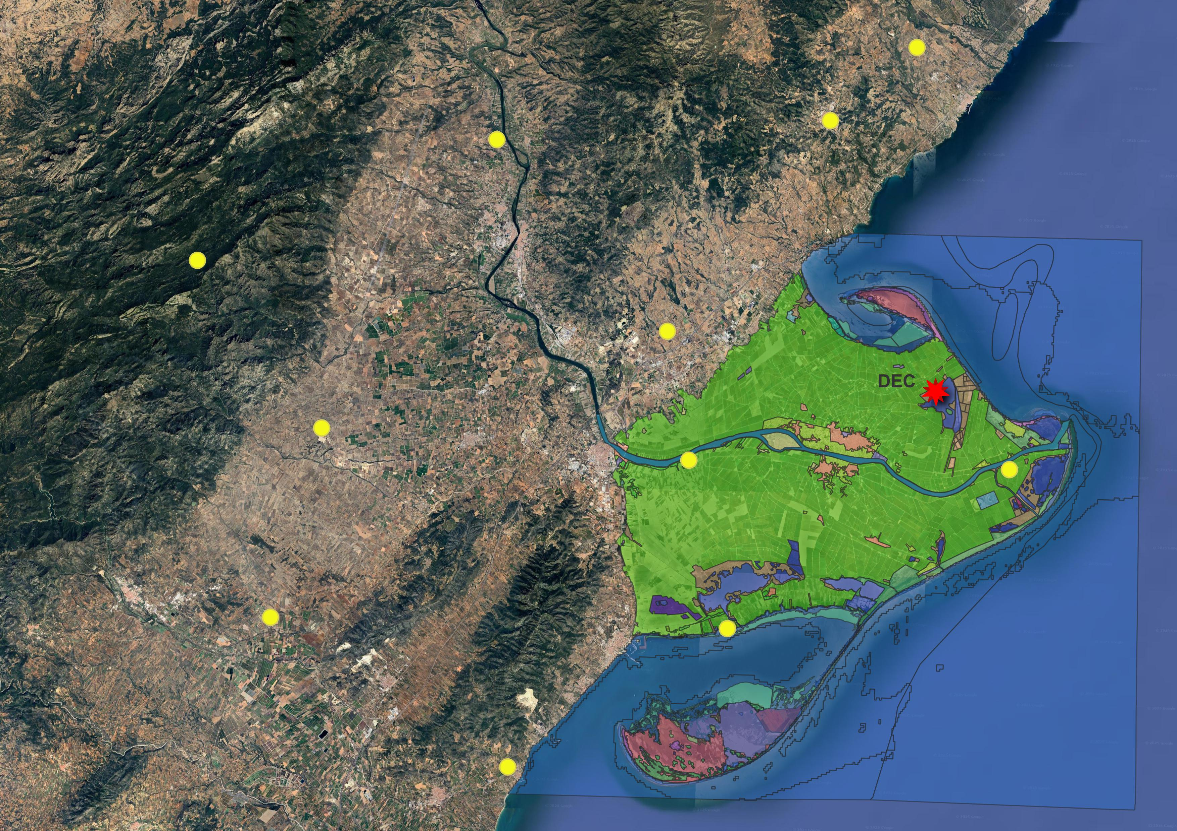
CO2 concentration validation
Notes:
interpolate the CO2 concentration based on the altitude above sea level (ASL) for each station,
ICTA：Lat: 41.4976ºN / Lon: 2.1089ºE Height: 15 m Altitude: 147 m asl.
Fabra:Lat: 41.418333ºN / Lon: 2.124167ºE Height: 15 m Altitude: 415 m asl.
IDAEA:Lat: 41.387444ºN / Lon: 2.114556ºE Height: 4 m Altitude: 80 m asl.
ICM: Lat 41.385111ºN / Lon: 2.195944ºE Height: 15 m Altitude: 40 m asl. AS for the Fabra and ICM, these 2 stations lack observed data for May 2022, the differences between Bottom-up and EDGAR are less pronounced, but the Bottom-up scenario still tends to show more variability and higher peaks, may suggest a representation of localized emissions.

Slide 11
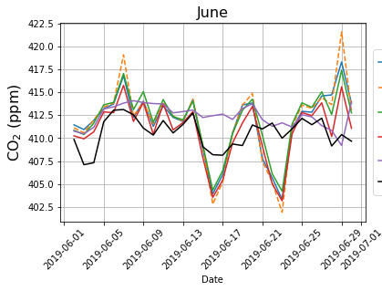
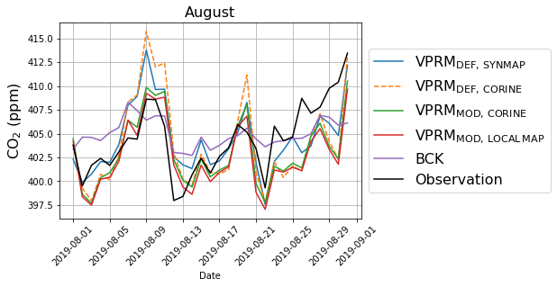
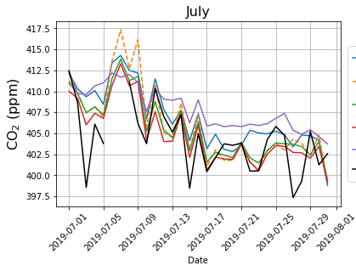
CO2 concentration validation during midday (11-16 UTC)
GHG network
Notes:
interpolate the CO2 concentration based on the altitude above sea level (ASL) for each station,
ICTA：Lat: 41.4976ºN / Lon: 2.1089ºE Height: 15 m Altitude: 147 m asl.
Fabra:Lat: 41.418333ºN / Lon: 2.124167ºE Height: 15 m Altitude: 415 m asl.
IDAEA:Lat: 41.387444ºN / Lon: 2.114556ºE Height: 4 m Altitude: 80 m asl.
ICM: Lat 41.385111ºN / Lon: 2.195944ºE Height: 15 m Altitude: 40 m asl. AS for the Fabra and ICM, these 2 stations lack observed data for May 2022, the differences between Bottom-up and EDGAR are less pronounced, but the Bottom-up scenario still tends to show more variability and higher peaks, may suggest a representation of localized emissions.

Slide 12
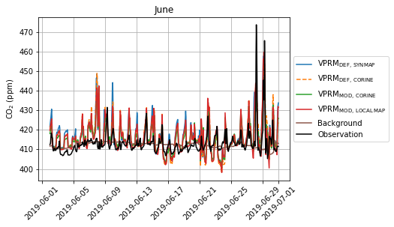
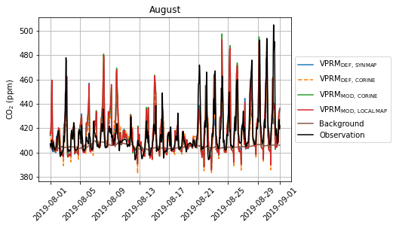
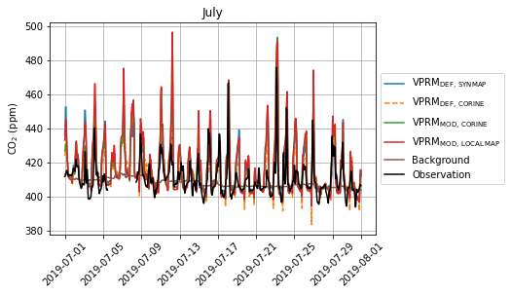
CO2 concentration validation
Notes:
interpolate the CO2 concentration based on the altitude above sea level (ASL) for each station,
ICTA：Lat: 41.4976ºN / Lon: 2.1089ºE Height: 15 m Altitude: 147 m asl.
Fabra:Lat: 41.418333ºN / Lon: 2.124167ºE Height: 15 m Altitude: 415 m asl.
IDAEA:Lat: 41.387444ºN / Lon: 2.114556ºE Height: 4 m Altitude: 80 m asl.
ICM: Lat 41.385111ºN / Lon: 2.195944ºE Height: 15 m Altitude: 40 m asl. AS for the Fabra and ICM, these 2 stations lack observed data for May 2022, the differences between Bottom-up and EDGAR are less pronounced, but the Bottom-up scenario still tends to show more variability and higher peaks, may suggest a representation of localized emissions.

Slide 13
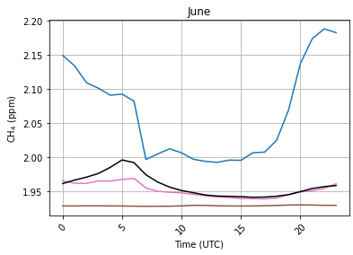
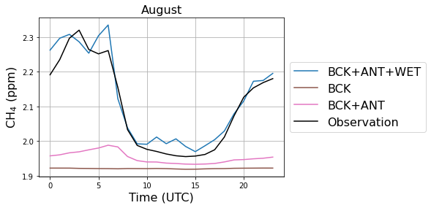
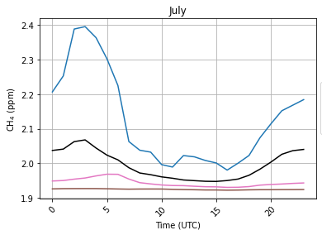
CH4 concentration validation
Notes:
interpolate the CO2 concentration based on the altitude above sea level (ASL) for each station,
ICTA：Lat: 41.4976ºN / Lon: 2.1089ºE Height: 15 m Altitude: 147 m asl.
Fabra:Lat: 41.418333ºN / Lon: 2.124167ºE Height: 15 m Altitude: 415 m asl.
IDAEA:Lat: 41.387444ºN / Lon: 2.114556ºE Height: 4 m Altitude: 80 m asl.
ICM: Lat 41.385111ºN / Lon: 2.195944ºE Height: 15 m Altitude: 40 m asl. AS for the Fabra and ICM, these 2 stations lack observed data for May 2022, the differences between Bottom-up and EDGAR are less pronounced, but the Bottom-up scenario still tends to show more variability and higher peaks, may suggest a representation of localized emissions.

Slide 14
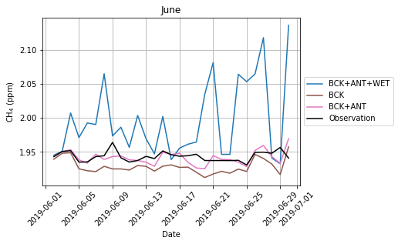
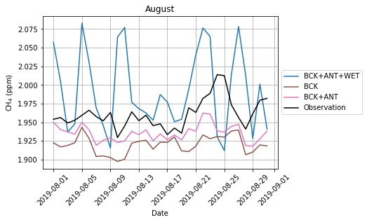
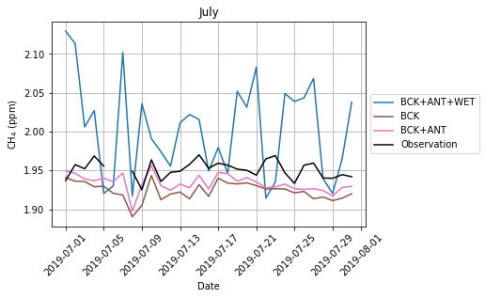
CH4 concentration validation during midday (11-16 UTC)
Notes:
interpolate the CO2 concentration based on the altitude above sea level (ASL) for each station,
ICTA：Lat: 41.4976ºN / Lon: 2.1089ºE Height: 15 m Altitude: 147 m asl.
Fabra:Lat: 41.418333ºN / Lon: 2.124167ºE Height: 15 m Altitude: 415 m asl.
IDAEA:Lat: 41.387444ºN / Lon: 2.114556ºE Height: 4 m Altitude: 80 m asl.
ICM: Lat 41.385111ºN / Lon: 2.195944ºE Height: 15 m Altitude: 40 m asl. AS for the Fabra and ICM, these 2 stations lack observed data for May 2022, the differences between Bottom-up and EDGAR are less pronounced, but the Bottom-up scenario still tends to show more variability and higher peaks, may suggest a representation of localized emissions.

Slide 15
Temperature validation
Month | Period of day | RMSE (ºC) | MB (ºC) | Pearson correlation
June | 24 hours | 2,16 | -0,87 | 0,90
 | Daytime (6-18 UTC) | 1,51 | 0,54 | 0,91
 | Night-time (19-5 UTC) | 2,74 | -2,54 | 0,92
July | 24 hours | 1,86 | -0,50 | 0,91
 | Daytime (6-18 UTC) | 1,56 | 0,69 | 0,85
 | Night-time (19-5 UTC) | 1,16 | -1,90 | 0,82
August | 24 hours | 1,49 | -0,28 | 0,91
 | Daytime (6-18 UTC) | 1,33 | 0,43 | 0,89
 | Night-time (19-5 UTC) | 1,66 | -1,13 | 0,81
Evaluation for the three meteorological stations inside the Ebre Delta region, marked with purple dots.
Notes:
interpolate the CO2 concentration based on the altitude above sea level (ASL) for each station,
ICTA：Lat: 41.4976ºN / Lon: 2.1089ºE Height: 15 m Altitude: 147 m asl.
Fabra:Lat: 41.418333ºN / Lon: 2.124167ºE Height: 15 m Altitude: 415 m asl.
IDAEA:Lat: 41.387444ºN / Lon: 2.114556ºE Height: 4 m Altitude: 80 m asl.
ICM: Lat 41.385111ºN / Lon: 2.195944ºE Height: 15 m Altitude: 40 m asl. AS for the Fabra and ICM, these 2 stations lack observed data for May 2022, the differences between Bottom-up and EDGAR are less pronounced, but the Bottom-up scenario still tends to show more variability and higher peaks, may suggest a representation of localized emissions.

Slide 16
References
Kountouris, P., Gerbig, C., Rödenbeck, C., Karstens, U., Koch, T. F., & Heimann, M. (2018). Technical Note: Atmospheric CO2 inversions on the mesoscale using data-driven prior uncertainties: methodology and system evaluation. Atmospheric Chemistry and Physics, 18(4), 3027–3045. https://doi.org/10.5194/acp-18-3027-2018
Mahadevan, P., Wofsy, S. C., Matross, D. M., Xiao, X., Dunn, A. L., Lin, J. C., Gerbig, C., Munger, J. W., Chow, V. Y., & Gottlieb, E. W. (2008). A satellite-based biosphere parameterization for net ecosystem CO2 exchange: Vegetation Photosynthesis and Respiration Model (VPRM). Global Biogeochemical Cycles, 22(2). https://doi.org/10.1029/2006GB002735
Oikawa, P. Y., Jenerette, G. D., Knox, S. H., Sturtevant, C., Verfaillie, J., Dronova, I., Poindexter, C. M., Eichelmann, E., & Baldocchi, D. D. (2017). Evaluation of a hierarchy of models reveals importance of substrate limitation for predicting carbon dioxide and methane exchange in restored wetlands. Journal of Geophysical Research: Biogeosciences, 122(1), 145–167. https://doi.org/10.1002/2016JG003438
Segura‐Barrero, R., Lauvaux, T., Lian, J., Ciais, P., Badia, A., Ventura, S., Bazzi, H., Abbessi, E., Fu, Z., Xiao, J., Li, X., & Villalba, G. (2025). Heat and Drought Events Alter Biogenic Capacity to Balance CO 2 Budget in South‐Western Europe. Global Biogeochemical Cycles, 39(1). https://doi.org/10.1029/2024GB008163
Notes:
interpolate the CO2 concentration based on the altitude above sea level (ASL) for each station,
ICTA：Lat: 41.4976ºN / Lon: 2.1089ºE Height: 15 m Altitude: 147 m asl.
Fabra:Lat: 41.418333ºN / Lon: 2.124167ºE Height: 15 m Altitude: 415 m asl.
IDAEA:Lat: 41.387444ºN / Lon: 2.114556ºE Height: 4 m Altitude: 80 m asl.
ICM: Lat 41.385111ºN / Lon: 2.195944ºE Height: 15 m Altitude: 40 m asl. AS for the Fabra and ICM, these 2 stations lack observed data for May 2022, the differences between Bottom-up and EDGAR are less pronounced, but the Bottom-up scenario still tends to show more variability and higher peaks, may suggest a representation of localized emissions.

